Slide 1



DISTRIBUTION PATTERNS OF CONTAMINANTS IN THE MOGALE GOLD TAILING DAM; CASE STUDY FROM SOUTH AFRICA
O., Abegunde; C., Wu; C.D., Okujeni; and A., Siad
Department of Earth Science, University of the Western Cape., Bellville, Cape Town. South Africa
Correspondence to: cokujeni@uwc.ac.za

Slide 2
OUTLINE
Introduction
Background
Methodology
Results
Conclusion
Recommendation
Acknowledgement
Reference

Slide 3

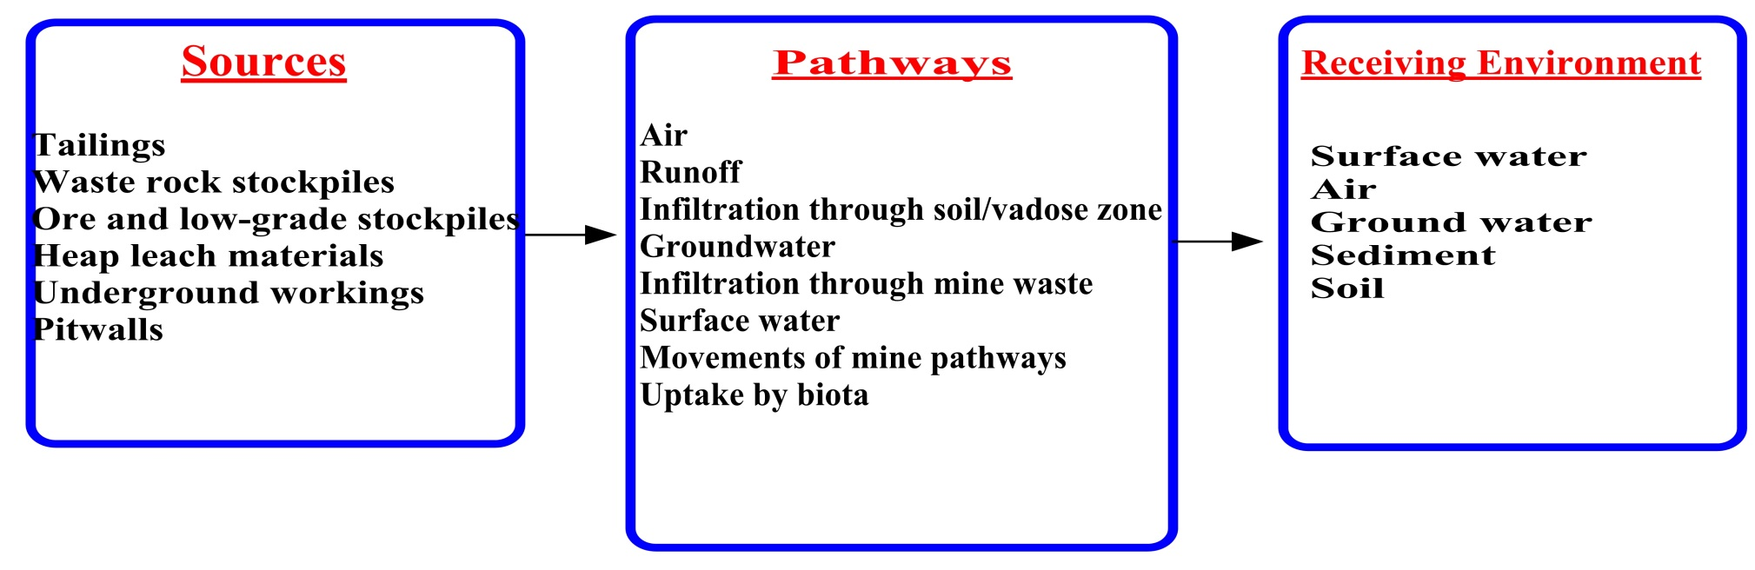
Introduction
As at 2007, South Africa has produced about 468 million tons of mineral waste per annum, of which gold mining waste accounts for 221 million tons (47 %), making it the largest single source of mine waste and pollution (Oelofse, et al., 2007).
Gold mining continues to expose the Witsbasin region to the threat of AMD pollution from mine wastes and abandoned mines (Tutu et al., 2008).
AMD is characterize by low pH, high sulphates (SO₄)²⁻, high Total Dissolved Solids (TDS), and high levels of heavy metals
Figure 1: Conceptual Model of AMD transport at a Mining or Processing Site (GARDGUIDE)
Total combination to form sulphuric acid
FeS₂ + 15/4O₂ + 7/2H₂O 2H₂SO₄ + Fe (OH)₃ (yellow boy)
(H+) ion is release, which in turn reduces the pH of the drainage or streams

Slide 4
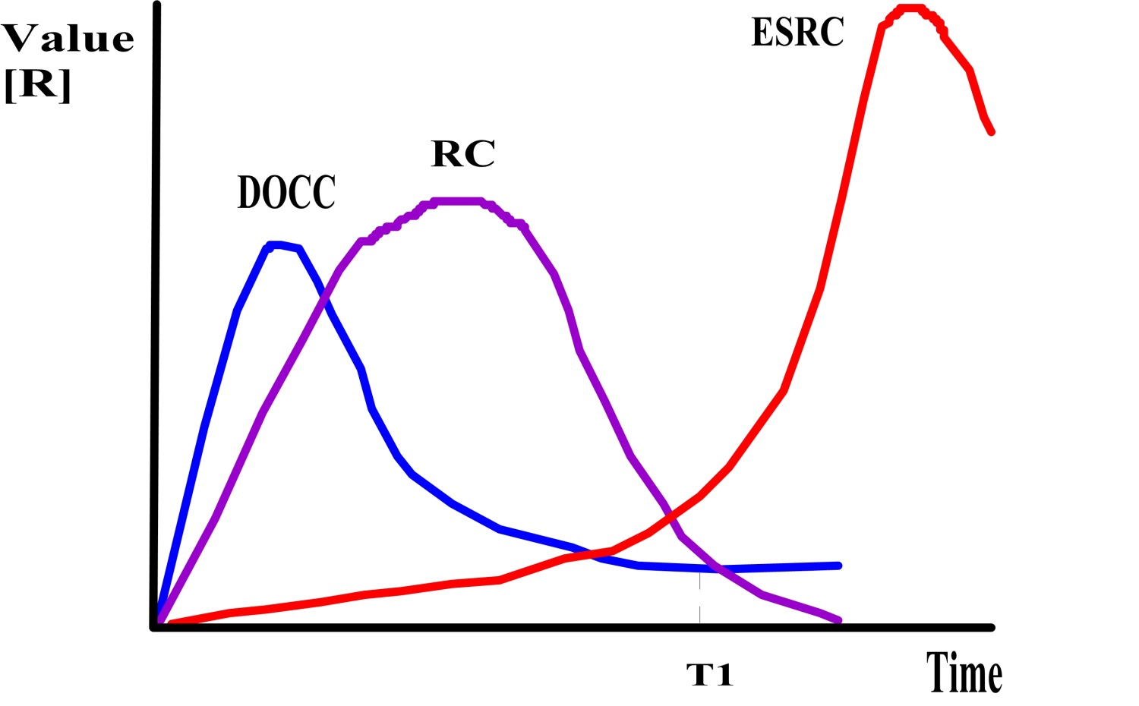
Socioeconomic Effect of gold mining in South Africa
As mines begin to close down (T1), after years of revenue romance, the impact of the mining activities begin to show up
Need arises for clean ups, environmental and social remediation
Figure 2:The theoretical representation of the externalization of costs by the gold mining industry in South Africa Culled from (Adler, et al., 2007)
Development and Operational Cost Curve(DOCC)
the Revenue Curve(RC)
the Environmental and Social Remediation Curve(ESRC)
Threshold time(T1)

Slide 5

Study aim
To assess the magnitude of leachable metals present and predict the AMD discharge from gold tailings dam into the environment over time.
WHY?

Slide 6
Background of Study
In lieu of a report by inter-ministerial committee on AMD by a team of experts in 2010, very limited expert investigations seem to have been done to ascertain the status of the geo-hydrological system, the level of contamination, preferential channels and predictions as regards long-term transport of AMD (Inter-Ministerial-Committee, 2010).
Introduction of AMD into the environment. Tailing dams (are major source of contamination)
Most studies focused on the oxidized zone (remediation) .
Few studies have been done on the interaction between the three zones (oxidized zone, transition zone and the un-oxidized zone) (Nengovhela, et al., 2006; Nico & Pierre, 2006), (the geological characteristics of and link between these zones have not been extensively studied).

Slide 7
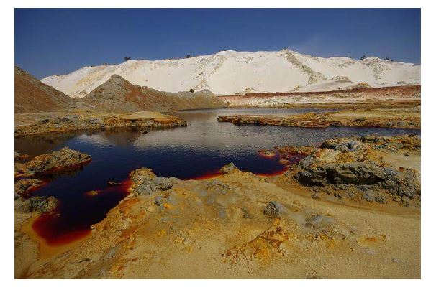
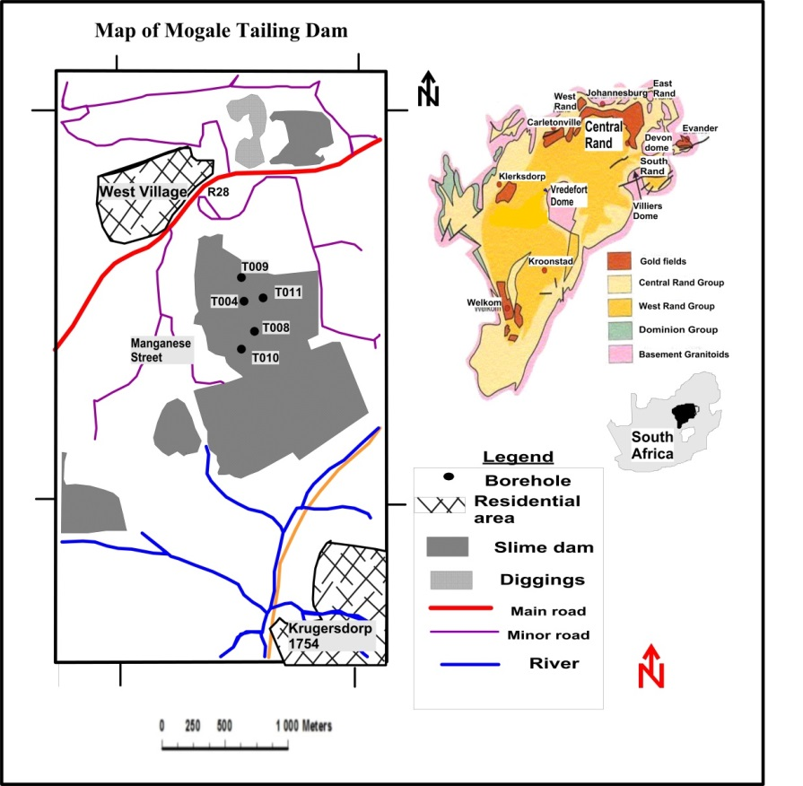
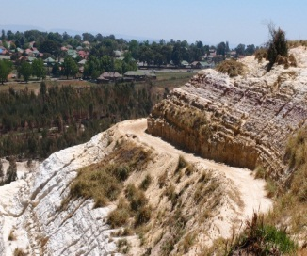
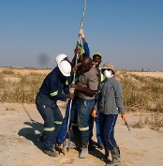
Study Area
AMD signature
Figure 4: AMD signature in the Wits basin and Sampling using an auger
Figure 3: Map of the study Area
The study area is situated along the Randfontein and Krugersdorp R28 road, between West Village and Krugersdorp in the West Rand area of the Gauteng province
Plate 1: Side view of the tailings dam sampled

Slide 8
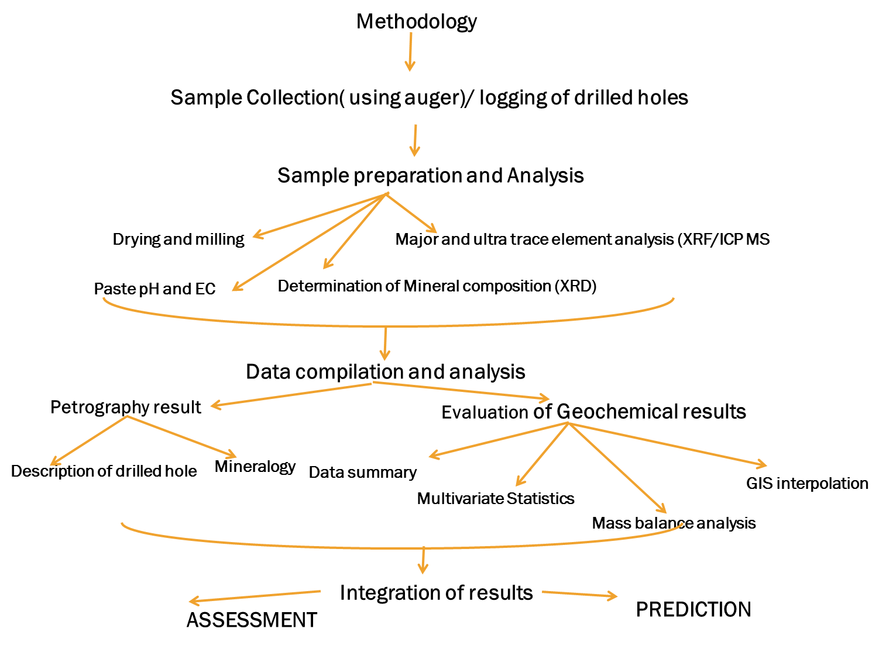
Methodology
(Five holes were drilled through the tailing dam to a depth of 10 meters and sampled at one meter interval.)
(Fifty-one drill core samples were analysed)
(Zhang & Selinus, 1998; Alkarkhi, et al., 2009)
(Mukherjee & Gupta, 2008; Lopez-Moro, 2012).

Slide 9

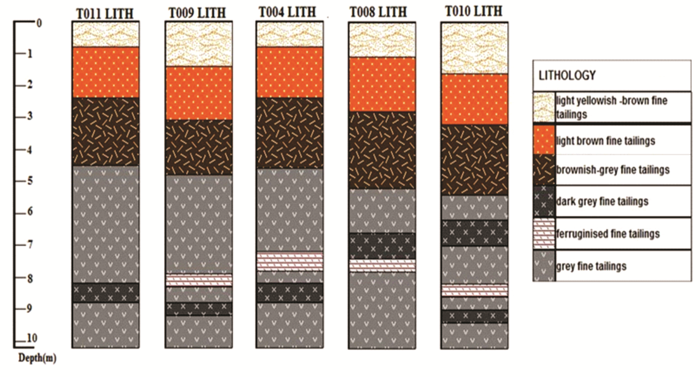
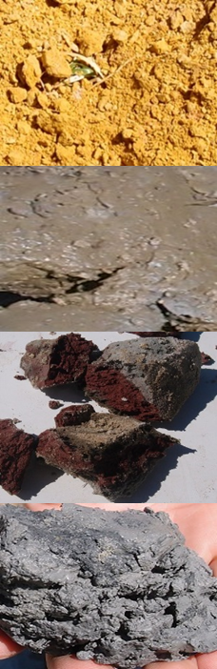
Results (Petrography)
Layer1
Layer 2
Petrography
Layer 3
Figure 5: Lithology of the five drilled holes sampled
Quartz, Muscovite, pyropyllite, gypsum, jarosite, delhayelite, hematite, pyrite and clinochore were identified qualitatively by XRD (which defines the mineralogy).
Quartz, jarosite and gypsum contents are higher in the upper two horizons while pyrophilite, pyrite, hematite and muscovite contents dominate in the lower horizons.
Layer4
Notes:
The Mogale tailing dam comprises of 4 layers: i.) a topmost oxidized layer with a whitish yellow to yellowish brown colour, which is underlain by ii,) a brownish grey coloured layer and further down by a reddish coloured layer and grey coloured layer at the base (Figure 2).
The above horizons are composed of varying proportions of quartz, muscovite, pyrophyllite, gypsum, jarosite/hydronian, delhayelite, hematite, pyrite and clinochlore based on the XRD results.
Quartz, Jarosite and gypsum contents are higher in the upper horizon while pyrophilite, pyrite, hematite and muscovite contents dominating in the lower horizons

Slide 10
Results (Geochemical Data Summary)
Based on the geometric mean, SiO₂(84.24%), Al₂O₃(6.25%), Fe₂O₃(2.64%) and LOI(3.28%)accounted for about 97.05% of the whole sample concentration (Rosner, 2000), while other major oxides are found in less concentration.
Trace elements such as U, Au, Ni, As, Cu, and Zn have maximum values of 655.5ppm, 1417.7ppb, 274.1ppm, 471.4ppm, 308.8ppm, and 817ppm respectively.
Average values for Cu(51.29ppm), Pb(49.66ppm), Zn(129.31ppm), Ni(99.79ppm), As(123.12ppm), Au(248.43ppb)
Layer 1 or the topmost oxidized layer has highest contents of SiO₂(87.32%) and the lowest contents of LOI and all other oxides and most trace elements

Slide 11
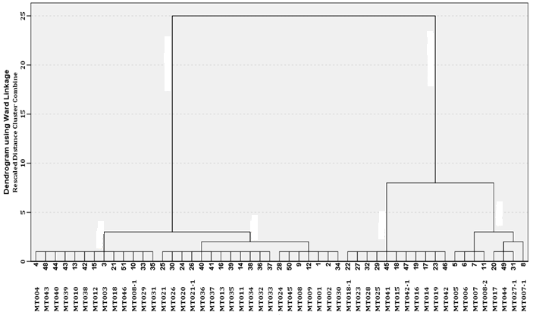
Figure 6: Dendrogram showing the results of HCA
Cluster 1b
Results (Cluster Analysis)
Cluster 1 (High SiO₂)
The analysis was extracted based on SiO₂ and Al₂O_{3 .}
The relative abundance of SiO₂ for the cluster is defined as follows: Cluster 1a> Cluster 1b> Cluster 2b> Cluster 2a (as defined by the discriminant analysis)
The relative abundance of Al₂O₃ is defined as Cluster 2b> Cluster 2a> Cluster 1b> Cluster 1a
Cluster 1a
Cluster 2b
Cluster 2 (High Al₂O₃)
Cluster 2a
Notes:
From Figure 3, two main clusters further comprising two sub-clusters are defined by SiO2 and Al2O3 contents. Main Cluster I represents samples which are rich in SiO2 but low in Al2O3 while main cluster II reflects samples that are rich in Al2O3 but low in SiO2. Most samples in layer 1 fall within sub- cluster 2 which shows the highest contents of SiO2 and lower content of Al2O3. All samples in layer 3 fall within in sub-cluster 3 which are with highest Al2O3 and lowest SiO2.

Slide 12
Results (Factor Analysis)
Table 1 : Principal component analysis for layers (Extraction Method: PCA; Rotation Method: Varimax with Kaiser Normalization).
Rotated Component Matrixª
 | Component
 | 1 | 2 | 3 | 4 | 5 | 6 | 7
MnO | .896
Th | .892
CaO | .888
As | .884
Pb | .812
TOT/C | .545 | .407
Sb |  | .898
Fe₂O₃ |  | .863
Au |  | .843
Bi | .597 | .621
Co |  | .617 | .576
SiO₂ | -.440 | -.544 | -.457 | -.487
Ni |  |  | .822
Zn |  |  | .820
MgO |  |  | .766
LOI | .535 |  | .601
TOT/S |  |  | .579 |  |  |  | .410
K₂O |  |  |  | .910
Al₂O₃ |  |  |  | .889
Na₂O |  |  |  | .887
P₂O₅ |  |  |  | .625 |  |  | .496
Zr |  |  |  |  | .905
TiO₂ |  |  |  | .433 | .582 |  | -.488
Cr₂O₃ |  |  |  |  |  | .797
Mo |  |  |  |  |  | .703
U |  |  |  |  |  | -.521
Cu |  |  |  |  |  |  | .820
% V | 20.31 | 14.33 | 14.19 | 14.01 | 7.566 | 6.663 | 6.473
7 factors were extracted:
Factor 1: CaO, MnO, Th, As, Pb, Bi and LOI but -ve score for SiO₂ (the additives).
Factor 2: TOT/C, Sb, Fe₂O₃, Au, Bi, Co but -ve score for SiO₂ (Fe/Au rich group).
Factor 3: Co, Ni, Zn, MgO, LOI, TOT/S but -ve score for SiO₂ (the sulphide group).
Factor 4: K₂O, Al₂O₃, Na₂O, P₂O₅, TiO₂ but -ve score for SiO₂ (the clay group).
Factor 5: Zr and TiO₂ (the titanium refractory group).
Factor 6: Cr₂O₃ and Mo but -ve score for U.
Factor 7: Tot/S, Cu and P₂O₅, but -ve score for TiO₂.
Notes:
From Figure 3, two main clusters further comprising two sub-clusters are defined by SiO2 and Al2O3 contents. Main Cluster I represents samples which are rich in SiO2 but low in Al2O3 while main cluster II reflects samples that are rich in Al2O3 but low in SiO2. Most samples in layer 1 fall within sub- cluster 2 which shows the highest contents of SiO2 and lower content of Al2O3. All samples in layer 3 fall within in sub-cluster 3 which are with highest Al2O3 and lowest SiO2.

Slide 13
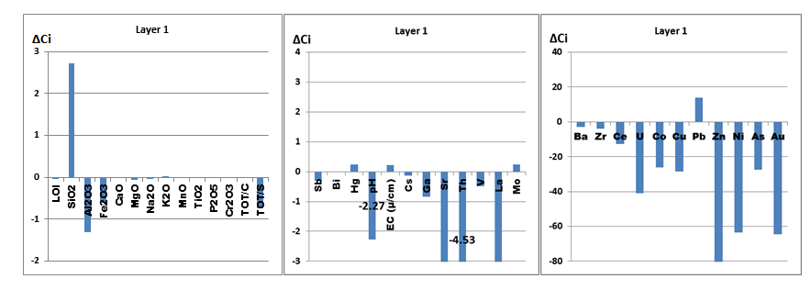
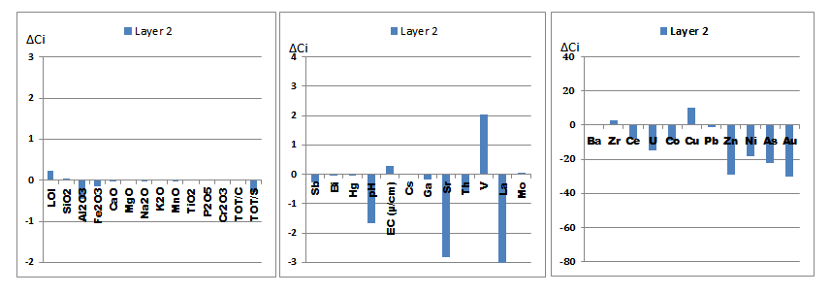
Results (Geochemical Mass Balance)
Gain/Loss relative to C_{i}⁰ denoted as ΔC_{i}/C_{i}⁰.(_{i})element analysed for, (⁰) original value, C_{i} the average value of element (_{i}) in the specific layer, C_{i}⁰ the average value of element (_{i}) in the bottommost samples, ΔC_{i} represents (C_{i} - C_{i}⁰), and when ΔC_{i} is +ve, there is gain /enrichment, when –ve, there is loss/depletion
Figure 5: Histogram showing the geochemical mass balance results

Slide 14
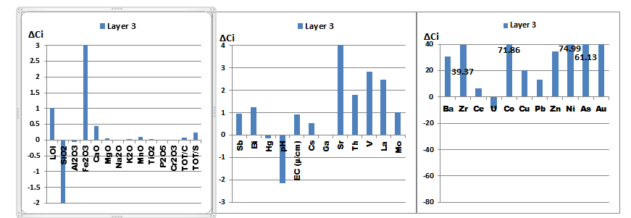
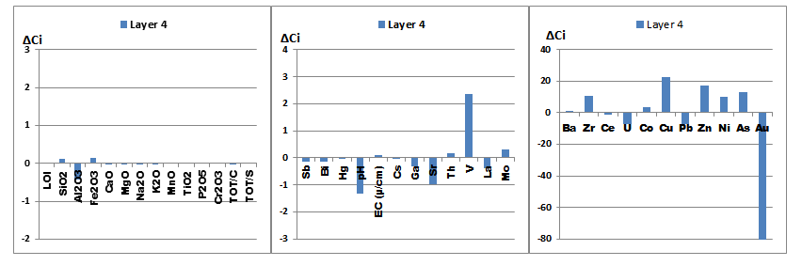
Results (Geochemical Mass Balance)
Figure 7: Histogram showing the geochemical mass balance results

Slide 15
Results (GM B Prediction)
Table 2: Rate of AMD generated in respect to time
Analysis | Layer 1 | Layer 2 | Layer 3 | Layer 4
Cul. Rate (kg/tonne) | -6.321 | -2.195 | 13.872 | -1.228
Max ΔCi | -6.610 | -2.467 | -0.293 | -2.976
Min ΔCi | 0.289 | 0.272 | 14.165 | 1.748
Av. Rate(kg/tonne/yr) | -0.122 | -0.042 | 0.267 | -0.024
The GMB prediction model was used to predict the rate of AMD generated over the period of the tailings dam existence.
Alteration rate = Σ^{i}_{n} ΔCi/T in which ΔCi is the loss or gain in concentration for element i, T is the estimated time in years (50 years) in which the tailings dam has been abandoned and n is the number of element analysed for and i is the element analysed for. Σ^{i}_{n} is the summation of the alteration rate of n elements used in the study.

Slide 16
Conclusions
Quartz, Jarosite and gypsum contents are higher in the upper horizon while pyrophyllite, pyrite, hematite and muscovite contents dominate in the lower horizons.
The cluster analysis revealed that the distributions of minerals and elements are defined by SiO₂ and Al₂O₃ contents. The highest SiO₂ and Al₂O₃ concentrations occur in the upper and lower horizons respectively.
The factor analysis revealed seven factors controlling element distribution, of which clay, additives, and sulphides are the major ones.
The mass balance calculations showed that the tailing dam has been oxidized to a depth of 3-4 meters with significant loss in major and trace elements.
Overall, it is estimated that about 0.164% (±0.02%) of the tailings materials are leached yearly.
The reddish Au rich layer occurs at a depth of ~7 meters, which is of sub-economic value.

Slide 17

Recommendations
The interaction between the oxidized zone and transition zone should be given more attention, to determine the actual extent of damage.
The incorporation of data from other tailings dams in the assessment and prediction using the tools employed in this study will give a comparison of results in which remediation process can be based on.
The mass balance calculation should be done based on individual element since the rate of oxidation and mobility of elements differs.
Data from soil and water surrounding the tailings dam should be incorporated into mass balance calculation, to determine if there is any trend of AMD heavy metals transport and correlation.
Acknowledgement
I would like to thank Inkaba yeAfrica, DST, NRF, GFZ as well as my supervisors Prof C. Okujeni and Dr A. Siad. I also thank Iris Wu for her support
THANK YOU

Slide 18
Reference
Adler, R.A., Claassen, M., Godfrey, L. & Turton, A.R. 2007, "Water, mining and waste: an historical and economic perspective on conflict management in South Africa", The Economics of Peace and Security Journal, vol. 2, no. 2, pp. 32-41.
Nengovhela, A., Yibas, B. & Ogola, J. 2007, "Characterization of gold tailings dams of the Witwatersrand Basin with reference to their acid mine drainage potential, Johannesburg, South Africa", Water SA, vol. 32, no. 4.
Bezuidenhout, N. & Rousseau, P.D. "Investigations into the depth and rate of weathering on witwatersrand gold tailings dam surfaces as key information for long-term ARD risk assessments",3134 Montavesta Road, Lexington, KY 40502, the American Society of Mining and Reclamation (ASMR), pp. 128-139. .
Expert Team of the Inter-Ministerial Committee 2010, "Mine water management in the Witwatersrand Gold Fields with special emphasis on acid mine drainage", Report to the Inter-Ministerial Committee on Acid Mine Drainage. Pretoria: Department of Water Affairs, pp. 1-128
Tutu, H., Cukrowska, E., McCarthy, T., Mphephu, N. & Hart, R. 2003, "Determination and modelling of geochemical speciation of uranium in gold mine polluted land in South Africa", Proceedings of the 8th International Congress on Mine Water and the Environment, pp. 137.

Slide 19

Let OPEN OUR EYES to the scourge of AMD!
There is Fire On the mountain!

