Slide 1
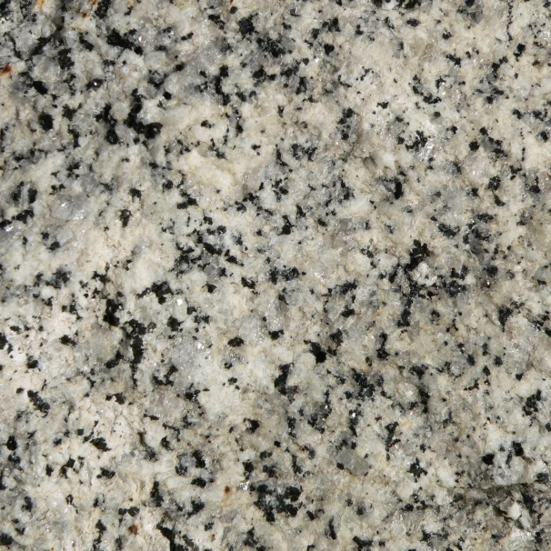
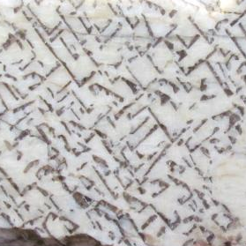
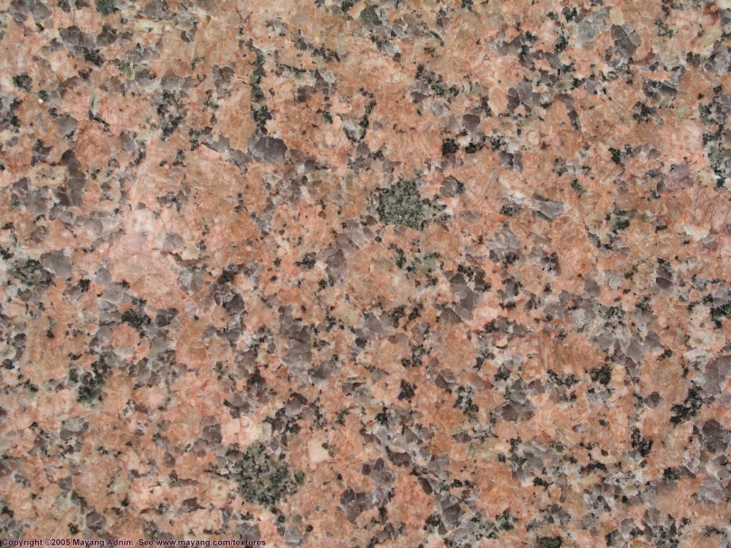
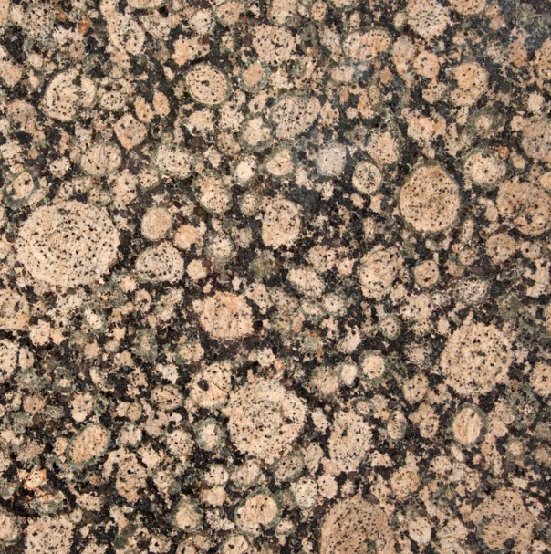

The Origin of Granite: From Werner to Read, From Bowen to Chappell
Stacy Phillips
Memorial University of Newfoundland
Department of Earth Sciences
Notes:
Hello and thank you for coming along to my talk.
Today I’m going to run you through one of the most controversial issues in all of the earth sciences. The origin of granite.
For such a simple rock, one composed primarily of quartz, feldspar, and mica it has astounding complexity, producing a variety of textures in a variety of tectonic environments. And that is why debates over granites has endured throughout the study of geology.

Slide 2
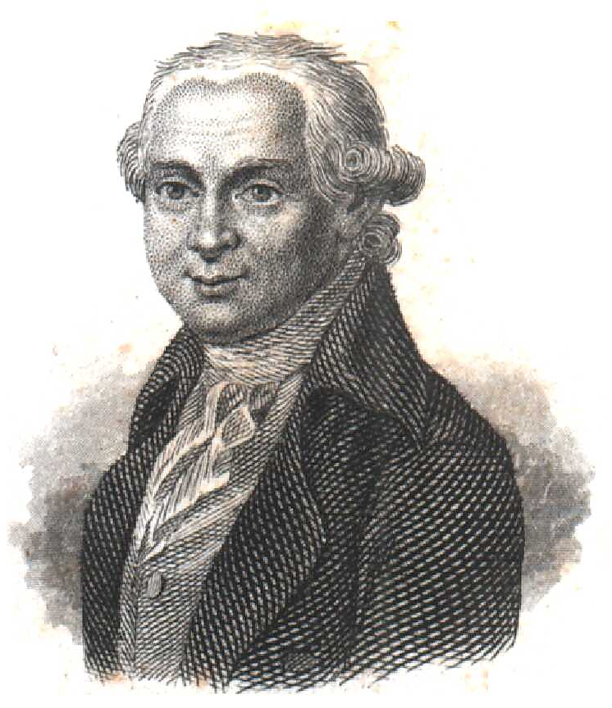
Abraham Gottlob Werner (1749-1817)
“This basalt, this wacke, this clay, and this sand, are all one and the same formation; that they are all the effect of a precipitation by the wet way…”
(1791)
Notes:
So we start out story in the 1700’s with the first great debate. Werner versus Hutton. The Neptunists vs The Plutonists.
Werner was the Professor of Mining and Mineralogy at the Bergakademie, a highly regarded mining school in Freiberg, Saxony, Germany. And he was a highly influential teacher, training many of the great early minds of the European Natural Scientists, like Alexander von Humboldt and Leopold von Buch.
Werner’s rock groups: Urgebirge (Primitive), Flötz (stratified), volcanic and alluvial. Volcanism was a recent phenomenon. Basalt was originally seen to be Primitive but then evidence that basalt was above the Flotz meant he had to introduce an intermediate class of Flotz-Trapp rocks. These were still considered to be aqueous precipitates.

Slide 3
Neptunists vs. Plutonists
“Once basaltic dykes and sills had been recognised as igneous, the acceptance of igneous granite soon followed, though never so completely.” (Dean, 1992)
Neptunists
A.G. Werner
“Primitive” rock
Plutonists
J. Hutton
Product of fusion
Notes:
Now the debate between the two schools of thought was fought on many fronts, with the igneous story being a fascinating one on its own.
Initial arguments concerned the origin of basalt, however thanks to the knowledge of recent volcanoes, it was a lot easier to correctly interpret ancient volcanic features. Granites did not have such a luxury. The whole argument was based on whether granite was formed by precipitation from an aqueous solution, and was the oldest Primitive rock type upon which all other lay, or whether it was the product of fusion.
The Huttonian theories are typically known for their controversial notions of deep time, but its need for heat was equally galling to Neptunists. In fact, the term Plutonist was coined by the Neptunist Richard Kirwan who poked fun at this central role of heat in his 1794 Elements of Mineralogy book.
Continued studies kept finding evidence of former basalt flows, and cross cutting relationships through strata
Huttonian views were not just controversial in their aspect of deep time, but also their use of heat
In 1794 in his second edition of Elements of Mineralogy, attempting to make fun of the use of heat in Hutton’s theory, Kirwan coined the term “Plutonic theory”.

Slide 4
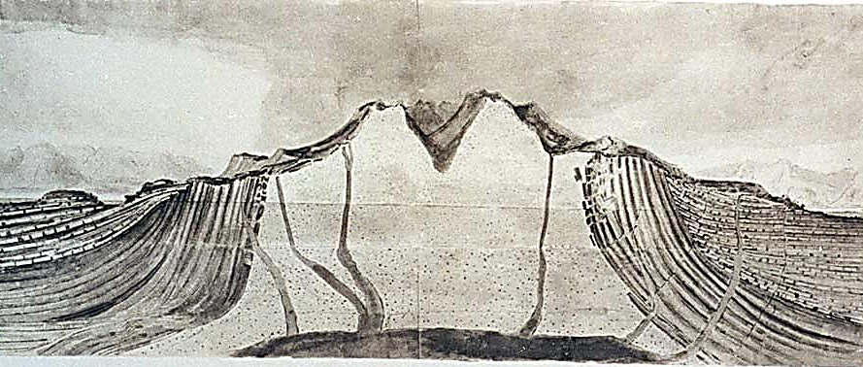
Granite on the Isle of Arran
Hutton (1787) vs. Jameson (1797)
Notes:
One of the key pieces of evidence to Hutton’s theory was field evidence from the west coast of Scotland. On the Isle of Arran, in Glen Sannox, Hutton observed that “the schistus had been broken and invaded by the granite”. It showed cross cutting relationships and proved that granite certainly wasn’t part of the oldest formation of rocks; it was not a primitive rock
Robert Jameson also visited Arran. Jameson was an excellent field geologist who made thorough field notes, however he clearly interpreted evidence using Wernerian theory. When he visited Arran, he went to exactly the same outcrop at Hutton, but he knew of Hutton’s evidence and went out of his way to remark that he didn’t see it. “I observed another junction of the granite and the schistus, but it presented nothing remarkable.”
The din caused by the Neptunists and Plutonists had largely quietened down by the 1820’s, largely as the most ardent supporters on either side had died. The concept of subterranean lavas, that is plutonic rocks had been largely accepted. How exactly they formed was the subject of the next great granite debate.
Jameson was an excellent field geologist, he just chose to interpret using Wernerian theory. He made thorough field notes. Fundamentally disagreed with the Huttonian need for heat. He did make observations that were difficult to understand in Wernerian terms, and he was more hard-line in print than in his journals.
“Nothing can be more evident than that here the schistus had been broken and invaded by the granite; as in this place the
regular stratification of the vertical schistus is broken obliquely by the other rock . . .” (Hutton 1899, 3, p. 221).
“The shistus appeared to be a very compact micaceous rock; but the granite was not intermixed with it at the junction, nor were there any veins to be observed shooting from the granite into the micaceous rock. We now crossed over the hills into another glen, where I observed another junction of the granite and shistus, but it presented nothing remarkable” (Jameson 1799 Journal, pp. 73–74).
There seemed to be enough evidence of granite in the field intruding into other rocks, and by the 1820s were convinced that volcanic and igneous activity was not confined to volcanoes- they had discovered plutonic rocks. Moved away from the idea of granite as a precipitate but thought that water would have an important role in the generation of granites
Classification schemes for rock types proliferated and were often local to the country in which you worked. Ideas about how magmas were generated and how they progressed through time led to Becker in 1897 introducing the term fractional crystallisation (which we will return to momentarily)

Slide 5
Magmatists vs. Granitisers
Magmatists
N.L. Bowen
Molten rocks
Granitisers
H.H. Read
Transformation by fluids
Notes:
The next threat to the magmatic origin of granite came from a group who were called the granitisers, or the transformists. While there were divisions within this camp, between the dry and wet diffusionists, their general idea was that country rocks could be transformed into granites, by fluids or chemical fronts in what we today might call metasomatism. These views largely came from European geologists who had noticed the intimate occurrence of granites, metamorphic rocks and the relatively newly discovered migmatites. These relationships are often difficult to untangle even today.

Slide 6
The Granite Controversy (1956)
Notes:
This is the frontispiece from the famous book, The Granite Controversy, and it describes one of the classifications of rocks presented in the 1950’s. You have the Neptunists, the Vulcanists and the Plutonists. Granites were considered to be plutonic rocks, but so were metamorphic rocks. The Granite Controversy was written by…HH Read.
Between 1939 and 1954 he gave 8 presidential addresses that form the body of The Granite Controversy, for which he is the most famous.
Frontispiece from “The Granite Controversy” HH Read 1956. Demonstrates the main rock types classification proposed by Read.
The most famous of his addresses was delivered at a GSA Special Symposium in Ottawa in 1947. Read’d talk “Granites and Granites” continued to proclaim the granite problem as a geological one, rather than one of petrography, mineralogy or physical chemistry
He argued that while some granites were probably of true igneous origin, that is formed from molten rock, this was a localised process in the upper crust and couldn’t produce large batholithic masses. Granitization however would solve this room problem. He used Doris Reynolds theories of basic fronts, and mentioned that the transformists who once had invoked a wet method of granitization using fluids and “ichors”, geologists such as Backlund, Reynolds, perrin, Roubault and Bugge had started to favour “dry diffusion”
Bowen disliked the wet granitizers on the basis that these chemical changes would be endothermic, thus requiring large amount of energy, and that the ichors would not be able to dissolve mafic materials to create a granite, despite the origin of the ichor in a highly mafic region.
Bowen disliked the dry granitizers as diffusion could not exist on such large scales – a rock would begin to melt before diffusion would ever become significant.

Slide 7
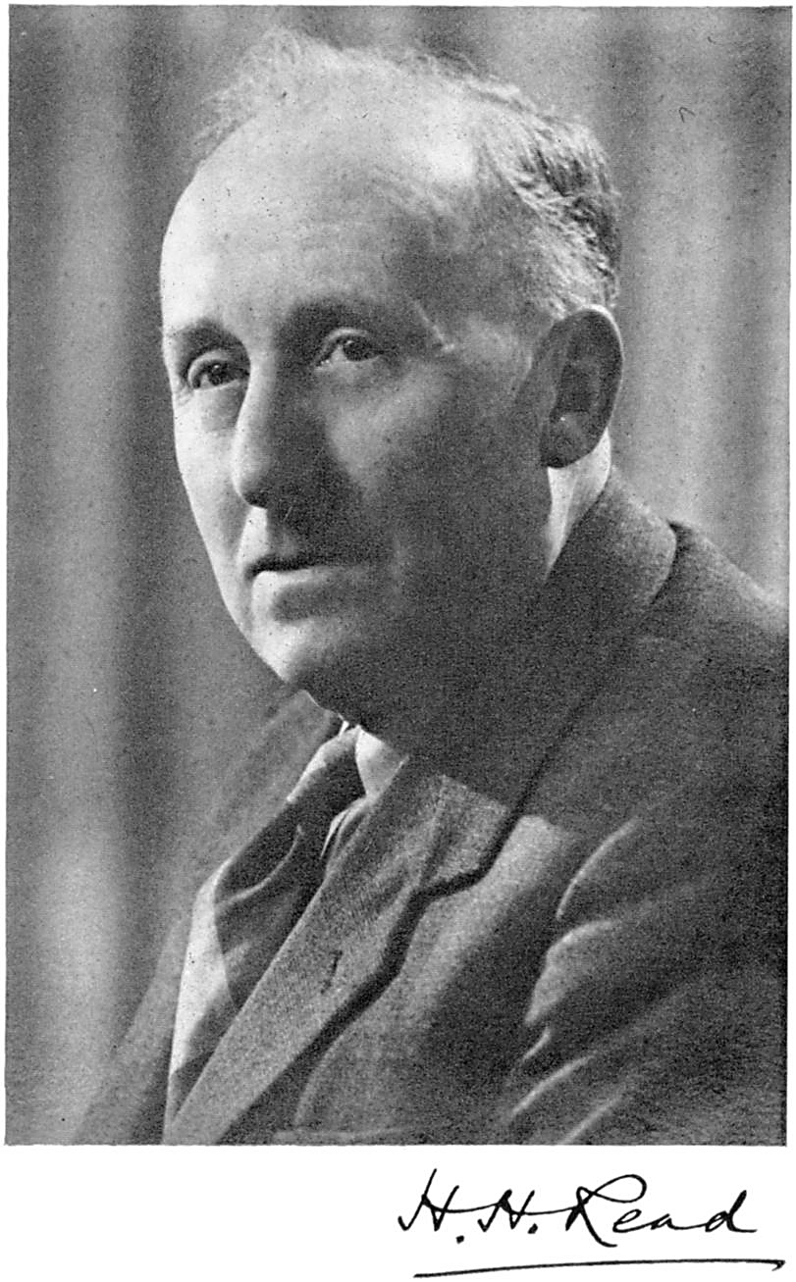
Herbert Harold Read (1889-1970)
“The best geologist is the one who has seen the most rocks.” (1940)
Notes:
HH Read was the most vocal of the granitisers. He was an accomplished speaker, demonstrated by this phrase which is one of the most famous in all of geology; the best geologists is the one who has seen the most rocks.
Read was very much like Hutton in his philosophy on geological study. The granite problem was one that would be dealt with in the field, not as Hutton described “in the bottom of a little crucible”.
Read had worked for the Geological Survey in the Scottish Caledonides, where he had observed the association of high grade metamorphic rocks and granites. His theories on granitic rocks developed over the course of his career, and while he conceded that some granites were truly formed by the solidification of molten rocks, he saw this as a small scale process in the upper crust. Only the “ichors” and fluids described by granitisation were capable of producing large batholithic masses. This was a way of solving “the space problem”, although this is a problem we still grapple with today.
Hutton and Read linked by their dislike of experimental petrology and reliance on field evidence. Hutton had said to be cautious of those who “judge of the great operations of the mineral kingdom from having kindled a fire and looked into the bottom of a little crucible” Indeed James Hall (the father of experimental petrology) waited until after Hutton died to begin his experiments.
HH Read was educated at Imperial College, London. Worked for the Geological Survey mostly in the Scottish Caledonides where he observed the close association of high grade metamorphic rocks and granites.
In 1931 he moved into academia at the University of Liverpool and then back to Imperial in 1939. Between 1939 and 1954 he gave 8 presidential addresses that form the body of The Granite Controversy, for which he is the most famous.
Hutton saw the granite problem as one that should be dealt with in the field.

Slide 8
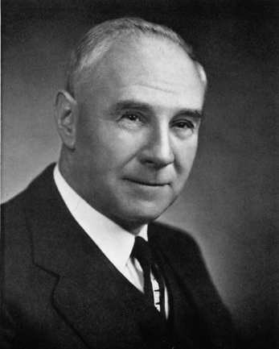
Norman Levi Bowen (1887-1956)
“The difference between the ‘pontiff’ and the ‘soak’ is that the latter must have his liquor in lavish quantities on all occasions, but the former handles his liquor like a gentleman.”
(1947)
Notes:
His equally vocal opponent was the accomplished experimental petrologist NL Bowen. He was a pioneer of igneous studies, bringing in the idea that melts evolved in composition over time, through differentiation, fractional crystallisation and by Bowen’s reaction series, the same concepts that are taught to undergraduates today.
He disagreed with the wet granitisers in that their chemical reactions would be endothermic and there wasn’t a suitable heat source invoked, and he disagreed with the dry diffusionists based on the sluggishness of diffusion.
This quote comes from the showdown between Read and Bowen at the special GSA symposium in Ottawa in 1947.
Bowen was a highly accomplished experimental petrologist
He pioneered the idea of the evolution of igneous rocks, differentiation and fractional crystallisation, and Bowen’s Reaction series
Here I’ll focus in his part in the so called Granite controversy and his battle against the granitisers – The Pontiffs and the soaks

Slide 9
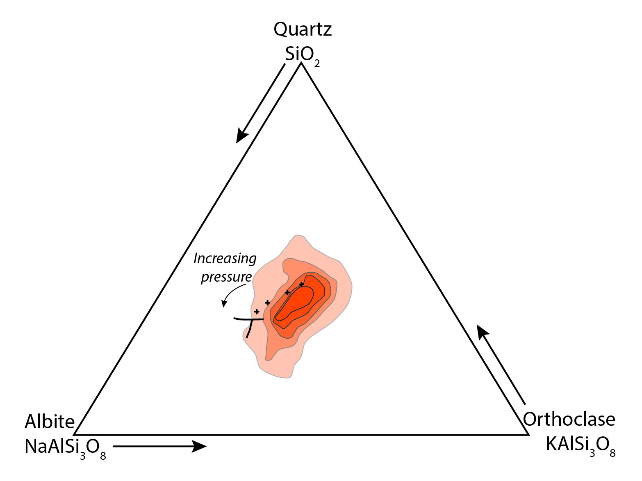
Tuttle & Bowen (1958)
Notes:
The heated debate came to a resolution shortly after Bowen had died, when his experimental work with Frank Tuttle was published.
The 1958 memoir showed the position of the minimum liquidus temperatures on the boundary curves for quartz and feldspar at differing water pressures. When they plotted the position of 571 low temperature rhyolites and granites they were found to cluster around this experimentally determined minima. Thus their compositions were determined during equilibrium between quartz and feldspar at magmatic temperatures. This restricted range of the rocks could not be explained by granitisation theories.
The publication of the Granite memoir had persuaded most geologists to the igneous nature of granite.
Bowen had always been moving towards experiments on granitic systems but had been delayed by his appointment at the University of Chicago and by WW2. He returned to the Geophysical Laboratory at the Carnegie Institute in Washington in 1947, eager to get started.
1958 memoir showed the position of the minimum liquidus temperatures on the boundary curves for quartz and k-spar for differing water pressures. They also plotted 571 analyses of the most felsic granites and rhyolites and found that they correspond to the lowest temperature melts. Thus their compositions were determined during equilibrium between quartz and feldspar at magmatic temperatures. The restricted range of the rocks could not be explained by granitisation theories.
1958 memoir persuaded most of the geological community as to the magmatic origin of granite
“The granite controversy, arguably the most spirited and vitriolic controversy in the history of igneous petrology, was more than a simple difference of opinion about scientific evidence. At the root of the controversy were two fundamentally different ways of pursuing the science of geology.” (Young, Mind Over Magma)
Read correctly pointed out that granites differ in different structural and tectonic settings, something the geochemists and mineralogists had glossed over – “There are granites and granites”. If anything this was one of the drivers of the debate. Different geologists were seeing different types of granites – Cordilleran batholiths, Scandinavian anatexites, French metasomatism.

Slide 10
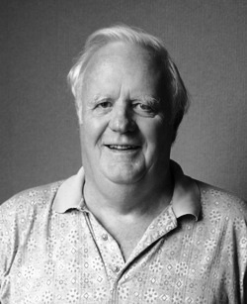
Bruce William Chappell (1936-2012)
“Although granites show a great diversity in their compositions and in details of their evolution, those features mostly relate back to the compositions of their source rocks…”
(2004)
Notes:
I now move onto the most modern of my granitic protagonists, to Bruce Chappell. Bruce Chappell was one of the most distinguished Australian geologists of his generation who began his work after this granite controversy had been resolved, and he was principally concerned with the origin of granites, and the unifying model for granite genesis.
Most of his work was done with Alan White and together their work involved meticulous field mapping of pluton, careful petrography and a huge amount of work generating geochemical data. This integrated approach is in stark contrast to that of Read’s.

Slide 11
I- & S-type Granites (1974)
I-type | S-type
High Na₂O (>3.2%) | Low Na₂O (<3.2%)
Al₂O₃/ (Na₂O + K₂O + CaO) <1.1 | Al₂O₃/ (Na₂O + K₂O + CaO) >1.1
CIPW normative diopside | CIPW normative corundum
Broad SiO₂ content | Restricted high SiO₂ content
Linear variation diagrams | More irregular variation diagrams
⁸⁷Sr/⁸⁶Sr_{i} <0.708 | ⁸⁷Sr/⁸⁶Sr_{i} >0.708
δ¹⁸O <10‰ | δ¹⁸O >10‰
Notes:
Chappell & White investigated a suite of granitoid rocks in the early Paleozoic Lachlan Fold Belt of eastern Australia. Distinct differences between the two granite types, which was attributed to their source compositions – I types derive from igneous/metaigenous sources, whereas S-types from sedimentary sources that tend to be aluminous and enriched in elements such as Rb. This distinction works neatly in these particular rocks, but it can’t be applied strictly everywhere. Geological theories are normally functions of particular field areas.
Another important concept that came out of this work was the restite model. When melting occurs there is a solid residue that can either be left at the source or entrained in a melt. This exerts a large control over the chemical composition of the granites produced.

Slide 12
Problem solved?
“Towards a unified model for granite genesis” (Chappell, 2004).
We still need to solve “the space problem”
New analytical techniques are constantly changing our understanding
Notes:
Granite continues to be controversial to this day. There is something to be said about the fact that since 1987 there have been seven “Hutton Symposiums on The Origin of Granites and Related Rocks”, with the eighth to take place in 2015. I would argue this is a good thing. Some of the people I have talked about were right, others were wrong. Things were learned. Controversy drives science.
One of the biggest controversies today concerns the “space problem”. How do we create large batholiths. What is the emplacement mechanism for these granitic masses. Theories are rich but argument continues.
We can at least say that we are in a better position to answer fundamental questions today than we were 300 years ago. Today we can answer questions about the source of granite. And we can ask questions that scientists like Read and Bowen couldn’t have even dreamt of asking. And this is often a direct result of improvements in analytical capabilities.

Slide 13
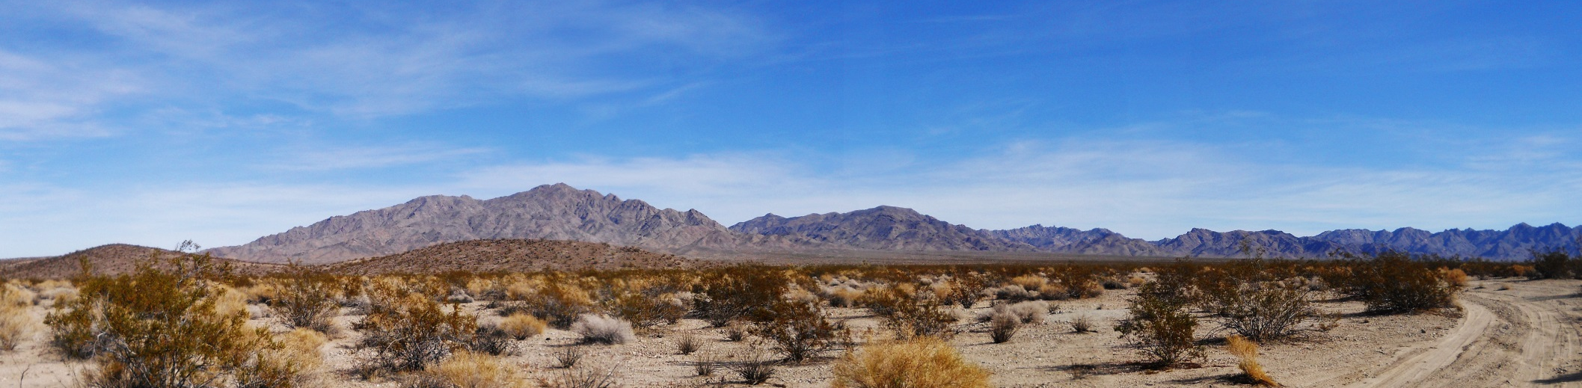
Phillips et al., (2014)
See my poster on Tuesday in Session 222-T17 Booth 270!
Notes:
I work on the Old Woman-Piute batholith in the Mojave Desert of California. I am using the cutting edge Laser Ablation Split Stream technique to analyse monazite and zircon crystals to constrain the petrogenesis of a suite of peraluminous plutons. Through U-Pb I can say when the granite formed and how the batholith was constructed. Using Hf and Nd I can describe the nature of the source material. As history has taught us, an integrated approach is key so by combining this geochemistry with field work and petrography I can build up a story to explain the origin of my granite.
The area of research that I am involved in still concerns the nature of granitic magma.
Using state of the art Laser Ablation Split Stream technology, I am investigating the
isotopic compositions of monazite and zircon crystals from the Old Woman-Piute
mountains of the Mojave Desert California. Using Nd and Hf isotopes and by dating the
grains by U-Pb we can delve deeper into magmatic processes, constraining the nature of
the source material, determining how the plutons were emplaced, and investigating the
levels of heterogeneity in the plutons. We have certainly come a long way since the
1700s.

Slide 14
Thank you for listening!
“There are granites and granites.”
“In these hurried days, geologists will take no harm from a quiet contemplation of the history of even this small part of their science.”
(Read, The Granite Controversy, 1957)
Notes:
But as we know, “there are granites and granites”.

Slide 15
“Granite is not a rock which was simple in its origin but might be produced in more ways than one” (Joseph Beet Jukes, 1863)
“I don’t know whether I am here in the capacity of President of the Geological Society, or as a penitent before the pontiff’s bench. But, I would remind Professor Bowen that the Pontiff is capable of great deal more misdeeds than the village drunk.” (Read, 1947)
In these hurried days, geologists will take no harm from a quiet contemplation of the history of even this small part of their science” (Read, The Granite Controversy, 1957).
“I have been particularly anxious about this subject of granite”. James Hutton, Theory of The Earth (1726-1797)
“The theory which I detail in this treatise is founded upon observations and facts partly well know, partly new, but which can be easily verified.” (1791)
“We can indeed for rough purposes, separate petrologists into the ‘pontiffs’ and the ‘soaks.’ Yet, among the pontiffs who bear the stigma of magma, there are none who do not believe that magmas contain volatile constituents of which the principal in water, that these may emanate from the magma and give rise to a liquor that pervaded the invaded rocks, transforming them at time into igneous-looking rocks. The difference between the ‘pontiff’ and the ‘soak’ is that the latter must have his liquor in lavish quantities on all occasions, but the former handles his liquor like a gentleman. He can take it or leave it, according to the indications of the individual occasion.” (Bowen , 1947)

Slide 16
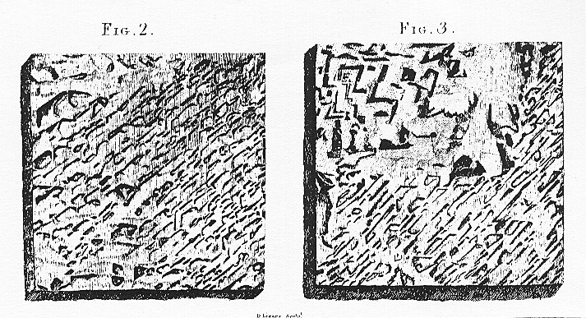
The Portsoy Granite (1788)
Notes:
Hutton’s had two key pieces of evidence for the igneous nature of granite. The first concerned a rock called the Portsoy Granite. It has what we call a graphic texture that is, “the regular lineal appearance of types set in writing”. The way that Hutton saw it was that the well defined feldspars had formed first, thus determining the shape of the quartz that formed next. This was enough for Hutton to proclaim that “there is sufficient evidence of this body having been consolidated by means of fusion, and in no other manner.”
There was strong opposition to this idea, that was based on the fact that feldspar had a lower melting temperature than quartz, and therefore quartz should crystallise first. Interestingly enough, John Playfair, known as Hutton’s populariser, found graphic granite where it was the quartz imprinting its shape on the feldspar.
The arguments against Hutton lacked the input of experimental petrology, something that Hutton himself thought to be of little use. Today we now know that the melting temperature of quartz changes drastically in the presence of feldspar, and that both quartz and feldspar can crystallise eutectically.
Graphic granite from Portsoy, Aberdeenshire. The rocks had “the regular lineal appearance of types set in writing”. 1788. Crystallisation of the feldspar had determined the regular structure of the quartz – the well defined feldspar formed first and the quartz molded onto those crystals. “it is not possible to conceive any other way in which these two substances, could this be concreted, except by congelation from a fluid state, in which they had been mixed”. Then moved onto a sweeping statement that “there is sufficient evidence of this body having been consolidated by means of fusion, and in no other manner.”
Opponents reasoned that because feldspar has a lower melting temperature than quartz, then quartz should crystallise first in a melt. The melting temperature of quartz in a melt however may be drastically changed when in the presence of feldspars. Also they didn’t know that you could crystallise both minerals on the eutectic. John Playfair (Hutton’s populariser) also argued in 1802 that he had seen numerous example of graphic granite where the quartz had imprinted on the feldspar.
Kirwan was a strong opponent of all Huttonian theory, and thought that if you had a melt hot enough to melt quartz that you couldn’t form separate minerals.

