Slide 1

Geologic controls on the chemical stream water response to atmospheric pollution (acid and Hg deposition) in Shenandoah National Park
Ami Riscassi
Drew Robison
Todd Scanlon
Jim Galloway
Jack Cosby
Rick Webb
Department of Environmental Sciences
University of Virginia
GSA
October 19, 2014

Slide 2
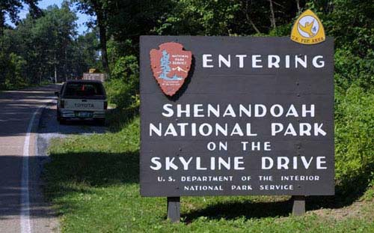
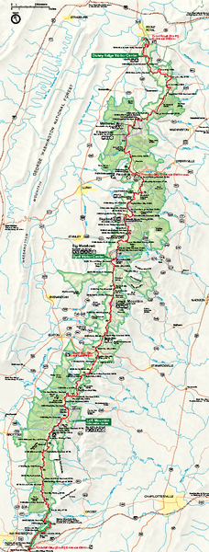
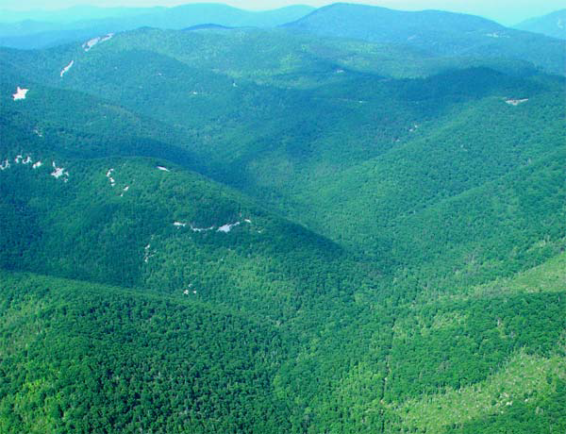
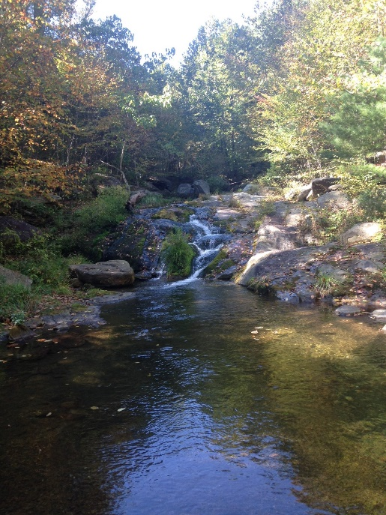
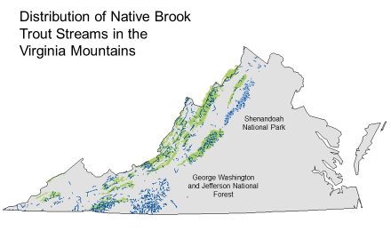
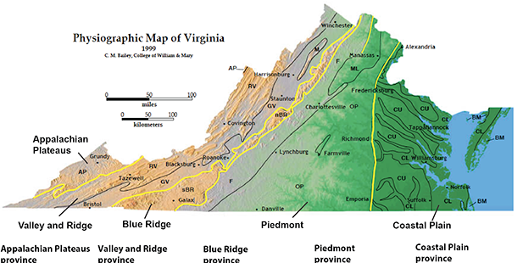
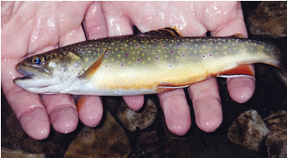
Shenandoah National Park (SHEN)
Established: 1935
Ridge and Blue Ridge Physiographic Province
Forested mountain watersheds
Contains over 70 mountain headwater streams that support diverse aquatic resources including brook trout.
Site of National Atmospheric Deposition Program and Mercury Deposition Monitoring stations.
Notes:
Ridge and Blue Ridge Physiographic Provinces
800 sq. km

Slide 3
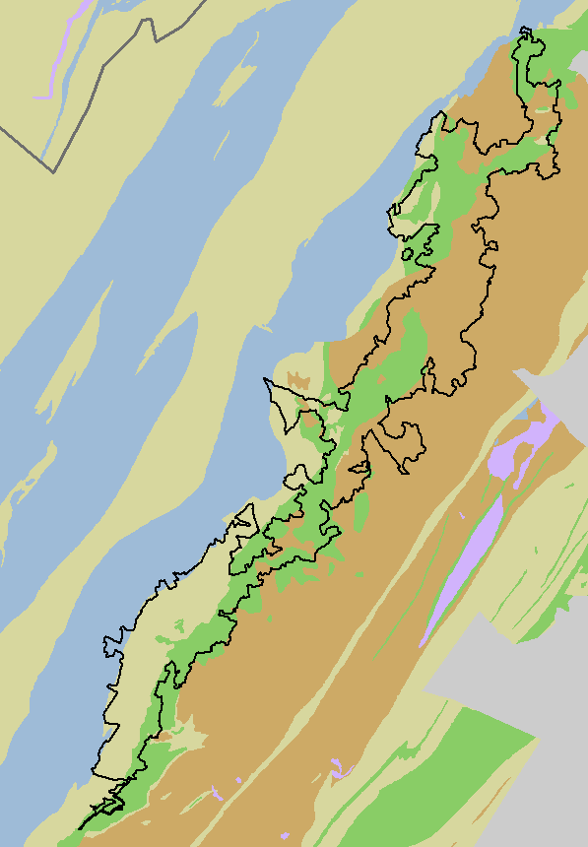
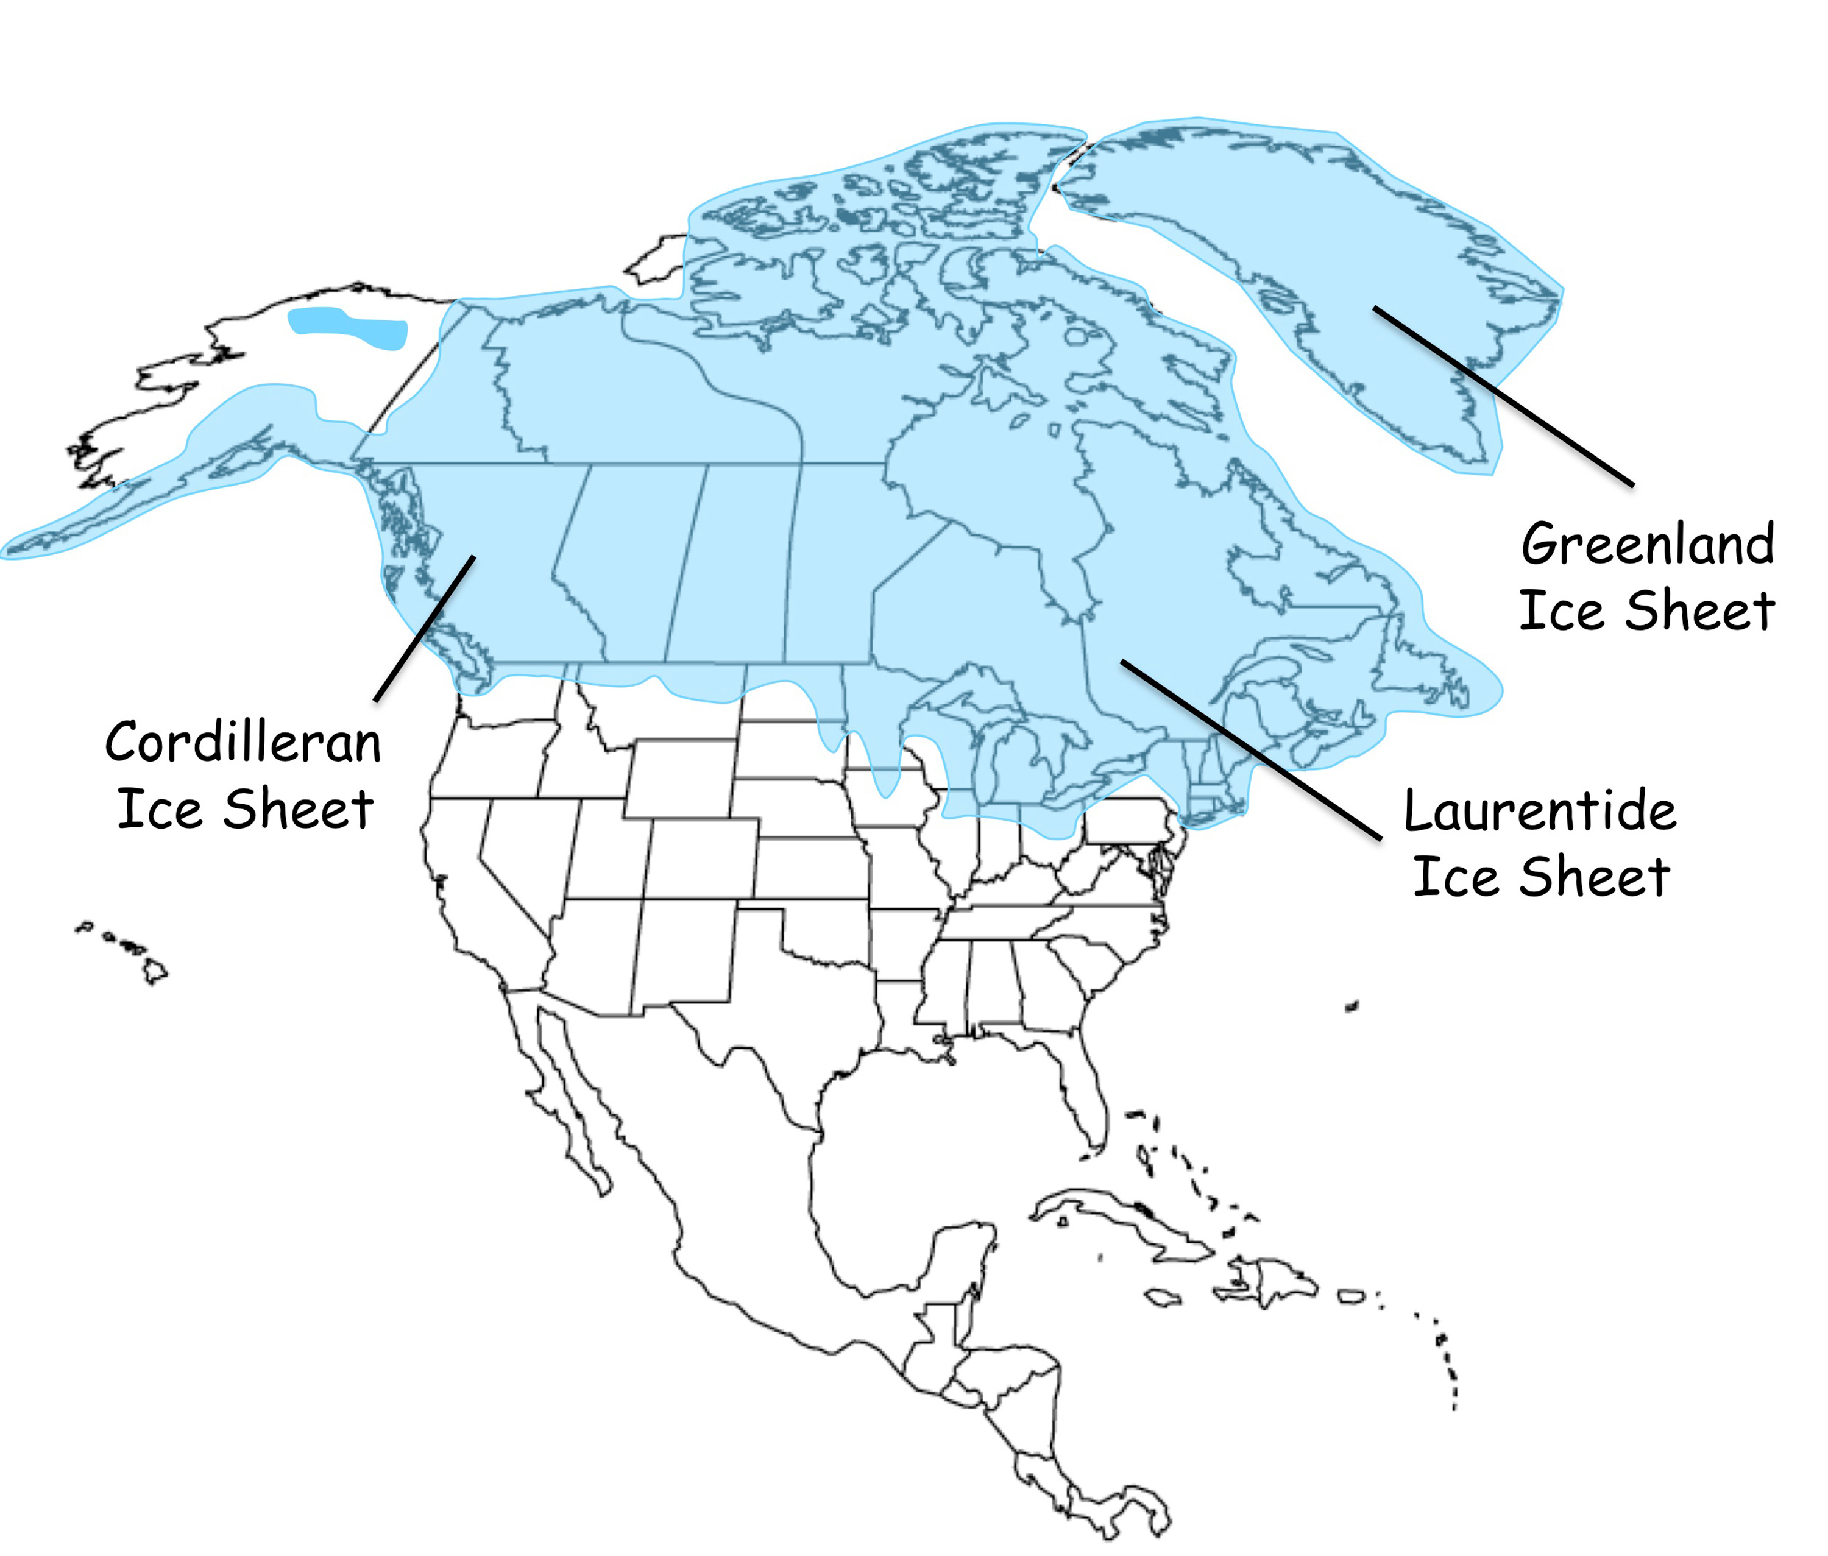
SHEN Geology
Regional distinctions
Local distinctions
Shenandoah National Park
Bedrock Class
Siliciclastic (quartzite)
Felsic (granitic)
South of Wisconsinan Glaciation
- older, more weathered soils
- sulfate adsorption of soils is higher south of glaciation (Rochelle et al., 1986)
Mafic (basaltic)
Carbonate (limestone)
Mafic- weatherable, base-rich, clay soils
Siliclastic- weather resistant, base poor, sandy soils
Notes:
Soils more weathered- accumulation of iron and aluminum oxide and hydroxide minerals
Bedrock represents a gradient in base cation content and weathering potential resulting in a range of soil types vary with base content and soil texture

Slide 4
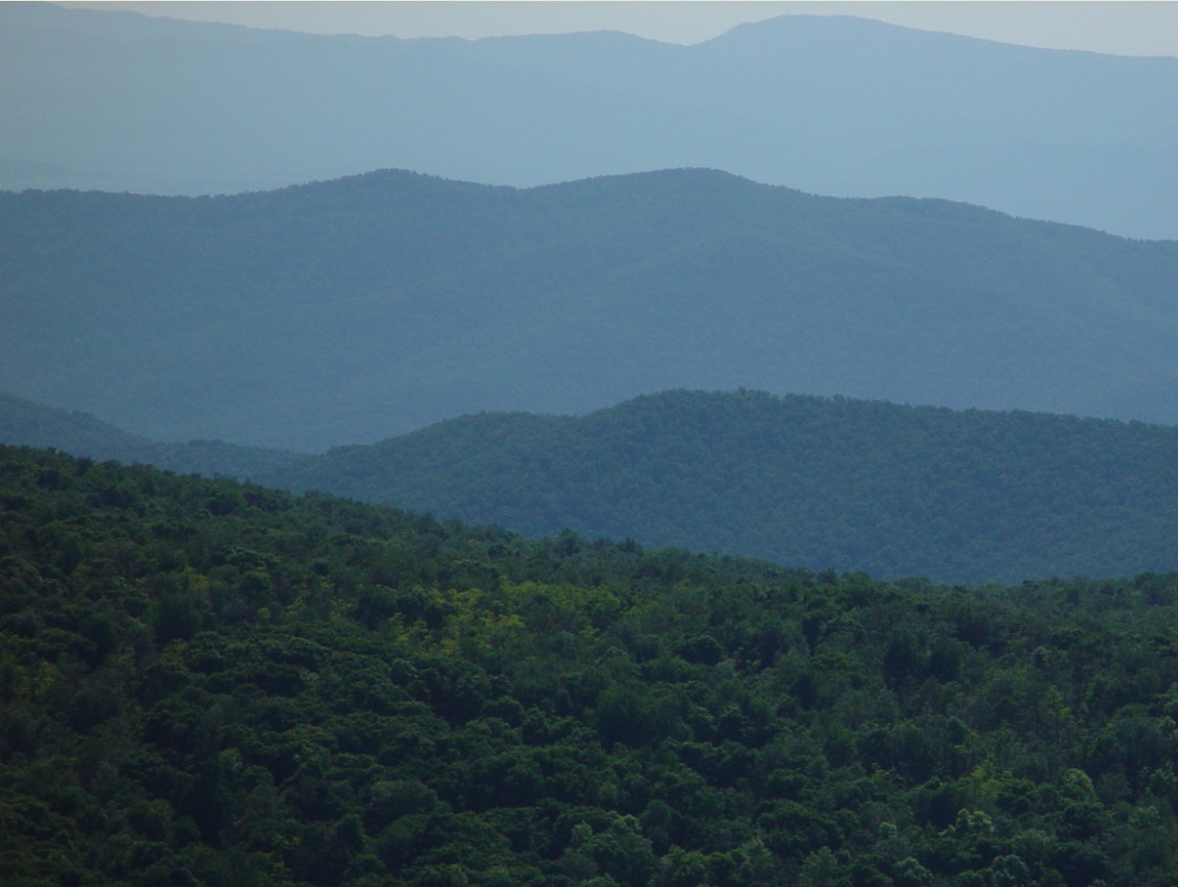
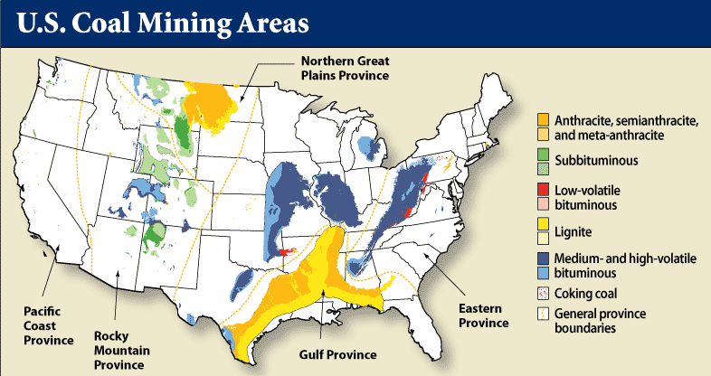
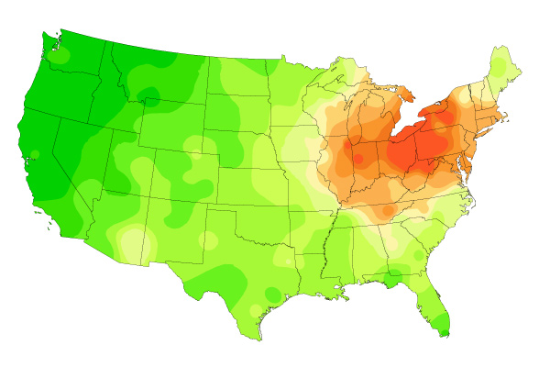
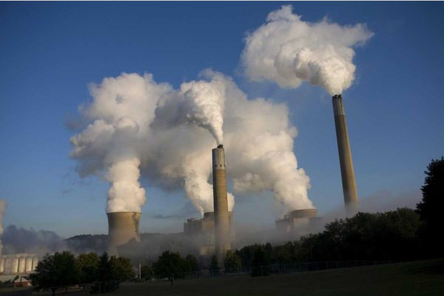
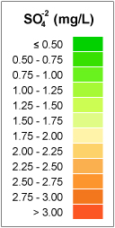
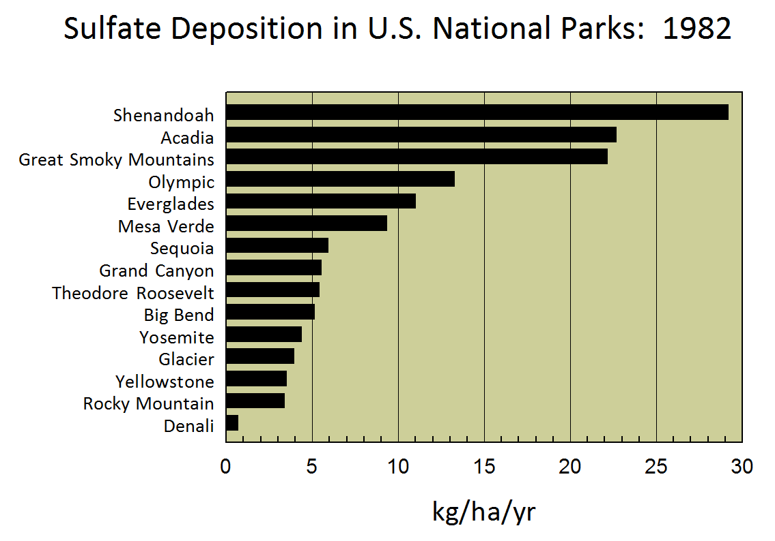


SHEN- upwind geology
Deposition
CO₂, SO₂,
NO_{X}….Hg
Sulfate Ion Concentration 1985
Data source: National Atmospheric Deposition Program
Emissions
In 1982, Shenandoah National Park was exposed to more sulfate deposition in precipitation than all other U.S. national parks.
SO₂ emissions,
thousands of tons
SO₂
Source: EPA National Emission Inventory
Stream acidity can lead to fish mortality
Notes:
Sulfur dioxide oxidized in atmosphere to form sulfate- sulfuric acid

Slide 5
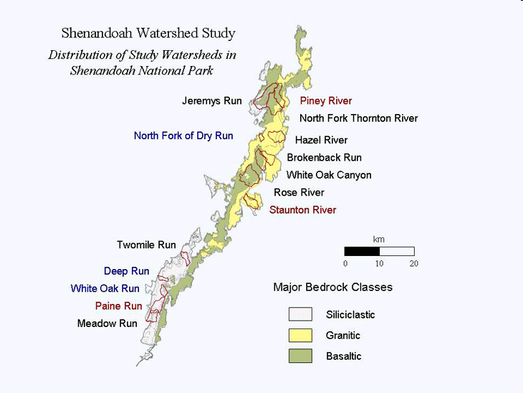
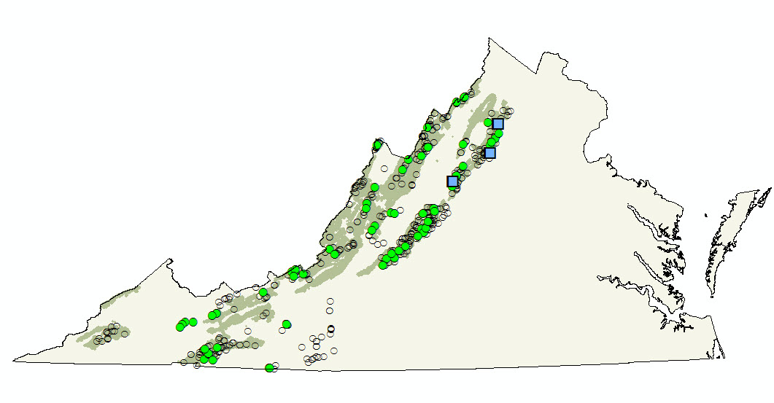

Shenandoah Watershed Study (SWAS)
Part of a regional monitoring network
Shenandoah National Park
Quarterly
Survey
Intensive
Stream Chemistry
pH
Base cations: Ca²⁺ + Mg²⁺ + Na⁺ + K⁺
Acid anions: SO₄²⁻ + NO₃⁻ + Cl⁻
Acid Neutralizing Capacity (ANC): measure of the overall buffering capacity against acidification
= sum base cations – sum acid anions
Siliciclastic
Felsic
Mafic
Initiated in 1979 as a cooperative research venture with the NPS
Since 1992
15 sites sampled quarterly
3 sites sampled weekly
- discharge gaging
- episodic sampling

Slide 6
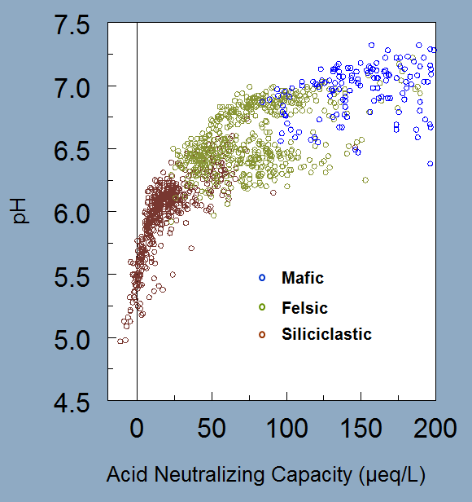
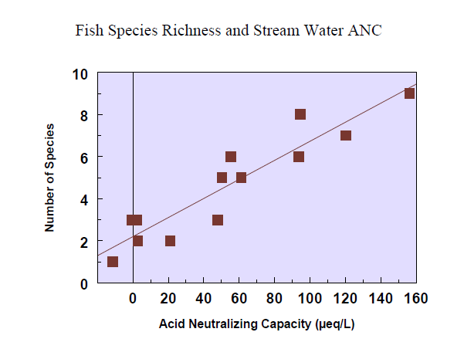
The role of bedrock in acidification of surface water
ANC = sum base cations – sum acid anions
Base cation supply is dependent on underlying bedrock composition and weathering potential
Shenandoah National Park
Number of Species
(from Bulger et al., 1999)
Bedrock Class
ANC (µeq/L)
Siliciclastic (quartzite)
Felsic (granitic)
Mafic (basaltic)
Carbonate (limestone)
Notes:
Mafic- Mg, Ca, highly erodible
Siliciclastic- base poor, resistant to erosion

Slide 7

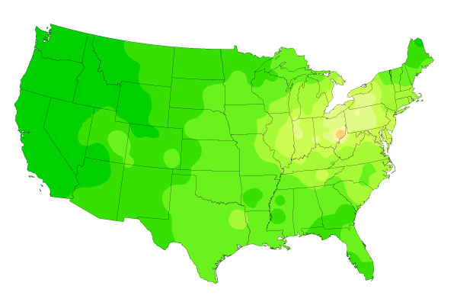
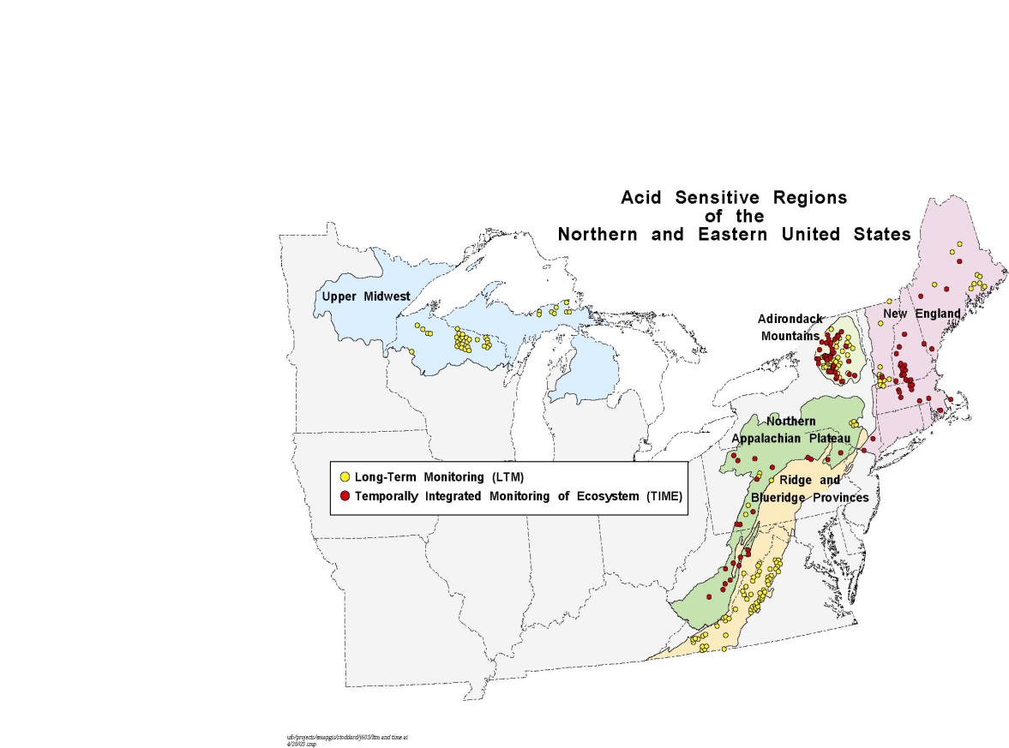
Recovery
The Clean Air Act Amendments of 1990 (CAAA)
Sulfate Ion Concentration
SO₂
SO₂ emissions,
thousands of tons
1985
2008
The SWAS quarterly stream monitoring sites are included in a long-term monitoring (LTM) program to track the environmental results of air pollution reductions achieved through the Clean Air Act.

Slide 8
Recovery (1990 - 2000 trends)
Sulfate
Acid Neutralizing Capacity
New England Lakes
Adirondack Lakes
Appalachian Streams
Upper Midwest Lakes
------------------------------
-3.5
-3.0
-2.5
-2.0
-1.5
-1.0
-0.5
0.0
0.5
-2.5
-2.0
-1.5
-1.0
-0.5
0.0
0.5
1.0
1.5
Slope of Trend (µeq/L/yr)
Sulfate concentrations and acidity of surface
waters in most regions have decreased in
response to decreased sulfur emissions

Slide 9
Recovery (1990 - 2000 trends)
Sulfate
Acid Neutralizing Capacity
New England Lakes
Adirondack Lakes
Appalachian Streams
Upper Midwest Lakes
Western Virginia Streams
------------------------------
-3.5
-3.0
-2.5
-2.0
-1.5
-1.0
-0.5
0.0
0.5
-2.5
-2.0
-1.5
-1.0
-0.5
0.0
0.5
1.0
1.5
Slope of Trend (µeq/L/yr)
Sulfate concentrations and acidity of surface
waters in most regions have decreased in
response to decreased sulfur emissions
But not in western VA.
What is different?

Slide 10
ANC = sum base cations – sum acid anions
Sum acid anions = SO₄²⁻ current atmospheric deposition + SO₄²⁻ _{historic} _{deposition, stored in soils}
Older, more weathered soils, found south of most recent glaciation, have a higher SO₄²⁻ adsorption capacity.
(Rochelle et al., 1986)
Response to CAAA delayed relative to changes in atmospheric concentration.
Notes:
Accumulation of iron and aluminum oxide and hydroxide minerals in mature soils

Slide 11
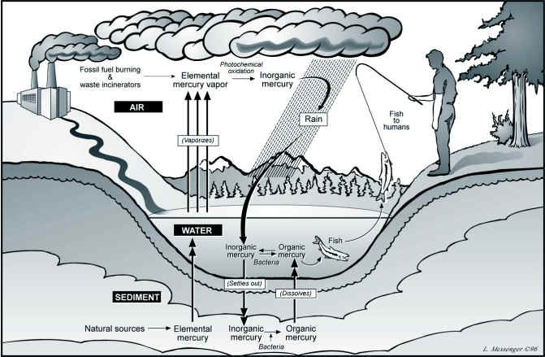
SHEN- upwind geology
Corbitt et al., 2011
CO₂, SO₂,
NO_{X}….Hg
Data source: National Atmospheric Deposition Program
Greater than 80% of the Hg deposited to the land surface is likely retained annually (Krabbenhoft et al., 1995; Allan and Heyes, 1998; Scherbatskoy et al., 1998; Shanley et al., 2008; Riscassi et al., 2013)
Notes:
Hg deposition increased 4X since pre-industrial levels

Slide 12
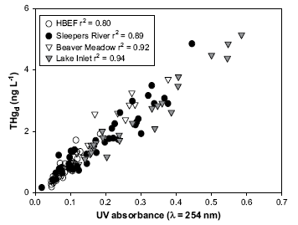
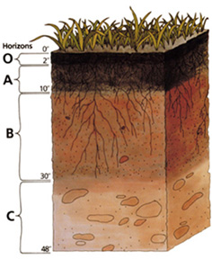
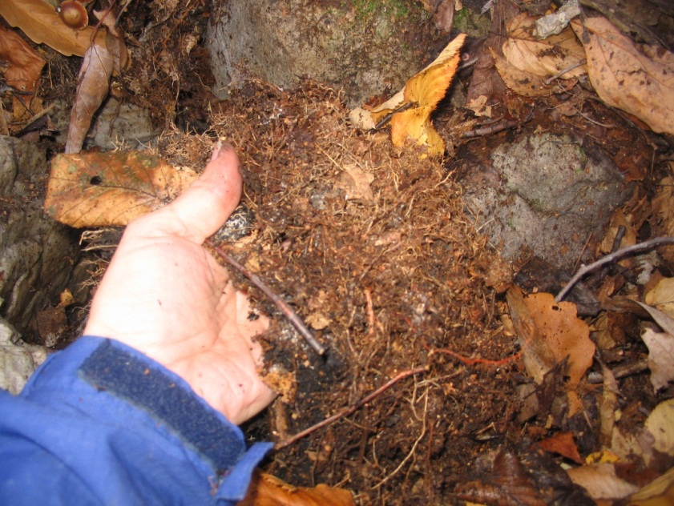
Hg in the terrestrial environment- the basics
Associated within organic carbon (OC) in upper soil horizons
Hg ²⁺
Hydrophobic Acid Fraction -HPOA
(more aromatic, UV absorbing)
Dittman et al., 2009
What we know
- Hg mobilized with OC
- Hg – OC mobilized with increased flow
- HPOA mobilizes more Hg
- Variability in Hg export within and between sites
What we don’t know
- What watershed factors influence differences in Hg export at the field scale
Evaluate Hg dynamics for a range of flow conditions and determine the effects of physical (soil type) and chemical (pH) watershed characteristics on Hg and organic carbon mobility.
Notes:
Preferentially binds to HPOA- more reduced suflur sites??
Organic carbon and Hg are in highest concentrations in upper soil profile, so majority of Hg is transported to the stream during high-flow events that mobilize soil water

Slide 13
HgD vs UV254
Mafic
Felsic
Silici.
0.90
Siliciclastic watershed has more Hg transported per unit UV
A site specific factor, unrelated to optical properties of DOC also affects Hg binding
Notes:
0.89 to 0.90 for Paine without Sept 2010 storm

Slide 14
Why do we have more HgD exported per unit UV at Siliciclastic site?
pH?
A
B
C
Yin et al., 1996
pH
Mafic Felsic Silici.
Mean 7.3 6.8 5.6
Notes:
-low pH, less DOC and HgD in solution

Slide 15
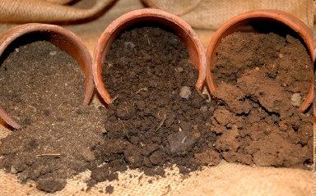
Why do we have more HgD exported per unit UV at Siliciclastic site?
Soil Composition
Yin et al., 1996
Mafic Felsic Silici.
clay sand
There exists a competition between the solid-phase binding of Hg species and the capacity of DOC to pull Hg into solution.
Notes:
Marvin-Dipasquale et al. (2009) found that as the relative amount of bed sediment pore water DOC increased or as the bed sediment percent fines (i.e. clays) decreased, more HgT partitions into the water reflecting “the competition between the solid-phase binding of Hg species and the capacity of DOC to pull Hg into solution.”

Slide 16

Summary
Differences in base cation content of bedrock within SHEN watersheds results in gradient of responses to acid inputs resulting in pH range from neutral to acidic.
Due to the higher sulfate retention in the older, more weathered soils south of last glaciation in SHEN, the response to reduced acid inputs (reductions in SO₄²⁻ and increases in ANC) due to the CAAA is delayed relative to watersheds in the NE.
Due to the difference in weatherability of bedrock and resultant differences in soil texture (sand to clay), the amount of Hg exported per unit DOC varies between watersheds in SHEN.

Slide 17






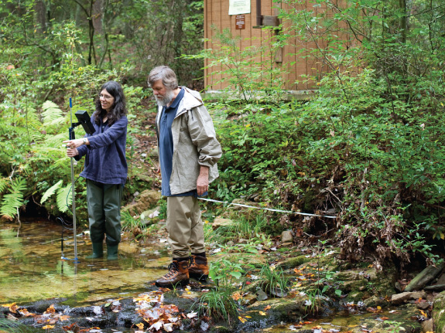
Acknowledgments
Shenandoah National Park
Dominion Foundation
U.S. Environmental Protection Agency Clean Air Markets Division
Appalachian Stewardship Foundation
Virginia Council of Trout Unlimited
University of Virginia
Susie Maben
Rick Webb

Slide 18

Questions

