Slide 1


Geoethics: building an ethical framework of reference for research and practice in geosciences
Peter T. Bobrowsky, Silvia Peppoloni, Vince S. Cronin, Giuseppe Di Capua
Session No. 265
Geoscience Education: Research and Practice
Wednesday, 22 October 2014: 8:00 AM-12:00 PM

Slide 2
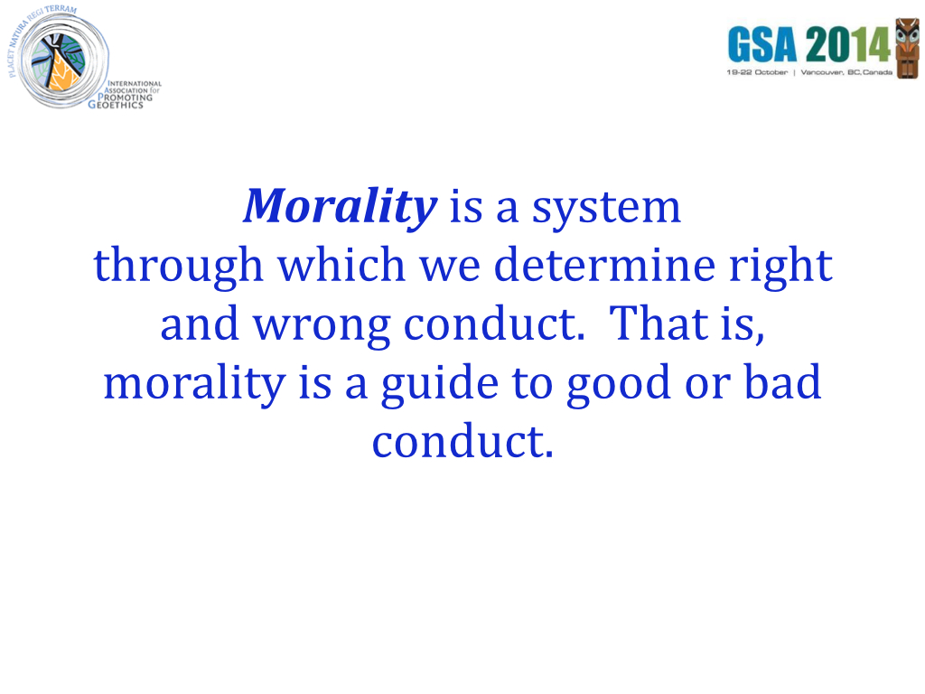
Notes:
(read slide)

Slide 3
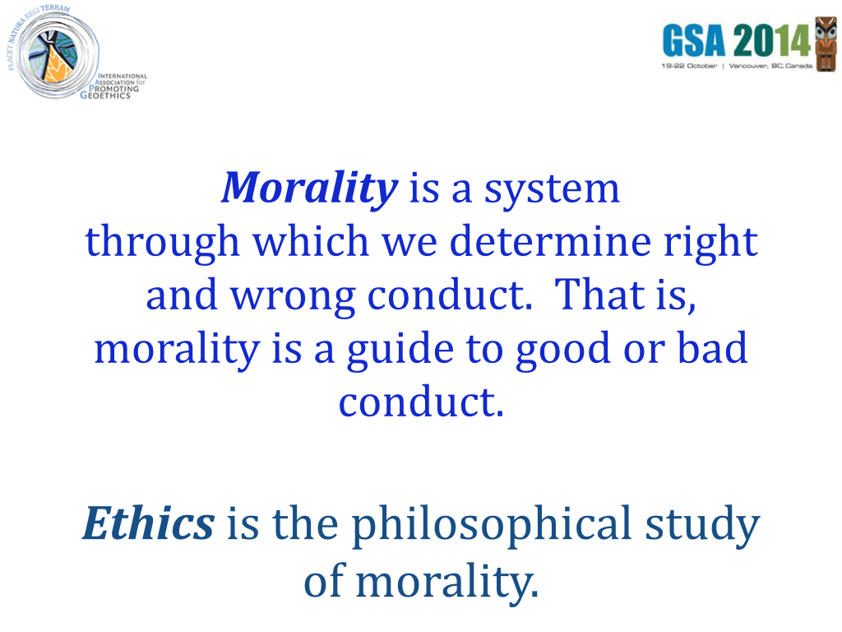
Notes:
(read slide)

Slide 4
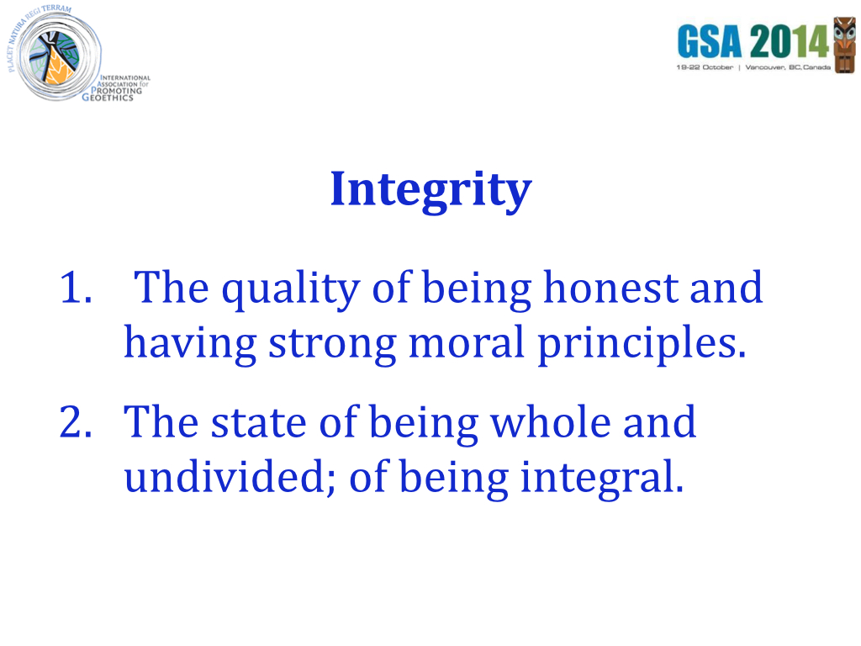
Notes:
A dictionary definition of integrity would include such things as the quality of being honest and having strong moral principles, or the state of being whole and undivided – of being integral.

Slide 5
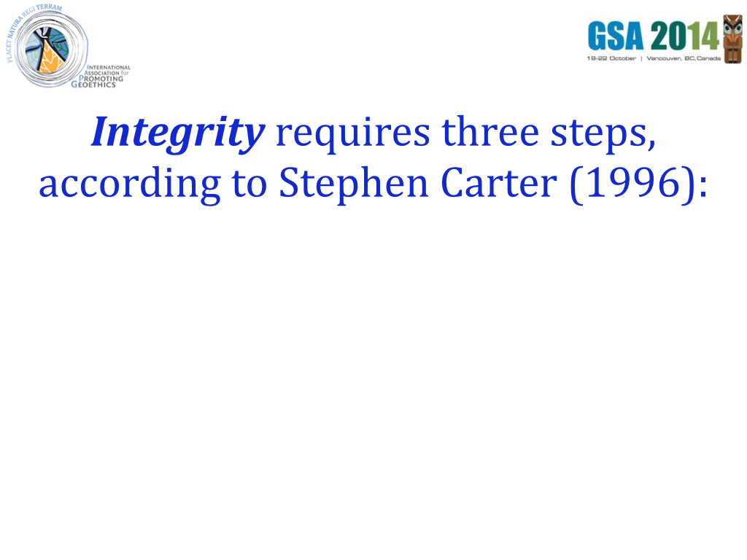
Notes:
(read slide)

Slide 6
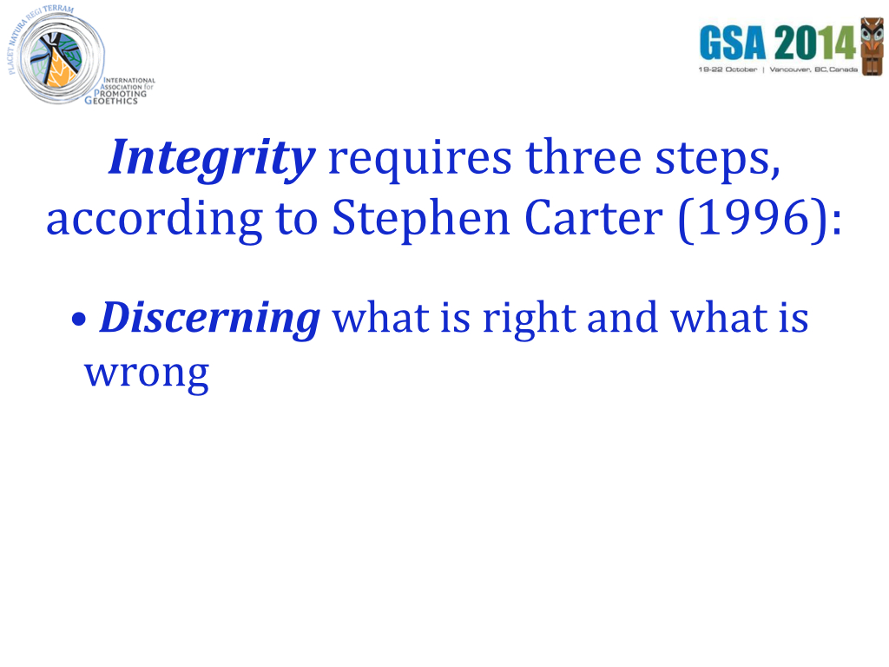
Notes:
(read slide)

Slide 7
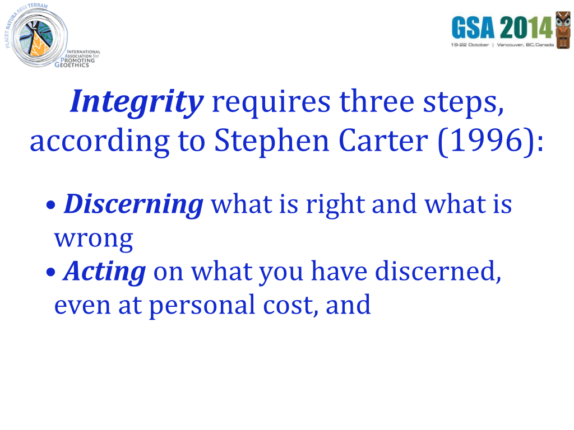
Notes:
(read slide)

Slide 8
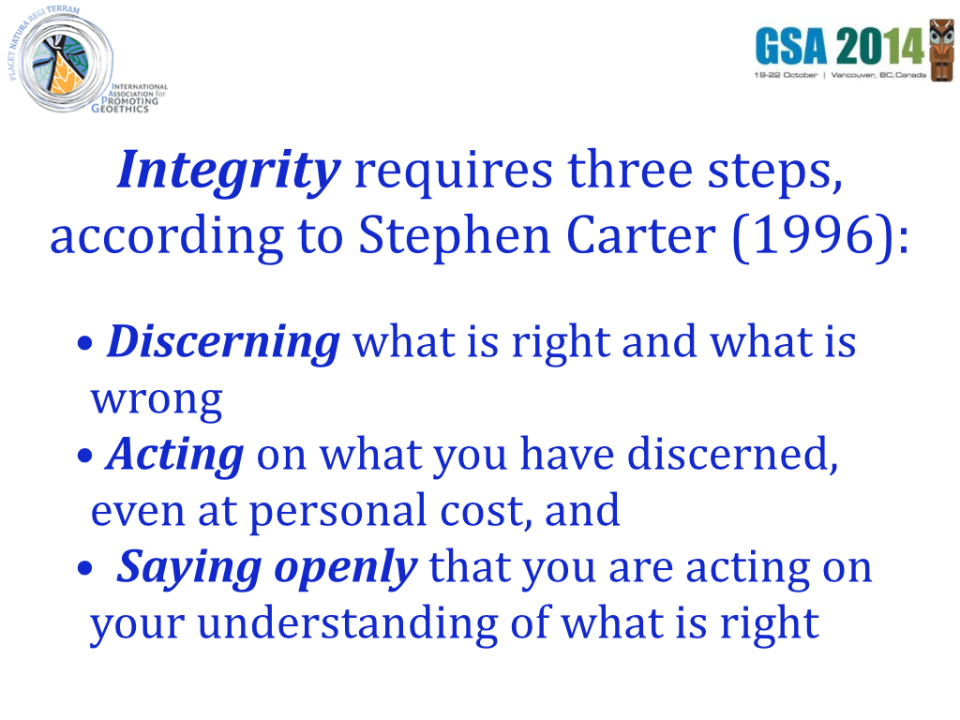
Notes:
(read slide)

Slide 9
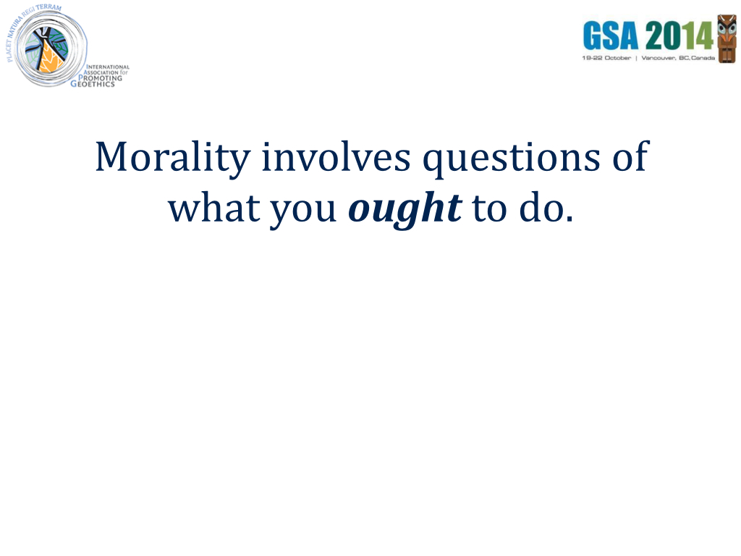
Notes:
(read slide)

Slide 10
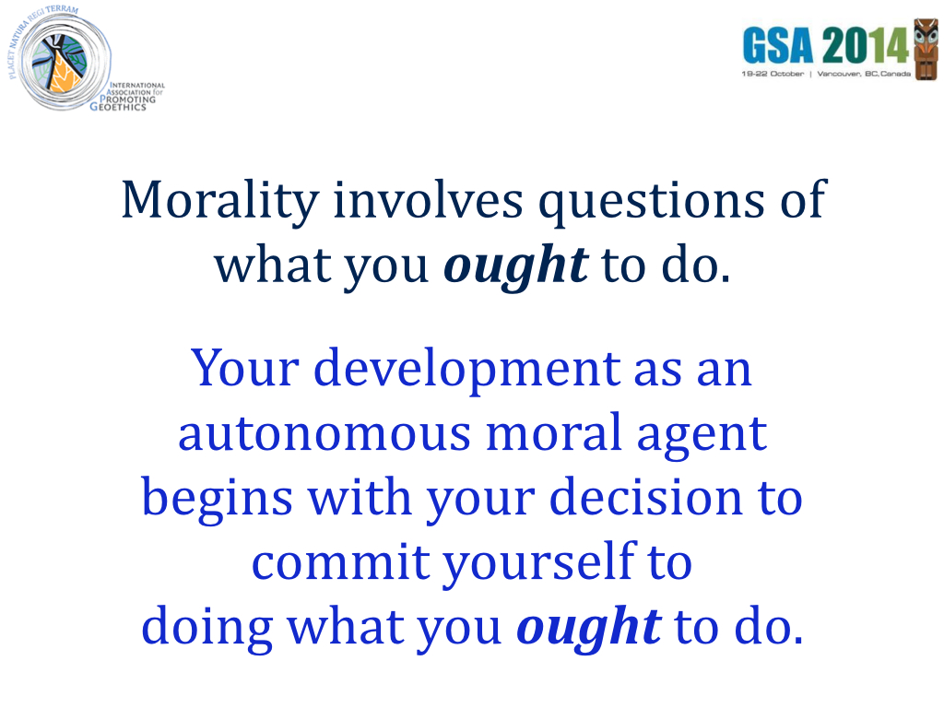
Notes:
(read slide)

Slide 11
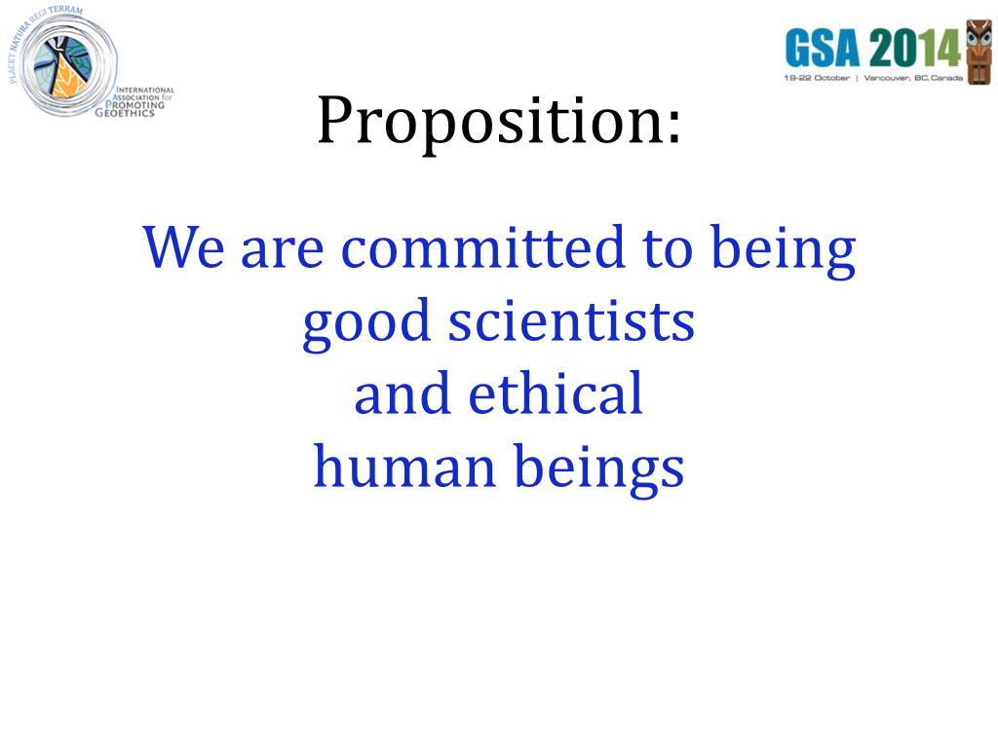
Notes:
So I have a proposition for you to consider. This is the audience-participation part of this presentation, so be alert!
The proposition is this: We are committed to being good scientists and ethical human beings.

Slide 12
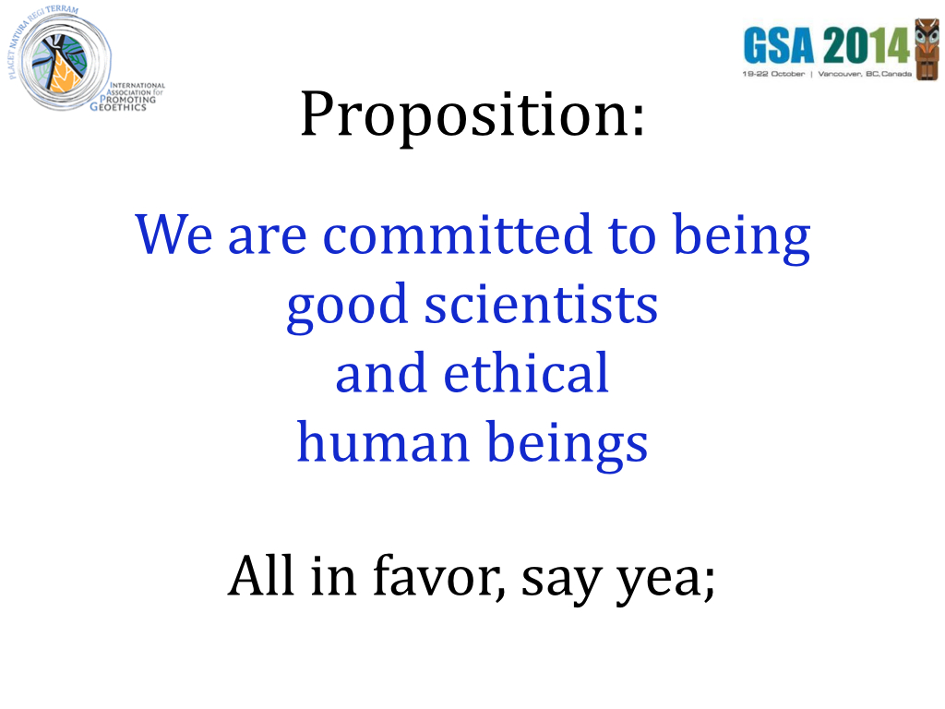
Notes:
All in favor, say yea;
(Raise hand to indicate the audience is supposed to respond.)

Slide 13
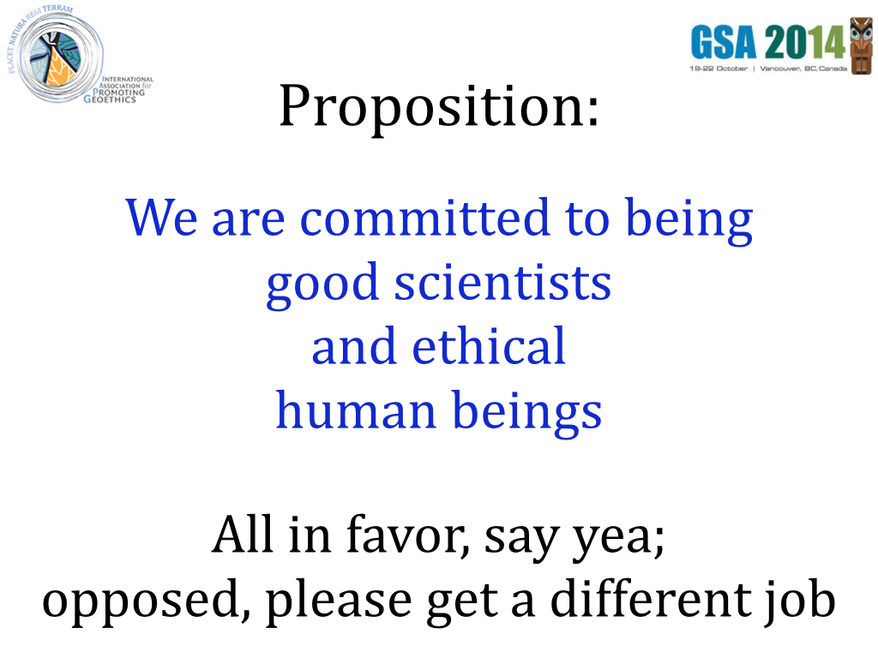
Notes:
…and anyone who is opposed should strongly consider getting another job, because we can only use people who are committed to being good scientists and ethical human beings in our community of the geosciences. After all, what positive role could a person who is NOT committed to being a good scientist or who is NOT committed to being an ethical human being play in the geosciences?

Slide 14
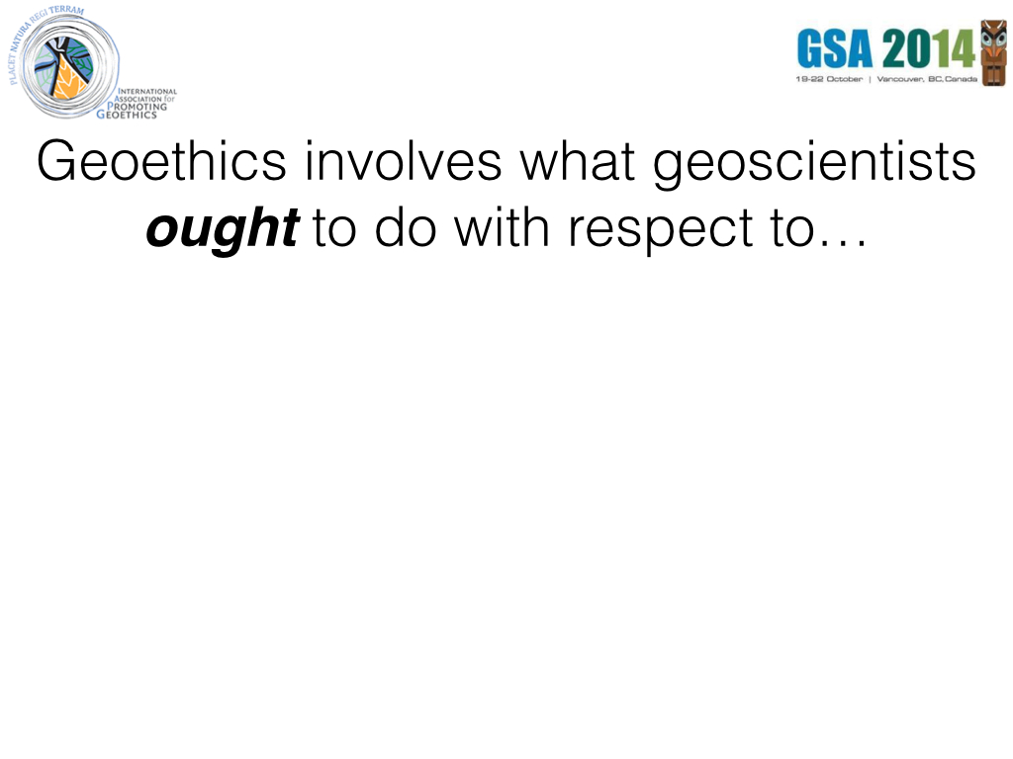
Notes:
Now we have prepared ourselves for considering the meaning of Geoethics.
(read slide)

Slide 15
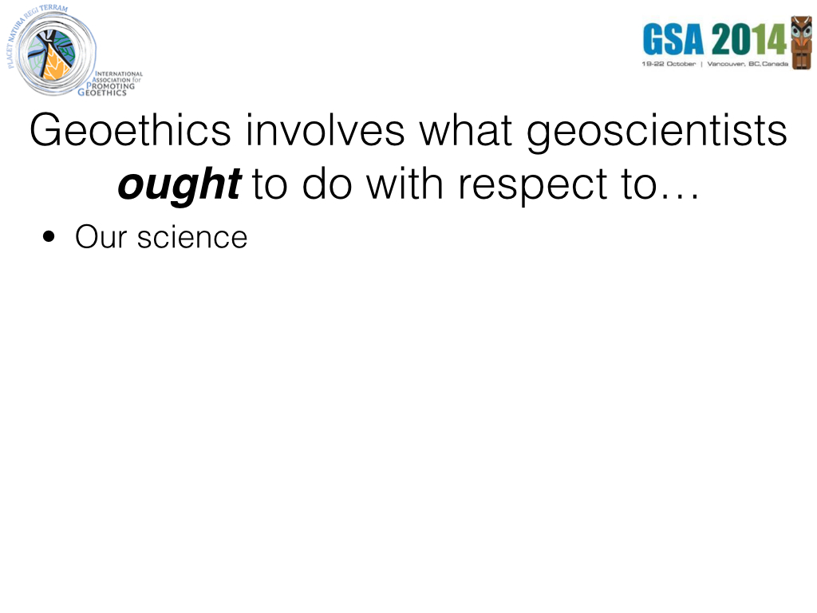
Notes:
(read slide)

Slide 16
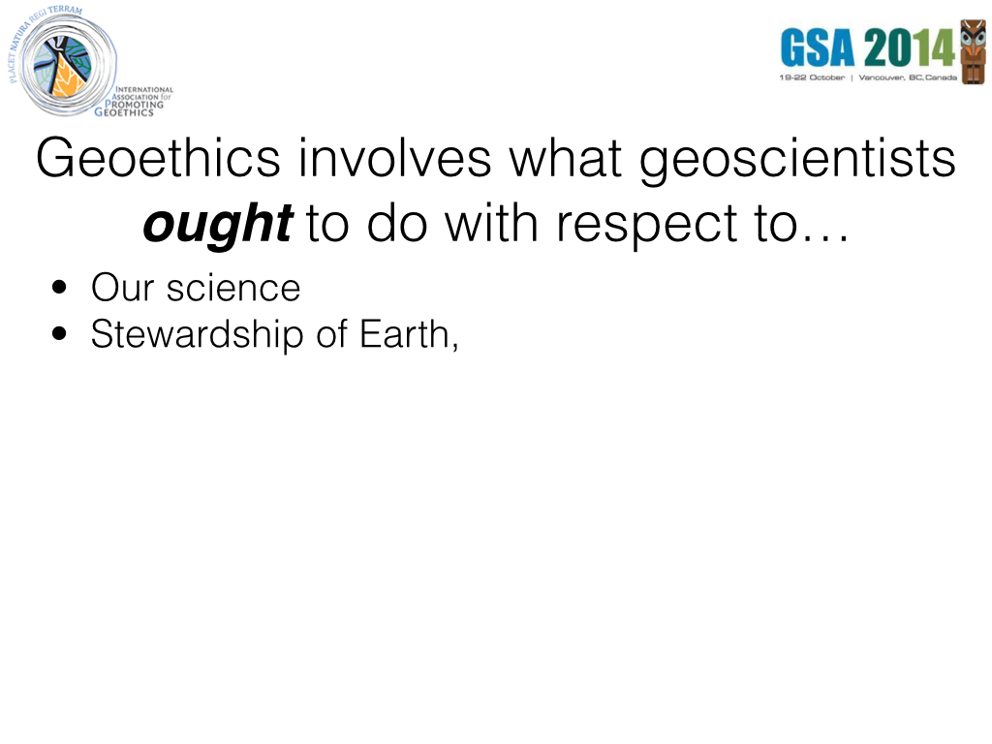
Notes:
(read slide)

Slide 17
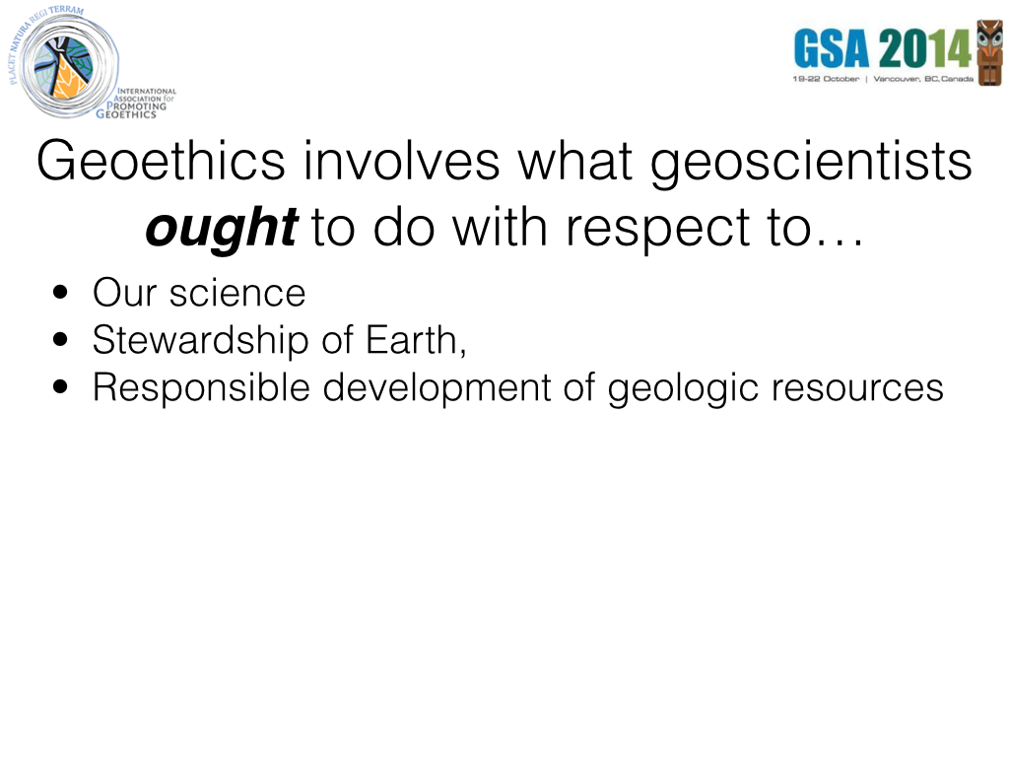
Notes:
(read slide)

Slide 18
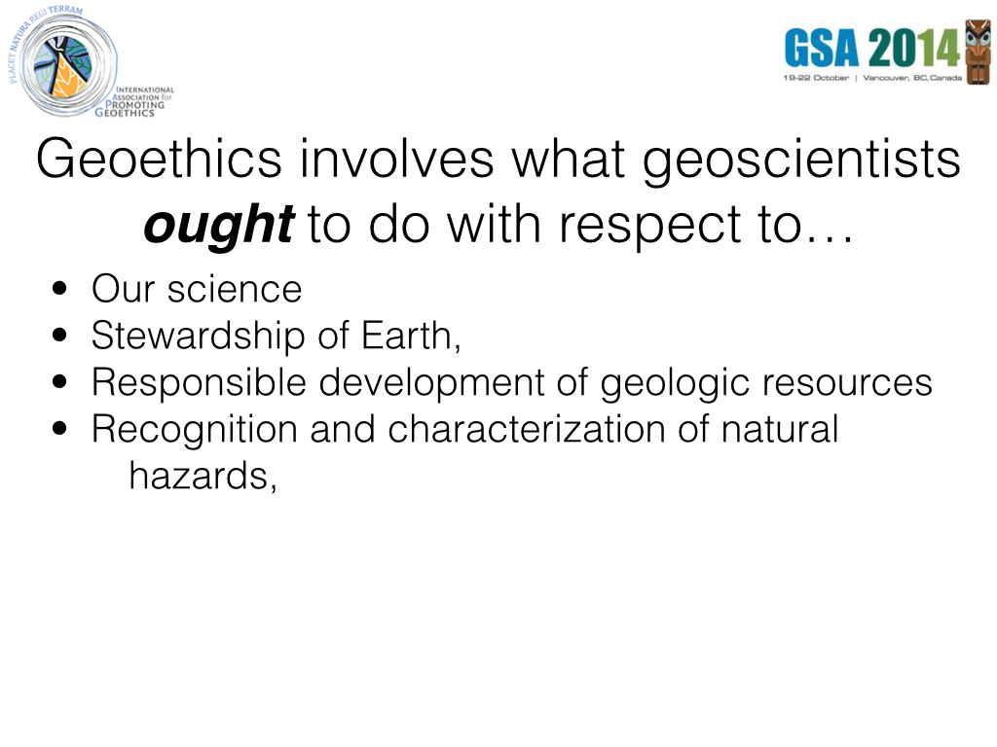
Notes:
(read slide)

Slide 19
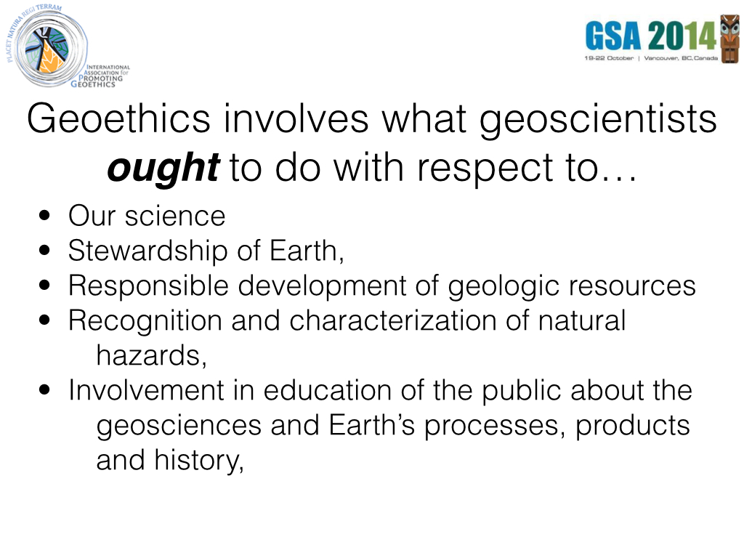

Slide 20
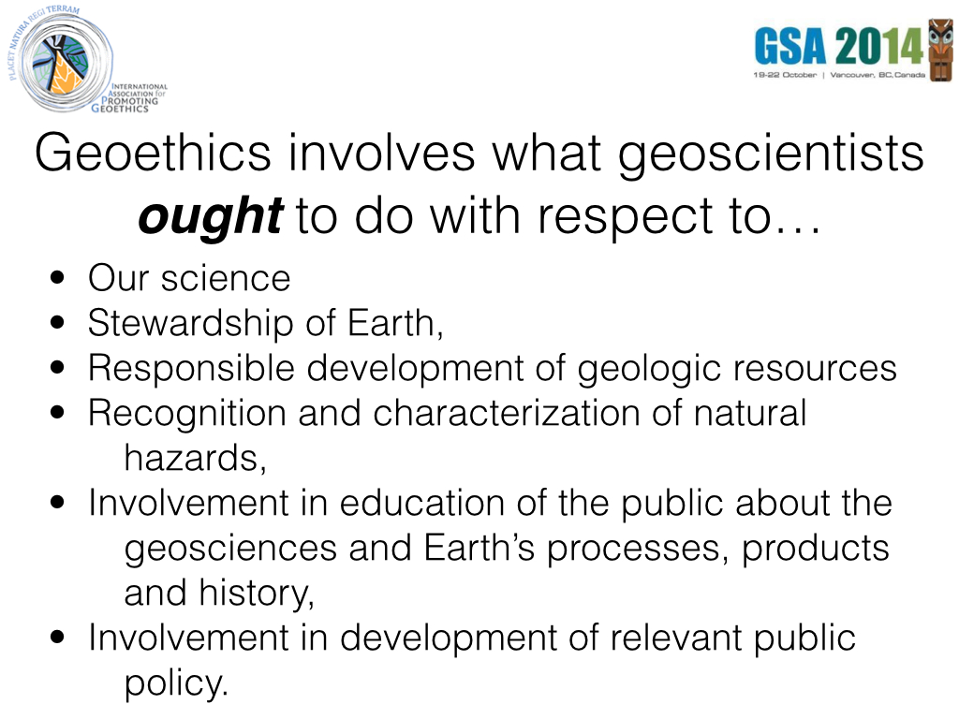
Notes:
(read slide)

Slide 21
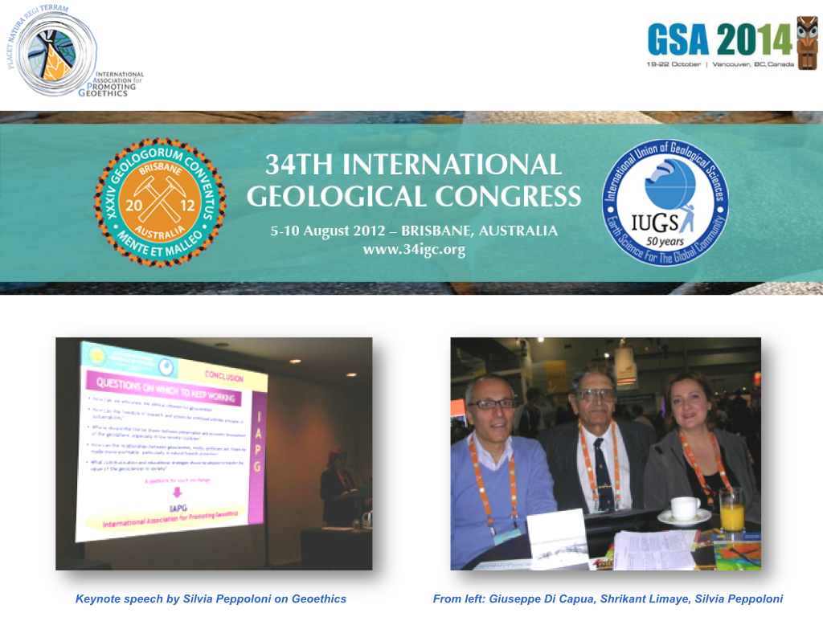
Notes:
The IAPG was born in 2012, during the 34th International Geological Congress in Brisbane. The idea to found an association for promoting Geoethics was raised during an earlier congress in Vienna, but the IAPG actually began in Australia, after consultation with colleagues from many different countries. In Brisbane we felt the need to create a home for geoscientists interested in helping improve the ethical character of our profession, embracing geoscientists of all sorts, from different countries, from different social and economic contexts.
We understood that ethical issues in Geosciences were numerous, and that opportunities for discussion about these issues within our community and in the broader society were too few.

Slide 22
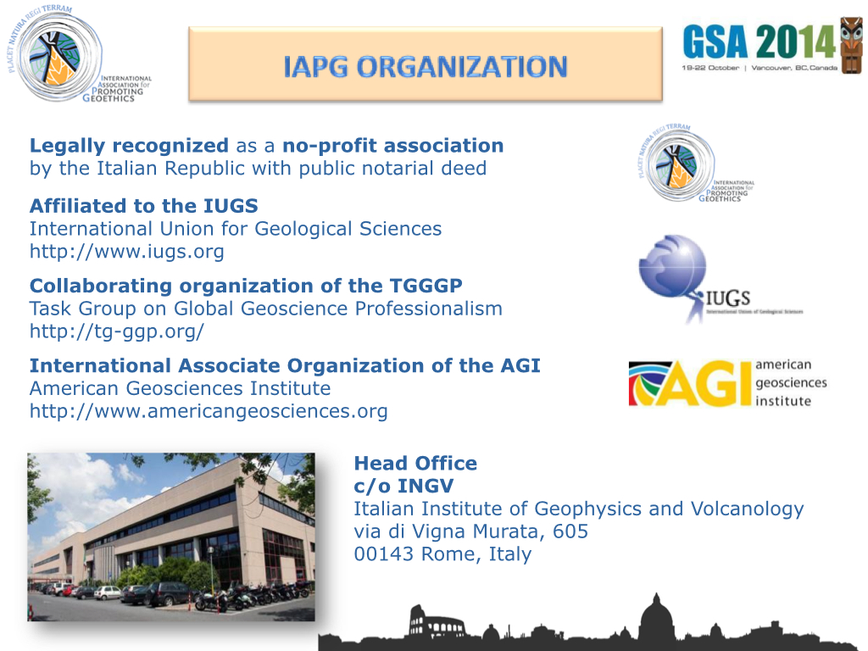
Notes:
The IAPG is now recognized by a growing list of professional organizations, including the International Union for Geological Sciences, American Geosciences Institute, American Geophysical Union, International Association of Engineering Geologists, and soon (we hope), the Geological Society of America, among others. The head office is located at the Italian Institute of Geophysics and Volcanology in Rome.

Slide 23
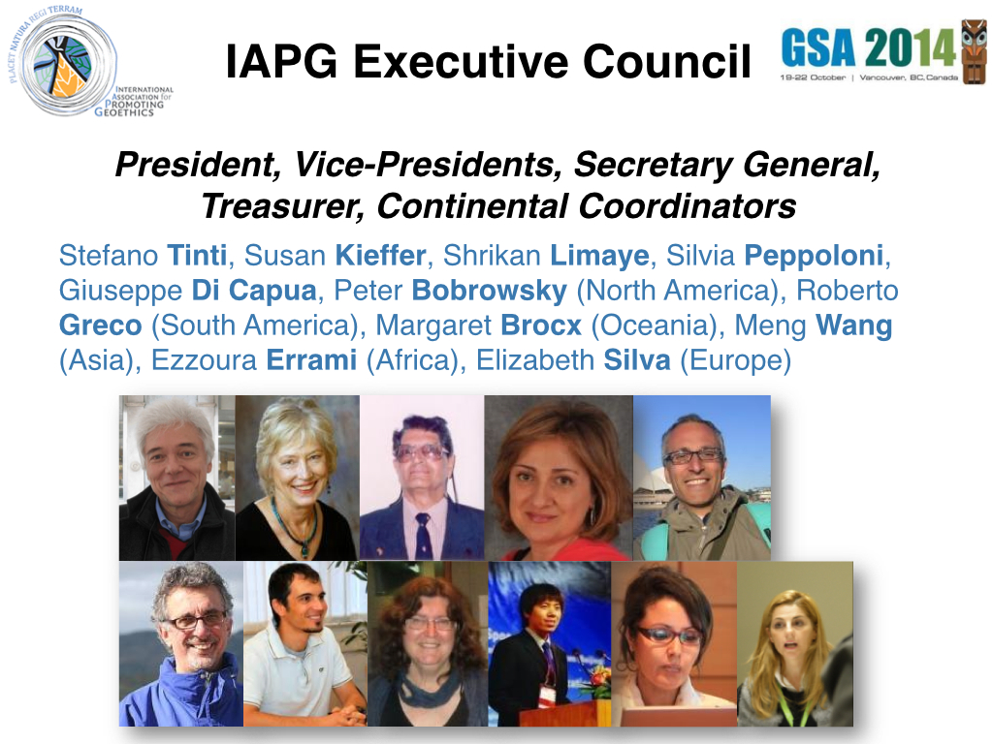
Notes:
These are the members of our Executive Council, composed by a President, 2 Vice-Presidents including Penrose Award recipient Susan Kiefer, a Secretary General, a Treasurer, 6 continental coordinators.
We are proud that our Executive Council includes people from different working experiences in geosciences, having an expertise on natural hazards, geoparks and geoheritage, geoeducation, natural resources, etc.

Slide 24
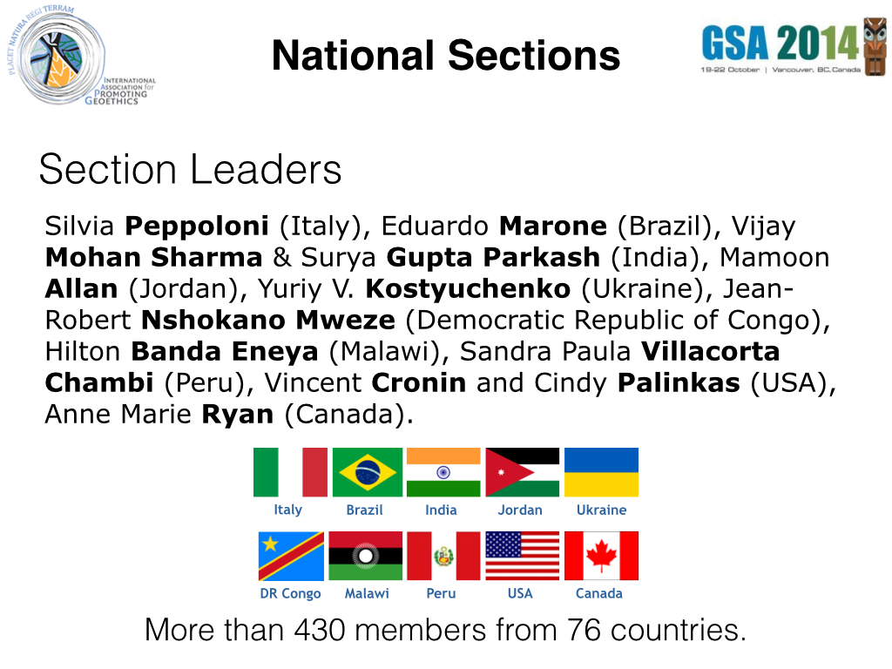
Notes:
IAPG is growing fast and the interest on Geoethics has demonstrated by requests to open national sections in many countries. Currently we have 10 sections, and other new ones are pending.
IAPG has reached 430 members from 76 countries.

Slide 25
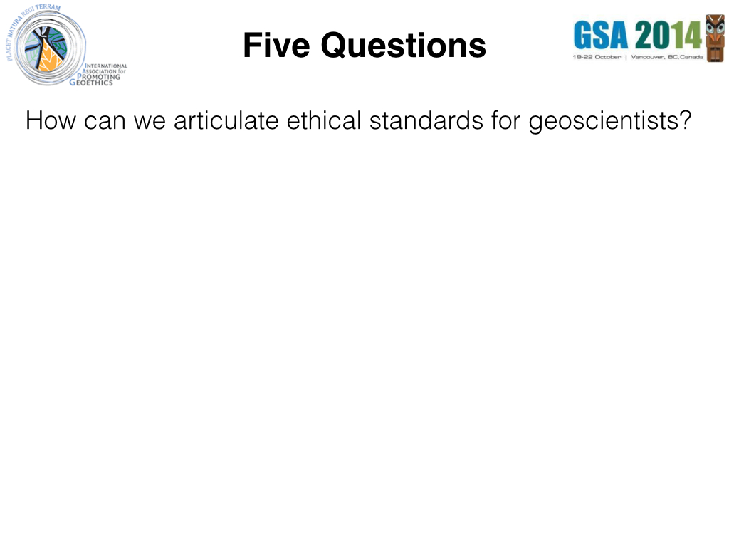
Notes:
IAPG co-founder and Secretary General, Silvia Peppoloni, posed five questions at the initiation of the IAPG two years ago...
(read slide)

Slide 26
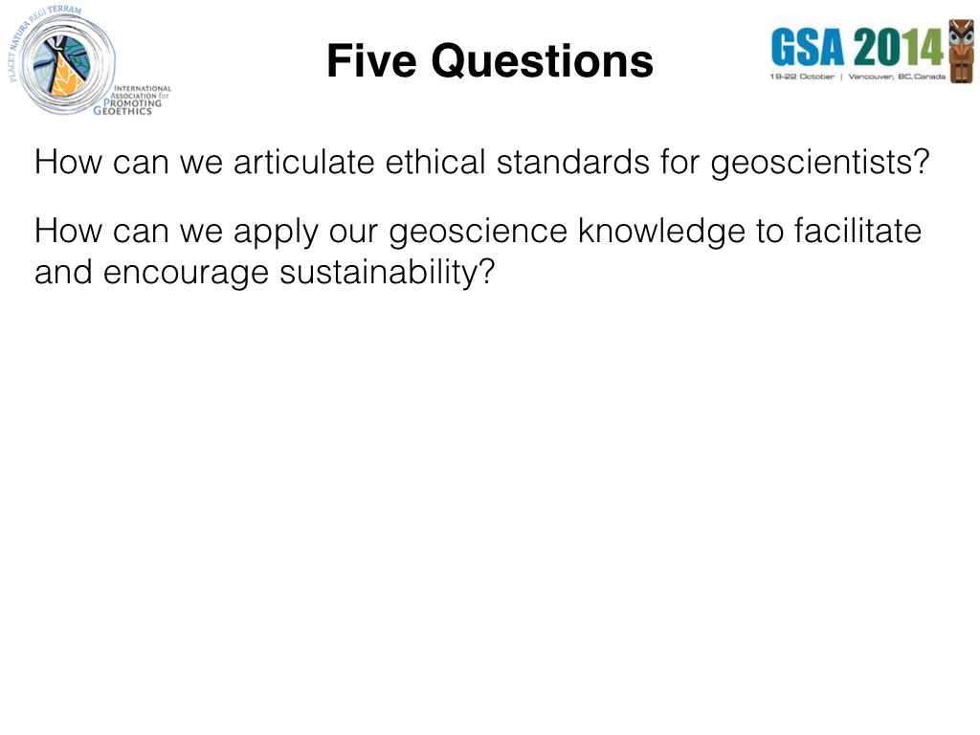
Notes:
(read slide)

Slide 27
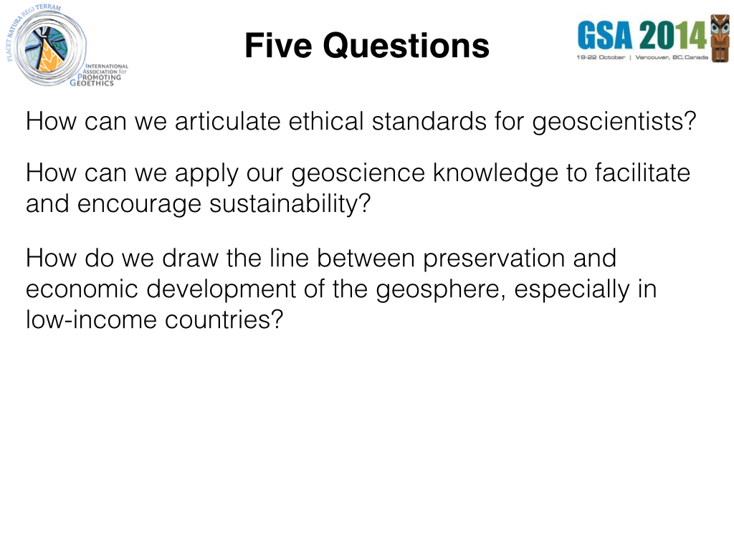
Notes:
(read slide)

Slide 28
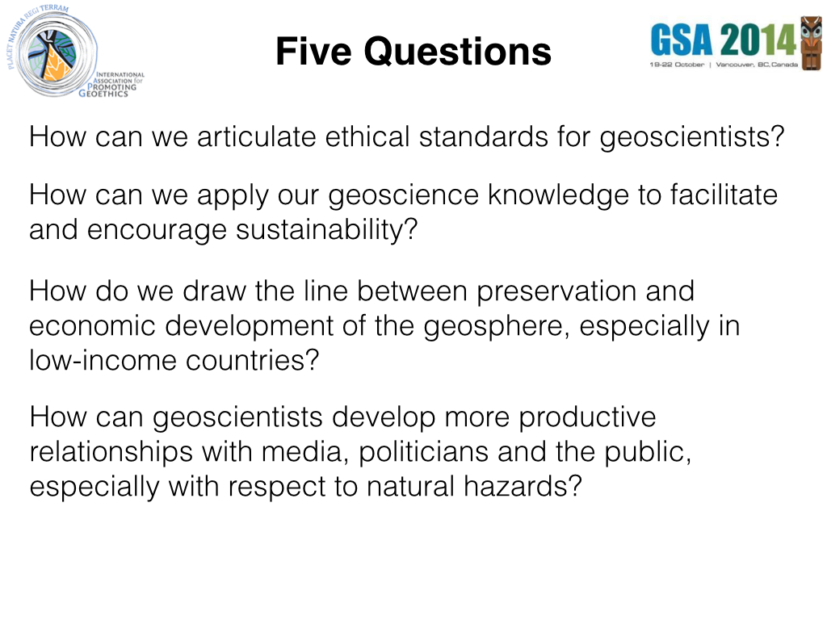
Notes:
(read slide)

Slide 29
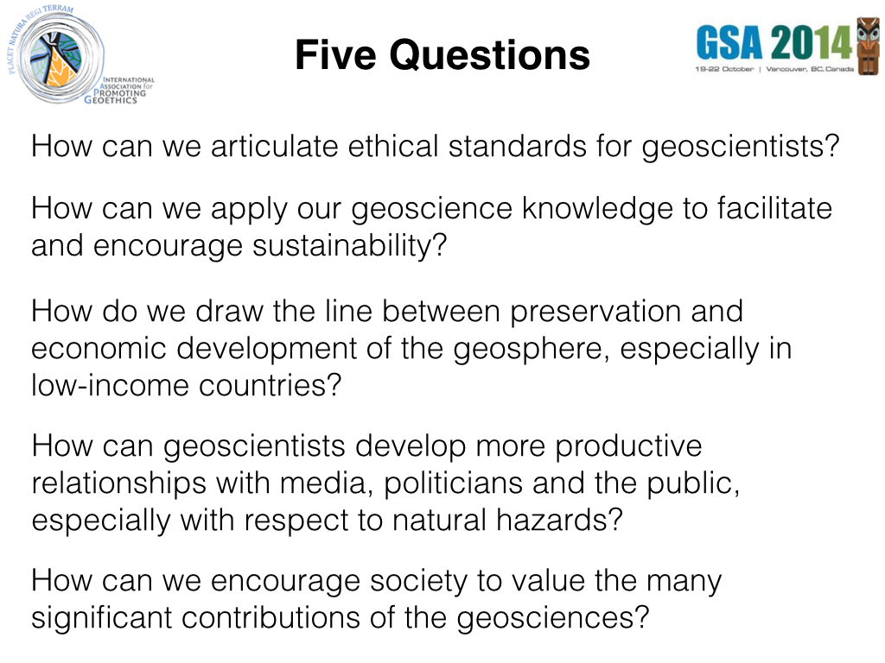
Notes:
(read slide)

Slide 30
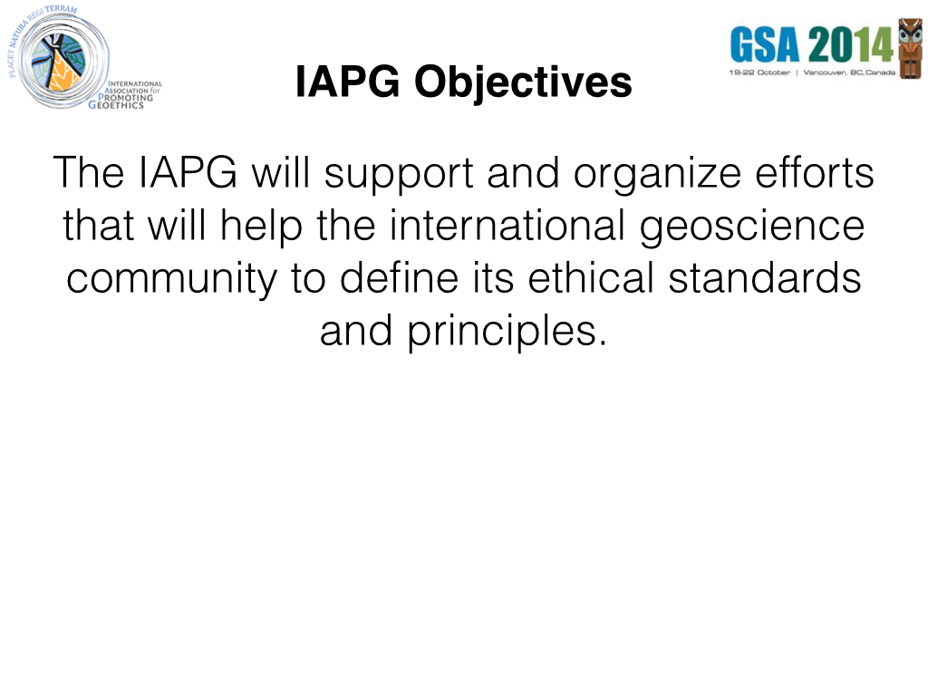
Notes:
(read slide)

Slide 31
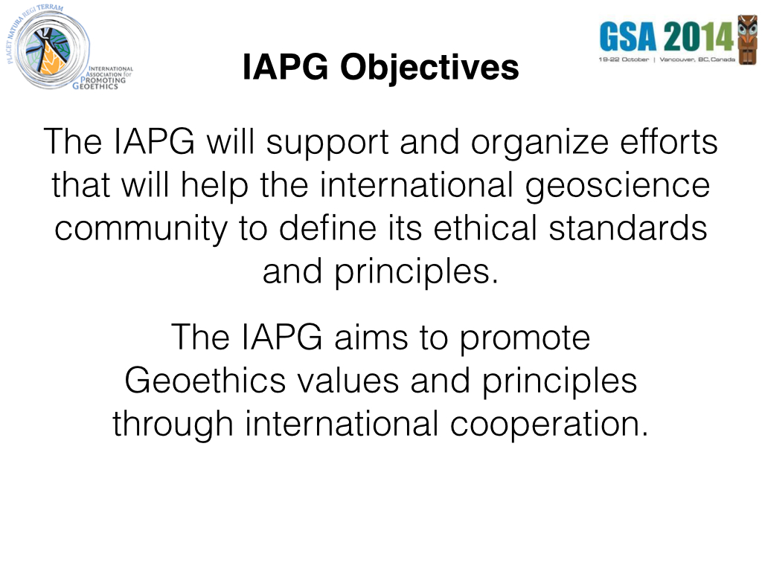
Notes:
(read slide)

Slide 32
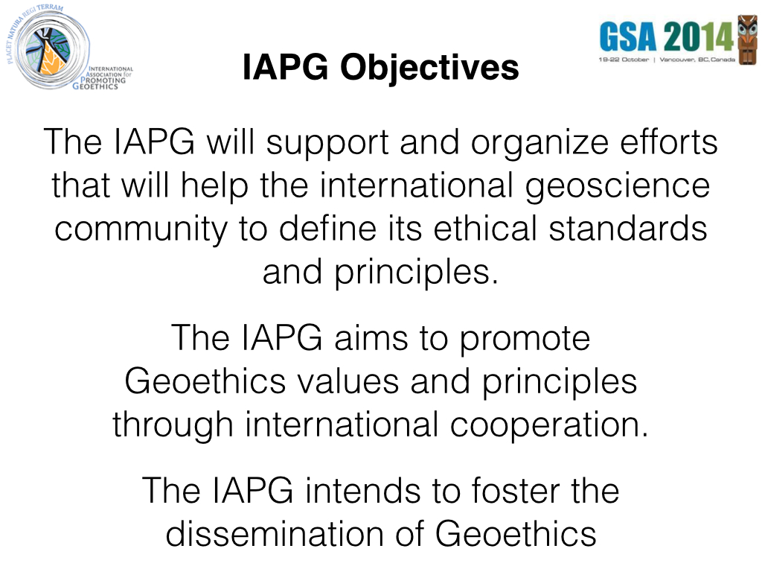
Notes:
(read slide)

Slide 33
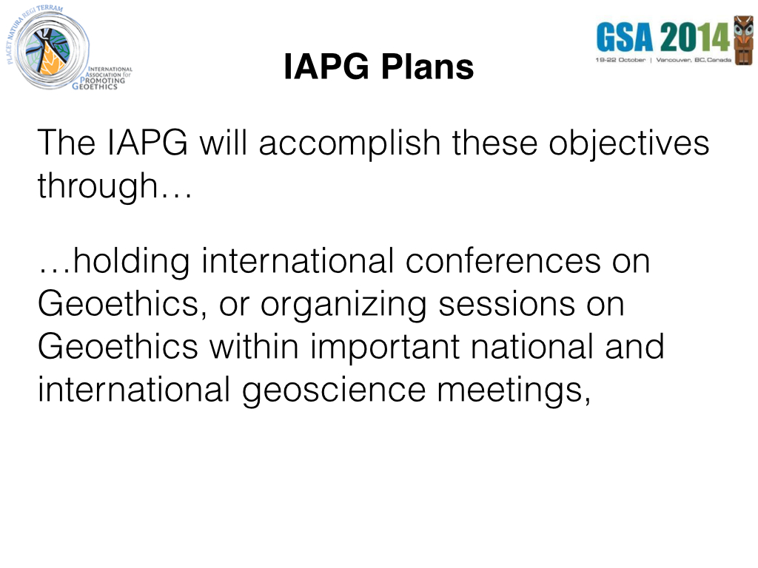
Notes:
(read slide)

Slide 34
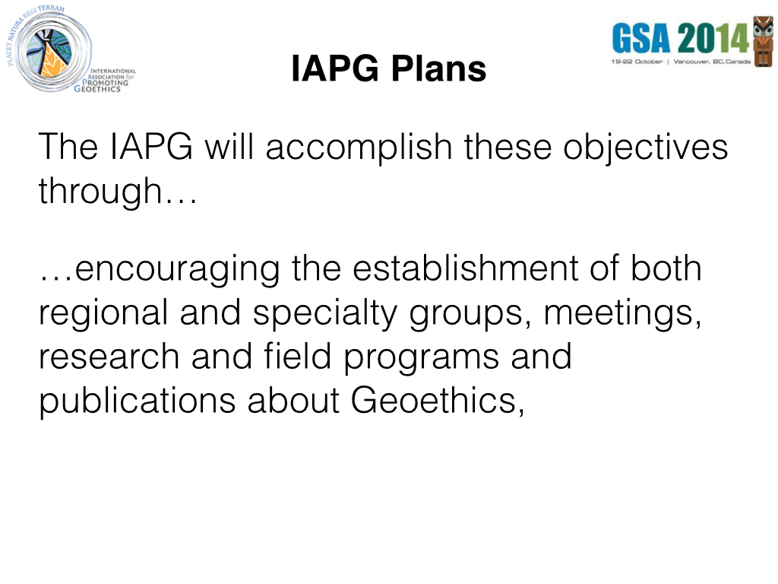
Notes:
(read slide)

Slide 35
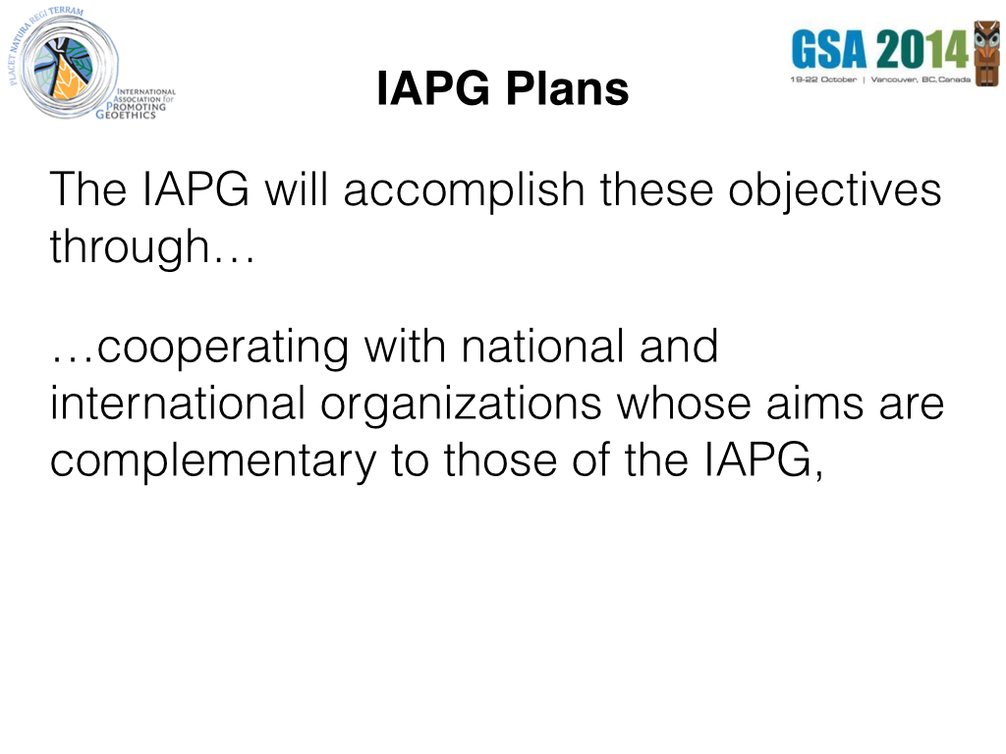
Notes:
(read slide)

Slide 36
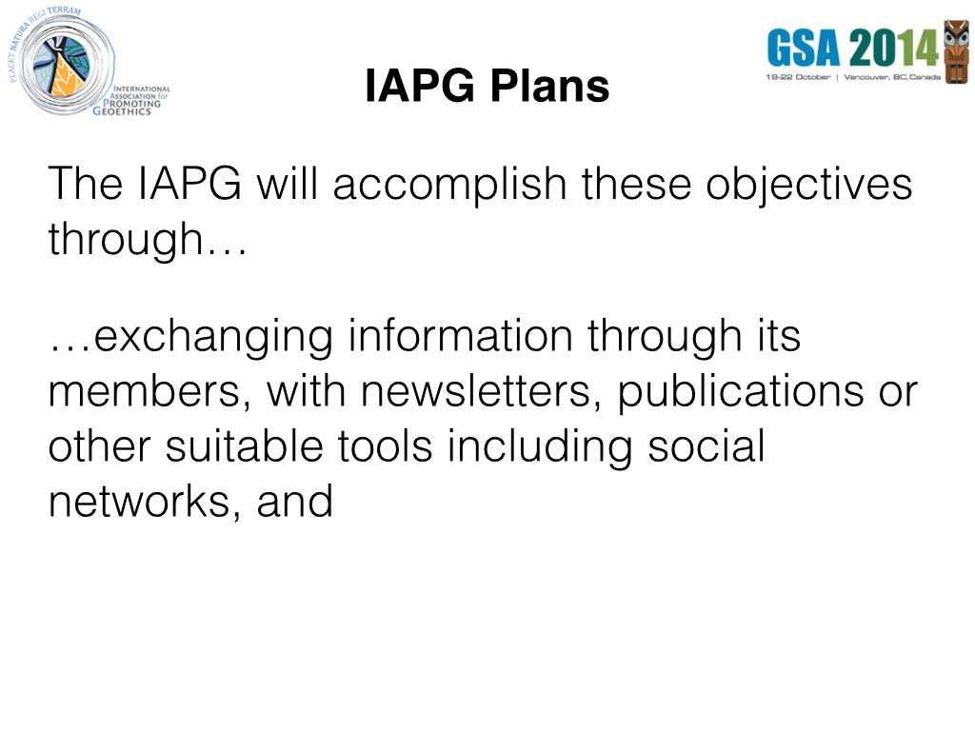
Notes:
(read slide)

Slide 37
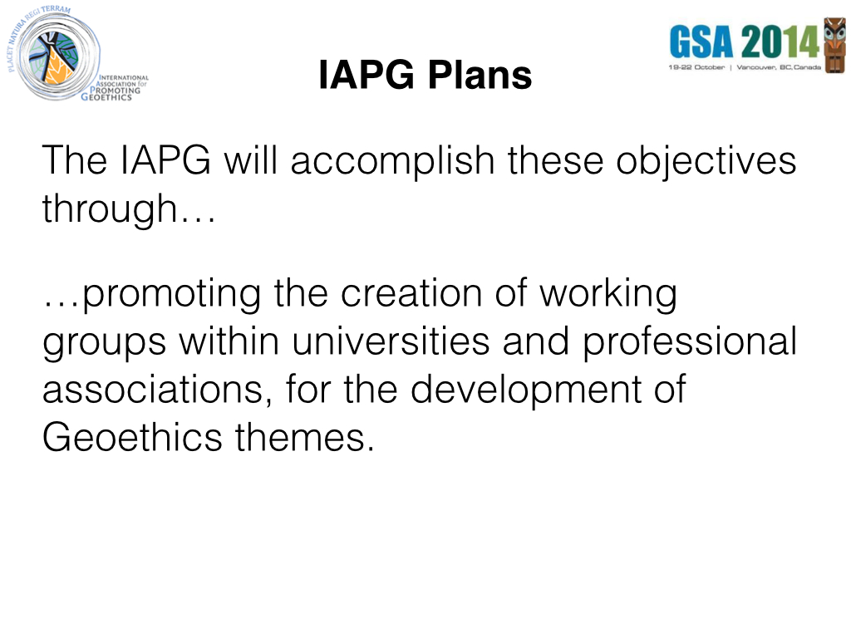
Notes:
(read slide)

Slide 38
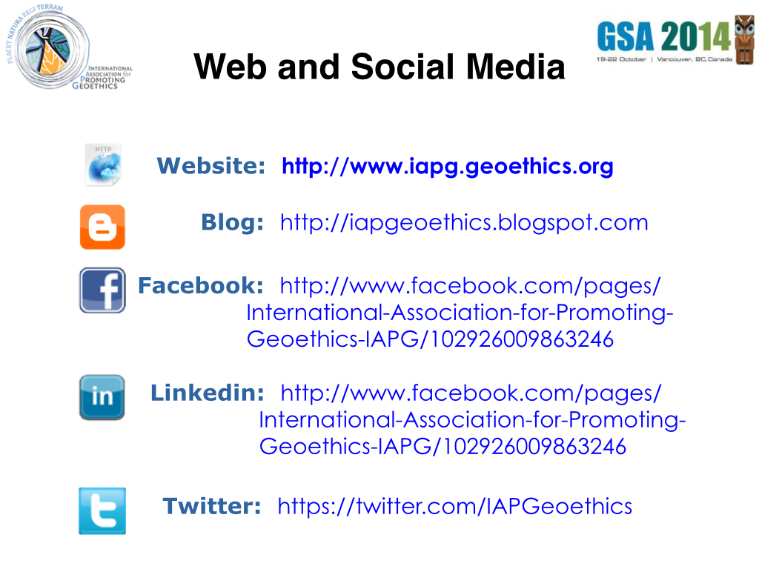
Notes:
The IAPG has developed lines of communication to its worldwide community through its website, www.iapg.geoethics.org, as well as throught a blog, Facebook page, and presence on Linkedin and Twitter.

Slide 39
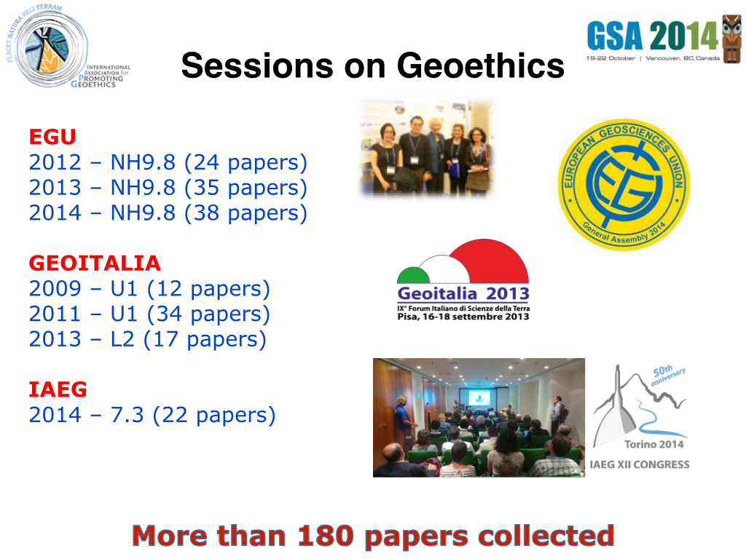
Notes:
We have already convened seven sessions at three international geoscience meetings, including sessions over three years at the European Geolsciences Union, three years of sessions at GeoItalia, and a session earlier this year at the International Association of Engineering Geosciences. More than 180 papers have been presented at these sessions.

Slide 40
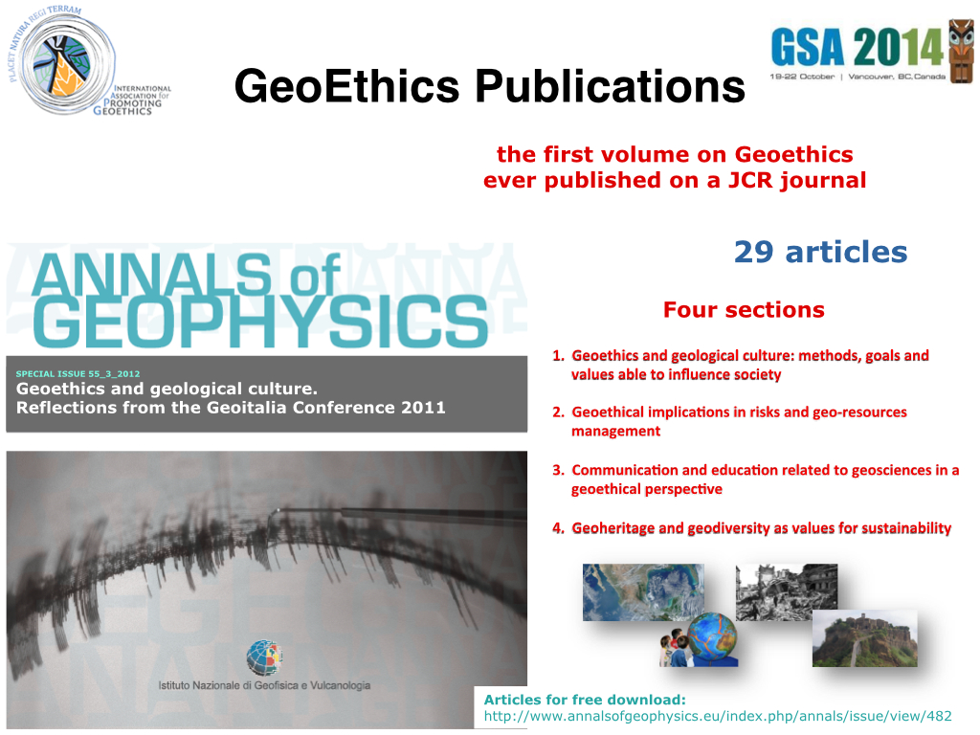
Notes:
Based on a proposal from IAPG, a special volume of Annals of Geophysics was entirely dedicated to GeoEthics -- the first such special volume ever published in a JCR journal. Annals of Geophysics is a peer reviewed journal. The special volume has 29 articles arranged in 4 sections:
1) Geoethics and geological culture: methods, goals and values able to influence society.
2) Geoethical implications in risks and geo-resources management.
3) Communication and education related to geosciences in a geoethical perspective.
4) Geoheritage and geodiversity as values for sustainability.

Slide 41
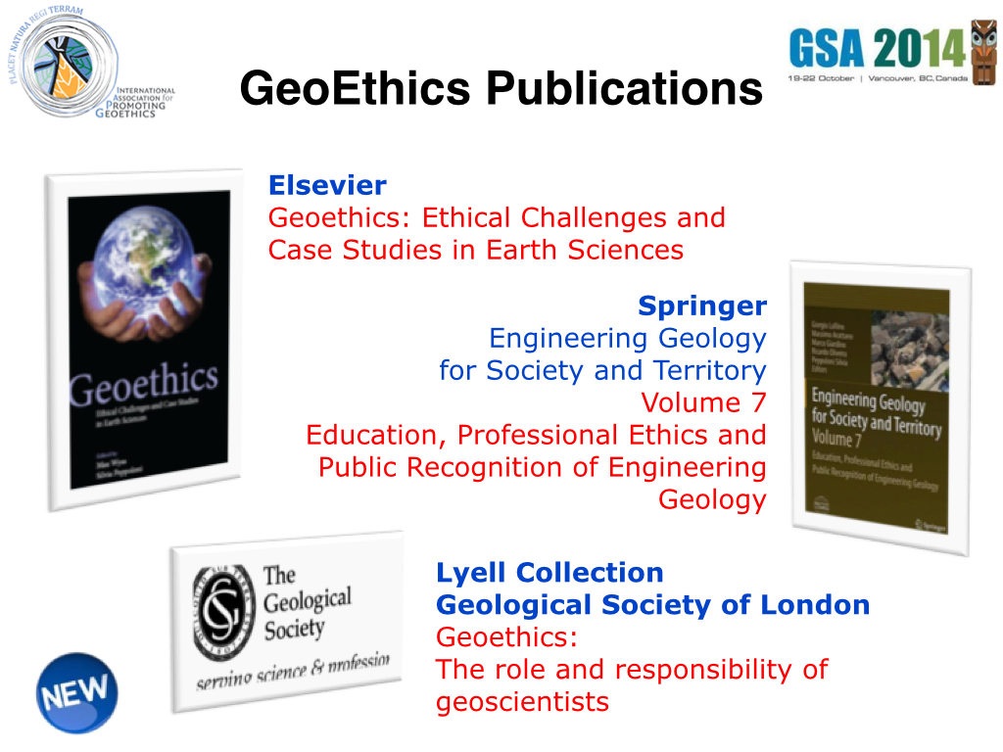
Notes:
There are further, really important, initiatives in publishing related to Geoethics. In particular the publication of several peer-reviewed scientific articles and books, including...
1) Geoethics: Ethical Challenges and Case Studies in Earth Sciences (that will be published by December 2014 by Elsevier), edited by Max Wyss and Silvia Peppoloni.
2) Geoethics: The role and Responsibility of Geoscientists (by Geological Society of London in the Lyell Collection), edited by Silvia Peppoloni and Giuseppe Di Capua.
3) Engineering Geology for Society and Territory – Volume 7: Education, Professional Ethics and Public Recognition of Engineering Geology (just published with Springer among volumes dedicated to the IAEG congress).

Slide 42
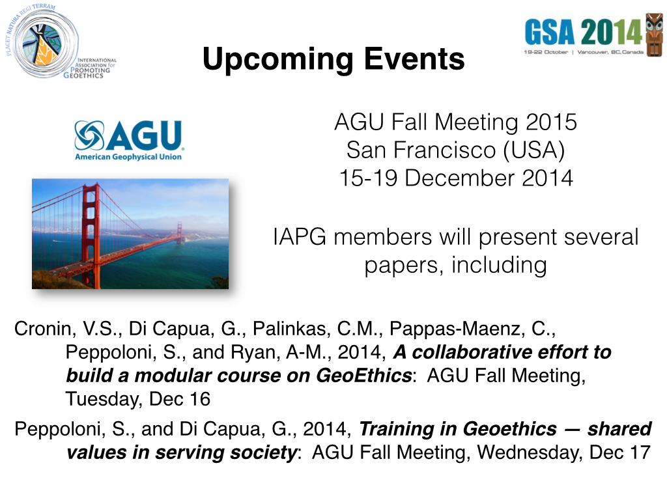
Notes:
IAPG will be at the AGU Fall Meeting in San Francisco, where members will present several papers including a paper by Silvia Peppoloni and Giuseppe DiCapua on “training in geoethics – shared values in serving society,” as well as a report from an international group of geoscientists on a collaborative effort to build a modular course on Geoethics. This group is working to create a variety of educational resources that can be inserted throughout the geoscience curriculum, ranging from short case studies to longer exercises to 2- or 3-week modules to an entire modular course on geoethics. We will gratefully accept any insights or assistance you might be able to provide in this effort.

Slide 43
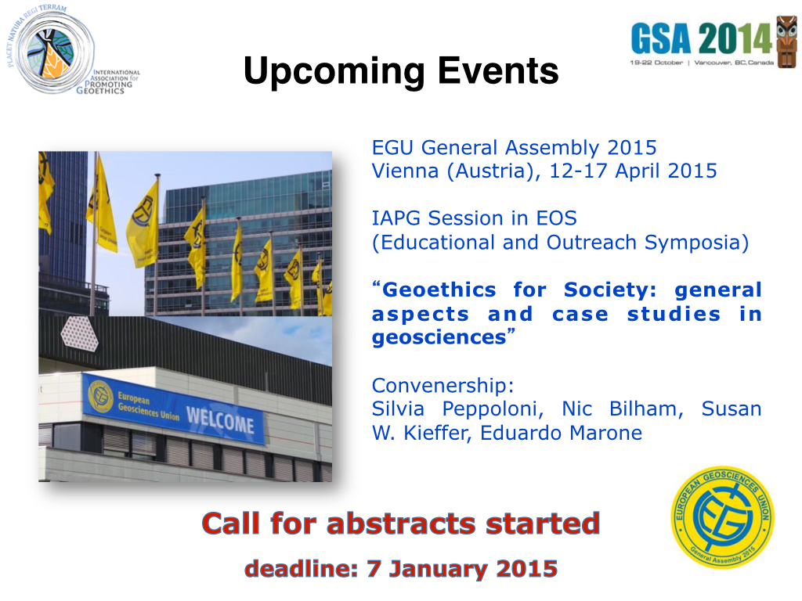
Notes:
IAPG will also be at the EGU General Assembly next Spring, where we will host a session on “Geoethics for Society: general aspects and case studies in geosciencs.” The call for abstracts is open until January 7, so perhaps we will see you there.

Slide 44
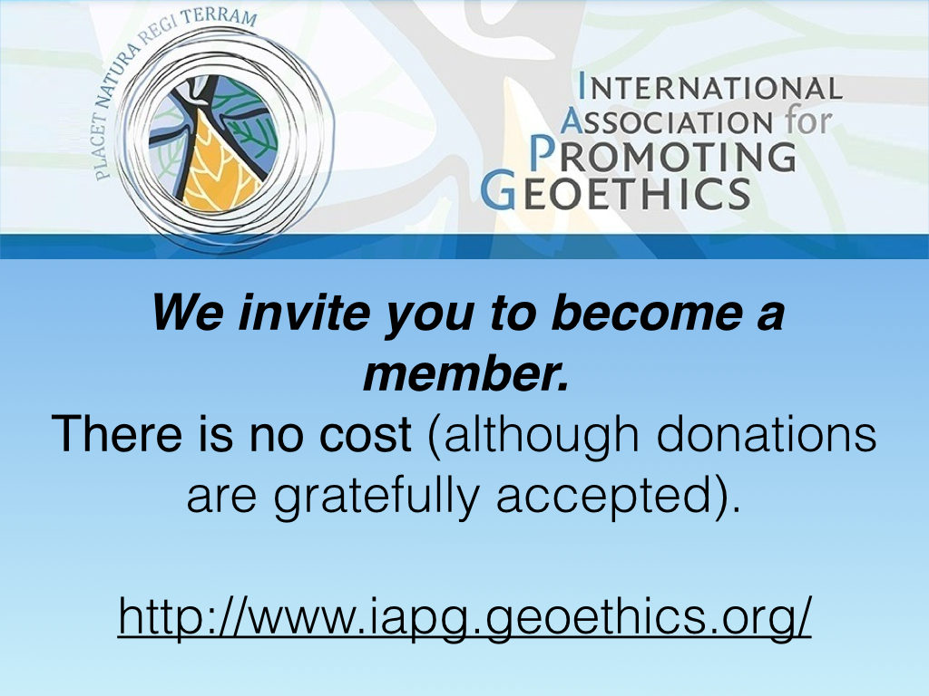
Notes:
We believe that the task of our association is not to judge, is not to decide what is right and what is wrong. We are not the “guardians of the truth.” The task of the IAPG is to promote a free and honest debate in the scientific community on ethical issues in Geosciences and to understand how to orient decisions; what tools to use. These goals need the involvement of the geological community as a whole.
So we invite YOU to become a member of the International Association for Promoting Geoethics. There is no membership fee, although donations are gratefully accepted.
Thank you for your attention.

