Slide 1

TECTONIC DEFORMATION OF THE PANDORA PEAK UNIT INFERRED BY FOLDING AT HARLING POINT, VICTORIA, BC: IMPLICATIONS FOR THE PACIFIC RIM TERRANE
Gerri McEwen, University of Victoria
Stephen T. Johnston, University of Victoria
Notes:
Good afternoon. My name is Gerri McEwen. I am a recent graduate of the University of Victoria and for my undergraduate thesis I worked under the supervision of Professor Stephen Johnston to devise a tectonic model explaining the deformation observed at Harling Point on the southern tip of Vancouver Island.

Slide 2
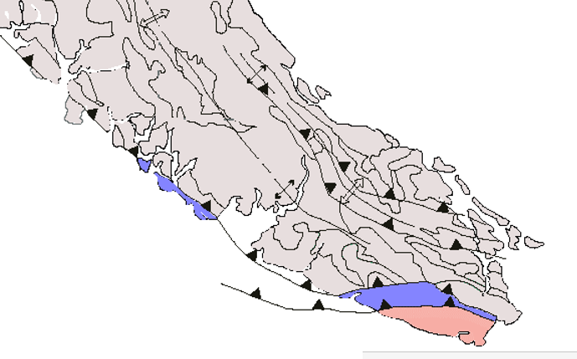
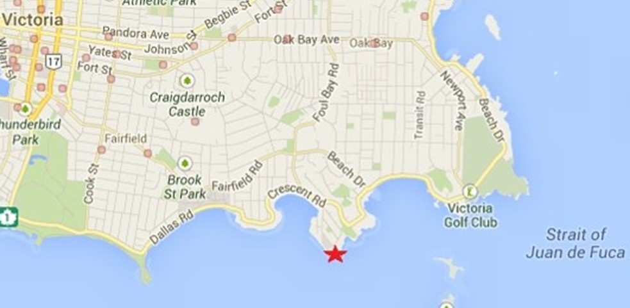
Southern Vancouver Island
Harling Point
Google Maps
Victoria, BC
http://web.mala.bc.ca/earle/mal-cut/geology-of-vancouver-island.ppt
Notes:
Harling Point is a small outcrop along the shores of Victoria. It is mapped as belonging to the Jura-Cretaceous Pandora Peak Unit, a subunit of the Pacific Rim Terrane which lies along the western margin and wraps around the southern tip of Vancouver Island. The PRT is sandwiched between rocks of the Wrangellia terrane to the northeast which forms the majority of Vancouver Island and the Crescent Terrane to the south.

Slide 3
Johns et al, 2012
Notes:
In southeast Victoria, partly retrograded amphibolites of the Wark-Colquitz complex overlie locally cataclastic lawsonite-bearing Pandora Peak rocks along the newly discovered Trial Islands thrust. The Pandora Peak terrane was emplaced during a major Late Cretaceous or early Tertiary tectonic event that modified and probably truncated the southern margin of the Wrangellia terrane. Following this event the Leech River complex was faulted against the southern margin of the Pandora Peak terrane near Port Renfrew and in Goldstream Park in the Late Eocene or Early Oligocene.

Slide 4
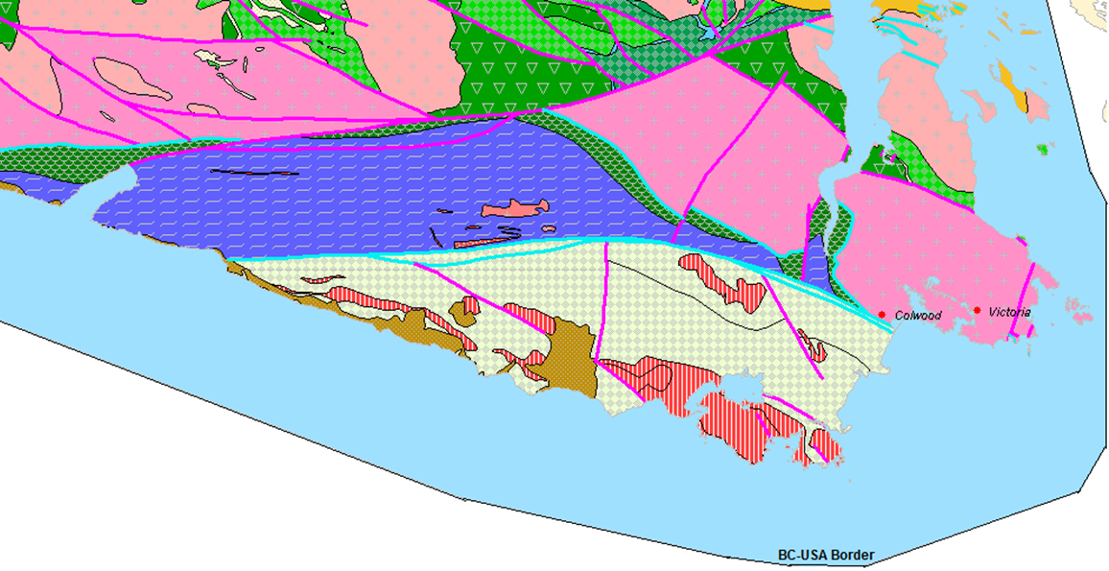
BCGS mapplace.ca
Notes:
"Melange" is a general term describing a mappable (at 1:25,000 or smaller scale), internally fragmented and mixed rock body containing a variety of blocks, commonly in a pervasively deformed matrix. The term refers to rock mixtures formed by tectonic movements, sedimentary sliding, or any combination of such processes, with no mixing process excluded. It does not imply a particular mixing process. "Melange" is a handy descriptive term, alerting the reader to the possibility that such a body may not conform to classic principles of superposition and stratigraphic succession. Type II consists of similarly deformed, thin layers of green tuff, radiolarian ribbon chert, and minor sandstone originally interbedded with black mudstone. Disruption in both types I and II, which probably occurred while the sediments were incompletely consolidated, has been ascribed to either imbricate
faulting in accretionary wedges or gravitationally driven deformation.

Slide 5
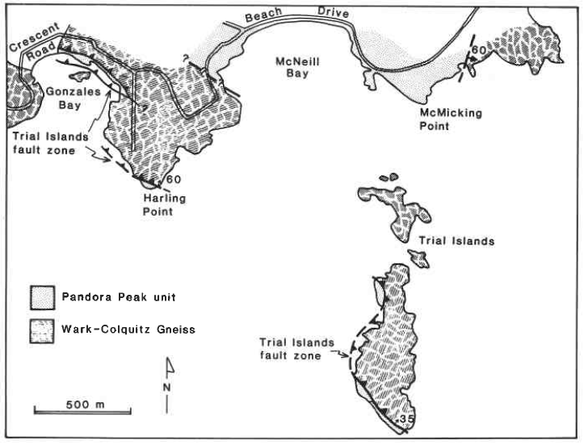
Rusmore and Cowen, 1985

Slide 6
BCGS mapplace.ca
Notes:
"Melange" is a general term describing a mappable (at 1:25,000 or smaller scale), internally fragmented and mixed rock body containing a variety of blocks, commonly in a pervasively deformed matrix. The term refers to rock mixtures formed by tectonic movements, sedimentary sliding, or any combination of such processes, with no mixing process excluded. It does not imply a particular mixing process. "Melange" is a handy descriptive term, alerting the reader to the possibility that such a body may not conform to classic principles of superposition and stratigraphic succession. Type II consists of similarly deformed, thin layers of green tuff, radiolarian ribbon chert, and minor sandstone originally interbedded with black mudstone. Disruption in both types I and II, which probably occurred while the sediments were incompletely consolidated, has been ascribed to either imbricate
faulting in accretionary wedges or gravitationally driven deformation.

Slide 7
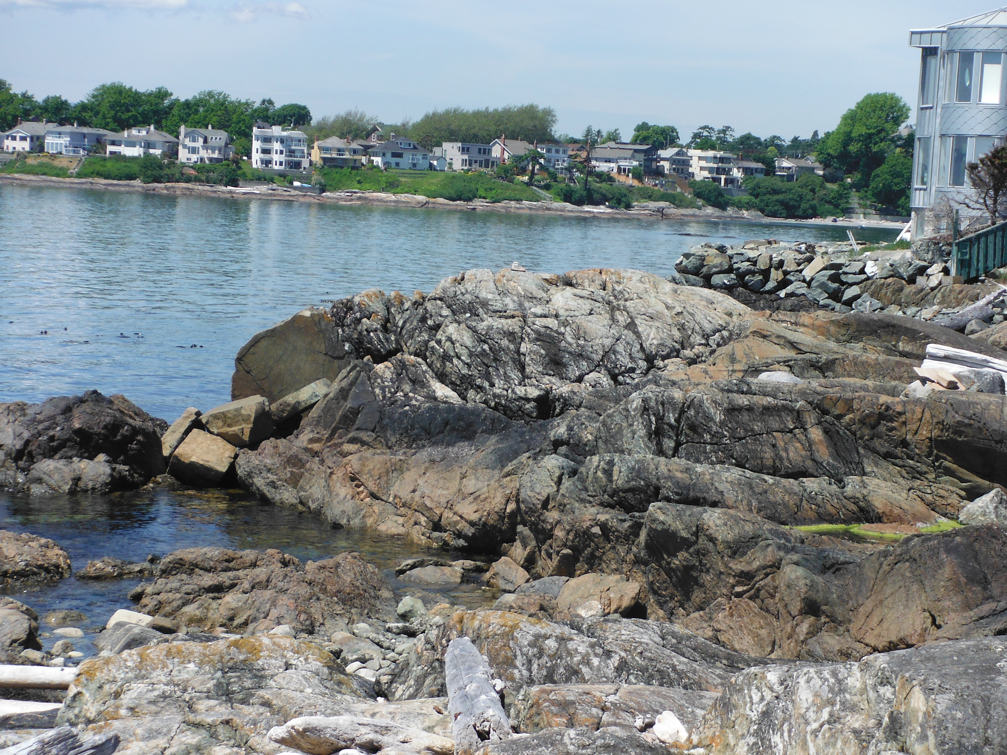
Project Objectives
The Project:
Perform detailed mapping and structural analysis of the rocks at Harling Point.
Goals:
Identify the stratigraphic and structural relationships between the units .
Devise a model for formation and deformation of the package that can help us understand the complex history of the outboard portion of the Cordilleran orogen
Notes:
A detailed understanding of these rocks and their correlations to adjacent rock units will help to further understand the complex history of the outboard portion of the Cordilleran orogen.

Slide 8
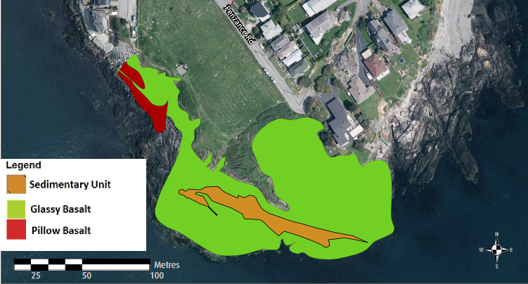
Notes:
There are 3 distinct rock units at Harling Point: a pillowed metabasalt which is constrained to the NW end of the outcrop forms the uppermost structural position; a tuffaceous metabasalt comprises the majority of the outcrop; and the lowest structural unit is a sedimentary package which forms a narrow strip down the center.

Slide 9
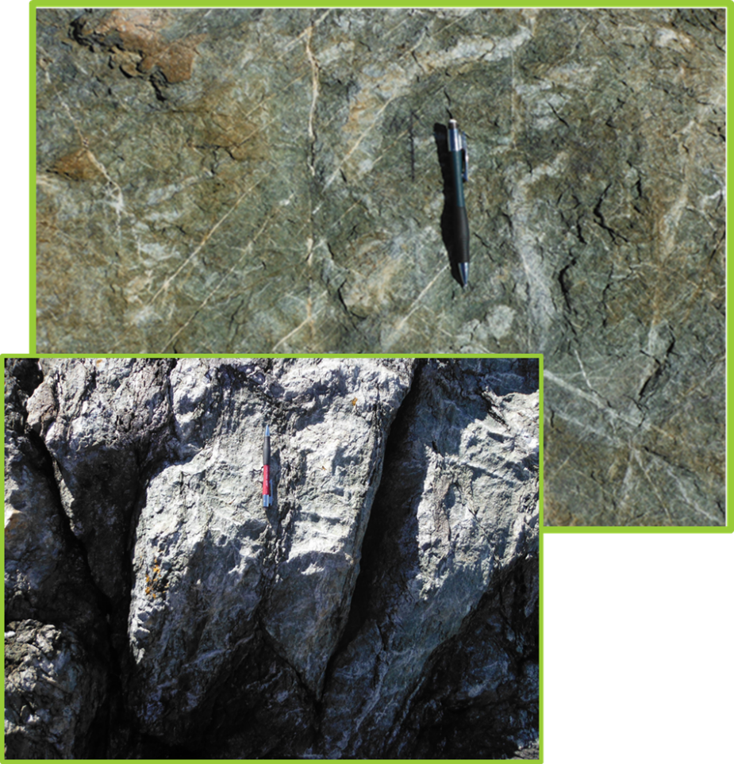
Pillowed Meta-Basalt
Light green
Quartz Veining
Dark Grey weathering
Mineralogy
Plagioclase
Epidote
Chlorite
Calcite

Slide 11
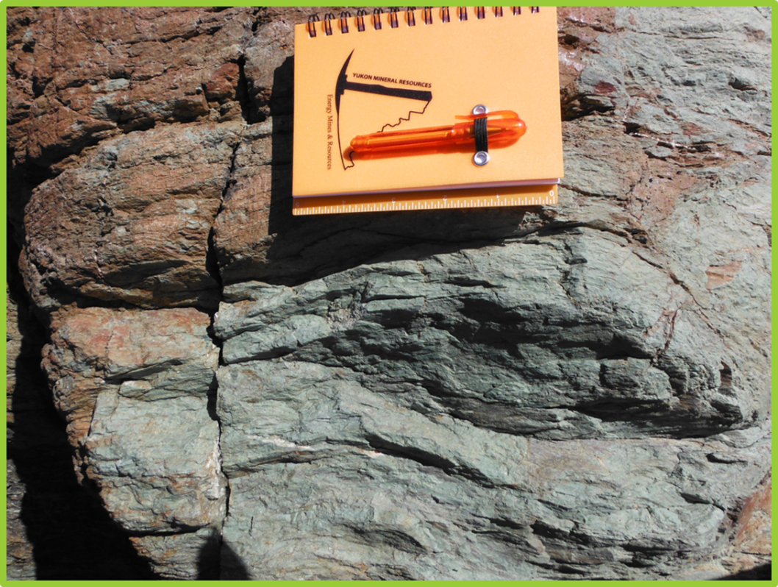
Tuffaceous Metabasalt
Fine-grained
Finely laminated
Lacks extensive veining
Reddish orange weathering
Mineralogy:
Plagioclase
Epidote
Chlorite
Calcite

Slide 13
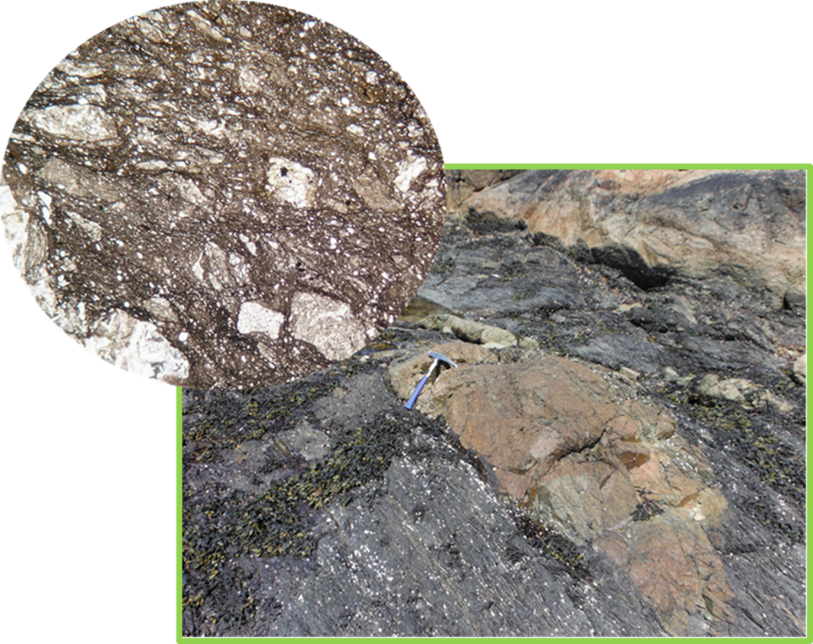
Sedimentary Unit
Black fine grained sandstone
Schistose foliation
Angular to sub-angular lithic fragments
Overlying tuffaceous unit
Basalt, Limestone, Greywacke
Youngest unit
Notes:
These rocks appear to form a coherent package indicative of an ocean floor sequence of pillowed basalts overlain by volcanic tuff and terrigenous sediments. The fact that the sedimentary unit contains large blocks of the overlying tuffaceous unit indicates that the sediments are the youngest.

Slide 14
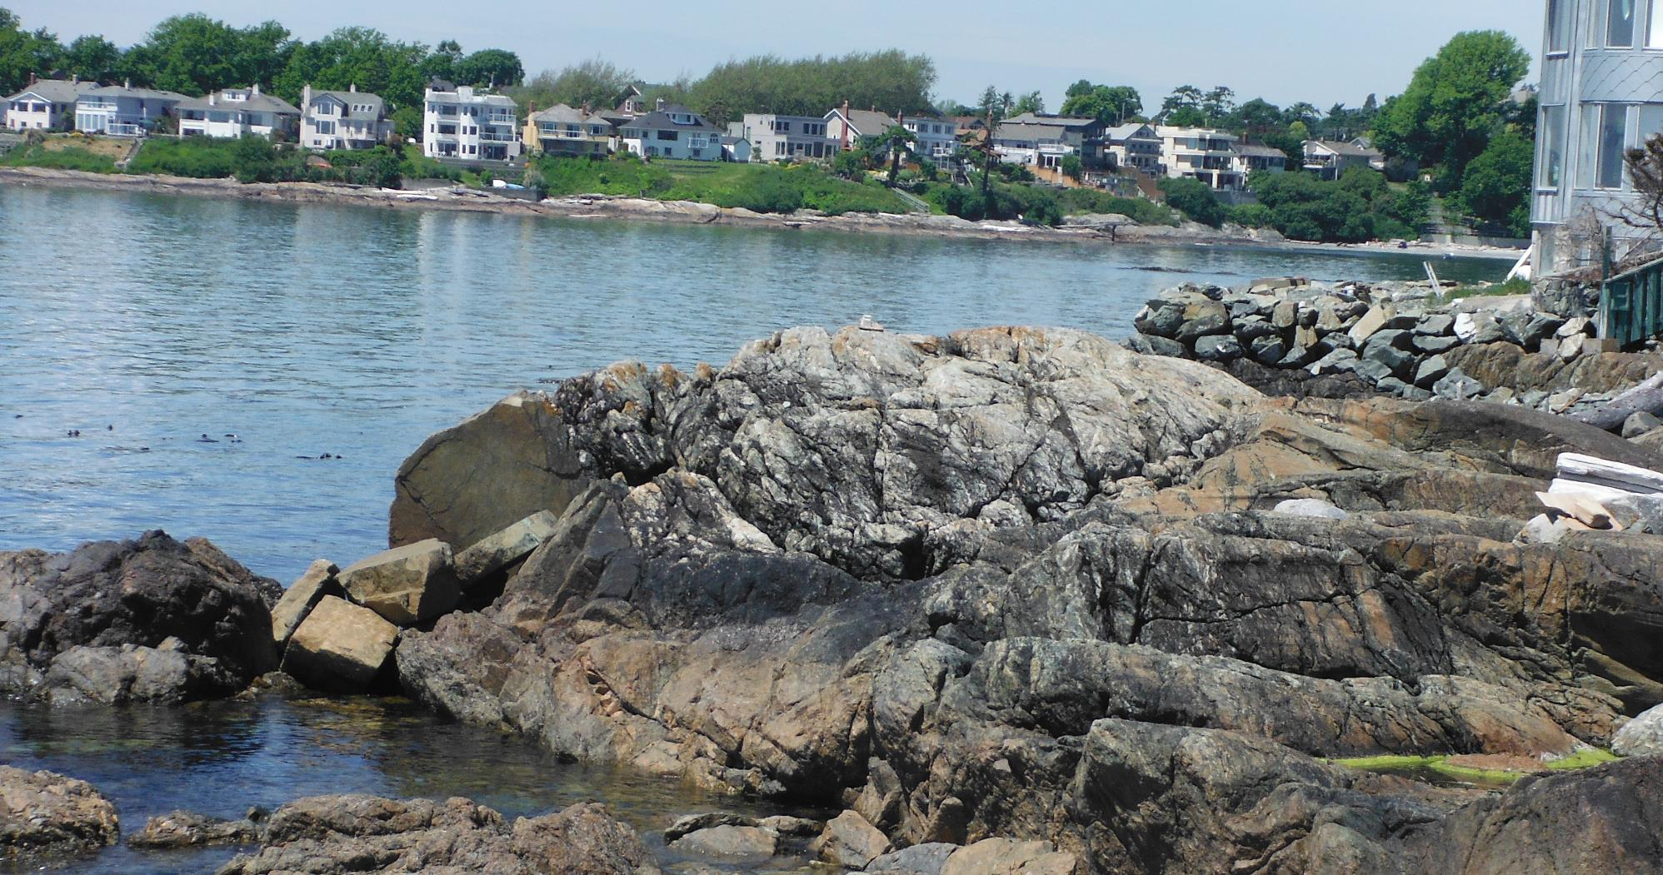

Slide 15
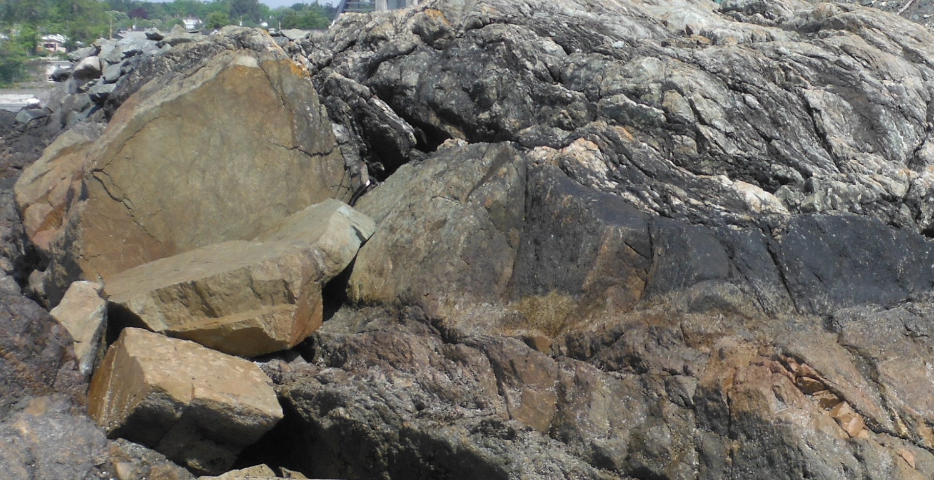
Notes:
A tight to isoclinal fold formed by D1.

Slide 16
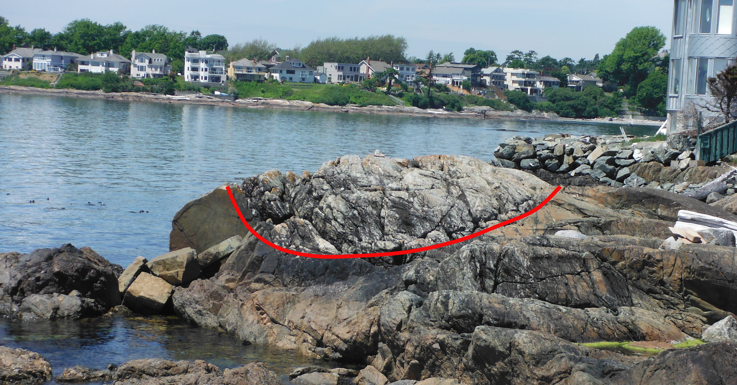
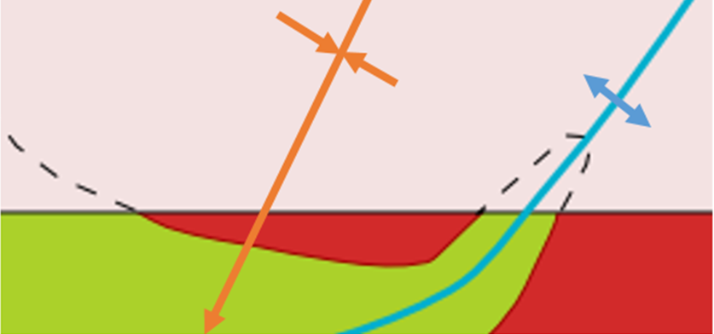
Notes:
The pillow basalt is preserved in a syncline formed by D2. The pillow basalt structurally overlies the tuffaceous unit which is older than the sedimentary unit indicating this entire package is overturned.

Slide 17
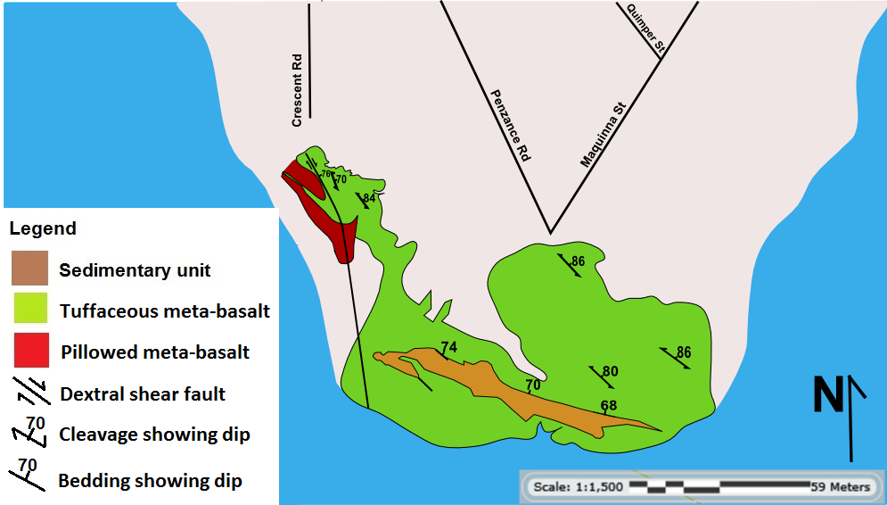
Structural Features
Notes:
Folds are subhorizontal to gently east plunging.

Slide 18
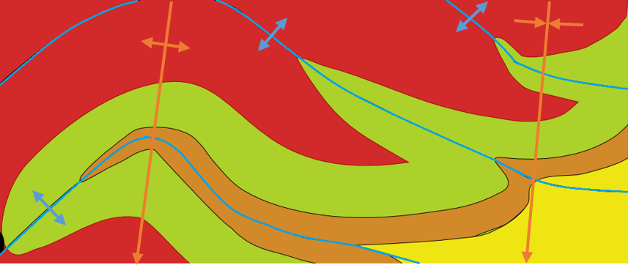
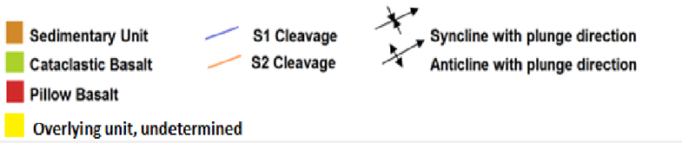

Slide 19
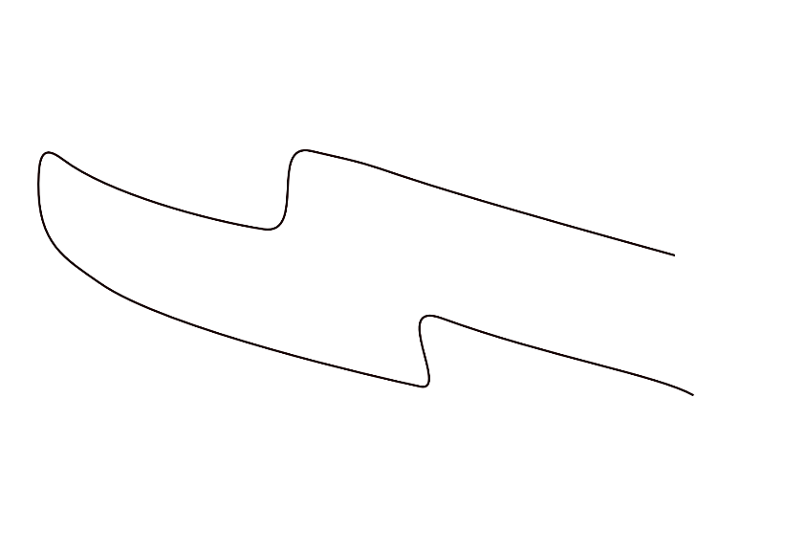
Two Folding Events
F1: North-Verging Nappe
F2: South-Verging Asymmetric Fold
http://www.files.ethz.ch/structuralgeology/JPB/files/English/8folds.pdf
Notes:
The rocks at Harling Point were deformed as a cohesive unit and do not have the characteristics of a tectonically mixed melange. Soft sediment deformation is restricted to the sedimentary unit suggesting that it was incompletely lithified at the time of nappe formation but cohesive enough to form a schistose fabric upon deformation.

Slide 20
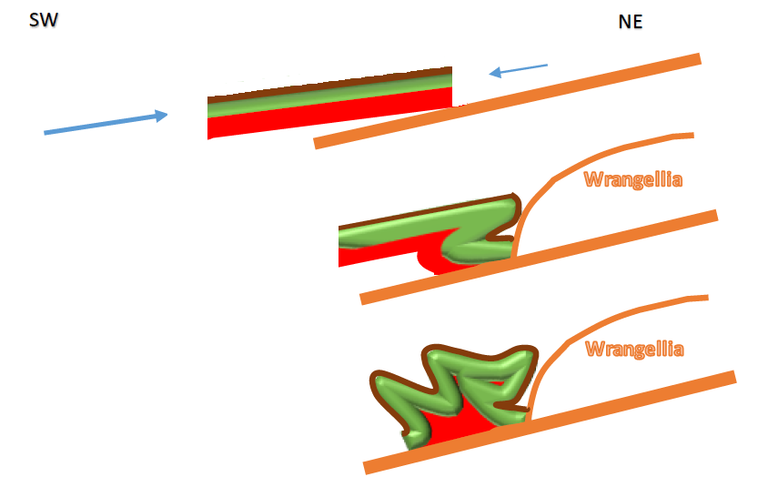
Sequence of events

Slide 21
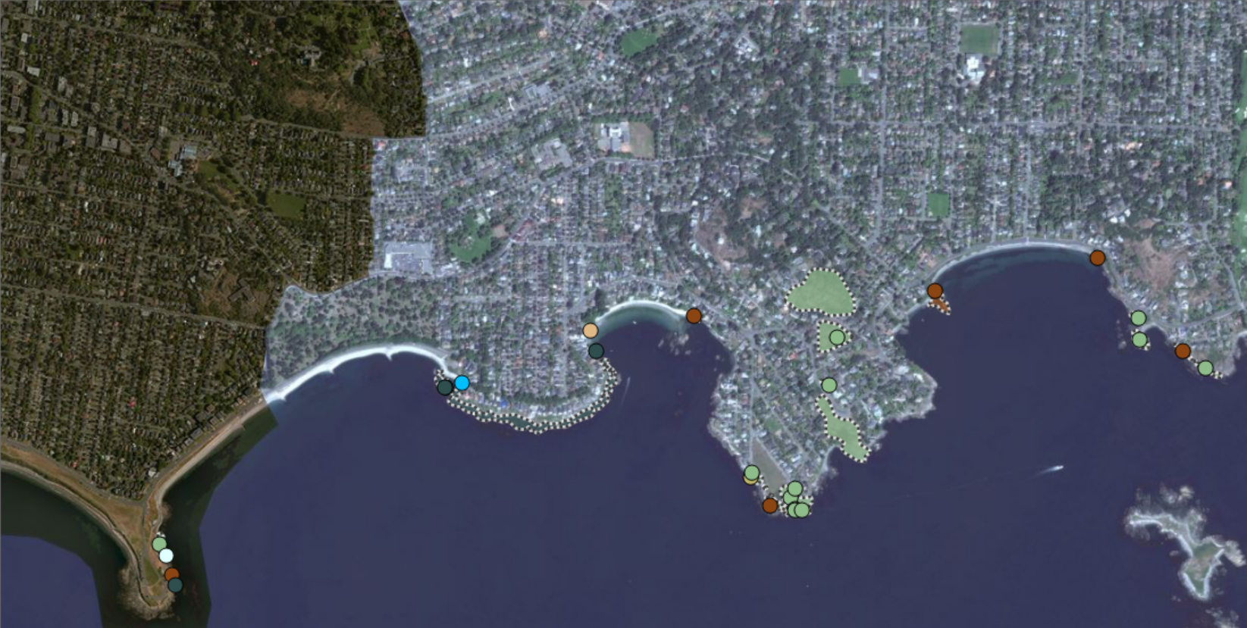
N
Harling Point
Mylonite zone
Notes:
The Pandora Peak Unit lies at the inboard margin of the Pacific Rim terrane. It has been interpreted as an accretionary mélange consisting of discontinuous and irregular beds and blocks of black mudstone, terrigenous greywacke, radiolarian ribbon chert, green tuff, and metabasaltic greenstone, with lesser amounts of pebbly mudstone and isolated limestone blocks. In the Port Renfrew area it lies in stratigraphic contact with the multiply-deformed Leech River formation is documented as exhibiting no evidence of folding itself.

Slide 22
Summary
Three rock units representing an intact segment of an ocean floor stratigraphic sequence
Harling Point rocks are in the overturned limb of an asymmetrically refolded N-verging recumbent nappe
Fault contact with Wrangellia must lie further inland
Rocks related to HP can be traced westward to a mylonite zone where rocks of Wrangellia form the footwall

Slide 23
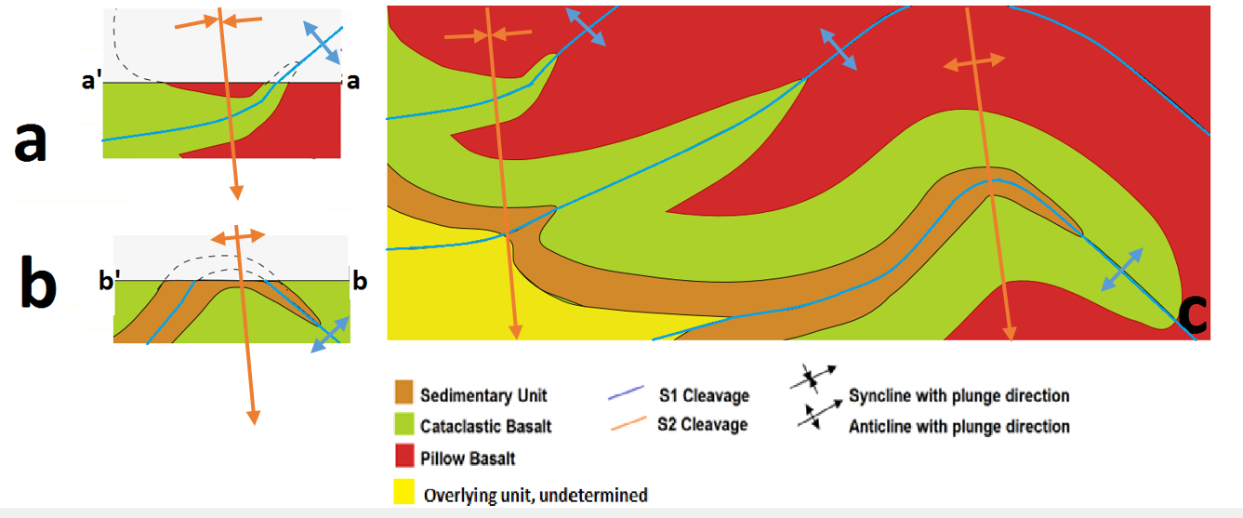
Thank You

