Slide 1
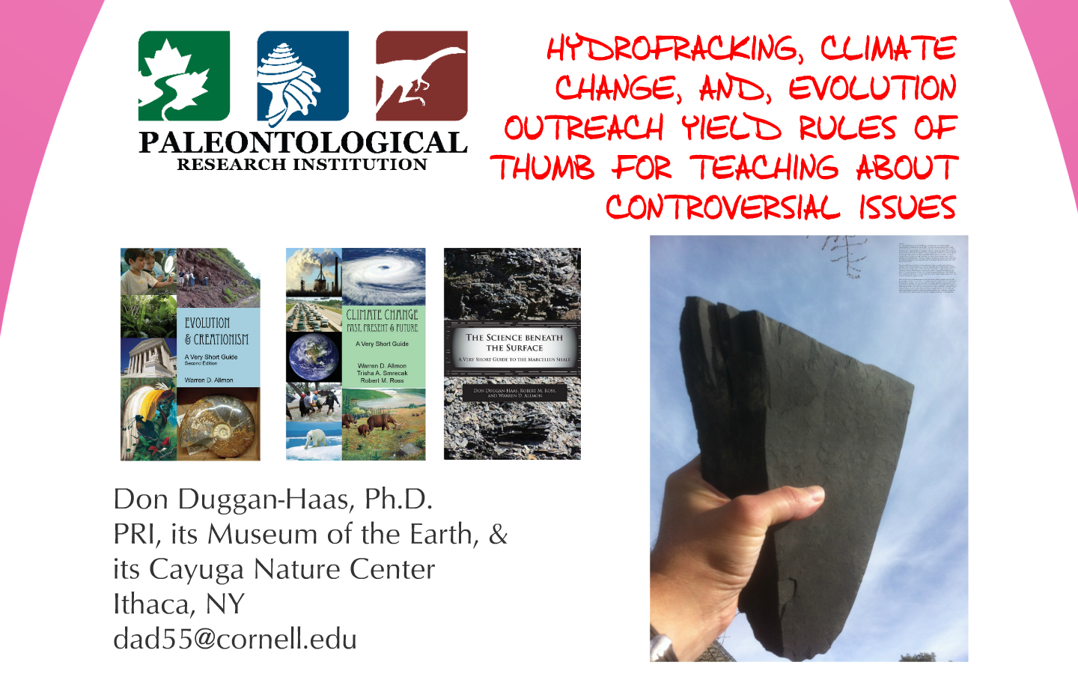
HYDROFRACKING, CLIMATE CHANGE, AND, EVOLUTION OUTREACH YIELD RULES OF THUMB FOR TEACHING ABOUT CONTROVERSIAL ISSUES
Don Duggan-Haas, PhD
Robert M. Ross, PhD
The Paleontological Research Institution
Ithaca, NY
dad55@cornell.edu

Slide 2
Find the presentation’s Prezi online here:
http://bit.ly/controversy2014

