Slide 1

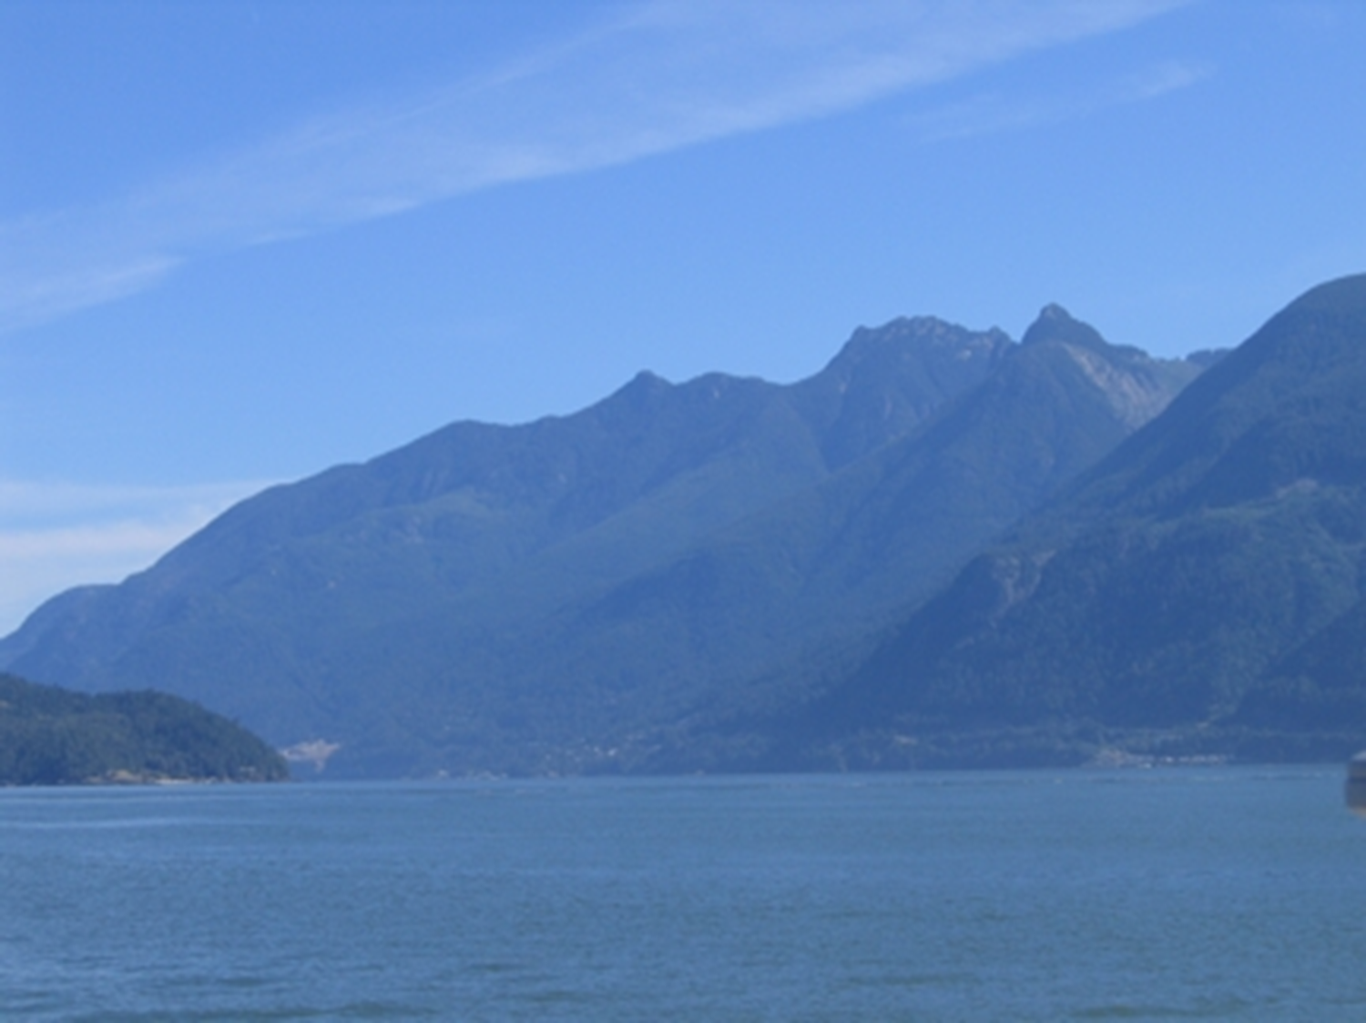
PARAGLACIAL SEDIMENTATION IN VANCOUVER’S NEIGHBOURING FIORD, HOWE SOUND, AND ITS IMPLICATIONS FOR EVALUATING FIORD TSUNAMI HAZARD
Lionel E. Jackson, Jr.
Geological Survey of Canada, Vancouver, British Columbia, Canada
Simon Fraser University, Burnaby, British Columbia, Canada
Andrée Blais-Stevens
Geological Survey of Canada, Ottawa, Ontario, Canada
Reginald L. Hermanns
Norges Geologiske Undersøkelse (NGU), Trondheim, Norway
Courtney E. Jermyn
Vlaardingen, Netherlands

Slide 2

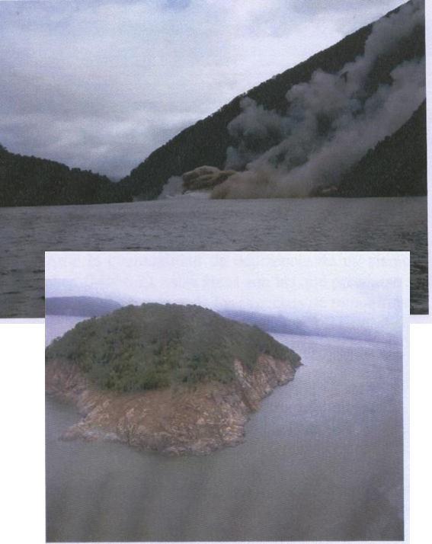
Canada’s west coast ports are situated within fjords
The fjord-indented coast of British Columbia (BC), Canada is comparable to that of Norway where fjord tsunamis triggered by rock slides are a known hazard.
Like the fiords of southern Chile, the BC coast is situated along a plate margin subject to megathrust and crustal earthquakes that can act as triggers as well as hydrometeorological triggering.
The frequency of the fjord tsunami hazard is unknown from historical record. Oral tradition of indigenous people indicate that one village was completely obliterated in the late 1500s CE in a fjord 100 km north of Vancouver.
How do we determine if there is evidence of past fjord-side slope failures that may have created displacement waves?
Puerto Aisén, Chile
12 April, 2007

Slide 3
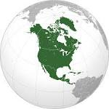
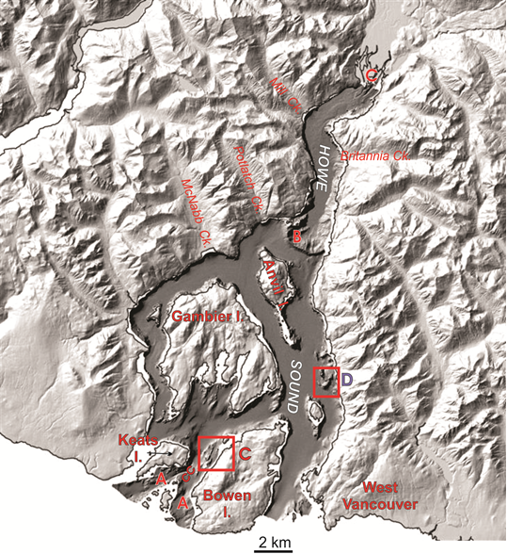
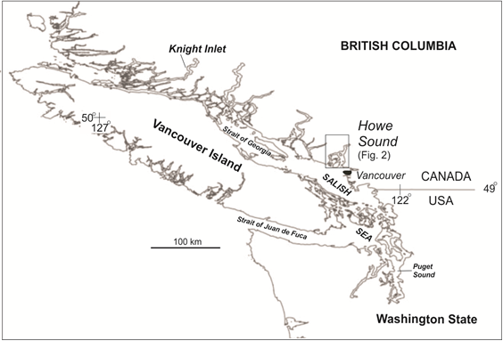

Squamish
River delta
Howe Sound
Study Area
Figure 1
--38 km north-south axis
--average width 6 km
--typical water depths 200-
250 m
--deglaciation by
glacier calving began
~15 kY BP
Figure 2
Vancouver

Slide 4
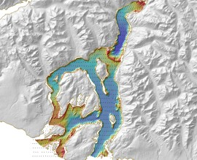
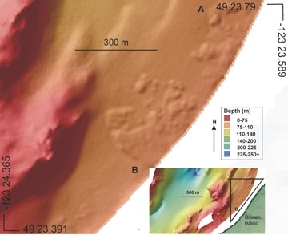
MSB used to image the sea floor of Howe Sound in the search for past displacement wave generating slope failures
Multibeam swath bathymetry (MSB) imaging was completed in 2007 for the Howe Sound, a large fjord immediately north of Vancouver. This provided an opportunity to search for the sea floor for land forms that suggest run-out of a slope failure.
Such deposits were seen along the west side of Bowen Island
This area was immediately offshore from a steep slope with evidence of instability.

Slide 5
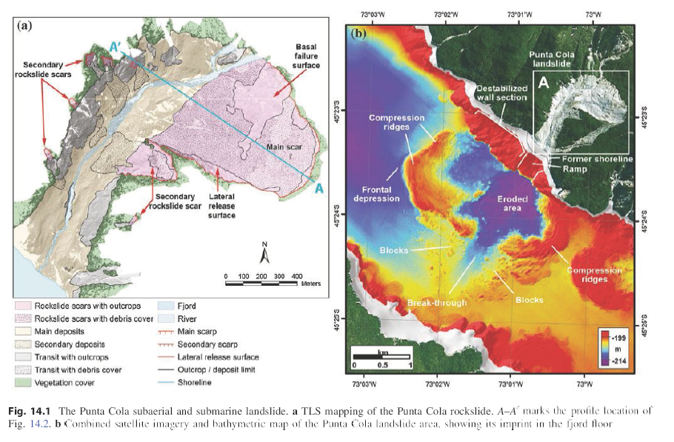
From Hermanns et al. 2014

Slide 6
Questions that we wanted to answer
What is the age(s) of the Bowen Island deposits? Were they large enough to trigger a displacement wave?
(post glacial debris flows; no, too small)
Because no similar deposits were recognized elsewhere on the Howe Sound sea floor, the logical question that we asked was “could it be that fast moving landslides have entered Howe Sound in the past but their deposits are buried by sediment and are not visible to SMB”?
(Little was known about the rates and patterns of sedimentation during the Holocene in Howe Sound when we began this study).

Slide 7
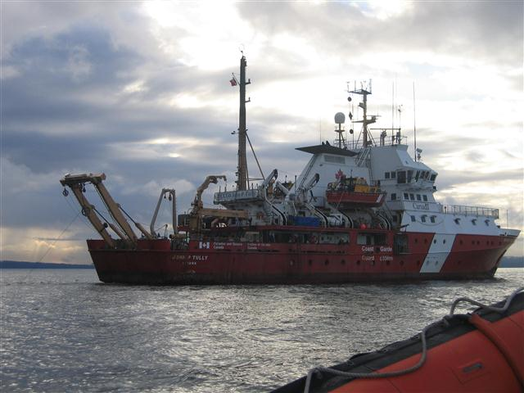
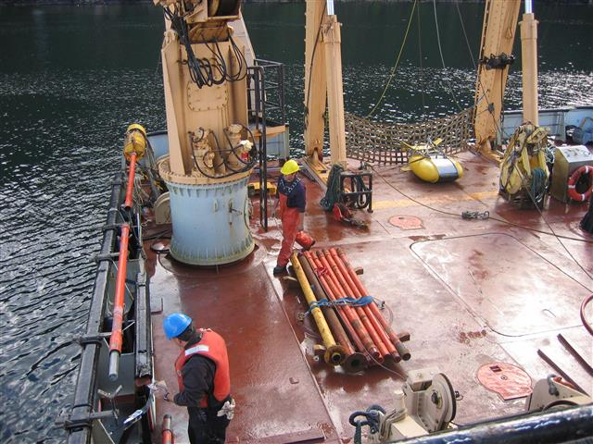
No sediment cores had been collected from the bottom sediments of Howe Sound prior to our study in 2007. Only dredge samples had been taken.
CCGS John P. Tully
Retrieving cores from the
Benthos piston corer

Slide 8
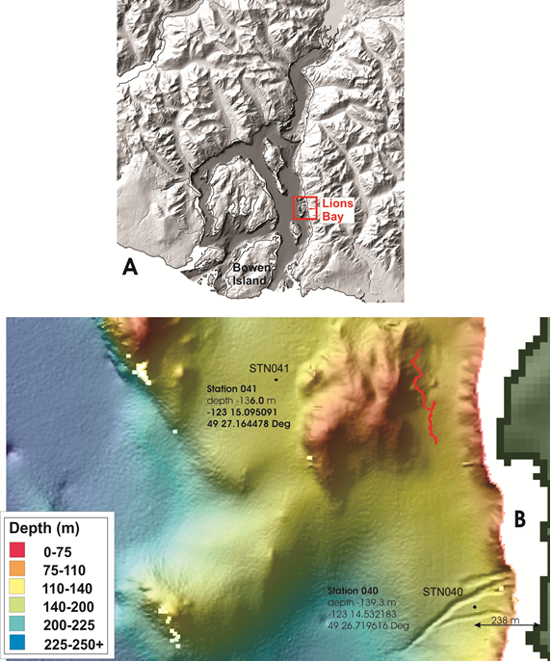
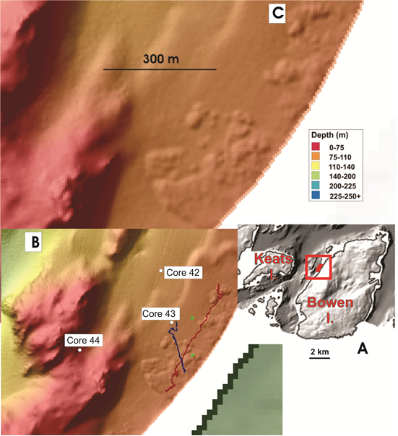
Bowen Island/Collingwood Channel
Lions Bay offshore
Collingwood
Channel

Slide 9
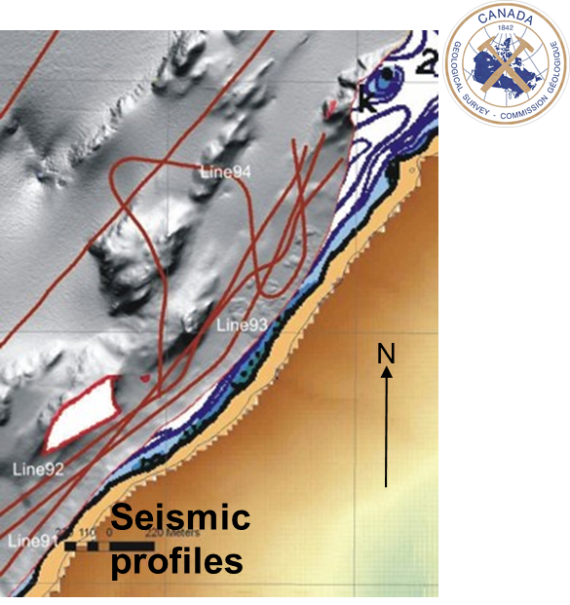
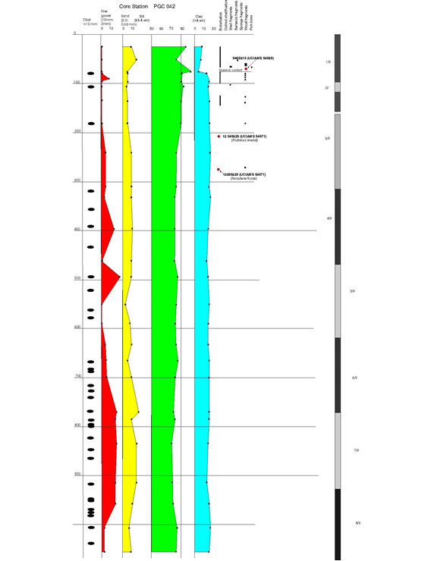
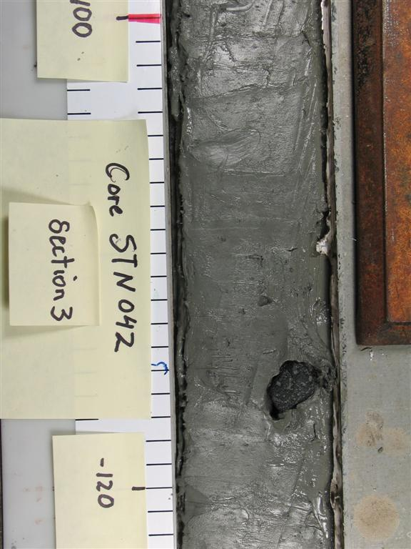
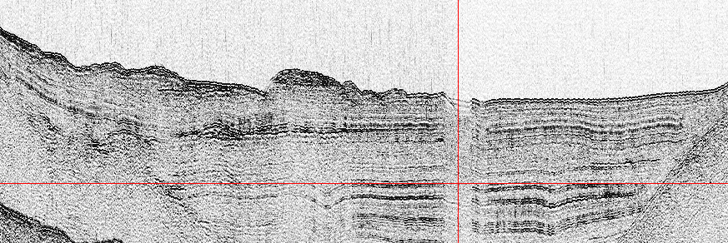
Bowen Island/Collingwood Channel
Core 42
Collingwood
Channel
Depth (cm)
¹⁴C ages
0
Holocene
9485+/-15 y BP
100
200
12540+/-20 y BP
300
12600+/-20 y BP
400
Bowen I.
500
600
Bouldery run-out deposits
700
Stratified glaciomarine sediment
800
900
1000

Slide 10
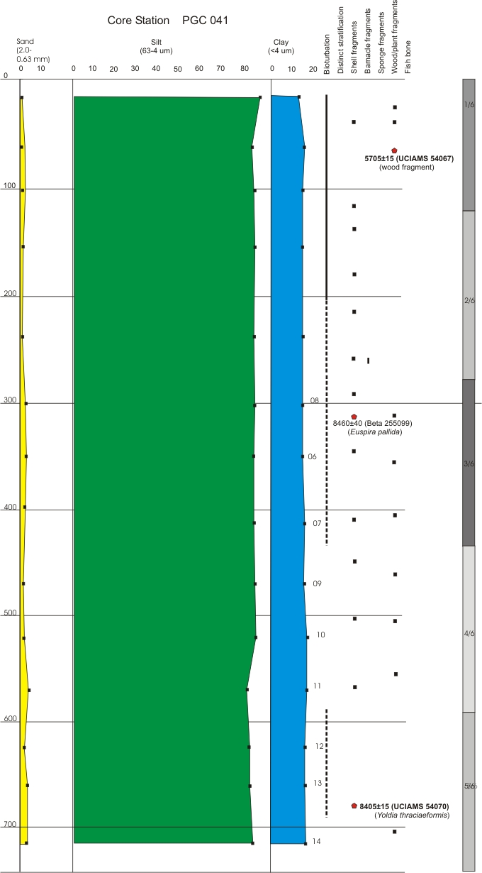
Core 41
Depth (cm)
Lions Bay offshore
¹⁴C ages
0
Late Holocene
5705+/-15
100
200
300
8450+/-40
400
500
600
8405+/-15
700
1000

Slide 11
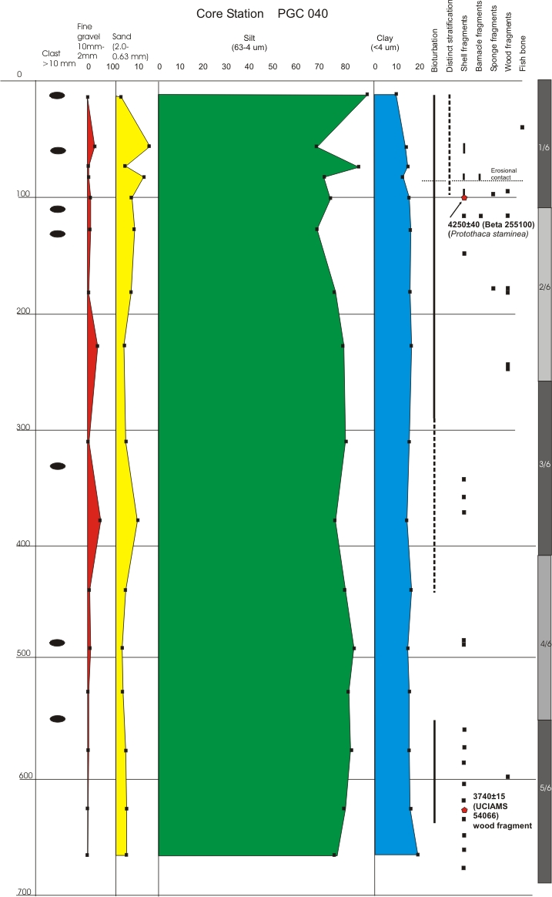
Core 40
Depth (cm)
Lions Bay offshore
0
100
4250+/-40
200
300
400
500
600
3740+/-15
700

Slide 12
Why was there a dramatic reduction of the rate of suspended sediment deposition
in core 41 during the latter
Holocene?
(The site of 41 is likely representative of most of Howe Sound)

Slide 13
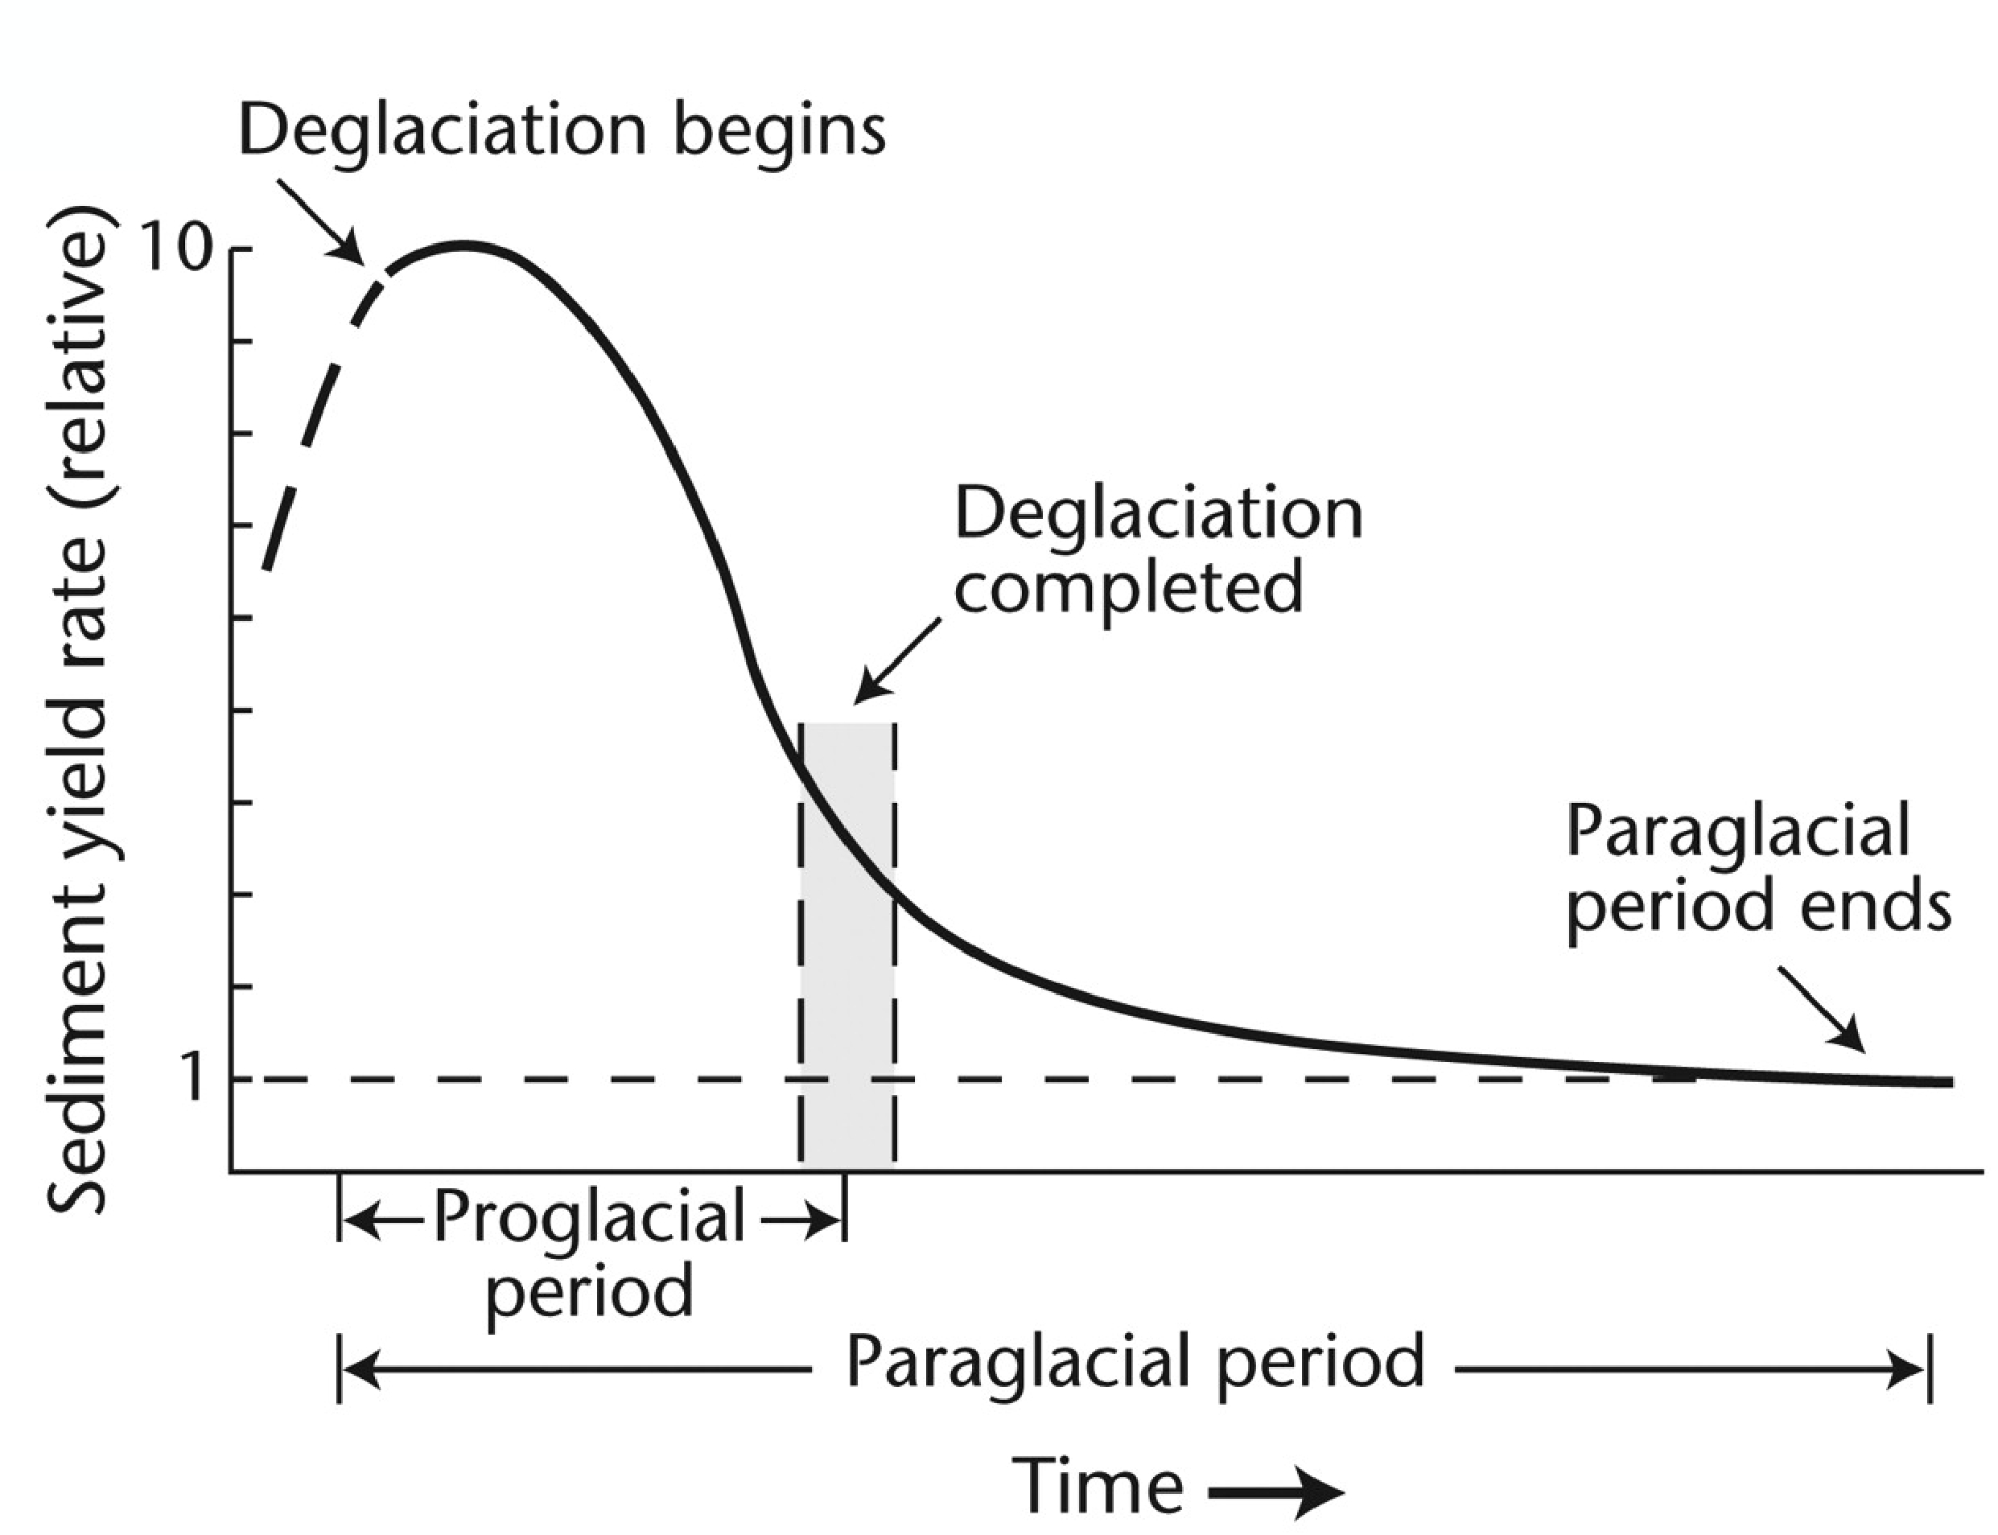
THE PARAGLACIAL EFFECT
paraglacial sedimentation is
documented throughout glaciated
areas of the Canadian cordillera and
analogous montane regions globally
Today
Modified from Church and Ryder, 1972

Slide 14
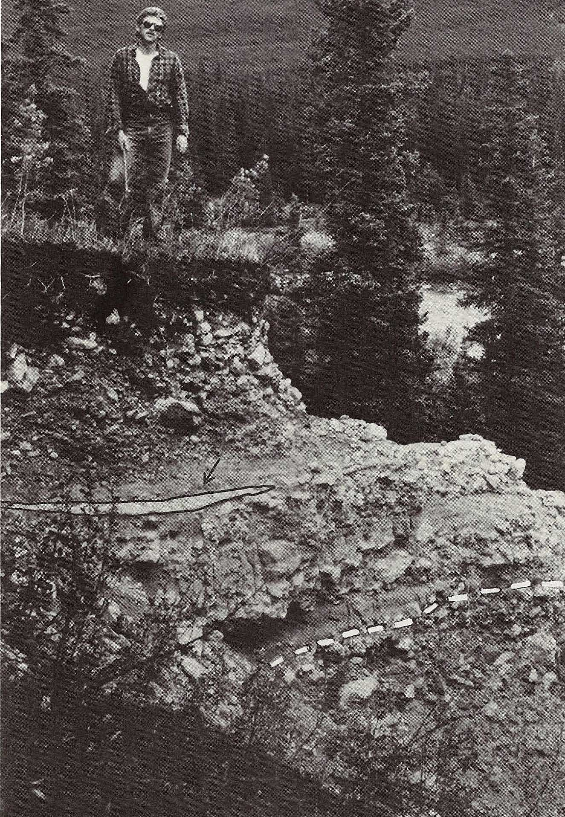
THE PARAGLACIAL EFFECT
paraglacial sedimentation is
documented throughout glaciated
areas of the Canadian cordillera and
analogous montane regions globally
Mazama Tephra
~6700 yBP
Today
Modified from Church and Ryder, 1972

Slide 15
Run-out deposits visible in shallow channels with strong currents like Collingwood Channel
ca. 15,000 BP
Deeper areas:
run-out deposits
visible everywhere
(except in submarine
fans)
(ca. 9000 BP
cores 42-44_
ca. 5000 BP
core 41
Today
Modified from Church and Ryder, 1972

Slide 16
Tentative conclusions:
--Sedimentation rates in open, deep reaches of lower Howe Sound
have been in the order of < 1 m/5000 years since ca. 5000 y BP.
Consequently, run-out deposits from large fast-moving landslides
(tsunami generators) during the last 5000 years should be
recognizable on SMB imagery.
--Such deposits should be recognizable back to the termination of
glacial-marine sedimentation ca. 10 y BP in shallow channels.
--These relationships can serve as a working hypothesis in hunting for
evidence of past potentially tsunami-generating landslide run-out
deposits on SMB imagery from the many similar fjords along
the BC coast.

Slide 17
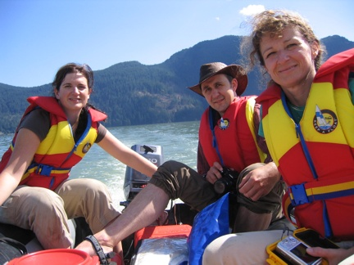
Thank you for your
attention!

