Slide 1
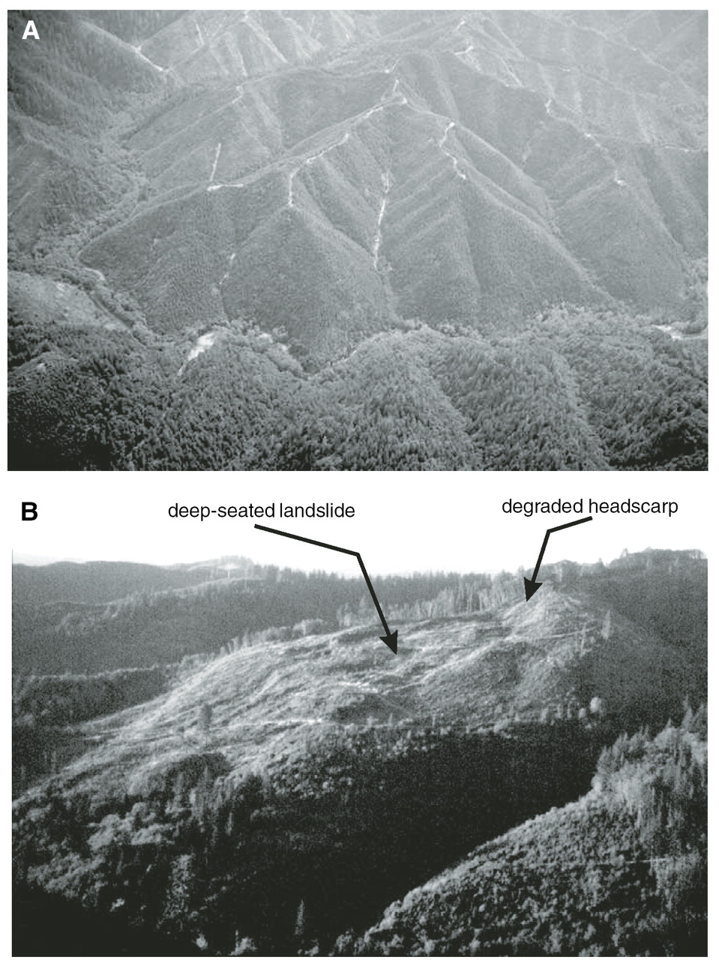
Influence of Seismic Site Response on Landslide Reactivation during the Next Cascadia Earthquake
Corina Cerovski-Darriau, Miles Bodmer, Joshua Roering, and Doug Toomey Department of Geological Sciences University of Oregon Eugene, OR, USA
GSA 2014—Vancouver, BC 21 October 2014
Notes:
…a pilot study on a landslide in the OCR to see if there were any pronounced site effects, in order to help quantify:

Slide 2
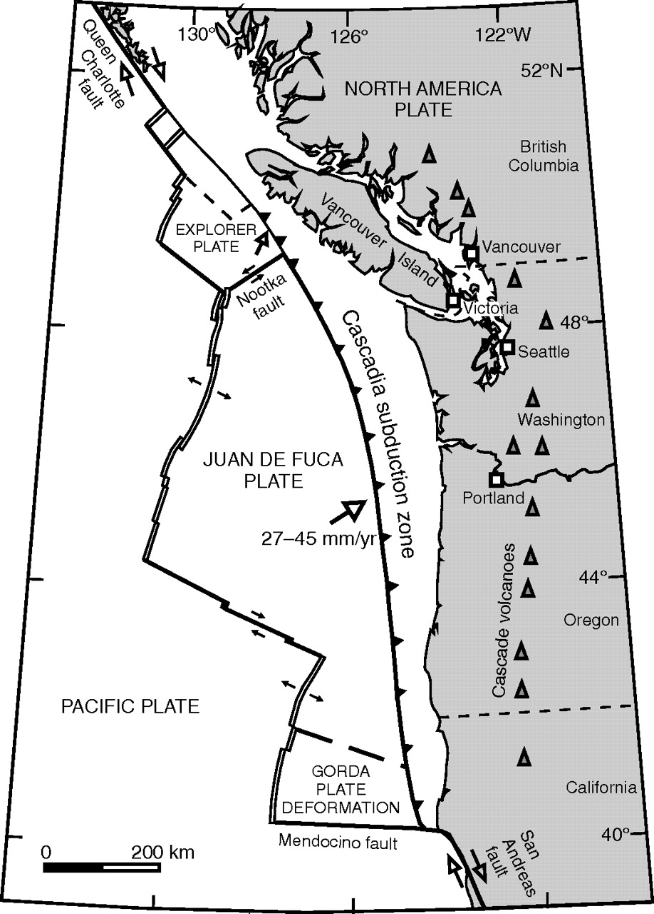
Coseismic Landslides and Cascadia
Earthquakes trigger landslides
Often the more damaging hazard
M9 Cascadia earthquake occurs every 300-500 years
Have Cascadia earthquakes triggered (or reactivated) landslides in the past?
And if so, what ground motion is needed for failure?
Oregon Coast Range
Leonard et al., 2010
Notes:
Coseismic landslides are a known hazard (i.e. Japan)
Cascadia earthquakes are known events.
But few constraints on how a future earthquake will affect landsliding. For example, the OCR is one of the most well-studied geomorphic landscapes, but almost no mention of EQ-triggered landslides or the affects of EQ on the landscape. Focus on Tyee.

Slide 3
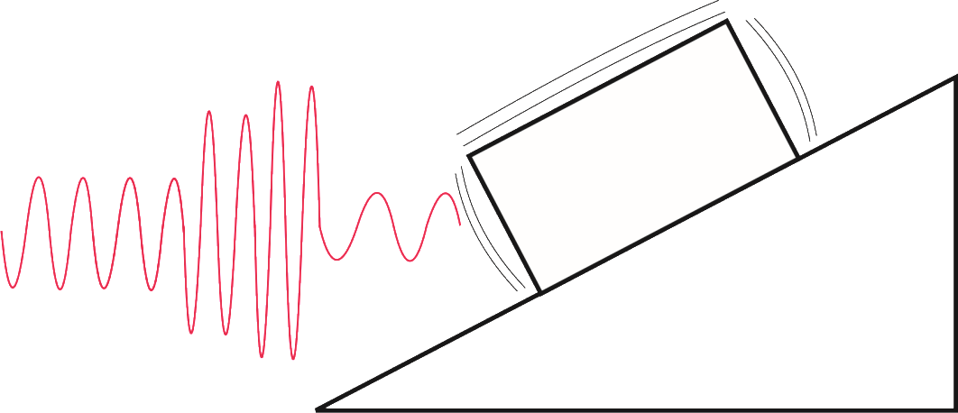
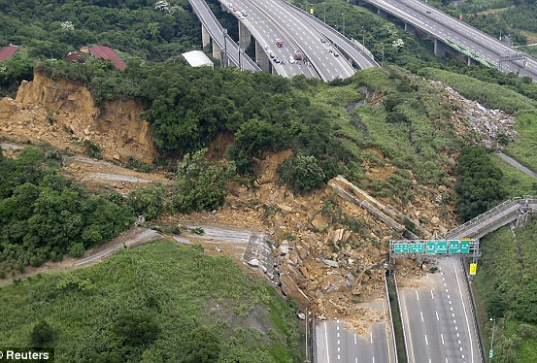
Motivating Question
Will This Go to This in the Oregon Coast Range?
2010 landslide blocked highway in Taiwan for nearly 2 months
Notes:
So this leads us to ask: ….
Essentially, can we approximate some of the large-scale features in the OCR as a block being shaken on an inclined slope…and what would be the best parameters to use…in order to prepare accurate hazard maps to prepare for and/or avoid a sitution like this (though not co-seismic, similar to what we expect could happen in the OCR).

Slide 4
Coseismic Landslides and Cascadia
Only need a single slide to reactivate to cause widespread damage
Landslides are significant primary and secondary hazard in Western Oregon
Threaten lifelines, property and safety
Notes:
As I said before, we focus on the OCR (for a variety of reason, that I will go into more).

Slide 5
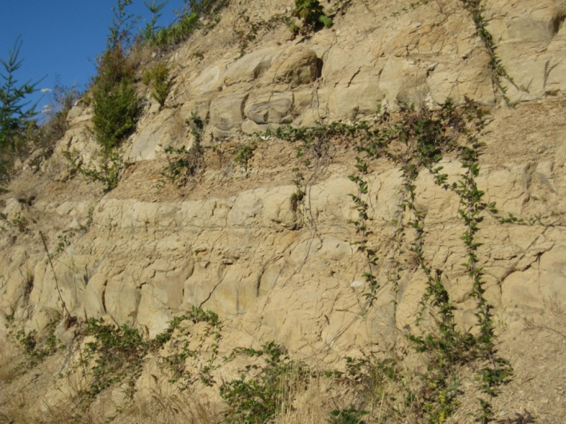
Oregon Coast Range (OCR)
Predominantly Tyee Formation
Middle Eocene turbidite sequence
Subsequently uplifted and folded
Mean elevation: 450 m
Characterized by steep hillslopes and narrow debris-flow carved valleys
Typical OCR ridge-valley topography
Roering et al., 2005
Large bedrock landslide, showing flat, bench-like morphology
Tyee Formation
Notes:
Focus on OCR as it predominately a single formation, Tyee, eliminated some of the variablity.

Slide 6
Coseismic Site Effects
Quantify shaking amplification within an existing landslide deposit
Using horizontal-vertical spectral ratios (HVSR), and ideally, standard spectral ratios (SSR)
Calculate ratios using both weak motion and ambient noise data
Compare amplification within landslide deposit to amplification at ridgetop
Look for potential influence of topography vs. substrate
Notes:
Quantify shaking amplification by comparing H-V motion (common method)…end goal being to have a correction factor for existing landslide deposits
Quantify topographic effects…debated whether or not topographic effects trump impedance constrasts.

Slide 7
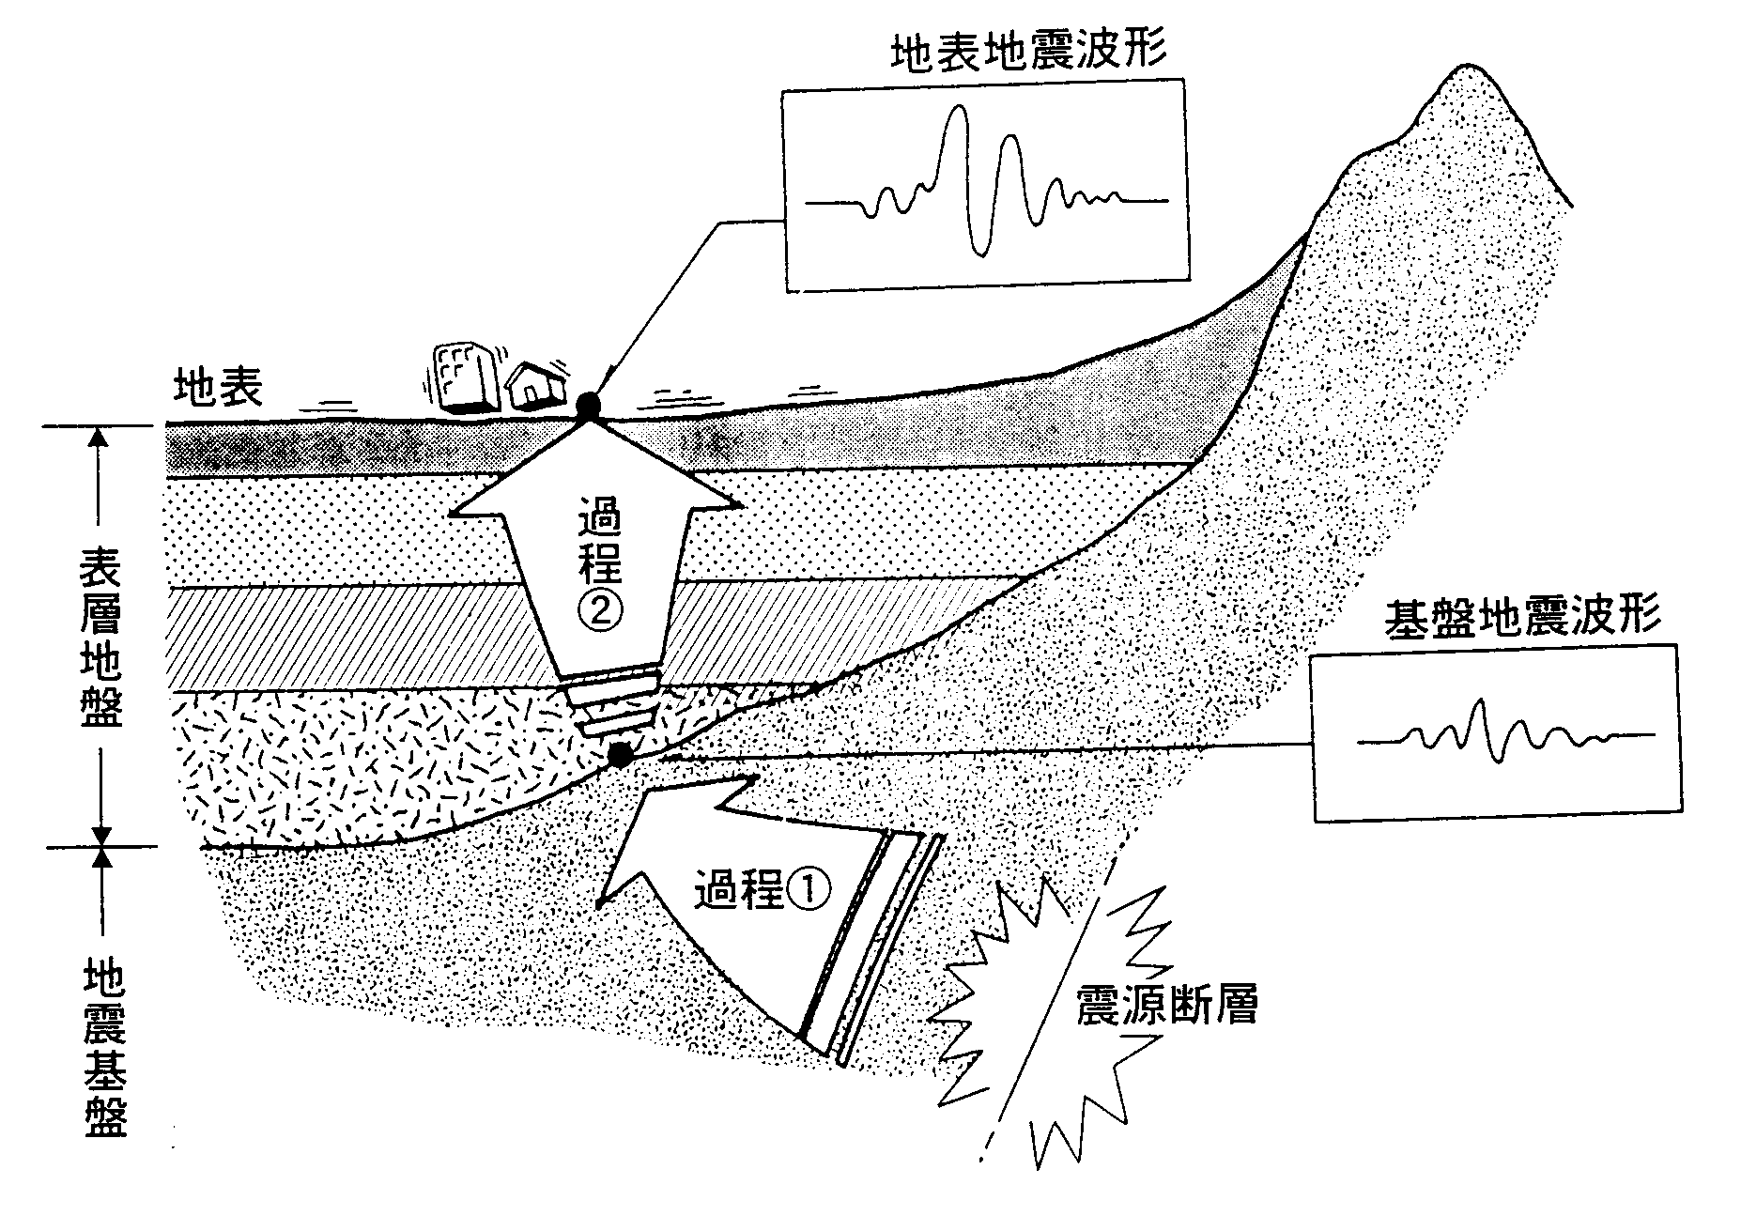

Coseismic Site Effects
Site Amplification
Depends on:
Velocity contrast between substrate layers due to impedance
Thickness of landslide deposit
Topography
Impedance
Wave amplitude changes with variations in velocity and density of substrate
Amplitude increases as wave moves into slower, looser material (i.e. from bedrock to landslide deposit)
$$\frac{A_{2}}{A_{1}}=\sqrt{\frac{ρ_{1}v_{1}}{ρ_{2}v_{2}}}$$
Impedance
A=amplitude
υ=wave velocity
Sediment
Bedrock

Slide 8
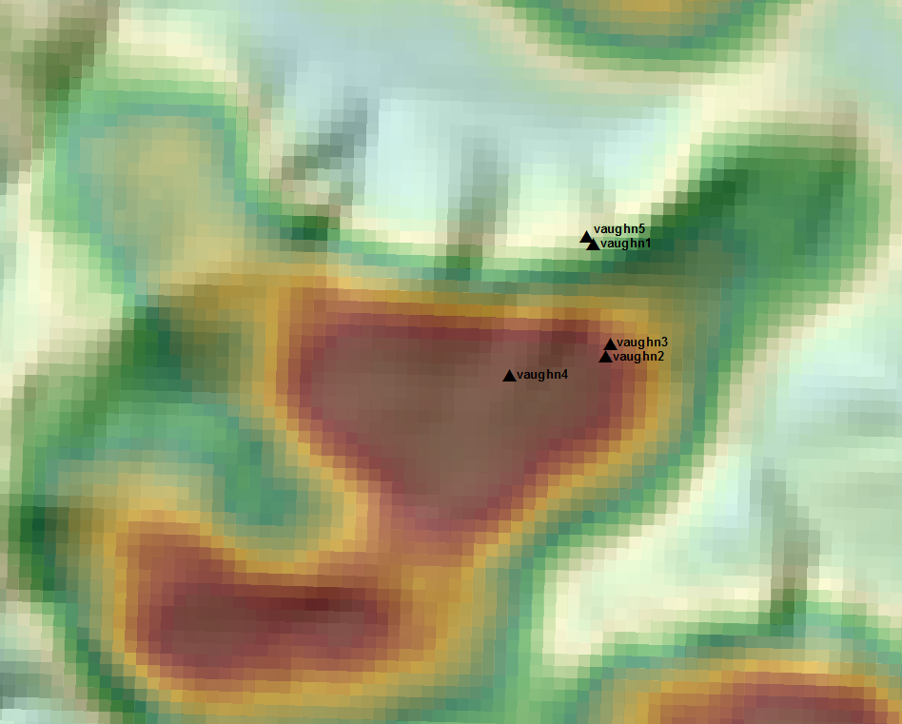
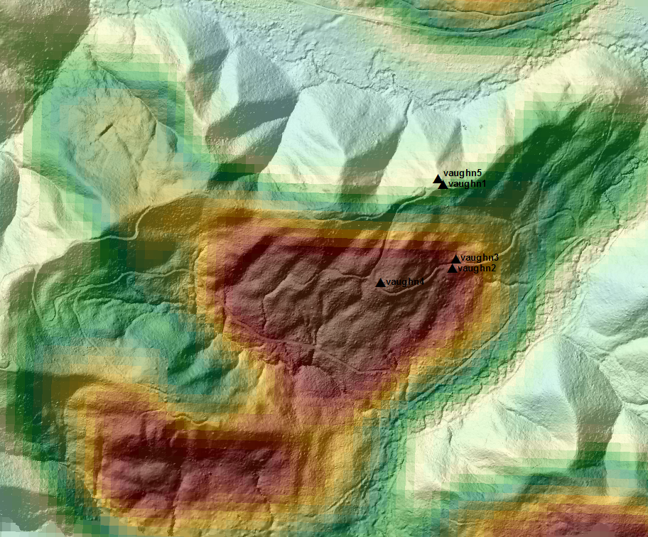
Pilot Study—Site Location
Deep-seated paleolandslide
5-15 m deep
400 m wide and 600 m long
Approximately ~100 ky old
More recent reactivation
NCALM Lidar (flown 2013)
N
N
200 m
200 m

Slide 9
Pilot Study—Site Location
Deep-seated paleolandslide
400 m wide and 600 m long
5-15 m deep
Approximately ~100 ky old
More recent reactivation
NCALM Lidar (flown 2013)
N
N
200 m
200 m

Slide 10
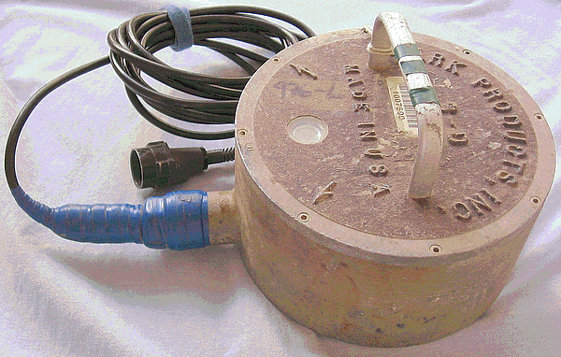
Pilot Study—Set-up
Installed 5 short-period seismometers
2 off-landslide; 3 on-landslide
Deployed for 2 months
Monitoring both ambient noise and weak motion

Slide 11
Pilot Study—Data Processing
Picked 5 earthquake events
M 2.6-4.1
Span 1 month
Used 5-400s noise sections
Processed data from each station using:
1 Hz high-pass filter and a weighted average smoothing
Calculated HVSR for E-W and N-S component
Compared HVSR and peak frequencies

Slide 12
Pilot Study—Results
From a single event:
Shift in peak frequency on vs. off the landslide
Largest amplitudes are at the ridgetop (Vaughn1) and in the middle of the landslide (Vaughn2)

Slide 13
Pilot Study—Results
Stack of 5 events and ambient noise display similar trends:
Shift in peak frequencies
Largest amplitude for ridgetop and middle of the deposit

Slide 14
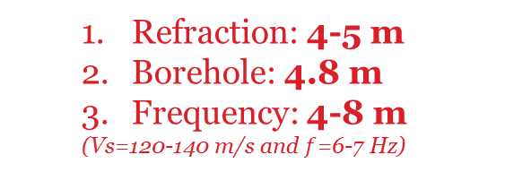

Pilot Study—Verification
Peak frequency relates to landslide thickness
Verified results by comparing:
Seismic refraction survey
Borehole data
Spectral data
At Vaughn3, thickness predicted by peak frequency agrees with other methods
$$f=\frac{Vs}{4H}$$
Vaughn3
Borehole
Refraction: 4-5 m
Borehole: 4.8 m
Frequency: 4-8 m
(Vs=120-140 m/s and $f$=6-7 Hz)

Slide 15
Conclusions
Found 2-3x amplification within the landslide compared to the neighboring bedrock
Found similar amplification at the ridgetop
Peak frequencies on the landslide are greater than the surrounding area
Correspond to thicker and/or less consolidated deposits
Highly variable across the landslide
Need a denser array
Need a better reference station
Topography and substrate properties have similar influence on site response
Seismic energy from a CSZ earthquake will be amplified within landslide deposits and at ridgetops

