Slide 1


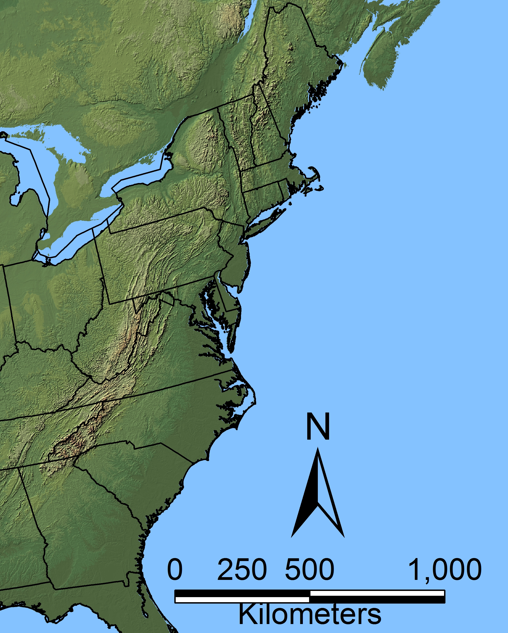
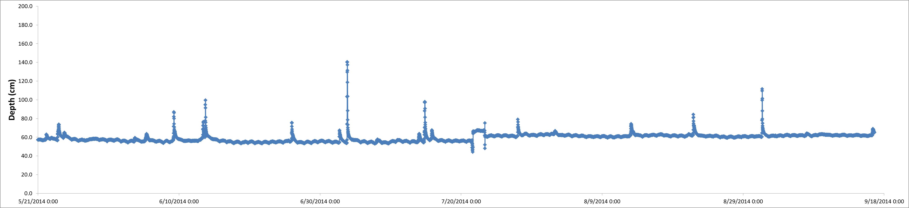
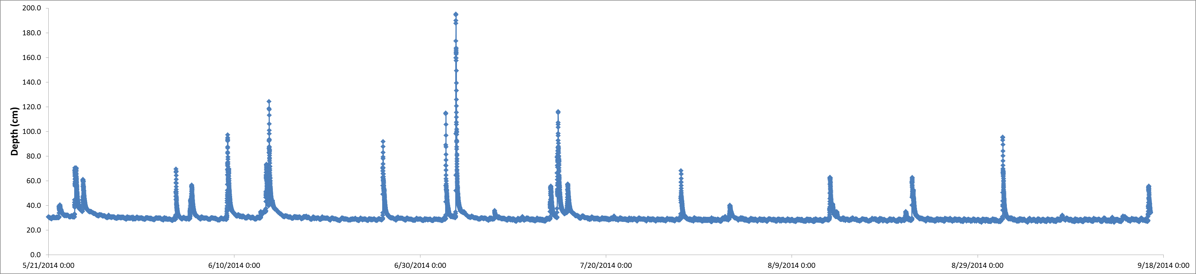
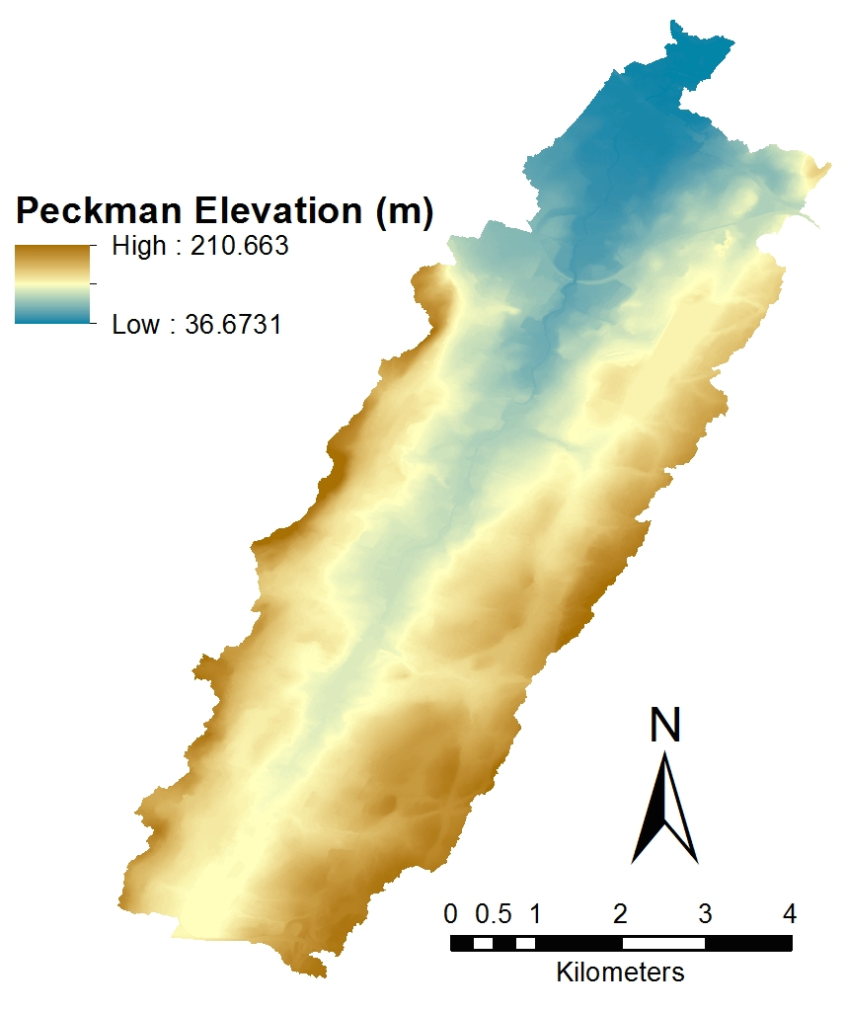
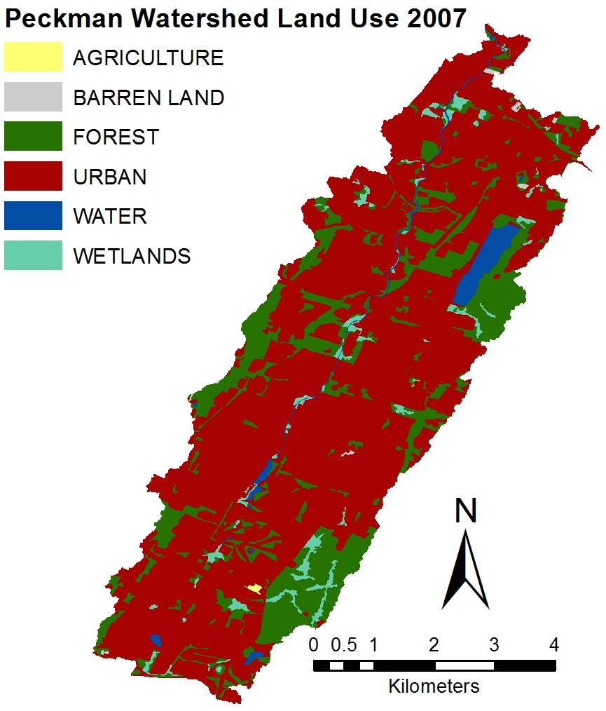
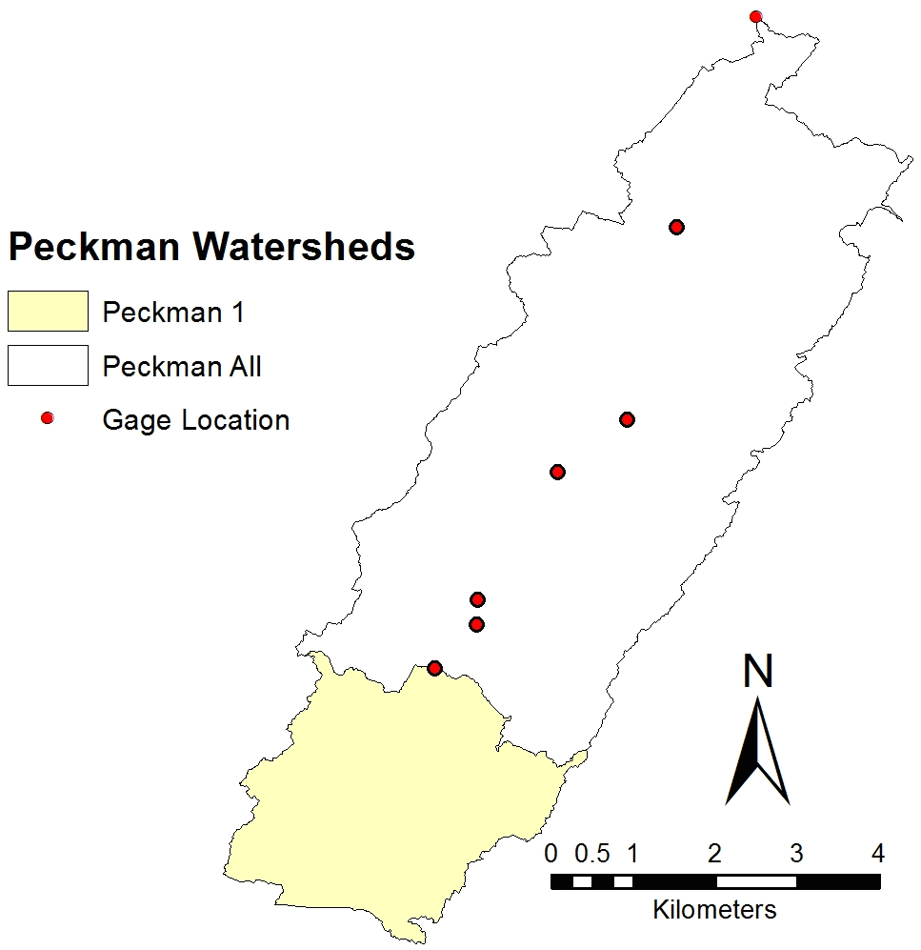
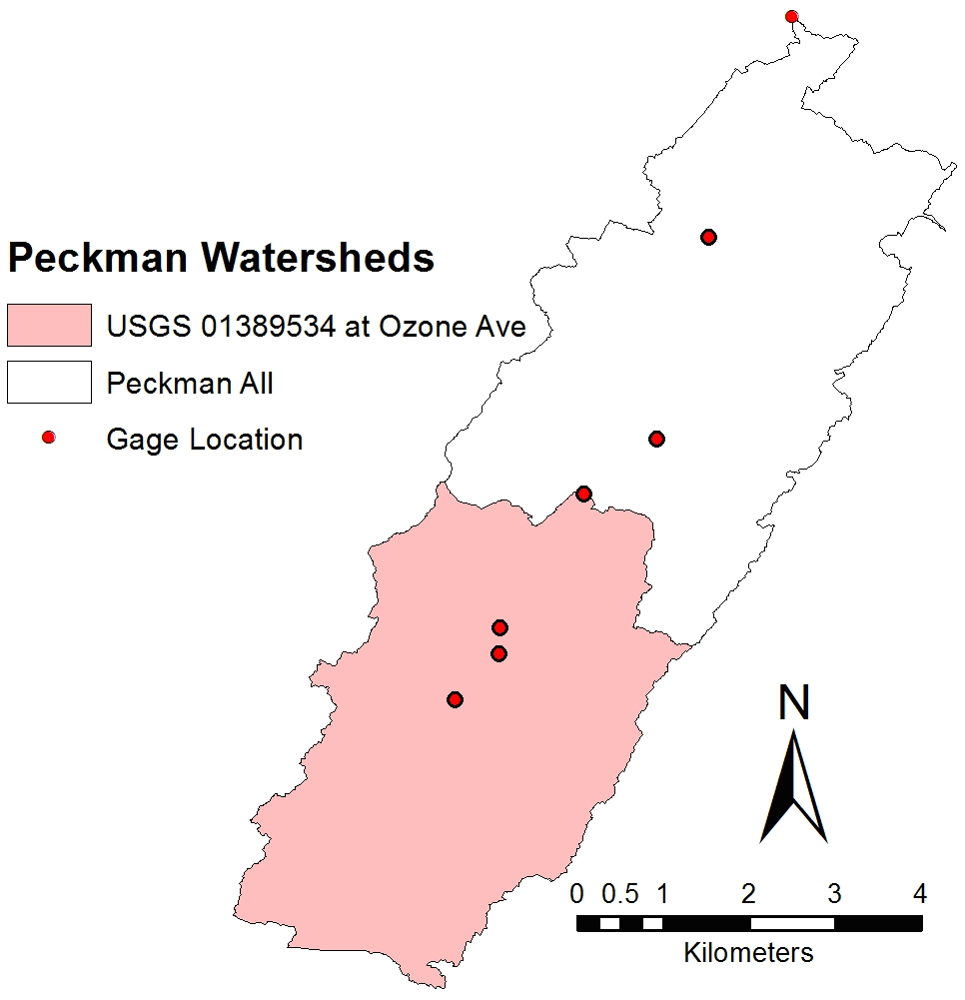
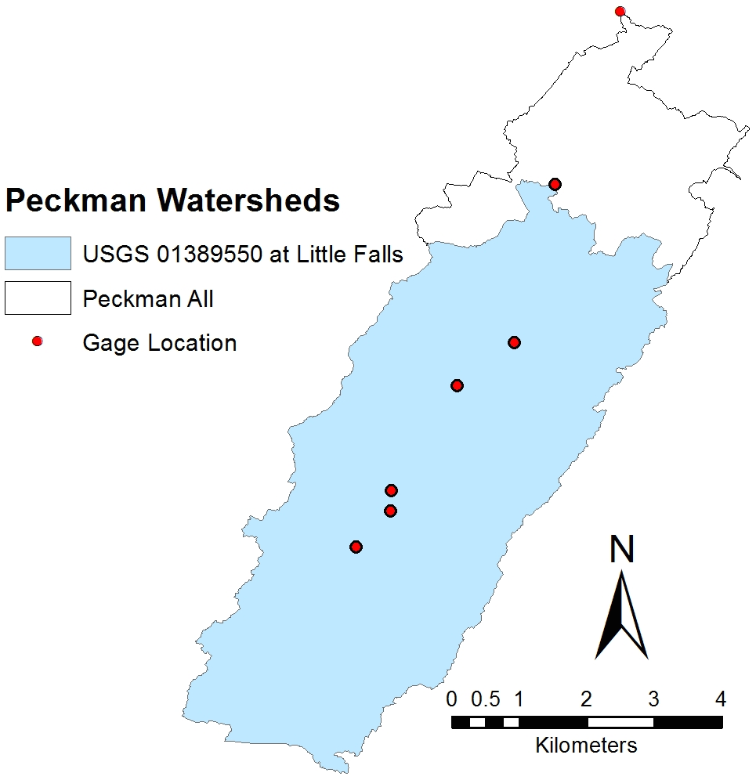
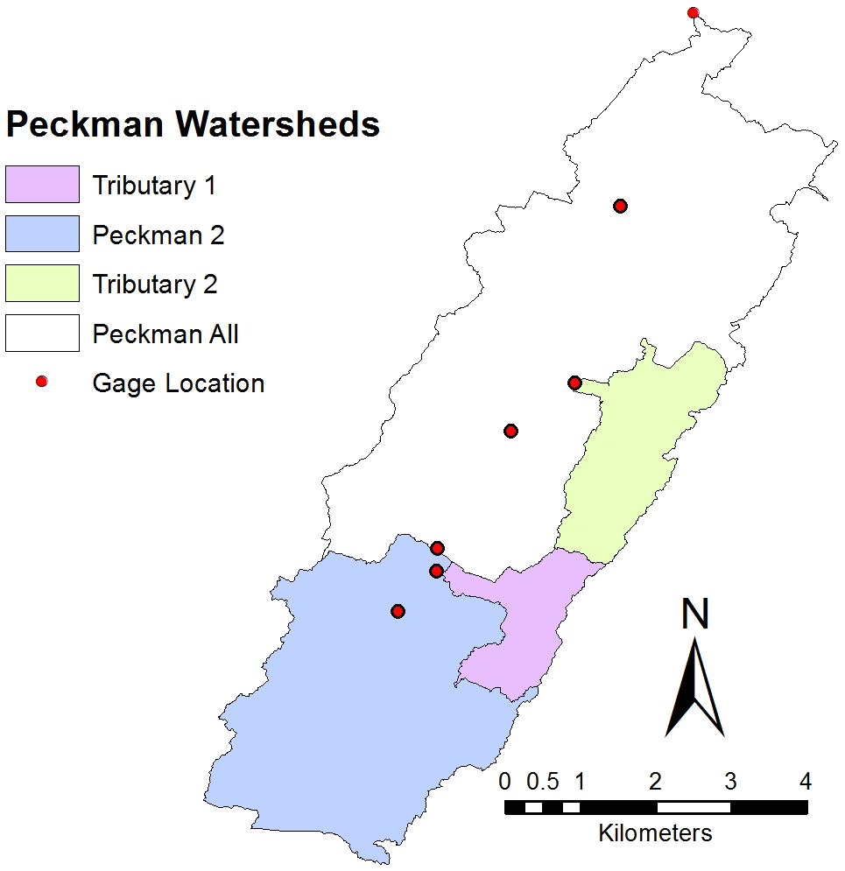
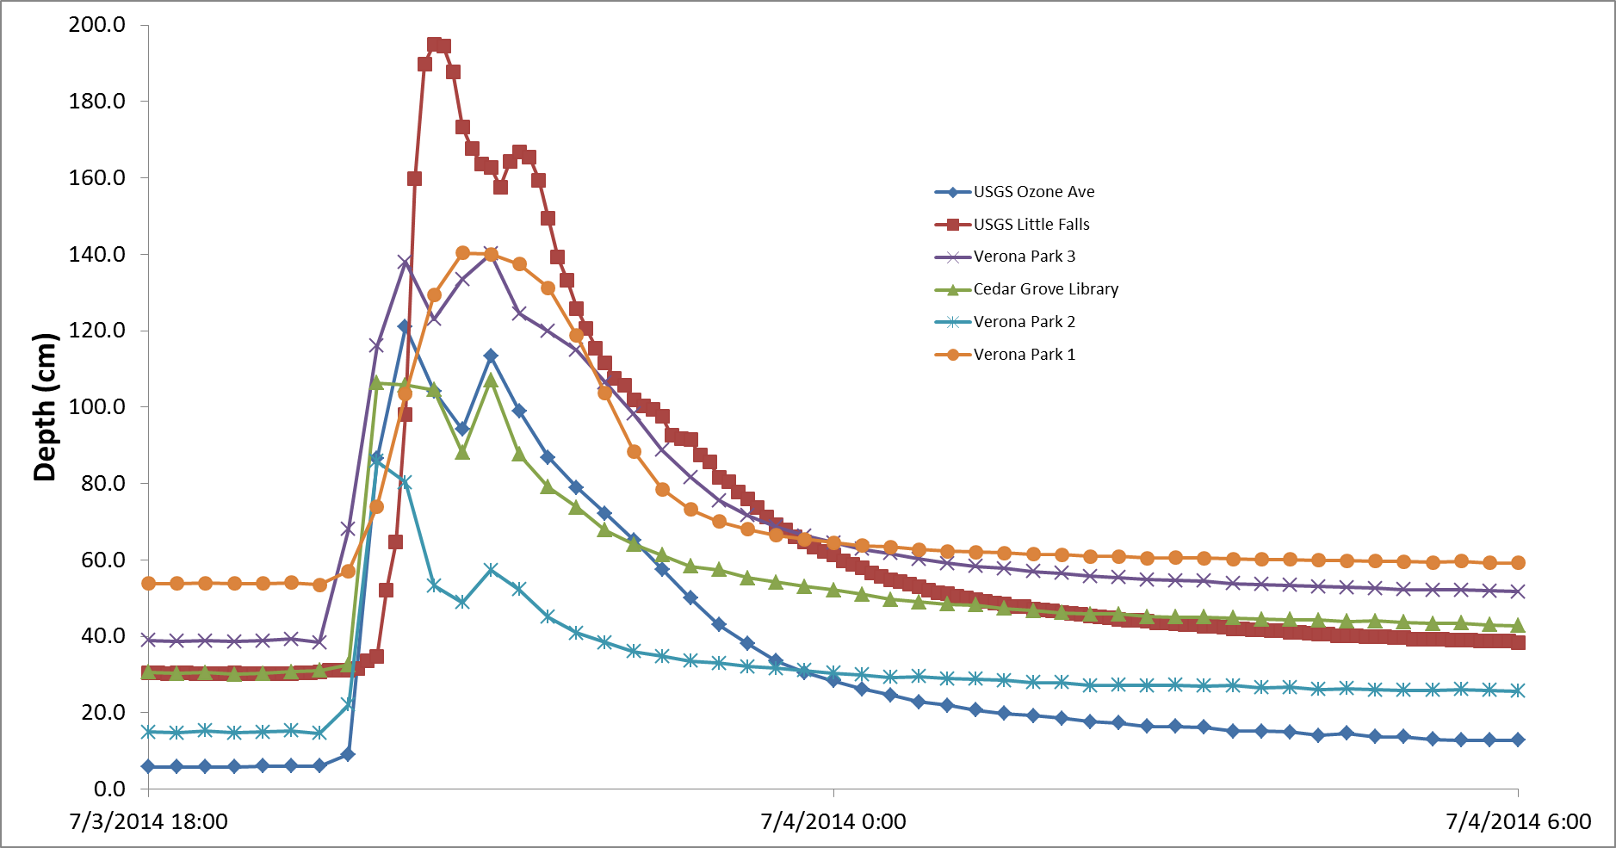
Erik Strandskov (strandskove1@mail.montclair.edu) and Joshua C. Galster (galsterj@mail.montclair.edu)
Dept. of Earth & Environmental Studies, Montclair State University, 1 Normal Ave. , Montclair, NJ 07043
THE SYNCHRONIZATION OF STORM DISCHARGE PEAKS AND THEIR ASSOCIATED FLOOD HAZARDS IN A SMALL, URBANIZED WATERSHED IN NEW JERSEY
#204-5
SHIP
Verona Park 1 Hydrograph
Research
Location
USGS Little Falls Hydrograph
ABSTRACT
Changes in Elevation of the Peckman River Watershed
Watershed for the Peckman 1 Sensor
Watershed for the USGS Gage at Ozone Ave
The study installed a series of depth sensors in the main stem and two tributaries of a small watershed, the Peckman River, in northeastern New Jersey. This small (~30 square kilometers), urbanized watershed has had recent flooding problems, especially with Tropical Storm Irene in 2011. By studying the timing of the flood peaks at different points in the watershed, flood mitigation strategies can be developed to reduce and desynchronize the peaks. The depth sensors, along with two USGS sensors (#01389550 and #01389534) measured water depth every fifteen minutes, recording the rise and fall of the river. Initial data from spring and summer 2014 recorded seven storm events in the watershed. The timing of the storm peak was determined for each rain event at each location. The flood peaks are occurring generally either simultaneously, or within fifteen to thirty minutes of the farthest downstream station. There is a small reservoir in the upper part of the watershed, and the peaks are especially synchronized downstream of it. With the river rising at each of the points almost simultaneously, this would cause the most damage in flooding situations, and synchronized flood peaks also contribute to increased channel erosion, altered aquatic habitats, and other aspects of “urban stream syndrome”. Future data will be collected to determine whether the synchronized flood peaks continue into fall and spring, or whether the synchronized peaks is a seasonal issue. This research project will also propose solutions that would be made specifically for the study areas, however they could be modified for rivers with similar flooding issues and be applied to other areas.
Installed 2 pressure sensors along the Peckman River and 2 within tributaries
Collected data from sensors installed, as well as 2 USGS gages
Used GIS to create for the watershed a Digital Elevation Model (DEM), a map of land use, and the watershed for each sensor location.
Used Microsoft Excel to make hydrographs, a bar graph of peak river discharge time differences based on the sensor data and a table of calculated peak discharges for 2, 5, 10, 25, 50, and 100 year storms for each sensors location.
Watershed for the USGS Gage at Little Falls
Watersheds for sensors Peckman 2, Tributary 1 & Tributary 2
Peak Discharges for Recurring Storms
 | 30 Minute Storm |  |  |  |  |  | 60 Minute Storm |  |  |  |  |  | 180 Minute Storm
 | 2 year | 5 year | 10 year | 25 year | 50 year | 100 year | 2 year | 5 year | 10 year | 25 year | 50 year | 100 year | 2 year | 5 year | 10 year | 25 year | 50 year | 100 year
Verona Park 1 | 1312 | 1611 | 1790 | 2088 | 2267 | 2386 | 895 | 1014 | 1163 | 1432 | 1551 | 1730 | 382 | 477 | 561 | 776 | 865 | 954
Verona Park 2 | 315 | 387 | 430 | 501 | 544 | 573 | 215 | 244 | 279 | 344 | 373 | 416 | 92 | 115 | 135 | 186 | 208 | 229
Verona Park 3 | 1967 | 2414 | 2682 | 3130 | 3398 | 3577 | 1341 | 1520 | 1744 | 2146 | 2325 | 2593 | 572 | 715 | 840 | 1162 | 1297 | 1431
Cedar Grove Library | 487 | 598 | 665 | 775 | 842 | 886 | 332 | 377 | 432 | 532 | 576 | 643 | 142 | 177 | 208 | 288 | 321 | 354
USGS Ozone Ave | 2469 | 3030 | 3367 | 3928 | 4265 | 4489 | 1683 | 1908 | 2188 | 2693 | 2918 | 3254 | 718 | 898 | 1055 | 1459 | 1627 | 1796
USGS Little Falls | 2877 | 3530 | 3923 | 4576 | 4969 | 5230 | 1961 | 2223 | 2550 | 3138 | 3400 | 3792 | 837 | 1046 | 1229 | 1700 | 1896 | 2092
Peckman All | 3422 | 4200 | 4666 | 5444 | 5911 | 6222 | 2333 | 2644 | 3033 | 3733 | 4044 | 4511 | 995 | 1244 | 1462 | 2022 | 2255 | 2489
Conclusions
Hydrograph for the July 3rd to July 4th,
2014 Storm Event
Peak depths are aligned or within an average 17.38 minutes of each other.
Peaks are especially synchronized downstream of the Verona Park reservoir.
The synchronization adds to the flood peaks downstream, increasing the flood hazards.
Calculated peak discharges for 2, 5, 10, 25, 50, and 100 year floods of 30, 60 and 180 minute durations will be used to determine the effectiveness of possible mitigation efforts.
The Merck and Roche Corporation provided funding for this project through the Science Honors Innovation Program (SHIP) at Montclair State University.
METHODS
Future Work
Further documenting of storms with pressure sensors to see if flood synchronization is consistent throughout the year or varies seasonally.
Effectiveness of rain barrels and other low-impact development techniques on the small watershed for flood mitigation.
Studying the dam at the small reservoir in Verona Park and finding ways it can regulate or better regulate water flowing into the Peckman River.
Acknowledgements

