Slide 1
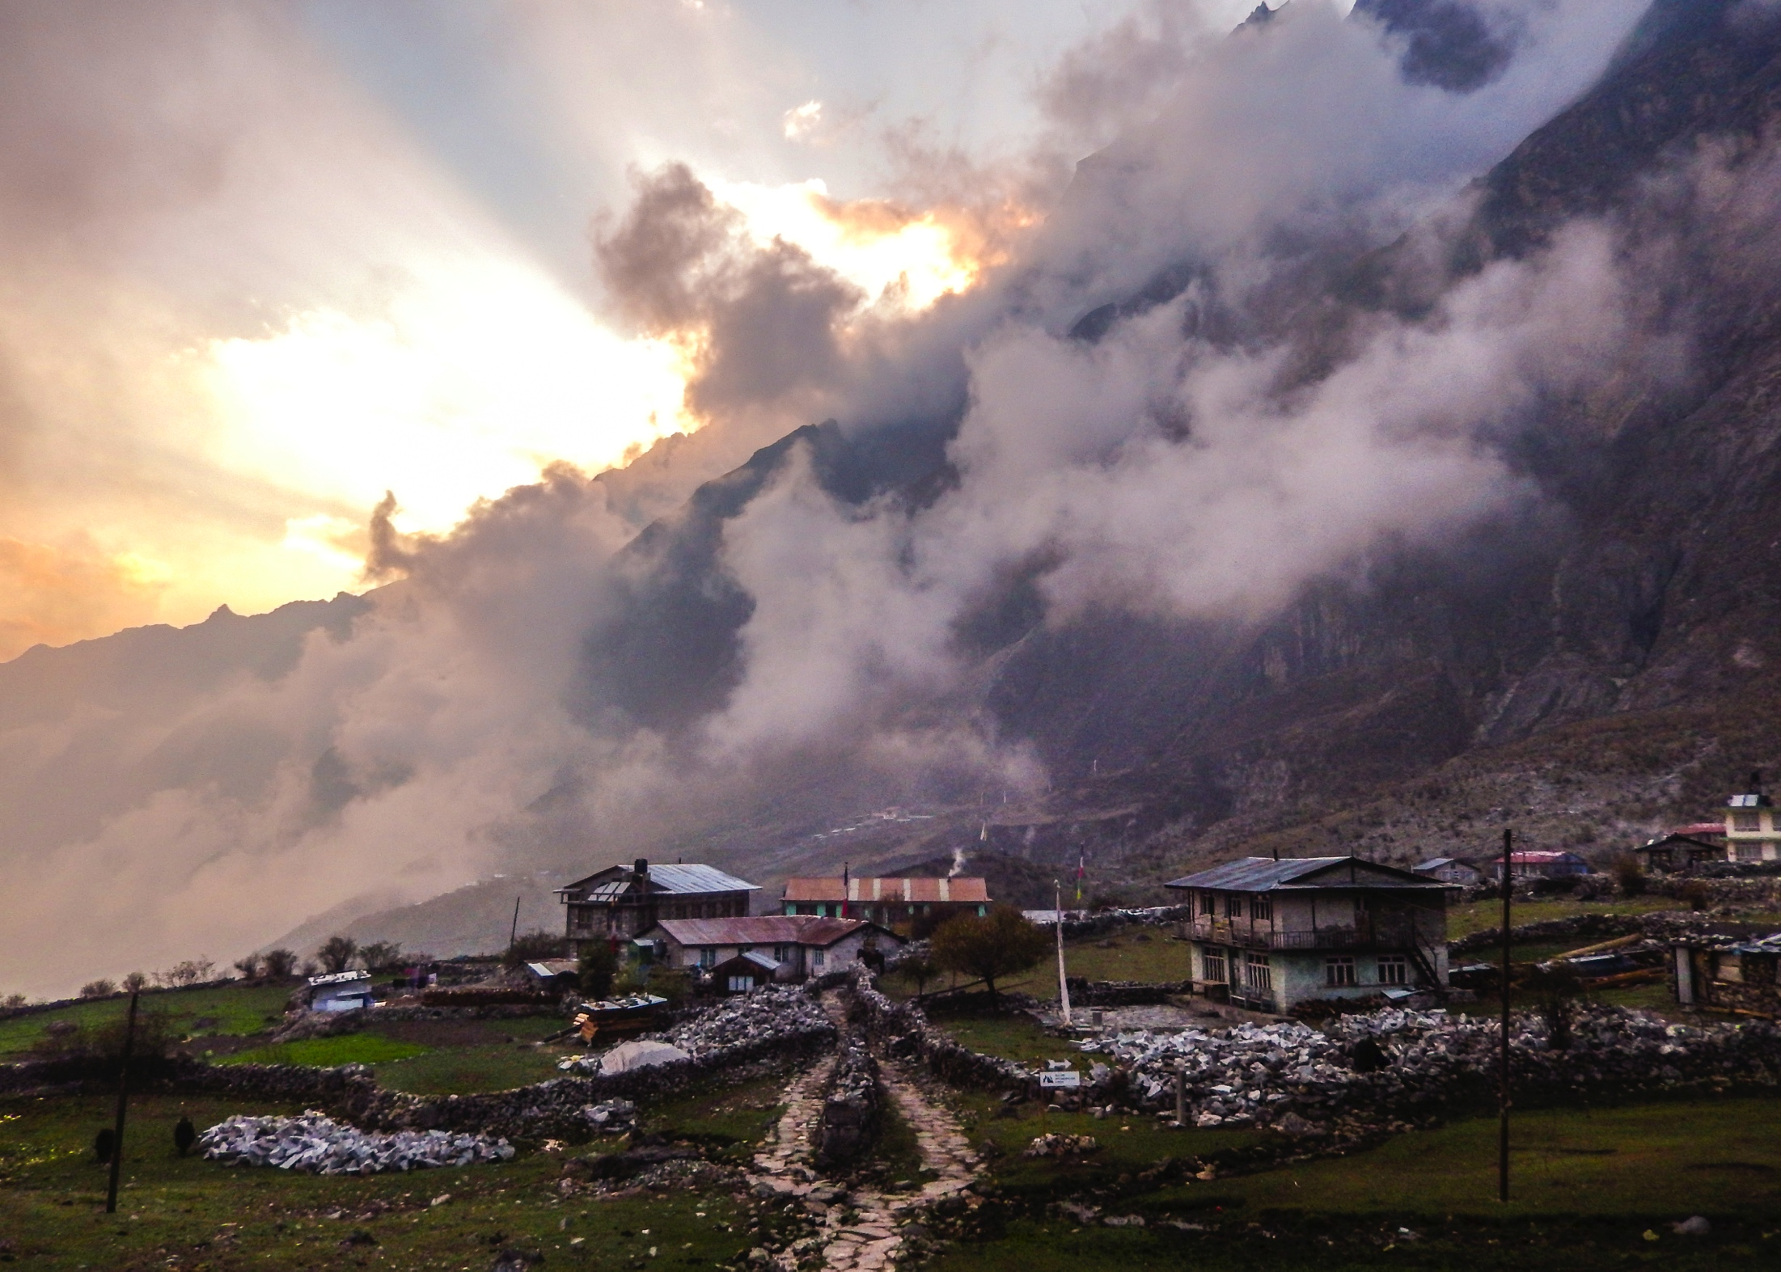




Geochemical Analysis of Tourmaline as a Tool for Determining the Location and Characteristics of the Main Central Thrust, Central Nepal
Buchanan Kerswell¹, Steven A. Fellows¹, Steven H. Emerman¹, Suman Panday², Santosh Adhikari²
¹Department of Earth Science, Utah Valley University, Orem, Utah
²Department of Geology, Tri-Chandra Multiple Campus, Tribhuvan University, Kathmandu, Nepal

Slide 2
Outline
Main Central Thrust
Motivation and Research Question
Tourmaline as a Geologic Tool
Field Work and Study Area
Analysis
Results
Future Work

Slide 3
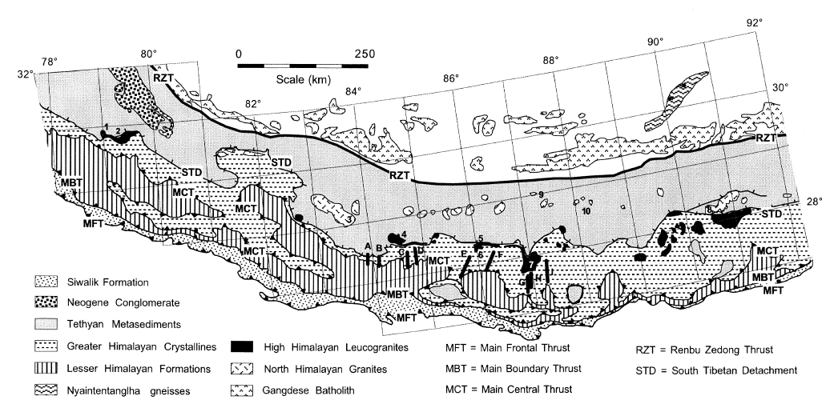
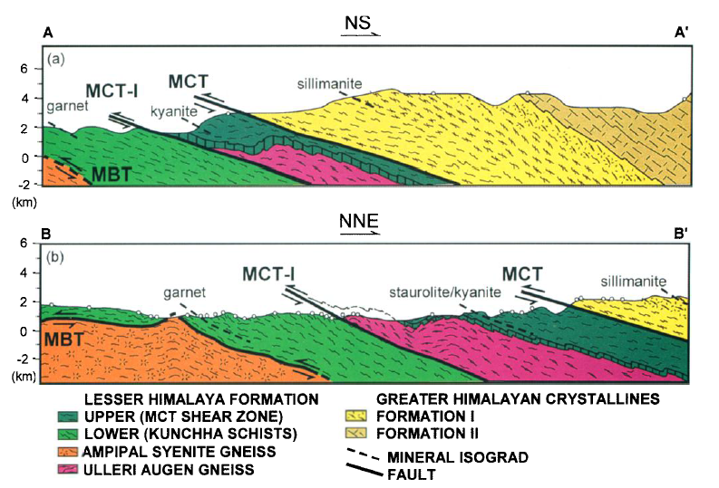
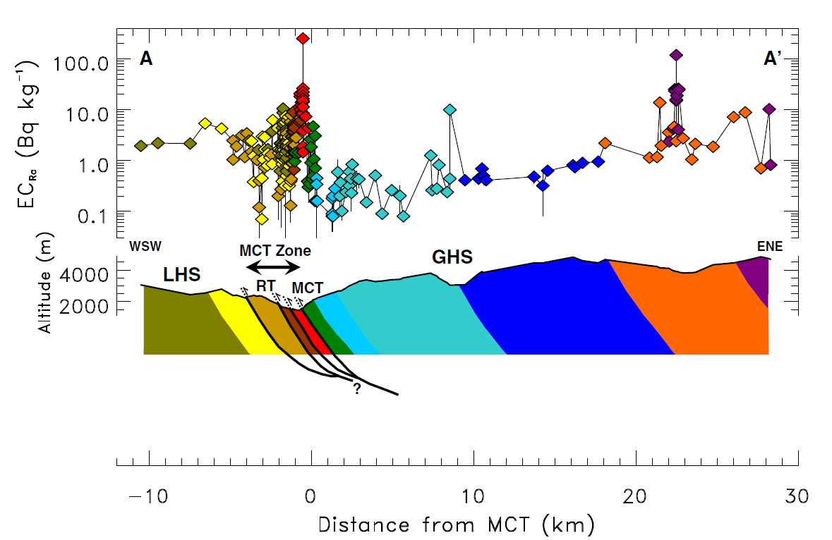
Main Central Thrust
Harrison et. al, 1999
Girault et. al, 2012
Catlos et. al, 2001

Slide 4
Motivation
Understanding the origin, timing of movement and associated metamorphism along the MCT holds the key to many questions about the evolution of the Himalaya.
Upreti et al. (1999)
Research Question: Can Tourmalines Be Used as a Tool for Delineating
the Main Central Thrust in Central Nepal?

Slide 5
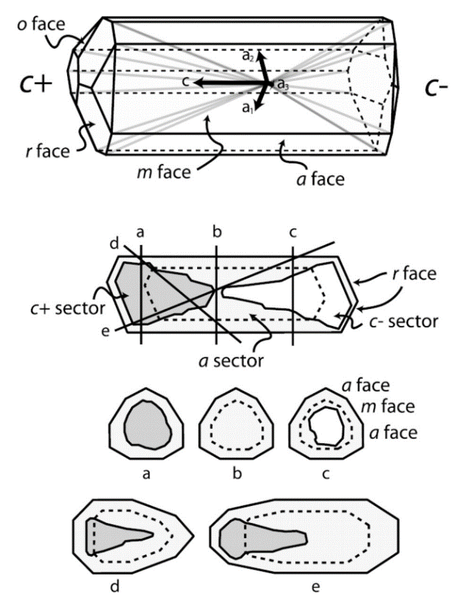
Tourmaline – Nature’s Multitool
Sectored and Zoned
Large Stability Field
Flexible Chemical Composition

Slide 6
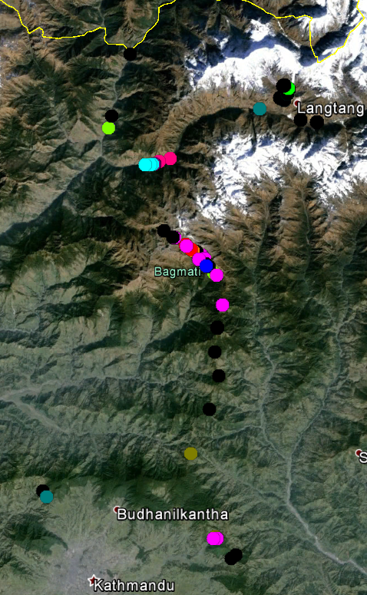
Study Area
Highest Elevation
n=34
Proximal to MCT
n=18
Langtang Valley
n=6
Lower Himalaya
n=47
Kathmandu East
Kathmandu West
n=7
n=2

Slide 7
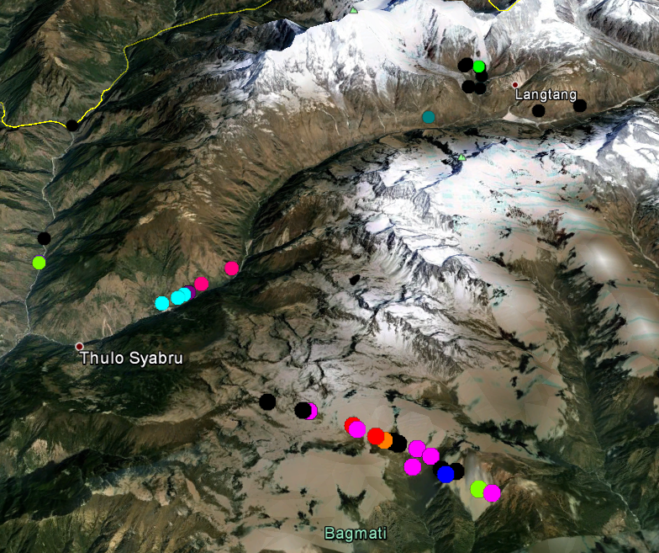
MCT Area
Highest Elevation
Proximal to MCT
Langtang Valley
Gneiss
Schist
Tourmaline-
Barren
Lower Himalaya

Slide 8
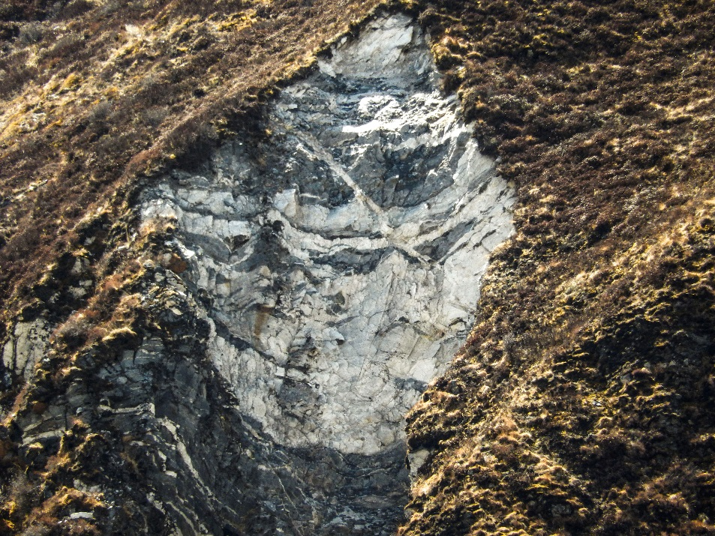
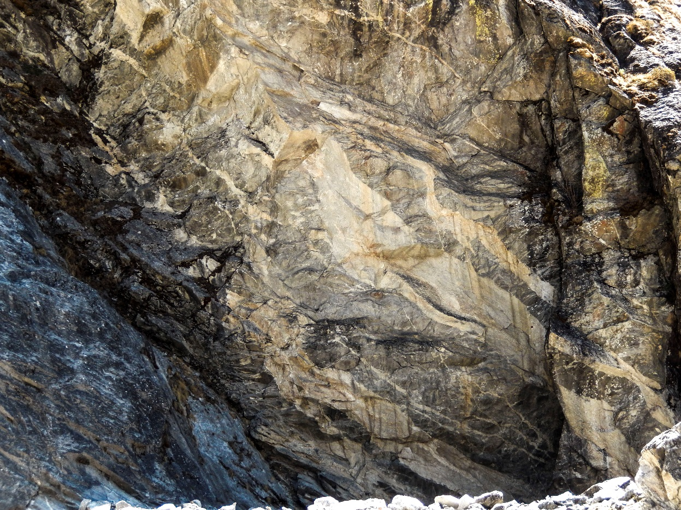
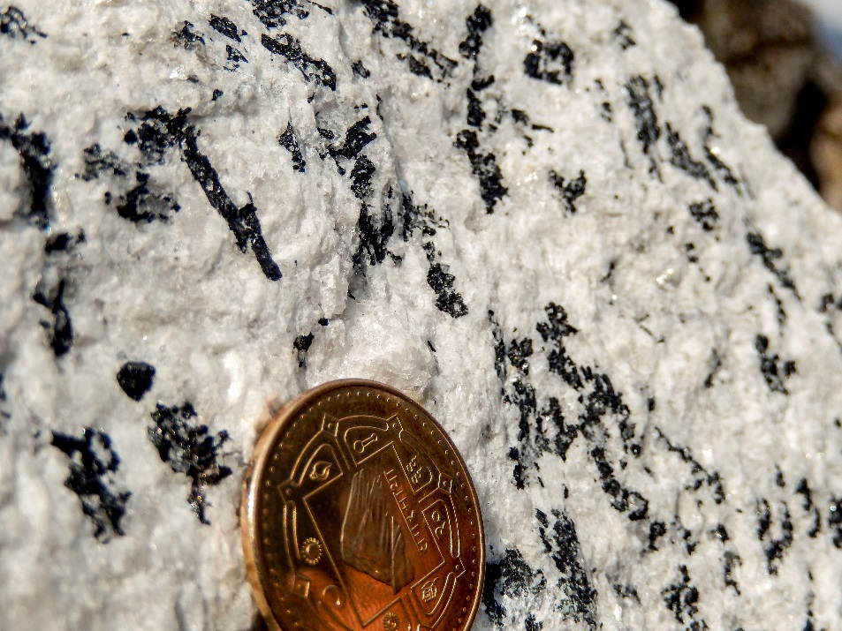
Field Work
Pegmatites in Gneiss
Pegmatite Samples

Slide 9
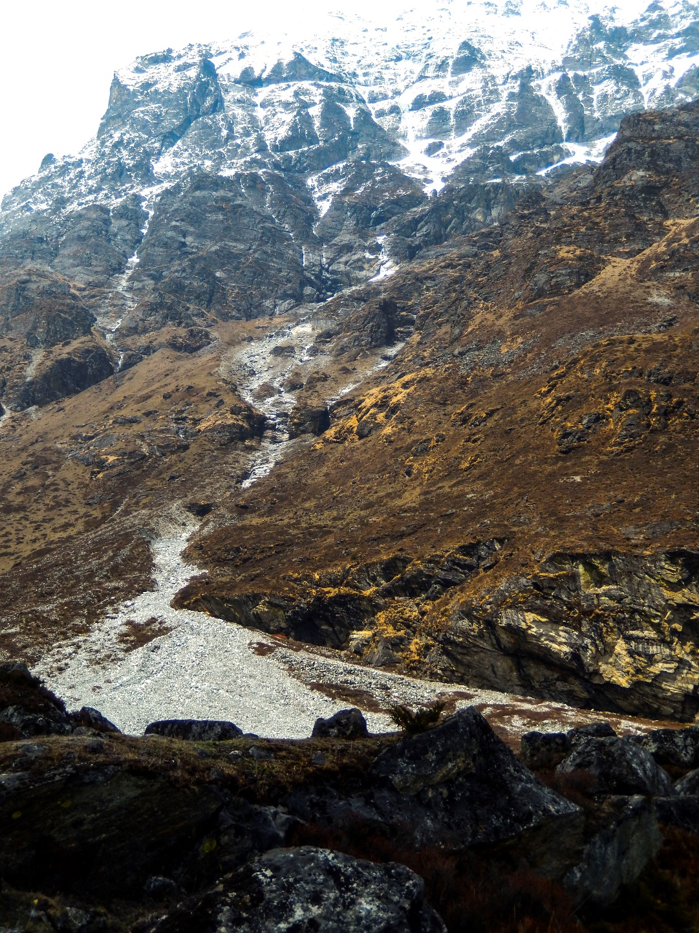
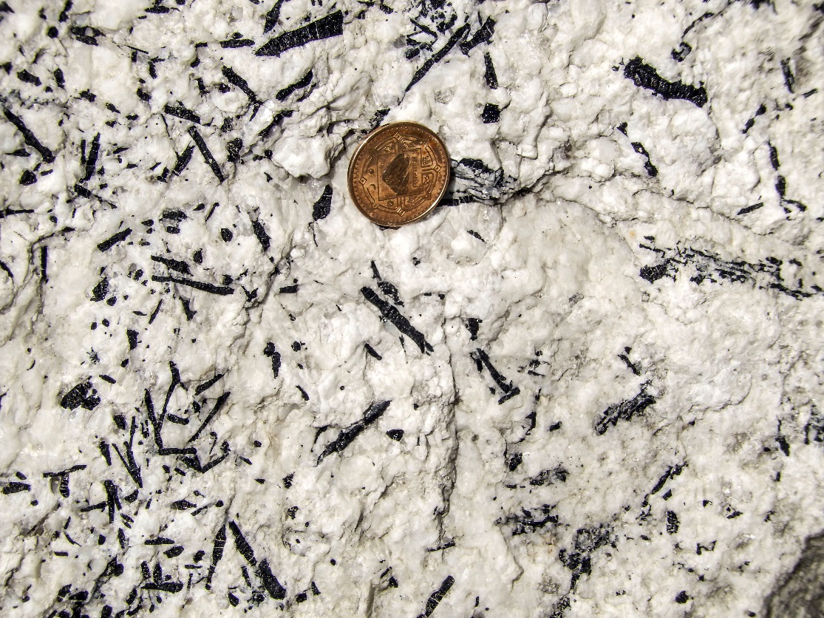
Field Work
Glacial Samples

Slide 10
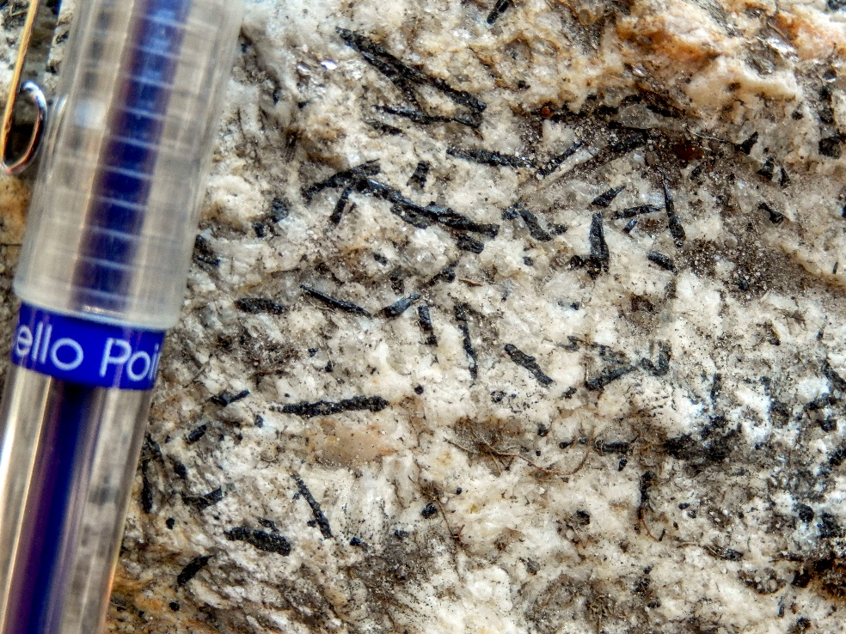
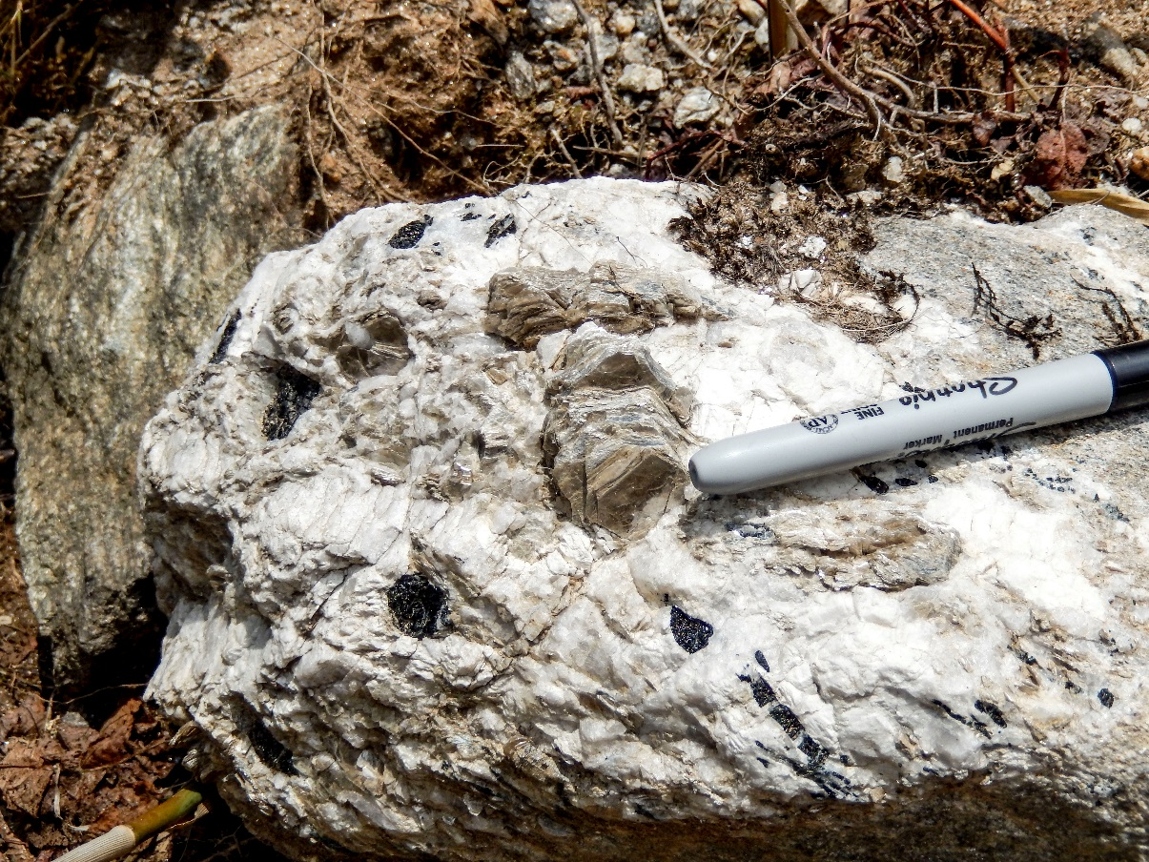
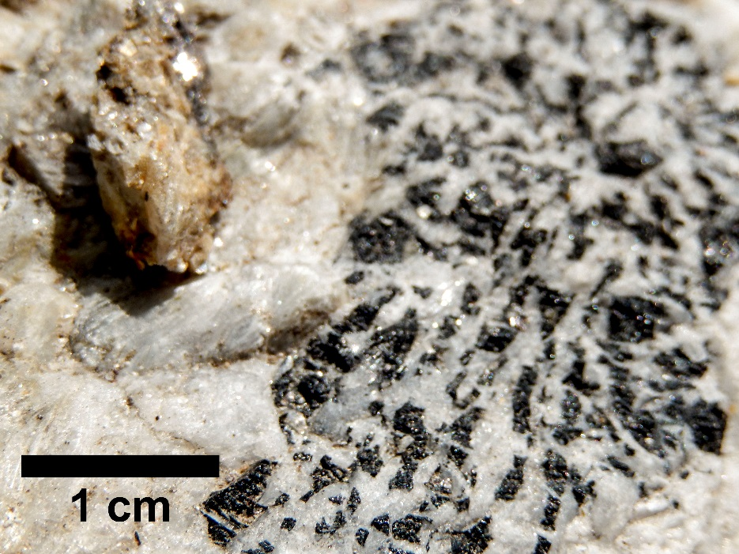
Field Work
Samples from Schist
Weathered Samples
from Transect

Slide 11
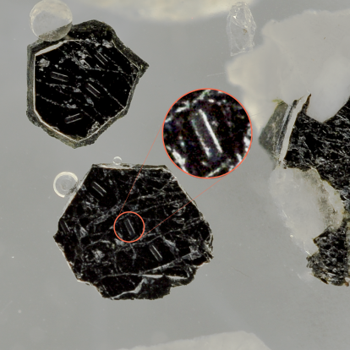
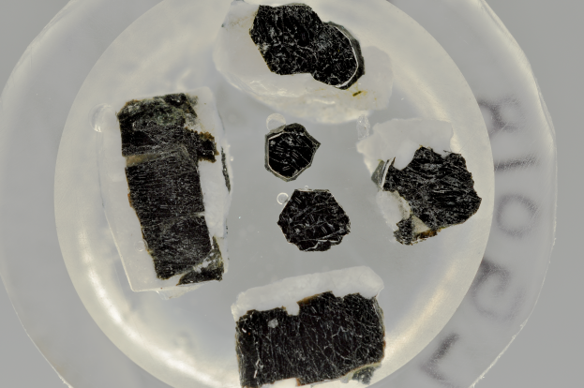
Analysis
LA-ICPMS
In-situ Trace Elements
Inter-sector, Inter-zone?
1 mm
LA-ICPMS Ablation Pits
21 Locations, ~200 individual grains, >400 lines

Slide 12
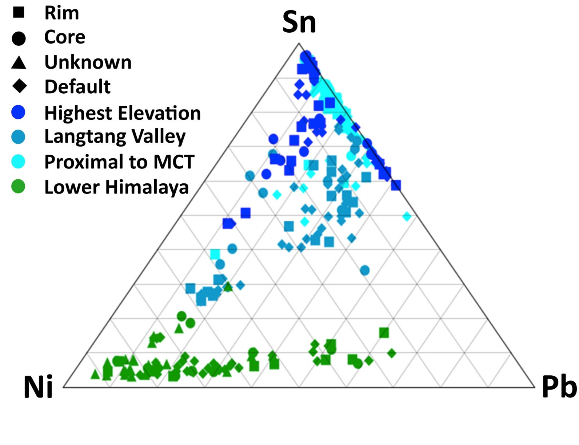
ICPMS Sn-Ni-Pb (ppm)

Slide 13
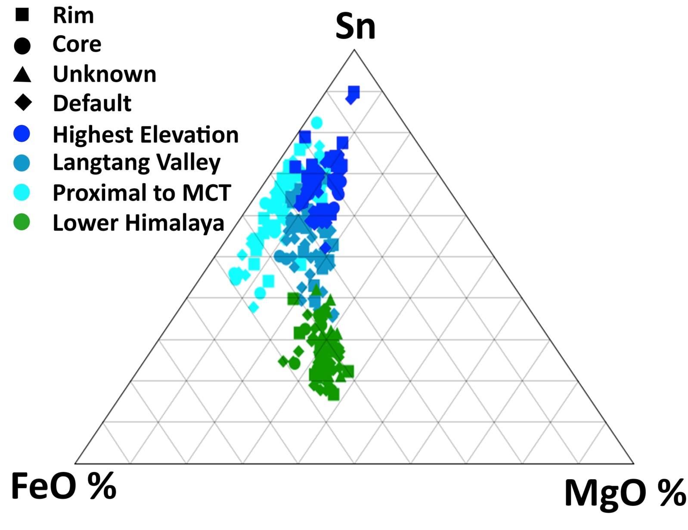
ICPMS Sn-FeO-MgO
(ppm)
(Schorl)
(Dravite)

Slide 14
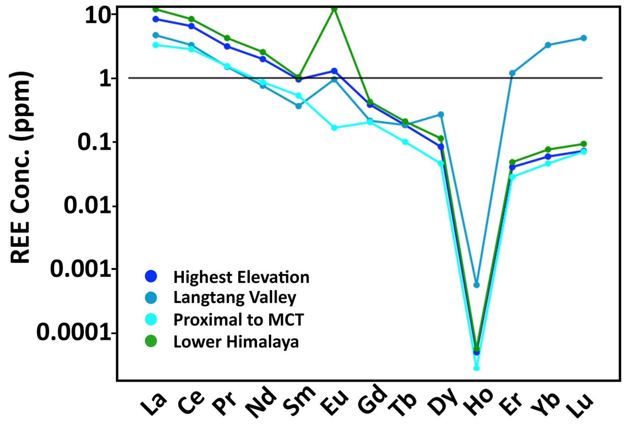
Chondrite Norm. REE
Eu²⁺
Reduced
Compatible
n≈300
Eu³⁺
Oxidized
Incompatible

Slide 15
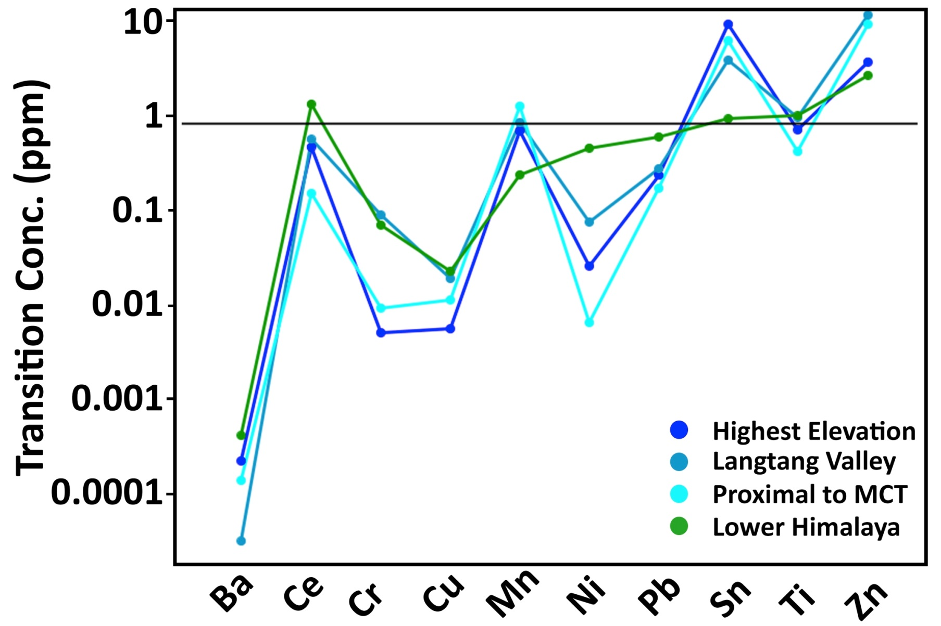
Shale Norm. Transition Metal
Ni
n≈300
Sn

Slide 16
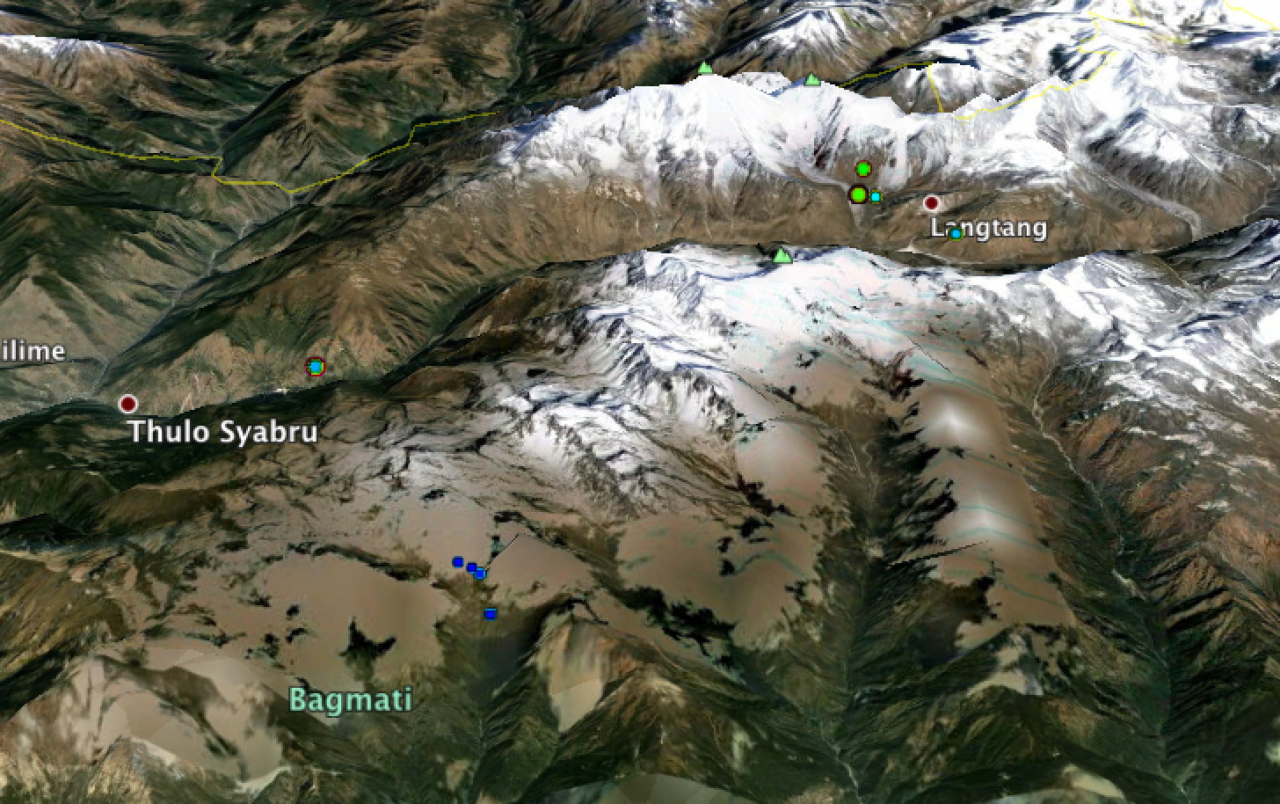
Sn Distribution
MCT
MCT ZONE?
Legend
More Sn
Higher Him.
Less Sn
Lower Him.

Slide 17
Implications
Take Home Messages:
Tourmalines are unique on either side of the MCT
Successful Use of Tourmaline as a Tool for Delineating Thrust Zones in the Himalaya
Use of tourmaline to investigate redox conditions in the Himalaya

Slide 18
Outlook
Many More Questions Arose From This Study
Himalayan Work
Higher Spatial Resolution Sampling for Delineating the MCT
Detrital Tourmaline Sampling from Streams for Delineating the MCT
Source of the Kathmandu Granites
P-T-X Evolution of the MCT
Further Investigation of Redox Conditions with Implications to Ore Exploration
Tourmaline Work
More Detailed Inter-sector and Inter-zonal Work
Many Isotopic Systems and Trace Elemental Signature Work to be Explored

Slide 19
Questions?
Acknowledgements:
Earth Science Department
College of Science and Health
Scholarly Activity Comittee
Steven A. Fellows
Steven H. Emerman
Suman Panday²,
Santosh Adhikari²
Marion Lytle
Matthew Kohn
Mark Schmidt

Slide 20
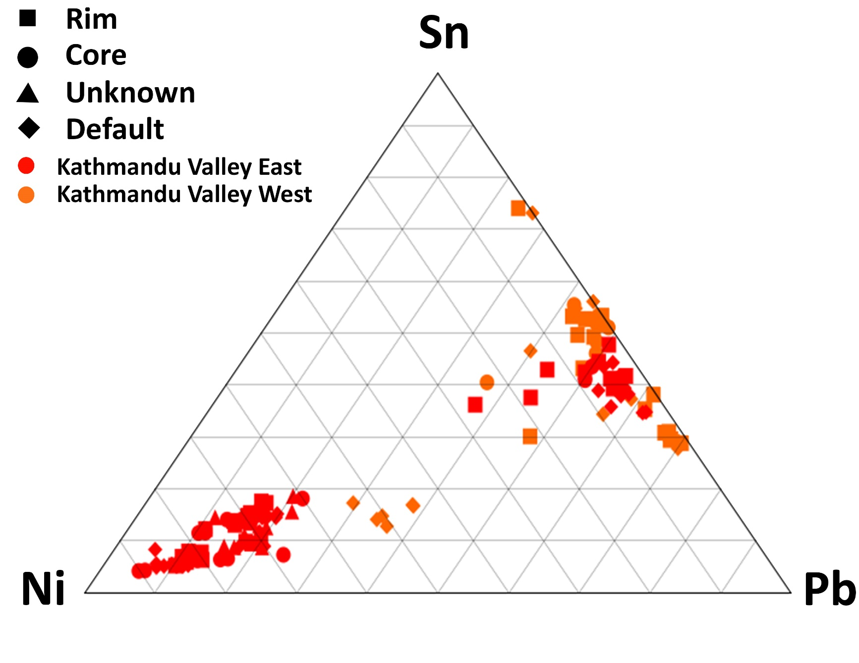
Kathmandu Sn-Ni-Pb

Slide 21
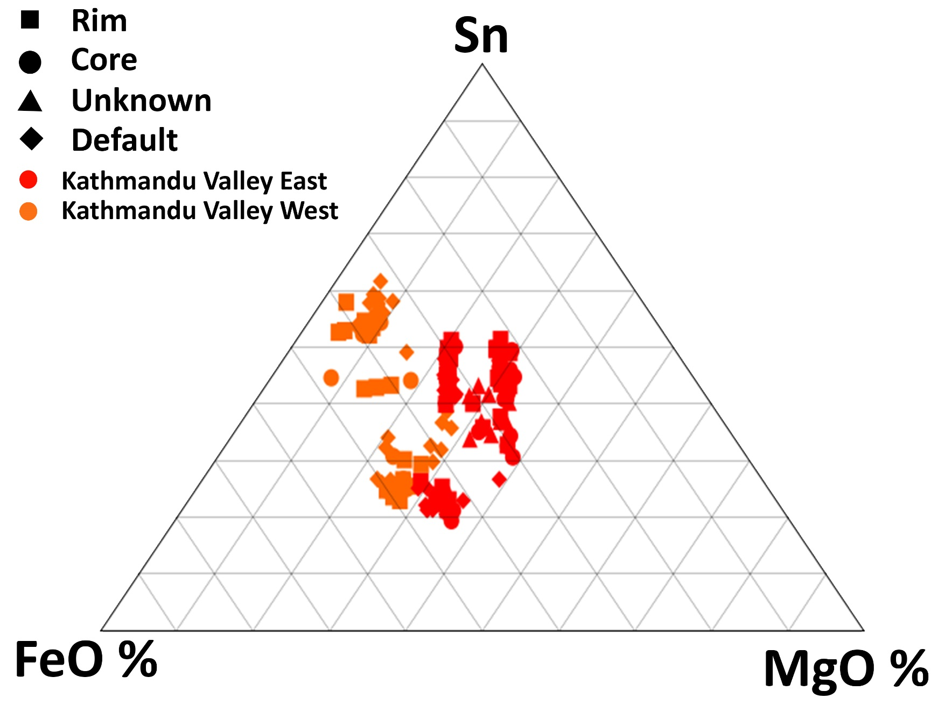
Kathmandu Sn-FeO-MgO

Slide 22
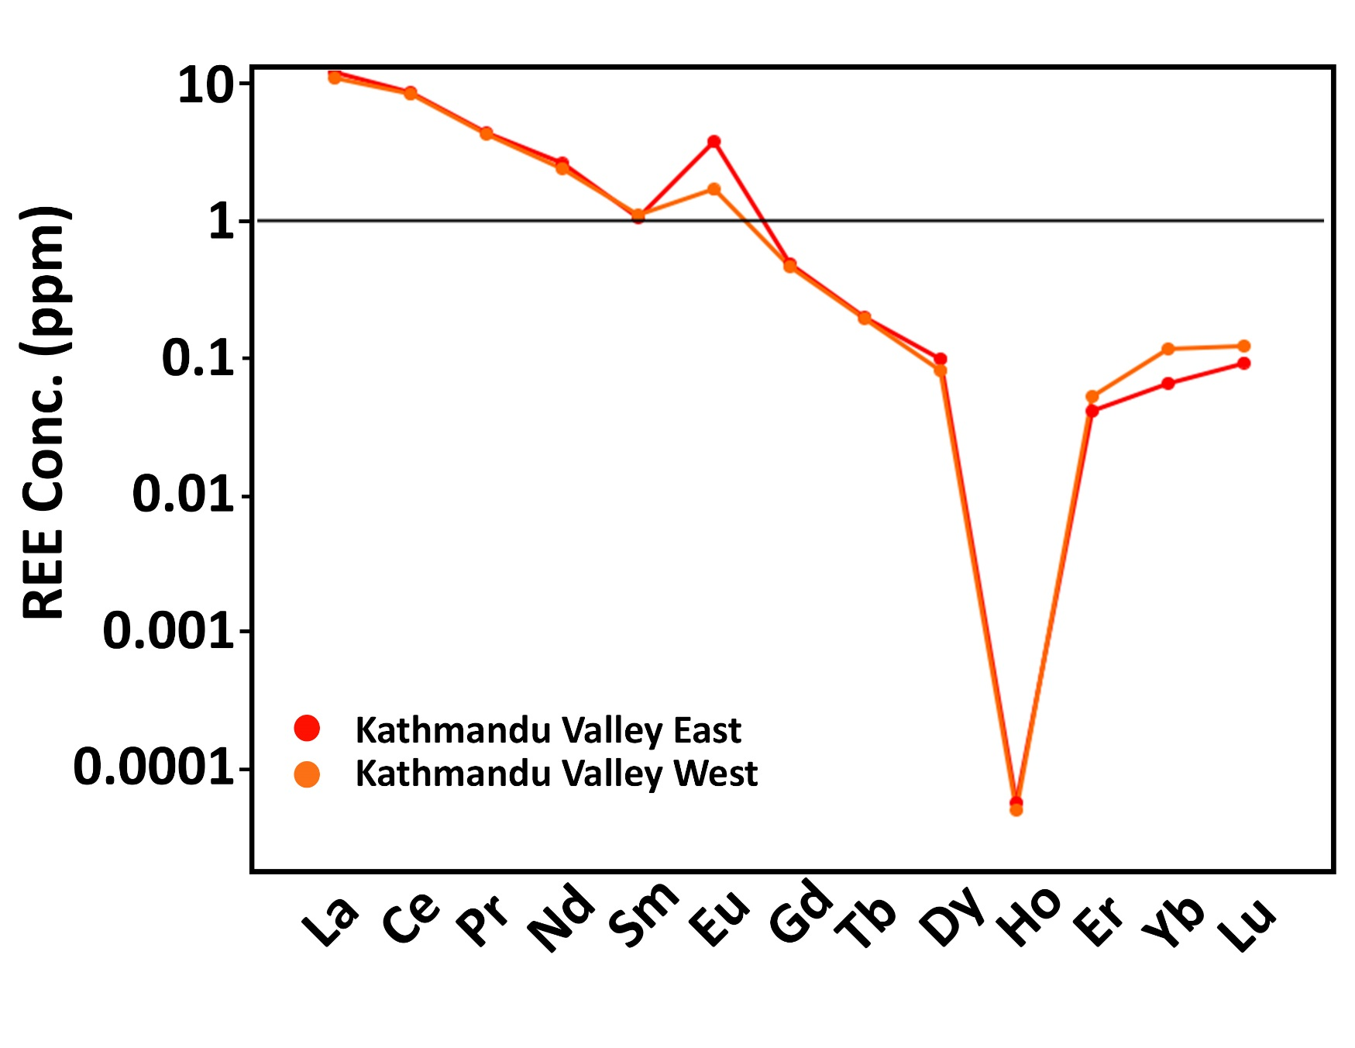
Kathmandu REE

Slide 23
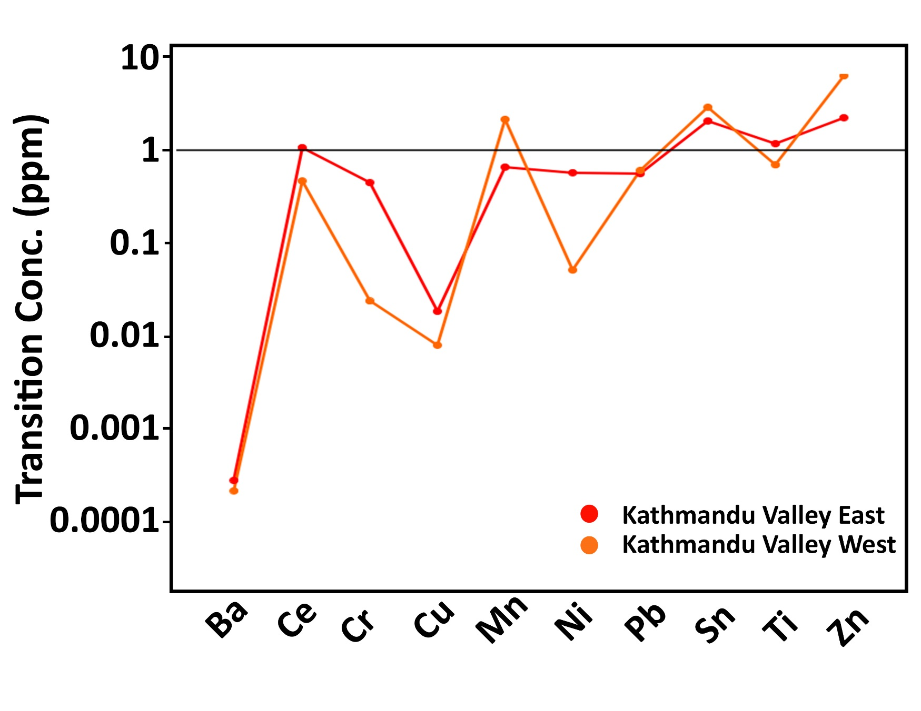
Kathmandu Trans. Metals

Slide 24
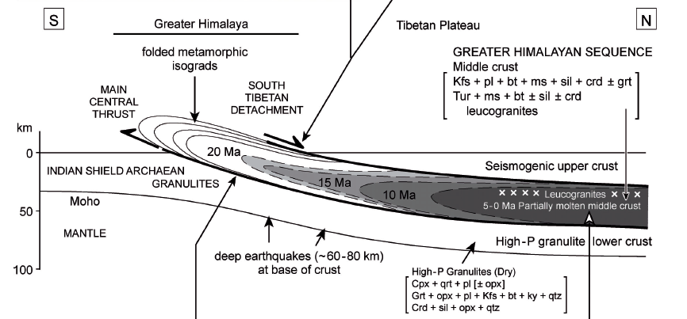
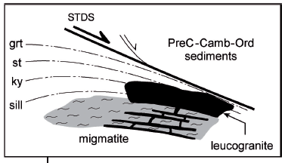
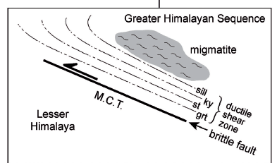
Crustal Flow Model
Kohn et al. (2004)

Slide 25
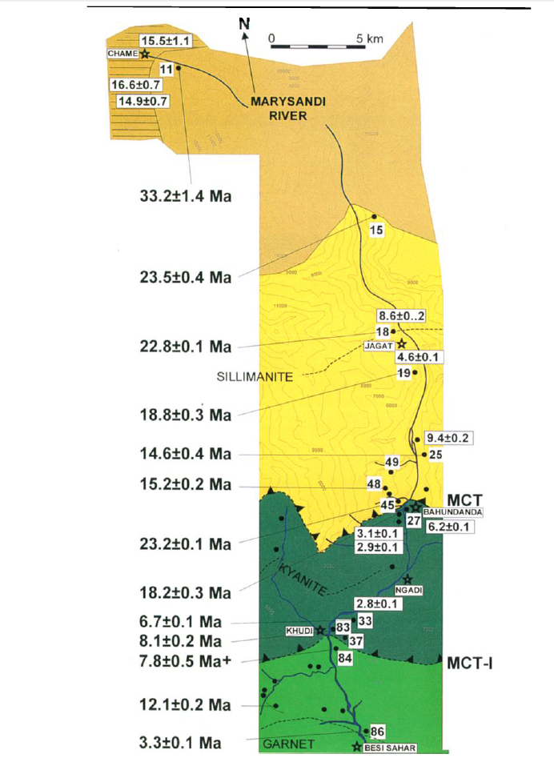
Monazite Ages
Catlos et al. (2001)

Slide 26
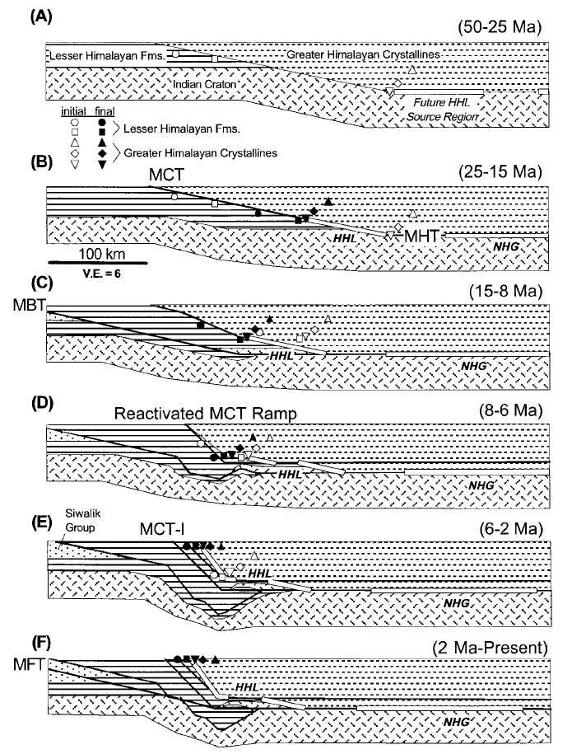
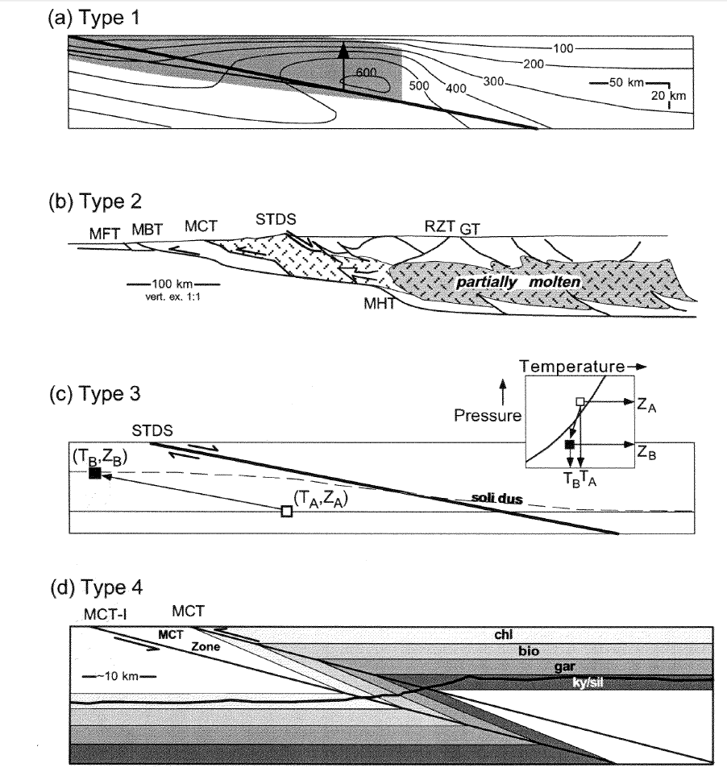
Shearing and out of Sequence Thrusting
Harrison et al. (1999)

Slide 27
Conclusion
Reconciliation?
Harrison et al. (1999)

