Slide 1
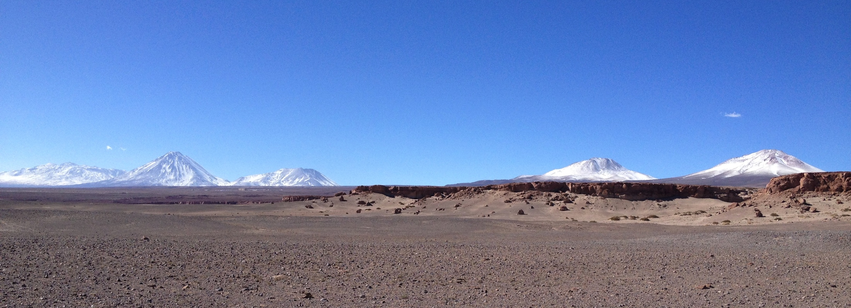
Equilibrium-Line Altitude Reconstruction in the Tropical and Subtropical Andes During the Last Glacial Maximum
Lauren Vargo and Joseph Galewsky
(Dept. of Earth and Planetary Sciences, University of New Mexico)

Slide 2
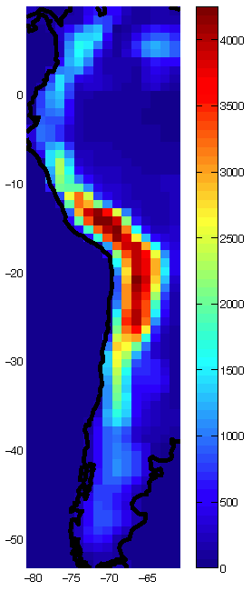
No glaciers exist in the Andes today between 19°S and 27°S
Evidence for glaciation during the Last Glacial Maximum (LGM) or late glacial times (15-12 ka; Ammann et al., 2001; Grenon, 2007)
Better understand processes behind the tropical Andes being continuously glaciated, and the subtropical Andes not continuously glaciated
Elevation (m)
CCSM4 elevation (m) of the Andes (white box indicates area of no present glaciation).
Sagredo et al., 2014

Slide 3
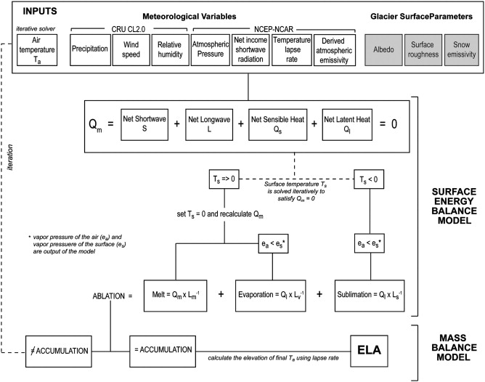
Surface Energy and Mass Balance Model
Model provided by Summer Rupper (Rupper and Roe, 2008)
Inputs: Climate data from general circulation models (GCMs) that are part of the third Paleoclimate Modelling Intercomparison Project (PMIP3)
Flow chart of the surface energy mass balance model, including model inputs, main algorithms and key formulations. Q_{m} = energy availible for melting snow/ice. L_{m}, L_{v}, L_{s} = latent heat of fusion, vaporization and sublimation, respectively (Sagredo et al., 2014).

Slide 4
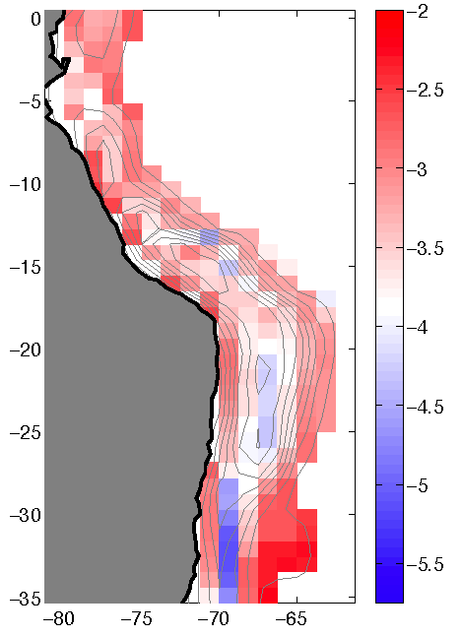
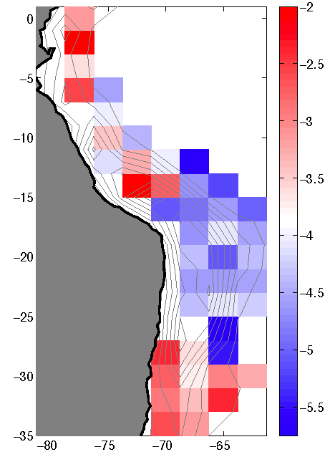
CCSM4
GISS
South
America
South
America
Temperature differences (°C)
Temperature differences (°C)
Pacific
Ocean
Pacific
Ocean
Temperature differences (°C) (LGM – Modern) for CCSM4 (left) and GISS (right) at elevations over 500 m (topography indicated by 500 m contours).

Slide 5
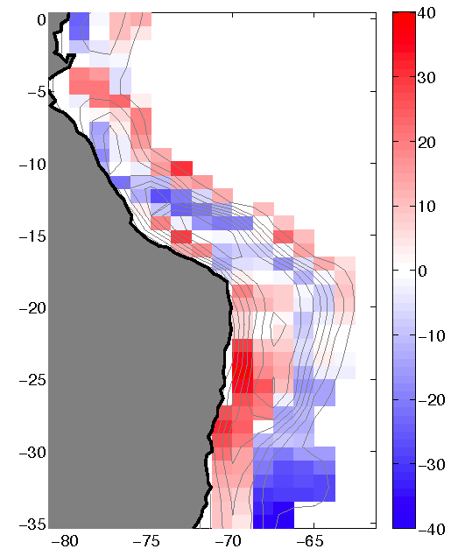
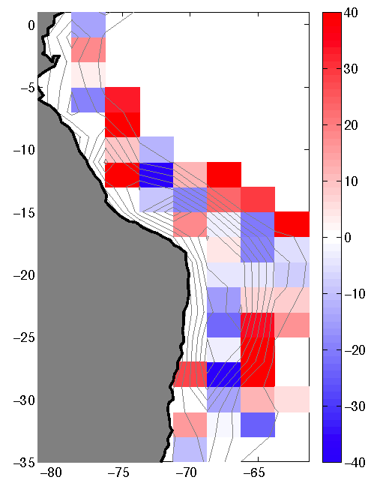
CCSM4
GISS
% of Precipitation difference (m/yr)
% of Precipitation difference (m/yr)
% of precipitation differences (m/yr) (LGM – Modern) for CCSM4 (left) and GISS (right) at elevations over 500 m (500 m contours).

Slide 6
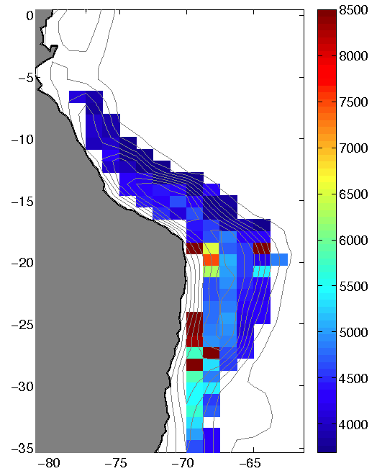
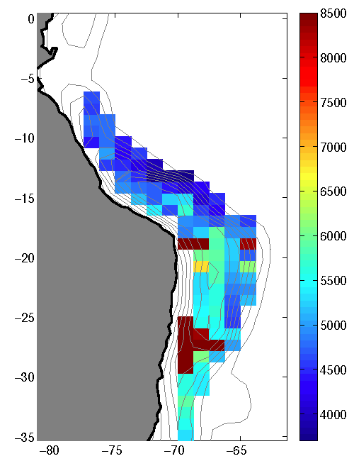
LGM
Modern
ELA (m)
ELA (m)
Modeled ELA (in meters) for CCSM4 LGM (left) and Modern (right) at elevations over 1500 m (500 m contours).

Slide 7
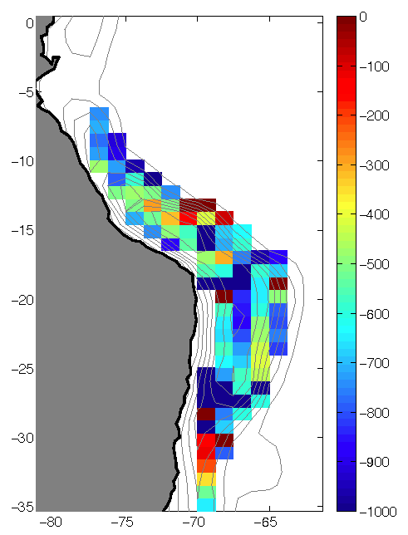
CCSM4 modeled LGM ELA depressions
(LGM ELA – Modern ELA) at elevations over 1500 m (500 m contours).
ELA Depression (m)

Slide 8
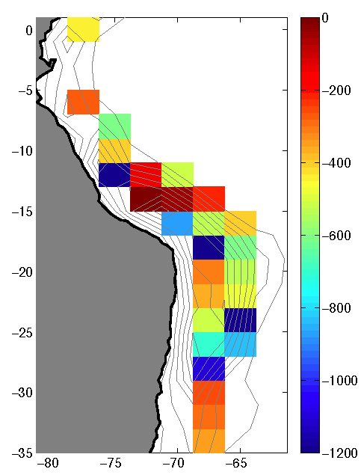
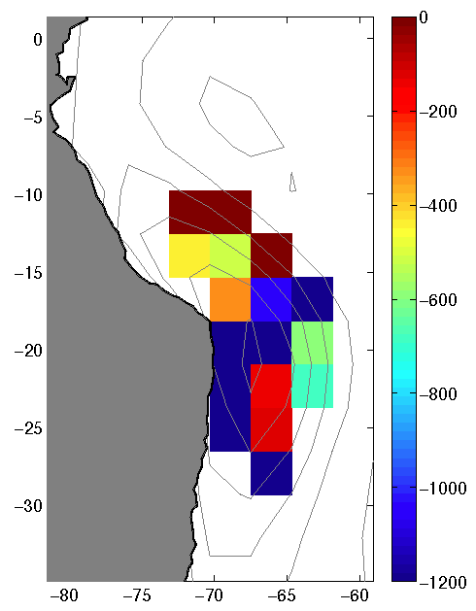
GISS
MIROC
ELA Depression (m)
ELA Depression (m)
Modeled LGM ELA depressions (LGM ELA – Modern ELA) for GISS (left) and MIROC (right) at elevations over 1500 m (500 m contours).

Slide 9
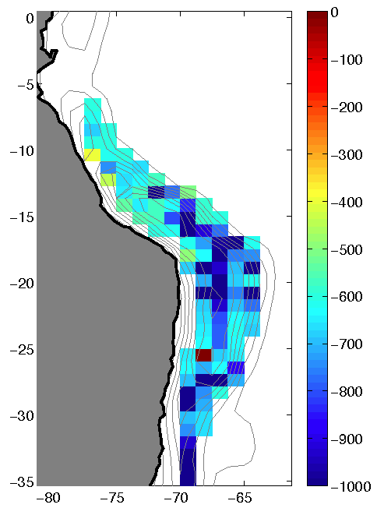
CCSM4 Temperature Sensitivity
ELA depression for Modern climate with decreased temperature, at elevations over 1500 m (500 m contours).
ELA Depression (m)

Slide 10
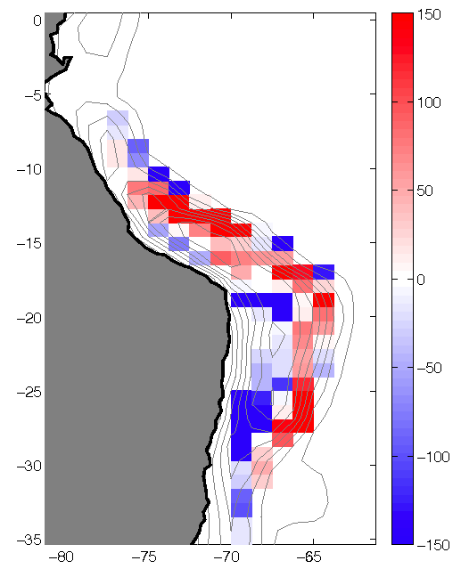
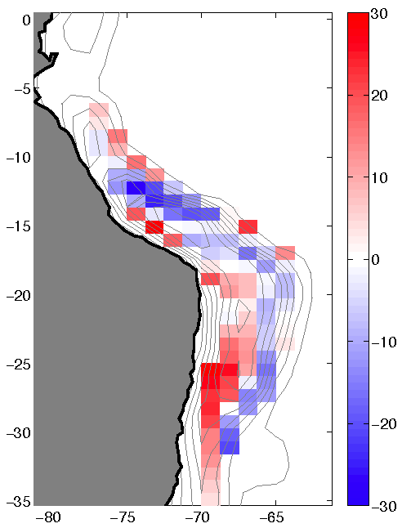
CCSM4 Accumulation Sensitivity
Left: ELA depression for Modern climate with LGM accumulation, at elevations over 1500 m (500 m contours). Below: Changes in annual accumulation.
ELA Depression (m)
% of Precipitation difference (m/yr)

Slide 11
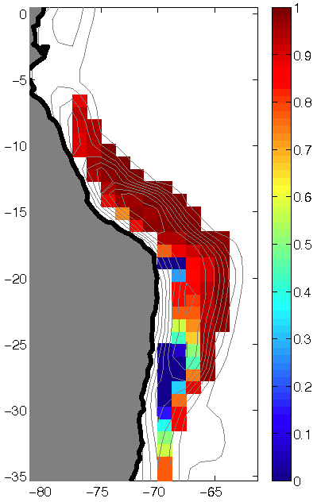
Ablation due to Melt
CCSM4 Modern
Mean annual precipitation vs fractional contribution of melt to total ablation at each grid point between 0.5°N and 35.3°S and at elevations over 1500 m in the Andes.
Total ablation due to melt at elevations over 1500 m in the Andes (500 m contours).

Slide 12
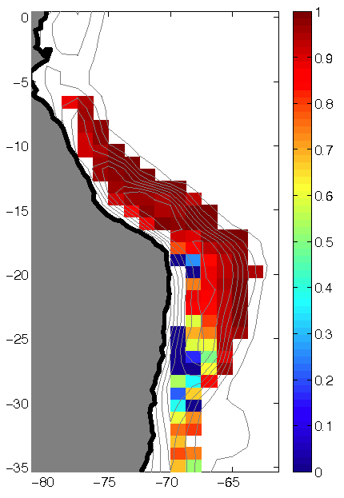
Ablation due to Melt
CCSM4 LGM
Mean annual precipitation vs fractional contribution of melt to total ablation at each grid point between 0.5°N and 35.3°S and at elevations over 1500 m in the Andes.
Total ablation due to melt at elevations over 1500 m in the Andes (500 m contours).

Slide 13
Preliminary Conclusions
Different processes control glaciation in the tropical versus subtropical Andes
Role of precipitation
  Model shows that changes in ELA are more sensitive to temperature than precipitation
  However, the subtropical region receives such little precipitation, that small changes in accumulation may cause significant changes in the ELA
Dominant ablation process
  Ablation in the tropics is dominated by melt
  Ablation in the subtropics also includes sublimation

Slide 14
Future Questions
How accurately does the SEMB model predict glaciers?
  Test using high resolution DEMs
  Compare model results to published values for ELA depressions in the northern Andes
What additional details do higher resolution simulations tell us about:
    LGM climate?
    ELA depressions during the LGM?
    Melt vs. sublimation trends through the Andes?

Slide 15
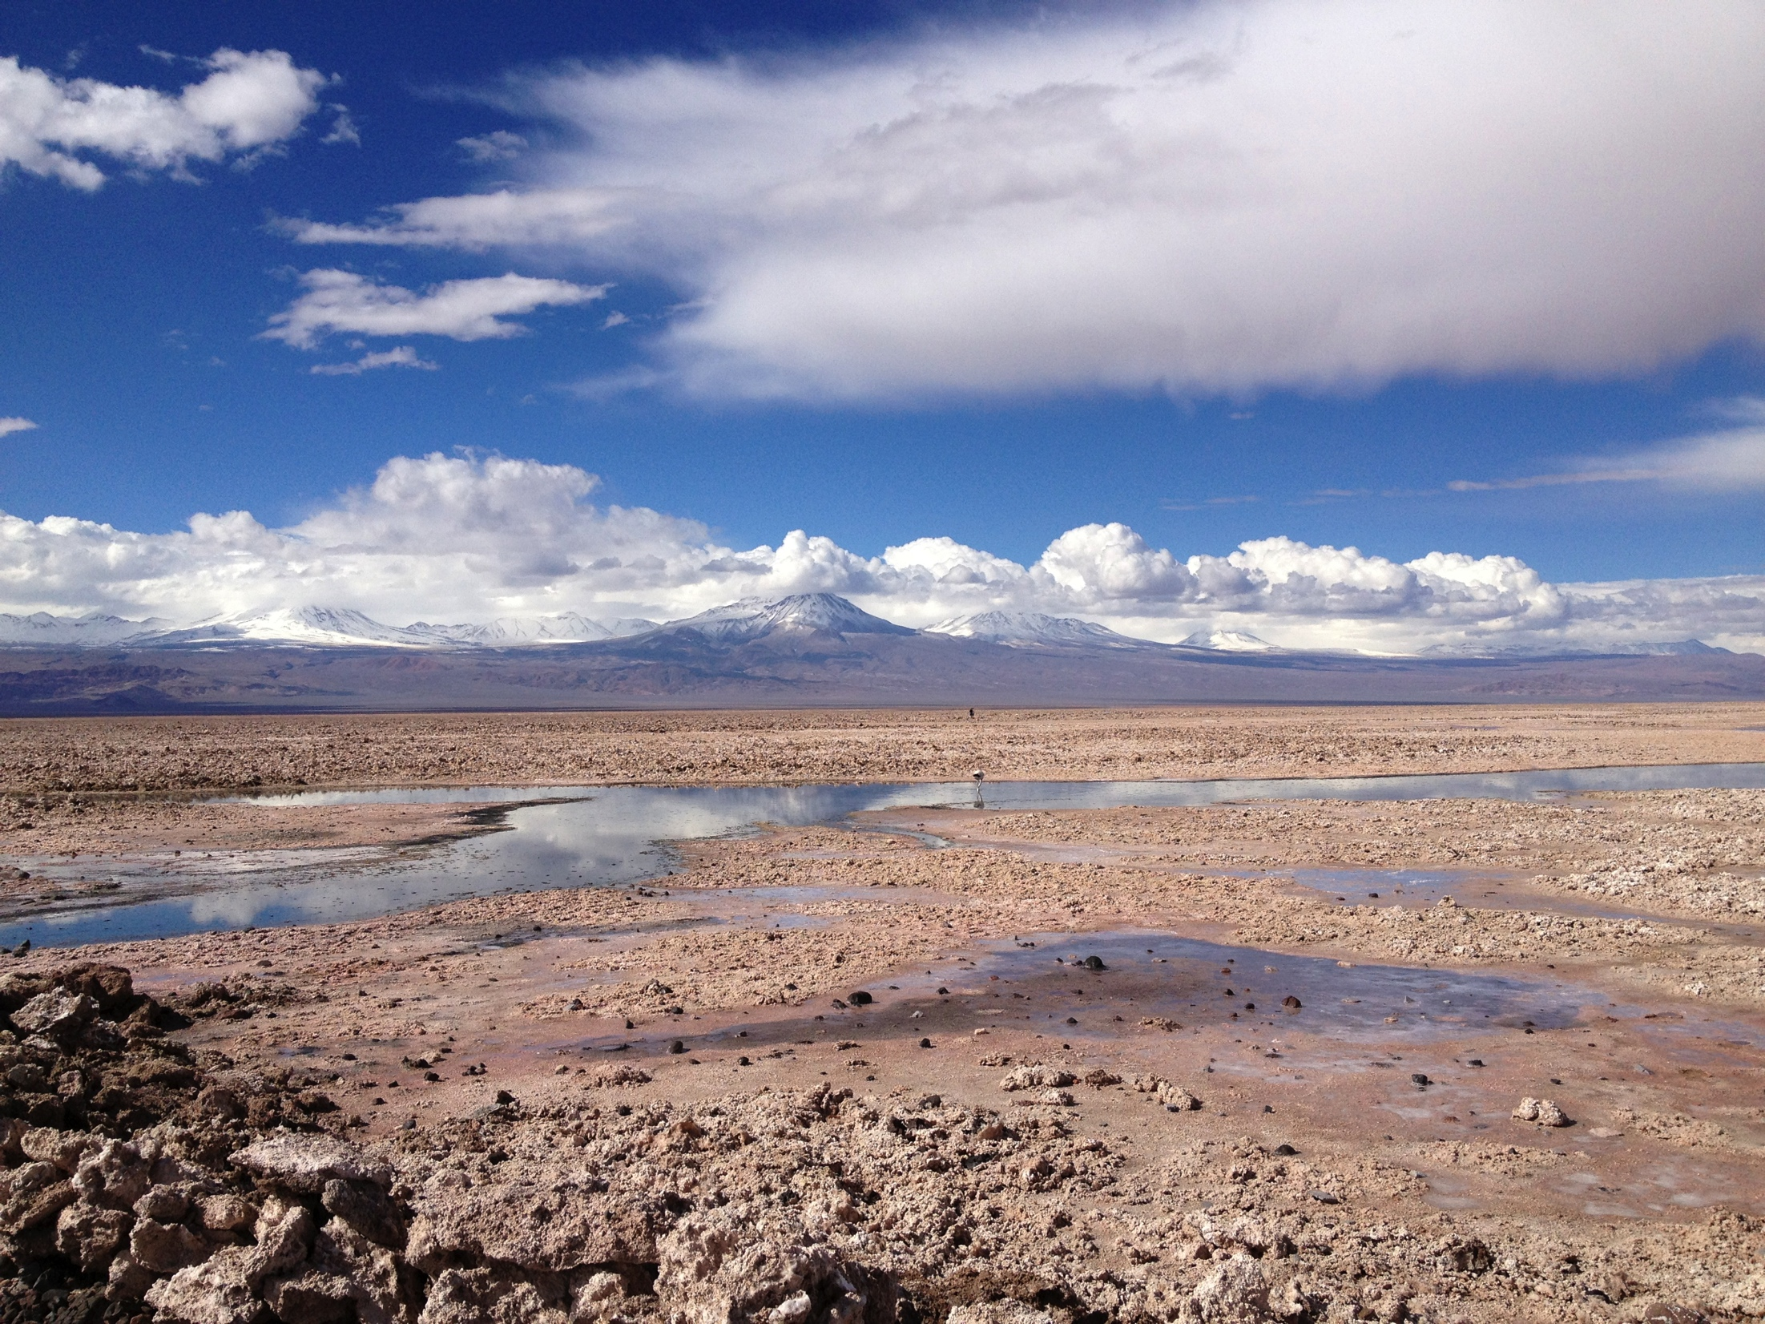
We thank Summer Rupper and Dylan Ward for their help with this research.
This work is supported by NSF Grant GLD-1226611.

