Slide 1

Understanding Graph Reading and Comprehension Through Eye-Tracking
James Lindgren and Karl Wirth
Notes:
Welcome, Title
The illustration of numerical information in graphic form is an age-old practice to disseminate important information and reveal relevant trends.

Slide 2
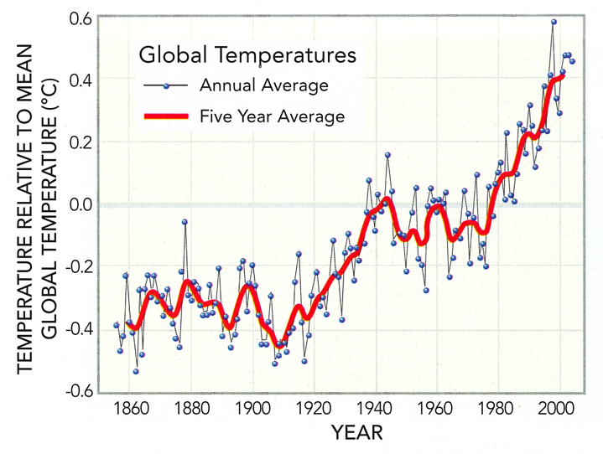
Reynolds et al. (2013)
Notes:
Graph comprehension is a critical science reasoning process. Graphic visuals are pervasive in and central to scientific research, education, media, and informed citizenship; therefore, in order to keep up with the demands of our modern society, students need to learn how to utilize their knowledge and skills to think critically and solve problems. Graphs are so widely used, because they seemingly make quantitative data easy to understand and communicate; however, in many cases graph comprehension requires additional levels of cognitive work and is prone to error.
This represents a traditional bivariate plot with year on the x-axis and relative-to-mean temperature on the y-axis. The data consists of annual average and superposed with a 5-year average in red. This graph came from a textbook written by Reynolds et al. and exemplifies the graphs student will regularly see and interact with.

Slide 3
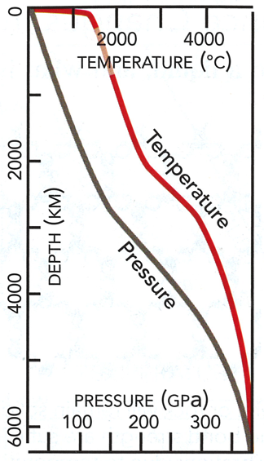
Reynolds et al. (2013)
Notes:
However, in the Geosciences we love to add some spice to our graph-making. Sure we have plenty of graphs like the one before, but we like to add various levels of difficulty like this quintessential geothermal gradient graph that inverts the y-axis and increases in value as you move down. The x-axis serves as a ground levels and they data progresses down in true geologic manor.

Slide 4
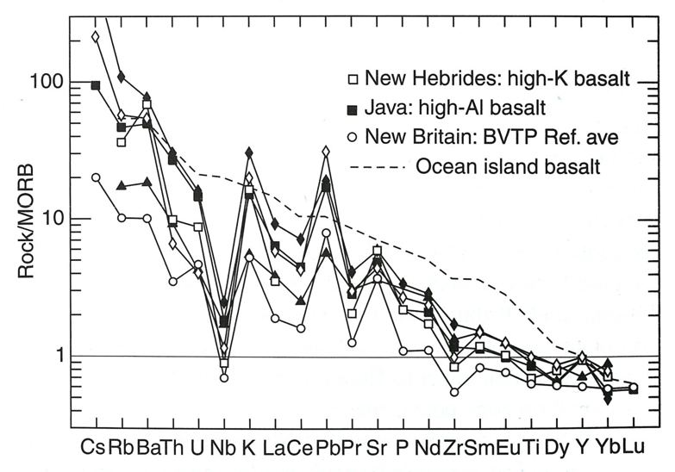
Winter (2010)
Notes:
We also like to normalize data like this graph which normalizes to Mid-Ocean ridge basalt on a log scale y-axis. Talk a levels on level of confusion. Our goal in this research is to not only improve graph reading skills of students in our introductory courses (science literacy of citizenry) but also to better understand the unique challenges that our majors face in learning to use specialized graphs like this and others such as Cumulative Curve, Ternary Plots, etc.

Slide 5
Research Question
How can we help students develop better graph reading skills?
Critical Look at graph design (Acarturk et al., 2008)
Eye-Track in problem solving (Schneider et al., 2012; Susac et al., 2014)
Signaling in Photographs (Coyan et al., 2010; Mason & Pluchino, 2013)
Geology field course (Maltese et al., 2013)
Expert/Novice Continuum (Petcovic & Libarkin, 2007)
What is the strategic difference between how novice and expert populations read and interact with graphs?
Notes:
Graph reading is an important skill in science literacy for our non-majors. And because it will help our majors become better scientists. However, little is understood regarding the details of how students explicitly perform these tasks. So, our initial guiding question was “How can we help students develop better graph reading skills?” At this point, we were thinking in the clouds reading literature from geoscience education research to statistical and scientific literacy research to the cognitive science research. Many people have written on this topic, but we were looking for more—a way to intervene against this difficulty students were having with these materials. There has been beginning to be a lot of rumination on this topic that I have sampled on the screen on the topics related to eye tracking from geoscientists and psychologists alike, for instance at GSA in 2012, there was an entire digital poster) session on it: Seeing Through the Eyes of the Geologist. Informed by this research and our own interests, the conversation became interested in understanding how novices and experts explicitly read graphs and other multimedia. So then we were able to ask (TRANSITION) “What is the strategic difference between how novice and expert populations read and interact with graphs?” What makes them different and how do we diminish that gap.

Slide 6
Methods
Recruited Two Populations
Students from Introductory Level Geology Courses
Faculty and professional staff from across the college
All participants looked at 8-12 graphs that we designed. For each graph, they were asked 3 questions.
Modeled off graph types common to the geosciences.
Coupled with accessible content.
Notes:
We recruited from two Populations: Students from Introductory Level Geology Courses, who we have defined as novices and Faculty and professional staff from across the college, who we have labeled a experts. For our purposed, to be an expert, you needed to have a Ph.D or equivalent professional degree and essentially be an expert in their field. These experts came from natural science, humanities, social science, and fine arts departments. As of this last Friday, we have run 45 novices and 23 experts through our eye tracking module. Unfortunately, not all of their data is in this presentation as I am sure you can understand. (TRANSITION) All participants came into the lab and looked at 8-12 graphs that we designed of graphs that are common to the geosciences coupled with accessible content rather than disciplinary material. For each graph were asked to observe each graph for 30 seconds and then while leaving the graph up responded to three questions (a MC, interpretive, and descriptive)

Slide 7
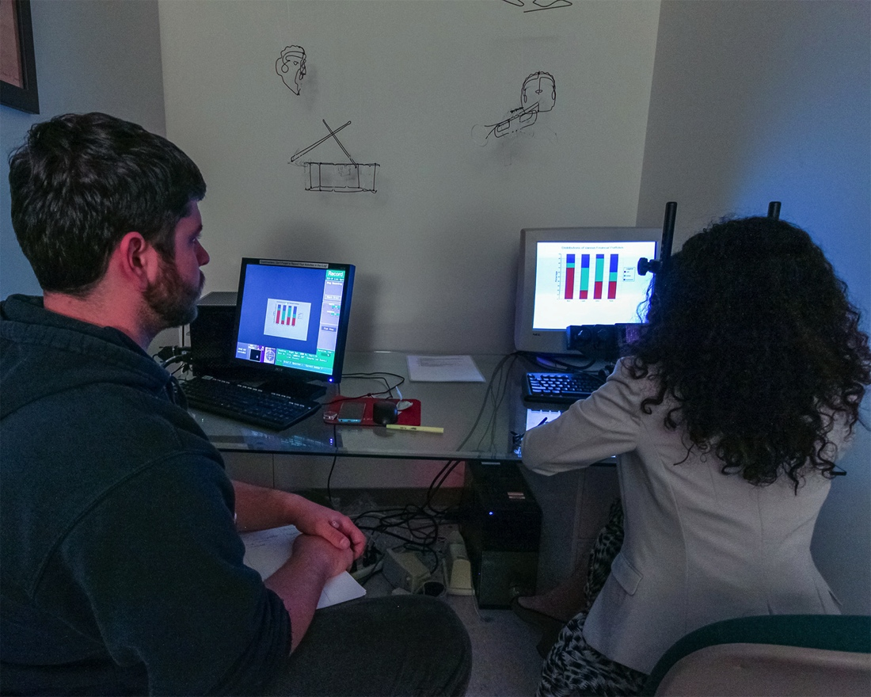
Notes:
The role of eye tracking is twofold. The graph modules will allow us to first quantitatively and qualitatively confirm the expert/novice difference in cognitive approaches that has been started to be seen in previous studies using a diverse pool of participants from across the college. Second, once we established some cognitive and strategic differences, we were able to learn the common successful strategies and may be able to make recommendations for interventions in the classroom. But first, we need to understand the data.

Slide 8
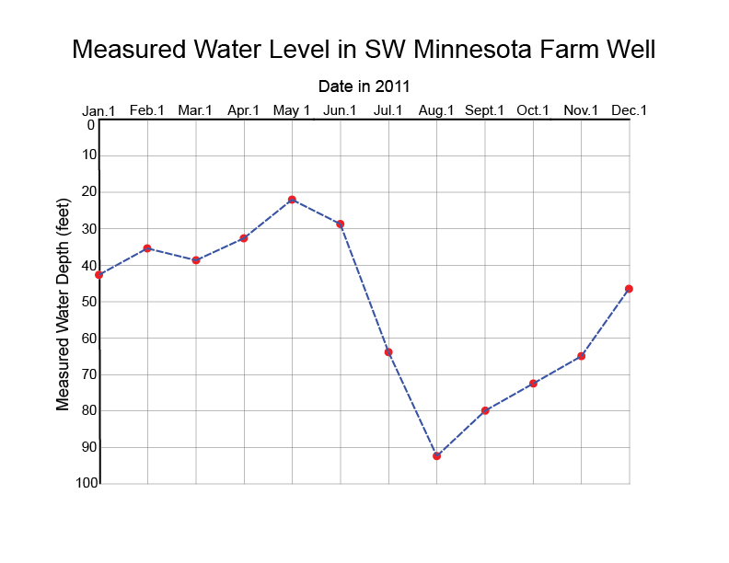
Notes:
This is an example of a graph that we used on the eye-track module. The y-axis is inverted and increasing down the graph. The topic is well data which is not highly disciplinary. The design is not what a conventional bivariate graph would look like and wouldb’t stand out in the geosciences.
We are able to create heat maps from the different graphs and stages that provide us with a wealth of qualitative information. When we asked participants to first observe the graph for thirty seconds, we can see some interesting trends.

Slide 9
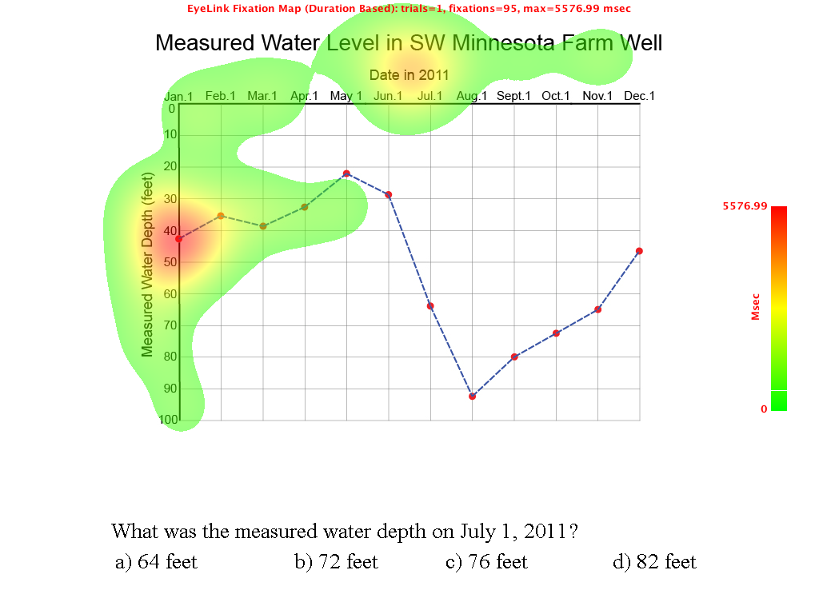
Novice (Pre-Question)

Slide 10
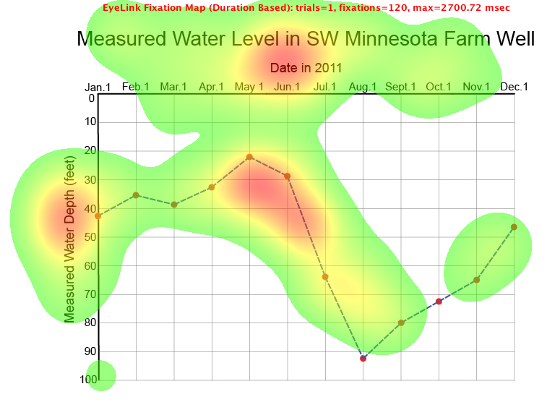
Expert (Pre-Question)

Slide 11
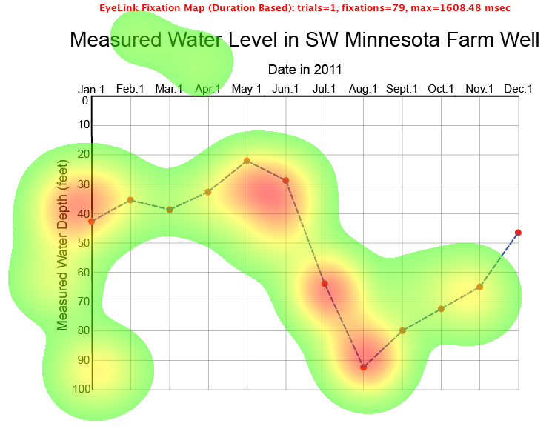
Expert (Verbal: Interpretive)
Notes:
Question: Describe the trends present in this data.

Slide 12
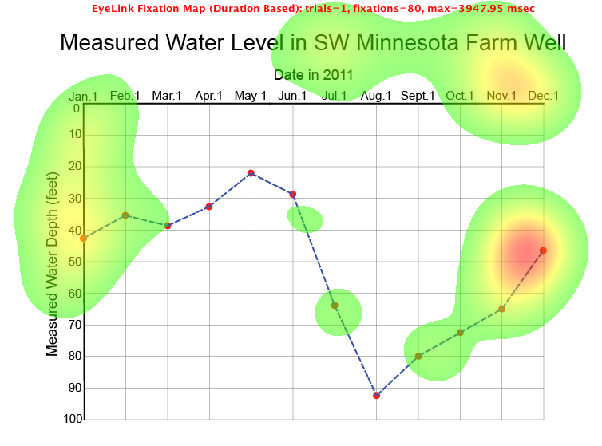
Novice (Verbal: Interpretive)

Slide 13
Graph Reading Assessment Scores
Assessment Level | Average Novice Score | Average Expert Score | P-value
Multiple Choice | 66.9% | 87.8% | 0.029
Verbal: Interpretive | 71.8% | 90.0% | 0.000
Verbal: Predictive | 60.0% | 90.4% | 0.000
Eye-Track Metrics
Metric | Average Novice Value | Average Expert Value | P-value
Number of Blinks | 40.84 | 8.20 | 0.006
Number of Fixations | 344.55 | 116.00 | 0.002
Number of Runs | 113.13 | 30.58 | 0.000
Notes:
Away from the qualitative, we can quantify these difference between the two populations. If only there was a way for me to represent this information in my intuitive and visual way (TRANSITION)

Slide 14
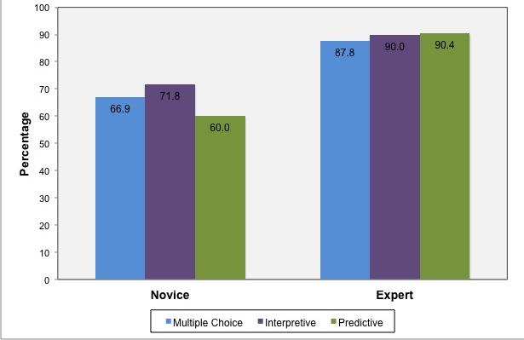
Graph Assessment Scores by Status and Question Level

Slide 15
Graph Reading Assessment Scores
Assessment Level | Average Novice Score | Average Expert Score | P-value
Multiple Choice | 66.9% | 87.8% | 0.029
Verbal: Interpretive | 71.8% | 90.0% | 0.000
Verbal: Predictive | 60.0% | 90.4% | 0.000
Eye-Track Metrics
Metric | Average Novice Value | Average Expert Value | P-value
Number of Blinks | 40.84 | 8.20 | 0.006
Number of Fixations | 344.55 | 116.00 | 0.002
Number of Runs | 113.13 | 30.58 | 0.000
Notes:
Eye-Track Metrics:
Blinks: could tell us many things including stress/anxiety to perform.
Fixations: could tell us a bit about rate of movement or deliberateness. All a bit subjective and subject to major assumptions (TRANSTION)
Runs on the other hand can give us some interesting insights into strategy in our quest to quantify strategy. Let me explain how we count runs.

Slide 17
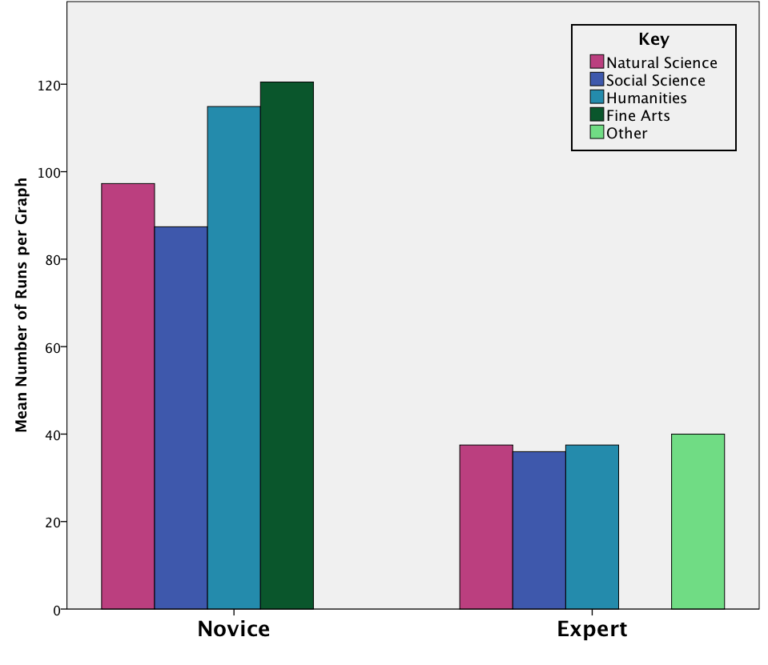
Mean Number of Runs per Graph by Status and Division
Notes:
-Statistical difference between status
-Novices (Student that interact with graphs more are lower)
-Experts are the same.

Slide 18
Preliminary Findings
Experts are more successful graph users
Novices and “experts” approach graphs in distinctly different ways
Approaches not affected by graph style
Expertise appears independent of disciplinary training.
Analogous to critical thinking development (?)
Expert strategies include thorough narration and problem-solving.

Slide 19
Acknowledgements
Dr. Brooke Lea and the Macalester iLab
Macalester College Travel Grant
Geoscience Education Division Travel Award
Macalester College Geology Department

Slide 20
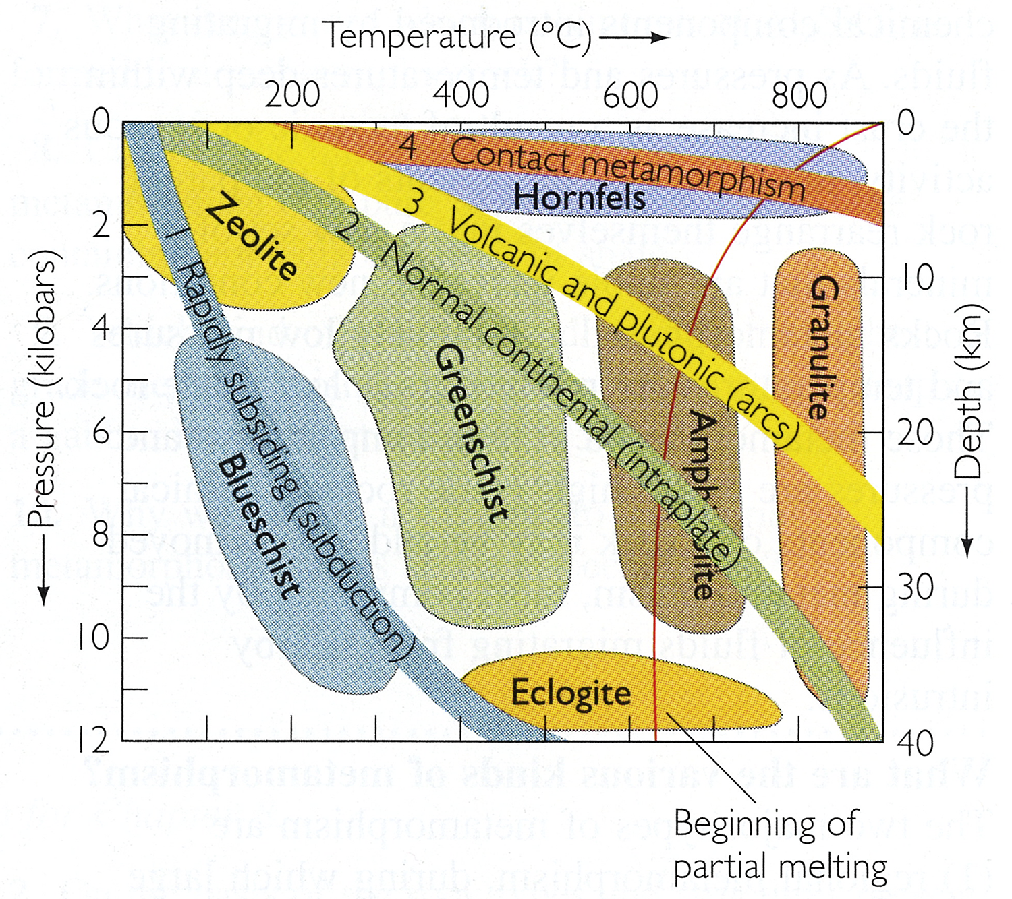
Thank you! Questions?
Notes:
I would love to take any and all of your questions… or if you all just want to see more graphs we can do that too.

Slide 21
Next Steps
Experts in different disciplines
Cross-sectional study of novices
Development of graphing skills across major
Analysis of temporal eye-track data
Survey of faculty instructional practices
Development of instructional interventions

Slide 22
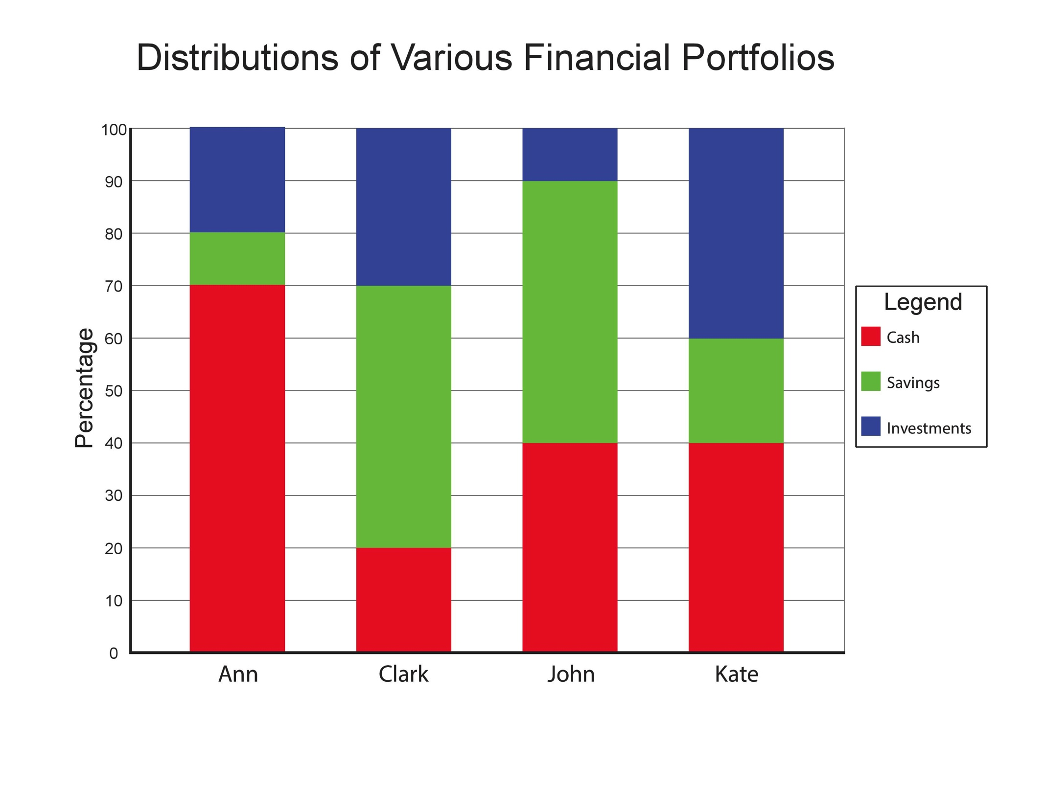

Slide 23
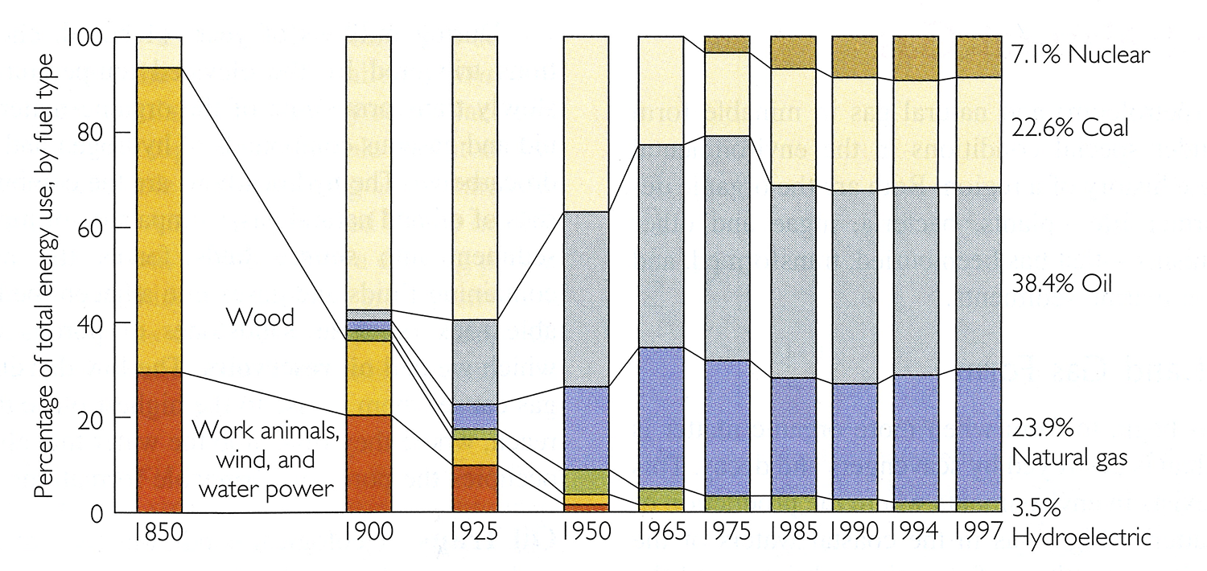
Press & Siever (2001)

Slide 24
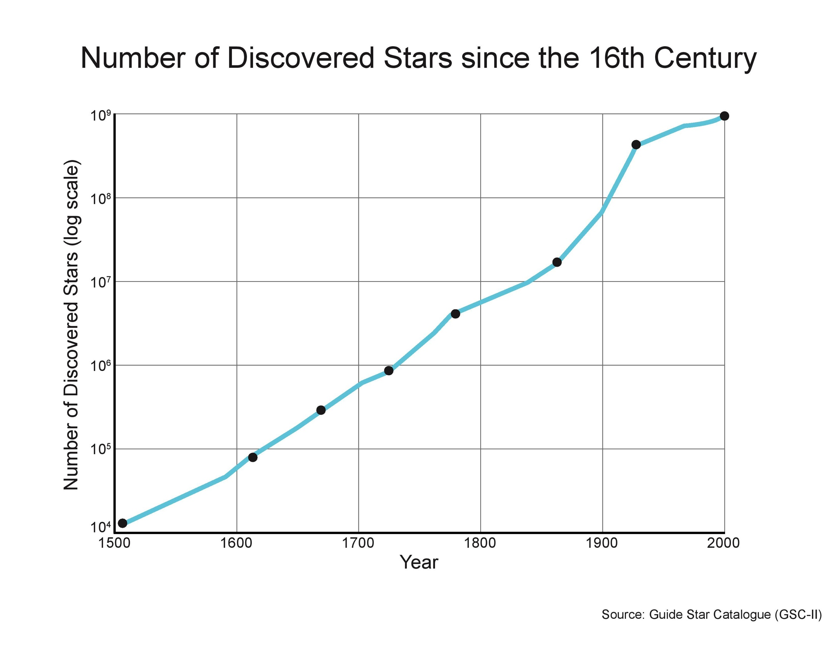

Slide 25
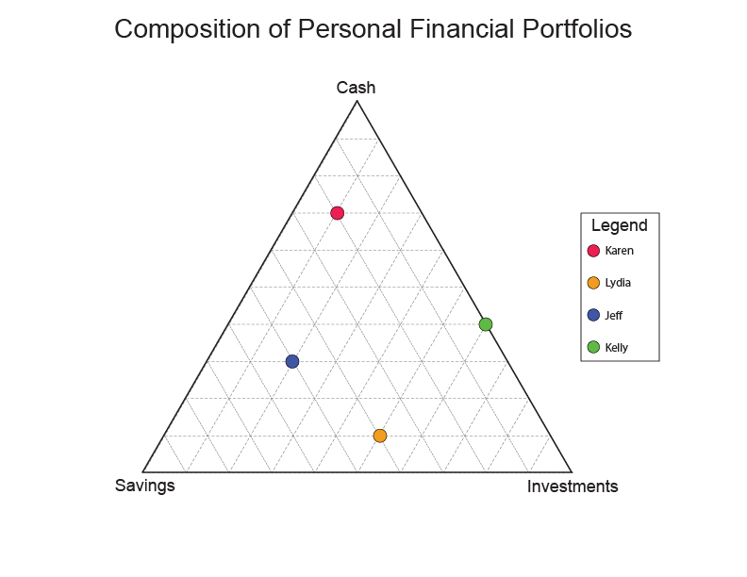

Slide 26
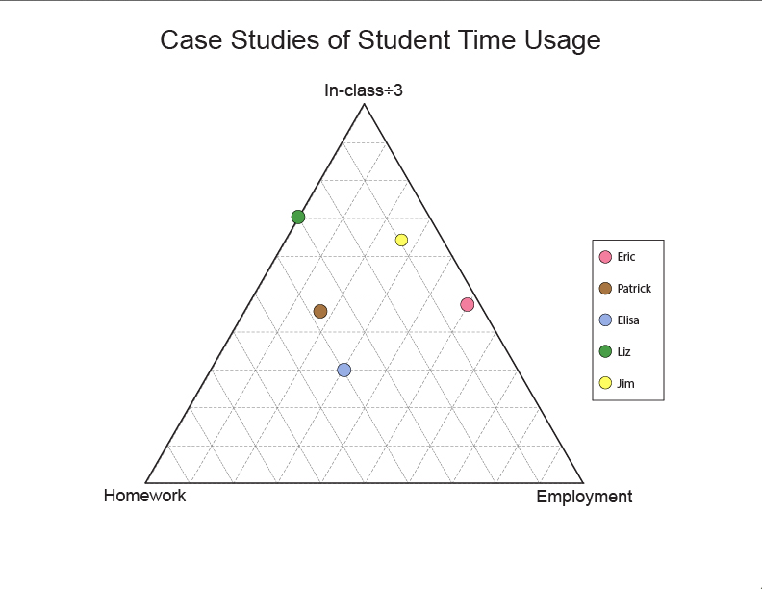

Slide 27
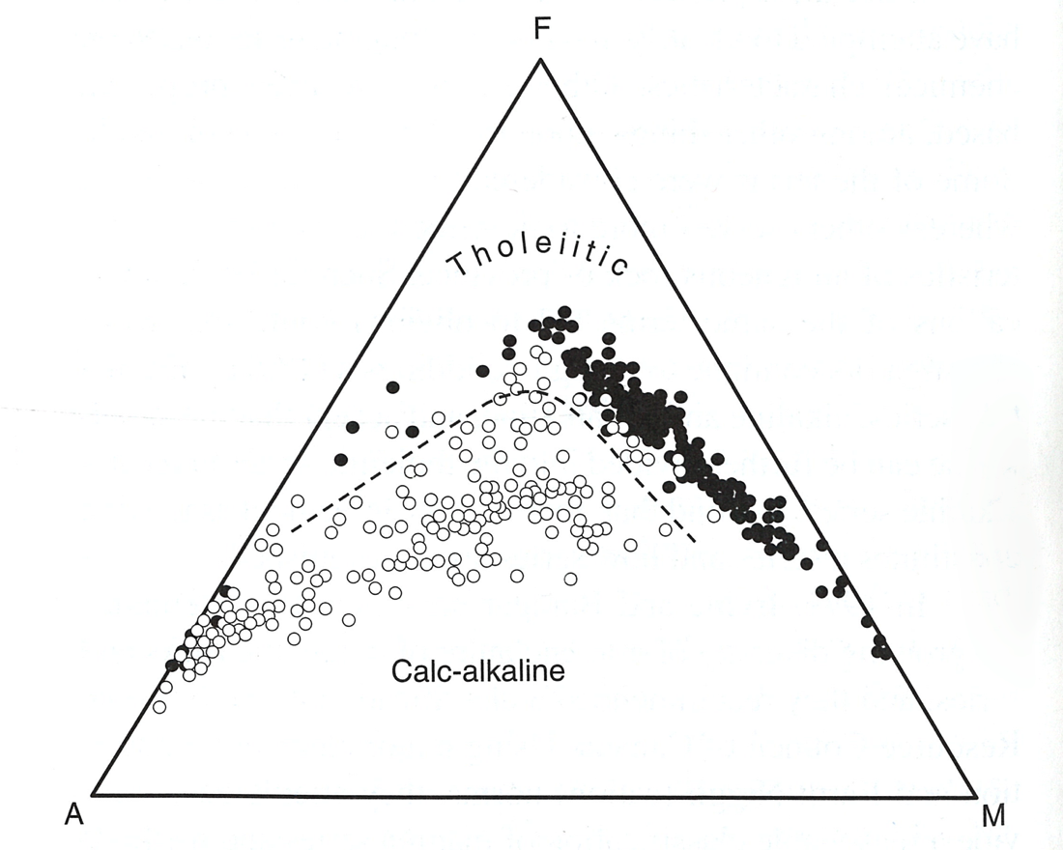
Winter (2010)
Notes:
Our goal is to not only improve graph reading skills of students in our introductory courses (science literacy of citizenry) but also to better understand the unique challenges that our majors face in learning to use specialized graphs.

Slide 28
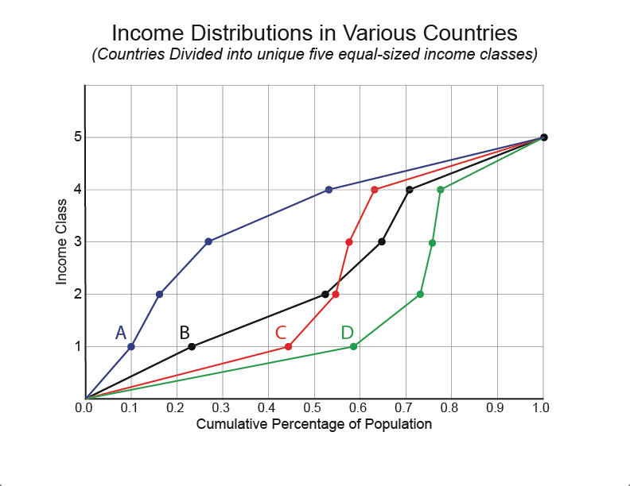

Slide 29
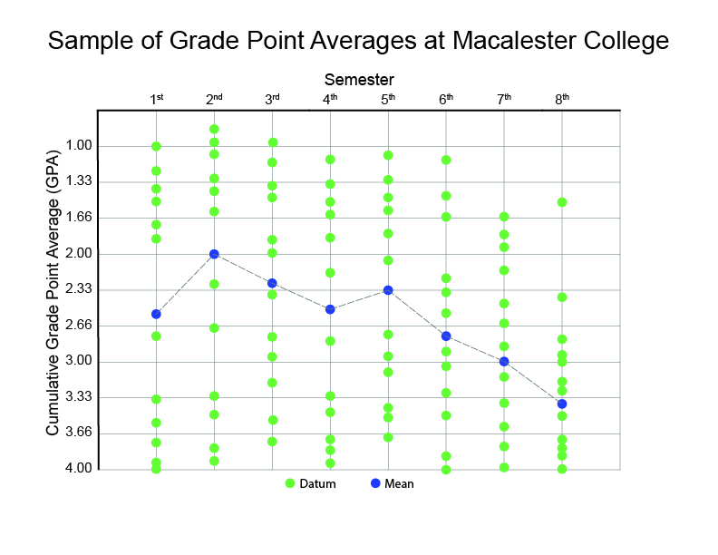

Slide 30
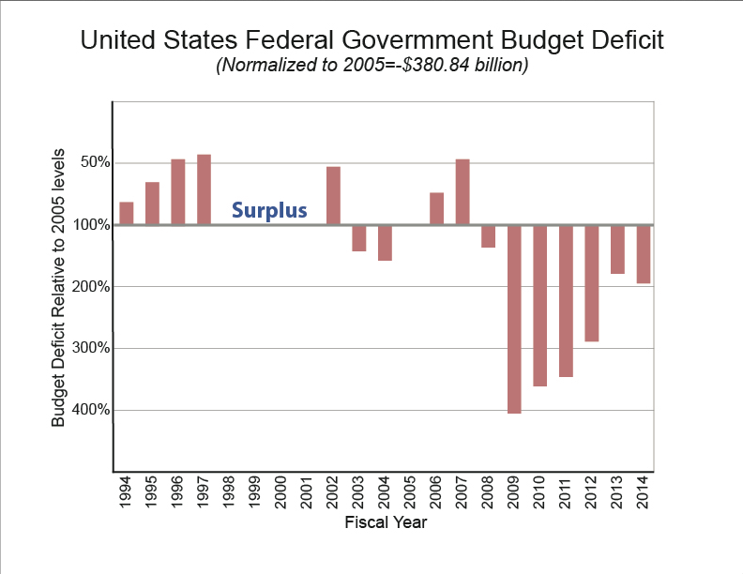

Slide 31
Press & Siever (2001)

