Slide 1
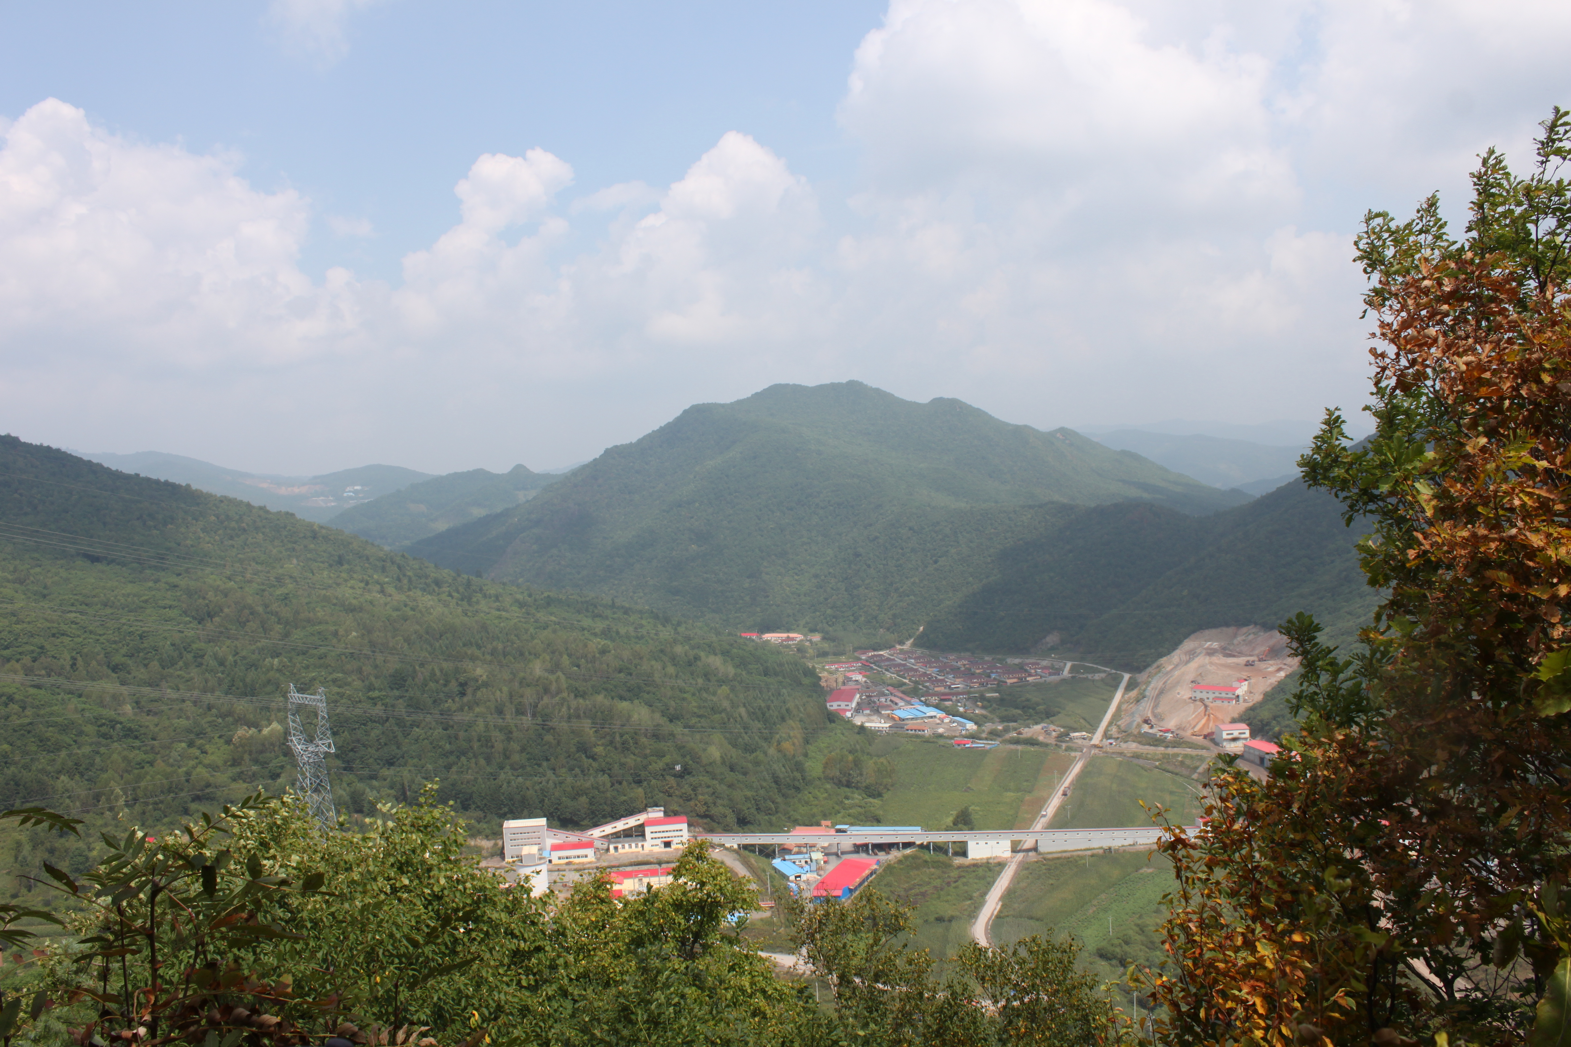
Field Relationships from the White Mountain Gold Deposit, Jilin Province, China: Defining Ore Controls in an “Enigmatic Breccia-Hosted Gold Deposit”
Halley Keevil, Thomas Monecke, Richard Goldfarb, Greg Collins, Tao Feng, and Tim Baker
GSA - October 21st, 2014
Notes:
This talk is going to be about the preliminary field work of my PhD research. Any conclusions are speculative and warrant further work that I will be doing over the course of my PhD.

Slide 2

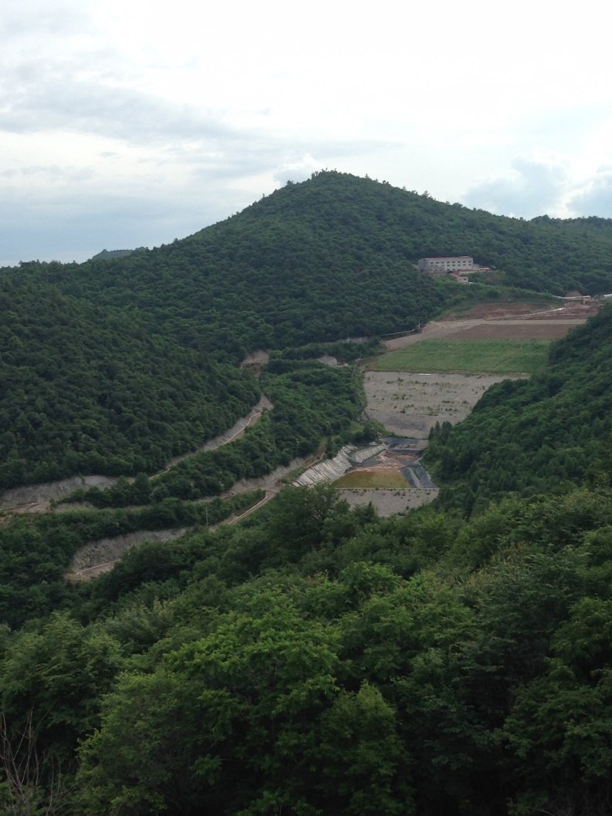

Overview:
Regional geologic setting
Mine scale stratigraphy
Breccia classification
Geology of the ore interval (polymictic breccia)
Geochemistry
Preliminary ore controls
Key research questions and future work

Slide 3
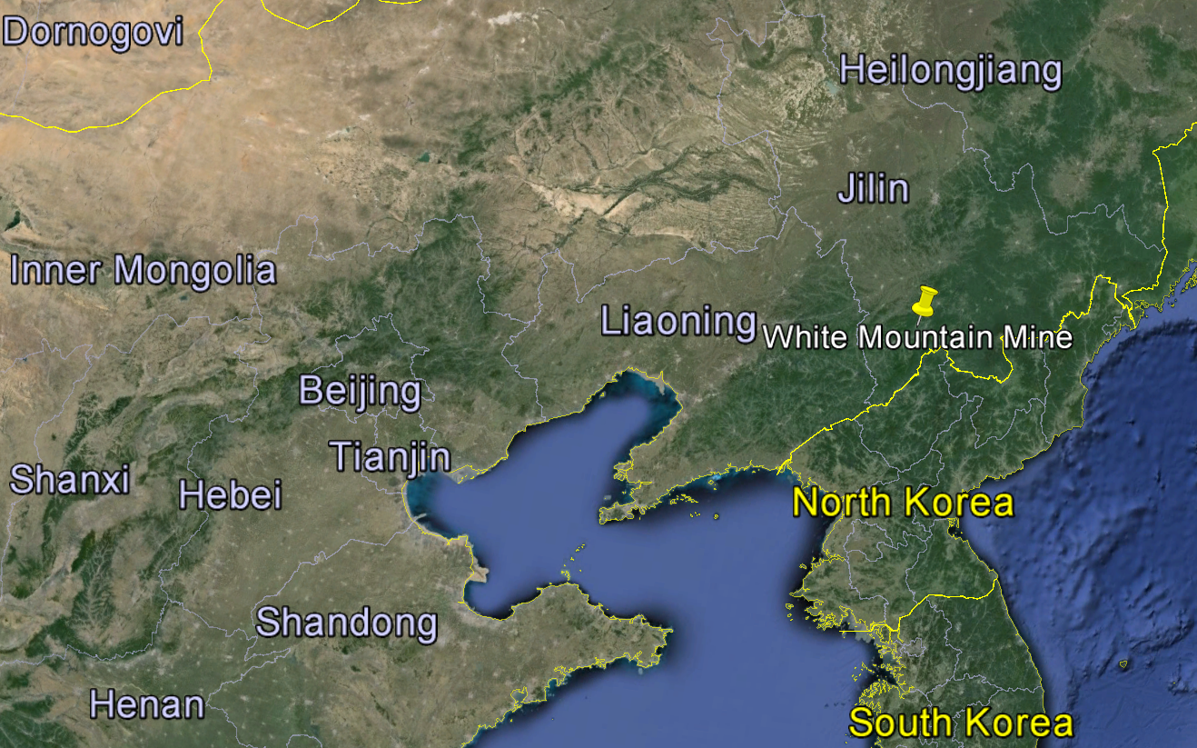
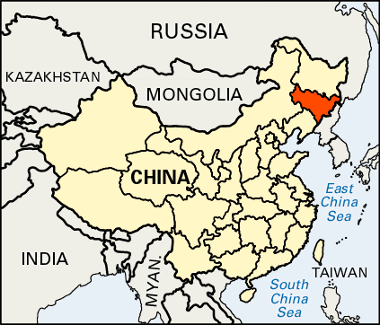
Regional Geologic Setting
350km
N
Map of China with Jilin Province filled in red (left), and Google Earth map of Jilin Province showing the location of the White Mountain mine (right).

Slide 4
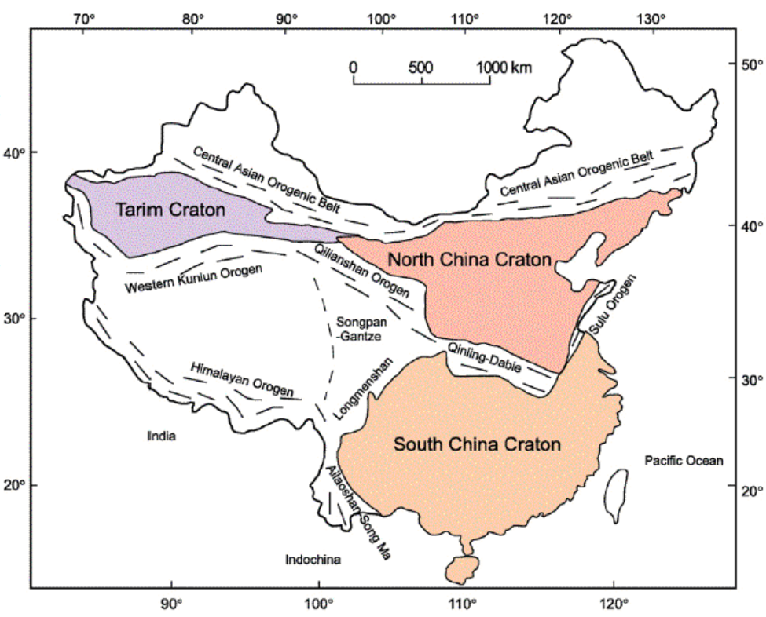
Regional Geologic Setting
China incorporates 3 large tectonic “blocks” (not cratons sensu stricto)
The northern margin of the North China Craton contains over 900 gold deposits and occurrences (Hart et al., 2002)
Minimal research has been done on the gold deposits of this area
Simplified tectonic map of China, showing the major Precambrian blocks that are connected by Phanerozoic fold belts (map from Zhao and Cawood, 2012).

Slide 5
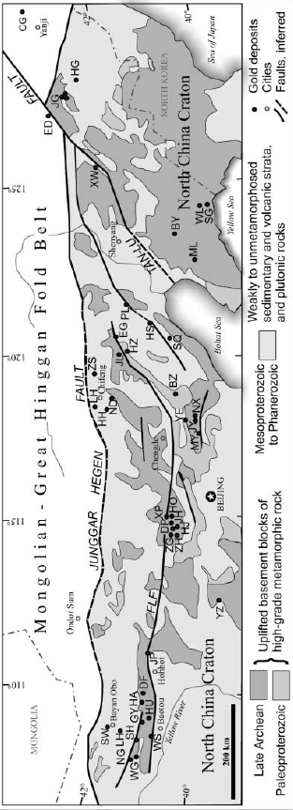
Regional Geologic Setting
Distribution of major gold deposits along the northern margin of the North China block, showing major fault systems and fold belts (from Hart et al., 2002).
Most gold deposits are orogenic deposits along an E-W belt

Slide 6
Regional Geologic Setting
Distribution of major gold deposits along the northern margin of the North China block, showing major fault systems and fold belts (from Hart et al., 2002).
Tan-Lu fault = major geologic feature in this part of China

Slide 7
Regional Geologic Setting
Distribution of major gold deposits along the northern margin of the North China block, showing major fault systems and fold belts (from Hart et al., 2002).
White Mountain is outside of the main belt of orogenic deposits

Slide 8
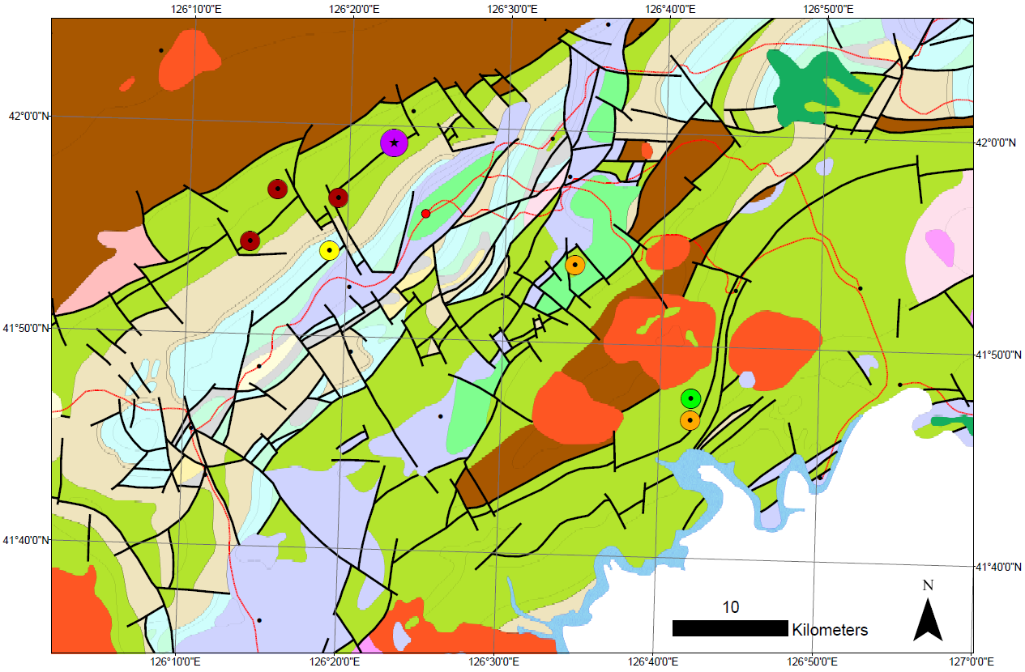
Regional Geologic Setting
Simplified geologic map of the Hunjiang basin, showing the location of the White Mountain gold deposit.

Slide 9
Regional Geologic Setting
White Mountain
Simplified geologic map of the Hunjiang basin, showing the location of the White Mountain gold deposit.

Slide 10
Regional Geologic Setting
White Mountain
Iron Mines
Simplified geologic map of the Hunjiang basin, showing the location of the White Mountain gold deposit.

Slide 11
Regional Geologic Setting
Cu-Au Porphyry
White Mountain
Iron Mines
Simplified geologic map of the Hunjiang basin, showing the location of the White Mountain gold deposit.

Slide 12
Regional Geologic Setting
Cu-Au Porphyry
White Mountain
Iron Mines
Epithermal
(Au and Zn-Pb mines)
Simplified geologic map of the Hunjiang basin, showing the location of the White Mountain gold deposit.

Slide 13
Regional Geologic Setting
Au occurrence
Cu-Au Porphyry
White Mountain
Iron Mines
Epithermal
(Au and Zn-Pb mines)
Simplified geologic map of the Hunjiang basin, showing the location of the White Mountain gold deposit.

Slide 14
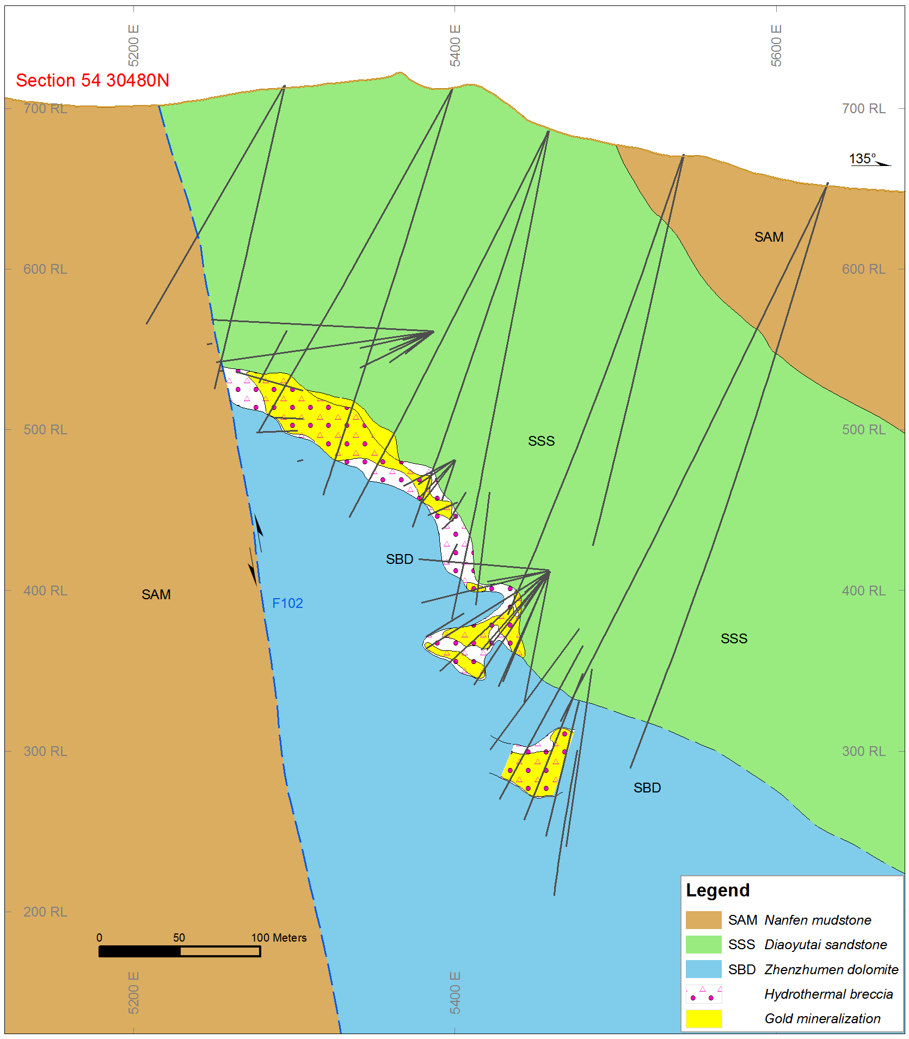
Mine Scale Stratigraphy
Hosted along contact between Proterozoic Zhenzhumen dolomite and Diaoyutai sandstone (both dipping SE)
Gold-bearing breccias are restricted to the deposit, but contact is brecciated regionally
No known mineralization below the F102 fault
Cross-section of the White Mountain gold deposit, with rock formations labeled on the section. Courtesy of Eldorado Gold Corp.
F102 Fault
Nanfen mudstone
Diaoyutai sandstone
Likely Nanfen mudstone
Zhenzhumen
dolomite

Slide 15
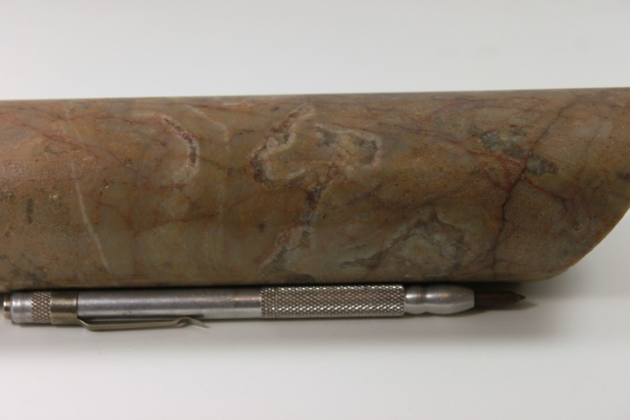
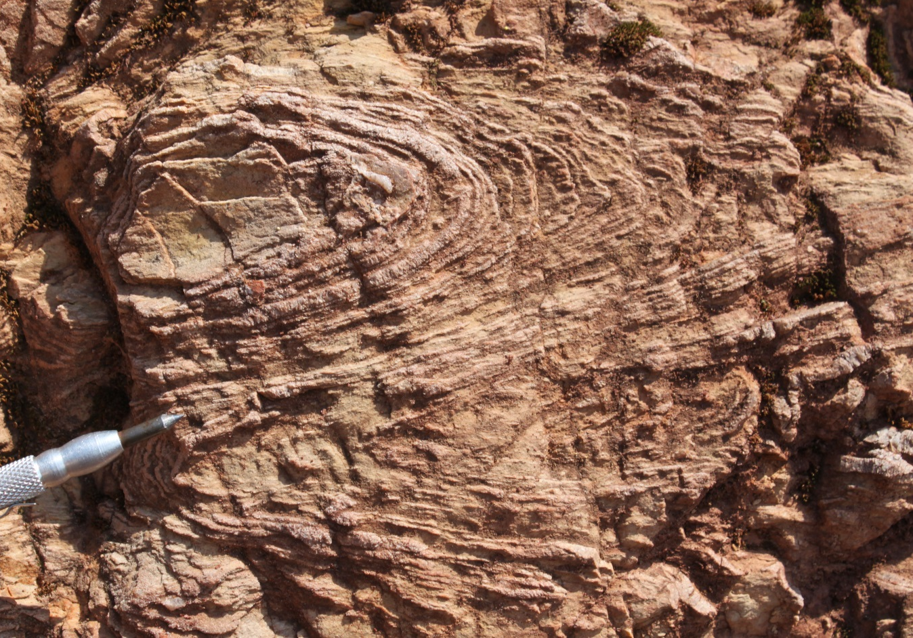
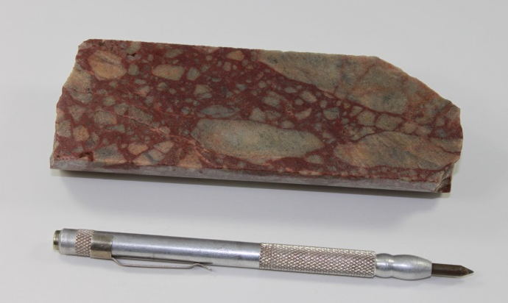
Footwall Dolomite
a)
c)
b)
a) Zhenzhumen dolomite in core, showing dissolution features. b) Brecciated dolomite with hematite-rich matrix. c) Stromatolitic dolomite in outcrop.

Slide 16
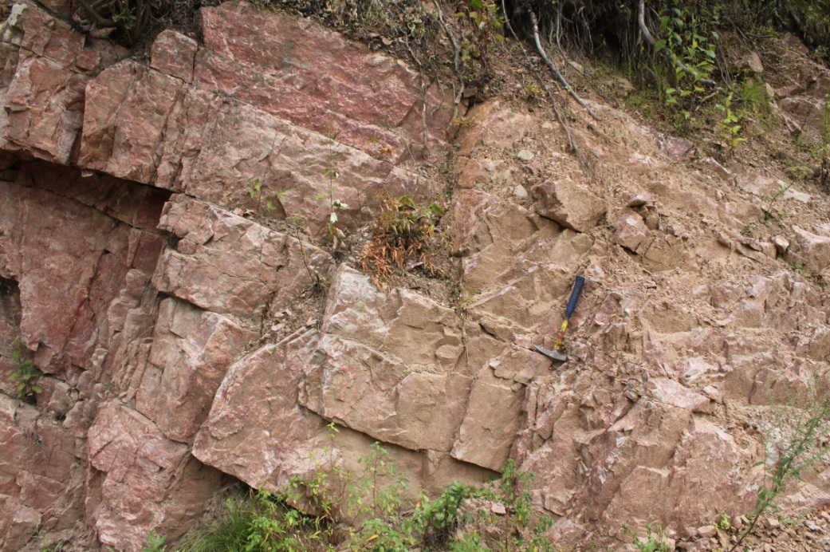
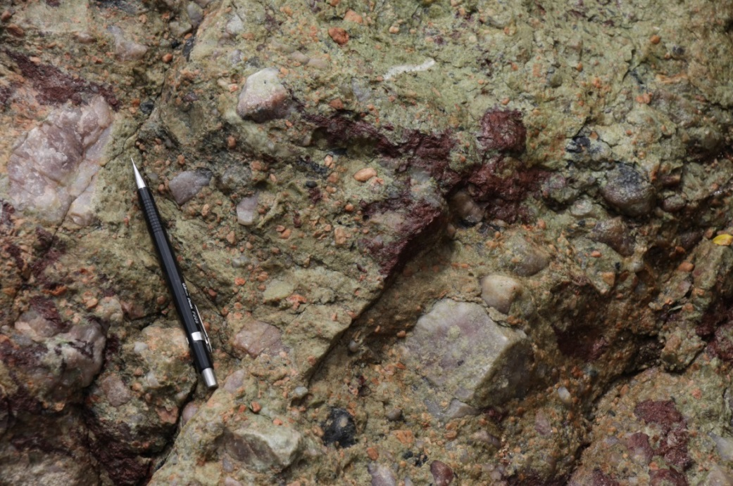
Hanging Wall Sandstone
Hanging wall Diaoyutai quartz-rich sandstone. View to the NE.
Hanging wall conglomerate, seen in outcrop and core below the sandstone.

Slide 17
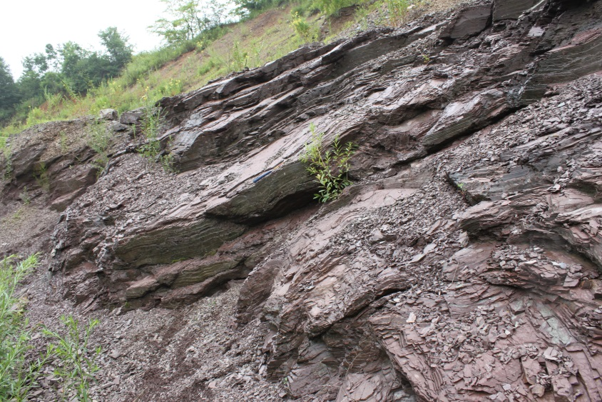
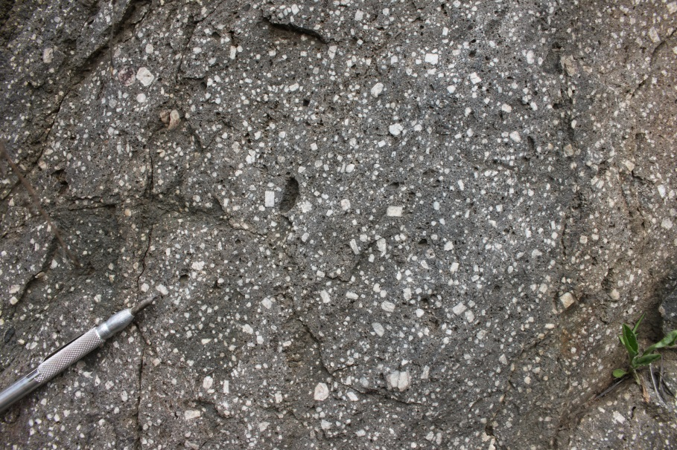
Hanging Wall Mudstone
Nanfen mudstone in outcrop, showing general southeast dip. View to the northwest.
Nanfen mudstone is broadly folded, but cut by extensional features
Porphyry dike cuts the mudstone on White Mountain property
Porphyritic outcrop on White Mountain exploration license.

Slide 18
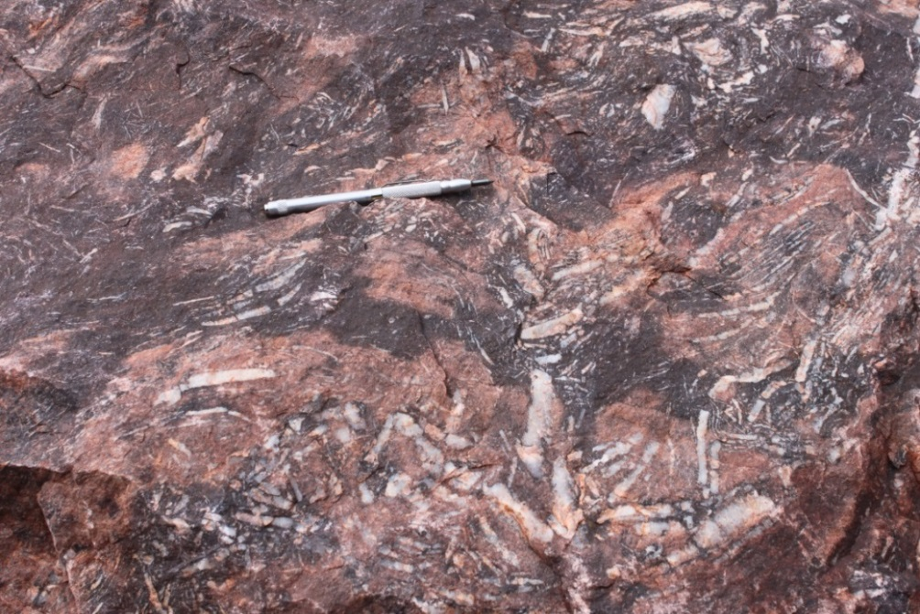
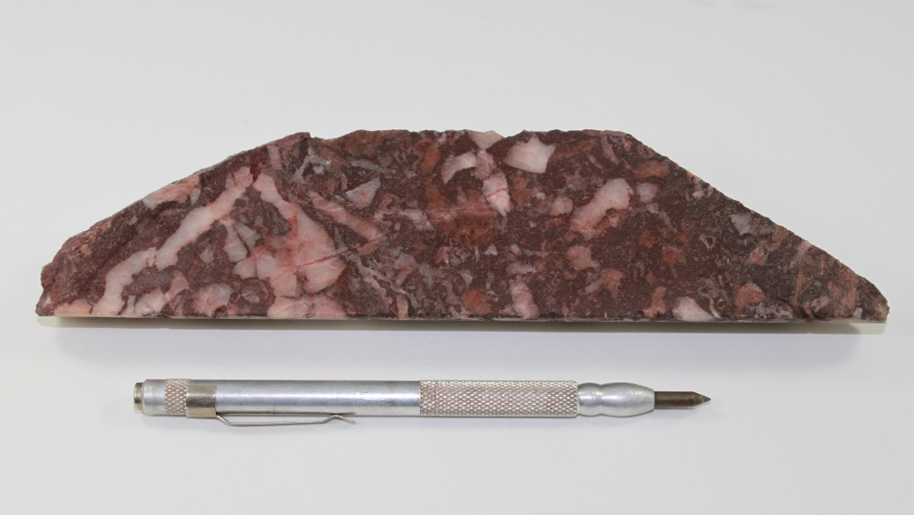
Favorable Interval
Contact = hematite cement-supported scalloped quartz breccia
Can contain dolomite clasts, but mostly contains scalloped quartz
Clasts range from parallel to randomly oriented
Scalloped quartz breccia in core at White Mountain.
Scalloped quartz breccia in outcrop (unmineralized).

Slide 19
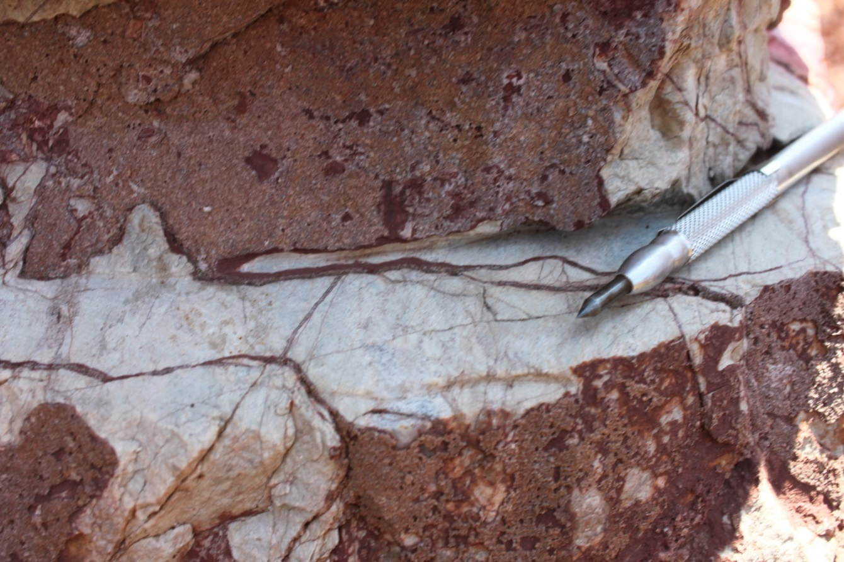
Footwall Breccias
Clast-supported monomictic dolomite crackle breccia
Outcrop of hematite cement crackle breccia, showing brick red hematitic cement.

Slide 20
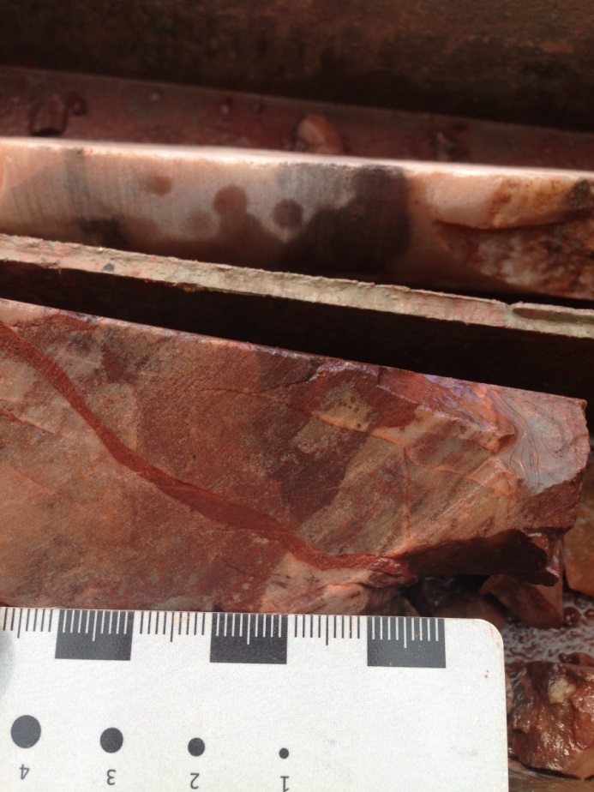
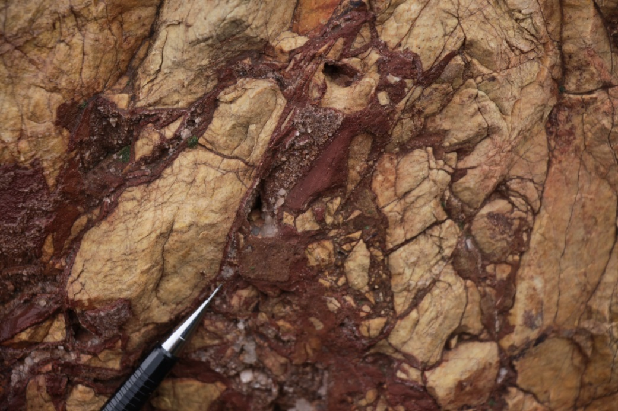
Footwall Breccias
Matrix to cement-supported monomict dolomite clast breccia
Matrix to cement-supported dolomite clast breccia in outcrop near the White Mountain mine.
Similar breccia in core, showing later hematite influx.

Slide 21
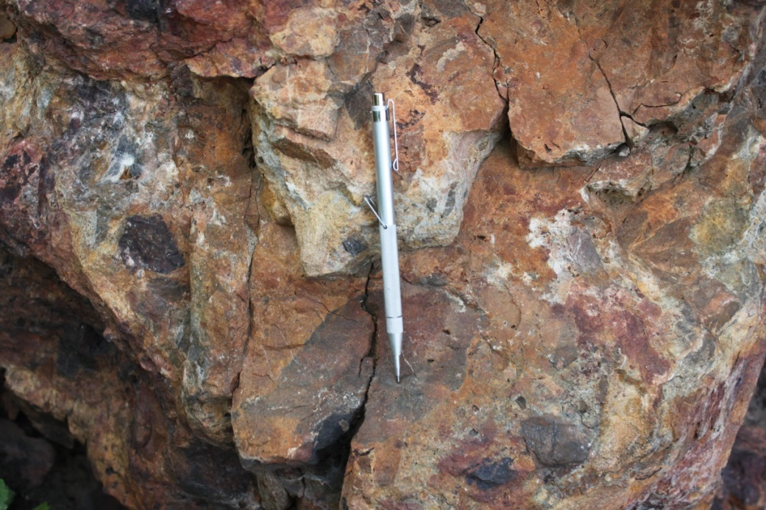
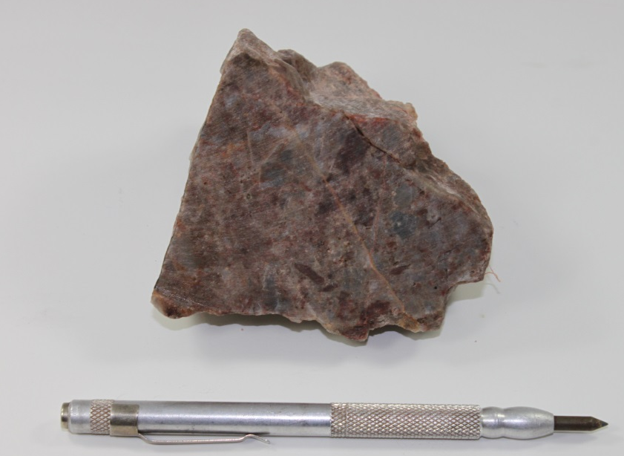
Geology of the Ore Interval
Ore horizon = silicified, polymictic breccia
Gold-bearing polymictic breccia in outcrop on the White Mountain exploration license.
Example of polymictic breccia from an open stope, underground White Mountain.

Slide 22
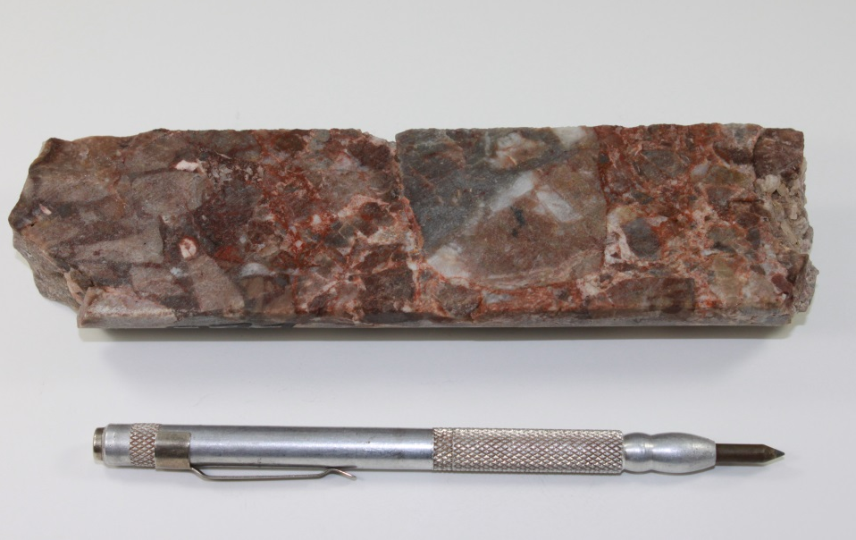
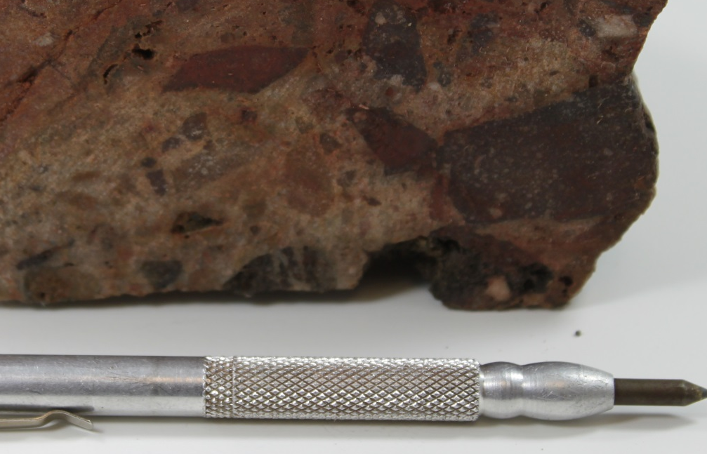
Geology of the Ore Interval
Hematitic breccia from favorable horizon is rebrecciated
Late barite and late hematite cement are common
Gold-bearing polymictic breccia with hematite and barite cement, showing evidence of rebrecciation.
Polymictic breccia with clasts of hematitic breccia from favorable horizon.

Slide 23
Geology of the Ore Interval
Hematitic breccia from favorable horizon is rebrecciated
Late barite and late hematite cement are common
Gold-bearing polymictic breccia with hematite and barite cement, showing evidence of rebrecciation.
Polymictic breccia with clasts of hematitic breccia from favorable horizon.

Slide 24
Geology of the Ore Interval
Hematitic breccia from favorable horizon is rebrecciated
Late barite and late hematite cement are common
Gold-bearing polymictic breccia with hematite and barite cement, showing evidence of rebrecciation.
Polymictic breccia with clasts of hematitic breccia from favorable horizon.

Slide 25
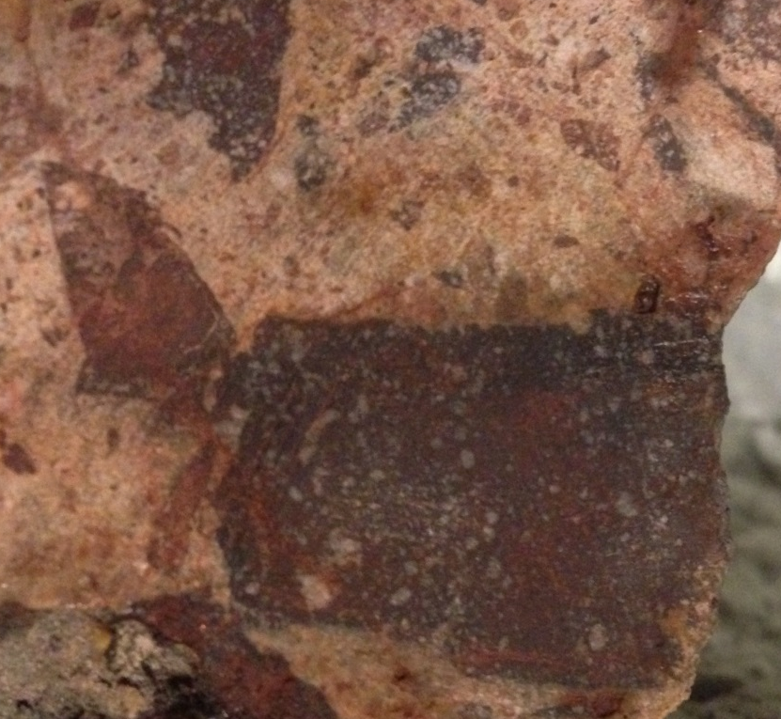
Geology of the Ore Interval
Hematitic breccia from favorable horizon is rebrecciated
Late barite and late hematite cement are common
Gold-bearing polymictic breccia with hematite and barite cement, showing evidence of rebrecciation.
Polymictic breccia with clasts of hematitic breccia from favorable horizon.

Slide 26
Geochemistry
Frequency distribution of gold from White Mountain core. (Geochemical data courtesy of Eldorado Gold)
Graph of As vs. Au (ppm), only showing values >0.5ppm Au.

Slide 27
Geochemistry
a)
c)
b)
d)
Histograms showing the frequency distribution of a) arsenic, b) antimony, c) mercury and d) barium for all samples with gold >0.5ppm.

Slide 28
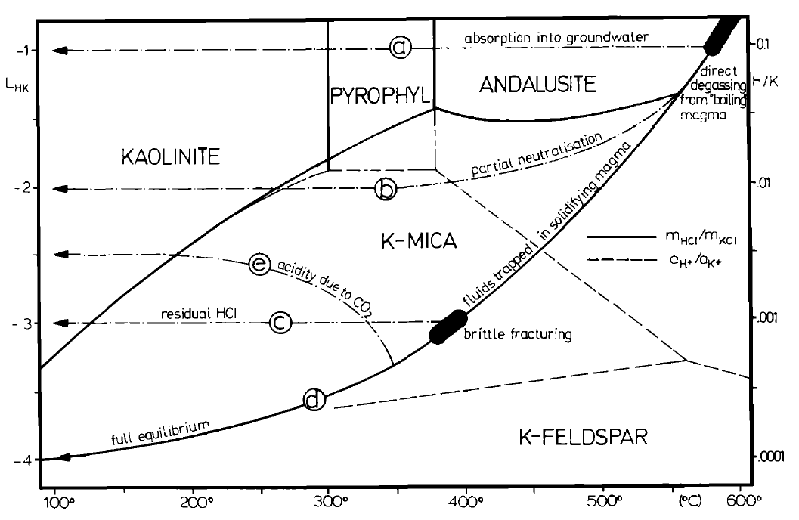
Preliminary Ore Controls
High grade ore is always strongly silicified, often with dissolution of dolomite
Rebrecciation associated with high grade ore
Barite spatially associated with ore (also pyrite/marcasite)
Alteration minerals = kaolinite and dickite
Stability fields of aluminum silicates as a function of temperature and acidity. From Giggenbach (1992).

Slide 29
Preliminary Ore Controls
High grade ore is always strongly silicified, often with dissolution of dolomite
Rebrecciation associated with high grade ore
Barite spatially associated with ore (also pyrite/marcasite)
Alteration minerals = kaolinite and dickite
Stability fields of aluminum silicates as a function of temperature and acidity. From Giggenbach (1992).

Slide 30
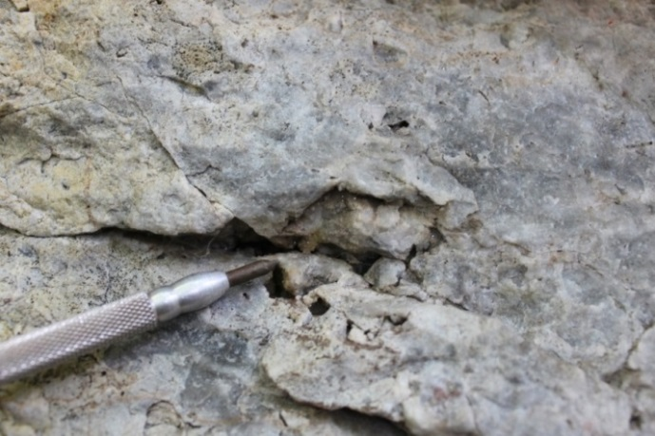
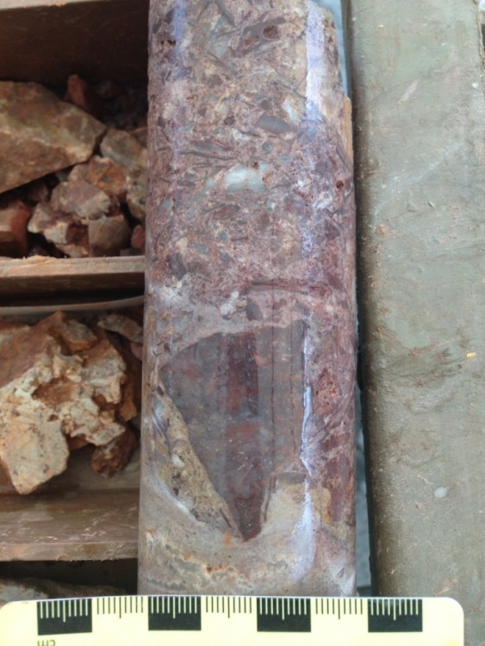
Interpretation
White Mountain is a comparably low-temperature (<300°C) hydrothermal deposit that formed from moderately acidic fluids
The hematite-rich breccia provided original permeability, and could have been a chemical trap
The moderately acidic nature could have caused dissolution of dolomite clasts and formed a collapse breccia
NOT an orogenic gold deposit! The strong stratigraphic control on the gold zones, geochemistry, ore associations and alteration minerals all show Carlin-like characteristics
Formation of euhedral quartz in open spaces within polymictic breccia
Soft sediment deformation below hematite clast in polymict, indicating possible collapse

Slide 31
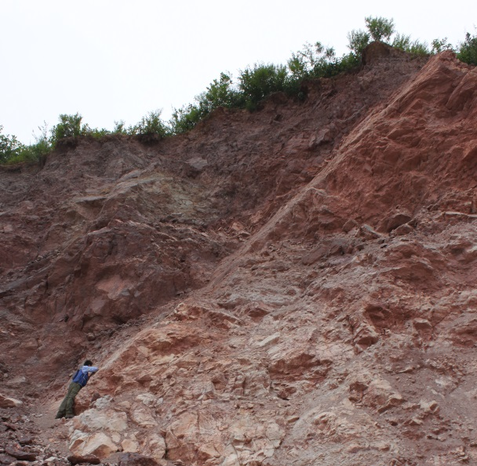
Future Work
Determine generations of hematite and relation to ore (at least 2), which will help determine the importance of stratigraphic controls on mineralization
Ore microscopy to determine where the gold is, and controls on gold distribution
CL work (and microscopy) to determine what the generations of silica clasts are
Dating of intrusions throughout the basin to compare ages
More regional mapping and sampling, especially to determine regional extent of hematitic horizon, and structural analyses to determine upflow zones
Structural measurements being taken on a normal fault, Hunjiang basin. View to the north.

Slide 32
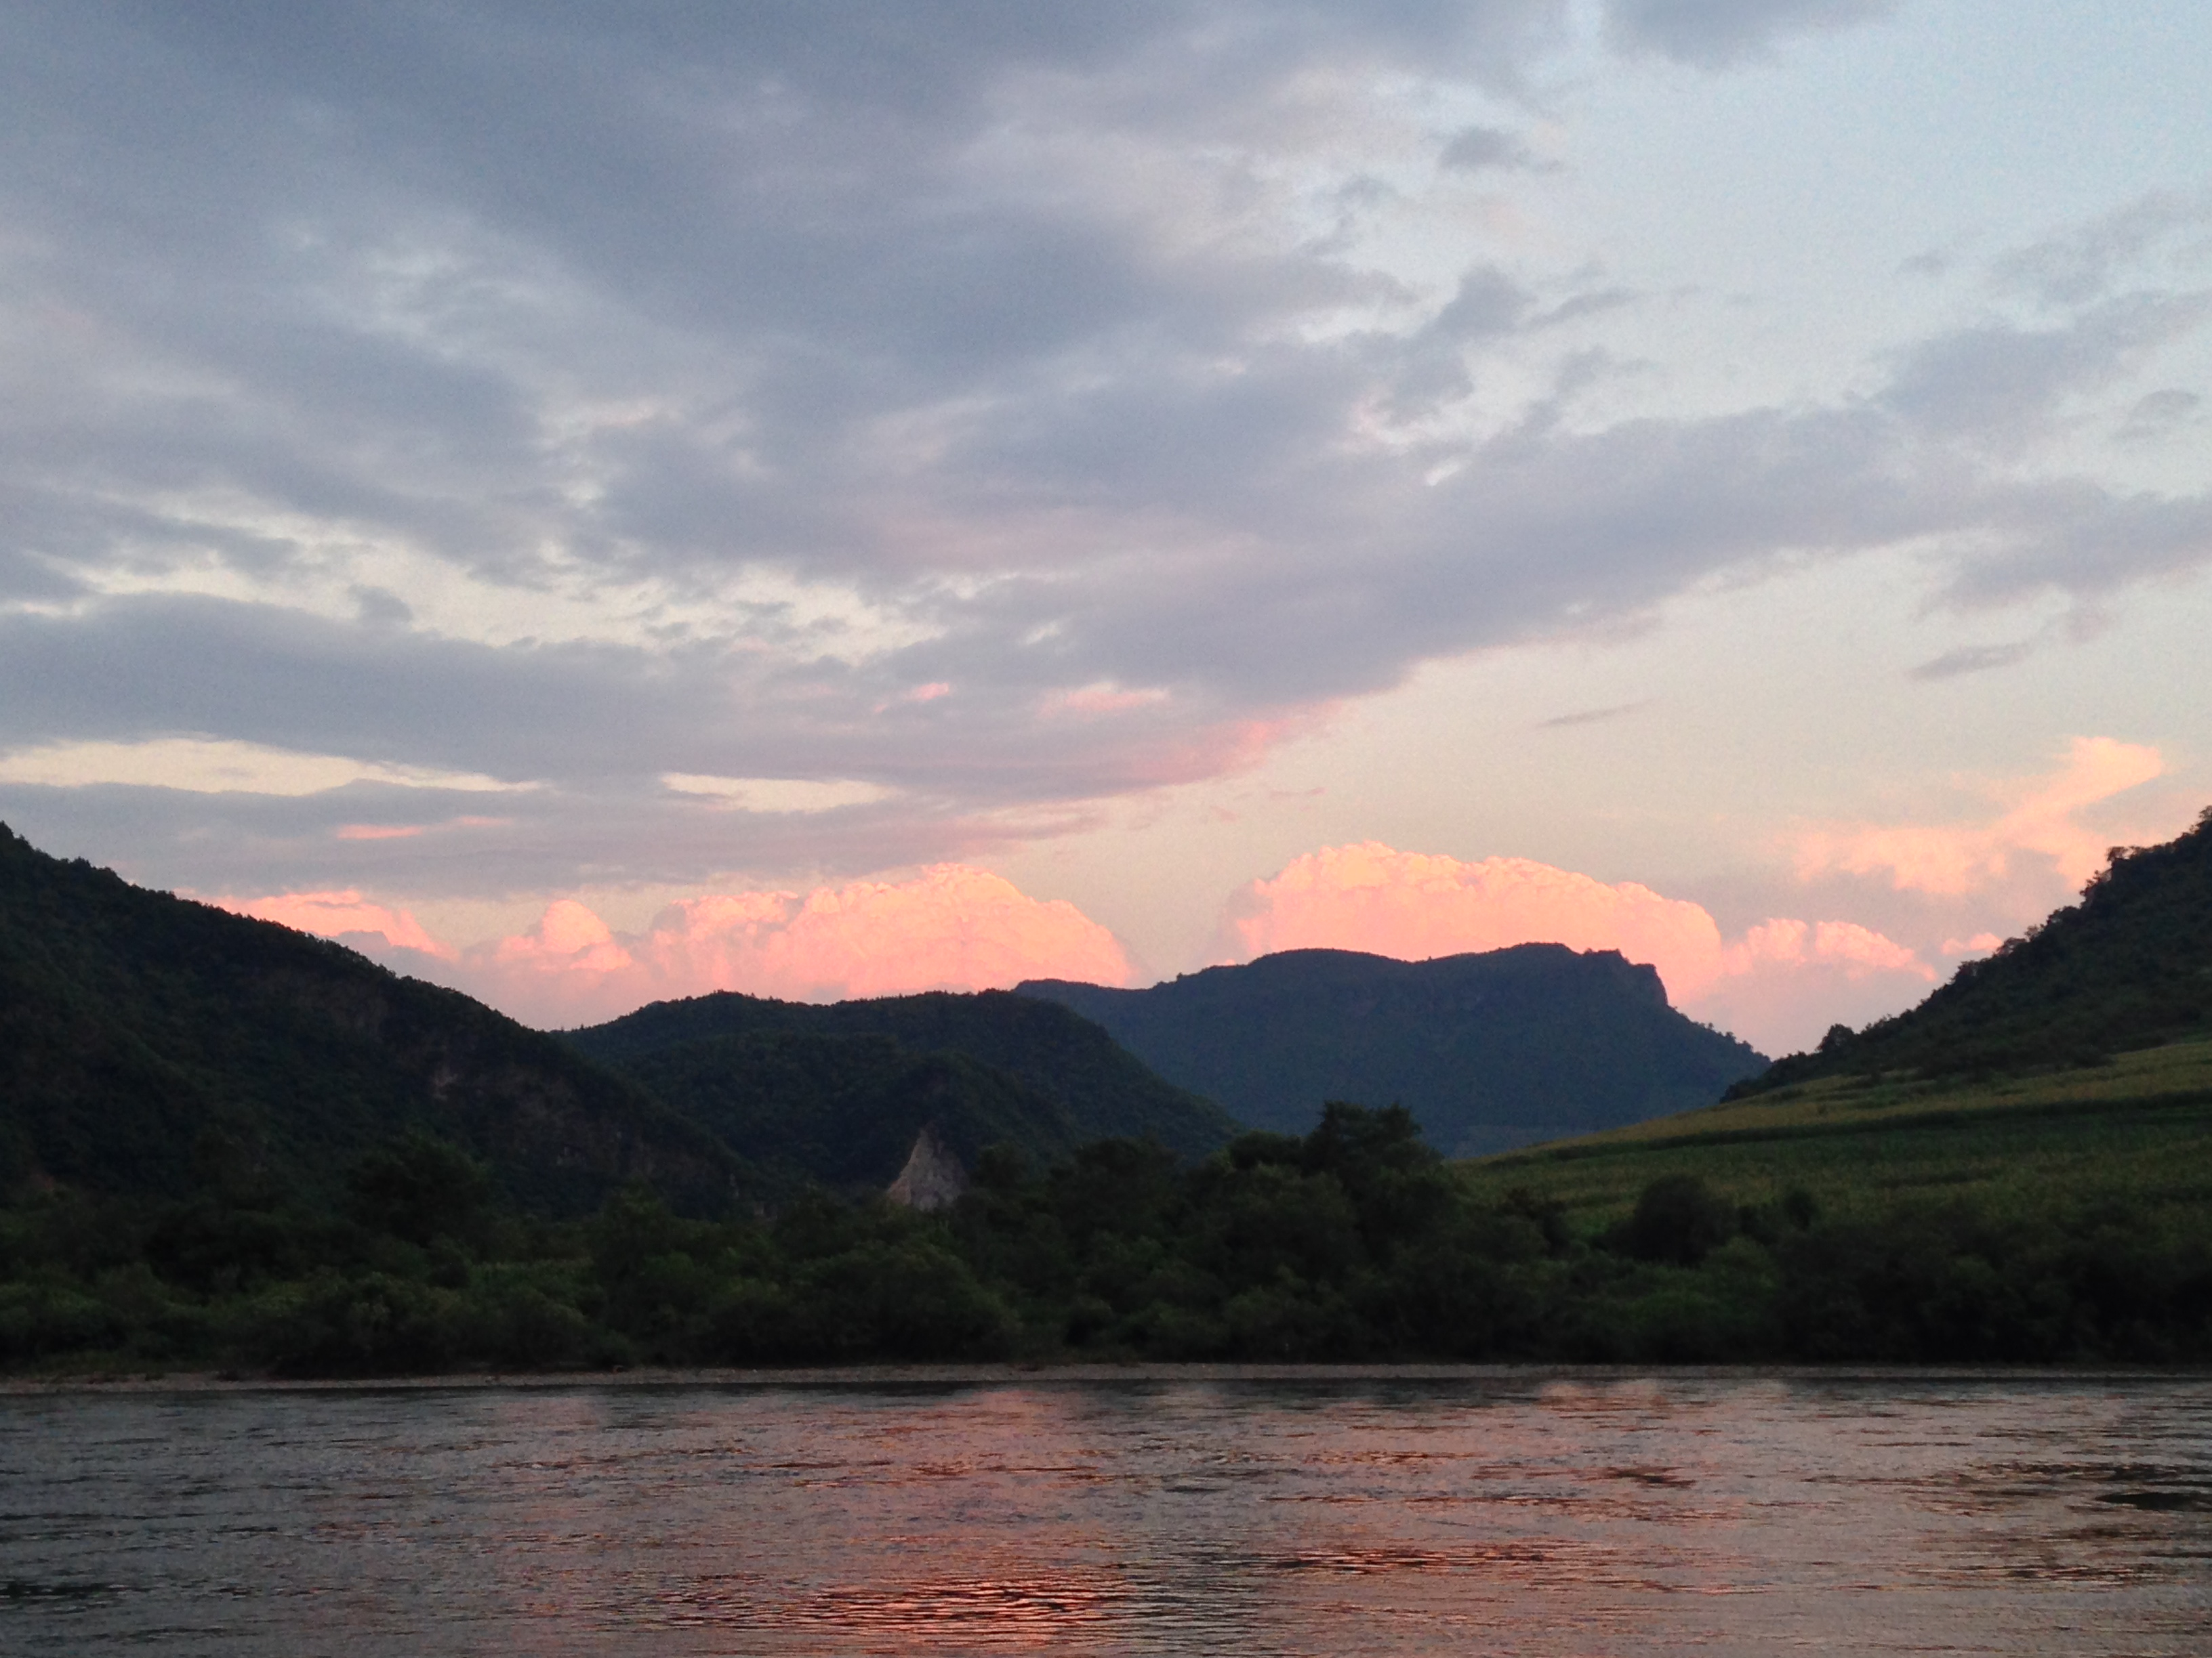
References Cited:
Giggenbach, W.F., 1992. Magma degassing and mineral deposition in hydrothermal systems along convergent plate boundaries: Economic Geology, v. 87, p. 1927-1944.
Hart, C.J.R., Goldfarb, R.J., Qiu, Y., Snee, L., Miller, L.D., and Miller, M.L., 2002. Gold deposits of the northern margin of the North China Craton: multiple late Paleozoic-Mesozoic mineralizing events: Mineralium Deposita, v. 37, p. 326-351.
Zhao, G., and Cawood, P.A., 2012. Precambrian geology of China: Precambrian Research, v. 222-223, p. 13-54.
Thank You!

