Slide 1
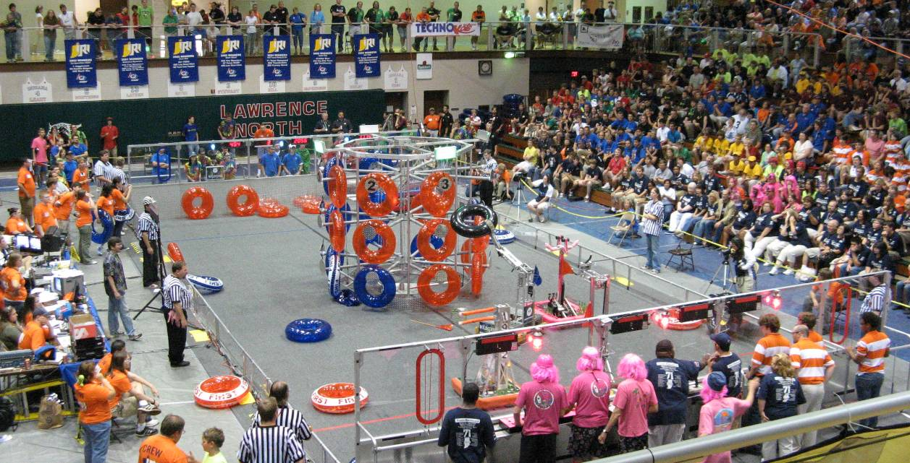
Curiosity Connections with Pre-College Robotics Competitions
David E. Brinza, PhD
Principal Systems Engineer
Jet Propulsion Laboratory
California Institute of Technology
and Lead Mentor, FRC Team 980
Robert D. Steele, Robotics Software Engineer,
Jet Propulsion Laboratory - Caltech
Mark J. Leon, Robotics Alliance Program Manager, NASA Ames Research Center
David B. Lavery, Program Executive for SMD,
NASA Headquarters
October 21, 2014
CL#14-4506
© 2014 California Institute of Technology. Government sponsorship acknowledged.

Slide 2
Overview
Pre-college robotics programs introduce youth to technical careers
FIRST Robotics Competition (FRC): inspires youth to change the culture and change the world
Similar programs: VEX Robotics, BEST, Botball,etc.
I won’t be discussing these other programs today
NASA’s investment in FRC
Mentors and volunteers from NASA Centers
Financial support to FRC teams and events
The return on investment
Interns/early-career employees in NASA: Curiosity
You can make an investment too!

Slide 3
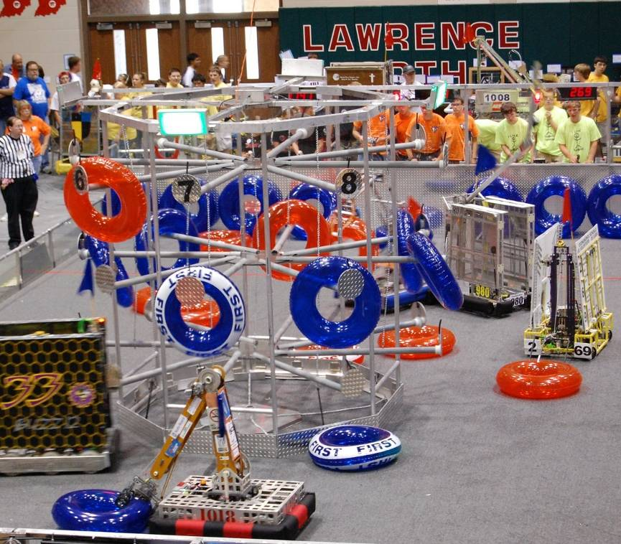
FIRST: Changing the Culture
For Inspiration and Recognition of Science and Technology
Giving everyone an opportunity to become our future innovators, engineers, and scientists
FIRST’s vision is to positively transform culture by inspiring young people, their schools, and communities to appreciate and celebrate science and technology. FIRST is about more than robots. It is a life-changing experience – and a lot of fun!

Slide 4
FIRST Robotics Competition Facts
Program Statistics (as of 03/06/14):
23rd Season game: Aerial Assist (SM)
2,727 teams
2,334 veteran teams, 393 rookie teams
68,175 students
16,362 Mentor/adult supporters
17 countries
U.S. (2,410 teams)
Canada (178 teams)
Israel (52 teams)
Mexico (38 teams)
Australia (17 teams)
China (10 teams)
Brazil (5 teams)
Turkey (5 teams)
Chile (3 teams)
Dominican Republic (2 teams)
Colombia, Germany, Netherlands, Singapore, Taiwan, United Arab Emirates, U.K. (1 team ea)
Scholarships:
Over $19 million available!
Over 150 Scholarship providers
Nearly 900 Scholarship opportunities
Hundreds of Internships
3,000+ Sponsors (including NASA)
Kit of Parts factoids:
246,120 lbs. of totes shipped to almost 100 Kickoff sites on more than 225 pallets
More than 110 Kit of Parts contributors
350 distinct items distributed via Kit of Parts
More than 32 miles of wire
54 miles of cable ties
Events:
1 Live and 94 Local Kickoffs (NASA TV)
54 Regional Events
4 District Championships
World Championship: Edward Jones Dome in St. Louis, MO (NASA TV)

Slide 5
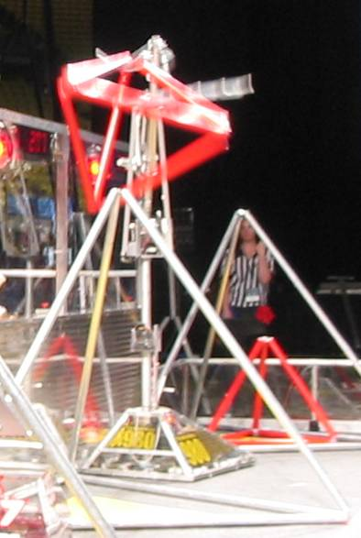
What is a FIRST robot?
FRC robots are amazing creations: fast, strong, maneuverable and even incredibly autonomous
Teams create robots based on how they plan to play the game
Brainstorming, strategy
Managing critical resources: (schedule, mass and money)
Robot is team-built, student-driven
Identical ‘Kit of Parts’ provides key parts (radio, controllers, motors, ...), but NO INSTRUCTION BOOK!
Robot designed and built from scratch, subject to size/weight limits (perimeter, 60” tall, <120 lbs.), many other rules on allowable components and safety

Slide 6
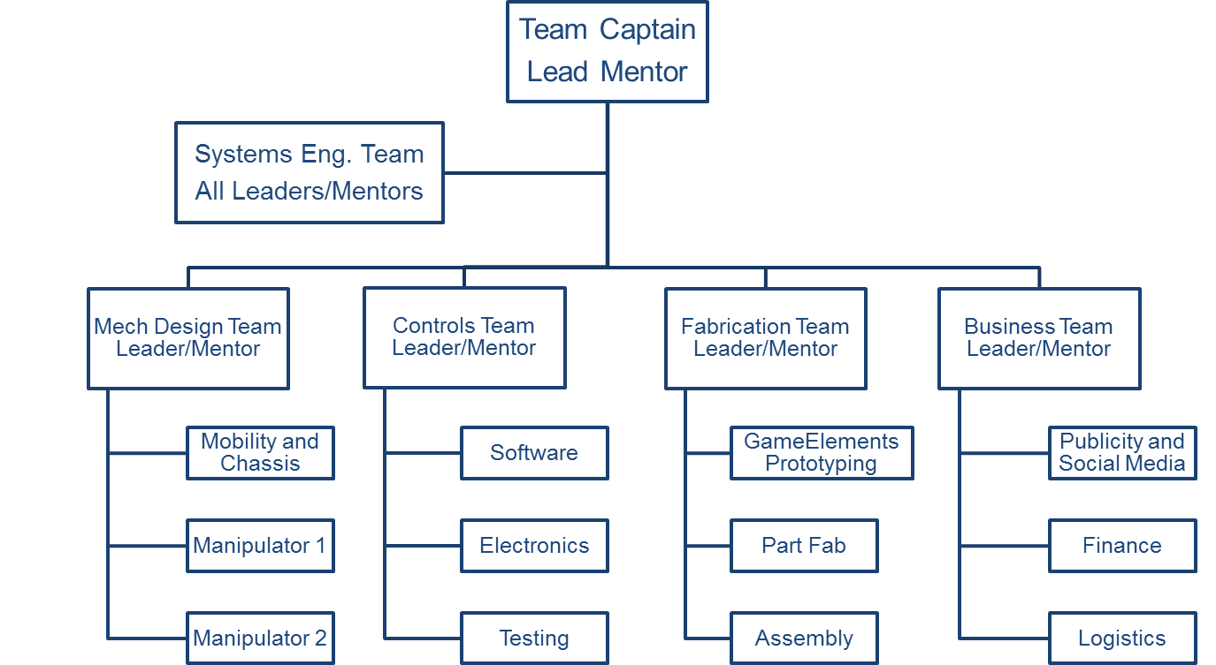
FRC Team Organization
Many FRC Teams work in a structured environment
Team Org Chart
Sub-teams with student leadership
Mentors as “shadows”
Project Schedule
Development process
Monitor progress

Slide 7
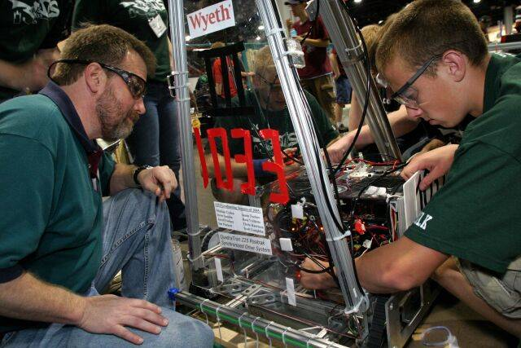
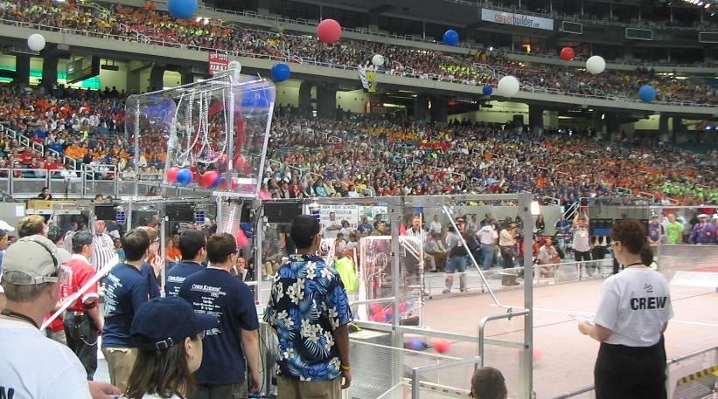
FRC: What’s it like??
A hands-on project-based experience
Students design, build and operate a functional robot
Useful skills developed: problem-solving, teamwork, meeting deadlines, focus
Mentoring: almost magic!
Experienced professionals advising the team members
Volunteers who are fully committed to helping students learn and succeed
Fun and Excitement
Competitions are exciting to watch: dramatic action, team spirit in a noisy stadium
Be yourself! Dancing, spiked hair, costumes and cheering!!

Slide 8
NASA: Inspiring our Youth
NASA missions have inspired youth to pursue technical careers for decades
Mercury, Gemini, Apollo moon landings, Space Shuttle
Mars Exploration: Sojourner, Spirit/Opportunity,
Curiosity: “Seven Minutes of Terror!”
NASA also supports robotics education to “change the culture” and inspire future innovators
Significant investment in FIRST Robotics Competition
Mentors, volunteers, program assistance
Grants via NASA Robotics Alliance Program
2010 Cooperative Agreement NASA - FIRST: $20M over 5 years
http://www.nasa.gov/home/hqnews/2010/nov/HQ_10-307_Student_Robotics.html
Hundreds of FRC teams submit grant proposals to NASA each year
In 2012, 241 teams shared $1.4M in grants

Slide 9
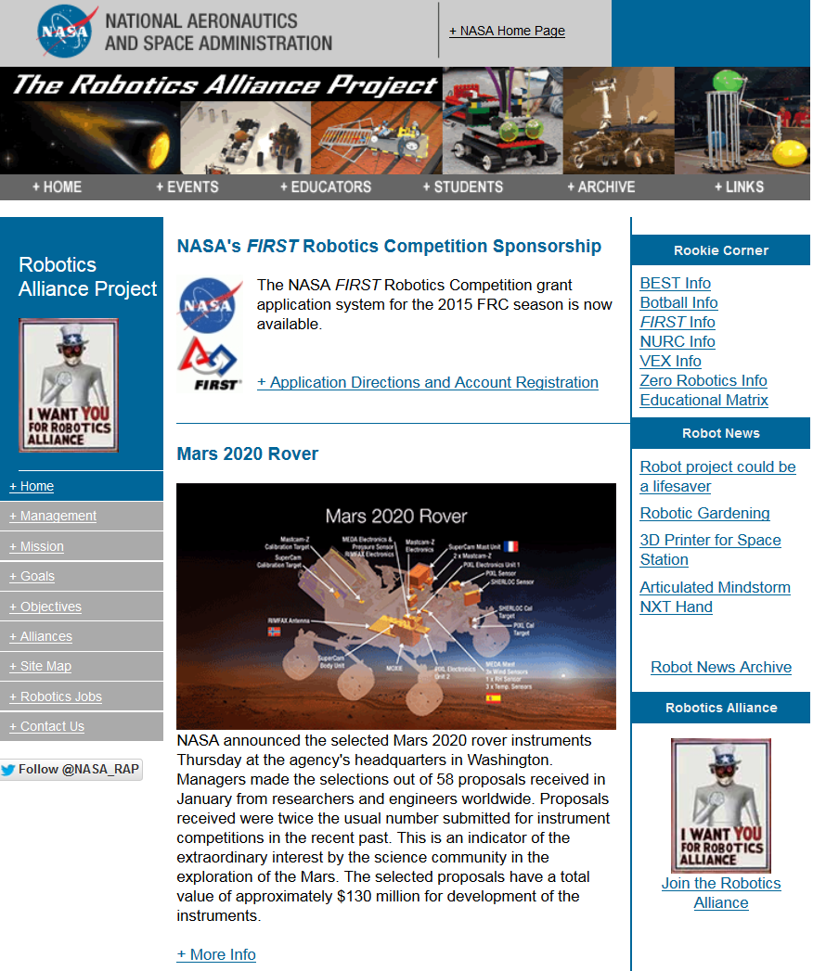
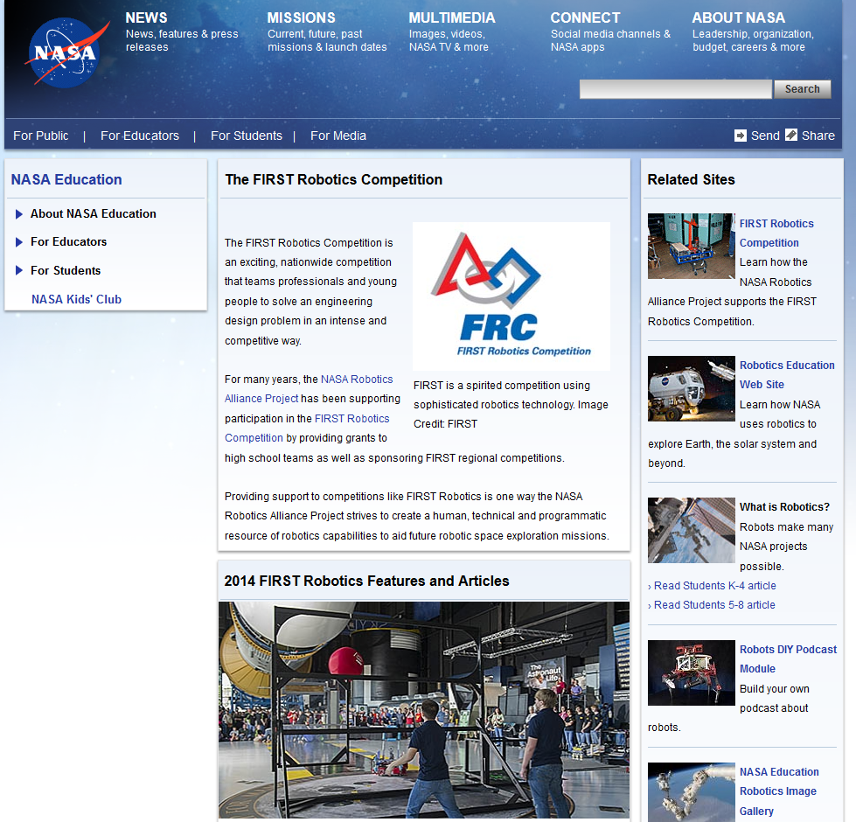
FRC on NASA Websites
http://www.nasa.gov/audience/forstudents/9-12/features/first-robotics-index.html#.U8_qnRAoByI http://robotics.nasa.gov/index.php

Slide 10
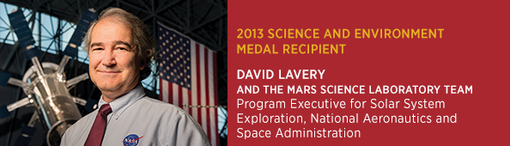
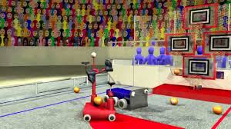
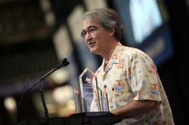
A Key Figure: Dave Lavery, NASA HQ
2013 Service to America Medal “Sammy”
For leading the Curiosity mission to Mars
2009 FIRST Volunteer of the Year
Executive Advisory Board, Game Design Committee , FRC Team 116 Mentor
Responsible for NASA grants to FIRST Robotics Competition Teams
Develops Game Animation released at annual kickoff event

Slide 11
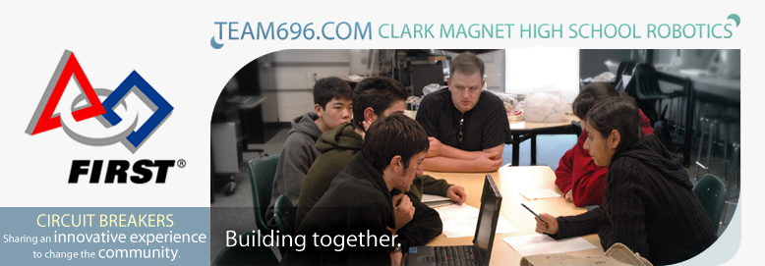
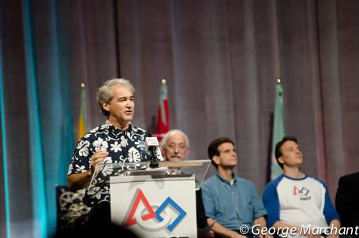
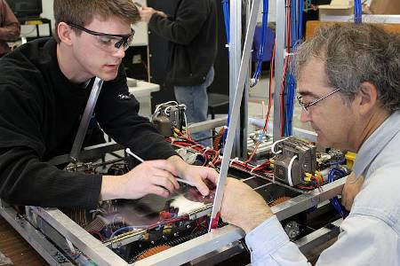
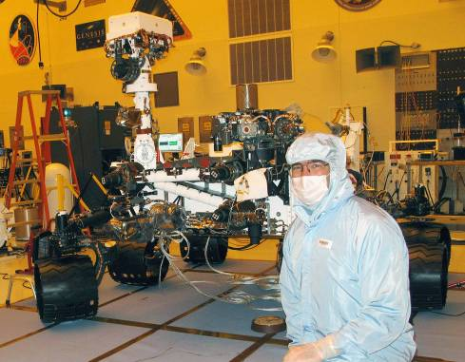
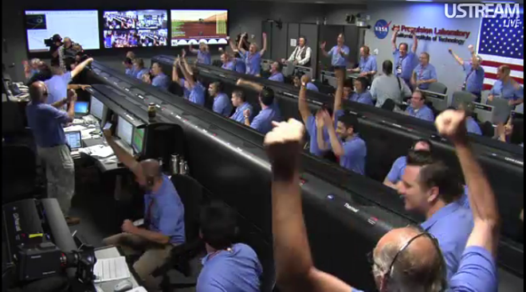
Connections between Curiosity and FRC
Product: Incredible Robots!
For Mars Exploration
For Education
People in FIRST:
Dozens of NASA Mentors
Hundreds of volunteers
FRC “alumni” on Curiosity team

Slide 12
NASA’s Return on Investment
Dozens of JPL Interns working on Mars Programs
FRC involvement (or other robotics programs) is often a discriminator on applications
These students fit well in the professional environment
Early-career employees involved in MSL development
Several FRC alumni served in mission critical roles
They attribute FRC involvement to their career choices
Next Generation Mars Explorers are emerging from programs like FIRST
Video: you too can participate!
Find a nearby team and/or volunteer at www.usfirst.org
See you at a competition…meet me in St. Louis!!

Slide 13
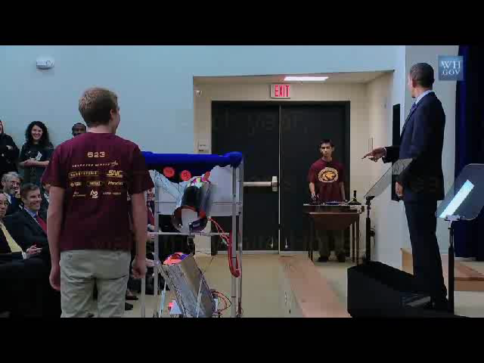
Conclusion: Let’s get involved!

