Slide 1



Leaf Wax n-Alkanes as a Biomarker for Holocene Paleoclimate in Tulare Lake, California
Jeremiah Reagan
Roy Lafever
Robert Negrini

Slide 2
The Lake
Situated in the San Joaquin Valley between Sierra Nevada on the east and Kettleman Hills on the west.
Largest freshwater lake west of the Mississippi River prior to agricultural diversion.
Has fluctuated several tens of meters over past 19,000 yrs in response to regional climate and elevation change of northern, alluvial fan formed, spillover sill.
Lake level history is important for understanding:
1) Western North American paleoclimate after last glacial maximum
2) Change in the San Joaquin Basin relative to other California lakes
3) Development of future forecast of water supply in San Joaquin Valley

Slide 3
Background Theory
  C3 vs C4 Photosynthesis: C3 and C4 plants do photosynthesis differently. This manifests as differences in isotopic discrimination of hydrogen and carbon in the long chain n-alkanes of leaf waxes.
  When washed into a lake, these n-alkanes leave a record of C3 vs C4 dominance in surrounding vegetation.
  C4 plants are more efficient in arid conditions and vice versa → A record of vegetation shift provides a proxy for local precipitation and climate.

Slide 4
Objectives
Resolvably extract n-alkanes from sediment samples.
Run 𝛿¹³C and 𝛿D analysis on individual n-alkanes (in progress).
Use 𝛿¹³C and 𝛿D data to determine C3 and C4 vegetation shifts over time.

Slide 5
The Cores and the Chemistry (methods)
34 samples taken from sediment cores TL05-4A-(1, 2, and 3), spanning a cumulative depth of 34cm to 440cm below ground surface.
Using the timescale from (Blunt & Negrini, 2014) gives a range of 1,802 – 18,759 calendar years before present.
Powdered samples mixed overnight in 9:1 dichloromethane and methanol solvent to extract n-alkanes.
Pipetted and concentrated to dryness, then eluted through chromatography column with hexane to filter out polar substances.

Slide 6
The Cores and the Chemistry (Methods)
Concentrated to dryness again and washed into GCMS vials with 1ml of the dichloromethane/methanol solvent.
Ran 1ml solutions through Gas Chromatography Mass Spectrometer (GCMS) to find n-alkane peaks. Calibrated to prepared standards of 0, 0.01, and 0.1 mg/ml mixtures of C₂₇, C₂₉, C₃₁, C₃₃, and C₃₅.
Samples sent to Florida for 𝛿¹³C and 𝛿D analysis of individual peaks.

Slide 7

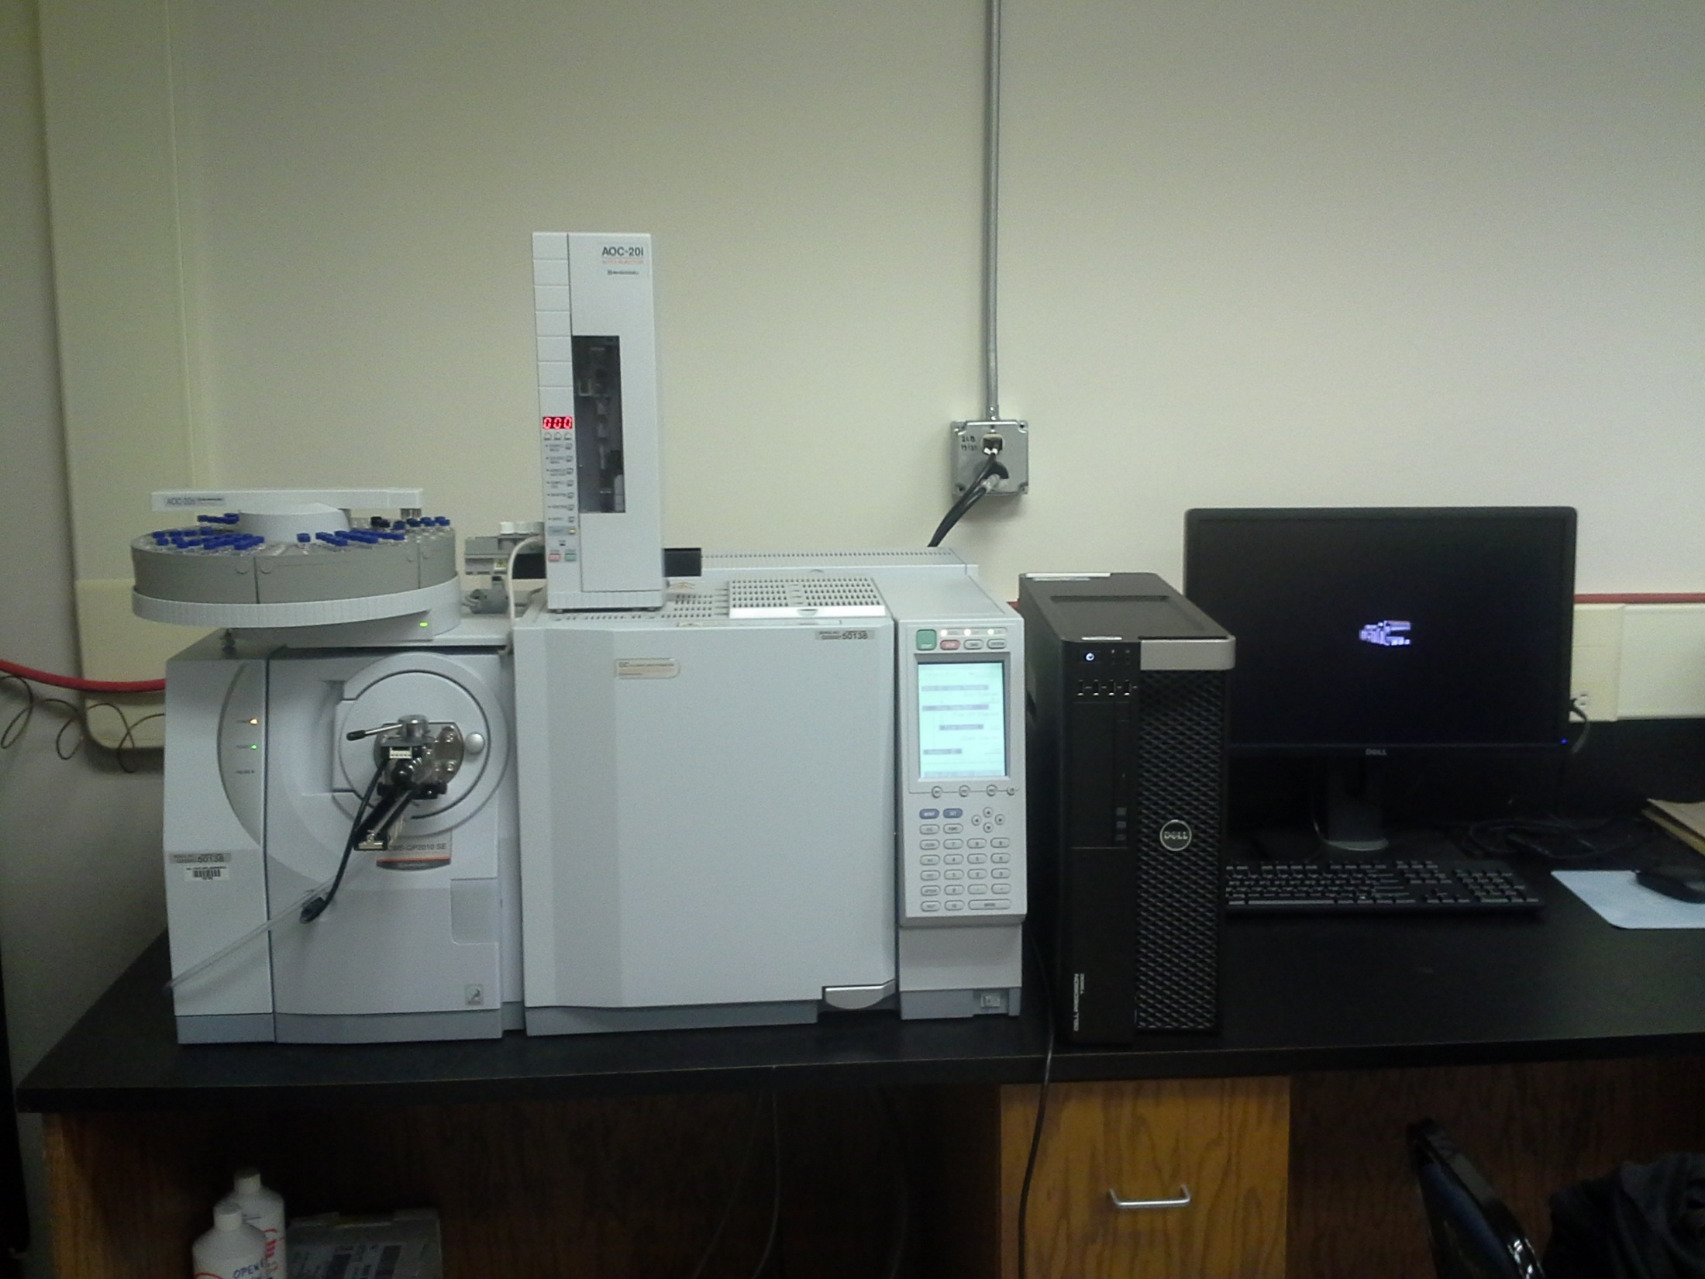

Slide 8
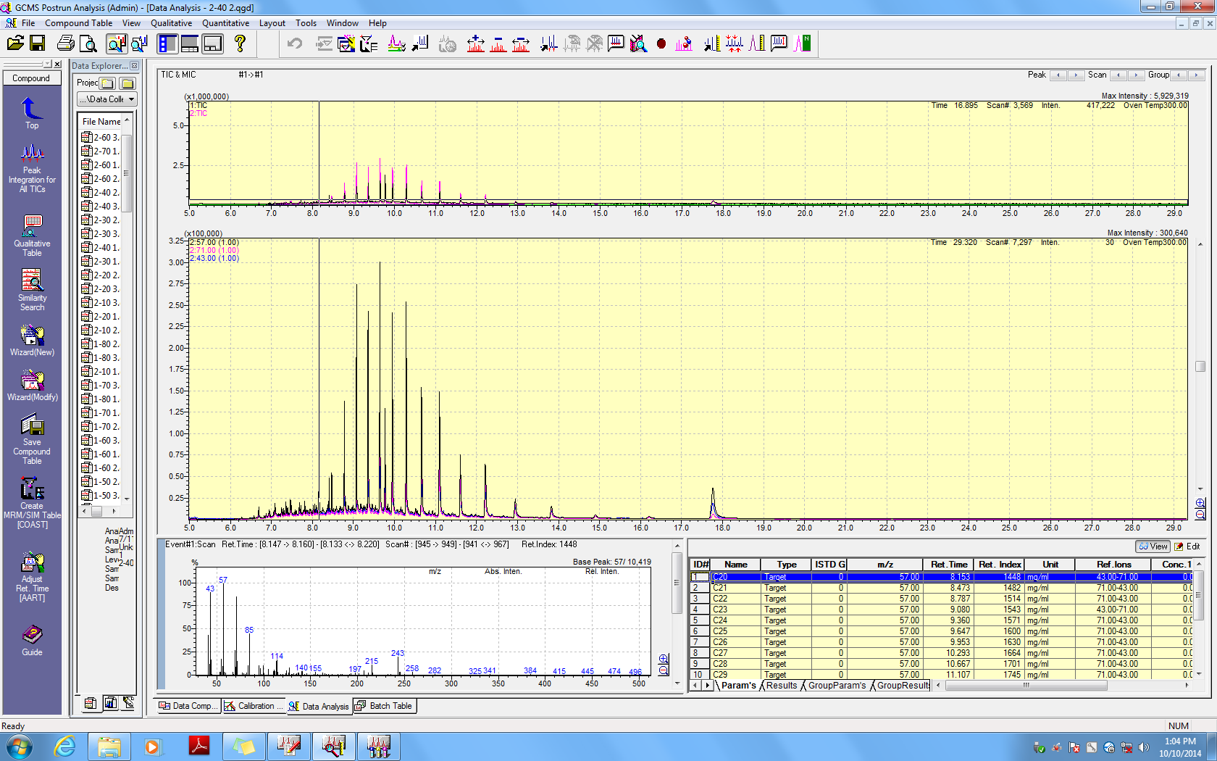
C29
C30
C36
C31

Slide 9
The Data
P_{aq} has been used in other studies (Ficken, 2000) to estimate the relative contribution of aquatic vs terrestrial plants.
Terrestrial plant average: 0.09
Emergent plant average: 0.25
Floating/Submerged plant average: 0.69
Values above 0.3 suggests terrestrial input into a dominantly aquatic assemblage, consistent with C/N data from prior studies of Tulare Lake.
Carbon Preference Index (CPI) is a ratio of odd over even n-alkanes, with values >1 indicative of a terrestrial source.
Values here exceed 1, but are far below the 10.61 average value measured in terrestrial plants (Bush & McInerney, 2013), suggesting terrestrial contribution was significant but not dominant.
Strong negative correlation with P_{aq} above shows agreement on shifts in runoff over time.

Slide 10
PRIOR DATA
Land Plant
C/N
Higher C/N and high frequency variations (Increased run-off corresponding to storm events surrounding the Lake?)
Low C/N (Organic matter dominated by lacustrine organisms)
C/N ratio: TL05-4A 1-3 and B2 cores. Data from Padilla et al., 2014.
Threshold for terrestrial input. Similar to a value of 1 for CPI.

Slide 11
Agreements!
High Runoff
Low Runoff
Low Runoff
High Runoff
High Runoff
Low Runoff

Slide 12
Grass
Relative abundance of C₃₁ vs C₂₉ and C₂₇ is used to represent change in the contribution of grasses vs. woody angiosperms to terrestrial carbon input. Elevated C31 is representative of grasses, while C27 and C29 are representative of trees and shrubs (Meyers, 1993).
As each plant produces significant amounts of all three alkanes, this ratio is only suitable for qualitative shifts in grass levels, and not for quantitative determination of relative contribution between grasses and woody angiosperms (Bush & McInerney, 2013)
Initial results show systematic variations in grass abundance over time, including abundant grasses during the early Holocene lake highstand observed in lake records throughout central and southern California.

Slide 13
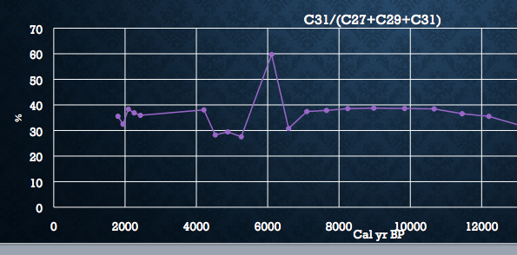
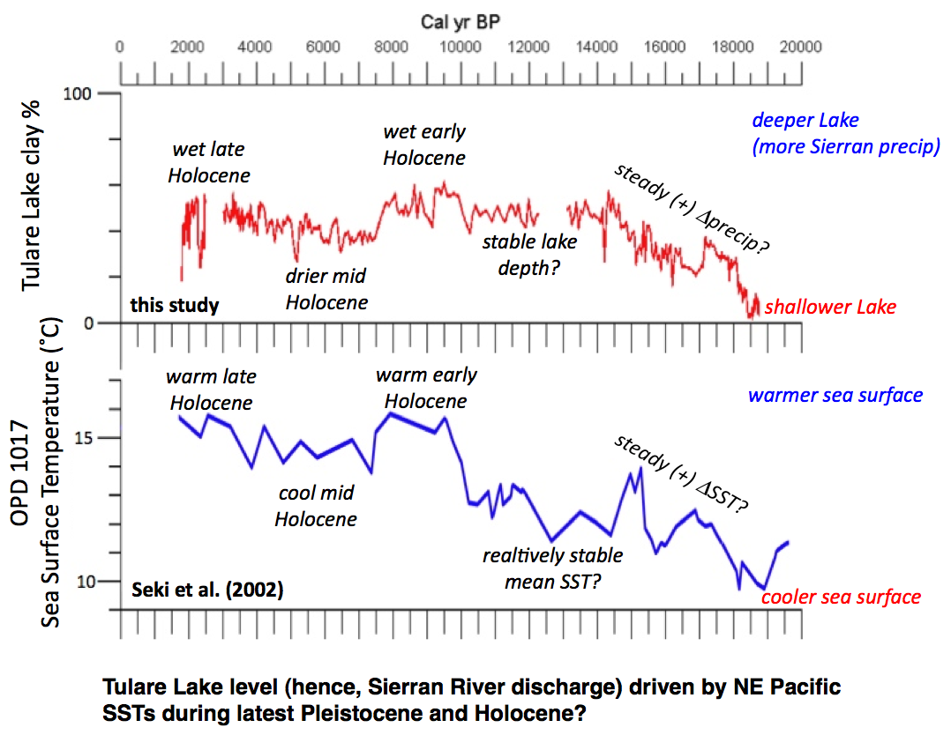
More agreement!
Single point anomaly
Figure from Blunt and Negrini, 2014
Clay% acts as a proxy for lake level.
After the end of glacial dynamics, Holocene lake levels follow sea surface temperatures.
Grassy Highstand

Slide 14
Predictions for Upcoming Isotope Data
The Central Valley of California is deficient in C4 grasses. Nearly all grasses in the area are C3 (Teeri & Stowe, 1976)
C3 plants thrive more in wet climates than C4 plants.
We see a large jump in grass in the wet early Holocene.
→ We should see a large negative swing in 𝛿¹³C during the early Holocene.
n-Alkanes from aquatic sources, such as algae, are minor and swamped by terrestrially derived alkanes. Aquatics contribute more to n-acids and n-alcohols (Eigenbrode 1999)
Figure from Meyers, 1999

Slide 15
Future work
Use 𝛿¹³C to build C3 vs C4 vegetation signal (serves as a proxy for precipitation).
Use vegetation signal to correct leaf wax 𝛿D into meteoric water 𝛿D (second precipitation proxy).

Slide 16
Acknowledgements
Ashleigh Blunt
Janosch Missbach
The National Science Foundation
Center for Research Excellence in Science and Technology (CREST)

Slide 17
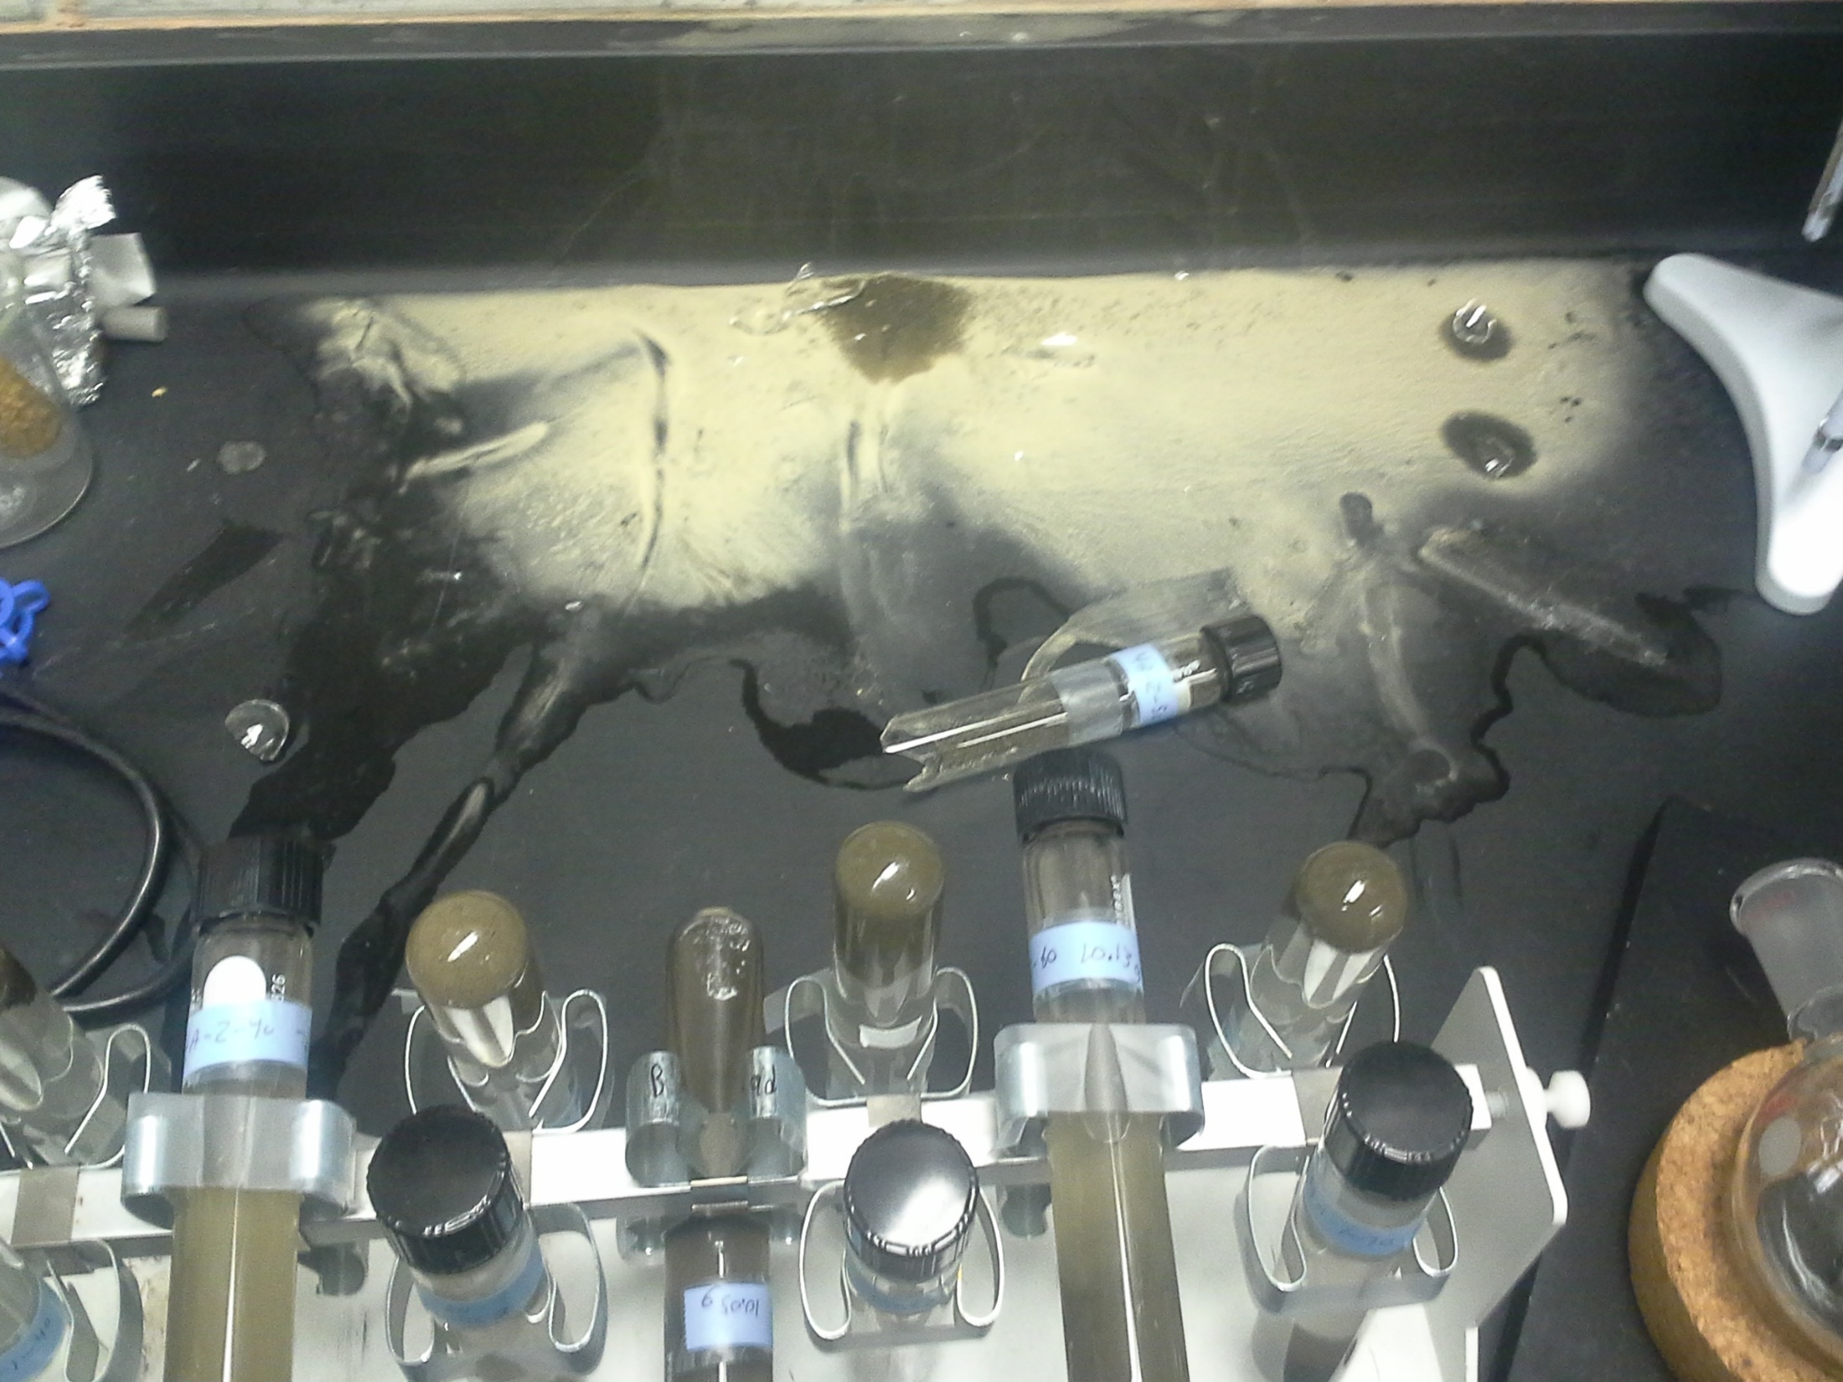
In Memory of Sample 2-50

Slide 18
References
Blunt, A., Negrini, R., 2014, Latest Pleistocene through Holocene Lake Levels from the TL05-4 Cores, Tulare Lake, CA. Department of Geological Sciences, California State University, Bakersfield.
Bush, R. T., McInerney, F. A., 2013, Leaf wax n-alkane distributions in and across modern plants: Implications for paleoecology and chemotaxonomy. Geochimica et Cosmochimica Acta, 117, 161-179.
Ficken, K. J., et al., 2000, An n-alkane proxy for the sedimentary input of submerged/floating freshwater aquatic macrophytes. Organic Geochemistry 31.7: 745-749.
Meyers, P. A., & Ishiwatari, R., 1993, Lacustrine organic geochemistry—an overview of indicators of organic matter sources and diagenesis in lake sediments. Organic geochemistry, 20(7), 867-900.
Meyers, P. A., & Lallier-Vergès, E., 1999, Lacustrine sedimentary organic matter records of Late Quaternary paleoclimates. Journal of Paleolimnology, 21(3), 345-372.
Padilla, K., Blunt, A., Medina, L., Negrini, R., 2014, Latest Pleistocene through Holocene Lake Levels from Tulare Lake, CA: Testing results using the Smear Slide Technique. Poster presented at GSA annual meeting, Vancouver, Canada.
Teeri JA, Stowe LG., 1976, Climatic Patterns and the distribution of C4 grasses in North America. Oecologia 23: 1-12

