Slide 1
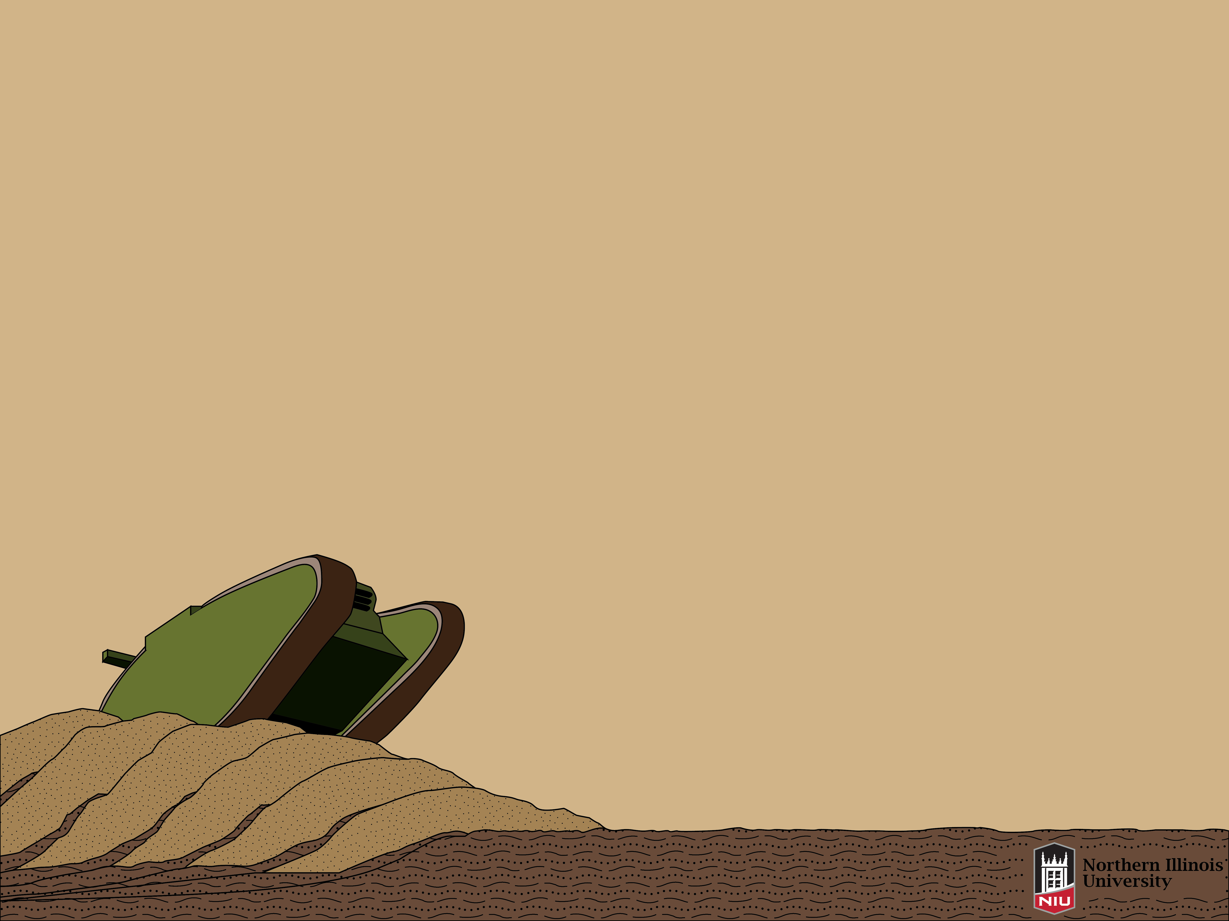

Notes:
Hello, I’m Joshua Olsen, a Graduate of Wheaton College and student of Northern Illinois University. Unlike the other talks in this session which have focused on big concepts in geoscience history, this talk will be on a much lesser known attempt to educate the general public about what we as geologists can contribute. That attempt was a book titled What a Geologist can do in War, written by Richard Alexander Fullerton Penrose, Jr., who as you all know was former GSA president and the namesake of the Penrose Medal. I and Melissa Lenczewski chose to research this topic as we both have a strong interest not only in geology but in military history as well.
<27sec>

Slide 2
OUTLINE
Introduction
The physical book
What CAN we do in war?
Penrose in 1917
Causes
Penrose’s background
National Research Council
Military Geology in 1917-18
Effects
Immediate
Long-term
Conclusions
Was it a Great Idea?
Notes:
We will approach this topic by answering a series of questions. These questions will begin with descriptions of the book, its contents, and, of course, the author himself. Then we will move towards the meat of our historical research asking why the book was written, the causes. Thirdly we will contemplate what Penrose actually accomplished by writing this brochure, the effects. And we conclude by asking the question; “Was it a Great Idea?”
<18sec>

Slide 3
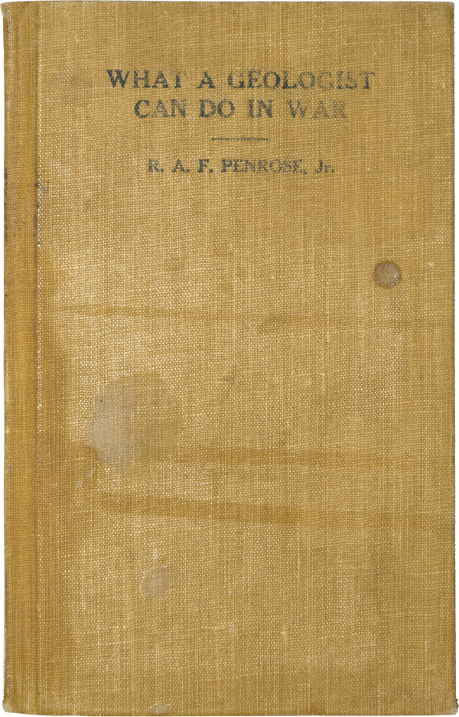
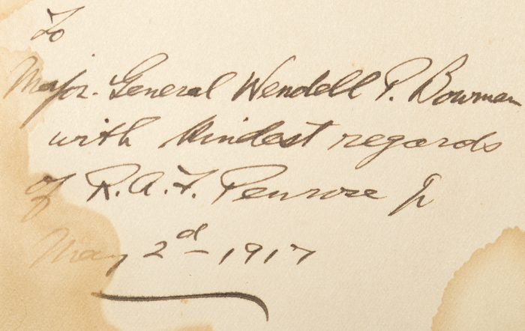
INTRODUCTION
What was the book?
Published: April 1917
Pocket Sized
1,600 words
Largely Distributed
“Untechnical”
Notes:
What a Geologist can do in War was published on April 24, 1917, just eighteen days after America officially declared war on Austria-Hungary. It measured about four by six inches, of appropriate size for the pocket of a military tunic, and it was distributed to military officers free-of-charge. In scarcely more than sixteen-hundred words, the book clearly and simply explained the ways in which a geological mindset can contribute to the strategies and logistics of war in both offensive and defensive manners.
The pictured copy – which is owned by my co-author – is autographed by Penrose himself. It was given by Penrose to a Major General Wendell P. Bowman, who had been commanding officer of the 28th infantry division in 1910 but who was also a business associate, traveling companion, and personal friend of Penrose.
<36sec>

Slide 4
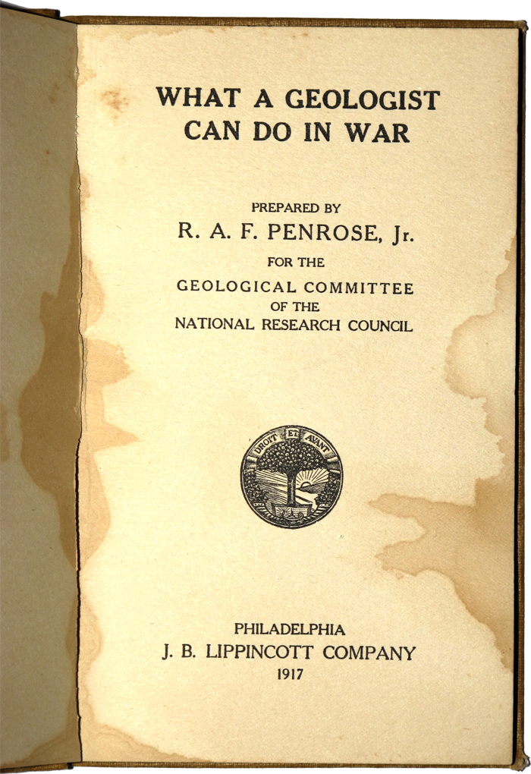
INTRODUCTION
What CAN we do in war?
Camps
Trenches and Tunnels
Ground for Artillery Positions
Roads
Maps
Long Distance Observations
Water Supply
Vibration Effects
Still applicable today!
To hear the book in a video: tinyurl.com/WWIGeol
Penrose, R.A.F., Jr., 1917, What a Geologist Can do in War: Philadelphia, J. B. Lippincott Company.
Notes:
In the opening sentence of the book, Penrose says that; “A knowledge of Geology can be made of use in many ways in time of war, not only to the army in camp but to the army on the march and the army in battle.” In the proceeding eight chapters, Penrose explains that Geologists can: (One) Help to site camps through their knowledge of water drainage and topography, (Two) Determine which soil is easy to dig and will remain dry for habitable trenches and tunnels,
(Three) Pick ground which will not shift under the barrage of a howitzer, thereby increasing its accuracy,
(Four) Build roads out of competent materials and site the quarries for those materials,
(Five) [Geologists can] Read maps and interpret contours and the passability of valleys and rivers,
(Six) Predict the landscape beyond that which can be seen to guide army movements,
(Seven) Determine where to site wells,
(And Eight) Asses the avalanche or landslide risks associated with heavy cannonading or use seismology to determine the distance of enemy fire
If you are interested, I have made a “video audiobook” which can be found at the URL shown.
All of these services, save for the fact that trench warfare is out of date, are still applicable today.
<52sec>

Slide 5
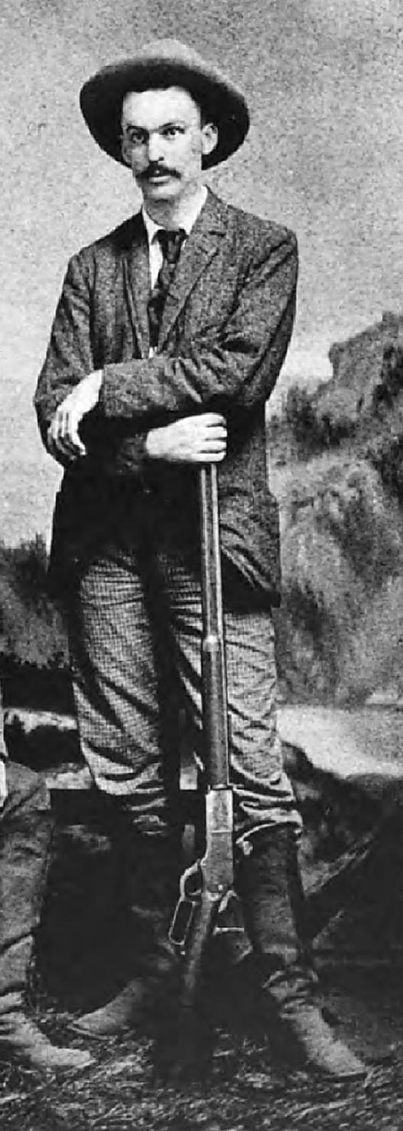
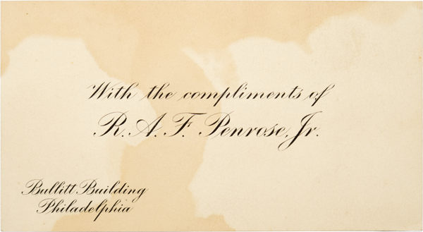
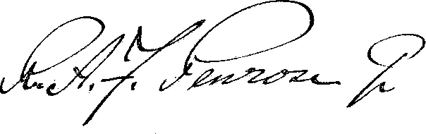
INTRODUCTION
Richard in Arkansas Survey, 1889
Who was R. A. F. Penrose, Jr. in 1917?
53 Years Old
World Traveler
Accomplished Mining Geologist
Wealthy, but lived in Hotel Suite
Fairbanks, H.R., and Berkey, C.P., 1952, The Life and Letters of R.A.F. Penrose, Jr.: New York, Geological Society of America.
Notes:
By April, 1917, Penrose was fifty-three years old and naturally far too old to serve in the military himself.
Thanks to various mineral prospecting ventures, he had already traveled to every continent and had spent time with the peoples of various nations. He was thus familiarized with and had a vested interest in preserving these cultures because he enjoyed these experiences. In fact, during time he spent in Tibet, there is one account of him “climbing to the top of the Grand Lama’s mountain and giving him… a banana which he ate with great enjoyment.” {Laughter}
Needless to say, by this point in Penrose’s life he had accumulated a large wealth, but he chose to live in a hotel suite and not squander it all away. The pictured business card was found inside the autographed book and shows the name of this residence.
<38sec>

Slide 6
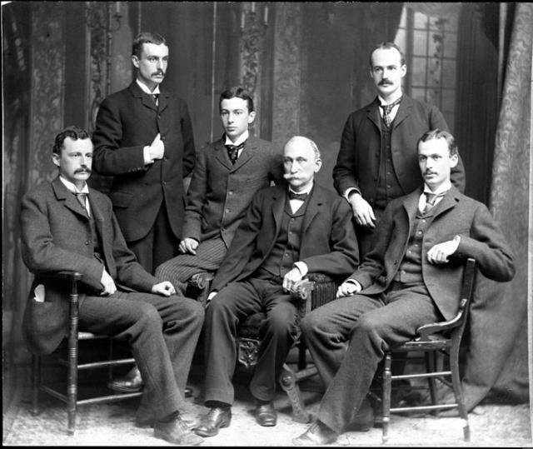
CAUSES
Why Penrose?
Patriotic Genealogy
Familiar with War
Philanthropist
Established Geologist
Penrose Family, 1882
“Even though you never intend to be a soldier you may possess a military bearing. [Keep your] Nose at angle 45°, head up, shoulders back…”
R.A.F. Penrose (Sr.) to his 6 sons in college
Fairbanks, H.R., and Berkey, C.P., 1952, The Life and Letters of R.A.F. Penrose, Jr.: New York, Geological Society of America
Photograph via: Pikes Peak Library Photographic Archive
Notes:
In order to understand why the book was written, we first researched Penrose’s genealogy to see if this would have conditioned him towards national service. We found that his father’s side was rife with military men. This began as early as the Revolutionary War with Penrose’s Great-Grandfather who was a standard-bearer in a Pennsylvania regiment when he was young. Next, Penrose’s Grandfather enlisted during the War of 1812 but never got called to battle. And finally, R.A.F. Penrose, Sr., known for his medical ability, was a surgeon in the largest army hospital in Philadelphia during the Civil War.
Penrose, Sr. passed on his proper military attitude to his 6 surviving sons by instructing them to keep their “nose at angle forty-five degrees, shoulders back.”
Penrose, Jr. himself had grown up in the Civil War era and thus knew the struggles of war. Perhaps because of this experience, he helped fund the Belgian Relief Commission in 1915.
He was of course also very familiar with almost every field of geology and also able to express the science in writing.
Because of these facts and those already mentioned, it comes as no surprise that Penrose would come to the aid his country through whatever means he could.
<53sec>

Slide 7
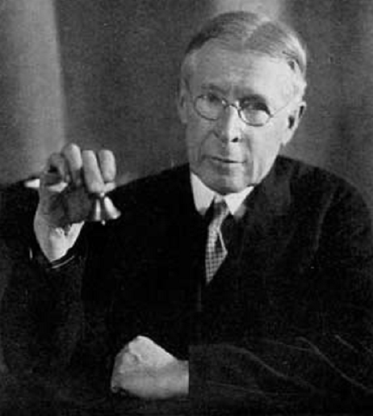
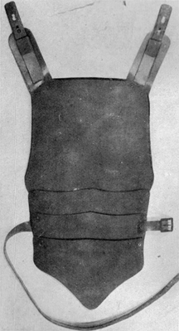
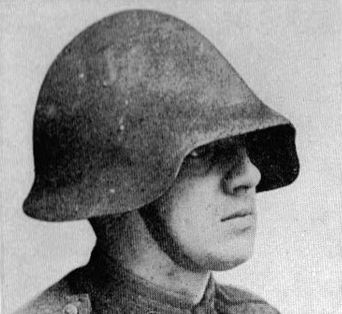
CAUSES
Who asked Penrose?
The National Research Council, Geology Committee
Chairman, John M. Clarke
Other Committee Projects:
Army Geology Training
Seismic Artillery Location
Devonian Fish Armor
John Mason Clarke
“To make clear to the military officers the nature of the service which geologists could render… What a Geologist Can Do in War was printed in a large edition and freely distributed among the officers.”
John Clarke
Bashford Dean’s Armor Prototype
Clarke, J.M., 1917, Report of the Geology and Paleontology Committee: Proceedings of the National Academy of Sciences of the United States of America, v. 3
Schuchert, C., 1926, Biographical Memoir of John Mason Clarke, in NAS Biographical Memoirs, Volume XII, Washington, D.C.
Crowell, B., 1919, America's Munitions, 1917-1918, Report of Benedict Crowell, Assistant Secretary of War for Munitions, Washington: GPO, pp. 223-26
Notes:
The next step was to understand who Penrose wrote the book for, specifically, the geology and paleontology committee of the National Research Council, which was founded in early 1917. The chairman of this committee was John Mason Clarke, who was the state geologist of New York.
Penrose was also a member of this committee and the publishing of What a Geologist can do in War was one of the first actions they took. To reiterate, the book was written to, quote “Make clear to the military officers the nature of the service which geologists could render…”
The committee also worked on many other projects and pushed for more geology courses in army education, a cause which was later realized. They did much research on how seismology can be used to locate enemy artillery, but one of their most unusual projects was the designing of new armor which was, no joke, based on Devonian Armored Fish fossils. This armor was actually produced and tested in the field. I included these pictures because I know “I” would be curious.
<44sec>

Slide 8
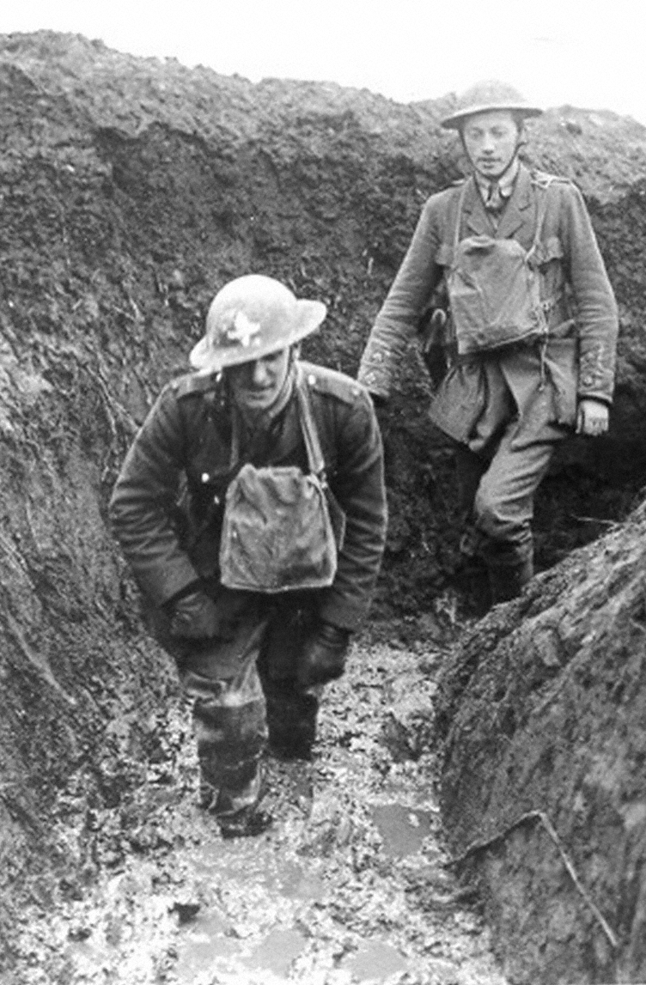
CAUSES
Why was it necessary?
Poor public understanding of geology
Increasing need
Poor water supply
Horrible trenches
“Mining war”
No organized US Geol. Corps
“[The report came back with,] ’What is the use of digging wells in a country which is already saturated with water?' …Summer came, the surface water disappeared… ‘For Heaven's sake come dig us some wells. We have no water.‘”
Douglas Johnson, Contributions of Geology
Johnson, D.W., 1920, Contributions of Geology, in Yerkes, R.M. ed., The New World of Science: It’s Development During the War, New York, The Century Co.
Photograph via: First World War Poetry Digital Archive
Notes:
It is easiest to understand why this book was necessary if we perform a little survey:
Please raise your hand if someone has ever confused you with an archaeologist or a “dinosaur hunter” and wished you luck on your next “dig.”
{Feign Counting}
Roughly everyone in the room.
And if it’s like that now, imagine what it was like a hundred years ago. Because of the nature of military education, most officials wouldn’t have the slightest clue what a geologist does, and those that did most likely thought we only dealt with hard rocks, not soils, water, or topography.
Yet despite this poor understanding, there was an ever-increasing need for our services in the war. Soldiers were often faced with water shortages, or an over-abundance of it in their trenches giving them trenchfoot. In addition, a heated “mining war” between Britain and Germany was being waged in which one side would tunnel under the other and light explosives under their feet. Before 1917 though, America had no geological corps in the military.
Stories that involved complete disregard for geological advice were frequent, including the one quoted here where a hydrogeological team submitted a report to a basecamp only to receive the response “What is the use of digging wells in a country which is already saturated with water?” No wells were dug. Summer came. And all their water dried up. “For heavens sake, come dig us some wells! We have no water!” they cried. But now, the team was too busy to respond. That particular unit never did anything without consulting a geologist first again.
<1min16sec>

Slide 9
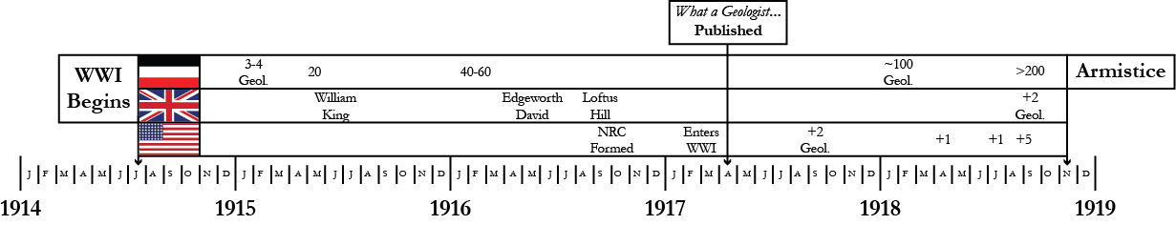
CAUSES
Why was it necessary? – Military Geology in 1917
British Expeditionary Force
2 geological advisors
High-ranking officers
Germans:
40-60 “Kriegsgeologen”
Privates
“The moral perhaps is that it is better to employ two first-class geologists like our own than twenty second-class or German ones.” (emphasis added)
Brigadier-General J. E. Edmonds (Deputy Engineer-in-Chief B.E.F.)
Johnson, D.W., 1920, Contributions of Geology, in Yerkes, R.M. ed., The New World of Science: It’s Development During the War, New York, The Century Co.
King, W.B.R., 1919, Geological Work on the Western Front: The Geographical Journal, v. 54, p. 201–215
Brooks, A.H., 1920, The Use of Geology on the Western Front: Washington, D.C., Government Printing Office.
.
Notes:
While America had no geological corps in early 1917, other nations, which had been at war for two years, better valued geologists. For example, Britain had realized the importance of scientific expertise in early 1915. In April of that year, they appointed their first geologist, Captain William King. He was followed almost a year later by Lieutenant Colonel Edgeworth David and together they had explicit authority to oversee military operations.
In contrast, by 1917 the German army had about forty to sixty geologists. However these men, or “Kriegsgeologen” which means simply “War Geologists”, were mostly only ranked as private and many were inexperienced. This caused one event where a geological team led a general to believe that a certain area was not able to be mined, but the British did it anyway. Needless to say, these particular Kriegsgeologen were quickly {mmm..} “sent to zee front.”
{Laughter}
Talking about this story after the war, a British official said “The moral perhaps is that it is better to employ two first-class geologists like our own than twenty second-class… or German ones.”
{Laughter}
So, take THAT as you will…
<59sec>

Slide 10
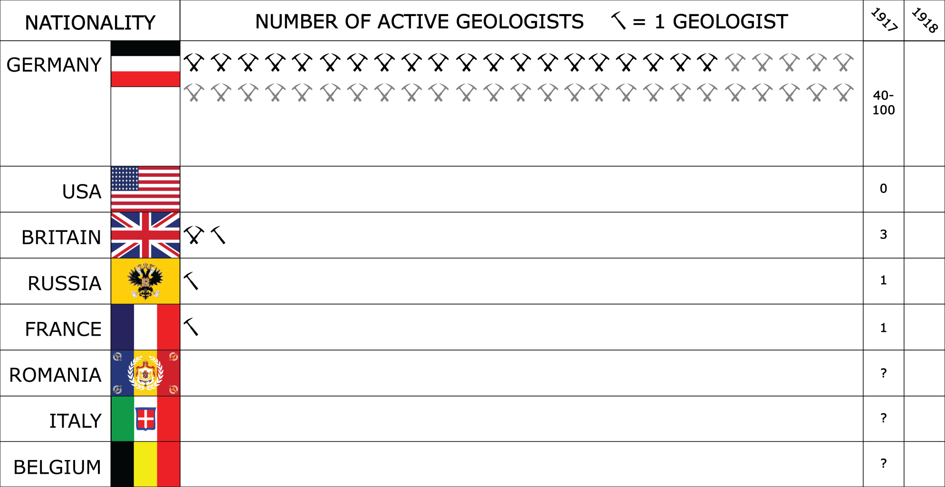

EFFECTS
CAUSES
Why was it necessary? – Military Geology in 1917
… and 1918
Estimated Maximum Total: 105
253
Macleod, R., 1995, “Kriegsgeologen and practical men”: military geology and modern memory, 1914–18: The British Journal for the History of Science, v. 28,
Brooks, A.H., 1920, The Use of Geology on the Western Front: Washington, D.C., Government Printing Office.
Johnson, D.W., 1920, Contributions of Geology, in Yerkes, R.M. ed., The New World of Science: It’s Development During the War, New York, The Century Co.
King, W.B.R., 1919, Geological Work on the Western Front: The Geographical Journal, v. 54, p. 201–215.
Notes:
While doing our research, we came across enough information to be able to tabulate the estimated number of geologists in WWI. To our knowledge, this is the first time this information has been collected together. Each hammer represents one geologist and grey hammers show estimated maximums. The data currently displayed is for shortly after What a Geologist can Do in War was published in 1917.
As you can see, Germany far outranked any other country in this regard and as far as we know none of the other smaller powers had any geologists.
If we fast forward to armistice day, however… *click*
We see that the shear number of active geologists had almost increased by a-hundred-and-fifty percent.
Among the smaller nations;
Russia had attached a geologist to each of its seventeen major divisions,
France had developed a geological advisory section of older geologists but those of military age were drafted into the regular army,
Romania had commissioned several members of its geological institute,
Italy had a few geologists but lacked any organized corps,
And Belgium had one geological advisor.
With the major powers, however,
Britain had added two additional geologists and the number of German geologists doubled. But, as we know, that didn’t really help.
Finally, USA had five geologists after What a Geologist can do in War was written… but was it because of it?
<1min8sec>

Slide 11
EFFECTS
What were the immediate effects?
Joseph Pogue, July, 1917
Copied Penrose’s book
Argued further for:
Field and Homefront Geology Sections
Army Geology Training
“The problem facing the geologist, at the present moment, is not so much to apply his knowledge as [it is] to lead military authorities to see clearly the service that he is prepared to render.”
Joseph Pogue
Pogue, J.E., 1917, Military Geology: Science, v. 46, p. 8–10.
Notes:
To answer this, we looked for references that directly cited Penrose’s work. We found one in an article written by petroleum geologist Joseph Pogue for Science three months after What a Geologist can do in War was published. Even this long after, it was still the case that, quote; “The problem facing the geologist, at the present moment, is not so much to apply his knowledge as [it is] to lead military authorities to see clearly the service that he is prepared to render.”
However, Pogue built upon Penrose to argue for a homefront geological section that would cooperate with geologists overseas, and, as others did, he argued for increased geological education in army courses. Both of these points would later gain traction.
<34sec>

Slide 12
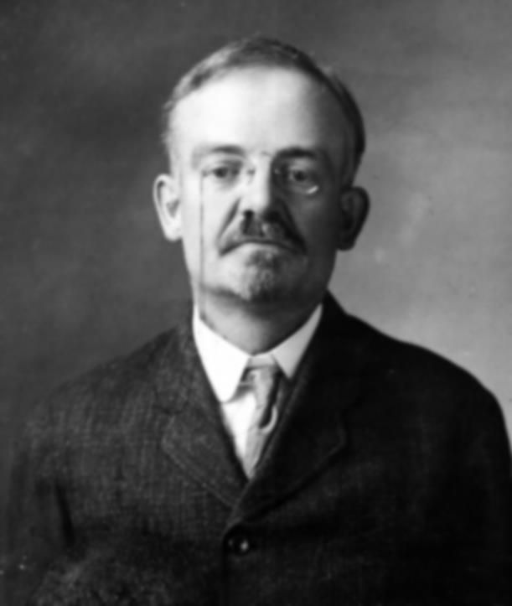

EFFECTS
What were the immediate effects?
American Expeditionary Force
September ‘17: 2 Geologists
“In midsummer, 1918, a total of 18 geologic officers had been authorized… though requisition had been made [in June]… but one arrived before the signing of the armistice… because the armies did not ask for their full quota of geologists.”
Alfred Brooks, Chief Geol., AEF
April ‘18: +1
June ’18: +1
September ’18: +5
Pulled from other ranks
Alfred H. Brooks
Brooks, A.H., 1920, The Use of Geology on the Western Front: Washington, D.C., Government Printing Office.
Notes:
The American headquarters finally added two geologists in September, 1917. The Chief Geologist was Lieutenant Colonel Alfred H. Brooks and he was assisted by another man who only lasted a month.
Two-thirds of a year later… *Click*
in April, 1918 one more geologist joined Brooks’ staff.
Several months again later… *Click*
Brooks had pushed hard enough for more geologists that command authorized the commission of eighteen officers distributed throughout the army. Some have mistaken this as meaning that there were eighteen geologists in theatre, but the key word is that they were authorized, it was still up to army officers to request them. As it happened though, division commanders, quote; “did NOT ask for their full quota of geologists.” Because of this, only one actually arrived in France.
By September, 1918… *Click*
Brooks managed to scratch together just five other men trained in geology who were serving as officers or enlisted men in non-geological capacities. But this wasn’t an easy task.
<54sec>

Slide 13
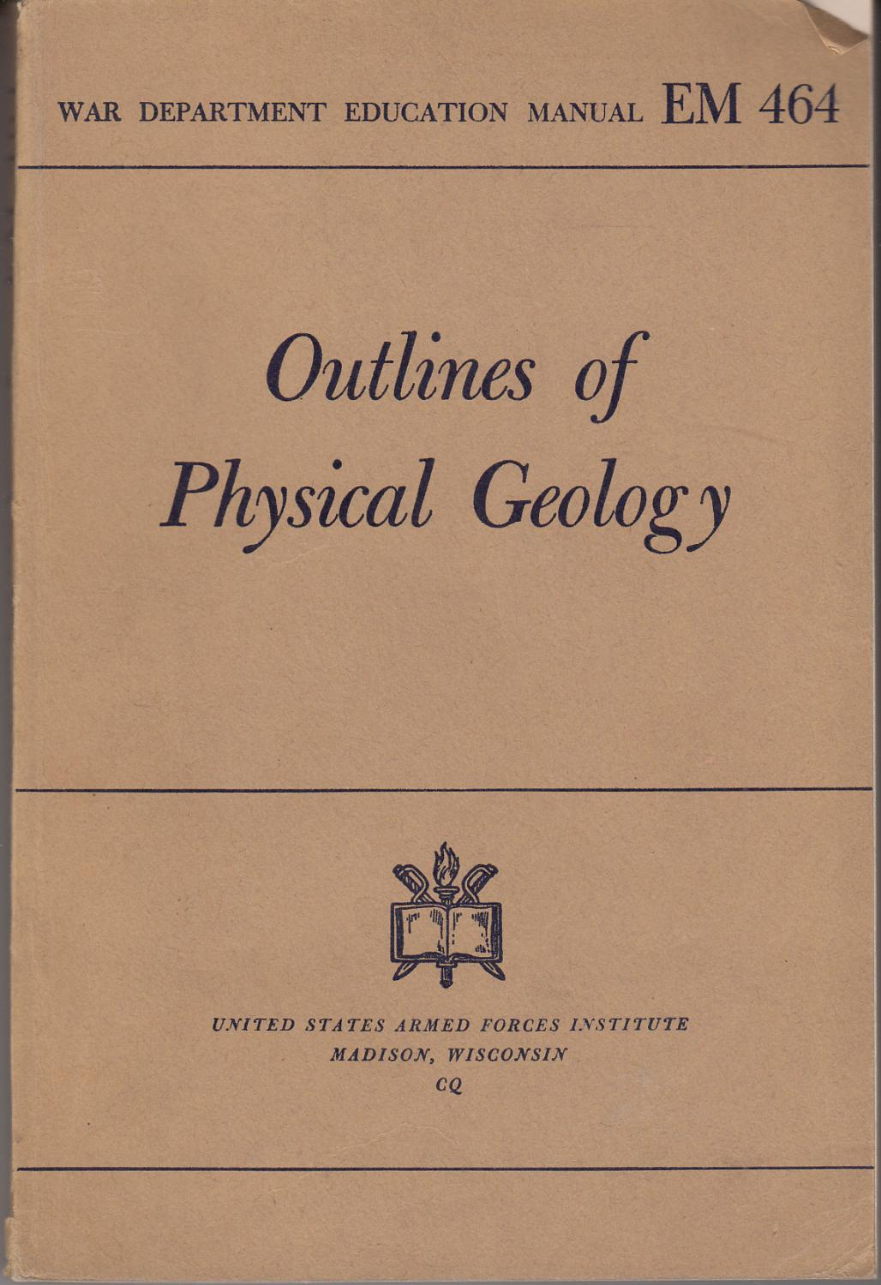
EFFECTS
What were the long-term effects?
Penrose stayed with NRC until 1923
Army Training Corps (ATC)
Geology Curriculum
World War Two:
Geology still taught in Army
Military Geology Unit
“Within a few weeks of the decla­ration of war [on] April 7, 1917… What a Geologist can do in War was written… but attracted so little attention that it was soon forgotten.”
Charles E. Erdmann, 1943
1944 War Department Education Manual
Fairbanks, H.R., and Berkey, C.P., 1952, The Life and Letters of R.A.F. Penrose, Jr.: New York, Geological Society of America
Pittman, W.E., 1998, American Geologists at War: World War I, in Underwood, J.R.J. and Guth, P.L. eds., Reviews in Engineering Geology, Vol. XIII: Military Geology in War and Peace, Reviews in Engineering Geology, Boulder, Colorado, Geological Society of America, p. 41–47.
Erdmann, C.E., 1943, Application of geology to the principles of war: Geological Society of America Bulletin, v. 54, p. 1169–1194, doi: 10.1130/GSAB-54-1169.
Notes:
Penrose would stay with the National Research Council until 1923 when he was struck with an illness he would not recover from. But, during this time he significantly shaped the NRC we know today. While he was active, the NRC lobbied for and succeeded in adding a geology curriculum to the Army Training Corps, which was a forerunner to today’s Reserve Officer Training Corps.
By the second World War, army students could still opt to take geology during their training. The pictured book is a 1944 War Department textbook for such a course. In addition, an organized Military Geology Unit had been established that consisted of about one-hundred-and-sixty men. However, to say these were a direct effect of Penrose’s work would be a huge overstatement. As a 1943 article on War Geology said when; “What a Geologist can do in War was written, it attracted so little attention that it was soon forgotten.”
<48sec>

Slide 14
CONCLUSIONS
Was it a Great Idea?
It was a Great Idea…
in theory
Did it work?
Not really.
It failed to convince officers that geologists were needed.
Why not?
Too simple?
Not publicized?
Not the right time?
Erdmann, C.E., 1943, Application of geology to the principles of war: Geological Society of America Bulletin, v. 54, p. 1169–1194, doi: 10.1130/GSAB-54-1169.
Notes:
So, in conclusion, What a Geologist can do in War WAS a Great Idea… *Click* In theory.
*Click* Did it work though?...
Not really.
It failed to convince army officers that geologists could be of assistance enough for them to request the eighteen geologists they were allotted. Which is exactly what Penrose intended to do.
Why Didn’t it work?
It’s hard to say. Perhaps it was SO simple that officers just disregarded it. Or maybe it wasn’t publicized in the circles of army officers enough. Most likely though it simply wasn’t the right time and officers had more pressing matters like worrying about mustard gas or troop moral to sit down and read it. If it had come out before we entered the war, perhaps it would have been better recognized.
Yet despite this limited recognition, *click*
<43sec>

Slide 15
CONCLUSIONS
“In addition to the matters already mentioned, the geologist whose work has been in the more newly settled parts of the world, and not in the older settled region where he has lived in civilization, is an efficient scout. His training has been in the wilds among mountains, hills and plains; often without trails, where he has had to take his course by the blazes on the trees or from the stars, the moon, or his compass, and often surrounded by hostile natives. He can fight, cook, withstand bad weather and discomfort, and still keep on with his scientific work; he has acquired the woodcraft of the old trapper, together with the education of a scientist. Few other men [or women] possess this unique combination of accomplishments.”
Richard Alexander Fullerton Penrose, Jr.
Penrose, R.A.F., Jr., 1917, What a Geologist Can do in War: Philadelphia, J. B. Lippincott Company.
Notes:
Penrose’s conclusion is perhaps the most poetic description of a geologist I have ever heard.
“In addition to the matters already mentioned,” [Penrose writes,] “the geologist whose work has been in the more newly settled parts of the world, and not in the older settled region where he has lived in civilization, is an efficient scout. His training has been in the wilds among mountains, hills and plains; often without trails, where he has had to take his course by the blazes on the trees or from the stars, the moon, or his compass, and often surrounded by hostile natives. He can fight, cook, withstand bad weather and discomfort, and still keep on with his scientific work; he has acquired the woodcraft of the old trapper, together with the education of a scientist. Few other men [or women] possess this unique combination of accomplishments.”
<44sec>

Slide 16

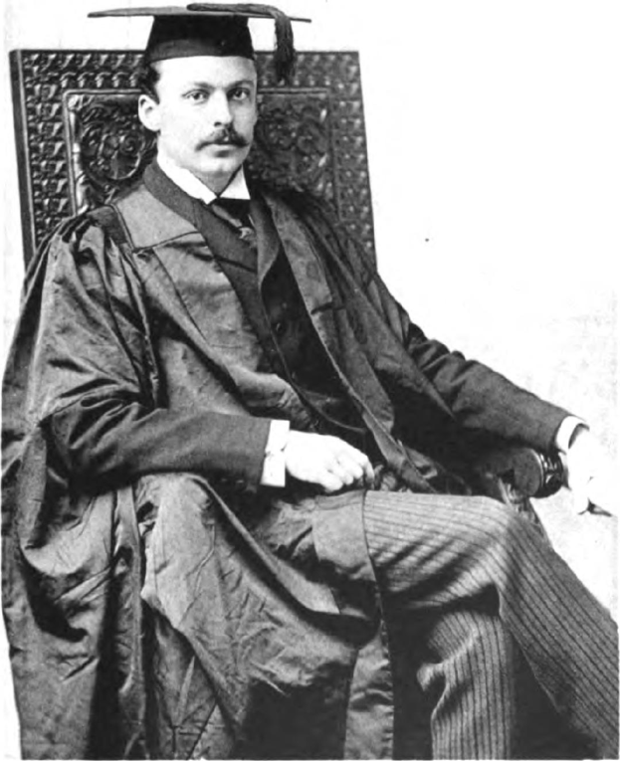

To hear and see the book, visit: tinyurl.com/WWIGeol
( links to )
Notes:
Thank you for listening. Are there any questions?
<2sec>

