Slide 1

  From subsurface to seafloor: Comparison of cold seep carbonates from the Tepee Buttes (Cretaceous) and the Stone City Bluff (Eocene)
Jennifer Hendricks

Slide 2
Outline
Research Problems
Cold Seeps
Tepee Buttes, Colorado
Stone City Bluffs, Texas
Cold Seep Formation
Conclusions

Slide 3
Problems
Determine field relationships, paragenetic sequence and diagenesis of seep carbonates
Trace seep carbonate porosity through time
Connect and compare the surface and subsurface expressions of methane derived carbonates
Identify the path of methane movement from the subsurface to the seafloor

Slide 4
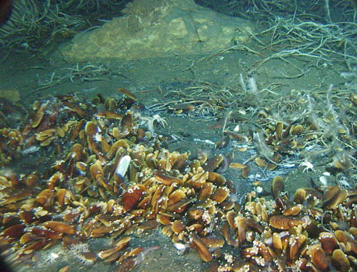
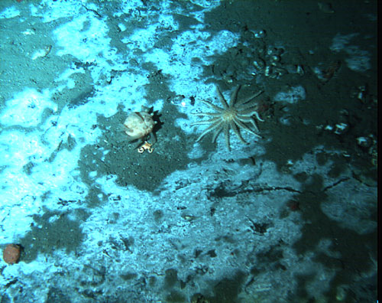
What are Cold seeps?
Ocean communities formed around hydrocarbon-rich fluids seeping from seafloor
Based around chemosynthetic bacteria
  Free living or symbiotic
Unique chemistry promotes carbonate formation
MacDonald
Texas A&M
Levin, Scripps Institute of Oceanography

Slide 5
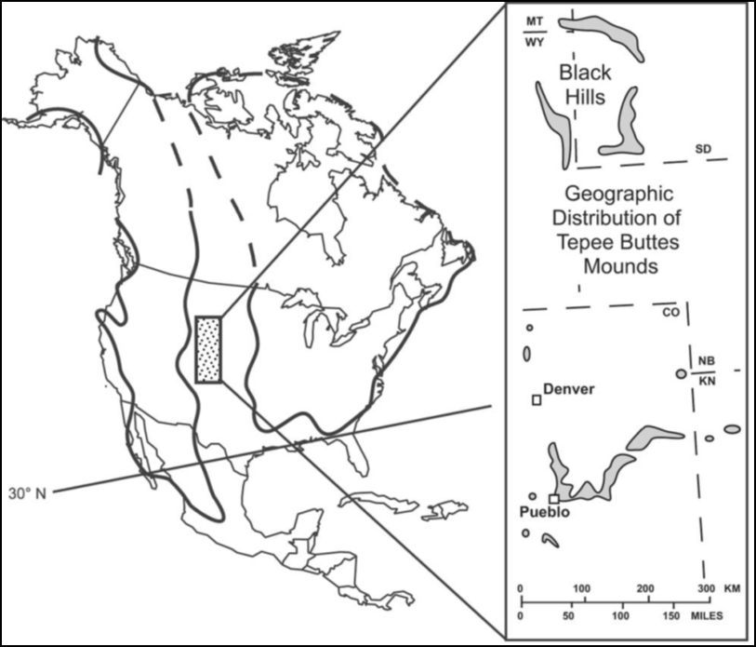
The Tepee Buttes
Carbonate mounds located in Pierre Shale
  Irregular grouping
    Laterally and vertically
Late Cretaceous methane seeps
  Seep activity over 10 my
Western Interior Seaway
  Shallow water
    <300 m depth
From Metz, 2010
From Shapiro and Fricke, 2002

Slide 6
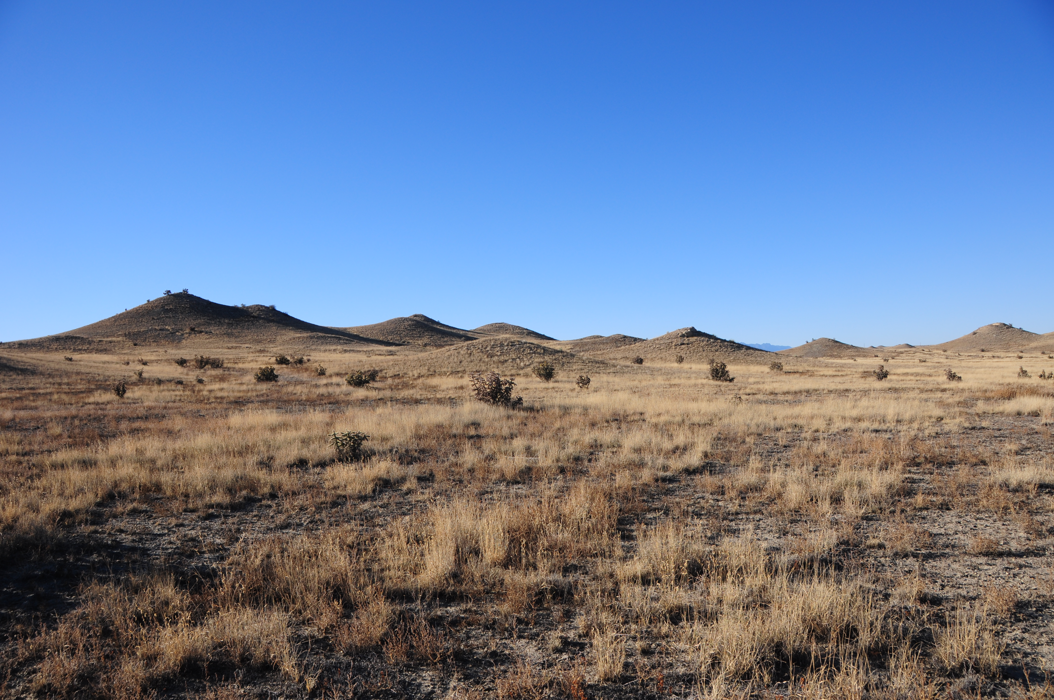
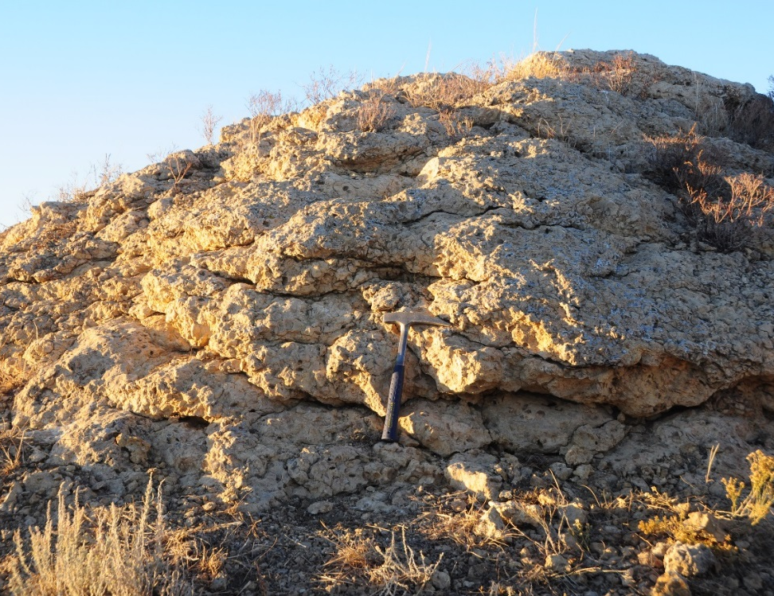
Mound Shape
Current mound shape is a result of weathering
  Forms in thin beds
  Interfingers with surrounding shale
Carbonate formed at or near the sediment-water interface
Notes:
Add mound shape picture

Slide 7
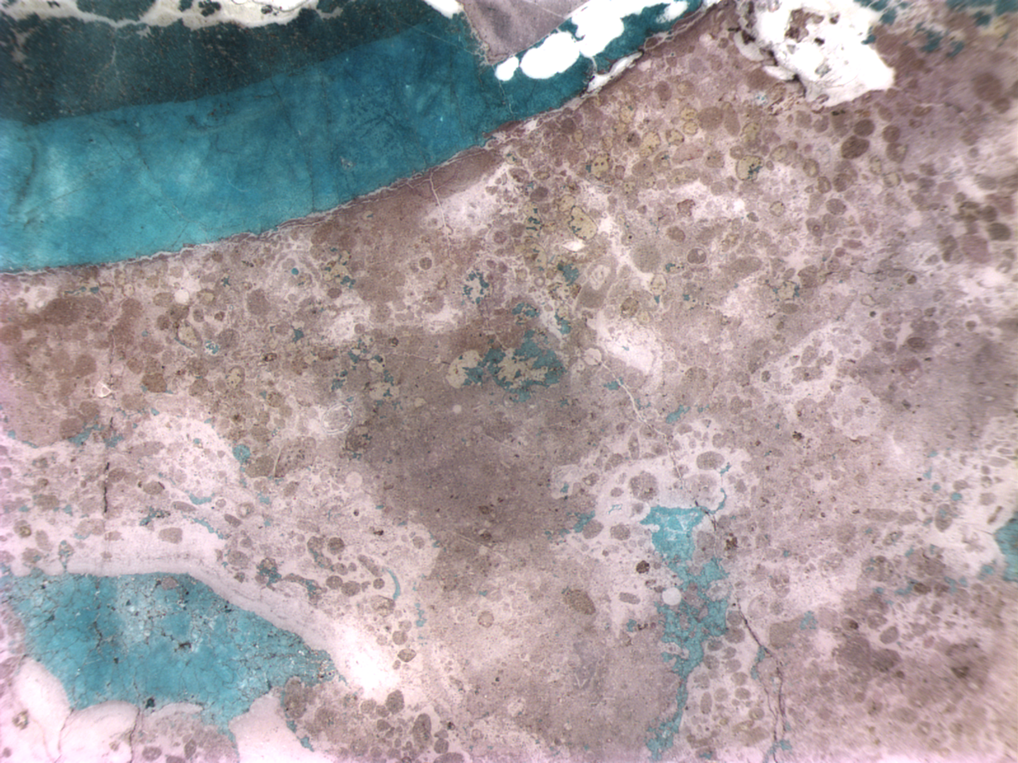
4. Bivalve shells replaced
by ferroan calcite
6. Silica Replacement
Beige Facies
1. Peloids in micrite
and calcite
1. Deposition of forams and bivalves
2. Formation of vugs
3. Botryoidal Calcite
3. Early sparry calcite
vug
5. Ferroan Sparry Calcite
Other Ferroan Calcite
Notes:
7

Slide 8
Stable Isotopes
Late Fabrics
Diagenetic trend
Early Fabrics

Slide 9
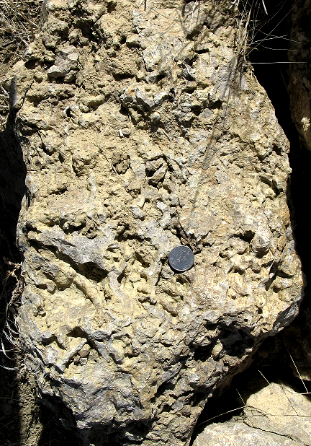
Methane Pathways
Seep Vent facies has been previously interpreted as containing worm tubes
Notes:
Number of facies, talking about seep vent though

Slide 10
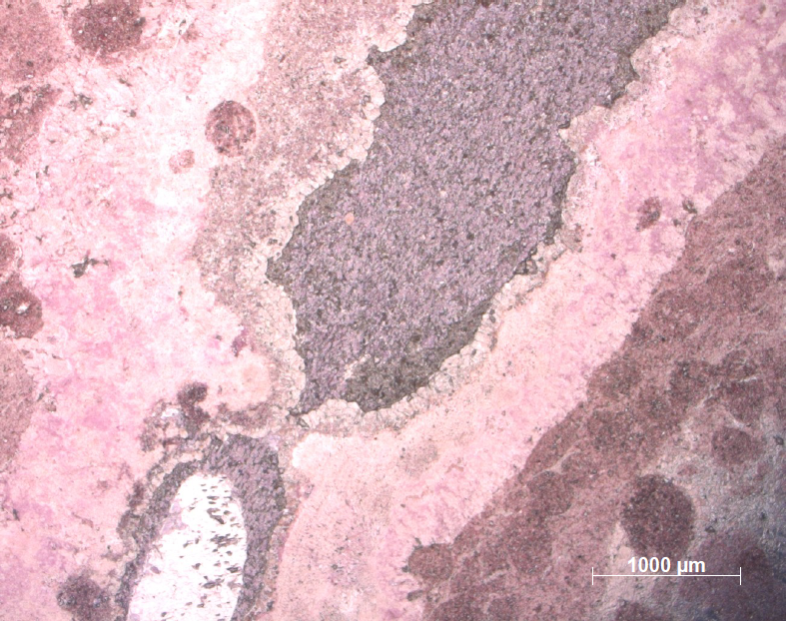
Methane Pathways
Tubes are more likely pathways through which methane rich fluids moved through
Preserves siliciclastic sediment in the tubes, suggesting fluid flow
  Later filled in with cement
Siliciclastic sediment

Slide 11
Methane Pathways
But… we don’t see the subsurface methane pathways expressed at the Tepee Buttes

Slide 12
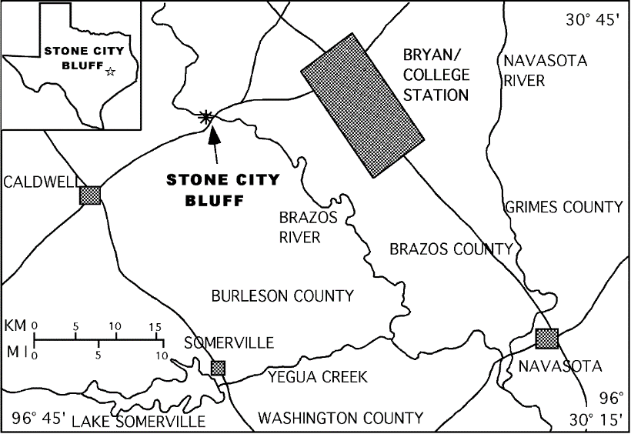
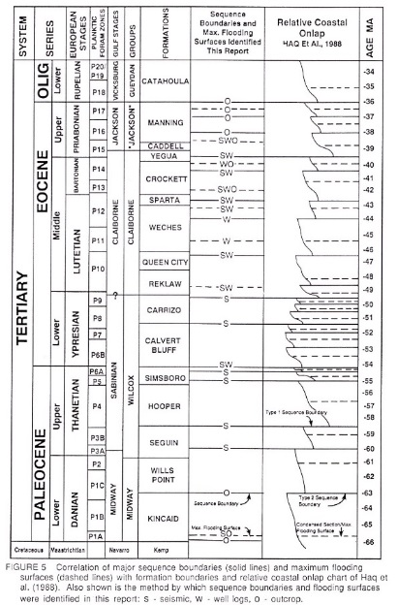
Stone City Bluffs
Located in Burleson County, TX on the Brazos River
  Also known as Whiskey Bridge
Part of the Crockett formation
  Upper Middle Eocene
  Siliciclastic transgressive systems tract
Contains unusual elongate carbonate concretions
From Hendricks et al., 2012
From Davidoff and Yancey, 1993

Slide 13
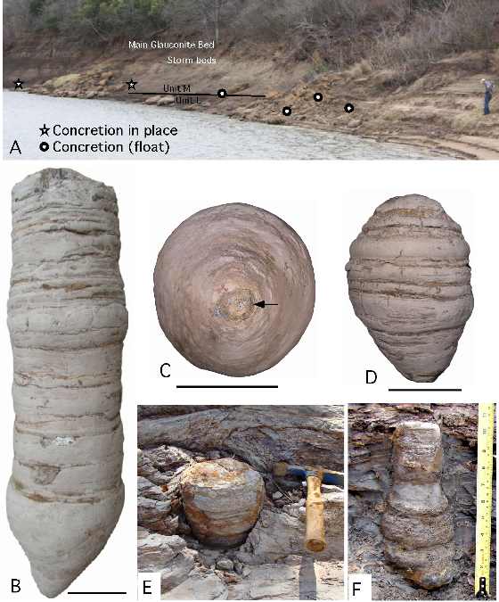
Exterior
Morphology
Located in shale above contact with lower sandy unit
Up to 70 cm long and 20 cm diameter
  Pinch and swell with surrounding sediment
1 cm micropipe runs through center of barrels

Slide 14
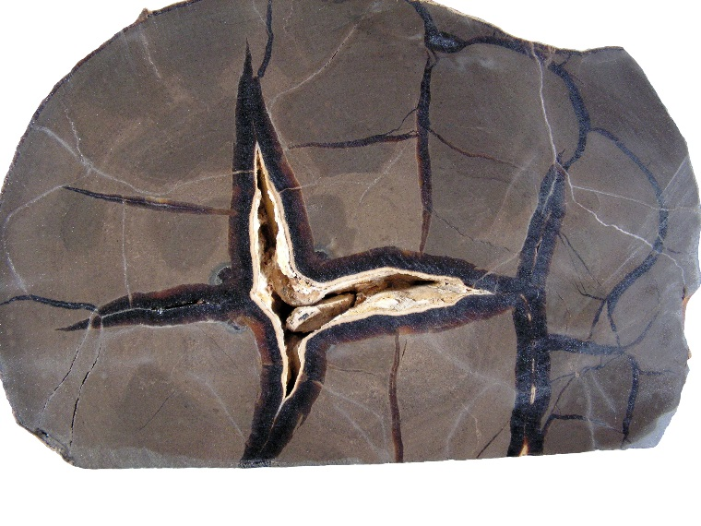
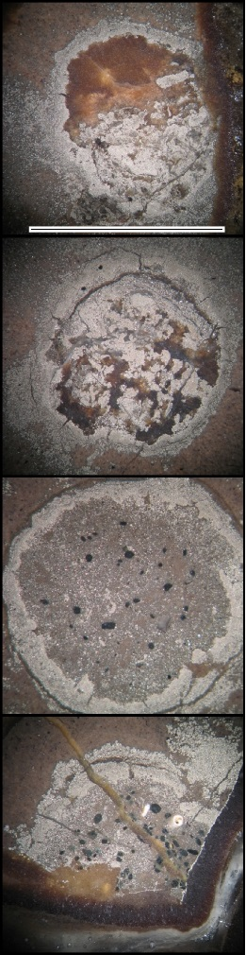
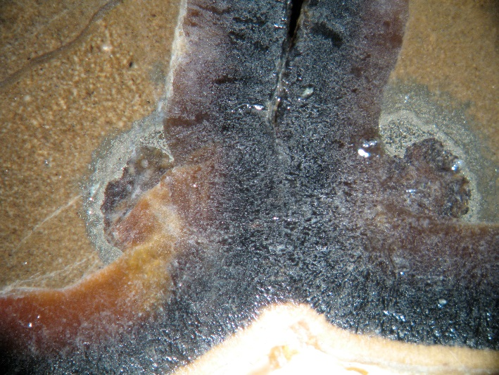
Interior
Morphology
Partially healed septarian fractures
  2 episodes of calcite fracture fill
Micropipe is always lined with pyrite
Micropipe filled with
  Calcite cement
  Pyrite
  Glauconite pellets
  Sediment
  Shell fragments

Slide 15
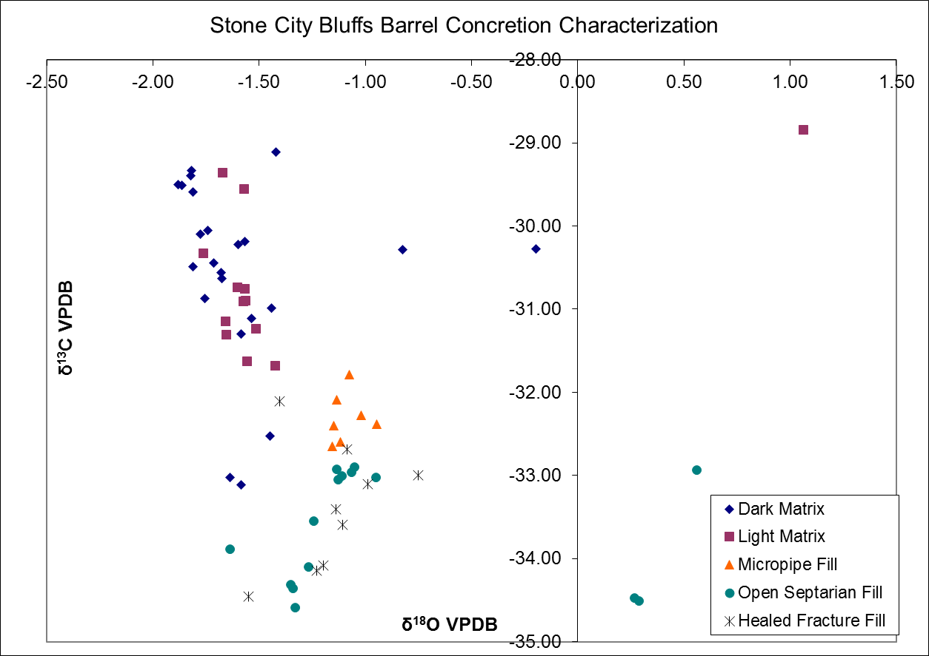
Isotopic Analysis

Slide 16
Methane Migration
Methane moves through the subsurface in preferred pathways
  These are preserved as barrel concretions, with the central micropipe being the main conduit
No surface or true “cold seep” carbonate seen at Stone City

Slide 17
Cold Seep Formation
Subsurface
Barrel Concretions
Methane Formation

Slide 18
Cold Seep Formation
Subsurface
Barrel Concretions
Methane Formation

Slide 19
Cold Seep Formation
Sedimentation
Organisms
Subsurface
Barrel Concretions
Methane Formation

Slide 20
Cold Seep Formation
Organisms
Subsurface
Barrel Concretions
Methane Formation

Slide 21
Cold Seep Formation
Organisms
Subsurface
Barrel Concretions
Methane Formation

Slide 22
Conclusions
Tepee Buttes are Cretaceous cold seeps that are the surface expression of a methane migration system
Barrel Concretions from Stone City Bluff preserve subsurface pipeways for methane migration
Combining these 2 features, we can formulate a comprehensive model of methane migration from the subsurface to the seafloor
  Barrel concretions form in the subsurface, and are the plumbing of the seep system, with the surface expression looking like the Tepee Buttes

Slide 23
Acknowledgements
Anne Raymond
Michael Pope
Tom Yancey
Ethan Grossman
Cheryl Metz
Shell
GSA Research Grant, 2012
AAPG James E. Hook Memorial Grant, 2012

Slide 24
Questions?

