Slide 1
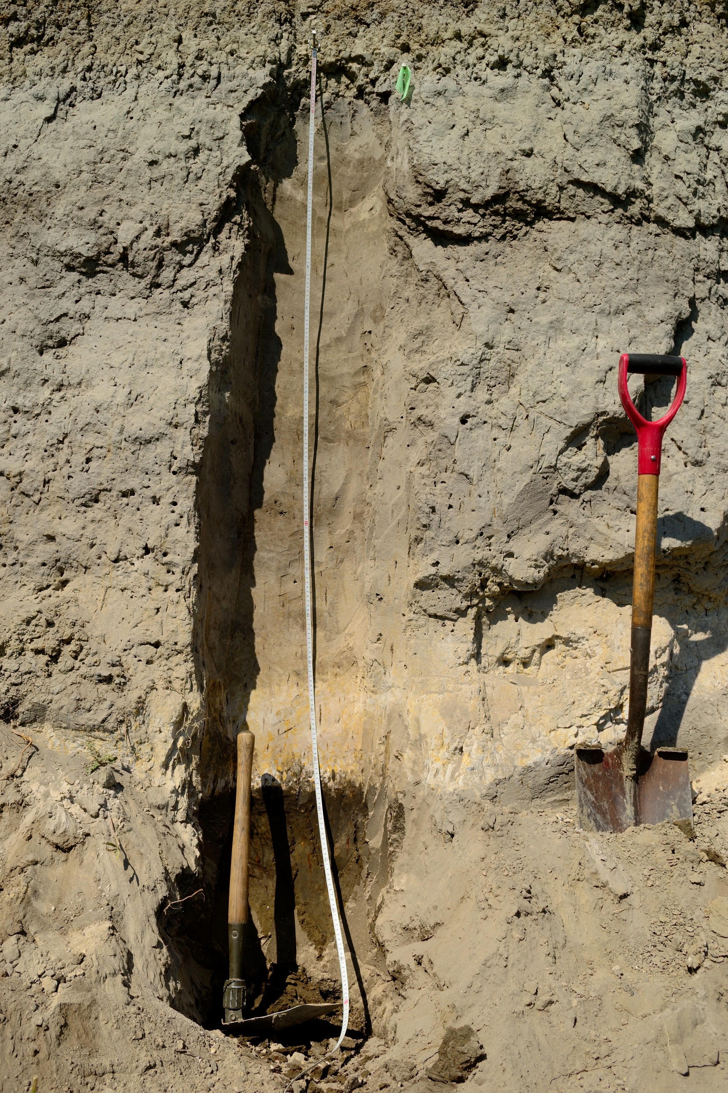
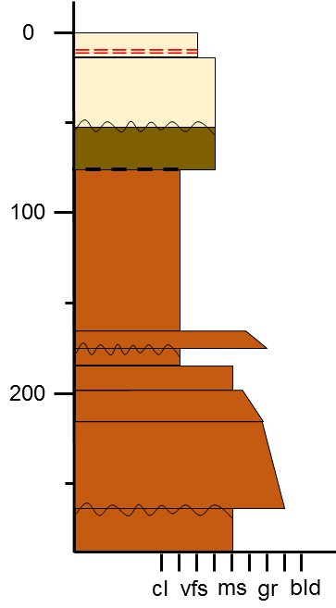
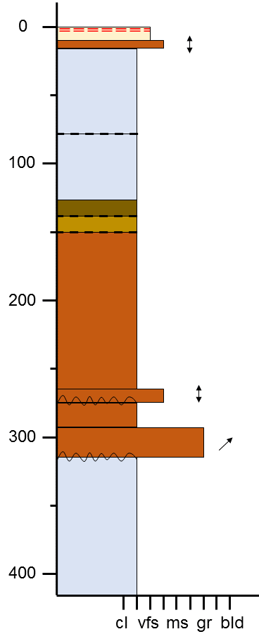
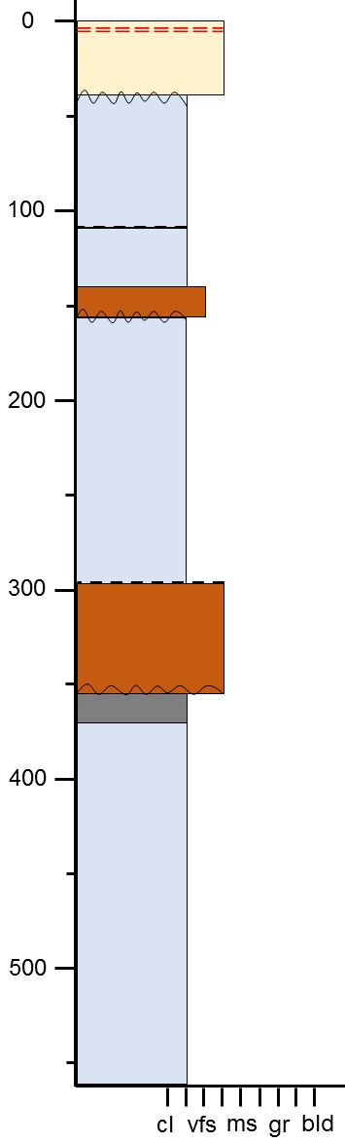
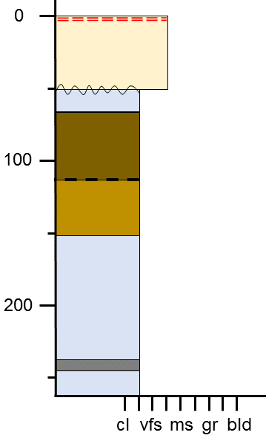
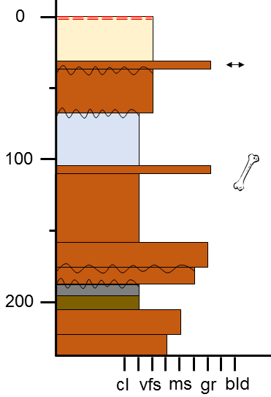
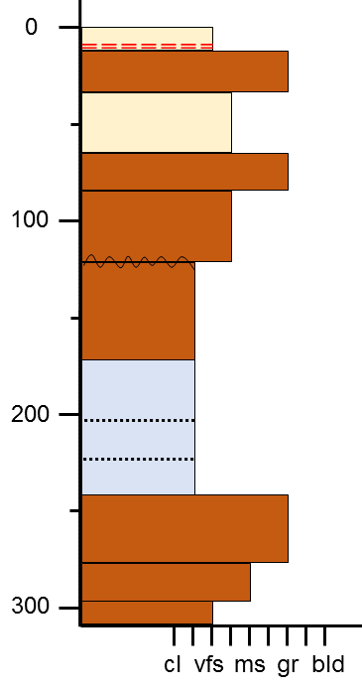
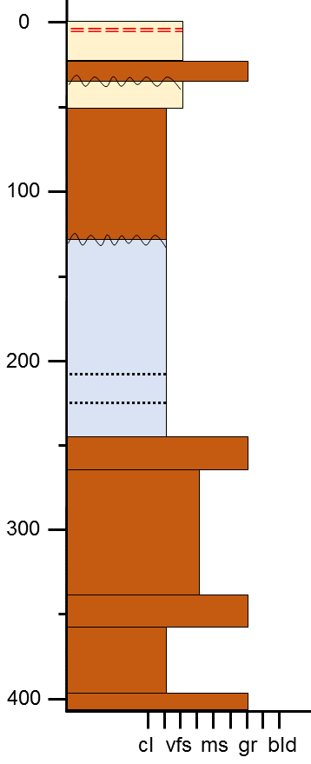
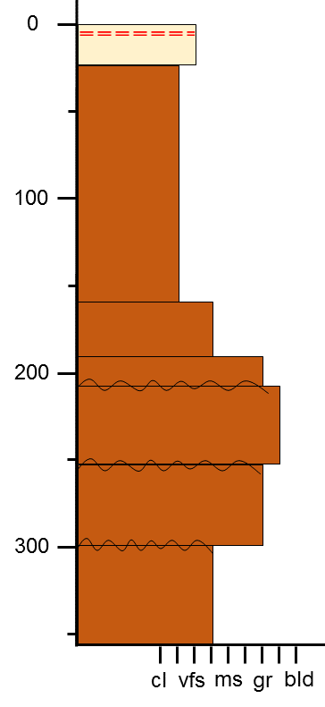
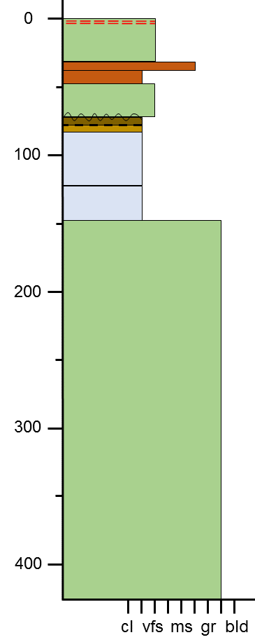
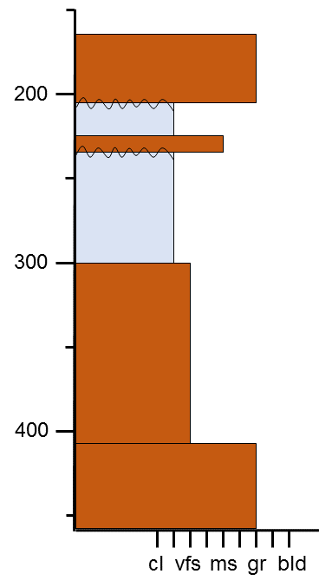
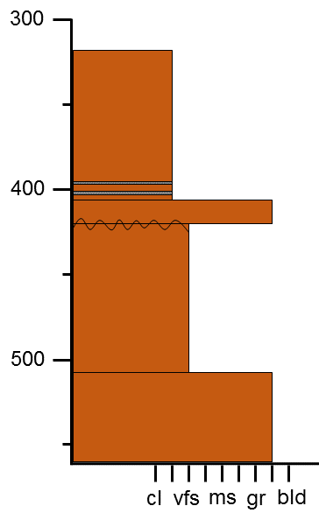
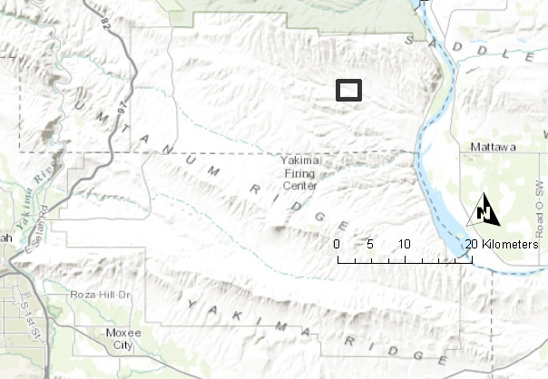

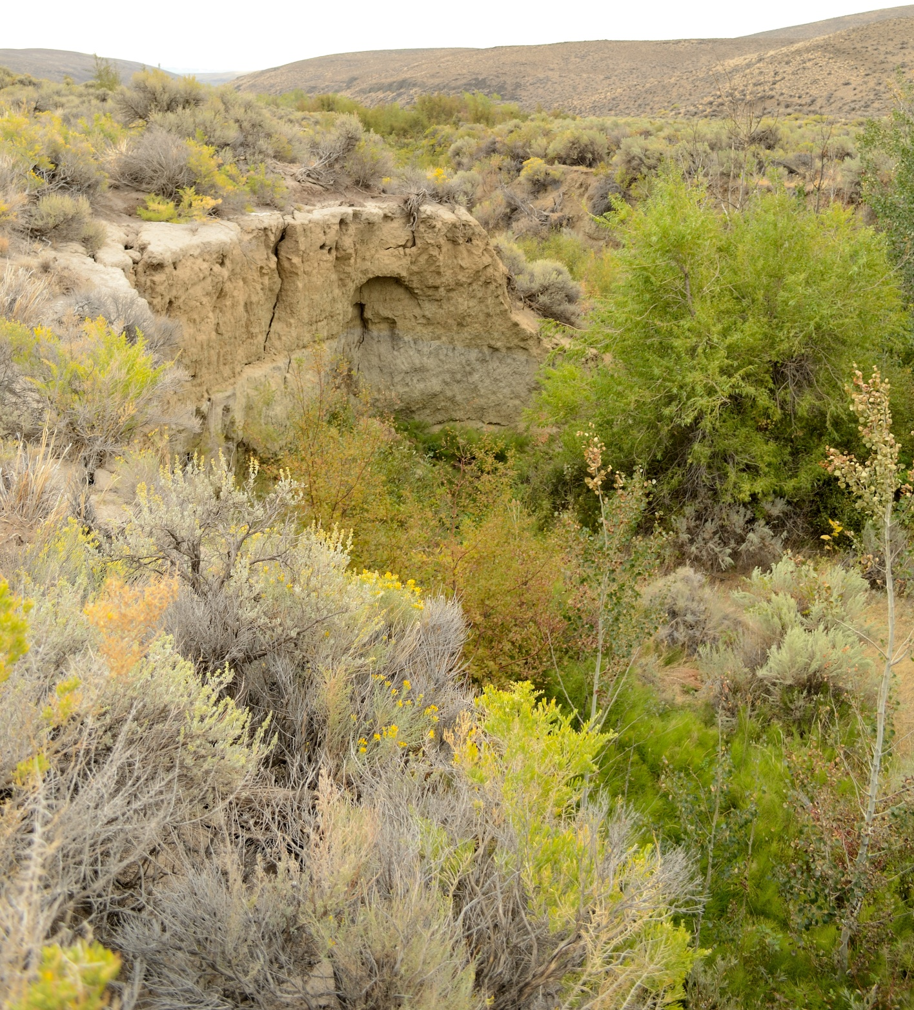
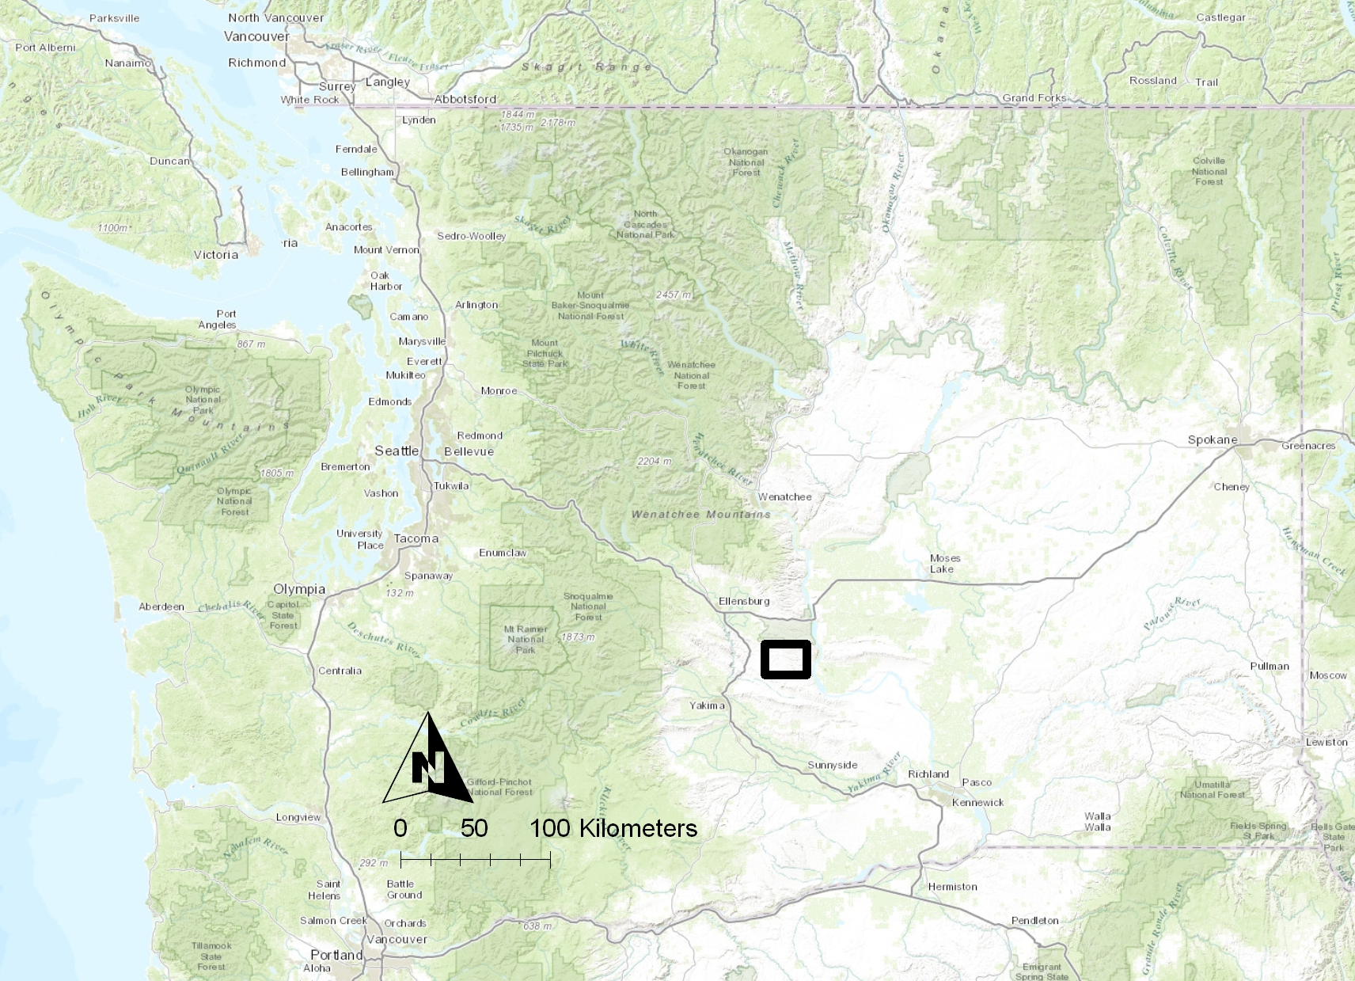
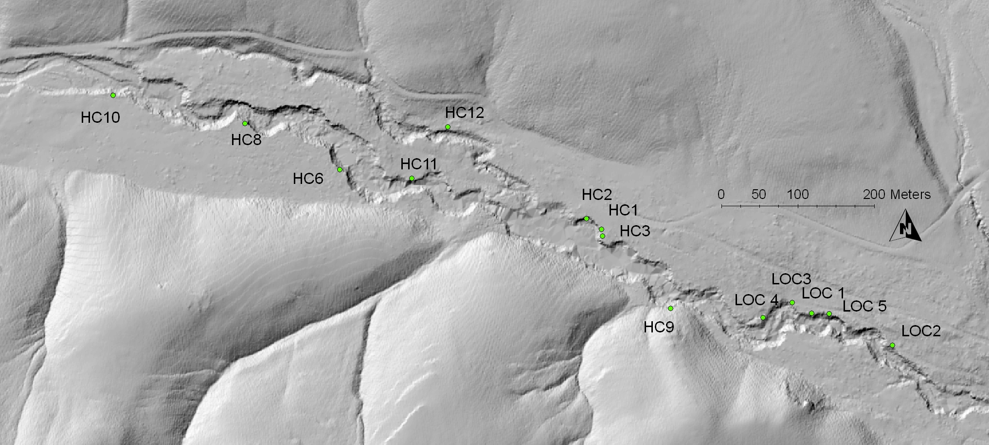
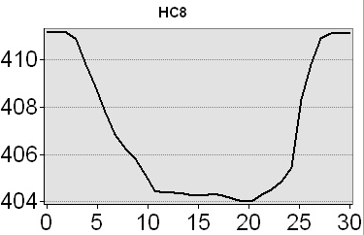
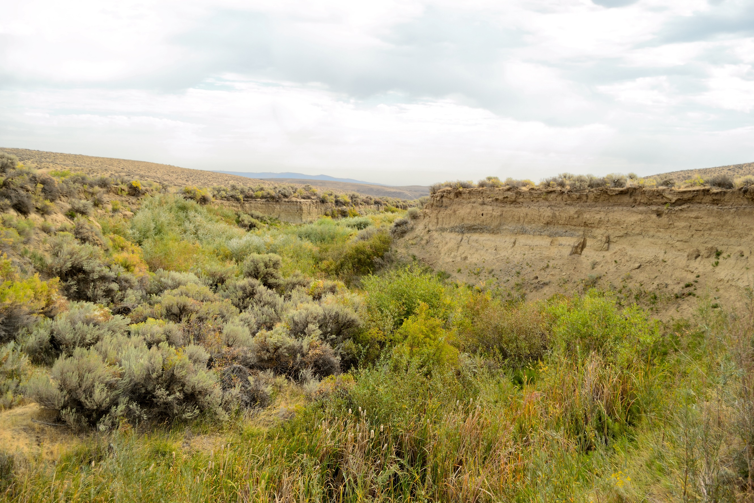
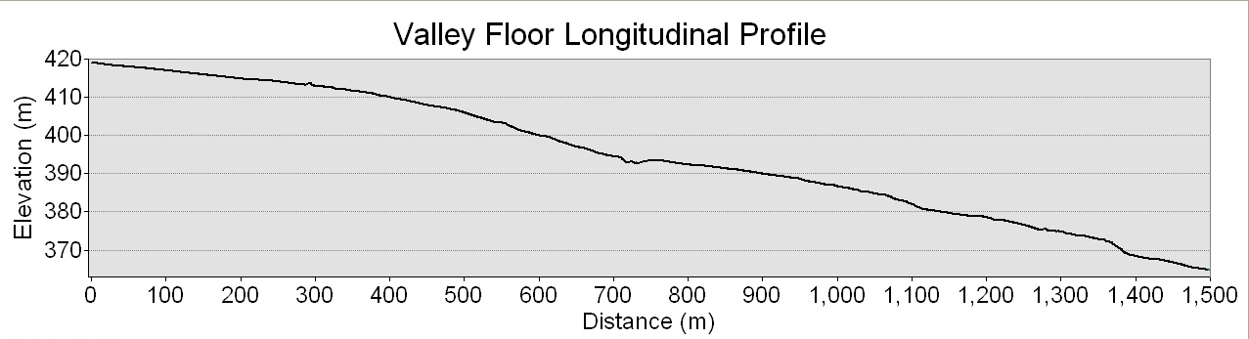
Processes and Timing of Holocene Deposition, Channel Incision and Coincident Archaeology, Hanson Creek, Washington
By Levi Windingstad, Lisa Ely and Steven Hackenberger
Central Washington University
Introduction
Research Objectives:
Evaluate changes in physical environment throughout the Holocene at Hanson Creek.
Determine causes and timing of spatially intermittent and prolonged, ponded sediments.
Determine number and timing of arroyo incision events.
Relate morpho-stratigraphic interpretations to archaeological evidence.
The causes and timing of cycles of sediment deposition and erosion in the Hanson Creek drainage in central Washington (Fig 1.) provide insight into changes in channel morphology and paleoenvironment within the region since the mid-Holocene (8 kya-present). Stratigraphically and spatially coincident archaeological evidence reveals information related to human occupation during the latter half of the epoch. Using LiDAR imagery and field surveys, recent processes such as degree of modern channel incision, accumulation of valley floor sediment, channel morphology and gradient were evaluated. The spatial distribution of these channel characteristics was assessed in relation to proximal land forms such as spring mounds, colluvial deposits, basalt outcrops, and bedrock anticlinal ridges.
HC10
HC8
MSH 1980 Tephra
HC6
HC11
HC12
HC2
HC1
HC3
Aeolian
Younger Inset Into HC1
A_{b}
Ponded
HC9
Fluvial
A_{b}
Younger Inset Into HC3
HC9
B_{b}
Tephra-Mazama? ~7600 BP
Tephra-Mazama? ~7600 BP
HC4
Legend
HC5
Tephra-Mazama? ~7600 BP
Aeolian
Buried A-Horizon
Erosional Unconformity
Figure 5. Photograph of ~20-cm thick tephra and thick, massive, fine grained sediment observed at HC6.
Fluvial
Buried B-Horizon
Tephra-Mazama? ~7600 BP
b.
Ponded
Mazama? Tephra
Lithic or Bone
a.
Colluvial
MSH 1980 Tephra
Gradual Contact
Hanson Creek
Figure 3. Selected stratigraphic columns displayed with depth below surface in centimeters (y-axis) and grain size, according to the Wentworth scale, from clay to boulder (x-axis). Arrows indicate measured paleocurrent direction with north pointing up.
Transition from an aggrading braided system to an expansive, fine grained, alluvial step-pool sequence that aggraded continually throughout the mid- to late- Holocene (Fig. 3).
A single, 9-m deep arroyo incision of a 1.3 km reach occurred around AD 1900.
Low gradient, fine grained, organic-rich, sediment suggests prolonged periods of ponding at HC 8, HC6, HC11 and LOC5, all of which are adjacent to evidence of ground-water springs (Fig. 3).
The intervening reaches exhibit comparatively high gradients for unconsolidated alluvium (Fig. 4).
Alluvial fans filling the basin from the north and south act as a terminus for low gradient conditions (Fig. 4).
a.
Conclusion
Figure 6. Photograph near LOC5 looking east. Shows contrast of vegetation from shrub-steppe on the surface to wetland vegetation on the channel bed.
Hanson Creek has undergone several pulses of aggradation dating back as far as ~7600 BP, but likely continued throughout much of the Holocene. The spatial correlation of thick ponded sediments to alluvial fan deposits suggests, at minimum, one damming episode which resulted in an expansive step-pool sequence. Several phases of minor channel incision related to the braided stream have occurred throughout the reach during the latter half of the Holocene. Most notably, the recent ~1900 AD arroyo incision has lowered the stream base level creating a stark contrast between the basin surface and channel bed as evidenced by vegetation (Fig. 6). The cause of the incision is likely a combination of factors including; thick accumulations of easily erodible sediment, steep gradients directly linked to alluvial fans and a high magnitude event triggering initial knickpoints, subsequently lowering base level.
The evidence of physical environment variation directly influences the archaeology found throughout the study location. Much of the archaeological evidence is found 0.5-m to 2-m below the surface which coincides with the step-pool sequence prior to arroyo incision. Furthermore, the physical environment during occupation included a series of lush ponded sections and an intervening braided channel with a wide flood plain, which was unconstrained due to the absence of arroyo incision. Human occupation was concentrated on the higher elevation adjacent fan and flood plain deposits as evidenced by concentrations of lithic and bone evidence found north of the current incision (Fig. 4). This physical evidence suggests a plausible inference of wetter conditions during occupation. Any correlation of archaeological evidence to stratigraphic position should be carefully assessed based on the dynamic depositional environment as some of the evidence is likely transported and subsequently redeposited.
The timing and physical environmental conditions associated with the deposition and erosion of Holocene sediment in the Hanson Creek watershed will supplement the minimal data available on arroyo formation in the northwestern U.S., and allow a comparison with previous alluvial chronologies from the region.
Figure 1. a.) Location of Hanson Creek relative to the State of Washington denoted by black box; b.) Magnified view of region. Study location denoted by green star.
Archaeological Excavations
b.
HC10
HC8
HC6
HC12
HC1
Gravel Lens
HC11
HC2
HC3
LOC4
LOC1
LOC2
HC9
LOC3
LOC5
Figure 2. Photograph and channel cross section of incised reach near HC6. Photograph is facing east. Example of large gravel-cobble lens indicative of the aggrading braided stream that once enveloped several sections of the reach. Location of archaeological excavations also shown on alluvial fan north of incision.
Figure 4. a.) 1-m² DEM of Hanson Creek with locations of stratigraphic columns denoted by green circles and respective column name. Generalized location of archaeological excavations denoted by green box.Data acquired 2009; b.) Longitudinal profile of basin surface sans incision. Y-axis is elevation in meters above sea level and X-axis is distance in meters. Each stratigraphic column is denoted by respective name and green diamond.

