Slide 1
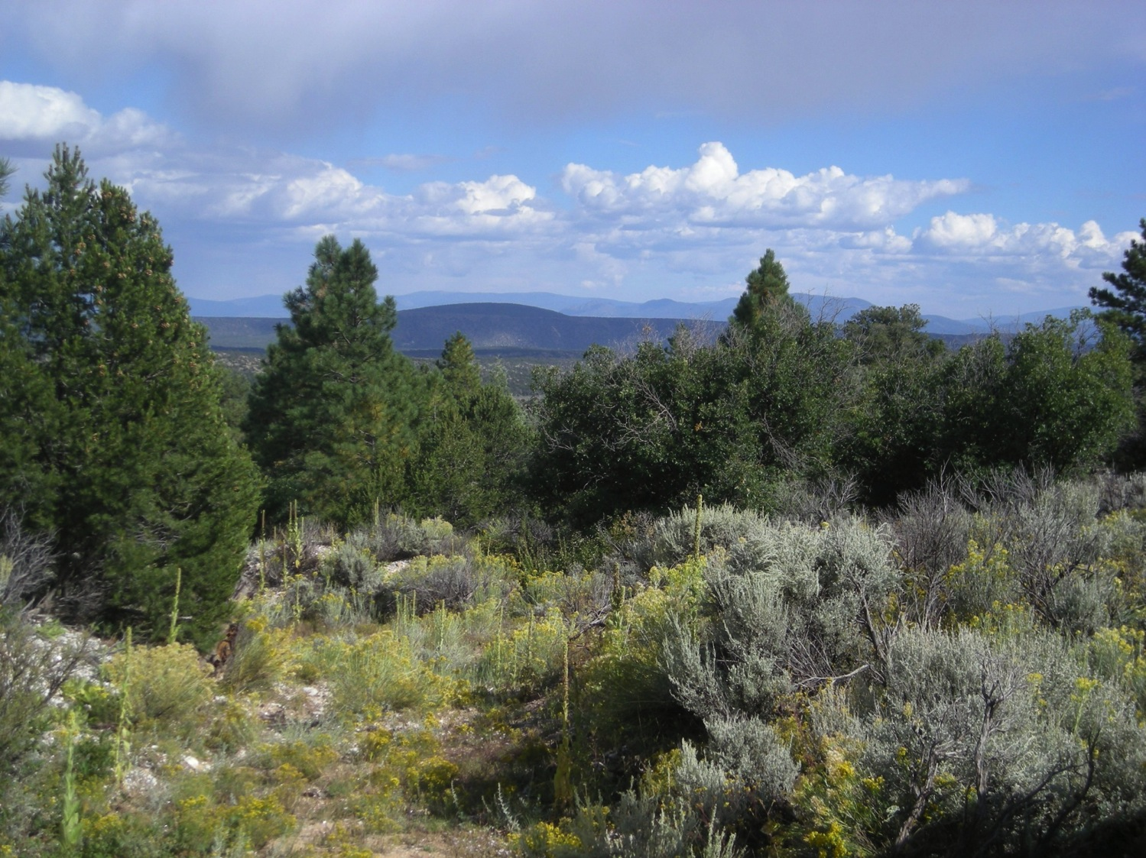
REE Minerals at the Petaca Pegmatite District, New Mexico
Michael Spilde
University of New Mexico, Albuquerque, NM
William Moats, Steve Dubyk, Brian Salem
Albuquerque, NM
October 22, 2014

Slide 2
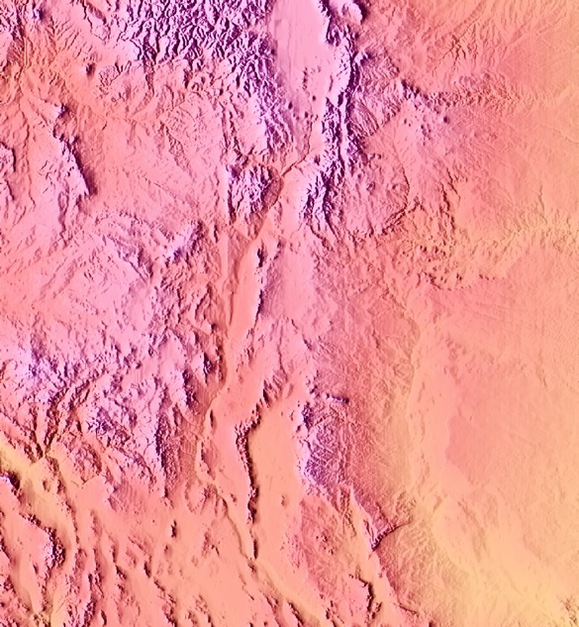
Petaca
Harding Mine
Santa Fe
Petaca, New Mexico
Albuquerque
Rio Grande Rift
New Mexico

Slide 3
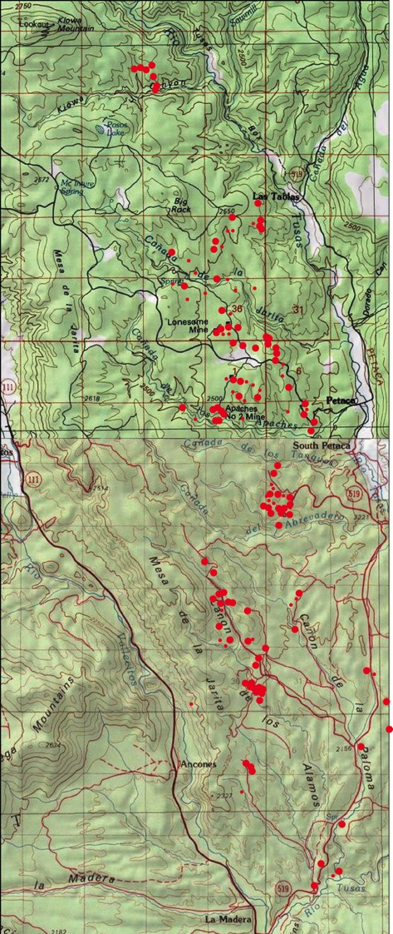
Petaca Pegmatites
District encompasses approximately 160 km².
Over 88 individual pegmatite bodies, 74 mapped/described by Jahns (1946).
Pegmatites crop out for 20 to 450 m in length, up to 80 m width (average 10 m).
Earliest workings in 17th century (may represent the first recovery of sheet mica in the U.S.A).
Granitic pegmatites mined for mica chiefly from 1870-1960s.
Mica : 115,000 kg.
Beryl: 4200 kg.
Nb-Ta minerals: 5500 kg (columbite group minerals).
from Jahns, 1946

Slide 4
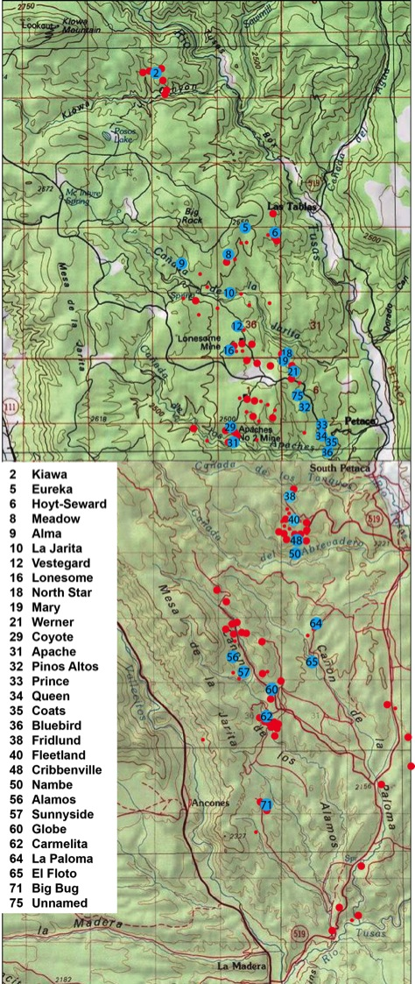
Petaca Pegmatite Study
2 Kiawa
5 Eureka
6 Hoyt
8 Meadow
9 Alma
10 La Jarita
12 Vesteguard
16 Lonesome
18 Mary
19 Werner
29 Coyote
31 Apache
32 Pinos Altos
33 Prince
34 Queen
35 Coats
36 Bluebird
38 Fridlund
40 Freetlund
48 Cribbenville
50 Nambe
56 Alamos
57 Sunnyside
60 Globe
62 Carmelita
65 El Floto
71 Big Bug
75 Unnamed
Pegmatites (NYF type) host rare and unusual minerals containing REE, U, and Th as essential constituents.
District has not been studied in detail since the 1950s.
Confirm minerals previously reported from and identify new minerals for the district.
Sampled 30 pegmatites with emphasis on rare (Y,REE,Th,U)(Nb,Ta,Ti) oxides and monazite.
Microprobe analysis to confirm/identify minerals.

Slide 5
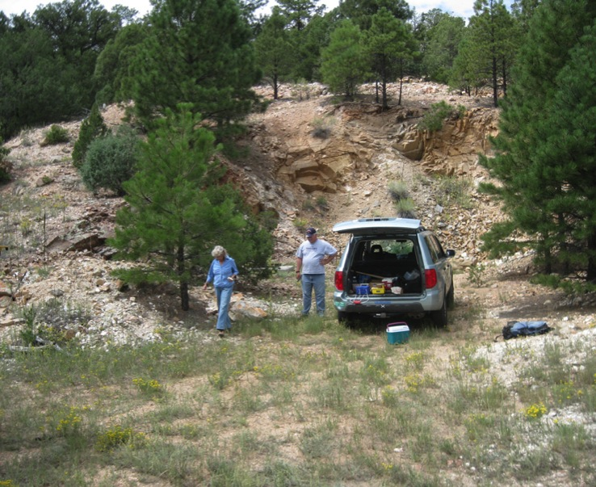
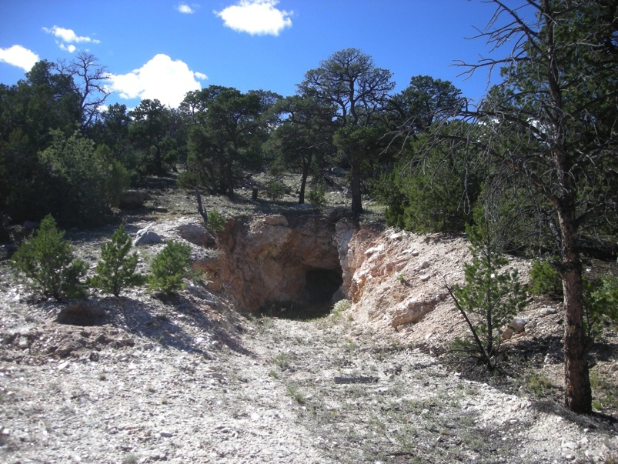
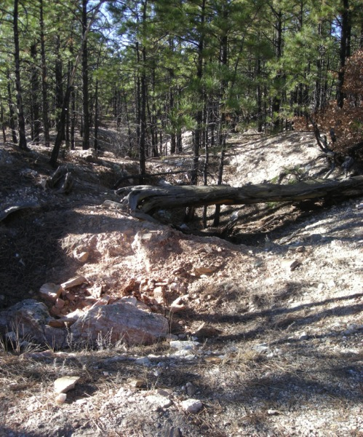
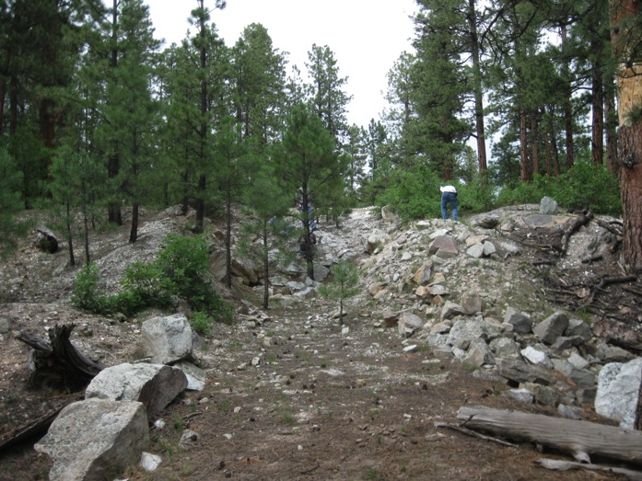
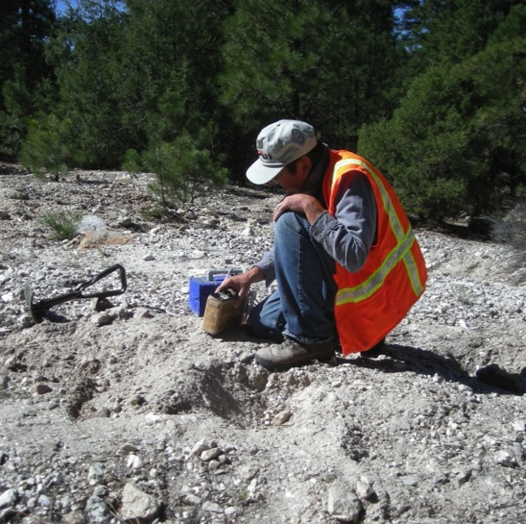
Coats Mine
Carmelita Mine
Vesteguard Mine
Collecting with radiation detecting equipment
North Star Mine

Slide 6
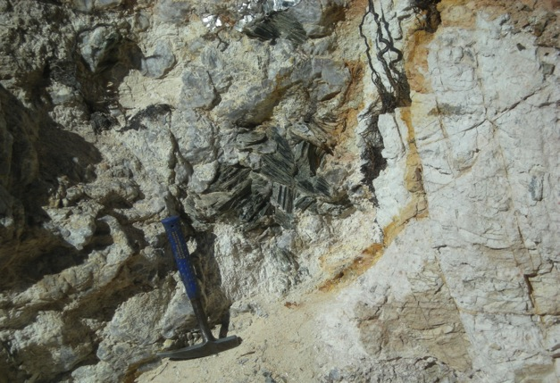
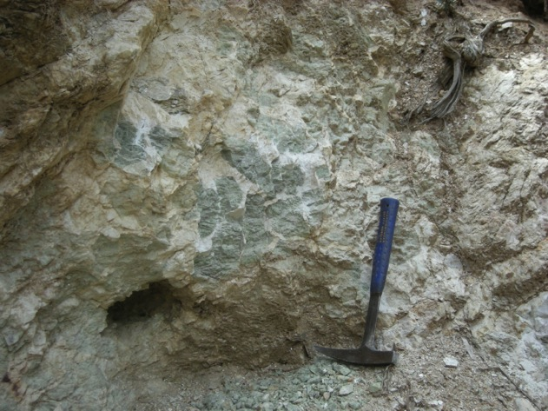
Identified Rare Minerals
(Y,REE,U,Th)(Nb,Ta,Ti) Oxides
Euxenite-(Y) (Y,Ca,Ce,U,Th)(Nb,Ta,Ti)₂O₆
Polycrase-(Y) (Y,Ca,Ce,U,Th)(Ti, Nb,Ta)₂O₆
Samarskite-(Y) (Y,U,REE,Fe,Th)(Nb,Ta,Ti)O₄
Microlite (Ca,Na,U)(Ta,Nb)₂O₆ (F,OH,O)
Uranmicrolite (U,Ca,Na)(Ta,Nb)₂O₆ (OH)
Columbite: (Mn,Fe)(Nb,Ta)₂O₆
Phosphates: (Ce,La,Nd,Th)PO₄
Monazite-(Ce) (Ce,La,Nd,Th)PO₄
Xenotime-(Y) (Y,Dy)PO₄
Thorite: ThSiO₄
Bismutite: Bi₂O₂(CO₃)
Ta-rutile (Struverite): (Ti,Ta,Fe,Nb)O₂
Muscovite books, Sandival Mine
Fluorite masses, Globe Mine

Slide 7
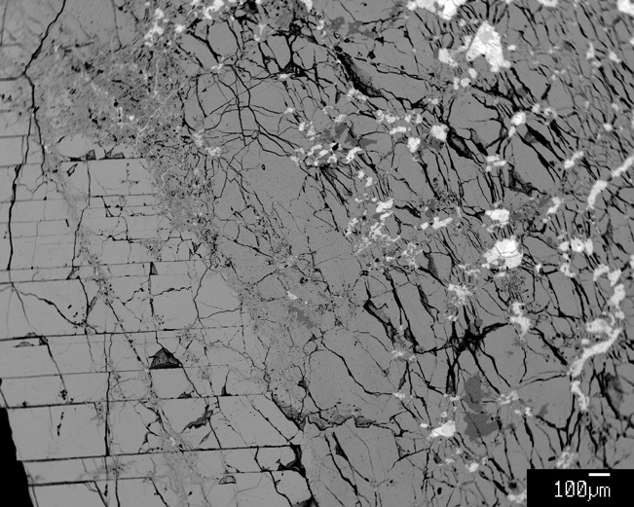
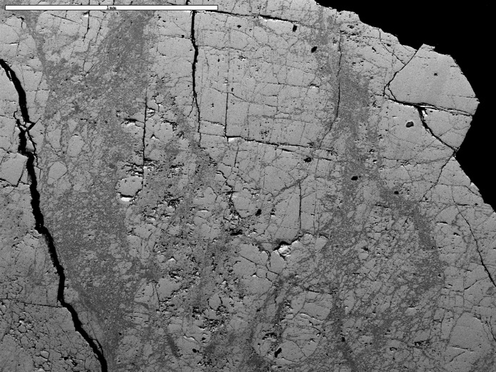
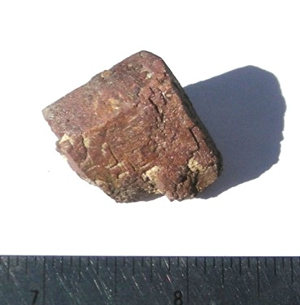
Monazite
Thor
1 mm
Mnz
Mnz
Xeno
Crystals & large masses (several kg)
High in ThO₂ (up to 17 wt%)
Thorite exsolution and radiation damage
Alteration veinlets of xenotime
3 cm

Slide 8
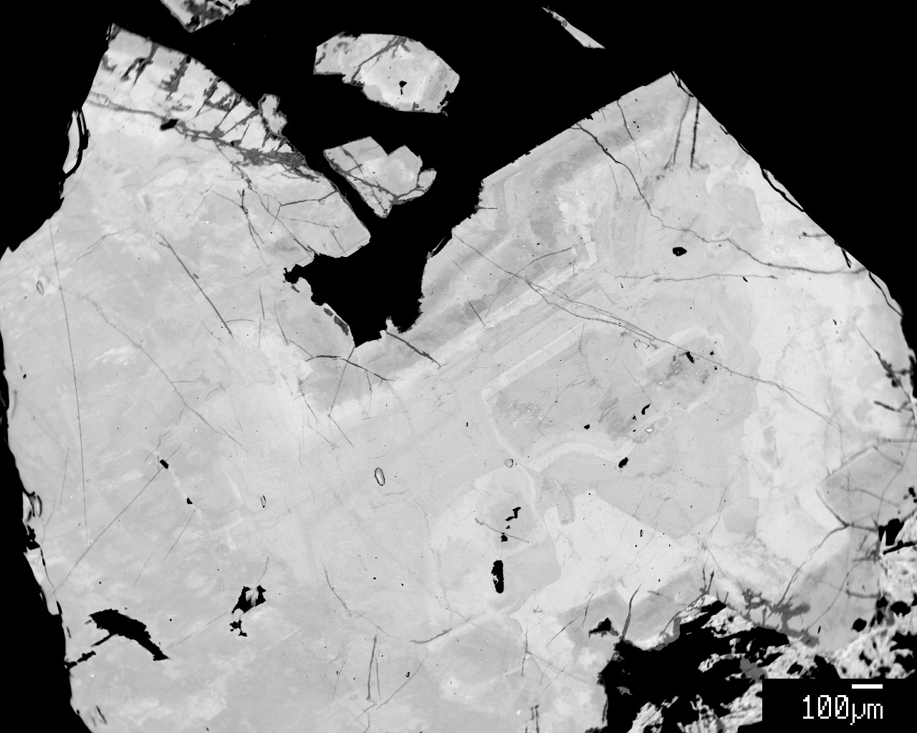
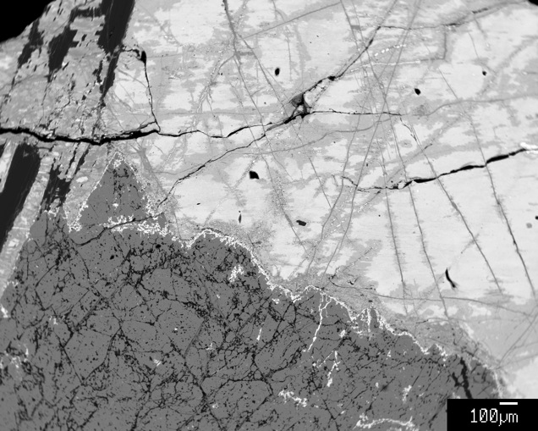
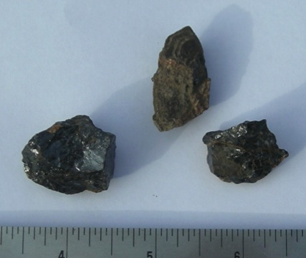
Polycrase-Euxenite-Samarskite
Mcr
Eux
Sam
Zirc
Zoned polycrase
Altered euxenite
High in UO₂:
Samarskite up to 19 wt%
Euxenite up to 15 wt%
Most pieces metamict—glassy brown (“beer bottle-ite”)
Some display complex zonation
Later alteration to secondary minerals common
3 cm

Slide 9
REE in Petaca Minerals
Chondrite Normalized REE Plot
Monazite enriched in LREE
Xenotime, polycrase-euxenite, samarskite enriched in HREE

Slide 10
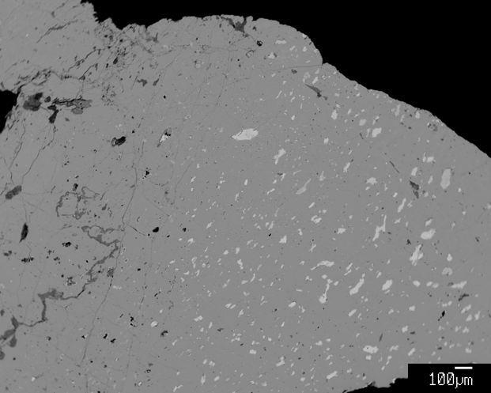
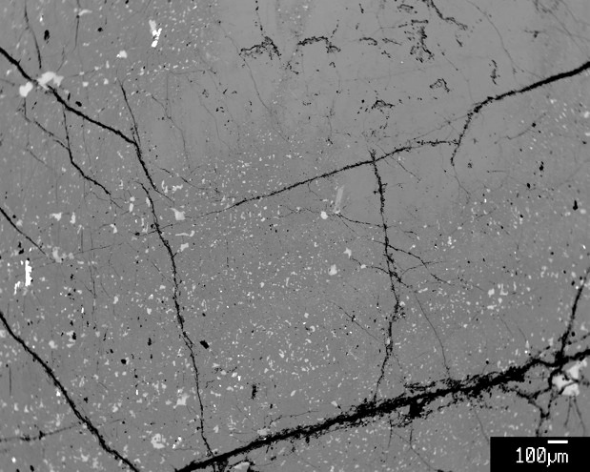
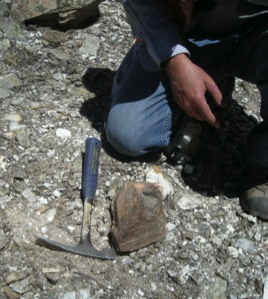
Columbite
Swarms of microlite inclusions
Zones of inclusions
Large crystals of columbite found (several kg)
Mn- and Nb-rich
Exsolution of microlite and other exotic minerals

Slide 11
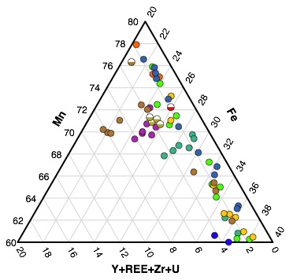
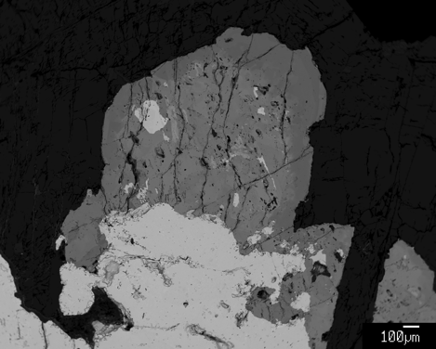
Columbite (AB₂O₆) Crystal Chemistry
A-site
(apu)
B-site
(apu)
Ta-rutile overgrowth on columbite

Slide 12
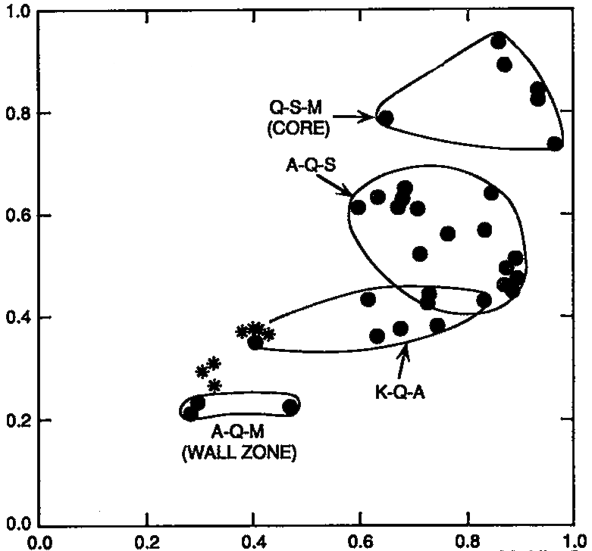
Pegmatite Crystallization from Columbite
Fe-rich columbite in wall zone evolves to manganocolumbite through the core as the pegmatite crystallizes.
Ta/(Ta+Nb)
Tin Mountain Mine,
Black Hills, SD
Mn(Mn+Fe)
Samples from individual Petaca pegmatites display range of Mn but not Ta.
May be due to lack of sampling control.
Displays district-wide increase in Mn & Ta.
Petaca columbite

Slide 13
Pegmatite Crystallization from Columbite
District-wide trend of increasing Mn & Ta mirrors trend of individual pegmatite crystallization.
Does this reflect crystallization history of the district?
Average of columbite analyses
Northern & southern clusters display lowest Ta values.
First emplaced?
Middle cluster has highest Ta values.
Emplaced last?
Columbite at Petaca contoured on Ta/Nb

Slide 14
Principle Component Analysis of (Y,REE,Th,U)(Nb,Ta,Ti) Oxides
+Fe, U, Th, Y
+Nb
+Alteration
+Ti
+Ca, Ta
PCA classification of mineral type.
Principle components define crystallization processes.
Primary crystallization vs. late stage fluids

Slide 15
Conclusions
Identified a number of complex (Y,REE,Th,U)(Nb,Ta,Ti) minerals at the Petaca District:
Euxenite-(Y) Microlite
Polycrase-(Y) Uranmicrolite
Xenotime-(Y) Ta-rutile
Petaca pegmatites display complex mineralogical history of crystal fractionation and secondary alteration.
Fractionation of Mn & Ta district-wide suggests a sequence of pegmatite emplacement.

