Slide 1
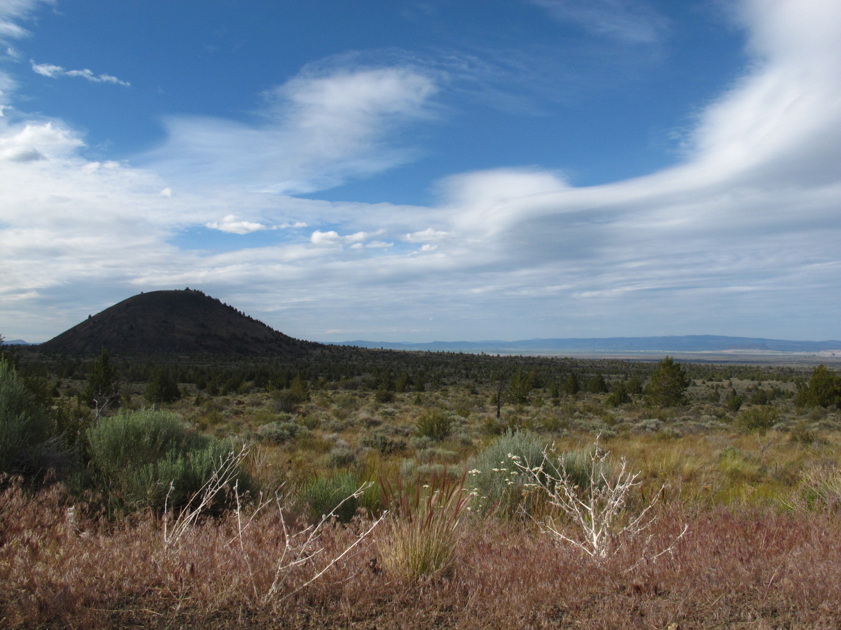
Science Communications: Lessons from Lava Beds National Monument
Sarina Patel
GeoCorps Mosaics Intern
Summer, 2014
www.facebook.com/LavaBedsNM

Slide 2
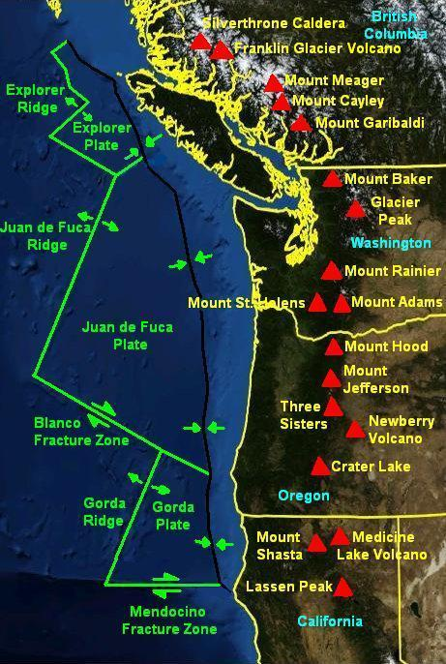
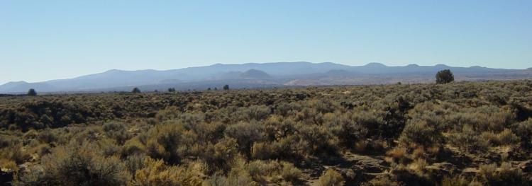
Setting the Scene
www.facebook.com/LavaBedsNM
commons.wikimedia.org
Notes:
Named for the lake infilling its caldera, At 150 cubmi, ML is largest volcano by volume in the cascades. Unlike the iconics, it is a shield volcano dominated by basaltic flows,

Slide 3
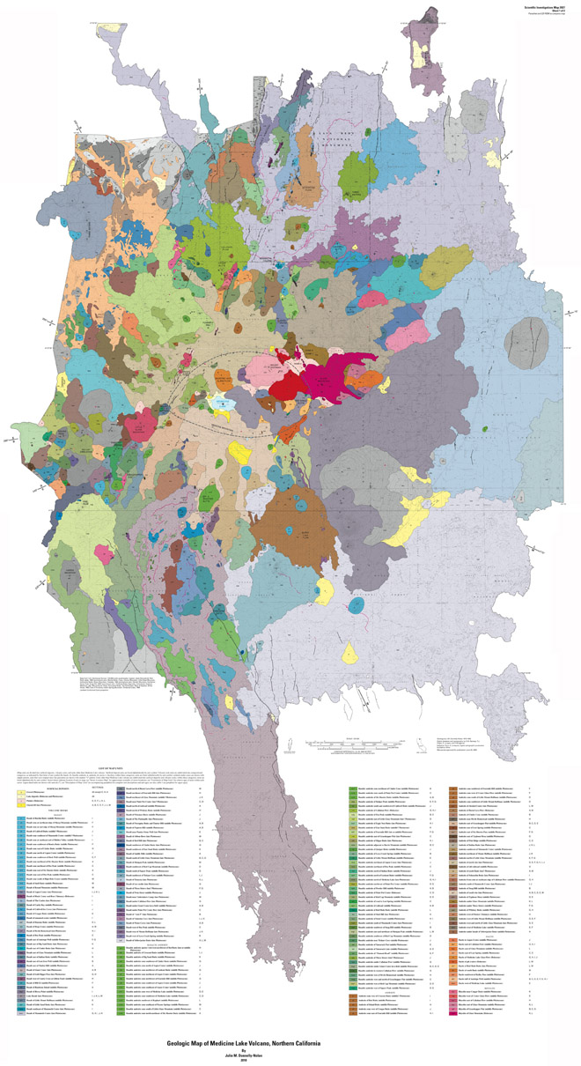
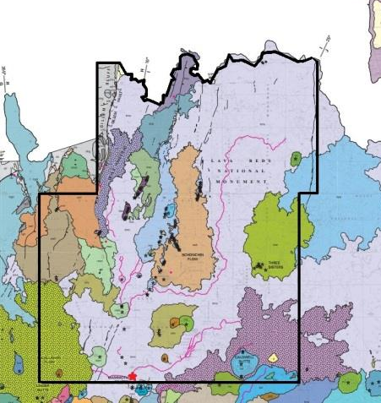
Lava Beds National Monument
Medicine Lake Volcano
pubs.usgs.gov via www.wired.com

Slide 4
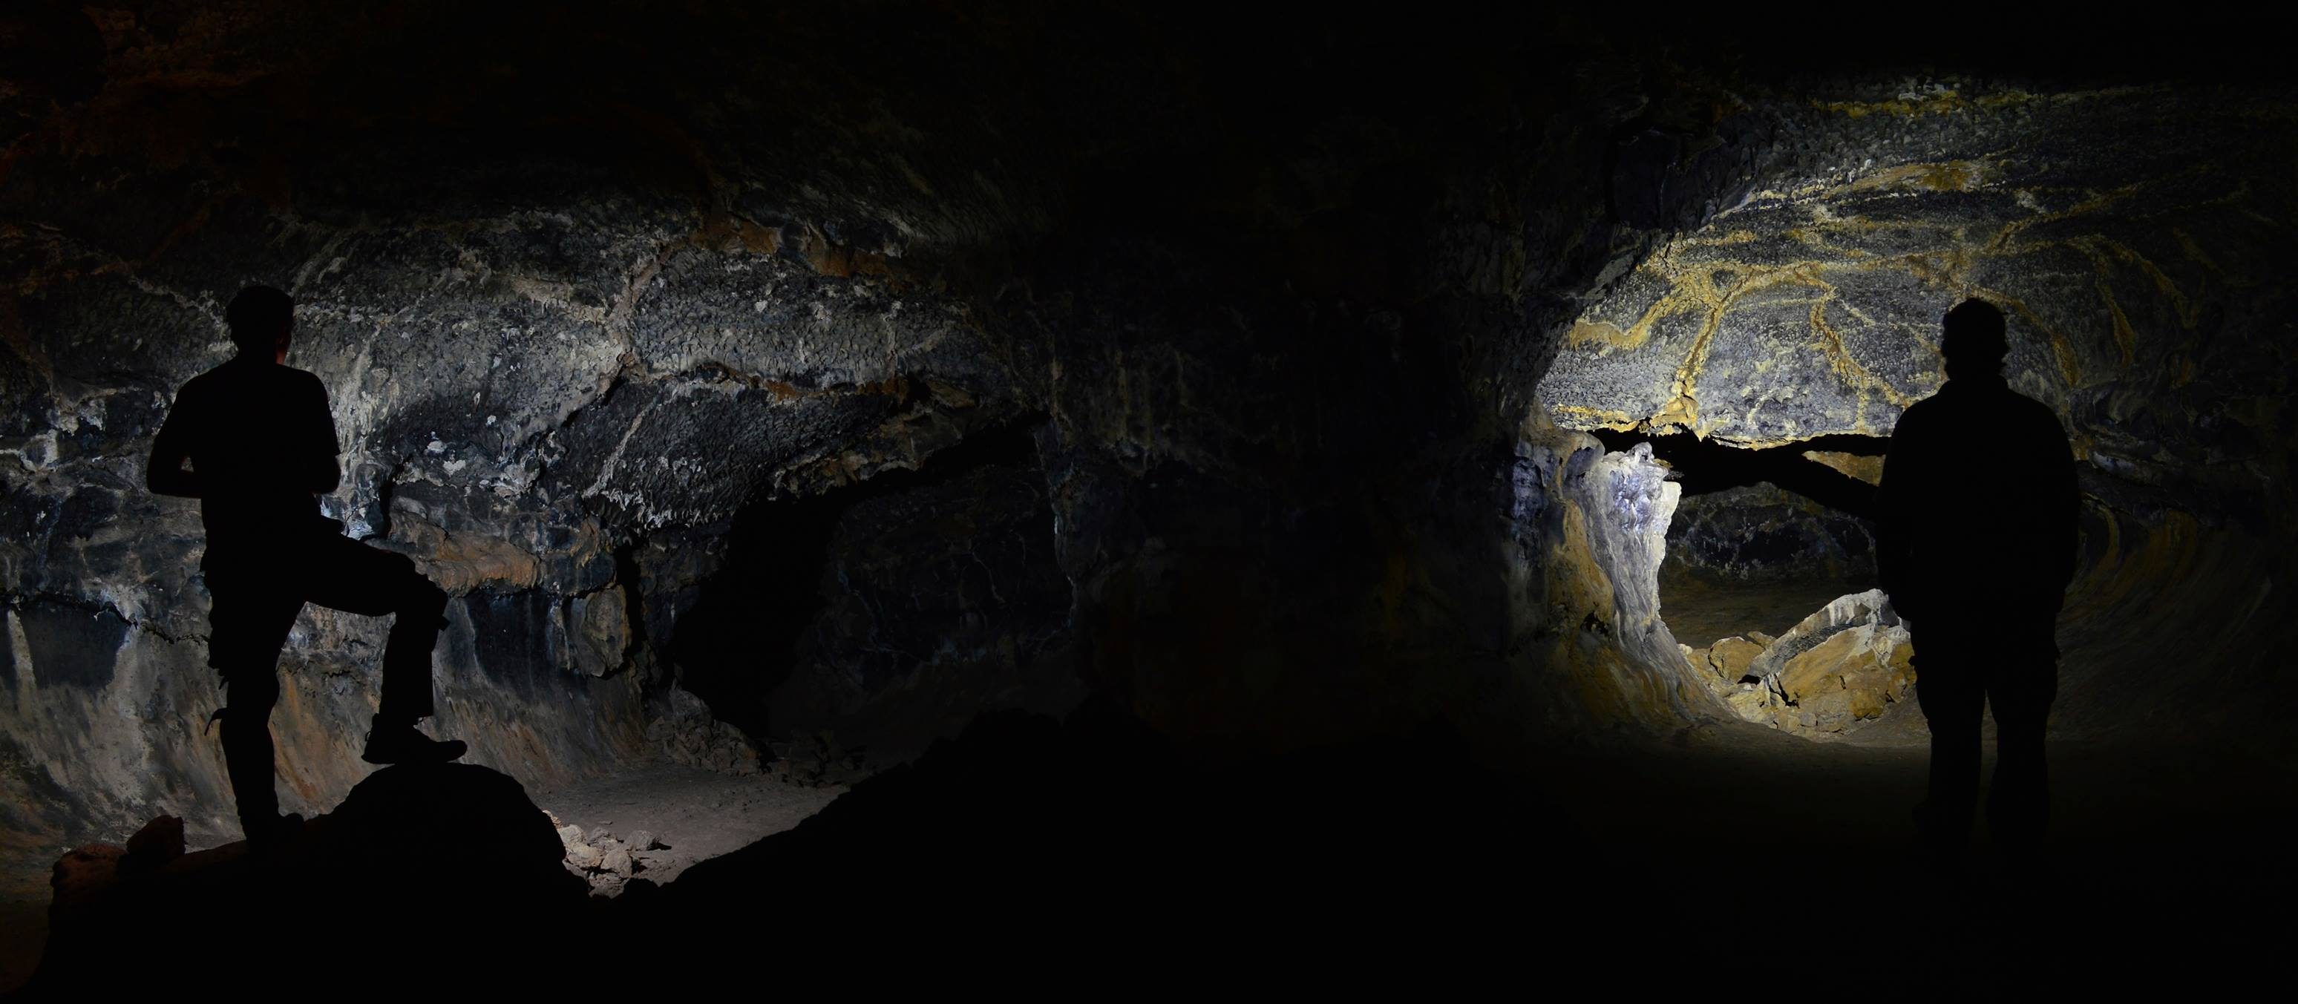
www.facebook.com/LavaBedsNM

Slide 5
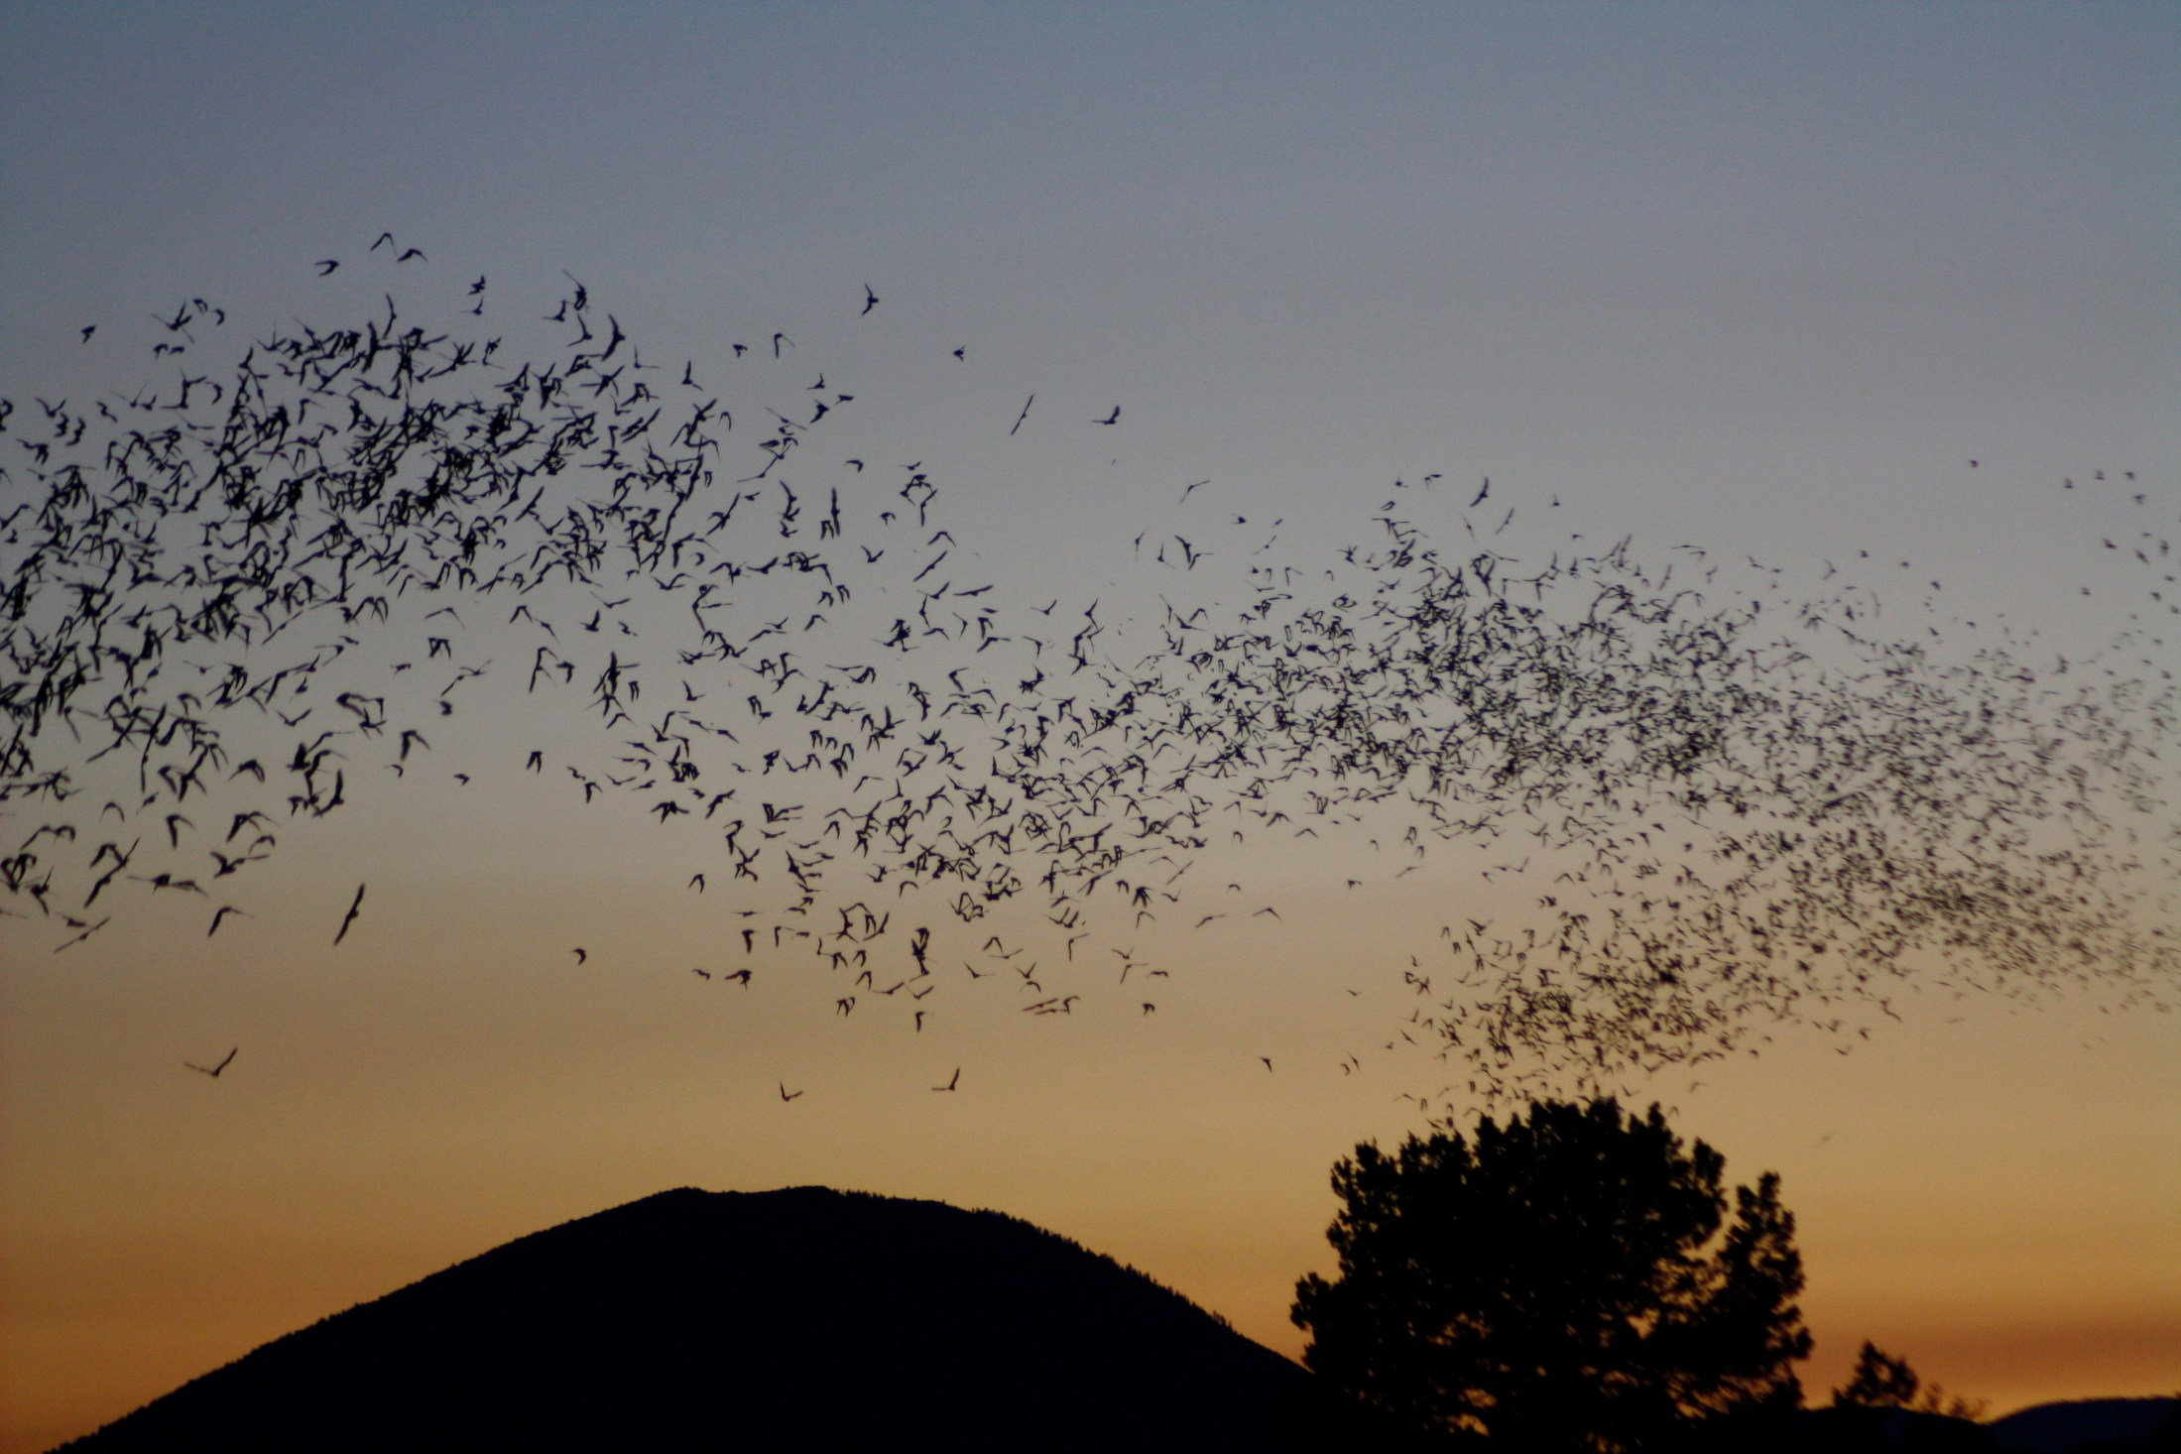
Kathy Whyte, 2014

Slide 6
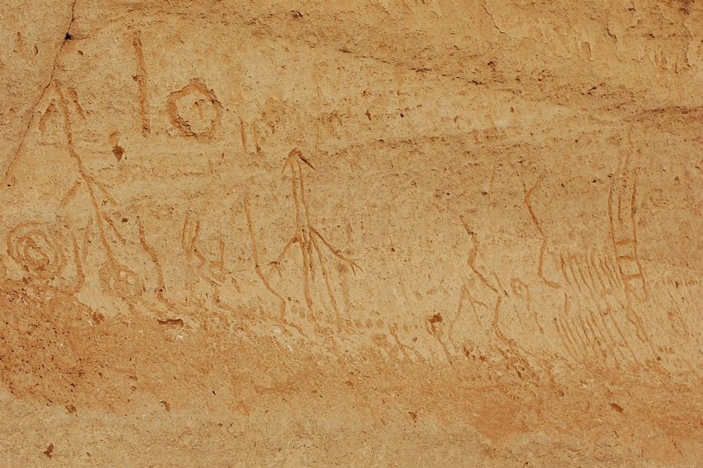
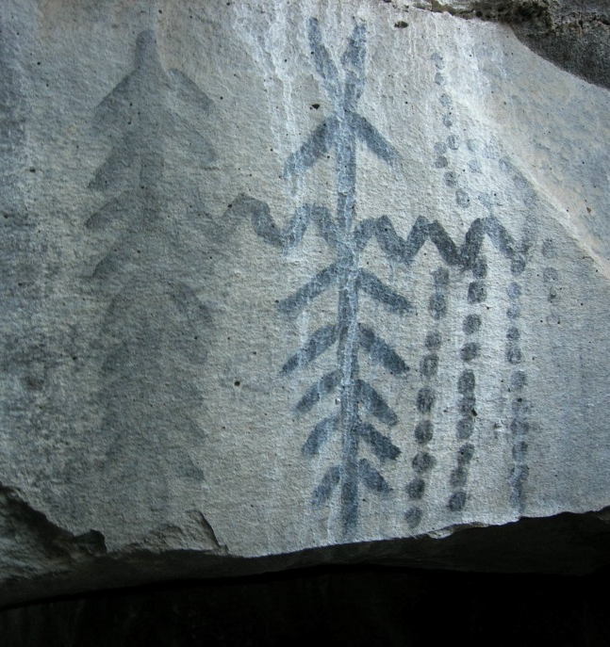
www.facebook.com/LavaBedsNM
www.facebook.com/LavaBedsNM

Slide 7
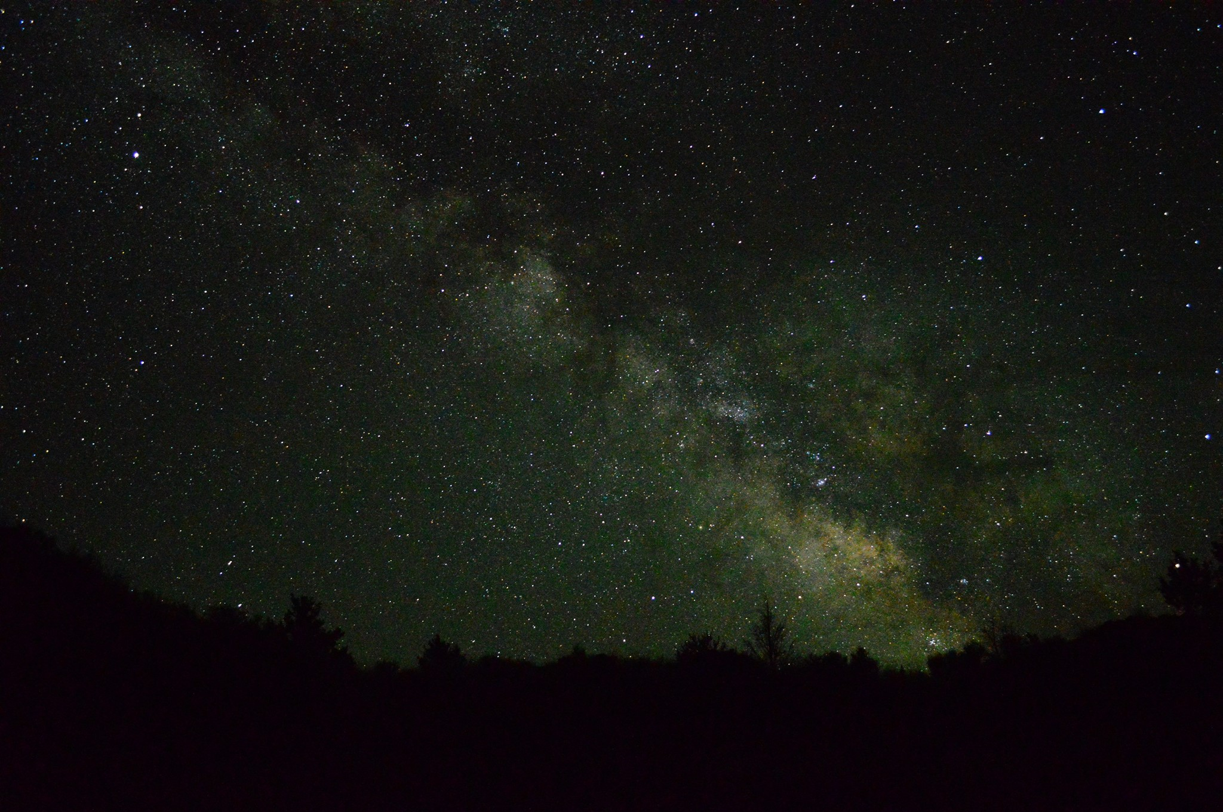
Jesse Barden, 2014

Slide 8
Science Communications: Lessons from Lava Beds National Monument
Sarina Patel
GeoCorps Mosaics Intern
Summer, 2014
www.facebook.com/LavaBedsNM

Slide 9
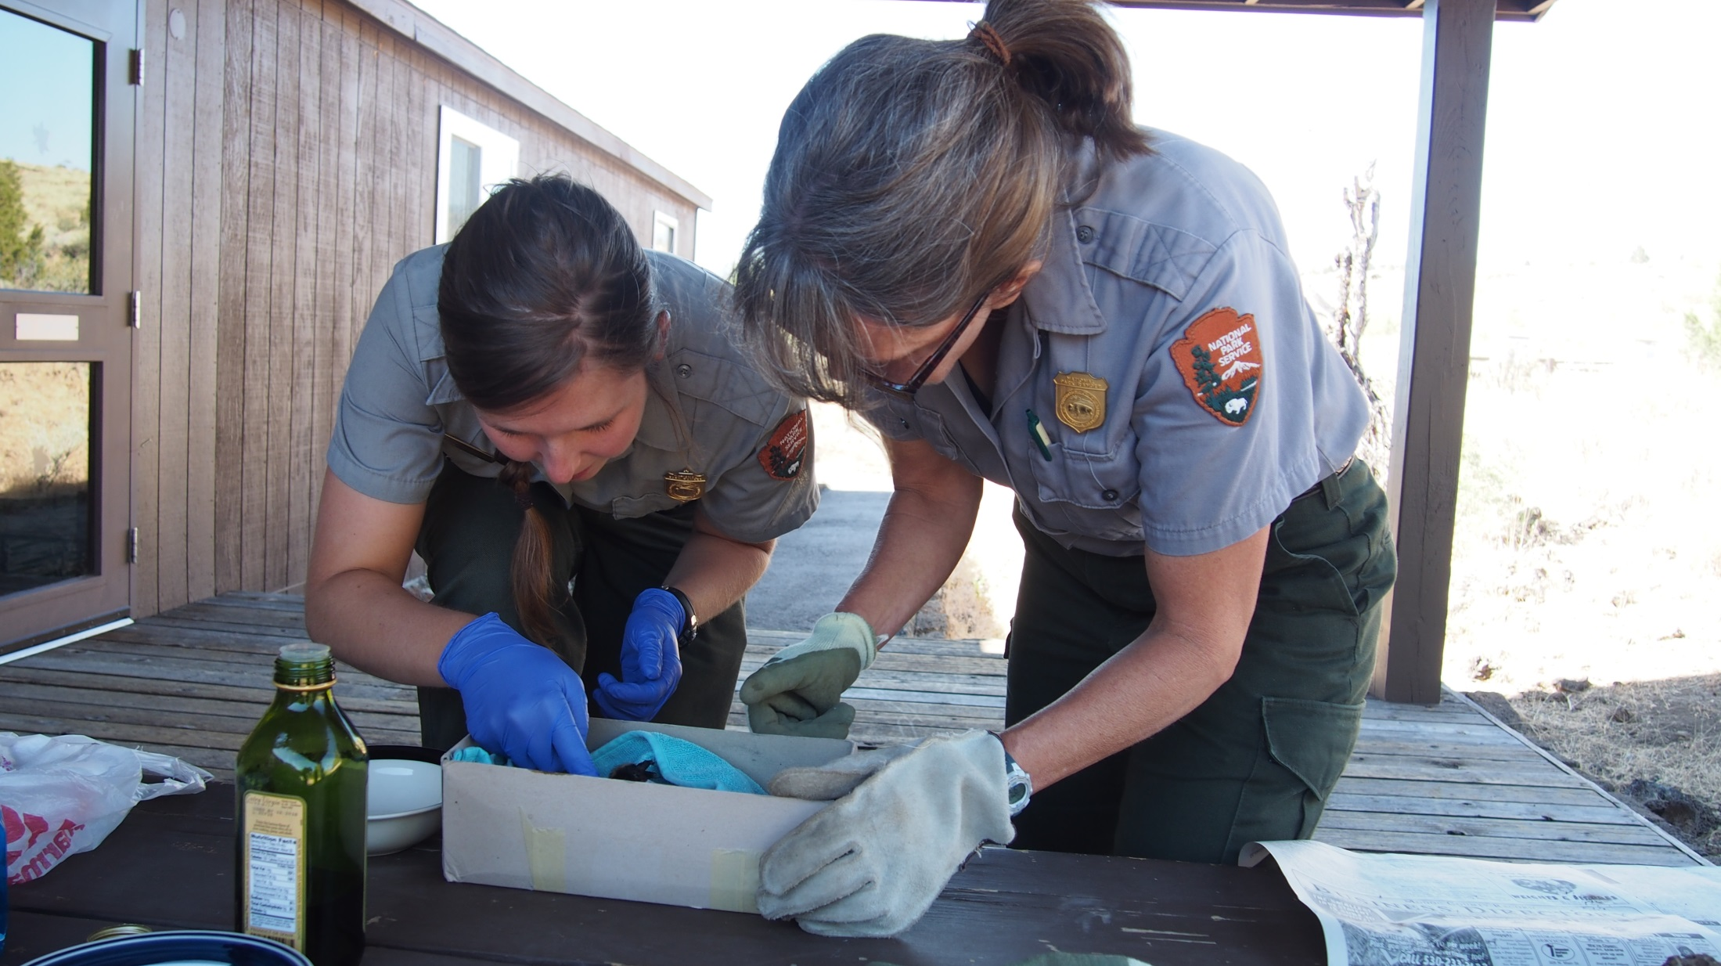
Katrina Smith
Physical Science Technician
Nancy Nordensten
Head of Resource Management
Notes:
Position was the brain child of these two
Can’t see their faces… because they’re like a lot of scientists
dedicated, passionate, curious, but they don’t like having their picture taken.
Knew, from years on the job, that there is an incredible wealth of data and information accumulated in the Resource Management archives, and wanted it used

Slide 10
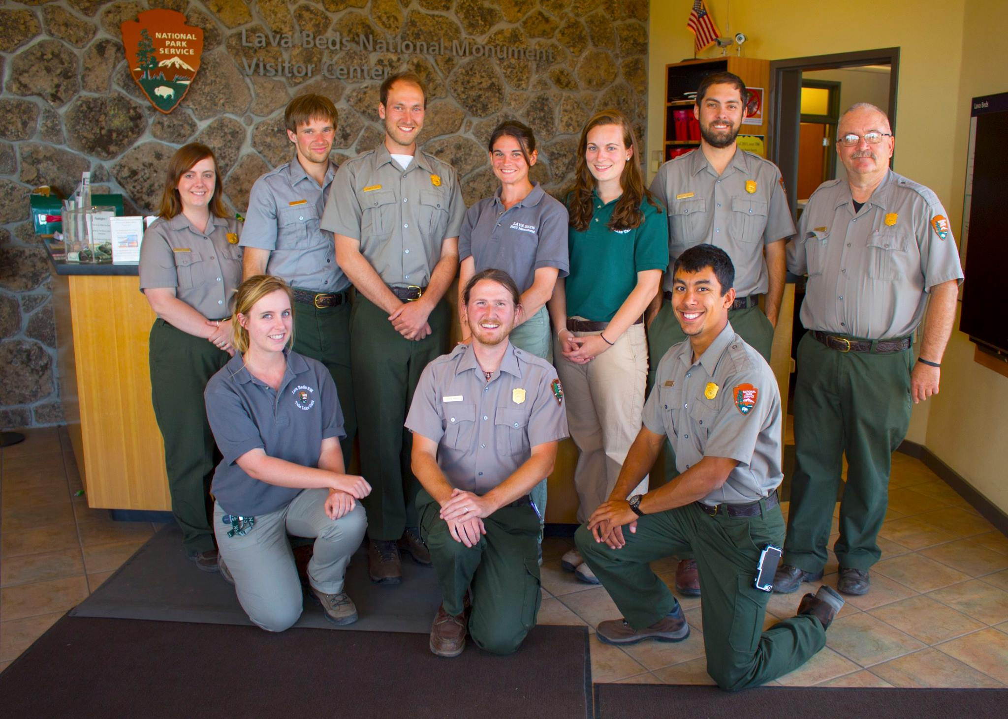
Geology
Geology
Wildlife Biology
Science Education
www.facebook.com/LavaBedsNM
Notes:
Interpretation seemed to have a similar idea, and over half their new hires were science majors. All these interpreters very good at their job, and my work wasn’t needed to generated quality public programming. But there had to be something notable about my position – next slide

Slide 11
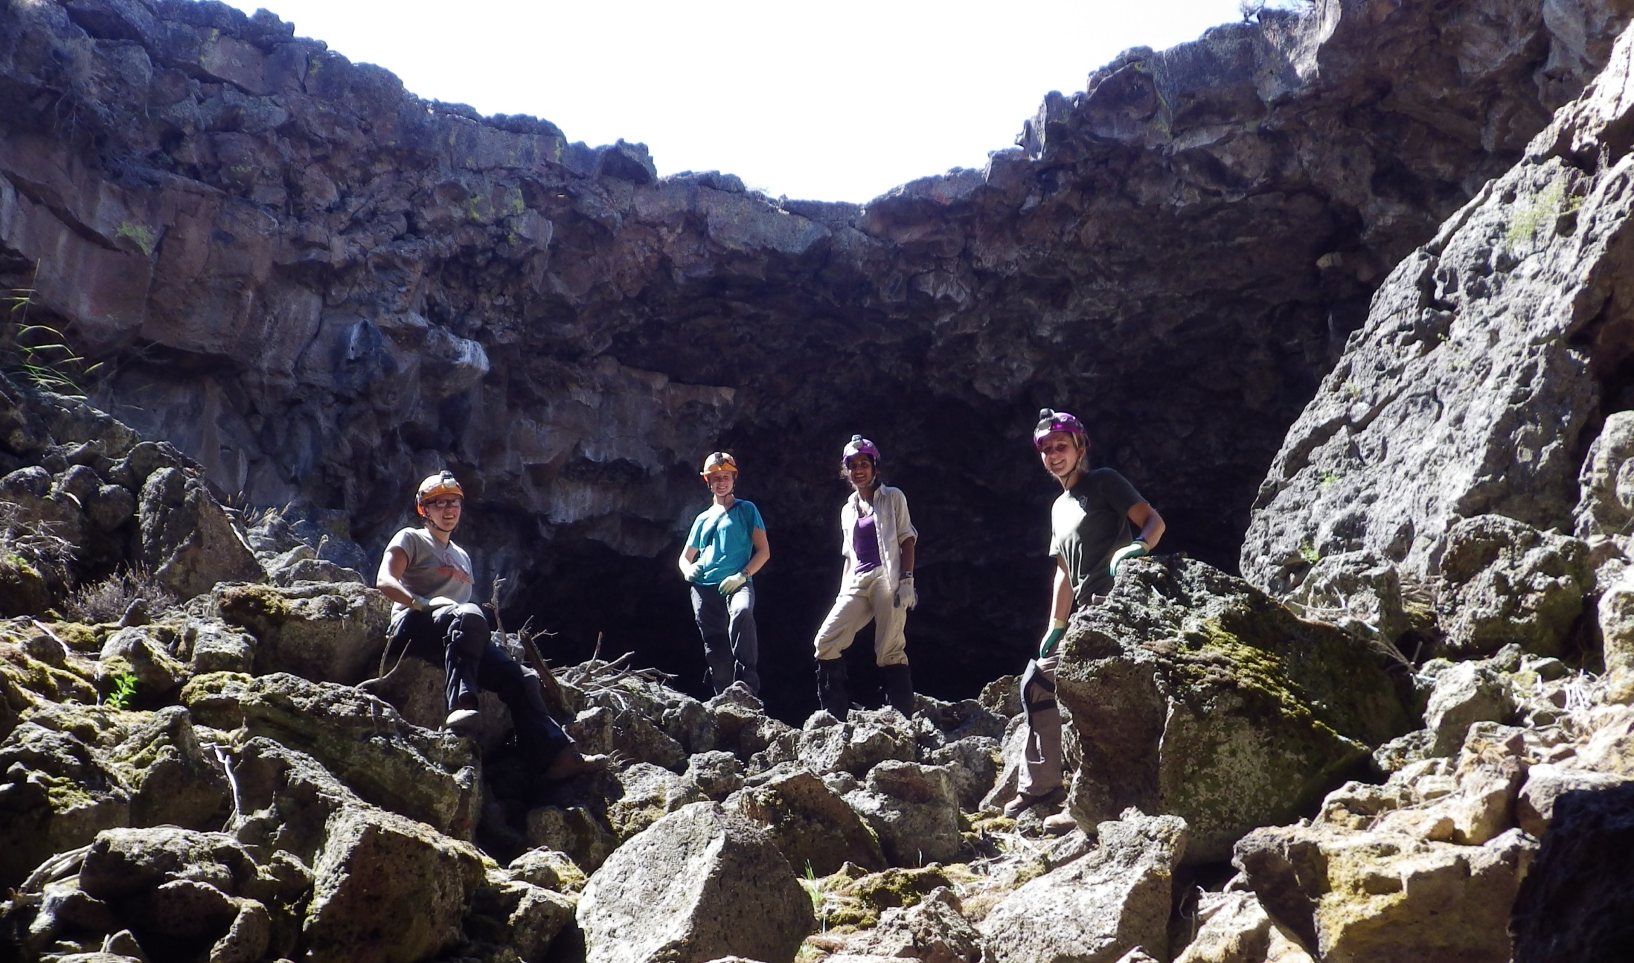
Physical Science Team
Notes:
With the physical science department, which afforded me a unique perspective. So I used the two halves of my internship – field work/ research and communications – to inform the other

Slide 12
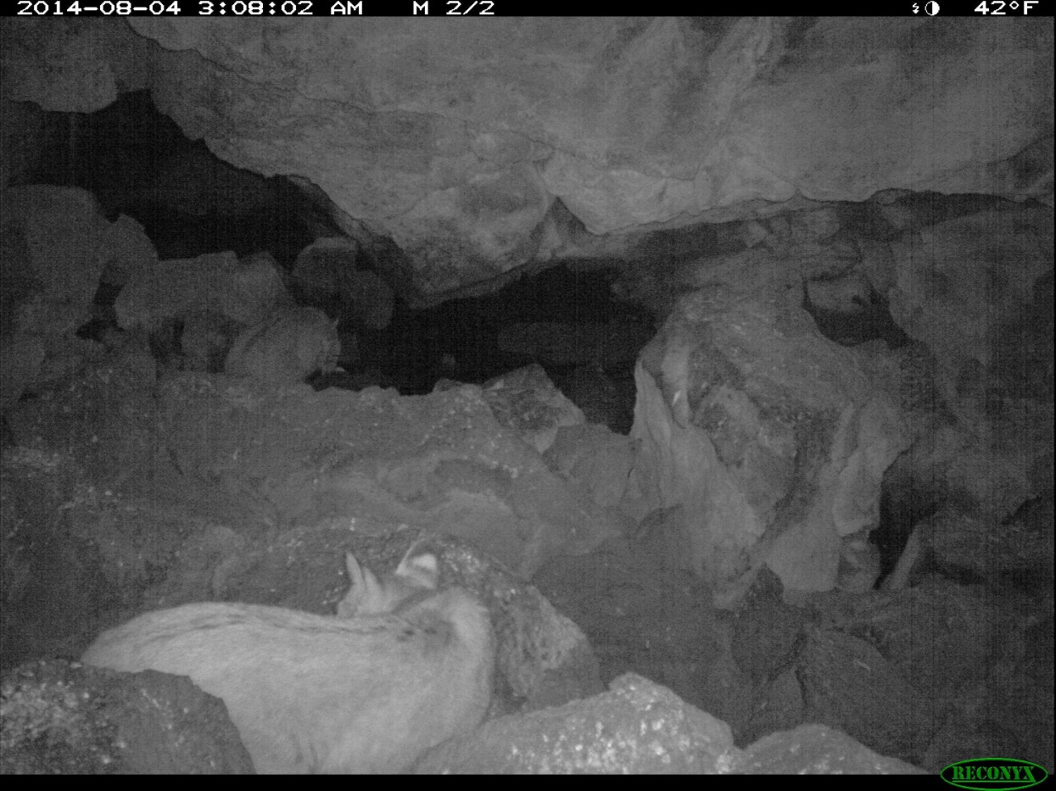
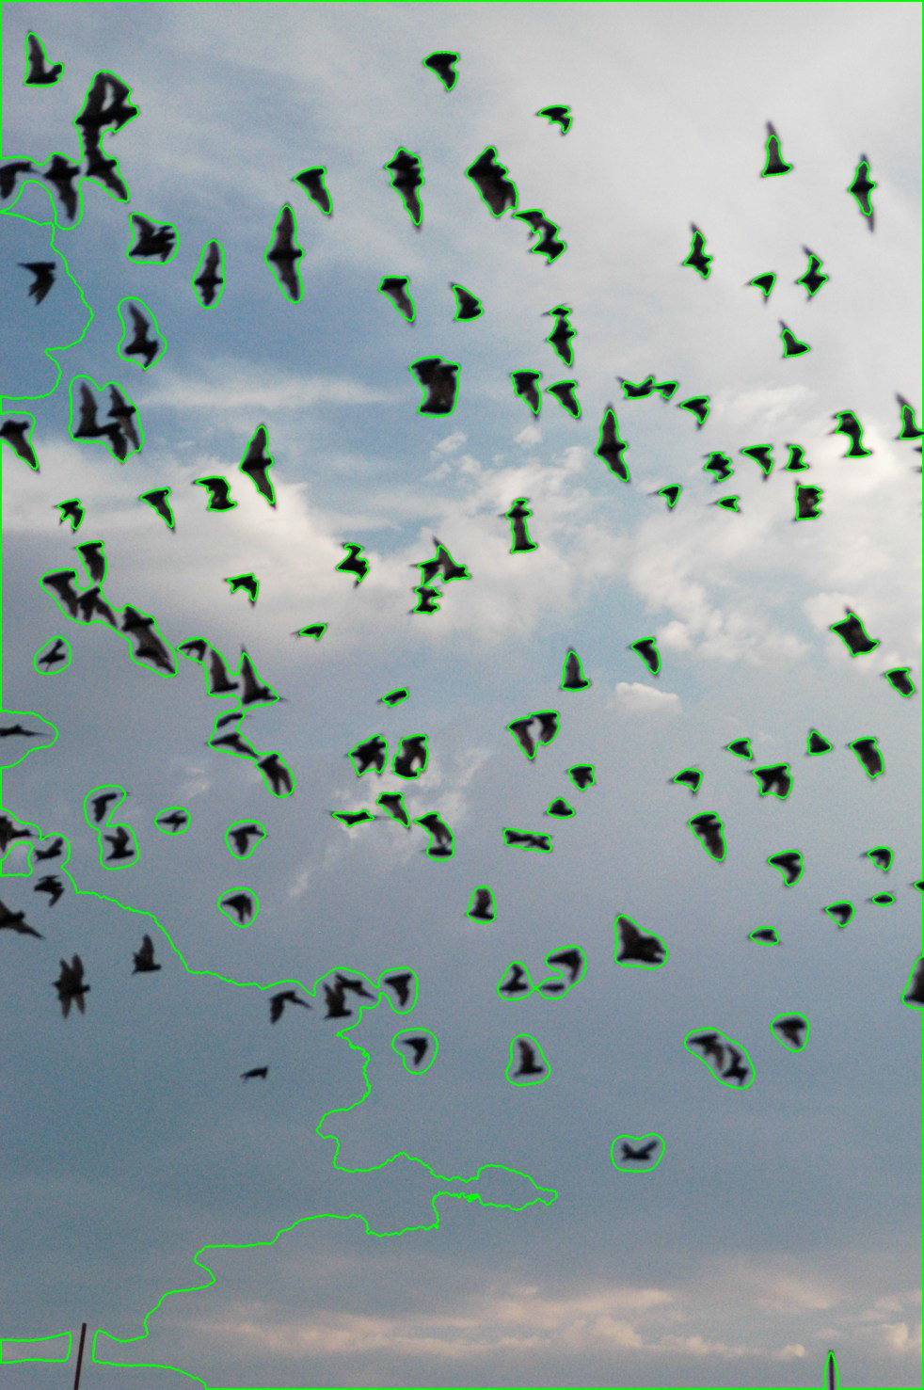
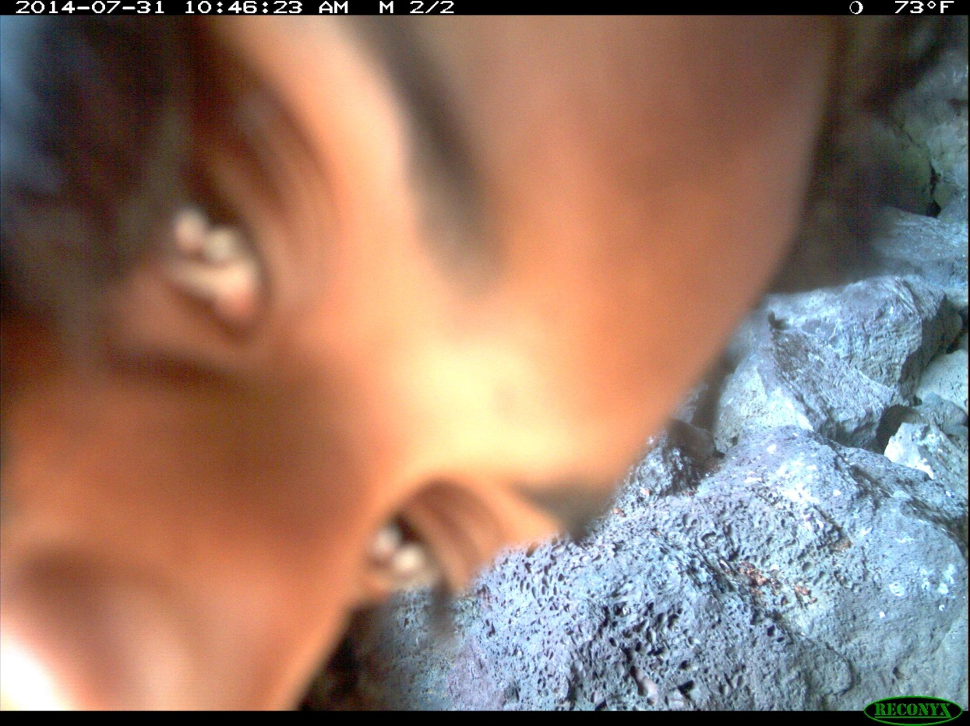
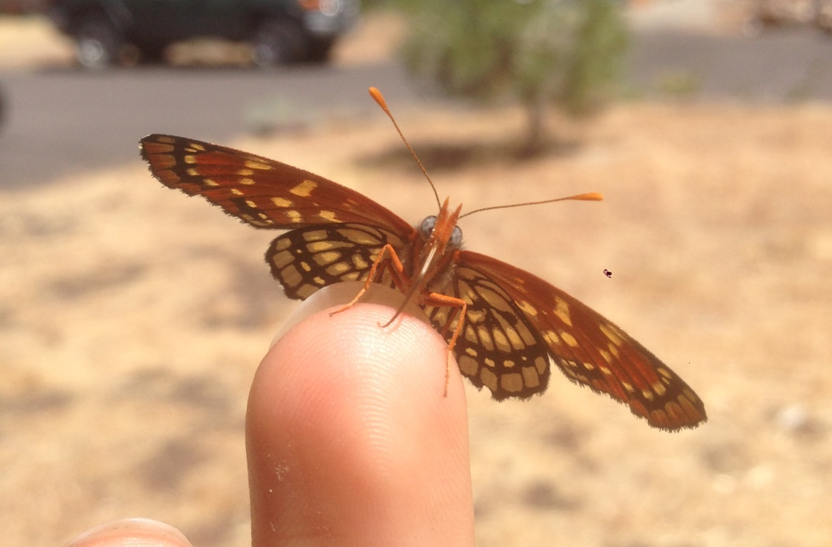

Slide 13
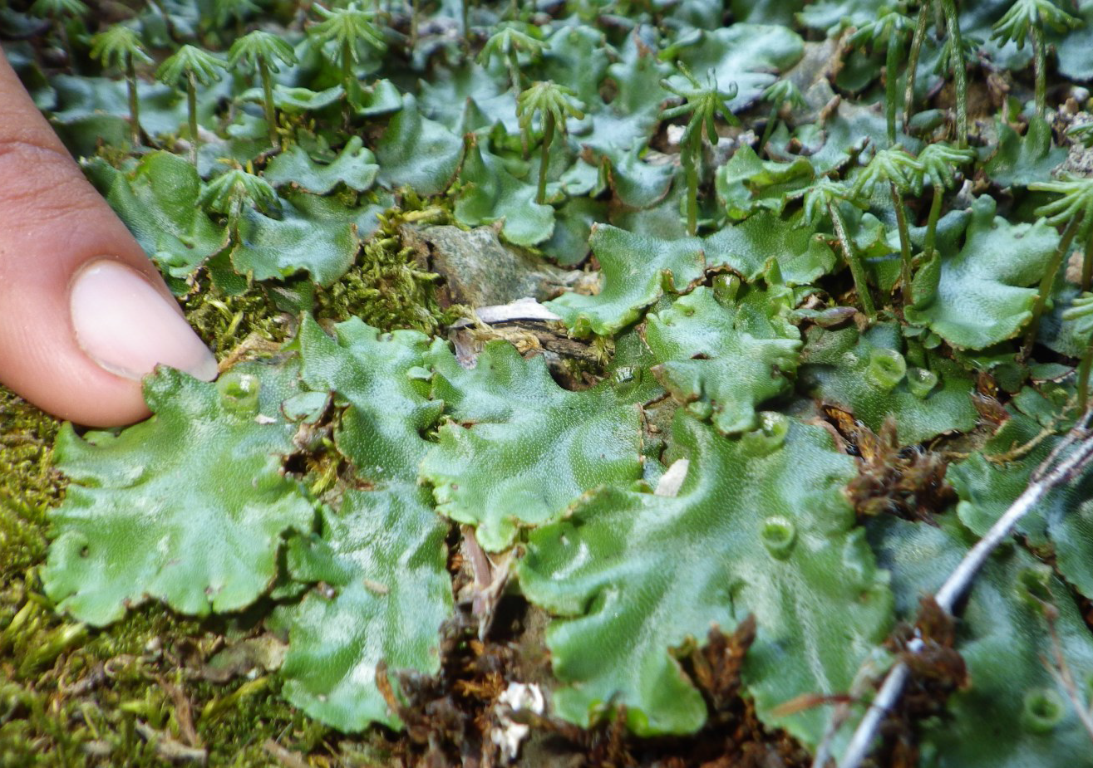
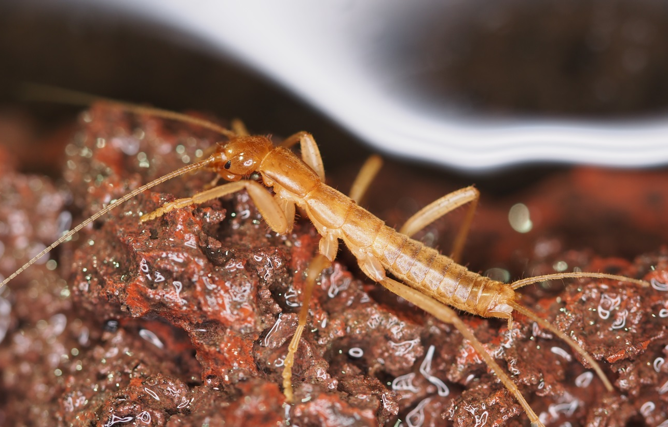
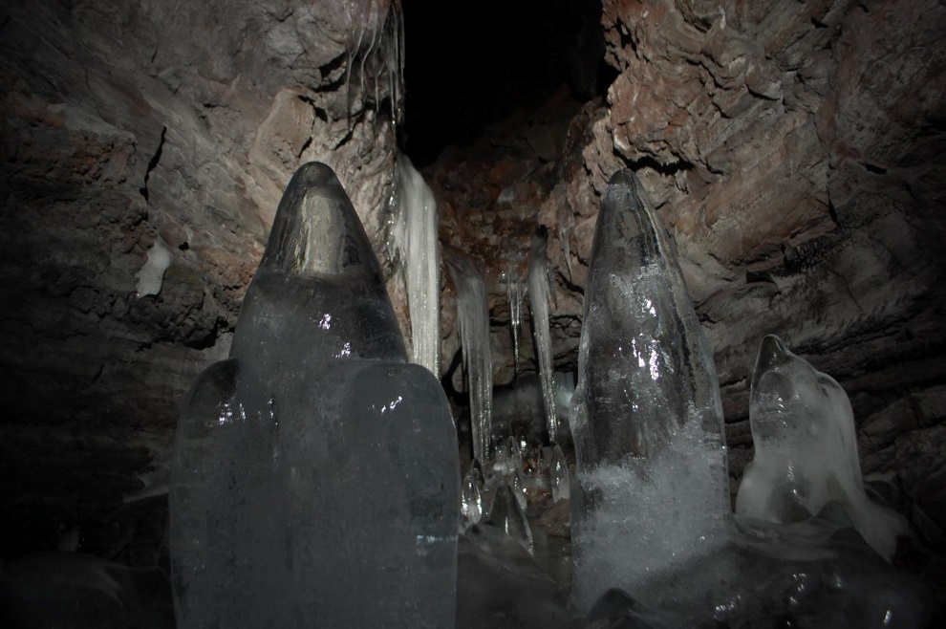
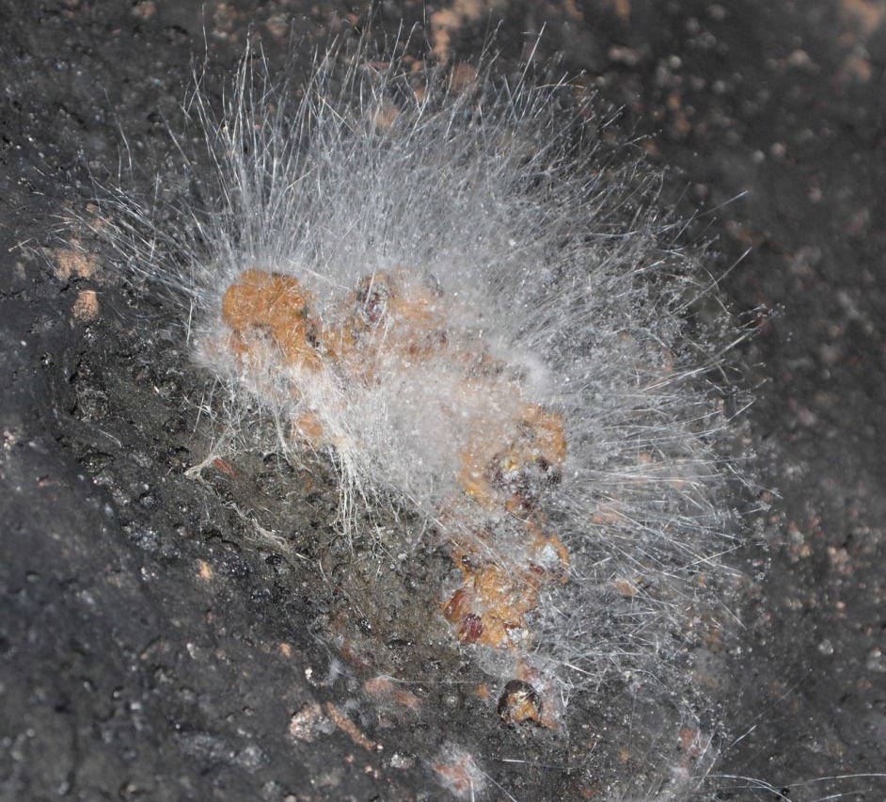
Cave Entrance Vegetation
Invertebrates
NPS Photo by Megan Mason, 2014
NPS Photo by Katrina Smith, 2014
Cave Climate & Ice
Visible Organics
www.facebook.com/LavaBedsNM
NPS Photo by Katrina Smith, 2014

Slide 14
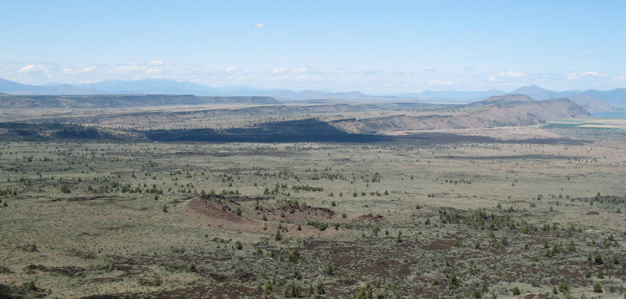
www.facebook.com/LavaBedsNM

Slide 15
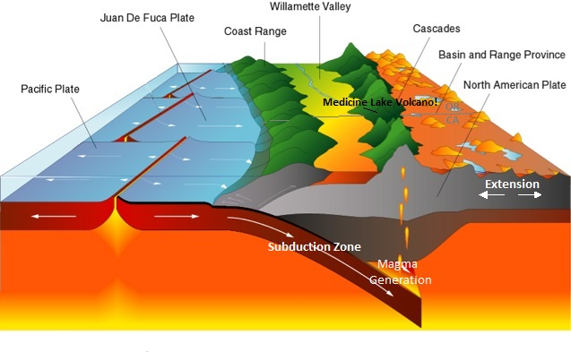
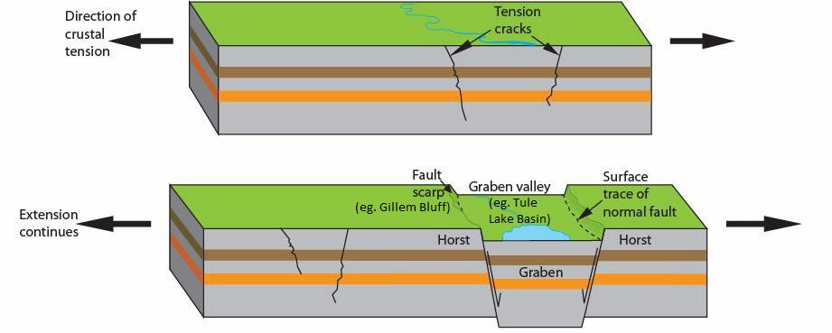
Adapted from blogs.canby.k12.or.us & nature.nps.gov/geology/education

Slide 16
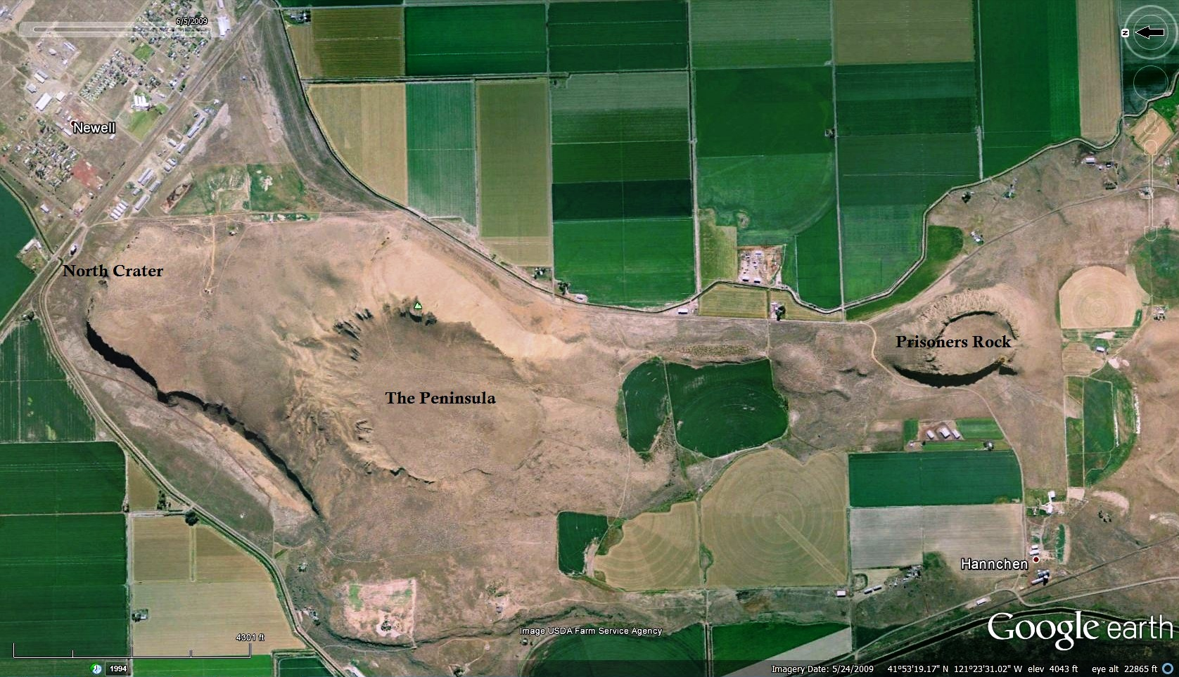
Linear Volcanic Features
Shaped by Extension

Slide 17
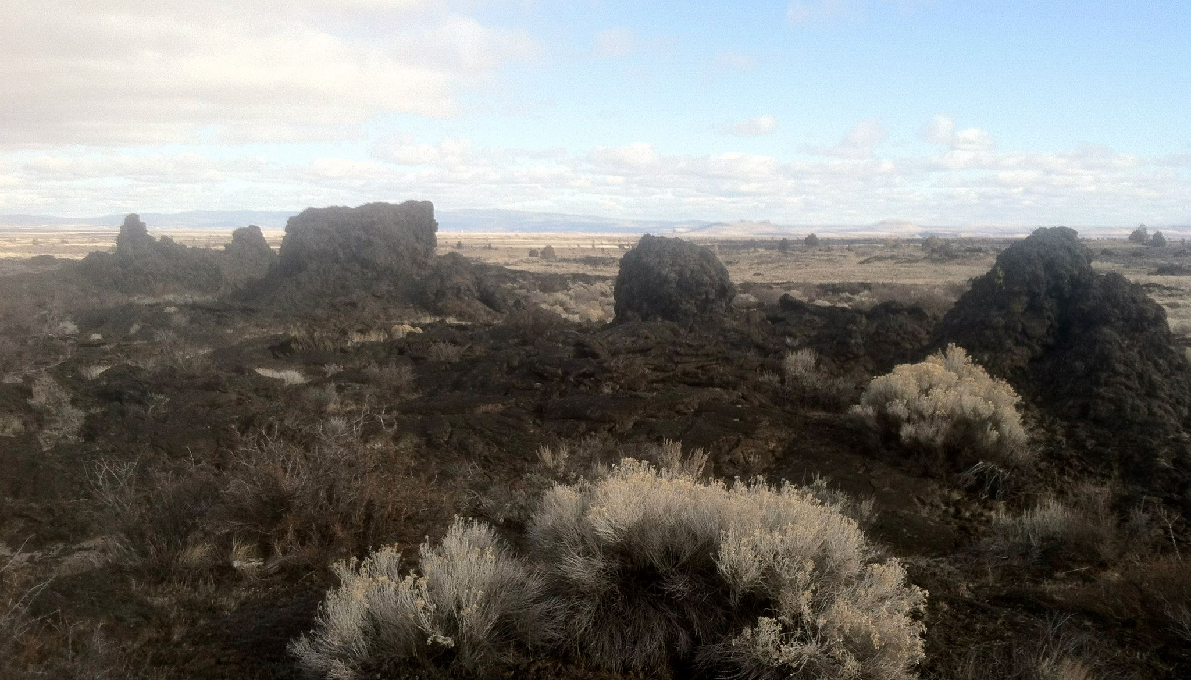
Linear Volcanic Features
Shaped by Extension
www.facebook.com/LavaBedsNM

Slide 18
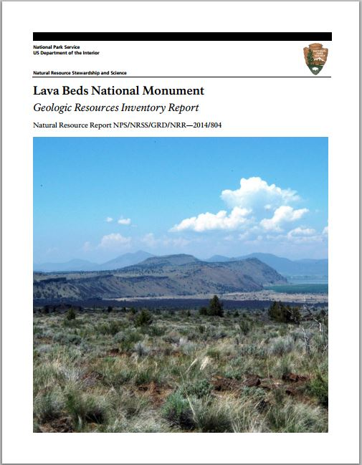
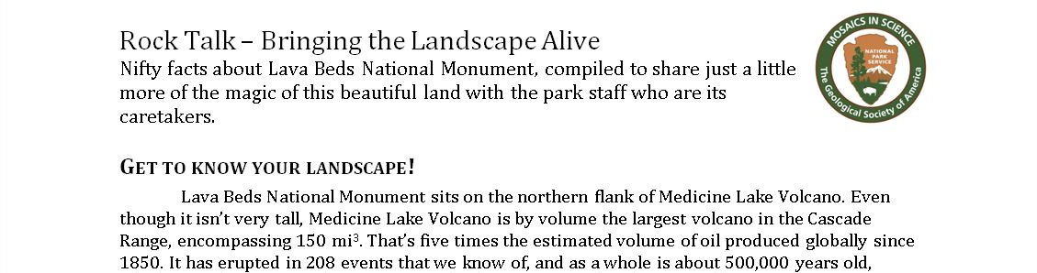
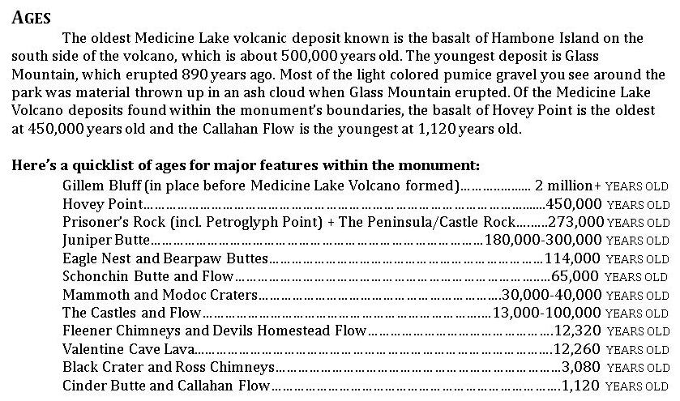
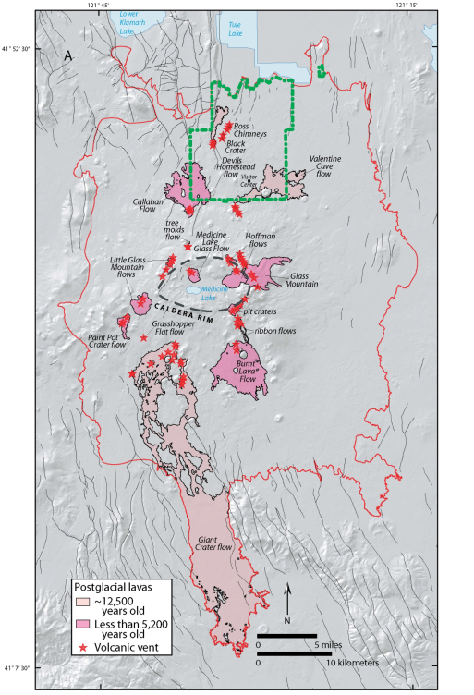
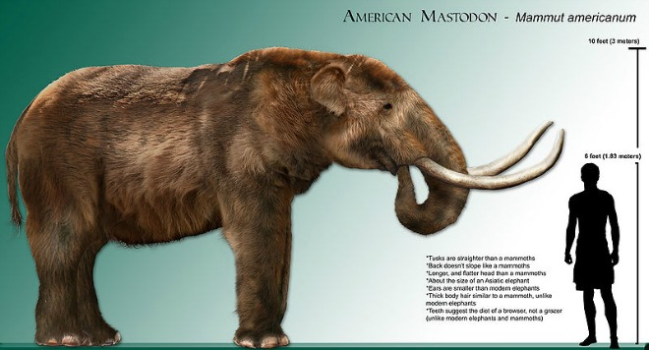
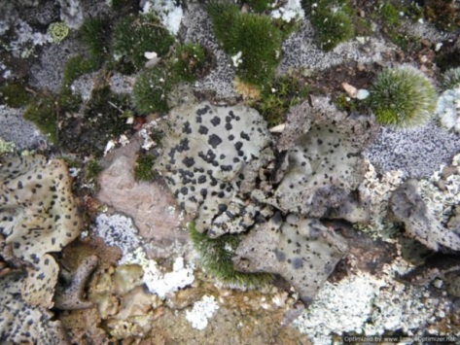

Slide 19
Petroglyph Point
a.k.a. why tuff cones are pretty cool
www.facebook.com/LavaBedsNM

Slide 20
Historians
www.facebook.com/LavaBedsNM
Notes:
This very understandably means that the interpretors giving tours at Petroglyph Point have backgrounds in history. Attending tours at Petroglyph Point, I found these interpretors to be very able at their jobs, with a rich understanding of the cultural significance of the petroglyphs, as well as the area’s history with both graffitti and protection. They are also a decent hand with bird identifications. What tripped them up, however, was how the natural history tied into the story. They knew it was important, but the documents they’d read, such as the GRI report, were too full of jargon to be useful to them.

Slide 21
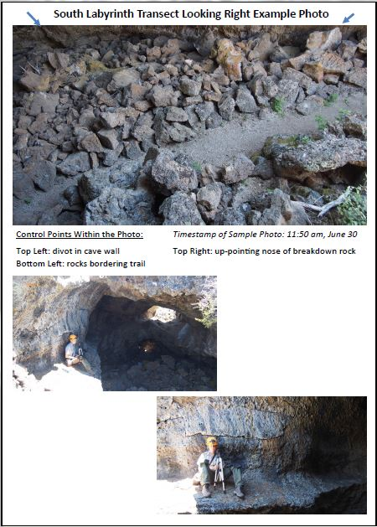
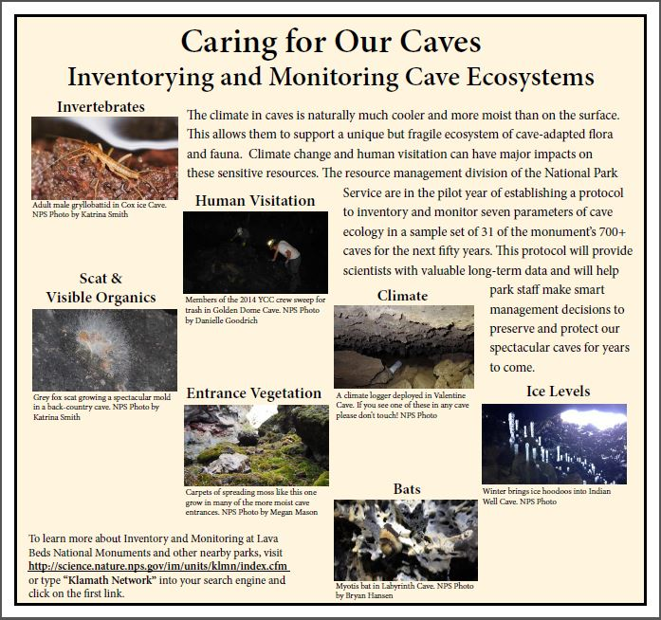
I&M-Related Projects

Slide 22
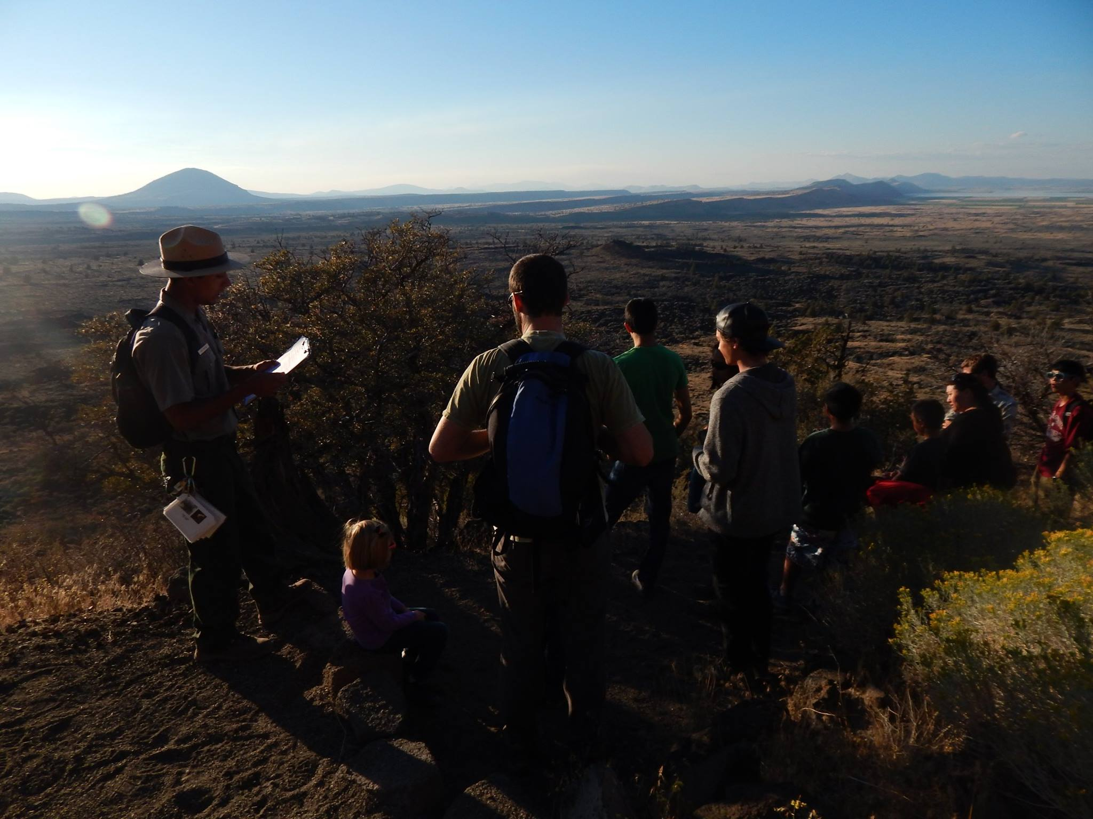
www.facebook.com/LavaBedsNM

Slide 23
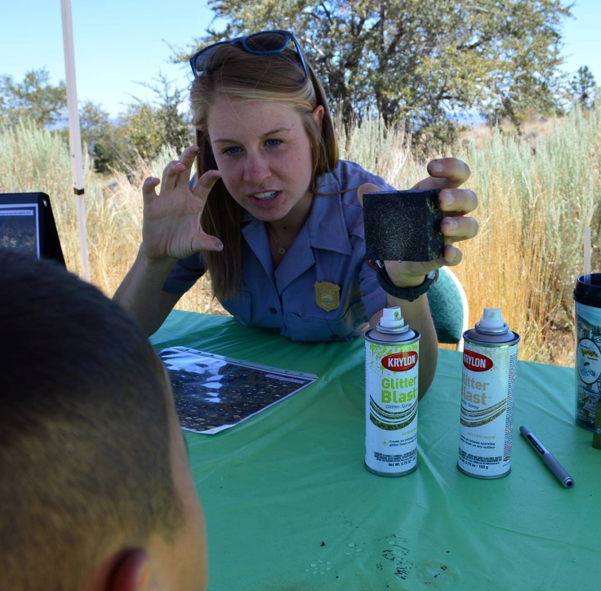
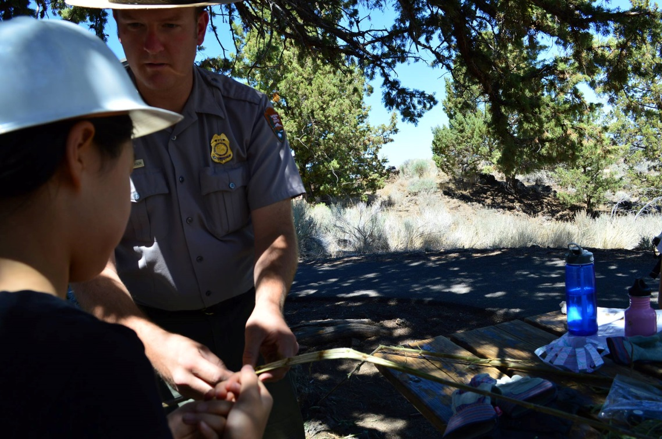
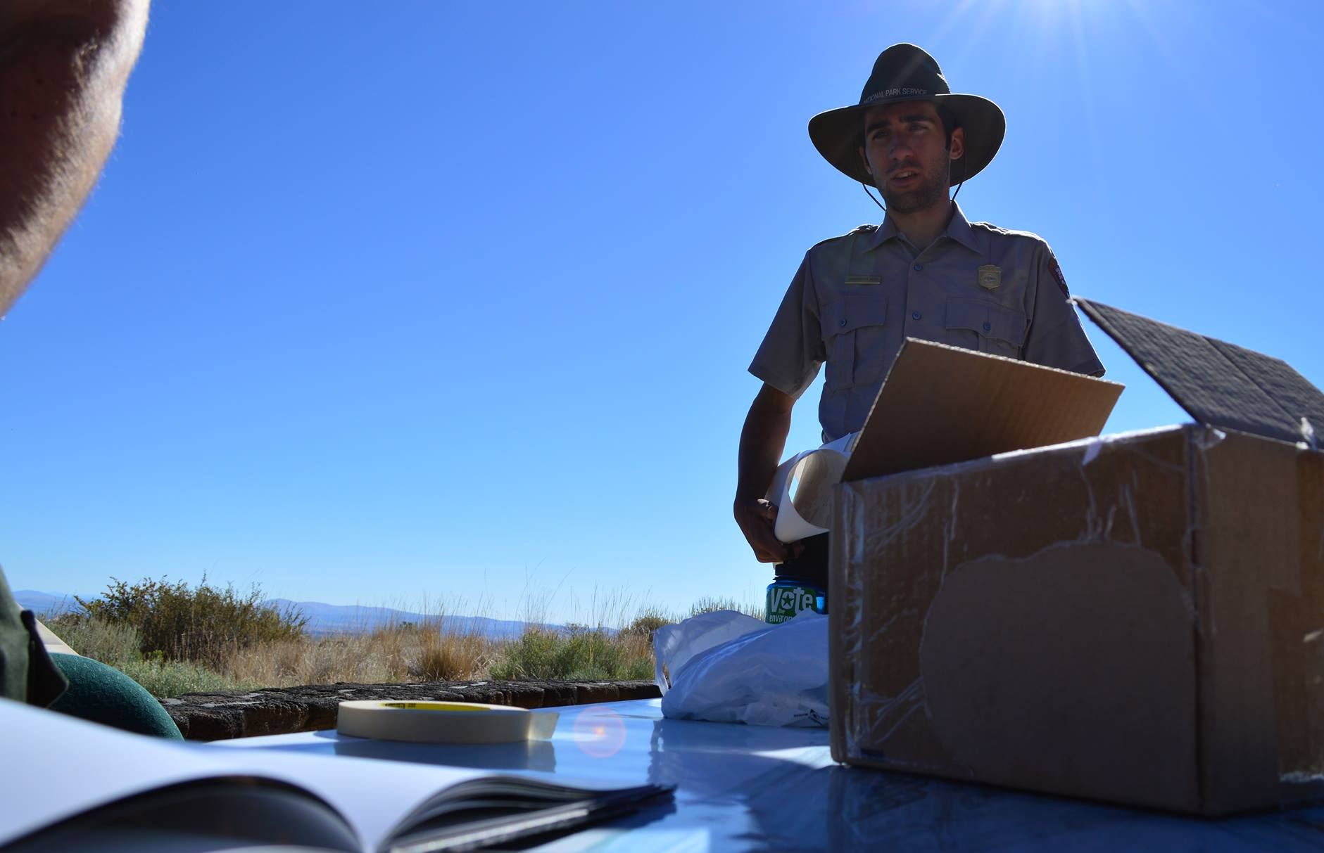
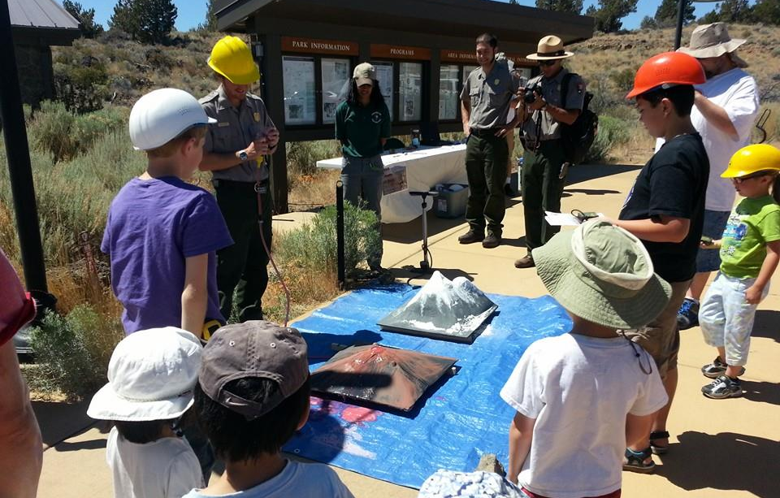
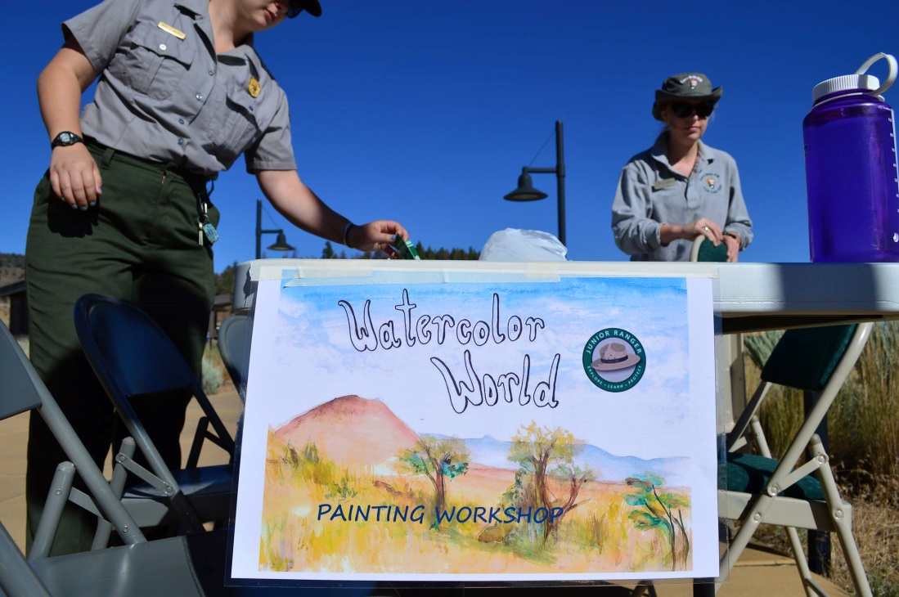
Law Enforcement
Physical Science
Archeology
Me!
Interpretation
YCC
www.facebook.com/LavaBedsNM

Slide 24
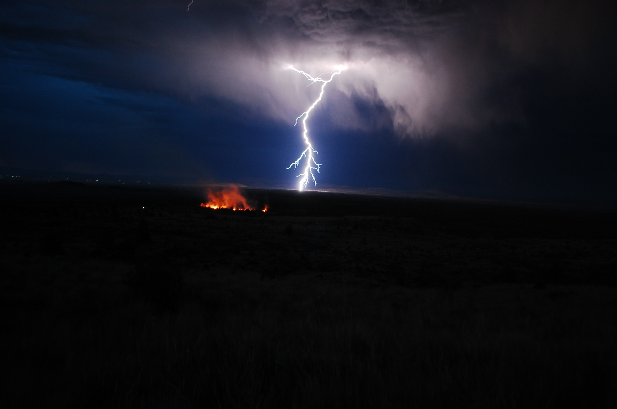
Nico Ramirez, 2014

Slide 25
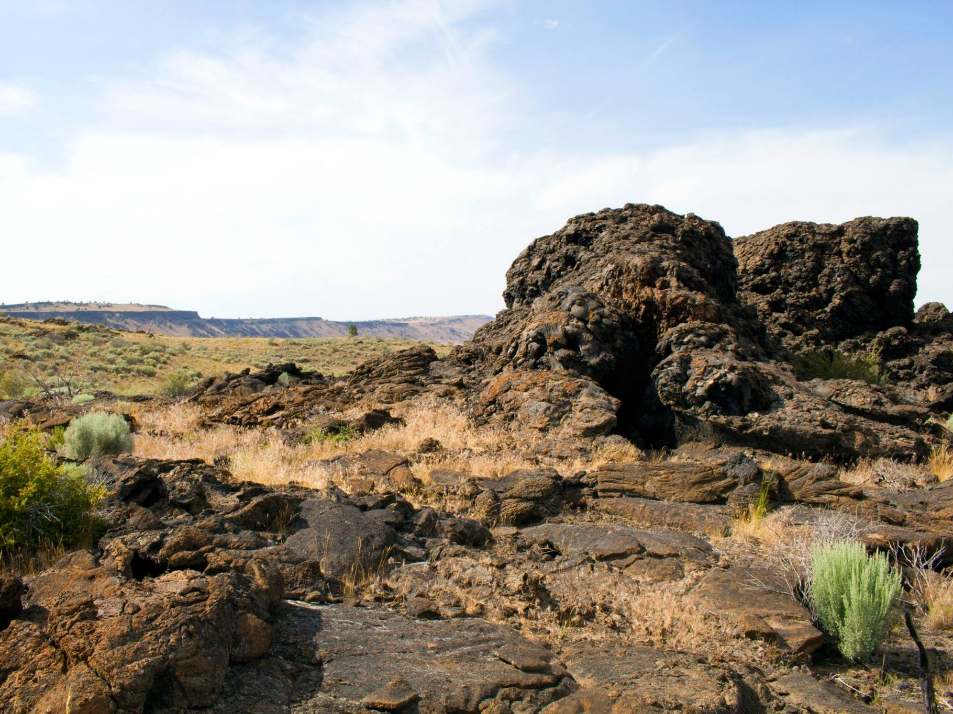

Acknowledgements
And especial thanks to Matthew Dawson, Allison Kerns, Lisa Norby, Katrina Smith, Nancy Nordensten, Megan Mason, Amy Rasmussen, and all the LABE rangers whose pictures populate the Facebook page
Questions?
www.facebook.com/LavaBedsNM

