Slide 1
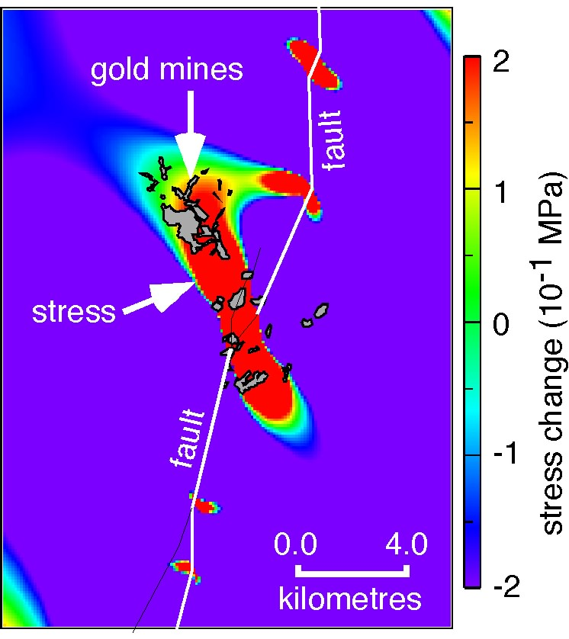
Duration & Dynamics of Orogenic-Type Gold Deposits
S. Micklethwaite, H. Sheldon
Micklethwaite et al., in press, Geofluids
Moir et al., 2013, Tectonophys
Micklethwaite et al., 2010, J.Struct.Geol.
Micklethwaite, 2010, Great Basin Metallogeny Symposium
Sheldon & Micklethwaite, 2007, Geology
Micklethwaite & Cox, 2006, EPSL
Micklethwaite & Cox, 2004, Geology

Slide 2
Introduction
Orogenic ore deposit formation strongly linked to permeability (k) enhancement during earthquake generation processes (mid to shallow crust):
Clustered, mineralisation on 2nd – 3rd order structures adjacent to master structures.
Multiple overprinting vein and breccia textures.
Extension fracture geometries relative to shear zones.
FLINCS, immiscible fluids from single low salinity fluid.
Implies association with mod long duration self-organising process (seismogenesis), involving fluids
Here, explore these dynamics and profound implications for duration of deposit formation
SELF-ORGANISATION
Open systems,
Continuous addition of M or E,
Evolution to critical state,
Transient, pulsed escape events of M or E,
Spontaneous order across range of scales (fractal).
Micklethwaite, Hronsky and others, Ec.Geol.
Notes:
Abstract not reflective of the results in this ppt 1-16 events, 10-8000 years
Recommend special issue Geofluids
Introduce concept of seismogenesis in orogenic systems or at bare minimum pulses of overpressured fluids … link to self-organisation … outline self-organisation
Orogenic maps and geometry scaling study
Underlapping models
Permeability calculations [note assumptions and evidence for assumptions; 100% efficiency, well-connected very large fluid reservoir, BUT conservative on the Au solubilities, damage zone area, permeability enhancement]
Rapid durations of other systems … or put this in intro
Outline
CHARACTERISTICS OF OROGENIC DEPOSITS
Periodic spacing and clustering and fractal spatial distributions … suggestive of self-organising processes influencing deposit formation
One of the most well-known self-organising earth systems are faults and earthquakes; seismogenesis …strong links between orogenic deposits and seismogenesis
Permeability values during seismogenesis & healing periods
Range of Au solubility values (Micucki 1998, Ore Geol.Rev. Simmons & Brown 2007, Geol)
Integrated equation for fluid flux

Slide 3
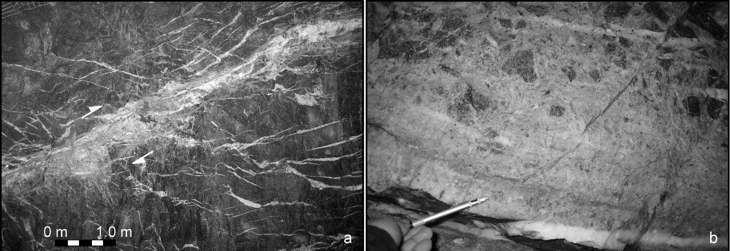
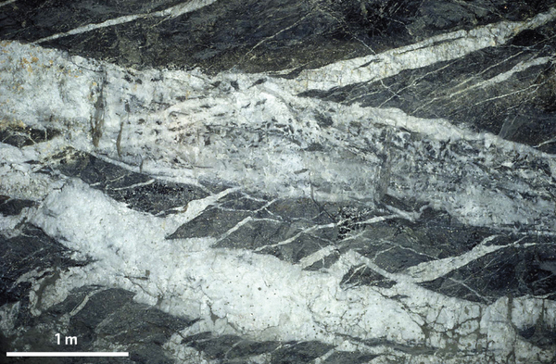
Argo, St Ives
Argo, St Ives
Characteristics: Orogenic Deposits
Tenthorey et al., 2003, (EPSL)
Micklethwaite 2008 (G3)
Mutual overprinting relationships. Multiple increments.
Transient pulses of overpressured fluid.

Slide 4
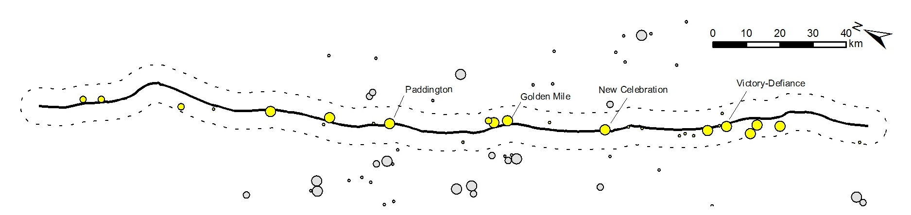
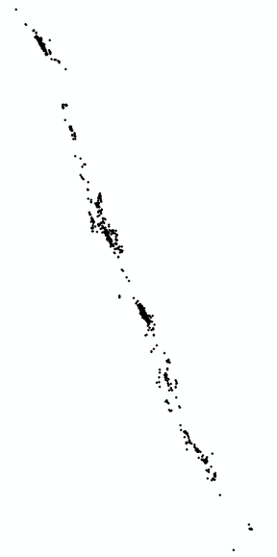
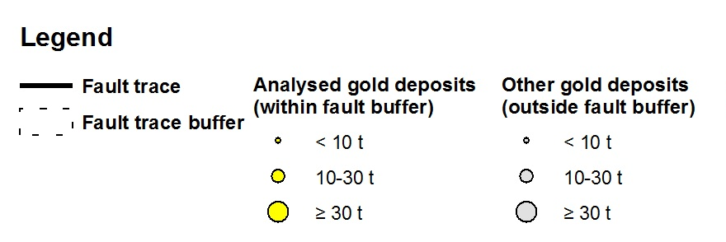
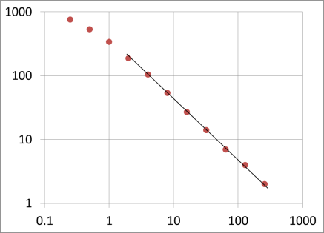
Boulder-Lefroy Fault; 5 km buffer
Deposit location and endowment; 2T cut-off
MINEDEX
Historical and active shafts & pits
(oreshoot equivalent)
Further evidence for self-organising properties:
Clustering (endowment & deposits) with periodic spacing
Power-law size frequency distributions in along-strike ore deposit distribution
D = 0.943
R² = 0.999
Box number
Box dimension (km)

Slide 5
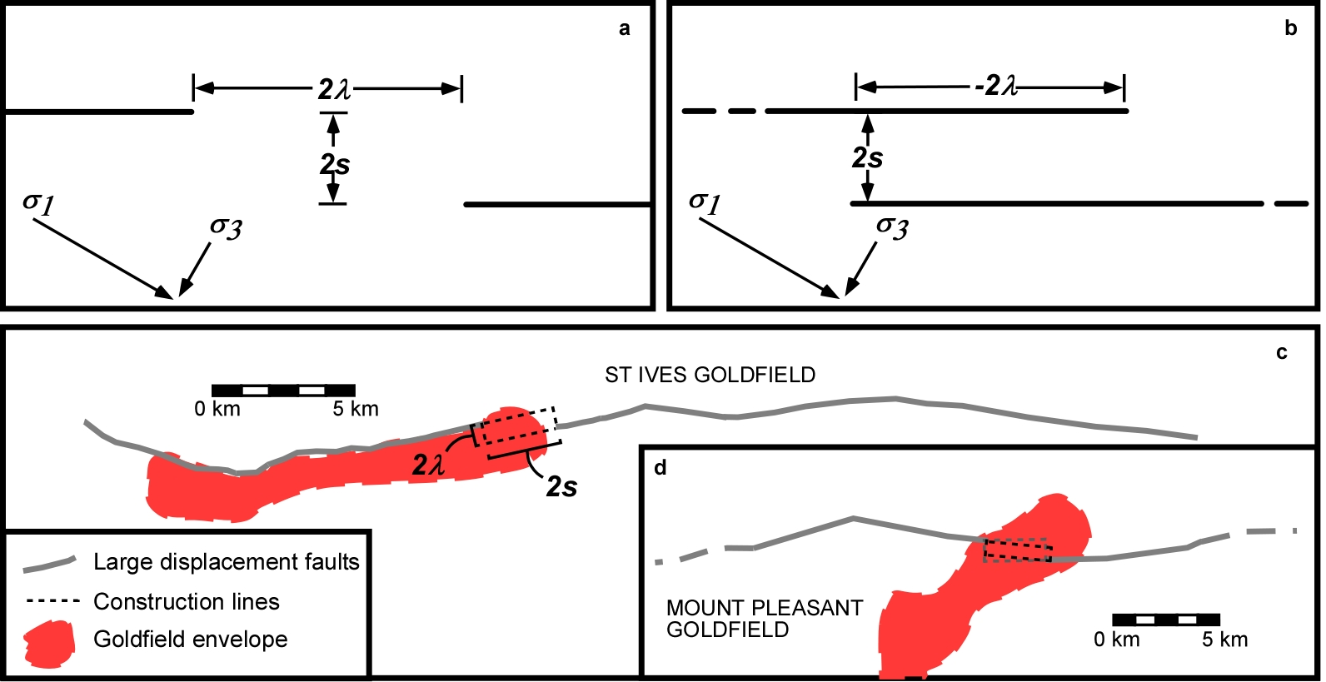
Geometry & Scaling Properties
2λ is the overlap/underlap distance
2s is the separation distance
Unlike previous step-over scaling studies, λ becomes negative when overlapping
- Provides a distinction between overlap or underlap

Slide 6
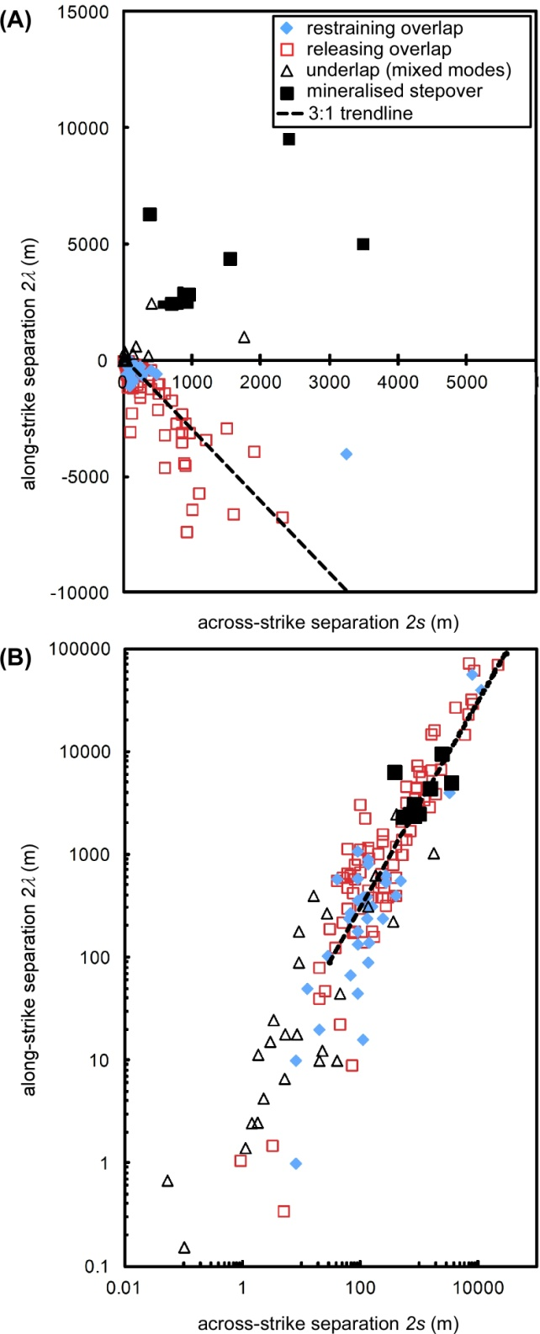
Note: deposit data from orogenic, carlin & porphyry deposits
Consistent step-over dimension (~3) for both underlapping & overlapping step-overs. Self-similar to a first-order (self-organisation ?)
Overlap dominates global data ~10:1. Just 9% of measured step-overs with an underlap geometry
BUT … Underlap dominates mineralised step-overs
Geometry & Scaling Properties
Notes:
Some form of spontaneous organisation of geometry

Slide 7
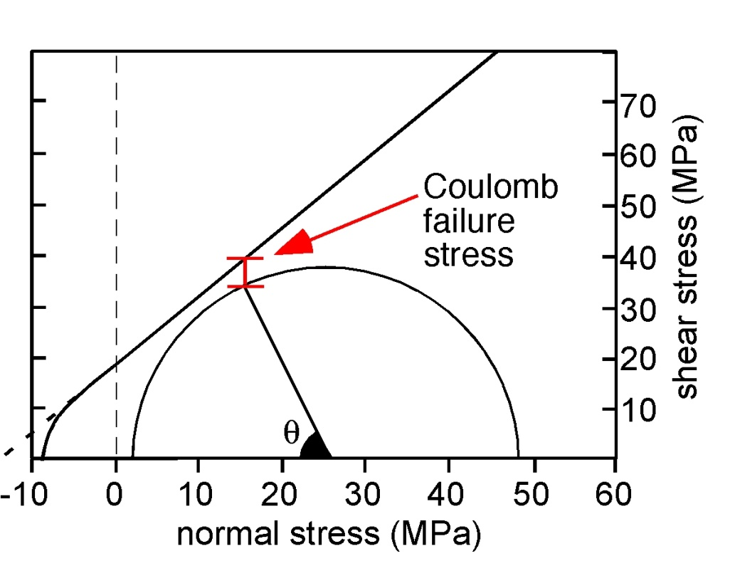
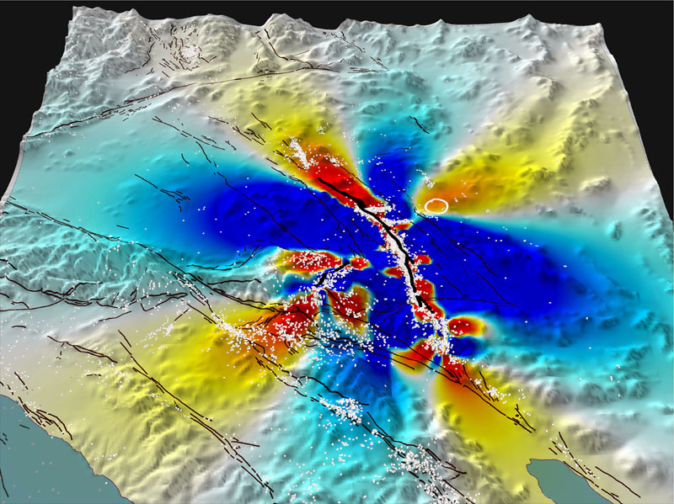
What is Stress Transfer Modelling?
Calculation of static stress changes (change in Coulomb failure stress)
proxy for failure of damage zone faults/fractures
Numerical Analysis: Stepovers & Damage
Landers sequence (1992-1999), M7.2 Earthquake
Proxy for near-field aftershocks (>M5)
Aftershock damage triggered >5 km away from master fault
Stein 2003, Nature

Slide 8
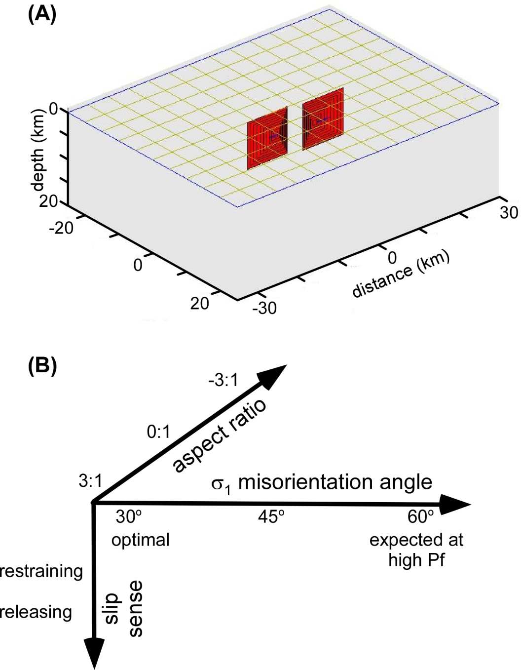
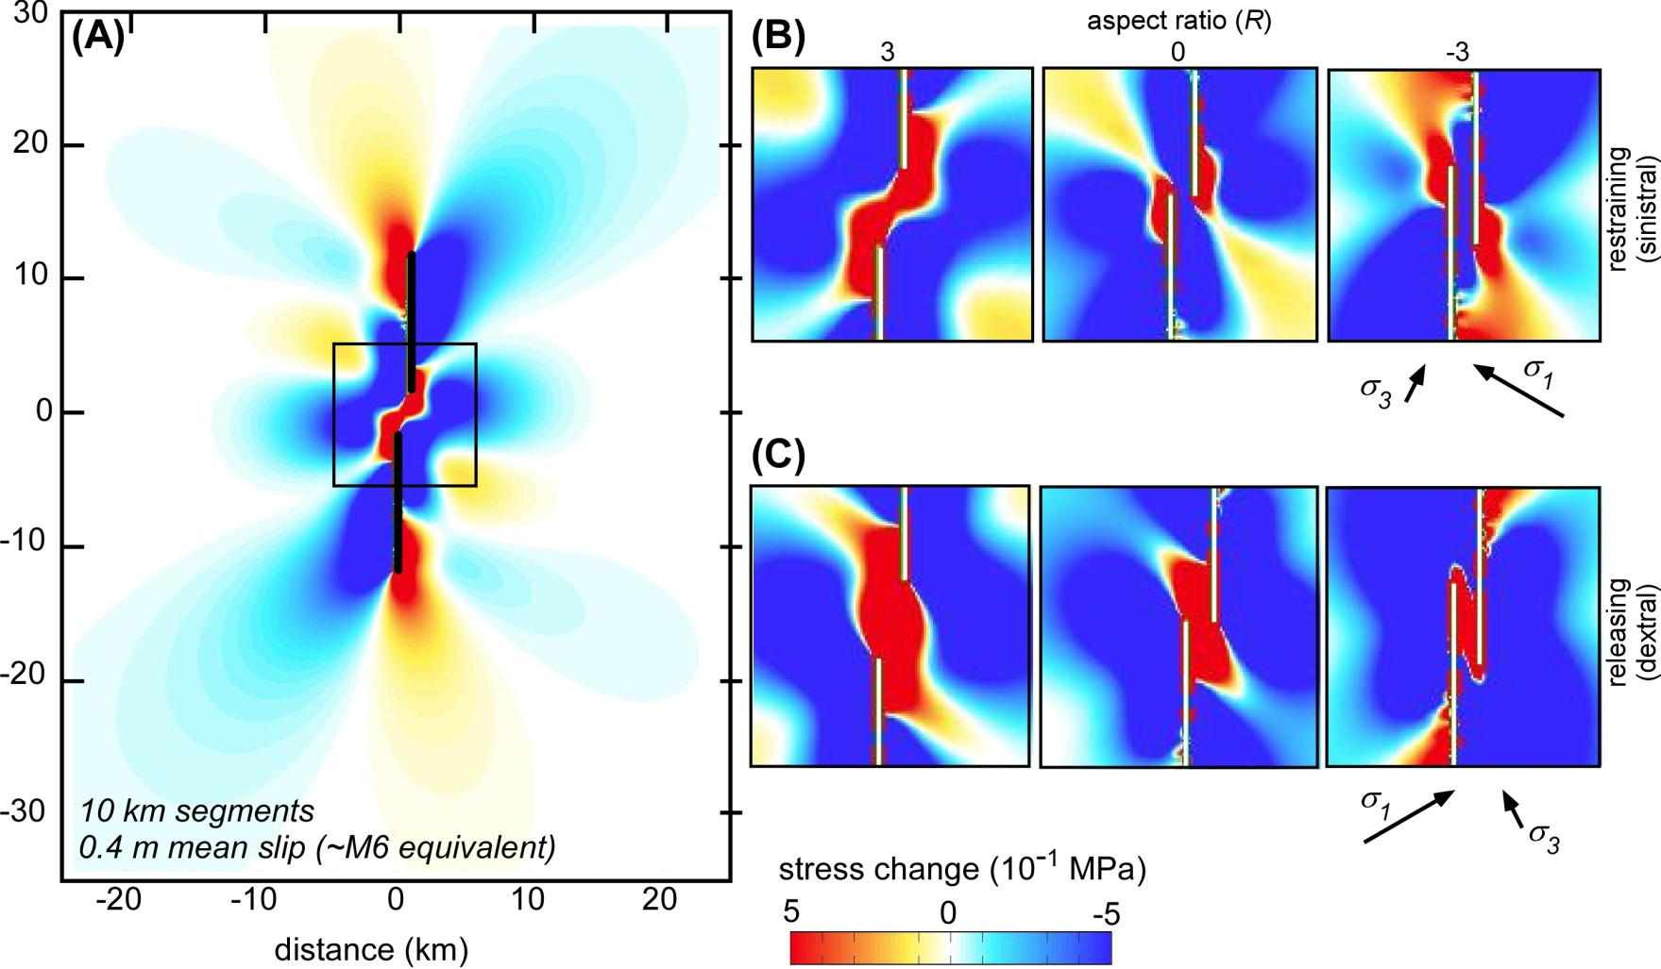
Result (linear tapered models):
Larger surface area of damage associated with underlap configurations.

Slide 9
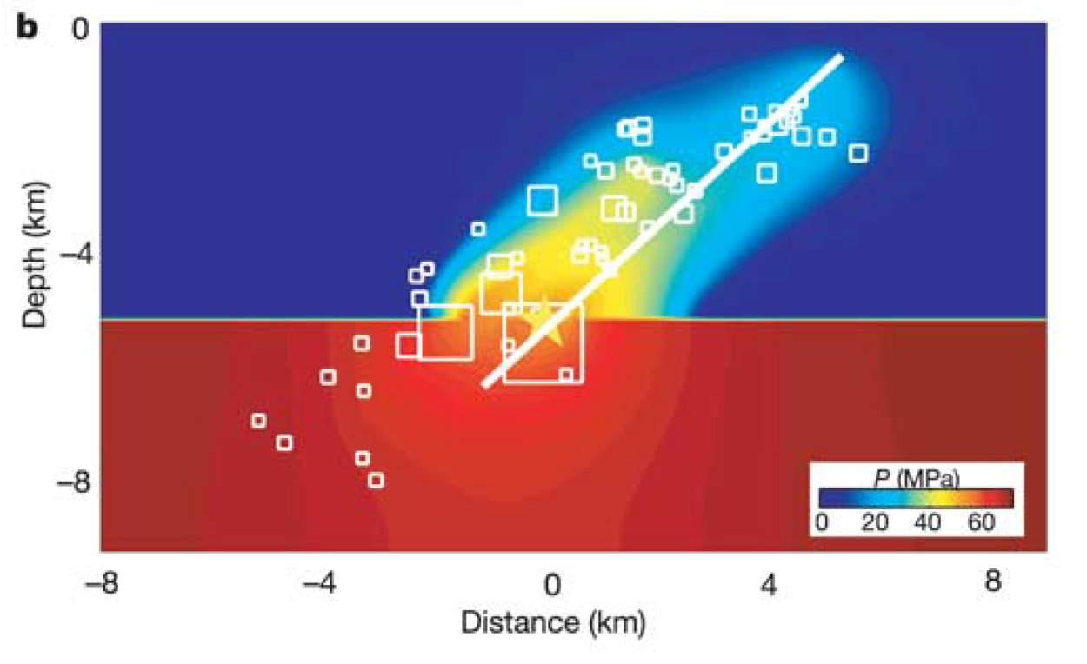
Fluid Flux & Formation Duration
Miller et al. 2002, Nature
1997 Umbria-Marche earthquake sequence analogue.
Mainshocks rupture overpressured CO2 reservoir at depth. High pressure fluids escape up main fault and adjacent surfaces, triggering a “wave” of aftershocks with time.
k is not static. Background k ~10⁻¹⁸ m². Co-seismic values transiently 10⁻¹³ to 10⁻⁸ m² (Noir et al., 1997; Waldhauser et al., 2012; Miller 2013, Adv.Geophys.)

Slide 10
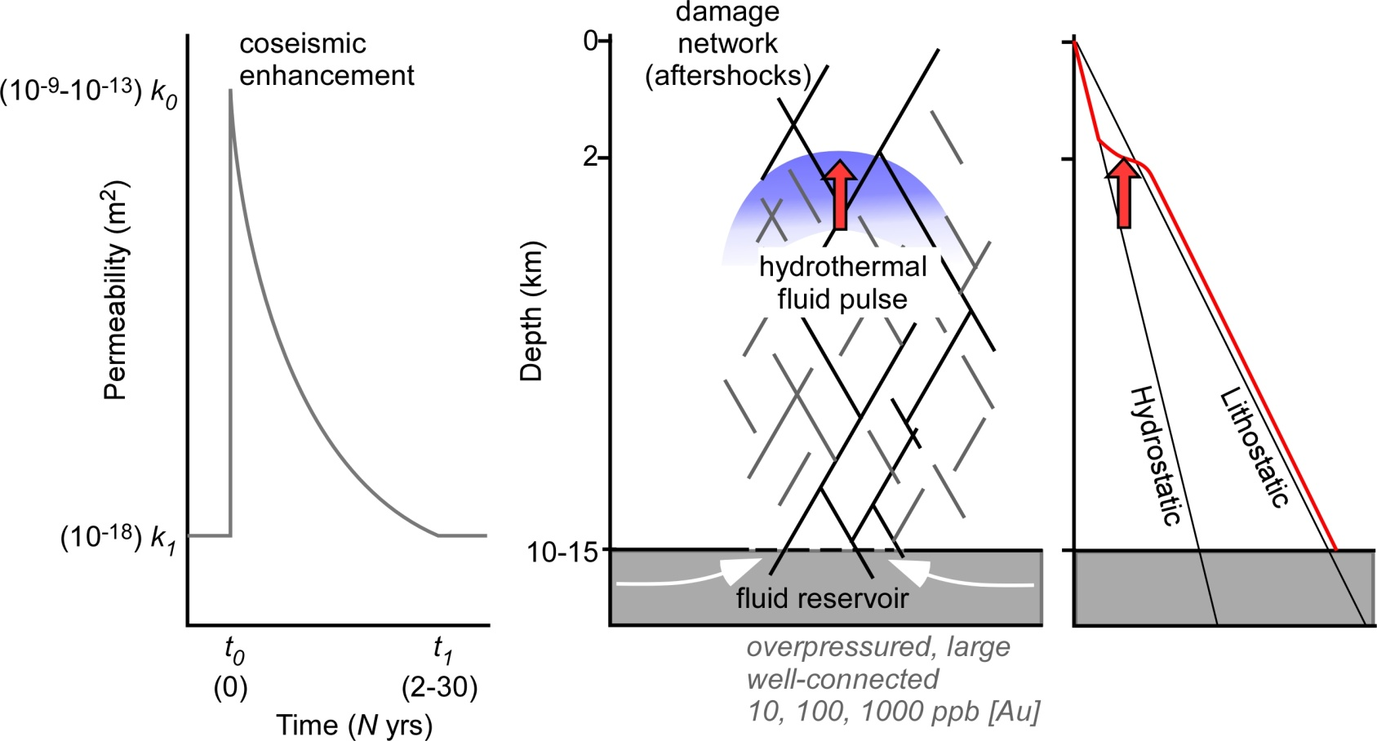
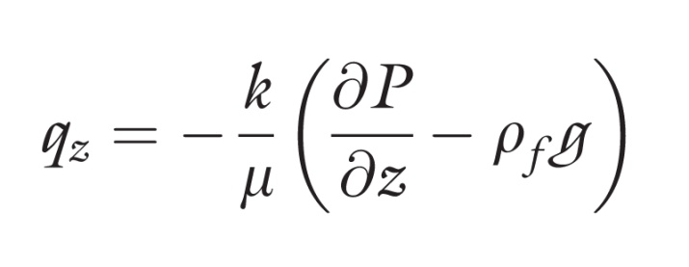
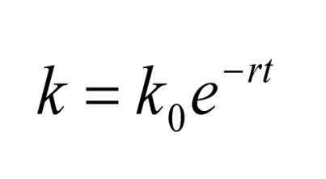
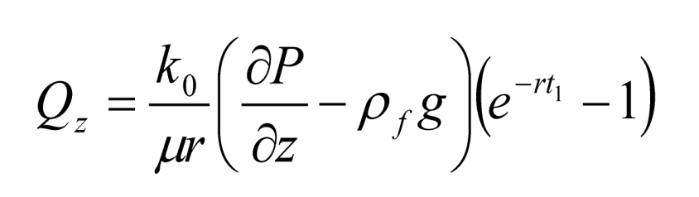
Fluid Flux & Formation Duration
Micucki 1998, Ore Geol. Rev.
Simmons & Brown 2007, Geol.
Giger et al. 2007, J.Geophys.Res.
Micklethwaite et al. 2014, Geofluids

Slide 11
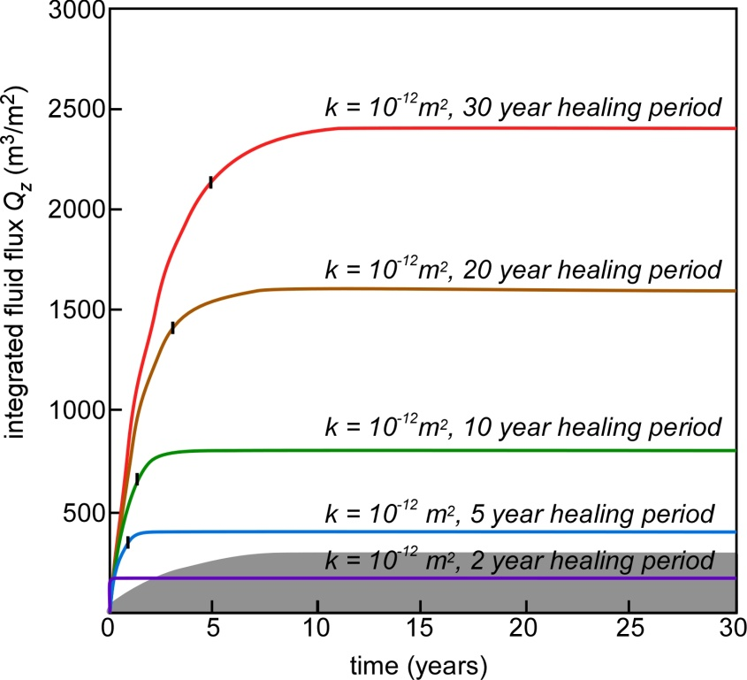
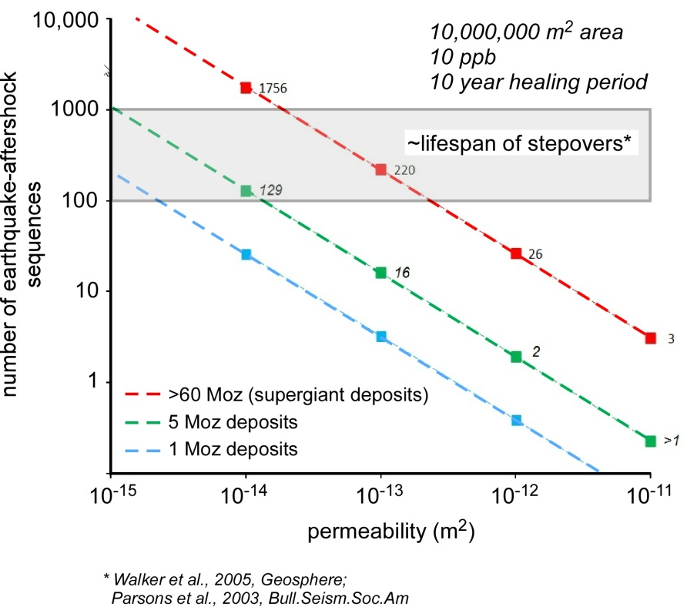
Coseismic permeability enhancement permits very large fluid flux over short time periods.
Even with slower healing periods, 90% of flux achieved in <5 years.
With coseismic permeability enhancement, 5 Moz deposits can feasibly form in 1-16 earthquake-aftershock sequences (1-26 sequences for supergiant deposits).
~10-8000 yrs given lifespans of stepovers (10⁵ yrs) and fault recurrence intervals 100-500 yrs (~10-13,000 yrs for supergiants)
Note: Assumes 100% efficiency in stripping Au from fluid (observed Brown 1986) BUT conservative estimates for [Au], gold camp surface area, permeability enhancement
Fluid Flux & Formation Duration

Slide 12
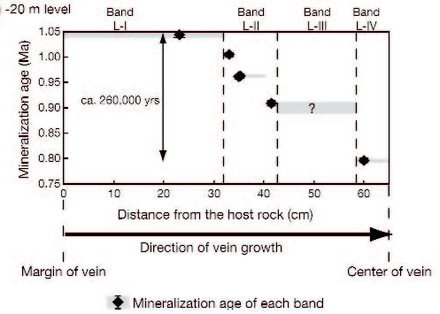
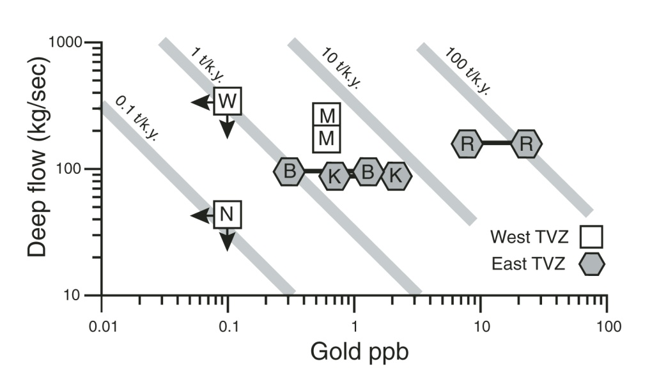
Epithermal Au-Ag
30-110 ka intervals in epithermal vein increments
Total vein formation ~260 ka (Hishikari)
Sanematsu et al., 2006, Ec.Geol.
[Au]_{TVZ and} fluid flux rates imply supergiant deposit in <20 ka to 50 ka.
Simmons & Brown, 2007, Geol.
Rapid Durations of Other Deposit Types
Notes:
Precious metal concentrations of
deep thermal solutions versus deep upfl ow
rates (Tables 1 and 2), showing the metal
fl ux rates (tonnes per 1000 yr, t/k.y.) in
Taupo Volcanic Zone (TVZ) geothermal systems.
B—Broadlands-Ohaaki; K—Kawerau;
M—Mokai; N—Ngatamariki; R—Rotokawa;
W—Wairakei.

Slide 13
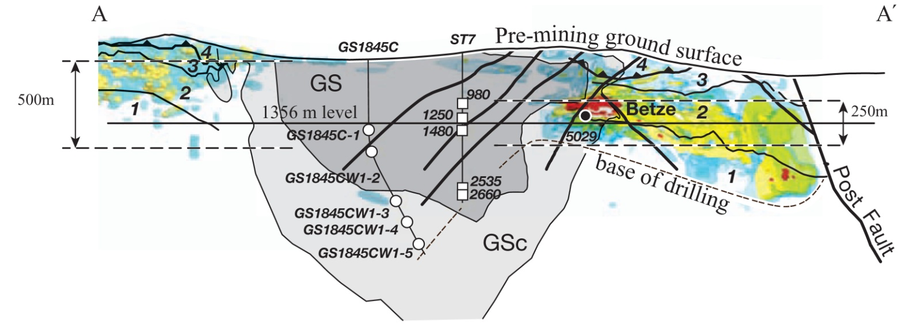
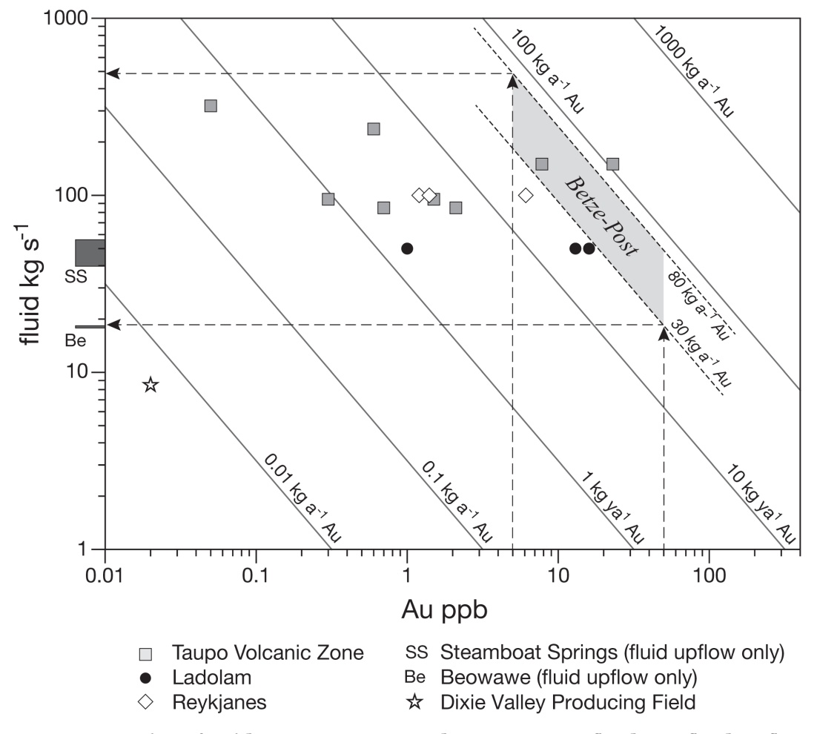
Rapid Durations of Other Deposit Types
Supergiant Carlin Au
Apatite fission tracks reset in mineralised sediments but not in granodiorite stock.
Implies duration of mineralising fluid flux <15-45 ka
Hickey et al., 2014, Ec.Geol.
Notes:
Precious metal concentrations of
deep thermal solutions versus deep upfl ow
rates (Tables 1 and 2), showing the metal
fl ux rates (tonnes per 1000 yr, t/k.y.) in
Taupo Volcanic Zone (TVZ) geothermal systems.
B—Broadlands-Ohaaki; K—Kawerau;
M—Mokai; N—Ngatamariki; R—Rotokawa;
W—Wairakei.

Slide 14
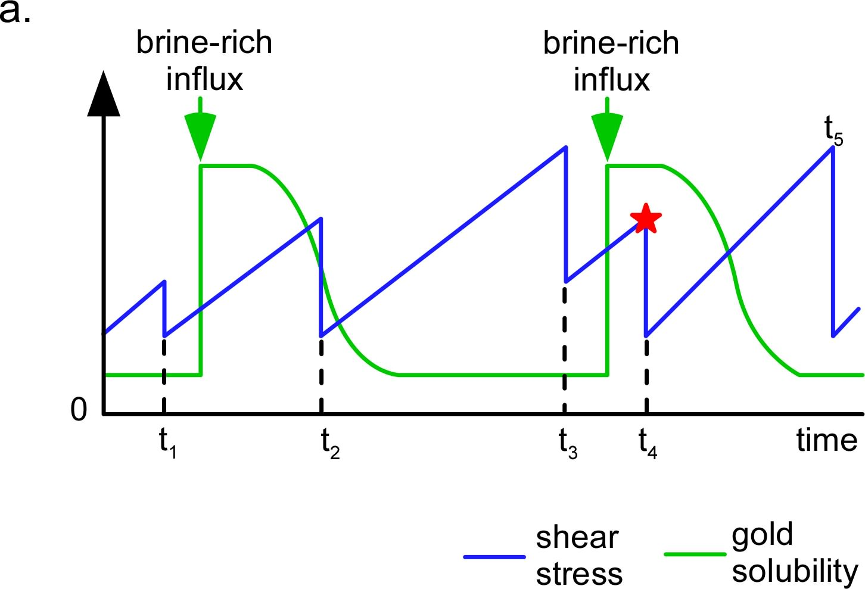
Conclusions
Acknowledgements
Hammond-Nisbet Endowment
S.F. Cox, R. Doutre
Orogenic deposit formation controlled by the dynamics of earthquake behaviour (a self-organising system)
Duration of formation, even for supergiants, is feasibly in order of 10-10⁴ yrs due to coseismic permeability enhancement (consistent with recent results from Carlin, epithermal and porphyry systems; Hickey et al., 2014, Ec.Geol.; Simmons & Brown 2007, Geol.; Heinrich 2006, Sci)
Question? Short duration elevated [Au]_{aq} nested in fault systems with potentially million year active lifespans

Slide 16
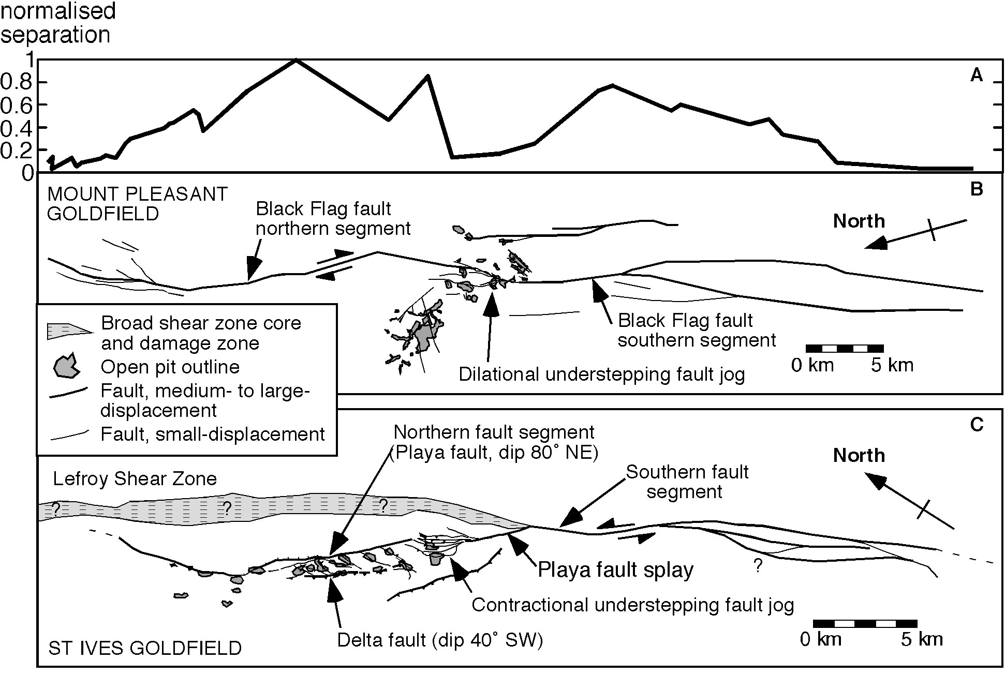
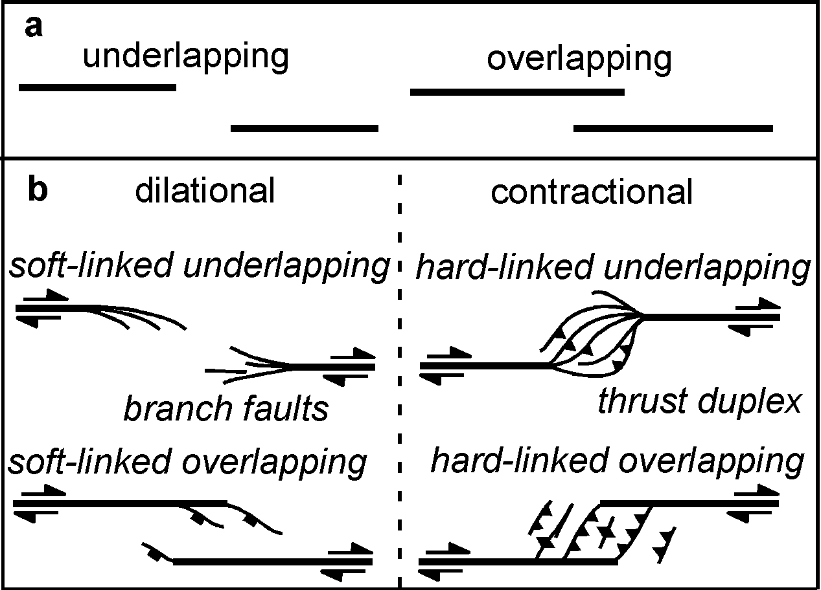
Characteristics: Orogenic Deposits
2nd-3rd order faults/shears around master faults (N.B. polyphase history to master structures)
Clustered, and association with underlap geometries
Notes:
Affinities to earthquake-aftershock sequences – master structure with damage and k enhancement on 2nd order faults in near-field

Slide 17
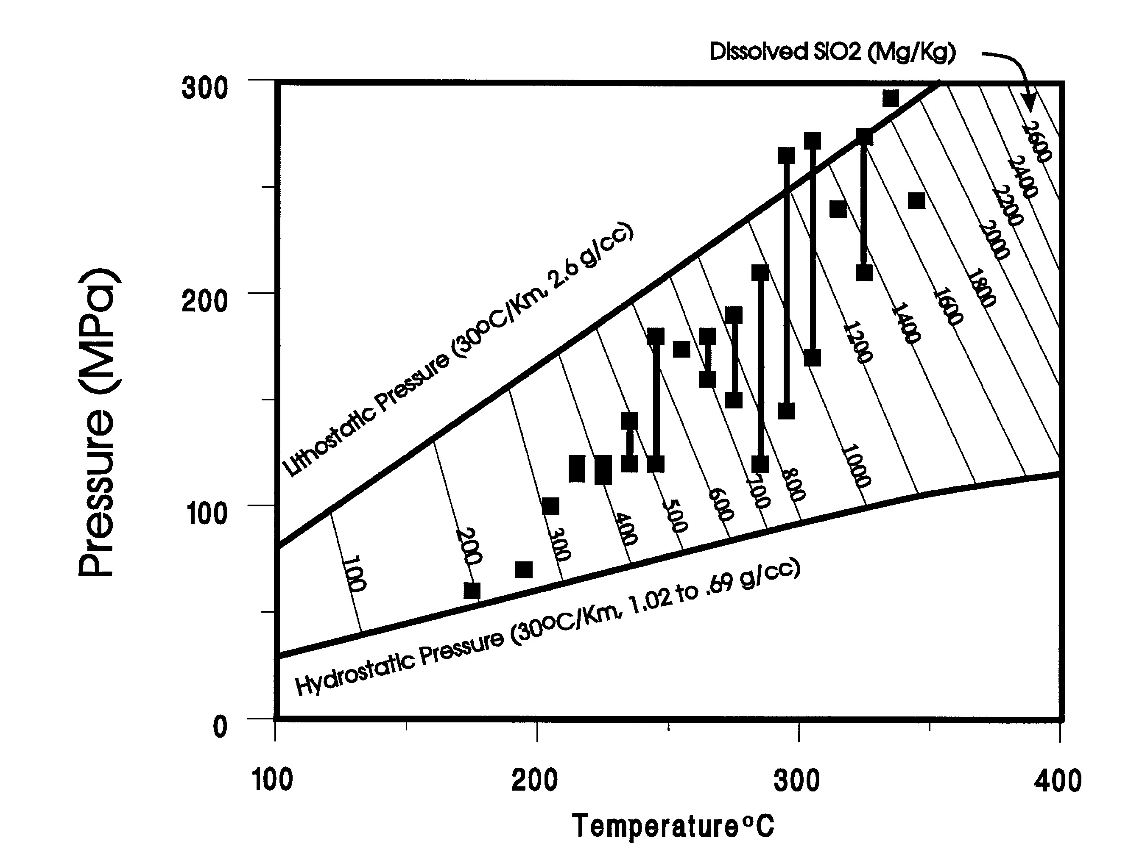
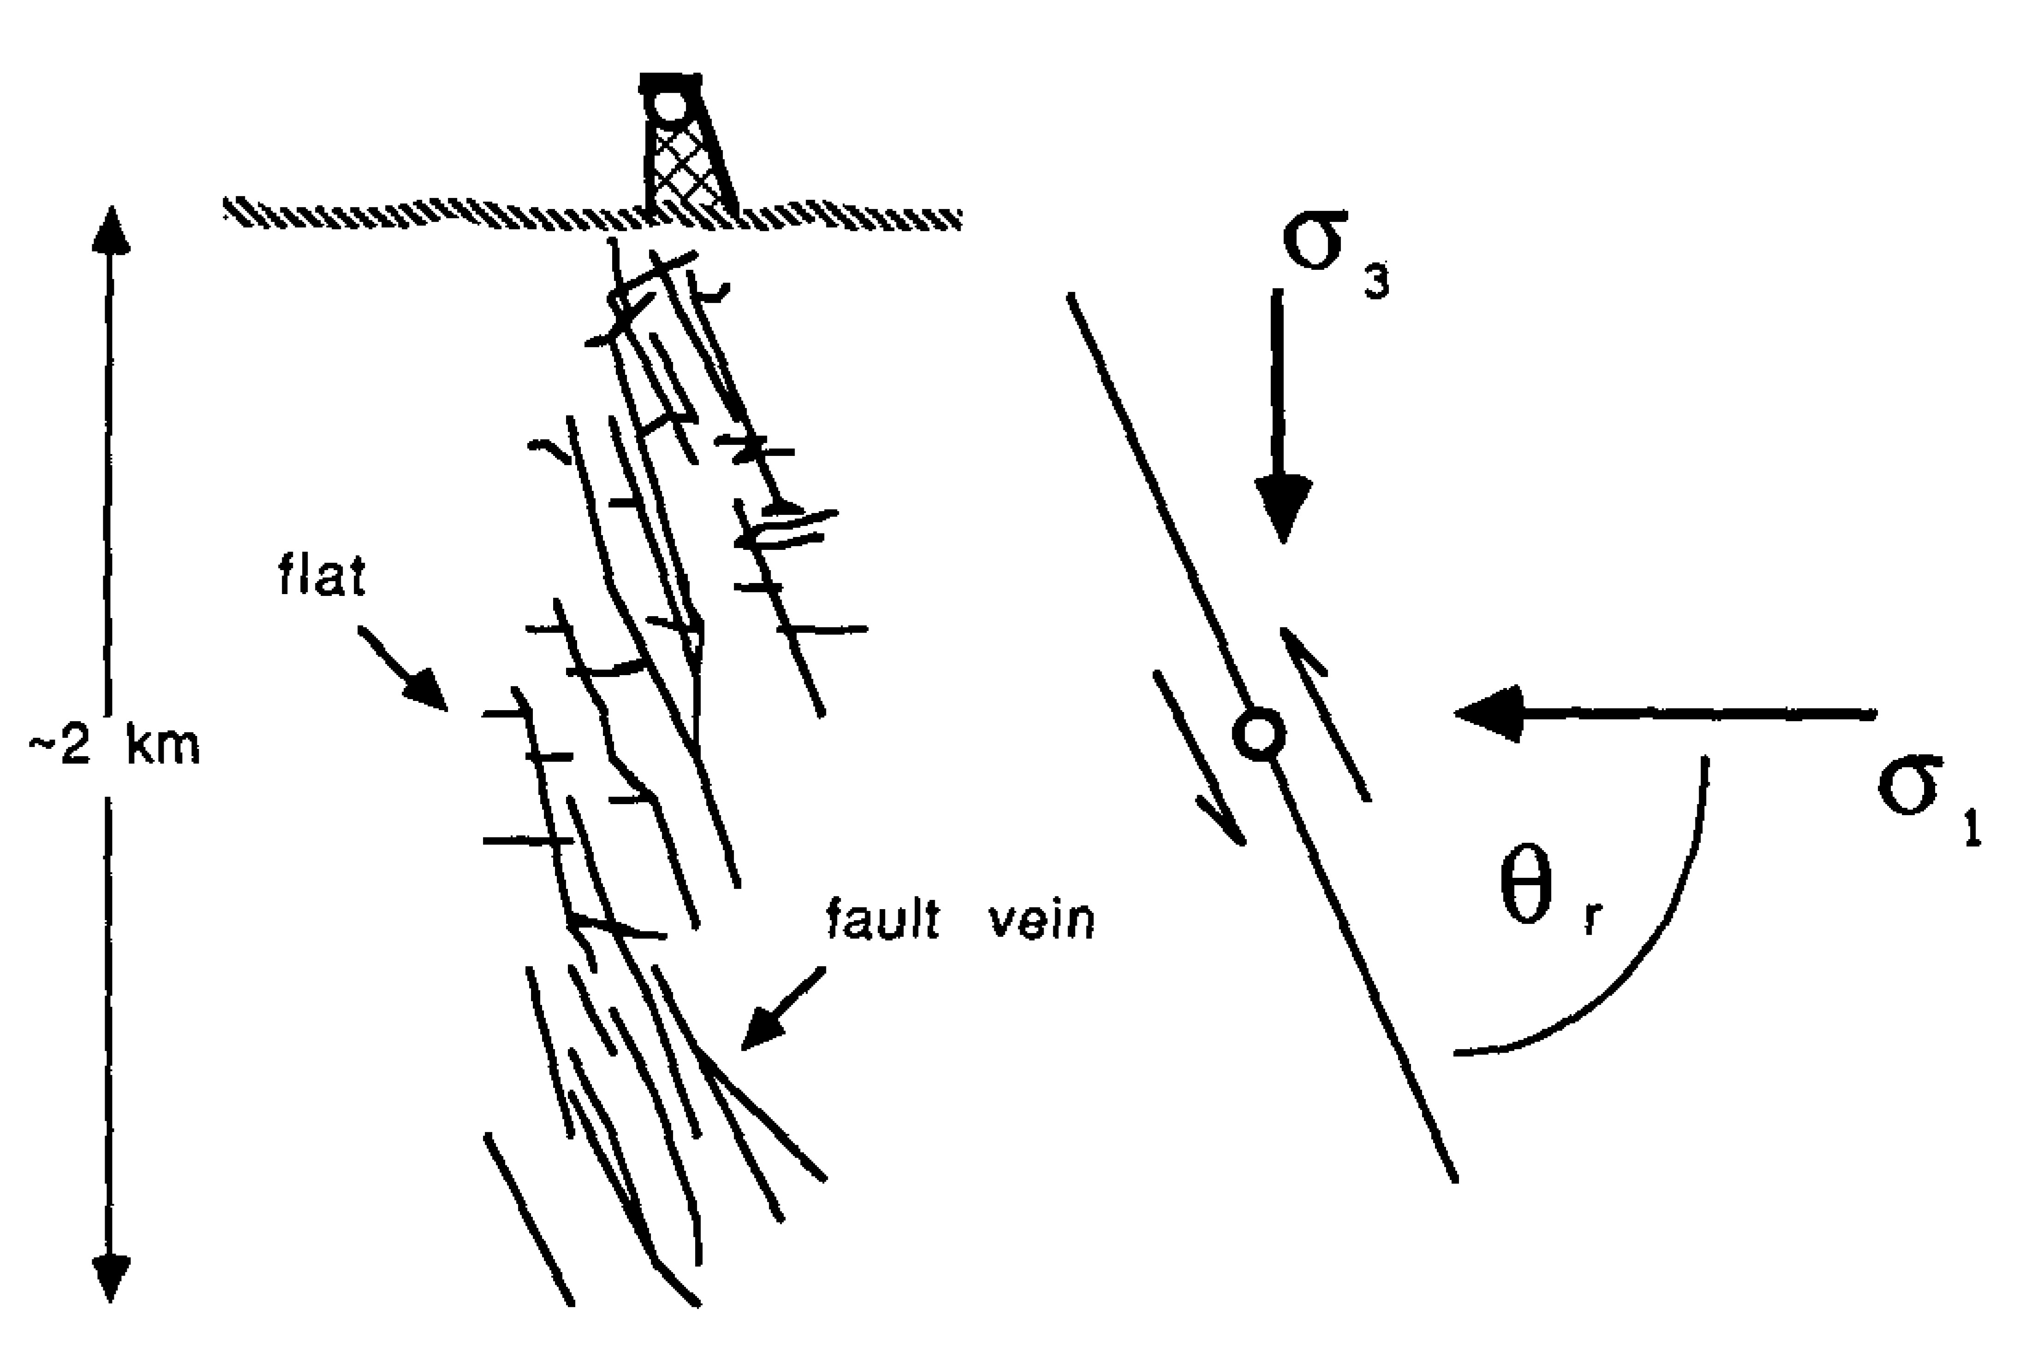
Carbonic or H₂O-CO₂-NaCl fluid inclusions with diversity of densities and CO₂ content
Different compositions of inclusions in close proximity (cms) within same vein
Scatter in Pf estimates at constant temperature (>100-150 MPa range)
Reflect entrapment of immiscible fluids, derived from phase separation of single low salinity fluid
Pressure drops from overpressured fluids
Parry, 1998, Tectonophys
Appendix
Sibson et al, 1988, Geology

Slide 18
Extension vein orientations relative to shear-extension veins, shear zones & faults
Inferred stress field (σ₁ > σ₂ > σ₃) and unusually large fault reactivation angle (~60°+)
Elevated fluid pressure (supra-lithostatic; Pf = σ₃ + T)
Extension fracture evolves to shear and seal rupture: Cyclical, linked to earthquake rupturing
Parry, 1998, Tectonophys
Appendix
Sibson et al, 1988, Geology

Slide 19
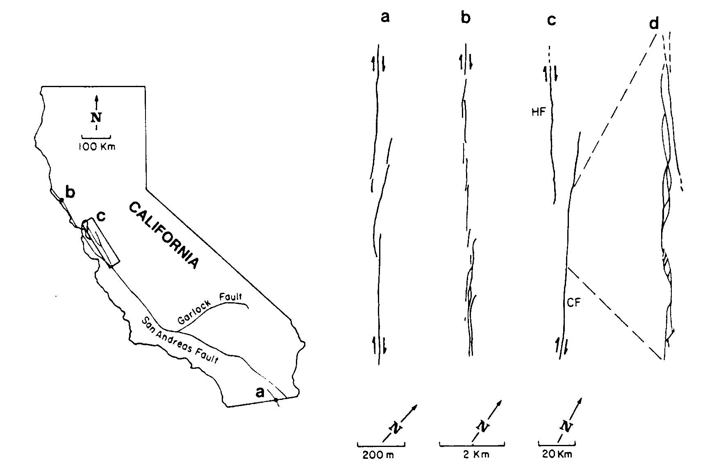
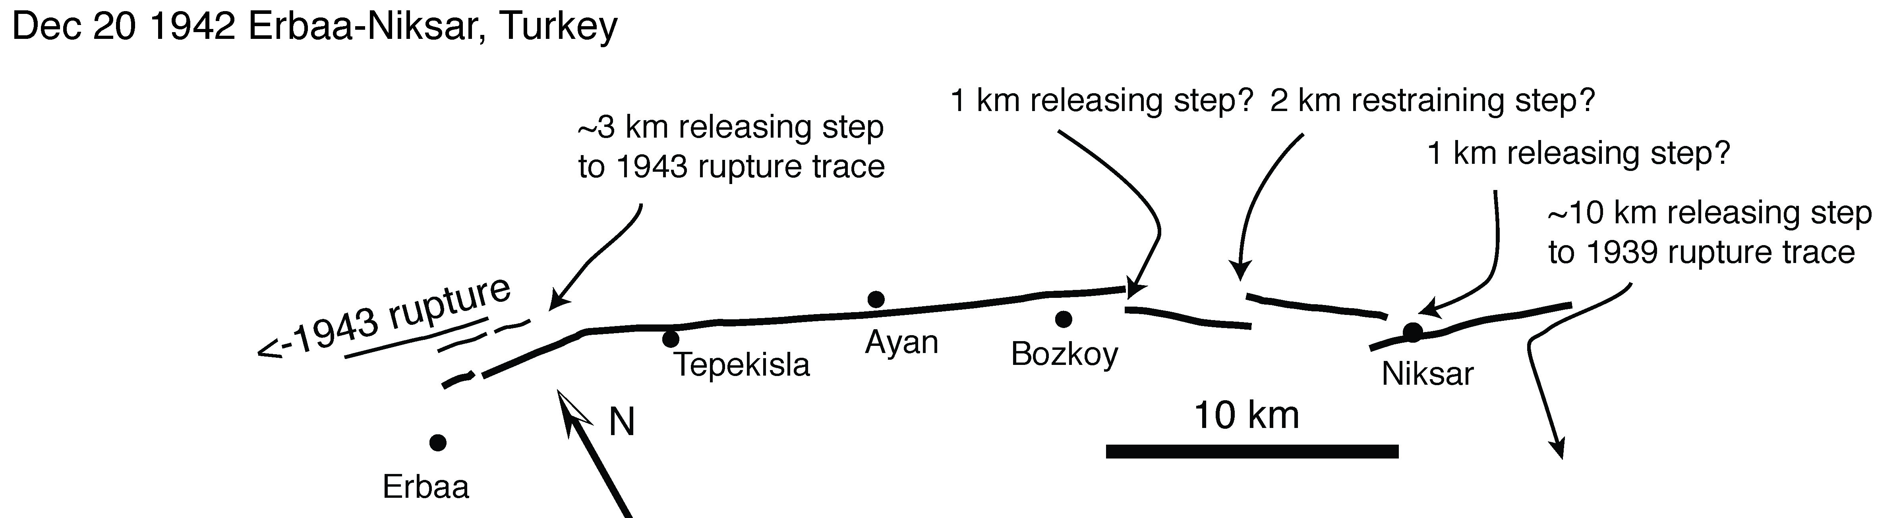
Aydin & Schultz, 1989, J.Geophys.Res.
Active Seismogenic Systems:
Existing databases of step-over geometries across multiple scales
Appendix
Wesnousky, 2008, Bull.Seism.Soc.Am

Slide 20
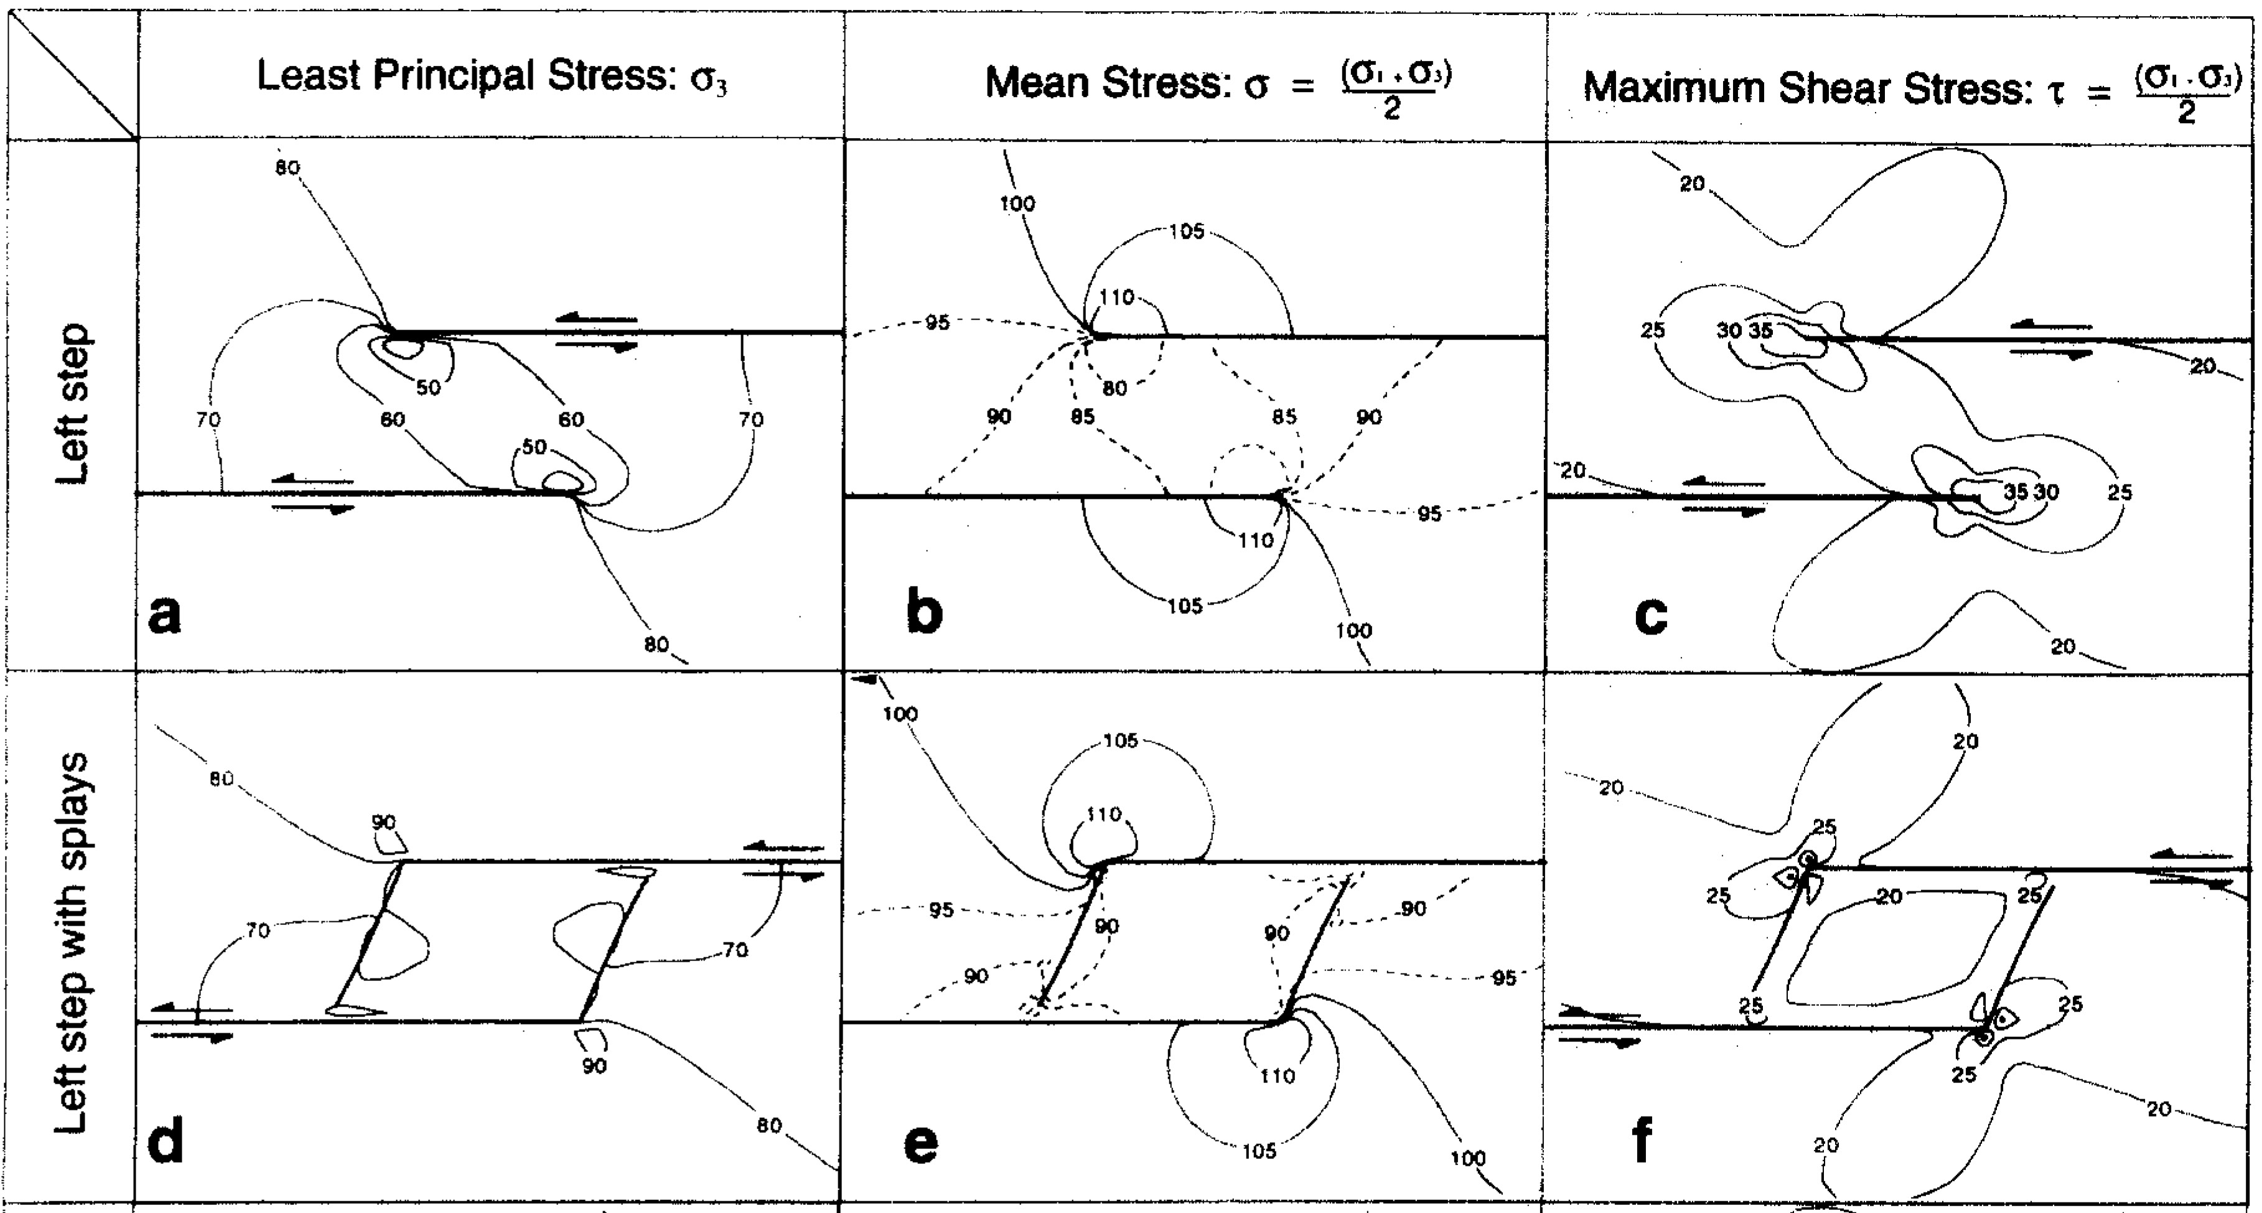
Appendix
Burgmann & Pollard, 1994, J.Struct.Geol.
Active System Data:
Overlap dominates ~10:1
Consistent with expected fault propagation and interaction from fracture mechanics theory

Slide 21
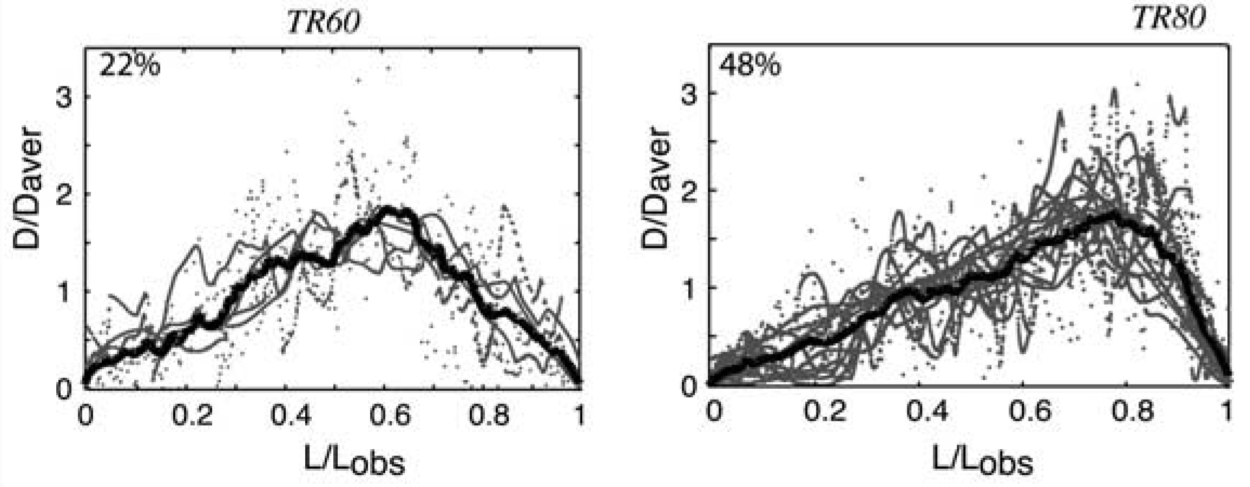
Manighetti et al., 2001, 2005, J.Geophys.Res
Appendix
Tapered Slip:
Slip distributions on the fault segments
Uniform 0.4 m
Linear tapered, assymetric due to tip restriction, (mean 0.4 m, max slip 0.73 m at 20-30% fault length)

Slide 22
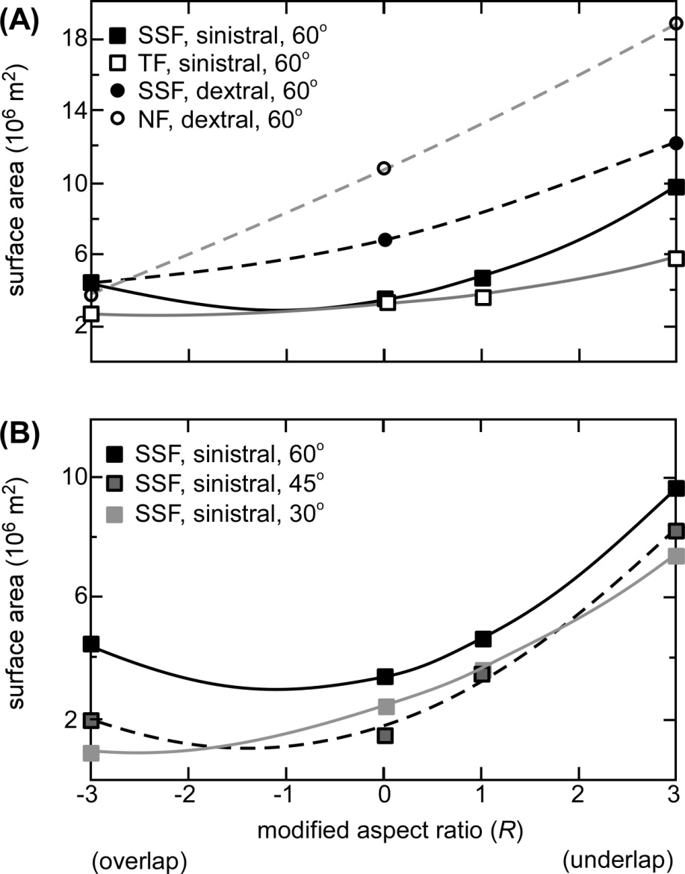
Result (linear tapered models):
Underlap promotes increase in surface area for damage triggering and dynamic permeability enhancement, relative to overlap.
Average surface area for transient damage ~10,000,000 m² (tallies with gold camp dimensions)
Appendix

Slide 23
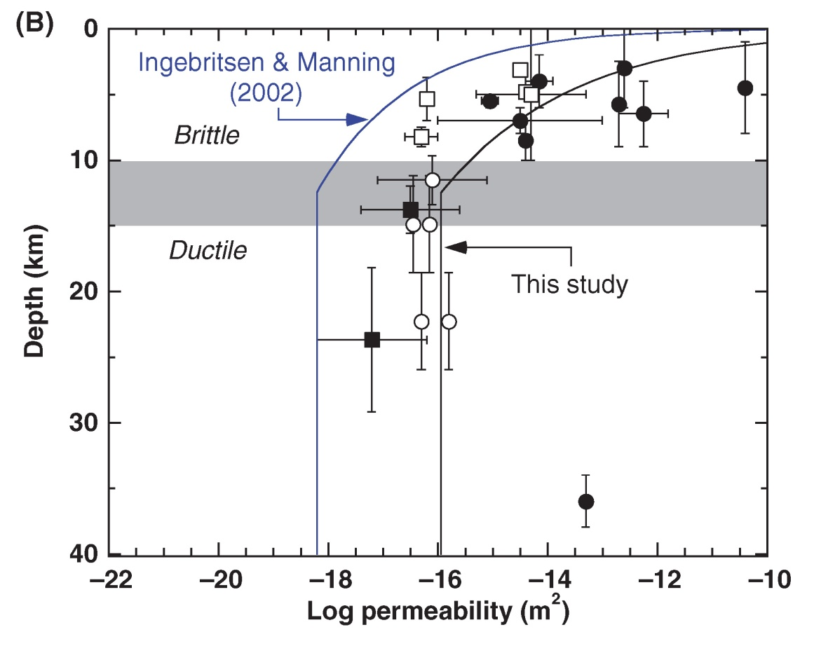
Metamorphic data, geothermal measurements, seismic hypocentre migration, thermal modelling
Ingebritsen & Manning, 2010 (Geofluids)
Appendix
k is not static. Changes with temperature/depth
Background k at midcrustal conditions is low (~10⁻¹⁸ m²)
Co-seismic values transiently 10⁻¹³ to 10⁻⁸ m² (Noir et al., 1997; Waldhauser et al., 2012; Miller 2013, Adv.Geophys.)

