Slide 1

Understanding Volcanic Features at the HiRISE Scale
Laszlo Keszthelyi, Windy Jaeger, Alfred McEwen
USGS Astrogeology Science Center
University of Arizona, Lunar and Planetary Laboratory

Slide 2

Outline
The challenge of HiRISE data - a resolution unlike other remote sensing data sets
An example: multi-ring structures in Athabasca Valles
Musings on the application of terrestrial analogs in interpreting planetary remote sensing data

Slide 3
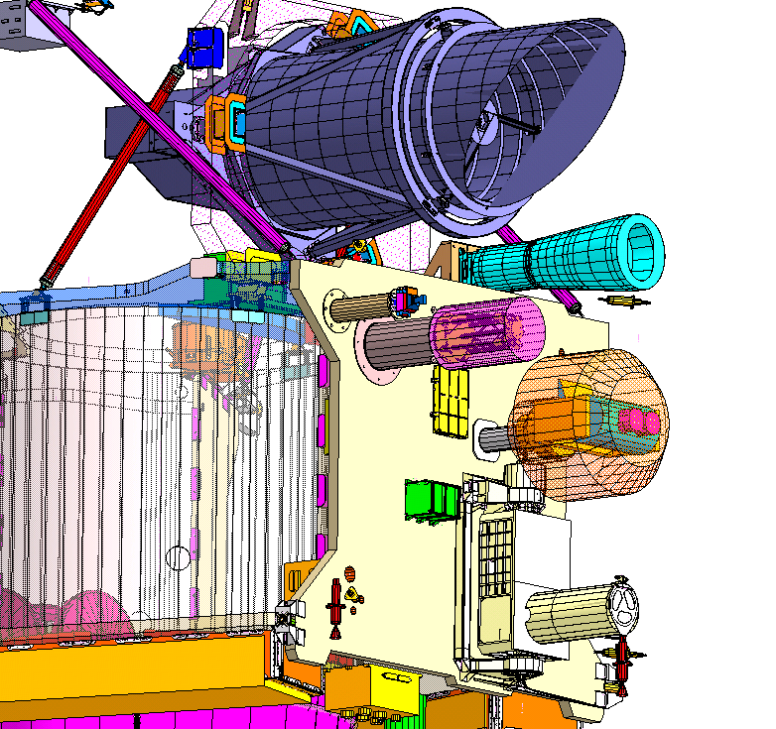

Instruments on MRO
HiRISE
MARCI
CTX
MCS
CRISM

Slide 4
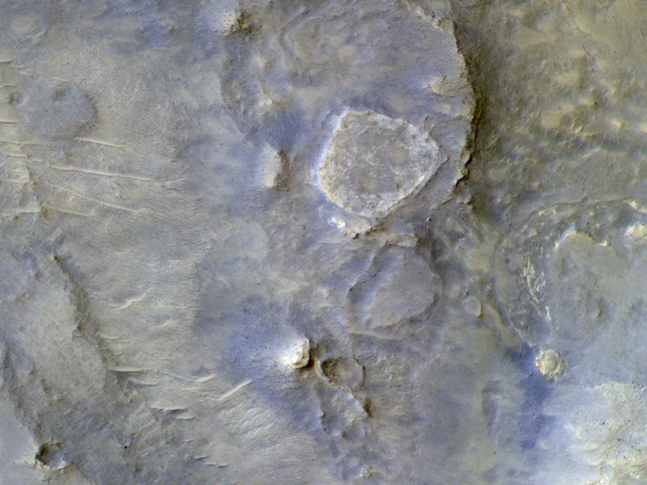

Slide 5
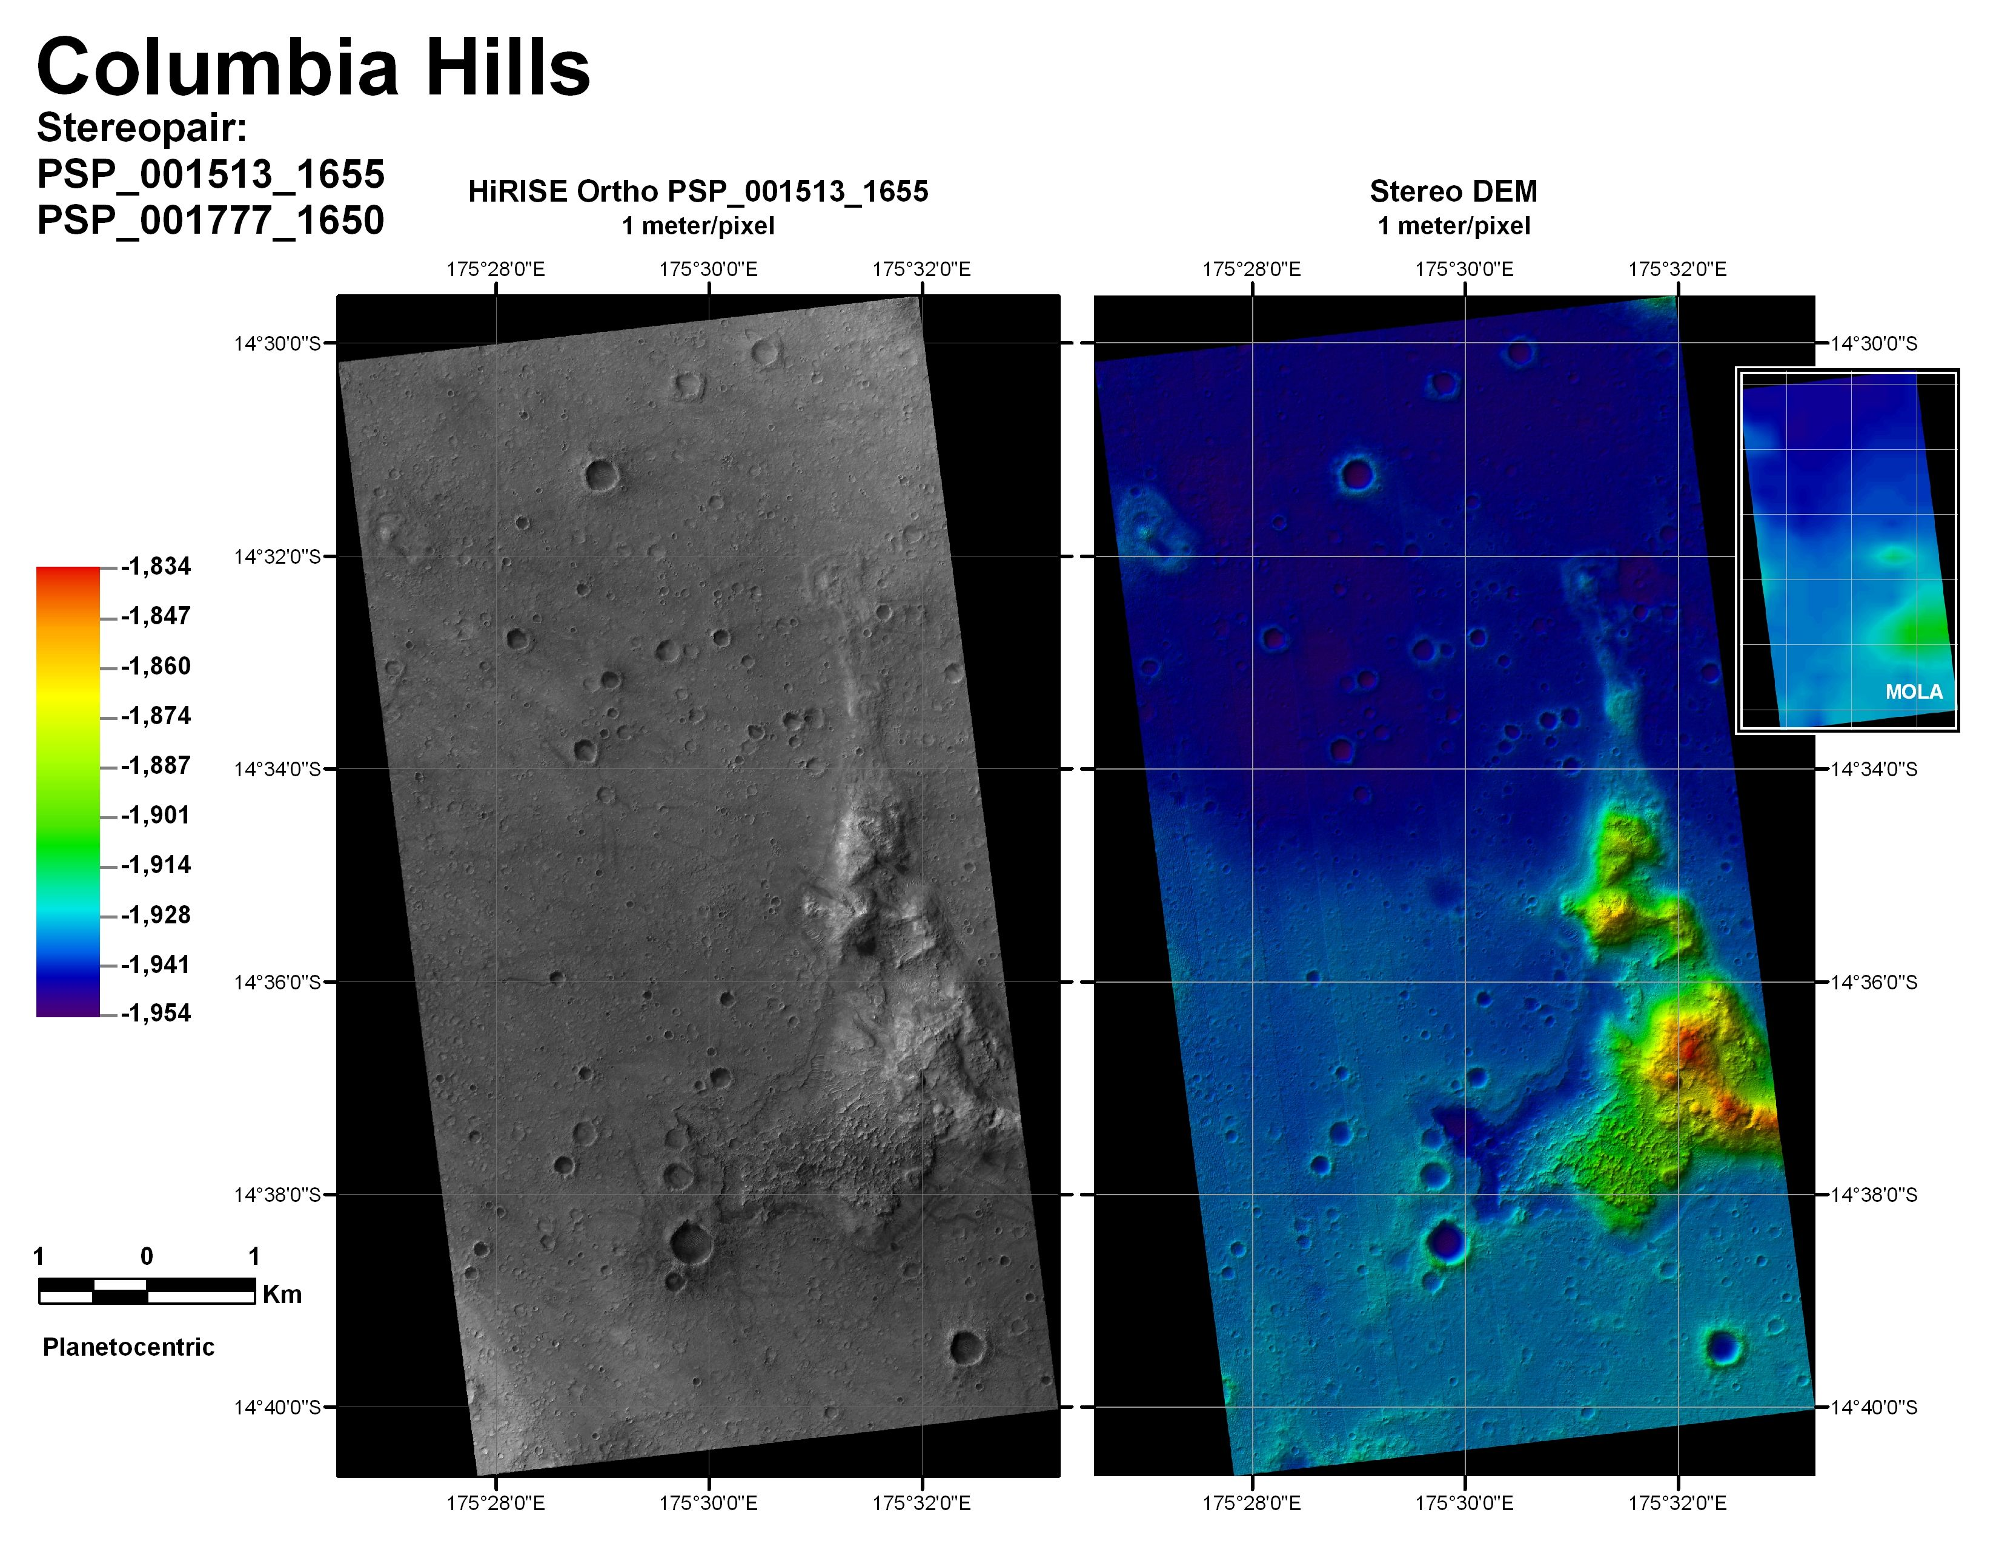

Slide 6
~2% of Mars covered by HiRISE
<<1% in stereo
Even less in stereo + color

Slide 7
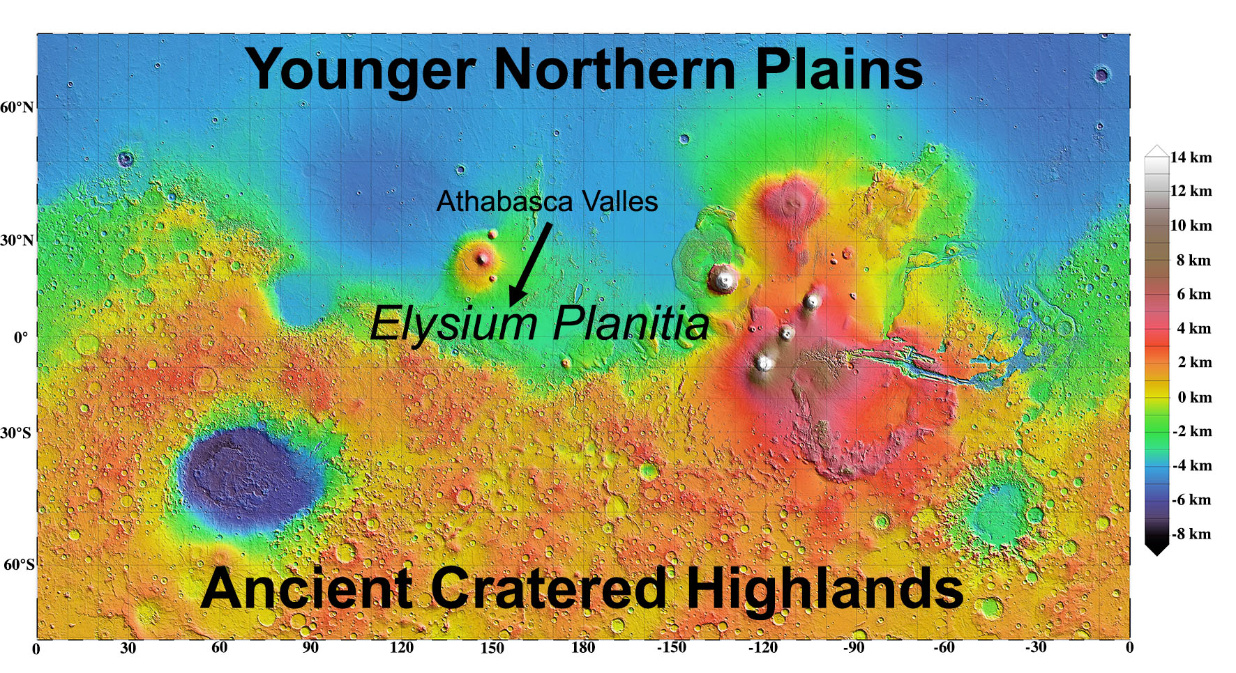

Slide 8
Athabasca Valles
Surface crater retention age of 2-5 Ma by most models – no more than 50 Ma
  Youngest “outflow” channel on Mars
Floor of Athabasca Valles, and the basin at its terminus (Cerberus Palus) has many unusual landforms…

Slide 9
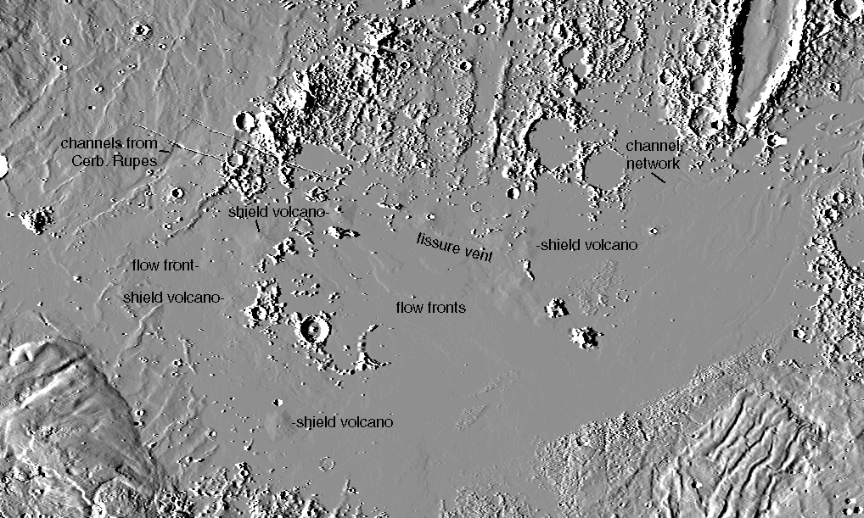
MOLA

Slide 10
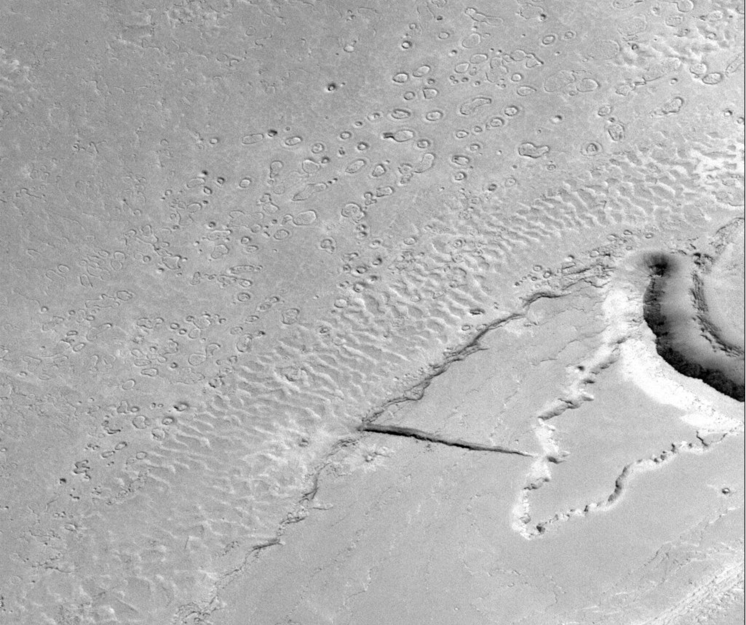
MOC

Slide 11
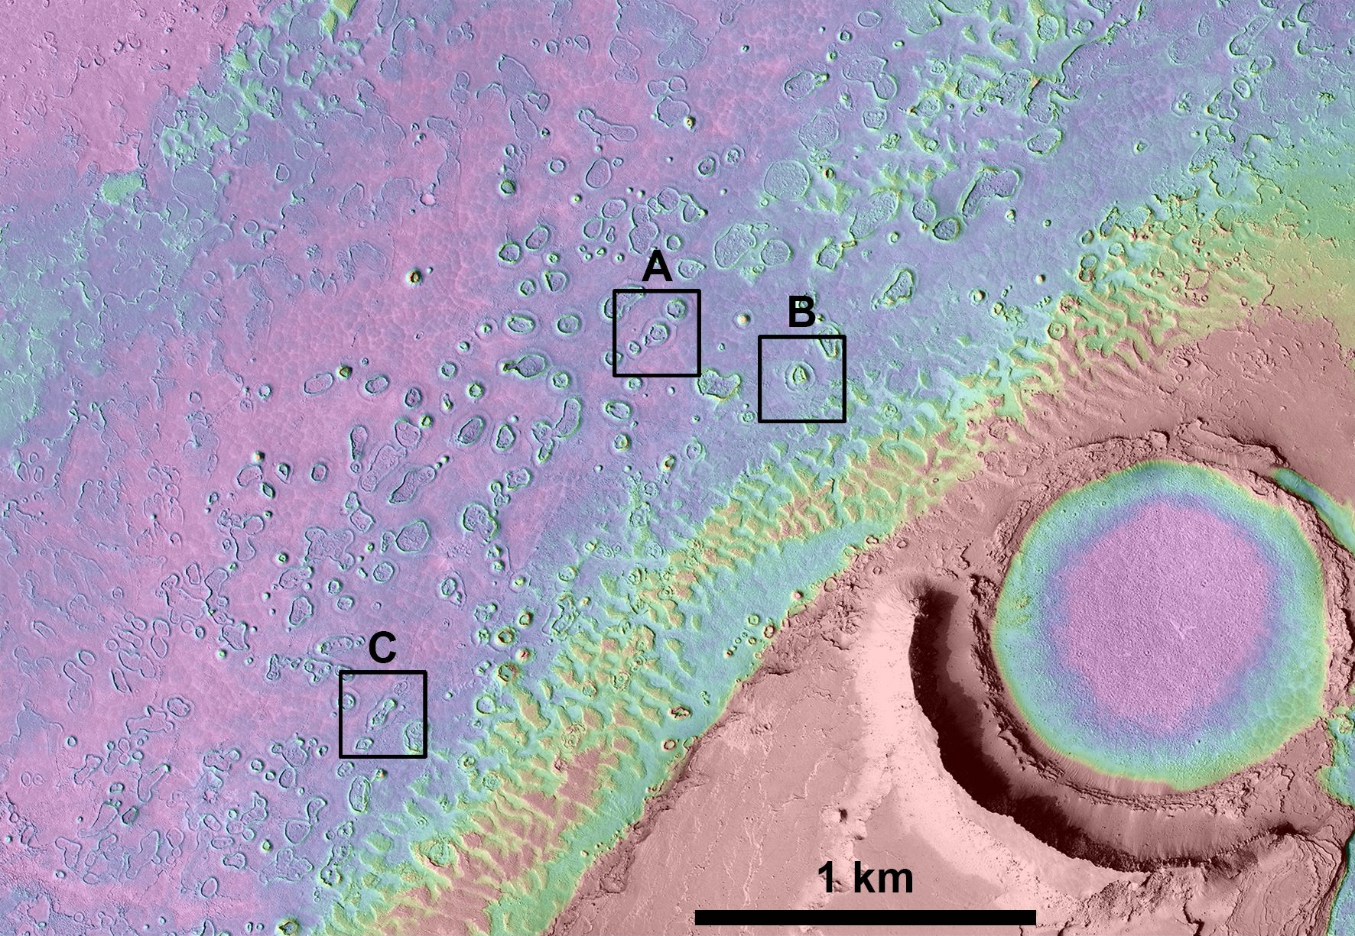

Slide 12
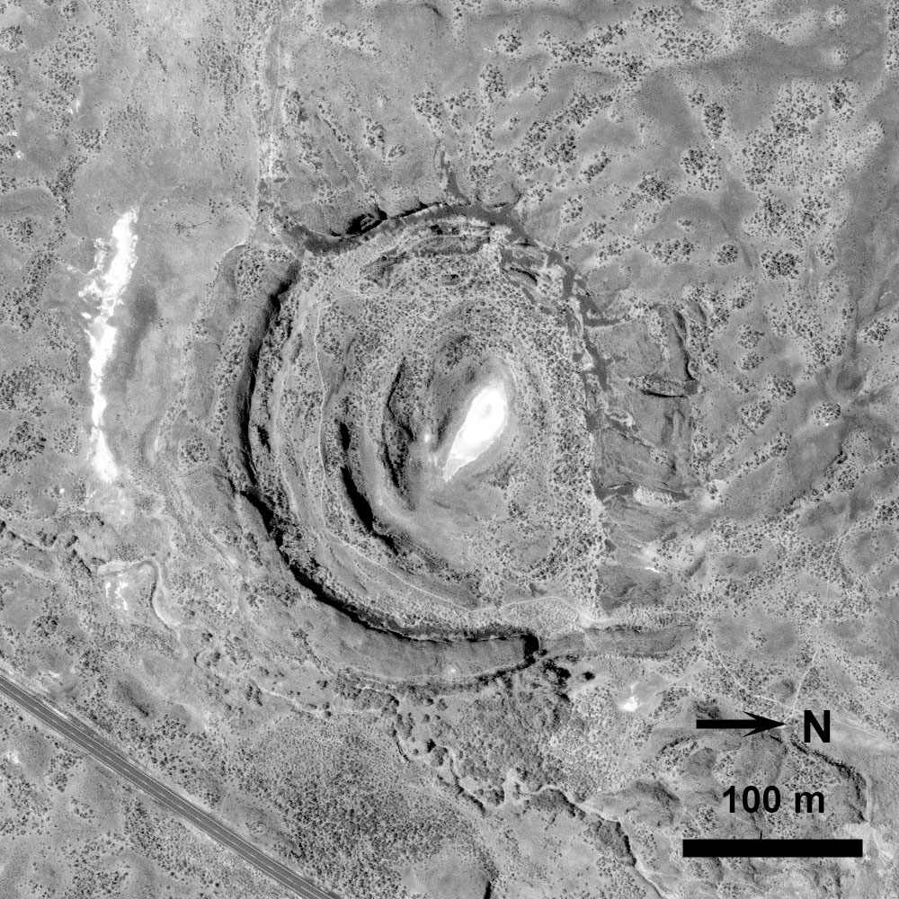

Slide 13
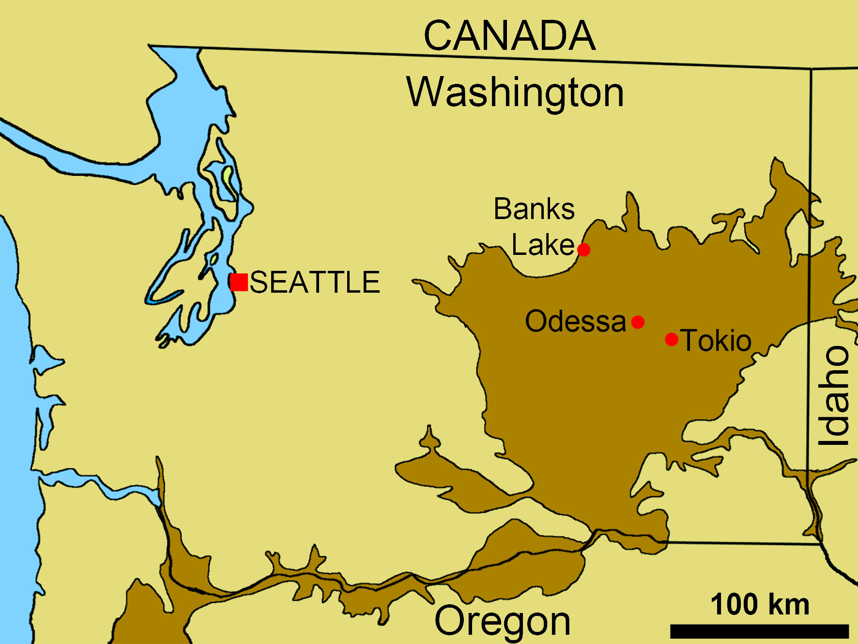

Slide 14
Channeled Scabland
10-15 Ma Columbia River Flood Basalts
  Hundreds of lava flows, each hundreds of km long, tens of m thick, and thousands of km³ in volume
  Start of the Yellowstone hotspot trace
Carved into by Pleistocene Missoula floods
  Catastrophic floods from collapses of ice dams on very large lakes
  Number of floods debated but definitely more than one

Slide 15
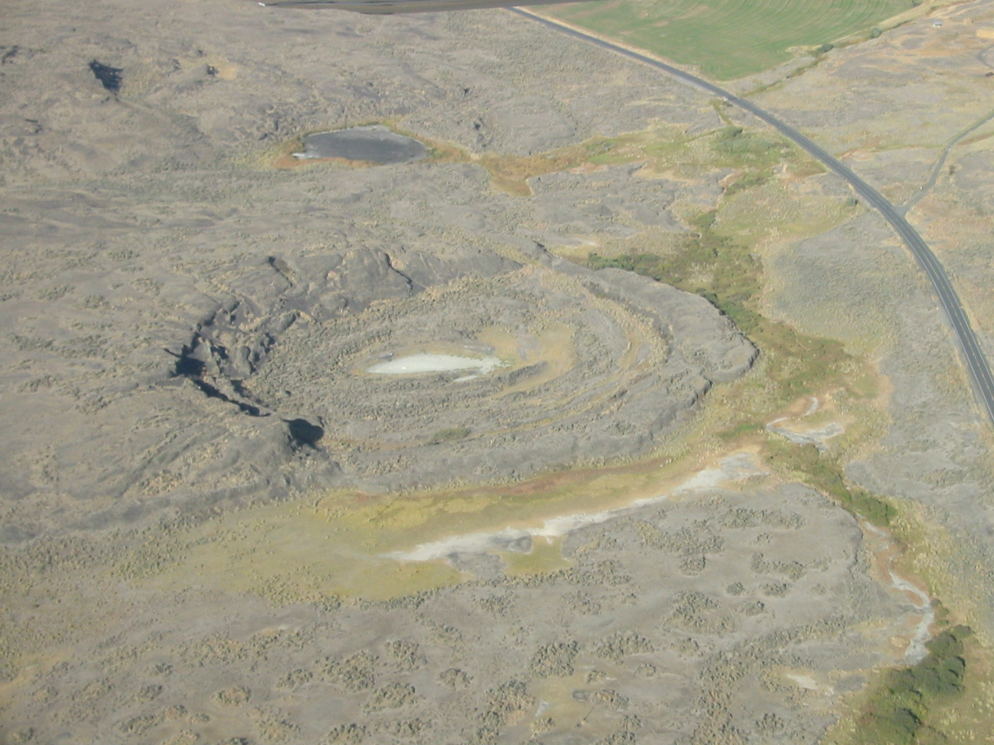
Amphitheater

Slide 16
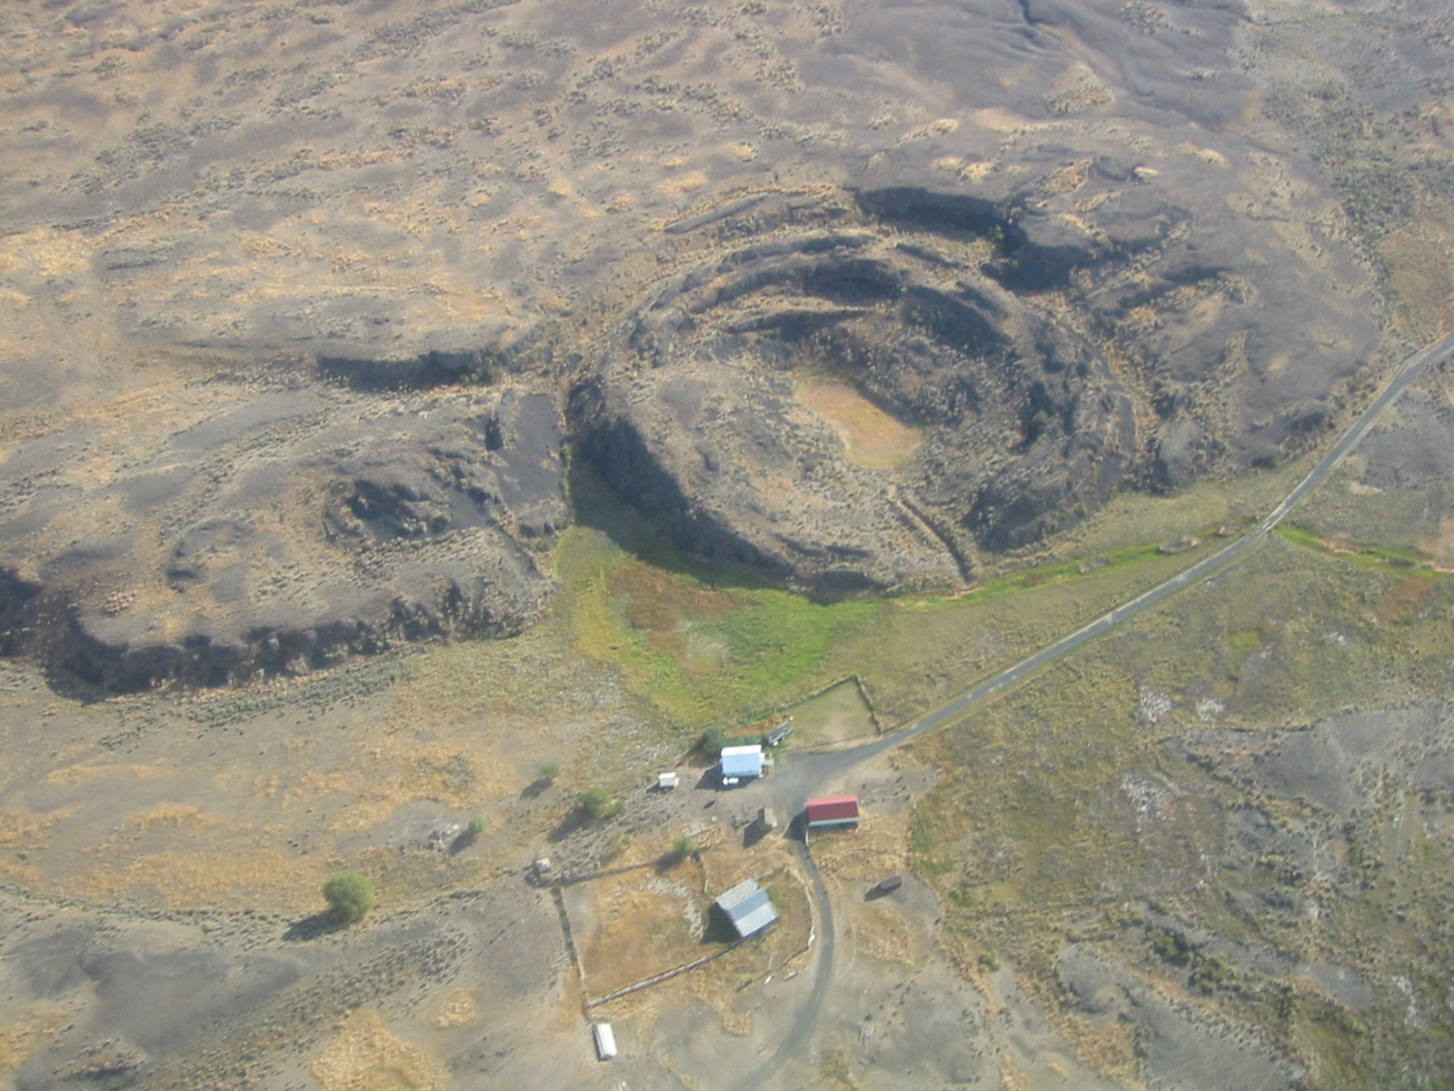
Colloseum

Slide 17
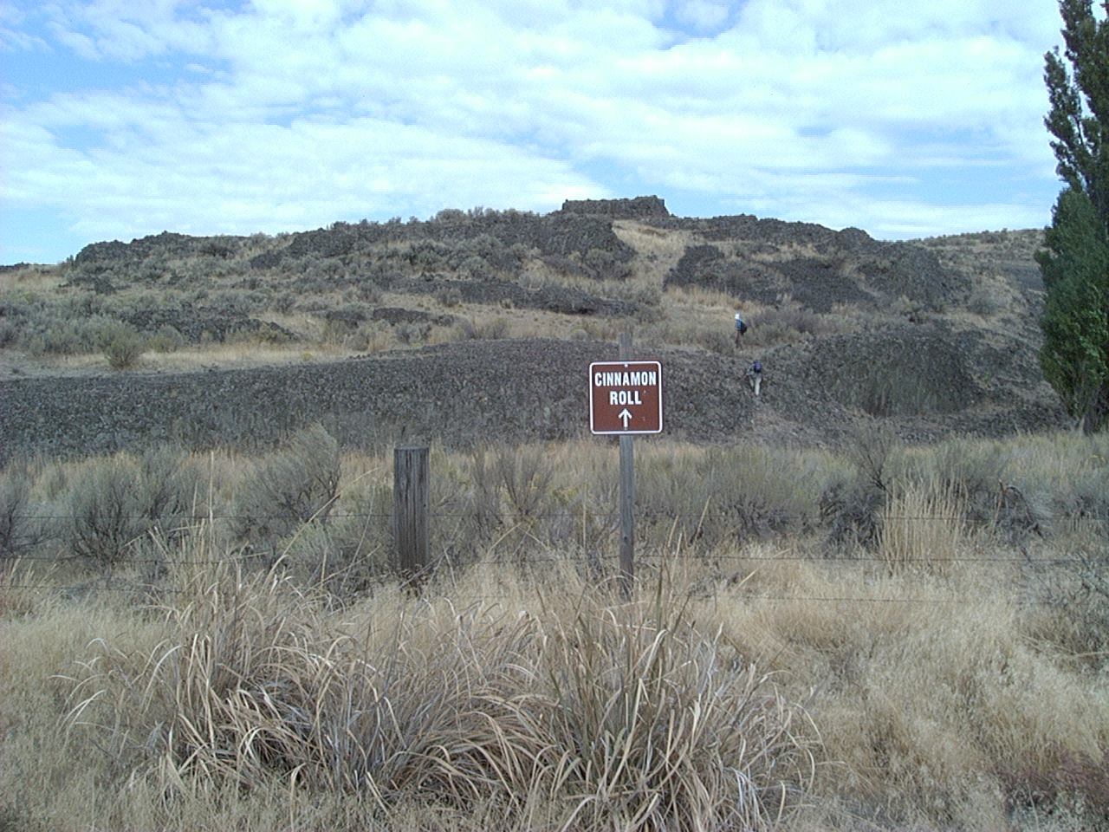

Slide 18
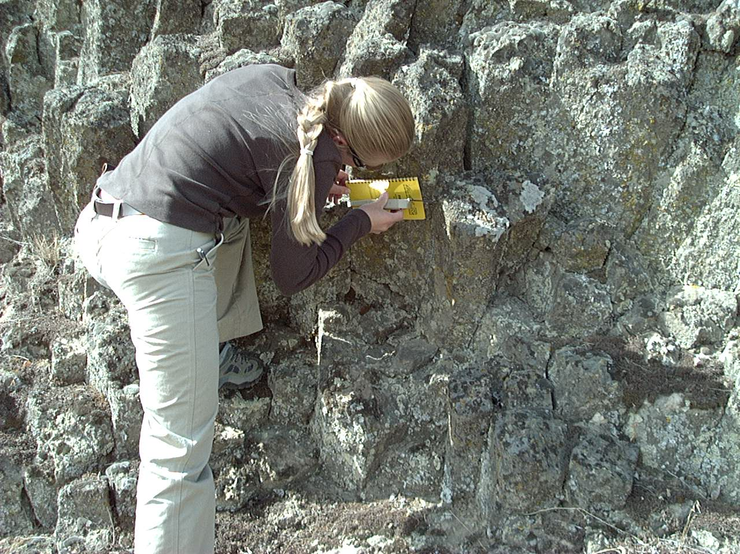

Slide 19
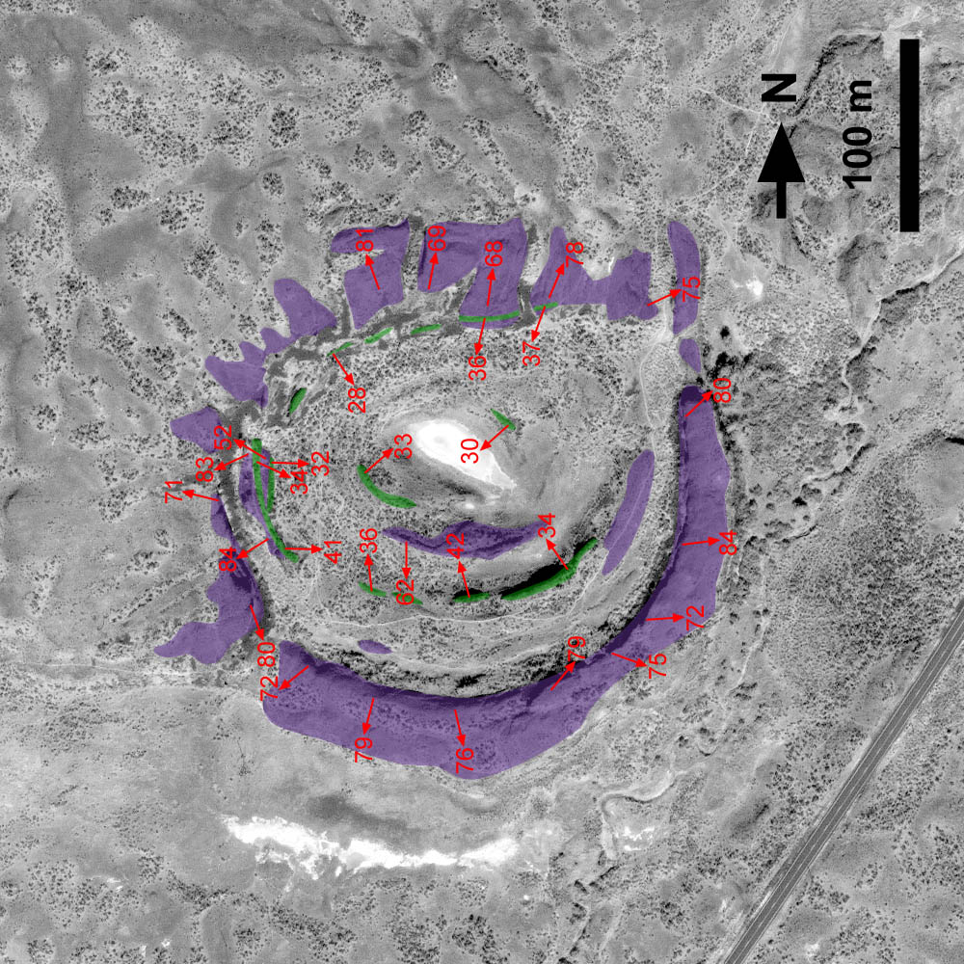
Amphitheater

Slide 20
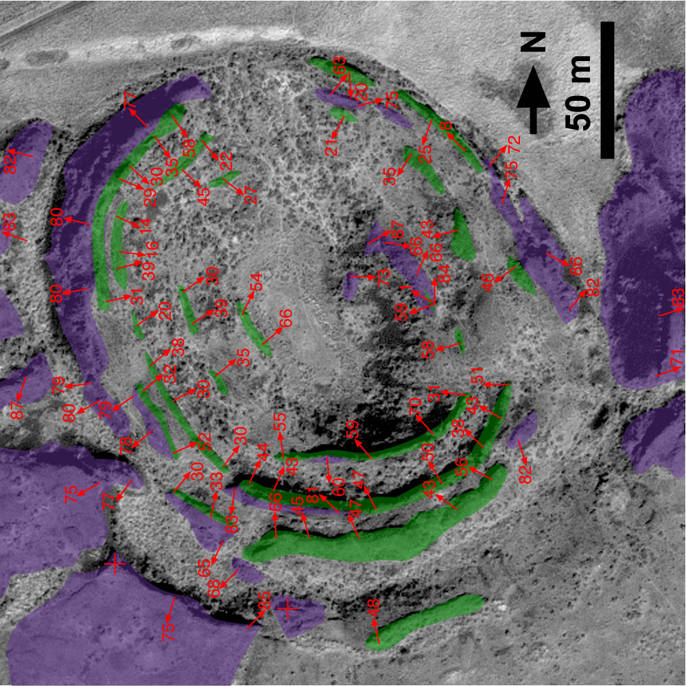
Tule

Slide 21
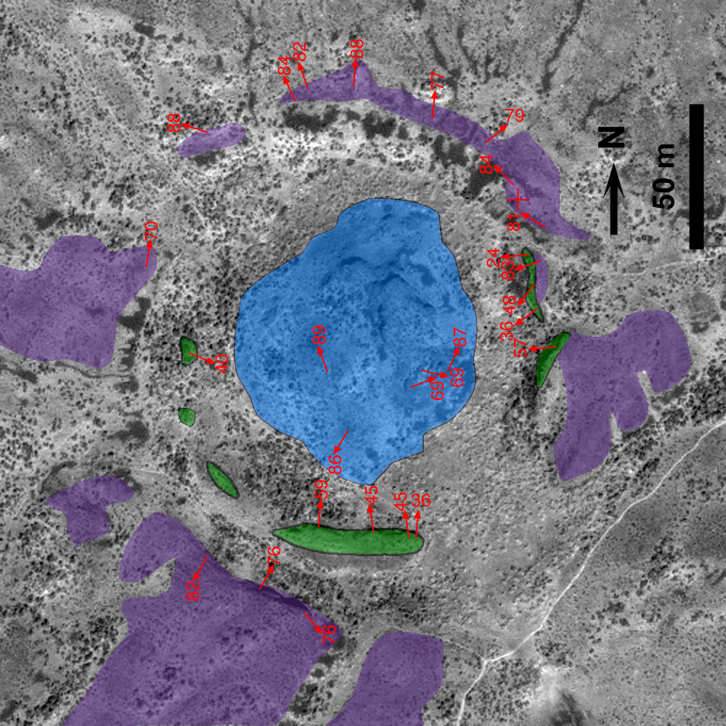
Rock Rose

Slide 22
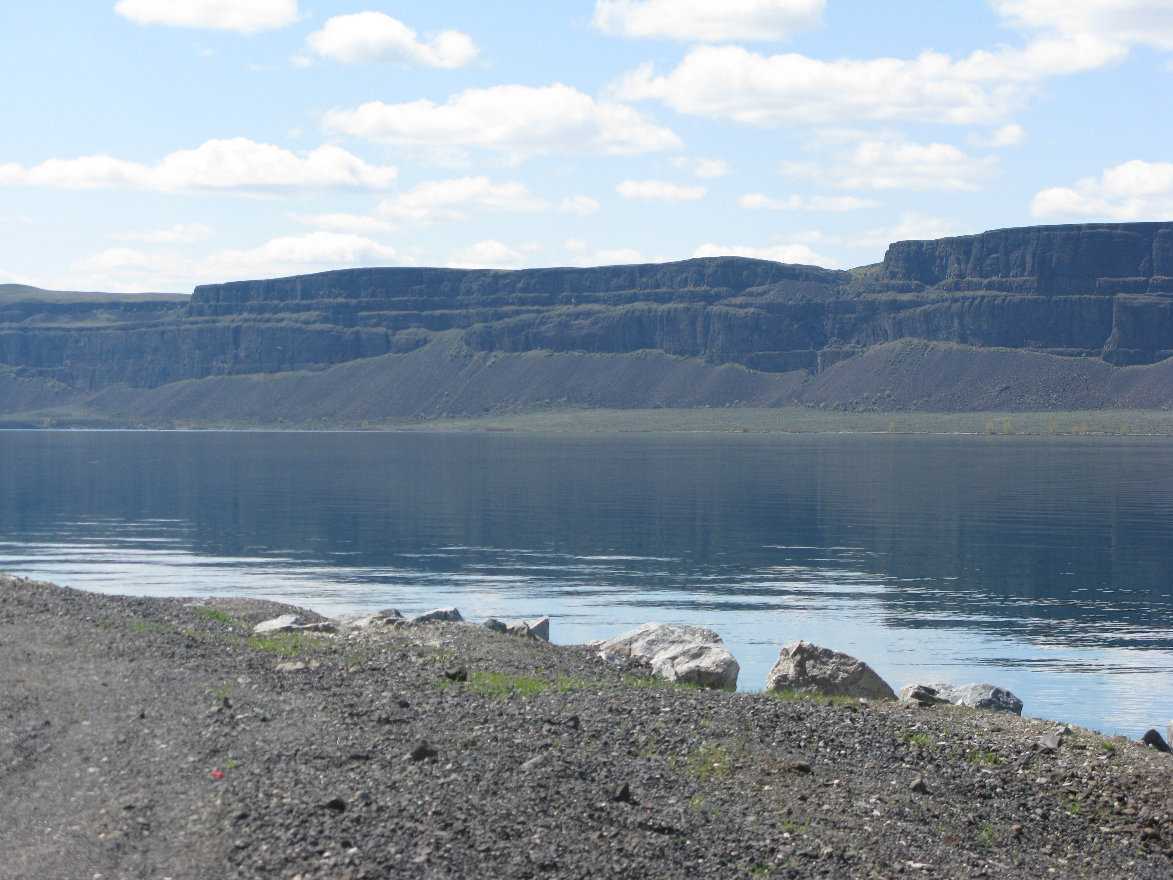
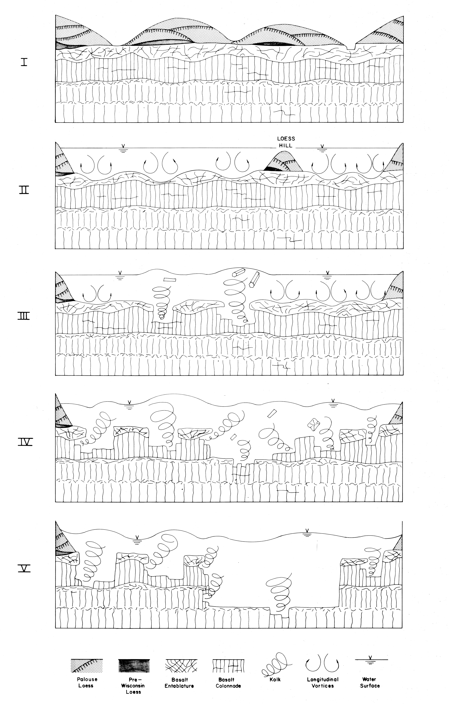

Slide 23
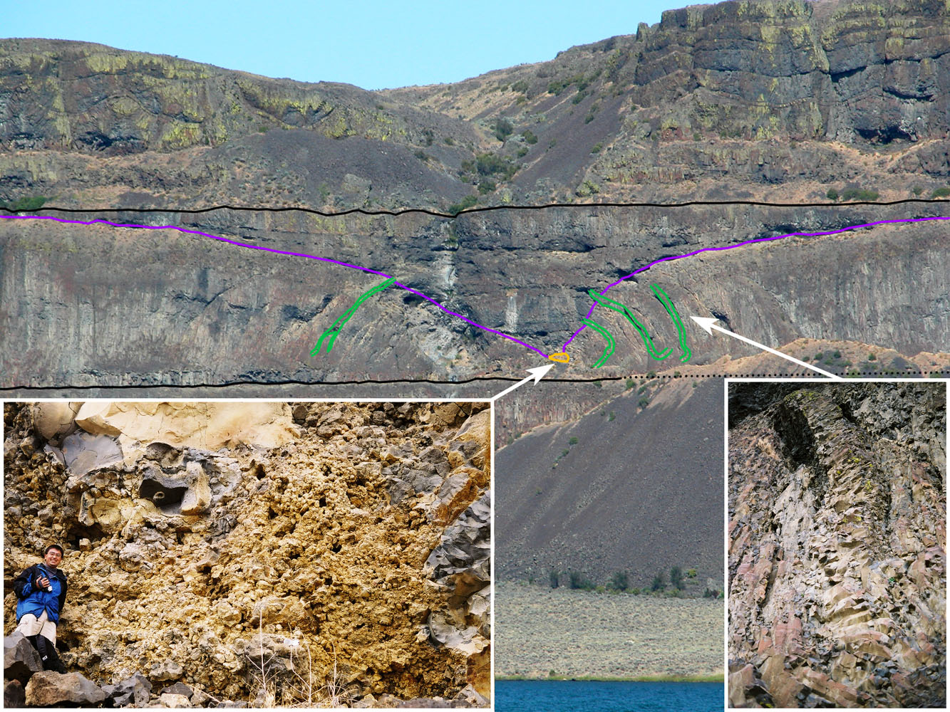

Slide 24
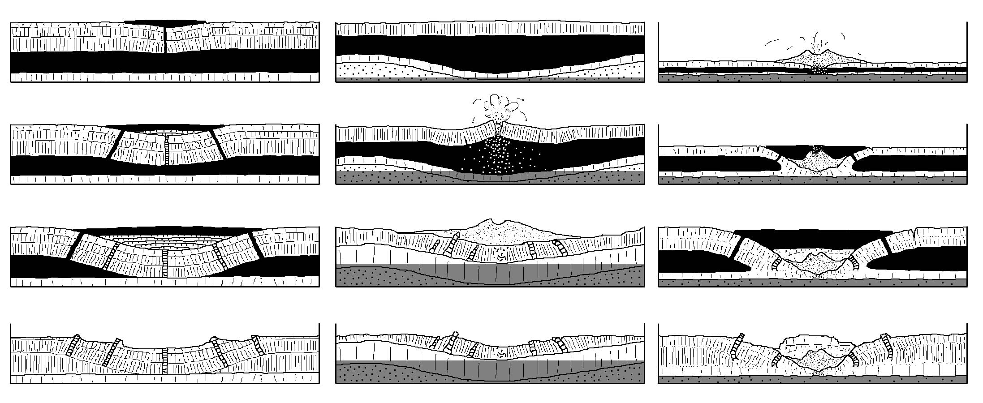

Slide 25
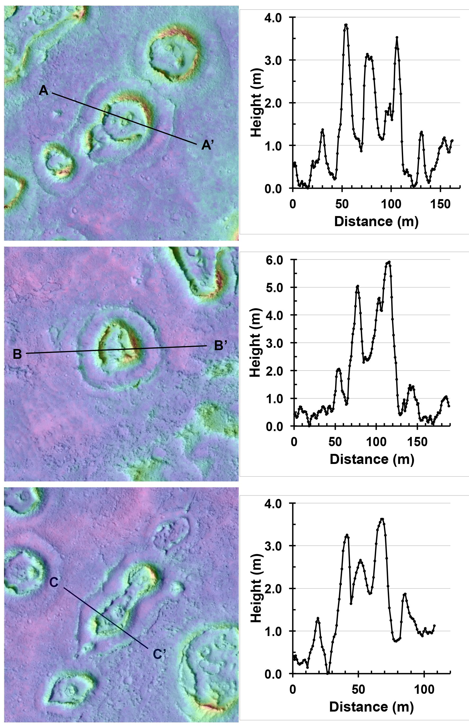

Slide 26
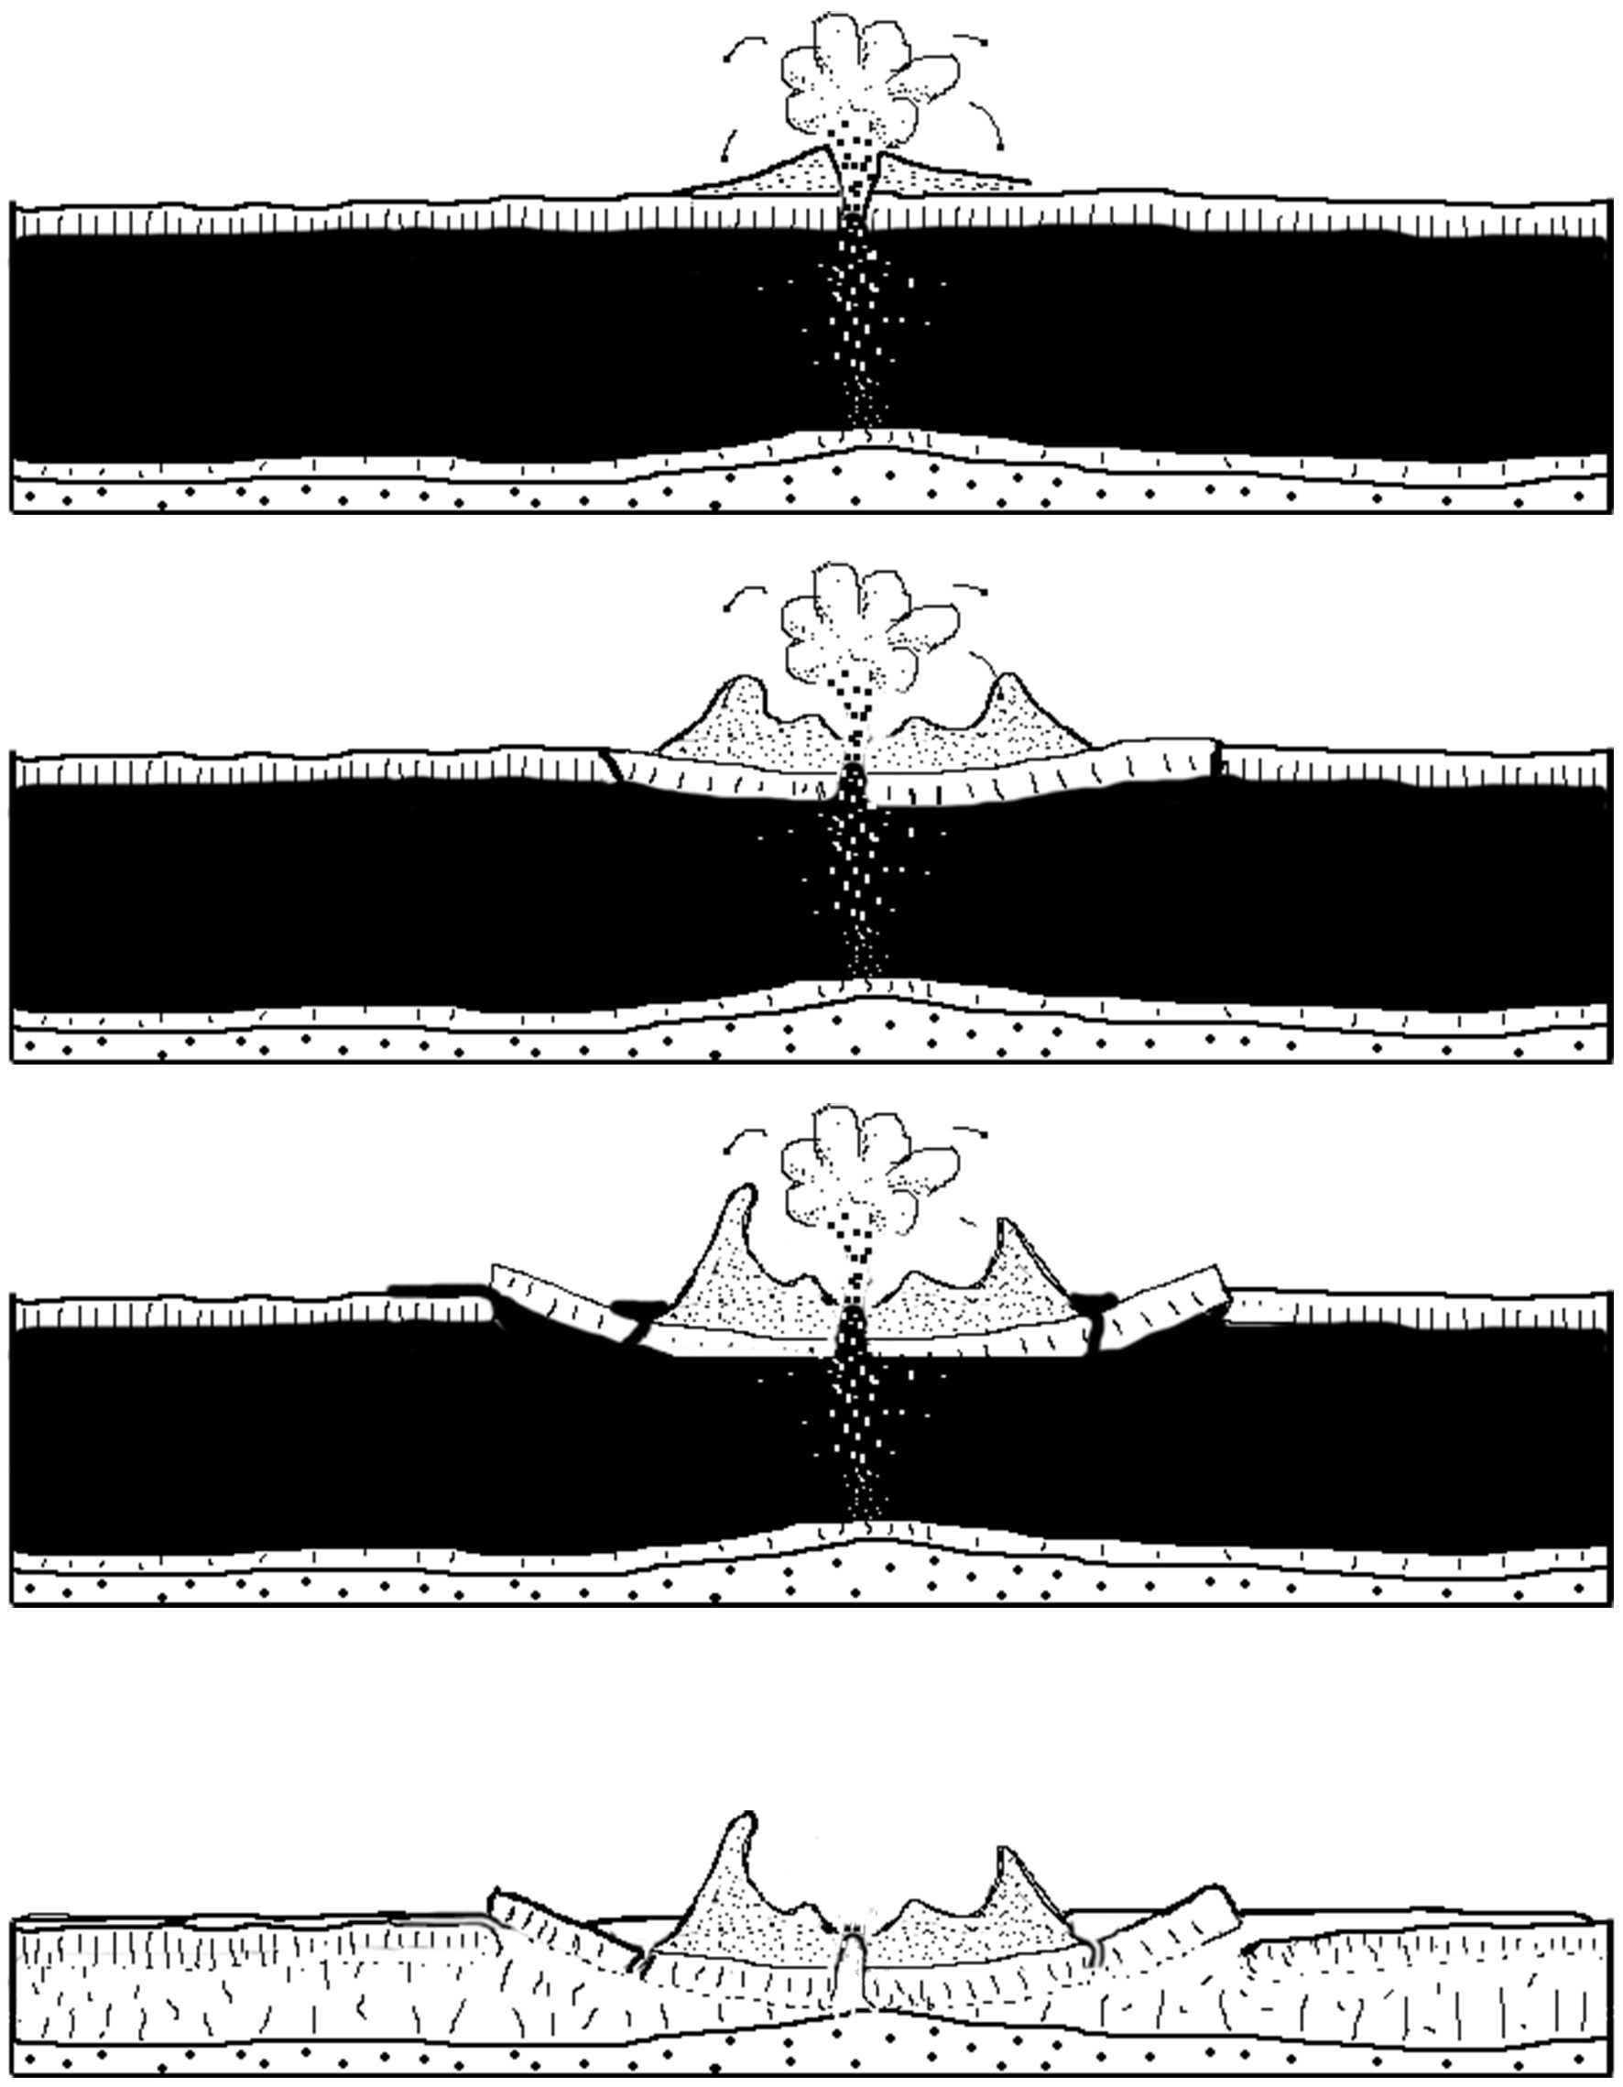

Slide 27
Conclusions About Ring Features
BRSs in the Channeled Scabland form by inflation around rootless cones
The rings in Athabasca form by sagging of the crust of a deflating lava flow under the weight of a rootless cone
Observations of key locations in 3D and high spatial resolution were needed to reach both of these conclusions

Slide 28
General Lessons
You need to pick the right targets
  Athabasca Valles, Banks Lake are special places
HiRISE resolves truly alien processes operating on Mars
  RSLs
  CO₂ driven gulley formation and “spiders”
You need many working hypotheses and copious imagination that is still constrained by the data

Slide 29
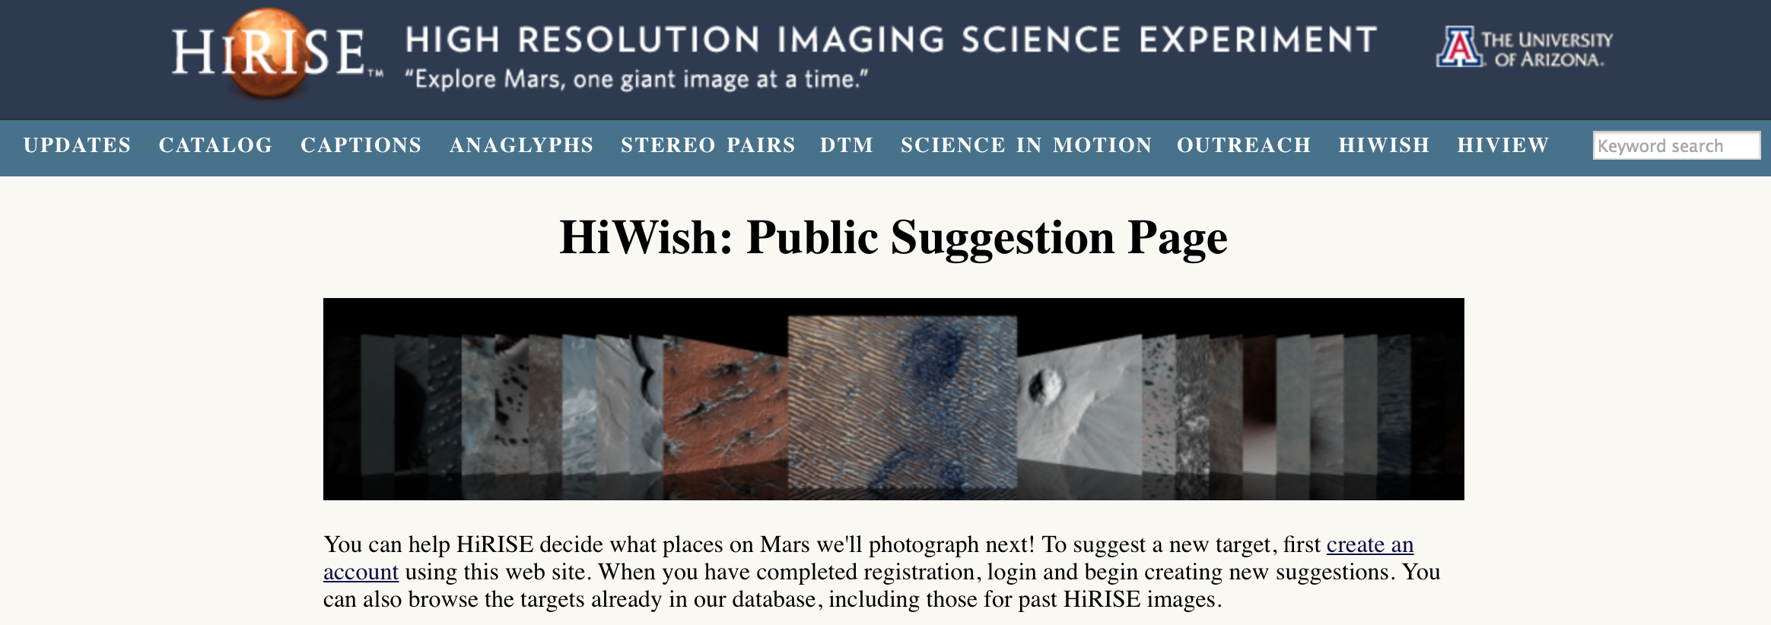
www.uahirise.org/hiwish/

