Slide 1
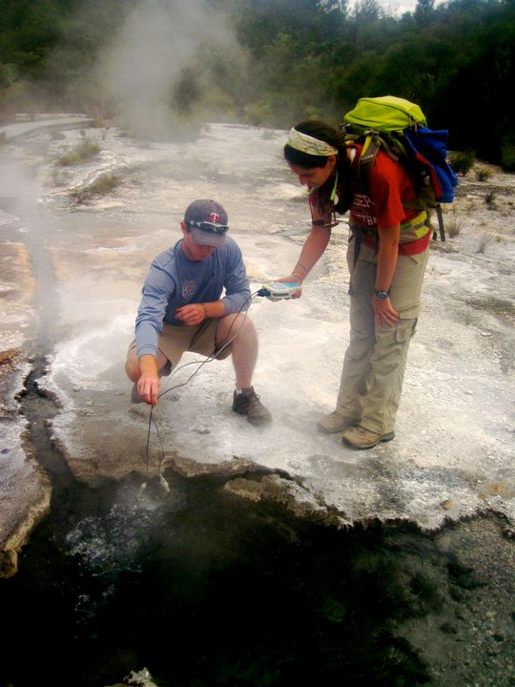




Strategies and perceptions of field note-taking: Insights from a geothermal field lesson
Jackie Dohaney, E. Brogt, B. Kennedy
Postdoctoral Fellow, Geoscience Education
jdohaney@gmail.com

Slide 2
Why research field note-taking?
Note-taking skills are fundamental in the geosciences.
Important for data collection, observation-making and forming hypotheses.
Usually not explicitly taught in programs. They are commonly learned via:
holistic, piecemeal ‘best practices’.
passed down from more experienced geologists.

Slide 3
Field Note-taking
Research Objective:
To determine strategies that students’ use during note-taking.
Review existing literature (classroom studies).
Design and carry out a case study
Uncover strategies, and factors that influence strategies
Inform field pedagogy

Slide 4
Field Note-taking
Case Study Design
One field outcrop, new field area; students from diverse field experiences
Set learning goals and protocol with Lecturer(s)
Collect hardcopy notes (n=42)
Carry out post-interview (reflect on note-taking) with subset of students (n=16)
Examine students’ notes for content.

Slide 5
Field Note-taking
Student Participants (n = 42)
Gender: (female = 18; male = 24),
Nationality: (Netherlands (1), United Kingdom (1), New Zealand (9), United States of America (31)).
Age: mostly 19 – 21; subset of 22 - 46 (n = 7).
Major: Mostly geology (26) ; Env. science students (8) and engineers (8),
Geology field experience*: none (4), little (21), lots (17)
*Determined using the number of field trips, the number of days in the field (total) and any independent research experience (e.g., summer internships) prior to the study.
‘Lots’ = >3 field trips and/or more than 20 days in the field (total) and any independent field experience.

Slide 6
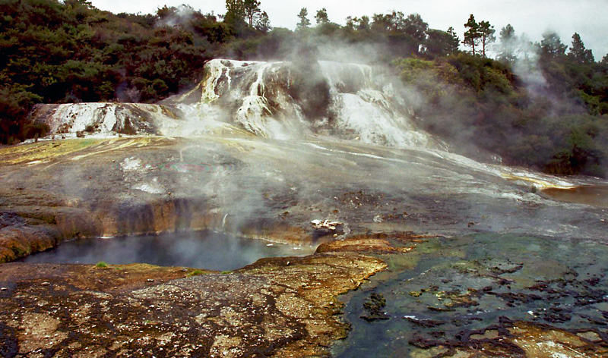
Field Note-taking
Hochstetter’s Cauldron
Field Course
Frontiers Abroad semester abroad trip
2-5 week field course
Advanced field techniques (i.e., 300- or 400-level)
Course topics - physical volcanology & geothermal geology
Taught by two lecturers, on two separate days
Field site – Geothermal field
Orakei Korako
North Island, New Zealand

Slide 7
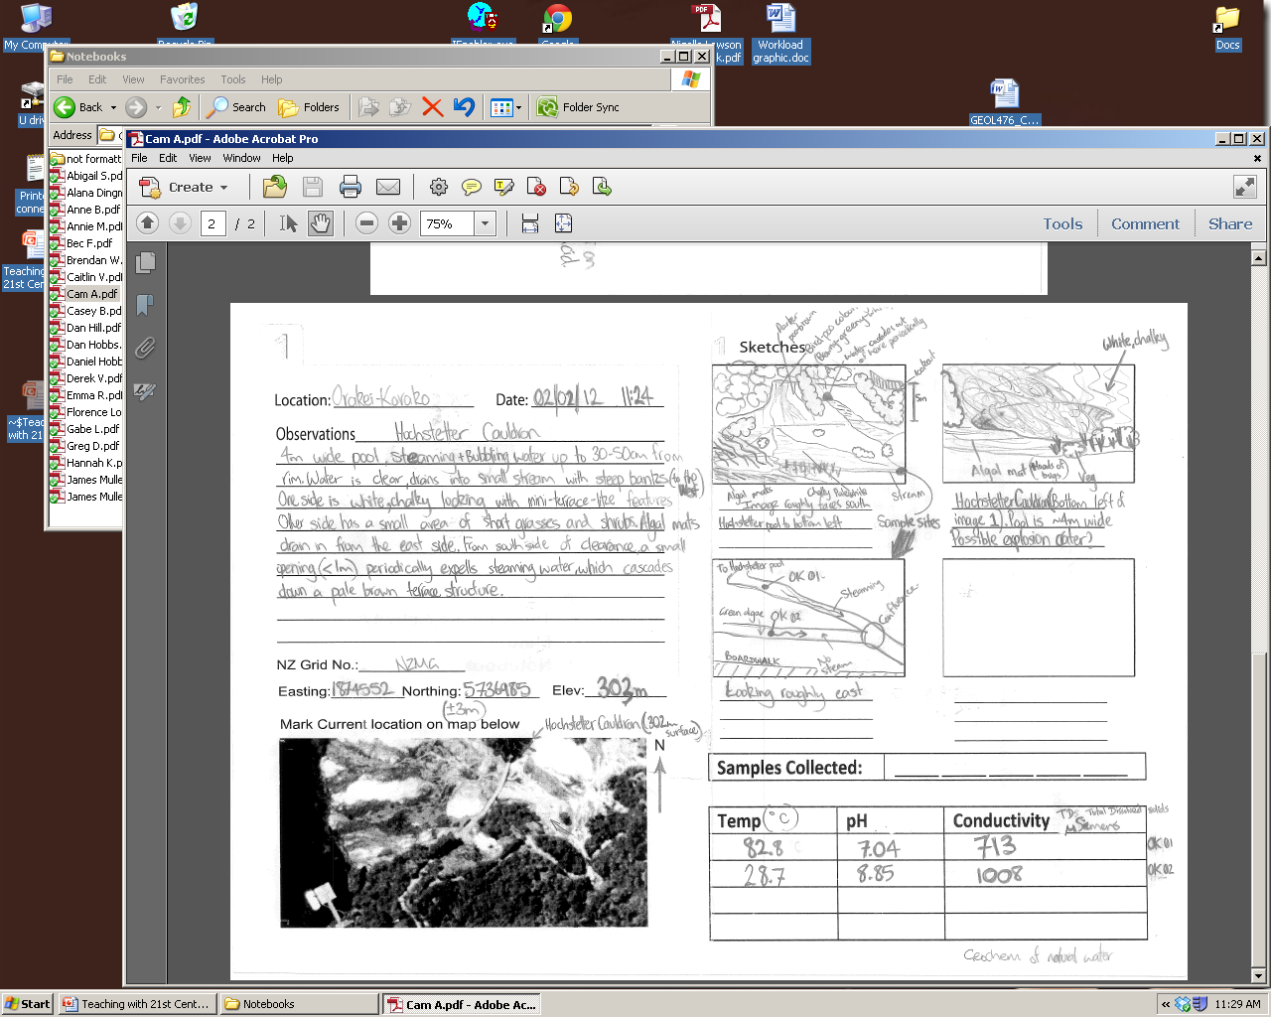
Field Note-taking
Field Data:
Notebooks Video Obvs.

Slide 8
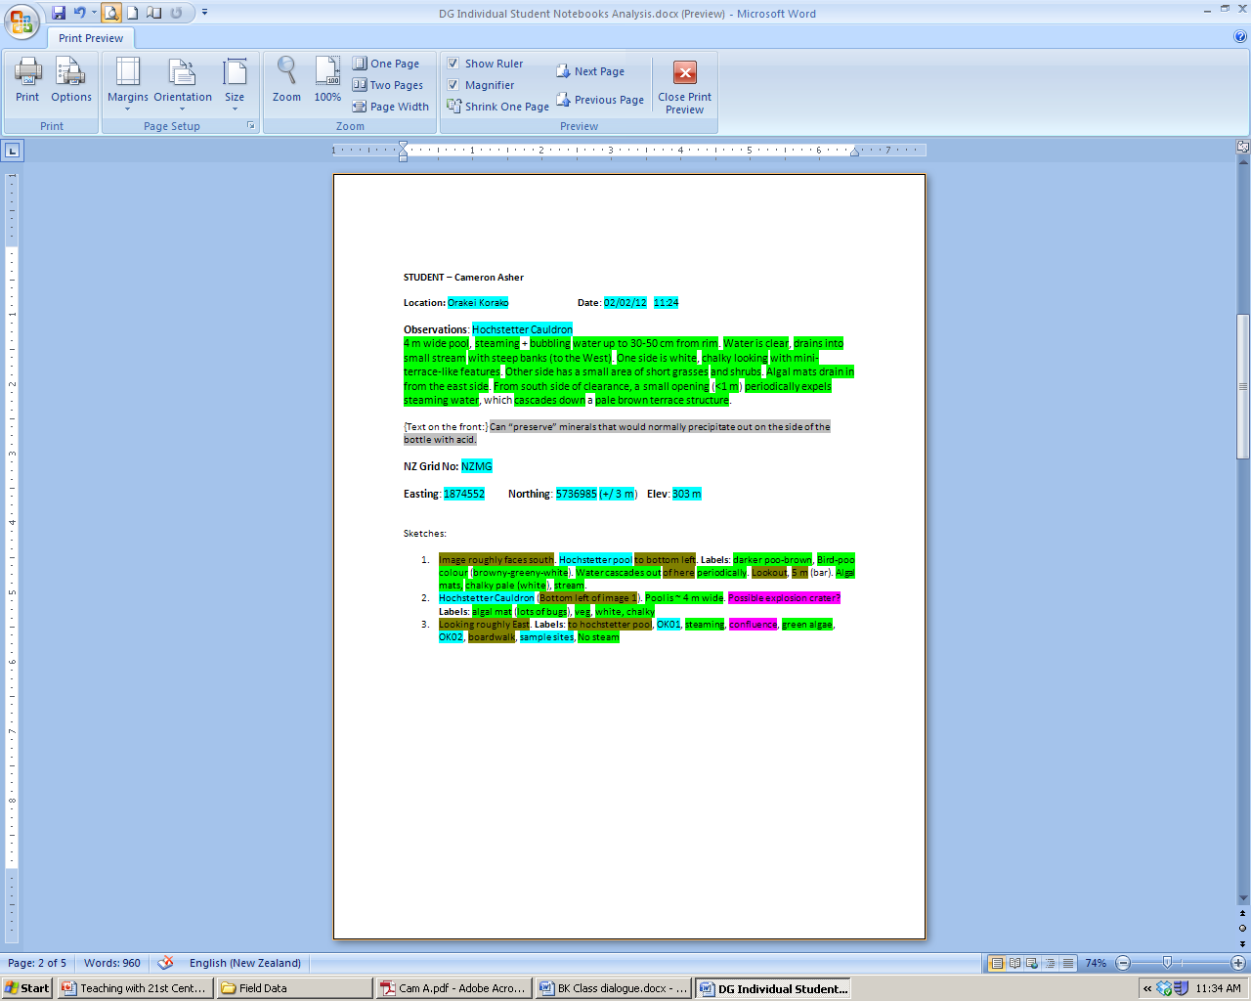
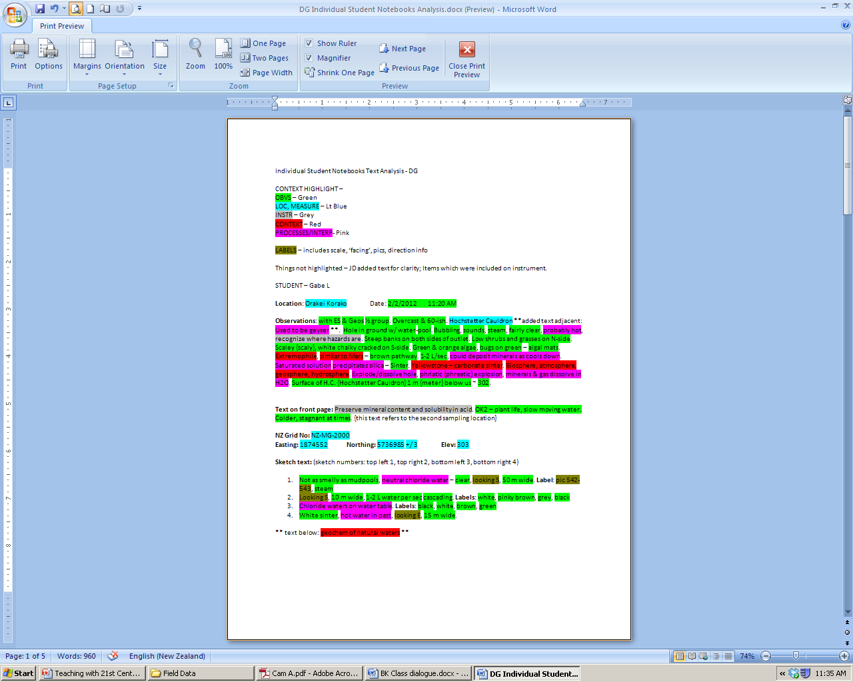
First glance:
Notebooks contained observations (green!), interpretations, contextual info, location information, etc.
Some students copied verbatim what the professors said, and included many extraneous details (red+pink)

Slide 9
Uniqueness & Completeness
Two obvious strategies emerged:
To write in their own words while others preferred to write verbatim what the lecturer said.
-> Uniqueness
To write complete notes (i.e., including all the information discussed as a class) while others missed a lot of important observations
-> Completeness
Similar findings from classroom studies:
Ganske (1981), Barnett and Freud (1985)

Slide 10
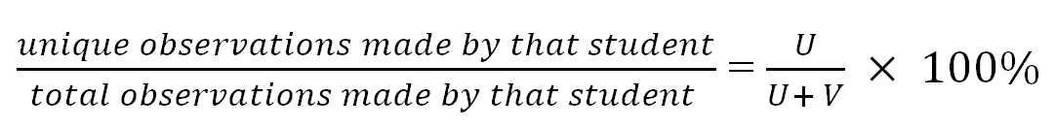
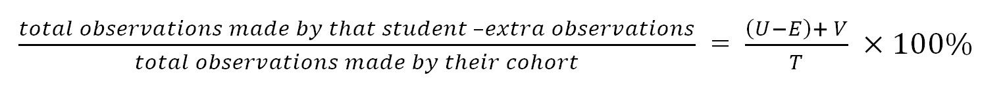
Uniqueness & Completeness
Uniqueness =
U represents the total number of unique phrases and V represents the total number of verbatim phrases.
Completeness =
E – extra observations, and T is total observations made by their class.
Note: Completeness is not an absolute value (representing all of the possible observations than can be made).

Slide 11
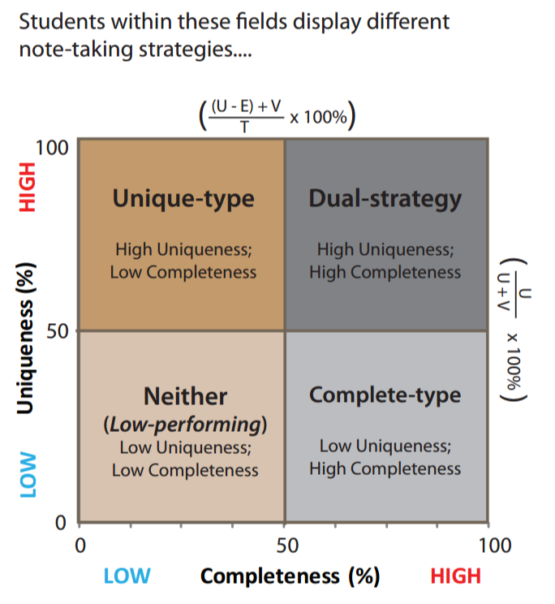
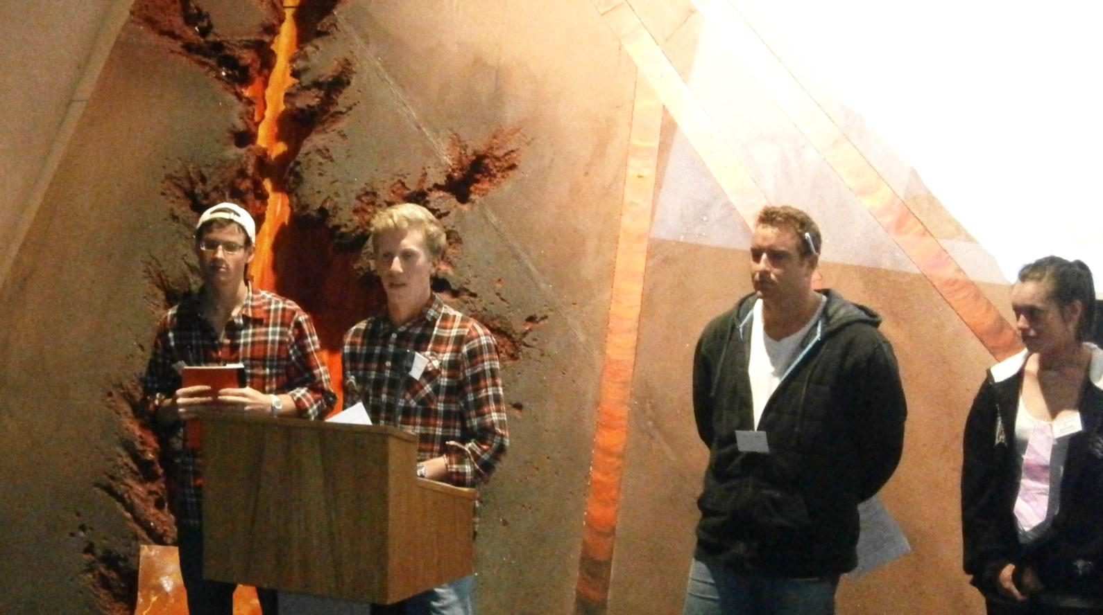
Field Note-taking
Boundaries:
50% (arbitrary cut off); solid lines
Use of mean (of population); dotted lines
Need more data
Could be context/content-specific

Slide 12
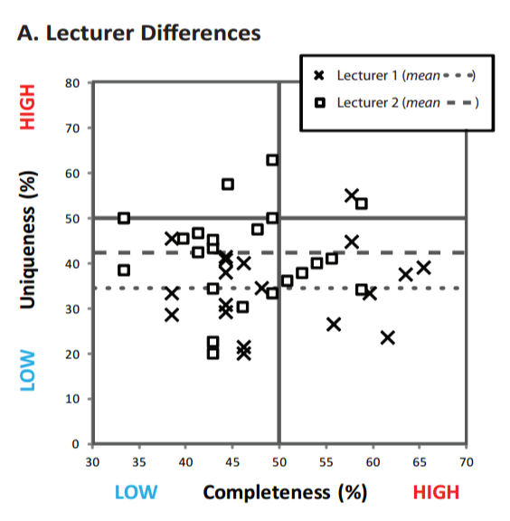
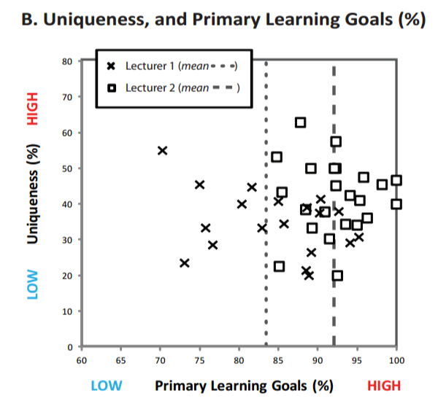
Field Note-taking
Lecturer Differences
Differences in pedagogy, focus on specific content
Lecturer 1 included lots of context and higher order interp.(not Primary LG)
Lecturer 2 included repeated prompts to ‘Think for yourself’
Lecturer 2’s students had higher Uniqueness (p=0.02; medium effect size)

Slide 13
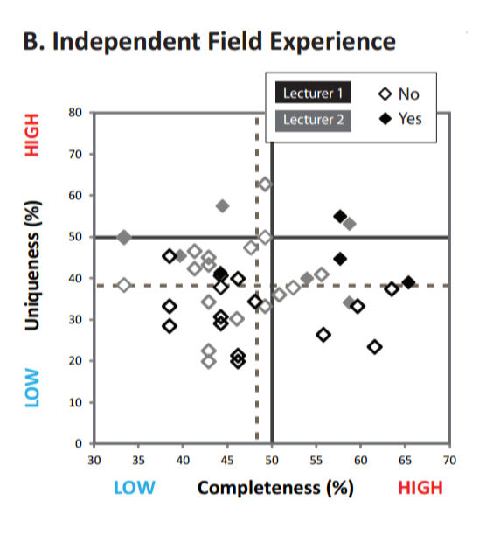
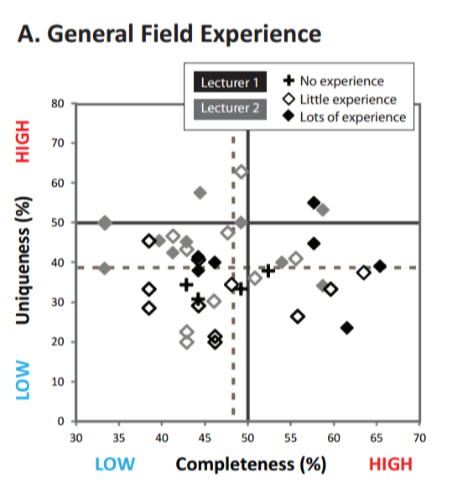
Field Note-taking
Field Experience
Field experience improves ‘Uniqueness’
(between Lots and Little categories; p=0.02; medium effect size)
No correlation to coursework
Proxy for independent thinking and higher cognitive functioning

Slide 14
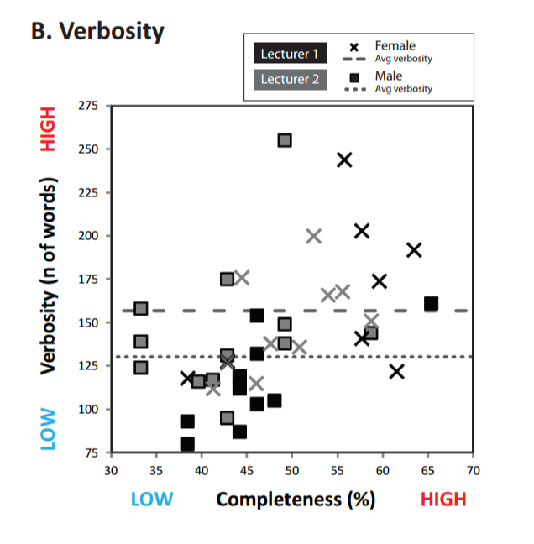
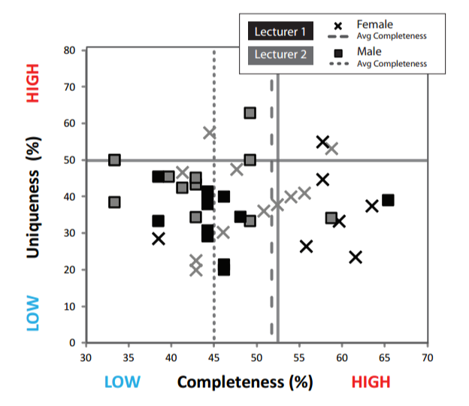
Field Note-taking
Additional data:
Gender Influences
Women had statistically significant higher completeness (p=0.003; large effect size)
When probing the data, we found that women also wrote more (verbosity; n of words total) (p=0.03, medium effect size)

Slide 15
Field Note-taking
Interview Data:
“Yea, I was basically just writing down everything, because we were getting so much information thrown at us, at the time. And like, I didn’t know what was important. So then, I was just writing it all down”
(Low-performing 2)
“... you have to write things down... it makes you deal with it... You can’t just say ‘there’s orange stuff here’. Like there is orange stuff here, but it could be ‘this’, or ‘this’ and it’s a process. It makes you reason more, or process the ideas more in your head. Otherwise you might just skip over things...”
(Dual-strategy 1)

Slide 16
Field Note-taking
Factors that Influence Note-taking:
Social environment – distracting
Physical environment – curiosity/excitement
Level of detail required (how much should be recorded?) – overwhelming, difficult to manage
All of these contributed to a high cognitive load during the task.
Students with more experience could have more opportunities to practice filtering their environment, and stay focused.

Slide 17
Field Note-taking
Suggestions for Note-taking
Learning goals should be clearly communicated.
Note-taking tasks can be broken into smaller parts
(e.g., Start with the larger perspective then progress to the smaller perspective
Let students reflect and organize their notes.
Establish field site ‘etiquette’
(to reduce social distractions and to initiate and maintain
focus.)
Once an introductory lesson has been completed, fullest complexity.
(Emphasis in the later lessons should be on fine-tuning these skills.)

Slide 18
Field Note-taking
Future Work:
Digital note-taking
Sketching (& the relationship to note-taking and observation-making)
Other strategies – efficiency, accuracy

Slide 19
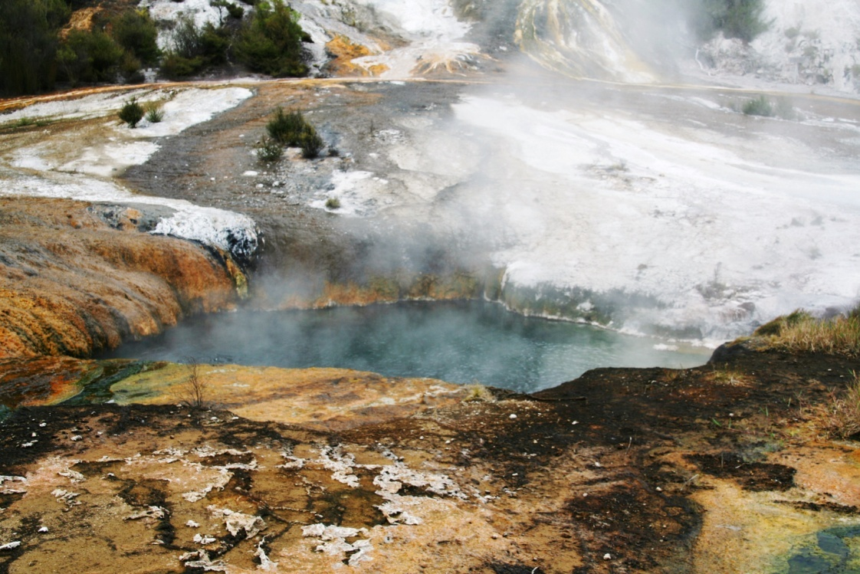
Thank You! Any Questions?
Jackie Dohaney
Postdoctoral Fellow, Geoscience Education
jdohaney@gmail.com

Slide 20
Field Note-taking
Limitations & Caveats
Introductory field lesson (not independent mapping).
Experiment not initially set up for some factors (e.g., Gender)
Other strategies (efficiency, accuracy, etc.) may be dominant and not accounted for here.
Much more cool research to do.
(Field notes are) “...external representations of student’s cognition in the field” (Balliet 2012)

