Slide 1
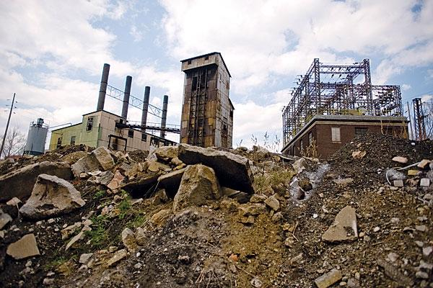
The Effects of Changes in Population Density on River Baseflow for the Midwestern United States
by
Catherine Konieczny, Joshua Galster
Department of Earth and Environmental Science, Montclair State University
http://www.tcdailyplanet.net/sites/tcdailyplanet.net/files/Rust%20belt_jpg_full_600.jpg

Slide 2
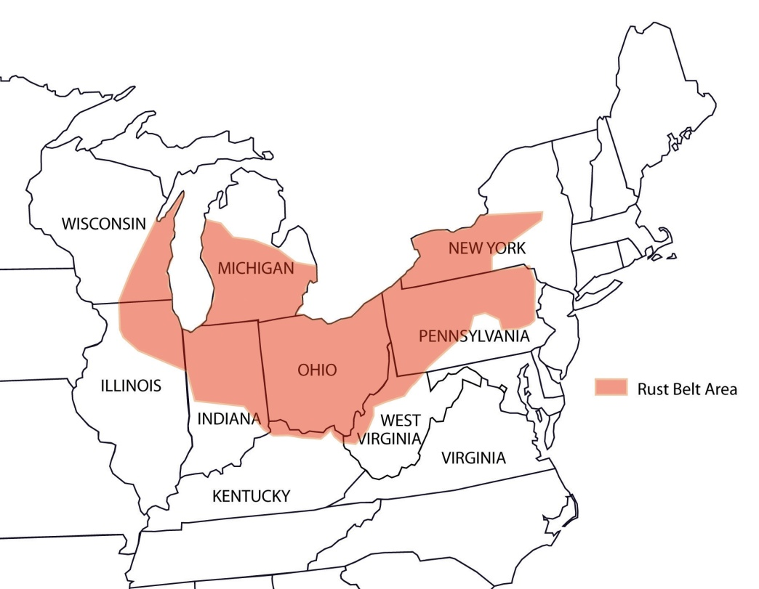
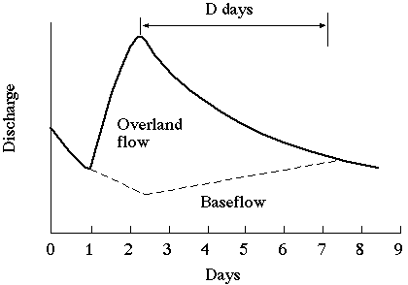
Goal: Test to see if a trend exists between population density and river baseflow
What constitutes as a depopulated city and where are these cities found?
What is river baseflow, runoff, and total flow?
(River Baseflow + Runoff = Total Flow)
http://images.flatworldknowledge.com/trowbridge2_1.0/trowbridge2_1.0-fig12_001.jpg
http://jan.ucc.nau.edu/~doetqp-p/courses/env302/lec6/Image41.gif
Notes:
What is the GOAL of this talk? Test to see if a trend exists between population density and baseflow.
What is the PURPOSE of this talk? What effect do urban populations have on baseflow?
The GEOGRAPHICAL aspect
What is a depopulated city? A depopulated city is an urban area that has experienced a decrease in population.
What is baseflow/runoff/total flow? Baseflow is the river discharge supported predominantly by groundwater; runoff is the amount of water that runs over the surface of the land; total flow is the combination of baseflow and runoff.

Slide 3
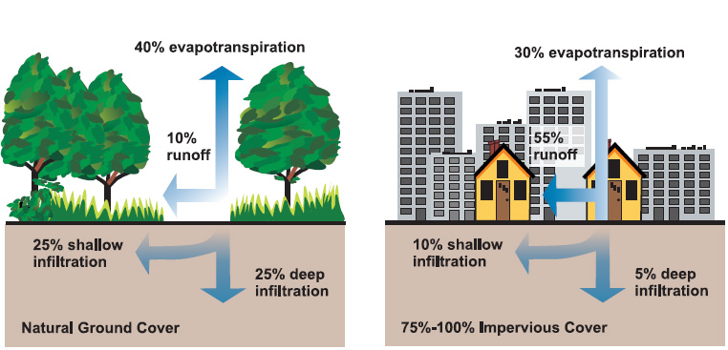
How are population density and baseflow connected?
http://www.beachapedia.org/images/4/46/Natural_%26_impervious_cover_diagrams_EPA.jpg
Notes:
How are these connected?
As urban cities develop impervious surfaces increase, intuitively, this decreases permeability and increases runoff. Underground water infrastructure expands to supply the surrounding populations with water, among other things. Naturally, these pipes are over-pressurized to avoid contamination, how might this cause a problem?

Slide 4
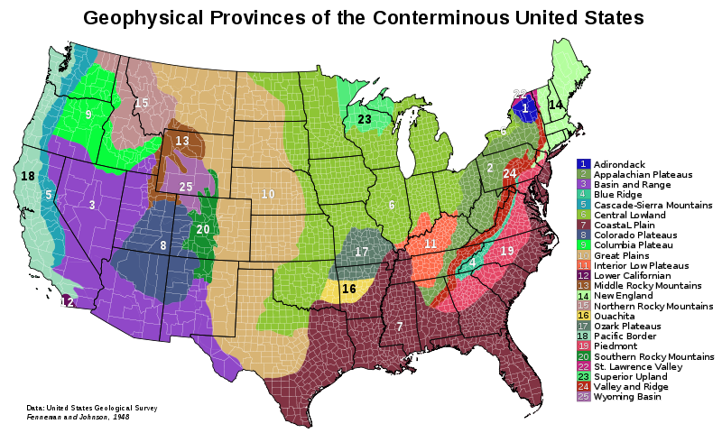
Konieczny et al. (2014)
Lopes et al. (2013)
http://upload.wikimedia.org/wikipedia/commons/thumb/4/4d/Physiographic_Provinces_48_Conterminous_US-v1.svg/800px-Physiographic_Provinces_48_Conterminous_US-v1.svg.png
Notes:
Lopes (2013), found that the effects of population density and baseflow differ based on geographic regions
The GEOLOGICAL aspect
The area of interested, highlighted in yellow.
2: The Appalachian Plateau comprised mainly of harder sedimentary rocks
6: The Central Lowlands comprised mainly of shales and limestones

Slide 5
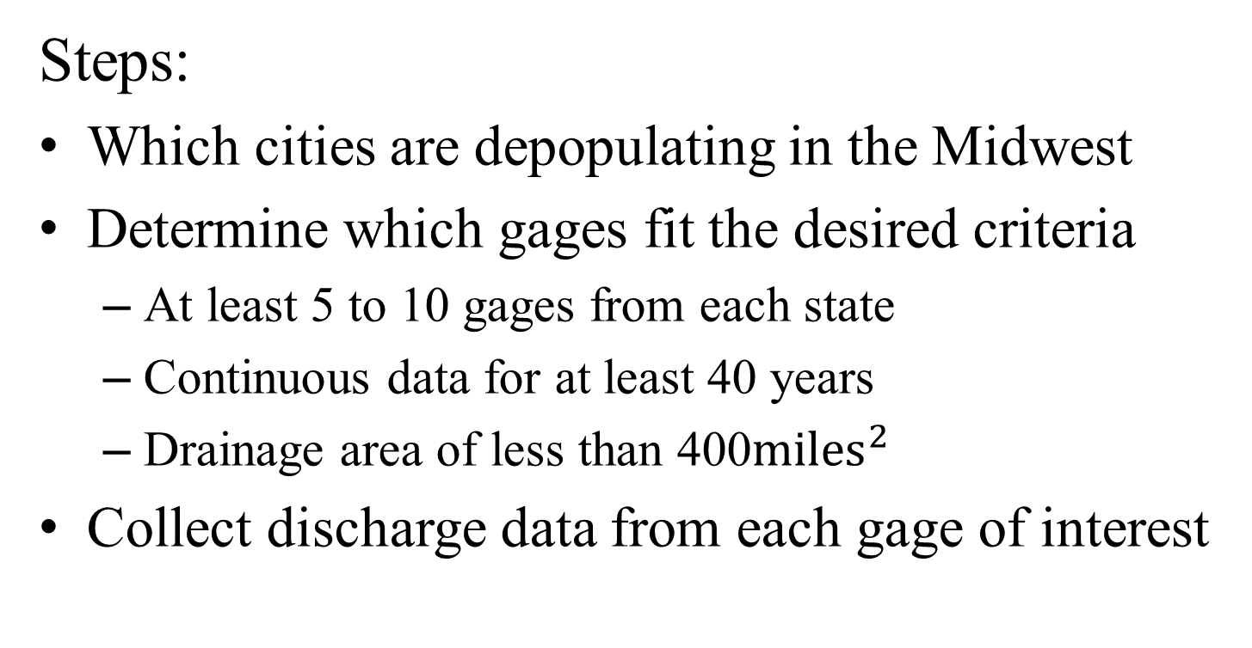
Objective: Test to see if a trend exists between population density and river baseflow
Steps:
Which cities are depopulating in the Midwest
Determine which gages fit the desired criteria
  At least 5 to 10 gages from each state
  Continuous data for at least 40 years
  Drainage area of less than 400${miles}^{2}$
Collect discharge data from each gage of interest
Notes:
Why do we have that criteria?
So a general trend can be established for each state
Longer record makes it easier to detect trends
Small watersheds limit the variables
^The assumptions make sense with these variables

Slide 6
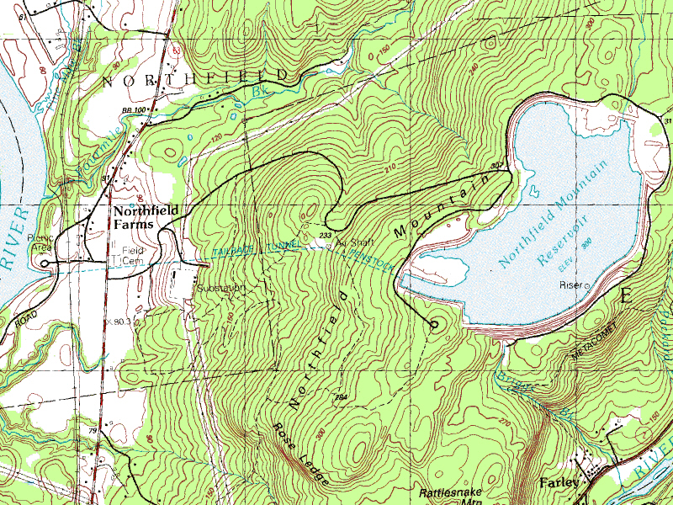
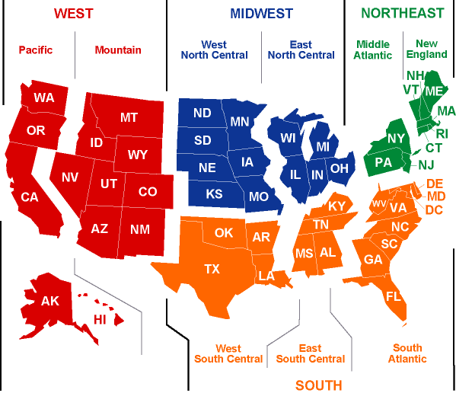



How is the goal going to be accomplished?
Lim et. al, 2010
http://www.eia.gov/emeu/recs/cendivco.gif
http://pubs.usgs.gov/of/1999/ofr-99-0364/usgs.gif
http://upload.wikimedia.org/wikipedia/commons/f/f0/Northfield_Mountain_Tailrace_Tunnel_-_USGS_map.jpg
http://upload.wikimedia.org/wikipedia/commons/thumb/6/6b/Census_Bureau_seal.svg/220px-Census_Bureau_seal.svg.png
Notes:
How are we going to do this?
By using information and data free to the public, such as:
US Census Population Density Data: To obtain population density data on the county level
USGS: To obtain county size information as well as information on desired gages, and precipitation data
WHAT –Web-based hygrograph analysis tool: To obtain flow data, including baseflow, runoff, and total flow for all the gages of interest.

Slide 7
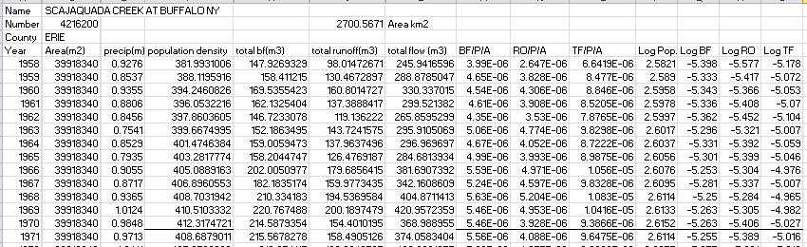
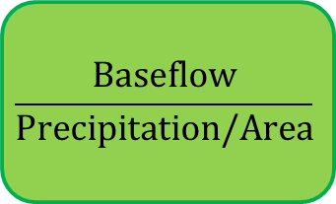
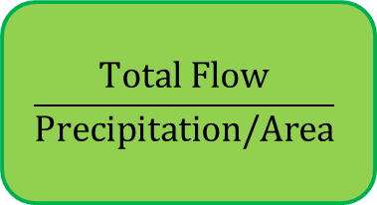
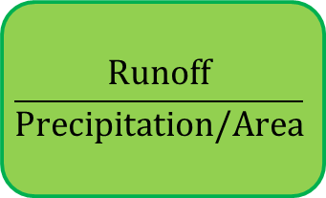
Compiling the Data
$$\frac{Baseflow}{Precipitation/Area}$$
$$\frac{Runoff}{Precipitation/Area}$$
$$\frac{Total Flow}{Precipitation/Area}$$
Notes:
Data for one gage: Scajaquada Creek at Buffalo, NY #4216200
Highlighted headings represent necessary information, all of which was collected for each 26 gages across the Midwestern United States.
***What are the baseflow metrics (BF/P/A, RO/P/A, and TF/P/A)? And what will these help us accomplish?
The baseflow metrics help normalize each type of flow to precipitation and area. We normalize this data to account for potential wet and dry years. These baseflow metrics will help us to determine if a trend exists between flow and population density.

Slide 8
Analyzing the Data
SUMMARY OUTPUT for | #4216200 |  | LOG Pop Den vs. LOG BF/P/A
Regression Statistics
Multiple R | 0.73947873
R Square | 0.546828791
Adjusted R Square | 0.533881043
Standard Error | 0.139887057
Observations | 37
ANOVA
 | df | SS | MS | F | Significance F
Regression | 1 | 0.826441611 | 0.8264416 | 42.233503 | 1.71084E-07
Residual | 35 | 0.684893608 | 0.0195684
Total | 36 | 1.511335219
 | Coefficients | Standard Error | t Stat | P-value | Lower 95% | Upper 95% | Lower 95.0%
Intercept | -23.92954385 | 2.8492442 | -8.3985584 | 6.612E-10 | -29.71381705 | -18.14527065 | -29.71381705
X Variable 1 | 7.164849305 | 1.102499768 | 6.4987309 | 1.711E-07 | 4.926655799 | 9.403042812 | 4.926655799
Notes:
Using the Data Analysis Tool in Microsoft Excel we can gather particular values of interest:
The x-variable coefficient because its value is correlated to the trend; a positive value represents a positive trend or a direct correlation, a negative value represents a negative trend of an indirect correlation.
The p-value represents the statistical significance by providing a confidence interval of how confident we are in our trend (x-variable); a p-value of 0.05 represents a 95% confidence interval, a p-value of 0.01 represents a 99% confidence interval.

Slide 9
Results Summarized
Out of 26 gages, 16 gages had statistically significant results, with a p-value equal to or less than 0.05 or 53% of gages proved to be statistically significant
Only 11% of the statistically significant gages are found within the Appalachian Plateau
65% of gages in the Central Lowlands produced statistically significant results
LOG Data
Gage Name | Gage # | BF X-var | p-value | RO X-var | p-value | TF X-var | p-value
LITTLE PINE CREEK NEAR ETNA, PA | 3049800 | 0.169248 | 0.643258 | -0.04655 | 0.927761 | 0.057203 | 0.889731
ABERS CREEK NEAR MURRAYSVILLE, PA | 3084000 | 0.569825 | 0.176394 | 0.446385 | 0.361264 | 0.51235 | 0.222733
TURTLE CREEK AT TRATTFORD, PA | 3084500 | -0.90586 | 0.193385 | -1.73619 | 0.063137 | -1.31276 | 0.078252
CHARTIERS CREEK AT CARNEGIE, PA | 3085500 | -0.05867 | 0.841827 | -0.47766 | 0.032828 | -0.20952 | 0.441274
MILL CREEK AT YOUNGSTOWN, OH | 3098500 | -1.50317 | 0.719685 | -1.3767 | 0.602494 | -1.59211 | 0.661382
TINKERS CREEK AT BRADFORD, OH | 4207200 | -0.89173 | 0.031647 | -0.51572 | 0.271409 | -0.71497 | 0.08092
MILL CREEK AT CARTHAGE, OH | 3259000 | 1.764329 | 0.297274 | 1.284297 | 0.197907 | 1.530912 | 0.279303
WOLF CREEK AT DAYTON, OH | 3271000 | 4.347494 | 6.15E-05 | 3.071518 | 1.98E-05 | 3.90621 | 4.35E-05
KEARSLEY CREEK NEAR DAVISON, MI | 4148140 | 0.003405 | 0.996545 | 0.194338 | 0.820923 | 0.073458 | 0.926282
PAINT CREEK AT ROCHESTER, MI | 4161540 | 0.472126 | 0.037587 | 0.439079 | 0.049125 | 0.464359 | 0.035363
BIG BEAVER CREEK NEAR WARREN, MI | 4162900 | -3.05725 | 0.001821 | -1.98547 | 0.01302 | -2.40282 | 0.005271
PLUM BROOK AT UTICA, MI | 4163400 | 2.798487 | 0.036314 | 2.298823 | 0.036283 | 2.590607 | 0.038592
NORTH BRANCH CLINTON RIVER NEAR MT. CLEMENS, MI | 4164500 | 0.167352 | 0.117787 | 0.098281 | 0.42571 | 0.135186 | 0.230124
RIVER ROUGE AT BIRMINGHAM, MI | 4166000 | 0.744842 | 2.65E-05 | 0.664054 | 3.37E-05 | 0.71436 | 2.07E-05
EVANS DITCH AT SOUTHFIELD, MI | 4166200 | 0.539942 | 0.007044 | 0.775435 | 0.002337 | 0.668435 | 0.002483
UPPER RIVER ROUGE AT FARMINGTON, MI | 4166300 | 1.35354 | 9.62E-10 | 1.530425 | 4.84E-09 | 1.420402 | 7.56E-10
MIDDLE RIVER ROUGE NEAR GARDEN CITY, MI | 4167000 | -3.9552 | 0.006259 | -3.15067 | 0.00387 | -3.71266 | 0.005654
LOWER RIVER ROUGE AT INKSTER, MI | 4168000 | -2.87629 | 8.88E-13 | -1.22821 | 0.00051 | -2.12386 | 4.46E-09
OTTAWA RIVER AT UNIVERSITY OF TOLEDO,OH | 4177000 | -1.92187 | 0.563865 | -0.7938 | 0.681552 | -1.52245 | 0.592616
ROCKY RIVER NEAR BREA, OH | 4201500 | -1.03629 | 0.007859 | -0.58063 | 0.003509 | -0.94026 | 0.00252
CAYUGA CREEK NR LANCASTER, NY | 4215000 | 3.98578 | 0.001067 | 1.794082 | 0.010848 | 3.152264 | 0.002332
CAZENOVIA CREEK AT EBENEZER, NY | 4215500 | 0.116348 | 0.55728 | -0.16465 | 0.529097 | -0.0231 | 0.913566
SCAJAQUADA CREEK AT BUFFALO, NY | 4216200 | 7.164849 | 1.71E-07 | 1.616311 | 0.013236 | 4.097149 | 5.03E-06
ELLICOTT CREEK BELOW WILLIAMSVILLE, NY | 4218518 | -2.18692 | 6.79E-06 | -0.32027 | 0.644189 | -1.36636 | 0.008506
ALLEN CREEK NEAR ROCHESTER, NY | 4232050 | -0.08975 | 0.896841 | 1.941338 | 0.007907 | 0.776752 | 0.234081
IRONDEQUOIT CR ABV BLOSSOM RD NR ROCHESTER, NY | 4.23E+08 | 1.363078 | 0.306641 | 2.032318 | 0.285113 | 1.575381 | 0.268717
Appalachian Plateaus | 0.01 significance
Central Lowland | 0.05 significance
Notes:
Color representation: Light grey- Appalachian Plateau
Dark grey – Central Lowlands
Dark green- 0.05 significance, 95% confidence interval
Light green- 0.01 significance, 99% confidence interval
Blue- positive trend & positive correlation
Red- negative trend & negative correlation
12 gages were found to have a high confidence interval of 99%
-Out of those 12 gages, 10 were found to have a high confidence interval in all three of the baseflow metrics (BF/P/A), (RO/P/A), & (TF/P/A)
-Of the 10 gages that produced a high confidence interval four show a negative trend, or a decrease in water and six show a positive trend, or an increase in water

Slide 10
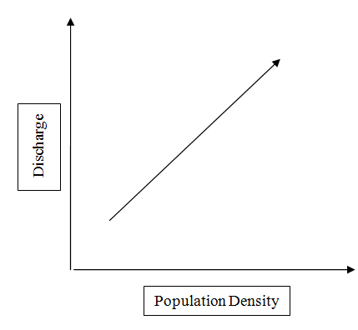
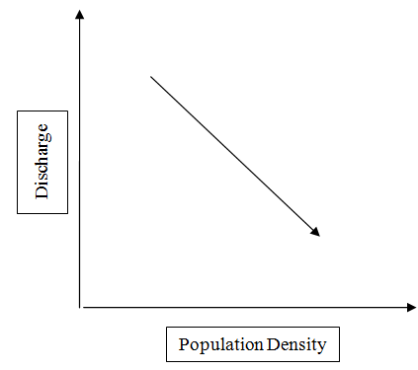
Positive Trend vs. Negative Trend
Appalachian Plateau:
0 Positive Trends & 2 Negative Trends
Central Lowlands:
9 Positive Trends & 5 Negative Trends
Notes:
A Positive Trend directly correlates changes in discharge to changes in population density, meaning that as population density changes, discharges change in the same direction. As population density increases, discharge increases and as population density decreases, discharge decreases
A Negative Trend provides an indirection correlation between changes in discharge to changes in population density, meaning that as population density changes, discharges change in the opposite direction. As population density increases, discharge decreases and as population density decreases baseflow increases.
Did this for linear and log axis but the result are based on the log results because the logarithmic regressions produced more statistically significant data.
The Big Picture: More statistically significant data was produced out of the Central Lowland physiographic province and therefore, RIVERS SITUATED WITHIN THE CENTRAL LOWLANDS ARE MORE SUSCEPTABLE TO CHANGES IN POPULATION.

Slide 11
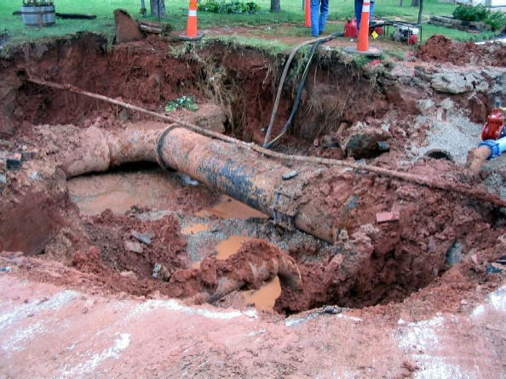
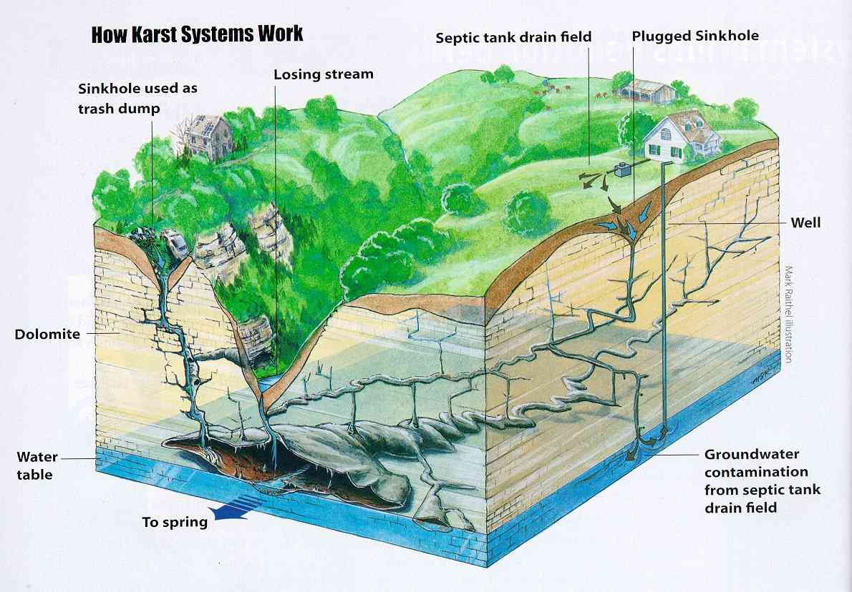
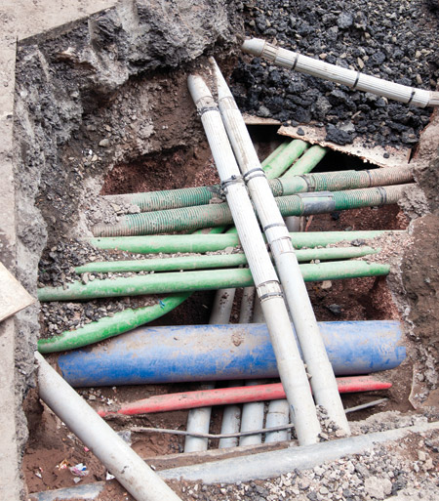
What does this imply?
Urban Karstification.
http://www.kwhpipe.ca/Link.aspx?id=1112003
http://academic.emporia.edu/aberjame/field/flint/rock02.jpg
http://1.bp.blogspot.com/_JRp7TJWTx4A/S8Zvpncq70I/AAAAAAAAAVU/HPmQaOgb0d8/s1600/KarstDiagram-70pct-730206.jpg
Notes:
Urban karst is just like natural karst in that there are a series of caverns under the surface, the difference however is that in an urban setting these caverns are replaced by water infrastructure (drainage pipes, sewage collection tanks, clean water delivery systems). The water infrastructure created out of man-made conduits, it is also eroding surrounding rock because of the over pressurization of pipes, like the clean water delivery systems.
This urban karstification is more likely to occur in the Central Lowland physiographic province than the Appalachian Plateau because the Central Lowlands are composed primarily of shales and limestones, the perfect environment for karst formation.
What is hydrologically happening in the ground with a positive/negative trend?
Positive trend: The urban karstification is more offsetting than the imperviousness
Negative trend: Impervious surfaces win over the karst formations
The baseflow, for cities that lie within the Central Lowlands, is more affected by changes in population than cities that are located in the Appalachian Plateau because the Central Lowlands experience the urban karstification at a quicker rate than Appalachian Plateau because of the composition of the underlying bedrock. The Central Lowlands are composed of shales and limestone, similar to natural karst. The over-pressurization and leaky-ness of the pipes weather and erode the surrounding bedrock of the Central Lowlands fast than the crystalline sedimentary bedrocks that make up the Appalachian Plateau.

Slide 12
Future Directions/Recommendations
Have finer grained population density data.
More precise impervious surface data.
Expand the geographic area and the amount of gages.
What are economic implications for the depreciated city losing excess water revenue.
Have cities in similar geophysiographic provinces experienced similar trends as a result of changes in population density?
Has the flood frequency changed in the Central Lowlands due to an overall increase in baseflow (Teo, 2014)?
Notes:
How can this help?/ Who can this benefit?
30 years ago, this trend wasn’t likely as strong, and 30 years from now it will too be to late to remediate effectively, the time is now.
If we can establish a trend between depopulation and baseflow we can better understand how humans alter the natural environment even after they’ve left, this could prepare cities facing a similar fate, and potentially what can be done to remediate this effect.
We can implement remediation techniques and applications immediately in these areas.

Slide 13
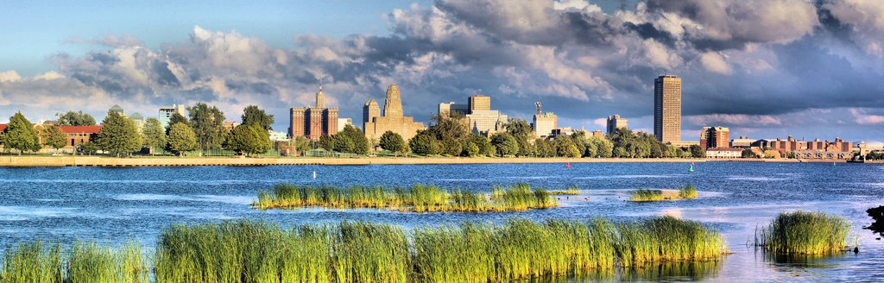
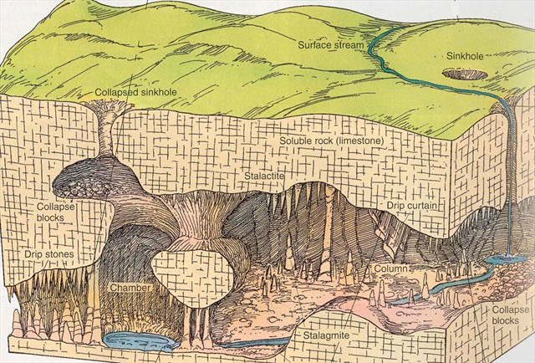
Questions?
http://static.panoramio.com/photos/large/18637974.jpg
http://img.geocaching.com/cache/large/5b64dd91-ba09-4fdf-aa2a-2aae1604be97.jpg

