Slide 1
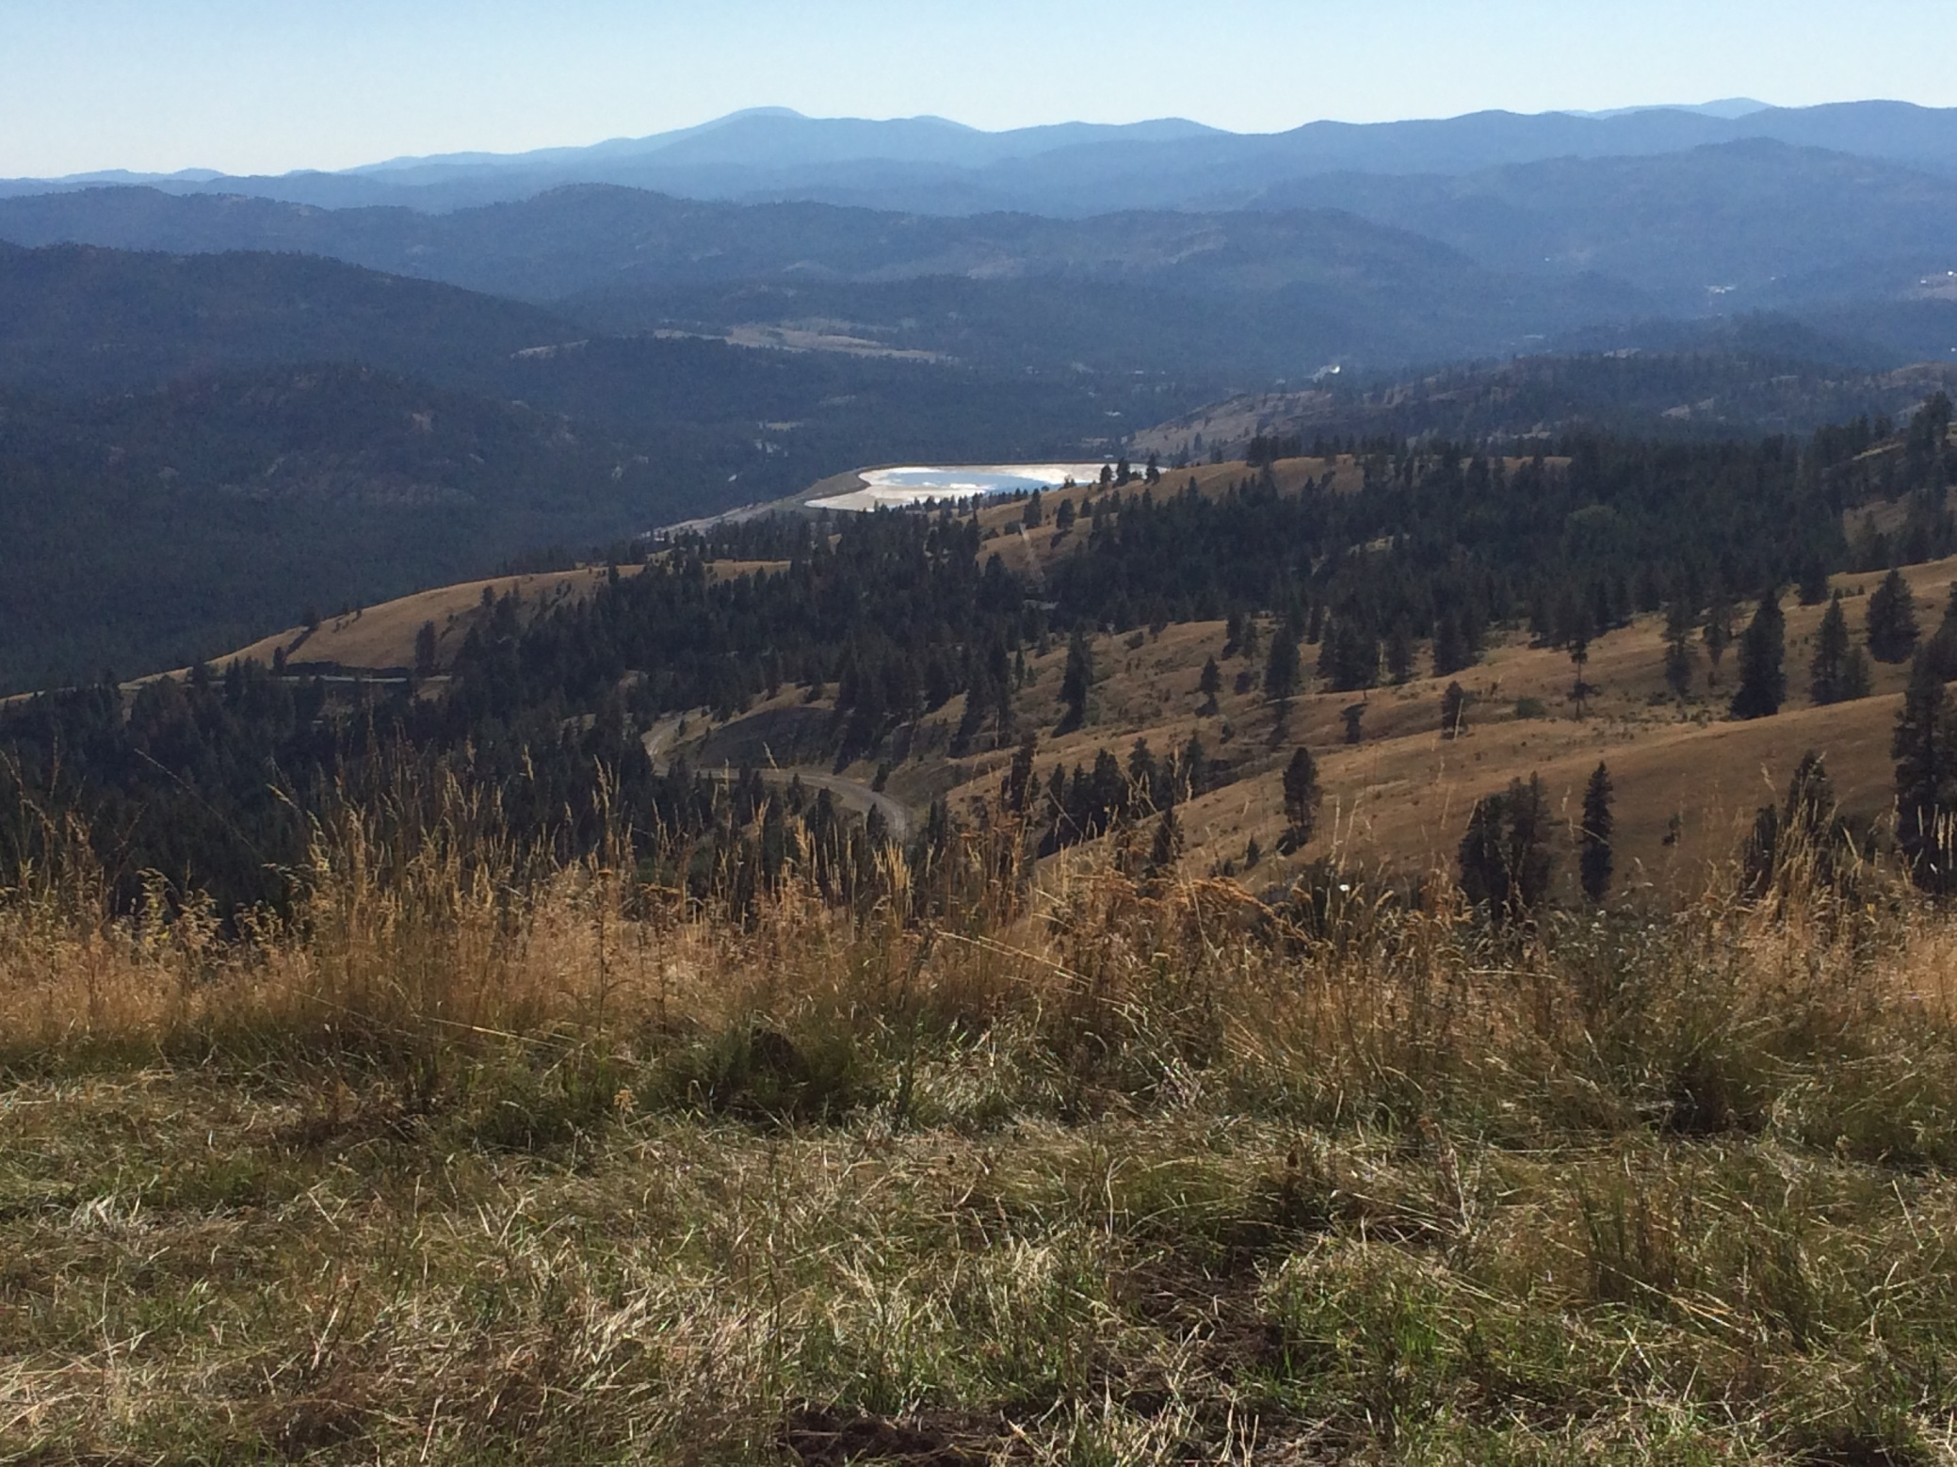
Oversight Points to an
Overlooked Structural Model
for Cooke Mountain,
Republic Gold District,
NE Washington
Michael Rasmussen, PhD, CPG
Nine Mile Falls, WA
Notes:
View to the SW from upper slopes of Cooke Mtn, at a prospect referred to as Oversight, a historically mapped magnetiferous metallic showing with anomalous gold nearby. Adamera Minerals conducted drilling on Oversight this summer, and determined that a structural model proposed in the 1990’s should be applied to this setting.
The Echo Bay tailings pond is in the middle distance, and
The now-reclaimed adits for Echo Bay’s Overlook underground gold mine (280,000 oz, at 0.15 opt) are downslope to the right (west) in this field of view.

Slide 2
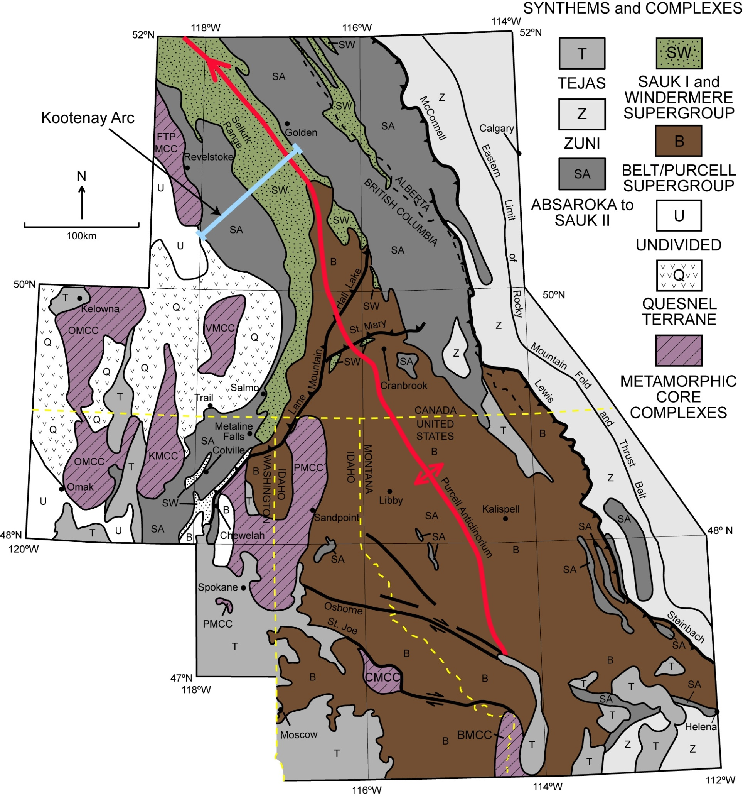
Calgary
●
100 km
Nelson
Quesnellia
Canada
US
CM
Spokane
●
Notes:
Cooke Mtn is in Quesnellian rocks, as depicted here in a map provided by Eric. Note its location between two metamorphic core complexes, that of the Okanogan and of the Kettle, separated by the Republic Graben, on the central eastern shoulder of which is an exposure of Quesnellian rocks of late Permian to Jurassic age.

Slide 3
Quesnel Terrane
Late Triassic
Southeast British Columbia
Quesnellia
Cache Creek
melange
Nicola
arc
Brooklyn
Kootenay
North
America
Sea Level
Harper Ranch
Late Triassic
after Hoy and Andrew, 1997
Notes:
Note the Harper Ranch designation. In this study, we considered clastic rocks to be Permian Attwood Fm., with cherts and greenstones as Knob Hill Formation.

Slide 4
Quesnel Terrane
Southeast British Columbia
Early Jurassic
Quesnellia
Cache Creek
melange
Elise
North
America
Nicola
Hall
Sea Level
Knob Hill
Early Jurassic
after Hoy and Andrew, 1997
Notes:
Rossland group rocks forming in the Early Jurassic, with final accretion to North America in late Jurassic.

Slide 5
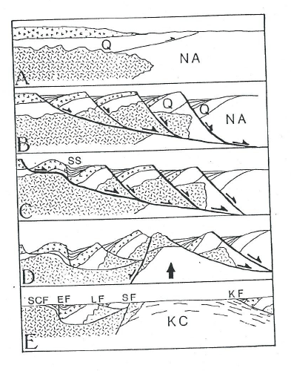
Jurassic Fold and Thrust Deformation
Growth of Metamorphic Core Complexes
with Synformal Grabens and Half-Grabens
Box, 1992
Notes:
Diagrams describing structural evolution of Quesnellian and Challis rocks.

Slide 6
Geology of the
Republic, WA Area
R.30 E.
R.31 E.
R.32 E.
R.33 E.
Buckhorn Mt
Vancover B.C.
Kettle
T.40.N
River
Kettle Mine
T.40.N
K2 Mine & East Veins
Curlew
Emanuel Creek
Republic Graben
T.39.N
T.39.N
0
100
200
300
400
500
Toroda Graben
Scale in Miles
Fault
T.38.N
Lamefoot Mine
T.38.N
Bodie Fault
Bacon Creek
Key East & West Pits
Explanation:
Republic District (Golden Eagle)
Volcanics
Overlook Mine
Intrusives
T.37.N
Kettle River Mill Site
T.37.N
Republic
Greenstone
High Grade Metamorphic
Fault
T.36.N
Republic Graben
T.36.N
Claim Block(s)
Sherman
0
1
2
3
4
5
R.30 E.
R.31 E.
R.32 E.
R.33 E.
R.34 E.
Scale in Miles
Geology of the Republic Graben Area
Notes:
If we look at the geology south of the international border, we see the dominant structures are the Republic and Toroda Synformal Grabens, cut into the central part of a composite metamorphic core complex that has been unroofed northward, eastward, and westward. This may be the only map you will ever see that refers to the grabens properly, as synformal grabens. Although we all know how reluctant Eric is to be contrarian, I will put these names in proper form in his honor today.

Slide 7
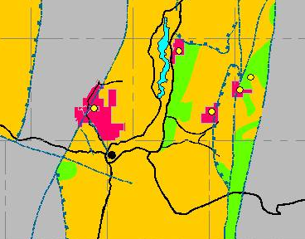
Lamefoot Mine
530,000 oz Au @ 0.21 opt
A -------A’
Key East & West Pits
Republic District
(Golden Eagle)
Overlook Mine
280,000 oz Au @ 0.15 opt
Kettle River Mill Site
Republic
Sherman Fault
Notes:
On this eastern shoulder of the Republic Graben are the deposits that brought Echo Bay/Kinross into the Republic District.
A section A-A’ follows

Slide 8
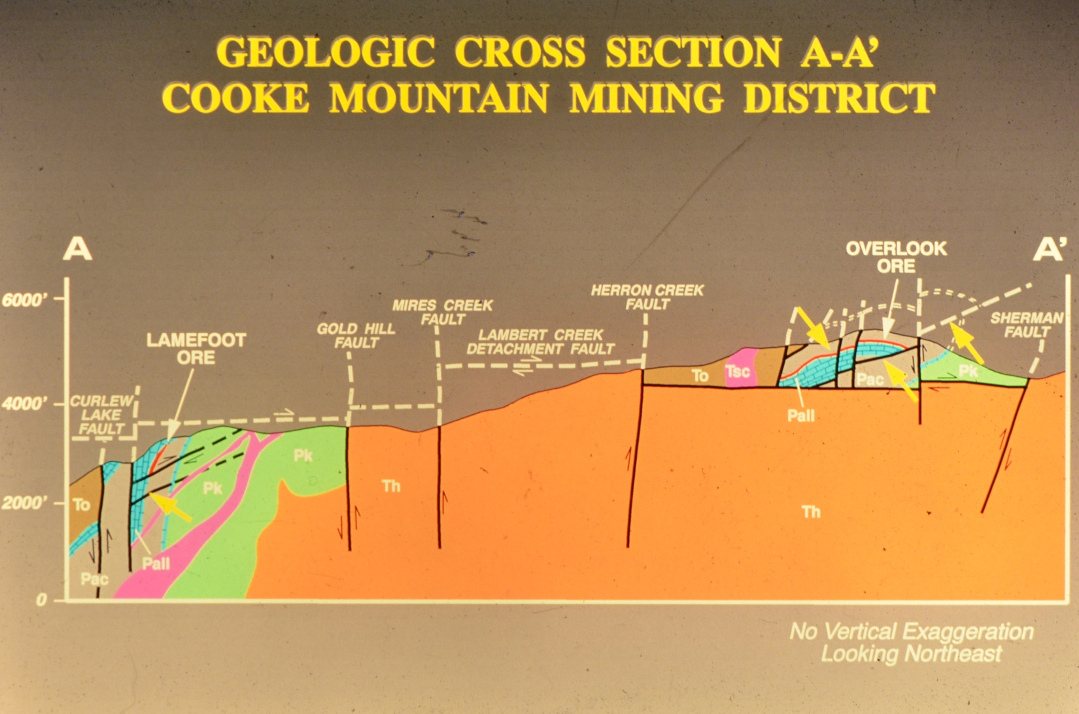
Notes:
Overlook and Lamefoot, separated by displacement of the upper plate-hosting Overlook eastward on the Lambert Creek Detachment Fault.

Slide 9
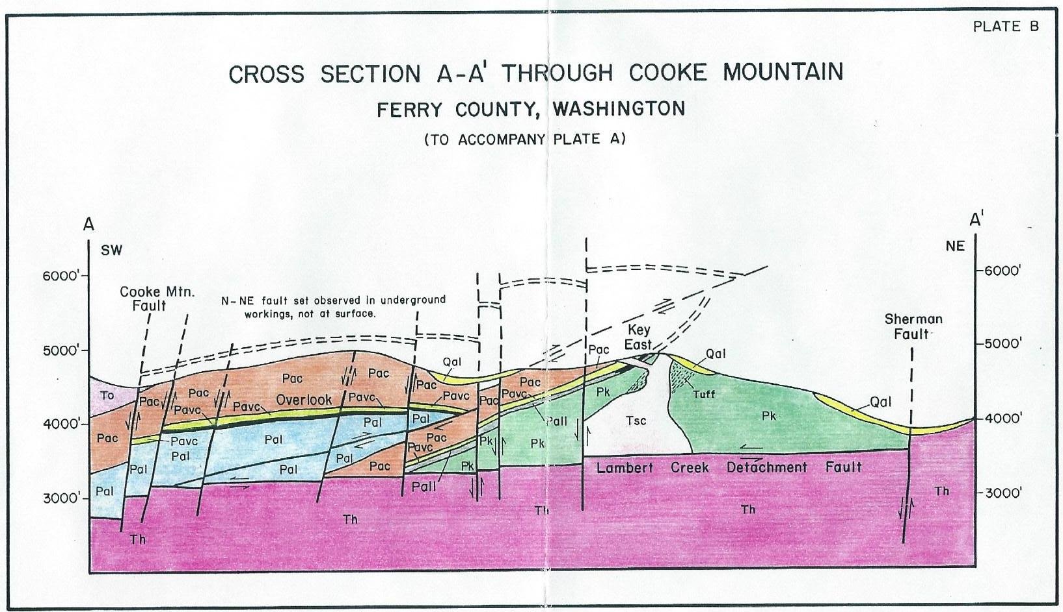
Cooke Mtn
Chesaw Fault
Notes:
Point out Cooke Mtn summit, and horizon of massive mineralization and felsic lithic tuff, and for clarity, deliberate omission of Tertiary dikes which are voluminous in the summit area of Cooke Mtn.

Slide 10
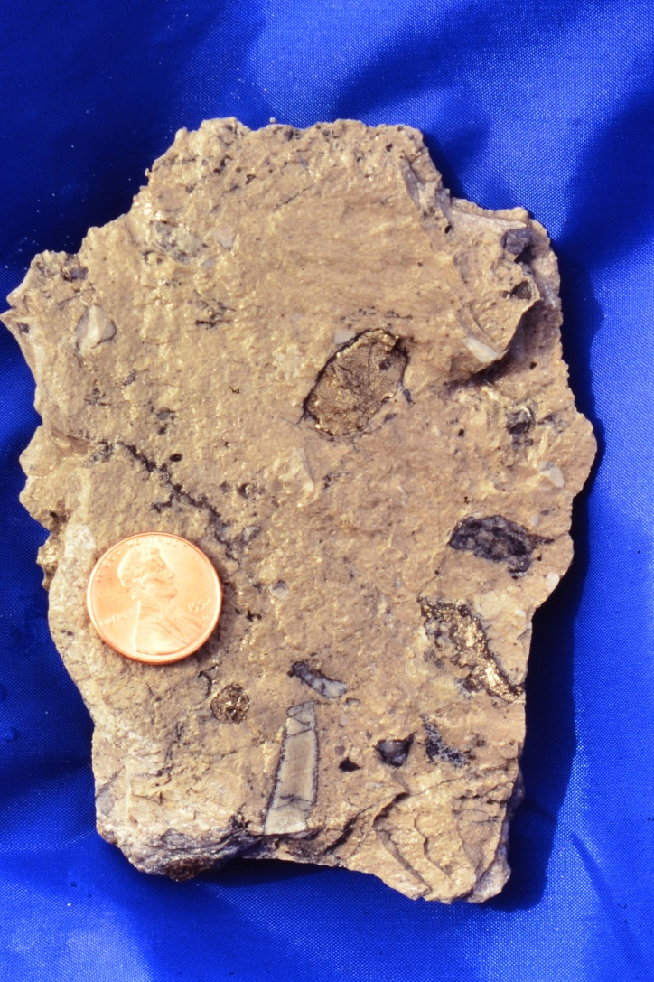
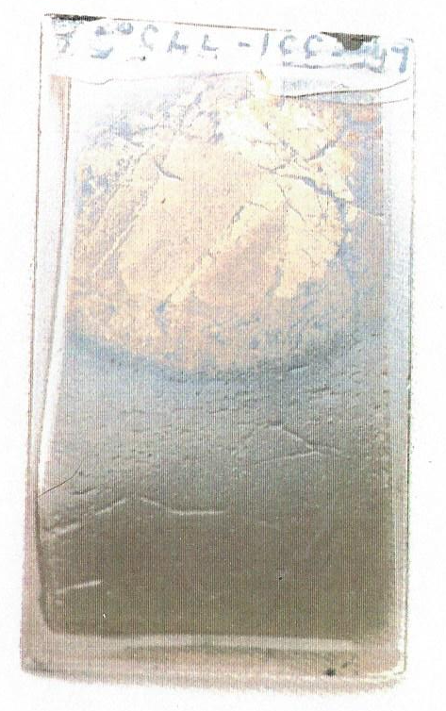
Pyrite Clasts
Felsic tuff
Bedded pyrite
with reaction rim.
Felsic tuffaceous siltite
Sericite 197 Ma ⁴⁰Ar/³⁹Ar
Notes:
Felsic volcaniclastic rock with Ar/Ar age of 197, determined at Queens Univ by D. Archibold in about 1994. Prominent planar textures are likely primary, not replacement in origin.

Slide 11
Overlook Project Generalized Geology Section 10210
Evidence for sea-floor deposition of massive mag+po+Au
Metamorphic foliation in massive sulfides
Au-bearing clasts in ls-mag-po conglomerate at ls contact
Zoned decrease in Cu/Cu+Zn from strat base upward
⁴⁰Ar/³⁹Ar sericite age 197 Ma in mineralized tuff
S isotope consistent w/ uPermian marine settings
Pb isotopes consistent with Permian Pb, later overprint
NW
SE
4400
Pcl
Pcl
Pcl
Overturned
Angular Unconformity
Veinlet Ore Zone
4200
Low-Angle Shear
Pvcl
Low-Angle Shear
Tsc-1
Ore Zone
Pvcl
Tsc-2
Pyrrhotite
Magnetite
Pls
4000
Magnetite
LF-xsecs.ppt
KCA 10-25-96
Pls
Po+Mag+Au
clasts in limestone
basal conglomerate
200 Feet
Notes:
Point out units: limestone, magnetite (some of which had depositional bedding textures, pyrhhotite (metamorphic foliation), felsic lithic tuff, and prominent evidence of overturning. Scours, graded beds within overturned channel scours, and angular unconformities. Mineralization clearly pre-Tertiary, emphasize ore-grade clasts in olistostrome.

Slide 12
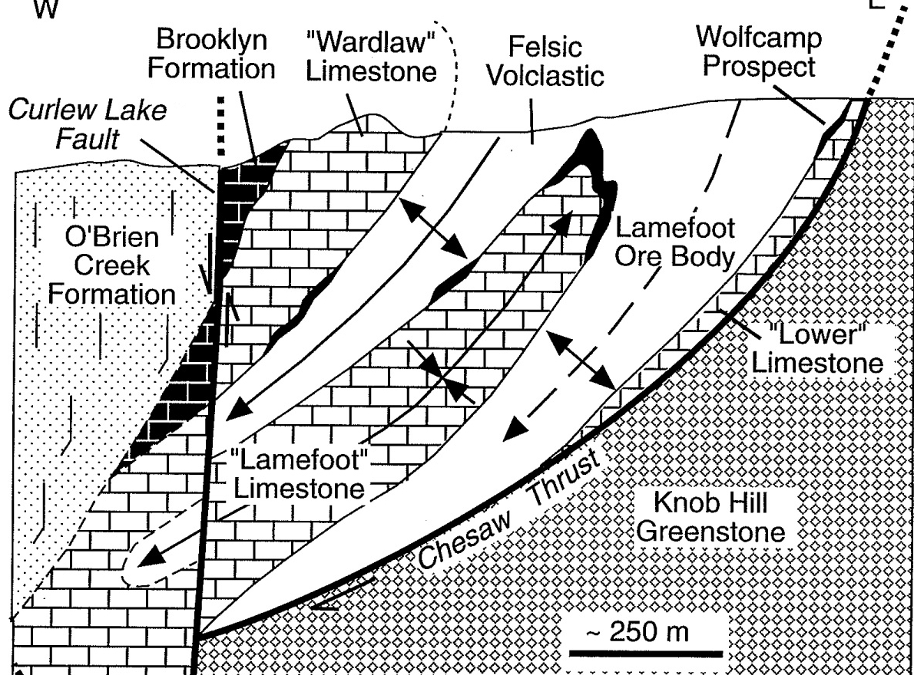
Lamefoot Isoclinal Fold Model
E.S. Cheney in 1996 at about 26700 N,
using data collected up to 11/19/94 by geologists
and consultants of Echo Bay Mines, Ltd.
c
~ 250 m
Notes:
By 1993 most attention was focused on Lamefoot, and it wasn’t long before an isoclinal fold model was invoked to explain facing directions at Lamefoot, with mineralzation localized on the nose or outer hinge of a tightly-folded limestone structure, and auriferous mag-po-limestone clasts in a depositional breccia on the upper W limb of the Lamefoot limestone.

Slide 13
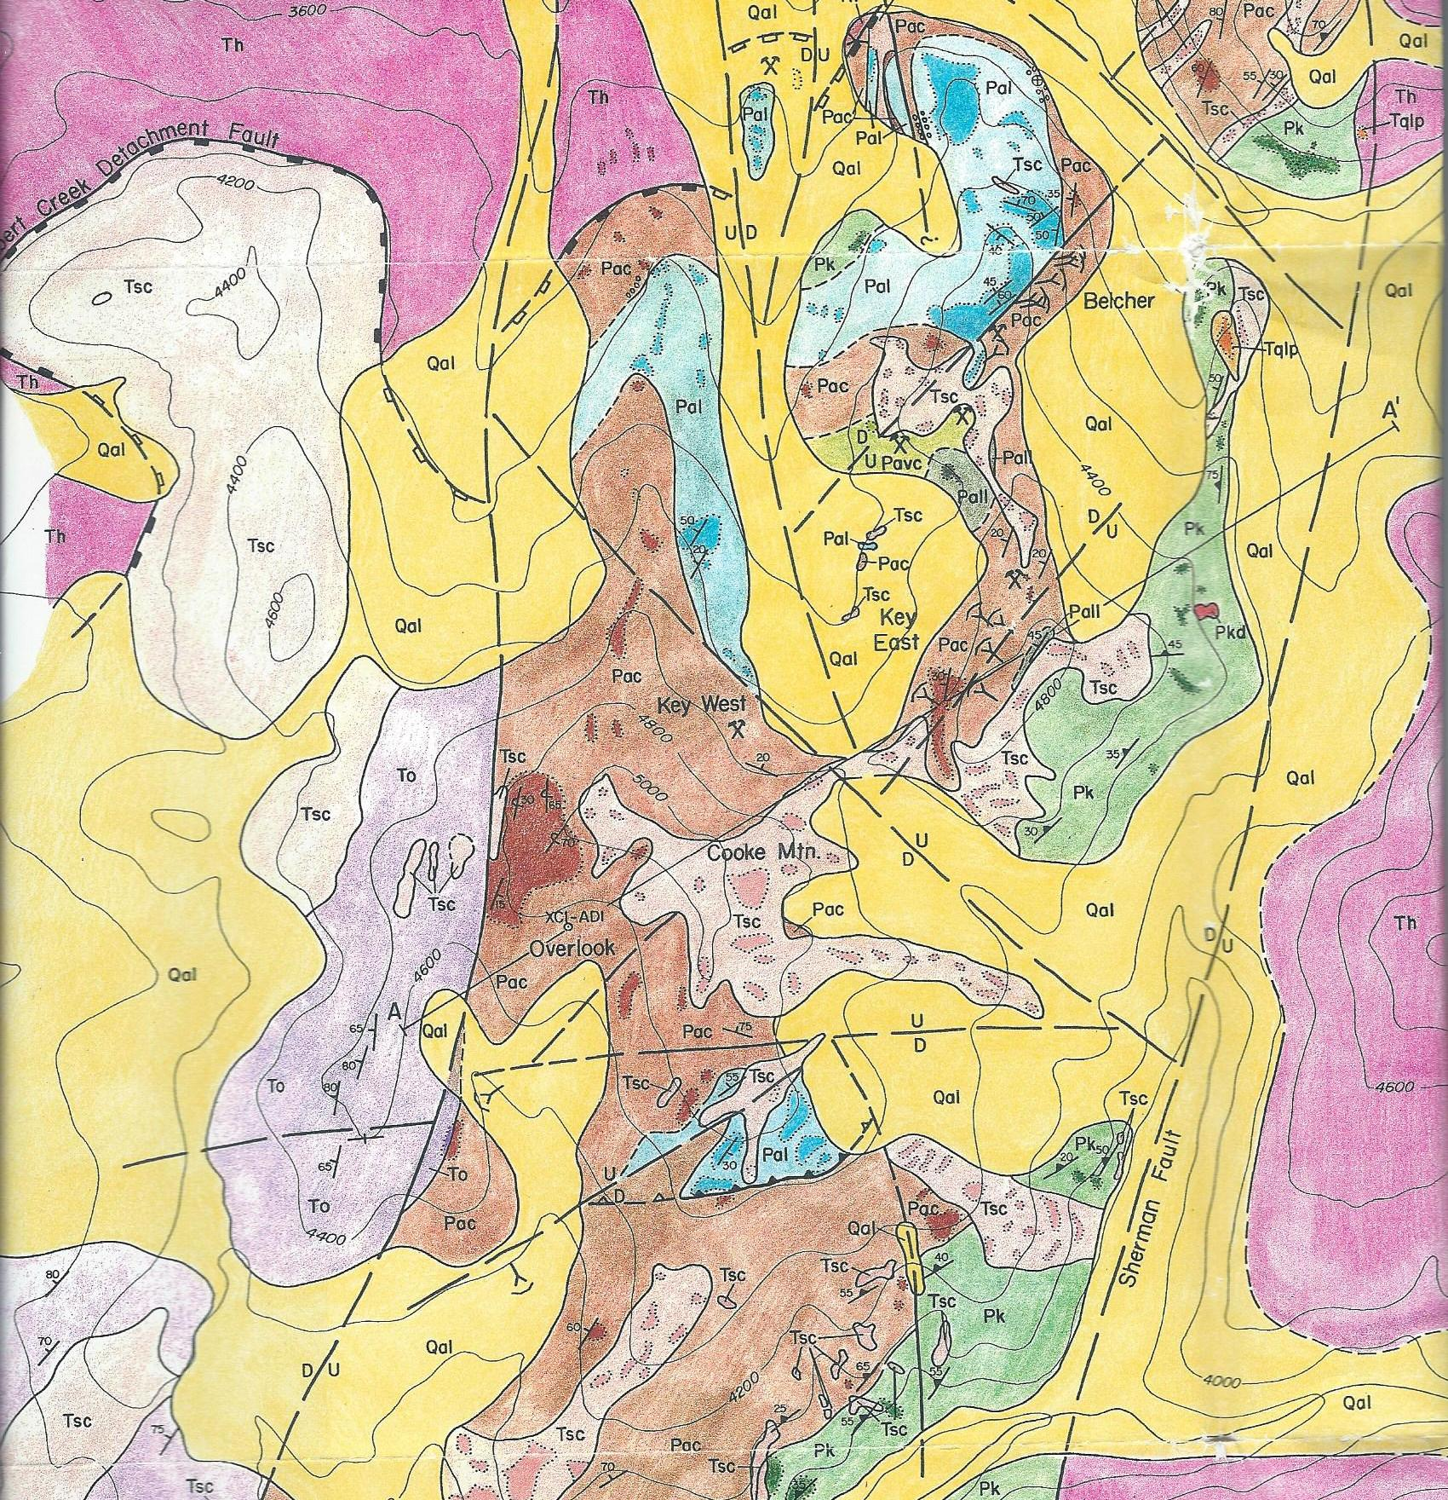
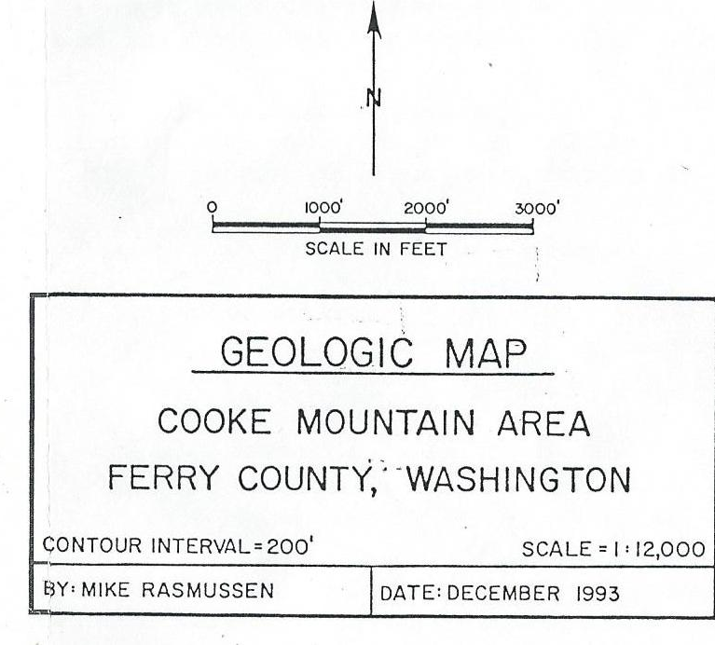
Key West
Key East
Oversight
Overlook
Notes:
Forward 15 years. Point out lack of limestone outcrops at the summit of Cooke Mountain, center view. Adamera identifies magnetic anomaly at summit. Carries out drilling summer 2014.

Slide 14
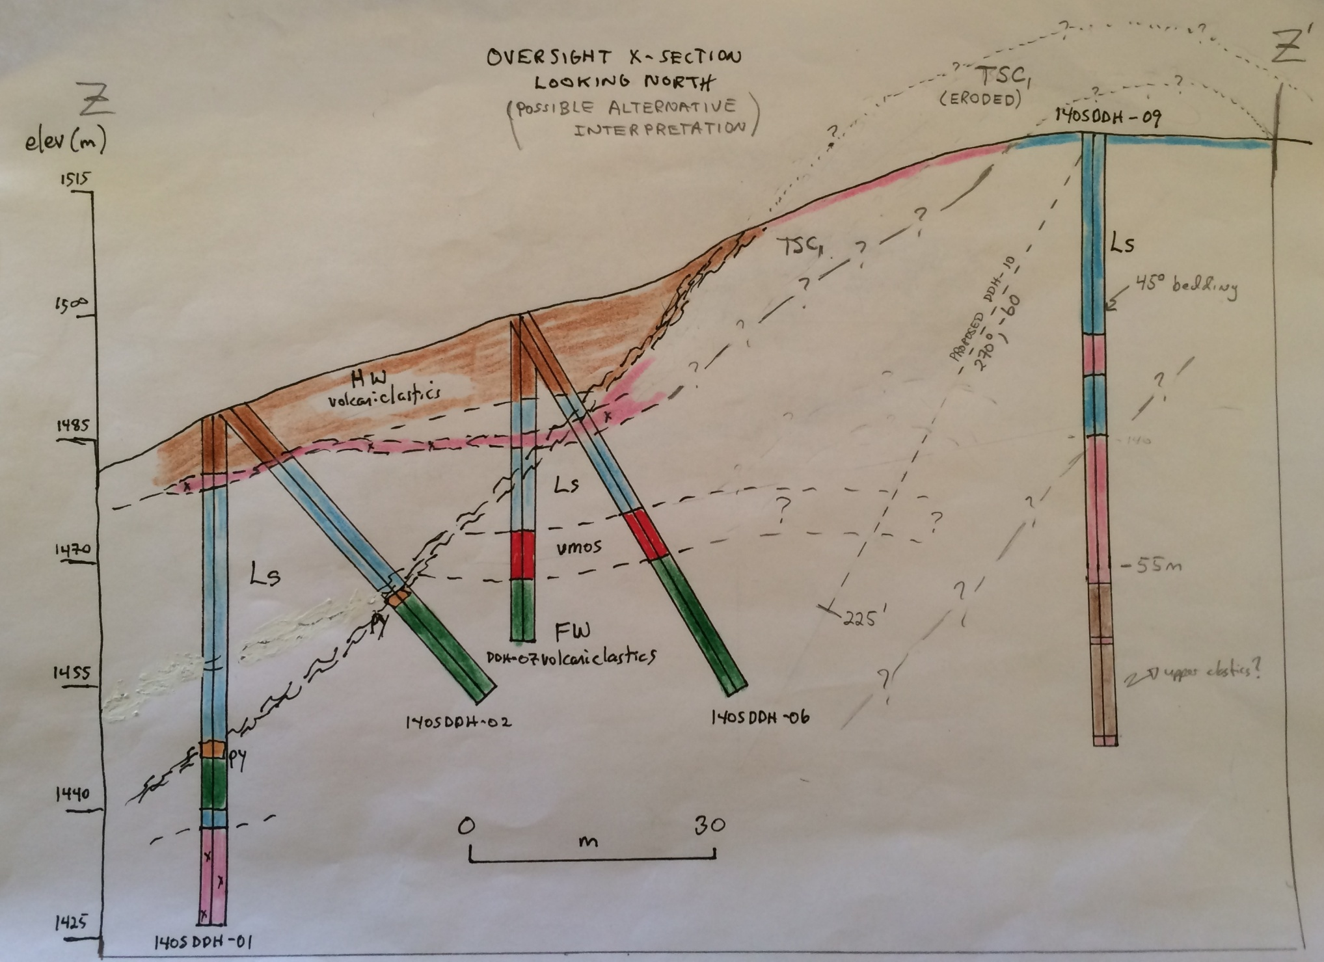
Notes:
In DDH 02, near TD, 50 m down, evidence of upright facing direction encountered.

Slide 15
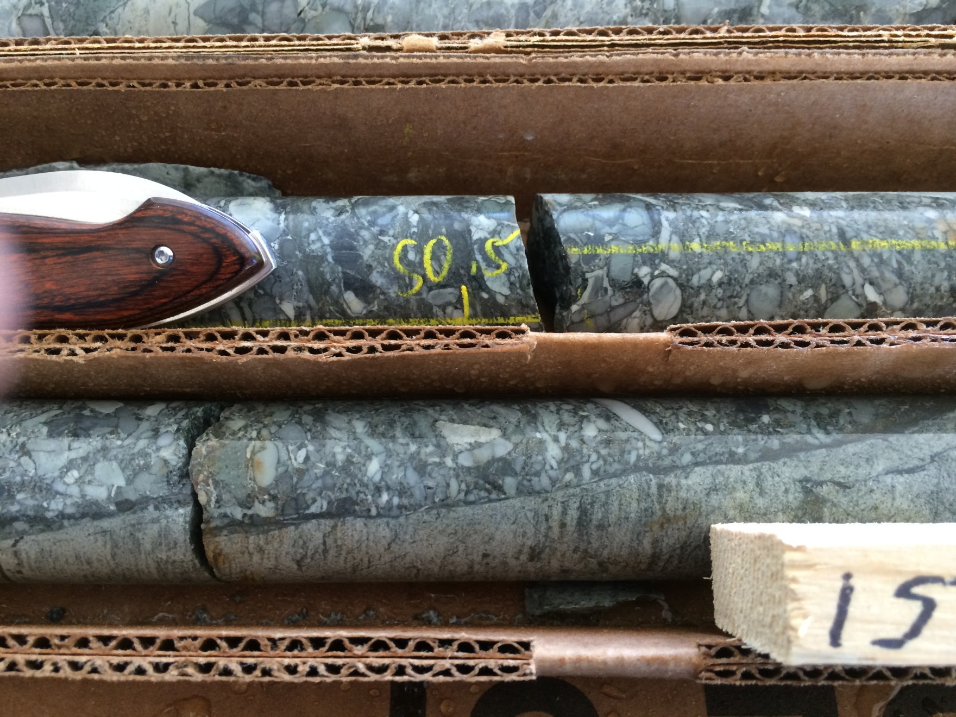
Adamera Drilling 2014, Oversight Prospect, 50 m depth
Downhole
Section is upright.
Notes:
Showing the section to be upright. The section then looks like this

Slide 16
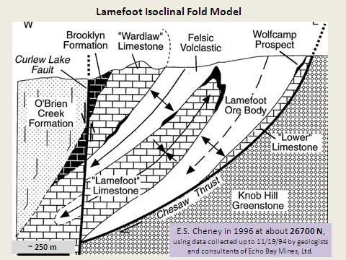
Overlook
Cooke Mountain
Cooke Mountain
Oversight

Slide 17
Cooke Mountain
Oversight
Notes:
There is an opposition of facing directions in the clastic rock above the Overlook horizon, the limestone represents an isoclinal fold, and the distance between Overlook and Oversight is greater than that suggested in this generalized, pre-T diagram. Untested, therefore, at depths beneath Oversight, lie two occurrences of the Overlook horizon, the consequence of a structural model which was not applied to Cooke Mtn in the years following closure of Overlook. The possibility of a hinge-localized mineralization zone was Overlooked, essentially, an Oversight which is about to be corrected.

Slide 18
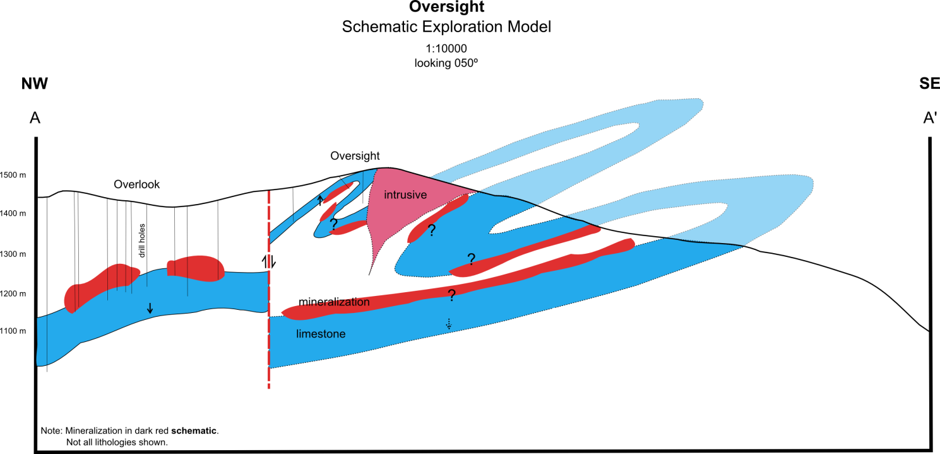

Slide 19
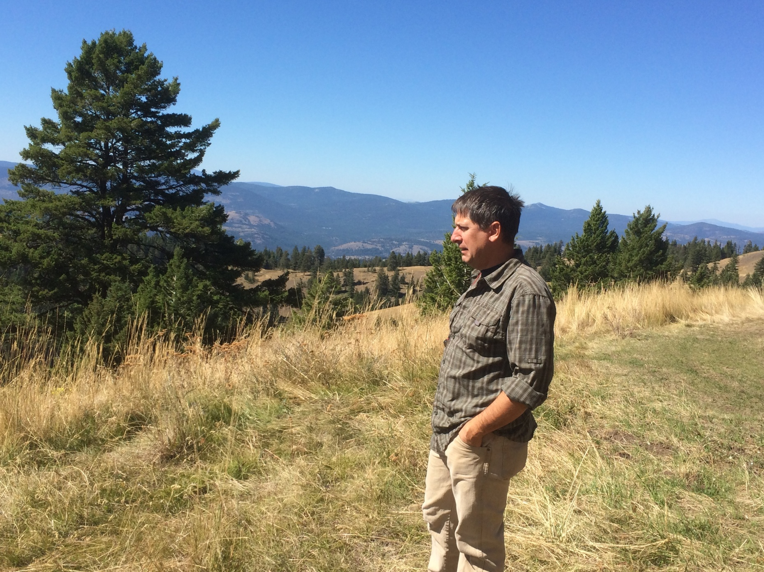
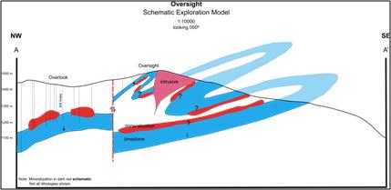
Mark Kolebaba, Pres/CEO, Adamera Minerals,
Oversight Prospect, Cooke Mtn,
Republic District, Washington
Notes:
Mark Kolebaba, Pres of Adamera, has structural models on his mind as he contemplates advancing Adamera at the Oversight property.

