Slide 1
A framework for the incorporation
of spatial thinking into K-12 geoscience
education
Martin M. Kaufman, University of Michigan-Flint
Randall L. Repic, University of Michigan-Flint

Slide 2
What we’ll cover today
Improving spatial thinking
A unifying spatial-temporal approach to geoscience education
The STEM pipeline
Constructive geography
Recruitment of students
The course site
Course outline and objectives
Course activities
Results and Discussion
Conclusions

Slide 3
Improving spatial thinking
Hypothesis: a place-based field curriculum that employs spatial-temporal frameworks to integrate high school sciences can improve spatial thinking across multiple science disciplines

Slide 4
Constructive Geography
Frameworks
Spatial-Temporal Primitives
Geographic Scale
Site and Situation
Physical and Social Realityeality
Objects
Events
Processes
Spatial-Temporal Primitives
Laws of Matter, Space, and Time

Slide 5
Spatial-Temporal Primitives
Spatial
Inherent – size, shape, location, containment
Relative – distance, direction, connectivity
Temporal
duration, frequency, sequence

Slide 6
Building Frameworks from the Spatial-Temporal Primitives
Geographic Scale
Size of the location where the objects, events, processes occur
Observation
Measurement
Geographic scale
Site and Situation
Size of the location where the objects, events, and processes occur
(Site)
Physical, systematic, or contextual connections occurring at locations outside of the site
Containment
Connectivity
Situation

Slide 7
Spatial-temporal primitives as an investigative framework
This sequence of questions might comprise a line of inquiry in the investigation of a volcanic eruption:
Where did it occur (location)
How far did the pyroclastic materials travel (distance)
Did this eruption occur within an area of volcanism (containment).
Then, incorporating a more complex spatial construct:
What was the pattern of ash, lapilli, and bombs ejected?

Slide 8
Recruitment of Students
DEEP program (advanced placement college credit)
Organization of effort – publicity, meetings
Administrators, Faculty, Parents, Students, Community
→ What we told the parents and administrators
Develop a deeper appreciation for science and scientific methods
Illustrate the benefits of teamwork via group work and partnerships
Improve written and oral communication skills
Promote comprehensive thinking processes by enabling the translation of raw data into a conceptual plan for a real physical space.
Build confidence via independent decision-making opportunities

Slide 9
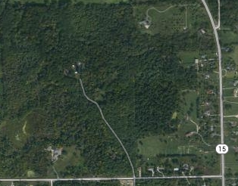
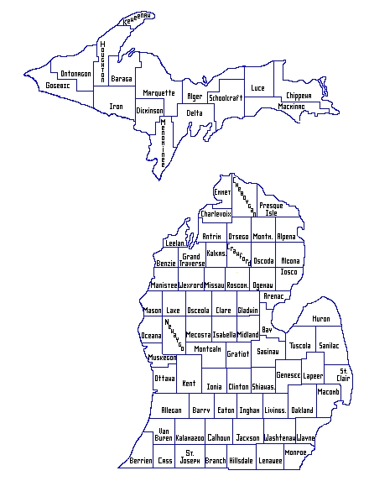
Course site
Robert Williams Nature Park and Historical Learning Center, Davison Township, Michigan
Kearsley Creek

Slide 10
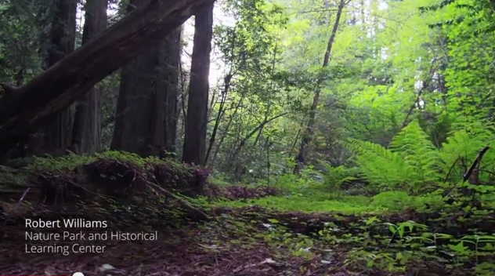
The site at ground level

Slide 11
Course Outline
Course is field based and organized into four instructional units:
Geographic grid and scale
Measurement and analysis
Field sampling and analysis
Data development and presentation
Each unit includes lecture, laboratory, field exercises, research, data
development and analysis, and report development.

Slide 12
Course Objectives
See meaning in the arrangement of things in space, and the relations between
people, places, and environment.
Use geographic skills and scientific methodologies to apply spatial and ecological
perspectives to “real world” situations.
Develop the ability for students to practice “integrated science”, that is, to apply
spatial thinking to effectively integrate content knowledge from different scientific
disciplines.
And…

Slide 13
Address and improve the emotional and intellectual
aspects of the students’ experience
Develop a deeper appreciation for science and scientific methods.
Illustrate the benefits of teamwork via group work and partnerships.
Improve written and oral communication skills.
Promote comprehensive thinking processes.
Build confidence via independent decision-making opportunities.

Slide 14
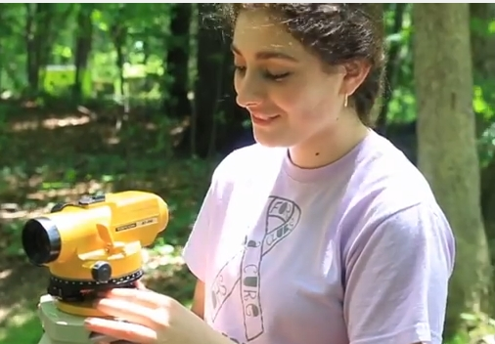
Course Activities
Site control: Pace and scale mapping; use of the level

Slide 15
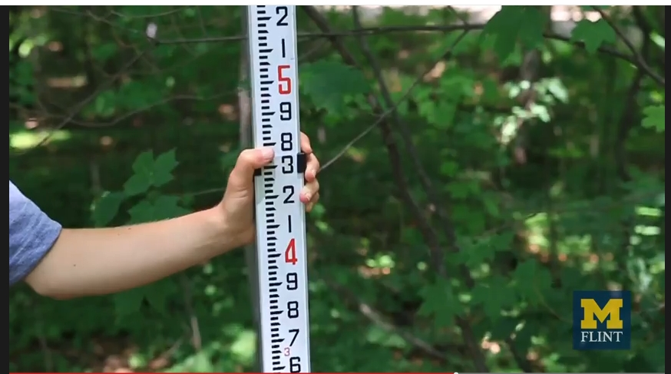
Measuring elevation for contour map construction

Slide 16
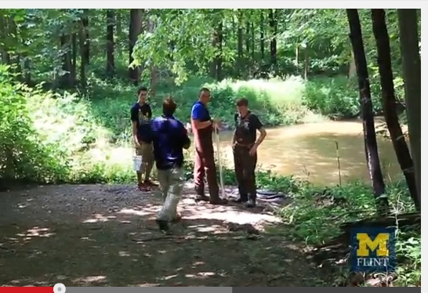
Instructions to the sampling teams:
Safety and proper technique

Slide 17
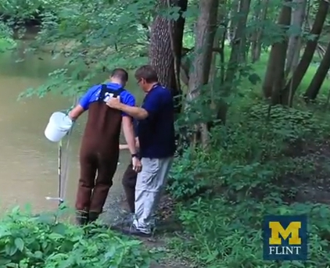
Water Sampling: Channel geometry; chemistry

Slide 18
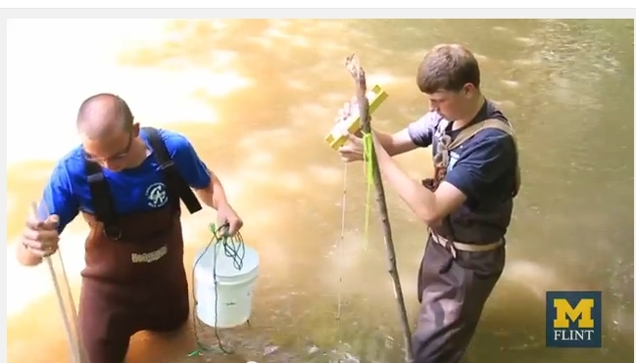
Measuring Depth

Slide 19
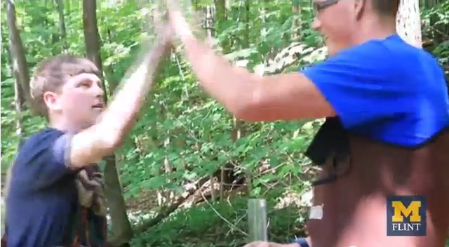
All sampling should end with a high-five

Slide 20
Results
Students in their own words from their final project write-ups
(including their typos)
“Throughout this course there have been a lot of different skills learned, used and applied to real life situations. Everything from drafting a Topographic map to taking water samples, this course has taught that Kearsley Creek’s watershed is just a small part of the larger watershed and ecosystems in southeastern Michigan. “
Objectives attained: spatial skills; application of a spatial framework

Slide 21
Results, cont.
“This water testing was a great benefit to the testers in an educational sense, but it was also an enjoyable experience because of the beautiful nature of the testing site. The tests were more beneficial because the site was diverse and 100% real world. The tests were affected by the weather and by the vegetation in the river which is something that cannot be replicated in a lab, and that is priceless”.
Objectives attained: appreciation for science and scientific methods;
Integrated science

Slide 22
Results, cont.
“Based on our research of the vegatation found in that region, we concluded that in this type of soil forest can grow well and that the red and white oak doninate in the upper conopy, but maples exsist in the lower canopy. The areas closed canopy helps prevent large amounts of erosion, due to the leafs intercepting the rain, and the leafs covering the ground continue to act as a barrier to protect the soil.”
Objectives attained: science methods; integrated science

Slide 23
Results, cont.
“This class was great, better than the 11 years I have been in High School. The only suggestions I have is to definitely push for the aerial view and the kayaking the creek. And for the soil sampling it would be nice to take samples from not only the uplands but also the low lands near the creek, then to compare and contrast them. Also if classes like this could be expanded throughout the year that would be awesome.”
Objectives attained: science methods; geographic skills

Slide 24
Results, cont.
“Throughout this three week course I observed many new surroundings, conducted many new test, and learned many new things. The most important concept I learned from this course is the value of team work, I also learned that even though this is a very large area compared to us, it is a very small area compared to the world. We all make an impact on our surrounding and it is important to watch what we do and how we interact in our world.”
Objectives attained: teamwork; application of a spatial framework

Slide 25
Conclusions
As domain knowledge increases, the ability to employ spatial frameworks also
increases (this meshes with studies of chess masters).
A sequenced, “constructive” approach to spatial education works well.
The three basic spatial frameworks of time/space, scale, and site and situation
overlap, as evidenced by student recommendations about the experimental
design for the class.
Understanding of the “nature of science” is beginning to come through.
The chances for success are increased by paying close attention to the
emotional and intellectual aspects of the students’ experience.

Slide 26
Questions?

