Slide 1


AMS Diversity Projects
Enhancing Geoscience Education at Minority-Serving Institutions
Dr. James Brey
Director, Education Program | American Meteorological Society

Slide 2


AMS
Founded in 1919
Over 14,000 members
Organizes over a dozen conferences annually
Publishes 11 leading journals
Certifies consultants and broadcasters
Significant educational activity since 1990
Non profit 501 c3
AMS Mission:
Promote the development and dissemination of information and education on the atmospheric and related oceanic and hydrologic sciences and the advancement of their professional applications in service to society.
American Meteorological Society | Education Program

Slide 3
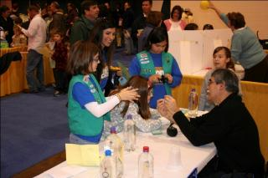
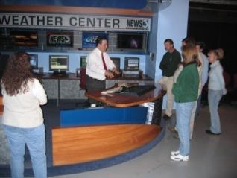
Our Mission
Foster scientific literacy in Earth system science for all
American Meteorological Society | Education Program

Slide 4

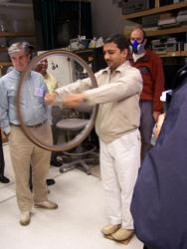
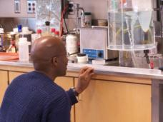
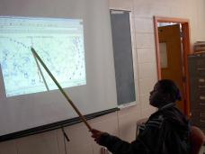
AMS Diversity Projects
Since 2001, AMS has initiated course implementation at MSIs through NSF-supported Geoscience Diversity/National Dissemination Projects
AMS Weather Studies Diversity Project
145 MSIs
More than 16,000 students took AMS Weather Studies
1st meteorology course offered for more than 67% of the institutions
AMS Ocean Studies Diversity Project
75 MSIs
More than 8,000 students took AMS Ocean Studies
About 50 MSIs implemented both AMS Weather and Ocean Studies
American Meteorological Society | Education Program

Slide 5

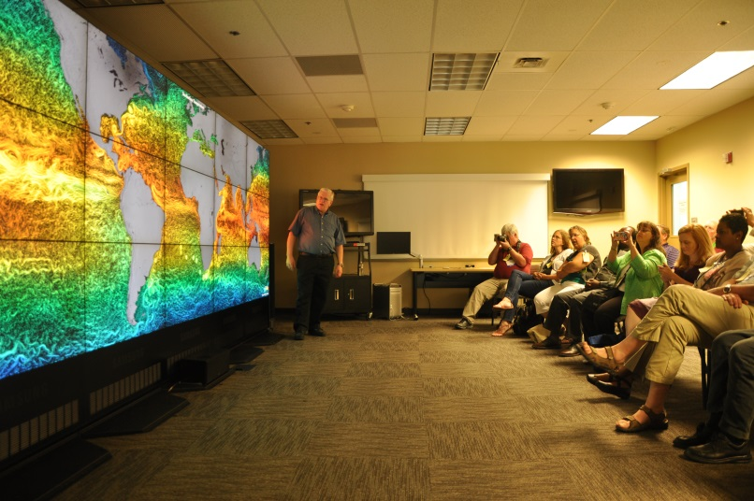
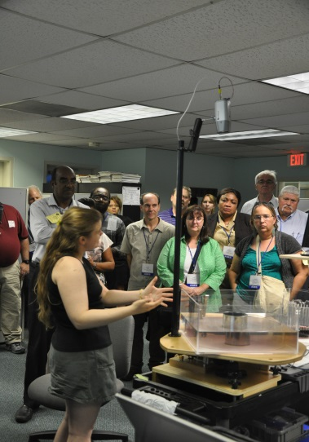
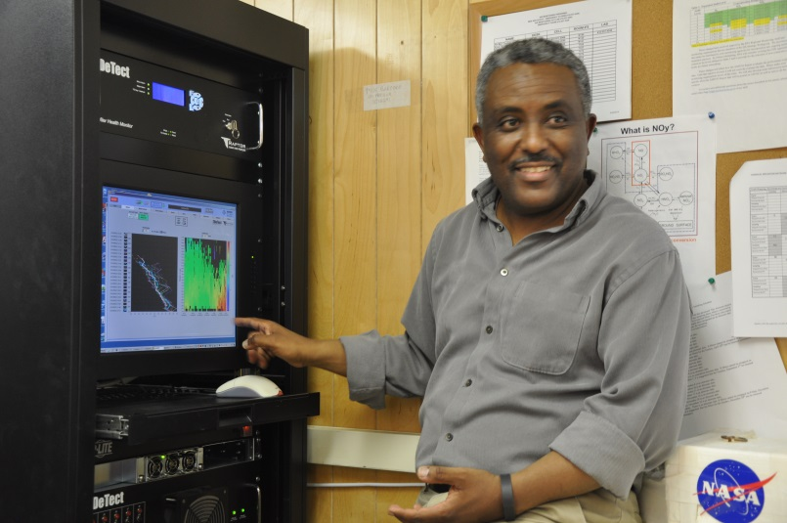
AMS Climate Studies Diversity Project
AMS Climate Studies Diversity Project
Partnered with Second Nature (administers ACUPCC)
Targeting 100 MSIs over 5 years
Already trained 75 MSIs
Currently recruiting for the 17-22 May 2015 workshop in Washington, DC with follow-up AMS Annual Meeting workshop in New Orleans in January 2016
American Meteorological Society | Education Program

Slide 6
AMS Climate Studies Diversity Project
AMS trains faculty
Faculty offer course; students learn
Faculty share knowledge/ experience
American Meteorological Society | Education Program

Slide 7
AMS Climate Studies Diversity Project
How it works?
Expenses-paid 5-day course implementation workshop in DC
Participants receive course materials and learn fundamental understandings within AMS Climate Studies and strategies for course offering
Features scientists from NASA, NOAA, Howard University, George Mason University, and other research institutions
Faculty offer AMS Climate Studies in year following DC workshop attendance
Invited to second workshop at AMS Annual Meeting the following year to report back the results of their work
American Meteorological Society | Education Program

Slide 8
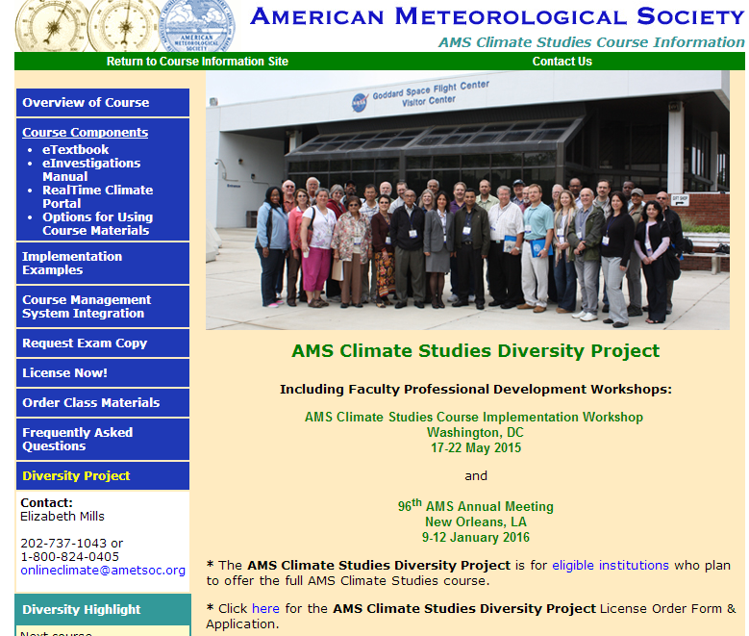
Interested?
Go to www.ametsoc.org/ climatediversity
Complete the license order form and application
Send to AMS
Deadline is 14 March and decisions will be made by 1 April
American Meteorological Society | Education Program

Slide 9
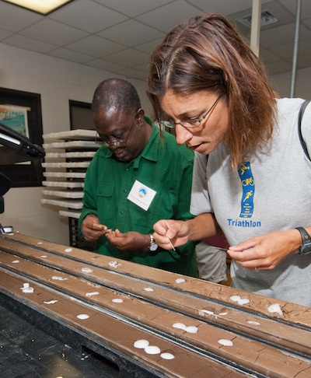
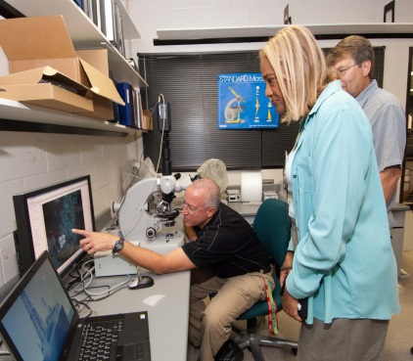
REaCH Reconstructing Earth’s Climate History
Do you teach at a MSI? Are you interested in:
expanding your knowledge or Earth’s climate record?
building scientific skills through hands-on investigations of IODP paleoclimate data?
If so, apply!
June 21-27, 2015
Gulf Coast Repository, Texas A&M University
The workshop will partner you with researchers and science instruction experts who will mentor you as you implement what you learn
Contact Beth Mills (mills@ametsoc.org) to learn more
American Meteorological Society | Education Program

Slide 10
Our Changing Climate
introduction to climate science
Comprehensive analysis of Earth’s climate system
What is climate?
How does climate operate?
How does climate change through time?
How do we interact with climate and how do its variations affect us?
Investigation of climate through statistics and GIS
Introduction to adaptive strategies and policies to lessen our vulnerability to climate change
Analysis of climate change denial
American Meteorological Society | Education Program

Slide 11
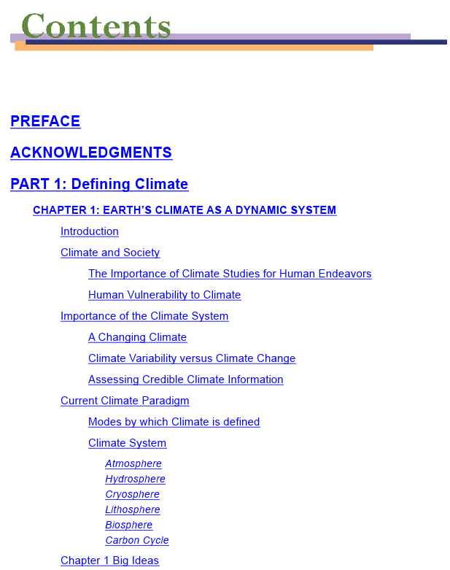
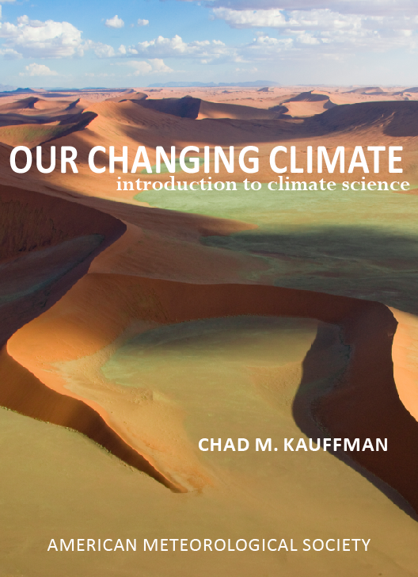
Our Changing Climate
introduction to climate science
Contents
Earth’s Climate as a Dynamic System
Observing Earth’s Climate System
Tools for Investigating Earth’s Climate System
Radiation and Heat in the Climate System
Water in Earth’s Climate System
Global Atmospheric Circulation
Atmosphere-Ocean Relationships
Natural and Anthropogenic Drivers of Climate Change
Paleoclimatic Investigations: Relevancy to the Present State of Climate
Future Projections and Extremes of Climate
Human and Ecosystem Vulnerabilities
Climate Change Mitigation and Energy Use
Human Needs, Actions and Public Policy
Climate Studies as a Scientific Endeavor in a Changing Society
American Meteorological Society | Education Program

Slide 12
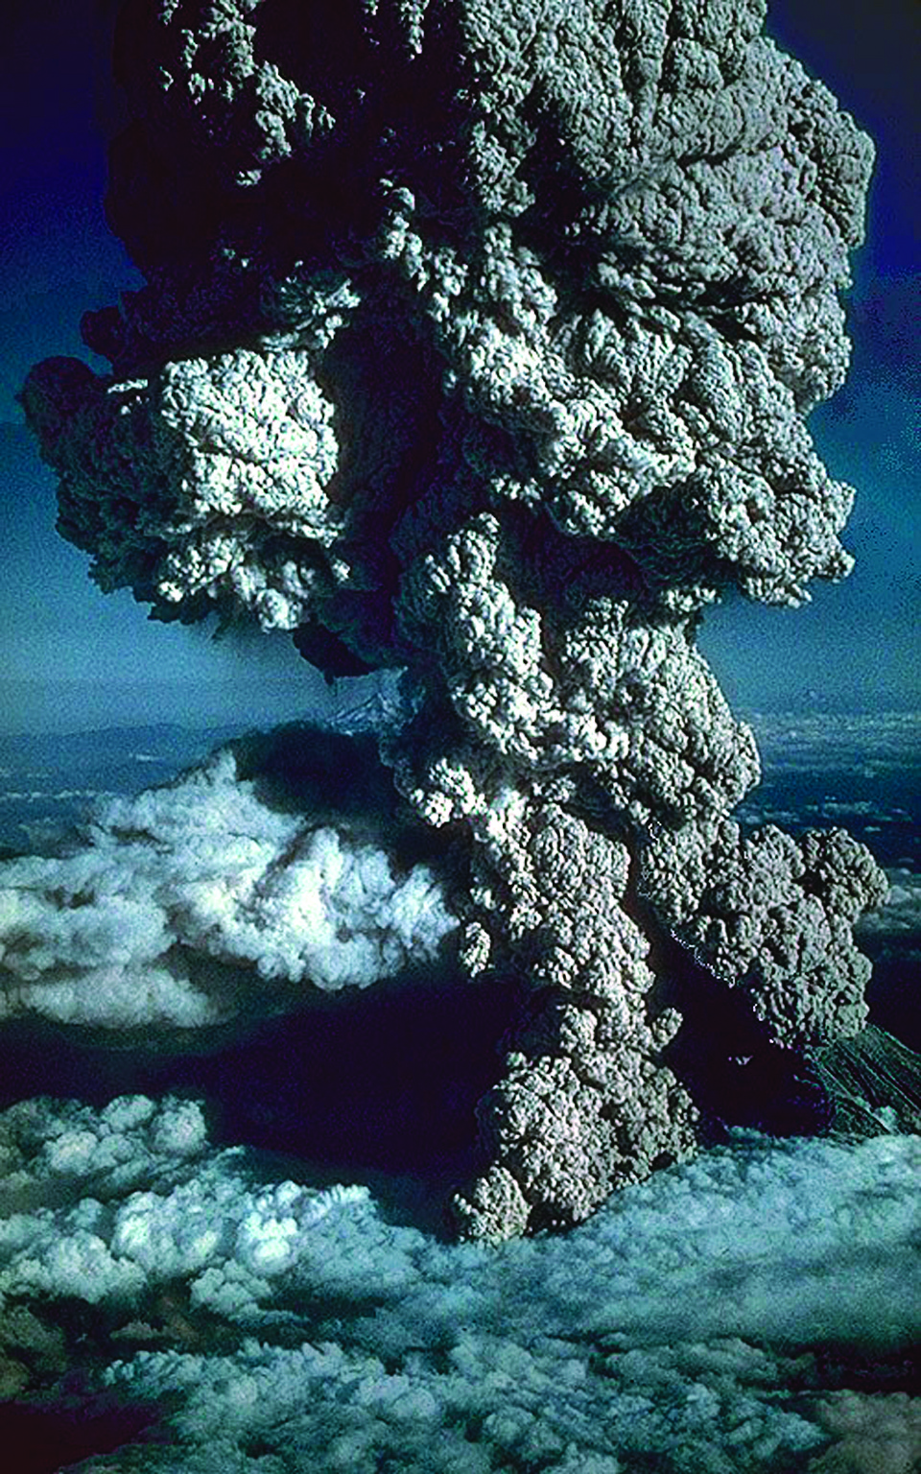
Our Changing Climate
introduction to climate science
Chapter 8: Natural & Anthropogenic Drivers of Climate Change
Current State of the Climate System from the Instrumental Record
Integrity of Instrument Data
Lessons from Climate Data
Natural Drivers of Climate Change
Solar Changes
Changes in Earth’s Orbit
Geologic Contributions
Plate Tectonics
Volcanoes
Feedbacks
Types of Feedbacks
Snow and Ice Cover
Shrinkage of Arctic Sea-Ice Cover
Biogeochemical Cycles
Greenhouse Gas Contributions
Trends in Greenhouse Gases
Aerosols
Changes in Land Use and Land Cover
Anthropogenic versus Natural Forcing of Climate
American Meteorological Society | Education Program

Slide 13
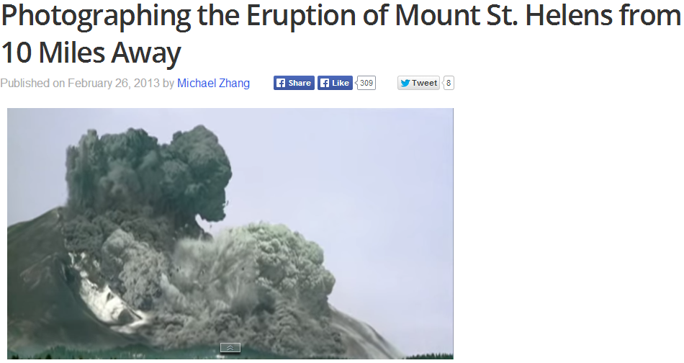
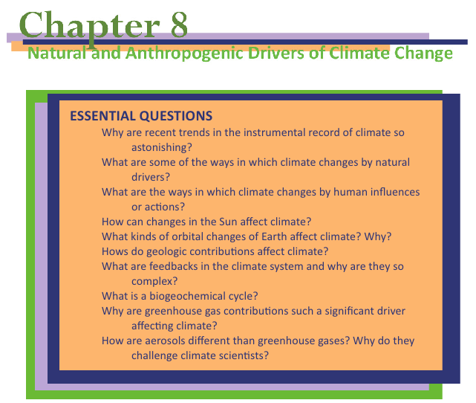
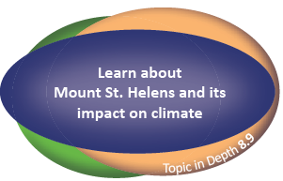
Our Changing Climate
introduction to climate science
American Meteorological Society | Education Program

Slide 14
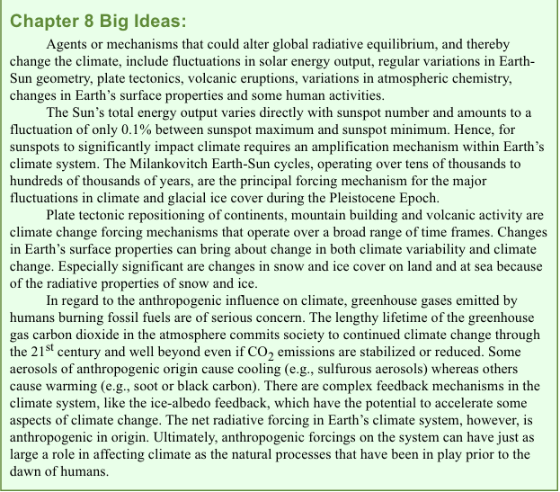
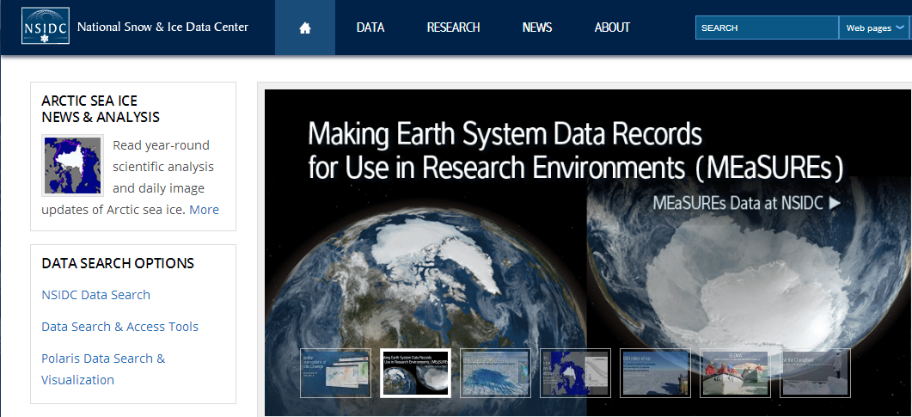
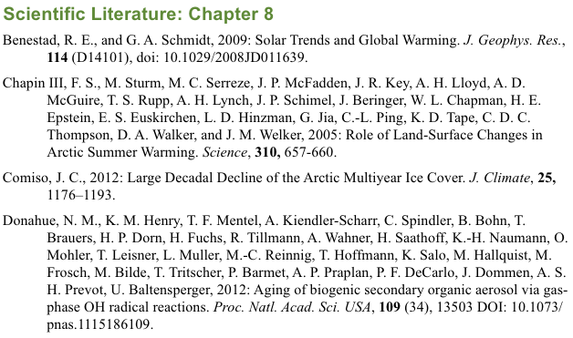
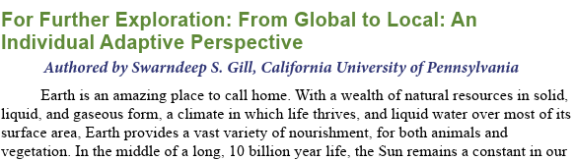
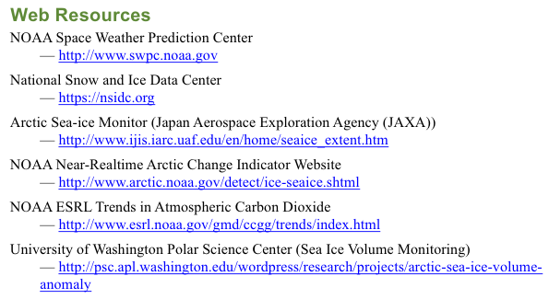
Our Changing Climate
introduction to climate science
Each chapter ends with:
Big Ideas
For Further Exploration
Key Terms
Review Questions
Critical Thinking Questions
Web Resources
Scientific Literature
American Meteorological Society | Education Program

Slide 15
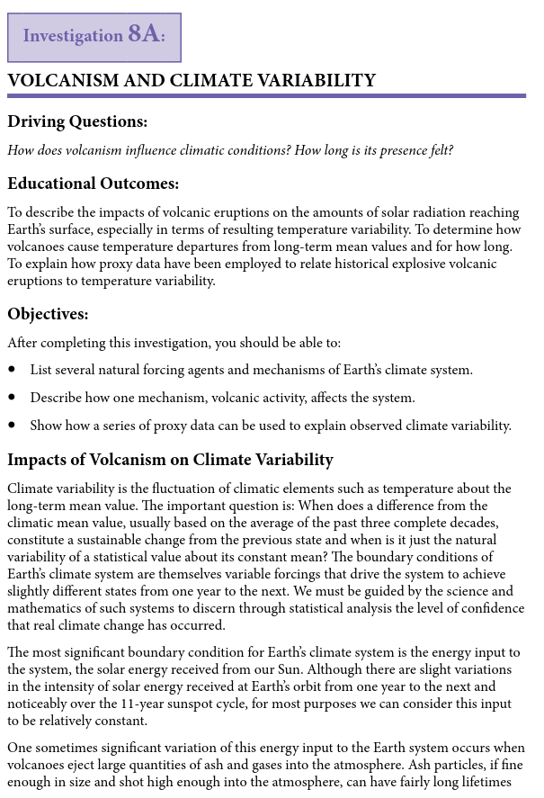
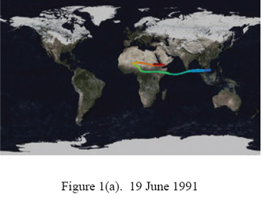
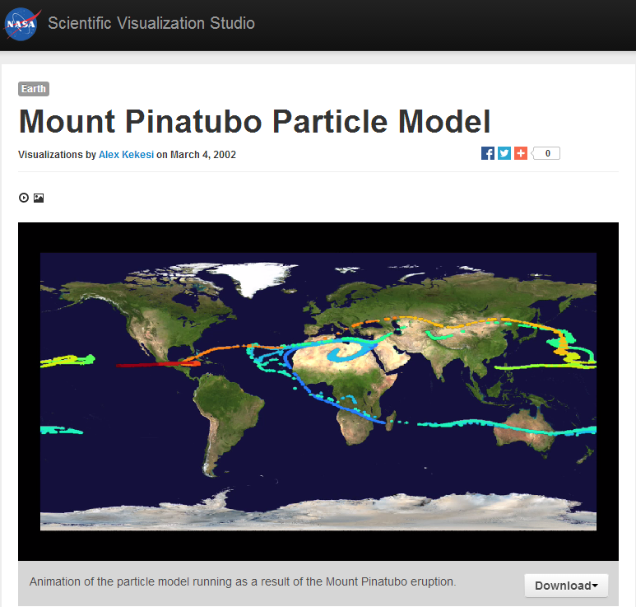
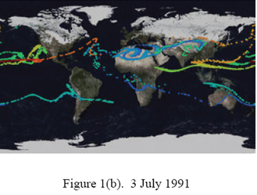
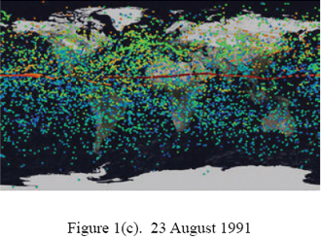
Climate Studies Coursework
American Meteorological Society | Education Program

Slide 16
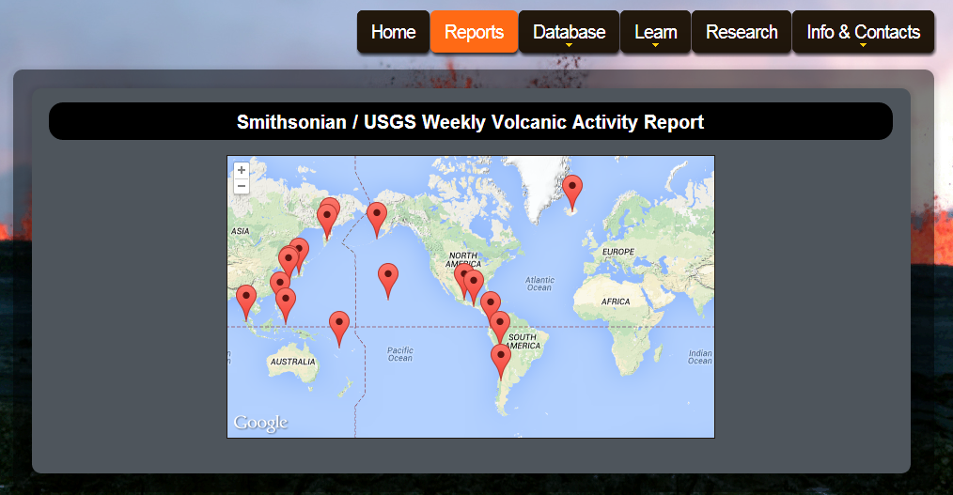
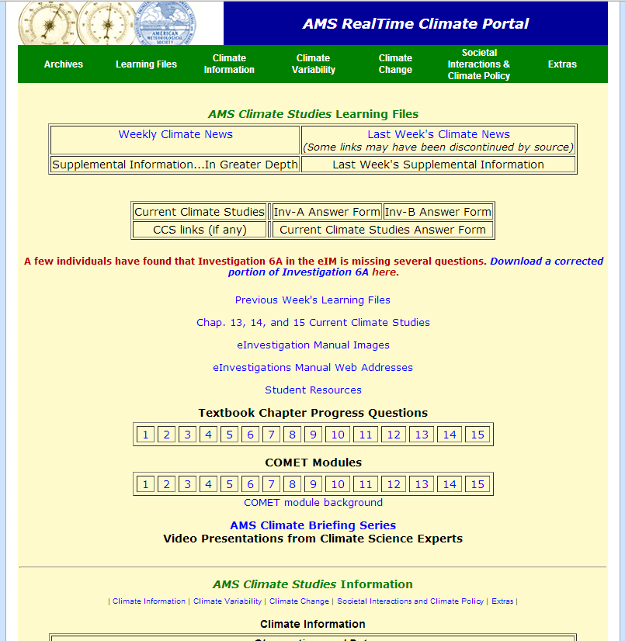
RealTime Climate Portal
American Meteorological Society | Education Program

Slide 17
Conclusions and Future Initiatives
AMS Climate Studies has been offered at 131 institutions, 91 of which have been MSIs.
Course encourages additional student exploration of the geosciences, possibly leading to careers in science or science teaching.
The next AMS Climate Studies Diversity Project workshop will be 17-22 May 2015.
American Meteorological Society | Education Program

Slide 18




Acknowledgements
AMS Climate Studies Diversity Project is supported by NSF grant 1107968 “AMS Climate Studies: Fostering Climate Science Literacy and Promoting Minority Participation in the Geosciences.”
Any opinions, findings, and conclusions or recommendations expressed in this material are those of the author(s) and do not necessarily reflect the views of the National Science Foundation.
American Meteorological Society | Education Program

Slide 19
?
Visit us at booth #1119 to check out our eBooks!
@AMSeducation
brey@ametsoc.org
www.ametsoc.org/amsedu
Dr. James Brey
Director, Education Program | American Meteorological Society

