Slide 1
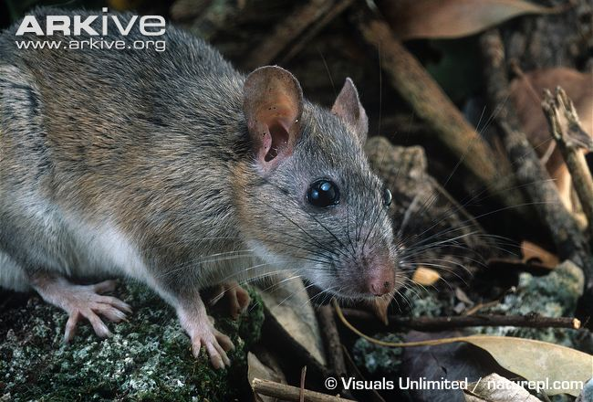
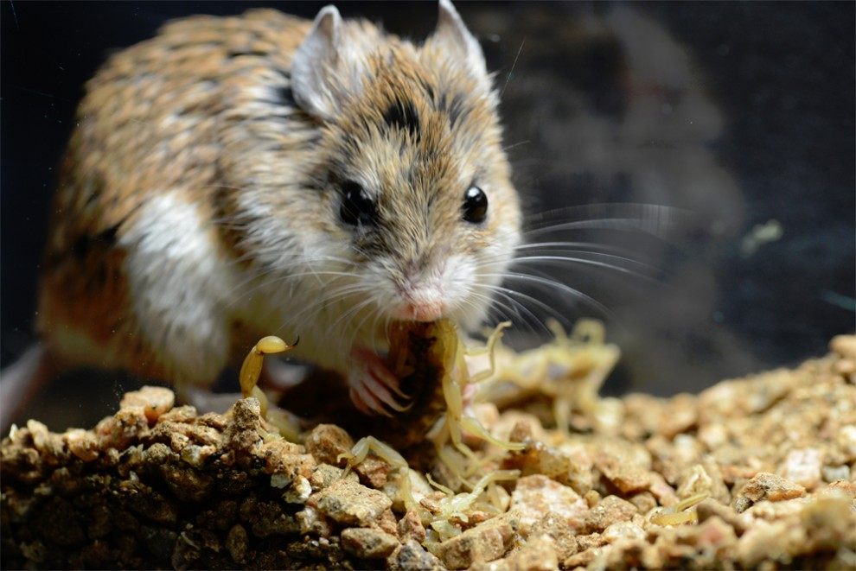
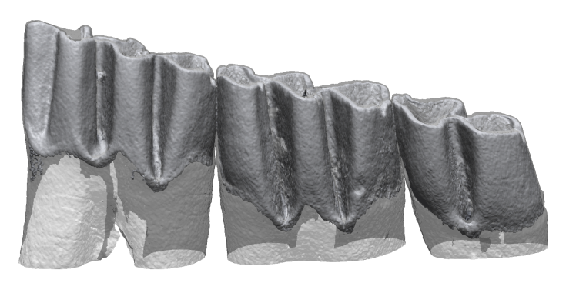
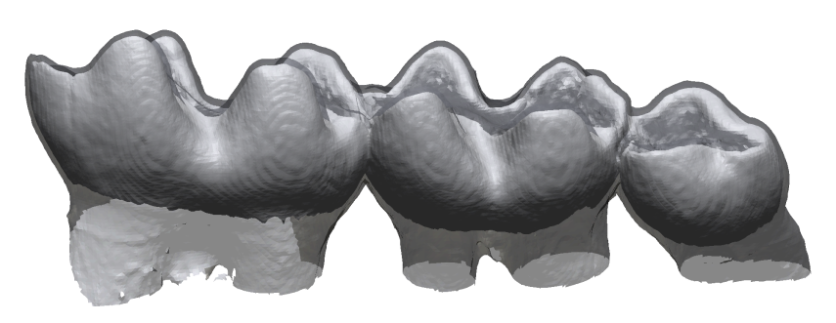
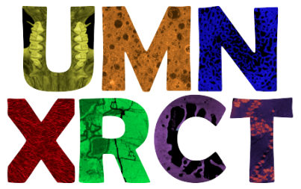
Dental ecometrics predict trophic categories in North American rodents
Credit: Matthew and Ashlee Rowe
Eastern Woodrat (Neotoma floridana )
Frugivore
~16µm scan
Grasshopper Mouse (Onychomys leucogaster)
Invertivore
~16µm scan
Jonathan S. Keller (kell1077@umn.edu) – Ecology, Evolution, and Behavior
David L. Fox (dlfox@umn.edu)– Earth Sciences
Kieran P. McNulty (kmcnulty@umn.edu)– Anthropology
University of Minnesota
Notes:
Diet is a primary mode by which consumers within populations and populations within ecosystems interact with their landscapes. While individuals might not be delimited solely by a single variable such as climate, vegetation, or topography, communities are associated with a very specific set of conditions and individuals within those communities are associated with a very specific set of adaptations.

Slide 2
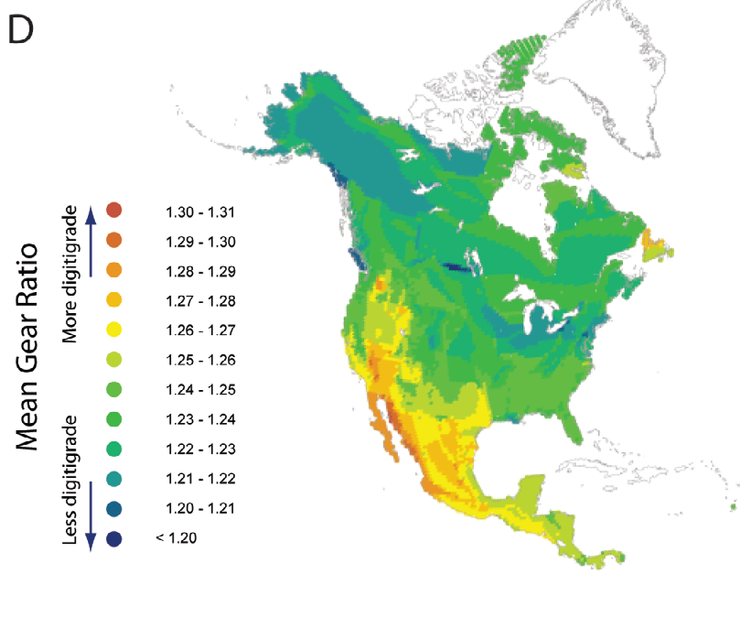
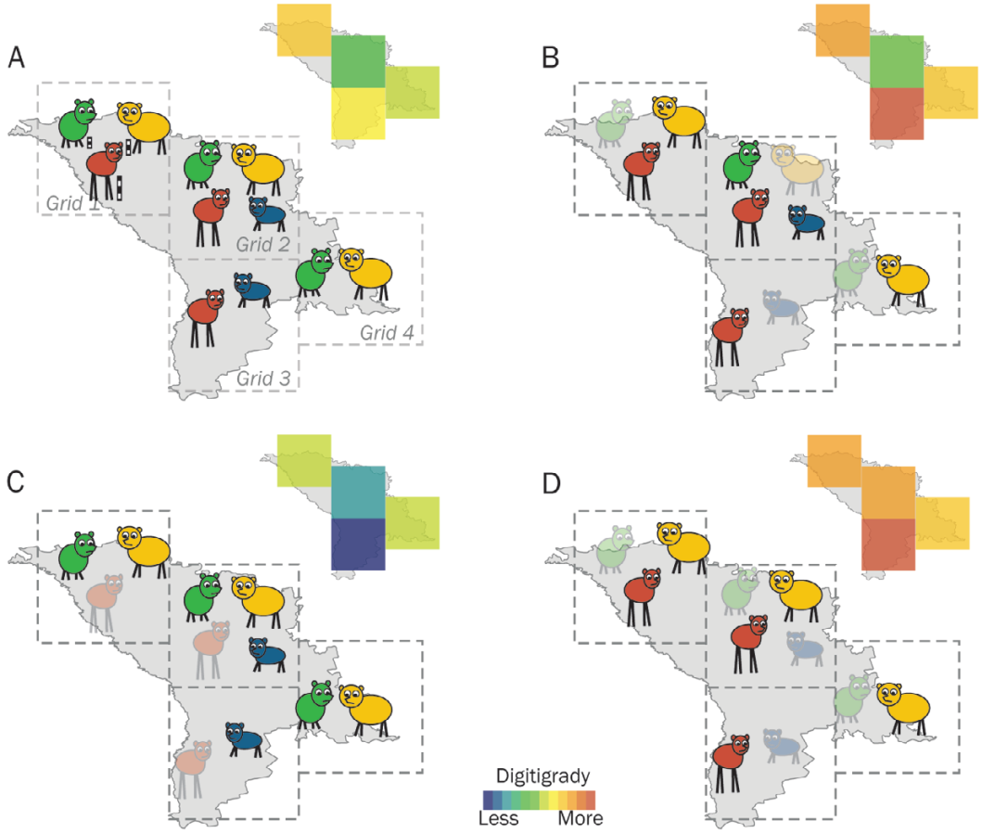
Trophic diversity and paleoecosystem reconstruction
Traits that reflect ecology and can be used to reconstruct past ecosystems are ecometrics.
In carnivorans, mean gear ratio within 50km x 50km cells explains 70% of variation in North American ecological provinces (Polly, 2010. Carnivoran Evolution).
Characteristics of fossil ungulate communities are often used to infer ecosystem based on diet.
Hypsodonty and number of longitudinal lophs in extant herbivores explain 73% of modern
biome net primary productivity (Liu et al., 2012. Proc R Soc B).
Polly and Sarwar, 2014. Ann. Zoo. Fennici.
Notes:
Frame as consumers having effects on ecosystem and specific members of community predicting ecosystem type/function
Rodents are a better system because they are more abundant in the fossil record, more cosmopolitan in distribution, and offer greater temporal and spatial resolution to understand changing landscapes.

Slide 3
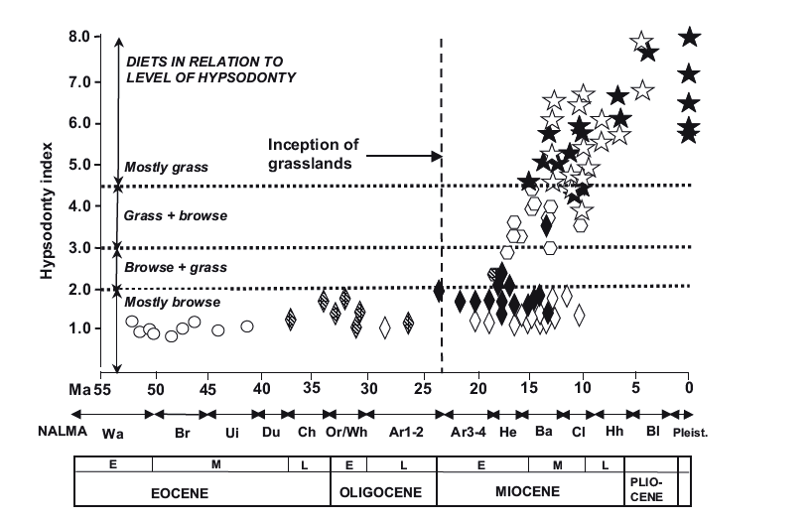
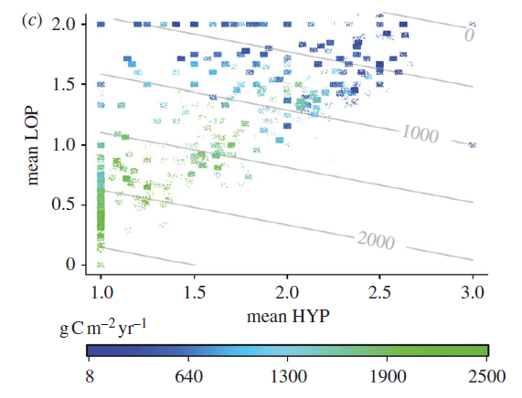
Trophic diversity and paleoecosystem reconstruction
Traits that reflect ecology and can be used to reconstruct past ecosystems are ecometrics.
In carnivorans, mean gear ratio within 50km x 50km cells explains 70% of variation in North American ecological provinces (Polly, 2010. Carnivoran Evolution).
Characteristics of fossil ungulate communities are often used to infer ecosystem based on diet.
Hypsodonty and number of longitudinal lophs in extant herbivores explain 73% of modern
biome net primary productivity (Liu et al., 2012. Proc R Soc B).
Hypsodonty and Diet
Loph #, Hypsodonty, and NPP
Janis and Damuth, 2011. Biological Reviews
Liu et al., 2012. Proc R Soc B
Notes:
Frame as consumers having effects on ecosystem and specific members of community predicting ecosystem type/function
Rodents are a better system because they are more abundant in the fossil record, more cosmopolitan in distribution, and offer greater temporal and spatial resolution to understand changing landscapes.

Slide 4
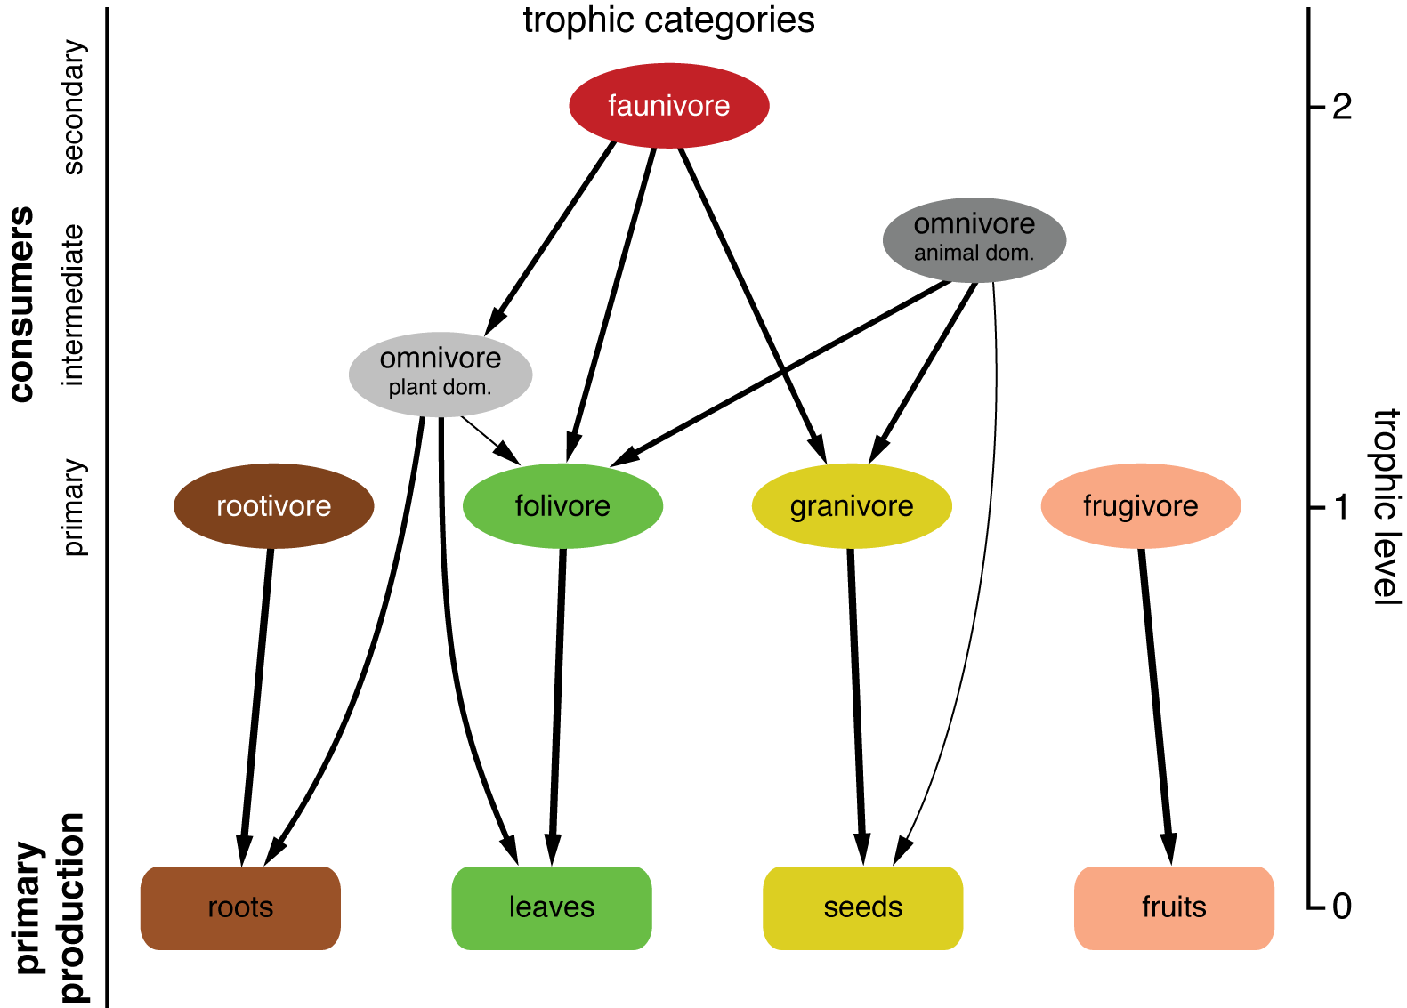

Simple Food Web Structure
Notes:
Logically, the more trophic levels and trophic categories occupied by a community under study, the more inclusive and specific the results should be. Beyond predicting abiotic ecosystem variables, with greater numbers of trophic categories and higher trophic levels, we can begin to understand interactions such as interspecific competition, predation, and herbivory.

Slide 5
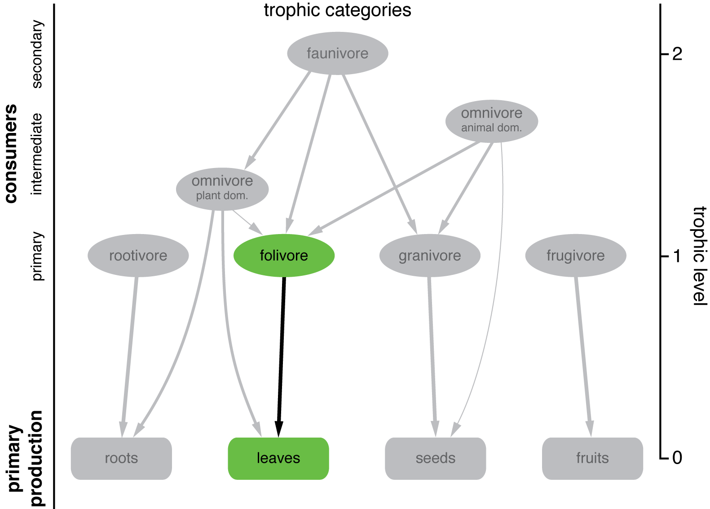
Trophic categories: ungulates
Notes:
Ungulates occupy a single trophic category in this representation, and definitely just one trophic level. However, inferences about their diet provide invaluable information

Slide 6
Trophic categories: rodents
Notes:
In contrast, rodents eat absolutely everything. And thus, studying just the assemblage of rodents in a locality, might yield greater insight into ecosystem function once we have the tools to do so.

Slide 7
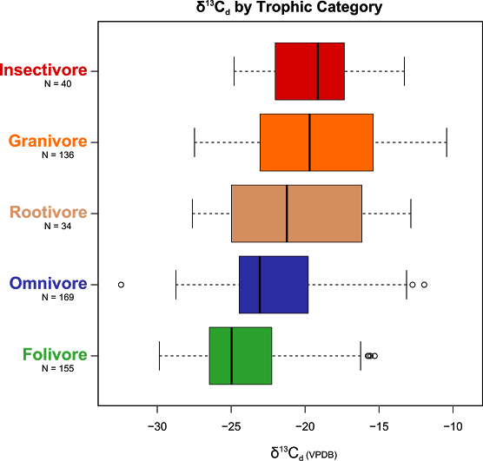
Credit: Andrew Haveles
Isotopes are good, but more tools are needed
Significant pair-wise differences in mean
Fol-Omni p < 0.001
Fol-Root p < 0.001
Fol-Gran p < 0.001
Fol-Ins p < 0.001
Omni-Gran p < 0.001
Omni-Ins p < 0.001
Notes:
As we've seen, isotopes are trophically informative for rodents, but the overlap between diet categories is too great for a single method to bridge. Mean values for granivores and folivores are significantly different, and omnivores are distinguishable from invertivores and granivores. Carbon isotopes give important, but very incomplete information about diet in rodents.

Slide 8
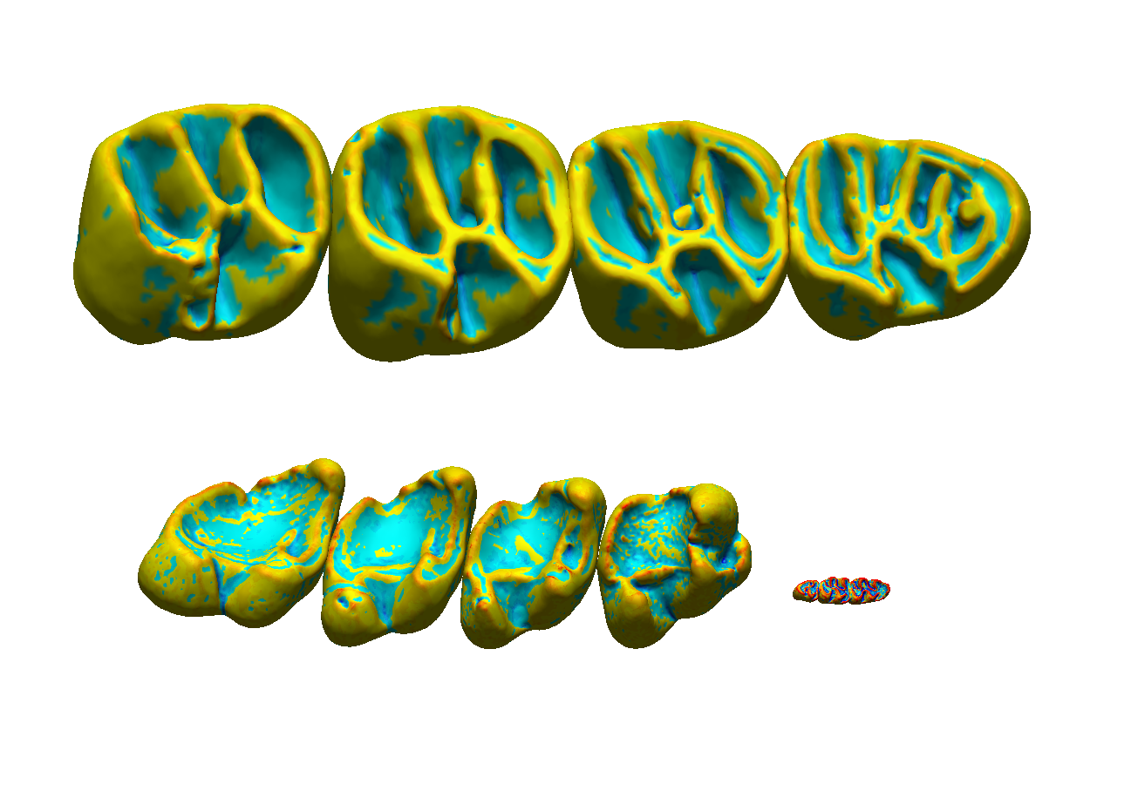
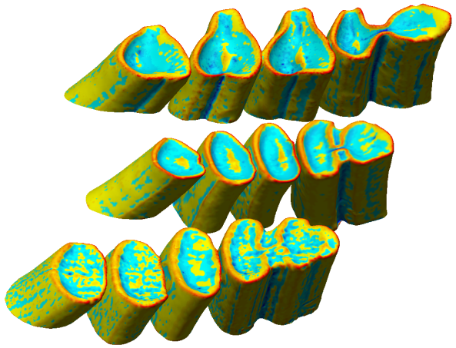
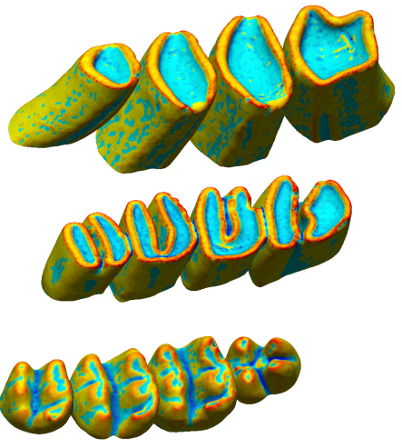
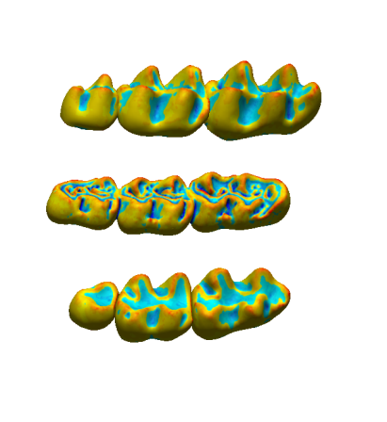
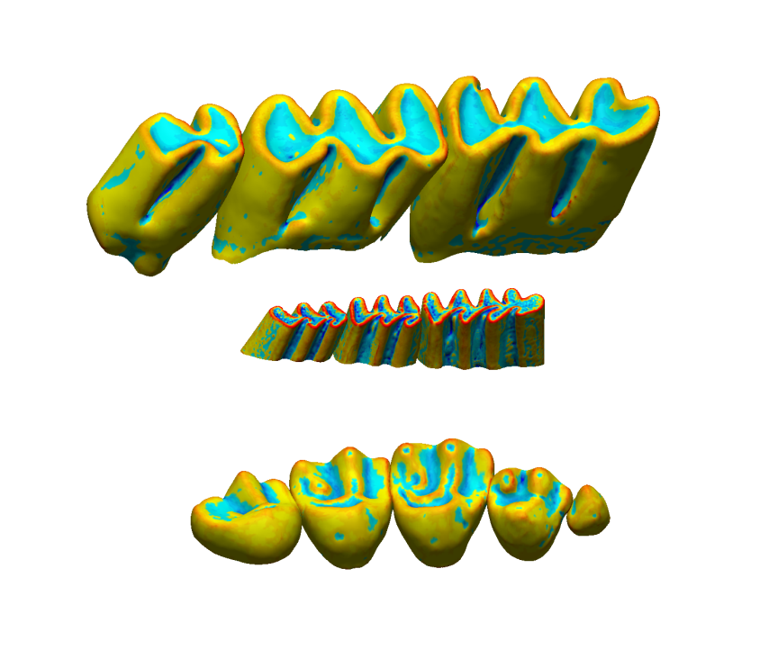
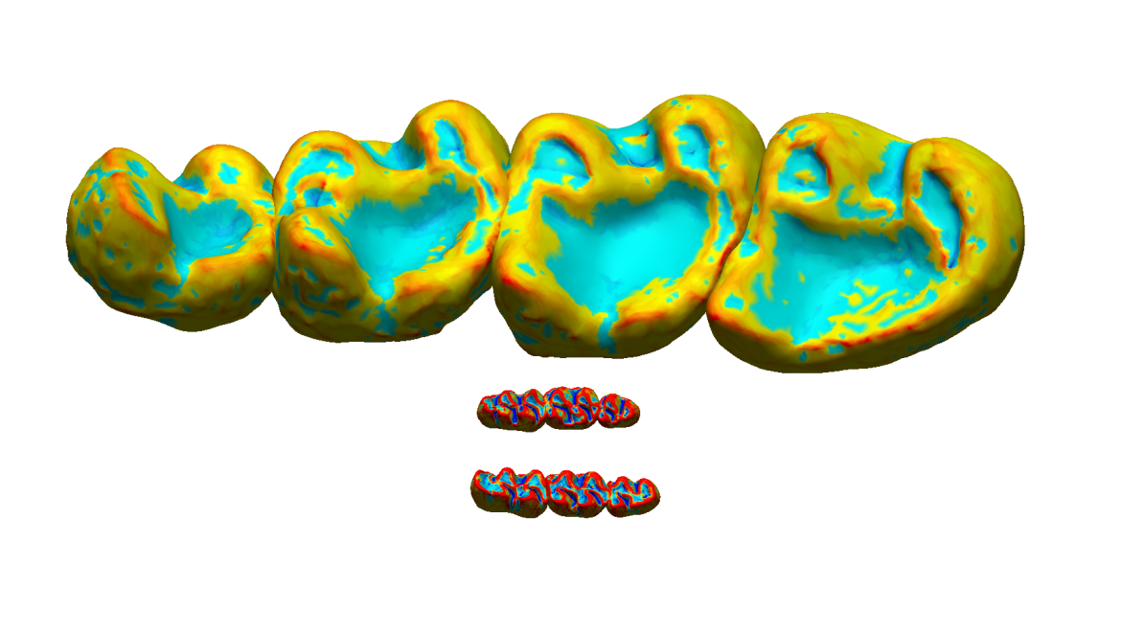
Morphological diversity
Rootivory
Folivory
Granivory
Invertivory
Frugivory
Omnivory
5mm
Anterior
Notes:
Rodents are a challenging system to work with because their morphologies are so disparate that it is often impossible to assign homologous points among species. This disparity in form and function highlights the need for homology-independent metrics and preferably also orientation- and wear-independent metrics given the non-ideal conditions of fossil rodent teeth.
In this figure, you see tooth crowns only. Mapped by surface curvature, areas of red indicate greater magnitudes of convex curvature while deep blues indicate very concave areas.

Slide 9
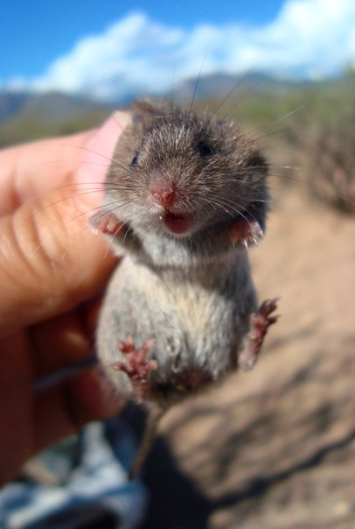
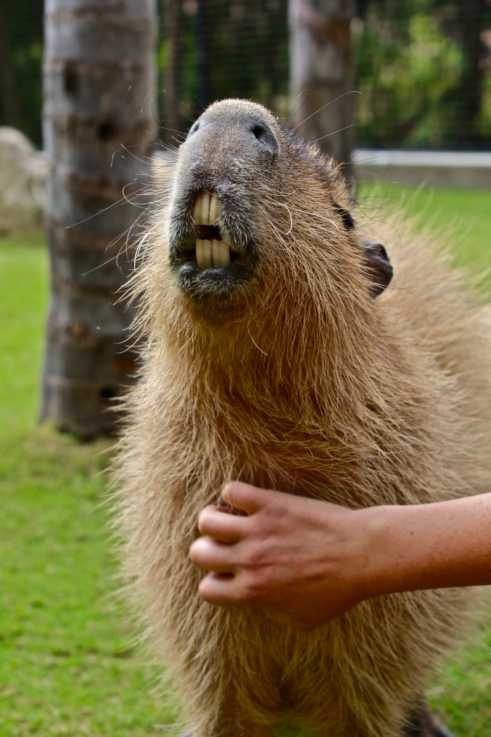
Northern Pygmy Mouse
Baiomys taylori
Tooth row length ~ 3.5mm
Capybara
Hydrochoerus hydrochaeris
Tooth row length ~120mm
Credit: Rachel Pyles
www.thesilverpen.com

Slide 10
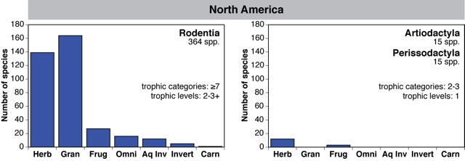
Taxonomic diversity: so why not use rodents?
Pros: Geographically cosmopolitan, ubiquitous in the fossil record, dentitions are diverse/fossilize well, offer high temporal and spatial resolution.
Goals: Understand how community structure has changed in response to climate, biotic, and landscape change.
To do this, we need reliable tools to predict trophic category.
Badgley and Fox. 2000. Journal of Biogeography
Notes:
So why not use rodents? As you can see in this figure, rodents are at least an order of magnitude more taxonomically diverse than ungulates and carnivorans. Rodents span 2-3 trophic levels in many relevant ecosystems and occupy 7 or more trophic categories across North America. Geographically ubiquitious and abundant in the fossil record, their dentitions are highly derived and fossilize well. Thus, rodents provide much greater spatial and temporal resolution than ungulates, carnivorans, or any mammal group that we know of.
One of the goals of our project on the evolution of rodent communities over the Pliocene and Pleistocene is to understand how the range of trophic categories within local faunas has changed over time in response to local and global climatic changes and to local biotic and landscape changes. Given the trophic diversity of rodents, to do this we need to be able to estimate multiple trophic categories from the morphology of fossil teeth. To begin, we're creating a model using extant North American rodents to be able to determine trophic category from lower or mandibular teeth. Ultimately, we'll expand these methods to uppers or maxillary teeth and apply them to isolated teeth in the fossil record rather than whole dental arcades, which is what we're using now.

Slide 11

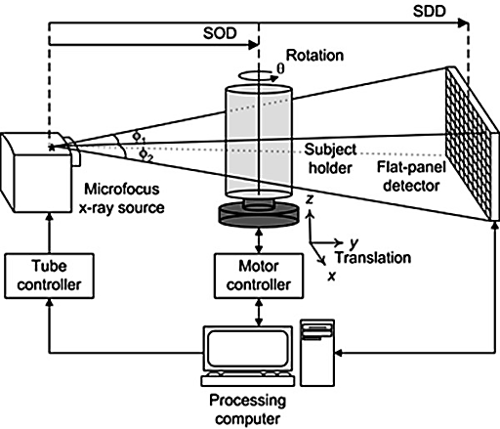
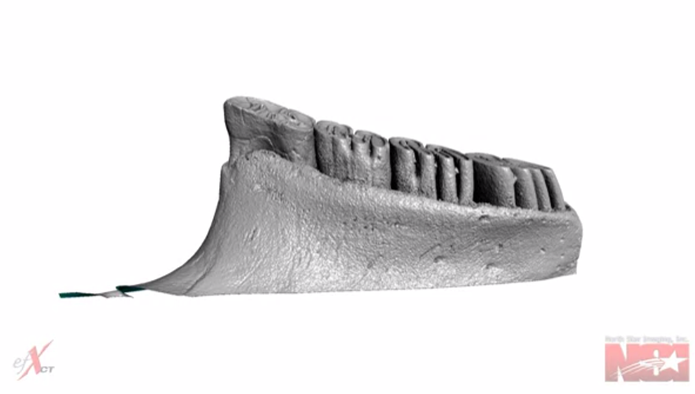
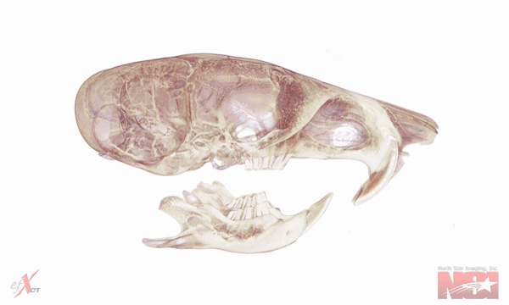
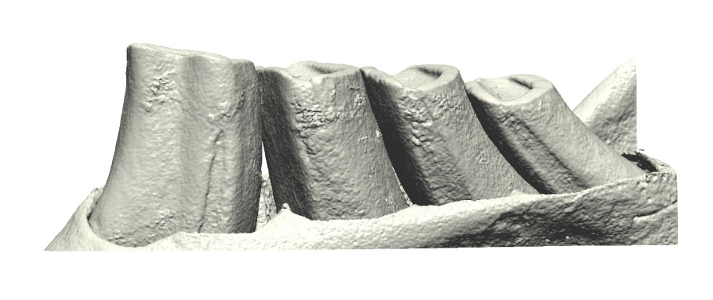
Workflow
1. MicroCT scan specimen
3. Create isosurfaces at dentin and enamel thresholds
Equipment: North Star Imaging X5000 XRCT scanner
Software: eFX-CT and Avizo Fire
2. Reconstruct volume
4. Crop/process isosurfaces before data collection
Software: eFX-CT and Avizo Fire
Software: Geomagic X, Surfer, MATLab, Morphotester
Notes:
Using microCT, we began by replicating various published dental metrics that had proved useful in predicting diets in other taxonomic groups such as primates and carnivorans. But before I get ahead of myself, let's quickly run through how we get from skulls and mandibles to 3D tooth models.
. MicroCT-scan specimen: First, I microCT scan several specimens at 4-35 micron resolution depending on the size of the tooth row. We later standardize for resolution and size differences between taxa. We've also run tests that confirm that scans at different resolutions produce near-identical values for appropriately sized tooth rows.
2. Reconstruct volume: Anyway, scanning produces 1440 gray-scale radiographs which are reconstructed into a 3D volume.
3. Create isosurfaces at dentin and enamel thresholds: We then select the area of interest from the 3D volume and surface it by creating a threshold at the gray-scale values that correspond to dentin and enamel. X-ray attenuation is a function of density and atomic number, so we can easily discriminate between dentin and enamel. The dentin threshold contains all the gray scale values higher or denser than dentin, so counterintuitively it includes enamel. Here, you can see what surfacing a volume at the dentin threshold looks like. Notice that alveolar bone is as dense or denser than dentin, so it is also being surfaced along with the enamel and will need to be cropped out.

Slide 12

Workflow
1. MicroCT scan specimen
3. Create isosurfaces at dentin and enamel thresholds
Equipment: North Star Imaging X5000 XRCT scanner
Software: eFX-CT and Avizo Fire
2. Reconstruct volume
4. Crop/process isosurfaces before data collection
Software: eFX-CT and Avizo Fire
Software: Geomagic X, Surfer, MATLab, Morphotester
Notes:
3. Create isosurfaces at dentin and enamel thresholds: Now, at top right you can see the enamel threshold. Here, we're just looking at enamel, and you can see the eruption of the last deciduous tooth, the fourth premolar in front. At present, we only use data from adults.
4. Crop/process isosurfaces before data collection: After we have the surface we want, it gets dumped into another program, Geomagic X (formerly Rapidform XOR/XOV) to be cropped, edited, and processed.
At this time, we have more than 140 species scanned, more than 100 reconstructed, and complete data extracted for 90 species. We collect data for each tooth and the tooth row as a whole so that one day we might apply these methods to isolated teeth. However, we're extracting nearly 300 variables, mostly manually, so data collection has been slow, and most of these metrics appear to be non-informative.
When we reach data collection for 100 species and round out sample sizes in our smaller trophic categories, we'll determine which variables are correlated with phylogeny, diet, and any other relevant categorial variables, then continue data collection only collecting those metrics.

Slide 13
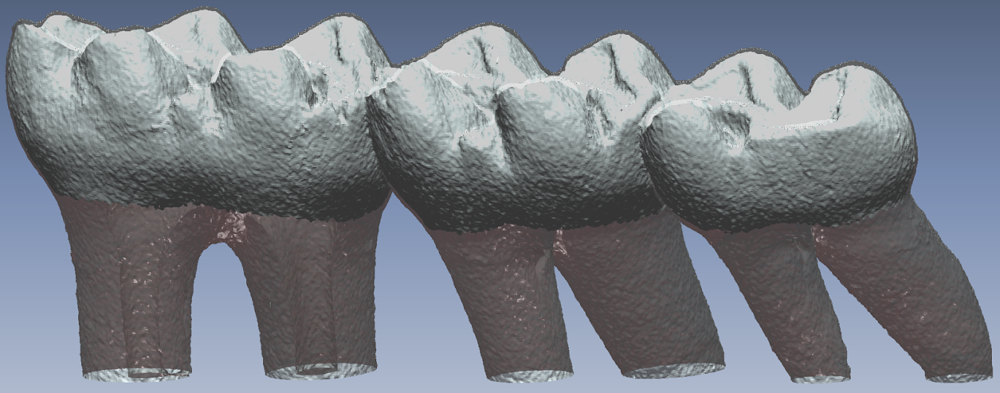
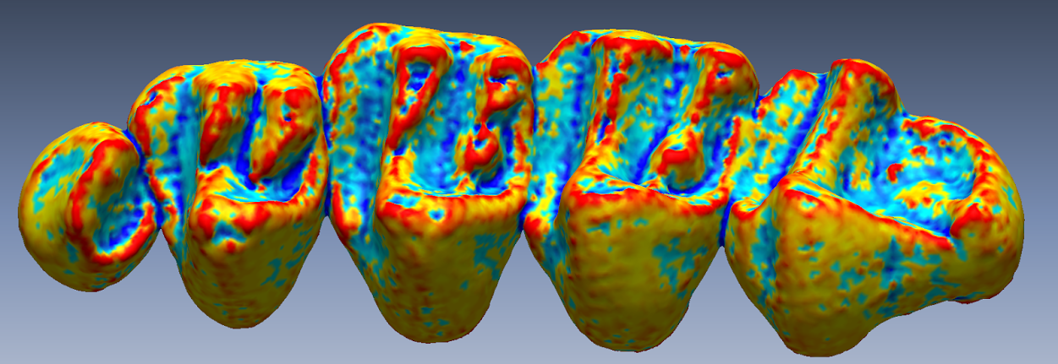
Cropping and Processing
Novel methods for obtaining replicable and functionally significant tooth areas for analysis
Enamel-dentin junction delineation:
XRCT grayscale values are a function of density and atomic number.
Occlusal curvature cropping:
User places points around areas of greatest curvature. Software finds best-fit line within 10 poly-faces of user-placed point, creating replicable spline from which to crop occlusal surface.
Past published methods:
-Approximate, manually placed points without density data
-DEM conversion from laser-scans
Southern Grasshopper Mouse (Onychomys torridus)
Invertivore
~16µm resolution
Harris’s Antelope Squirrel (Ammospermophilus harrisii)
Omnivore
~16µm resolution
Notes:
As I mentioned, we've developed several novel metrics, but none of them would be possible without a reliable and repeatable way to crop tooth rows to functionally significant areas. We crop to the enamel-dentin junction by overlaying the dentin threshold on the enamel threshold and asking the software to fit a spline to their junction. We then crop to that spline, leaving us with just the crown.
We also developed something I'm calling occlusal curvature cropping, which involves fitting a spline to the absolute greatest curvature surrounding the occlusal surface. This method is semi-manual in that users need to place points near the areas of greatest curvature, but the software refits the spline to the best-fit curvature within 10 poly-faces of the user-placed point.
We believe these represent significant improvements over past methods, which were either less repeatable or did not discriminate functionally relevant surfaces.

Slide 14
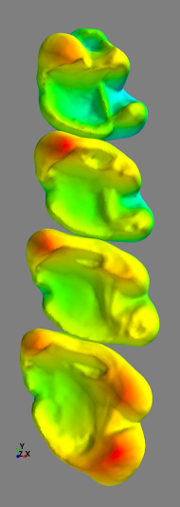
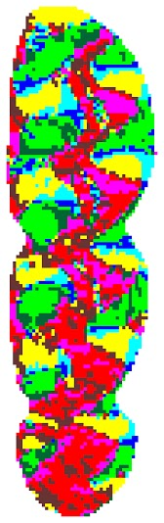
Replicated Methods: OPC and DNE
Orientation Patch Count (OPC):
A measure of tooth complexity based on the number of patches (“tools”) as mapped by slope and orientation.
Ex: Reithrodontomys mexicanus
Dirichlet Normal Energy (DNE):
A measure of average surface curvature based on the Dirichlet Normal Surface Energy equation.
Ex: Marmota monax
OPC DNE
Evans et al. 2007 Nature Bunn et al. 2011 Am. J. Phys. Anthropol.
Notes:
Alistair Evans and colleagues developed OPC or orientation patch count in 2007. OPC has been shown to be highly predictive in separating very broad diet categories for carnivorans and rodents, but only at the level of hypercarnivore, carnivore, animal-dominated omnivore, , etc. OPC is a measure of tooth complexity that is derived from the number of patches distinguishable by slope and orientation in the 8 cardinal directions. Herbivores have greater tooth complexity, while carnivores and invertivores have very low tooth complexity.
Dirichlet normal energy is a measure of the average curvature of a tooth based on the Dirichlet Normal Surface Energy equation. It is distinct from the curvature mapping that I showed earlier, as it provides a single number that represents the "curvedness" of a tooth or tooth row. Both OPC and DNE are lauded as homology, orientation, and wear independent metrics.

Slide 15
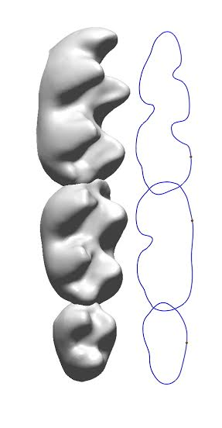
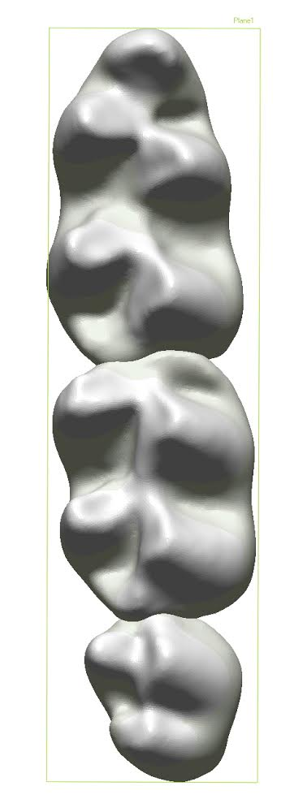
Replicated Methods: RFI and vHI
Relief Index (RFI):
Planimetric area of a tooth as projected onto a plane in the occlusal direction divided by the crown’s surface area.
Volumetric Hypsodonty Index (vHI):
Planimetric area divided by volume. Approximates a feature that is neither hypsodonty nor relief, but that is related to both.
Onychomys leucogaster shown in both.
RFI vHI
Boyer 2008 J. Hum. Evol. Lazzari et al. 2008 PlosOne
Notes:
Doug Boyer developed relief index in its modern form in 2008. We compute two types of relief index based on either the cross-sectional area of a tooth or the planimetric area of the tooth projected on an occlusal plane. This value is divided by the surface area of the tooth crown.
Volumetric hypsodonty takes the same planimetric measurement as the previous methods and divides it by volume rather than surface area. Lazzari et al. have found this approximates a feature similar to hypsodonty and relief, but that is functionally neither.

Slide 16
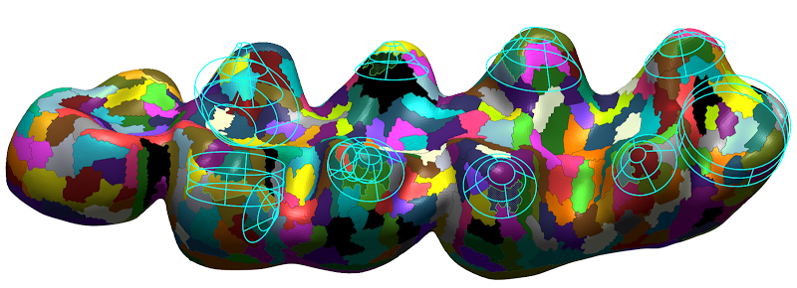
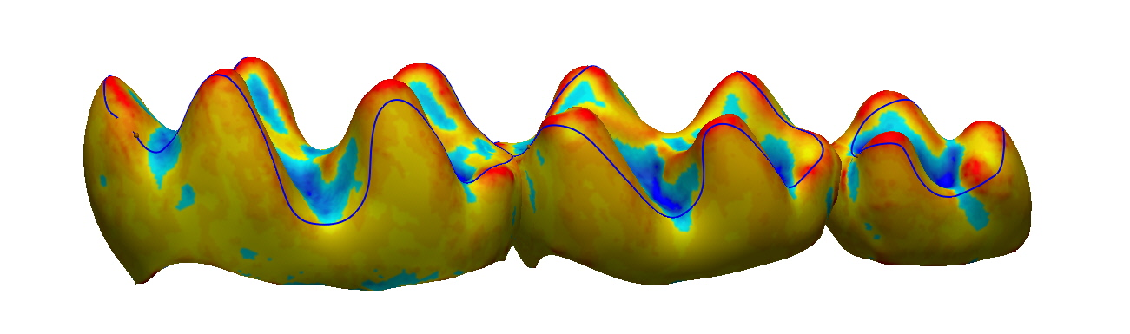
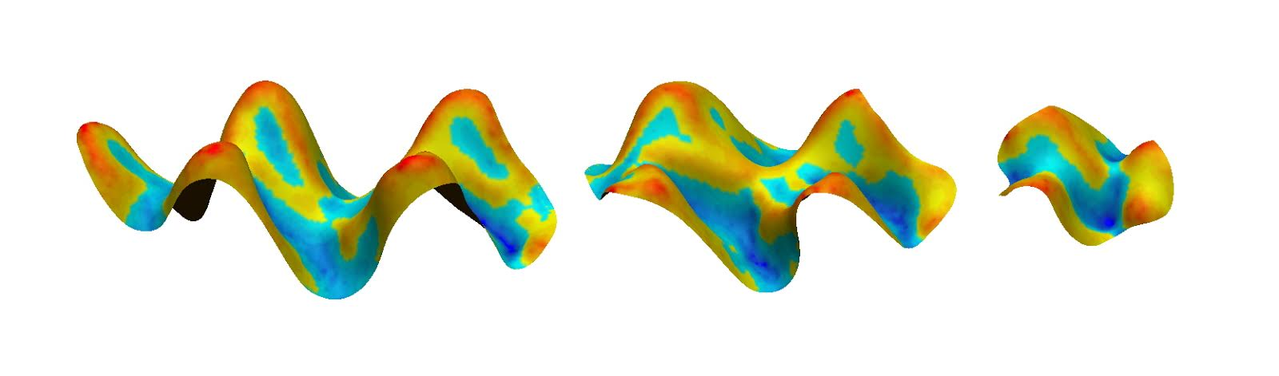
Novel Methods
Enamel/dentin ratio (EDR):
Volume of enamel divided by crown volume; ignores volume of roots.
Platonic shape extraction:
Software attempts to break up tooth surface into geometric shapes. Numbers of specific shape correlates with function.
Vertical complexity (VC):
Occlusal curvature cropping perimeter divided by EDJ perimeter
Occlusal concavity:
Occlusal volume divided by occlusal surface area (currently binary)
And many more...
Notes:
Playing with the software, I developed several novel methods. Here, I'm highlighting a few that worked.
EDR or the enamel:dentin ratio is the volume of enamel divided by crown volume, ignoring the volume of tooth roots.
Platonic shape extraction involves telling the software to extract given shapes from the mesh to aid in surface registration, so the software finds bits of mesh that conform to cones, cylinders, spheres, and tori. The number of these shapes and their ratios relative to one another give us an idea of functionality that we haven't been able to derive from other methods.
Vertical complexity is the ratio of the EDJ perimeter divided by the occlusal curvature perimeter to give us an idea of what's happening between the EDJ and the occlusal surface.
And occlusal concavity is a simple measure of whether the volume encased beneath the occlusal surface is overall convex or concave. When a tooth is convex relative to the occlusal plane, the value is recorded as negative. While very effective so far, this metric is definitely wear dependent, and will need to be applied with caution to worn teeth.

Slide 17
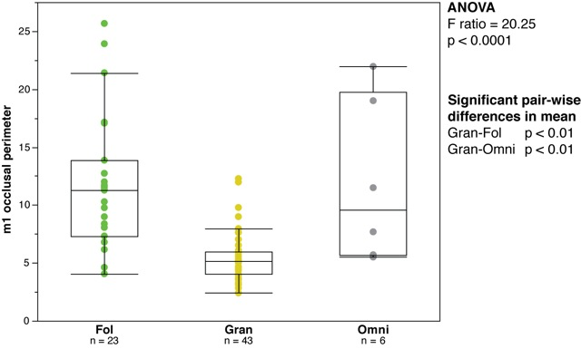
Results: m1 occlusal perimeter and m3 concavity
Granivore teeth often appear to be a series of mortars used to grind up seeds. These teeth tend to be very simple, resulting in very low perimeters. In the future, we will scale this metric to size to prevent scale bias.
Notes:
Granivore lower teeth often appear to be a series of mortars used to grind seeds. They are often relatively simple and columnar, leading to lower occlusal perimeters relative to their size than others. At present, we have not yet included this metric in a ratio that makes it size independent, but we will in the future. Specifically, this metric aids in distinguishing granivores from folivores and omnivores. I have not included a box and whisker plot for one of our most effective metrics, m3 concavity, because our data are currently in binary -- just is the tooth concave or not. To date, every granivore we've scanned has a concave m3, though two folivores also have concave m3s.

Slide 18
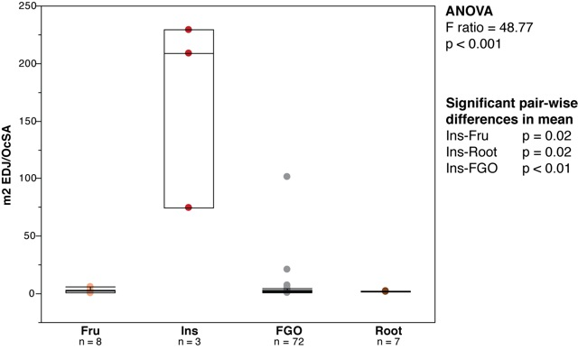
Results: m2 EDJ/Occlusal Surface Area
Invertivores have low occlusal surface areas because conical cusps are relatively simple. In contrast, conical cusps often influence the shape of the EDJ, creating waves that increase its perimeter. Invertivores also very low in occlusal complexity as measured by OPC.
Notes:
Invertivores tend to have low complexity as measured by OPC because they have relatively simple dentitions, mostly pointy cusps. Similarly, this means that they tend to have low occlusal surface areas relative to other rodents. In addition, their enamel-dentin junctions tend to reflect cusp topography, leading to greater perimeters. The ratios of these two values is thus highly effective at delineating invertivores.

Slide 19
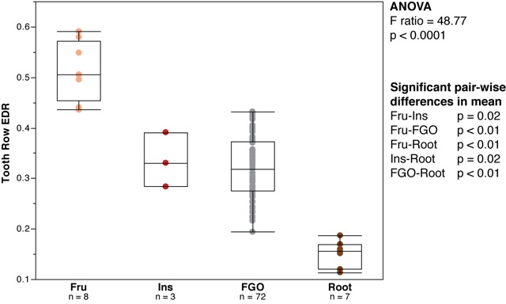
Results: Enamel-Dentin Ratio
Rodents appear to follow the primate pattern in that more frugivorous species have significantly more enamel to cope with fruit acidity.
Notes:
Rodents appear to follow the primate pattern in that more frugivorous species have significantly more enamel to cope with fruit acidity. Rootivores, in contrast, have very low levels of molar enamel. We have a few hypotheses about that that I don't have time to get into now. This metric alone distinguishes frugivores and rootivores from everything else.

Slide 20
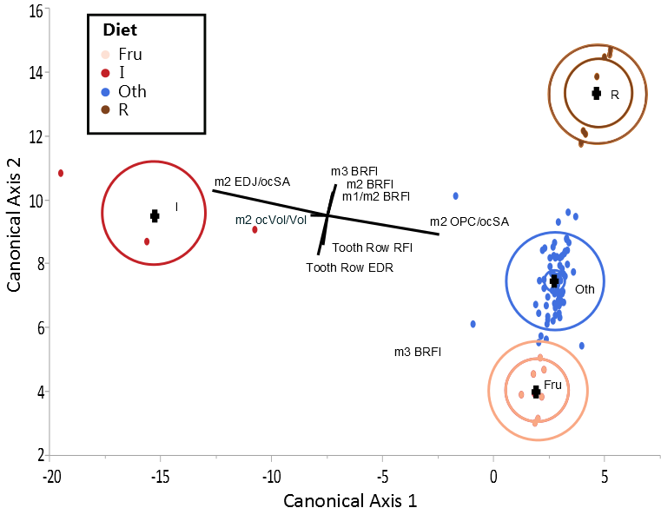
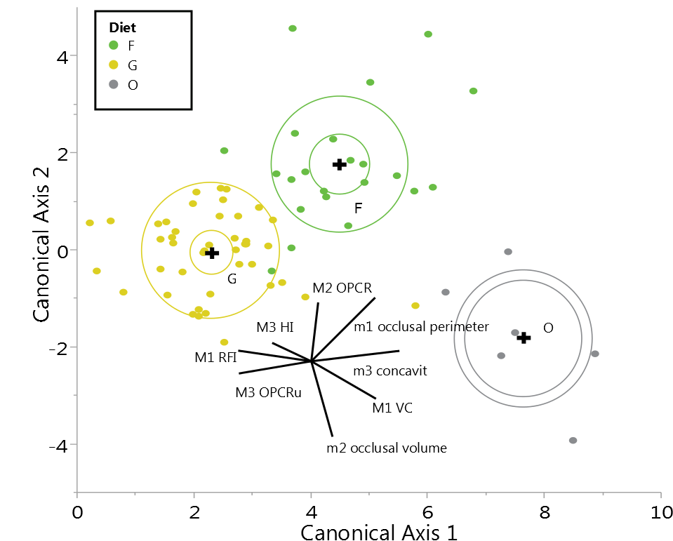
Results: Discriminant Function Analysis
Species correctly classified
by cross-validation
90 modern species
4 trophic categories
8 metrics
Frug
Invert
Root
Other
Total
8/8
2/3
7/7
70/72
87/90
96.6%
Included Variables:
Tooth Row EDR
Tooth Row RFI
m2 BRFI
m3 BRFI
m1/m2 BRFI
m2 EDJ/OcSA
m2 OcVol/Vol
m2 OPCR/ocSA
Notes:
Here's the prize. We used discriminant function analysis, an ordination method that maximizes the differences in categorical variables given many quantitative variables, to develop a model that delineates our 6 trophic categories of interest. We used a priori diet categories derived from the massive North American compendium published by Badgley and Fox in 2000. There are two things that aren't quite Kosher with the model you're looking at. One, our sample size of invertivores is quite low and they are so different from everything else that they are essentially defining the first Canonical Axis. I'm not at all concerned about our ability to distinguish invertivores in the future, and we're working on getting more specimens on loan from other museums. Two, we've lumped Folivores, Granivores, and Omnivores into a group called Oth for other. Differences in sample size and the similarity in morphologies of Folivores, Granivores, and Omnivores has prevented us from distinguishing them in a single DFA, so we're using a two-tiered approach in which we separate our invertivores, rootivores, and frugivores first before running a second DFA on the remainders. The circles on this plot show 95% confidence intervals and 50% data contours.
It's worth taking a second to talk about the difference between misclassification by substitution and cross-validation. Using substitution, each component of the model is evaluated within its parent model, so you can think of it as someone introducing a duplicate of any given species labeled as an unknown and seeing what the model will do with it. Using substitution, we correctly classify all species. In contrast, cross-validation removes each species from the model in turn, and rebuilds the model without it.
Using cross-validation, we misclassify three species, though two of these are very explainable. Onychomys leucogaster is misclassified because without it, we're lowered to an n of two for invertivores, and the mean shifts drastically. I'll talk about Peromyscus truei in just a moment.

Slide 21
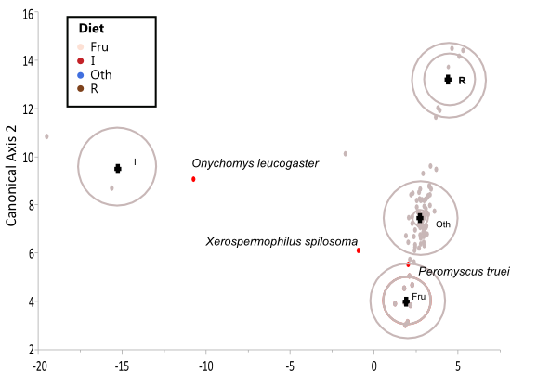
Results: Discriminant Function Analysis
Species correctly classified
by cross-validation
90 modern species
4 trophic categories
8 metrics
Frug
Invert
Root
FOG
Total
8/8
2/3
7/7
70/72
87/90
96.6%
Included Variables:
Tooth Row EDR
Tooth Row RFI
m2 BRFI
m3 BRFI
m1/m2 BRFI
m2 EDJ/OcSA
m2 OcVol/Vol
m2 OPCR/ocSA

Slide 22
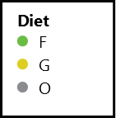
Results: Discriminant Function Analysis
Species correctly classified
by cross-validation
91.6%
72 modern species
3 trophic categories
8 metrics
F
O
G
Total
19/23
6/6
41/43
66/72
Included Variables:
m1 occlusal perimeter
m2 occlusal volume
m3 concavity
m1 RFI
m1 VC
m3 vHI
m3 OPC
m2 OPC
Notes:
This is the second tier in our analysis, where we pull apart granivores, folivores, and omnivores. Here, we correctly classify all omnivores, but have more trouble delineating folivores and granivores by cross-validation. Fortunately, we can absolutely delineate folivores and granivores using isotopes. Erethizon dorsatum, the North American porcupine and Baiomys taylori, the Northern Pygmy Mouse are likely misclassified by cross-validation because they represent extremes in size, though both are correctly classified by substitution. Those two species of Spermophilus are the two folivores with concave m3s, which is pulling them toward the granivores. I'm not sure what's going on with Reithrodontomys though. Neotoma micropus, however...

Slide 23
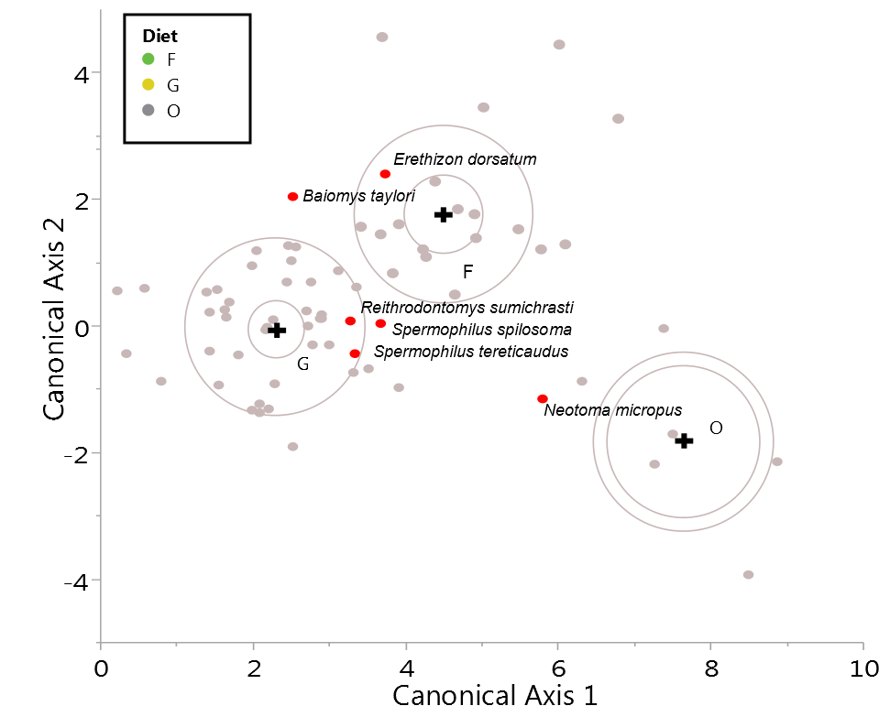
Results: Discriminant Function Analysis
Species correctly classified
by cross-validation
91.6%
72 modern species
3 trophic categories
8 metrics
F
O
G
Total
19/23
6/6
41/43
66/72
Included Variables:
m1 occlusal perimeter
m2 occlusal volume
m3 concavity
m1 RFI
m1 VC
m3 vHI
m3 OPC
m2 OPC

Slide 24
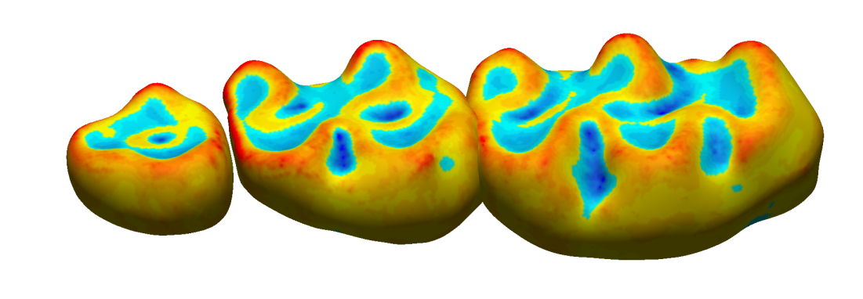
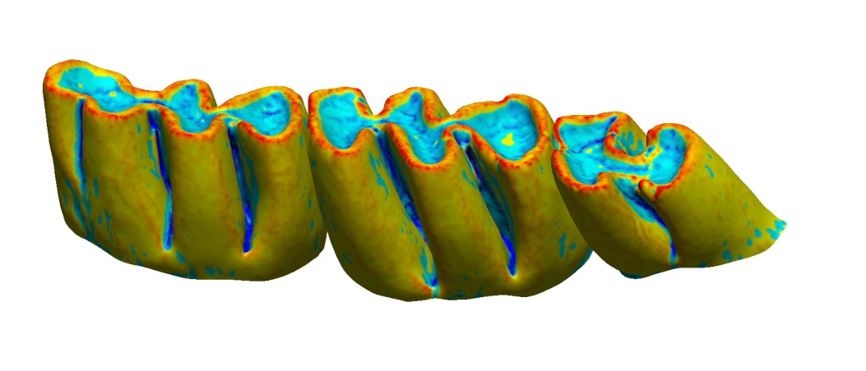
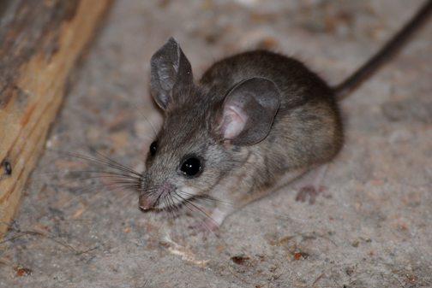
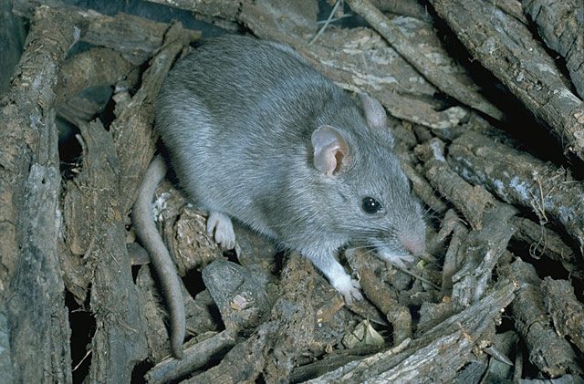
Encouraging misclassifications: fallback foods
Pinyon mouse (Peromyscus truei)
A priori class: Granivore (isotopes, st. contents)
Predicted by model: Frugivore
Smartt (1978) reports seasonal frugivory.
Southern plains woodrat (Neotoma micropus)
A priori class: Folivore (stomach contents)
Predicted by model: Omnivore
Hope and Parmenter (2007) record seasonal omnivory.
Credit: Sally King
CC: Rober W. Barbour
Seasonally shifting diets and limiting fallback foods may be responsible for species whose morphology does not appear to match stomach content data.
Notes:
...I would call an encouraging misclassification. Both Neotoma micropus in the second DFA and Peromyscus truei in the first DFA have dental morphologies that appear adapted to seasonal or fallback foods rather than to their primary diets. These results show that seasonally shifting diets and limiting fallback foods may be responsible for species whose morphology does not appear to match stomach content data, though we wouldn't suggest that for most species.

Slide 25
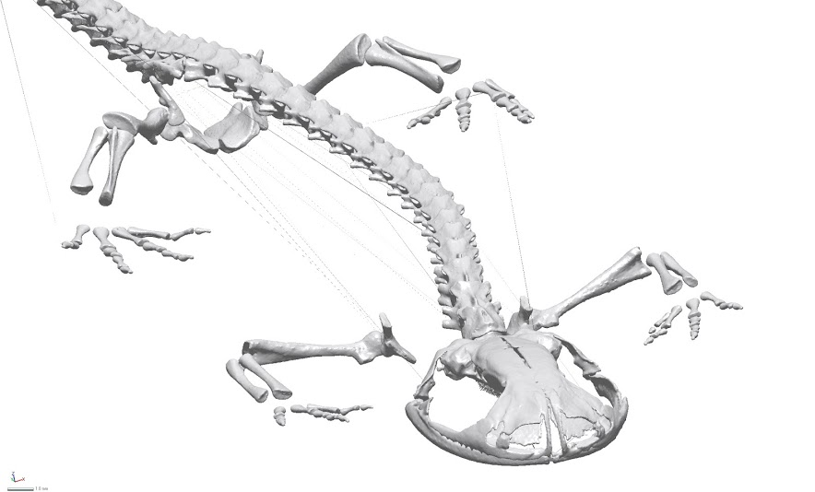
Conclusions and Future Directions
We can robustly infer diet from tooth shape.
Dental ecometrics provide context for reconstructions.
Future:
Automated GIS metrics (aspect, slope, etc.)
Cranial and mandibular landmarks/semi-landmark-based analyses
Expand beyond rodents
Analyze diversification/disparification in a phylogenetic context
Apply to stratigraphic sequences of faunas in the Great Plains (Meade and Bighorn basins)
Apply to salamander cranial morphology to track character displacement

Slide 26
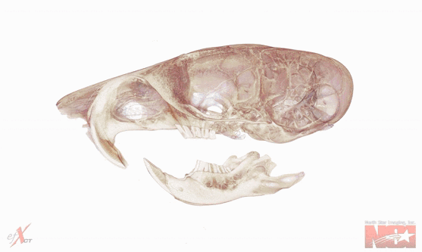






Acknowledgements
We thank Brian Bagley, Sharon Jansa, Anessa DeMers, Jackson Mitchell, and Joel Torgeson for aid in specimen acquisition, data collection, and ideas about methodology.
Ord’s Kangaroo Rat
Dipodomys ordii
~10µm resolution

