Slide 1
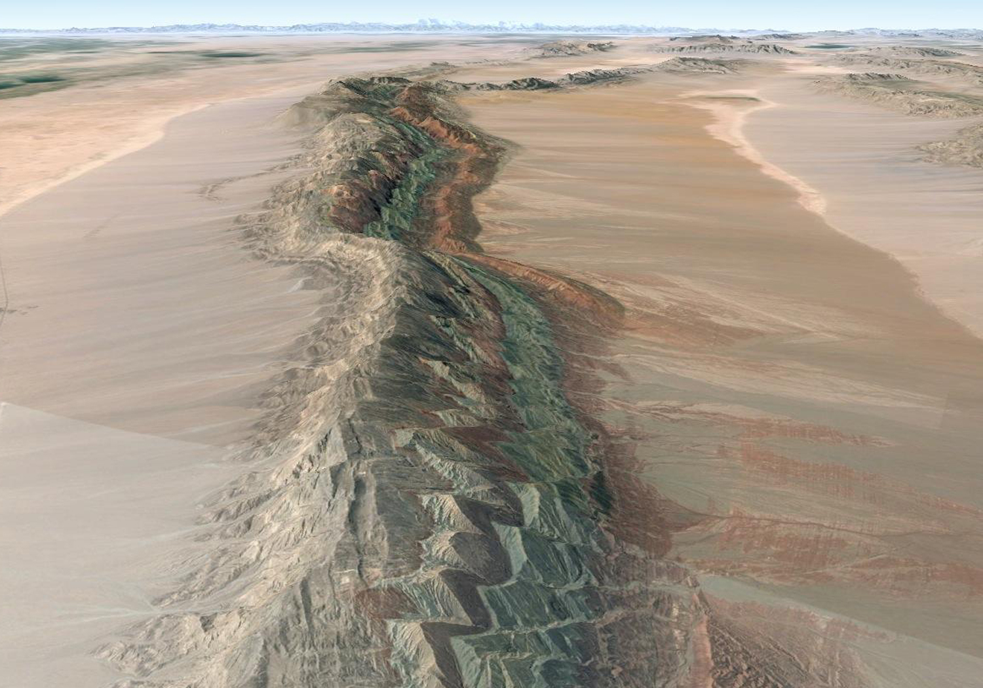
Using the World’s Great Sites for Teaching Structural Geology and Geologic Mapping
Orbit to Outcrop and Outcrop to Orbit
Barbara Tewksbury
Department of Geosciences
Hamilton College
btewksbu@hamilton.edu

Slide 2
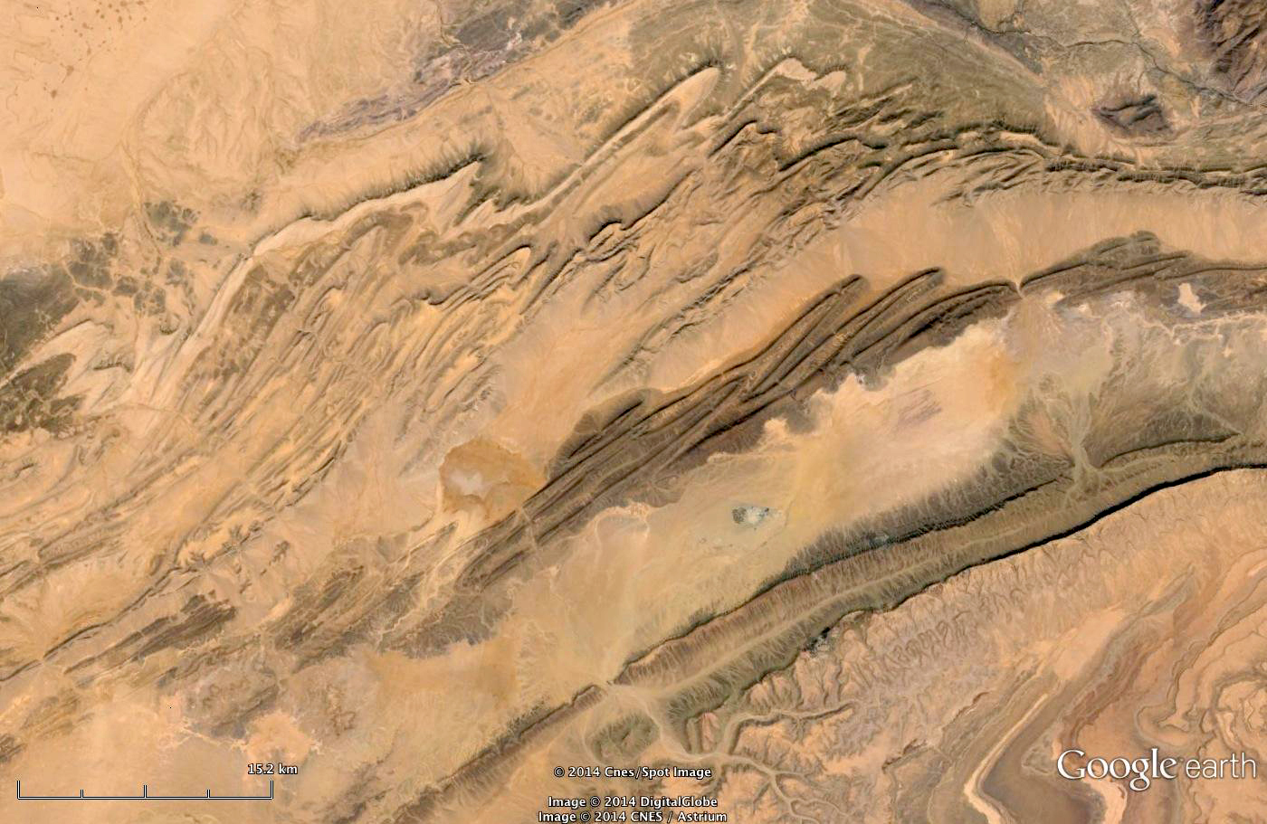
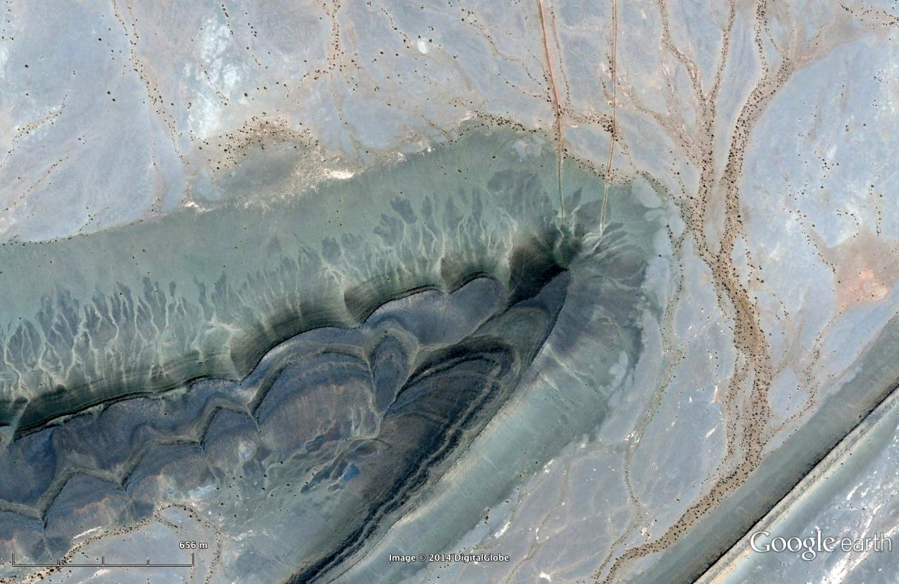
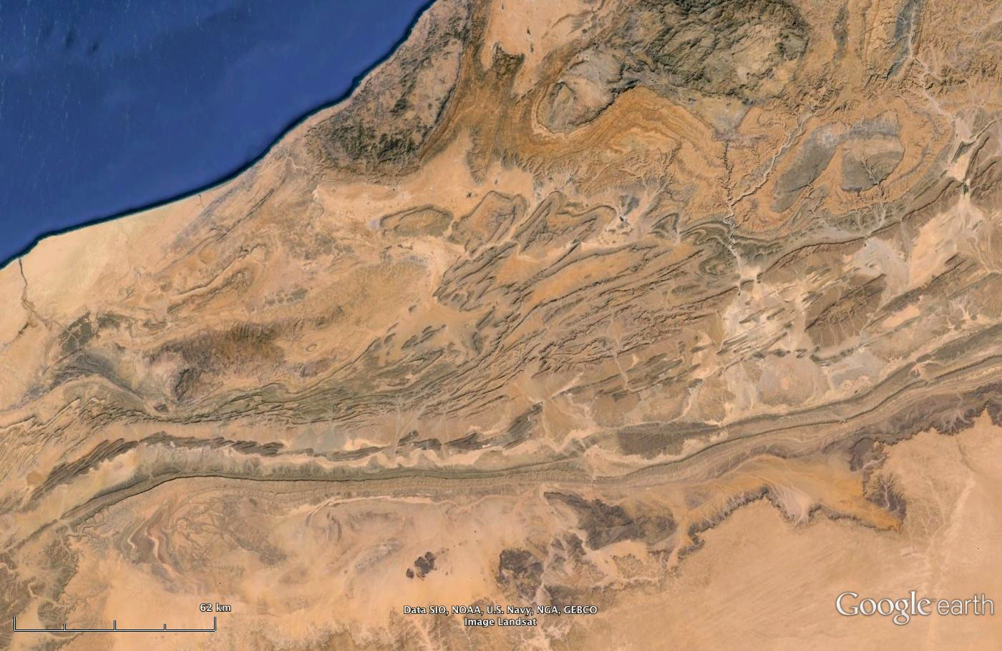
asdf
Notes:
Desert areas have world class exposures of fabulous structures – make a structural geologist’s heart go pitty pat. Many are just heartbreakingly beautiful.

Slide 3
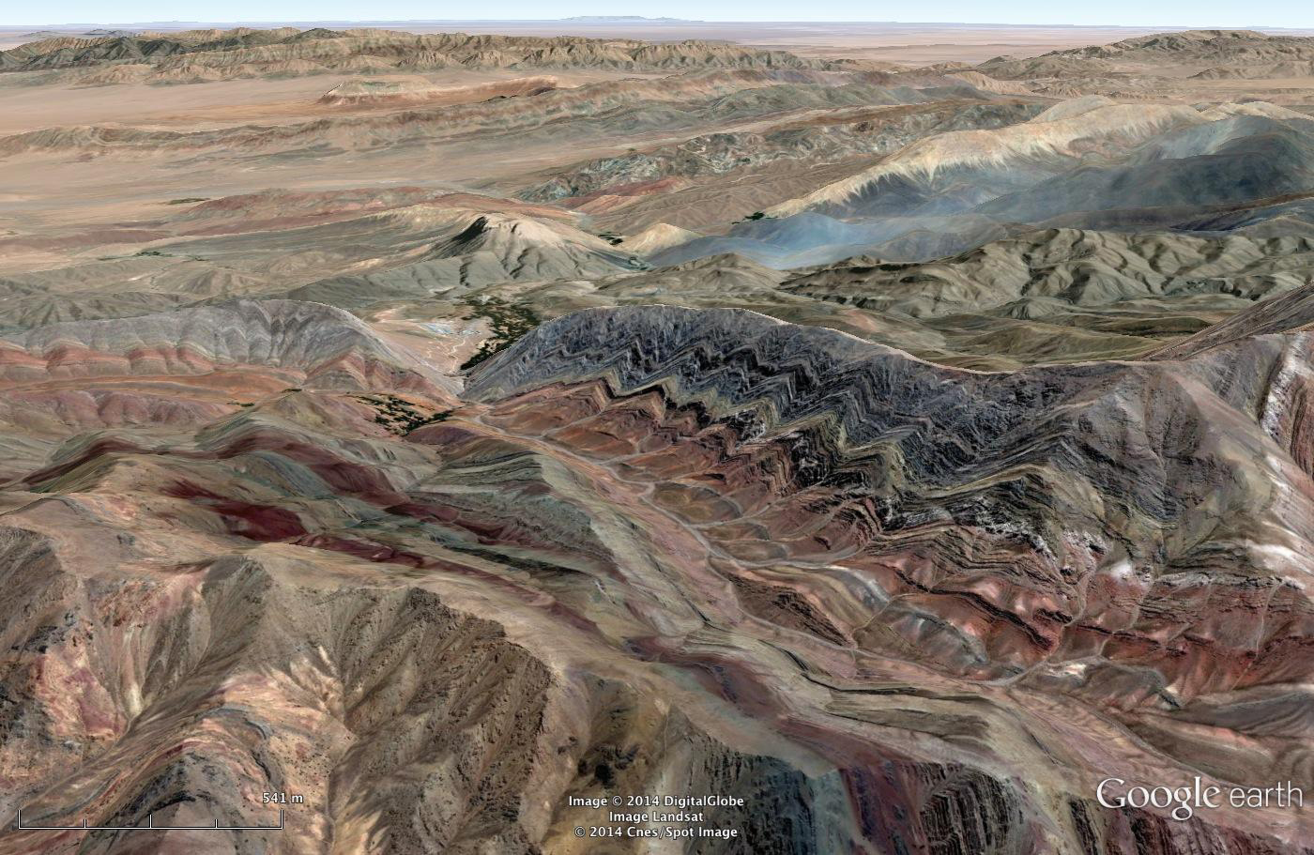
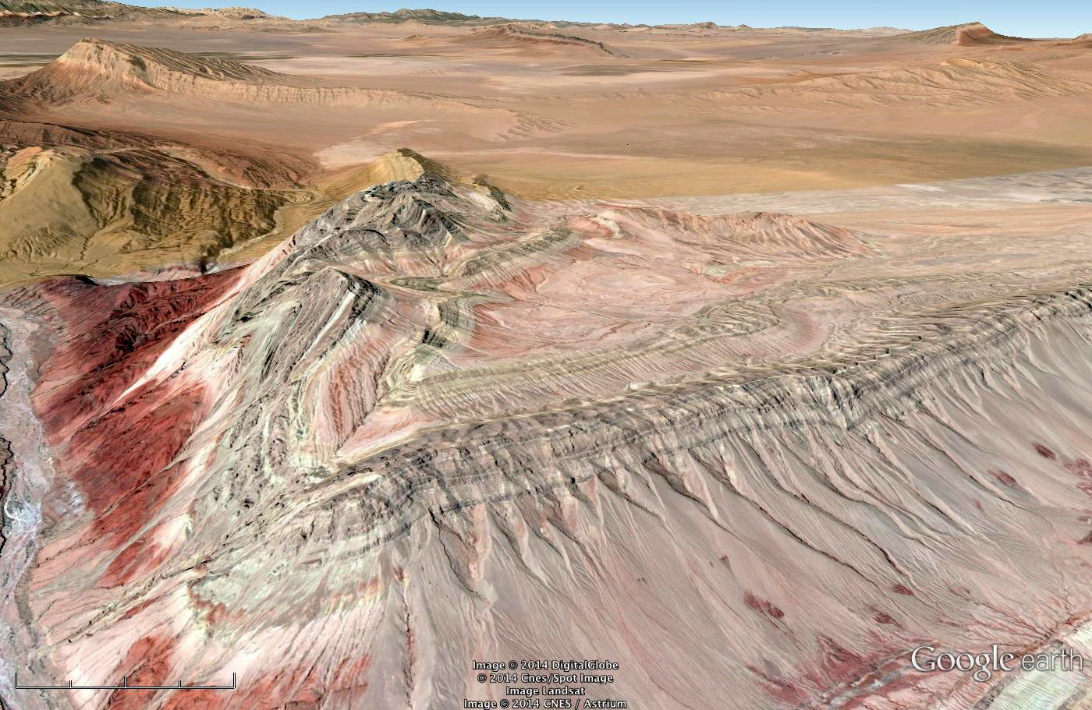
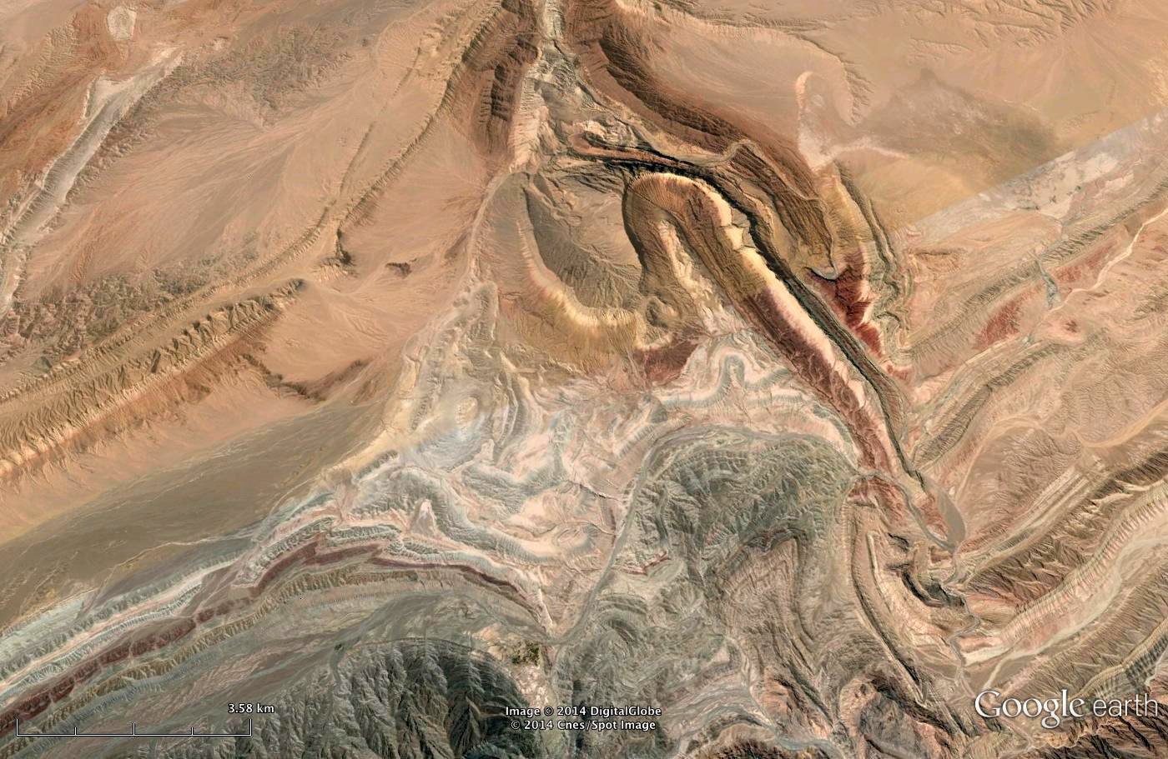
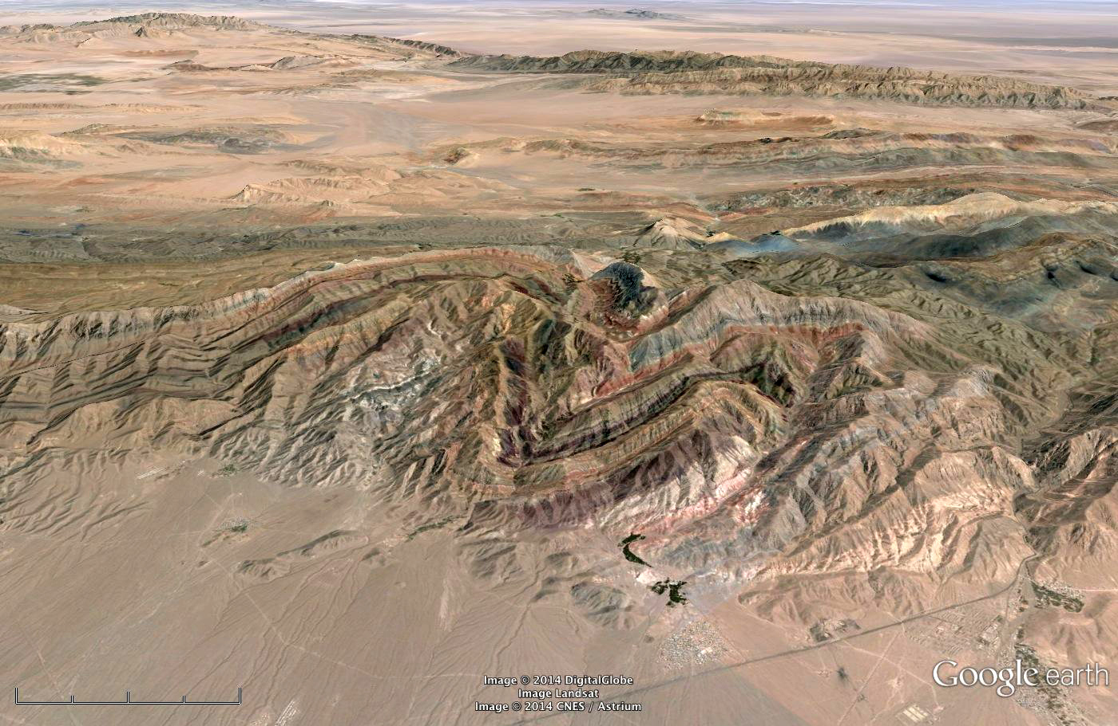
asdf
Notes:
Know where to go for “likely suspect” structures – see intriguing patterns that make us want to zoom in; once we’re there, we have instant pattern recognition – dipping layers, erosion, likely sedimentary, now folded and tilted, even put it into a context regional, wonder about the 4th dimension

Slide 4
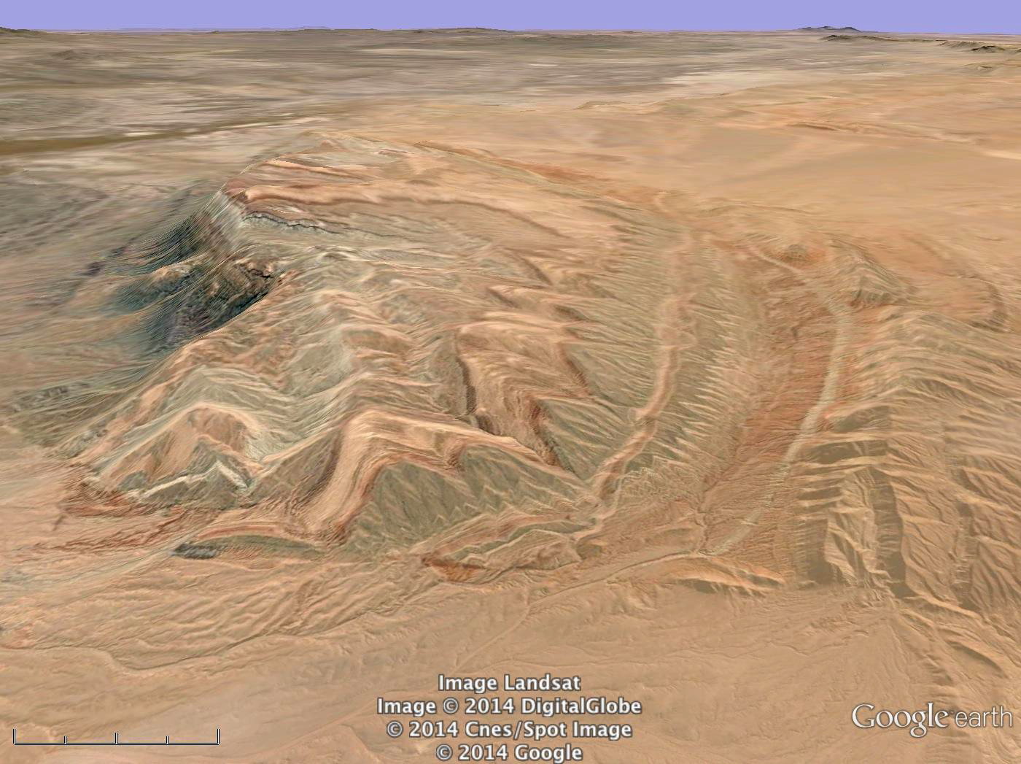
Notes:
Google Earth is an incredibly rich environment for us, and we know intuitively that it should have huge potential for helping students learn geology better. The question is, how do we do this effectively? I’ve worked with students for nearly 10 years with structures in Google Earth, NASA astronauts as well. Rather than focusing on a list of places, going to focus on how to use whatever places you have most effectively by thinking about what the challenges are and some ways to solve them. I will focus on SG, but the ideas are more broadly applicable. At the end, I will have a link to a site with literally scores of placemarks of potential “grand tour” sites.

Slide 5
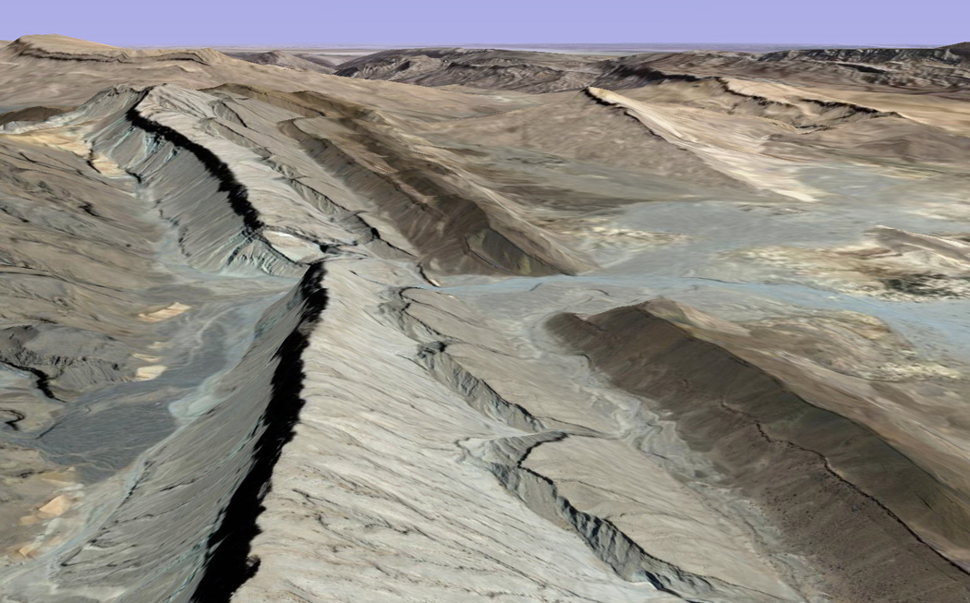
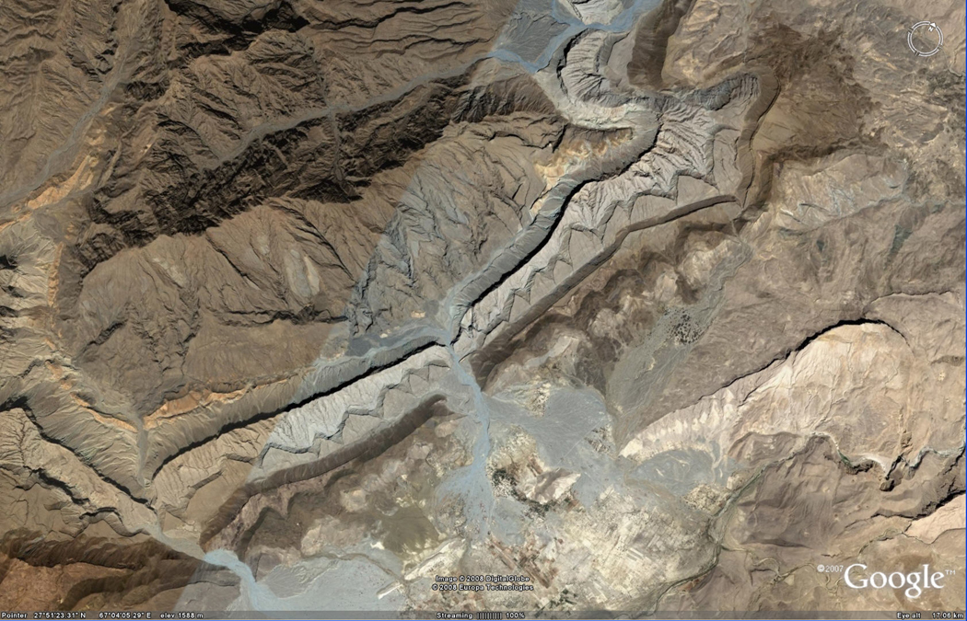
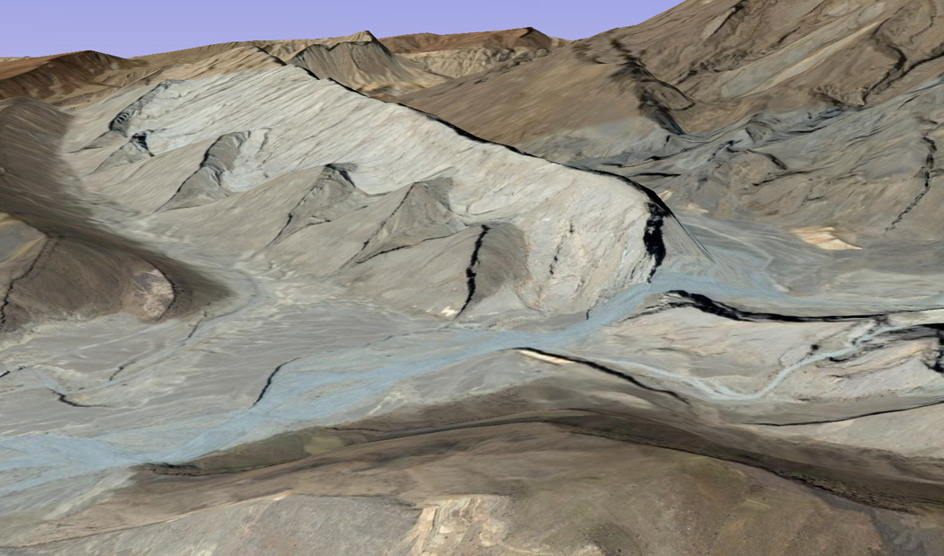
Challenge
Most students don’t see what you see
Most of my students don’t see layers in this view
Notes:
Here are some of the things that you should know that are unexpected and critical to success in helping students make a leap in interpretation and get to the point where WE are in the first slides – namely instant pattern recognition and interpretation. Important regardless of what strategy you use.
Issue #1: realize that most students don’t see LAYERS – show Alkali Anticline and Pakistan layers. This is a shock. We need to help them develop” structural geology eyes”. Need to think consciously about how to help them develop those “eyes” and do metacog stuff on realizing that their thinking has changed ***add idea of us not seeing fractures

Slide 6
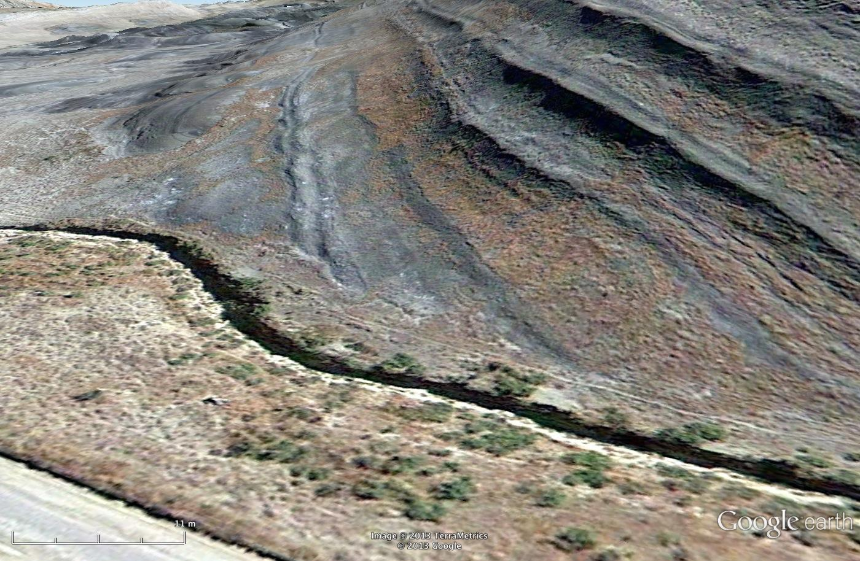
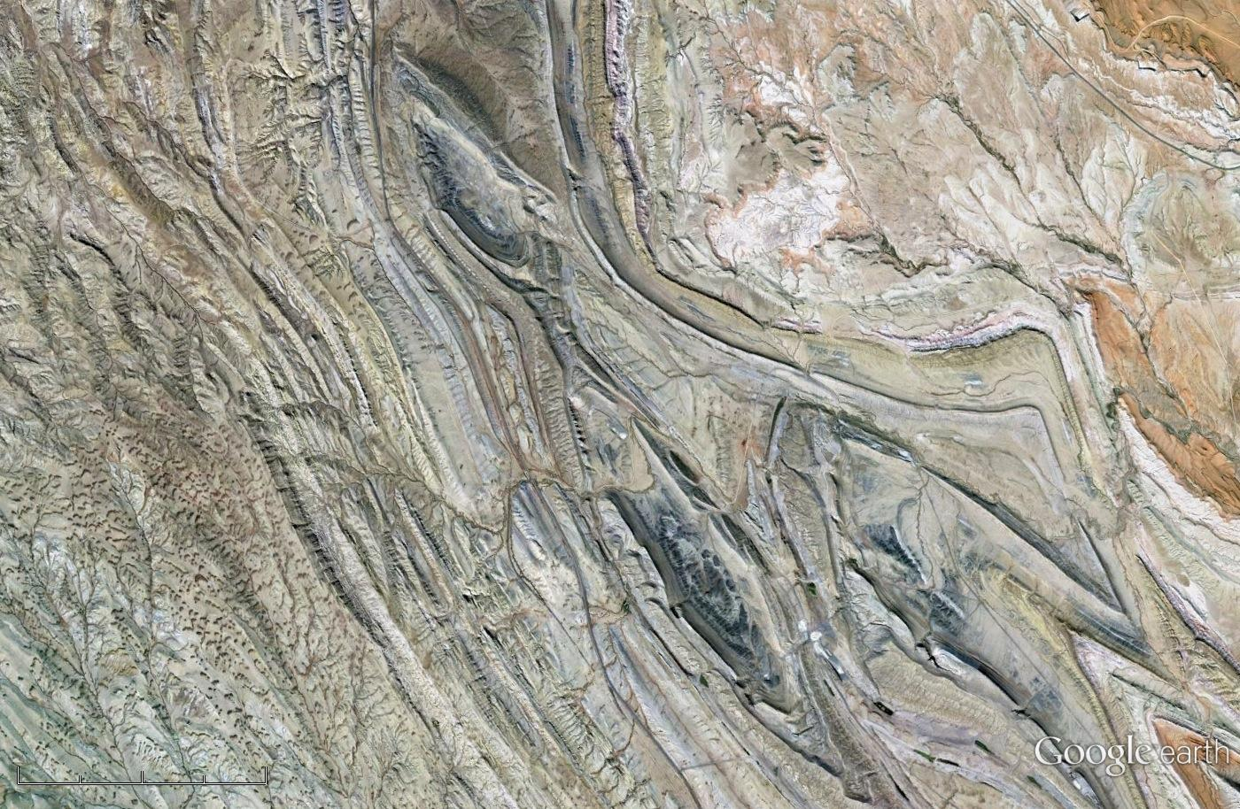
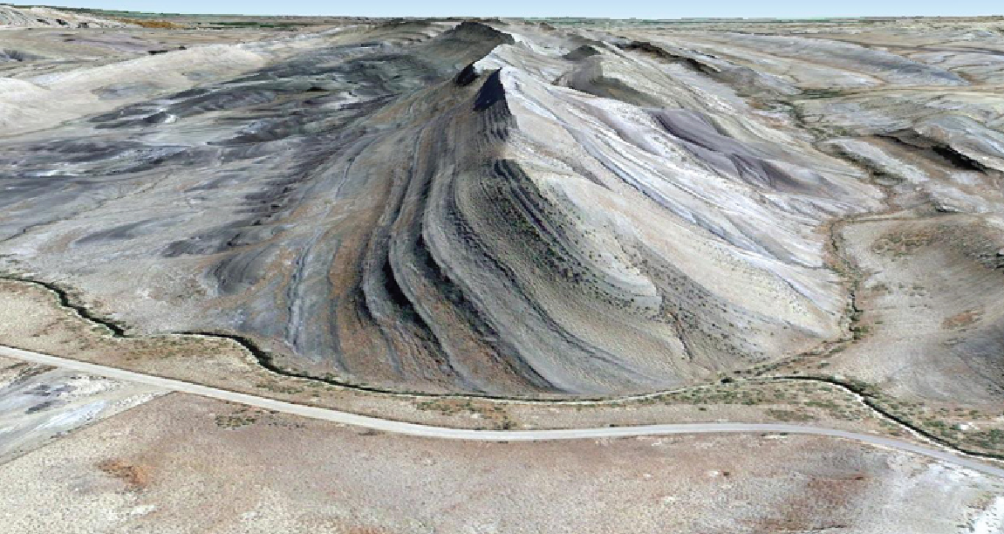
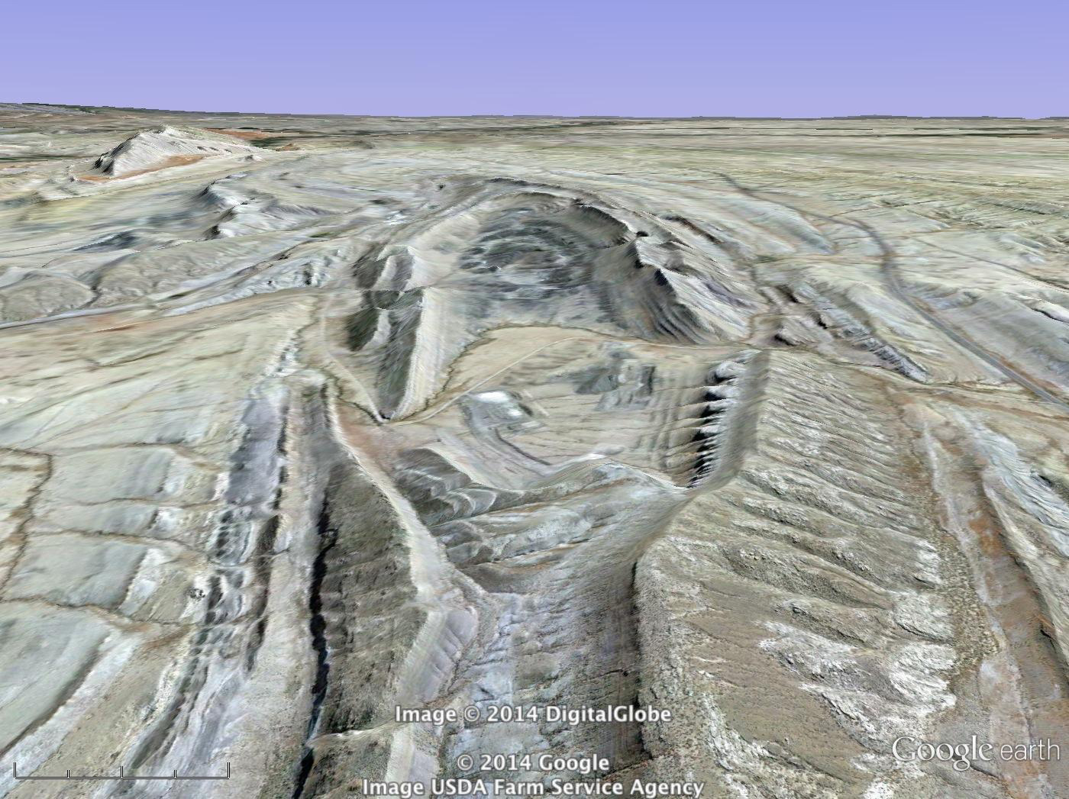
Helping students see what you see
Help them develop “structural geology eyes”, rather than assuming that they see what we see
Students email me placemarks w/ what they see
In class: work together on layers, layer continuity, resistance, bedrock vs. surficial deposits
Notes:
Be proactive about helping them develop the eyes you want them to have. Don’t just assume – ask. Then figure out ways to help them develop the “eye” that you have. I typically do this by asking them to describe what they see and email me a placemark

Slide 7
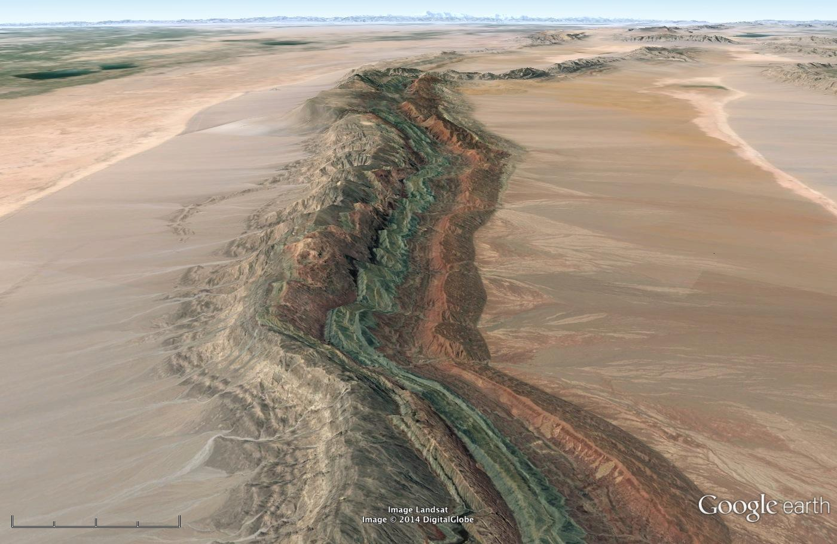
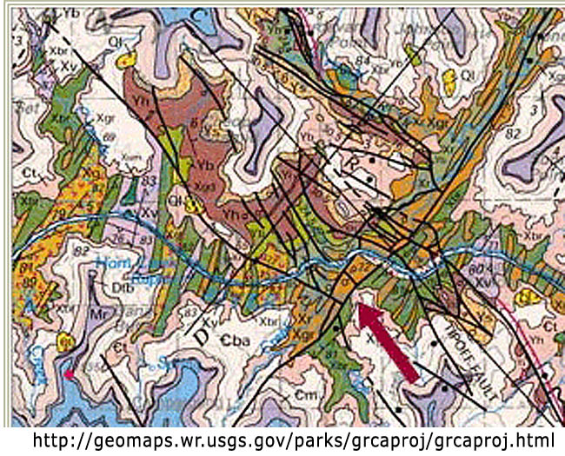
Challenge
Many students don’t see rock volumes – they see surface color patterns, like paint stripes
Notes:
They don’t see rock _volumes_; they see color patterns on a surface – like paint stripes – they try to make sense of color patterns without an understanding that the color stripes aren’t paint stripes but the intersections of rock volumes with the Earth’s surface.
they don’t have the intuitive understanding that what we are looking at is a very thin sliver, with most of the rock eroded away and most of it under the ground;

Slide 8
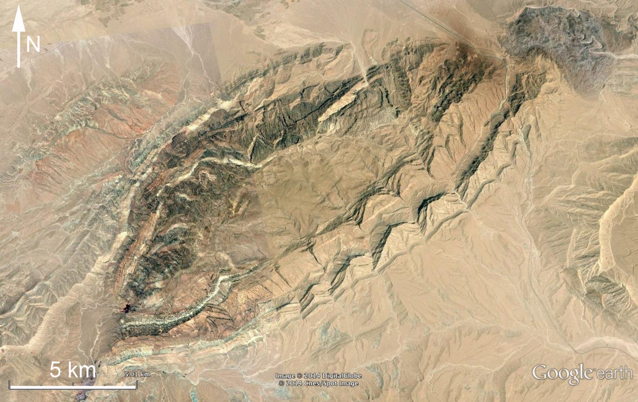
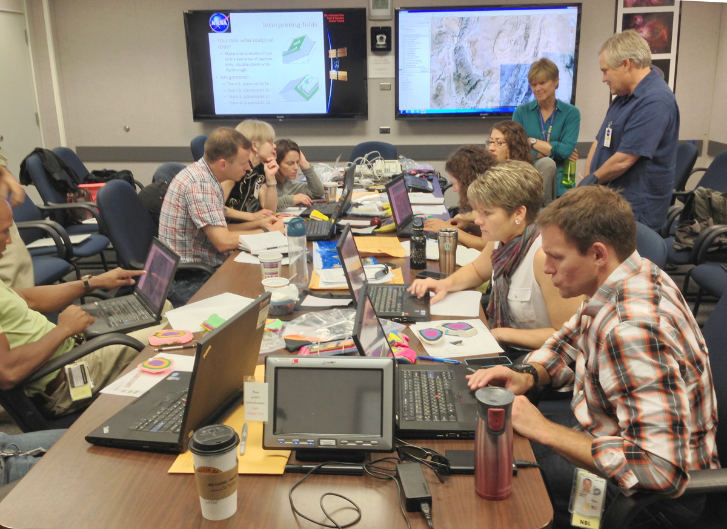
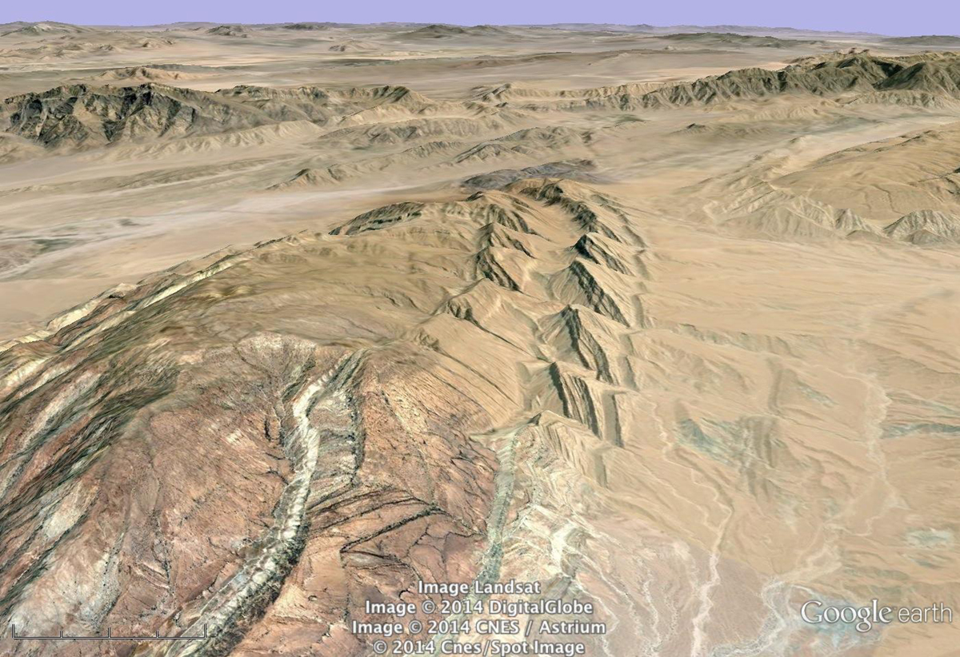
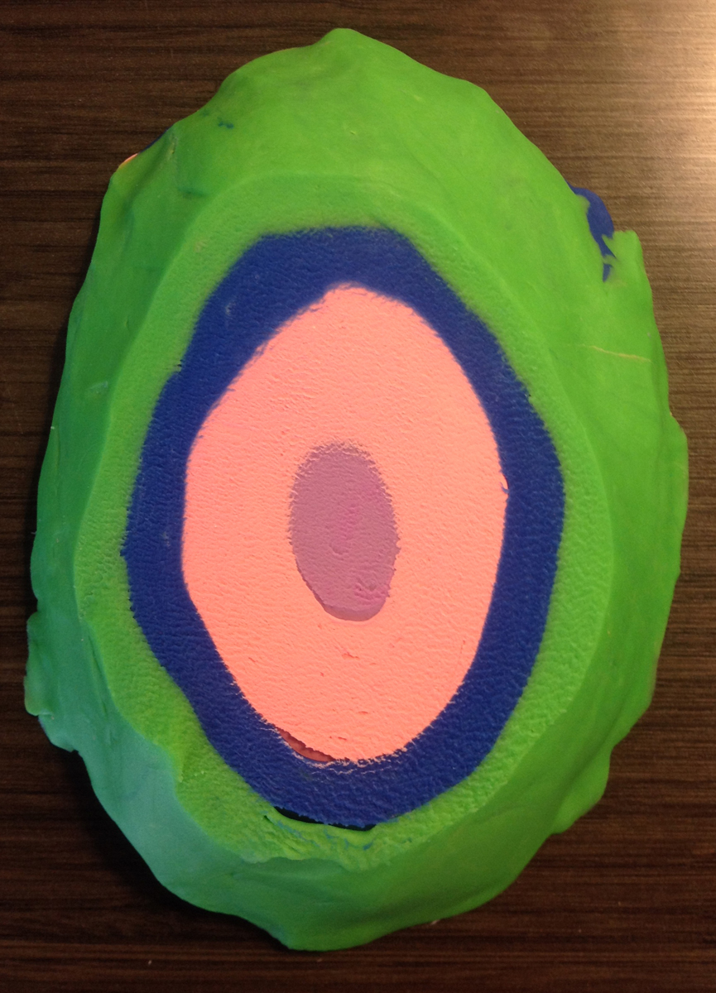
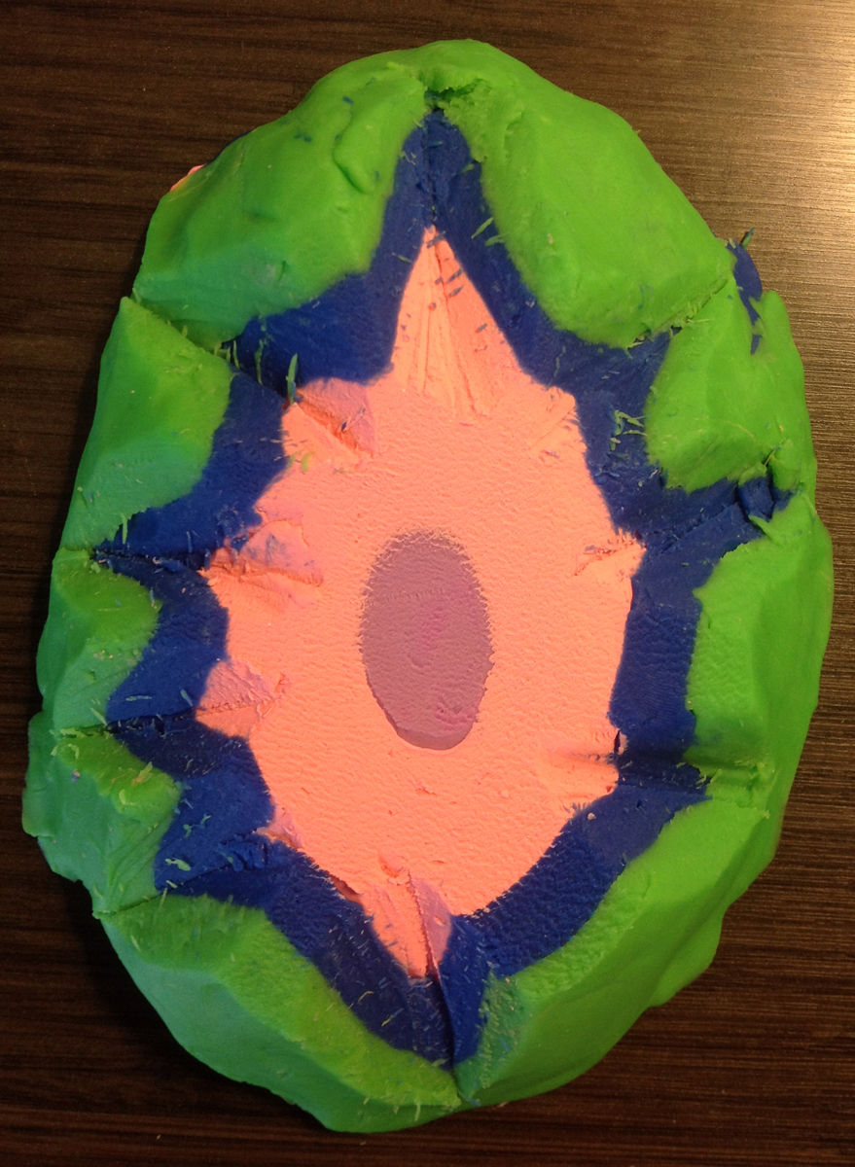
Helping students see rock volumes
Pair analog models with Google Earth
Notes:
ANALOG MODELS help – one solution; pair with Google Earth. Early mapping and cross section construction helps. Use GE to help students visualize the 3rd dimension; build models or draw cross sections to consolidate the third dimension. value of 3D terrain view; pilot in command time; visualizing and interpreting geologic structures

Slide 9
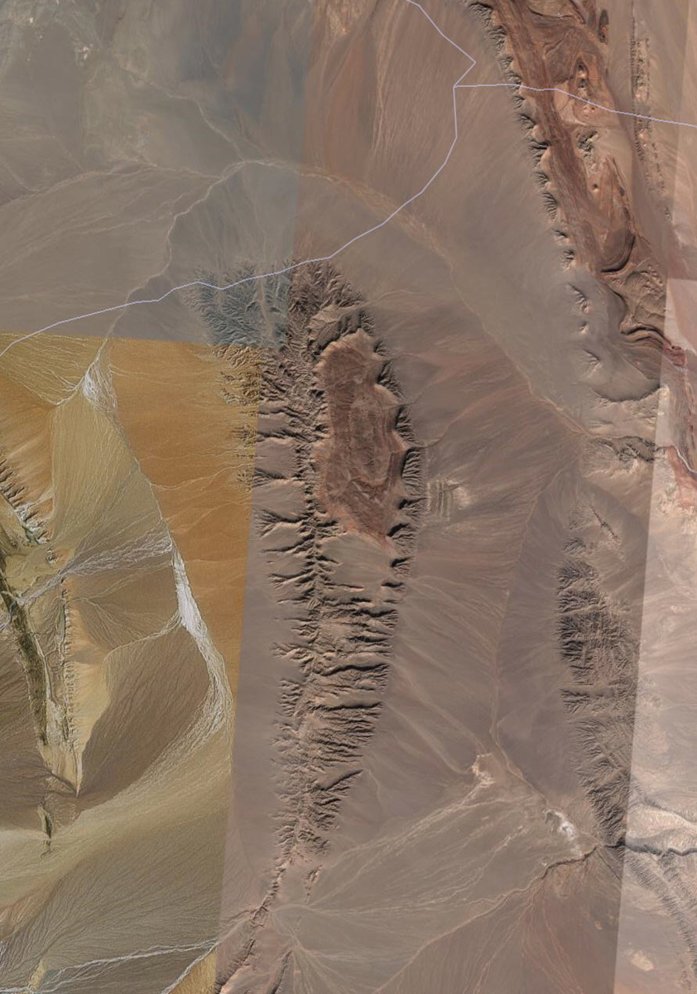
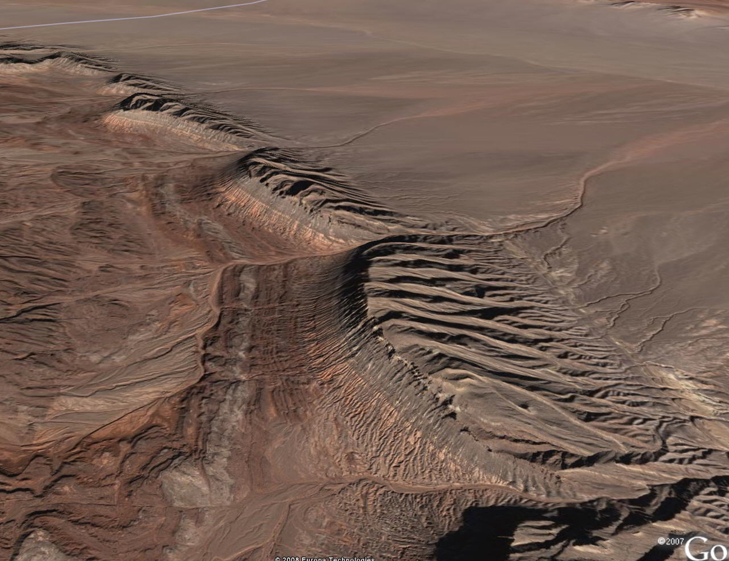
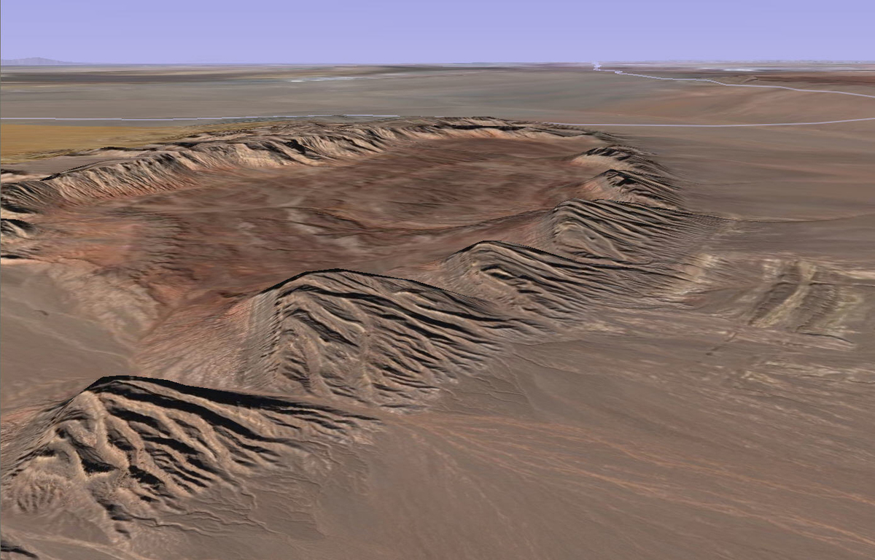
Helping students visualize the 3rd dimension
Fly-though in Google Earth is fabulous for helping students visualize rock volumes in 3D
Students must be in control of the mouse
Notes:
Part of seeing rock volumes, of course, it visualizing the 3rd dimension

Slide 10
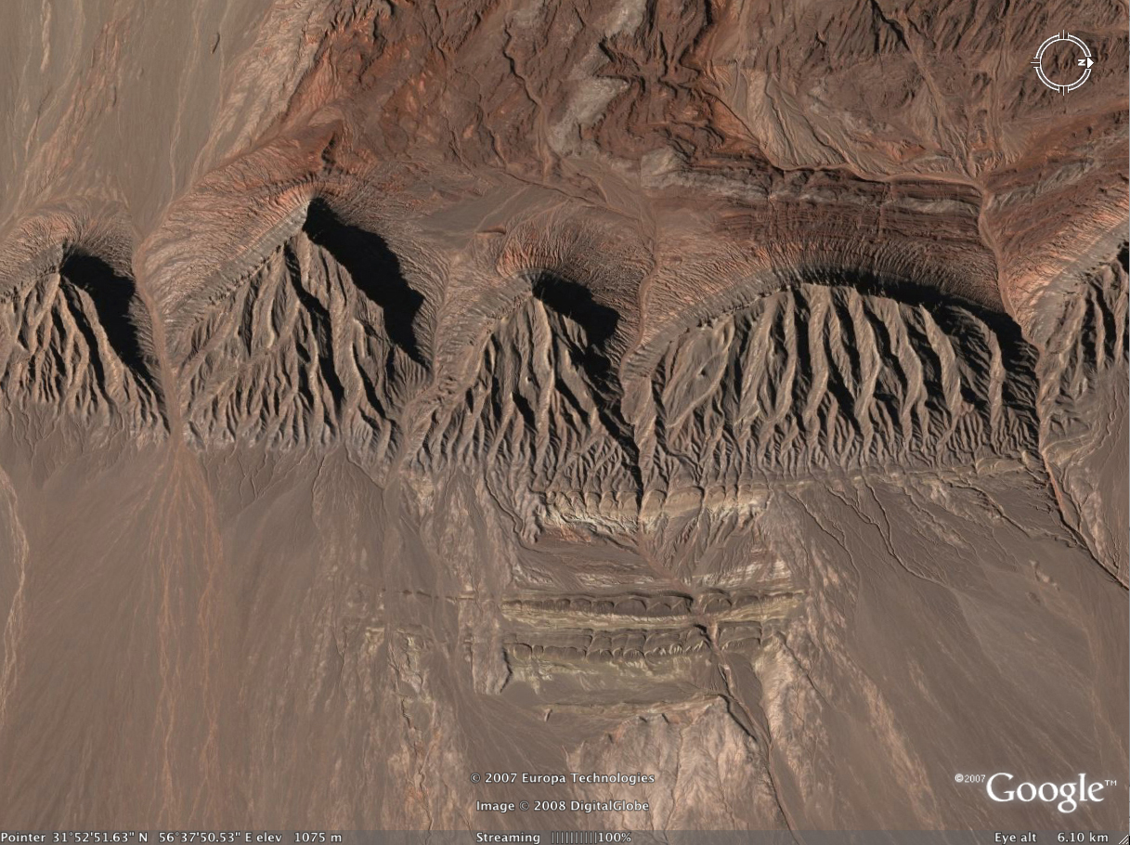
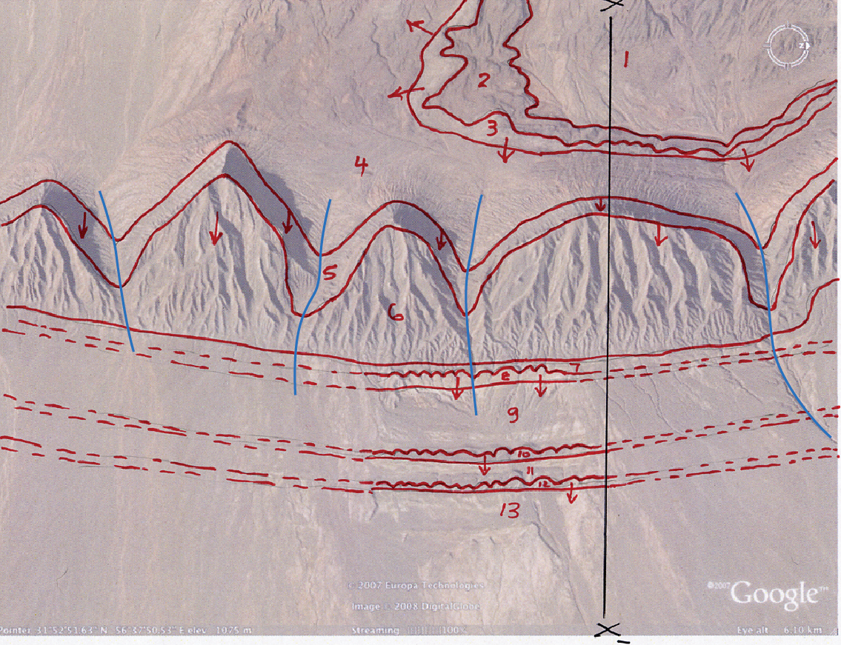
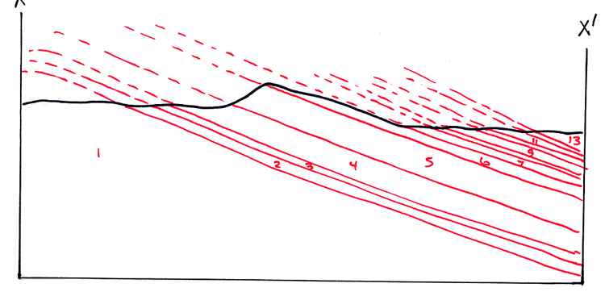
Helping students visualize the 3rd dimension
Teach mapping and cross section construction early.
Notes:
Using Google Earth to teach geologic mapping – most students learn map interpretation first and then mapping – mapping can mimic field experiences in Google Earth with placemarks for “field notes”; GE Pro; overlays, screened back images; Arc2Earth; builds on what they did at Alkali Anticline in distinguishing bedrock from surficial deposits and what to do when you can’t see the bedrock. Don’t want to just circle areas of outcrop. Tilt direction same regardless of which way the land slopes. Define mappable units based on color and characteristics such as resistant and non-resistant.

Slide 11
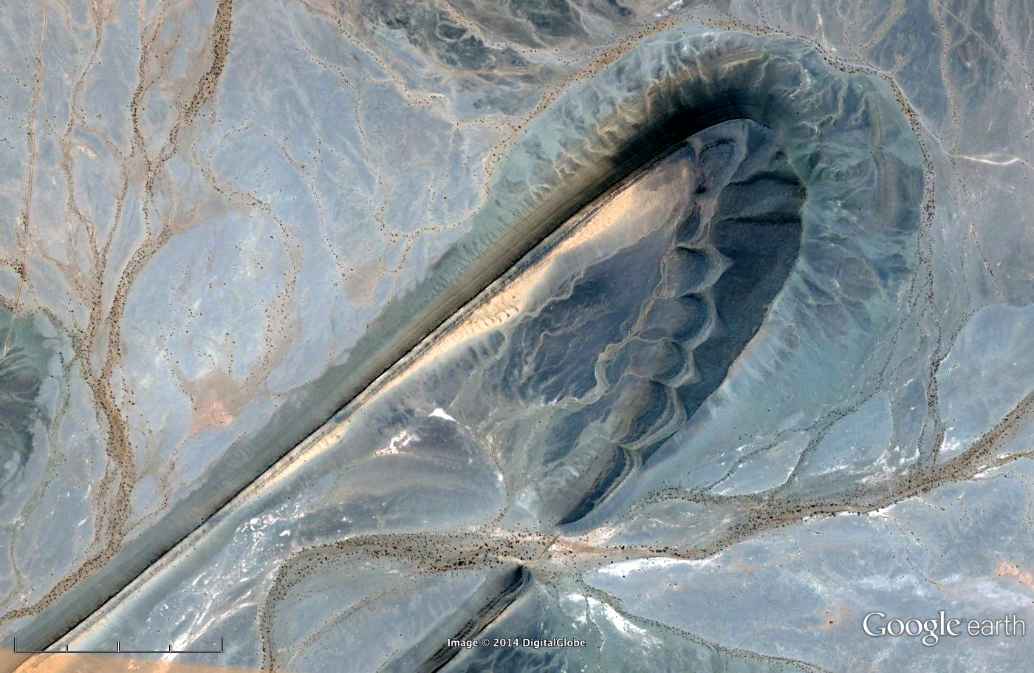
Challenge
Many students don’t see current features as a snapshot of a long history of multiple processes
Notes:
They don’t see current features as a snapshot of a long history of multiple processes. what did this _used_ to look like? what does erosion do to structures? Solution - lots of places to see the continuum – great in Google Earth; also helps them deal with surficial deposits and “where did the bedrock go”? Can practically see in the view above how the core of the structures is eroded and forming the fans. Have them talk about processes in modern world, going on today; describe evidence for past processes.

Slide 12
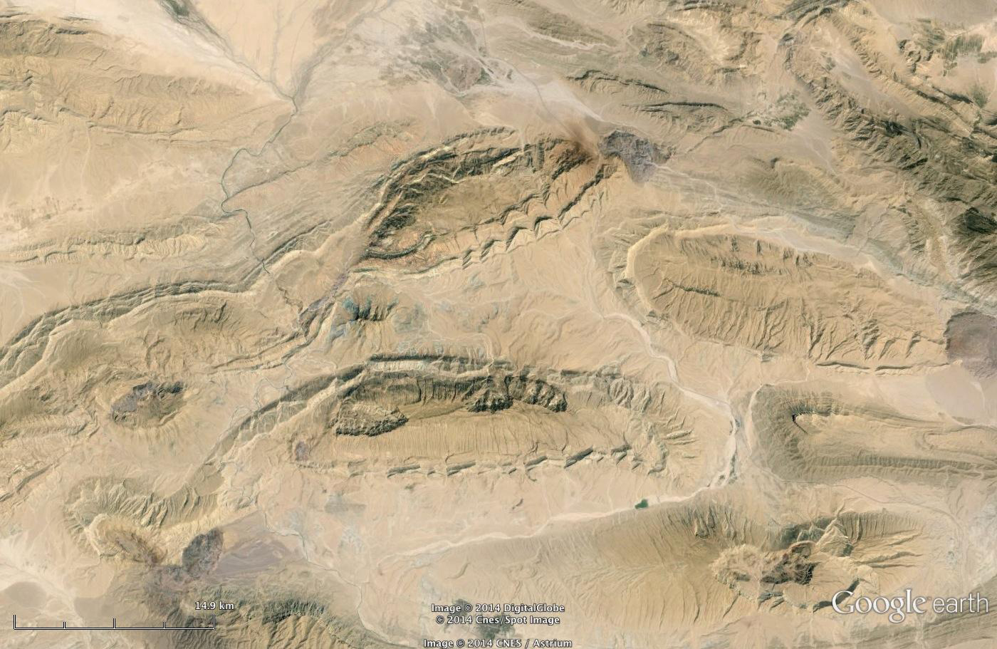
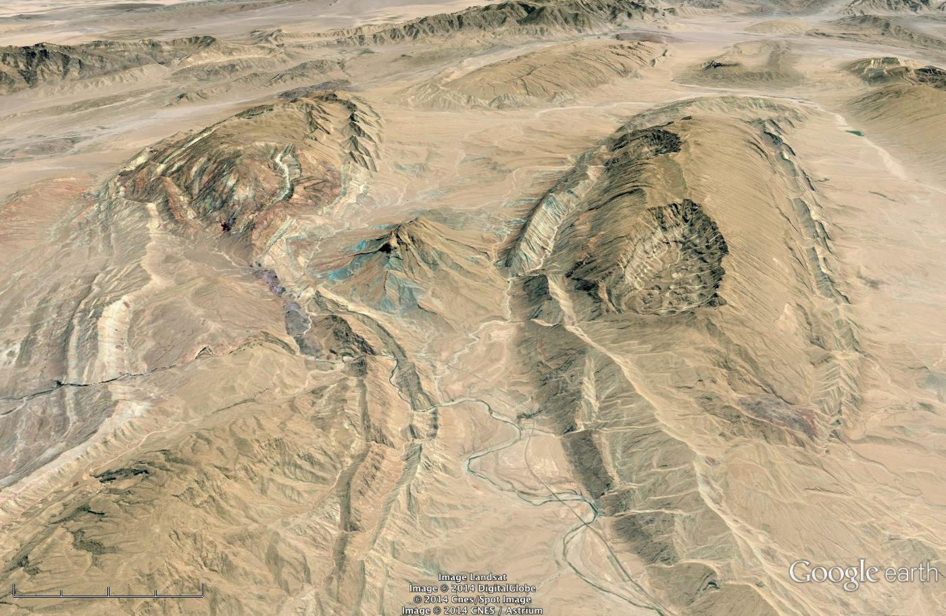
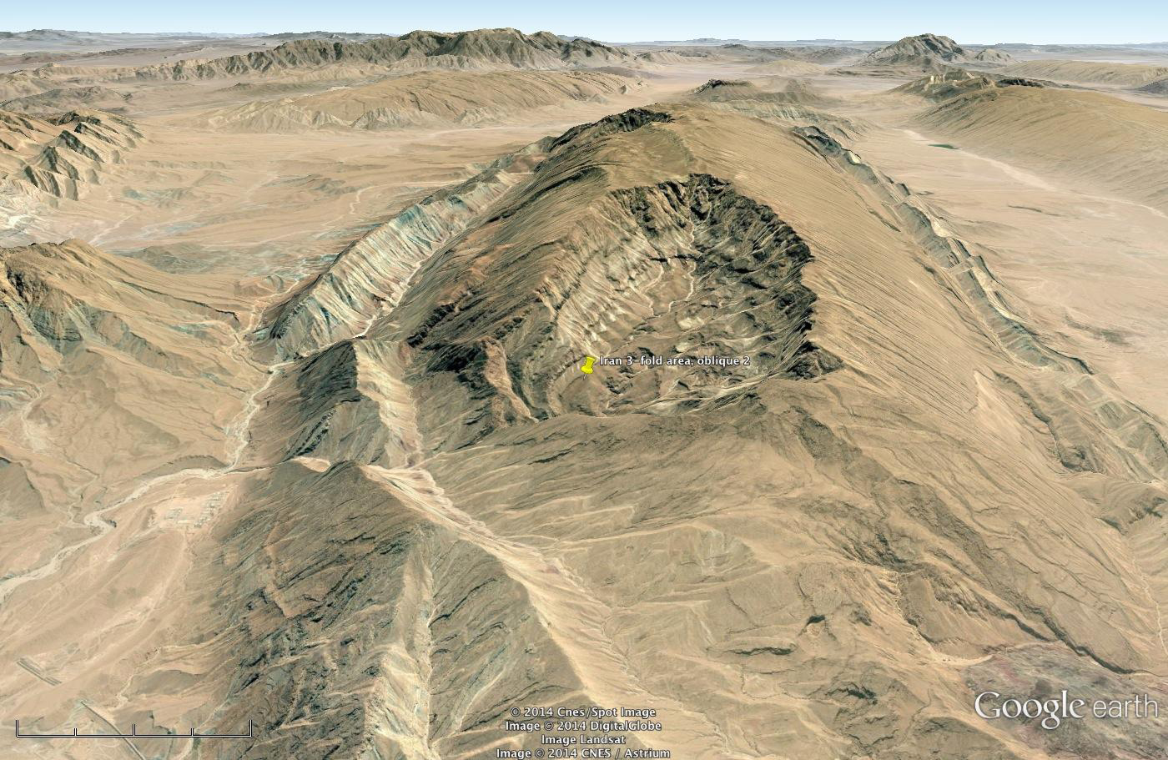
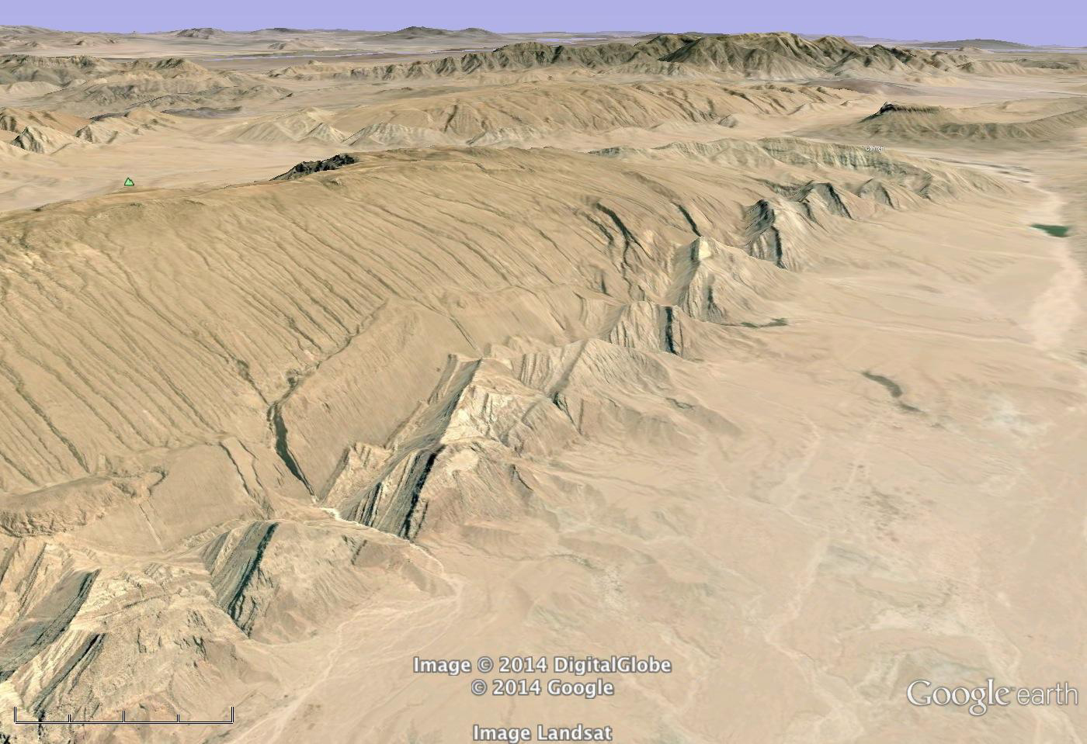
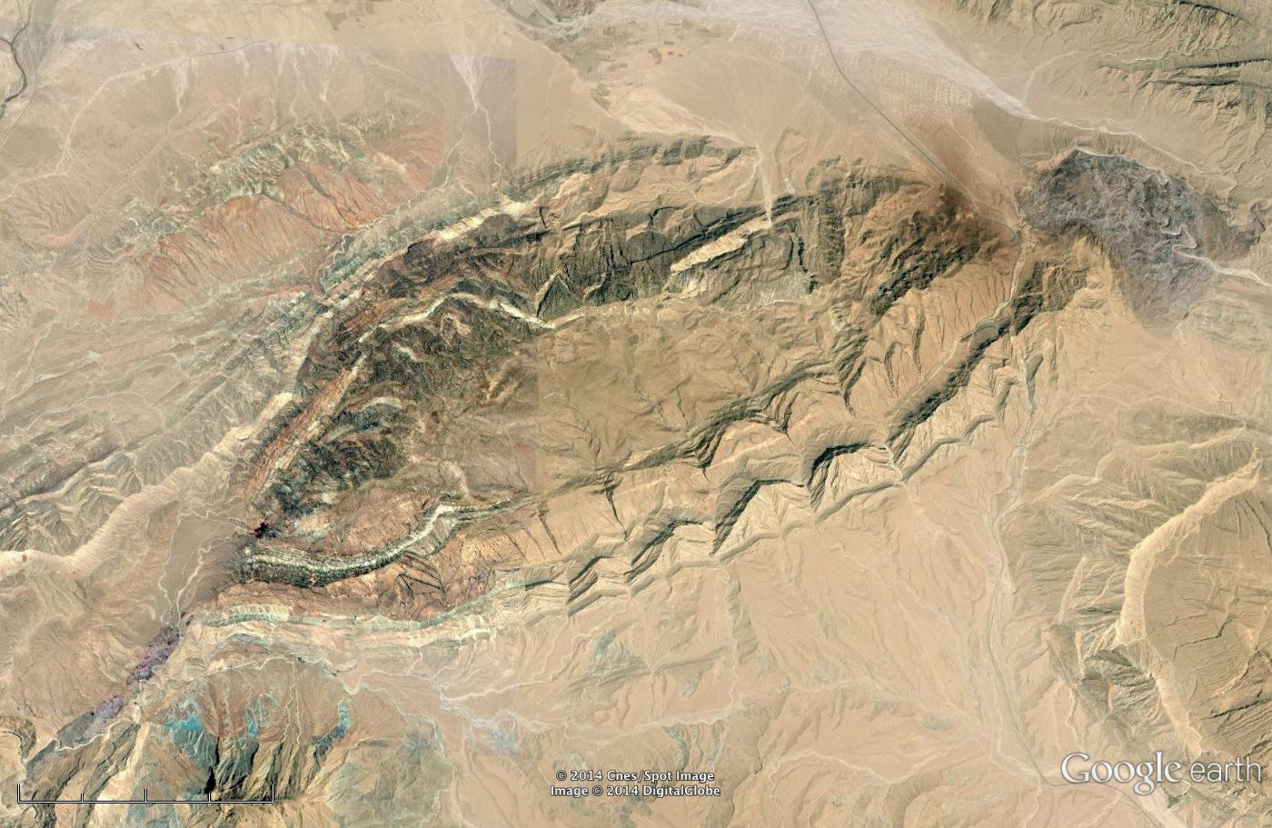
Helping students visualize the 4th dimension
Use areas in GE that allow students to visualize evolution over time
Reconstructing what’s gone due to erosion, what’s underground – draw cross sections
Notes:
visualizing folded contacts; fold mapping and cross sections – reconstructing what’s not there (gone by erosion, under the ground); resistant vs non-resistant layers;
Draw cross sections; have them write lists of ‘events”; make strat columns

Slide 13
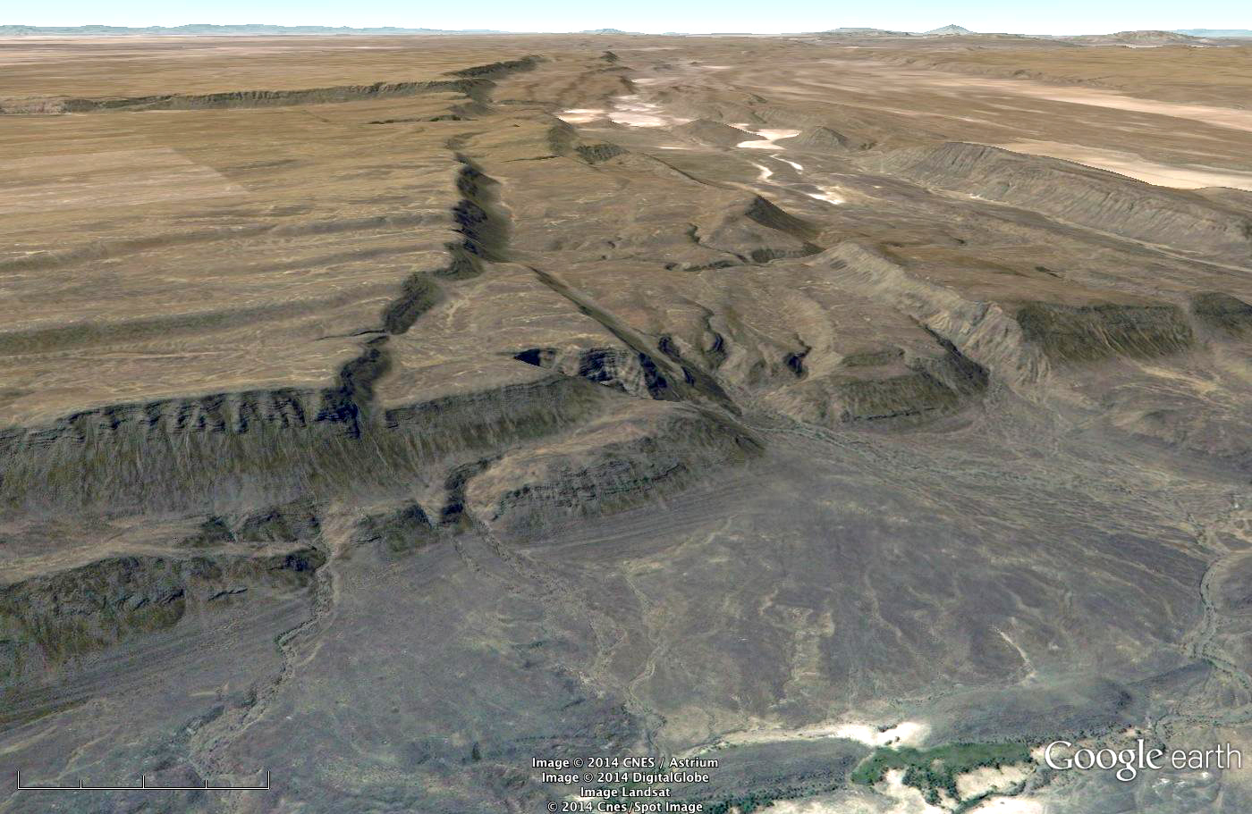
Challenge
Many students don’t see the process in the product
Notes:
We effortlessly see the process in the product – they don’t. they don’t see current features as result of processes – use of analog models, Santa Ana mesa and flour models.
integrate models for process, product, pattern recognition, and interpretation

Slide 14
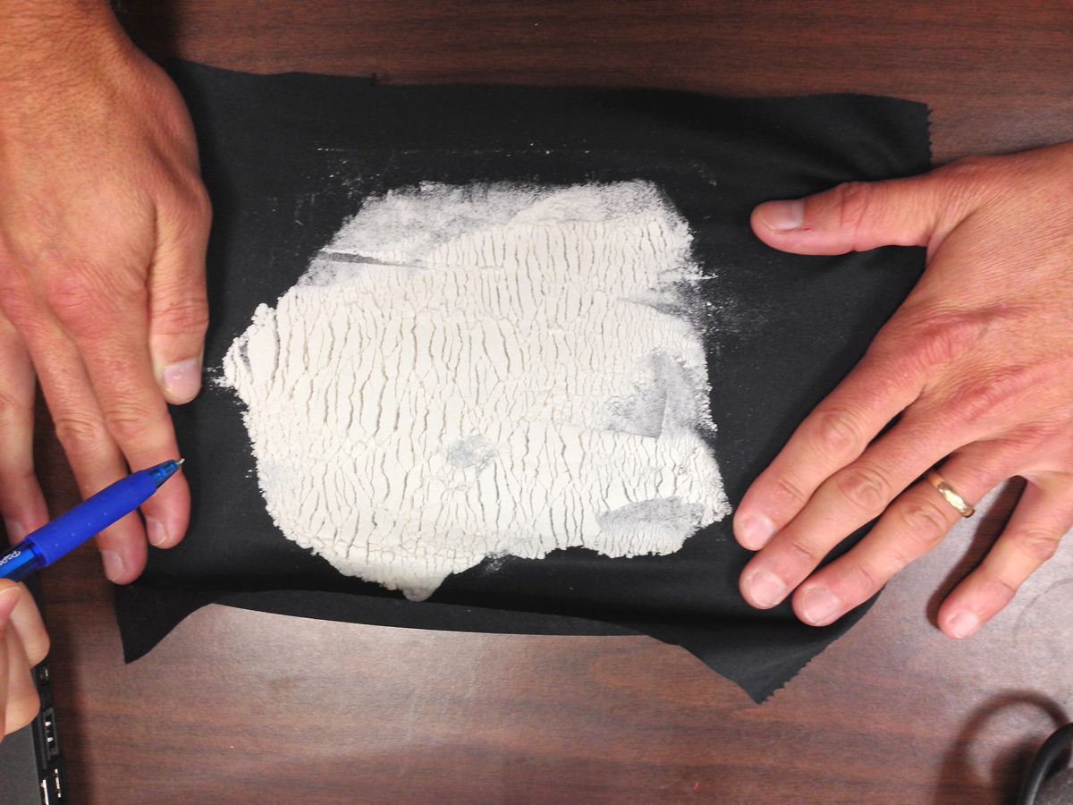
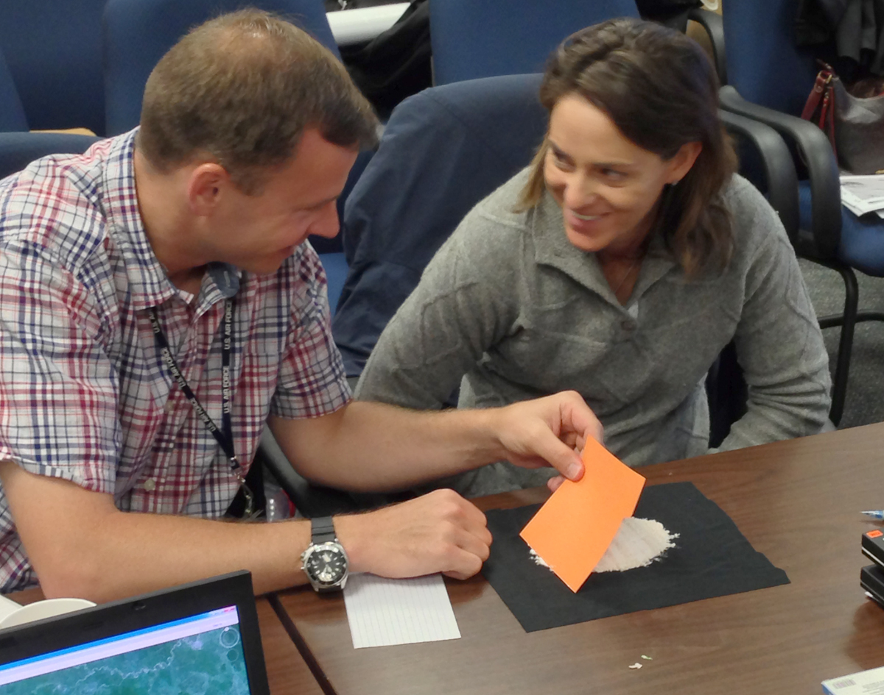
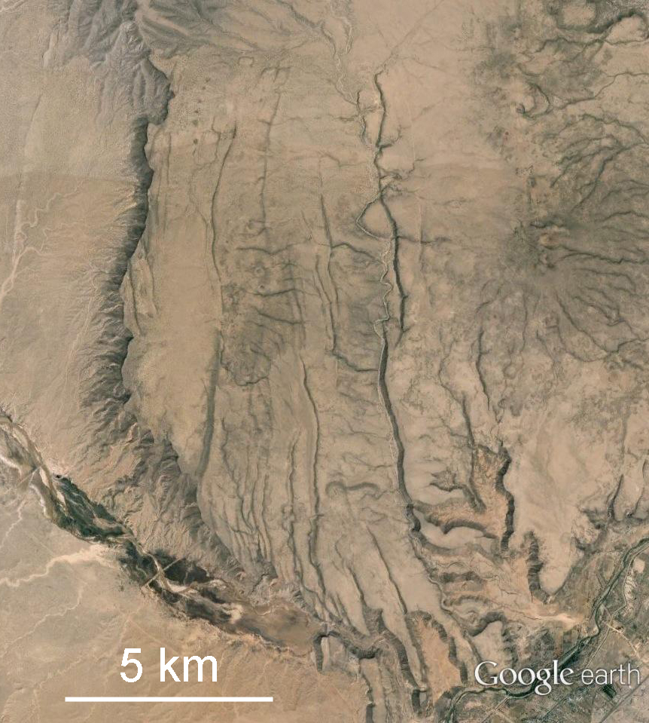
Helping students see process in product
Integrate models to help students with process, product, pattern recognition, and interpretation
Notes:
We effortlessly see the process in the product – they don’t. they don’t see current features as result of processes – use of analog models, Santa Ana mesa and flour models.
integrate models for process, product, pattern recognition, and interpretation

Slide 15
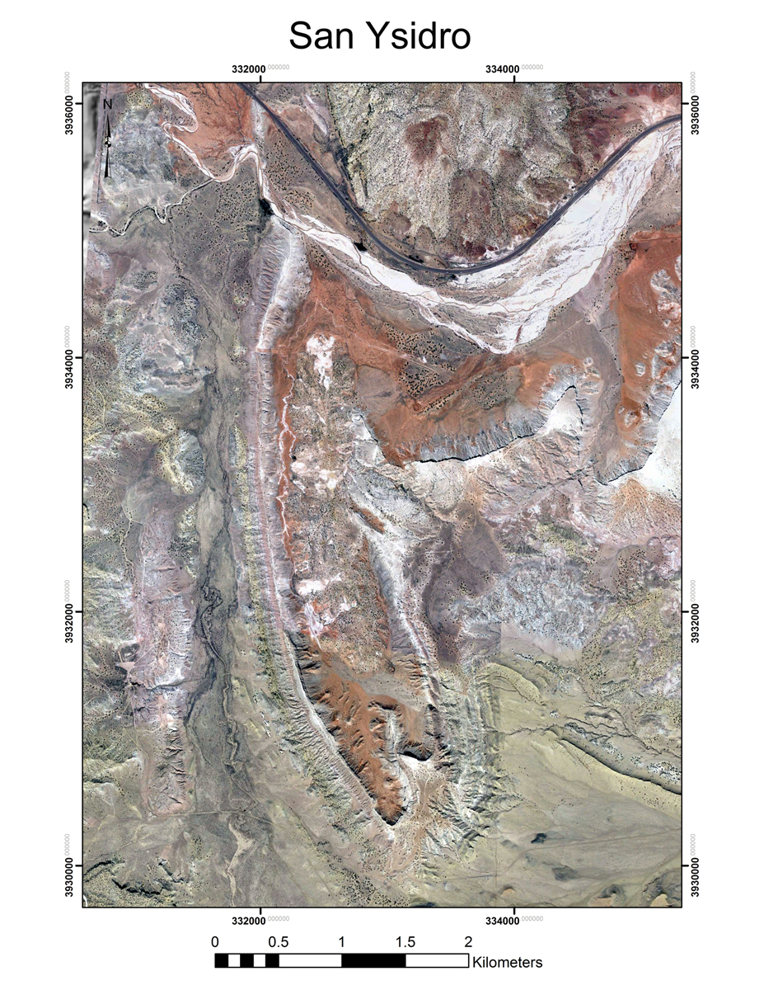
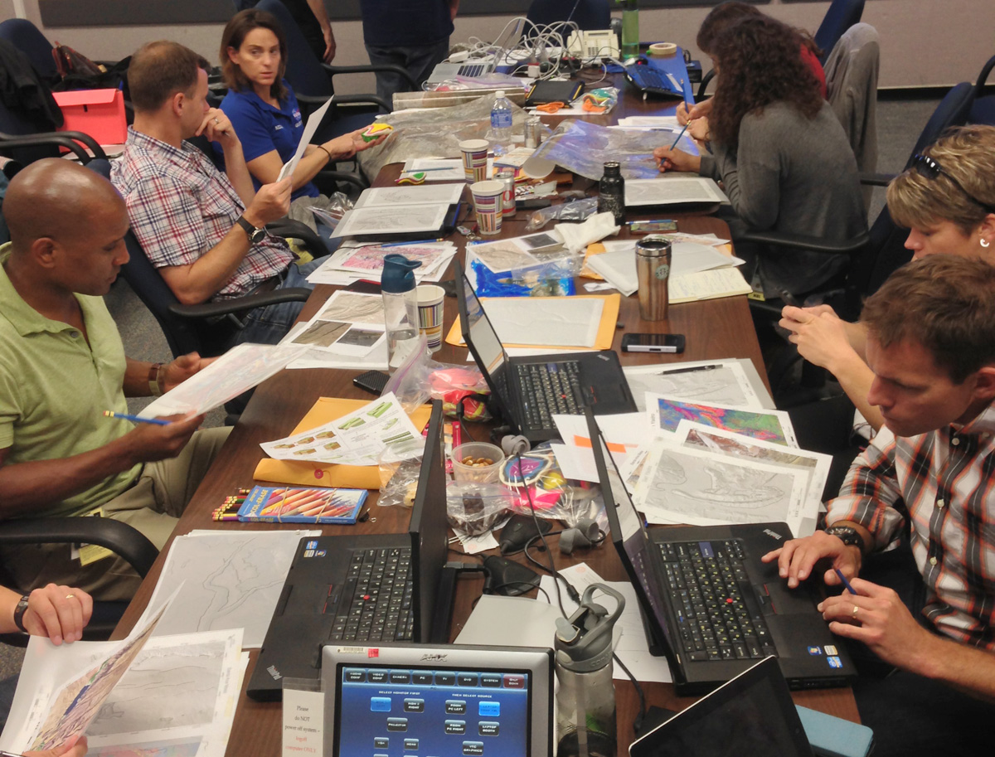
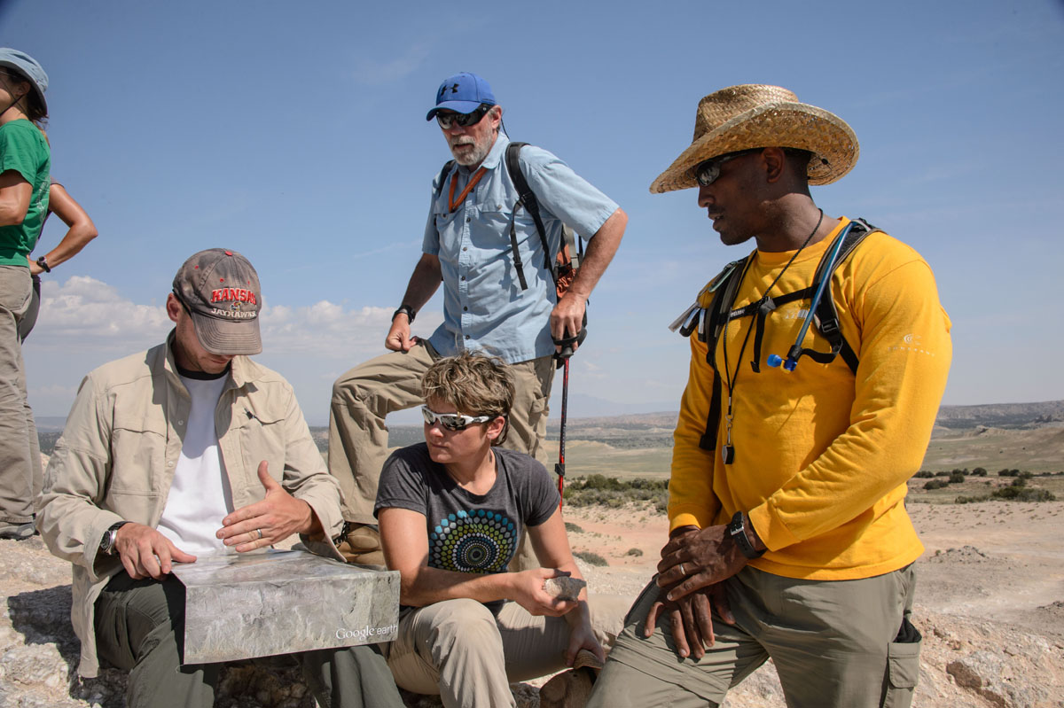
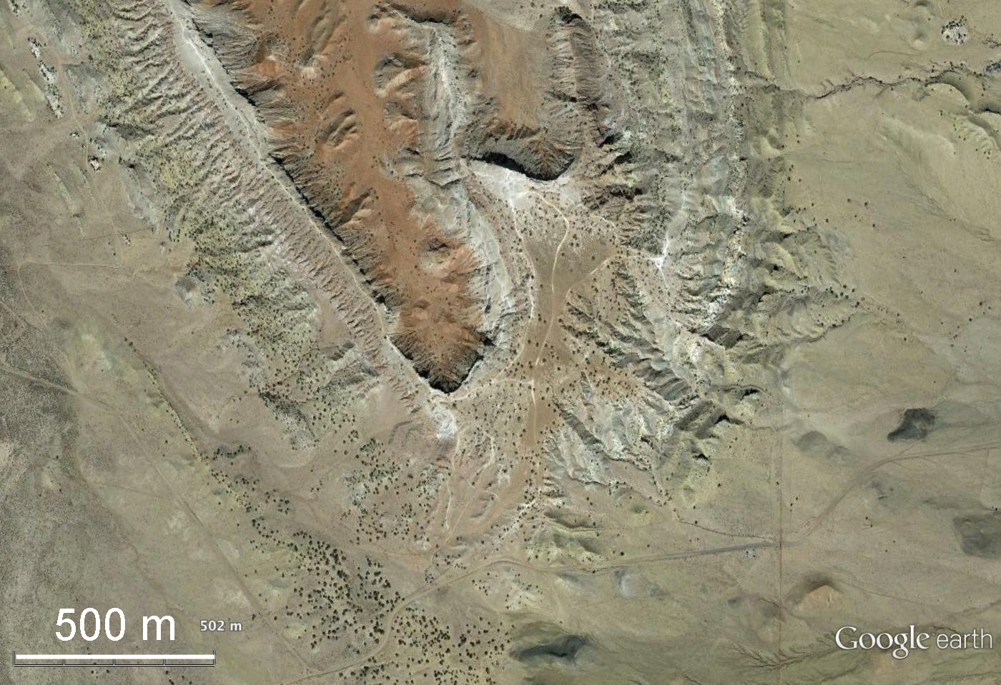
Use Google Earth for pre-field mapping
Orbit to outcrop; framing hypotheses to test in field; targeting field work.
Notes:
pre-field mapping – orbit to outcrop; mapping can mimic field experiences in Google Earth with placemarks for “field notes”
GE Pro; overlays, screened back images; Arc2Earth; for NASA astronauts

Slide 16
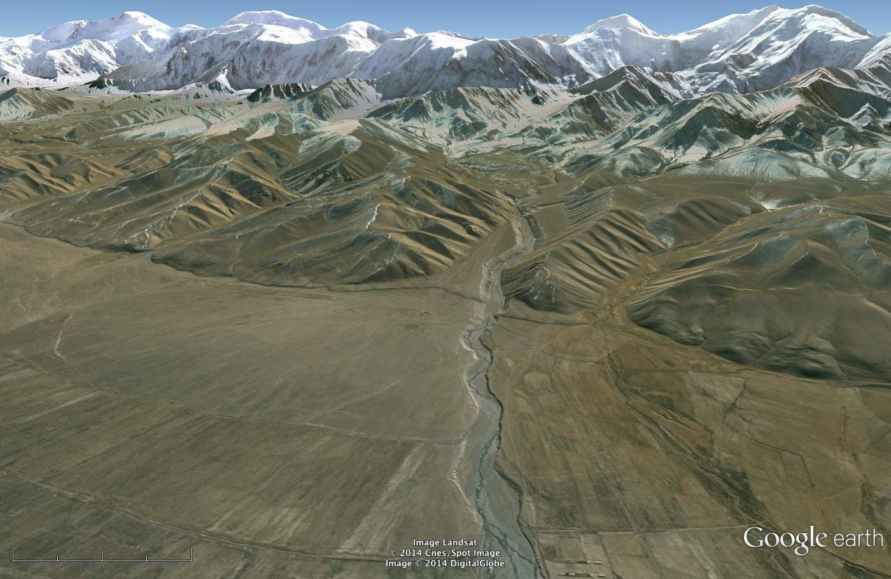
Use Google Earth to make literature-reading more meaningful for students
Example from Pavlis et al., 1997 on tectonics and erosion in the Tien Shan and Pamirs
Notes:
Orbit to outcrop: personal – example from NASA
Virtual – reading articles – use GE to help with visualization – example from Terry’s article; Simon’s Hat Creek; Mohamed’s Afar; Anti-Atlas; Quetta-Chaman

Slide 17
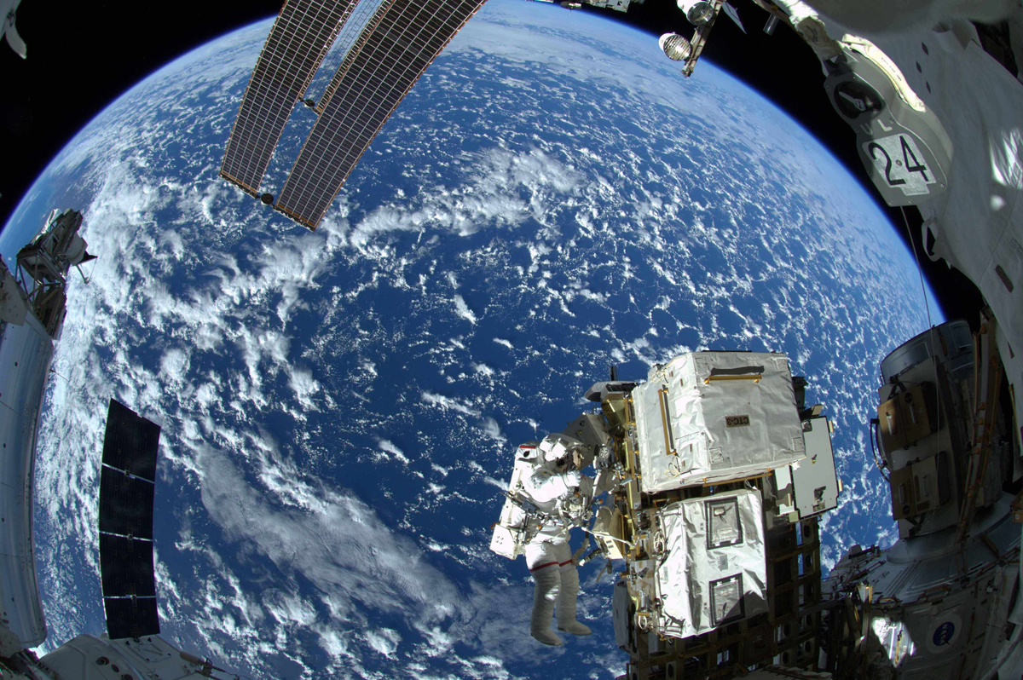
From outcrop to orbit
http://serc.carleton.edu/NAGTWorkshops/structure/Google_Earth/approach.html
Notes:
Separate out NASA and student – critical to point out outcrop to orbit again – not everything can be done remotely.

Slide 18
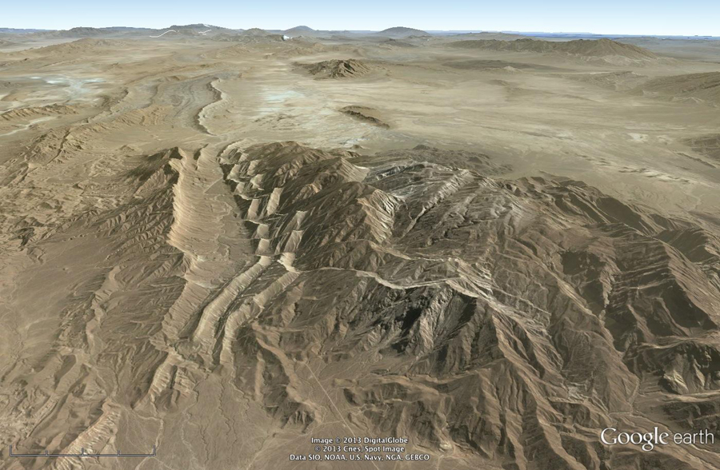
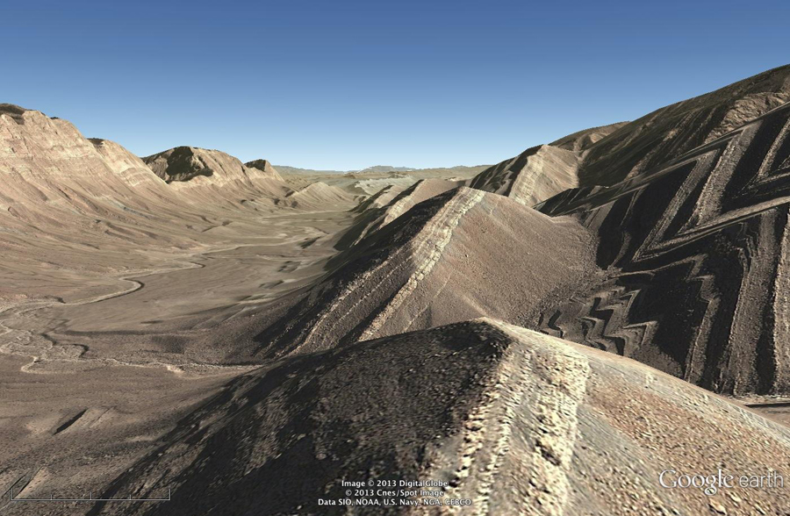
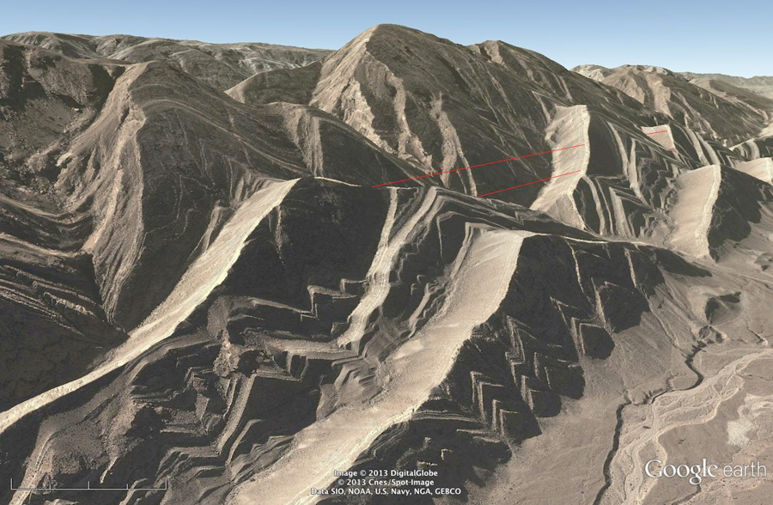
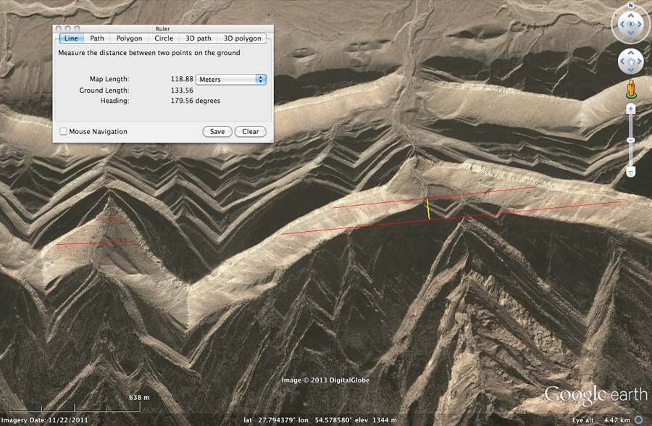
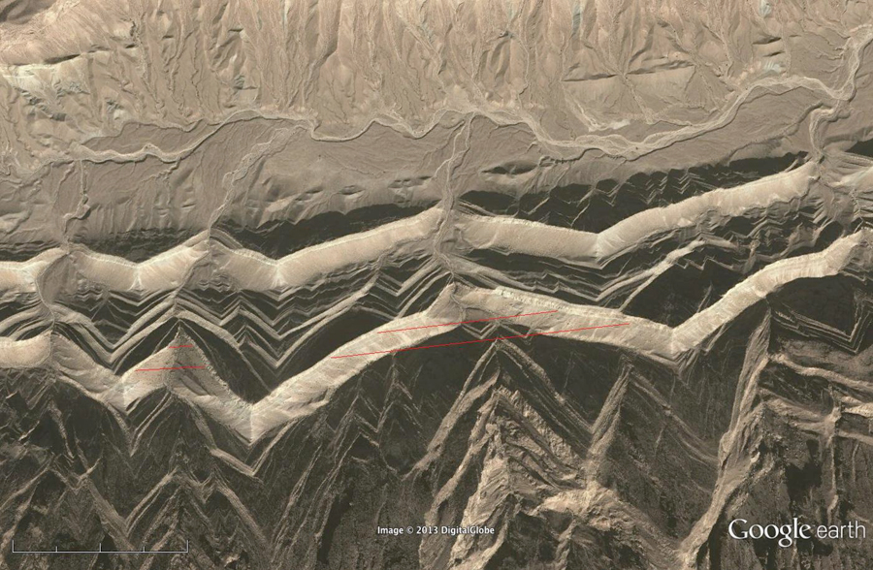

Calculating dip, backing into strike
Measure dip with protractor in 3D view
Use line tool in GE to “fill in” the Vs (what did it used to look like before erosion??)
Calculate dip of contact; define structure contours and strike.
Notes:
visualizing strike and dip in Dekuyeh – number the Dekuyeh placemarks; hasn’t always looked this way!!

Slide 19



Pattern recognition and interpretation
Fold terminology and symbology, visualization
Down-plunge views for true fold shape
Notes:
Fold terminology, and symbology;

