Slide 1



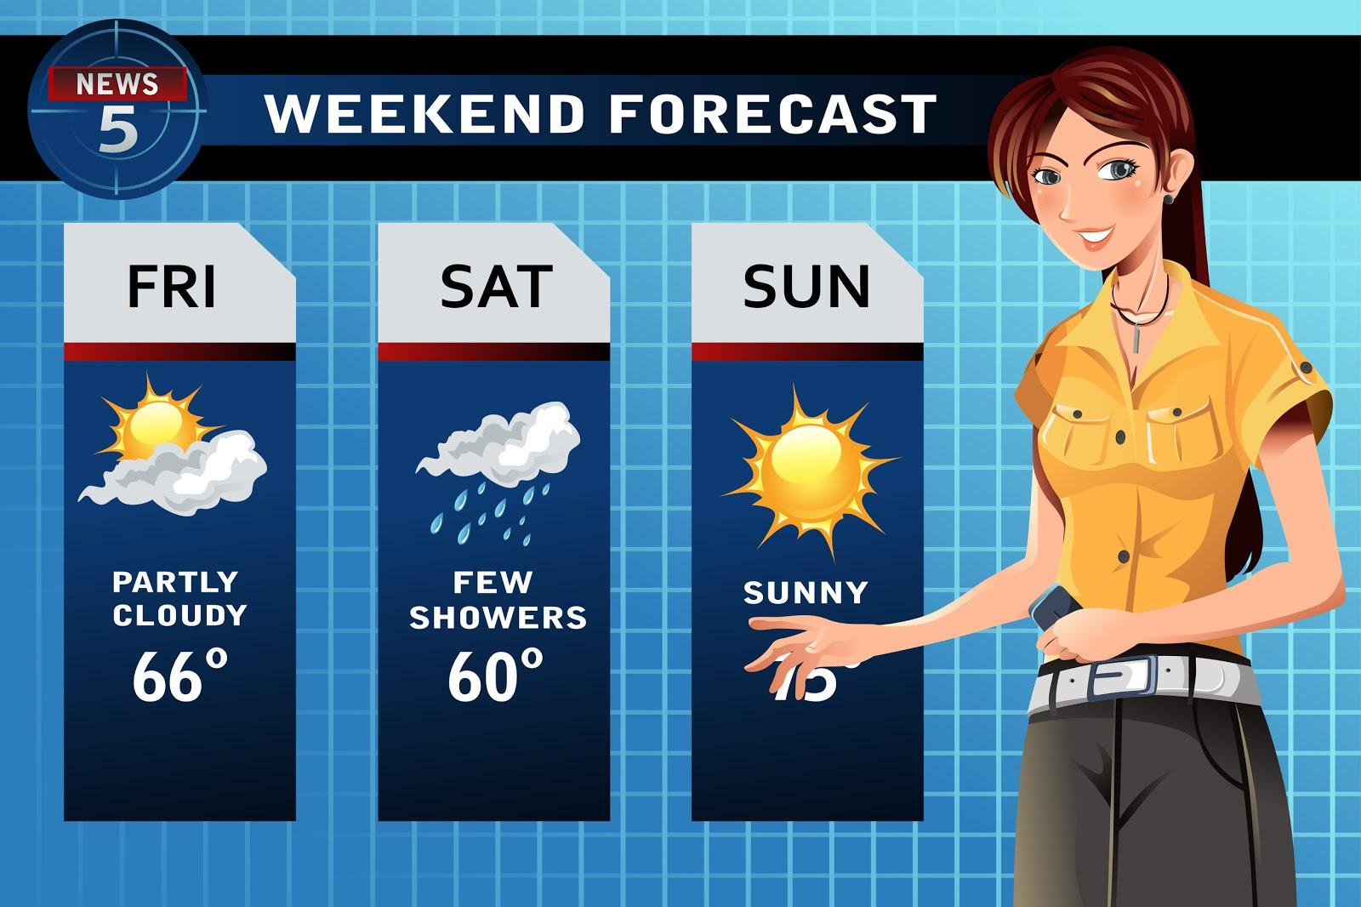
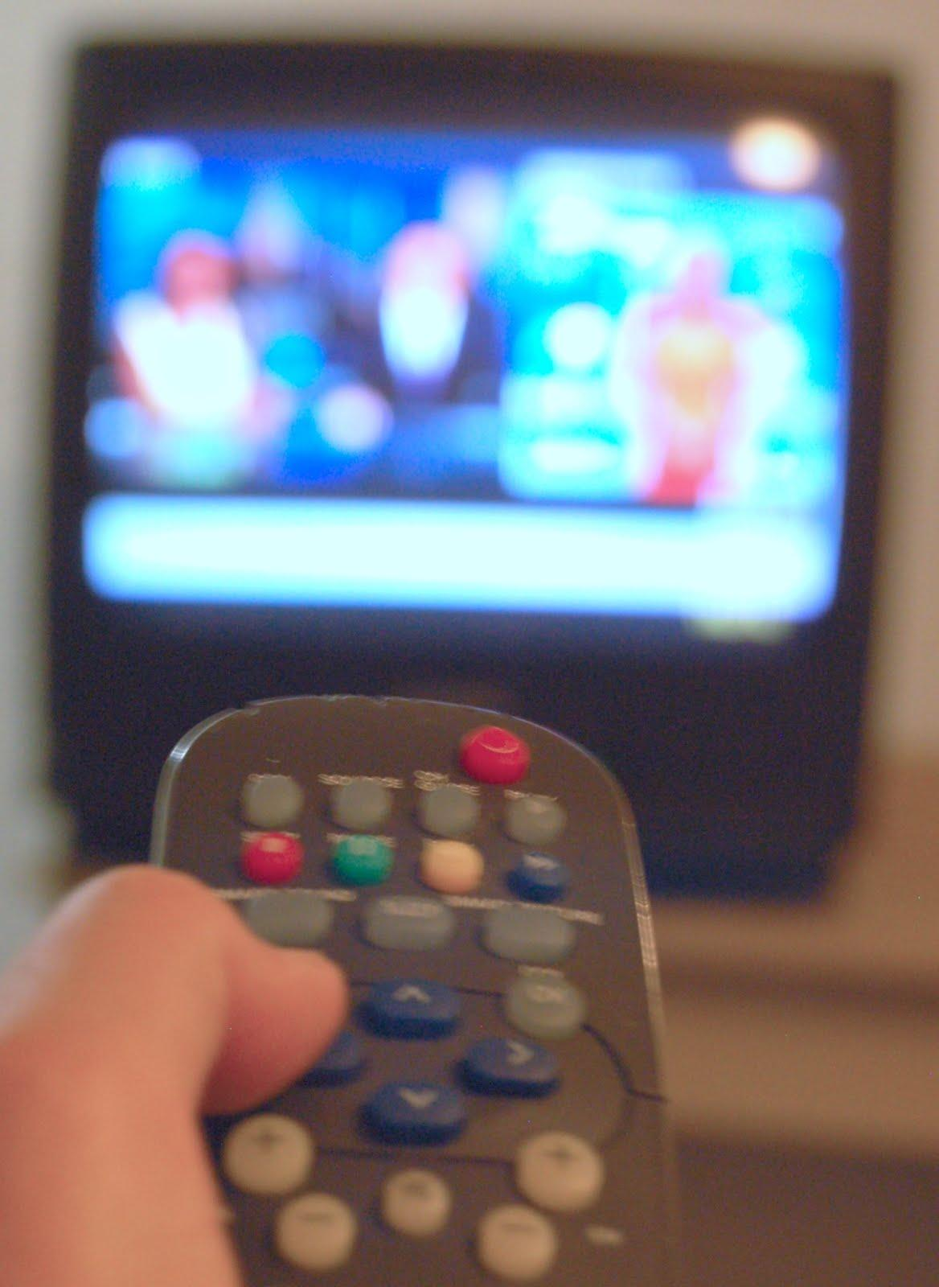
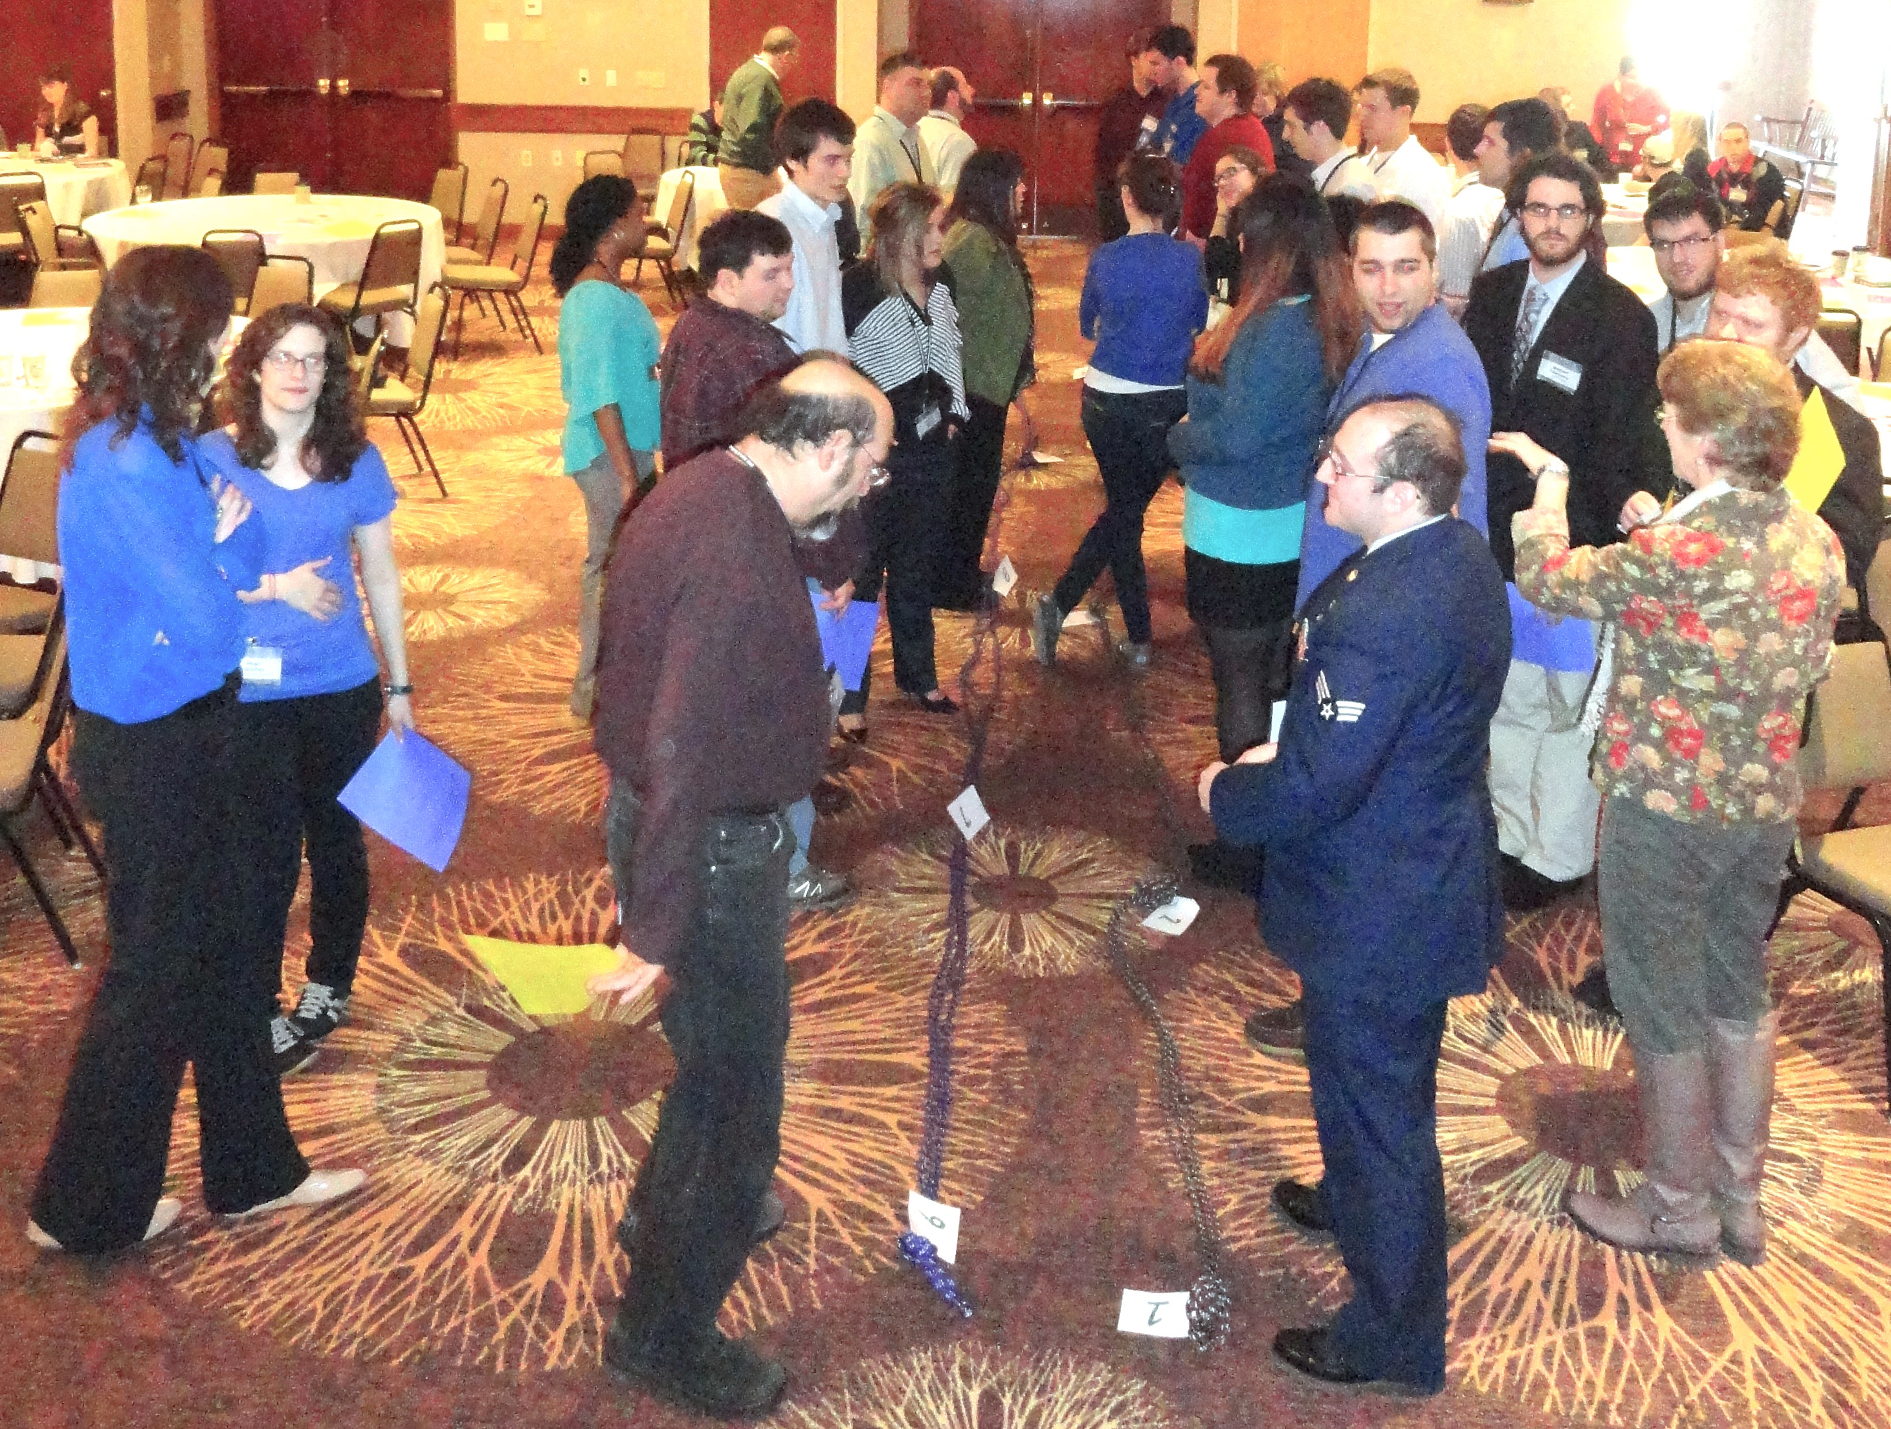
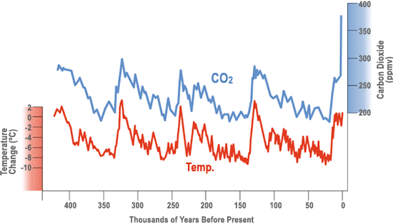
Climate Change Communication Between Broadcast Meteorologists and Their Viewing Audiences
P. Thompson Davis¹, Lisa Doner², Mary Ann McGarry², Helen Meldrum¹, David Szymanski¹, Rick Oches¹, Eric Kelsey²
Melanie Perello²**, Evan Gaudette²* Kathryn Foley¹*
1. Bentley University 2. Plymouth State University **Graduate Student *Undergraduate Student
Introduction
Television news broadcasts are a primary source of information for the public on recent and ongoing climate changes. Broadcast meteorologists, who also serve as science correspondents for many news stations, are well positioned to communicate climate science to the public. However, despite position statements from nearly every U.S. Earth and atmospheric sciences professional society acknowledging human responsibility for much of the global-scale warming trend of the last century, 30% of broadcast meteorologists remain skeptical of anthropogenic influences on climate and many more avoid public engagement on the topic (Wilson, 2002, 208, 2009; Maibach et al., 2011).
We seek to improve public engagement in climate communication by broadcast meteorologists, using scientific methods to identify probable causes for their skepticism and/or reticence, and to test the efficacy of proposed solutions. This work is funded by a 2-year, collaborative Pathways award (DRL-1222752) in NSF’s Advancing Informal STEM Learning [AISL] program.
Entities involved
This project involves faculty, undergraduate and graduate students from Geologic Sciences, Business and Social Science Departments at Bentley University, and from the Environmental Sciences and Policy and Meteorology programs at Plymouth State University.
The project also includes 86 workshop participants at the 2014 Northeast Storm Conference, 22 broadcast meteorologists working at radio and television stations in the Northeast U.S., 139 students (78 seniors and 61 freshmen) in 10 (of 70) meteorology degree programs across the U.S., and 50 participants in an upcoming workshop that brings together upper-level and recently graduated meteorology students, and professionals in broadcast meteorology, over the topic of climate communication by broadcast meteorologists.
Methods
To address our 5 hypotheses, we surveyed:
published curricular requirements for 120 meteorology degree programs in the U.S.
climate literacy of undergraduate students (graduating and 1st year) enrolled in U.S. meteorology degree programs.
climate literacy and public climate communication efforts by practicing broadcast meteorologists.
Additionally, we used a workshop at the 2014 Northeast Storm Conference (an annual meeting of meteorology faculty, students and professional meteorologists) to assess the potential for additional training to increase ability for, and commitment to, communication on climate science by broadcast meteorology students, faculty and professionals via:
a presentation and prolonged question/answer interval led by climate expert, Raymond Bradley (U. Mass-Amherst) at the 2014 Northeast Storm Conference workshop.
an interactive self-assessment exercise on “confidence for communicating climate news” that provided participants with a visual representation of their own status compared to that of their peers, and opportunity to investigate the reasons for these differences.
pre- and post-self assessment surveys on confidence in communicating news on a variety of climate topics, such as sea-ice area, volcano influences, global carbon cycle and ocean acidification.
Results of the national undergraduate student survey (above, n=139) support the hypothesis that meteorology students graduate with an inadequate level of climate literacy for effective communication and outreach about climate. Students performed well on questions about scientific process, but on all climate-related topics were markedly less literate (red dotted line indicates a 75% competency level). Interestingly, freshmen (green) scored better than seniors (blue) on topics related to model predictions and current biogeophysical trends.
Results
Of 137 broadcast meteorologists surveyed in New England and eastern New York:
93 (68%) have undergraduate degrees in meteorology or atmospheric science.
16 have graduate degrees in meteorology or atmospheric science.
16 have meteorology degrees or certificates from Mississippi State University.
Thus, our hypothesis about lack of academic science background for broadcast meteorologists does not appear to be an issue in the northeast U.S.
Premise
Broadcast Meteorologist Climate Training Workshop 1:
2014 Northeast Storm Conference
70% of Americans watch televised local news primarily to see the weather forecast (Miller et al, 2006; PEW, 2011). Since the public also tends to think that meteorologists are climate science experts (Leiserowitz et al., 2011), the prospective reach of broadcast meteorologists as disseminators of climate knowledge is enormous. But are broadcast meteorologists adequately prepared and willing to be climate communicators?
Workshop participants (n=83) self-evaluated their confidence to broadcast climate change news (pie chart). Before and after surveys assess the efficacy of training to improve willingness and ability to accurately report on 11 climate topics. Participants were a mixture of university faculty, students and professional meteorologists.
Sources: http://www.dreamstime.com/photos-images/tv-weatherman.html, June 3, 2013.
To understand and convey the link between carbon dioxide and temperature (figure at right), a broadcast meteorologist would need to understand:
how data from Antarctic ice cores were created,
what processes affect temperature and carbon dioxide levels,
and the timescales at which those other processes have greatest impact on climate.
Improved Confidence to Report on Climate (51%)
Decrease in confidence (3%)
No Change
(46%)
Human bar-graph exercise: participants rank themselves alongside their peers about their confidence to report on a particular climate topic. Facilitated discussion allowed those scoring high, medium and low to compare aspects of training and experiences that led to their ranking.
Source: http://biolojoie.wordpress.com/2013/09/10/as-carbon-dioxide-levels-pass-a-new-milestone-misconceptions-about-climate-change-persist/
Results of 20-42 minute-long phone interviews with all 22, of 137 (16%), broadcast meteorologists who responded positively to solicitation letters.
Interview approach was not to focus directly on broadcasters' views on climate change, but on the "four A's": attention, awareness, analysis and action.
Analyses reveal clearly defined types of participant response: well-informed, informed and under-informed about climate change.
Participants also demonstrate different approaches to climate change communication with their audiences: avoidance, compromise and engagement.
Audience
The intended audiences for this project are developers of U.S. meteorology degree programs and broadcast meteorologists. Broader impacts of this project are aimed at the U.S local radio and television news audiences.
OUTREACH
Szymanski, D.W., Meldrum, H., Davis, P.T., Oches, E.A., Foley, K., and Doner, L.A. (2014). Views of broadcast meteorologists on climate change communication with their audiences. T71. Climate literacy: formal and informal education and outreach efforts to increase awareness and enable responsible decisions. GSA Abstracts with Programs Vol. 46, No. 6.
Doner, L., McGarry, M.A., Perello, M., Davis, P.T. and Foley, K. (2014). National climate literacy gaps in meteorology graduates. T71. Climate literacy: formal and informal education and outreach efforts to increase awareness and enable responsible decisions (Posters), GSA Abstracts with Programs Vol. 46, No. 6.
Doner, L.A., Davis, P.T., Lyons, R., Wilkinson, K., Foley, K., McGarry, M.A., Meldrum, H., Szymanski, D.W., Oches, E.A., and Avilés, L.B. (2014). Climate Change Communication between TV Broadcast Meteorologists and Their Viewing Audience; NE Storm Conference, Rutland, VT.
Doner, L.A., Davis, P.T., Lyons, R., Wilkinson, K., Foley, K., McGarry, M.A., Meldrum, H., Szymanski, D.W., Oches, E.A., and Avilés, L.B. (2013). Climate Change Communication between TV Broadcast Meteorologists and Their Viewing Audience. Geological Society of America Abstracts with Programs. Vol. 45, No. 7, p.655. Paper No. 283-7 (Talk).
Davis, P.T., Oches, E., Szymanski, D.W., Meldrum, H., Doner, L., McGarry, M.A., Aviles, L., Miller, S., Lyons, R., Wilkinson, K., Foley, K., (2013). Climate change communication between TV broadcast meteorologists and their viewing audience. AGU Chapman conference on communicating climate change, Granby, Colorado, June
Approach
In this project, we examine and test the following hypotheses to explain the high level of skepticism about anthropogenic climate change and general avoidance by broadcast meteorologists for reporting on climate science:
Education focus
A majority of U.S. meteorology degree programs fail to provide a sufficient number of courses that address salient aspects of climate change mechanisms, processes and Earth system interactions;
Meteorology students, despite earning STEM-rigorous B.S. degrees, graduate with an inadequate level of climate literacy for effective communication and outreach about climate;
Many broadcast meteorologists only have degrees in broadcast journalism with limited backgrounds in meteorology or climate science.
Work experience focus
Most meteorology professionals lack experience with pre-instrumental records of climate change and synoptic-global scale climate behaviors that would inform them about climate change;
Differences in quantitative approaches by meteorologists compared to climate scientists affects the credibility of climate findings for meteorologists.
Four websites on this project and its findings are aimed at public outreach. Two of the sites are portfolios that document graduate student work on the project. Two others are about the project in its entirety, one for CAISE audiences and one for the general public. Both include resources about climate change, climate change reporting by the broadcast meteorologists and climate education in meteorology programs.
Nearly all interviewees note that their communication approach is partially influenced by expectations of station management, the public or impressions of impartiality on the climate "debate." Communication approach is not always correlated with how well informed the broadcast meteorologist is about climate change.
Graduate Student Portfolios:
www.plymouth.edu/eportfolio/view/view.php?t=uRcv8SwVTB0J2shKDUtG
www.plymouth.edu/eportfolio/view/view.php?t=kjr4LdYgnGweEQB2uTMt
CAISE website:
informalscience.org/projects/ic-000-000-008-436/Collaborative_Research_Pathways_Project_Enhancing_Climate_Change_Communication_between_Broadcast_Meteorologists_and_Viewing_Audiences
Climate Literacy Survey (Survey Monkey) https://www.surveymonkey.com/s/H6JDFC9

