Slide 1



The Silver Hill Isolated Terrane: an Upper Plate of Paleozoics on the western flank of the Spokane Dome
Andy Buddington – Spokane Community College
Ted Doughty – PRISEM Geoscience
Eric Cheney – University of Washington

Slide 2
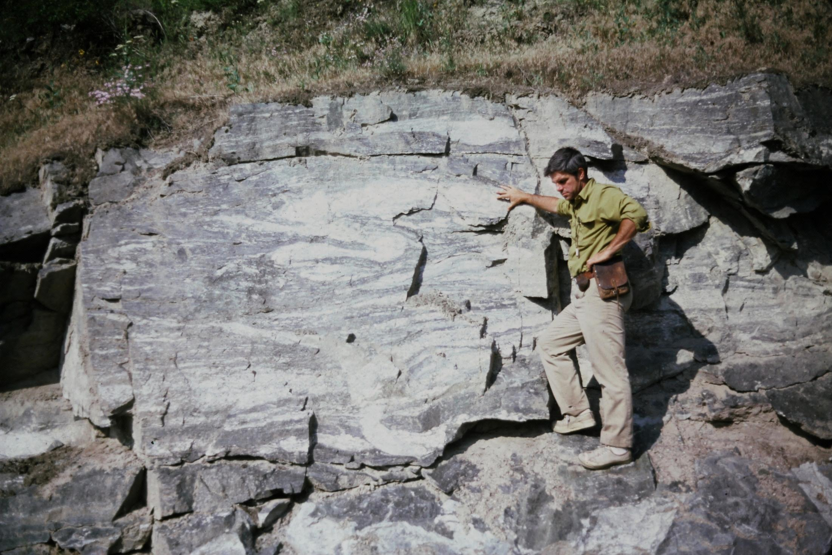

Slide 3
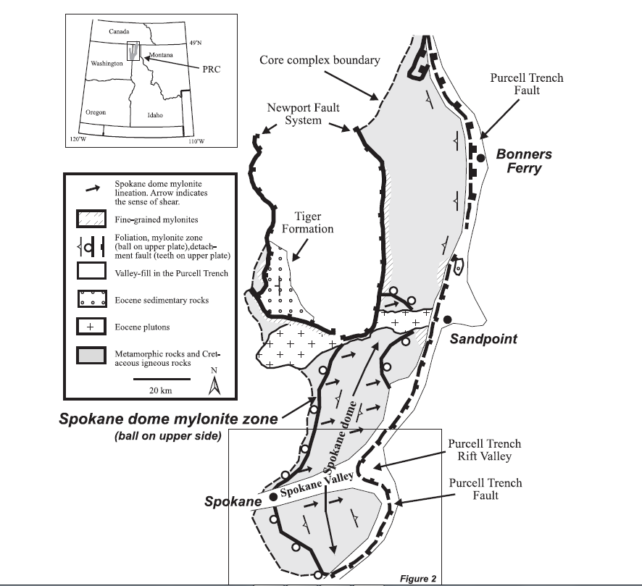
Priest River Complex & Spokane Dome
Silver Hill

Slide 4
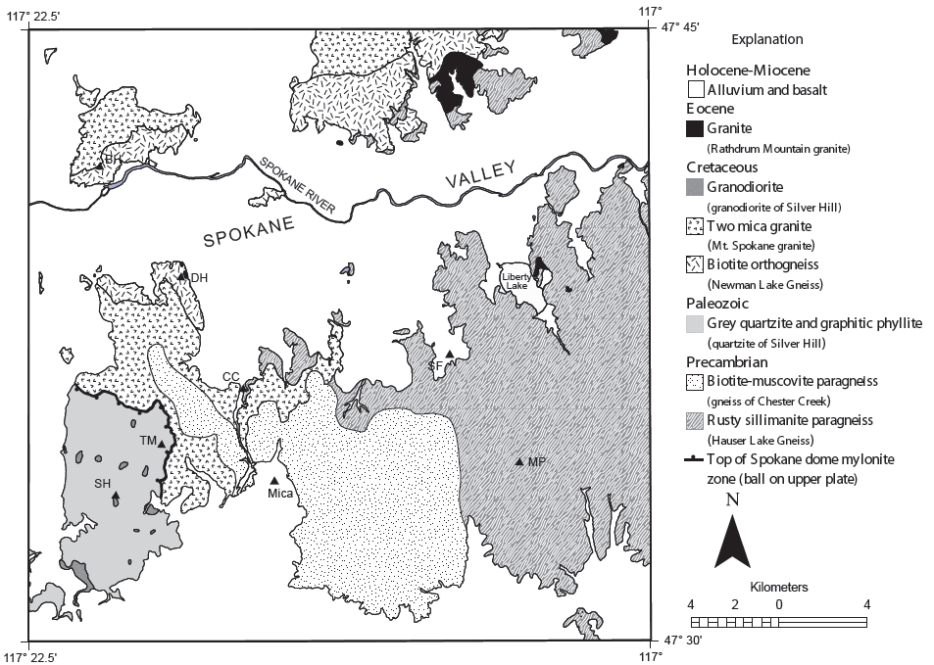


Geology
HLG
qSH
gCH

Slide 5
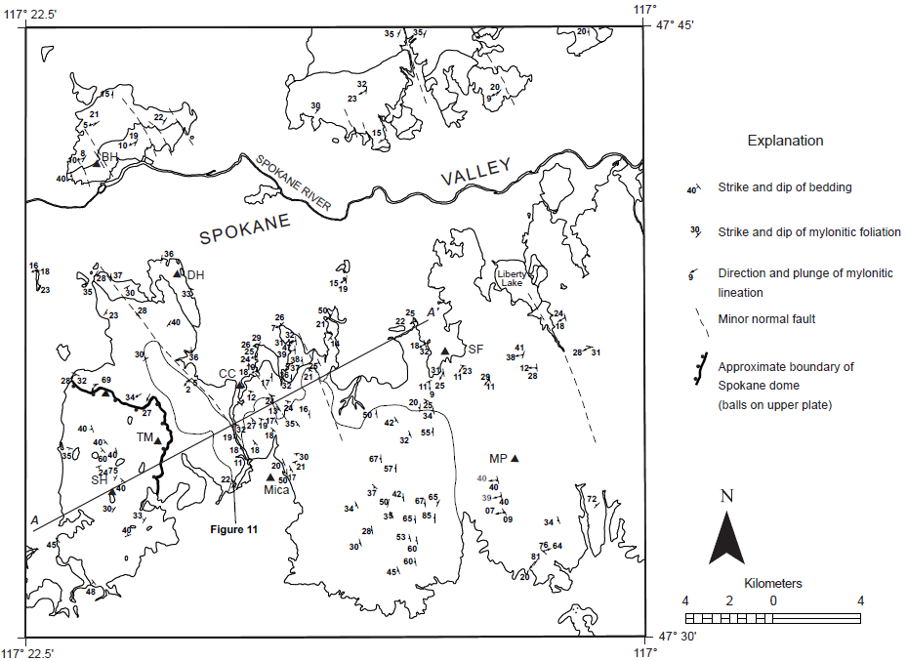

Regional
Fabrics
West dipping
mylonite with
East vergence
Non-foliated
rocks

Slide 6
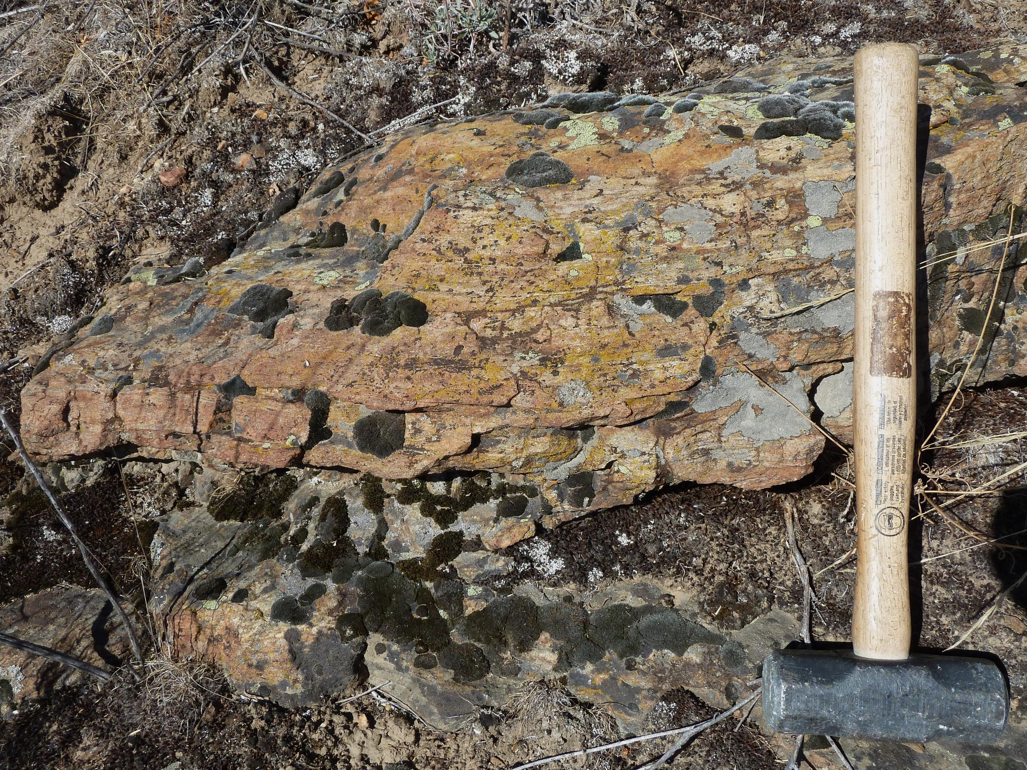

Slide 7
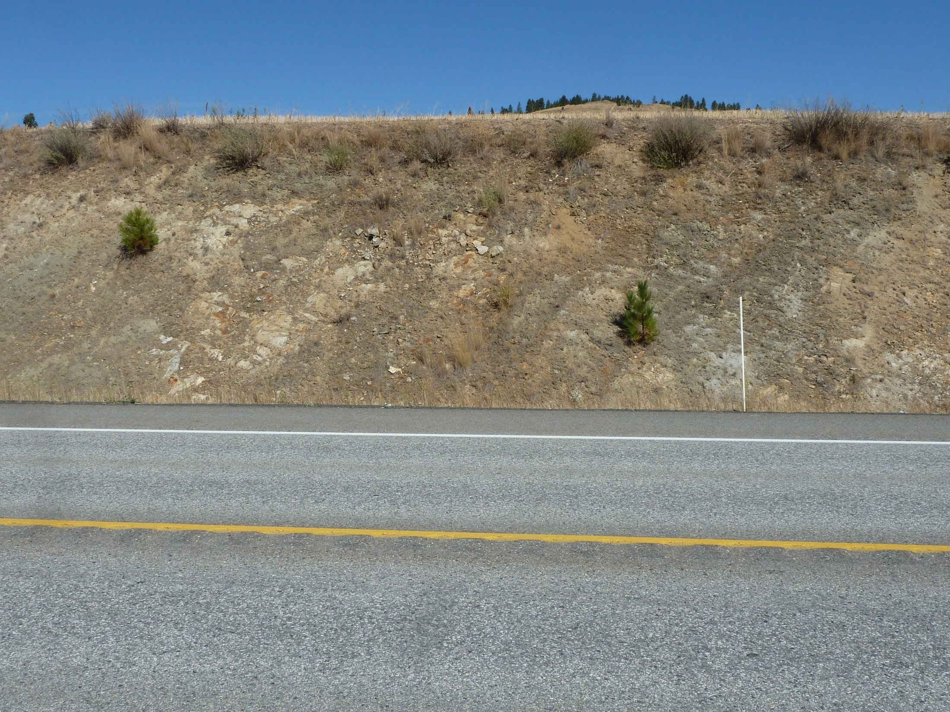

GD
GD

Slide 8
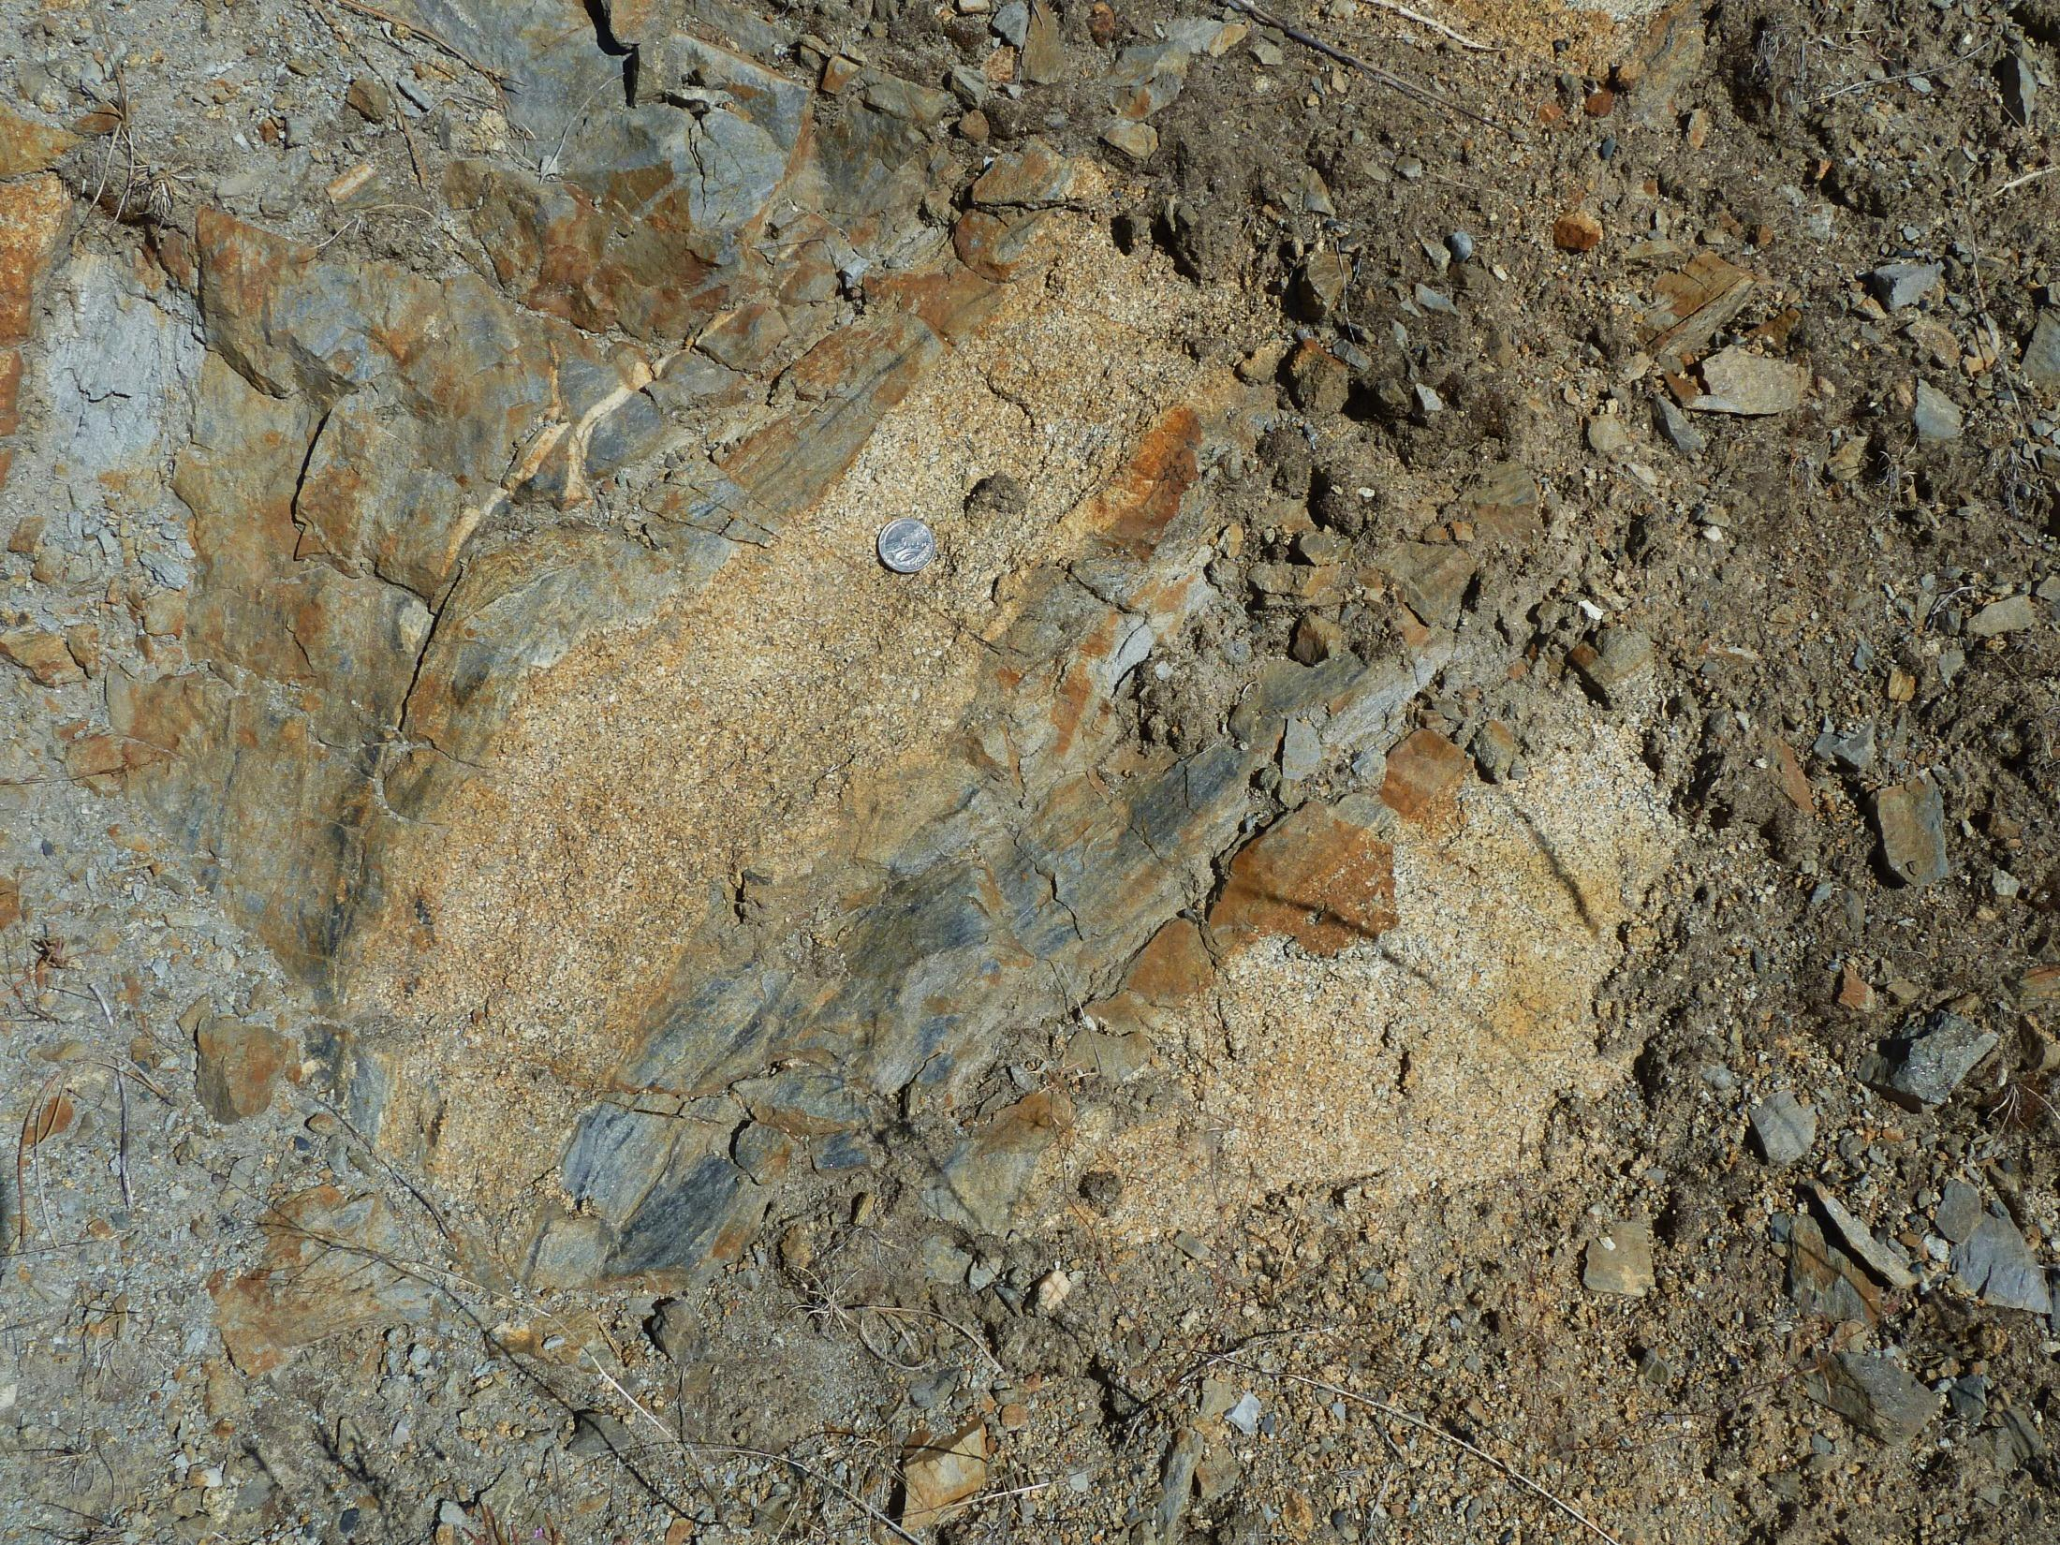

Slide 9
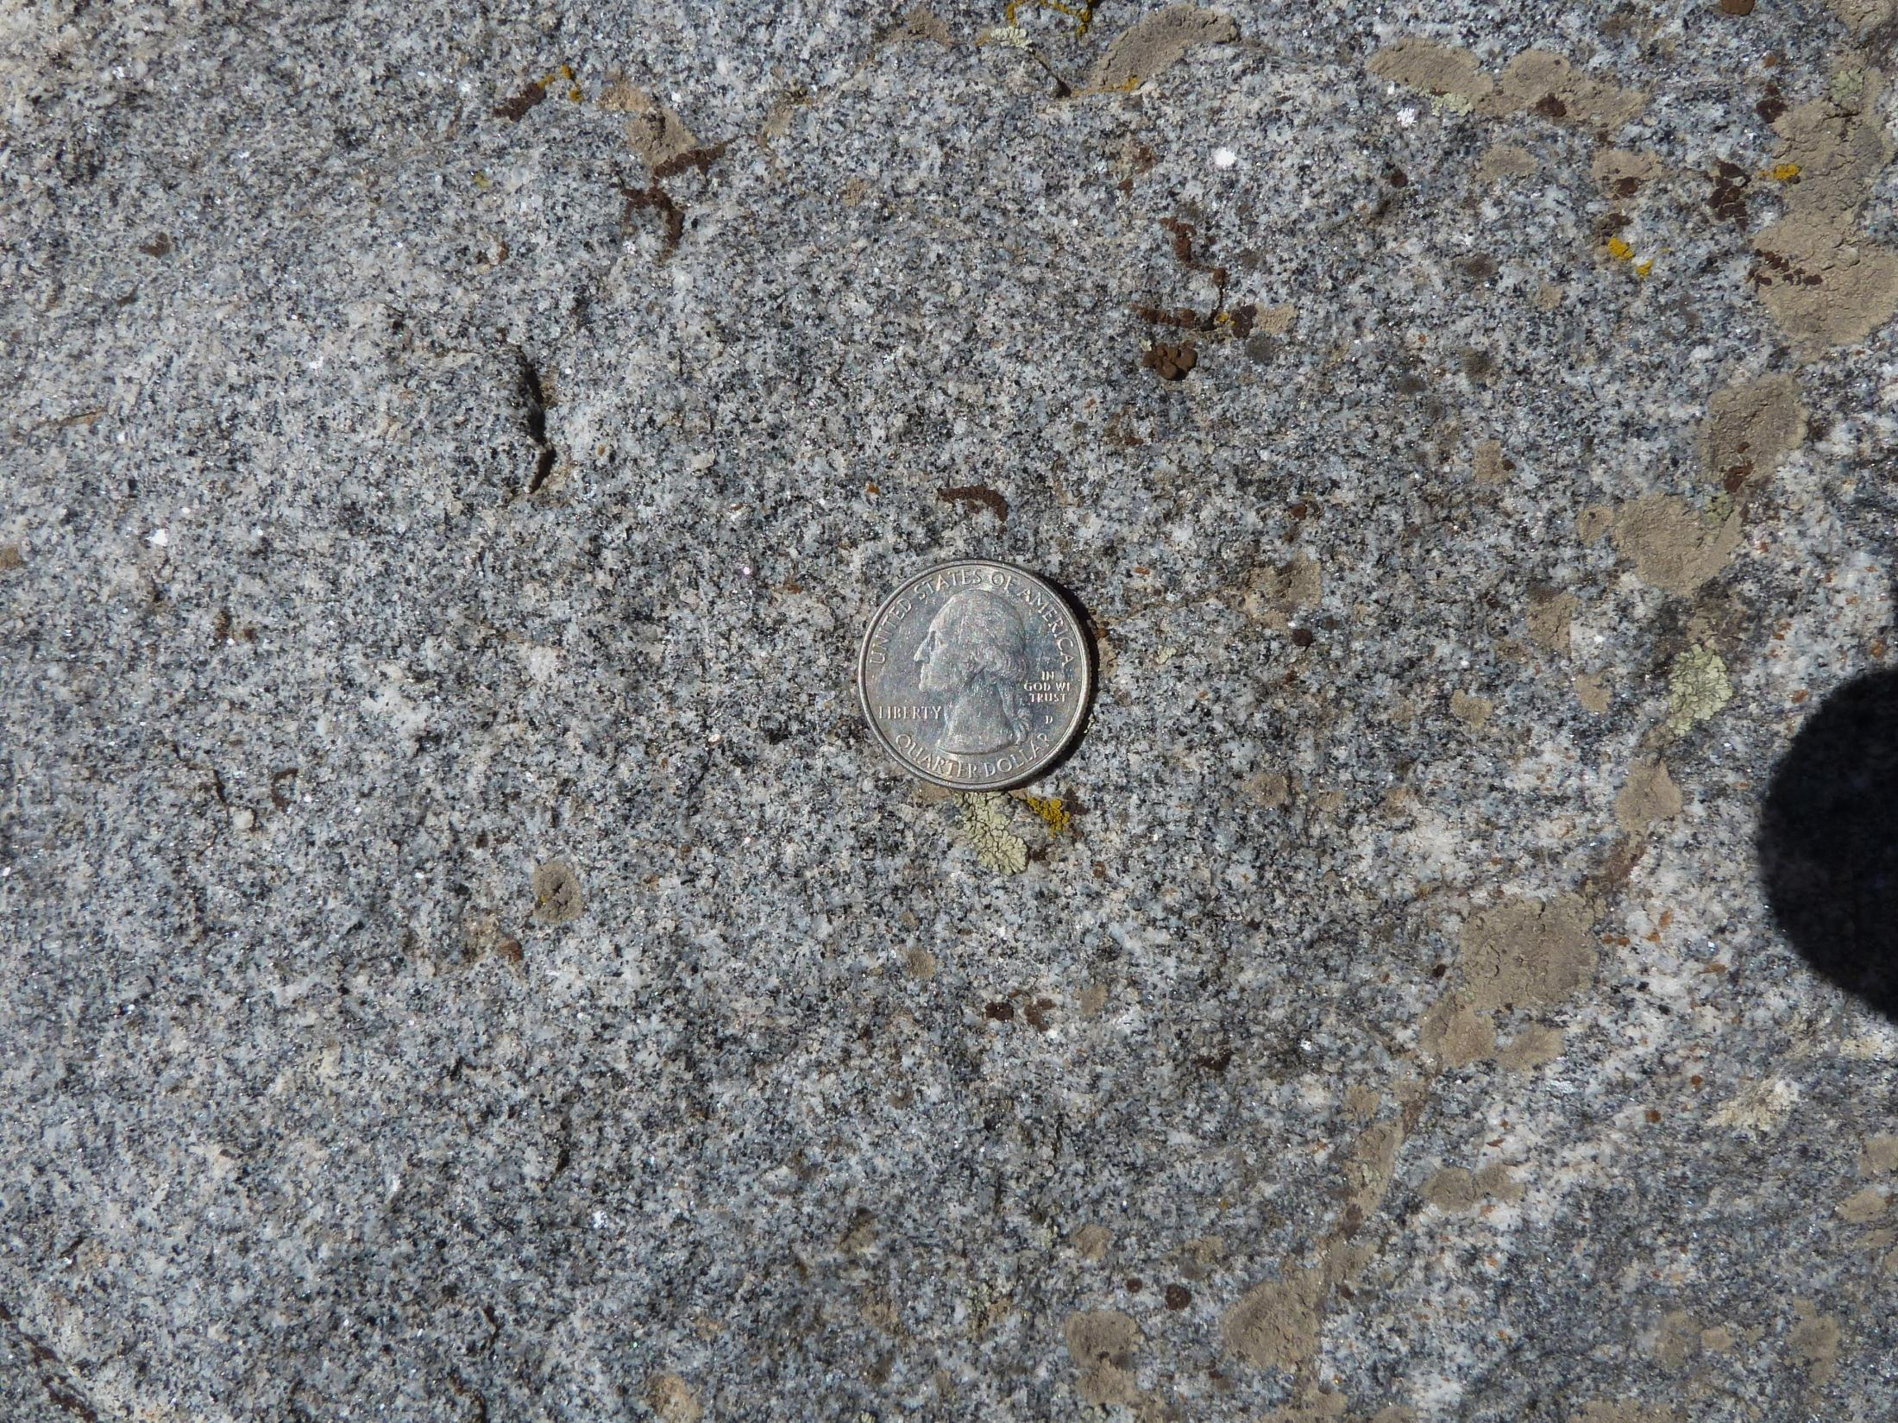

Slide 10
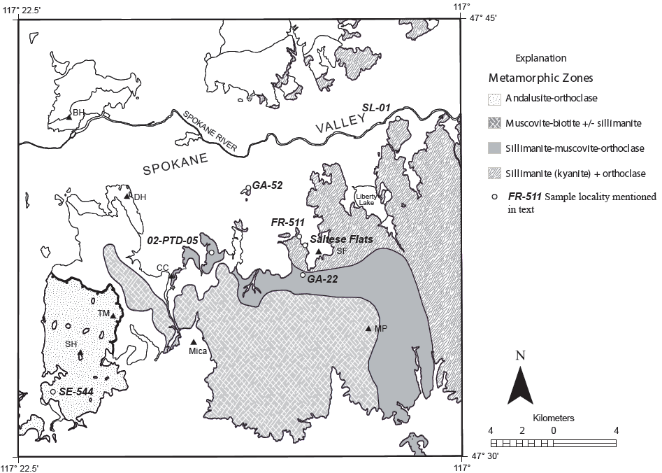
Metamorphic
Zones
WA
ID

Slide 11
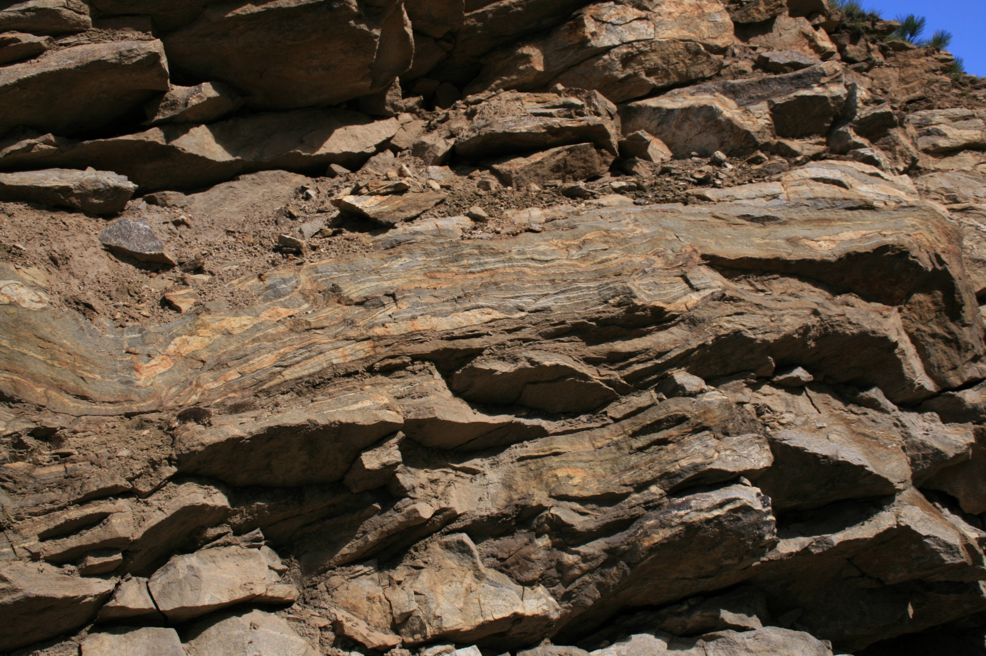
Hauser Lake Gneiss

Slide 12
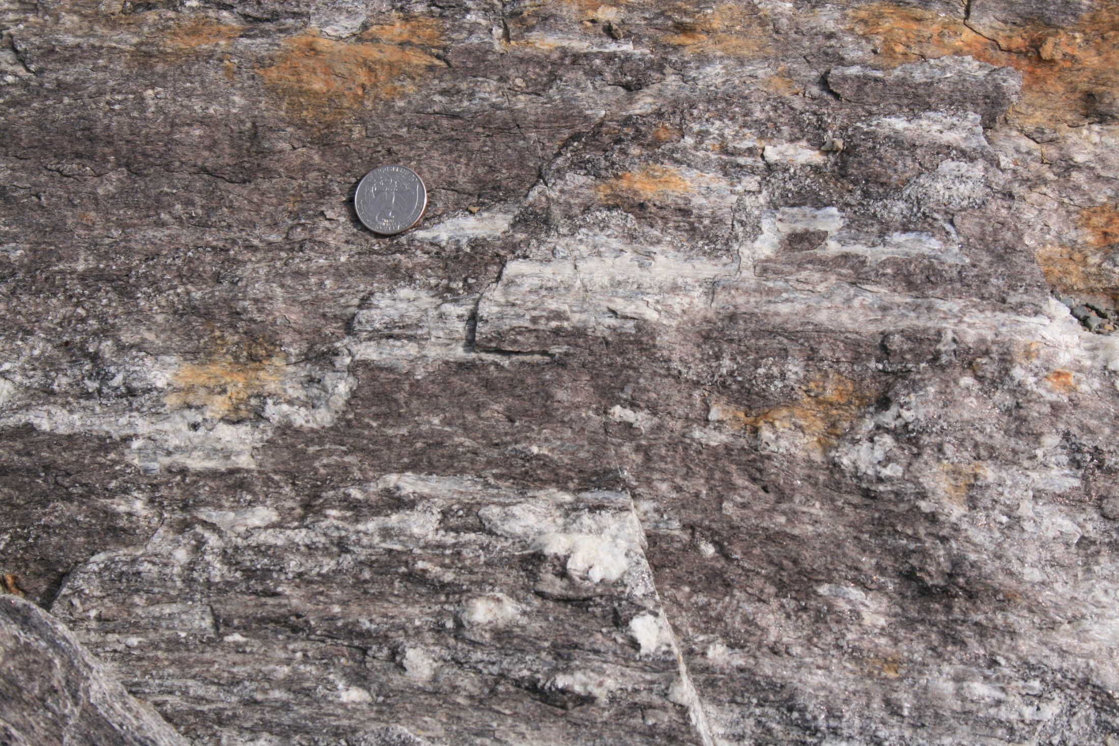
sillimanite

Slide 13
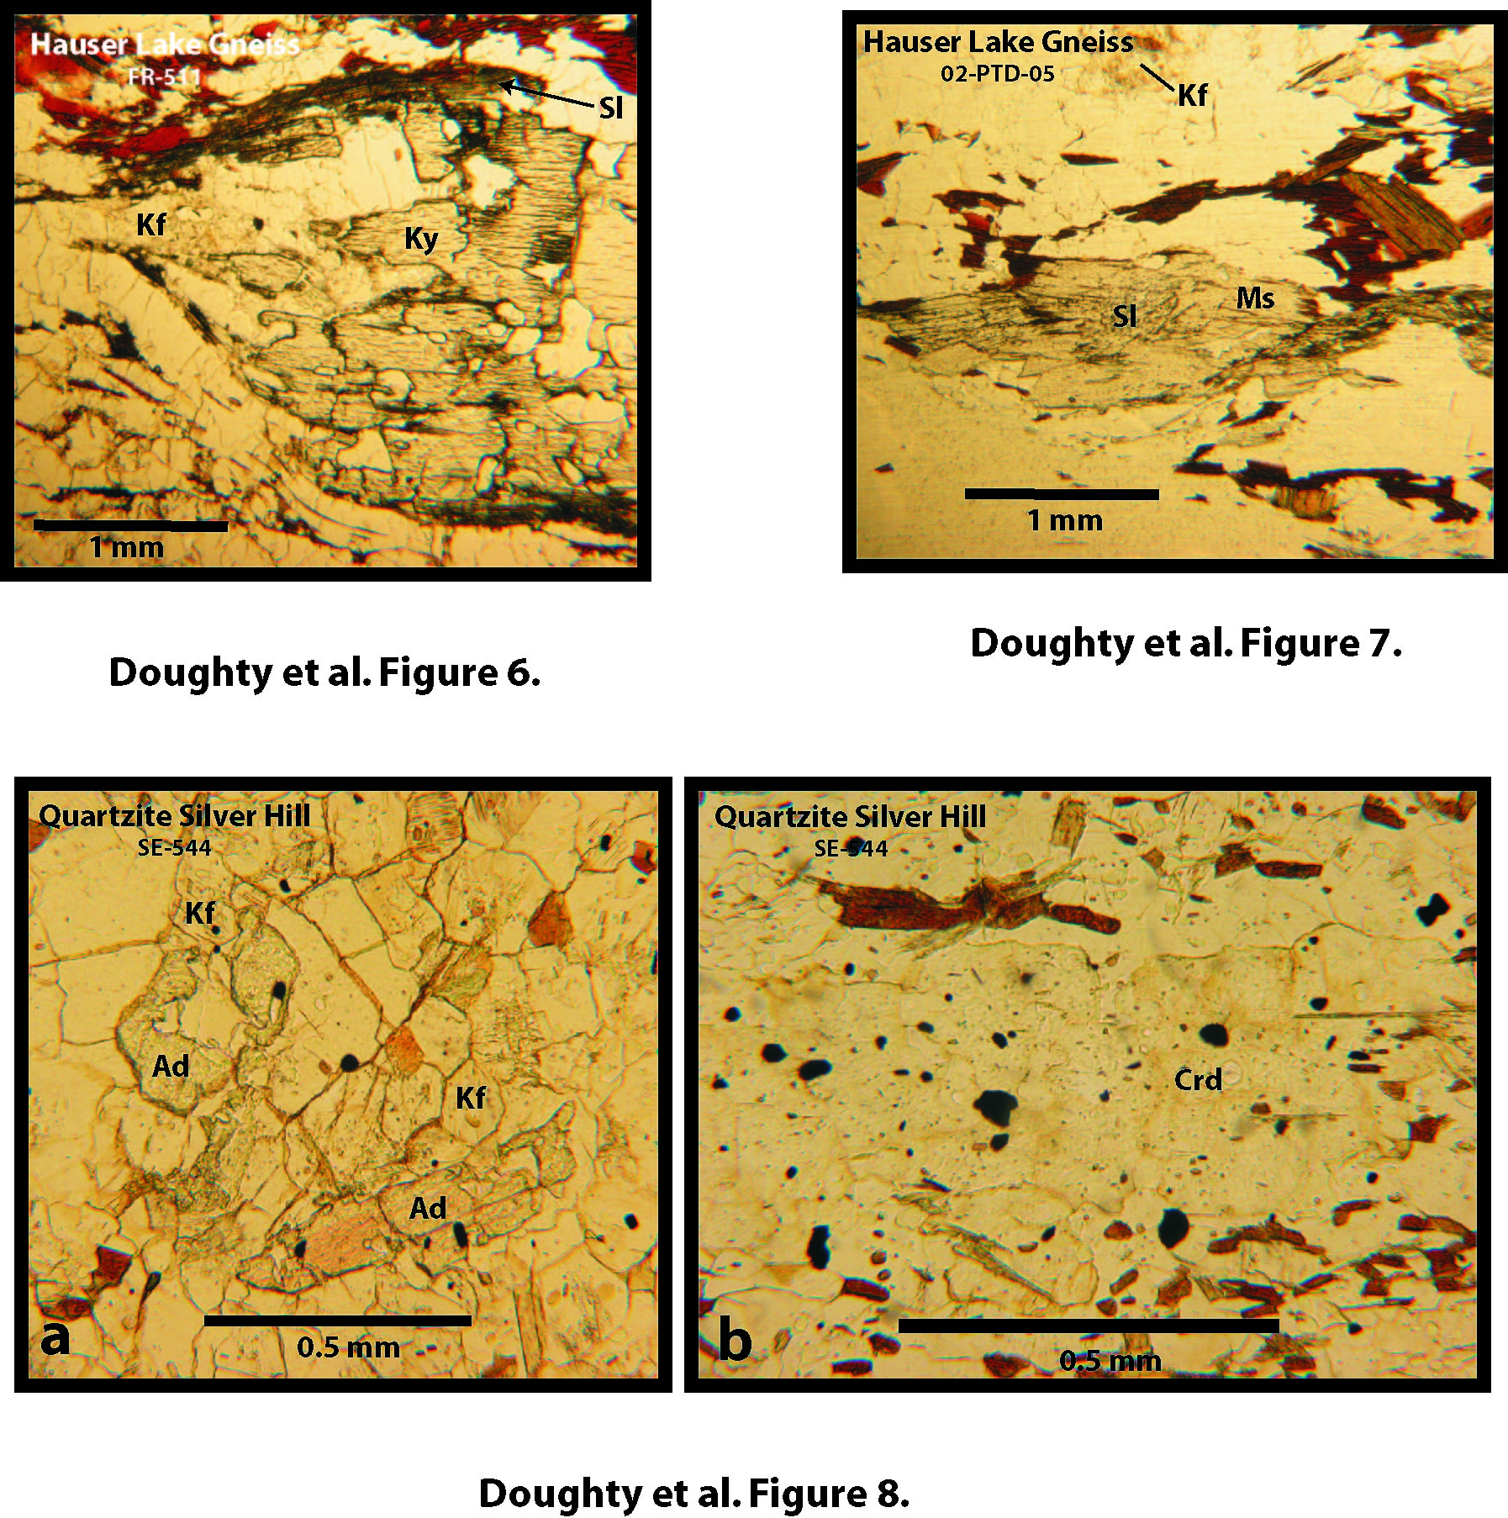

Slide 14
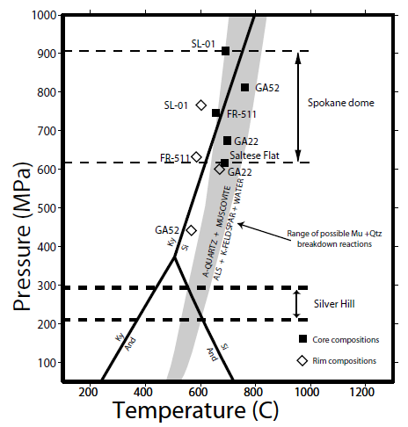

Slide 15
Metamorphic
Zones
WA
ID

Slide 16
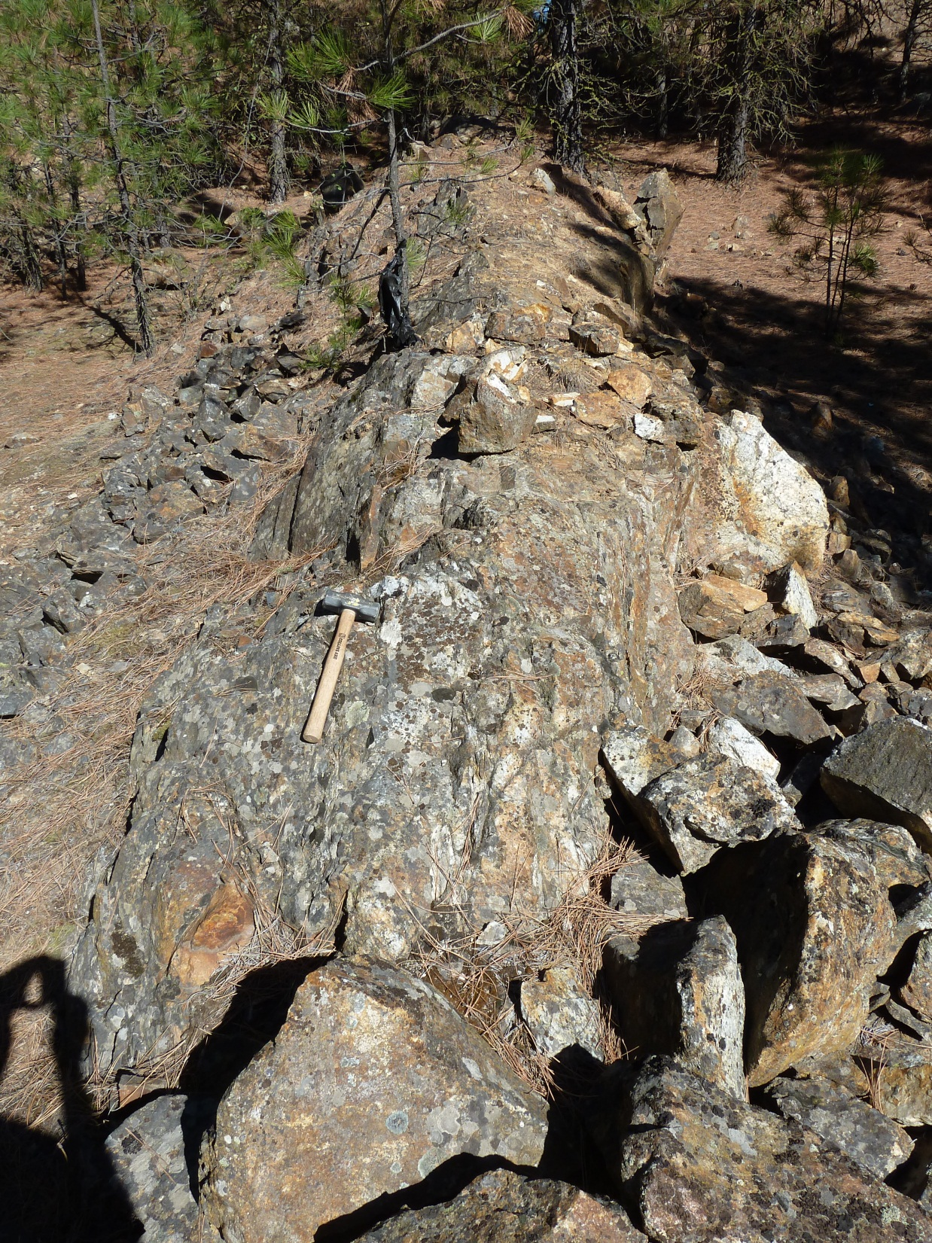
Quartzite of
Silver Hill

Slide 17
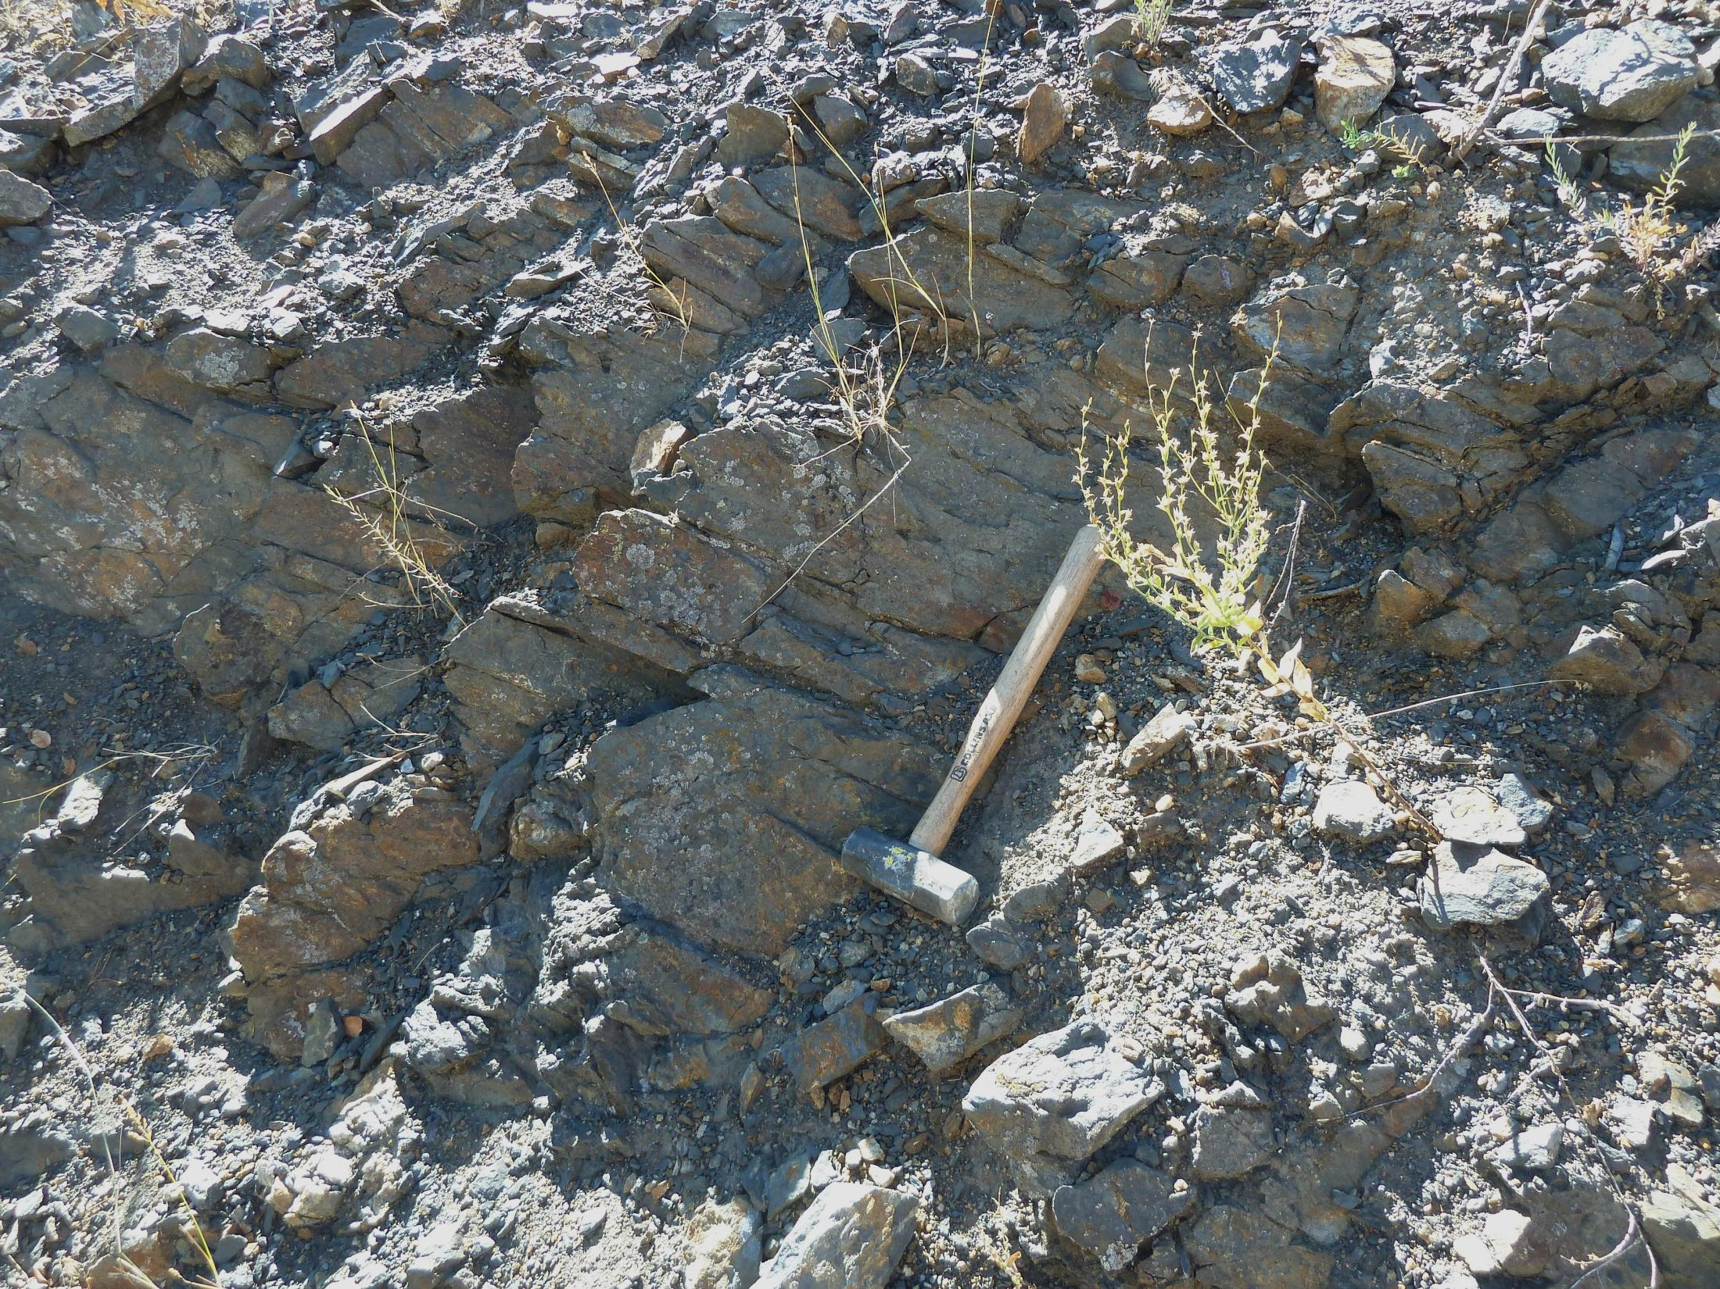

Slide 18
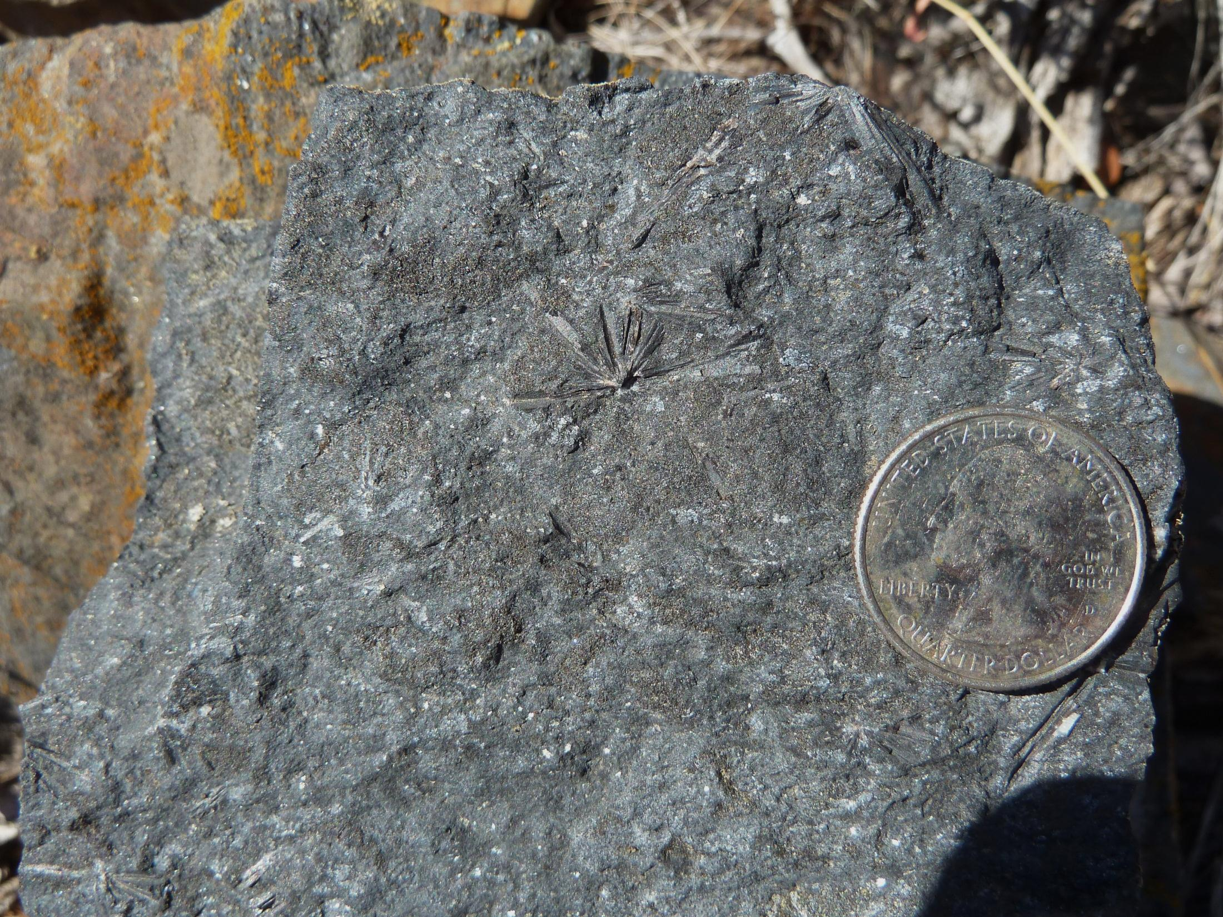

Slide 19
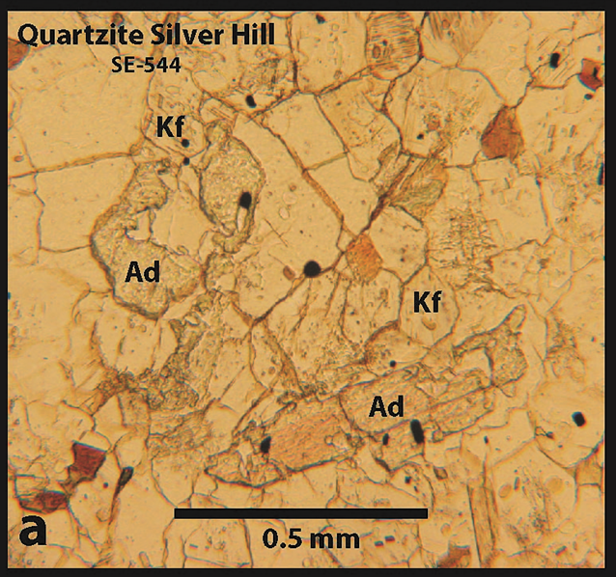

Slide 21
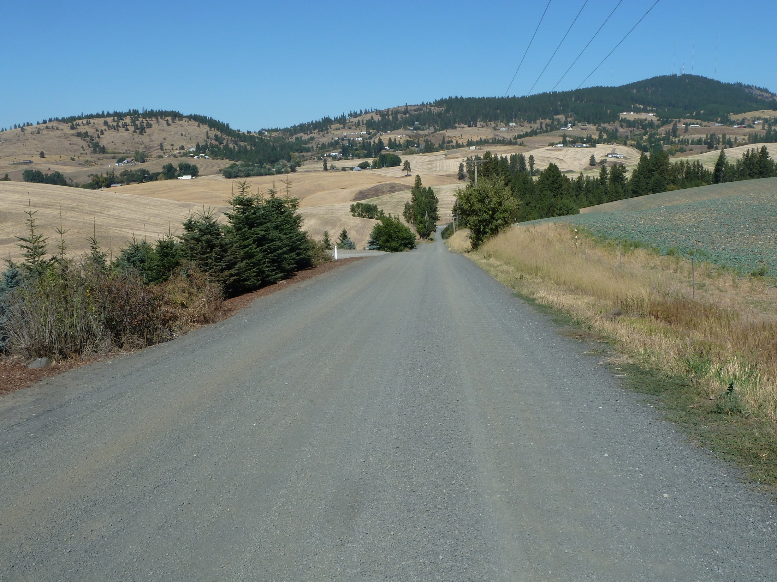
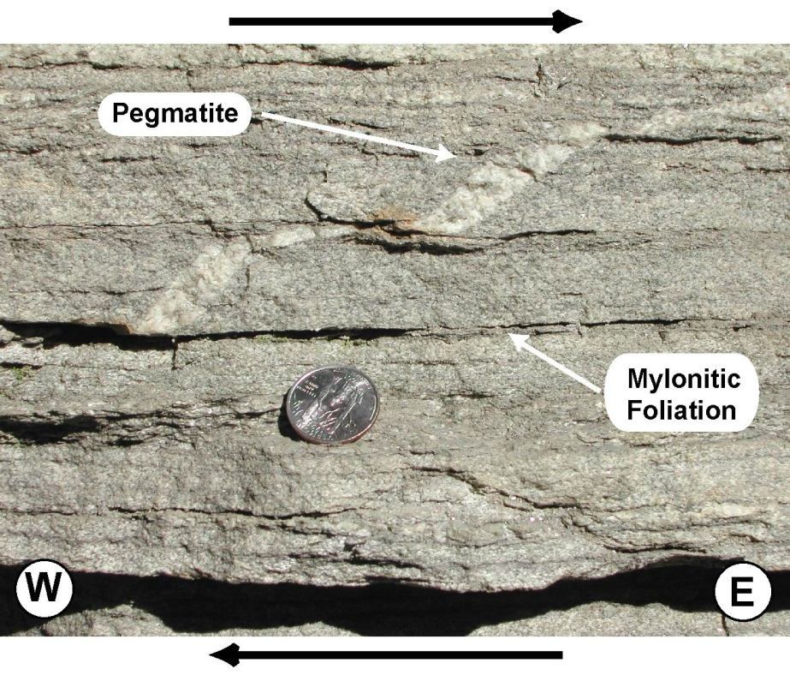
SW
NE
Silver Hill
SDMZ

Slide 22
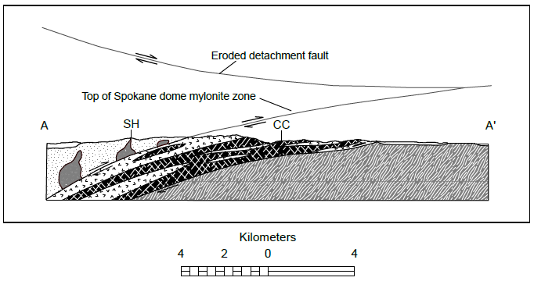
SW
NE

Slide 23
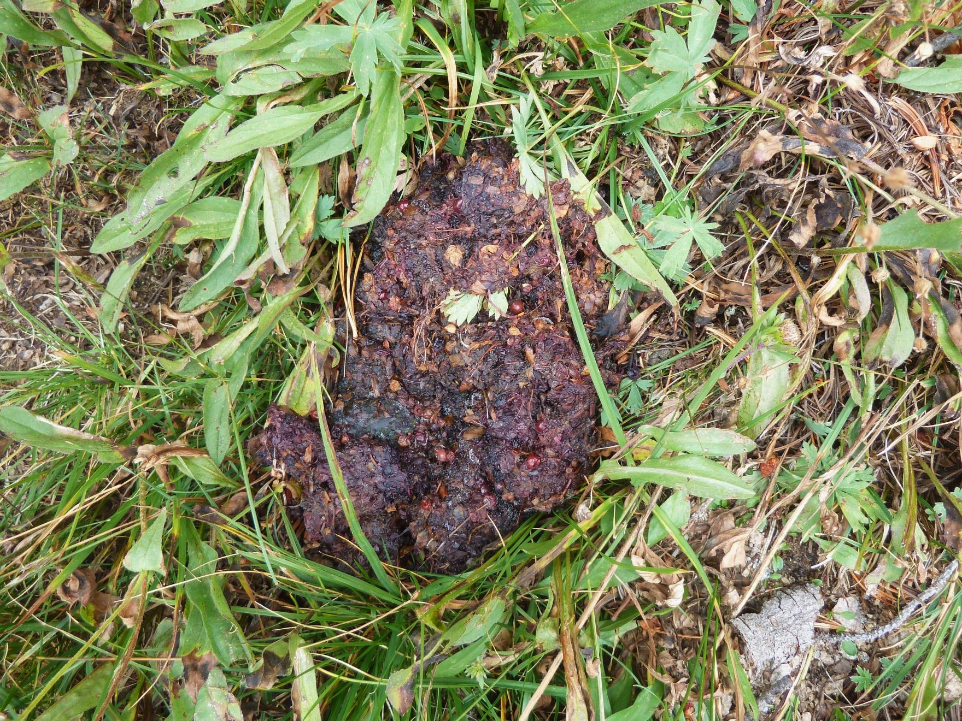
What is the Silver Hill Isolated Terrane?

Slide 24

Lithological Comparisons
Qtzite
of
Chewelah
Lakeview,
Rennie,
Gold Ck.
Silver
Hill
Clear
Lake
Addy
Qtzite
Windermere
SG
Libby,
MT
mudstn
+/- sh
gph-hornfels
greenstone
Wolsey sh
ls
qtzite +/- sh
sh
qtzite
qtzite
qtzite
qtzite
diamic
FH qtzite
M.
Cambrian
*
Lt. PC-
E. Cambrian
*
M.
Cambrian
*
Neo
Proterozoic
M.
Cambrian
*
*trilobite
biozones

