Slide 1
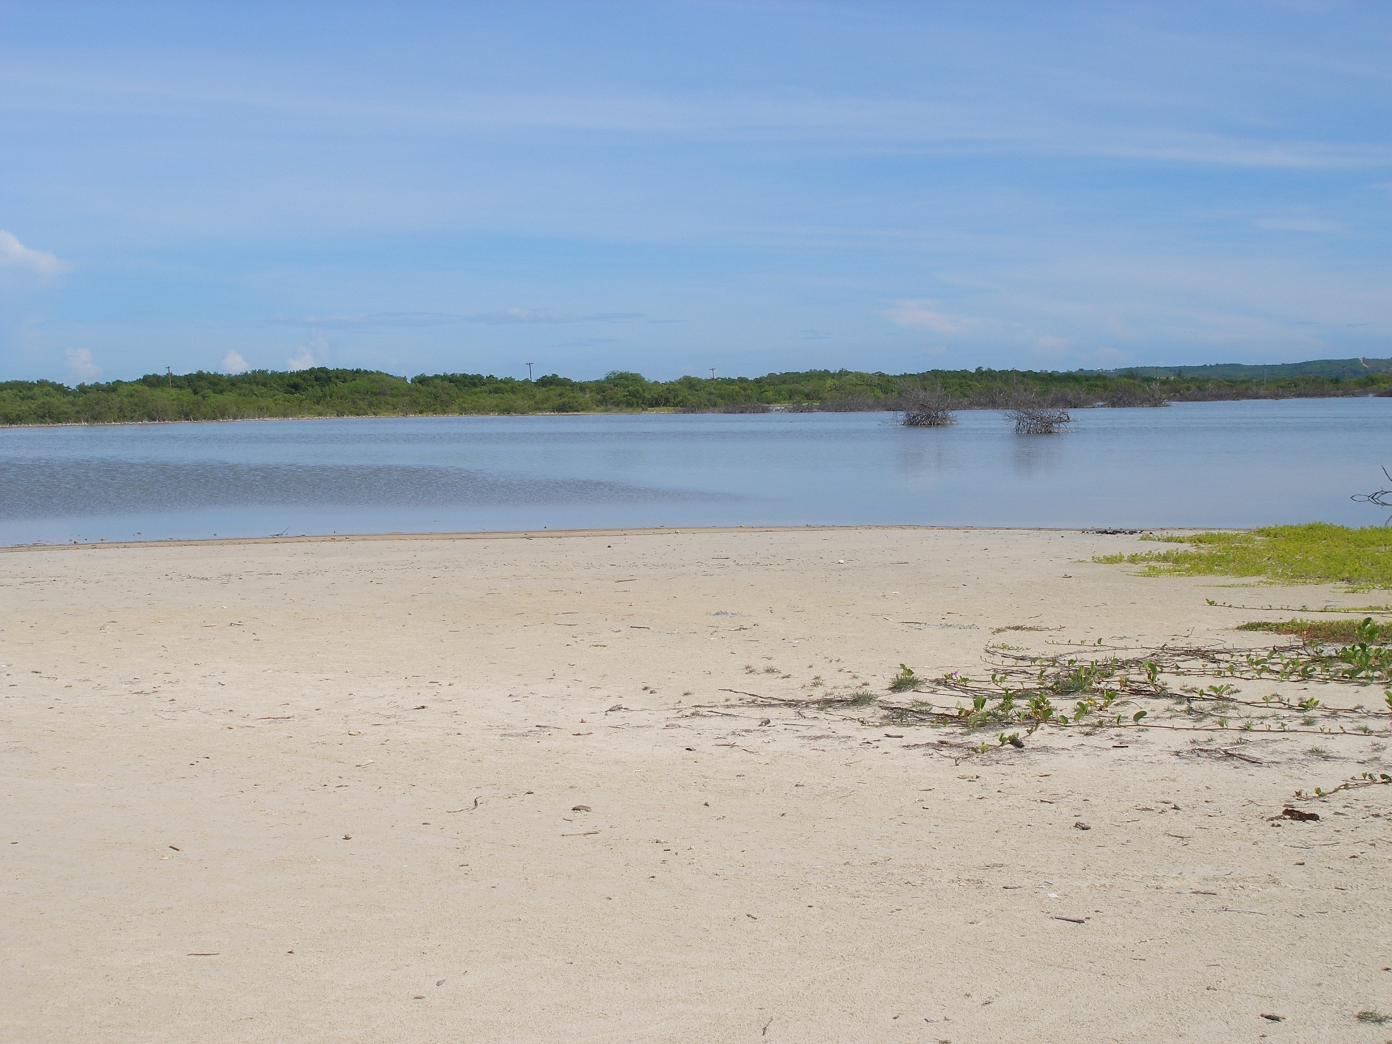



A record of late Holocene coastal evolution and relative sea-level change from a coastal salt pond, southwest Puerto Rico
Clark Sherman and Joel O. Fernández
Department of Marine Sciences
University of Puerto Rico - Mayagüez

Slide 2
Coastal lagoons and salt ponds are important natural resources
Ecologically significant
Buffer zone between terrestrial and marine environments
Contain unique sedimentary archives of paleoenvironmental information
Climate
Marine flooding events
Tropical cyclones
Tsunami
Sea-level change
Paleoecology
Geoarchaeology

Slide 3
Coastal lagoons and salt ponds are important natural resources
They are also delicate and dynamic environments
At risk due to coastal development and/or resource extraction
Vulnerable to global climate change
Important to understand the paleoenvironmental history of these unique settings
Records of recent changes and events
Assess how these settings may respond to future changes

Slide 4
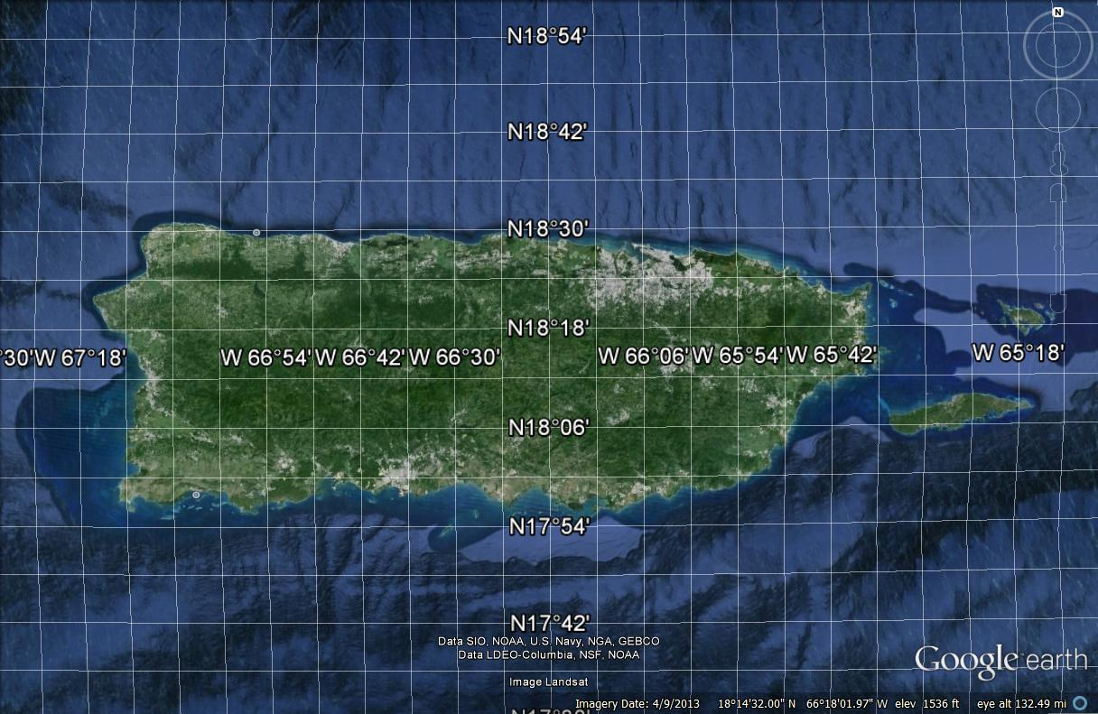
Study Area

Slide 5
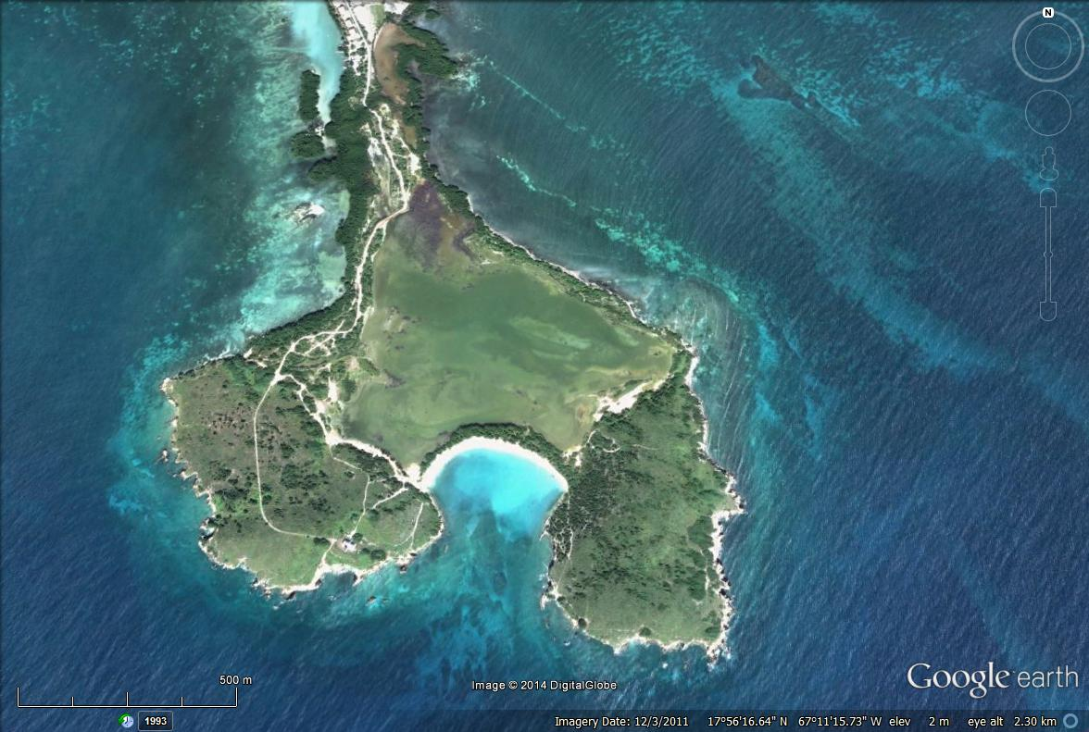
Study Area
Bahía Salinas
Bahía Sucia
Low annual precipitation
Strong winds
High temperatures
Faro de Cabo Rojo

Slide 6
Study Area
Bahía Salinas
Bahía Sucia
Shallow (< 1m deep) hypersaline pond
Isolated from adjacent coastal ocean by rocky headlands and barrier beaches backed by mangroves
Faro de Cabo Rojo

Slide 7
Study Area
Mangroves
Hypersaline pond
Barrier beach

Slide 8
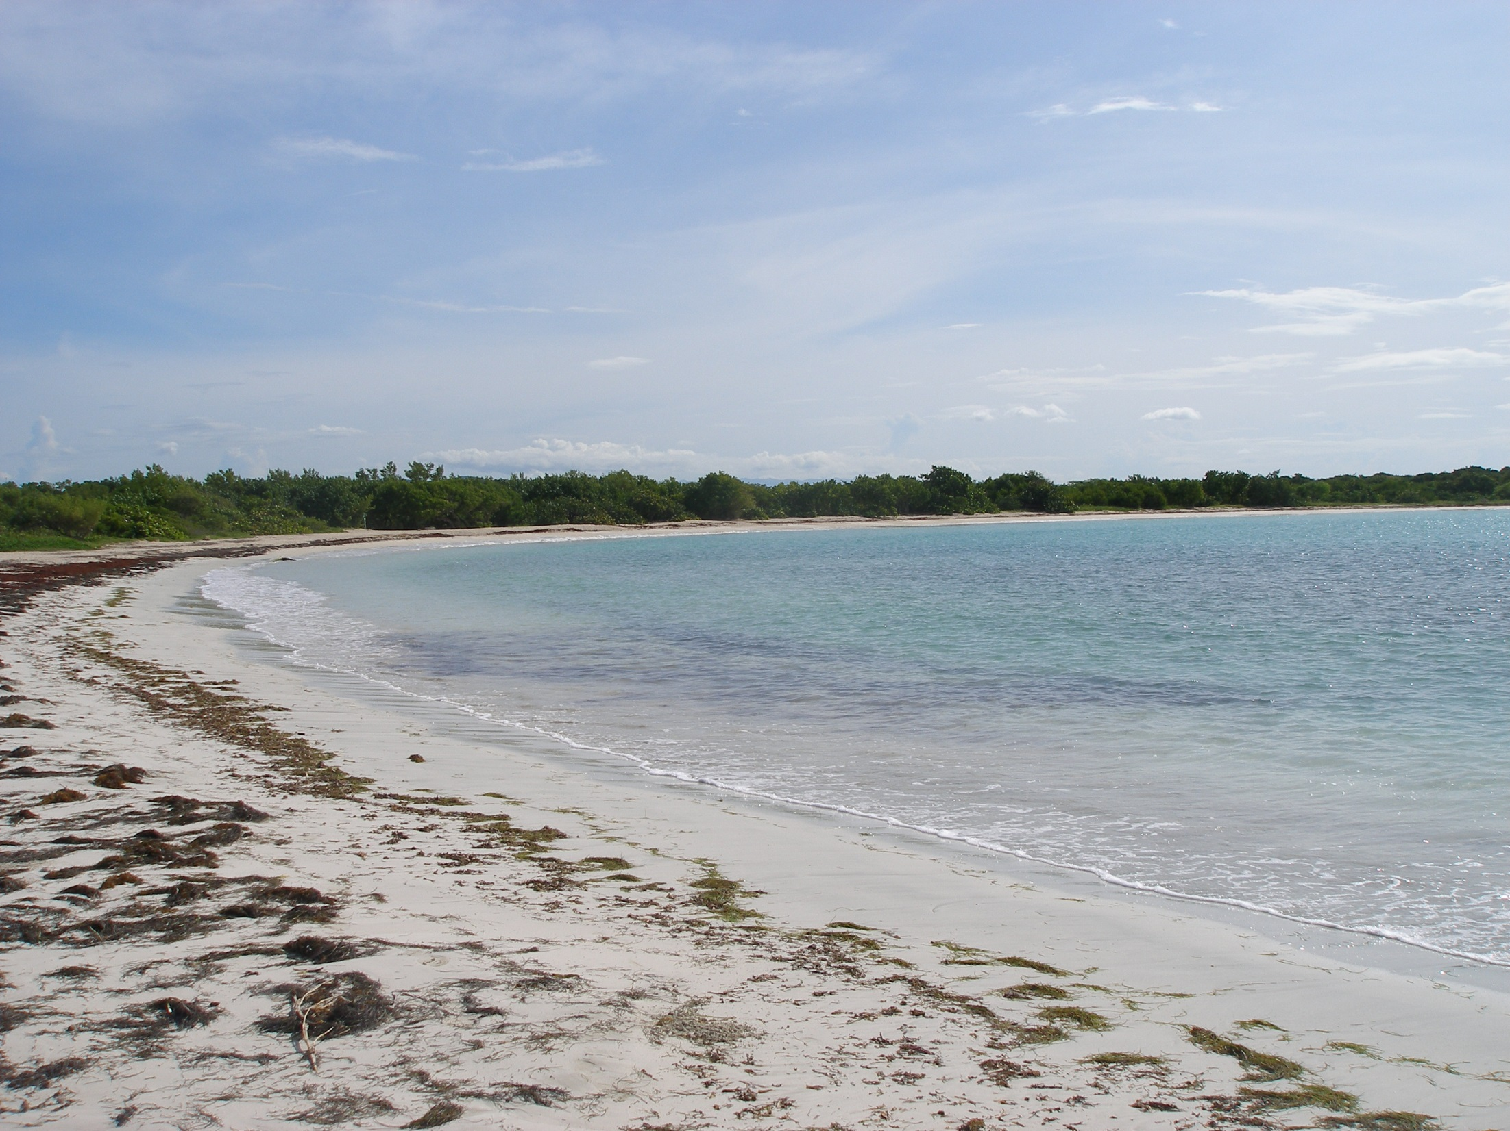
Study Area

Slide 9
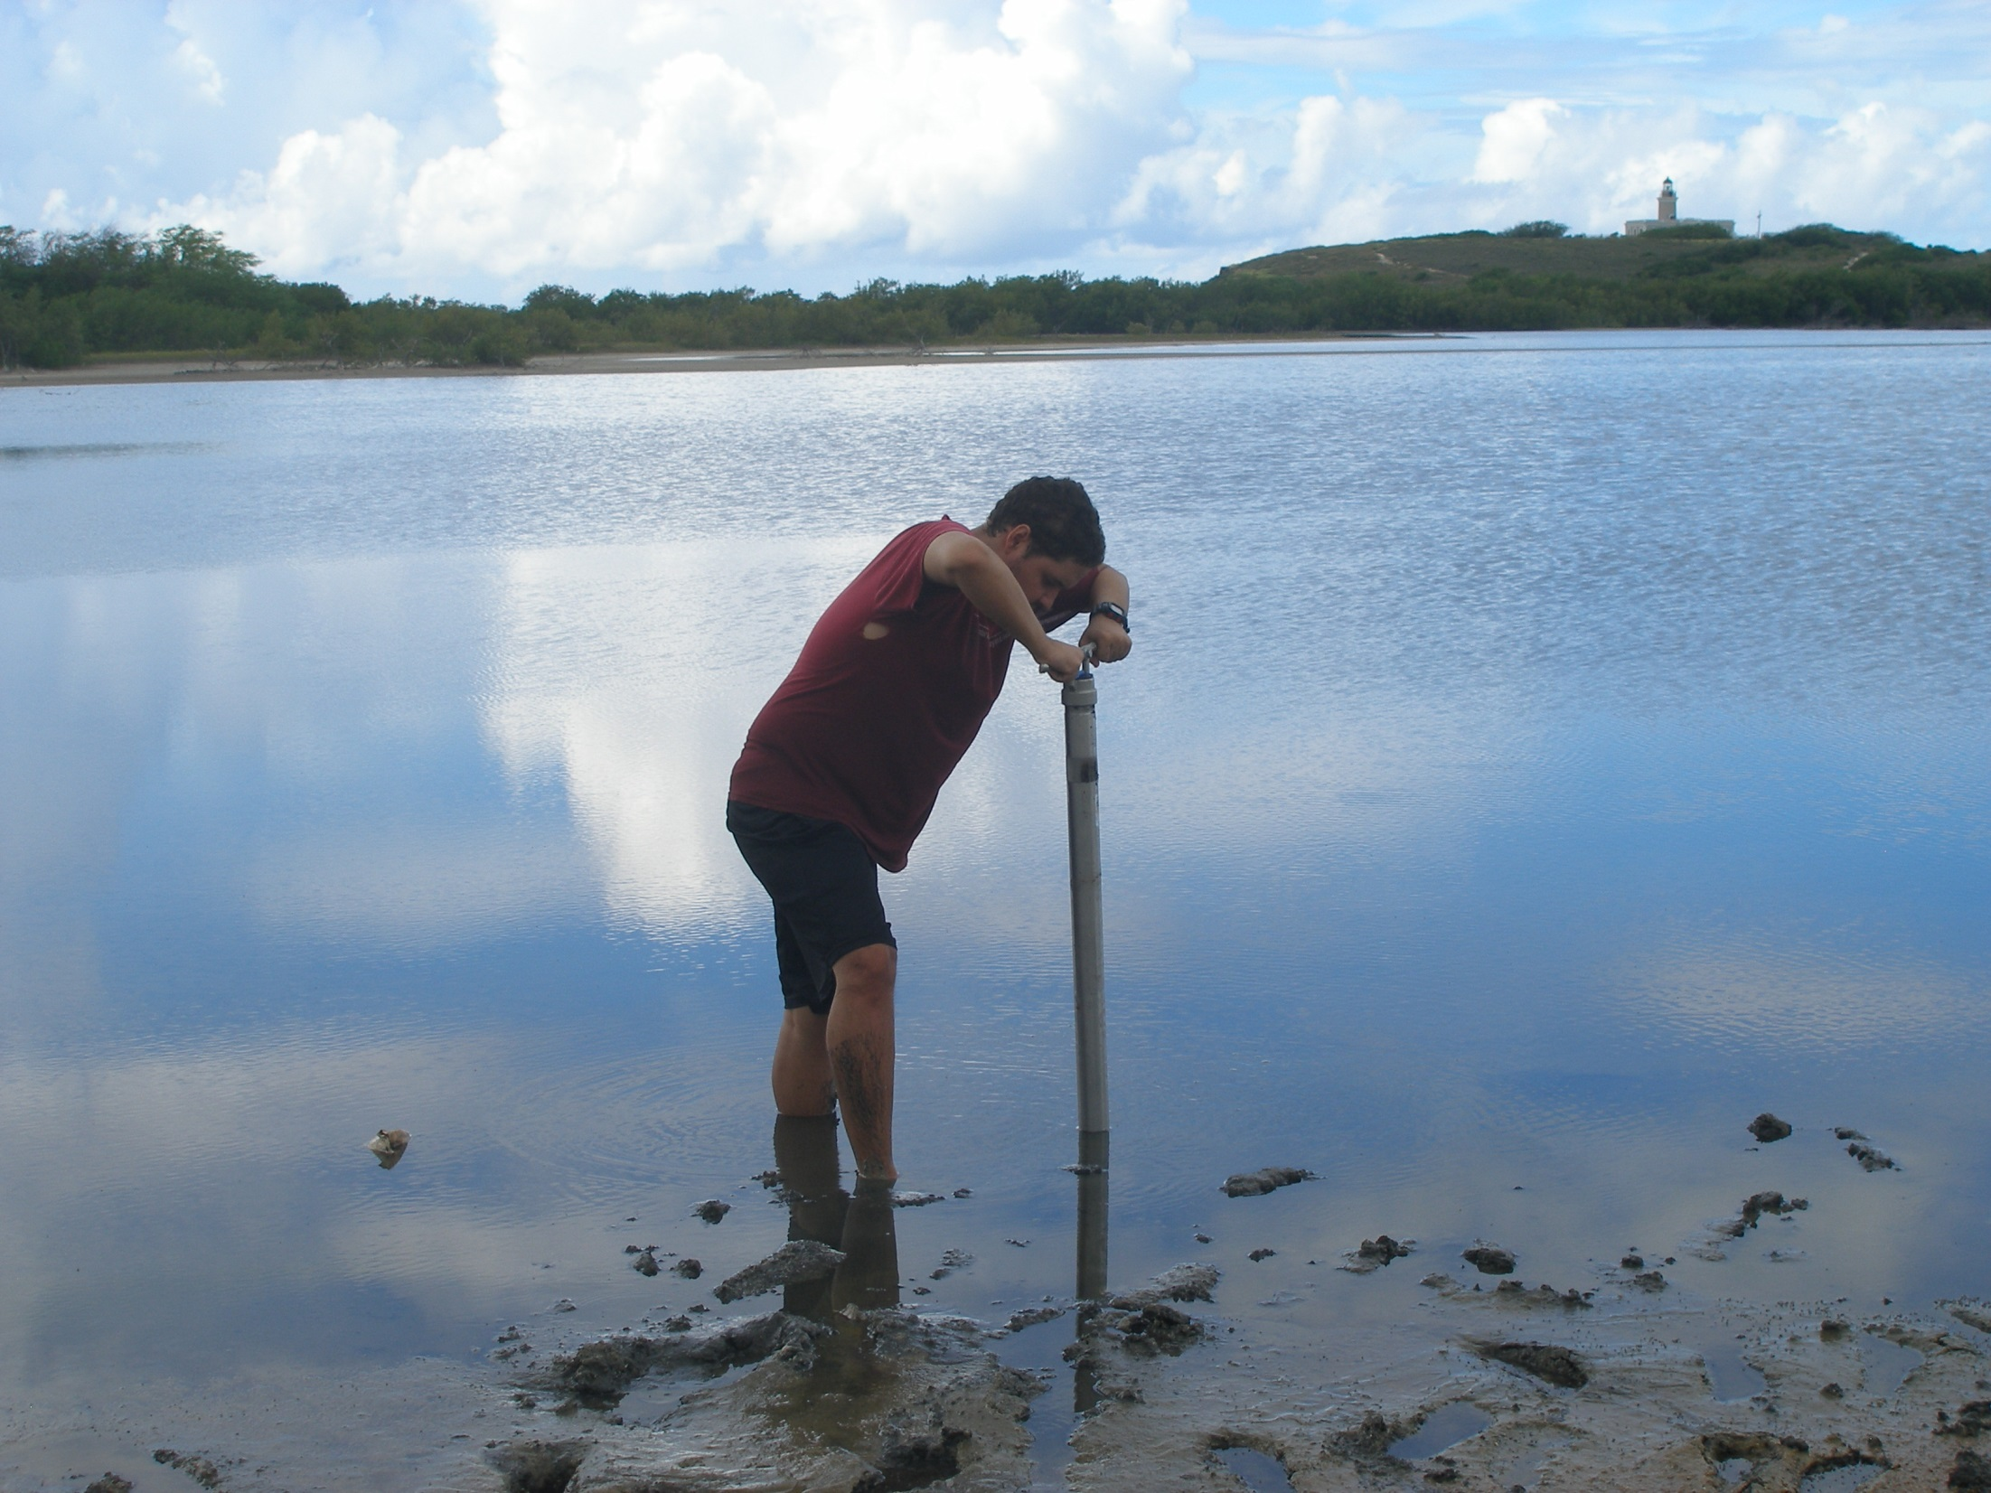
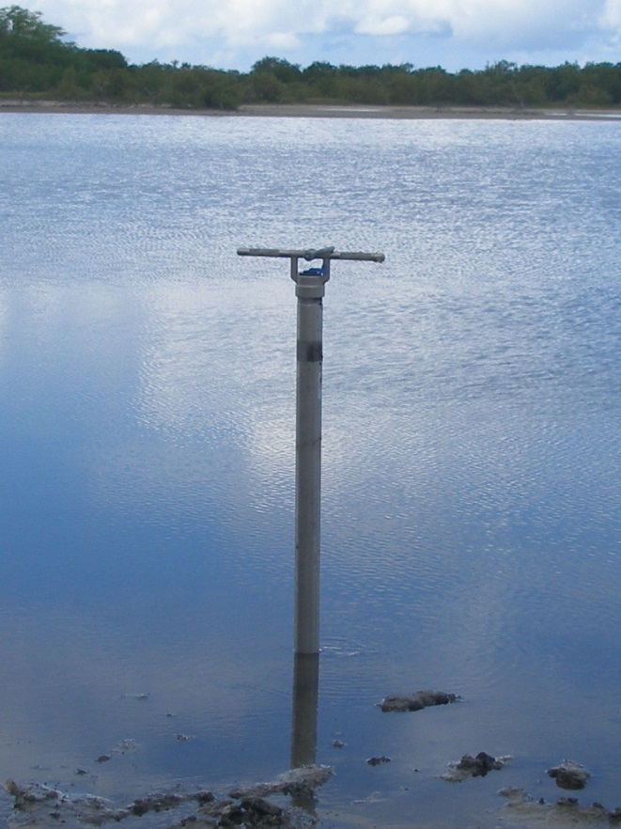
Methodology - Coring -
Wildco stainless steel hand corers of 1.2 and 2.4 m lengths (ID=52.6 mm)
Cores are recovered in plastic liner tubes with an internal diameter of 48 mm

Slide 10
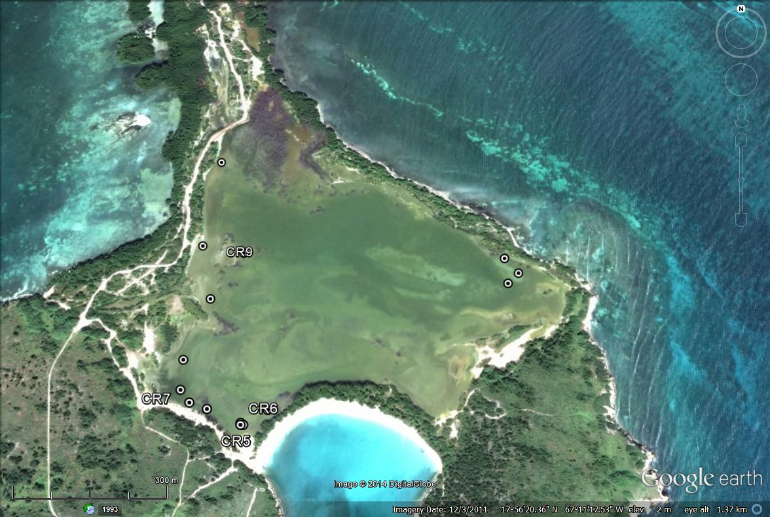
Core Locations
Bahía Sucia
Bahía Salinas

Slide 11
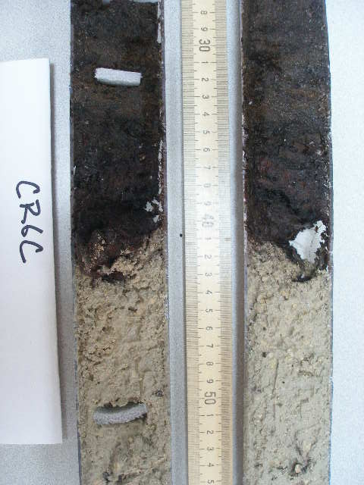
Methodology - Core Description -
Cores are split lengthwise and their sedimentology and stratigraphy described with regard to:
sediment type
grain size
color
and the character of transitions between sedimentary layers

Slide 12
Methodology - Sedimentology -
Bulk carbon composition of core material (TC, TIC, TOC) determined by carbon coulometry
converted to percent calcium carbonate
percent organic material
and percent other

Slide 13
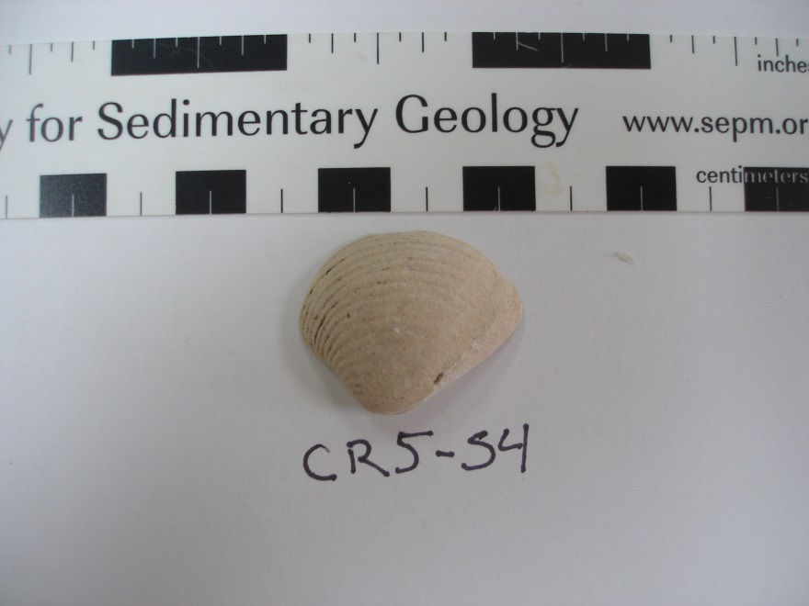
Methodology - Sedimentology -
Mineralogy of sediments determined by x-ray diffraction
Numerical ages of material are determined using radiocarbon (¹⁴C) methods

Slide 14
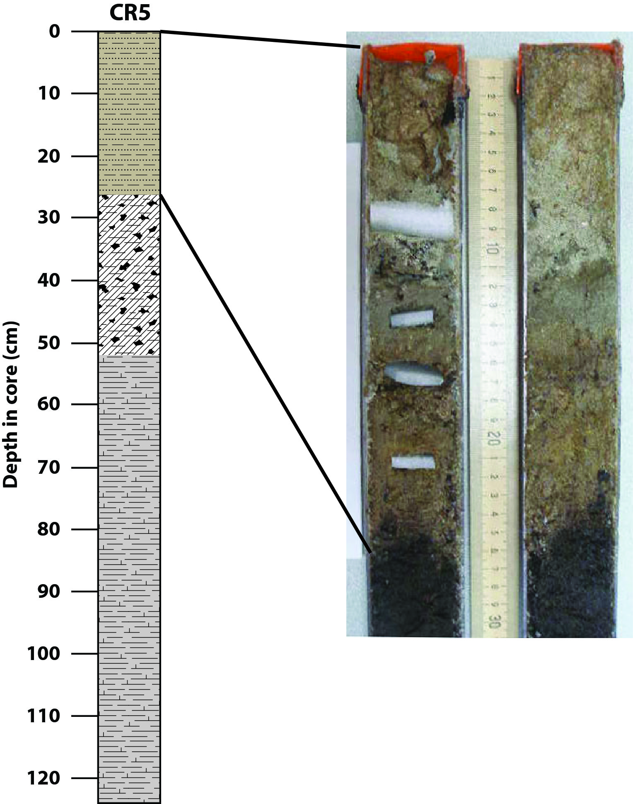
Results - Sedimentology and Stratigraphy -
Unit I
Brown, organic-rich sandy calcareous mud with microbial mats
Unit I

Slide 15
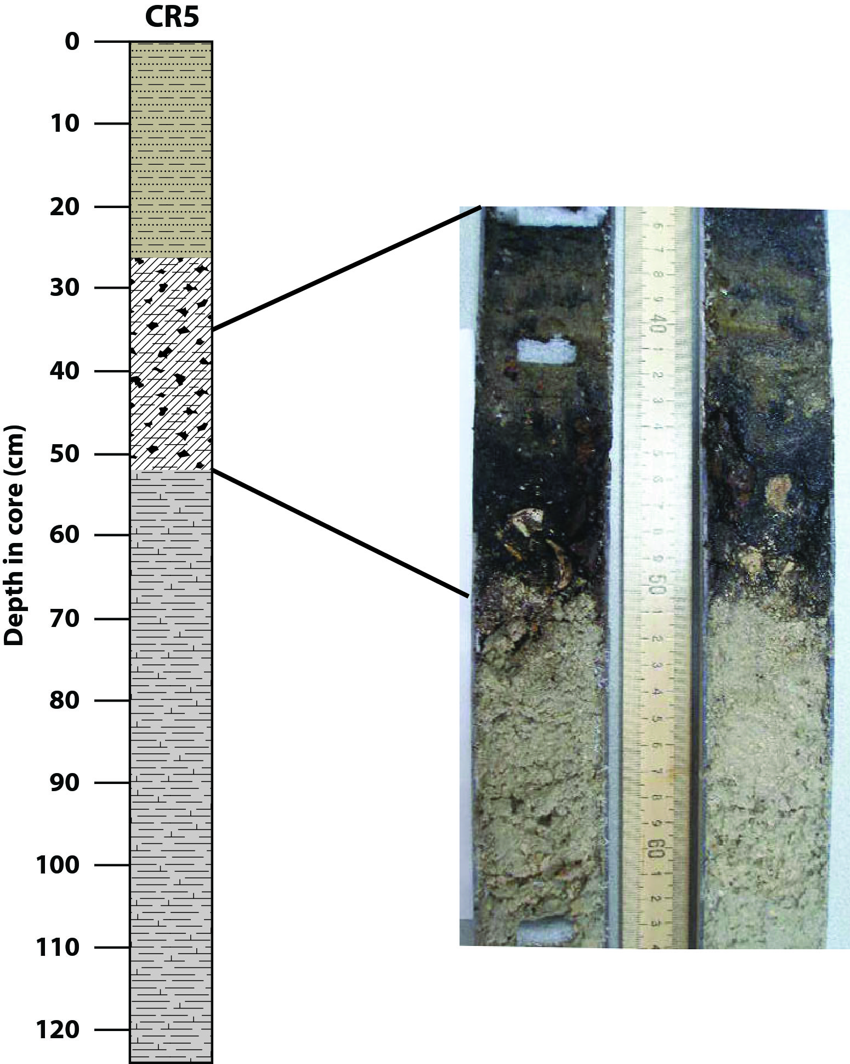
Results - Sedimentology and Stratigraphy -
Unit II
Dark peat with woody material (mangrove) and rare shells
Unit II

Slide 16
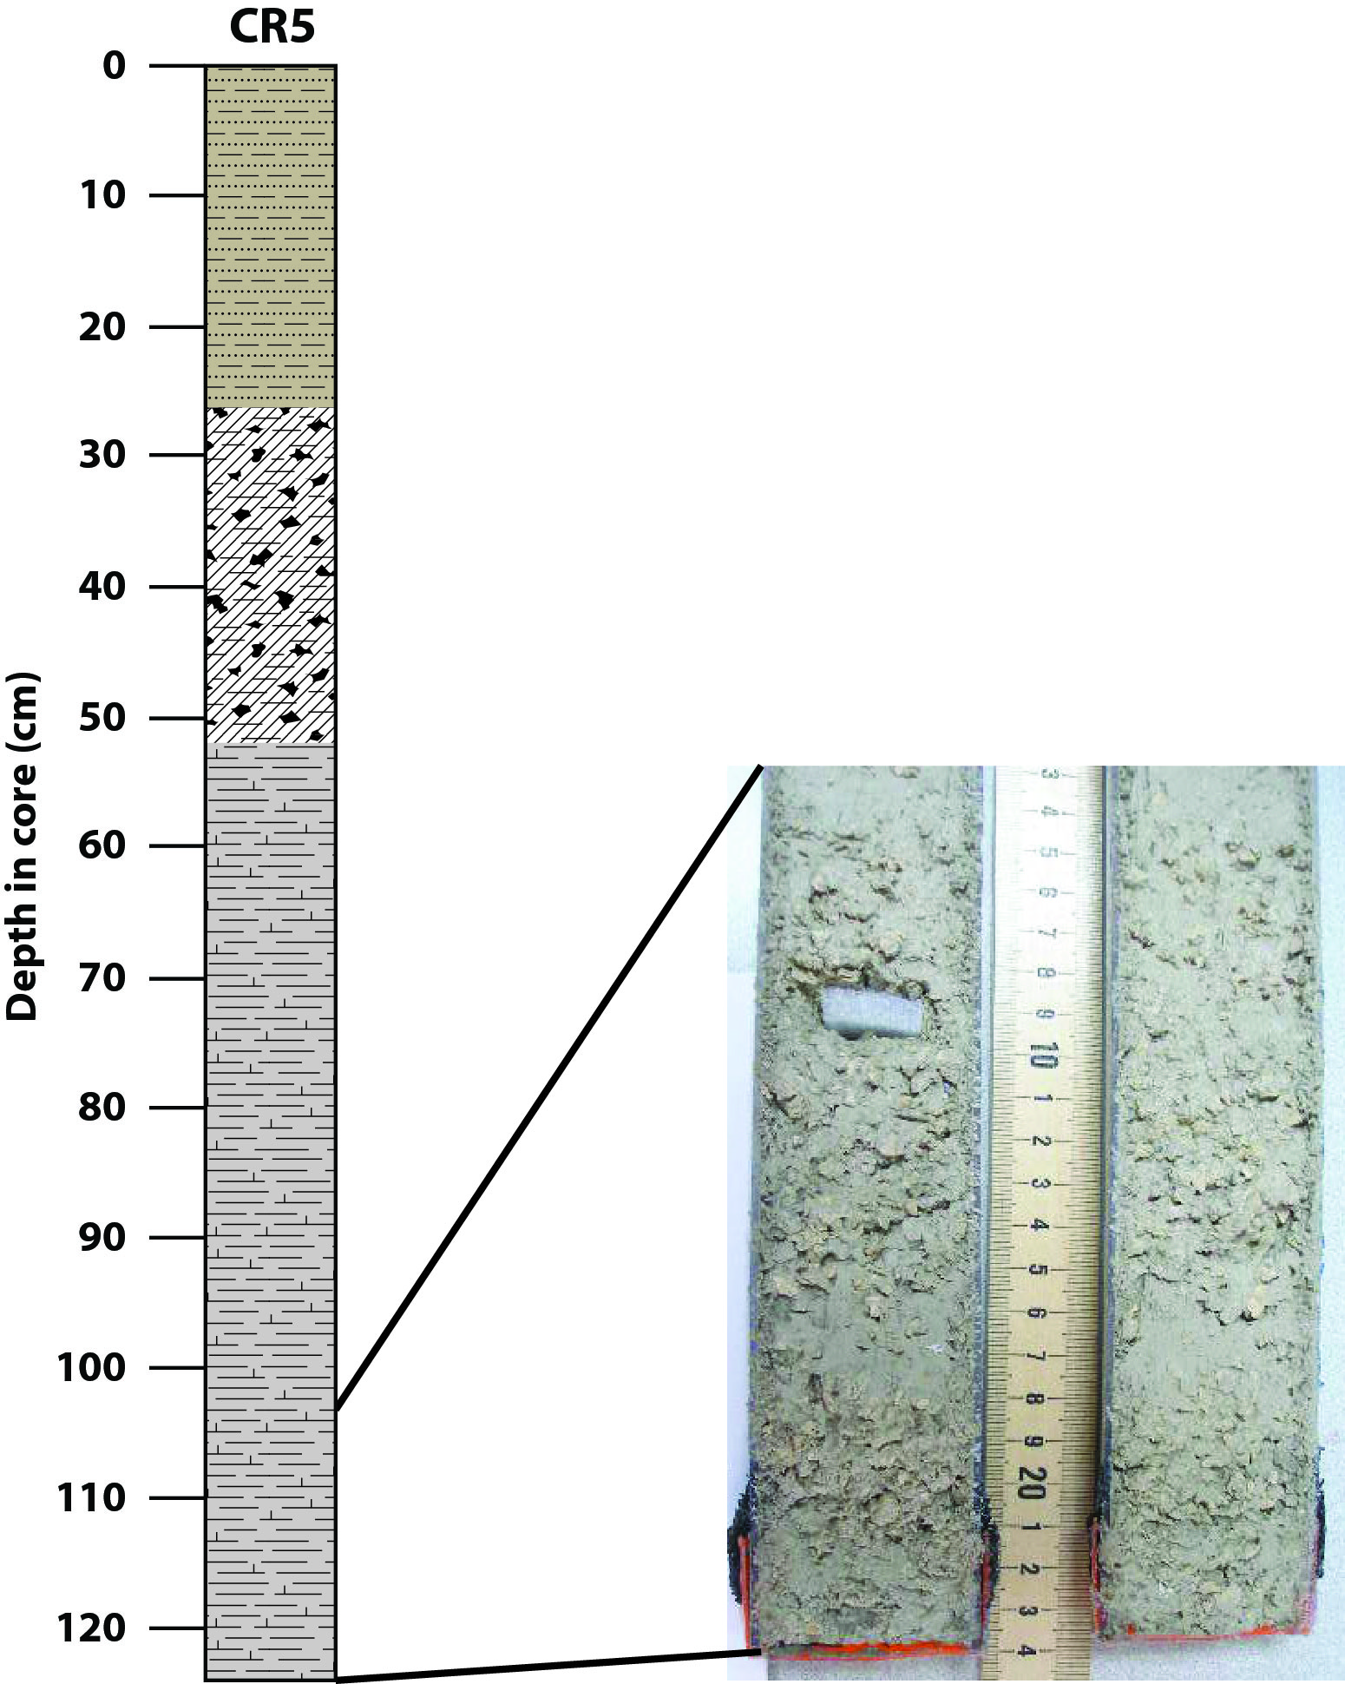
Results - Sedimentology and Stratigraphy -
Unit III
Buff-colored, fossiliferous carbonate mud with abundant Halimeda plates
Unit III

Slide 17
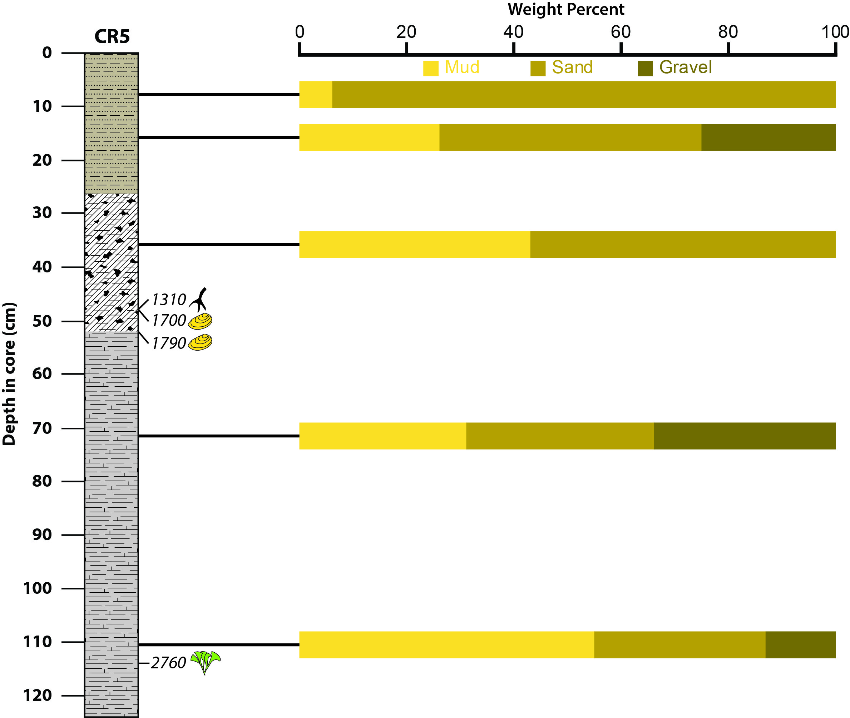
Results - Grain size -
<63 μm
63 μm-2 mm
>2 mm

Slide 18
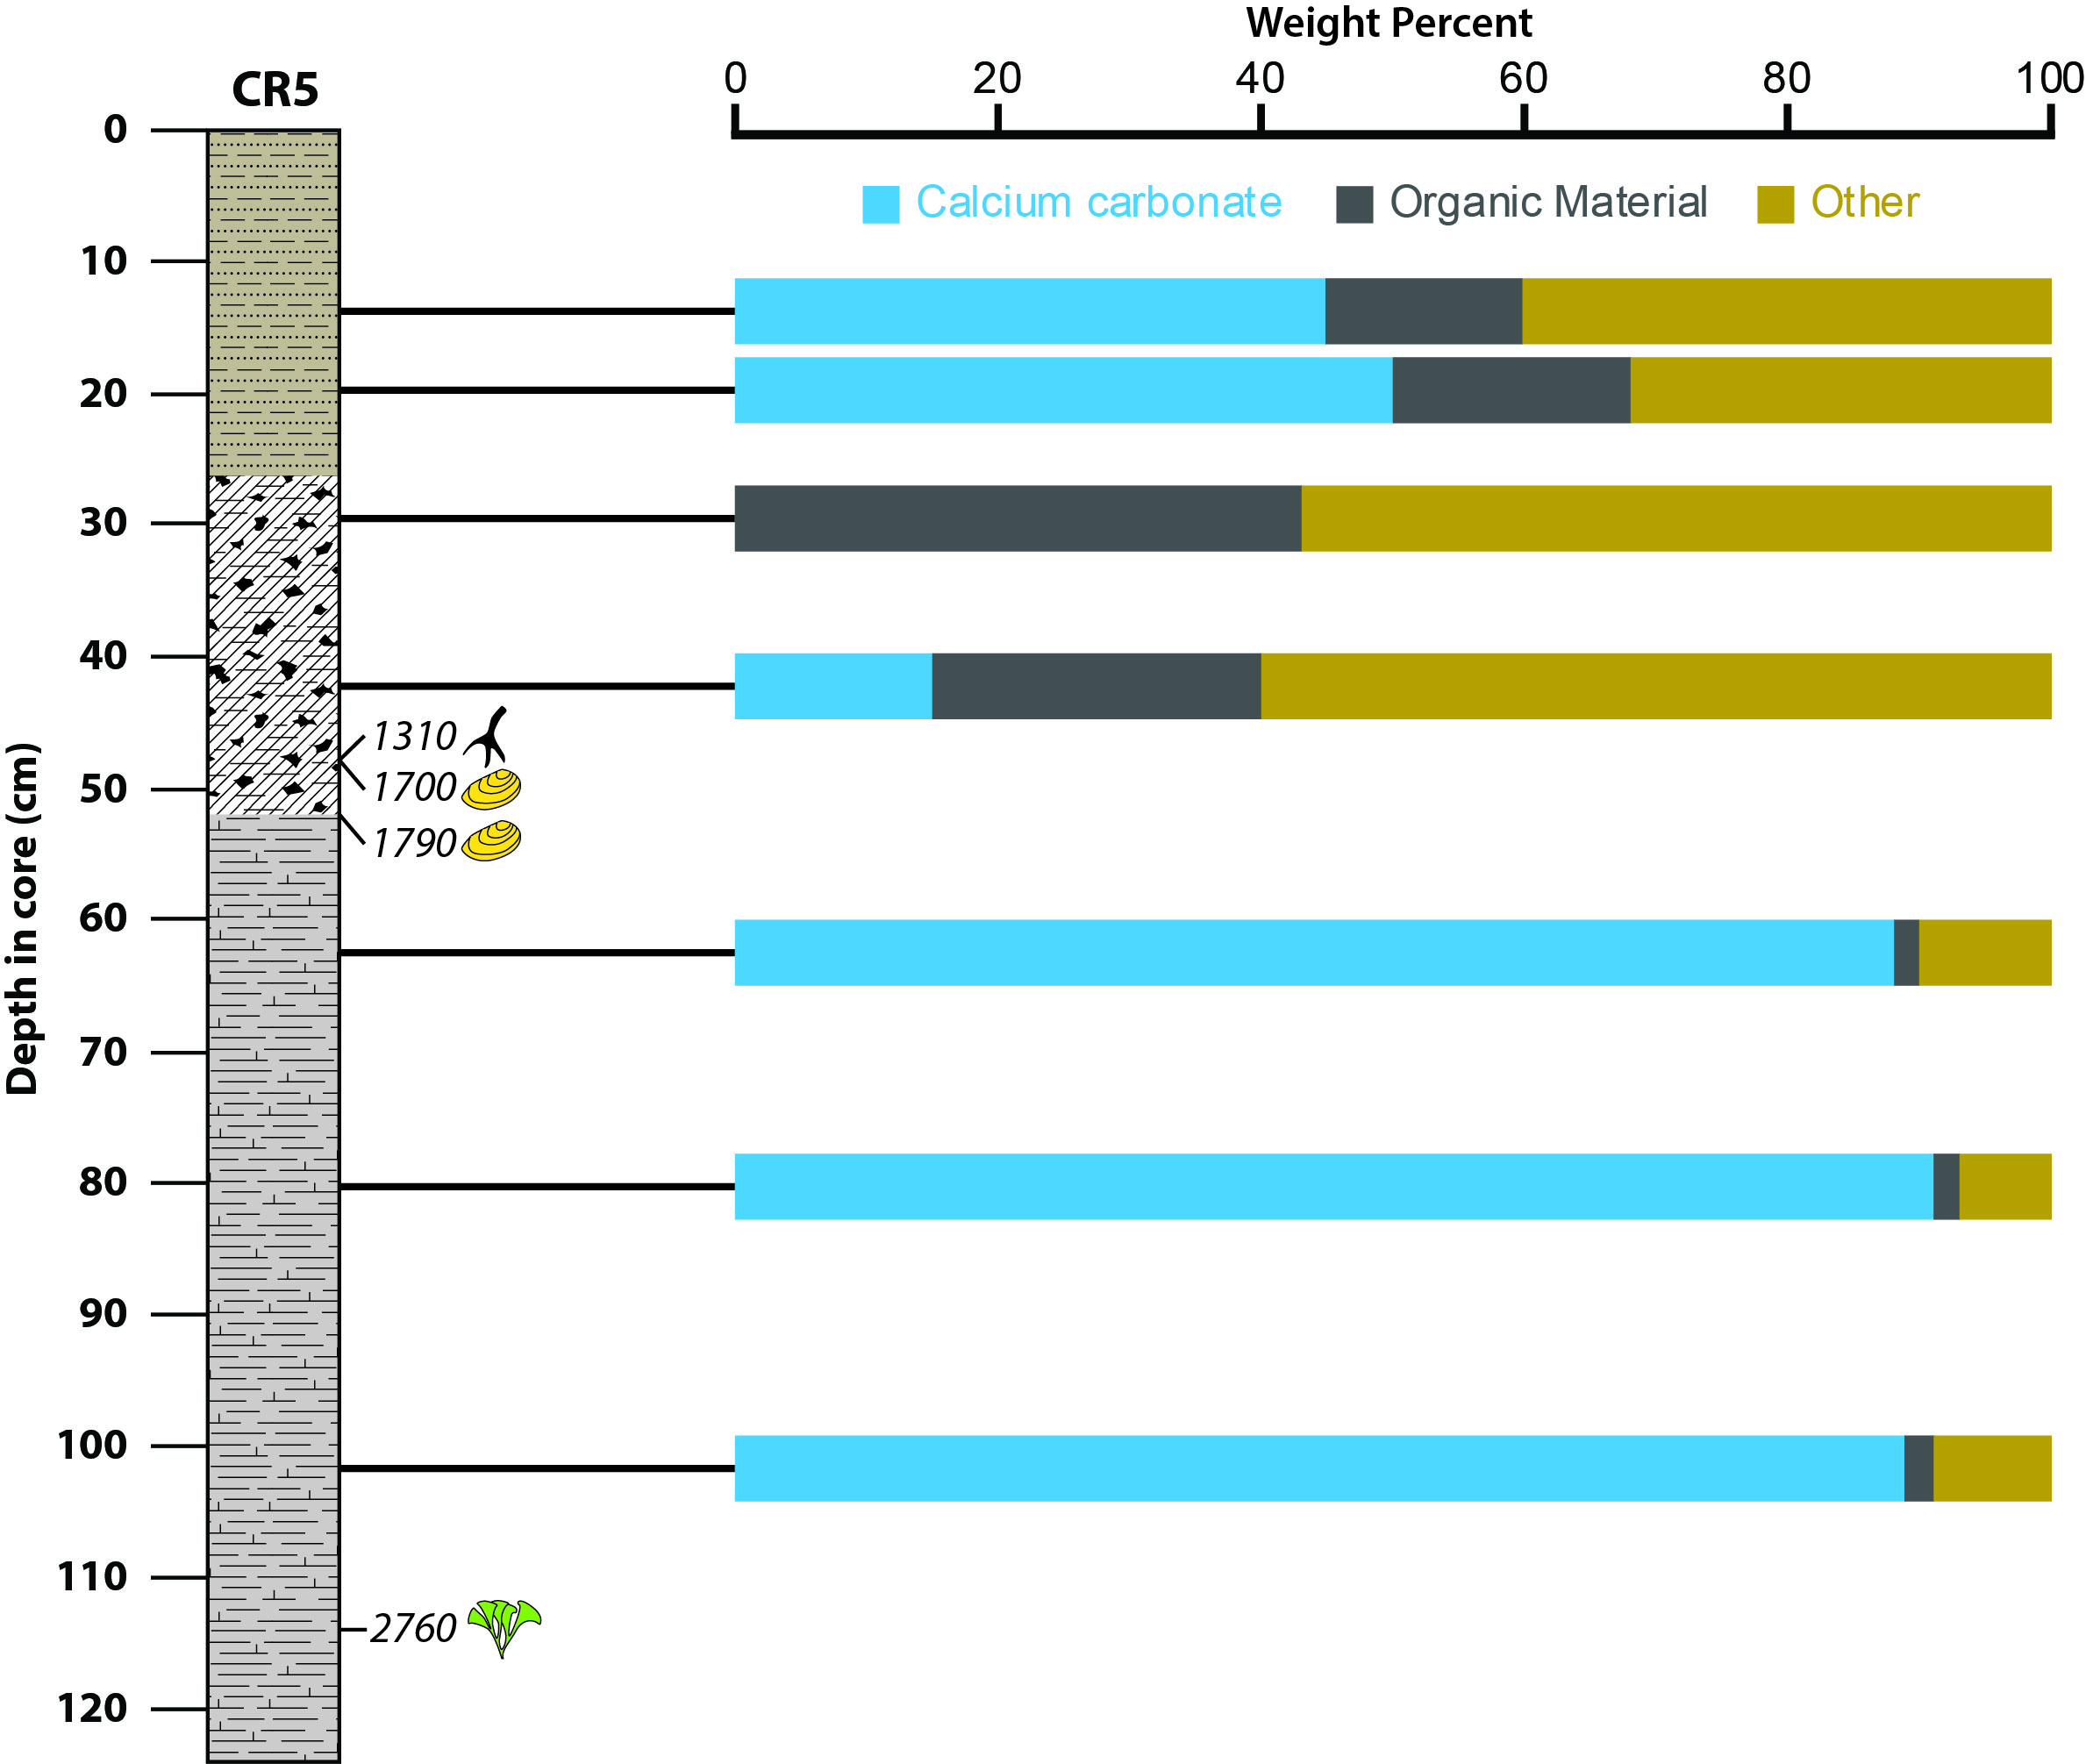
Results - Bulk carbon composition-

Slide 19
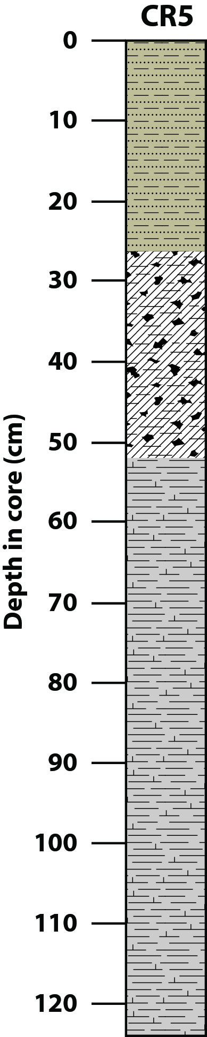
Environmental Interpretation
Unit I
Establishment of hypersaline pond
Intermittent breaching of barriers
Unit II
Barrier beach and mangrove development
Isolation of bay
Unit III
Open to semi-protected shallow bay, normal marine conditions

Slide 20
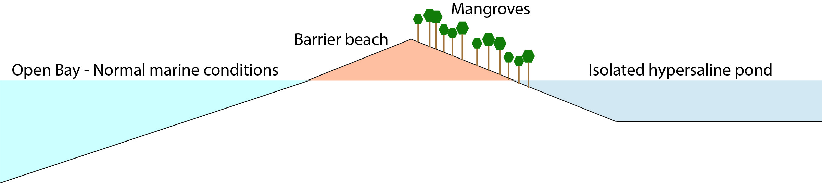
Environmental Interpretation
Relative sea level
Falling
Rising

Slide 21
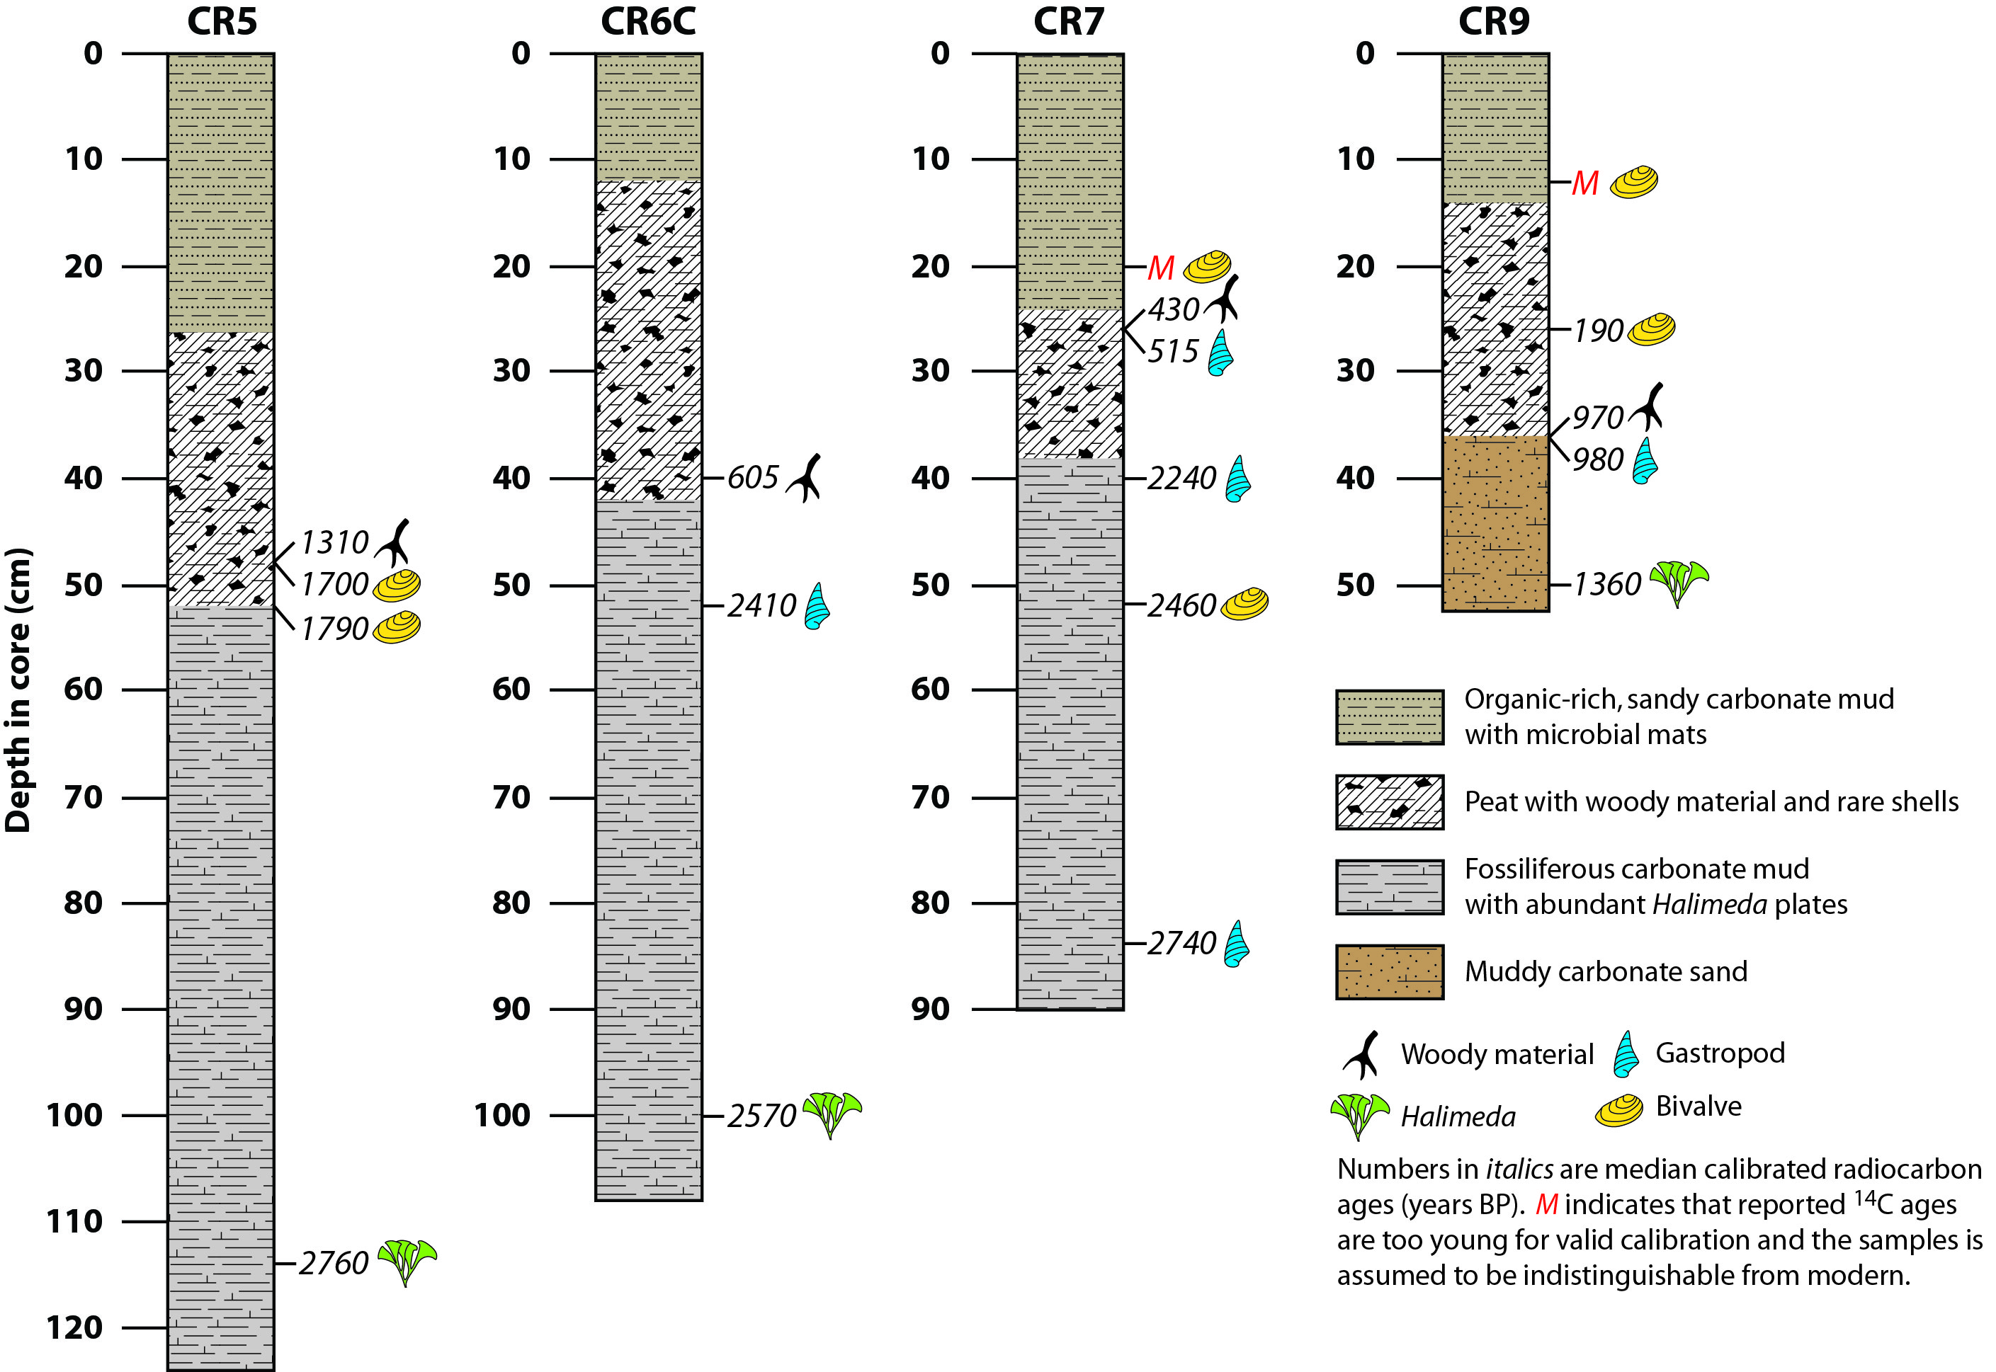
Results - Radiocarbon (¹⁴C)-

Slide 22
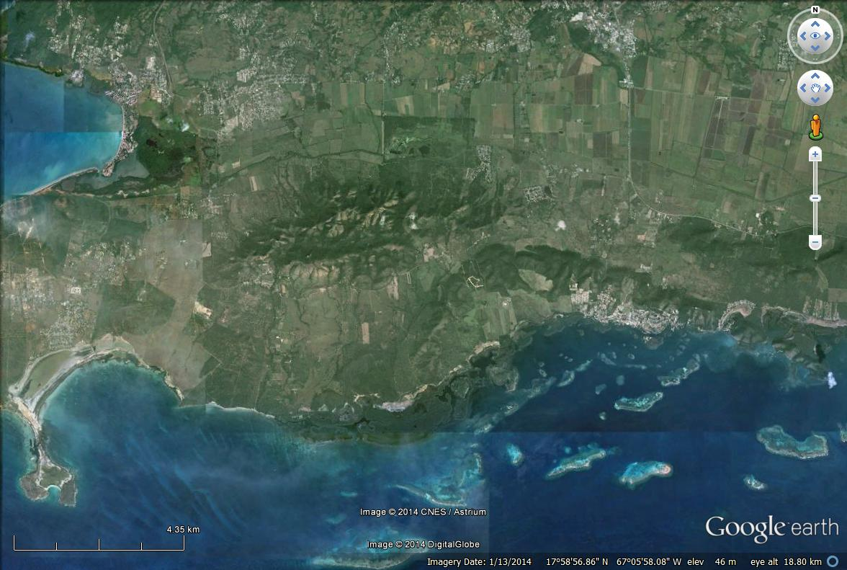
Results from Additional Sites

Slide 23
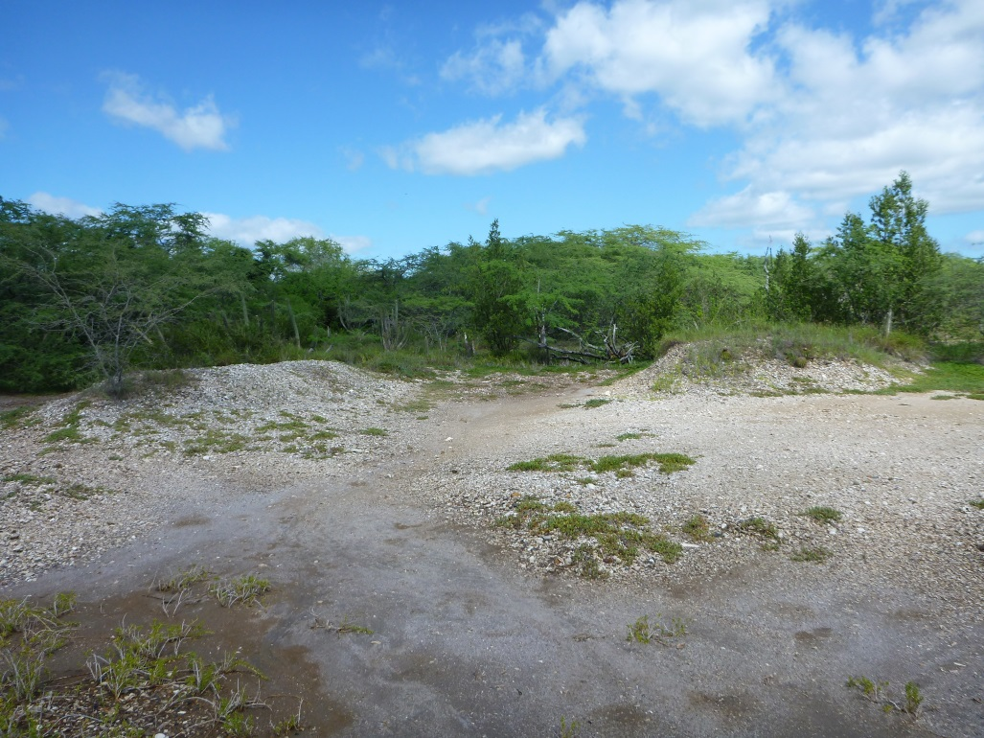
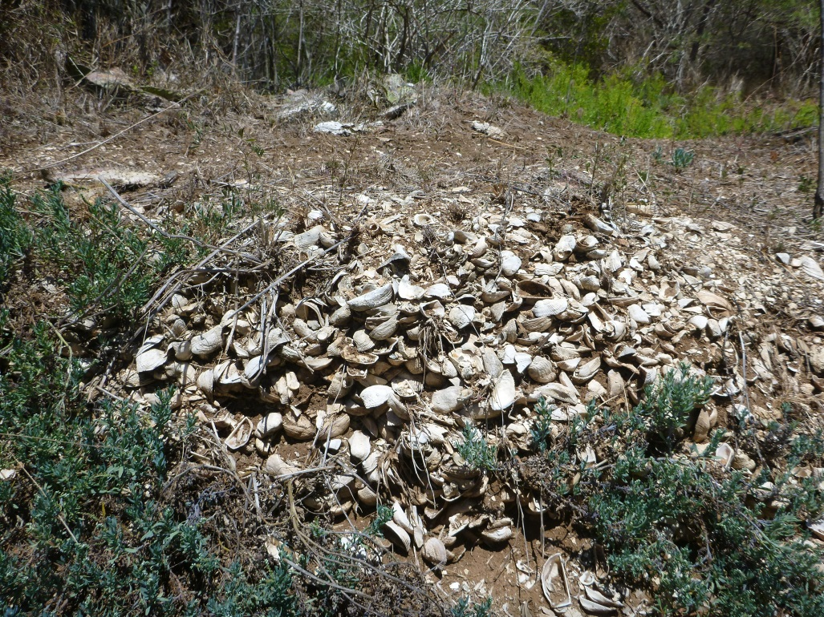
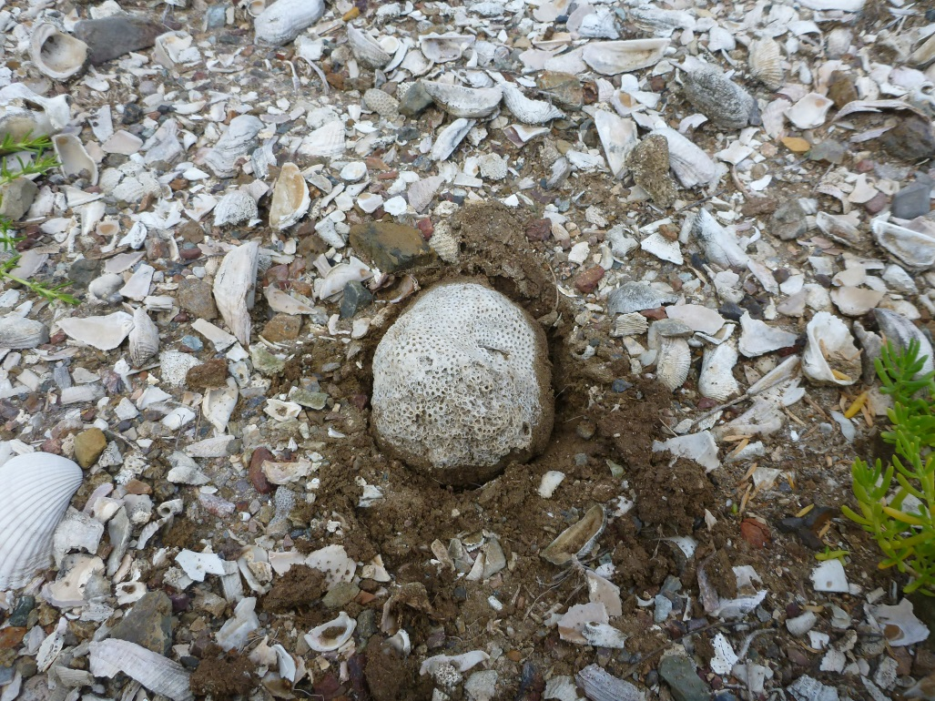
Results
Emergent carbonate gravels
Shell middens?
Calibrated ¹⁴C age ~1900 yr BP

Slide 24
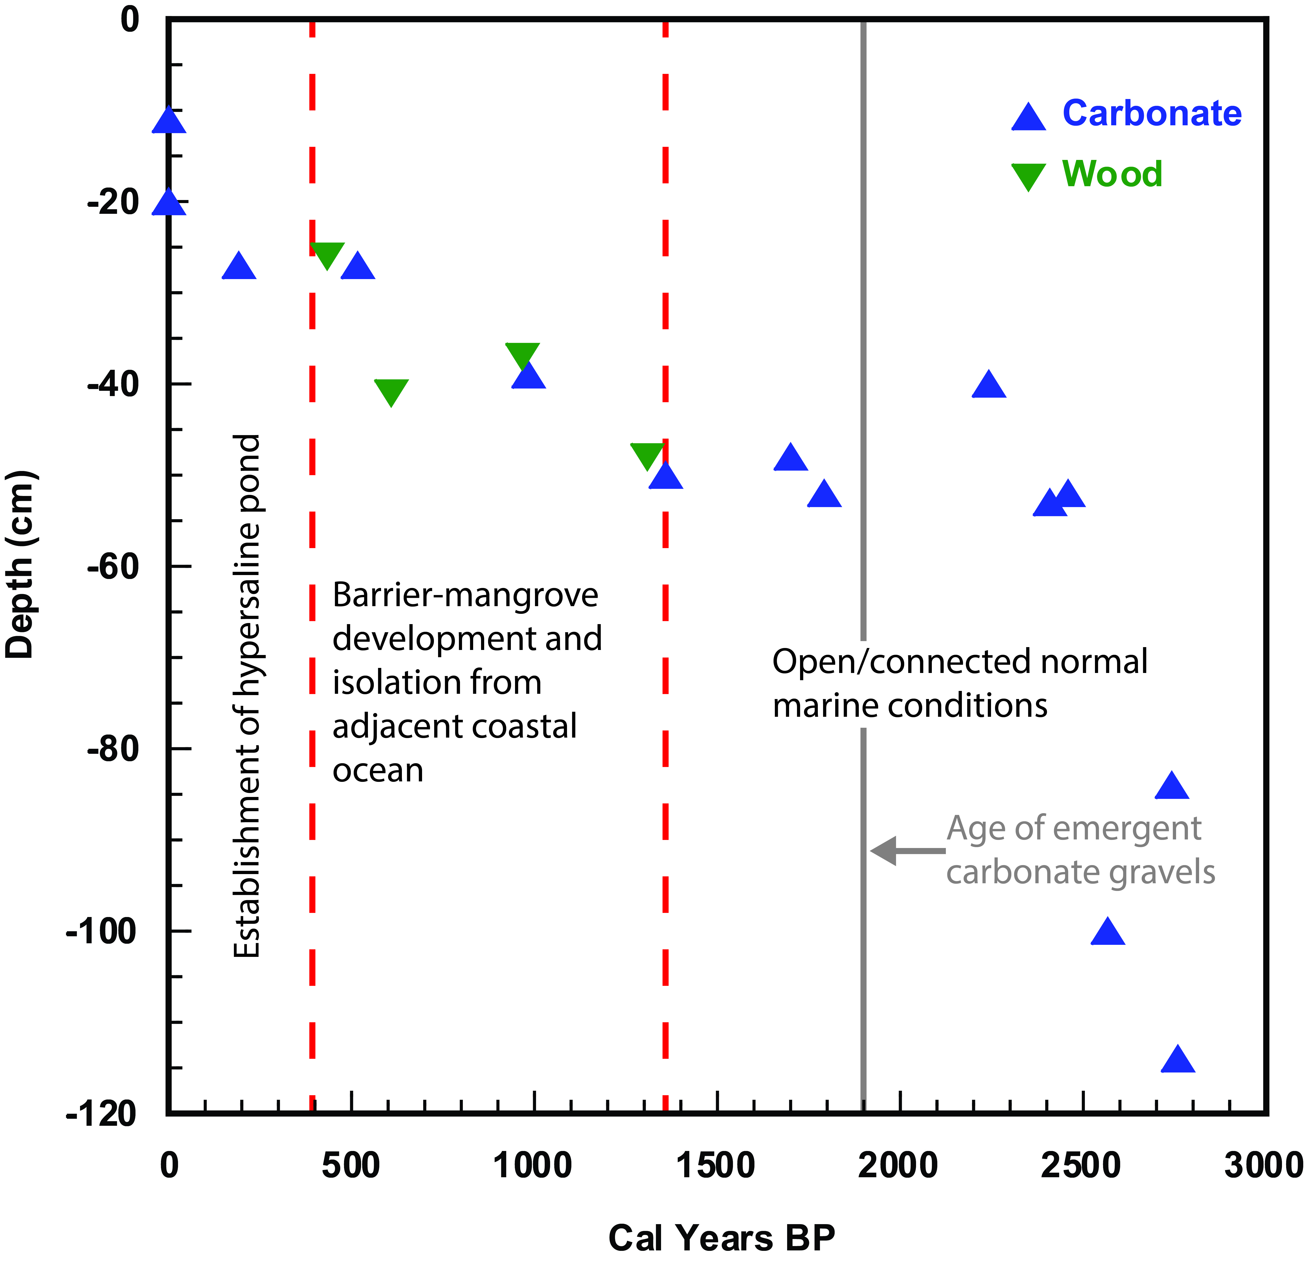
Results - Radiocarbon (¹⁴C)-

Slide 25
Environmental Interpretation
Relative sea level
Falling
Rising

Slide 26
Discussion
Potential drivers of change
Sedimentary dynamics
Local tectonic movements
Regional sea-level change

Slide 27
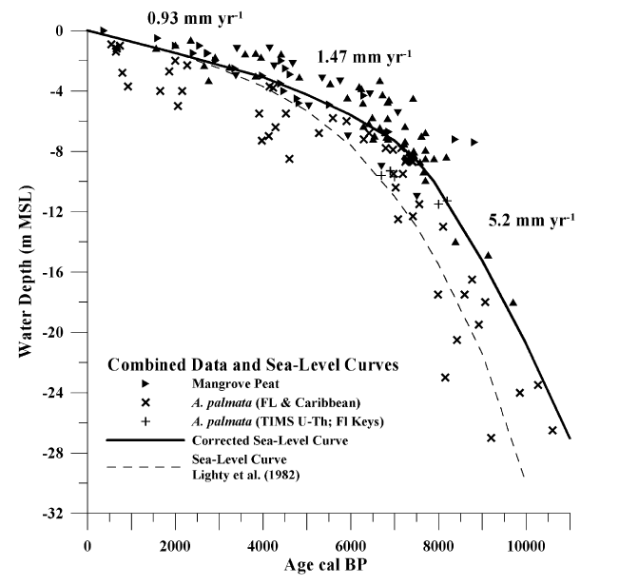
Discussion
Potential drivers of change
Sedimentary dynamics
Western Atlantic sea-level curve for the last 11,000 years based on calibrated ¹⁴C dates from Acropora palmata framework and intertidal mangrove peat (Toscano and Macintyre, 2003)

Slide 28
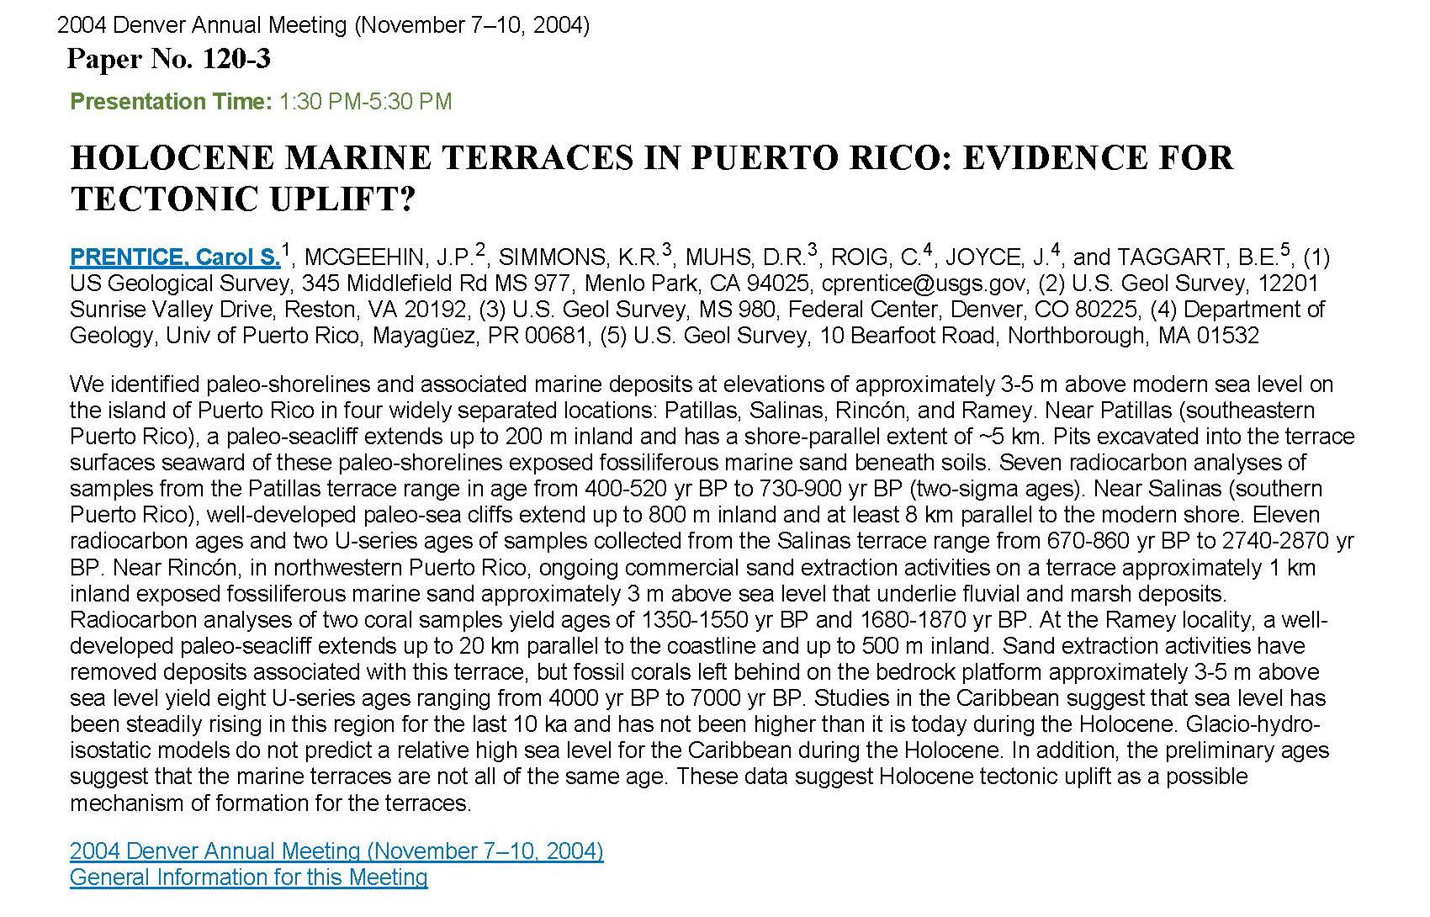
Discussion
Potential drivers of change
Local tectonic movements
Near Rincón, in northwestern Puerto Rico, ongoing
commercial sand extraction activities on a terrace
approximately 1 km inland exposed fossiliferous marine
sand approximately 3 m above sea level that underlie
fluvial and marsh deposits. Radiocarbon analyses of two
coral samples yield ages of 1350-1550 yr BP and 1680-1870 yr BP.

Slide 29
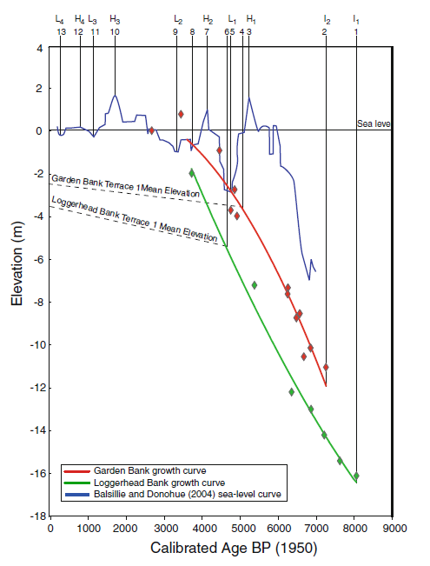
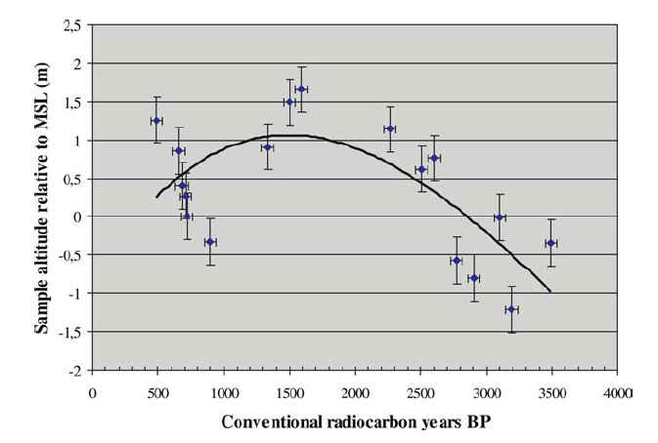
Discussion
Age vs depth/elevation of reef frameworks and beachrock from Atol das Rocas, Brazil and interpreted local sea-level trend (After Gherardi and Bosence, 2005)
Potential drivers of change
Regional sea-level change
Growth histories of Dry Tortugas reefs in relation to the Holocene sea-level reconstruction of Balsillie and Donoghue (2004) (After Brock et al, 2010)

Slide 30
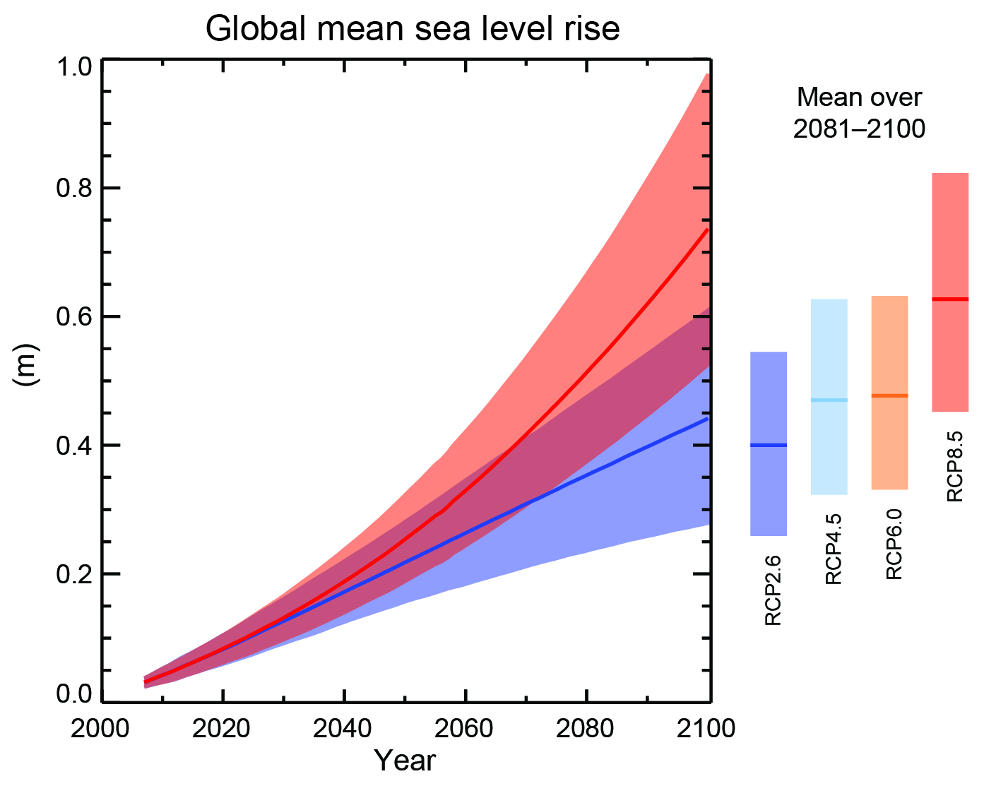
Projections of global mean sea level rise over the 21st century relative to 1986–2005
~4.8-7.9 mm yr⁻¹
IPCC, 2013: Summary for Policymakers. In: Climate Change 2013: The Physical Science Basis

Slide 31
Concluding thoughts
The studied Cabo Rojo salt pond has undergone significant changes in the last ~3000 yrs
Open/normal marine conditions existed from at least ~2800 yrs BP to ~1500 yrs BP
An extensive emergent shell deposit ~10 km to the east of our primary study site has age of ~1900 yr BP
Mangrove systems dominated from ~1500 to 500 yrs BP
Hypersaline pond conditions have existed from ~500 yrs BP to Present

Slide 32
Concluding thoughts
The recorded environmental changes are consistent with a relative lowering of sea-level/progradation of the shoreline
Potential drivers of these changes include:
Sedimentary dynamics
Local tectonic movements
Regional sea-level change
High-magnitude events?
Tsunami, tropical cyclones

Slide 33
Concluding thoughts
Carbonate skeletal materials in the hypersaline pond sediments (Unit III, <500 yrs BP) are indicative of overwash
However, there were no distinct layers consistent among the cores to indicate large-scale marine flooding events

Slide 34
Concluding thoughts
Results indicate that this coastal system is a dynamic environment highly sensitive to environmental changes
This coastal system has evolved under a regime of relative sea-level fall
Projected sea-level rise over the coming century should be expected to have a significant impact on this delicate system

Slide 35
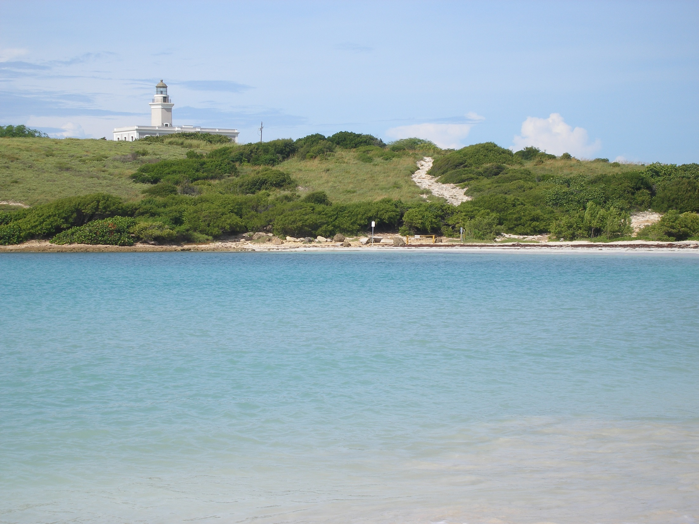
Questions?

