Slide 1
Color cathodoluminescence and trace elements of quartz-bearing veins from the Dabaoshan polymetallic deposit, South China
Wei Mao^{1, 2}, Xiaofeng Li¹, Brian Rusk²
1. State Key Laboratory of Ore Deposit Geochemistry, Institute of Geochemistry, Chinese Academy of Sciences, Guiyang, Guizhou 550002, China
2. Geology Department, Western Washington University, Bellingham, Washington 98225, USA
Wei.mao@wwu.edu
10/22/2014

Slide 2
1. Introduction

Slide 3
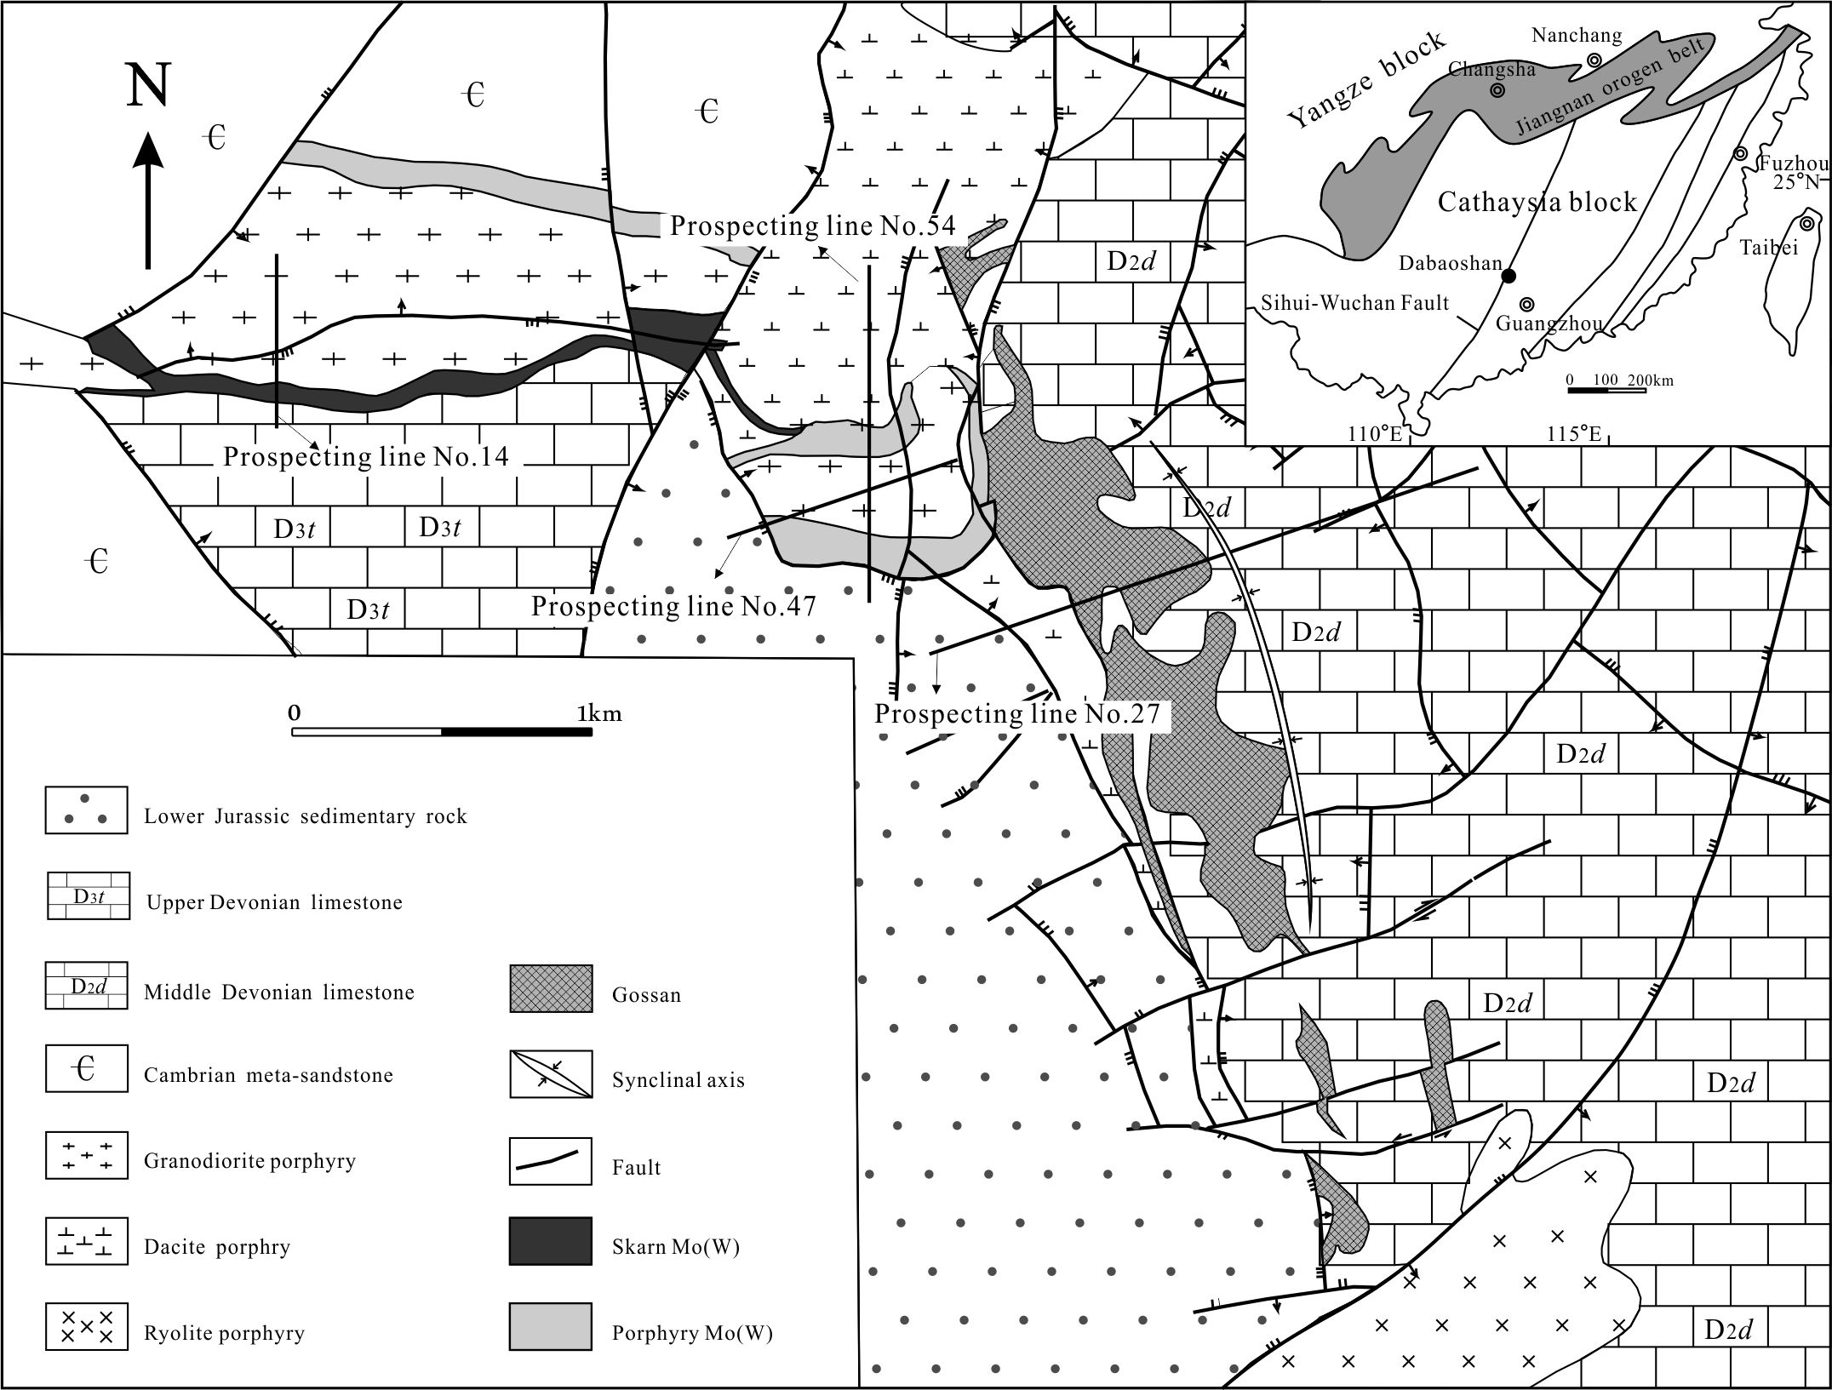
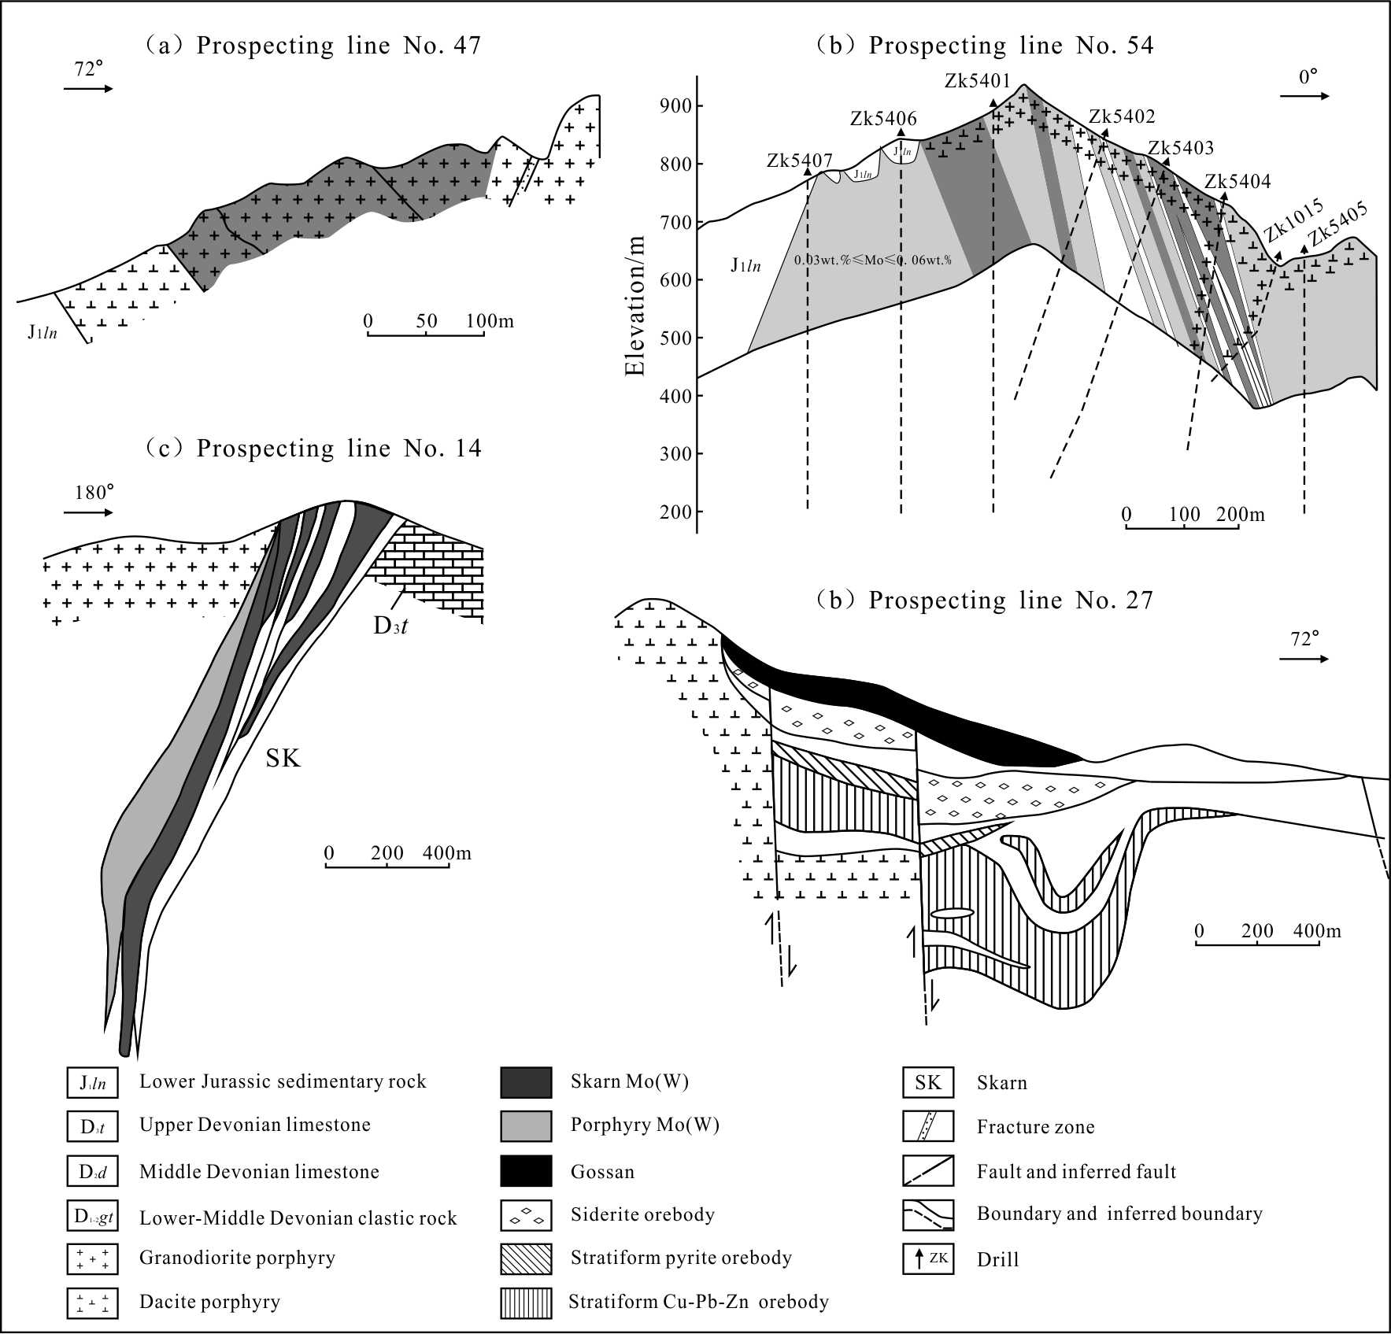
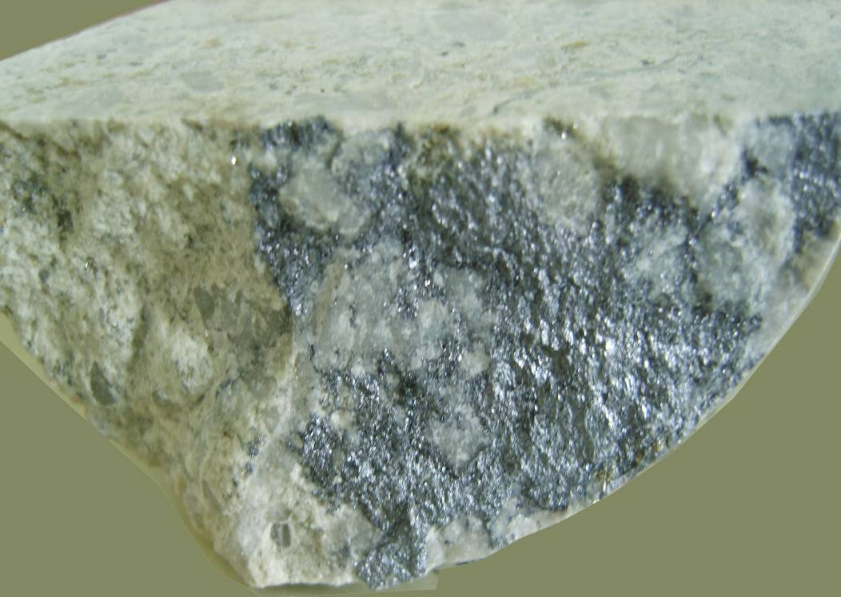
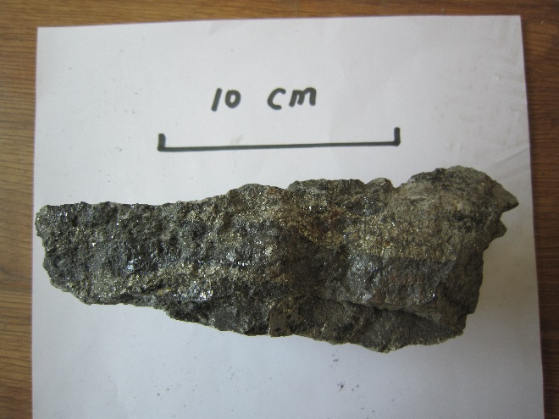
Dacite
porphyry
162.2Ma
Granodiorite
160.2Ma
Porphyry Mo(W)
52,000t Mo, average grade 0.07wt.%
45,000t W, average grade 0.3wt.%
Granodiorite
porphyry
161.2Ma
Skarn Mo(W)
Gossan
Strata-bound Cu-Pb-Zn deposit
Siderite
Porphyry related
or
SEDEX???
Sulfides
313,000t Cu, average grade 0.86wt.%
20,000t Pb, average grade 1.77wt.%
52,000t Zn, average grade 4.44wt.%
11Mt Fe, average grade 48.21wt.%

Slide 4
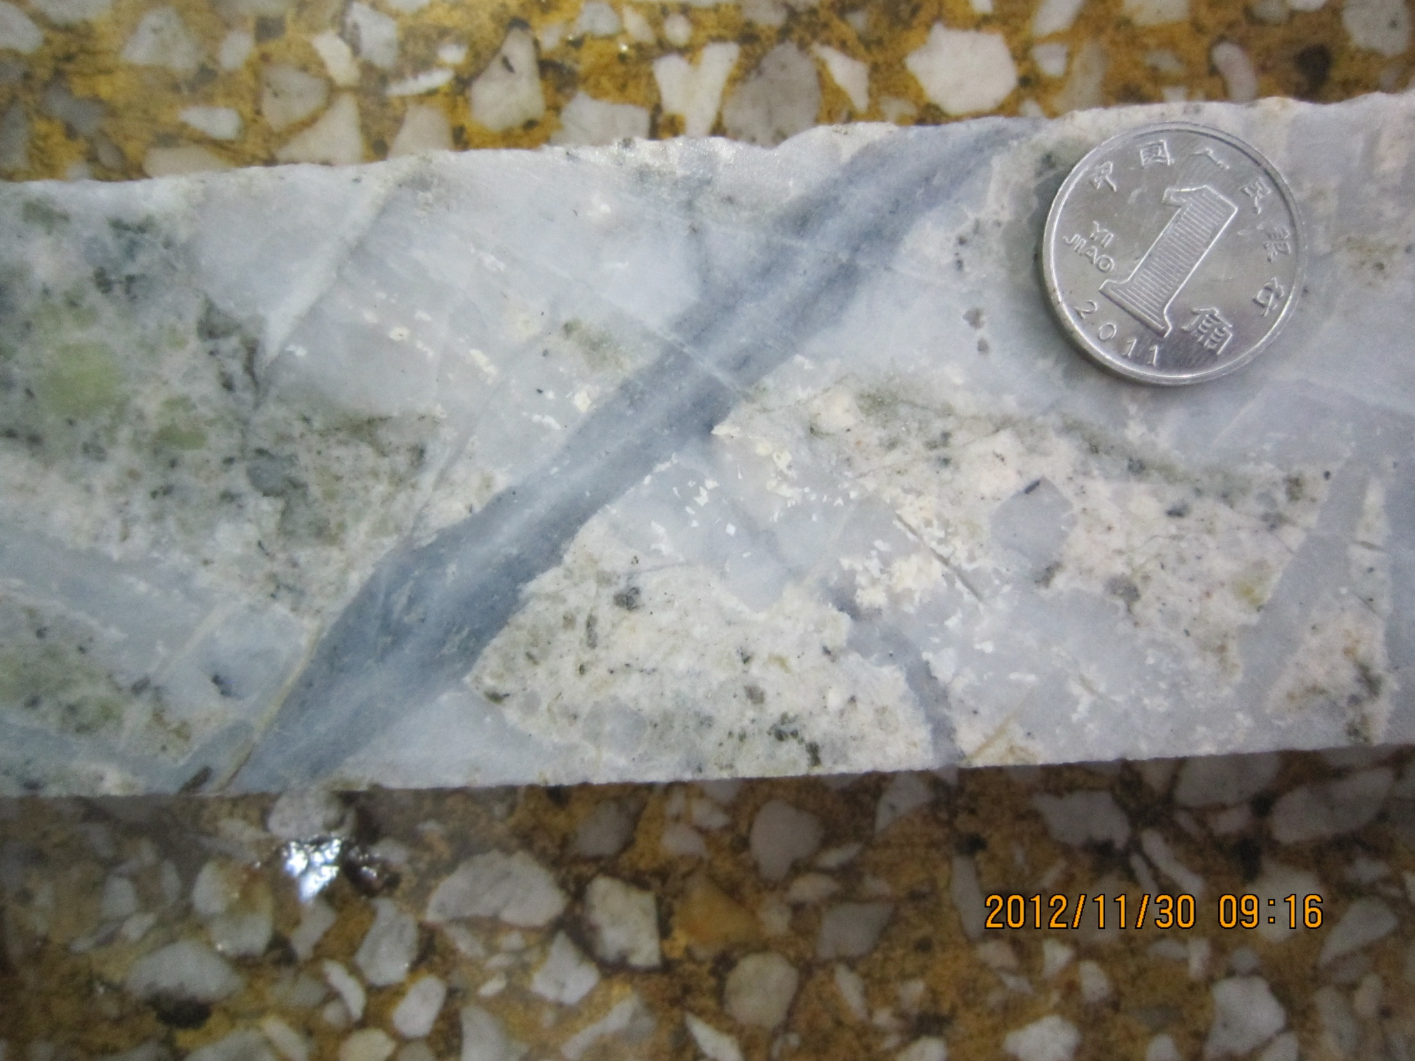
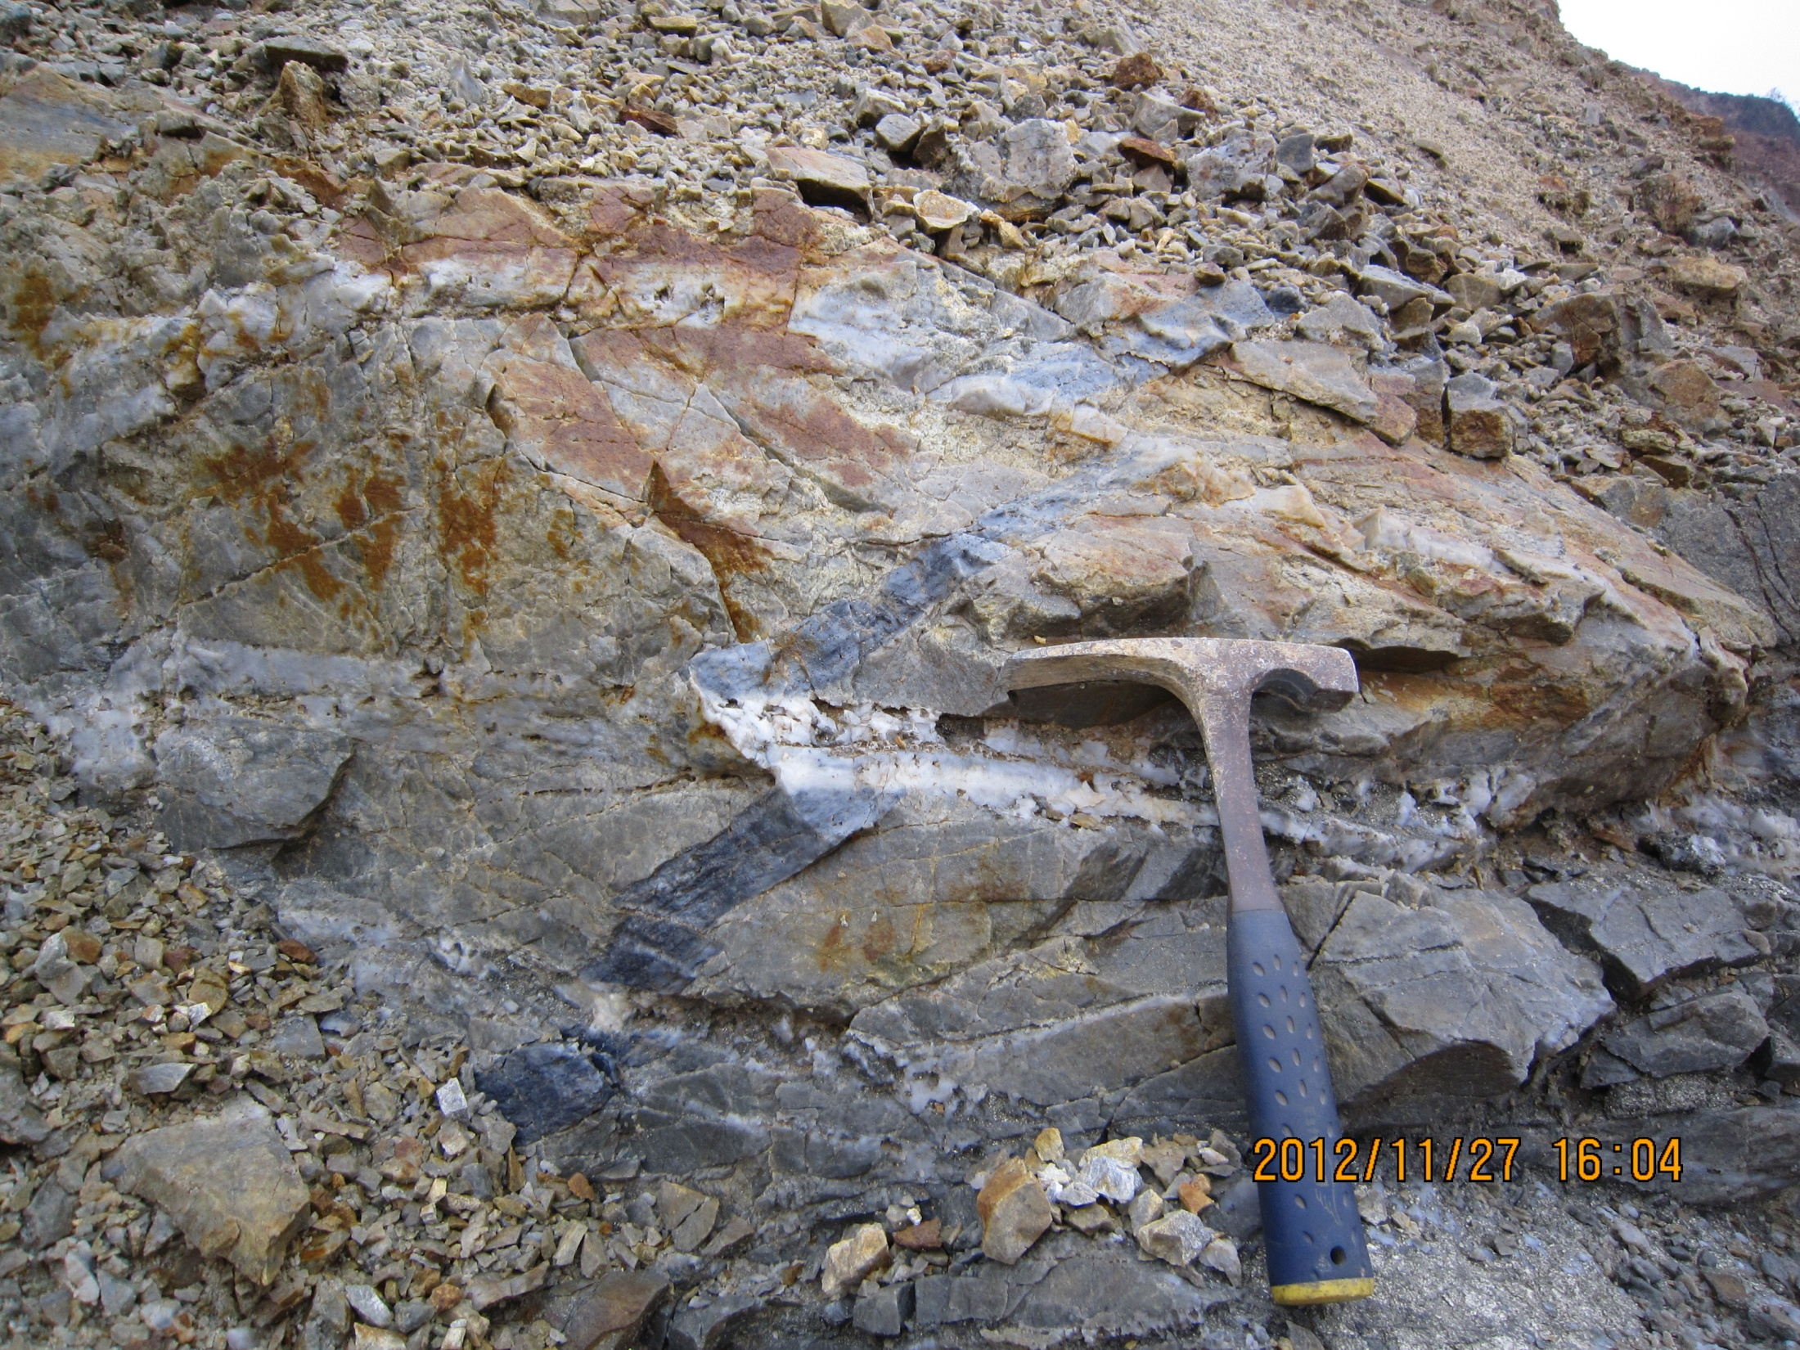
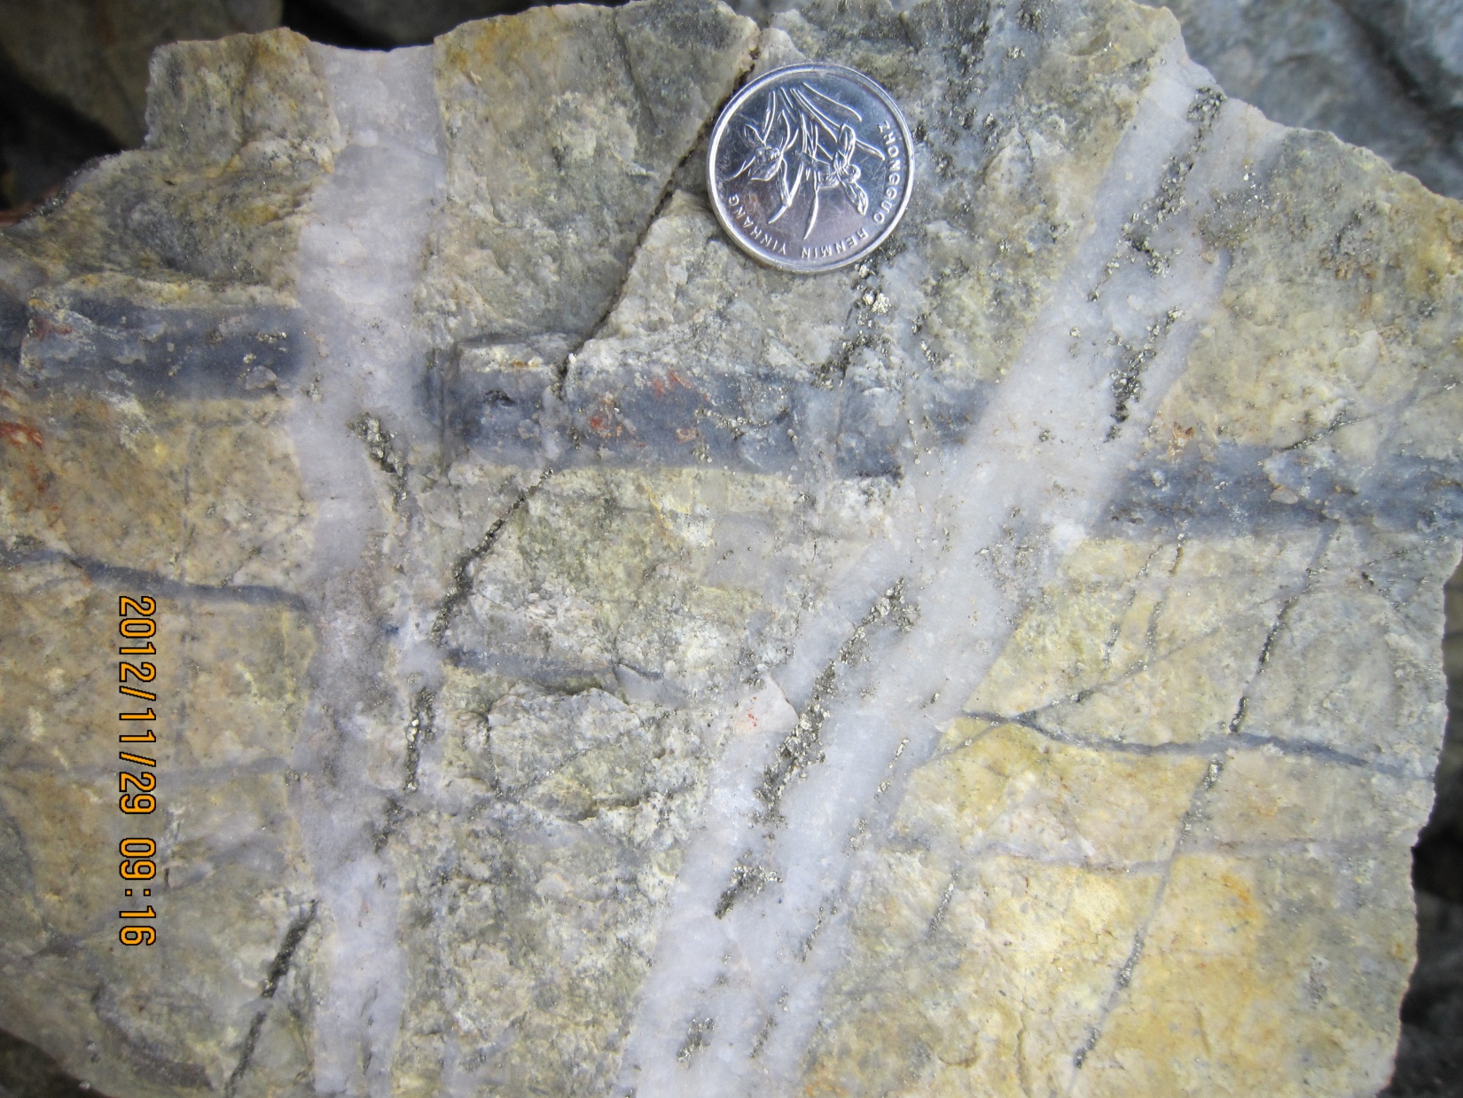
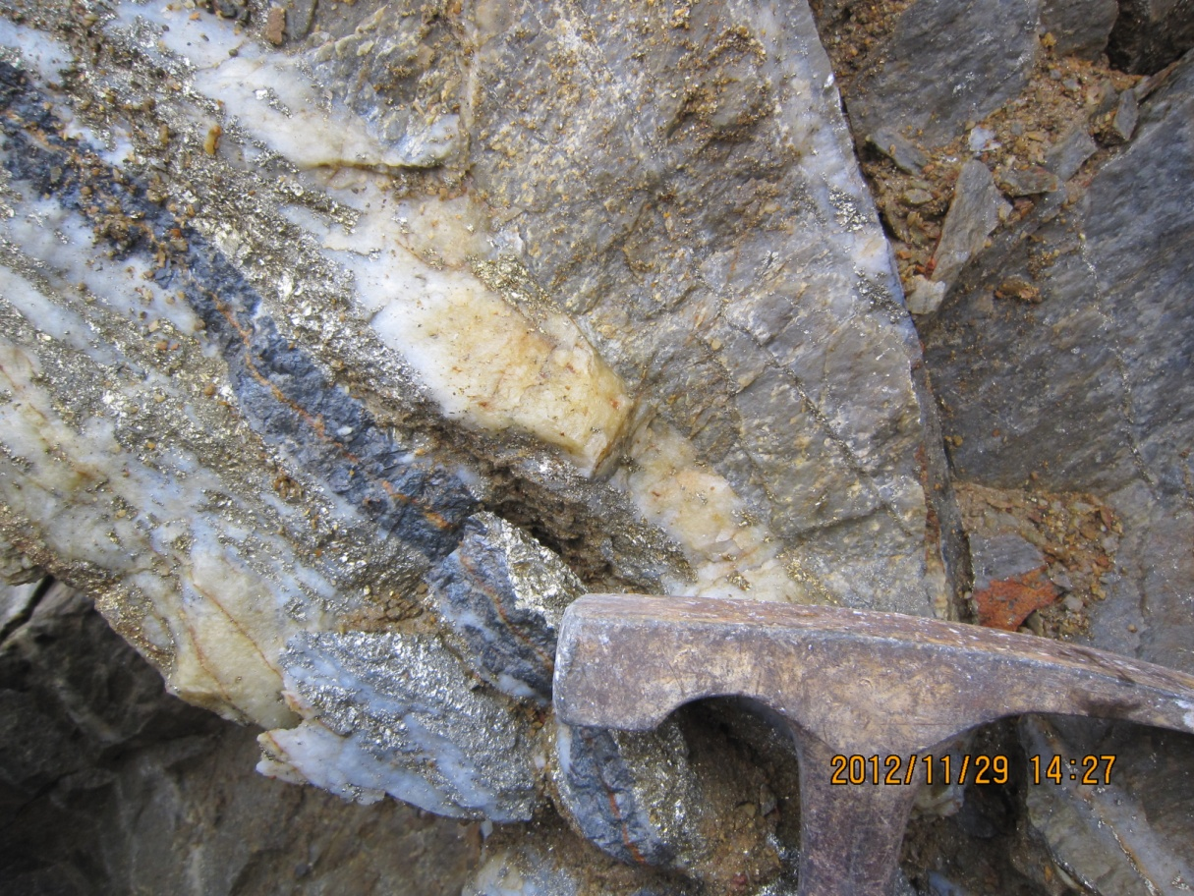
Quartz bearing veins in the porphyries
Qz-Mb
Wavy Qz
Qz-Mb
Qz-Py
Qz-Mb
Qz-Py
Qz-Cp-Gn-Sl
Qz-Py

Slide 5
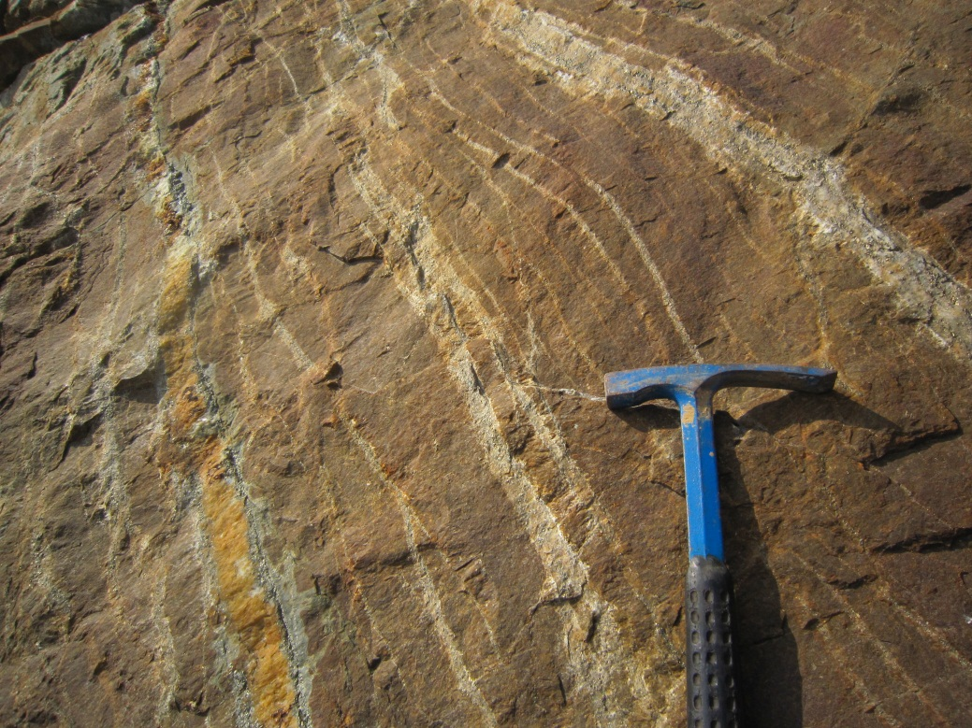
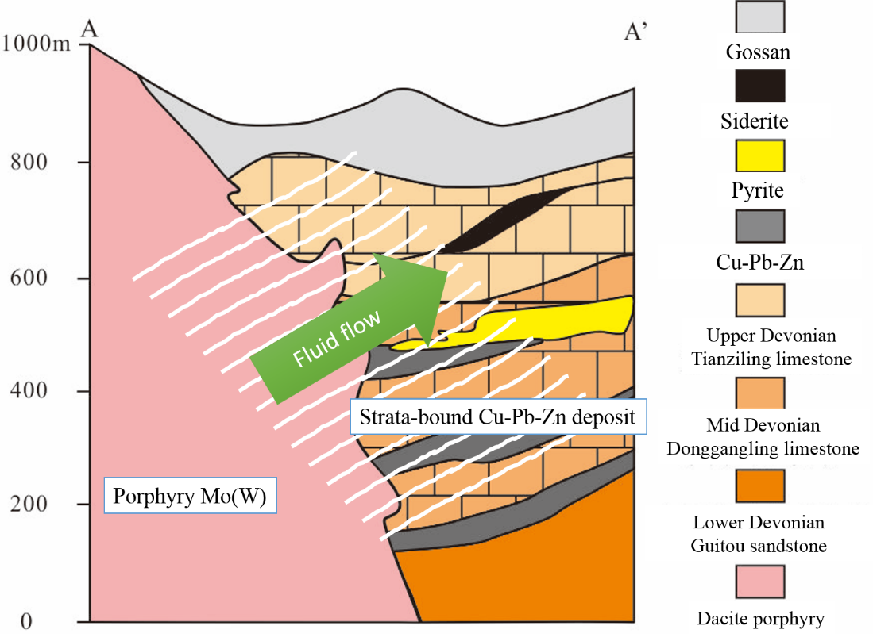
Qz-Py veins show very consistent occurrence

Slide 6
Evolution of quartz bearing veins

Slide 7
2. Quartz CL and trace elements

Slide 8
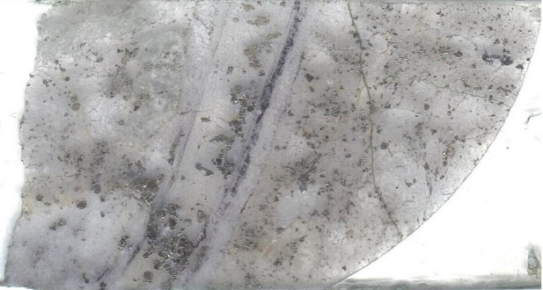
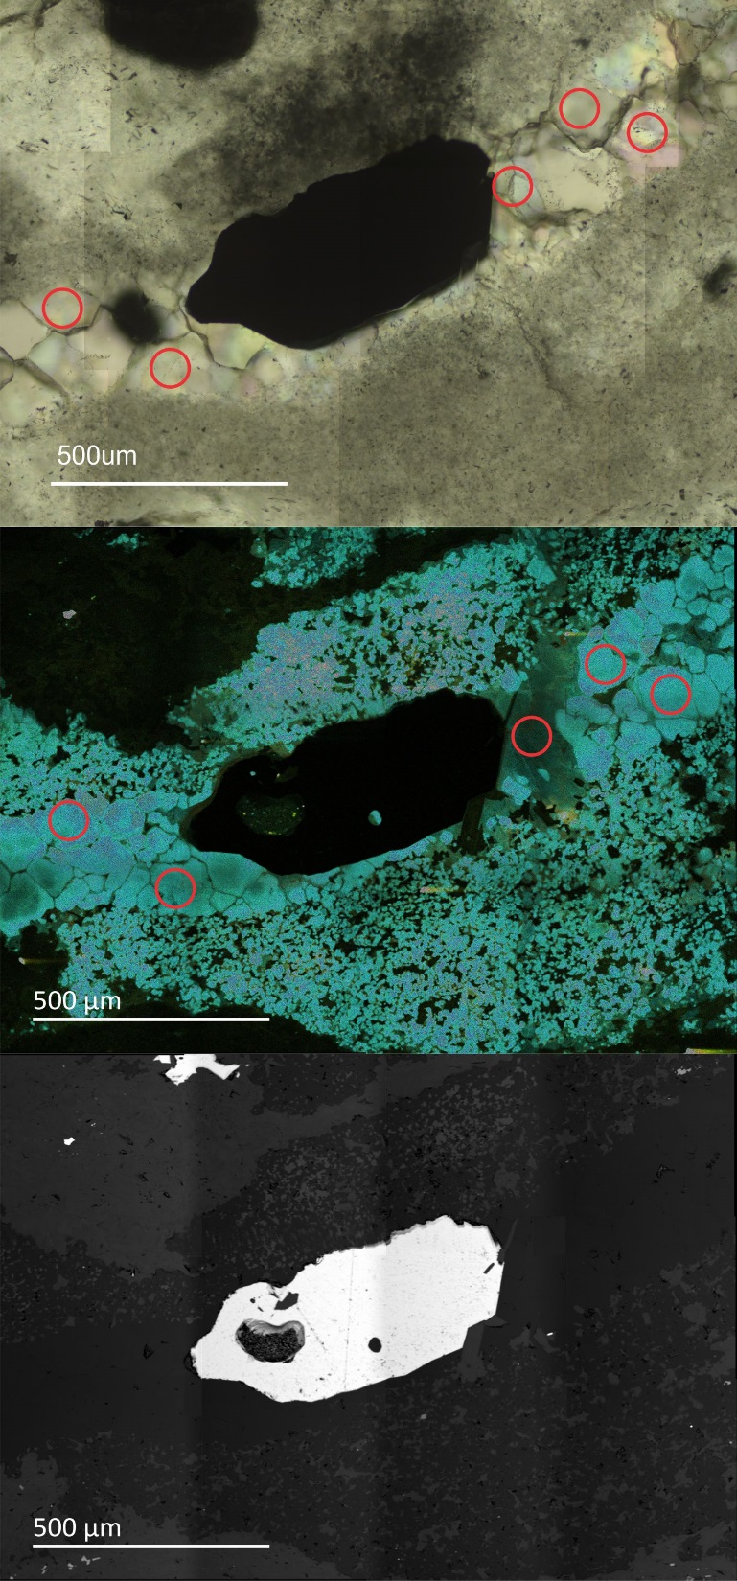
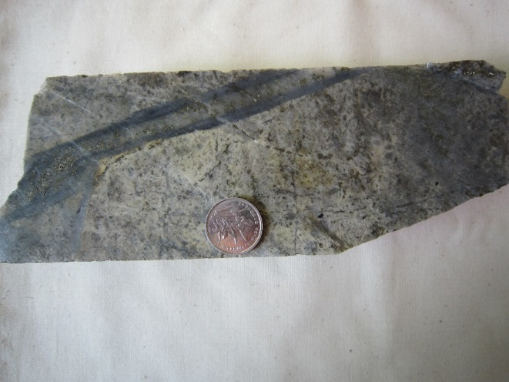
A. Wavy Quartz vein
ZK5101-11-2
Transmitted
A1
Li 0.34
Al 123.29
Ti 40.36
Ge 1.38
A1
A2
A2
Li 0.12
Al 31.09
Ti 4.76
Ge 2.21
CL
Highest CL Intensity
Fine grain granular mosaics
No internal growth zone
Py
BSE

Slide 9
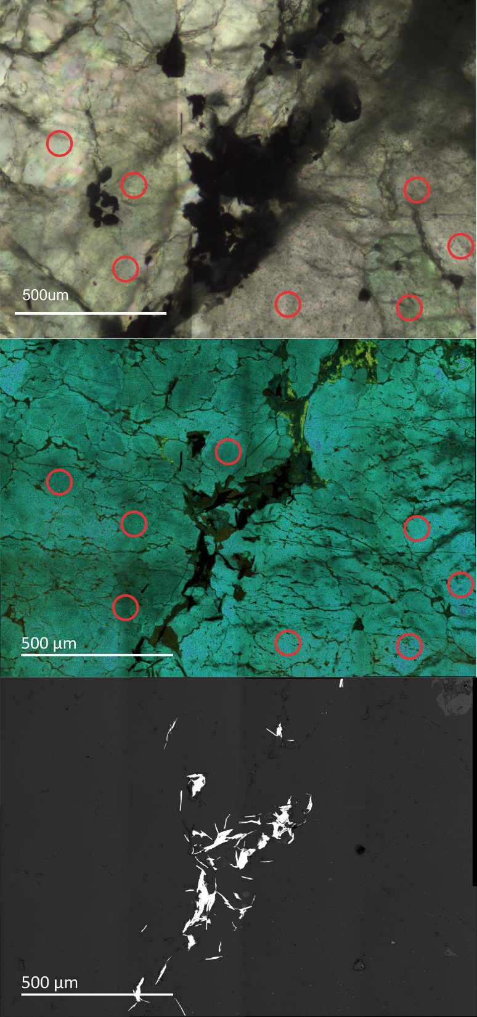
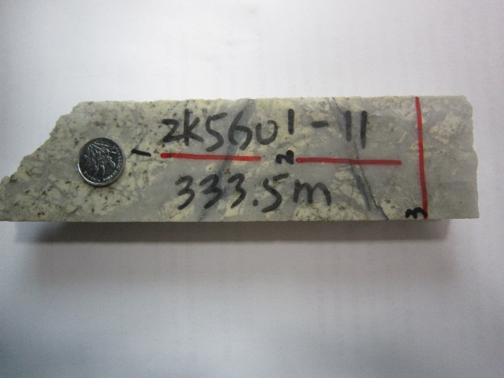
B. Quartz-Molybdenite vein
ZK5601-11-1
Transmitted
B1
Li 0.45
Al 53.08
Ti 19.11
Ge 1.68
B1
CL
High CL Intensity
Granular mosaics
No internal growth zone
Mb
BSE

Slide 10
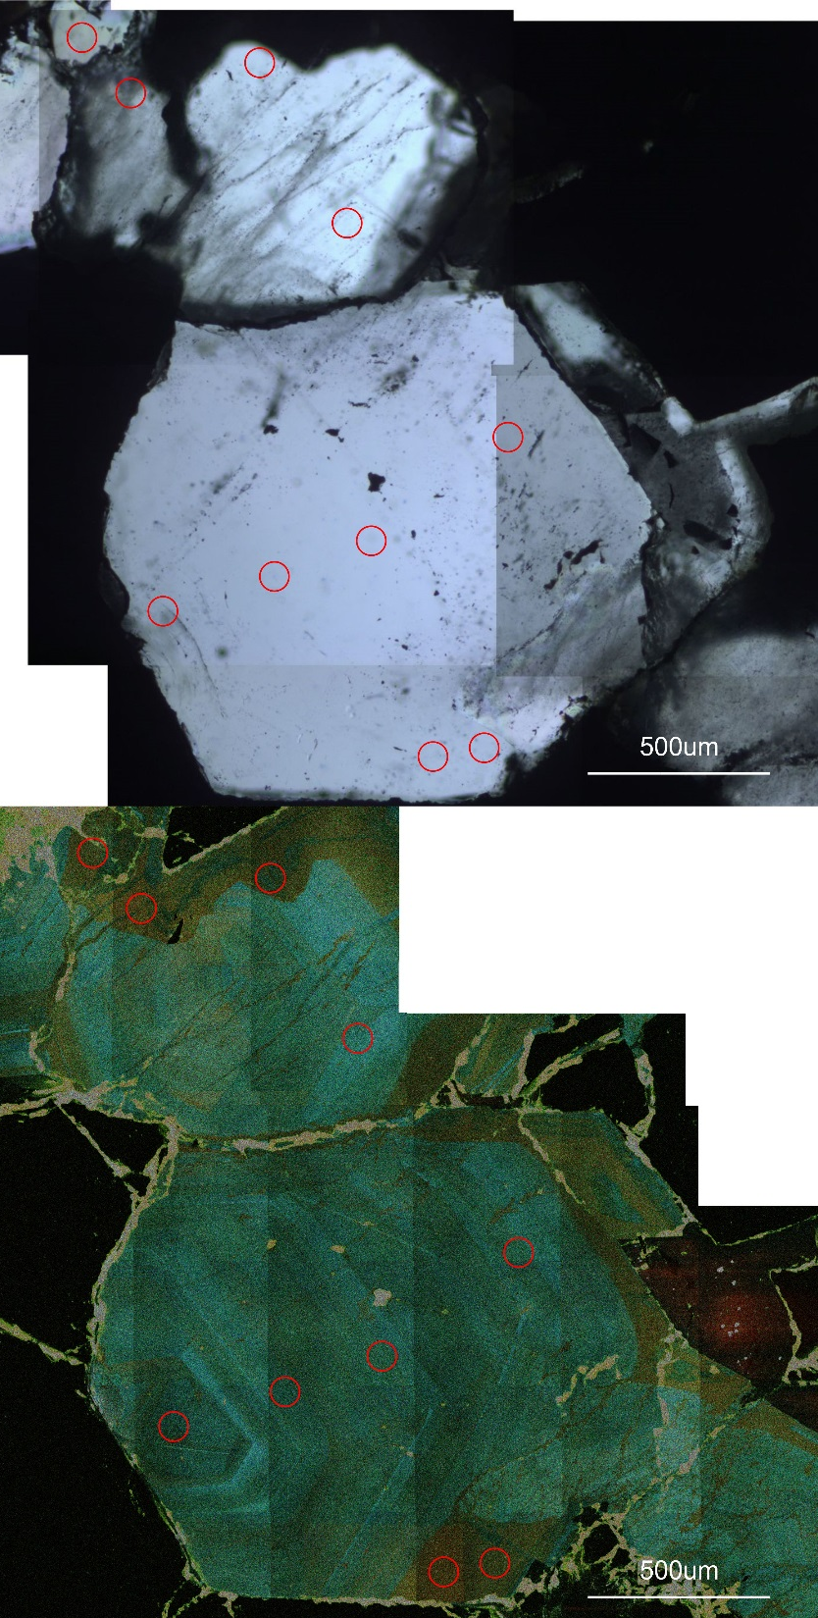
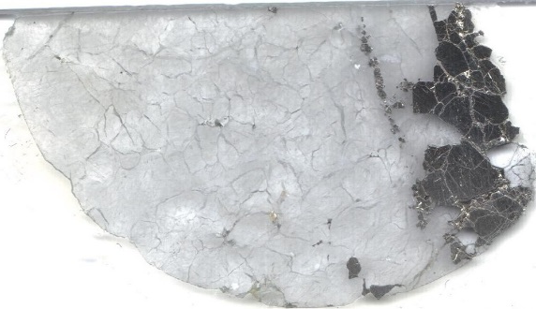
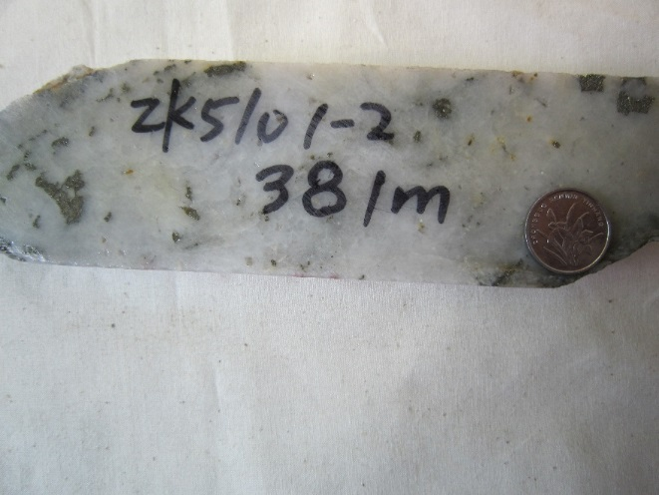
D. Quartz-Pyrite vein
Py
Zk5101-2-2
D2
Li 0.54
Al 34.22
Ti 0.16
Ge 1.07
Transmitted
D2
Low CL Intensity
Large euhedral crystal
Internal growth zone
D1
Li 2.40
Al 60.98
Ti 7.66
Ge 1.88
D1
CL

Slide 11
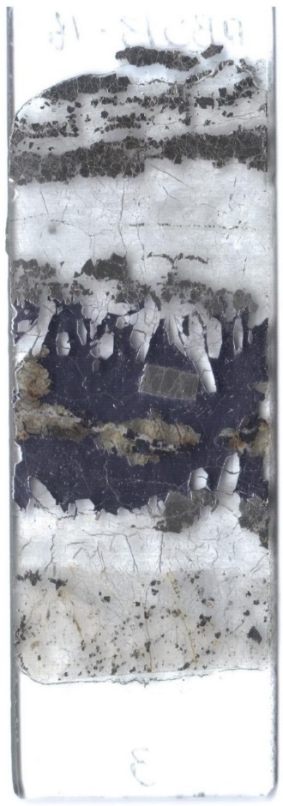
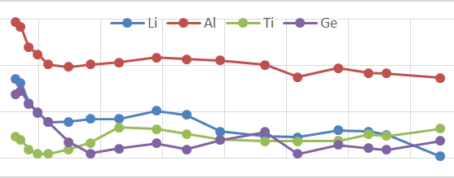
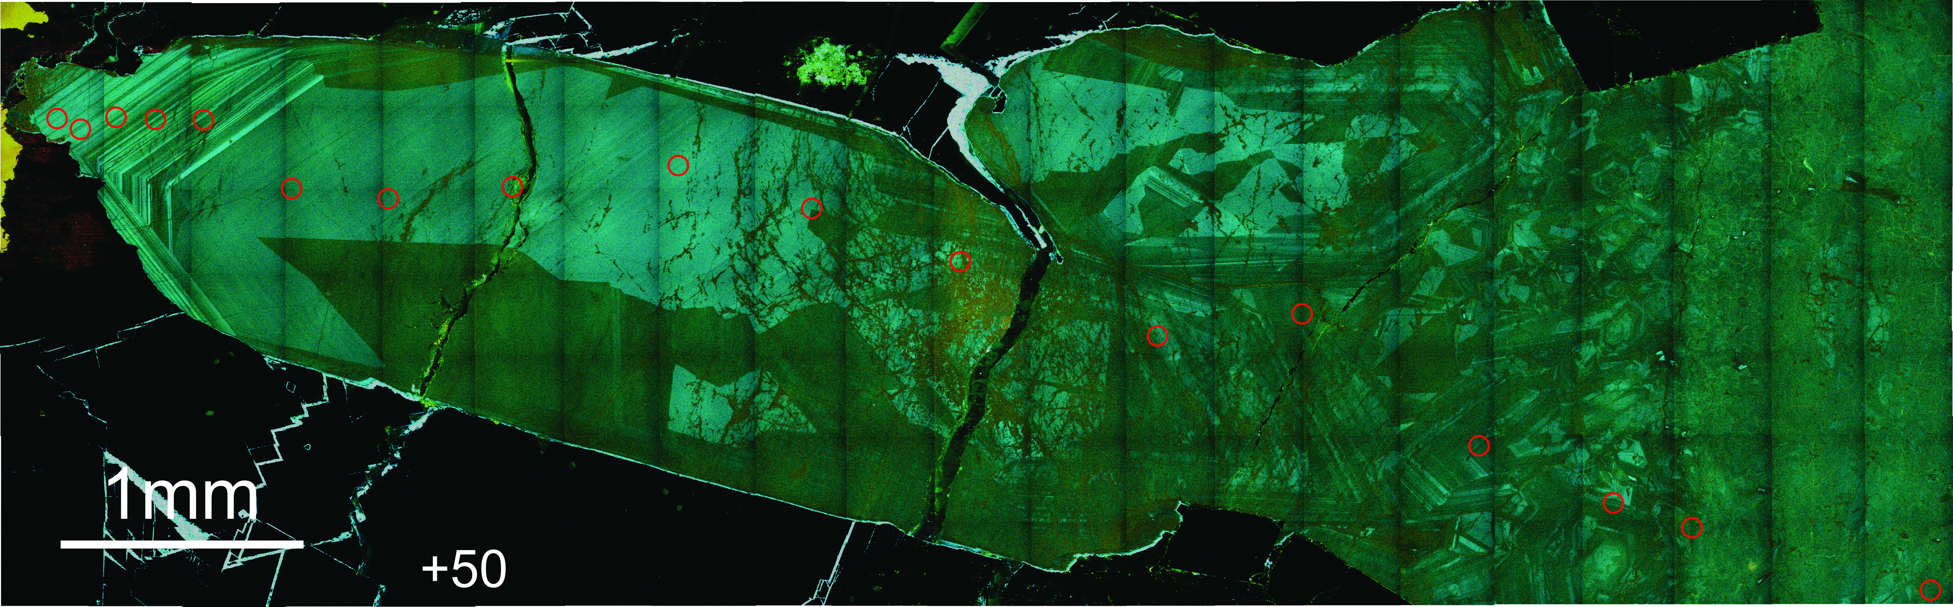
E. Epithermal vein
DBS13-16
Lowest CL Intensity
Large euhedral crystal
Internal growth zone
Sector zoning
Brightness +50
E1
E1:
Li 7.90
Al 120.68
Ti 3.18
Ge 1.75
Gn
E2

Slide 12
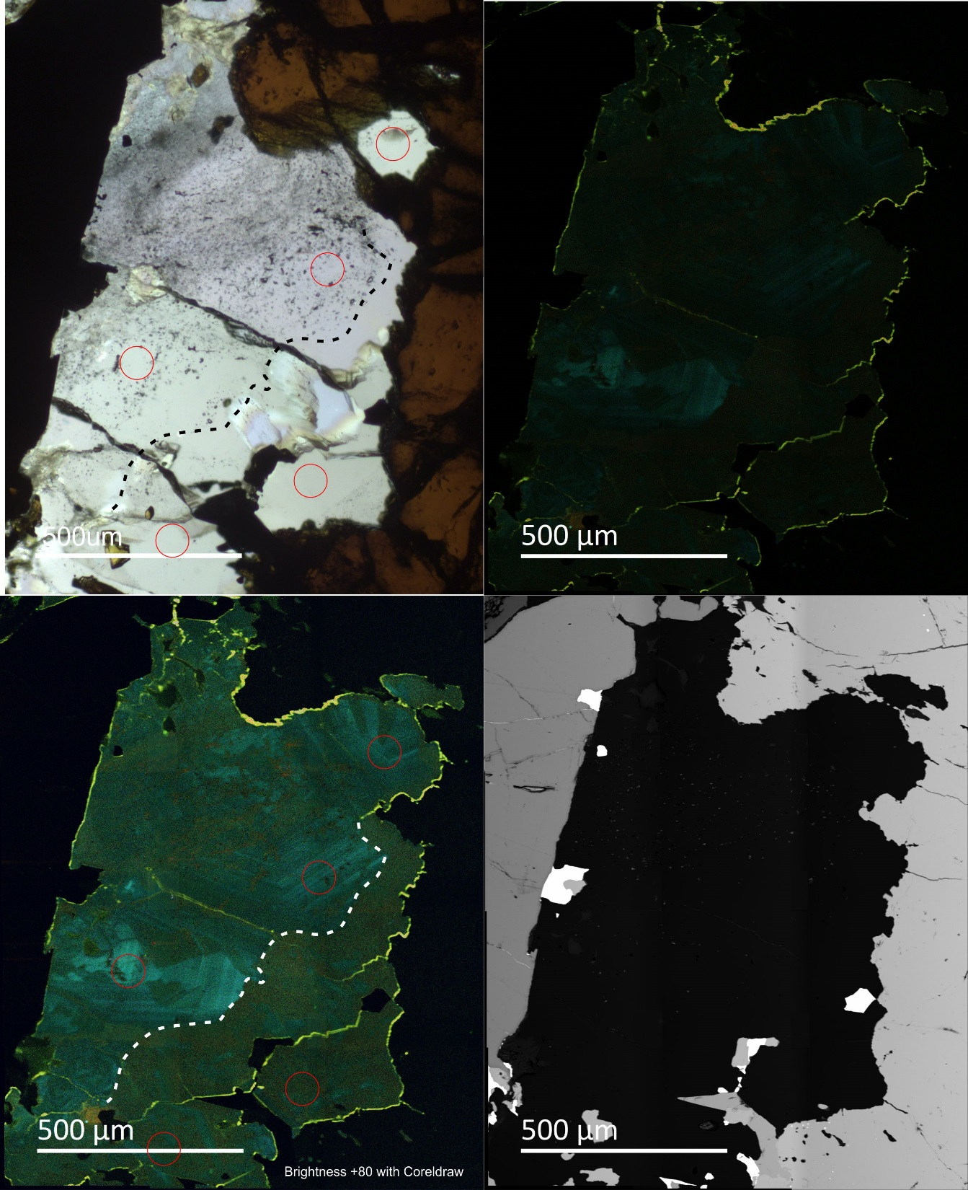
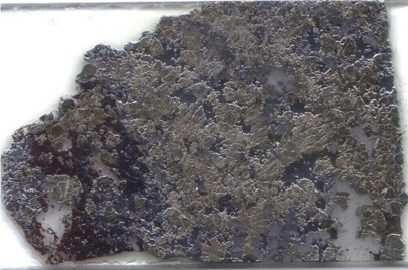
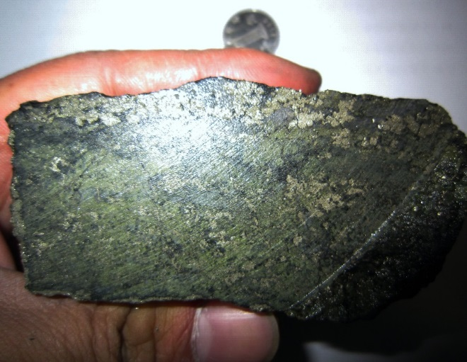
S. Strata-bound sulfides
DBS12-25-4
Transmitted
Original CL
Brightness +80
S2
S1
Li 2.33
Al 95.66
Ti 1.57
Ge 1.67
Lowest CL Intensity
Large euhedral crystal
Internal growth zone
Sector zoning
S3
Li 0.25
Al 25.12
Ti 0.57
Ge 2.78
S1
S3
BSE

Slide 13
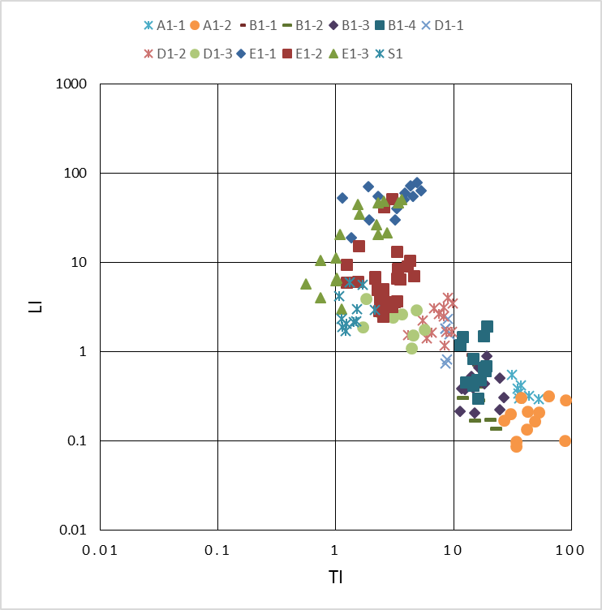
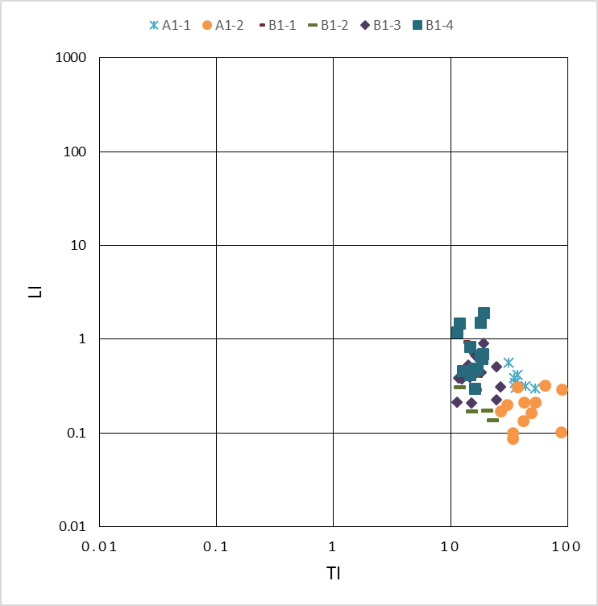
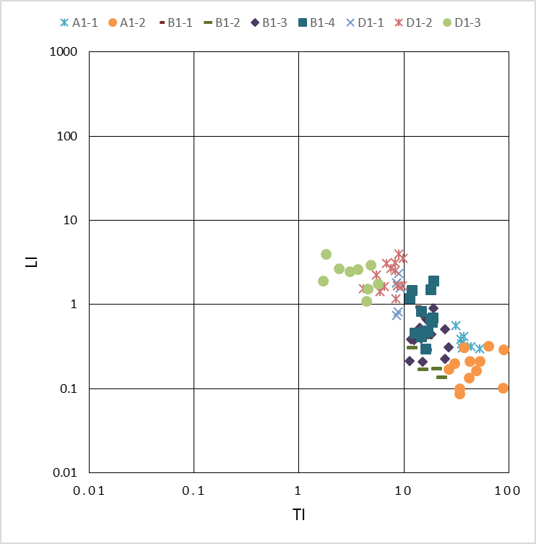
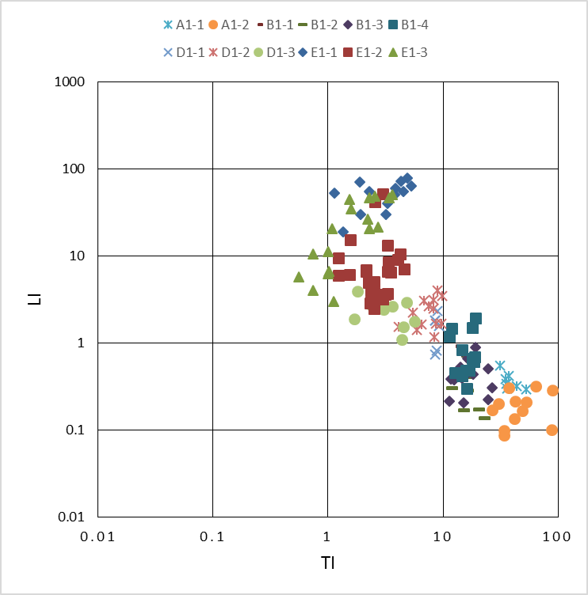
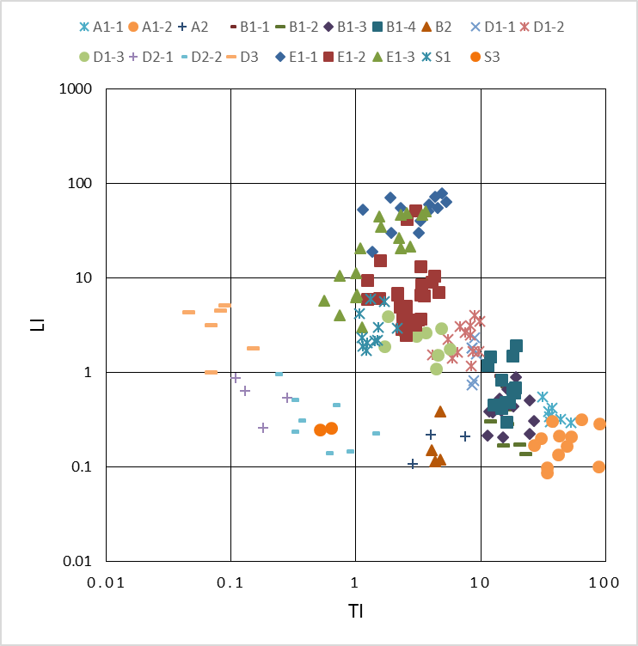
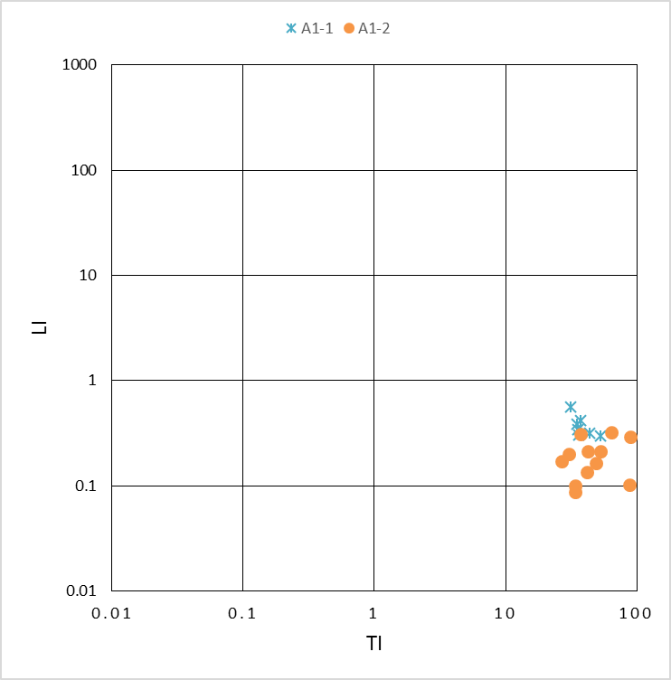
E vein
general trend
Li (ppm)
late dark qz in D, E, S
late dark qz in A, B
Ti (ppm)

Slide 14
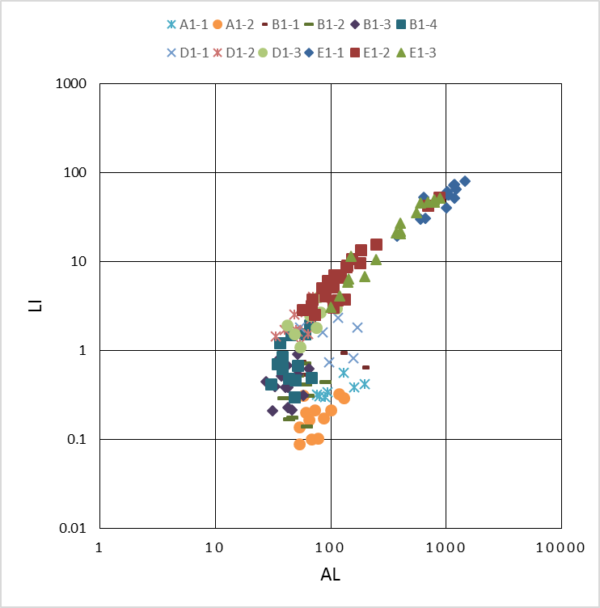
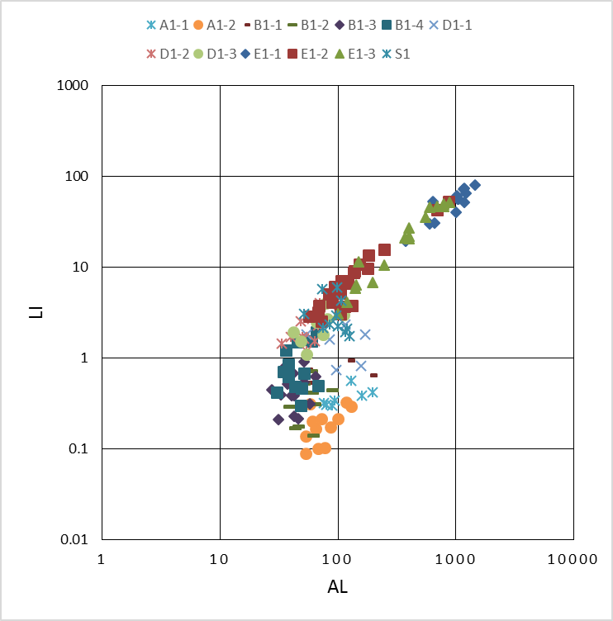
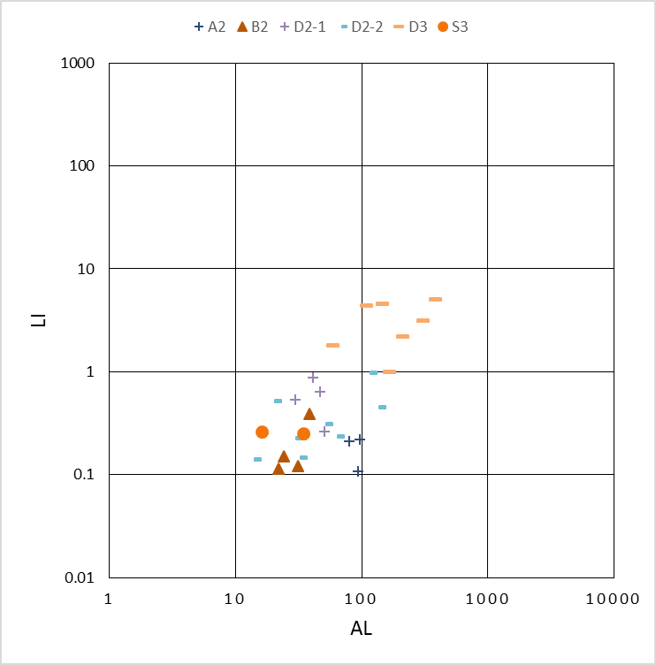
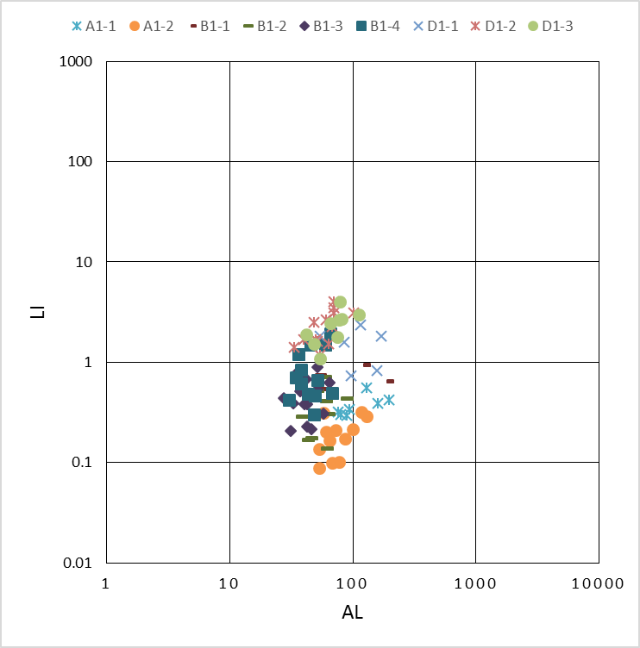
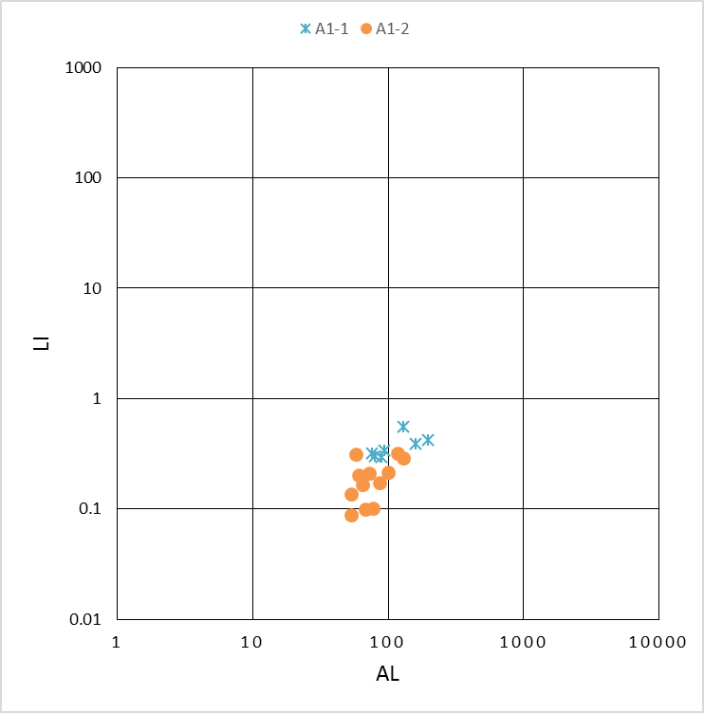
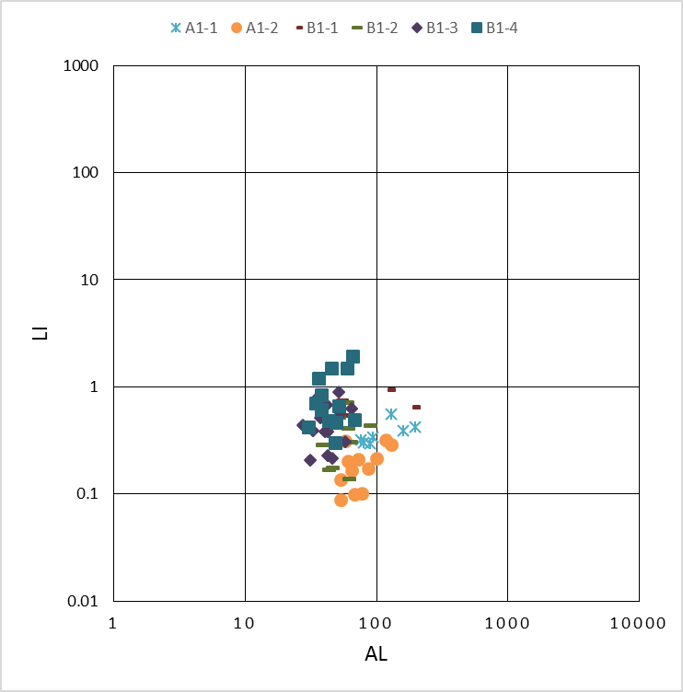
general trend
Li (ppm)
late dark qz
Al (ppm)

Slide 15
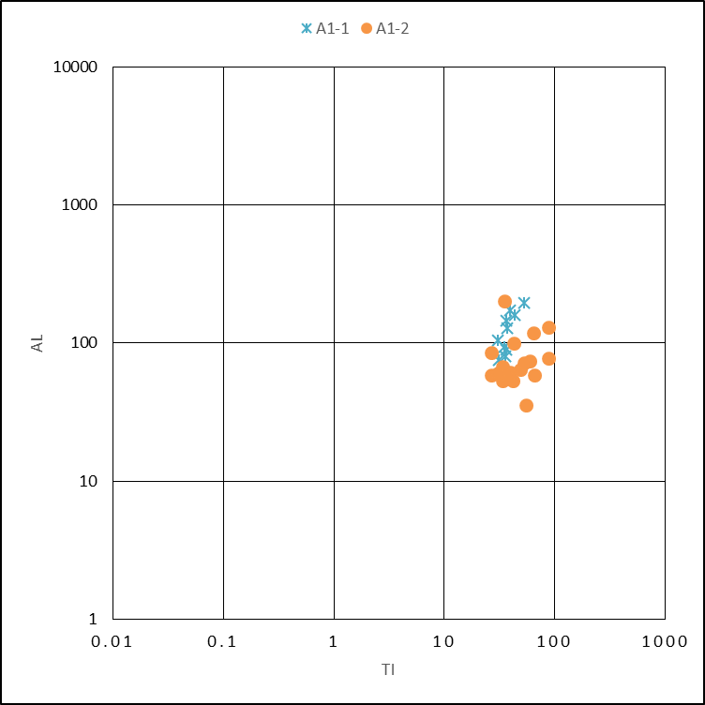
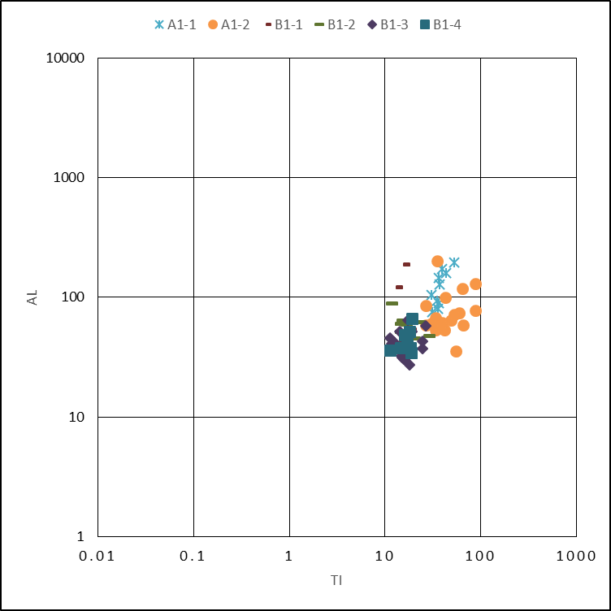
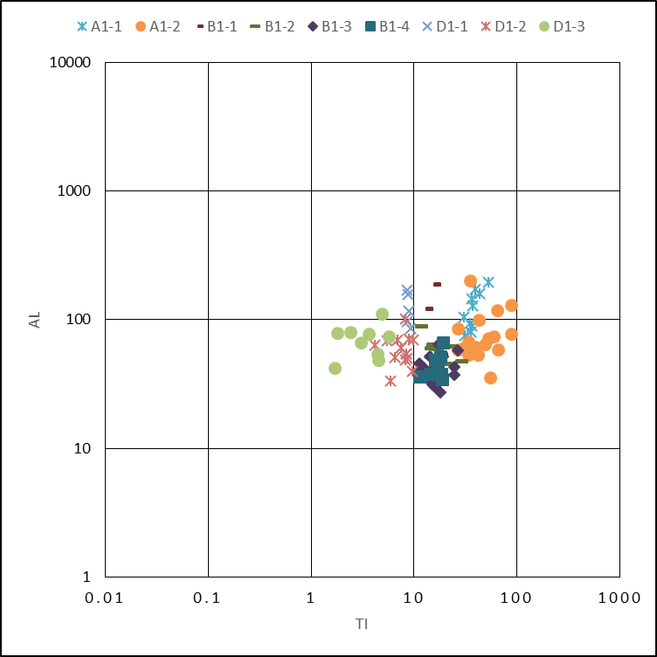
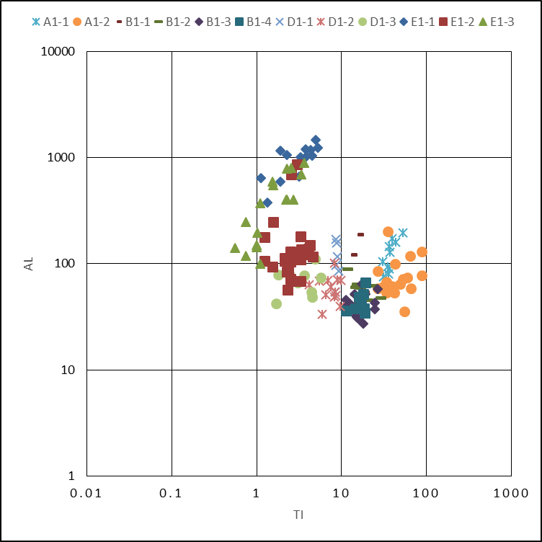
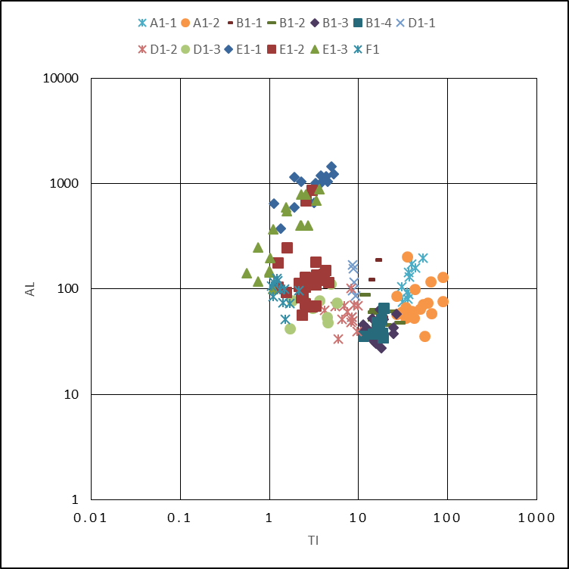
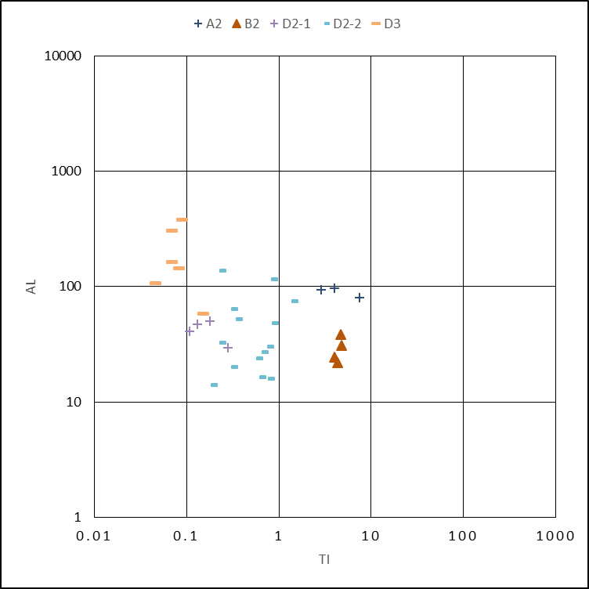
E vein
general trend
Al (ppm)
late dark qz in A, B
late dark qz in D, E ,S
Ti (ppm)

Slide 16
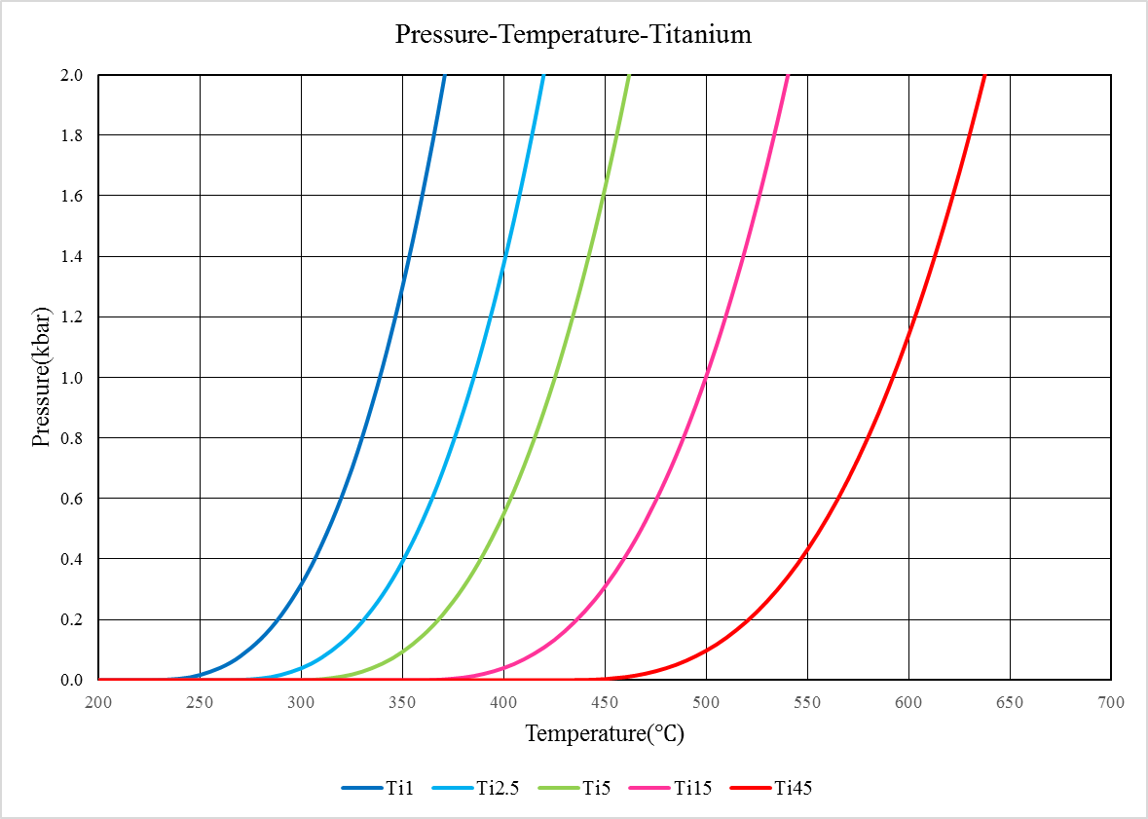
Titanium in quartz thermobarometer
A
1ppm
2.5ppm
5ppm
15ppm
45ppm
B
D
S
E

Slide 17



Thank you!

