Slide 1
Decoupling of Nb-Ta and Ti in arc magmatism: A case study of the Yangzhuang granite porphyry in West Junggar, Xinjiang, China
Wei Mao^{1, 2}, Xiaofeng Li¹, Brian Rusk²
1. State Key Laboratory of Ore Deposit Geochemistry, Institute of Geochemistry, Chinese Academy of Sciences, Guiyang, Guizhou 550002, China
2. Geology Department, Western Washington University, Bellingham, Washington 98225, USA
Wei.mao@wwu.edu
10/22/2014

Slide 2
1. Introduction

Slide 3
Baiyanghe Be-U deposit
-the largest Be-U deposit in Asia
Late Carboniferous to Early Permian A-type Granites
Fig. 1. Geological map ofWest Junggar, Xinjiang, Northwest China.
Modified after Chen et al. (2010). Age data fromChen et al. (2010), Geng et al. (2011), Shen et al. (2012), and Zhang and Zhang
(2014).
Notes:
Our study area lies in the West Junngar, which is characterized by abundant subduction-related Late Carboniferous-Early Permian A-type granites. The Yangzhuang granite porphyry lies in the northmost of these granites is inferred to be the metal source of the Baiyanghe Be-U deposit.

Slide 4
Late Devonian tuff
Carboniferous tuff
Fig. 2. Geological map of the Baiyanghe Be-U deposit, Xinjiang, Northwest China.
Modified after Wang et al. (2012).
Notes:
We collected unaltered fresh samples away from the mineralized area for the analysis. And the compare the Yangzhuang granite porphyry with other regional coeval A-type granites. Next is our results.

Slide 5
2. Results

Slide 6
Ages of the Yangzhuang granite porphyry and the RCAG
Samples | Rock type | Analytical methods | Ages (Ma) | References
Miaoergou | Alkali-feldspar granite | SHRIMP Zircon U-Pb | 308±6 | Geng et al. (2009)
Miaoergou | Alkali-feldspar granite | LA-ICP-MS Zircon U-Pb | 305±2 | Su et al. (2006)
Miaoergou | Alkali-feldspar granite | LA-ICP-MS Zircon U-Pb | 306.4±8.8 | Gao et al. (2006)
Miaoergou | Alkali-feldspar granite | SHRIMP Zircon U-Pb | 327±7 | Han et al. (2006)
Karamay | Alkali-feldspar granite | LA-ICP-MS Zircon U-Pb | 296±4 | Su et al. (2006)
Karamay | Alkali-feldspar granite | SHRIMP Zircon U-Pb | 295±4.6 | Han et al. (2006)
Akebastao | Alkali-feldspar granite | SHRIMP Zircon U-Pb | 290±8 | Han et al. (2006)
Akebastao | Alkali-feldspar granite | Rb-Sr isochron | 302±8 | Li et al. (2000)
Akebastao | Alkali-feldspar granite | LA-ICP-MS Zircon U-Pb | 303±3 | Su et al. (2006)
Akebastao | Alkali-feldspar granite | LA-ICP-MS Zircon U-Pb | 305±4 | Geng et al. (2009)
Akebastao | Alkali-feldspar granite | LA-ICP-MS Zircon U-Pb | 318±2.9 | Gao et al. (2006)
Hongshan | Alkali-feldspar granite | LA-ICP-MS Zircon U-Pb | 301±4 | Su et al. (2006)
Tiechanggou | Alkali-feldspar granite | SHRIMP Zircon U-Pb | 308.4±4 | Han et al. (2006)
Hatu | Alkali-feldspar granite | Rb-Sr isochron | 287±29 | Li et al. (2000)
Hatu | Alkali-feldspar granite | SHRIMP Zircon U-Pb | 302.4±4 | Han et al. (2006)
Kulumusu | Alkali-feldspar granite | LA-ICP-MS Zircon U-Pb | 302±2 | Chen et al. (2010)
Sailike | Alkali-feldspar granite | LA-ICP-MS Zircon U-Pb | 304±2 | Chen et al. (2010)
Jiangbule | Alkali-feldspar granite | LA-ICP-MS Zircon U-Pb | 309±2 | Xu et al. (2012)
Taergen | Alkali-feldspar granite | LA-ICP-MS Zircon U-Pb | 309±4 | Xu et al. (2012)
Taergen | Alkali-feldspar granite | SHRIMP Zircon U-Pb | 296±3 | Song et al. (2011)
Yangzhuang | Granite porphyry | SHRIMP Zircon U-Pb | 309.3 | Ma et al. (2010)
Yangzhuang | Granite porphyry | LA-ICP-MS Zircon U-Pb | 313±2.3 | Zhang et al. (2012)
Similarity 1:
Identical intrusion age
Late Carboniferous-Early Permian

Slide 7
Similarity 2:
Identical major and trace elements and CIPW norm mineral calculation results between the YGP and RCAG

Slide 8
Previous research showed that all the Regional Coeval Granites are A-type granites(Su et al. 2006)
Similarity 3:
They can all be classified as A-type granites.
All feldspar in the phenocryst and matrix are alkali-feldspar
CIPW results shows no anorthite (An)
High SiO2, Na2O+K2O, Fe/Mg, F, Nb, Ga, Sn, Y and REE
Low CaO、Ba、Sr
Notable negative Eu anomaly
10000Ga/Al>2.6
Sample | 10000Ga/Al
YZ-1 | 3.32
YZ-2 | 3.31
YZ-3 | 3.23
YZ-4 | 3.31
YZ-5 | 3.42
YZ-6 | 3.34
YZ-7 | 3.45
YZ-8 | 3.84
YZ-9 | 3.37

Slide 9
Difference 1:
Decoupling of Nb-Ta, Zr-Hf and Ti
-How???
Samp. | YZ-1 | YZ-2 | YZ-3 | YZ-4 | YZ-5 | YZ-6 | YZ-7 | YZ-8 | YZ-9 | KM* | MG* | HONG* |  | AK* | Hatu*
Rock | Yangzhuang Granite Porphyry |  |  |  |  |  |  |  |  | Regional Coeval A-type Granites
Nb | 93.6 | 87.2 | 84.4 | 92.8 | 90.6 | 86.6 | 100 | 81.9 | 95.8 | 10.20 | 8.75 | 8.77 | 8.88 |  | 10.4
Ta | 8.04 | 7.77 | 8.32 | 8.36 | 7.91 | 7.62 | 8.53 | 5.71 | 8.34 | 1.03 | 0.61 | 0.75 | 0.76 |  | 0.57
Left leaning HREE
U、Th rich
Nb、Ta strongly
enriched (~10 times)
Eu、Ti depleted
High-field-strength elements Nb-Ta (HFSE⁵⁺), Zr-Hf (HFSE⁴⁺), and Ti share similar crystal-chemical properties

Slide 10
Difference 2:
A1 VS A2

Slide 11
3. Discussion

Slide 12
Tectonic setting
in Late Carboniferous to Early Permian
Ridge subduction model:
Geng et al. 2009, 2011; Tang et al. 2009, 2010a, b; Yin et al. 2010, 2011;
Zhang et al. 2011 a,b; Yang et al. 2012 …
Volcanic and intrusive rocks -- mantle magmatic source
Dioritic rocks with adakitic characteristics -- high temperature
Sanukite-like dikes --extensional setting & high T geothermal gradient
MORB-like tholeiites -- mixed mantle source consisting of subducted depleted oceanic lithosphere & enriched upwelling asthenospheric mantle.
Volcanic rocks similar to rocks formed during ridge subduction in Chile
…

Slide 14
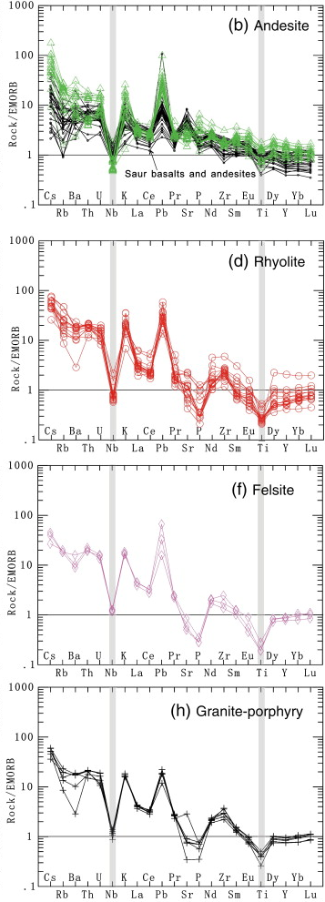
Decoupling of Nb-Ta, Zr-Hf and Ti
-How???
Hydrothermal alteration?
-Fluid inclusion study and alteration
minerals reveal very low T (<150 C)
fluid alteration.
Crustal contamination?
-average Nb content in the earth's
crust is merely 19 ppm
-average Nb content in the
Xuemisitan volcanic belt is 19.5 ppm
Origin anomaly?
Nb-Ta-Ti depletion in island-arc magmatic rock
Rutile and ilmenite left in the origin
High Nb, Ta, Ti
（Shen Ping，2012）

Slide 15
Hofmann (1988) -
amphibole in the upper mantle can be an important host for Nb and Ta.
Ionov and Hofmann (1995) -
when the fluids generated by dehydration of the subducted slab ascend through the
mantle wedge, highly incompatible elements including Nb and Ta are transferred
into the mantle wedge by the precipitation of amphibole.
Tiepolo et al.(2001)-
Nb becomes compatible, whereas Zr remains incompatible, in amphibole
crystallized in Ti-poor systems in the mantle wedge.
Notes:
Hofmann (1988) firstly proposed that amphibole, a most common hydrous mineral in the upper mantle, can be an important host for Nb and Ta.
Ionov and Hofmann (1995) proposed that when the fluids generated by dehydration of the subducted slab ascend through the mantle wedge, highly incompatible elements including Nb and Ta are transferred into the mantle wedge by the precipitation of amphibole.
Experimental investigations reveal that Nb becomes compatible, whereas Zr remains incompatible, in amphibole crystallized in Ti-poor systems in the mantle wedge.

Slide 16
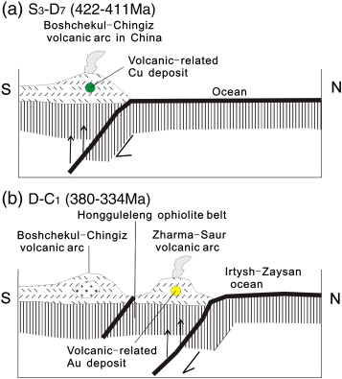
Why YGP, not other RCAG?
（Shen Ping，2012）

Slide 17
Two stages of southward subduction
One northwestward subduction
Extensive metasomatism
Nb,Ta rich and Ti-poor amphibole
Ridge subduction
Enhanced heat flux
Decompose amphibole
Nb,Ta rich and Ti-poor magma
Yangzhuang granite porphyry

Slide 18



Thank you!

