Slide 1
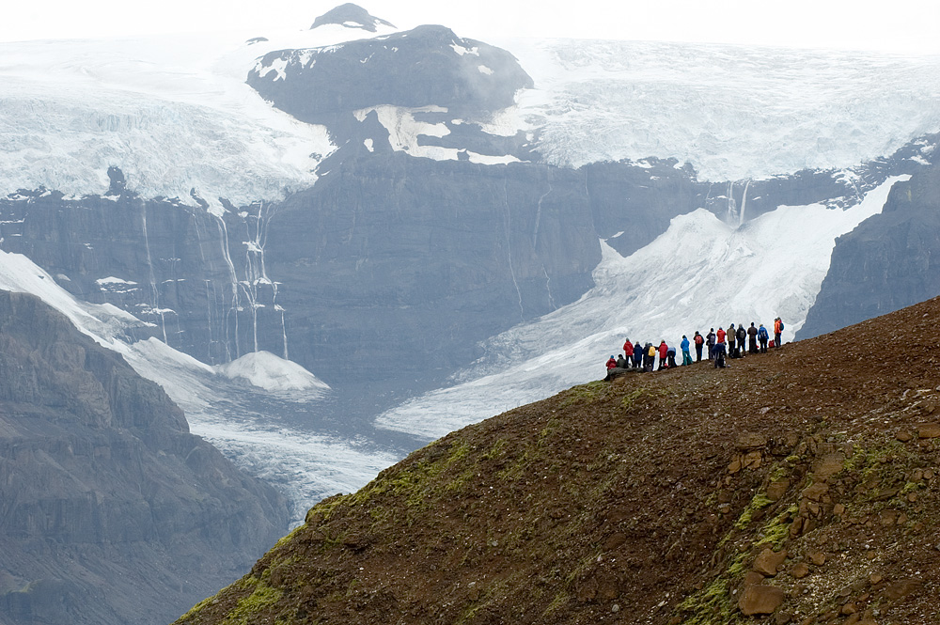
Land of Fire and Ice: Summer Field Study in Iceland
Barb and Dave Tewksbury, Hamilton College

Slide 2
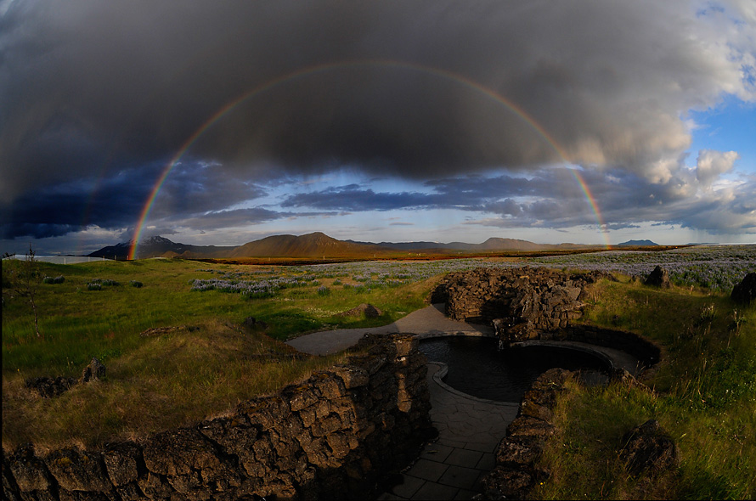
A 40-year view
Notes:
My first trip to Iceland was in 1975. That was 12 years after Surtsey eruption; it was in the early plate tectonic era and predicted spreading in Iceland; major volcano-tectonic event in N Iceland; hot springs that we soaked in in N Iceland are now too cool and some that were too cool are now parboiling temperatures. Glaciers have retreated. There have been a dozen volcanic eruptions. Incredible geologic activity and incredible change. Manmade changes, too. one year after Ring Road; . -; joke about what to do if you get lost in a Icelandic forest;no blue lagoon. remarkable changes; A blink in the eye geologically.

Slide 3
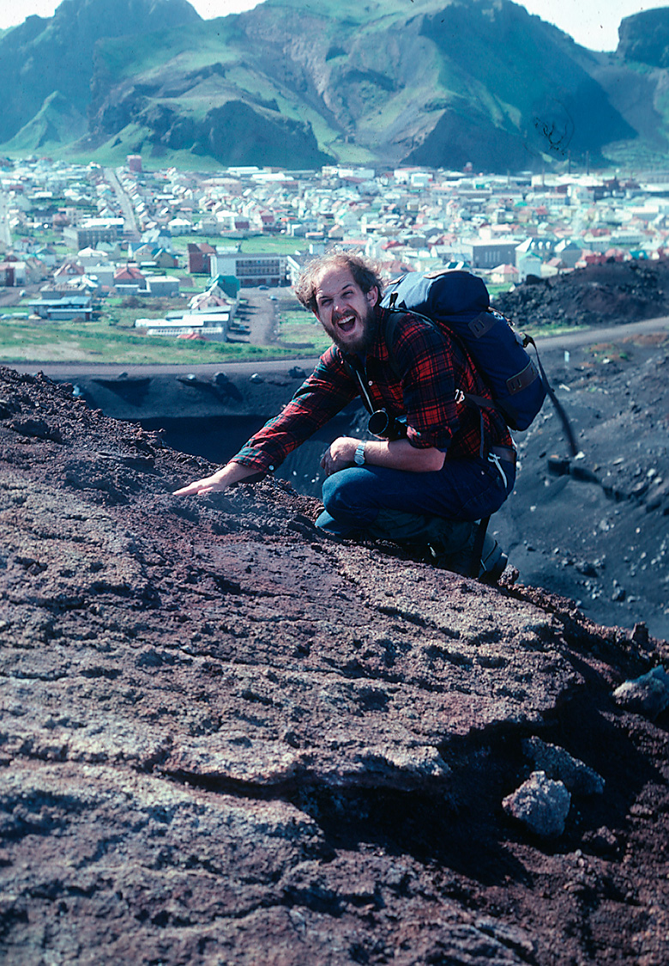
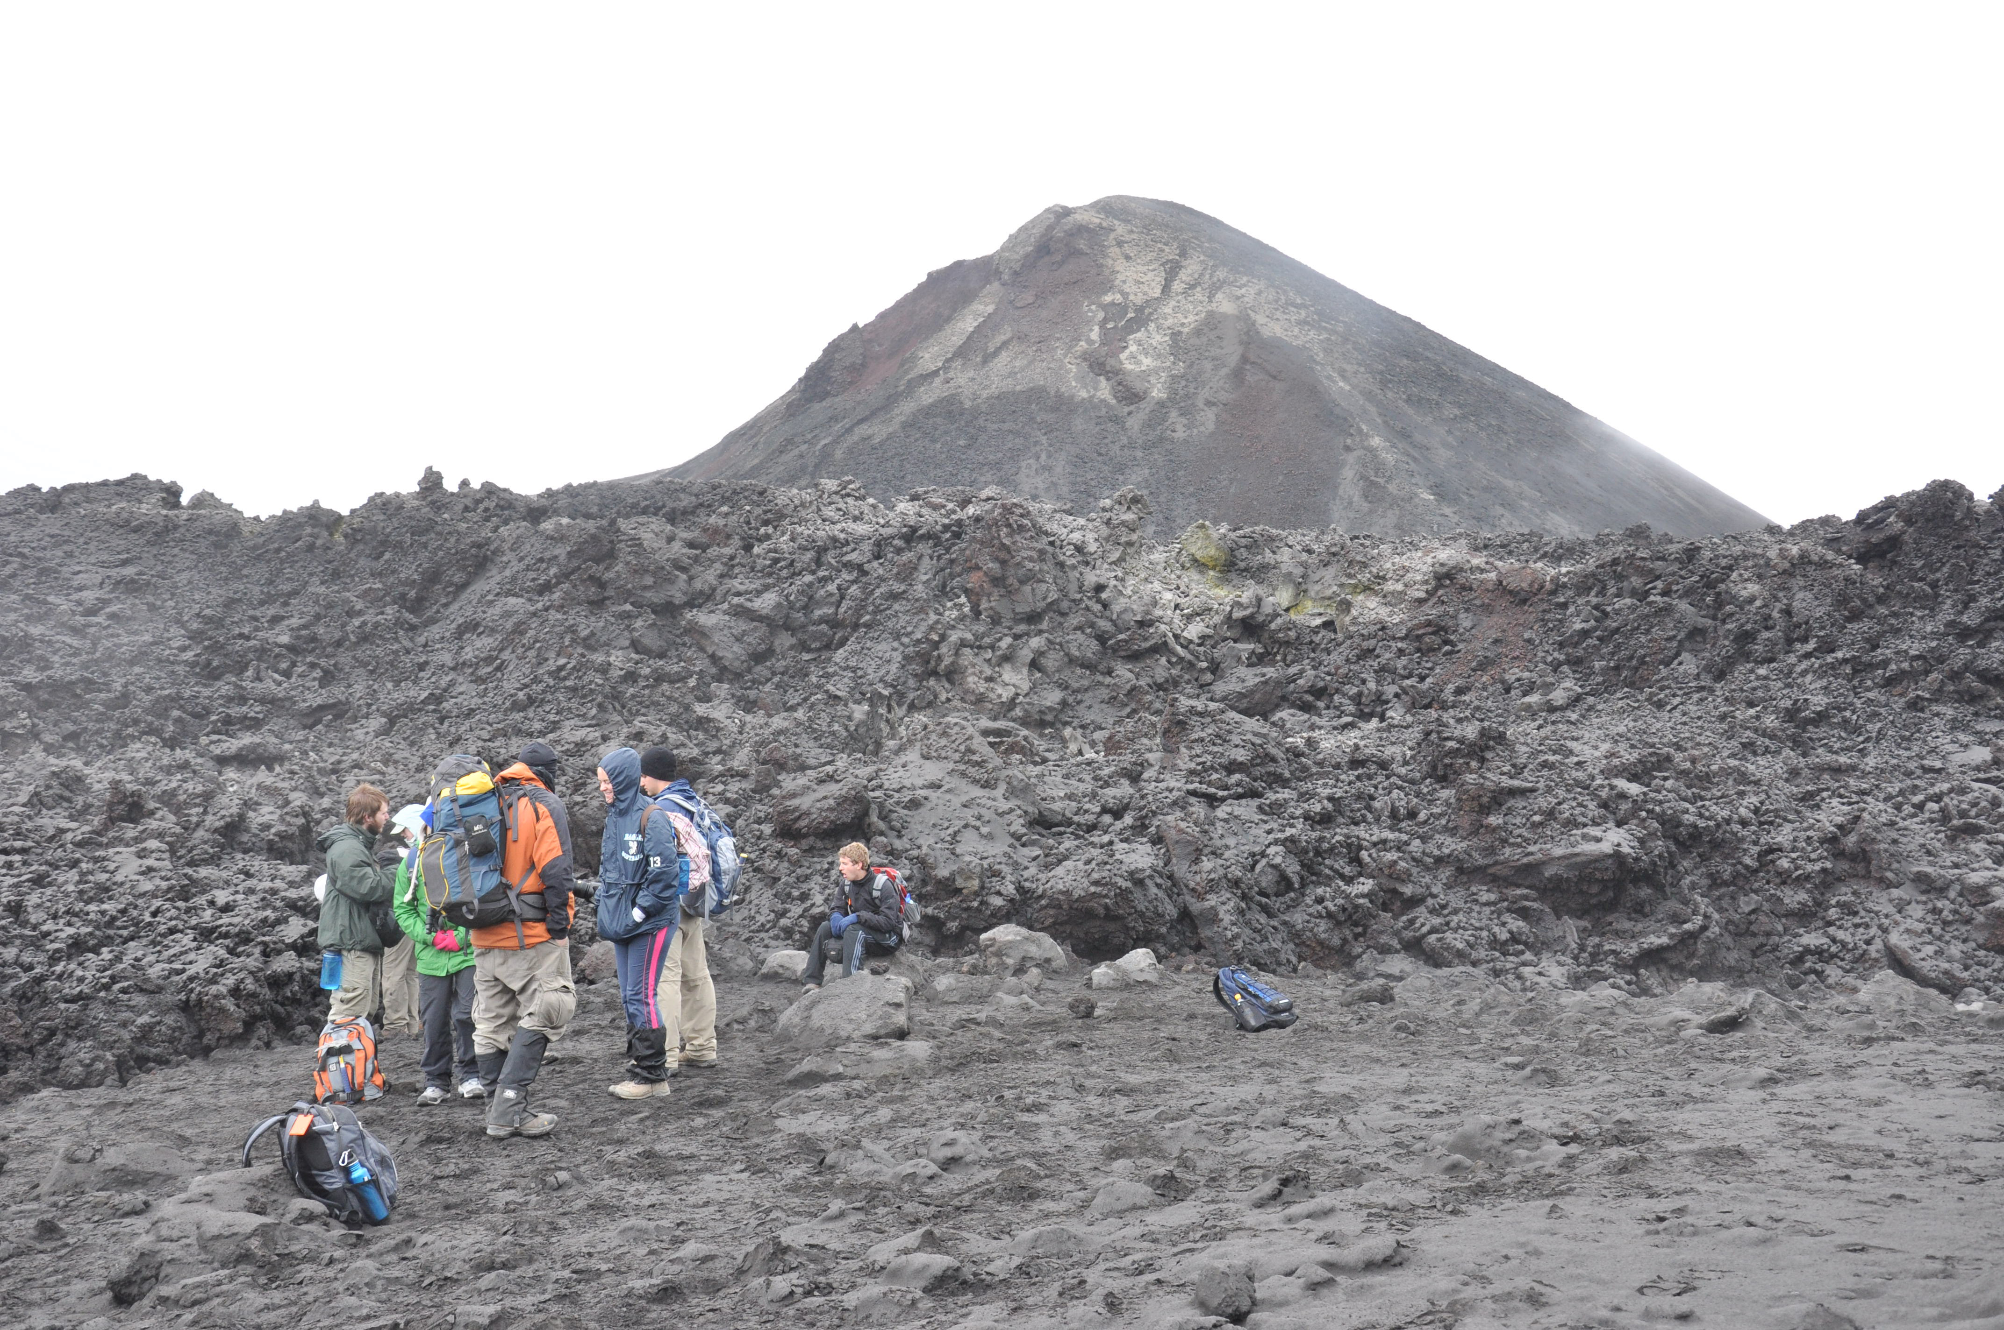
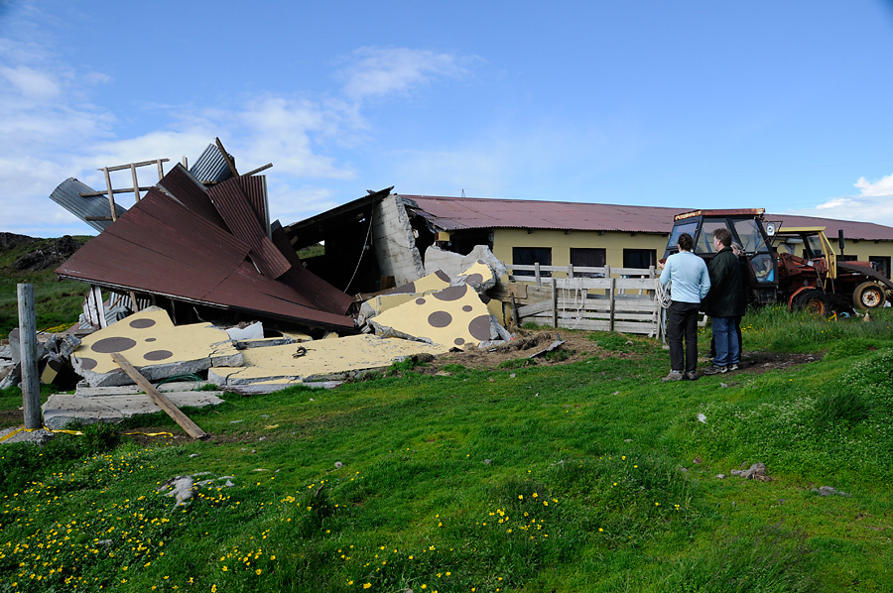
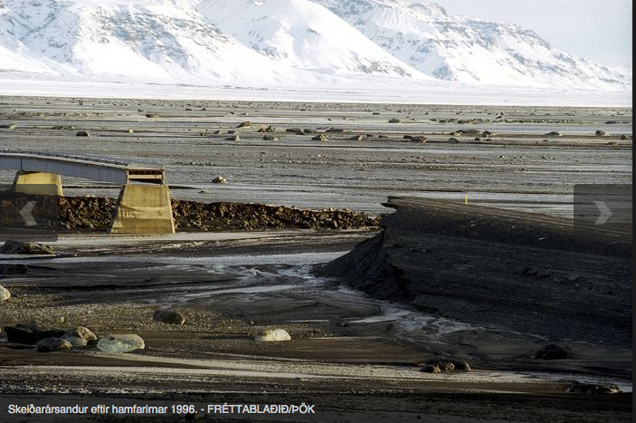
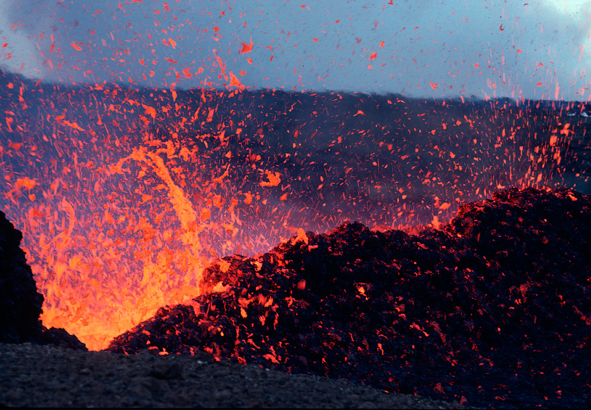
7 field courses 1980-2015
Notes:
Taught 7 field courses since 1980 – benefited from “real-time volcanic activity and interactions. Shortly after Heimaey eruption – ground too hot to touch, Krafla (subaerial, volcano-tectonic event, changes in the hydrothermal regime in N Iceland), Grismvotn aftermath (subglacial), SISZ earthquake 2008 aftermath, Eyjafjallajokull, aftermath (subaerial, subglacial, and glacier burst); Fortunate enough to hike into actual event or the aftermath; And it’s accessible, for the most part.An extraordinary place to take students.

Slide 4
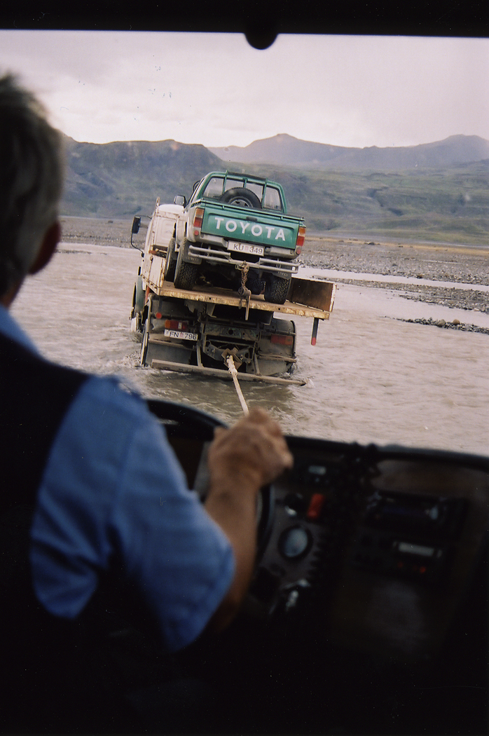
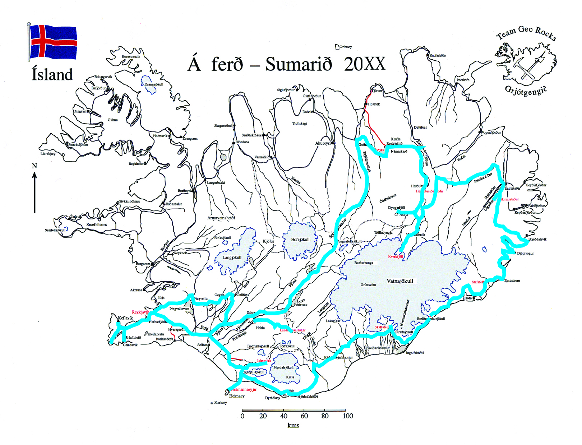
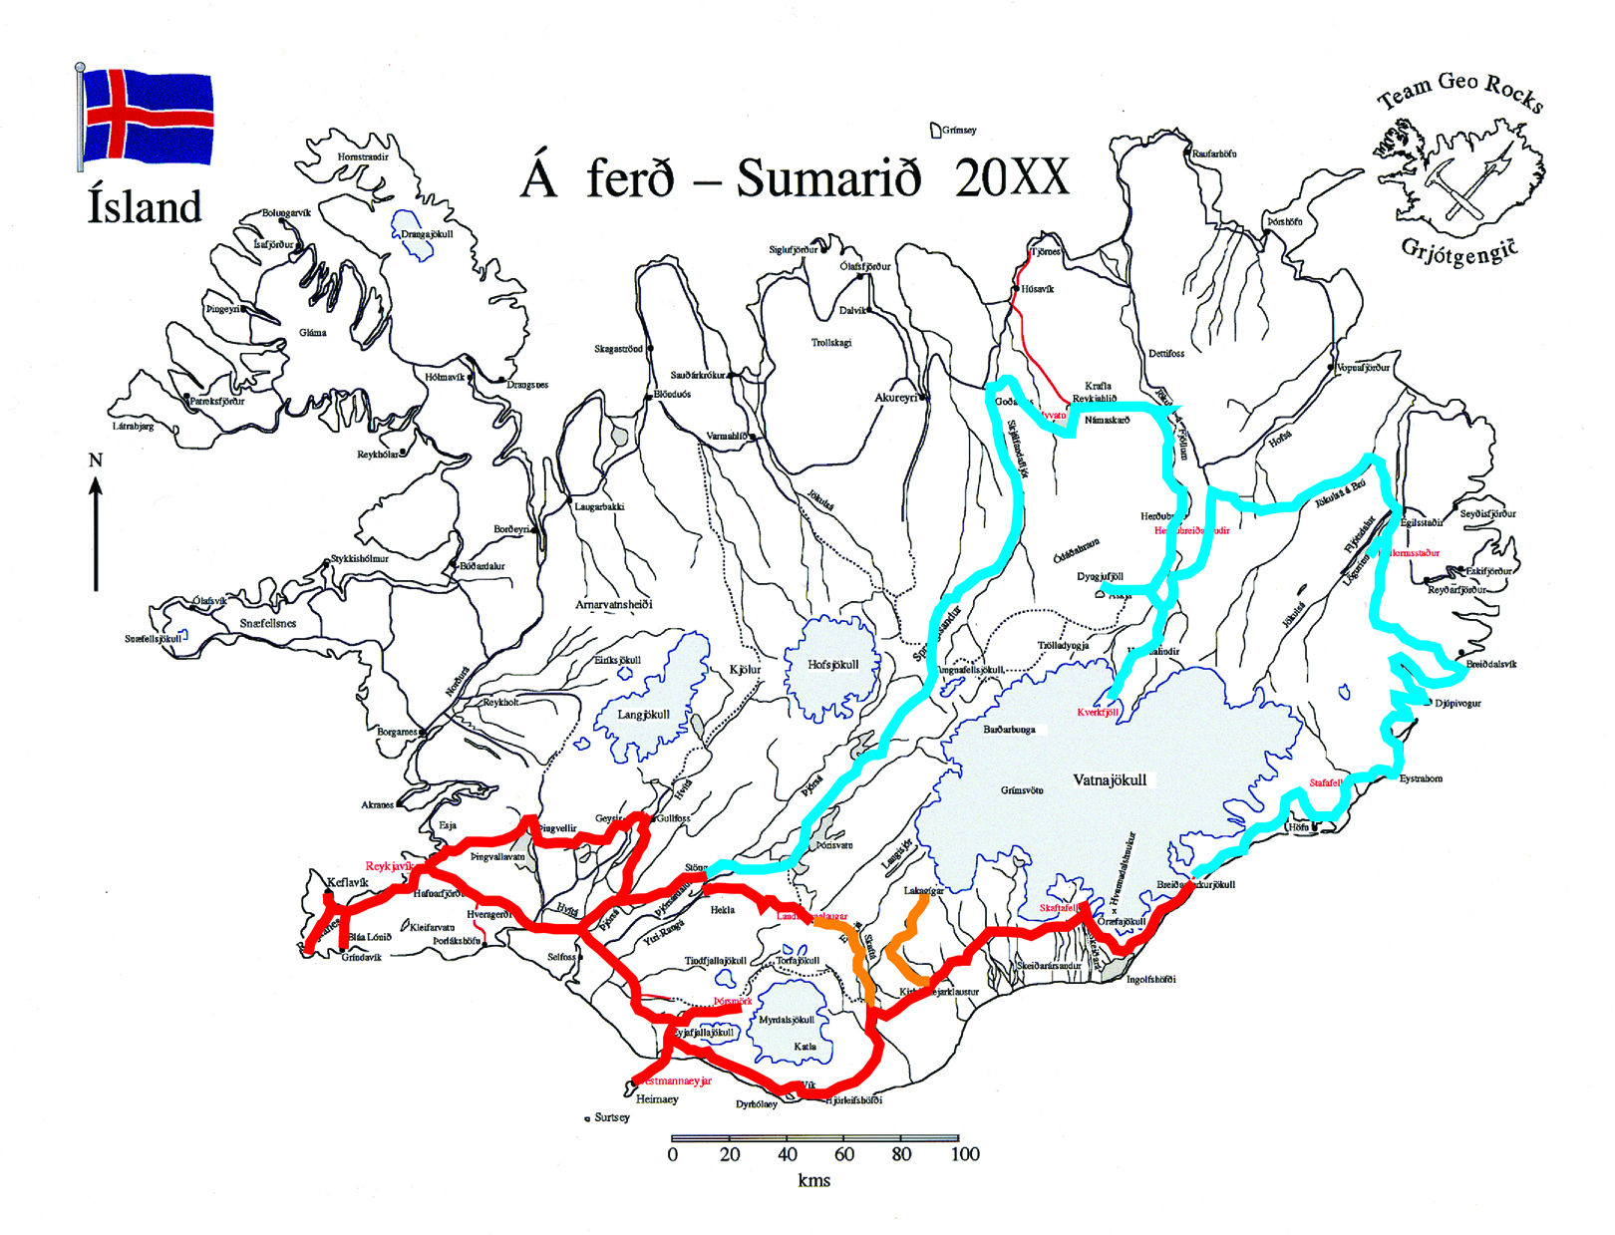
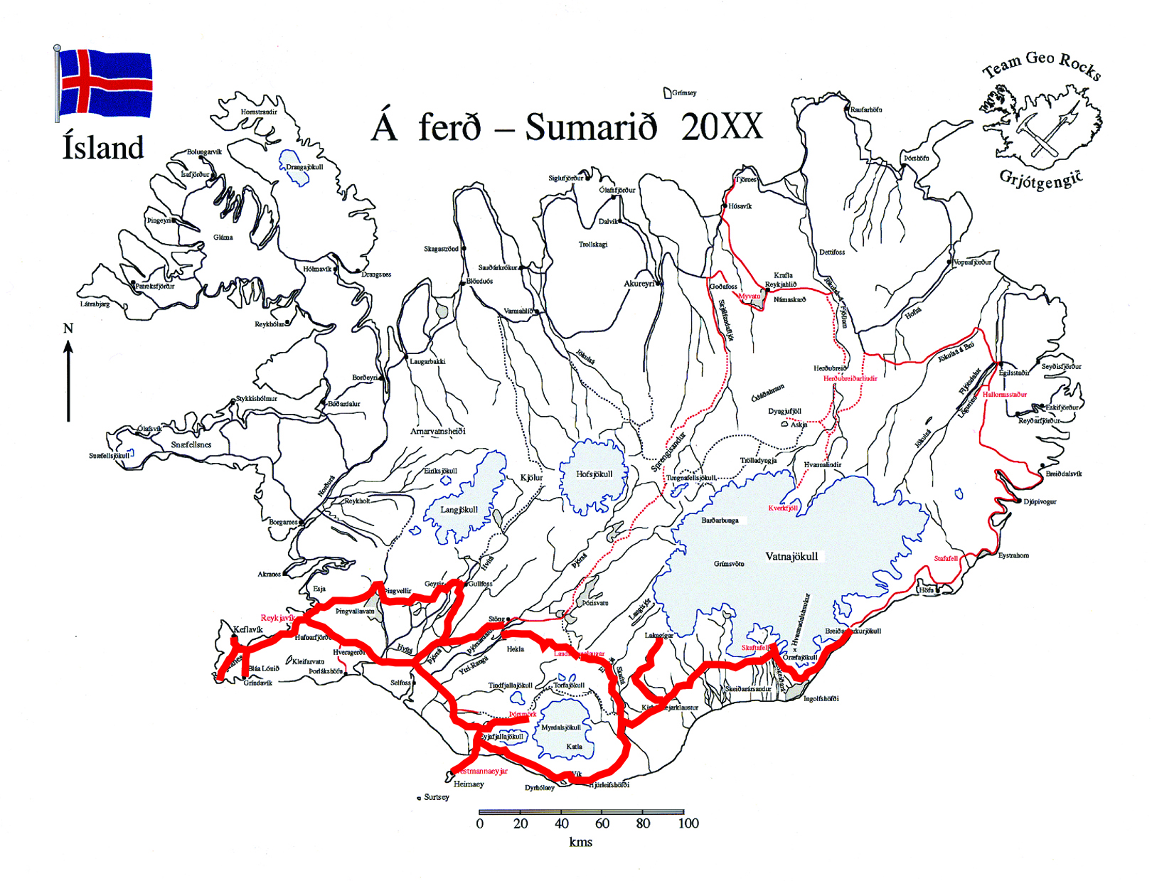
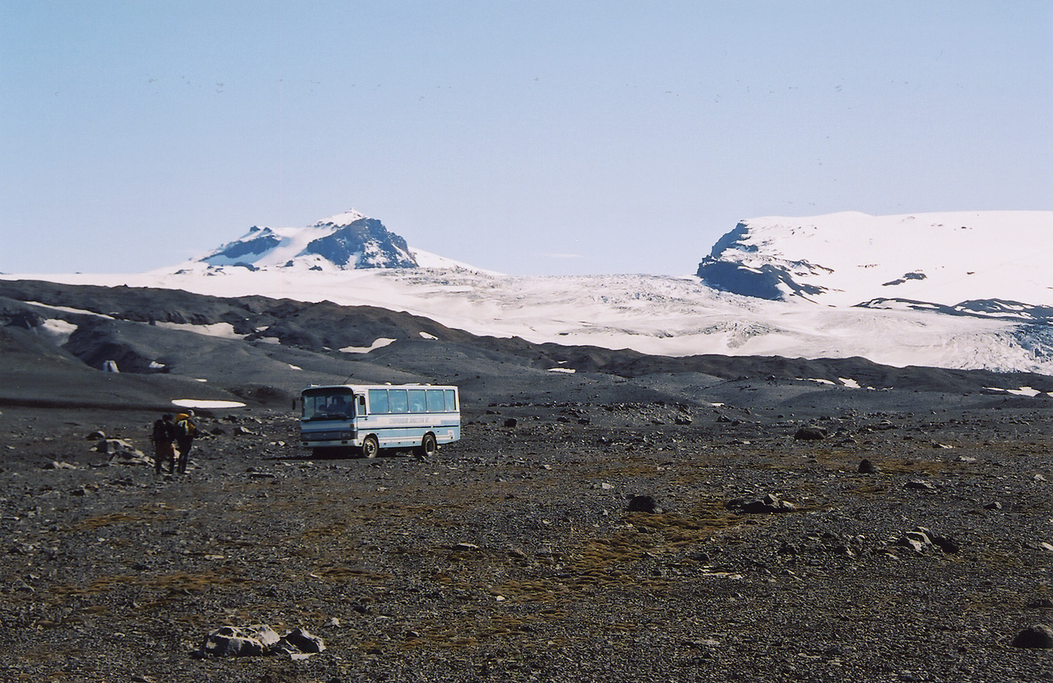
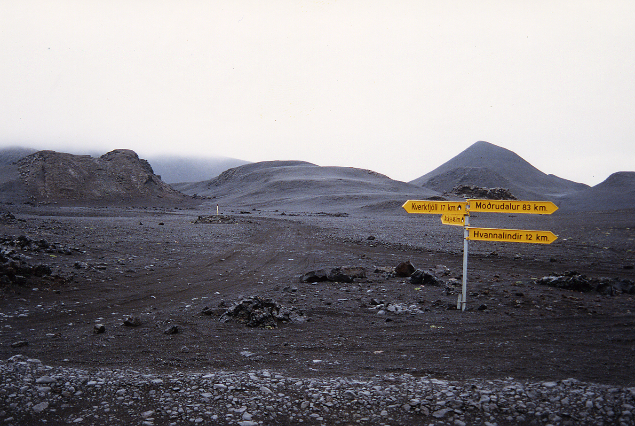
Itineraries
2-week ($3K) vs. 3-week ($4K) incl. air
Notes:
Tours we’ve done – 2 vs 3 weeks, routes with map; routees requiring back-country access; need skilled drivers

Slide 5
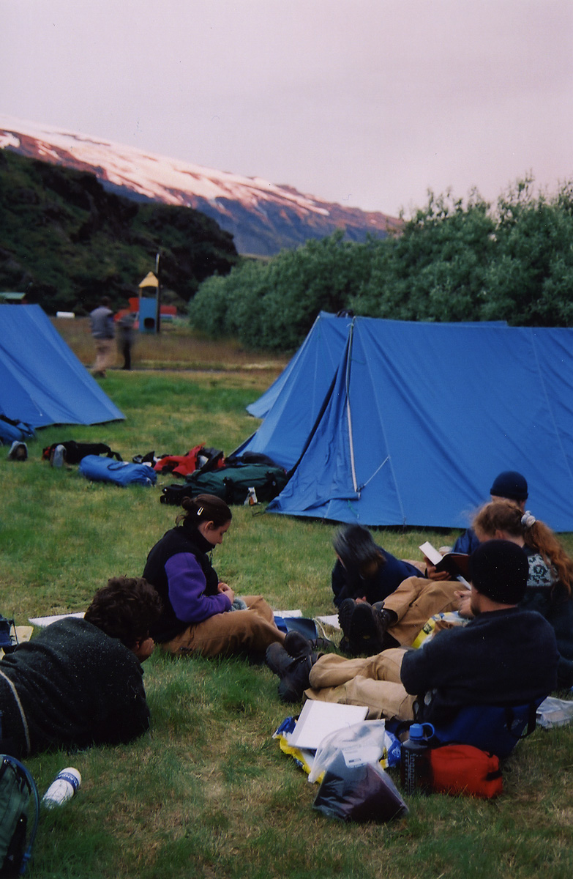
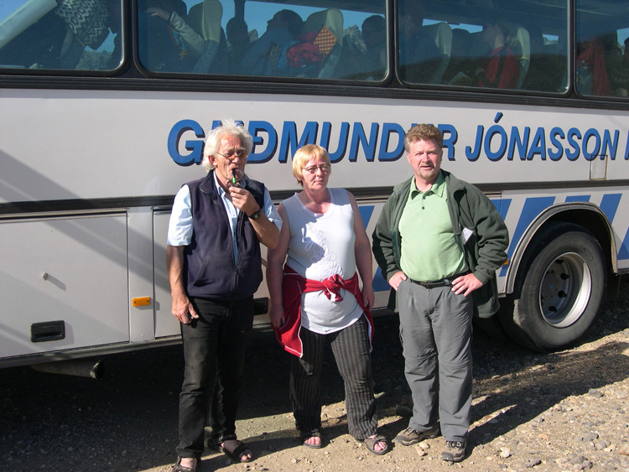
Logistics
Part camping (1/2 to 2/3), part hostel and day trips (Reykjanes & Heimaey)
Notes:
Logistics and costs: ½ camping tour, ½ Youth hostel; 2/3 camping tour, 1/3 Youth hostel (roughly $2 K vs. $3K); hire an outfitter (river crossings are dangerous; Provide adequate tents; Iceland weather is bad enough that it’s nice not to have to deal with logistics; guides are really knowledgable – you providde the geology, they provide all kinds of other insights)

Slide 6
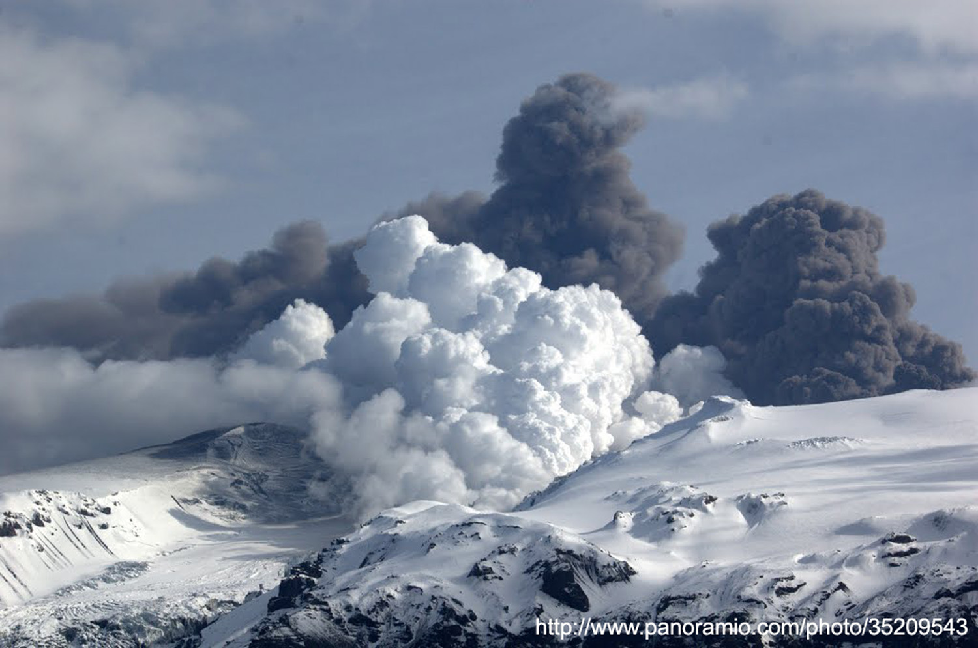
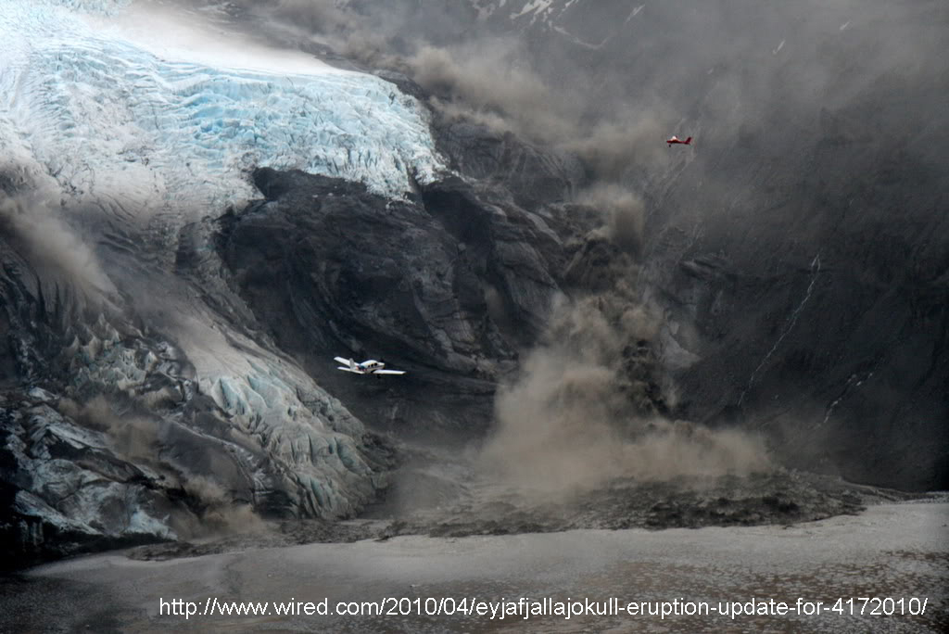
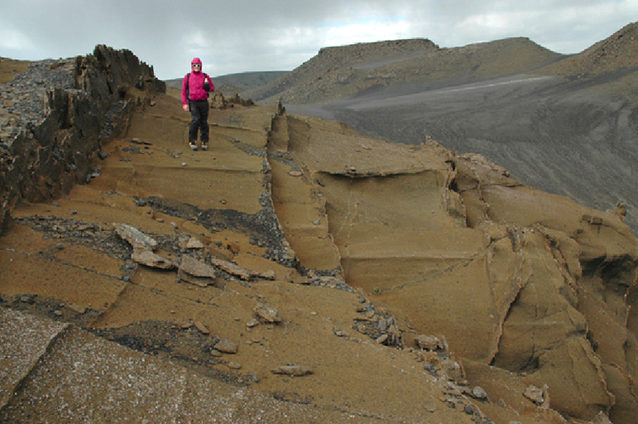
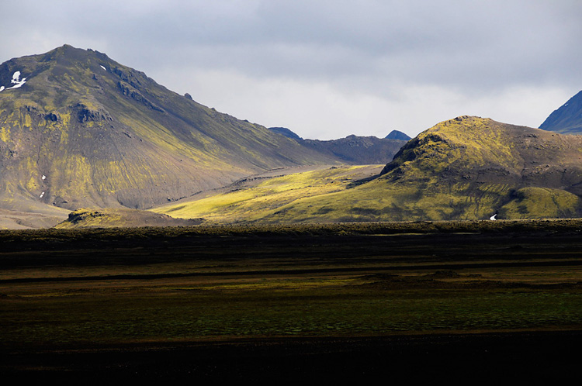
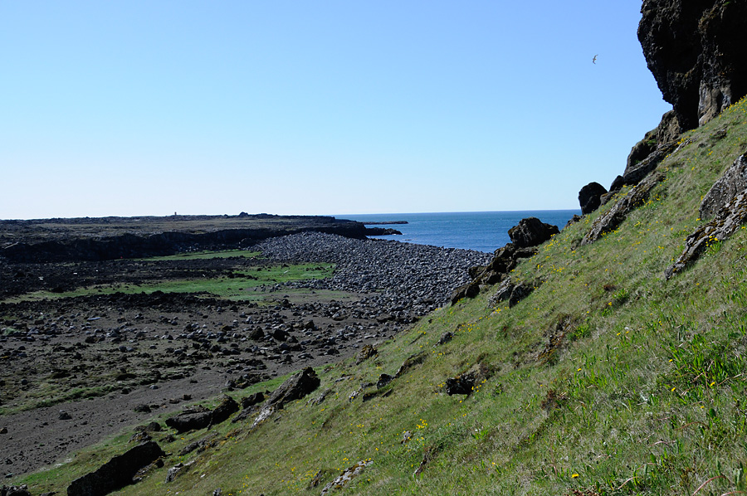
Student work focuses on interactions
Notes:
Iceland is a land of extraordinary geological interactions – while it’s possible to go to many places elsewhere in the world to see interactions among volcanic and hydrologic processes or glacial and sedimentologic processes, Iceland is nearly unique in having interactions among all three. The photo of the Eyjafjallajokull eruption (not mine!) shows these interactions in real time. The water melted generates glacier bursts and unique sediment deposits. The lave/water interactions produce explosive eruptions and generate subglacial deposits or unique character that characterize much of the Icelandic landscape. And all, of course, is in the context of an active plate boundary.

Slide 7
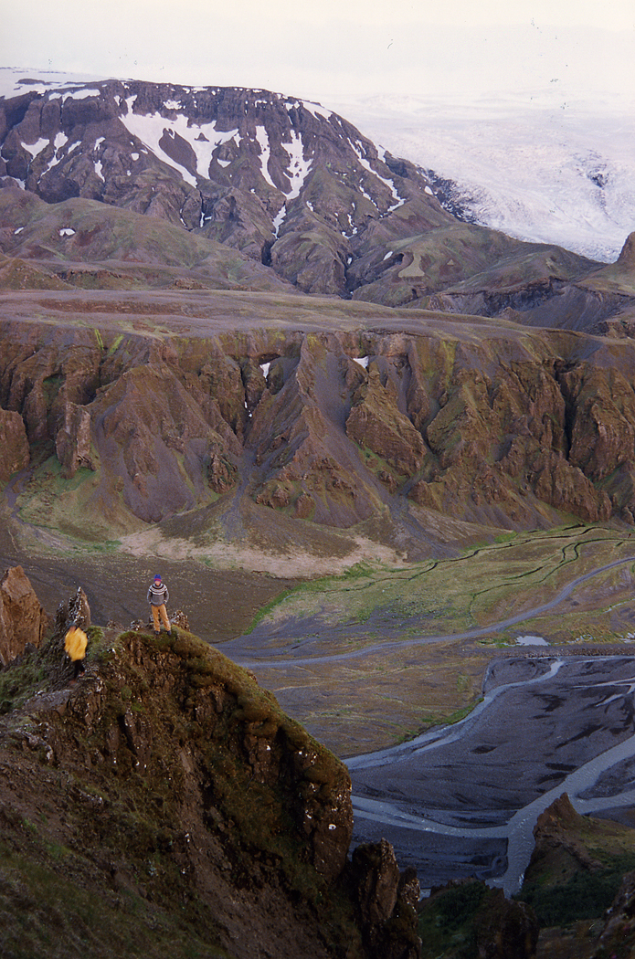
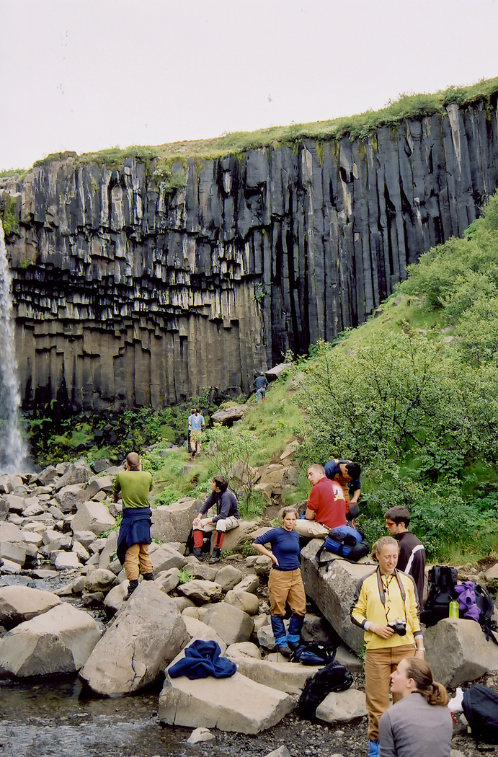
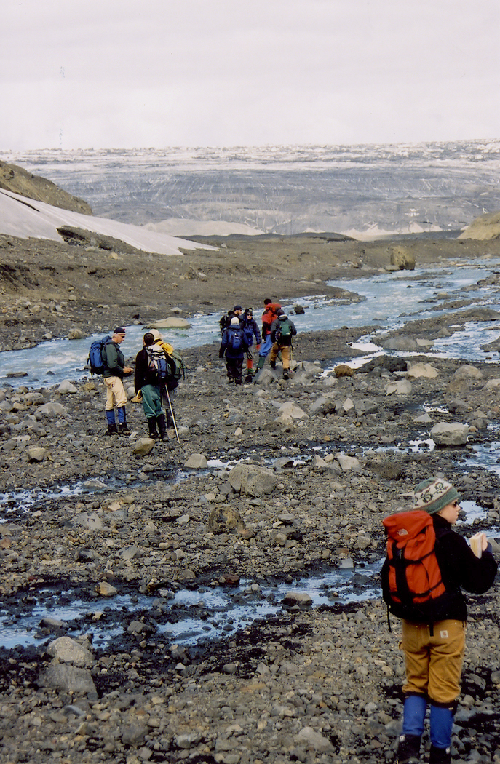
Student work focuses on interactions
Each student has a specialty for duration of field course:
  volcanologist
  hydrogeologist/sedimentologist
  glaciologist

Slide 8
Student work focuses on interactions
Assignment at each field location
  Study area from viewpoint of specialty, working on assigned problem with that viewpoint in mind.
  Work with people from the other two specialties; determine how the processes of your specialty interact with theirs.
  Serve as an expert in your specialty

Slide 9
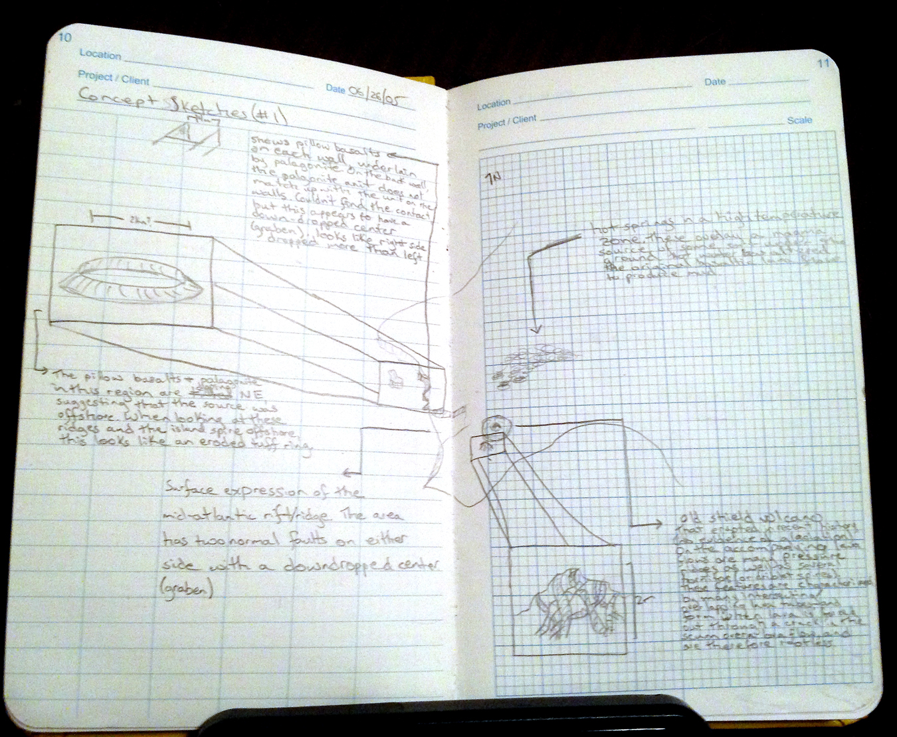
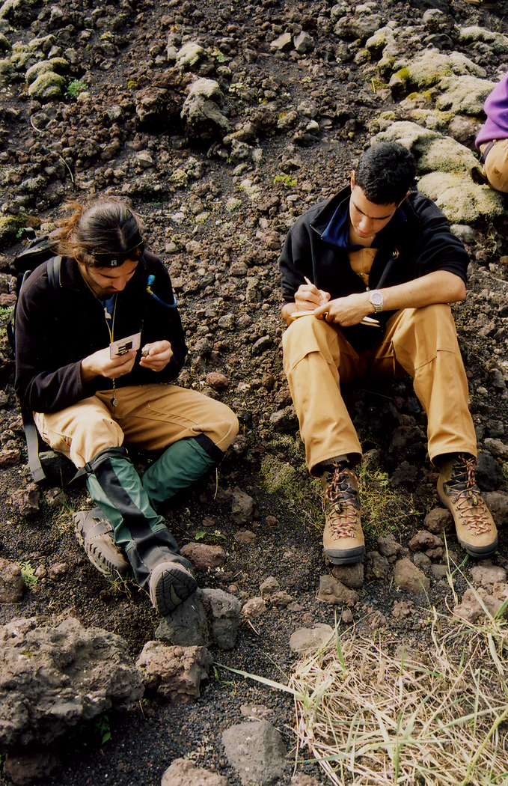
Notes as concept sketches
Paint a picture of interactions; different specialties different; long-term value
Notes:
Concept sketch approach to taking notes; value of the notes for the future; informal presentations in the field.

Slide 10
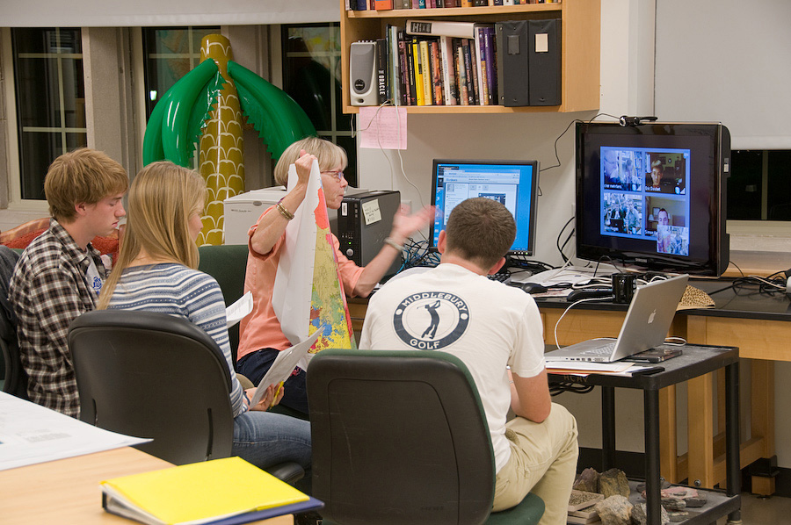
Pre-trip semester seminar
Seminar prepares students for specialties
This year will be virtual with Mt. Royal Univ.
Notes:
To prepare for specialties. Spring semester seminar: worth half the credit; value is getting students well-prepared; meets once a week, this year with Calgary students as an virtual seminar; tie to poster on Weds; opportunity for bag drag

Slide 11
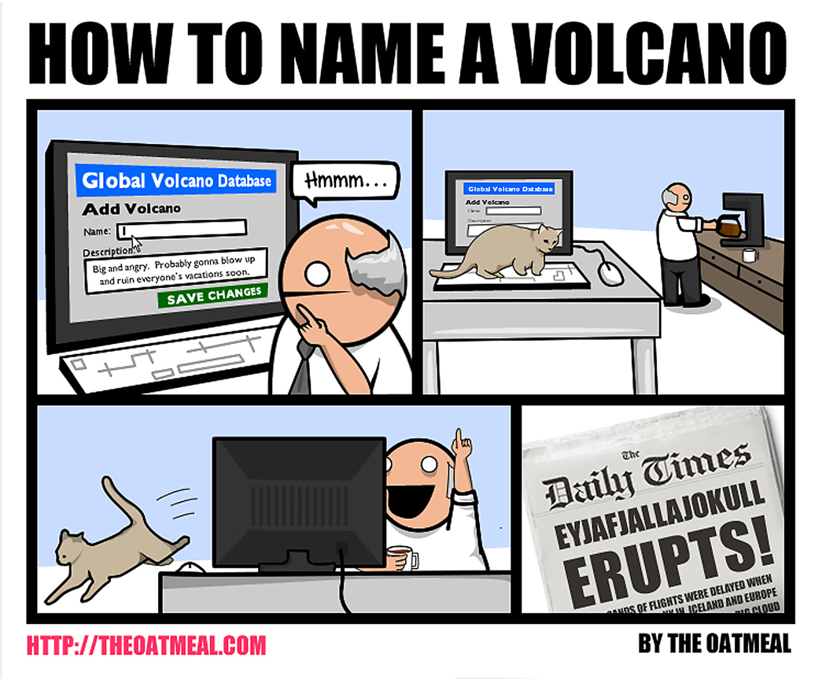
Scope of the seminar
Geology, of course (only intro geo as prerequisites,so wide prior experience in geo)
A bit on language (focus on pronunciation meanings of place names) and history
At least one of the sagas (Njál’s Saga typically)
This year, working with Philosophy students as well
Notes:
To prepare for specialties. Spring semester seminar: worth half the credit; value is getting students well-prepared; meets once a week, this year with Calgary students as an virtual seminar; tie to poster on Weds; opportunity for bag drag

Slide 12
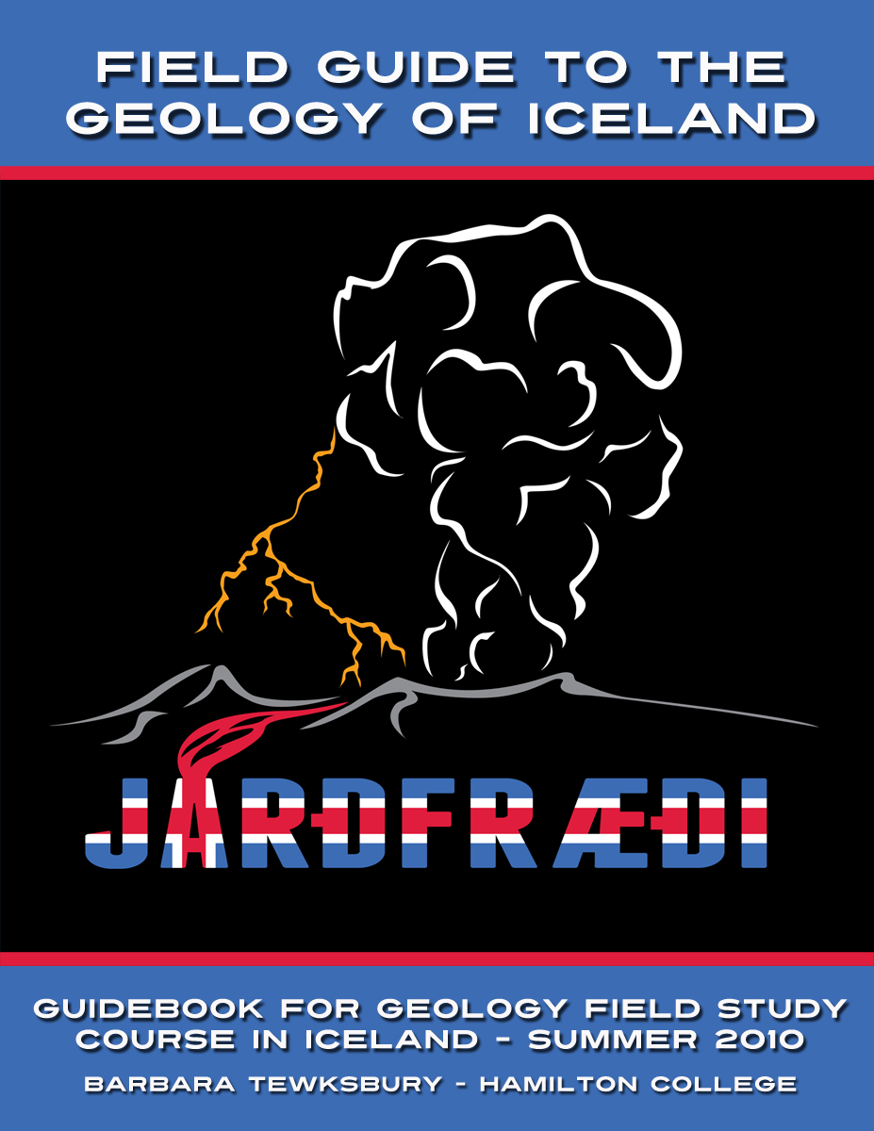
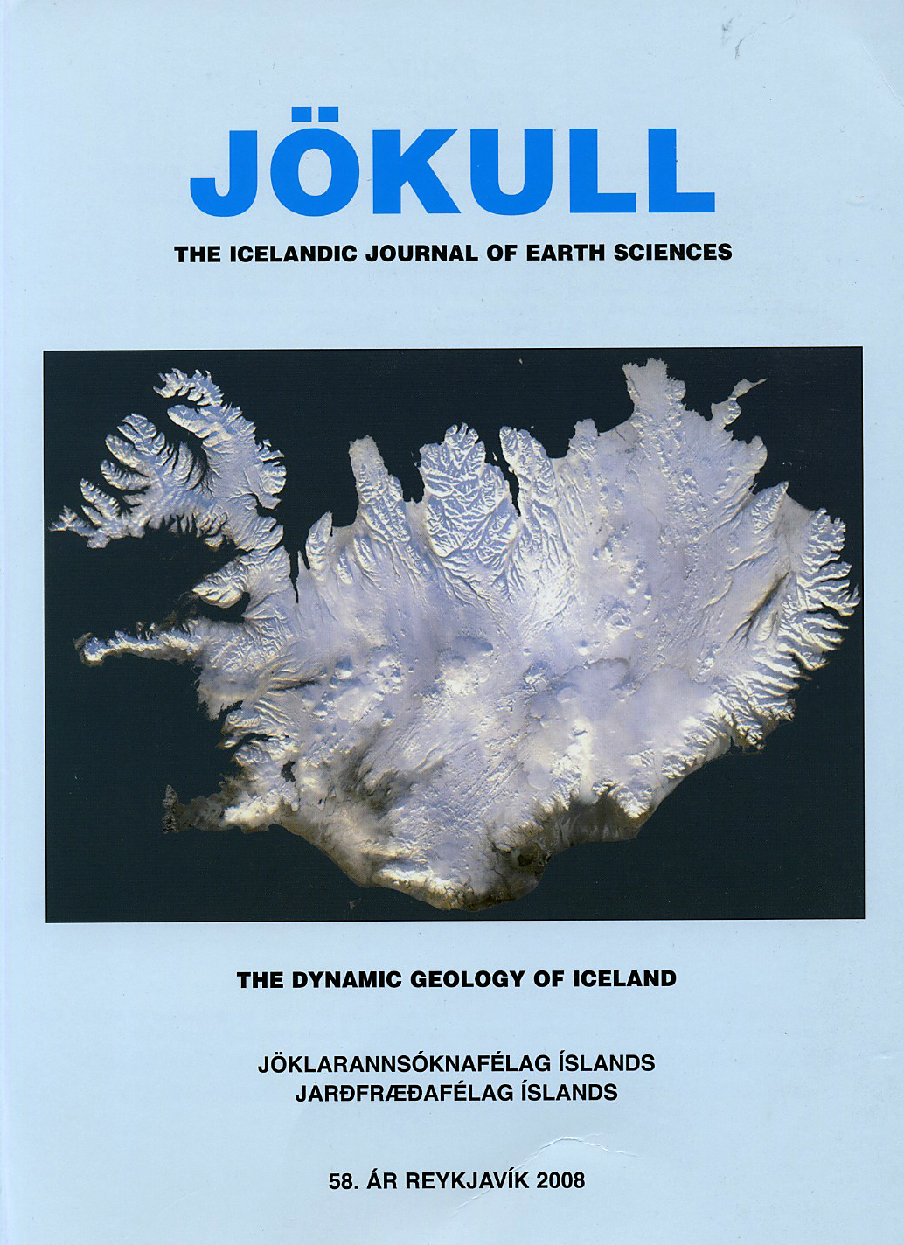
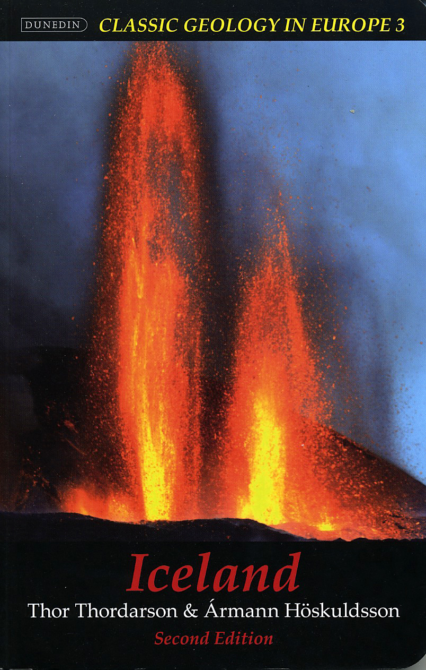
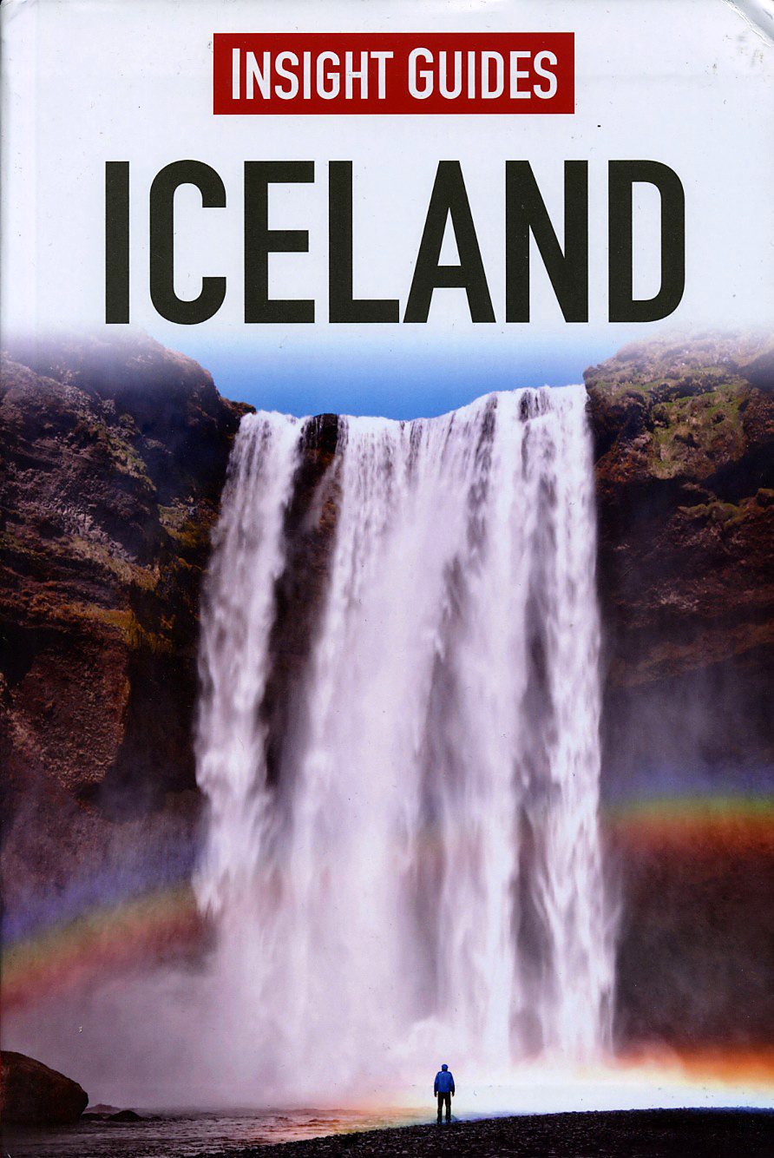
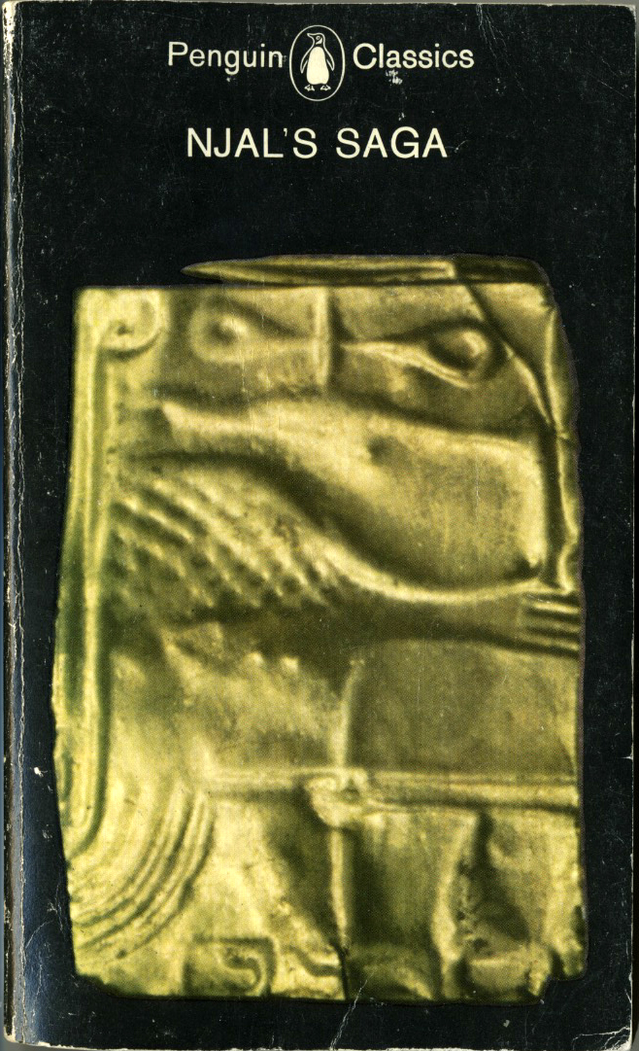
Resources
Notes:
Resources that we use: the books, field guide; have a handout to go with these; maybe include a map with Jonasson’s web site plus approx costs?
Need a scan of sagas

Slide 13
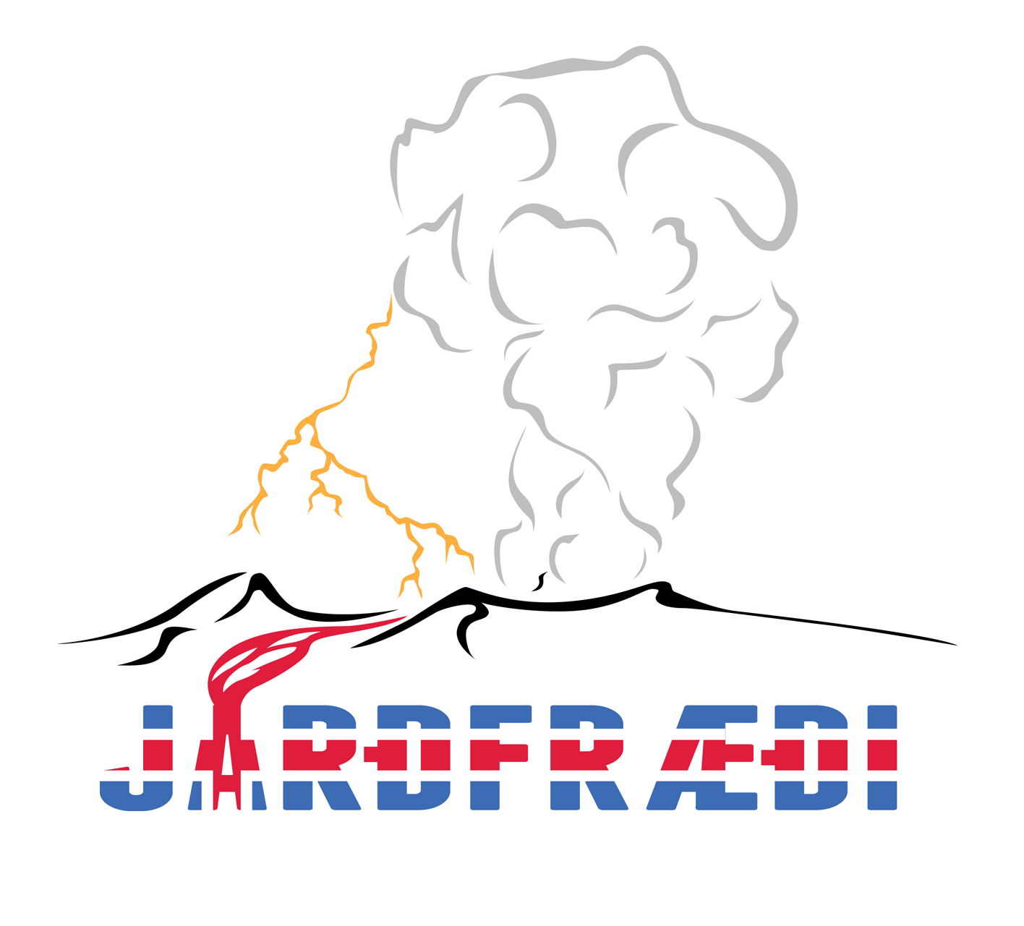
Risk and preparedness
Our risk & emergency procedures docs are available – btewksbu@hamilton.edu
Notes:
Risk docs and emergency procedures; Iceland is a comparatively safe place – standard field risks with none of the disease, crime, political unrest, dangerous animals and insects, etc. But risk docs and emergency procedures are critical. Provide links to Egypt risk docs. Will replace with Iceland docs about mid-year. Include my contact information on the slide.

