Slide 1
The Chiwaukum Structural Low (CSL) & the tectonic history of the Central Cascade Range
Nicholas W. Hayman, UTIG, Austin TX
Based on work with Eric Cheney published in 2008 GSA Bulletin

Slide 2
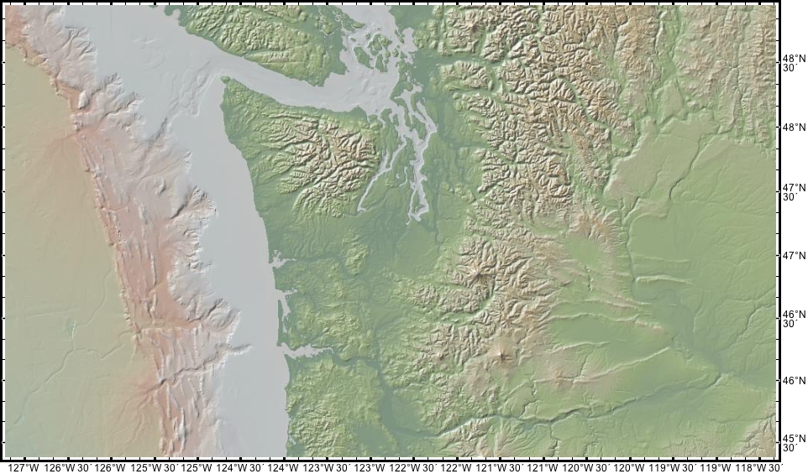
From geomapapp

Slide 3
8-12 Ma U-Th/He dates
(Reiners et al., 2002)
CSL
deformed ~15-16 Ma CRBGs
But remember, topography is young

Slide 4
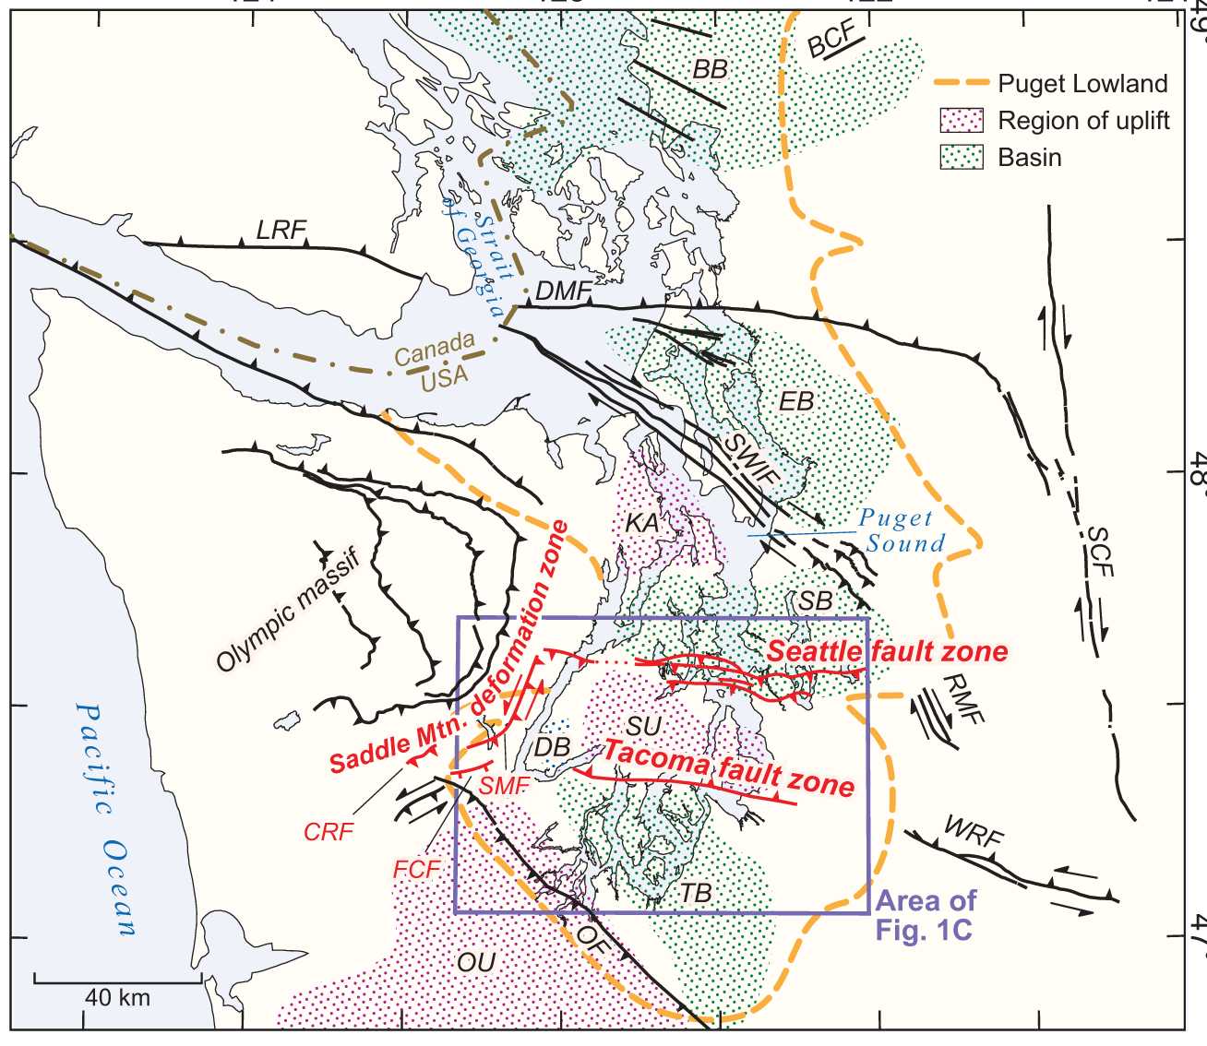
Why is the Chiwaukum Structural Low (CSL) important?
Provides a window beneath CRBG, occasionally a target of hydrocarbon exploration (good reservoir, poor source), & potential CO₂ sequestration site (good seal (reactive)).
Quaternary scarps, including those in the Seattle area, formed on faults that are potentially linked with faults in the CSL region.
Seattle fault
(reverse fault)
From Nelson et al., 2014

Slide 5
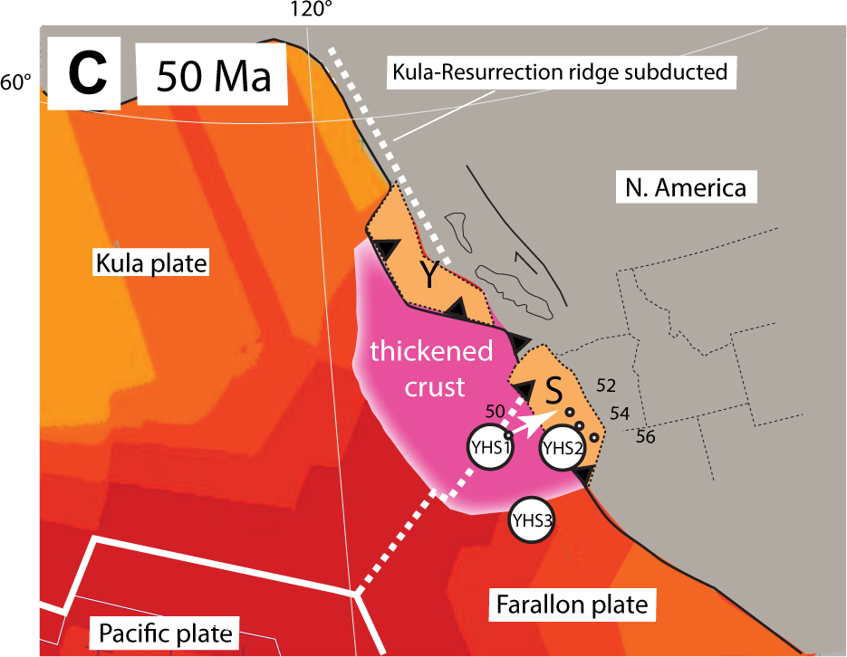
Wells et al., 2014: Siletzia (S) impinged on the margin ~50 Ma (see also work by Laura Wallace on indentors), potentially accreted by a subducting ridge (e.g. Umhoeffer, Miller, Bowring, Eddy, and others, this meeting). See Brandon Wednesday am, this meeting for alternative back-arc interpretation.

Slide 6
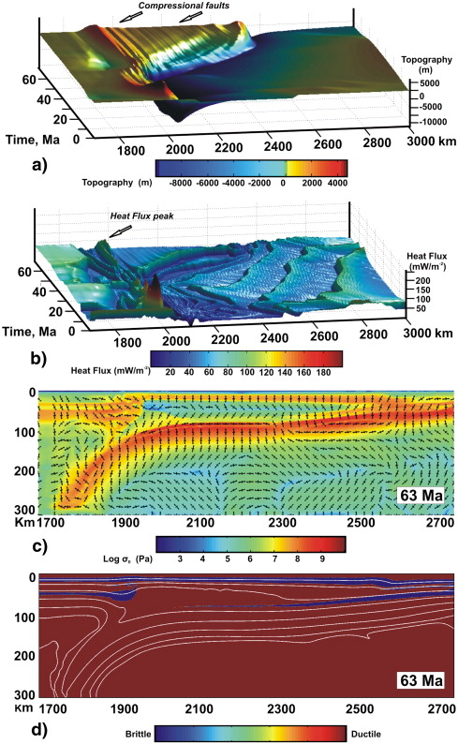
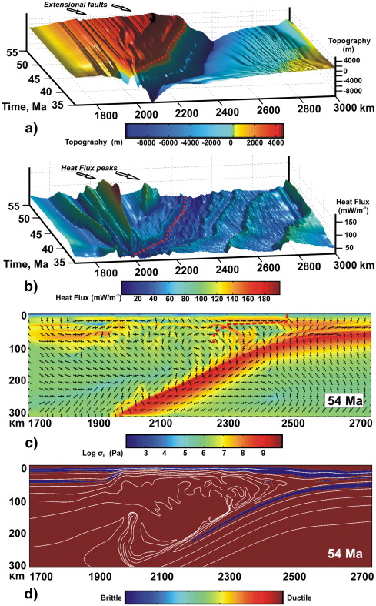
Geodynamics of Intra-Arc Deformation (Faccenda et al., 2009)
Compressional faulting across intra-arc region when base of crust is “coupled” (strong)
Extensional faulting across intra-arc region when base of crust is “decoupled” (weak)

Slide 7
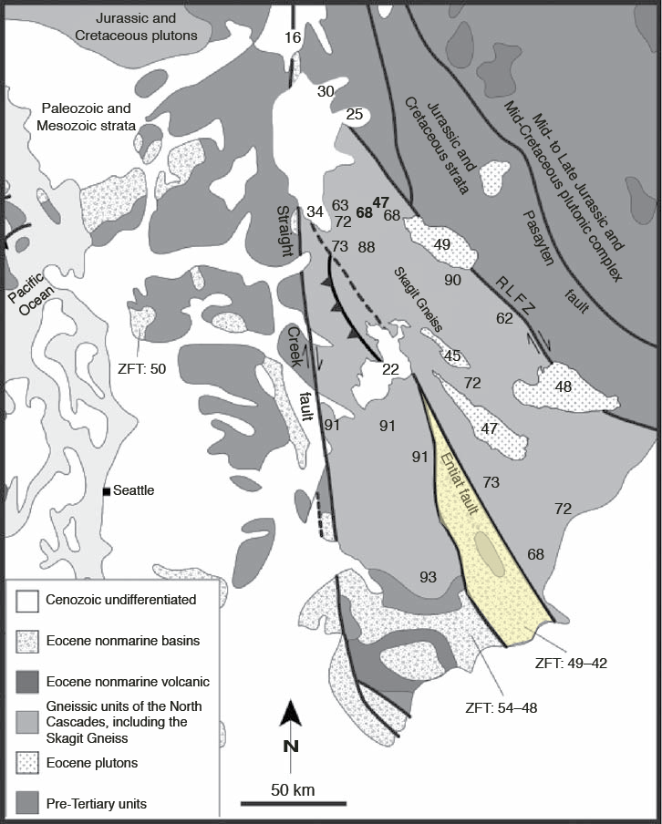
Zircon ages from leucosomes in basement are predominantly Late Cretaceous
Late plutons = early-mid-Eocene (47-49 Ma)
Chiwaukum “graben”
From Gordon et al. (2010)
Seattle
50 km scalebar

Slide 8
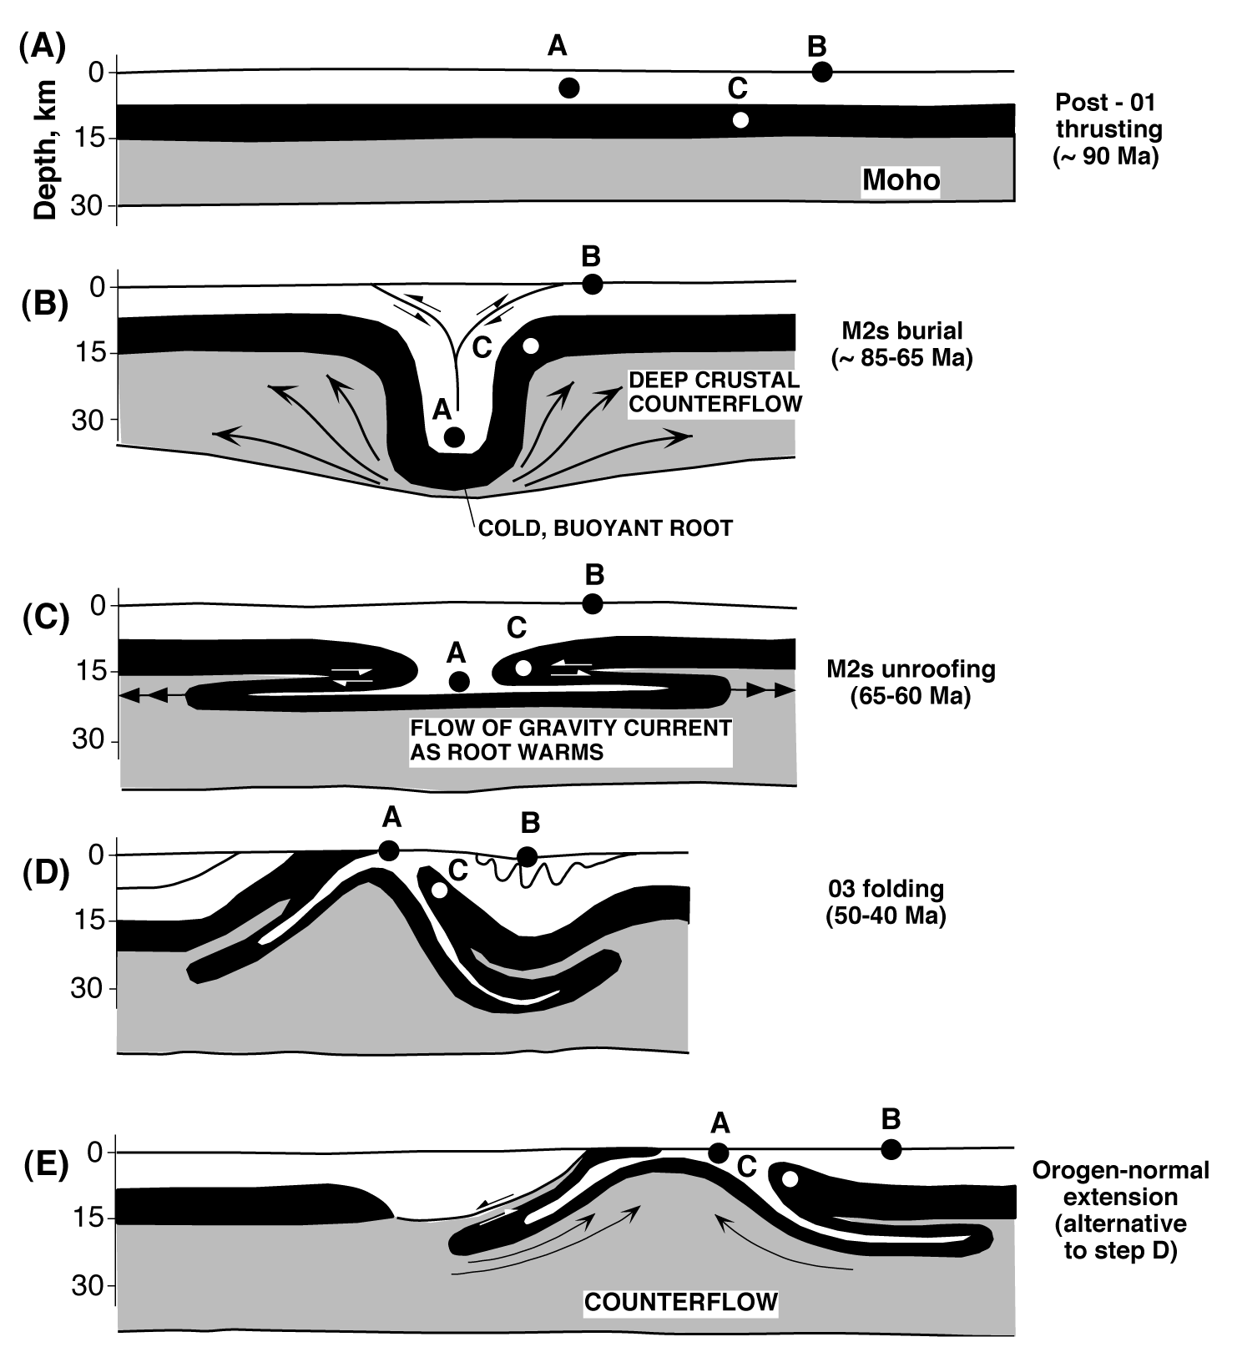
Alternative hypotheses for Skagit gneiss exhumation from Wernicke & Getty, 1997:
includes both shortening & extension as possibilities
All workers (e.g. building on early work of Miller & Bowring etc…) agree that region underwent shortening through the late Cretaceous & even early Tertiary

Slide 9
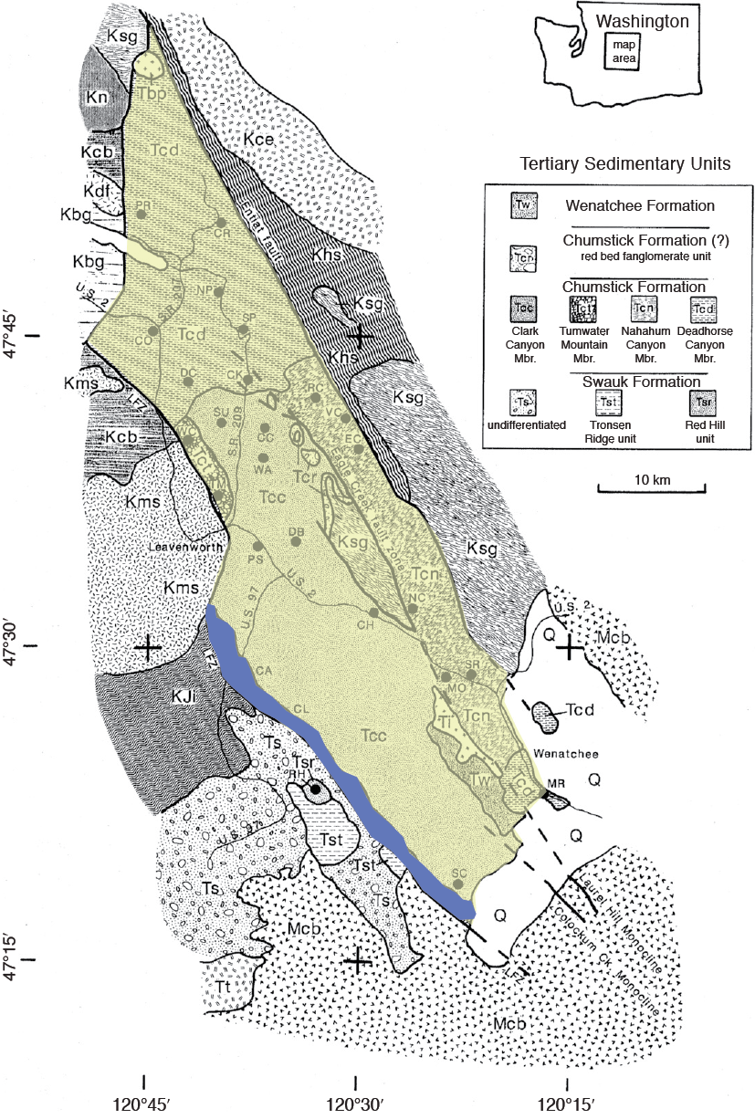
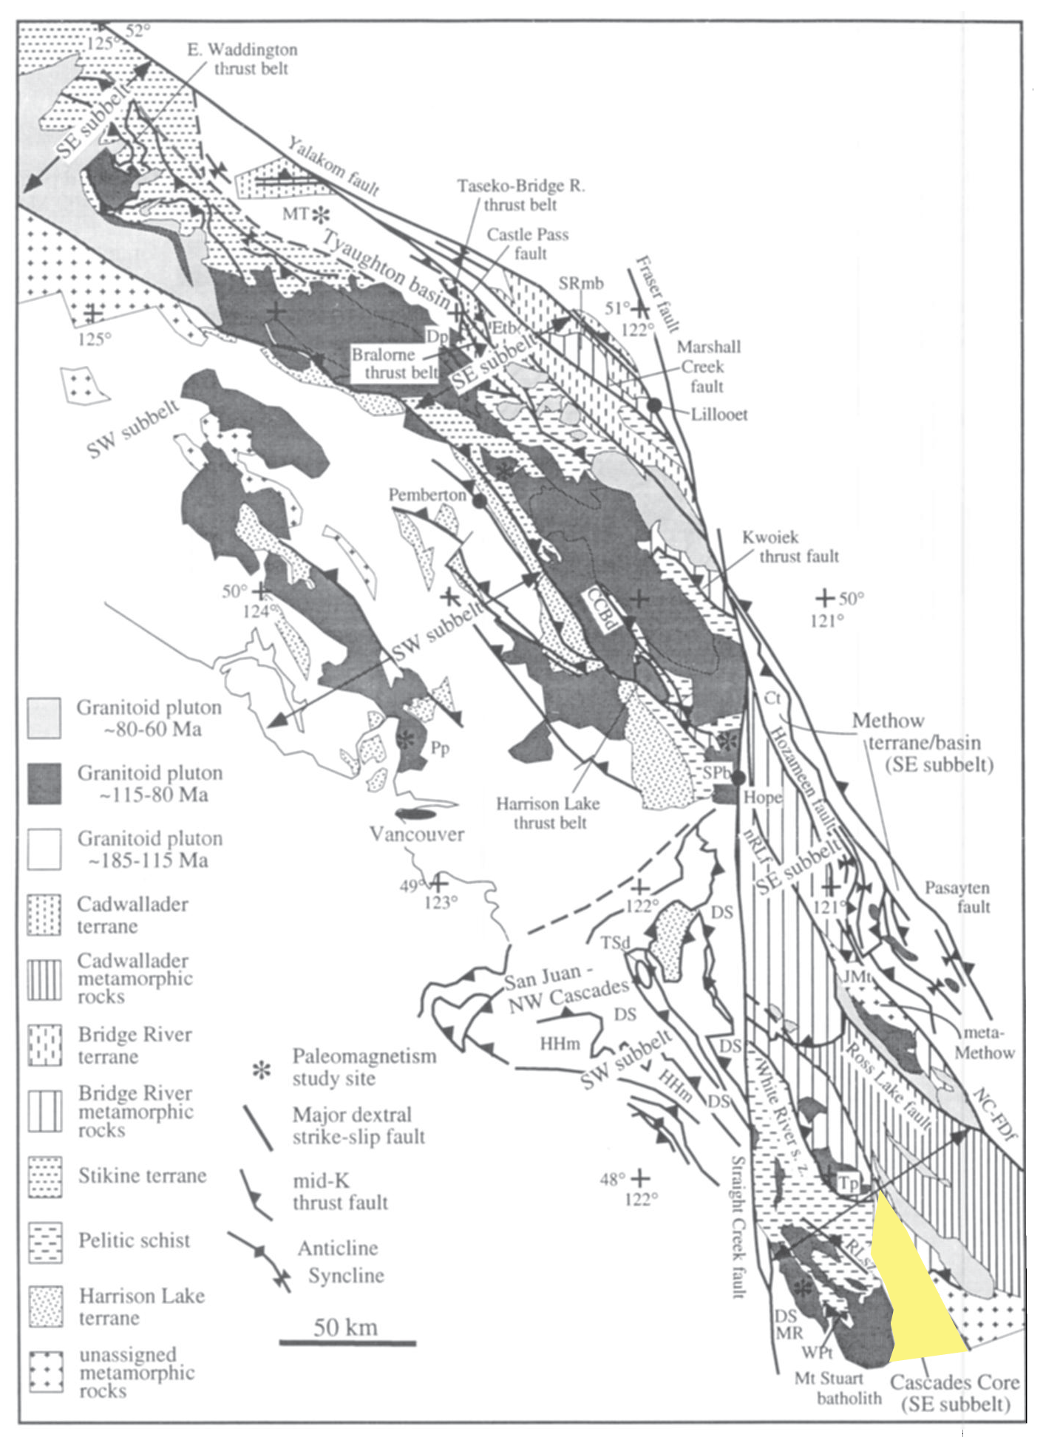
Transtensional basin from Umhoefer & Miller (1996) & Evans (1988) going all the way back (at least) to Sue Cashman (1974)
Predominantly plutonic
Predominantly metamorphic

Slide 10
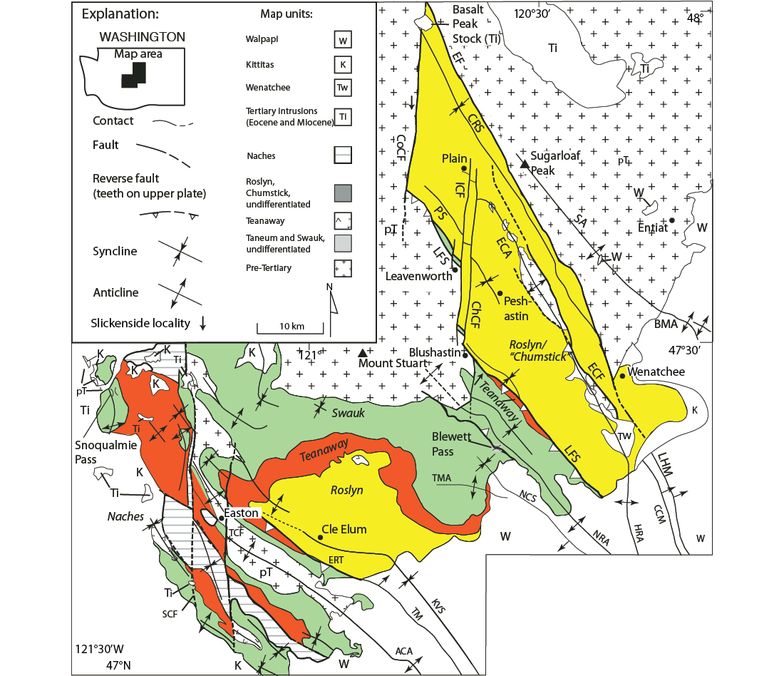
Chumstick
Teanaway volcanics & volcaniclastics
=
Roslyn
Map pattern can also be seen in Tabor’s maps

Slide 11
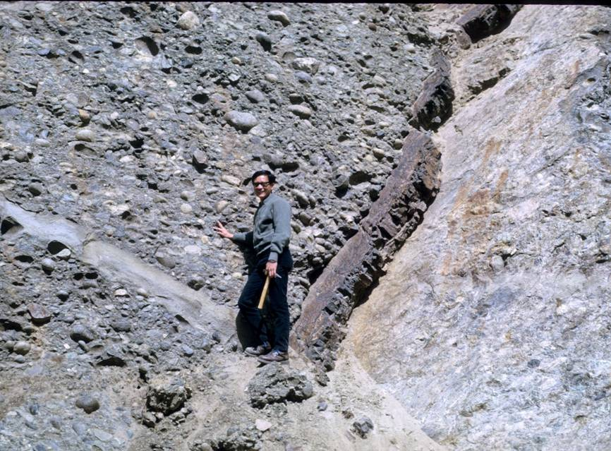
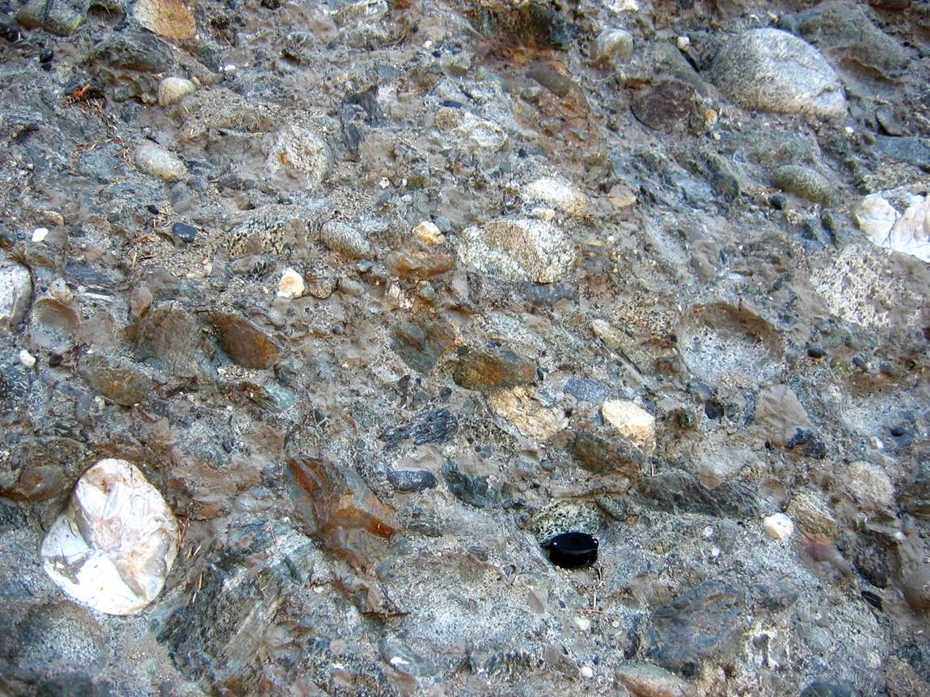
descriminants for
SWAUK FM.
Tsc
Magnet Creek
Teanaway dikelet
pre-Tertiary crystalline cobbles (local western provenance)

Slide 12
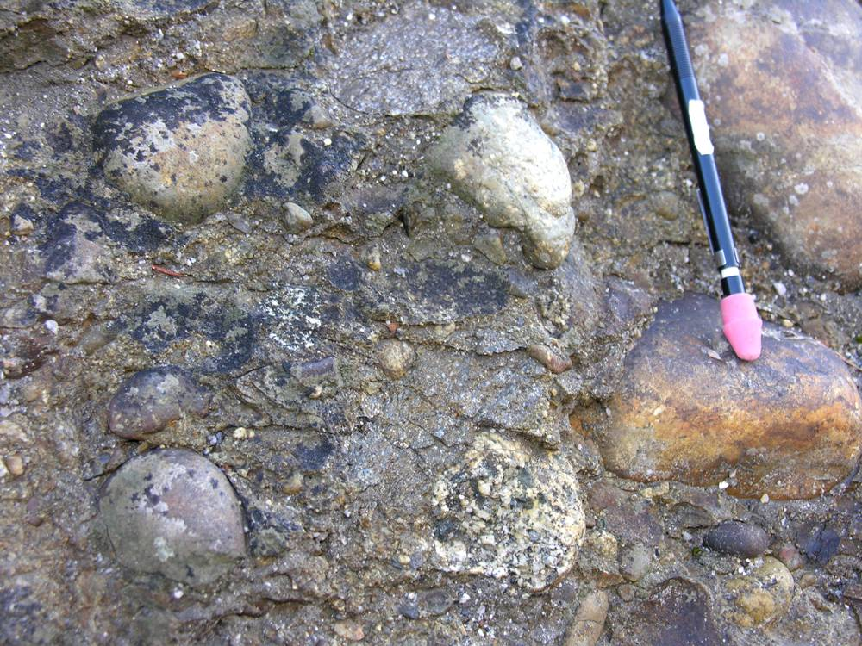
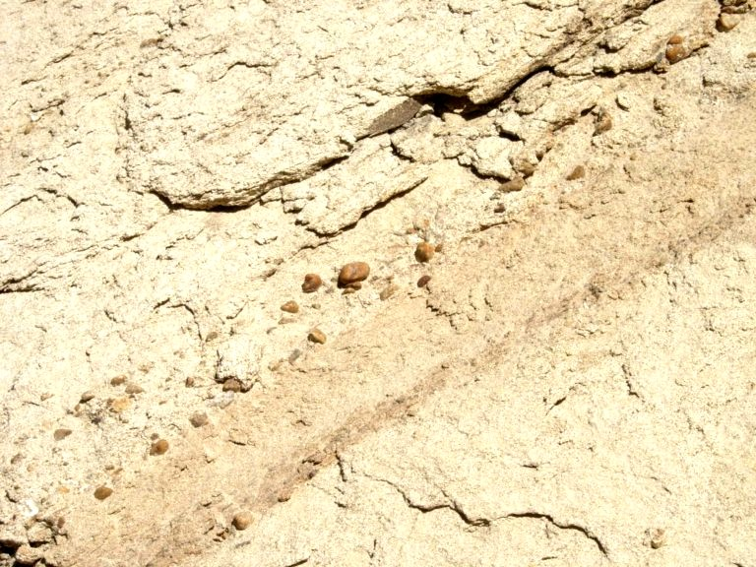
discriminants
“CHUMSTICK” FM.
3 cm
> 30 to 70% felsic clasts in conglomerates & lags Chumstick Creek
lags of pebbles in sandstones, Camasland

Slide 13
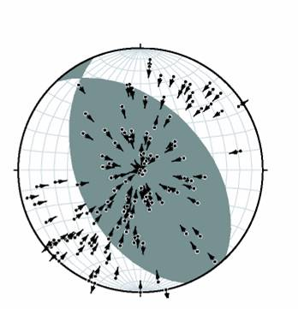
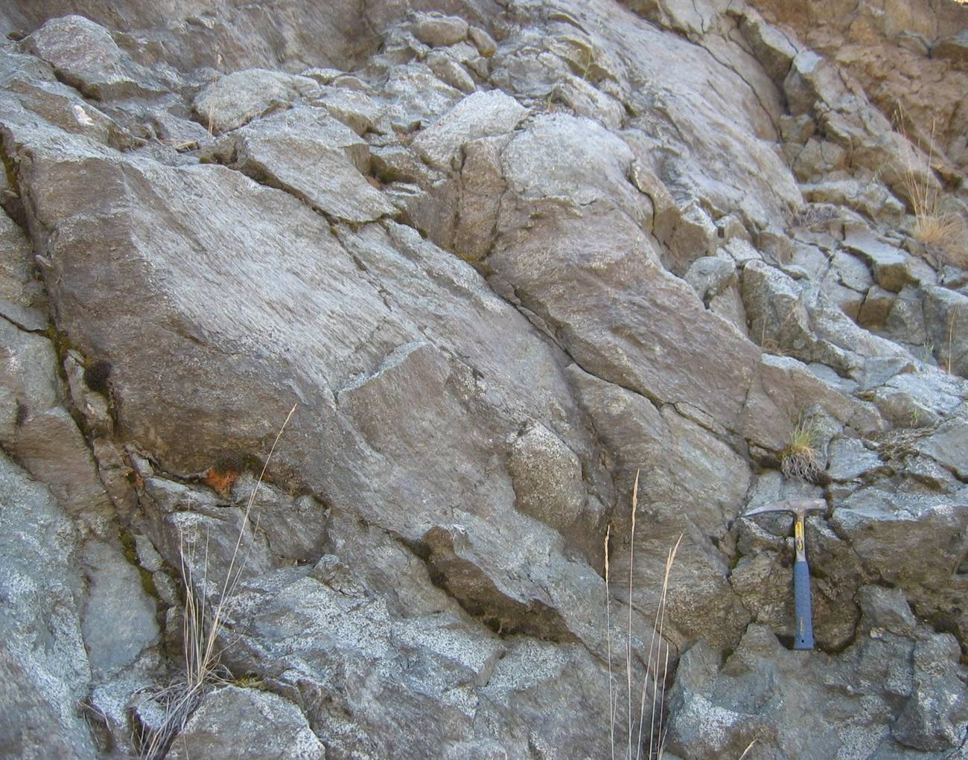
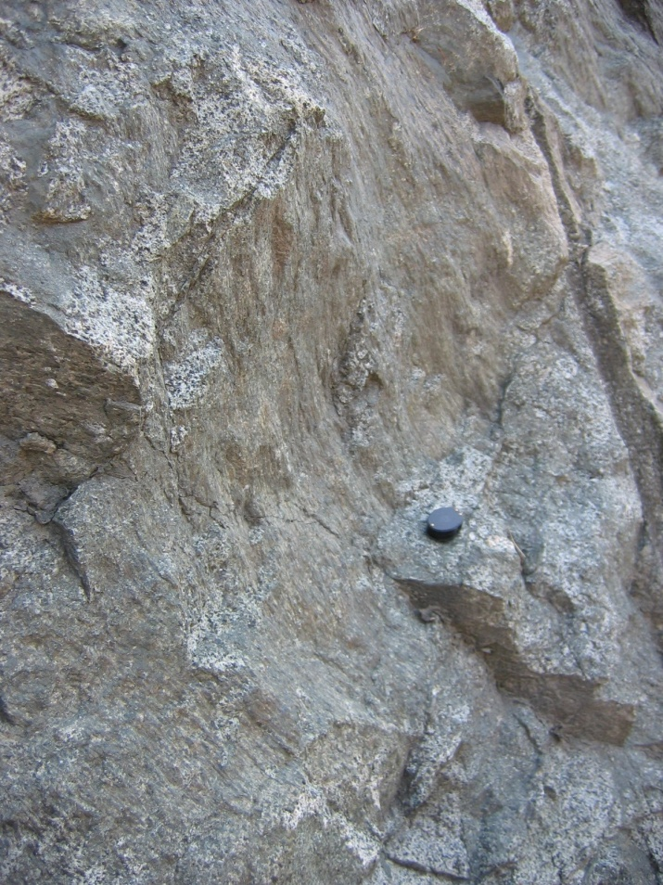
Multiple Slickensides diamictite in hanging wall of Camas Creek fault, Blushastin
Trend and plunge “focal mechanism” using “FaultKin program of Cladouhos Allmendinger (1993)
NE
SW
Notes:
Multiple moderately plunging

Slide 14
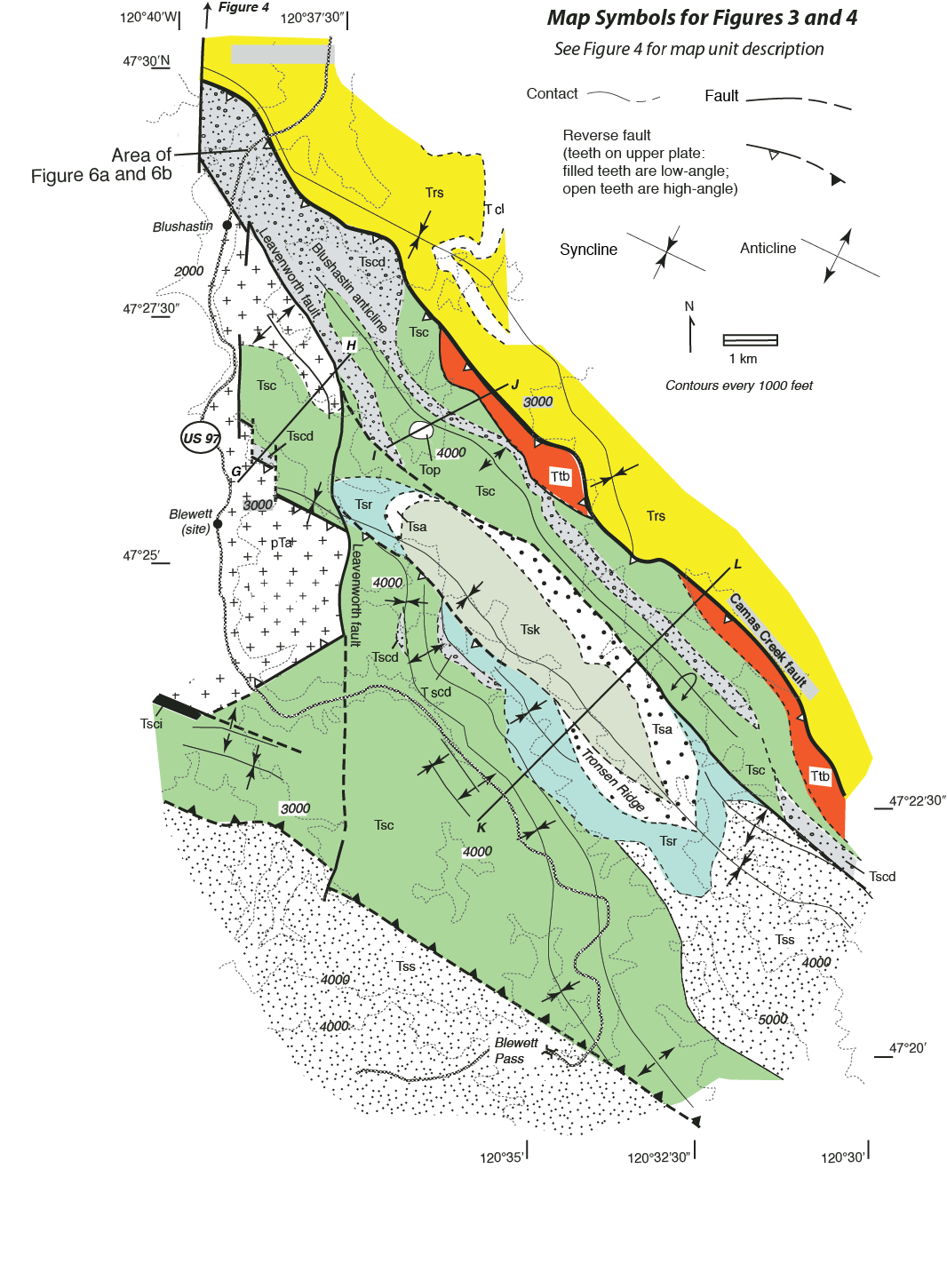
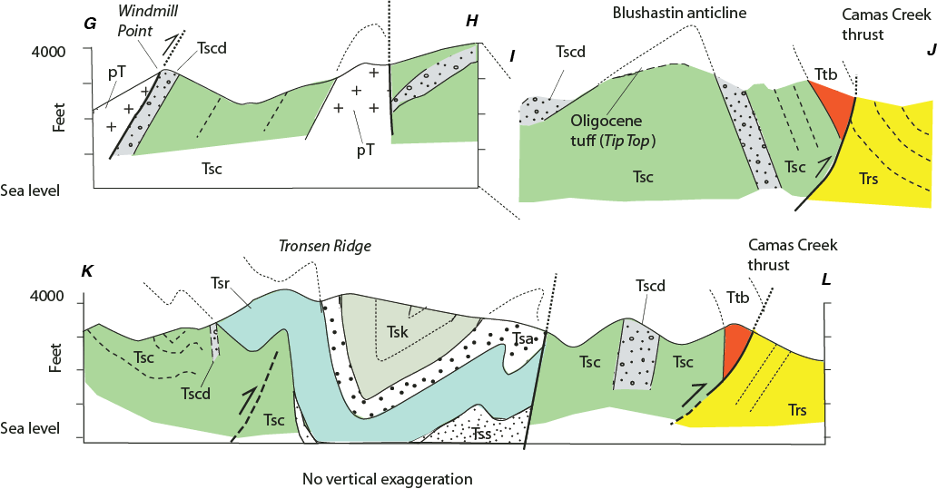
Camas Creek Fault:
Previously mapped as Leavenworth normal fault, accommodates shortening along a Swauk-over-Chumstick reverse fault

Slide 15
Chumstick
Swauk

Slide 16
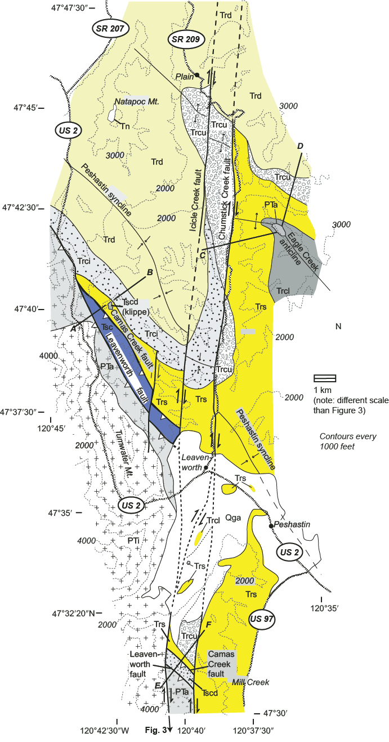
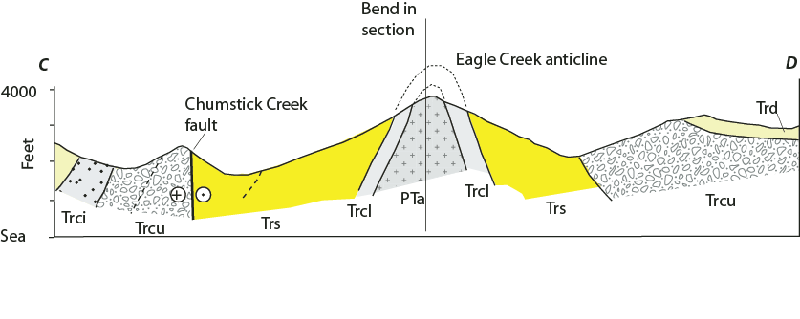
Cashman’s breccias are in the swauk, beneath the Camas Creek thrust; tight folds are mappable across the graben. Dates from 47-49, such as presented at this meeting, bound a thick section, but one with internal, mappable structure

Slide 17
Chumstick
=
Roslyn

Slide 18
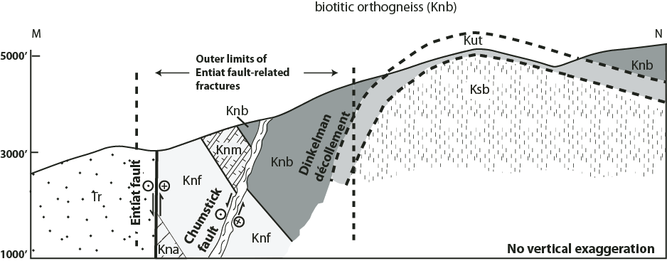
Lastly, as the Skagit gneiss was exhumed, the fault (Dinkelman decollement) “stepped out into the basin” in the phyllonitic (pressure solution) and cataclastic field…..

Slide 19
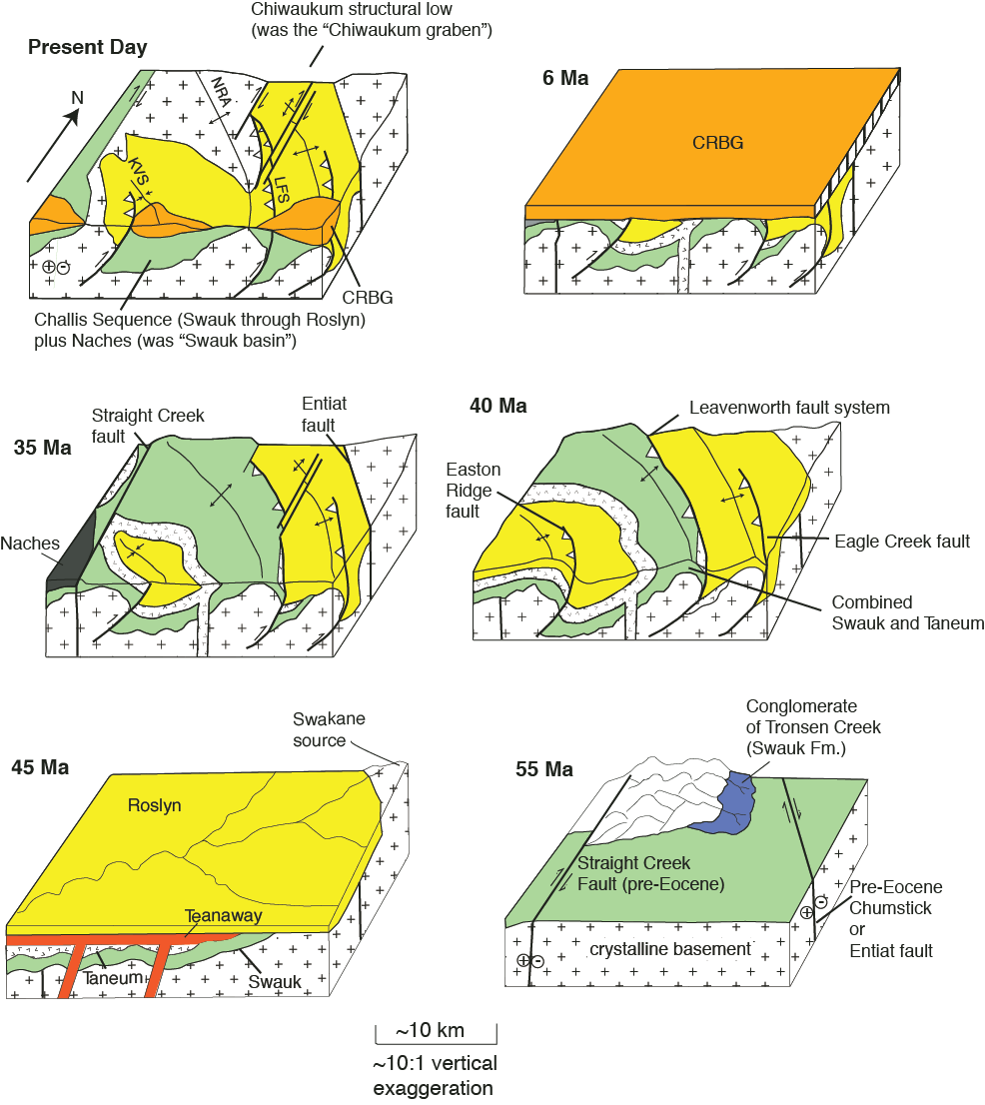

Slide 20
New dating by Bowring, Umhoefer, Miller, Eddy, et al.
Equals 47-49 TIMS dates, so rapid deposition of up to 8km thick section (locally). Pull apart or complex alluvial-fluvial system across an earlier topography?

