Slide 1
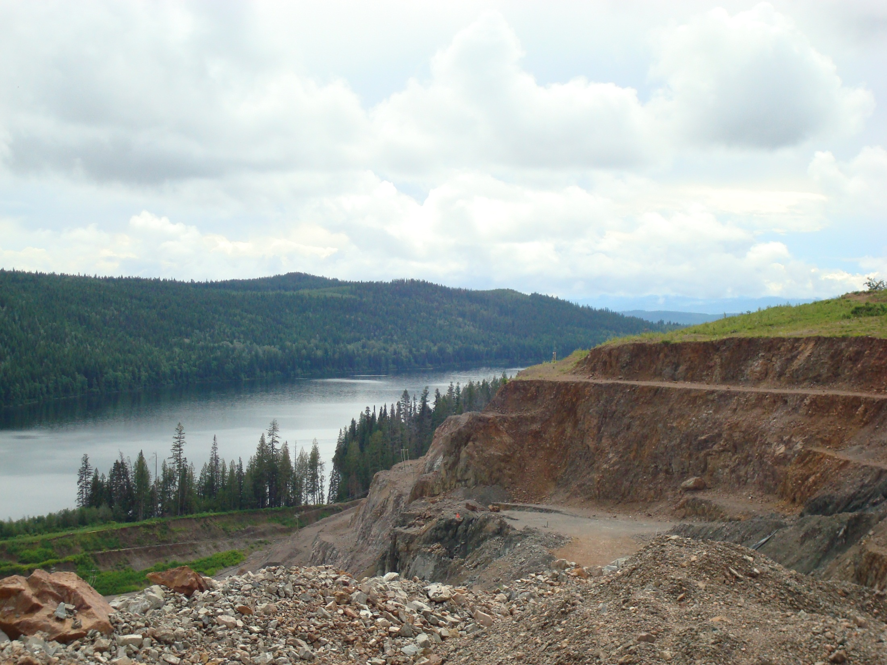



Structural Analysis of the Mount Polley Porphyry Cu-Au Deposit: Restoration of Post-Mineral Deformation using Ore Body Geometry
Stephanie Wafforn
October 21, 2014

Slide 2
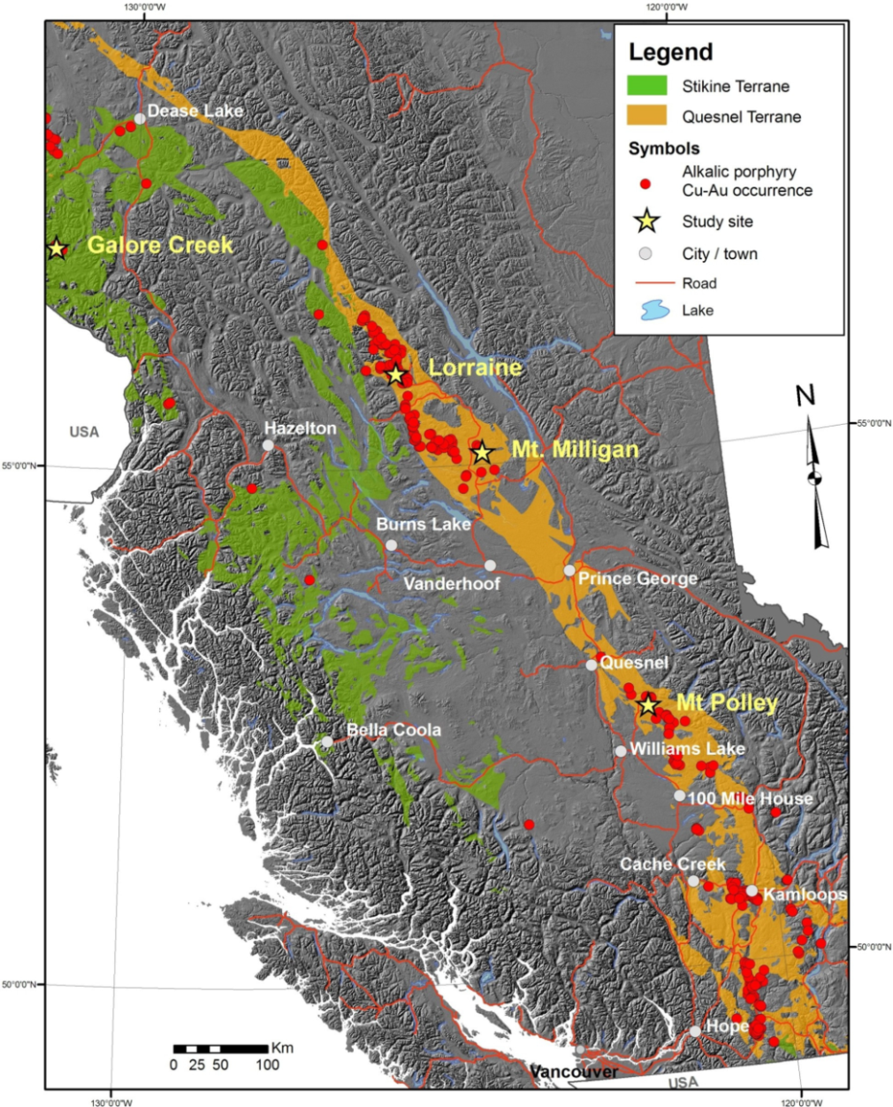
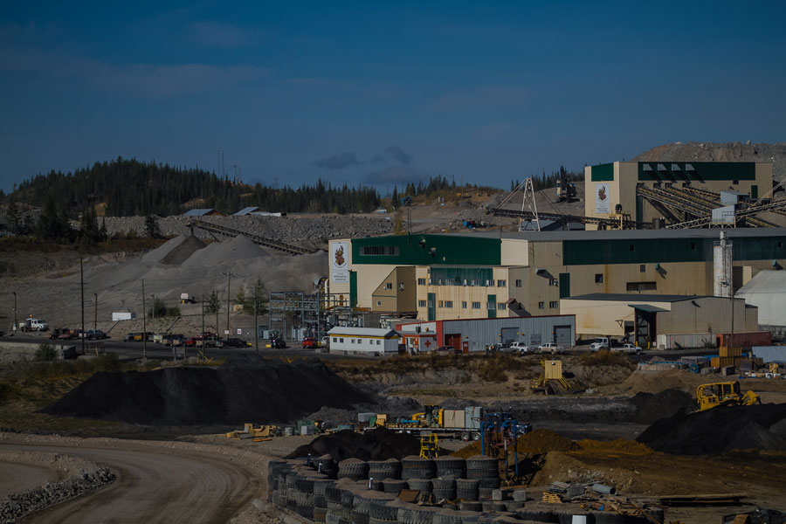
Mount Polley Deposit
Located in the accreted island arc Quesnel Terrane in the Canadian Cordillera
Silica-undersaturated alkalic porphyry Cu-Au deposit
Breccia hosted, multiple ore zones
Tosdal et al., 2008

Slide 3
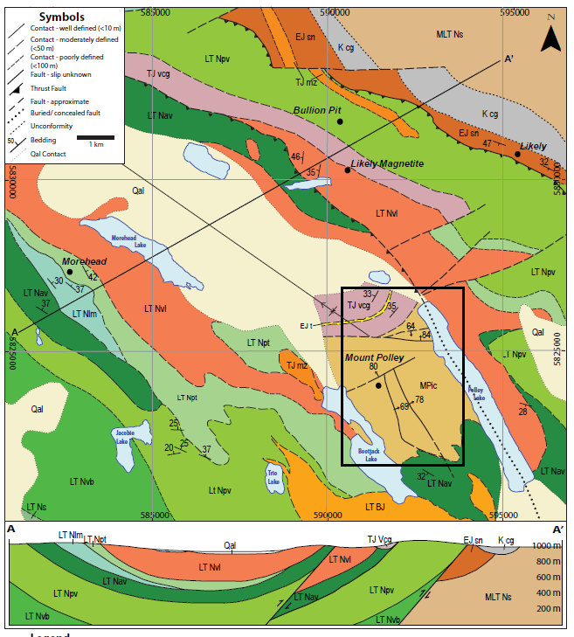
Geology of the Nicola Group
5.0 – 6.5 km sequence of Carian-Norian submarine alkali basalts and limestone lenses
Open syncline plunging NW 30°
Thrust faults
Modified from Geoscience BC
Map 2007-1

Slide 4
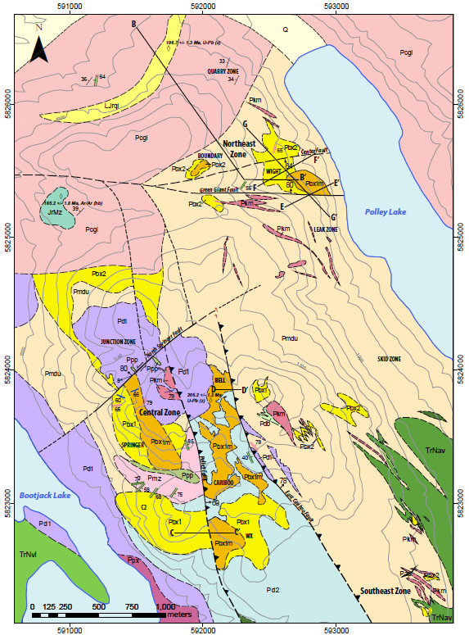
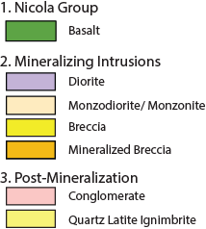
Mount Polley Geology

Slide 5
Mount Polley Geology
Motivation: Understand the nature of post-mineral deformation at Mount Polley by integrating new field mapping and the use of ore body geometry as a strain marker to resolve the relative sequence of faulting, folding, and tilting.

Slide 6
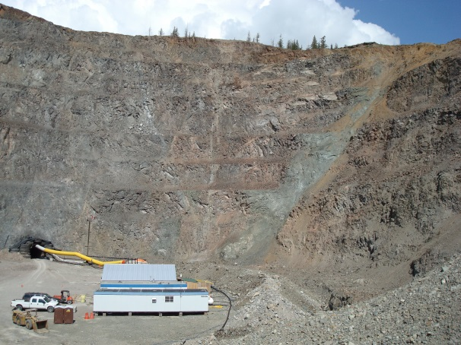
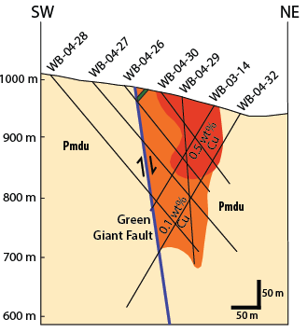
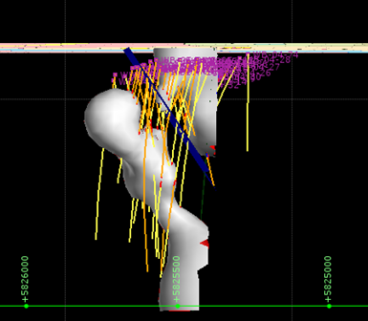
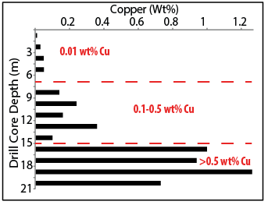
Methods
Bench mapping and float mapping
Constructed cross sections using drill core data to evaluate ore body geometry
3 new apatite fission track ages

Slide 7
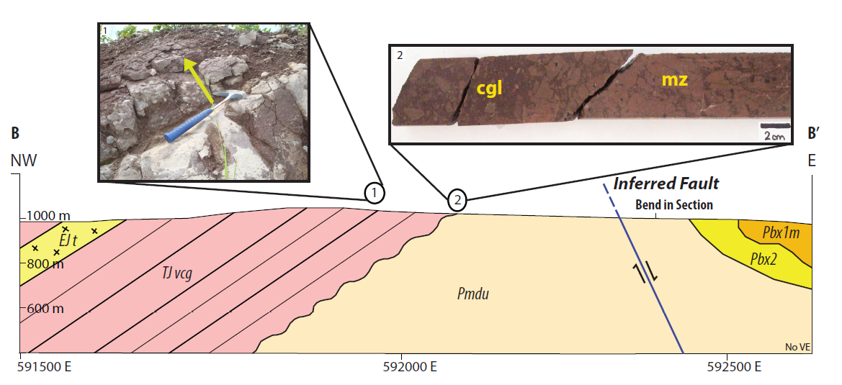
Age Relationships
Unconformity overlying the Northeast Zone
Quartz latite ignimbrite interbedded with the conglomerate dated at 196.7 ± 1.3 Ma (Logan et al. 2007)

Slide 8
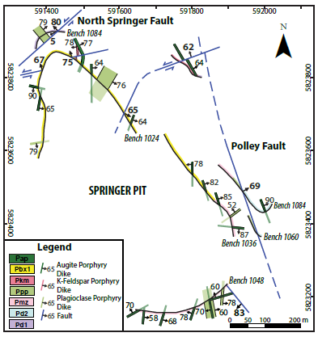
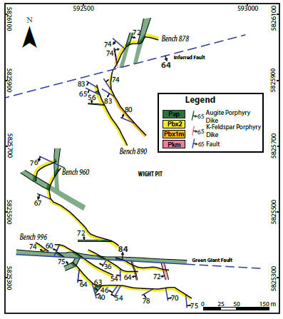
Age Relationships Cont.
Central Zone
Northeast Zone
Reverse faults are older than strike-slip faults
Augite porphyry dikes are youngest dikes
Augite porphyry dikes are cut by normal faults

Slide 9
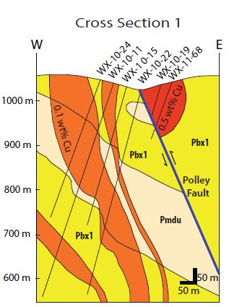
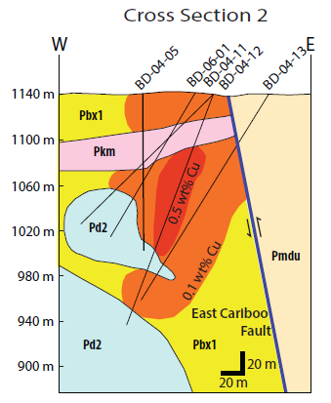
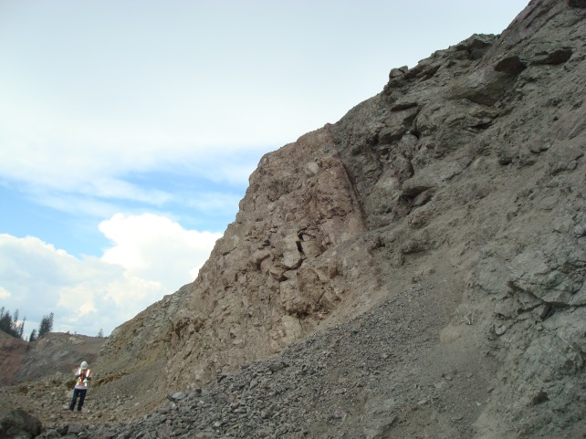
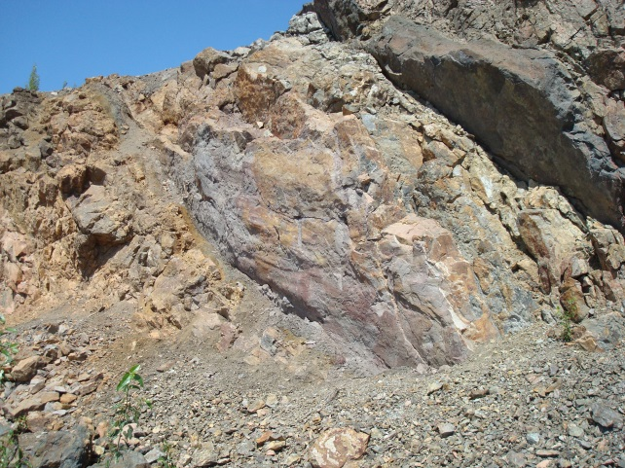
Faulting
Polley Fault
East Cariboo Fault
Reverse Fault
Minimum 500m dip slip separation
Parallel to the Polley Fault
Unknown magnitude of slip

Slide 10
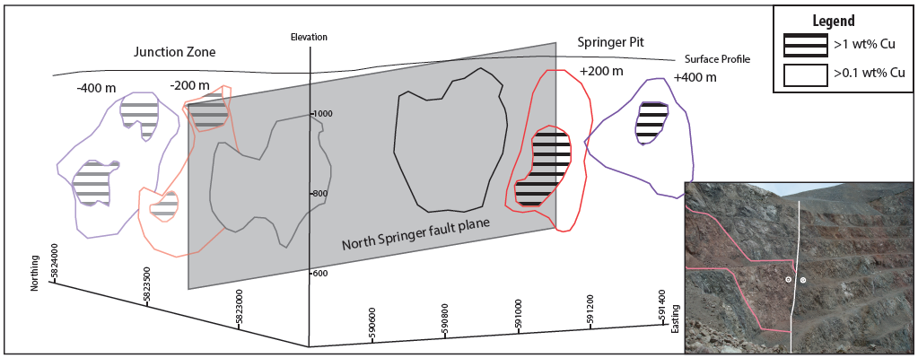
Faulting
North Springer Fault
230°/80° NW
slickenlines trend and plunge 235°→5°
Sinistral displacement of 180 m ± 20 m

Slide 11
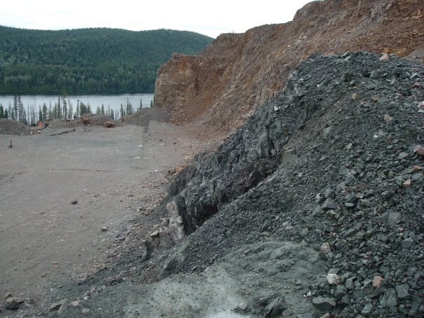
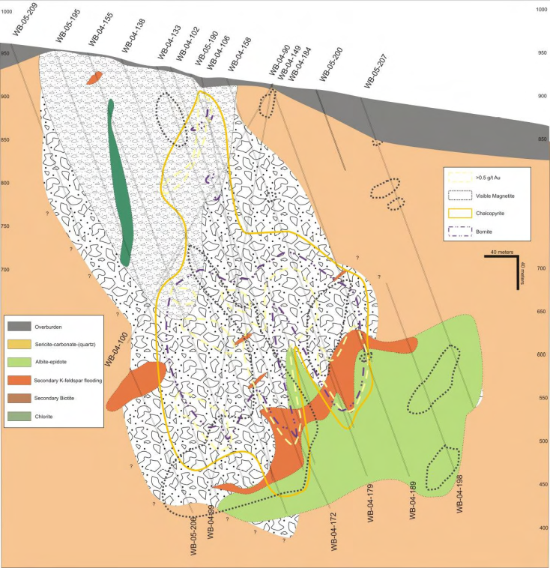
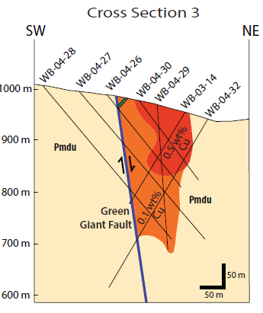
Faulting
Green Giant Fault
<1 m wide fault zone containing pink and green fault gouge
Albite + actinolite alteration found at surface in Leak Zone (1100m) and at depth in Wight Pit (650m - 400m)
Dip-slip separation - 450 m to 700 m
Jackson (2008)

Slide 12
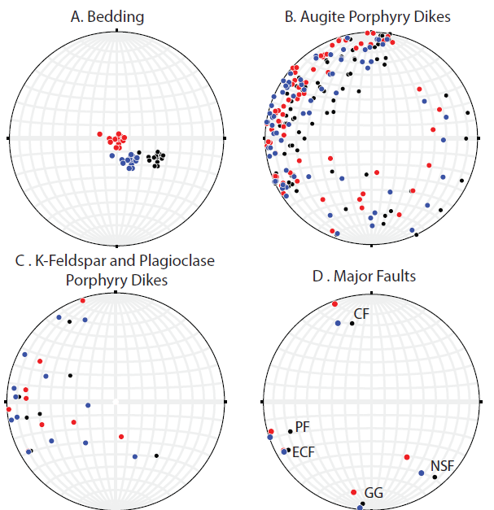
Folding and Tilting
Folding
Regional open syncline plunging to the NW
Folding occurred following deposition of the conglomerates and augite porphyry dikes
Tilting
Conglomerate beds are tilted 30-35° NW
Timing of the tilting is unknown
Maybe related to reverse faulting and folding or to normal faulting?

Slide 13
Apatite Fission Track Ages
Indicates slow cooling during the Paleocene to Eocene
Short fission tracks indicative of time spent in the partial annealing zone
Sample | Location | Easting | Northing | Elevation (m) | FT Age (Ma±1σ) | Mean Track Length (µm±1σ)
WB-07-240 | Quarry Zone | 592240 | 5826217 | 900 | 65.8 +12.1 -10.2 | 13.16 ± 1.83
WB-05-212 | Wight Pit | 592448 | 5825389 | 900 | 59.1 +11.23 -9.45 | 13.44 ± 2.09
SE-09-81 | Southeast Zone | 593489 | 582113 | 900 | 45.9 +40.3 -21.5 | 14.38 ± 1.49

Slide 14
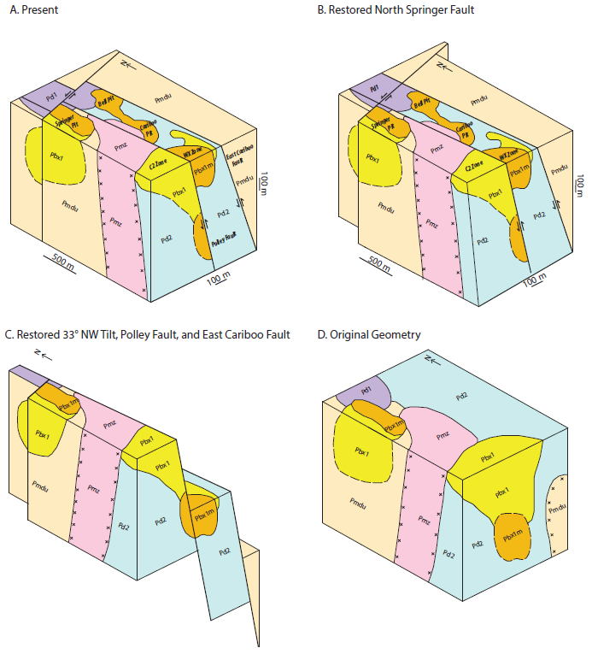
Central Zone Restoration

Slide 15
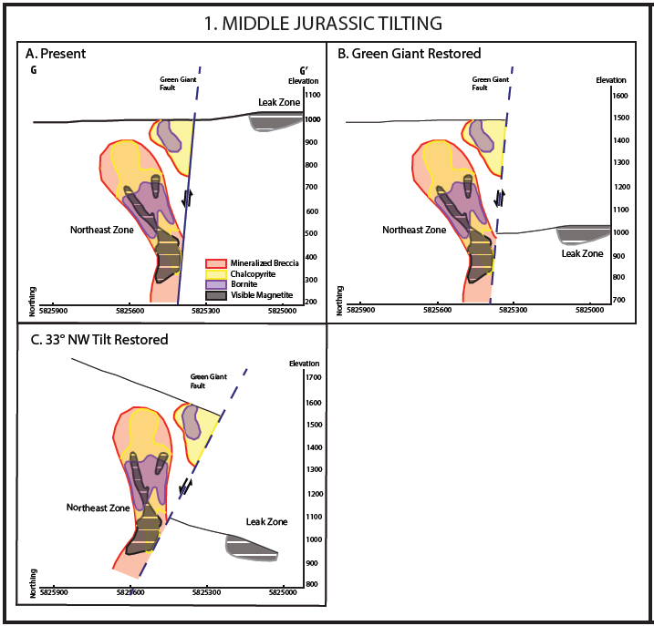
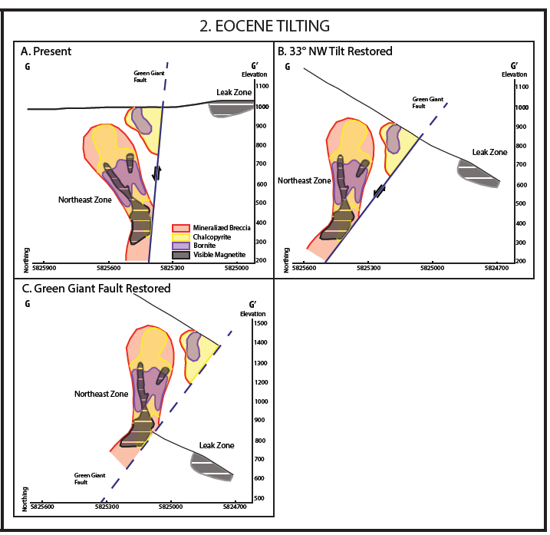
Northeast Zone Restoration

Slide 16
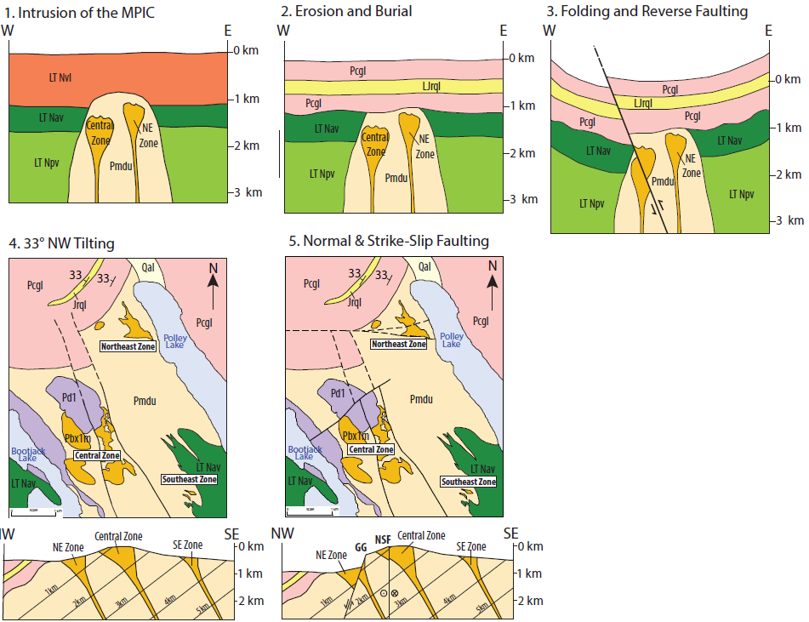
Summary of Structural Events

Slide 17
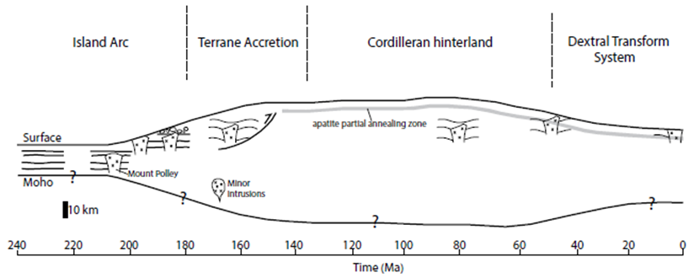
Regional Implications
Emergence of the island arc offshore of the North American continent
Accretion in the Middle Jurassic
Relatively non-deforming in the hinterland of the orogenic fold and thrust belt
Extension and exhumation in the Paleocene to Eocene

