Slide 1


Supporting Student Success through
Intentional Professional Preparation:
An Example from Western Kentucky University
Dr. Fred Siewers, Department of Geography and Geology, Western Kentucky University, Bowling Green, KY

Slide 2
Geology at WKU
BS in Geology
Introductory Geology Courses (8 hrs)
Core Geology Courses (15 hrs)
Spatial Analysis (GIS) (8)
Field or Adv. Spatial Analysis (6 hrs min)
Analytical and Research (4 - 5 hrs)
Cognate Math and Science (13 hrs)
Professional Growth (11 hrs)
BA in General Geoscience
BA in Earth - Space Science Ed.
Introductory Geology Courses (8 hrs)
Core Courses (13 hrs)
Spatial Analysis (GIS) (4 hrs)
Field (3 hrs)
Supportive Courses (21 hrs)
Minor Field (18-21 hrs)
Professional Growth (8 hrs)

Slide 3

Geology 499: Professional Preparation
Capstone Spring semester course
2 credit hour, pass/fail course
Meets once per week for two hours
Résumé and Cover Letter Preparation
Instruction on how to prepare a résumé and cover letter
Critical review of résumé and cover drafts
Mock interviews and coaching

Slide 4
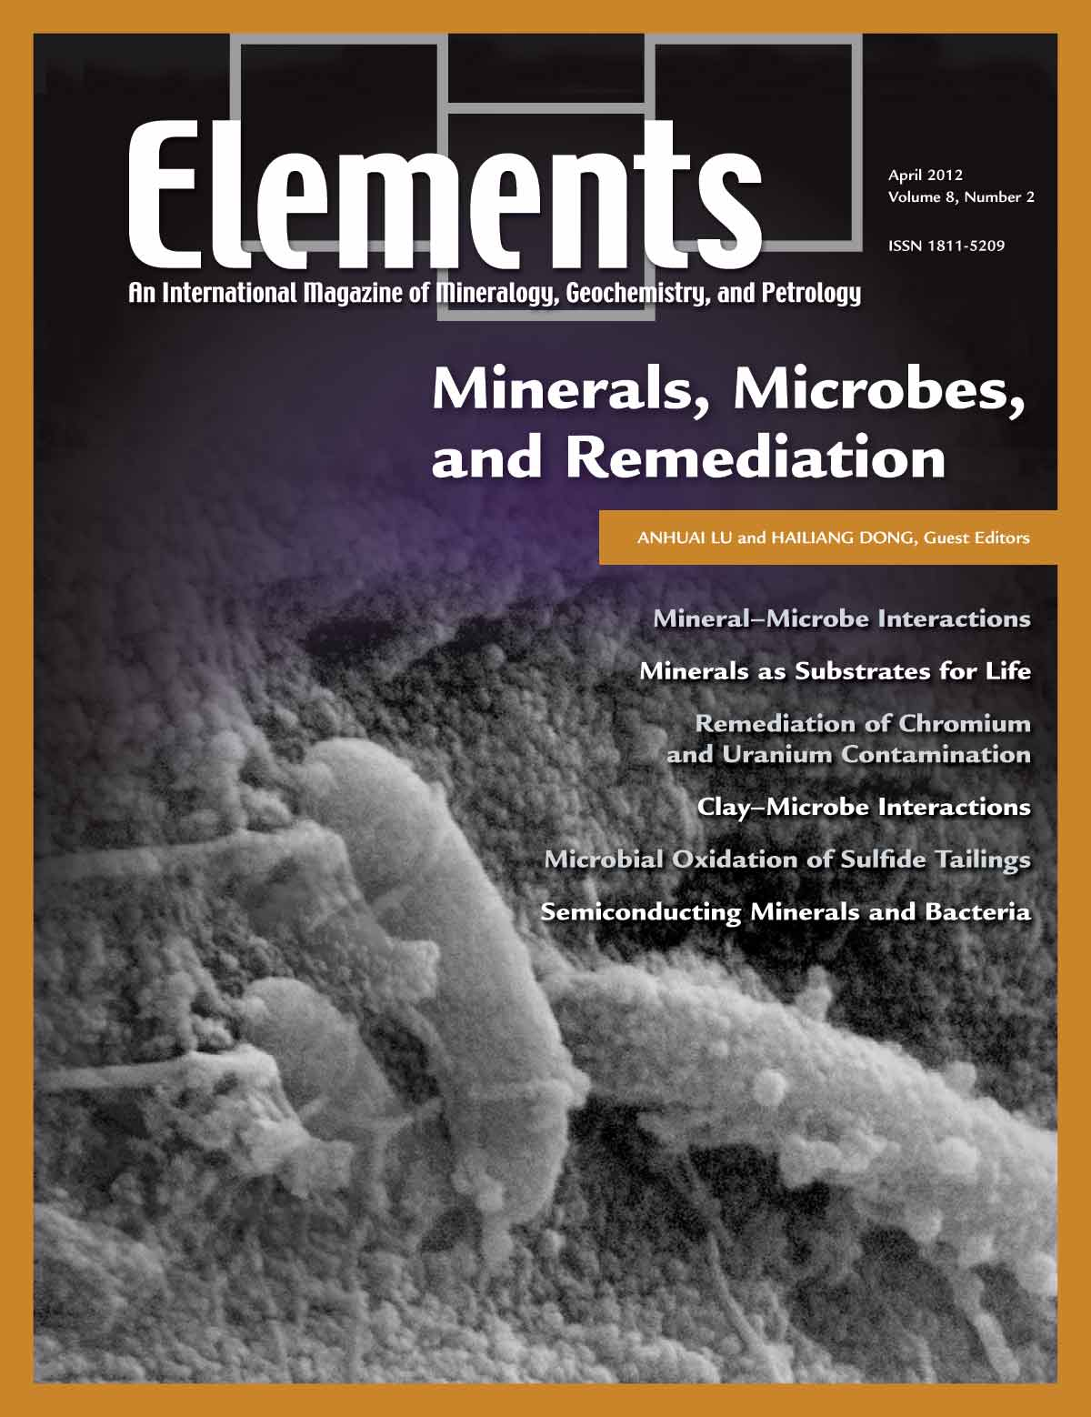

Student Presentations
Each student must give a 15-20 minute oral presentation
Presentations based on readings from Elements or Scientific American
Presenters assign readings to their class colleagues
Presentations are evaluated by the instructor and each member of the class

Slide 5

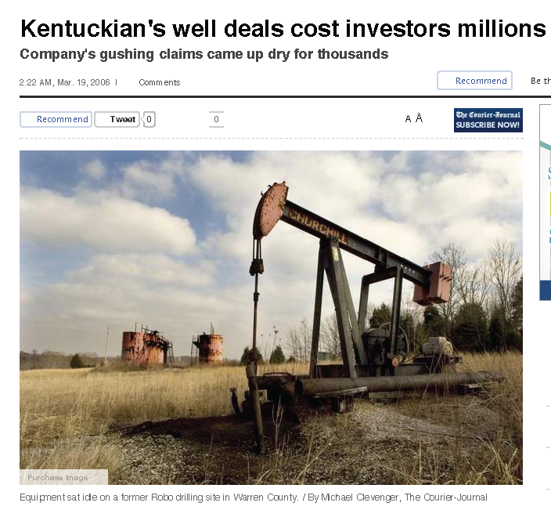
Professionalism and Ethics
Integrity
Honesty
Trustworthiness
Responsibility
Respect
Enthusiasm

Slide 6
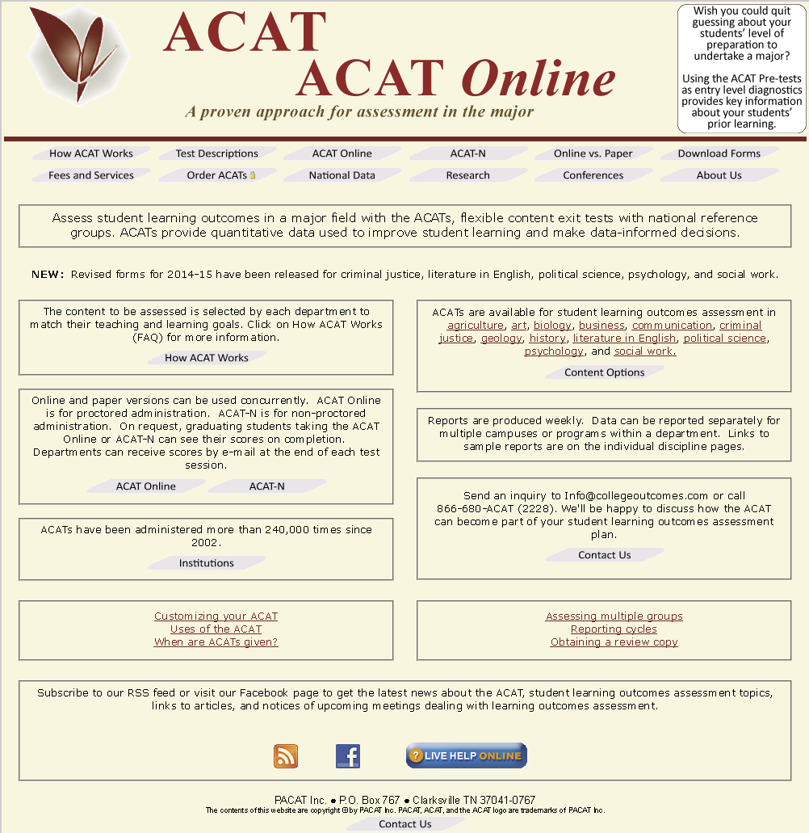
Outcomes Assessment: ACAT Exam
www.collegeoutcomes.com

Slide 7
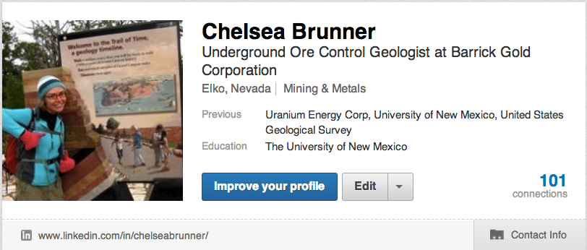
Life after WKU: Presentations from Alumni
6-8 program graduates per semester talk about their life after WKU
Professions Represented
Energy sector
Environmental sector (state and private)
Mining (gold)
State Geological Surveys
Solar Power Industry
Organic farming!
Mission work
Graduate School
“I did not realize just how many different directions I could go with a geology degree until after the visitors spoke.”

Slide 8

Summary and Future Directions
A Professional Preparation course is an effective transitional capstone experience
Students graduate from program with tools and abilities that smooth the transition to post-graduate life
Students learn to conduct themselves professionally and ethically
Alumni Presentations
- very worthwhile for everyone involved
Future Directions
Have students create LinkedIn profiles
Program specific outcomes assessment
Syllabus? Course Materials? Email me!
fred.siewers@wku.edu

