Slide 1
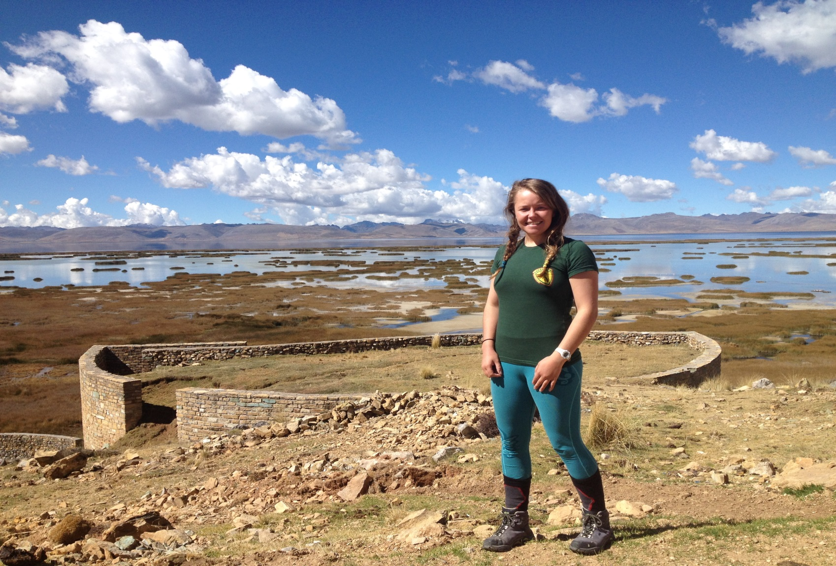
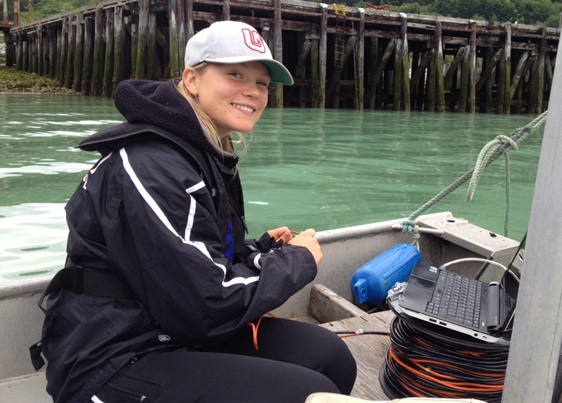
Balancing Enthusiasm and Expectations: The Emotional Context of Undergraduate Research Projects
Kestrel Kunz, Kyle Kirkegaard, and Rich Wildman, Quest University Canada, Squamish, B.C.
2014 Geological Society of America Annual Meeting, Vancouver, B.C. | rich.wildman@questu.ca
Our Premise
Kestrel’s project
who: Kestrel Kunz, class of 2016
when: between 2nd and 3rd years
previous research experience: none
Observations
Undergraduates represent a significant resource for water-related projects because water projects are:
numerous enough to provide endless opportunities
potentially simple enough for undergraduates to contribute meaningfully or manage successfully
relevant, exciting, interdisciplinary, and applicable to the non-academic world.
All these attributes make recruiting undergraduates for water projects fairly straightforward. Many established professors have projects in store that are ready for interested students.
These two student projects differed in their:
Structure: Because Kyle needed to produce deliverables by a specified date, her work was far more focused and constrained than Kestrel’s.
Professor support: Because his first concern related to logistical complexity, the professor was quick to provide intellectual support to Kyle, whose project was not operationally complicated. He focused most discussion with Kestrel on solving logistical problems and defining research questions carefully. Only much later did he invest energy in the intellectual complexity of Kestrel’s work.
Excitement: Kestrel’s project was imbued with excitement and adventure; it represented her chance to start an inspiring research project in an interesting location. Kyle’s project felt like a course assignment that required intellectual discipline to ensure its timely completion.
the project g
Kestrel traveled to Peru to make preliminary limnological measurements at Lago Junin. This large and hydrologically-complex lake receives seasonal inflows from past and present mine sites upstream. She characterized temperature, pH. and dissolved oxygen in the water column and scouted potential future sampling sites. Kestrel created this project by searching for interesting lakes in South America, reading peer-reviewed literature, and bringing her ideas to her professor.
the professor’s priorities g
Safety and communication.
Logistical feasibility of multiple and flexible visits to a distant field site.
Sample analysis, either by measuring in Peru or by transporting water/sediment samples
to Canada.
the student’s priorities g
Travel in South America and study water resources and water quality.
Research concepts raised in her introductory limnology class.
Lay the groundwork for a field-based undergraduate thesis.
the outcome g
Kestrel drew on her outdoor leadership and travel experience in her visit to Lago Junin. She kayaked through wetlands surrounding the lake, identified sampling locations, and collected vertical profiles of T, pH, and dissolved oxygen. She successfully connected with local stakeholders and resources. Her trip ended early because of a difficult day kayaking across the lake alone in a storm. She isolated the importance of future study parameters at Lago Junin.
The Complication
The ideas above can draw a student into a project, but what factors allow students to make progress towards meaningful results? What must be true for undergraduates to stay with a project long enough to have a satisfying educational experience? The experience of the third author suggests that:
The project must continually win a competition for the student’s attention against course, extracurricular, and personal obligations.
The professor must offer continual attention and support; undergraduates can not be expected to run their projects independently for extended periods.
The professor needs to ensure that the project can keep a feeling of newness and the student can make progress forward so that the long-term nature of a research project does not become overwhelming.
The student needs the patience and emotional fortitude to stay with a project when it becomes tedious.
The professor must size the project appropriately and resize it as needed to accommodate changing student interests and enthusiasm.
Open Questions
Which of these students is more likely to produce results in future research experiences? Will Kestrel have the discipline to return to Peru repeatedly and collect the data sets needed to complete a study? Has a disciplined and quiet summer empowered Kyle to succeed in future projects or sapped her inspiration for them?
How should professors balance the need to excite and inspire students with big-picture thinking against the need to consider logistics and safety? In this experience, the professor found himself trying to scale back Kestrel’s ambitions because he feared that she did not see the difficulties embedded in international fieldwork. Is this responsible advising or does it detract from her education?
What about a project is most likely to inspire a sense of ownership from an undergraduate student? Should projects be primarily experiential or based in productivity?
How do we construct undergraduate research projects that are both emotionally and intellectually satisfying? What is the key to both being productive and having fun?
How much should students direct their projects? Should professors lead so that students make progress on a clear path, or should students gain experience structuring their own work? Where is the balance between content-based research and practical experience?
Kyle’s project
who: Kyle Kirkegaard, class of 2015
when: between 3rd and 4th years
previous research experience:
research internship during summer 2013
the project g
Kyle conducted a three-part literature review of A) the pollution created by pulp mills, B) industrial water treatment technologies, and C) landfill leachate management practices. She then discussed the probable contamination associated with the landfills from a former pulp mill near campus and explored alternatives for management and/or remediation of the landfill. This project was created by the professor to match the goals of a funding agency to Kyle’s interests.
the professor’s priorities g
Satisfy the contract with the funding agency (i.e., finish the study on time).
Introduce the student to professionals in her field.
Encourage well-defended original thought in
all writing.
the student’s priorities g
Collaborate with other students and private-sector environmental professionals.
Work proactively to meet deadlines to avoid stress at the end of summer.
Study local remediation project that she had heard about in class
Live near home and earn income.
the outcome g
From her previous research experience, Kyle knew to work diligently and avoid distraction. She dutifully sat in her workspace each day and produced her required deliverables on time. Private-sector professionals were unwilling to engage her, so this summer had fewer career benefits than she had hoped.
Summer 2014
Two undergraduates started new water research projects in the summer of 2014. This poster presents their different priorities and the reactions of the professor who supervised them as a way of assessing whether the premise and experience described above hold true for real students in real time.

