Slide 1
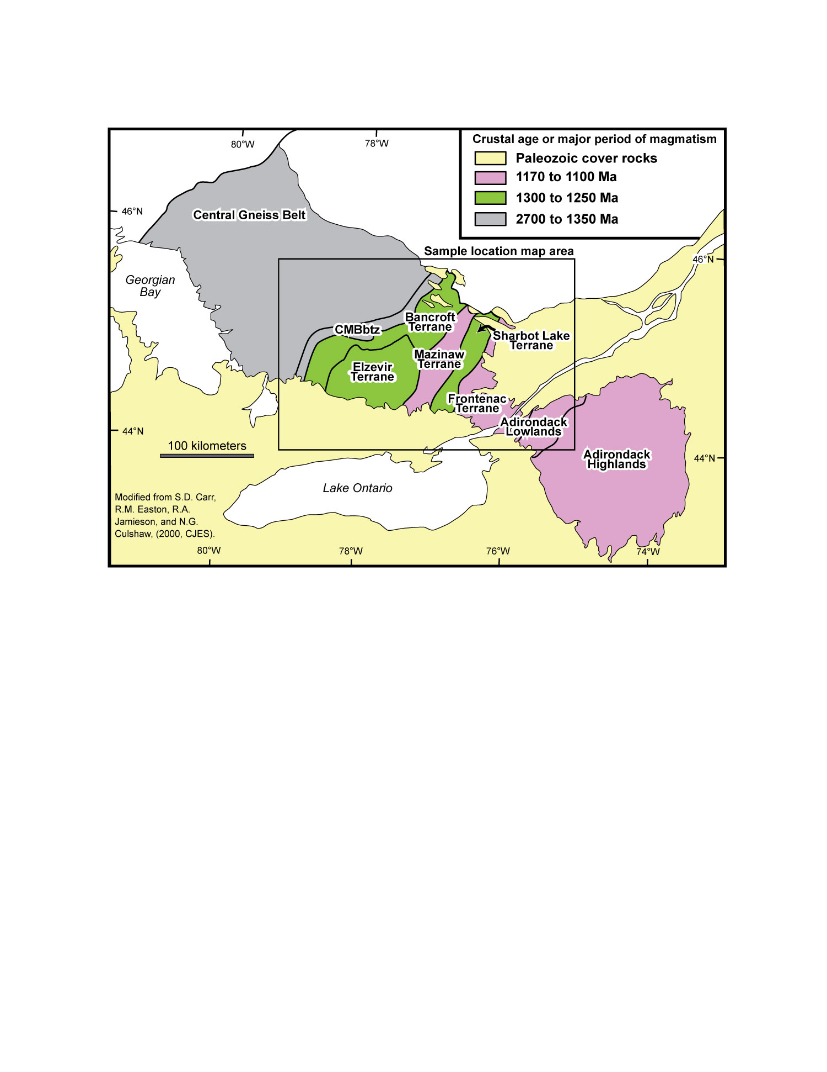
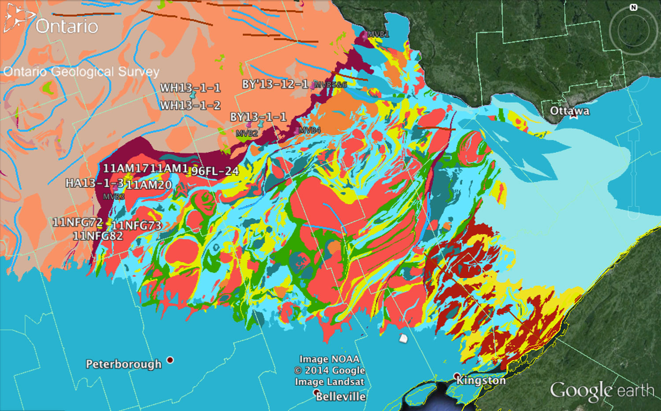
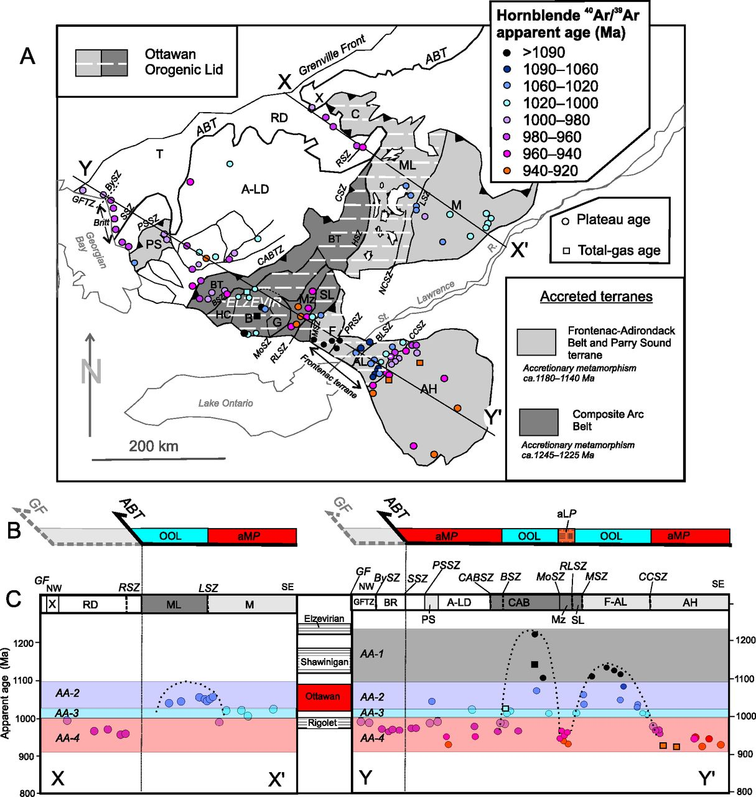
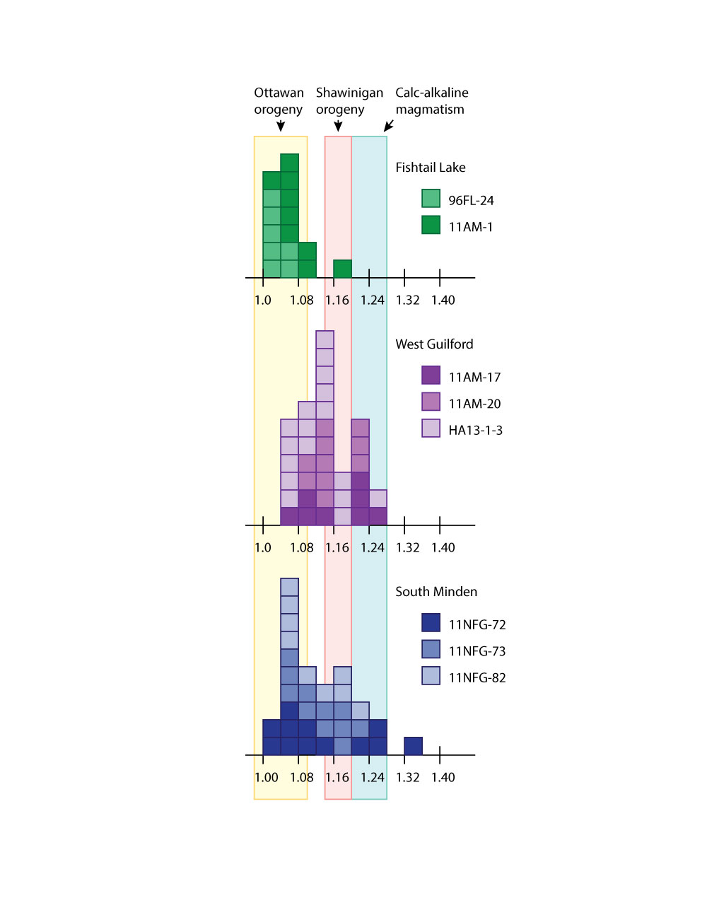
TIMING OF DEFORMATION IN THE CENTRAL METASEDIMENTARY BELT BOUNDARY THRUST ZONE (CMBBTZ), SOUTHERN ONTARIO, CANADA FROM ELECTRON MICROPROBE DATING OF MONAZITE
Steven R. DUNN (sdunn@mtholyoke.edu) & Michelle J. MARKLEY (1), William H. PECK (2), Michael J. JERCINOVIC & Michael L. WILLIAMS (3)
(1) Geology & Geography, Mount Holyoke College
(2) Department of Geology, Colgate University
(3) Department of Geosciences, University of Massachusetts, Amherst
GEOLOGICAL BACKGROUND: In the Grenville Province of Southern Ontario, the CMBbtz is a crustal-scale tectonic boundary between the older, granulite-facies Central Gneiss Belt to the NW and the younger, amphibolite-facies Central Metasedimentary Belt (CMB) to the SE. Although there are a range of tectonic models for the CMBbtz, most workers agree it is a major tectonic boundary that accommodated ductile thrusting and crustal shortening during the Ottawan phase of the Grenville Orogeny (~1080-1020 Ma), based on previously published U-Pb zircon and titanite dates from a variety of igneous and metamorphic rocks. Some studies suggest that ductile thrusting in the CMBbtz was roughly synchronous with extension and with peak Ottawan metamorphism in the CMB, which has been interpreted as evidence for synorogenic extensional collapse with the CMB as an orogenic lid. Previous geochronological studies provide evidence of earlier deformation and/or metamorphic events in the CMBbtz (~1185 and 1150-1100 Ma) and some igneous protoliths ages of ~1350 Ma.
Geology of the SW Canadian Grenville. CMBbtz = Central Metasedimentary Belt boundary thrust zone of Hanmer (1988 CJES) and Hanmer & McEachern (1992 CJES). Note that they consider much of the Bancroft Terrane as the CMBbtz, but we follow the Ontario Geological Survey Geological Map at right.
SAMPLE LOCATIONS from this study (yellow thumbtacks) along the maroon CMBbtz (upcoming work on samples in blue thumbtacks). MVB samples (pink thumbtacks) are McEachern and Van Breemen’s (1993 CJES) U-Pb zircon dates from syntectonic pegmatites. This figure is Geology of the SW Canada Grenville, on the Ontario Geological Survey KML (https://www.ontario.ca/rural-and-north/ontario-geological-survey-geological-maps-and-digital-data-index) in Google Earth.
OUR STUDY is the first to report electron microprobe monazite (mnz) dates from amphibolite-grade orthogneisses of the CMBbtz in the Minden–Haliburton region. Our results are broadly consistent with other studies. Thus far, we have dated 83 age-domains within 55 mnz grains in 8 samples. Two samples are from Fishtail Lake, three from the West Guilford area, and three from south of Minden. Fishtail Lake samples cluster at 1010-1080, except a single mnz core at 1160 Ma. West Guilford samples have a cluster of old grains and cores at 1240-1200 Ma, a distinct cluster of grains and rims at 1135-1100 Ma, a cluster of “early Ottawan” grains and rims at 1090-1060 Ma, and no ages younger than 1060 Ma. Orthogneiss samples from just south of Minden yield the widest range of dates with grains and cores replicating the 1240-1200, and 1135-1100, and 1090-1060 Ma “events,” as well as younger 1050-1020 Ma grains and rims. A few dates greater than 1240 Ma, including one mnz core at 1356 Ma, may represent igneous protolith ages. Mnz inclusions in garnet restrict garnet growth to post 1046 ± 14 (2σ) Ma at Fishtail Lake [M10 in sample 11AM1, see adjacent poster] and post 1115 ± 12 at West Guilford [M6 in sample 11AM20, see adjacent poster]. Together these data indicate a long-lived period of episodic igneous activity, deformation and metamorphism in the CMBbtz spanning the Shawinigan (~1180 Ma) and Ottawan (~1050 Ma) orogenies.
Ottawan Orogenic Lid (OOL) of Rivers (2012 CJES). Abridged text from his Figure 5: (A) Map showing distribution of 40Ar/39Ar hornblende apparent ages in the southwest Grenville Province. Cold colours indicate “old” apparent ages that predate or are coeval with the Ottawan orogenic phase, warmer colours indicate younger apparent ages that postdate the Ottawan orogenic phase. (B) Sketch showing boundaries of aMP Belt, aLP Belt, and the Ottawan Orogenic Lid (OOL) along the two transects. (C) 40Ar/39Ar hornblende apparent ages projected onto X–X′ and Y–Y′. Clusters of “old” apparent ages in Frontenac–Adirondack Lowlands (F-AL) terrane, Elzevir terrane, and Mont Laurier terrane are bounded by dotted bell-shaped curves. [Rivers’ CABSZ (Composite Arc Belt Shear Zone) is roughly equivalent to the CMBbtz in the top map above.]

