Slide 1
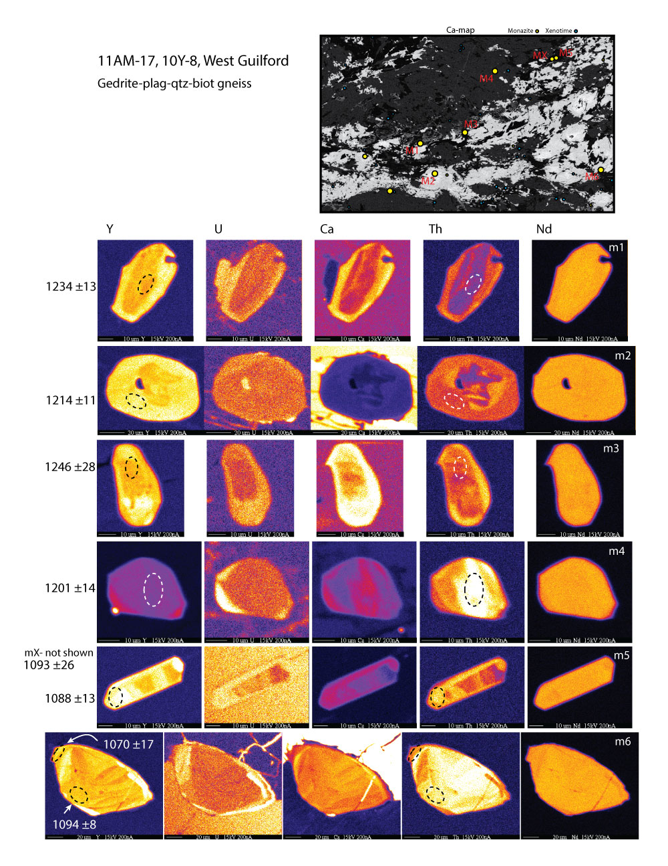
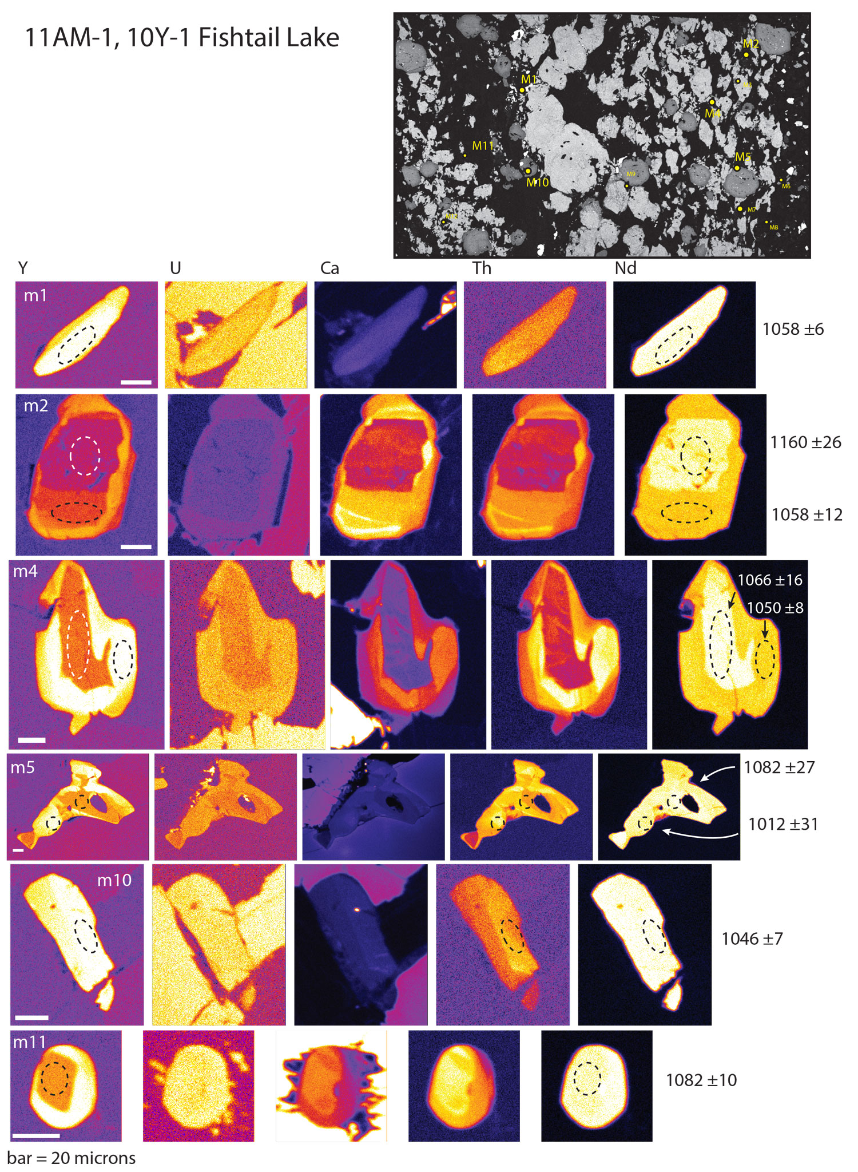
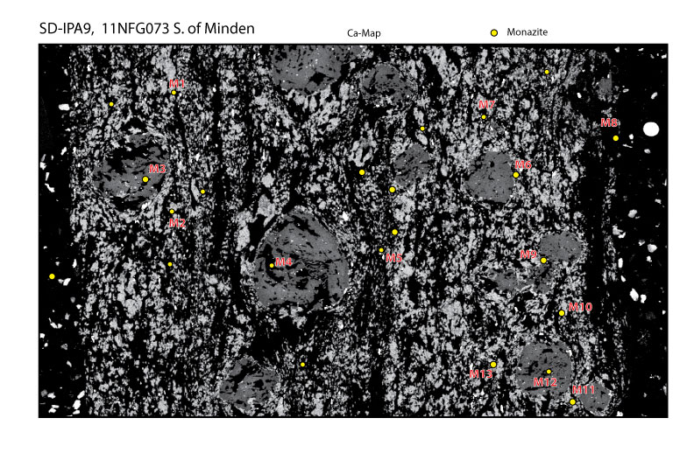
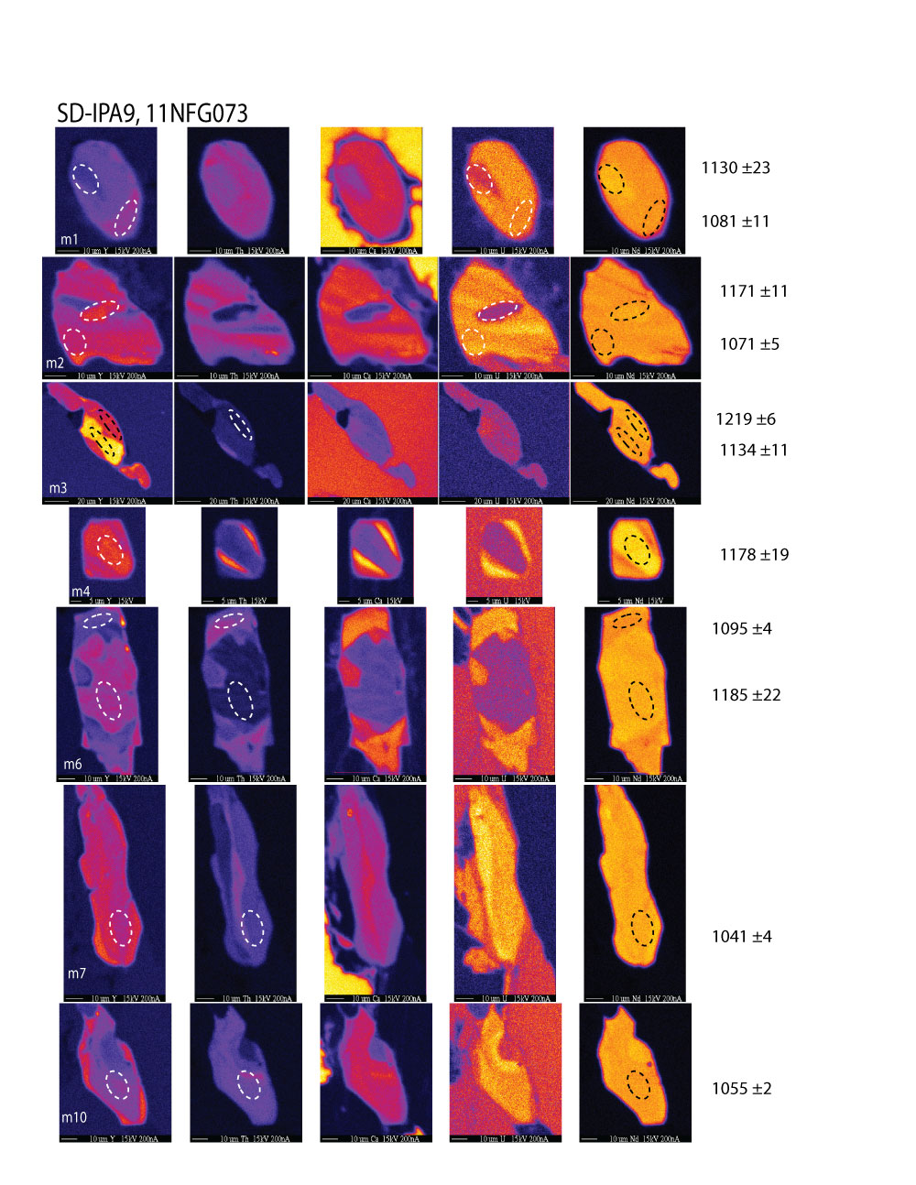
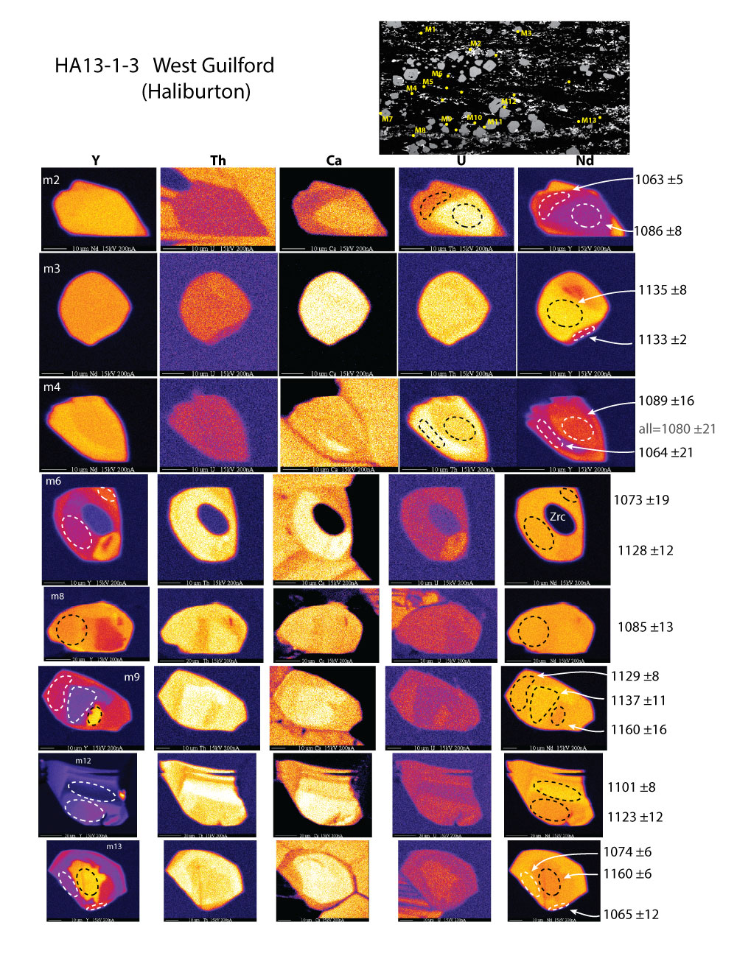
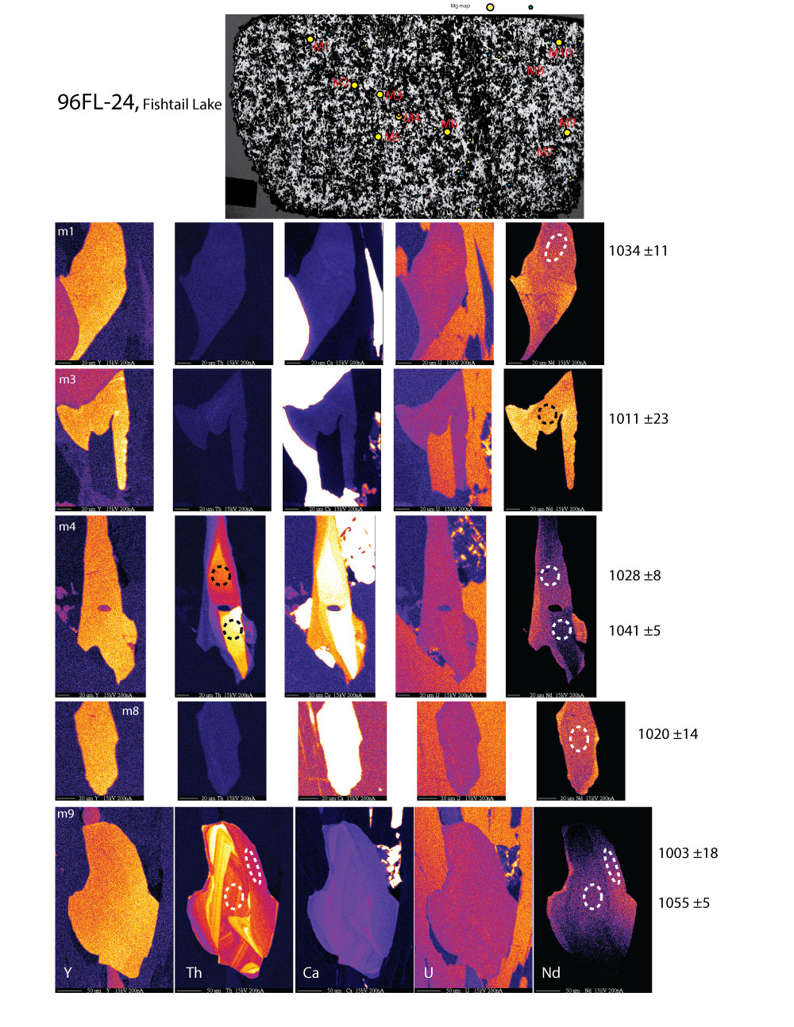
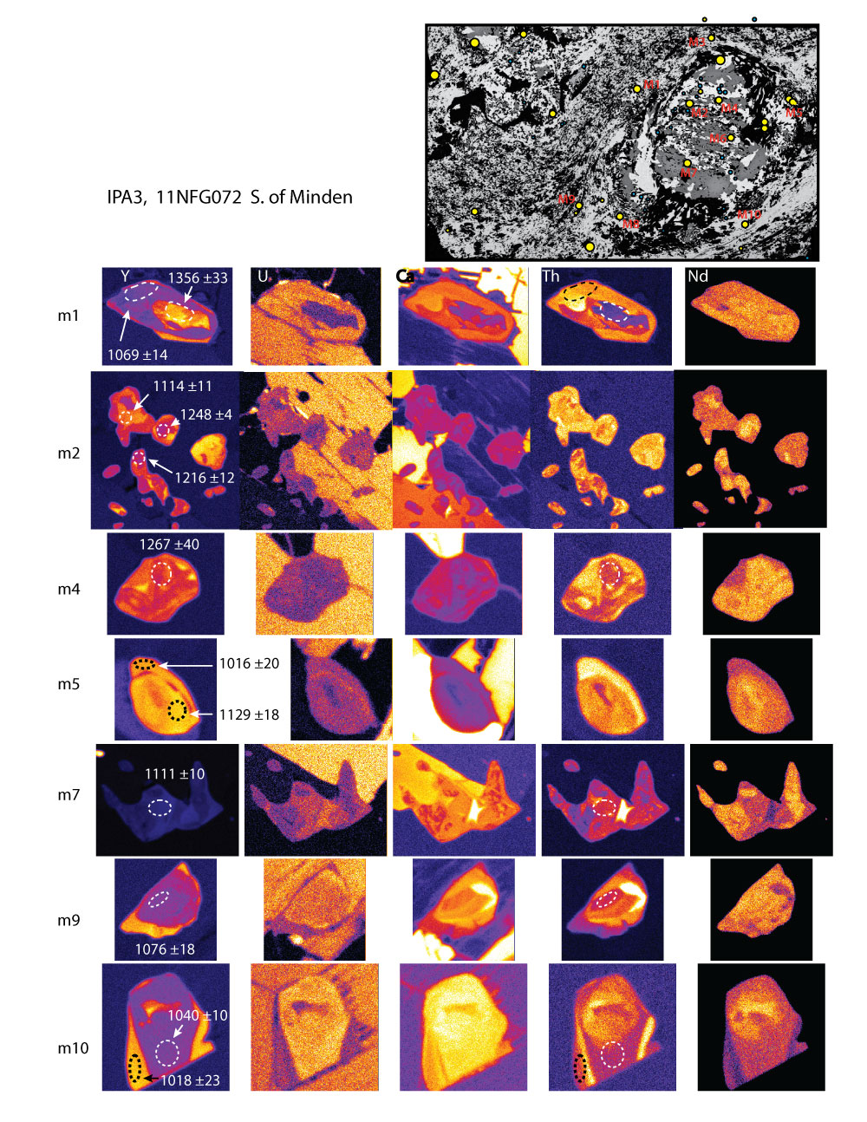
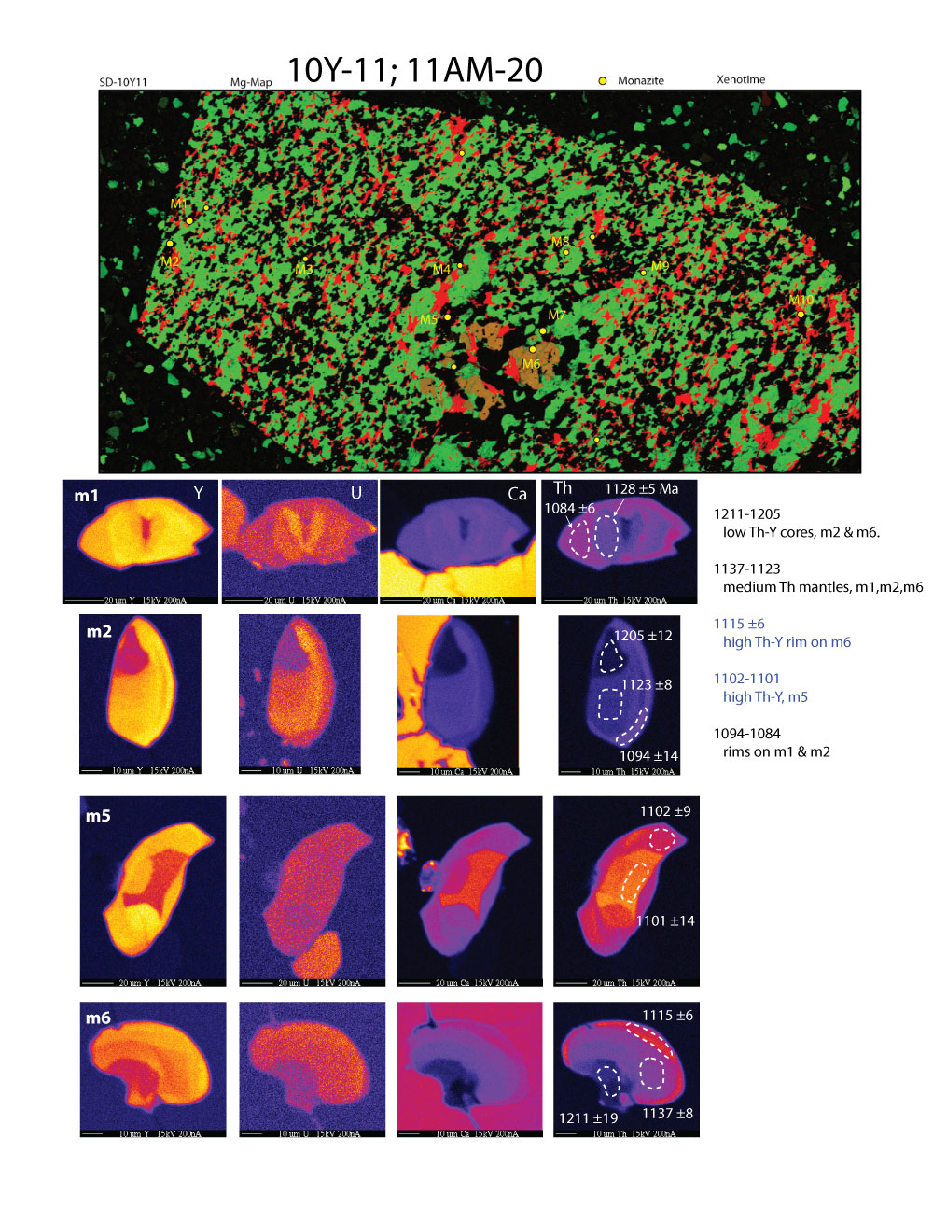
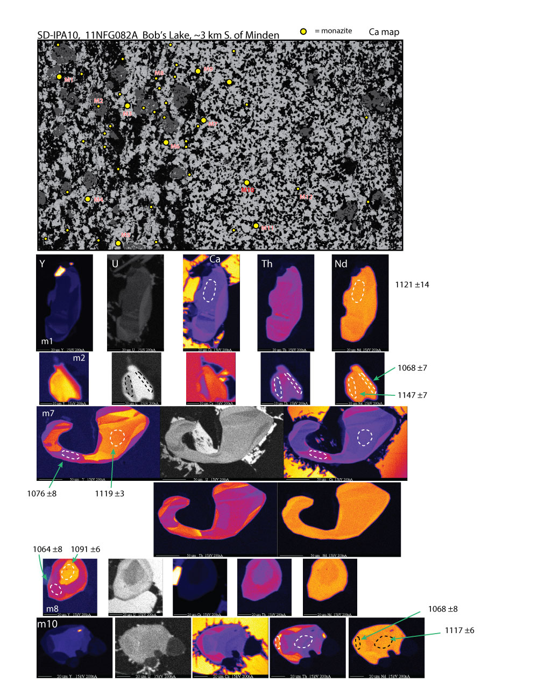
PHOTOMICROGRAPHS and DATED MONAZITE GRAINS from ORTHOGNEISSES
CONSIDER Rivers’ (2012 CJES) tectono-thermo-chronological sythesis of the Ottawan Orogeny:
1090-1050 Ma: thrusting and peak granulite metamorphism in the aMP (allochthonous mid-pressure) belt .
1050-1020 Ma: thrusting and peak amphibolite metamorphism in the aLP (allochthonous low-pressure) belt.
1020-990 Ma: extension and late heating of OOL (Ottawan orogenic lid).
11AM17 ->
•West Guilford area
•Two Amphibole Schist: quartz, plagioclase, biotite, chlorite, cordierite, gedrite
•Monreal, Keck 2011/2012
11AM1 ->
•Fishtail Lake area
•Garnet Gneiss: biotite, quartz, plagioclase, cordierite, accessories
•Monreal, Keck 2011/2012
11NFG73 ->
•South Minden area
•Biotite Gneiss: quartz, plagiocalse, rutile, ilmenite, apatite, sulfides
•Garnet-rich leucosome
•690°C (GARB)
•Fowler-Gerace, Keck 2011/2012
HA13-1-3 ->
•West Guilford area
•Garnet Sillimanite Gneiss: quartz, K feldspar, plagioclase, biotite, sillimanite
•Dunn & Markley
96FL-24 ->
•Fishtail Lake area
•Gedrite- or Sillimanite-bearing Garnet-Cordierite Gneiss: quartz, plagioclase, biotite
•Peck
11NFG72 ->
•South Minden area
•Biotite Gneiss: quartz, plagiocalse, rutile, ilmenite, apatite
•Garnet-rich leucosome
•Blue dots are xenotime
•710°C (GARB)
•Fowler-Gerace, Keck 2011/2012
11AM20 ->
•West Guilford area
•Garnet Schist: quartz, K feldspar, plagioclase, biotite, muscovite
•Monreal, Keck 2011/2012
CONSIDER McEachern & Van Breemen’s (1993 CJES) U-Pb zircon study of syntectonic granite veins in the CMBbtz (the six “MVB” locations on the location map at left). Our West Guilford samples are close to McEachern and Van Breemen’s Sample #3, with a U-Pb zircon date of 1078 +- 3. Their study suggests that imbrication of the CMBbtz started before 1190 Ma, that re-imbrication of the CMBbtz “took place ca. 1080-1060 Ma,” but that “deformation persisted in the shear zone until ca. 1000 Ma.”
11NFG82 ->
•South Minden area
•Garnet Sillimanite Gneiss: quartz, plagioclase, biotite
•660°C (GARB)
•6kbar (GASP, GRIPS, & GRAIL)
•Fowler-Gerace, Keck 2011/2012
THANKS to all nine participants in the 2011 Grenville Keck Undergraduate Research Project “Anatomy of a mid-crustal suture: petrology of the Central Metasedimentray Belt Boundary Thrust Zone, Grenville Province, Ontario,” especially Neva Fowler-Gerace, who collected the three 11NFG samples, and Abby Monreal, who collected the three 11AM samples.

