Slide 1
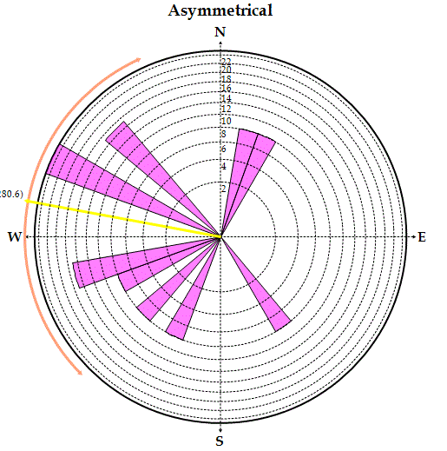
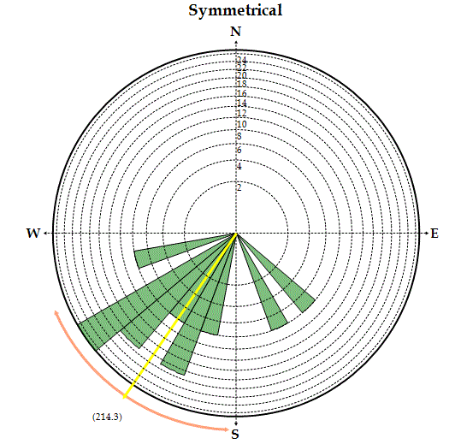
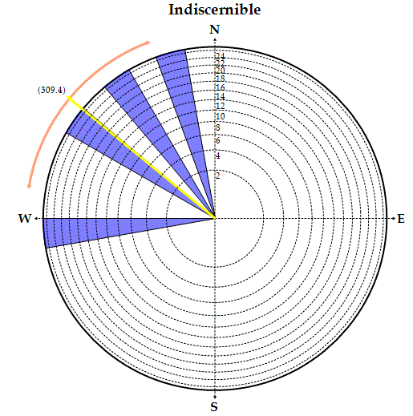
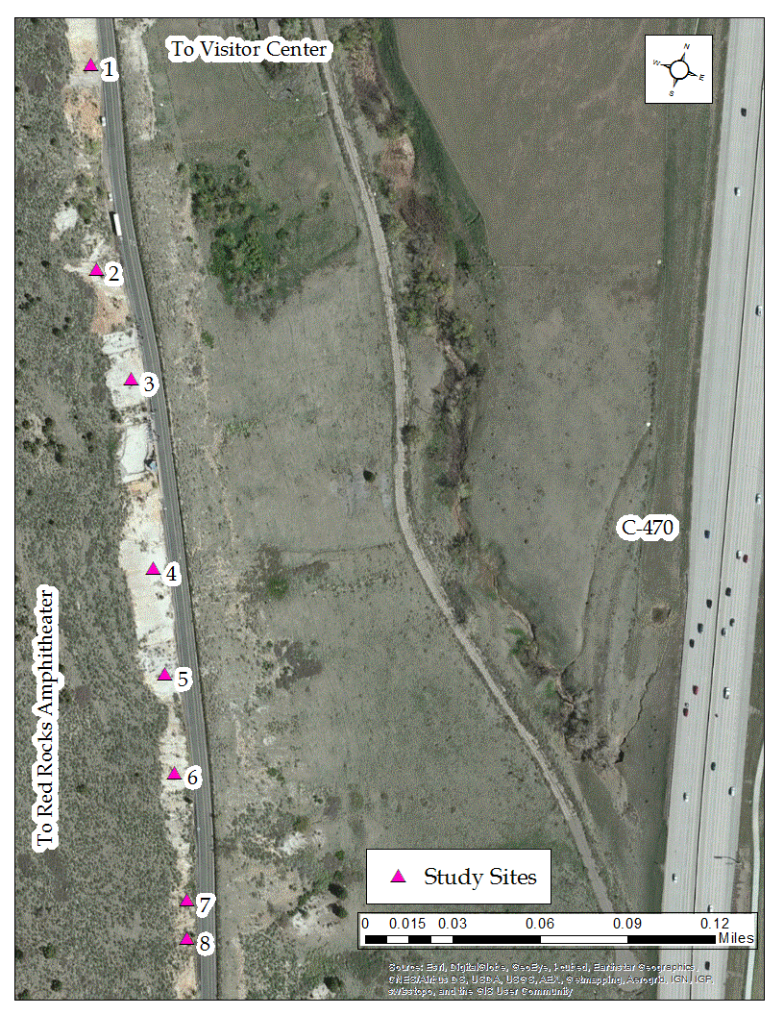
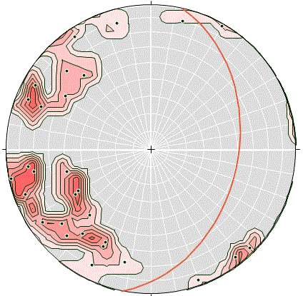
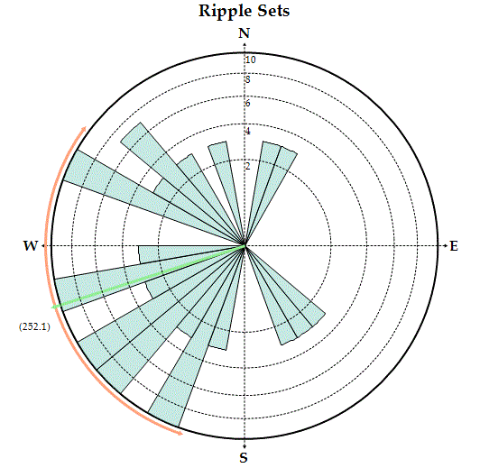
Analyzing Paleocurrents in Marine-Marginal Marine Cretaceous Strata while Developing a Schema for Field Work: Undergraduate Research
Victoria Ives and Dr. Barbara EchoHawk, PhD
Metropolitan State University of Denver, Colorado, US 20 October 2014
BACKGROUND
RESULTS
DISCUSSION
The Dakota Formation is composed of sediment deposited during the initial transgression of the Late Cretaceous Western Interior Sea. The study area is located at Dinosaur Ridge National Natural Landmark in Morrison, Colorado, US. Locally, the Dakota is mainly a fine to medium grained white to yellow sandstone composed primarily of well rounded quartz grains and accessory chert. In some areas, the sandstone is heavily oxidized and contains a high concentration of trace fossils. Ripple marks record the orientation and behavior of marginal marine processes along the transgressive shore.
Table 1: Results of paleocurrent study
Asymmetrical
RESULTS
A paleocurrent trend is recognized with an analysis of the contour image. The resulting rose diagrams indicate paleocurrents flowing to both the northwest and southwest quadrants. The results indicate that the shoreline was oriented north-northwest to east-southeast. A new pattern emerges when the ripple marks are analyzed by type. The results suggest that oscillatory currents, which produced the symmetrical ripples, flowed along a general southwest-northwest trend, at a high angle to the shore. Directed currents, which produced the asymmetrical ripples, may be associated with flow in channels or from storm events. If they indeed result from storm events, the paleocurrents that seem to flow into the sea may be the result of turbid flows or debris backwash. In this scenario, the indiscernible-type ripples may represent normal digressions of the beach current. They are found at the boundary between what may be beach and channel zones, so they may record flow in a transitional zone. Alternatively, they may be symmetric or asymmetric ripples whose crests were blurred or removed by shoreline. More research is needed to support the validity of these interpretations.
FIELD WORK
A secondary goal of this project was to develop a schema for field work and identify undergraduate field work challenges. The most significant challenge encountered was the disconnect between how geologic ideas are presented in the classroom and how they present themselves in the field. In order for students to understand geoscience principles, they are often taught as discrete categories, such as asymmetrical or symmetrical ripples. In the field, however, these principles infrequently occur as “textbook” end members but rather within a continuum of non-exclusive categories. Another issue encountered was the logistical aspect of obtaining research permitting. It is often difficult to identify what permits are needed and where to obtain them. For these reasons, engaging in undergraduate research, especially in the field, is essential to gain the practical knowledge and experience in order to apply textbook concepts in future career situations. Undergraduate field work is also important when understanding the limitations of classroom learning in relation to the endless scenarios encountered when conducting field research.
No. | Ripple Type | Grain Size | Wave Length (CM) | Plunge (DEG.) | Bearing
1 | Asym. | Fine | 8.50 | 32 | N42W
2 | Asym. | Med. to Fine | 9.0 | 10 | N61W
3 | Asym. | Med. to Fine | 7.75 | 2 | N30E
4 | Ind. | Fine | 12.0 | 11 | N15W
5 | Sym. | Fine | 14.50 | 4 | S45E
6 | Sym. | Fine | 14.50 | 11 | S56W
7 | Sym. | Fine | 15.50 | 26 | S26W
8 | Sym. | Fine | 13.75 | 42 | S60W
9 | Sym. | Fine | 12.50 | 21 | S13W
10 | Sym. | Fine | 9.0 | 2 | S78W
11 | Sym. | Fine | 14.25 | 11 | S27W
12 | Sym. | Fine | 12.75 | 4 | S20E
13 | Sym. | Fine | 14.50 | 21 | S50W
14 | Sym. | Fine | 13.50 | 26 | S39W
15 | Sym. | Fine | 12.75 | 18 | S44W
16 | Sym. | Fine | 12.0 | 39 | S59W
17 | Ind. | Med. to Fine | 7.0 | 7 | N34W
18 | Ind. | Med. to Fine | 5.0 | 31 | N58W
19 | Ind. | Med. to Fine | 7.0 | 16 | S82W
20 | Asym. | Fine | 7.25 | 29 | S26W
21 | Asym. | Med. to Fine | 6.50 | 40 | S75W
22 | Asym. | Med. to Fine | 6.25 | 22 | N47W
23 | Asym. | Med. to Fine | 8.0 | 38 | S43W
24 | Asym. | Med. to Fine | 3.75 | 6 | S38E
25 | Asym. | Med. to Fine | 5.50 | 9 | S70W
26 | Asym. | Fine grained | 10.0 | 19 | S79W
27 | Asym. | Fine grained | 14.25 | 20 | N69W
28 | Asym. | Med. to Fine | 5.0 | 10 | N68W
29 | Asym. | Med. to Fine | 8.25 | 10 | N14E
280.6
METHODOLOGY
Symmetrical
DATA COLLECTION
Qualitative observations regarding the lithology of the area were collected for the entire studied region. Quantitative data (wavelength, bearing, and plunge) were collected from the ripple sets themselves.
DATA MANAGEMENT
In addition to conventional field notes, a systematic collection process was used to measure and record data from each ripple set. The collected data were entered into a database for management.
DATA ANALYSIS
The original bearings and their magnitudes were reconstructed based on the spatial orientation of the region prior to analysis. The data were graphed and analyzed with two software programs for visual interpretation. The contour analysis (Figure 3) is used to visualize the orientation of the paleocurrents in relation to the regional strike and dip (shown with the red line), while the rose diagrams (Figure 4) illustrate the paleo-flow orientation of the various ripples.
214.3
Indiscernible
309.4
Figure 2: Occurrence of ripple types in study area
Entire Set
REFERENCES
252.1
Allmendinger, R. (2013). Stereonet (Version 9). Cornell University.
Freeman, T. (1999). Procedures in field geology (1st ed.). Maiden, Mass.: Blackwell Science.
MacKenzie, D. (1965). Depositional environments of Muddy Sandstone, western Denver Basin, Colorado. AAPG Bulletin, 49(2), 186-206.
Thompson, T. (2009). Rose.NET (Version 0.10.0). Indiana University.
Waage, K. (1955). Dakota Group in northern Front Range foothills, Colorado. Geological Survey Professional Paper, 274-B.
Weimer, R., & Cooper, Jr., L. (1972). Field guide to Dakota Group (Cretaceous) stratigraphy Golden-Morrison area, Colorado. The Mountain Geologist, 9.
Weimer, R. (1960). Upper Cretaceous stratigraphy, Rocky Mountain area. AAPG Bulletin, 44(1), 1-20.
Figure 4: Rose diagrams of the distribution of bearings for asymmetrical, symmetrical, and indiscernible ripple marks, as well as for the entire data set. Mean vectors are shown in red and standard deviation curves are shown in orange around rim.
Figure 3: 1% area contour analysis of reconstructed paleocurrent directions and magnitudes. Regional orientation also delineated.
Figure 1: Geographic location of study sites
ACKNOWLEDGEMENTS
Special thanks to Dr. EchoHawk for her assistance and guidance throughout the course of this project as well as to the Friends of Dinosaur Ridge for their cooperation and support.
Victoria Ives is an undergraduate researcher in the earth and atmospheric sciences at Metropolitan State University of Denver, vives@msudenver.edu. Dr. Barbara EchoHawk is an associate professor in the Earth and Atmospheric Science Department, echohwk@msudenver.edu

