Slide 1
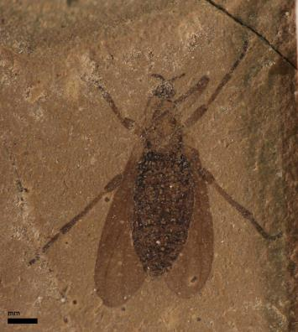
Collections in the Classroom Promoting the wider use of paleontological collections data
Derek Briggs, Susan Butts, Richard Kissel, and Chris Norris
Yale Peabody Museum of Natural History
Dena Smith and Talia Karim
University of Colorado Museum of Natural History
Notes:
With a spider and myriapod or two

Slide 2
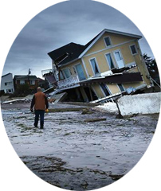

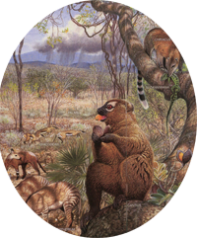
Natural history collections enable us to reconstruct Earth’s past, understand the present, and forecast the future
SPNHC, 2008
Image sources:
National Geographic
www.causecast.com
wunc.org

Slide 3
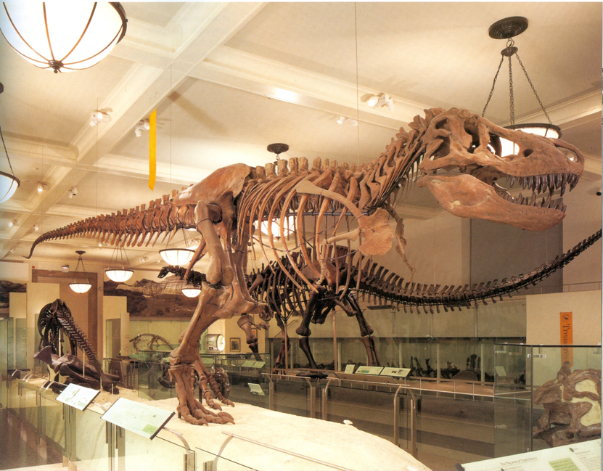
Some aspects of what we do are easy to grasp…
Image Source:
Dingus et al, Next of Kin (1996)
Notes:
For example, the idea of high value objects like a dinosaur skeleton that can be both displayed and studied
How good are we at conveying this?

Slide 4
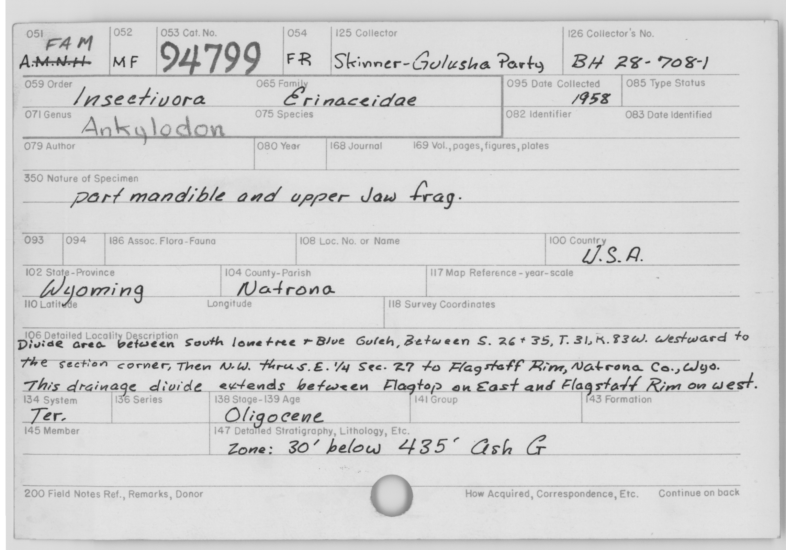
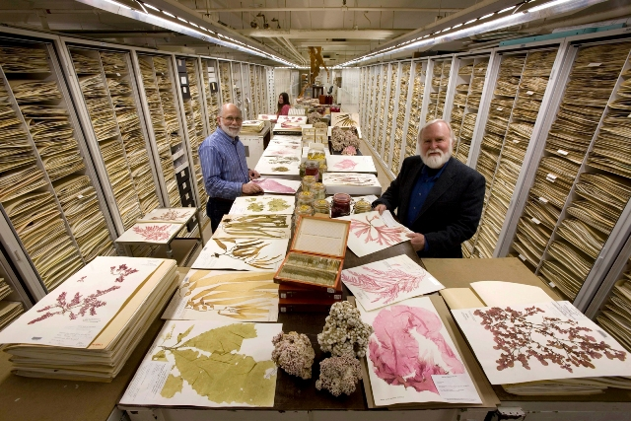
But two of the most critical features
Data
Size
Image Sources:
NMNH
AMNH
...are less suited to gallery-based outreach
Notes:
How good are we at conveying collections to our visitor public and to the public in general?
We can take a limited number of people on behind the scene tours,
but how many know the breadth of our function and purpose?

Slide 5
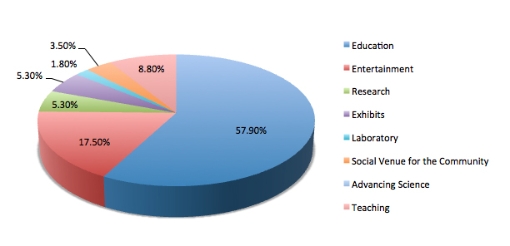
YPM Survey
Please select the word that best describes
your view of the Museum’s role
Notes:
Kissel designed and had a YPM intern administer survey to visitors in August 2014 (prelim study N=57)
ADVANCING SCIENCE!!!!?!?!??!! 0.0%

Slide 6
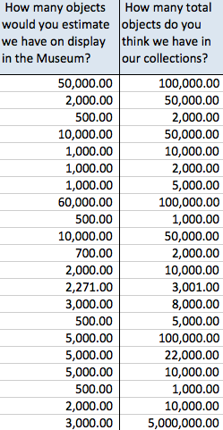
YPM Survey

Slide 7
YPM Survey
Actual Number of Objects on Display
5,000
Number of Objects within Collections
13,000,000
Percent of Objects on Display 0.04%
Visitor Impressions 27%

Slide 8
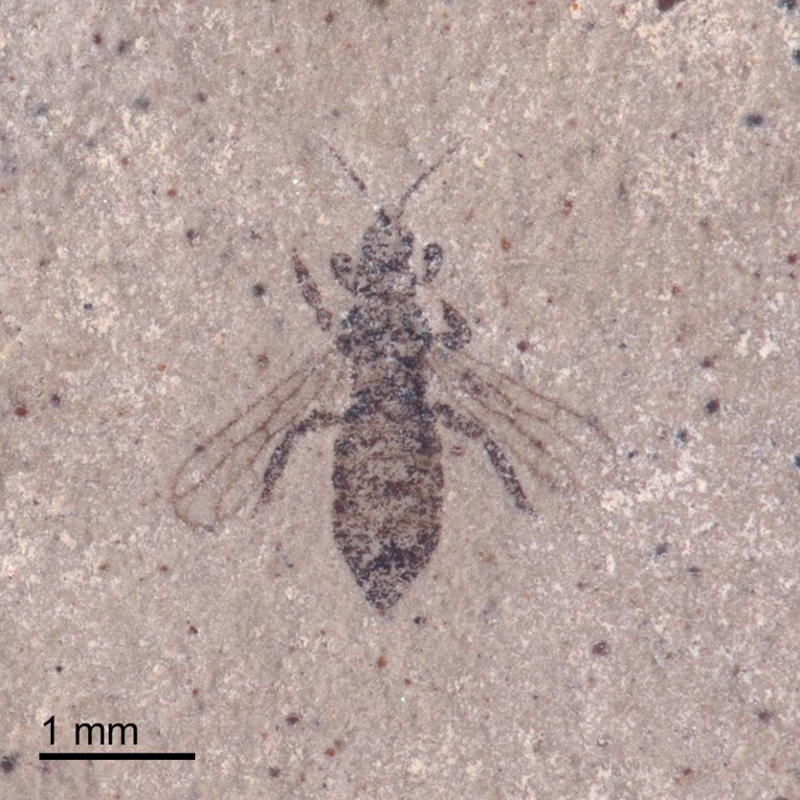

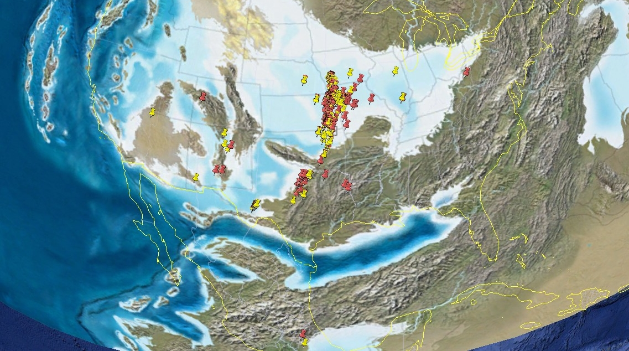
Students working with collections in the classroom
Image sources:
Illinois Natural History Survey
Susan Butts/Richard Krause/Yale University
Notes:
limits to the number of students that can have hands-on experience with the collections (city)
toolkit that can be used to extract and manipulate the data in the classroom.
real-time access to the same data that researchers use, and being able to use it to ask the same questions that they do.
What does the changing distribution of that species tell us about the changing climate?
What is the relationship between an animal and the plants that it feeds on? Why might they be different?
How can fossils show the changing positions of the continents over time?
The data are there in museum collections and more and more of these data are becoming accessible on-line because of the global digitization efforts.

Slide 9
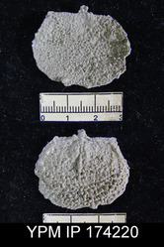

PaleoNiches PEN
PEN: Increasing the Robustness of the Ordovician and Pennsylvanian Dataset of PALEONICHES-TCN
Lead (TCN): University of Kansas (Lieberman, Beach, and Farrell)
YPM: Briggs
YPM will digitize
specimens that have been cataloged in EMu, but lack georeferenced data,
material cataloged in ledgers, and
uncataloged material from our stratigraphic collection.
Broader impacts: interns and kiosk

Slide 10
Fossil Insect Collaborative TCN
TCN: Fossil Insect Collaborative: A Deep-Time Approach to Studying Diversification and Response
to Environmental Change
Lead: University of Colorado Museum of Natural History - Smith and Karim
YPM: Butts and Norris
Notes:
$2.3M – digitization grant from NSF
4 year project 2013-2017
TCN Thematic Collections Network – ADBC advancing digitization of biological collections
Some of these slides are from the PIs

Slide 11

Fossil Insect Collaborative TCN
aggregate specimen data and images from collaborators and then to serve these data to iDigBio (national hub)
educational resources for fossil insects
central resource to interact with bio and geo cyberinfrastructure initiatives
High school student involvement
Notes:
PRODUCT: idigpaleo
Collaborate infrastrutures for answering BIG PICTURE questions – esp. biodiversity through time and climate change
You will be able to :
-query for insect groups
-update taxonomic determinations (vetted by museum)
-assemble groups of photos (i.e. before you go out collecting in a certain area, you can make a faunal list with images)
-connect to social media

Slide 12
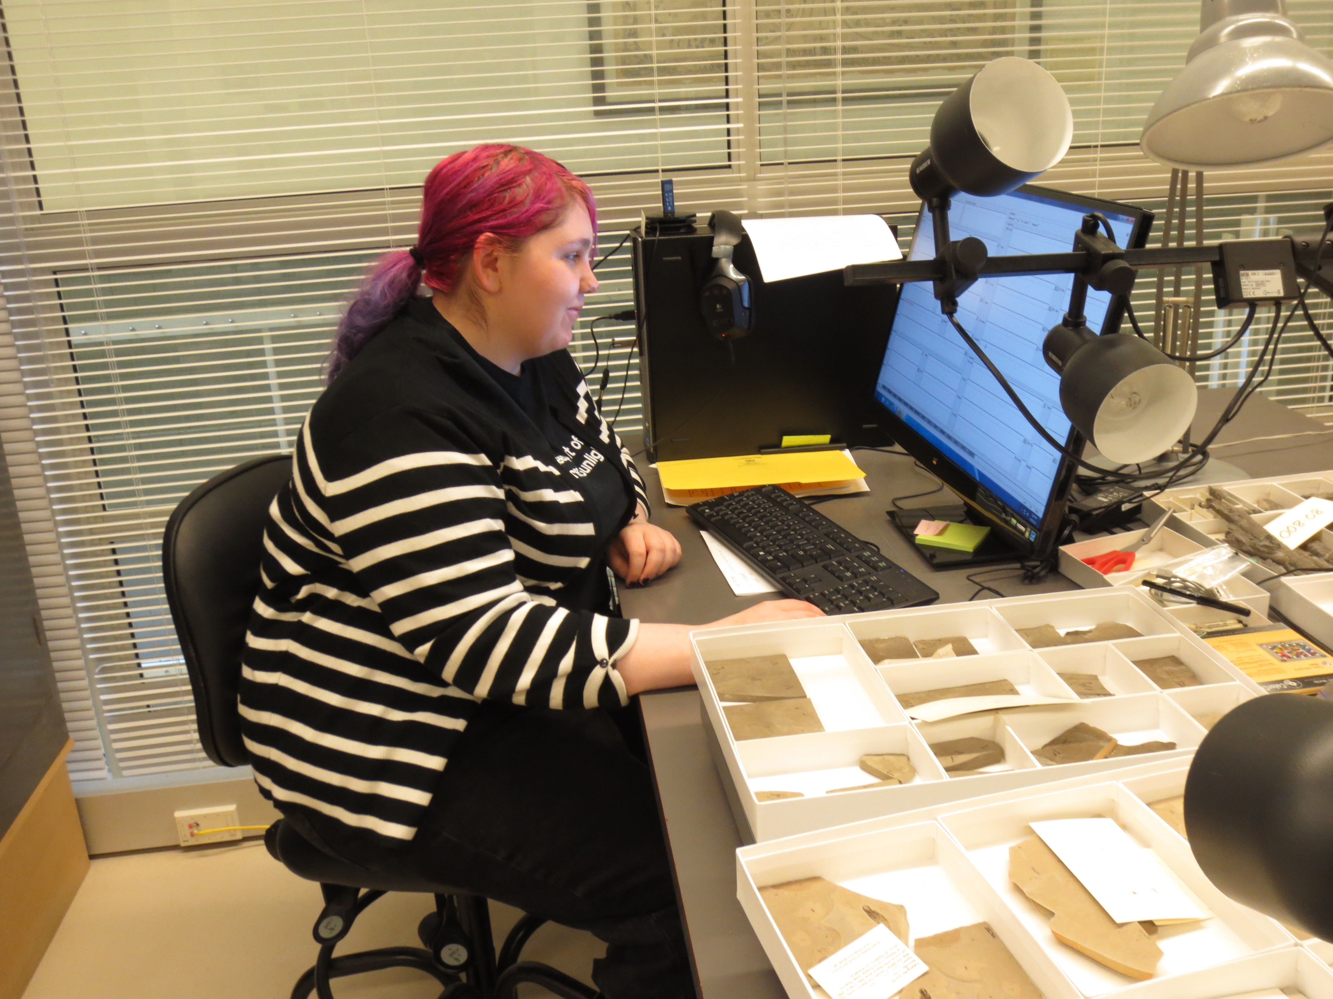

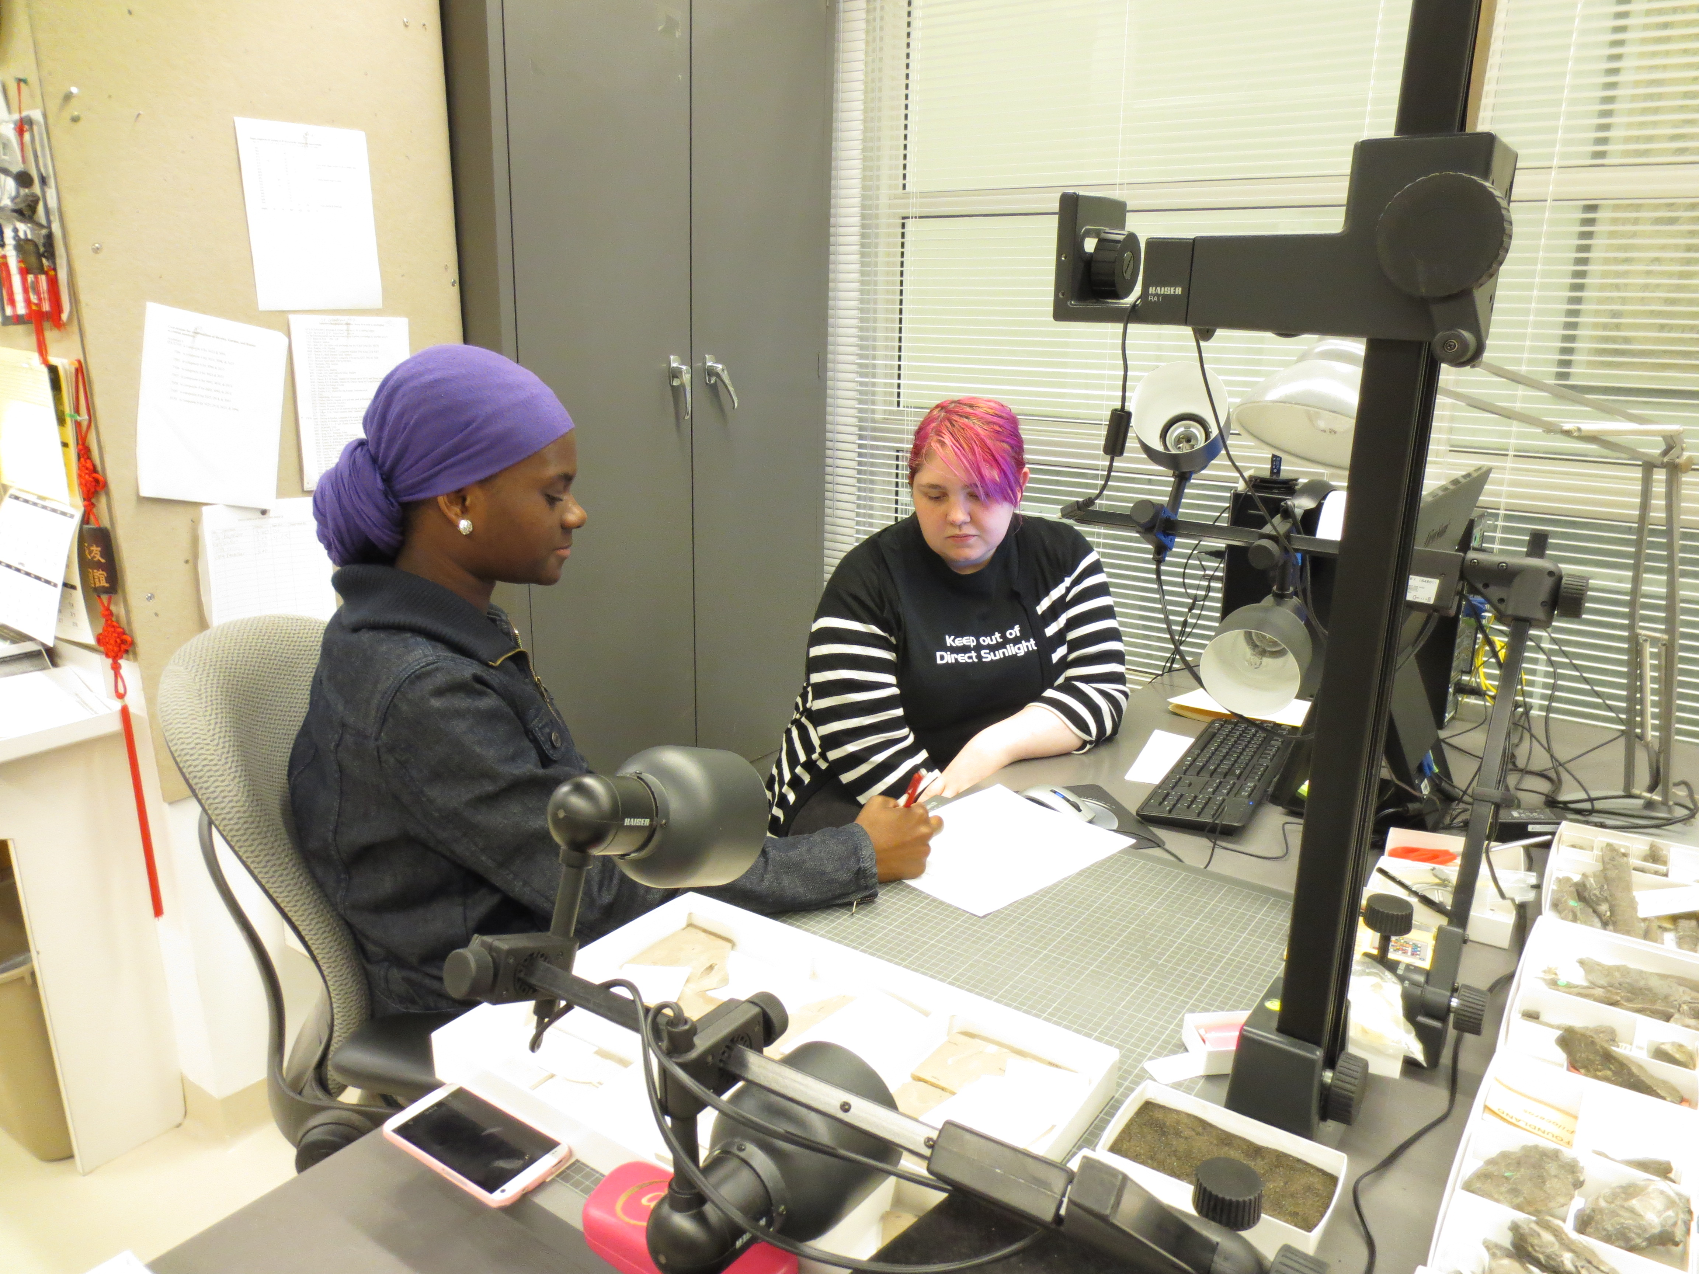
EVOLUTIONS
Notes:
One way to expose students to the collections is to have them work with the collections themselves…
We do this through YPM’s after school program for high school students, EVOLUTIONS ("EVOking Learning and Understanding Through Investigations Of the Natural Sciences")
EVOLUTIONS engages high school students in a curriculum that focuses on:
Development of transferable skills, enhancing scientific literacy
Making clear connections between secondary education and STEM (science, technology, engineering, and mathematics) careers
Empowering students through hands-on science experiences, and reshaping student perceptions of what it means to be a scientist and do science
Interns – One year in collections - digitization and museum curation, develop kiosk as a final product

Slide 13
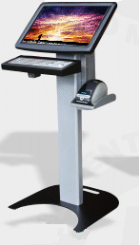
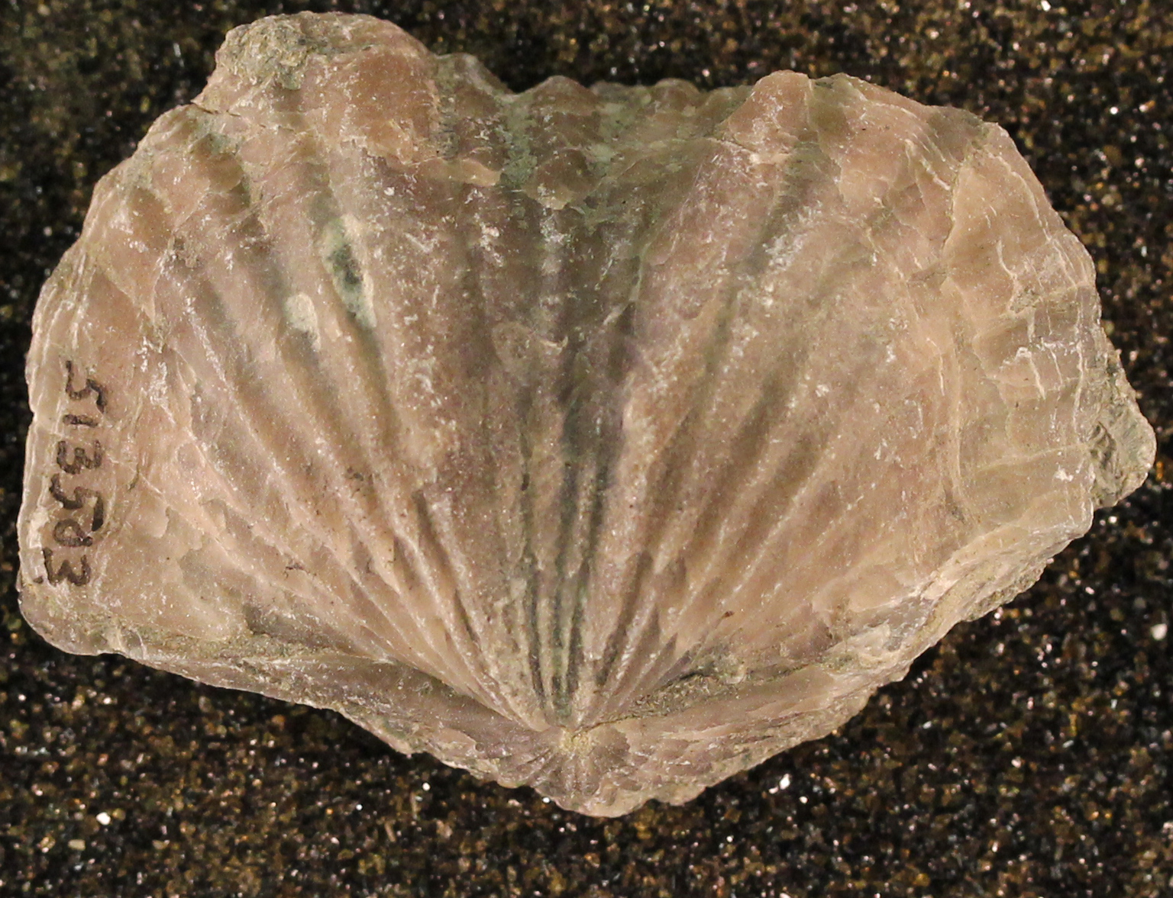
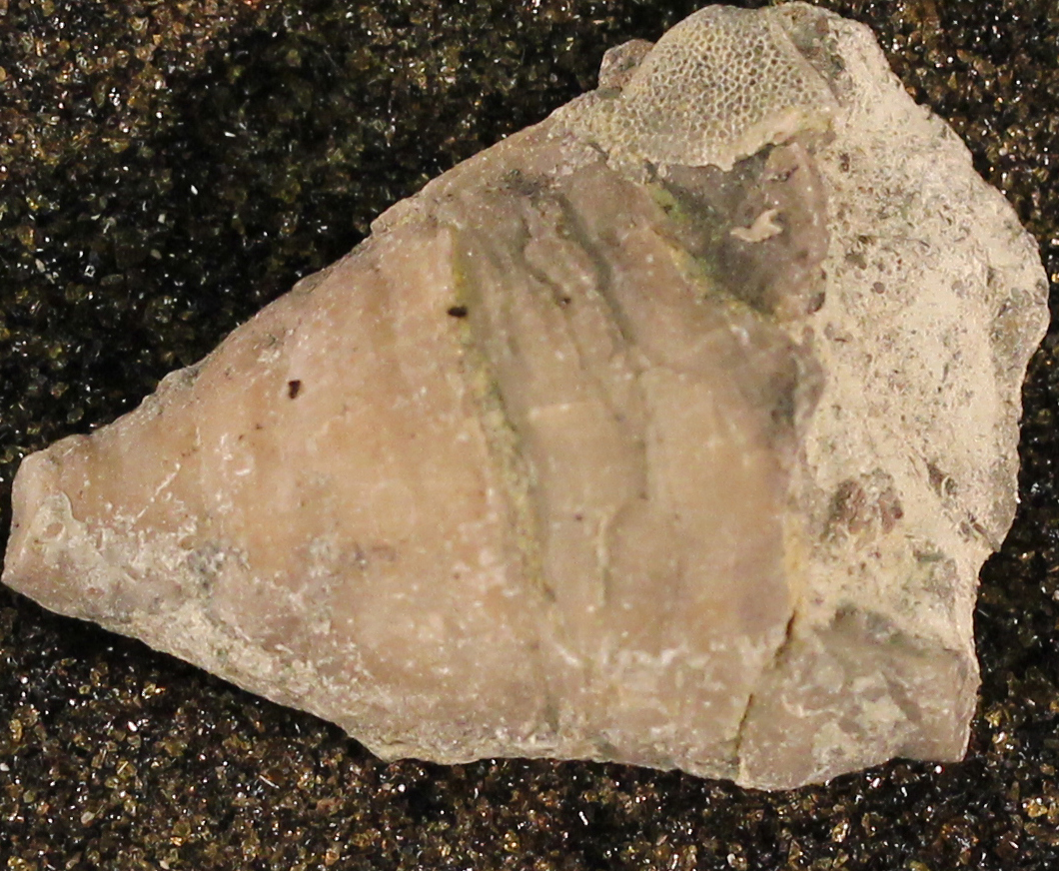
EVO kiosk
SciCORPS Interpreters
*Do you want to look at/touch some real fossils?
*Do you know what type of fossil animal it is?
Ordovician assemblage
Notes:
SIMPLE criteria for identification to higher taxon level
Lead-in to video tour

Slide 14
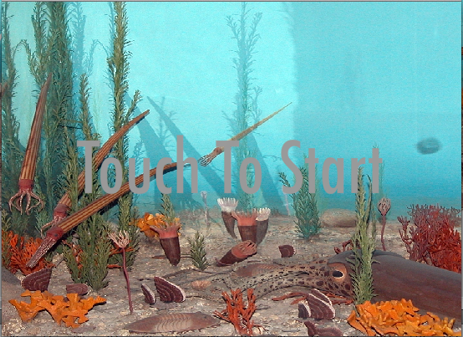
EVO kiosk

Slide 15
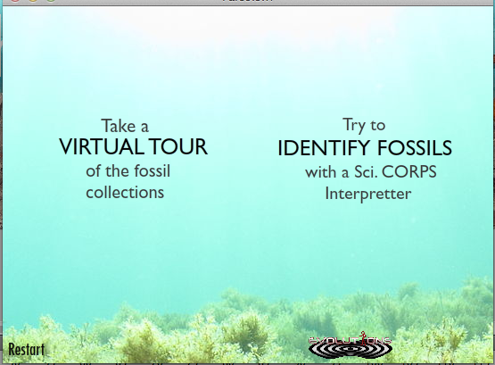
EVO kiosk
Notes:
Talk about Identify fossils _____ 12 very different fossils
Connect to Digital atlas (paleoniches TCN)

Slide 16
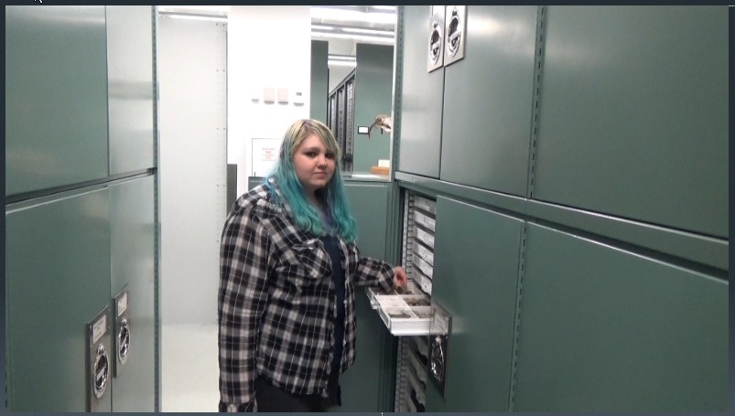
EVO kiosk
Watch the video:
https://www.youtube.com/watch?v=DhMHht-Cemk
Notes:
Approachable!

Slide 17
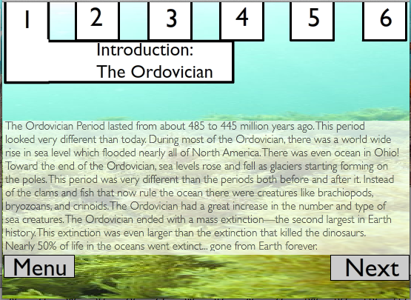
EVO kiosk
Introduction: The Ordovician
Collecting
Digitization
Identification
Behind the Scenes
Big Ideas
Available online

Slide 18
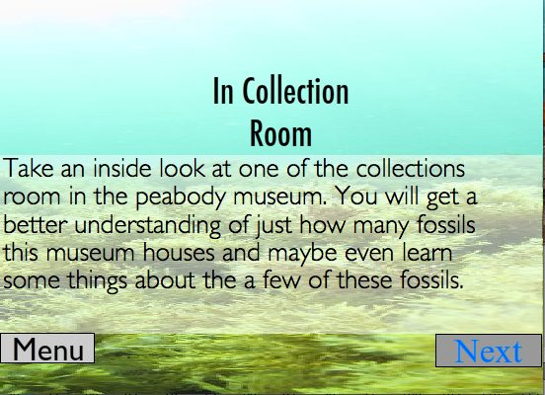
EVO kiosk

Slide 19
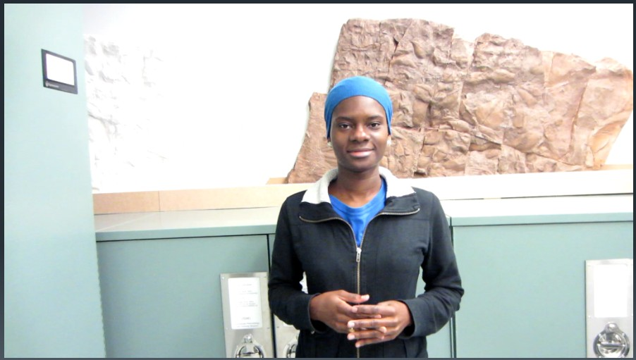
EVO kiosk
Watch the video:
https://www.youtube.com/watch?v=iJUseYmTReU

Slide 20
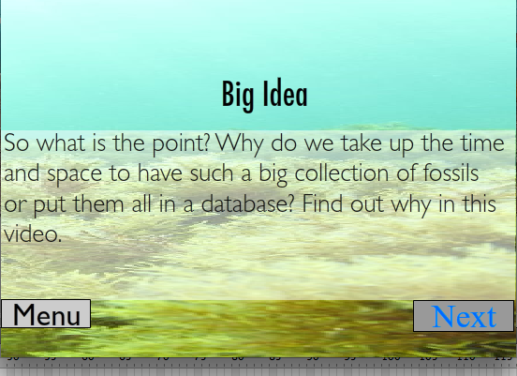
EVO kiosk
Notes:
Interview with visiting researchers

Slide 21
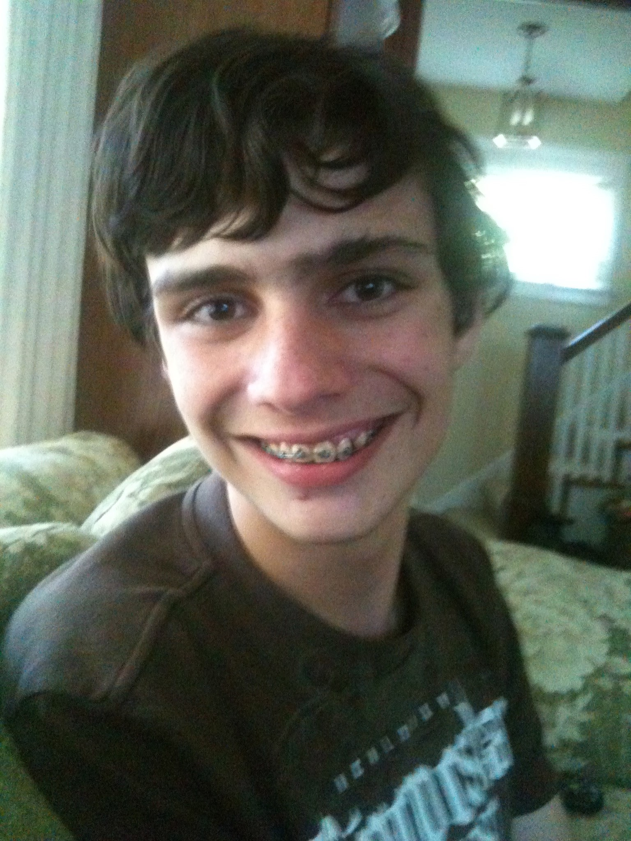
EVO kiosk
Kristie M.
Junior, Metropolitan Business School
Intern, development, text, host
Kaussar R.
Senior, West Haven High (now Mount Holyoke)
Intern, development, text, host
Shawn D.
Senior, Metropolitan Business School
Programmer
TBD
Interpretation developer
Sci CORPS interpreters

Slide 22
Teacher workshop
EVO interns
~94,323 specimen records
~10,500 digital images
Ultimately: 500,000 digitized specimens
Notes:
Teacher workshop will explore potential uses in classroom, refine toolset, and create sample activities.
EVOLUTIONS after-school students will work with YPM staff to test and ground-truth activities

Slide 23
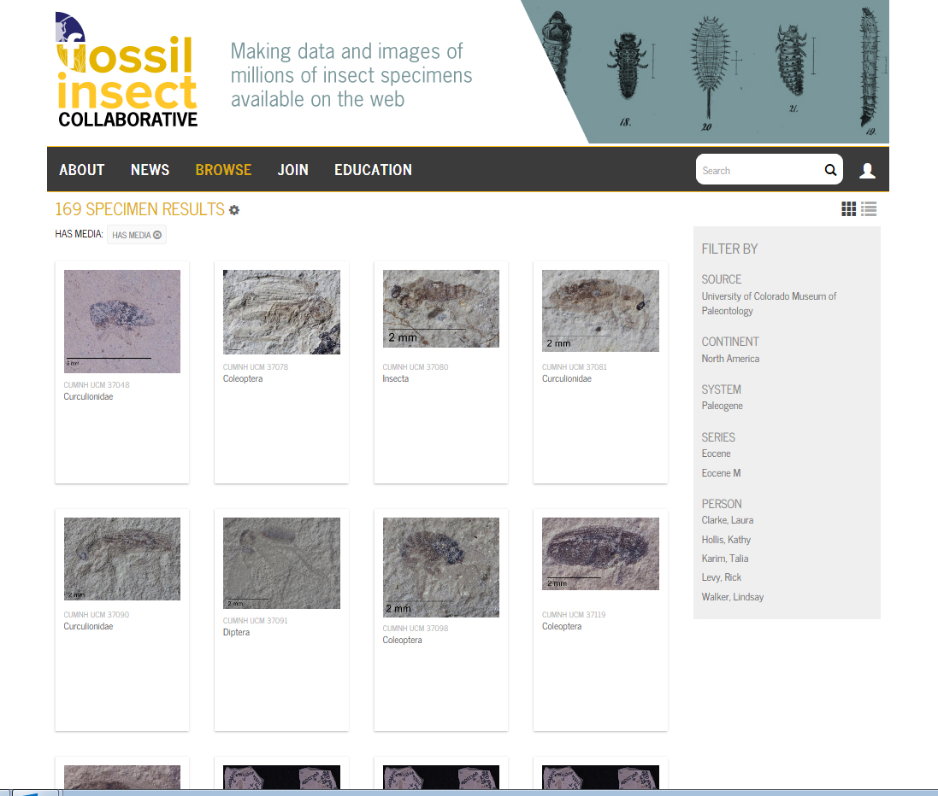

Slide 24
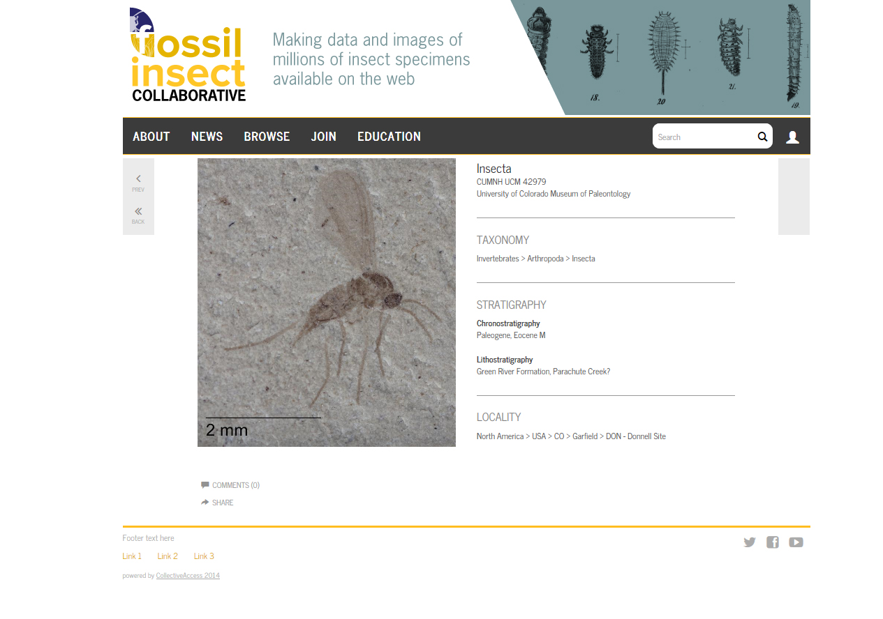

Slide 25
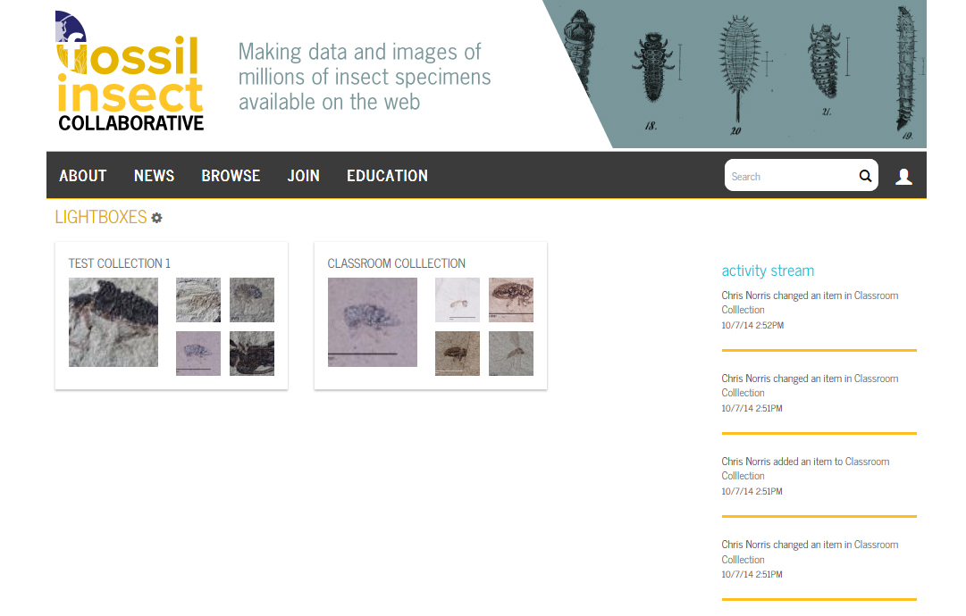

Slide 26
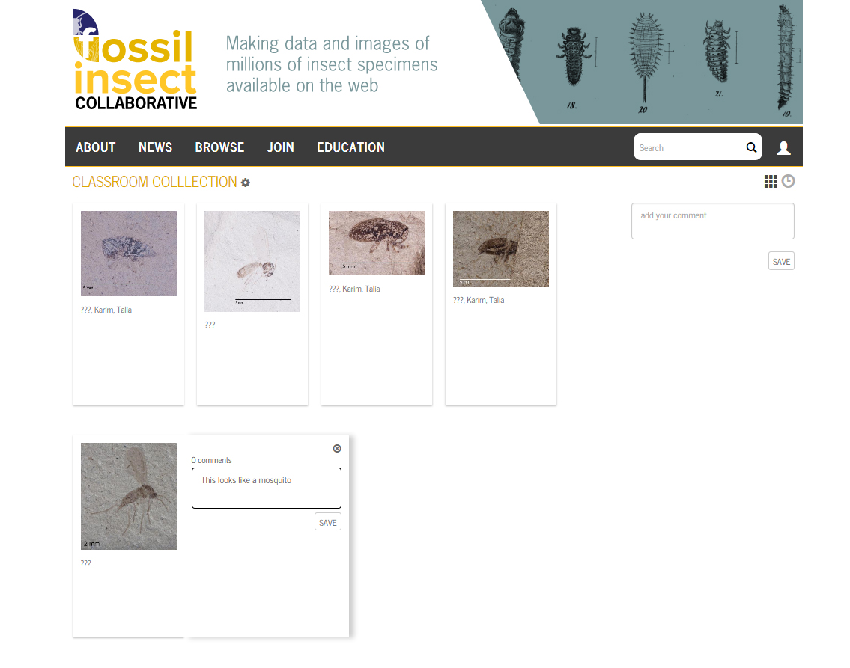

Slide 27
Work on TCN/PEN allows students
To gain an understanding of the size and scope of museum collections
To build their own virtual collections in the classroom
To use data from those collections to answer real scientific questions
Bring the collection to the classroom and the public

