Slide 1
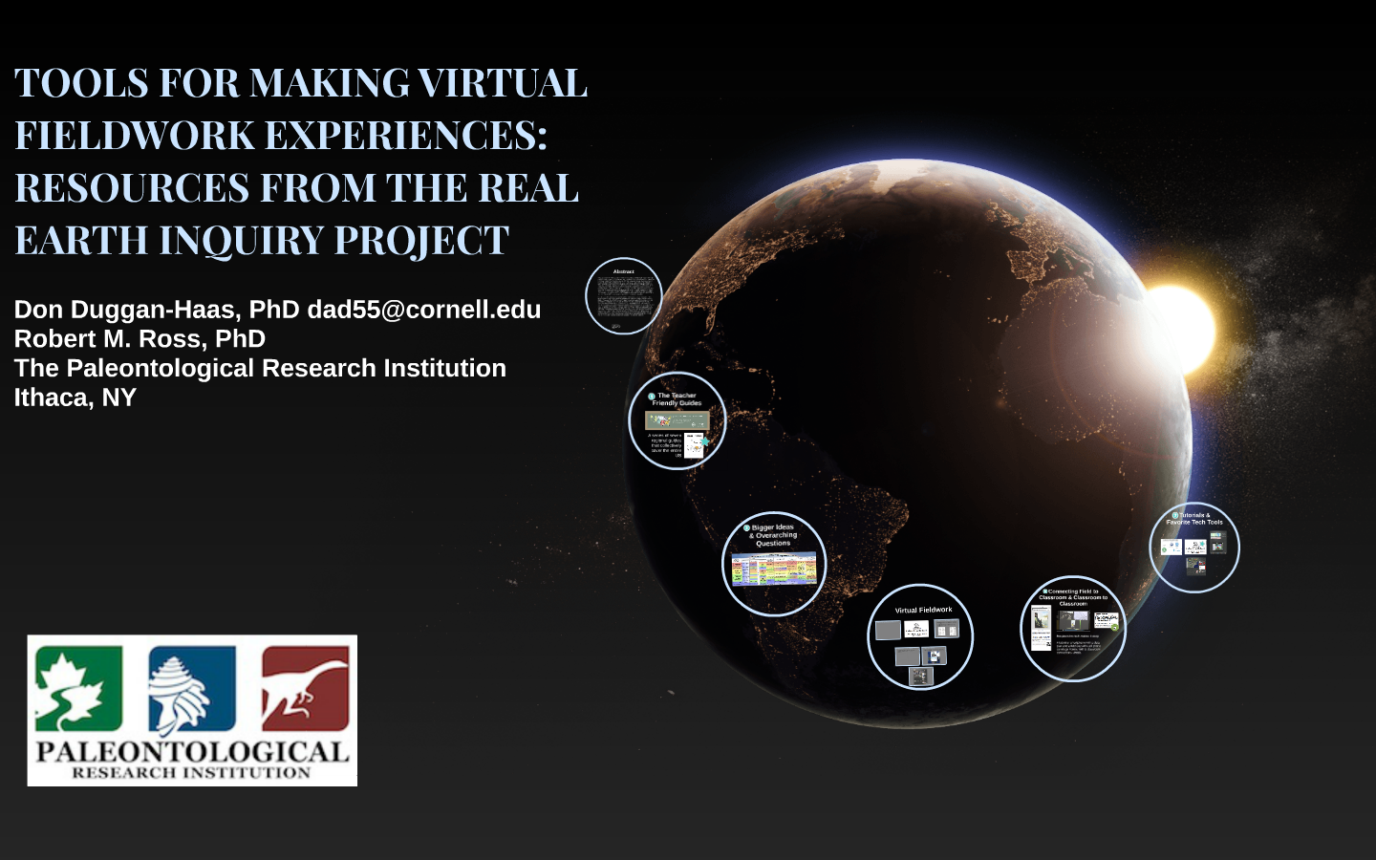
TOOLS FOR MAKING VIRTUAL FIELDWORK EXPERIENCES: RESOURCES FROM THE REAL EARTH INQUIRY PROJECT
Don Duggan-Haas, PhD
Robert M. Ross, PhD
The Paleontological Research Institution
Ithaca, NY
dad55@cornell.edu

Slide 2
Find the presentation’s Prezi online here:
http://bit.ly/VFEtools2014

