Slide 1


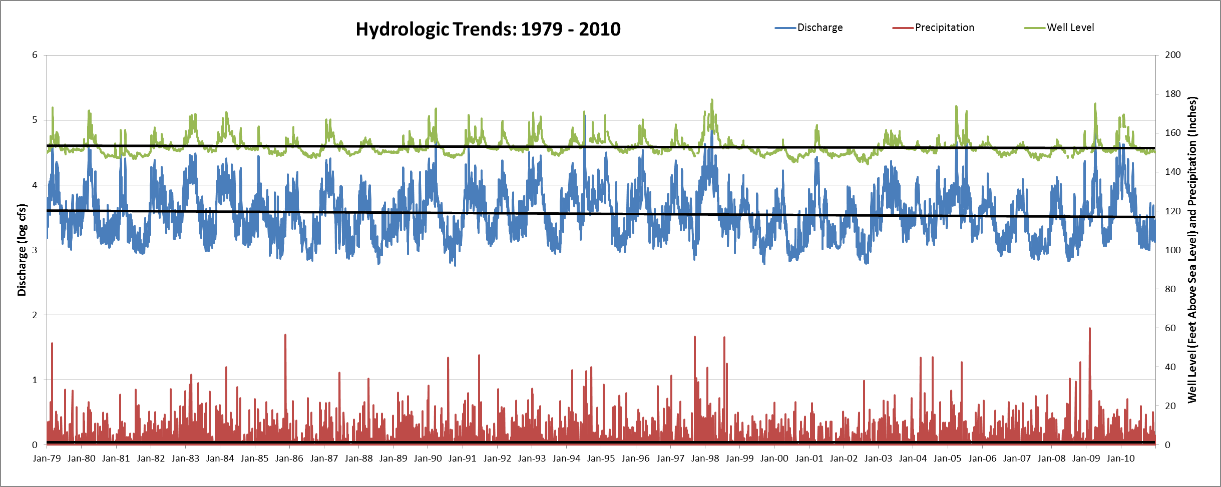
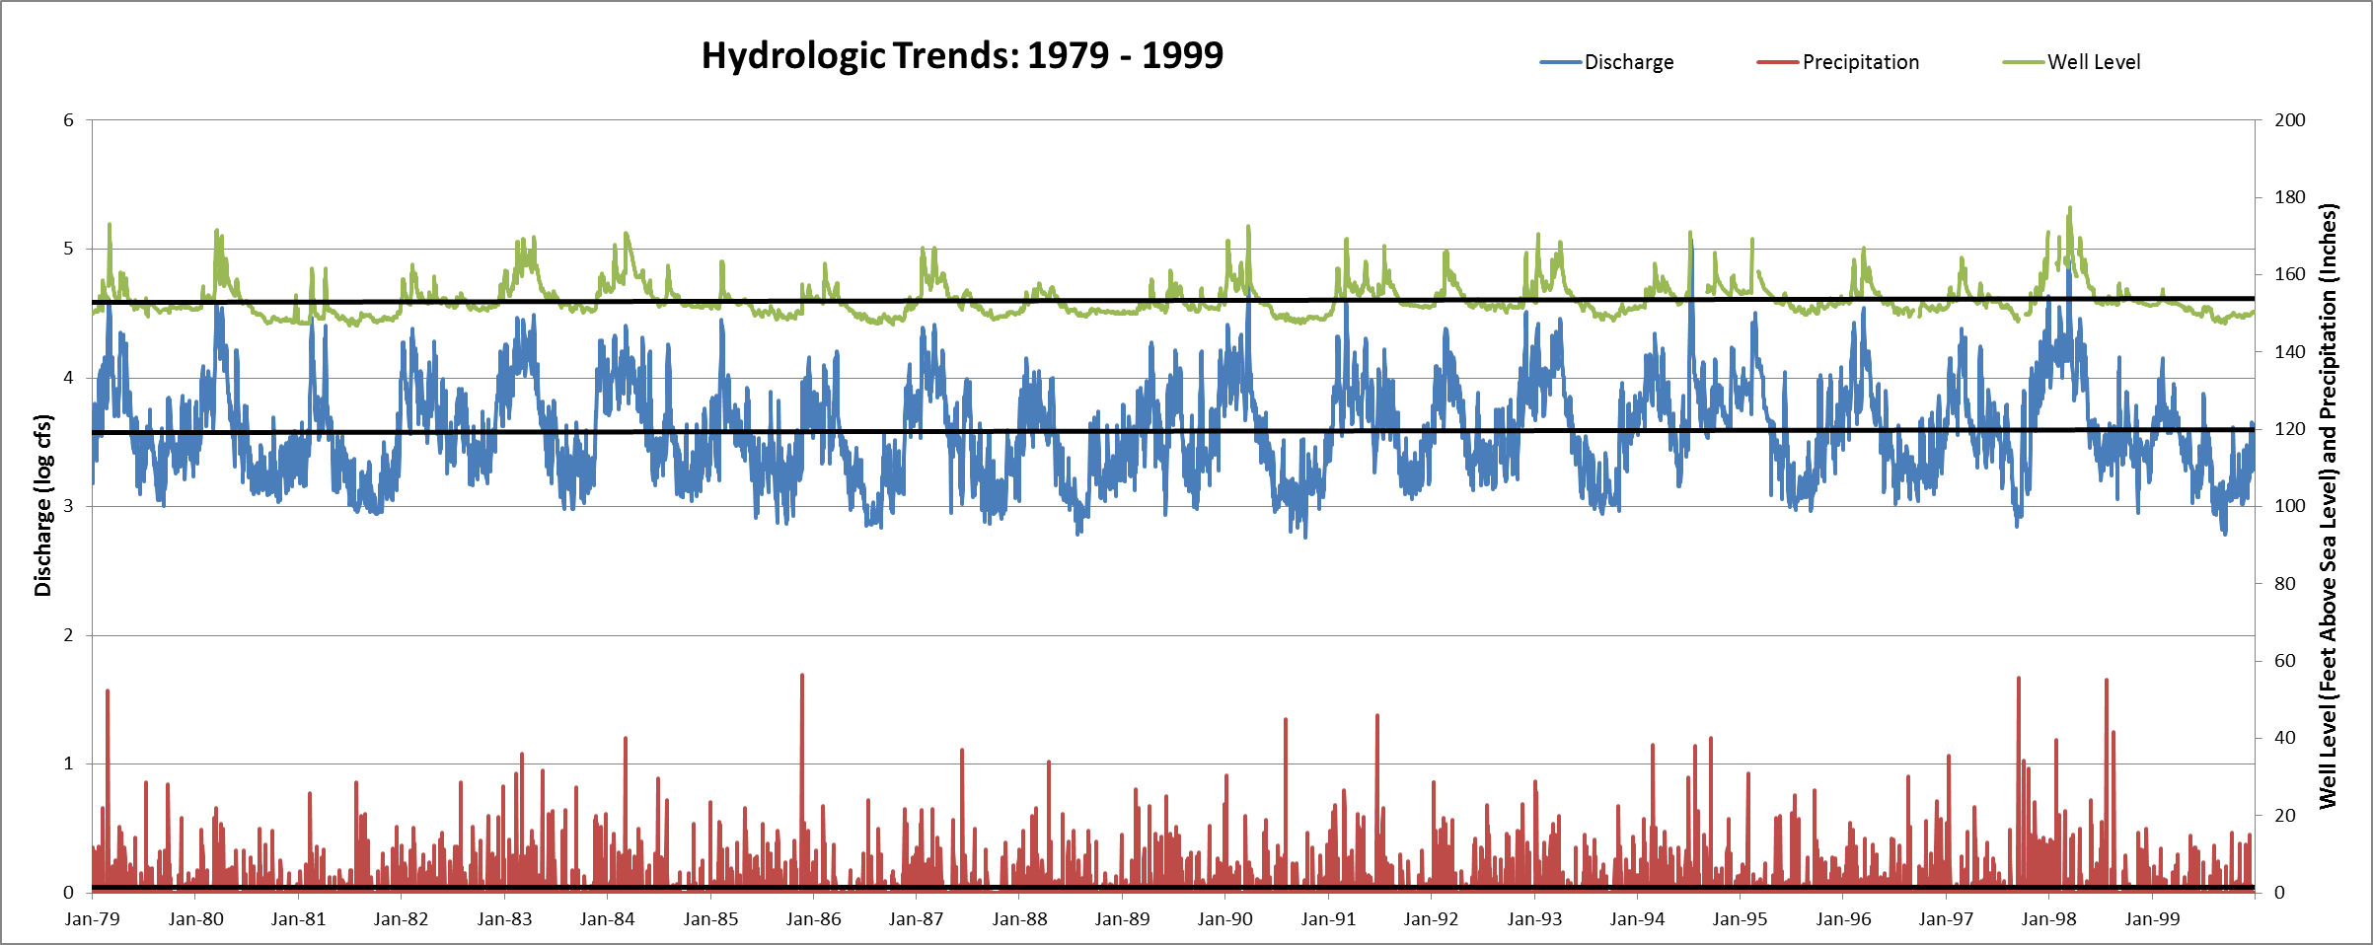
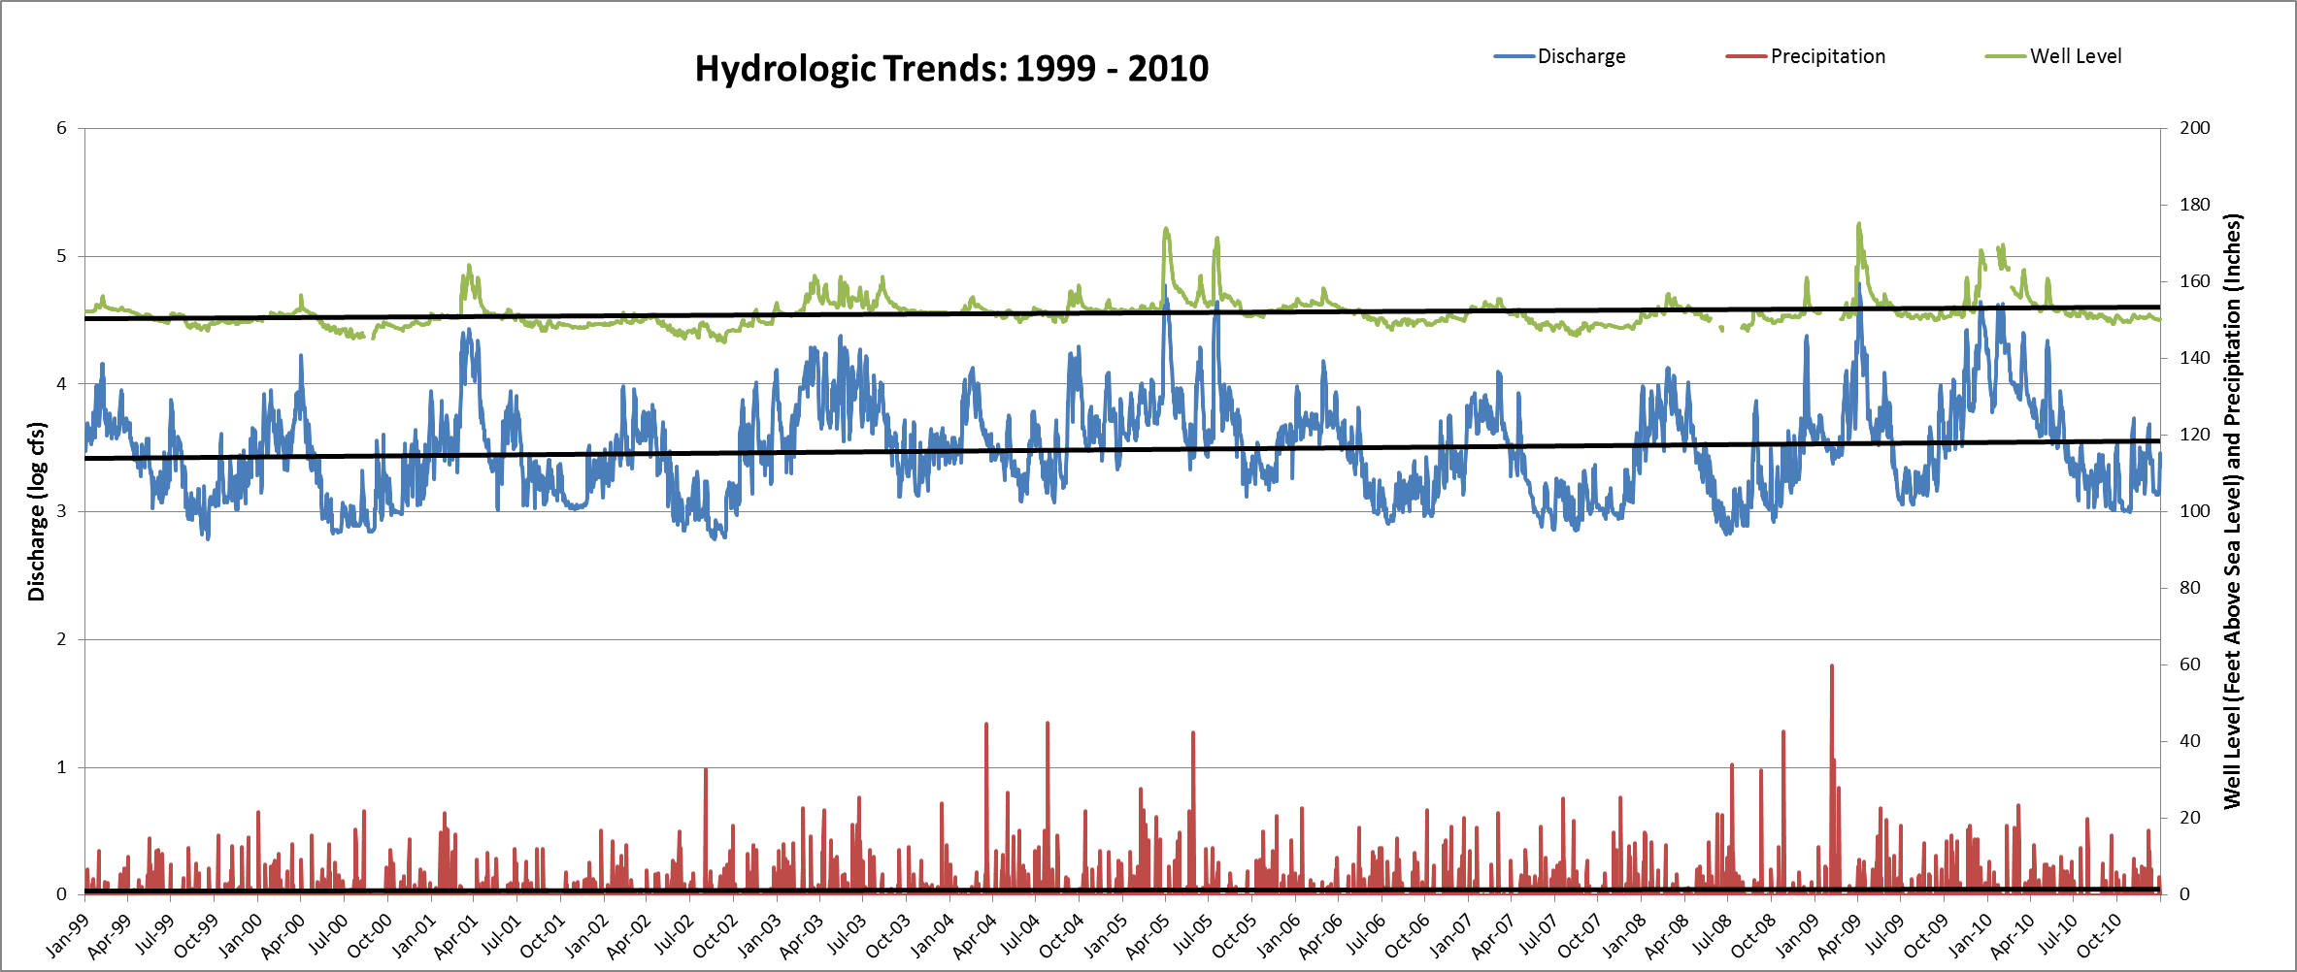
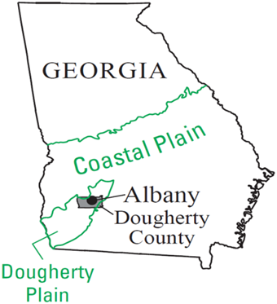
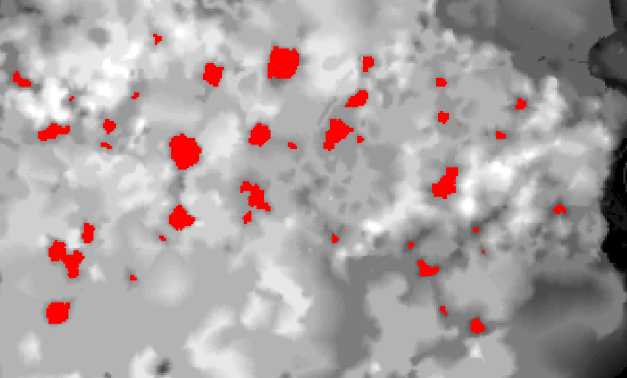
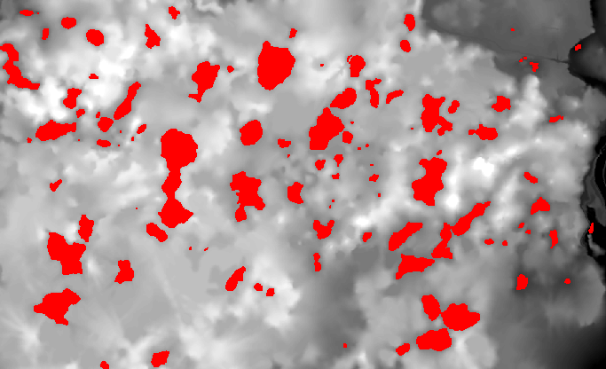
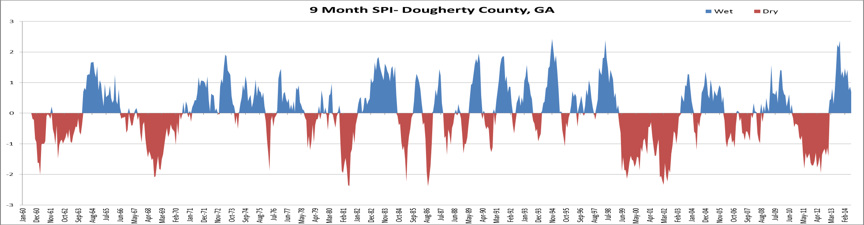
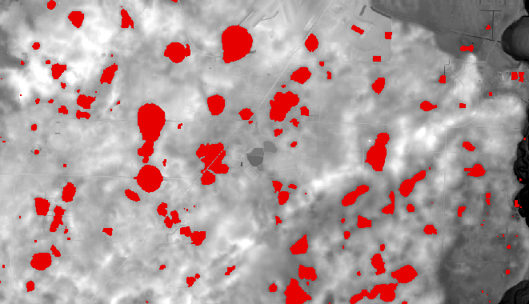

Spatiotemporal Analysis of Sinkhole Development in the Covered Karst Terrain of Dougherty County, Georgia
Matthew Cahalan¹ and Adam Milewski¹
¹ Department of Geology, University of Georgia, Athens, GA, 30602, USA
Abstract:
The Upper Floridan Aquifer (UFA) has provided important ecosystem services in Dougherty County for several decades. Alongside increased water demand due to a growing populace in an agricultural area, this area has experienced short and long-term fluctuations in precipitation, surface water discharge, and groundwater levels. Located within karst terrain in southwest Georgia, sinkhole development has placed many areas at risk. Evaluating the causes of sinkhole formation is essential for risk reduction within karst settings.
In this study, we evaluate sinkhole development in Dougherty County utilizing digital elevation models (DEM’s) from 1979, 1999, 2010, and 2011 processed using ArcGIS 10.1 software and compare them with one another to determine the change in the spatial variation and number of sinkholes through time. Alongside past sinkhole maps, geologic maps, and aerial imagery, well level, river discharge, precipitation, soil, and land use data were used to correlate hydrologic, climatic, and geologic phenomena with sinkhole formation.
Results indicate a direct relationship between hydrologic factors and sinkhole formation. DEM analysis results show a 77.2% ±5% increase in sink points from 1979 to 1999 and a 9.8% ±5% increase from 1999 to 2010. A 5% error was estimated due to variations in DEM resolution, source, and processing techniques. The increase in depressions is consistent with climatic and hydrogeologic data. Furthermore, the Standardized Precipitation Index shows increases in frequency and magnitude of drought conditions from 1970 – 1999, and a prolonged drought period from 1999 - 2004. Historical analyses of precipitation, Flint River discharge, and well level data are consistent with average conditions from 1970 – 1990 (50 inches annually, 6,000 cubic feet per second (cfs), and average well levels, respectively). From 1990 – 2000, conditions were above average (53 inches annually, 7,000 cfs, and increasing well levels). Conditions were below average from 2000 – 2010 (45 inches annually, 5,000 cfs, and declining wells levels).
Results from regression analysis provide further insights into sinkhole formation. Distance to fractures, interpolated groundwater elevation surfaces, soil type, and land use were used as explanatory variables. Groundwater elevation and distance to fractures proved to be the most influential variables in sinkhole location.
Future research efforts will focus on identifying the temporal evolution of county-wide subsidence using satellite data and radar interferometry. These data will provide higher temporal resolution for more precise correlations between sinkhole formation, subsidence, and hydrologic and anthropogenic patterns.
.
Hydrologic and Climatic Analysis
Temporal Analysis
Sinkhole Delineation and Regression Procedure
Climatic, discharge, extraction, well levels, roads, buildings, urban structures
Data acquisition
DEM’s, aerial imagery, geology, land use/land cover, soils, hydrography
Digital Elevation Model
Fill in sinks to spill level
Extract values greater than vertical accuracy of DEM
Fig. 7 - Overall hydrologic and climatic trends from 1979 – 2010. This area experiences highly fluctuating groundwater levels and discharges.
Generate a “fill-difference” raster
Reclassify to integer type raster
Fig. 11 - An increase in sink points was observed for every time-step. The relationships between varying spatial resolutions of DEM’s in sinkhole analysis can also be seen, particularly between 2010 and 2011.
Convert to polygon layer without simplifying
Calculate zonal geometry table and join to polygon layer
Regression Results
Remove polygons based on threshold area
Begin regression procedure on threshold sinkhole polygon layer
Validate with aerial imagery and previous sinkhole maps
Produce interpolated aquifer elevation surface
Fig. 8 - Trends in hydrologic and climatic variables from 1979 – 1999.
Attribute explanatory variables to threshold polygon layer
Land use/land cover
Distance to fractures
Fig. 12 – Adj. R² results from the regression models (OLS) for each year. Explanatory variables were groundwater levels, soils, land use, and distance to fractures. Among the four regression models that were run for each year (1979, 1999, 2010, and 2011), and between the different years, groundwater levels and distance to fractures were the most influential variables. However, the regression models performed best when all four explanatory variables were considered for each year.
Aquifer levels
Perform regression analysis
Soils
Fig. 2 - Processing procedure for the Digital Elevation Models (DEM’s) from 1979, 1999, 2010, and 2011, which were used to analyze sinkhole development within an area of Dougherty County that experienced moderate to high groundwater extraction rates.
Fig. 9 - The frequency and magnitude of fluctuations are less than previous years, which may explain the decrease in sinkhole development.
*Discharge and well level data were collected from the National Water Information System (USGS). Precipitation data were gathered from the National Climatic Data Center (NOAA).
Conclusion
Objectives:
Delineate both verified and potential sinkholes using ArcGIS software and DEM’s.
Evaluate the influences of hydrologic and climatic variables on sinkhole formation rates.
Apply regression models to better understand the relationship between sinkhole development and hydrologic, geologic, landscape, and climatic influences.
Area of Investigation
Proposed Sinkhole Maps*
Sinkhole formation showed varying rates of increase between 1979 – 2011. The proposed processing procedure was successful at delineating sinkholes temporally and attributing their formation to various factors spatially. The increase in sinkholes exhibited correlations with hydrologic (stream discharge), climatic (precipitation), and geologic (aquifer levels and distance to fracture traces) factors, as well as soil type and land use. The increased spatial resolution of LiDAR DEM’s and utilization of radar interferometry for subsidence analysis will improve the proposed processing procedure.
Standardized Precipitation Index
Fig. 3 - 1979 sinkhole map.
Fig. 5 - 2010 sinkhole map.
Questions?
Matthew Cahalan – mcahalan@uga.edu
Acknowledgements
Fig. 1 - Map of study area.
Fig. 4 - 1999 sinkhole map.
Fig. 6 - 2011 sinkhole map.
Fig. 10 - Standardized Precipitation Index (9 month) from two NOAA rain gauges. Dry conditions are prevalent from 1999 – 2013. However, more frequent fluctuations and greater magnitudes are observed from 1970 – 1999.
The Geological Society of America
International Association for Mathematical Geosciences
University of Georgia Office of the Vice President for Research
Randy Weathersby-Albany GIS
*Proposed sinkholes are in red

