Slide 1
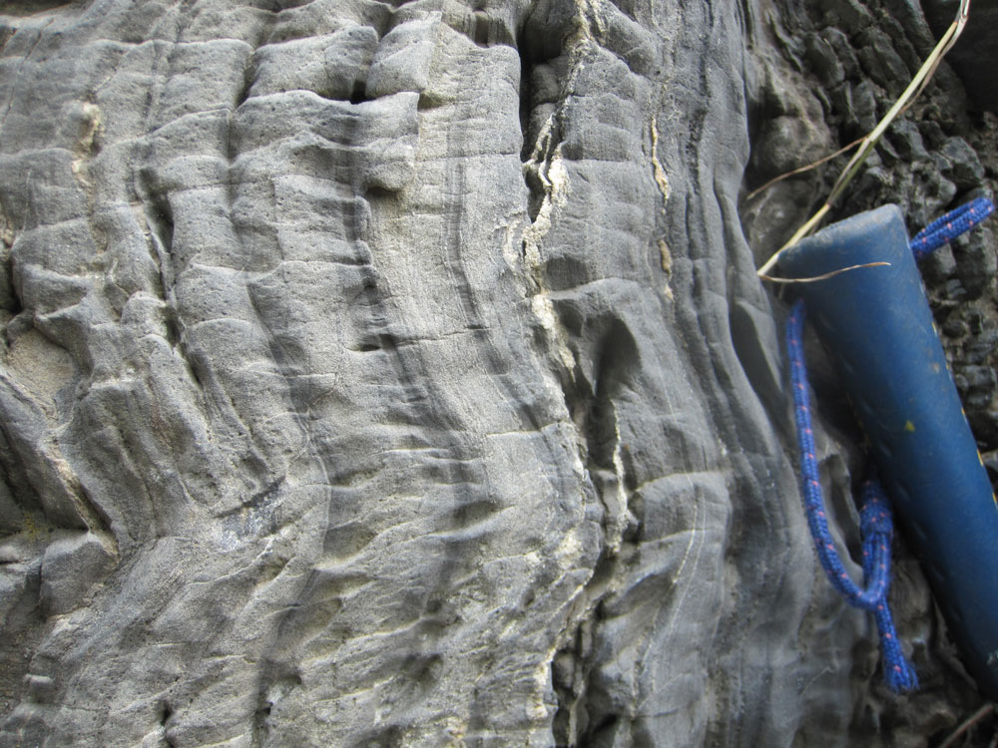
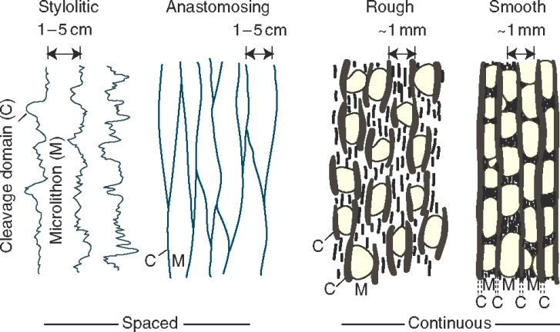
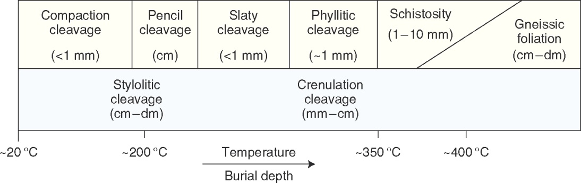
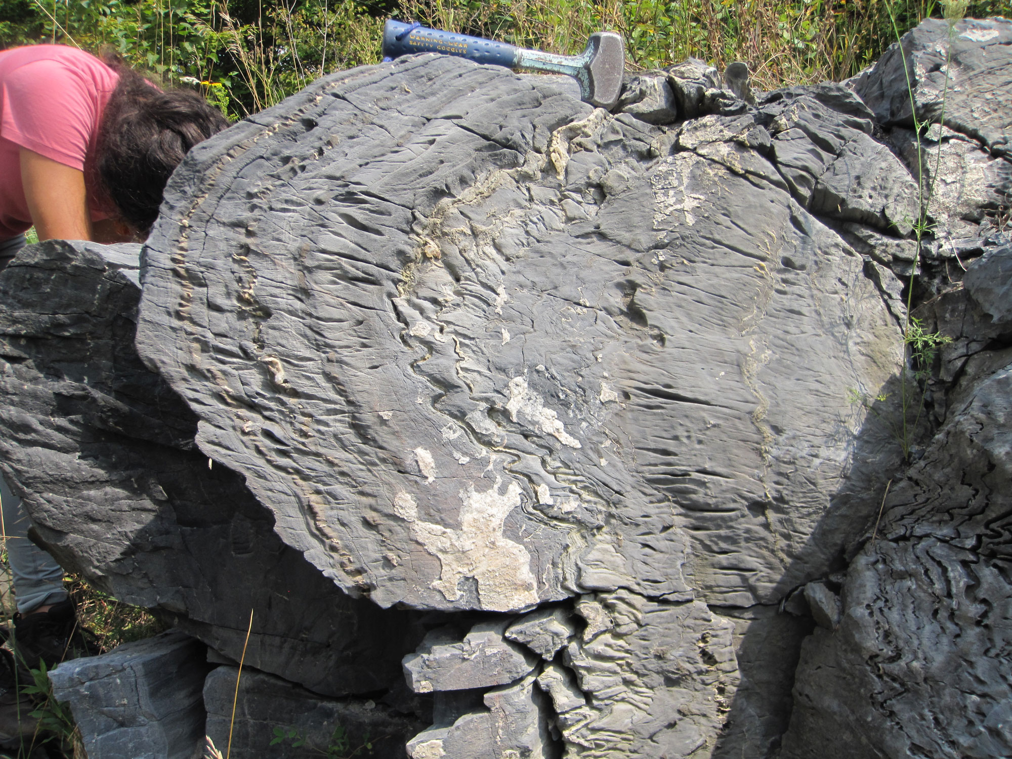
AN UNUSUAL DISJUNCTIVE CLEAVAGE IN GRENVILLIAN CARBONATES FOLDED AT THE UPPER GREENSCHIST FACIES (SOUTHERN ONTARIO, CANADA)
Michelle MARKLEY (mmarkley@mtholyoke.edu), Steve DUNN, and Taylor BENNETT
Geology & Geography, Mt.Holyoke College, 50 College Street, South Hadley, MA 01075
1. THE FOLDED MARBLES
2. THE RUB: A SUB-GREENSCHIST FACIES FABRIC AT A GRADE OF UPPERMOST GREENSCHIST FACIES GRADE
3. OBSERVATIONS IN THIN SECTION, DEFORMATION MECHANISMS
In some thin sections, axial planar cleavage (below dipping moderately to the left) is penetrative and defined by oriented mica and elongate calcite grains. The uniform compositions of calcite, dolomite, and phlogopite, in addition to relatively straight grain boundaries, are evidence for neo-crystallization of mica and recrystallization of calcite (rather than pressure solution) as the mechanism for axial planar cleavage formation.
Figures 12.2 & 12.3 from Fossen’s 2010 Structural Geology (these ideas and images are ubiquitous in structure texts)
I 200 microns
At the outcrop- and hand-sample scale, the axial planar cleavage appears to be a spaced disjunctive cleavage, of the sort commonly associated with pressure solution during sub-greenschist facies deformation.
Folds in Grenville Supergroup marbles here are open to tight, sub-similar to sub-parallel, with cm- to dm-scale wavelengths. Variations in grain size and mode define layering, which is likely transposed bedding (the protolith is limestone/dolomite with varying proportions of pelitic material). Cleavage is strictly axial planar; it rarely fans about fold axial planes.
A STUNNINGLY BEAUTIFUL, DISJUNCTIVE, AXIAL PLANAR CLEAVAGE
In other sections, axial planar cleavage is less penetrative, calcite grains are relatively equant, and spaced cleavages are sometimes defined by wispy layers of isotropic material and/or pods of relatively coase-grained calcite and quartz (in the thin sections below, cleavage is sub-vertical). These observations are consistent with pressure solution and reprecipitation of calcite during low-grade metamorphism.
BUT these rocks experienced peak conditions of deformation and metamorphism to the upper greenschist facies (about 450-500 degrees Celsius) in the “Hastings Metamorphic Low” of the Elzevir Terrane of the Composite Arc Belt (and the Central Metasedimentary Belt). They are likely deformed during peak regional metamorphism of the Ottawan phase of the Grenville Orogeny. The mineral assemblage is calcite and mica (phlogopite), with lesser dolomite, quartz, muscovite (possibly detrital), chlorite, and plagioclase. Accessory minerals include graphite, apatite, rutile, hematite, and sulfides. The mineralogy of the rock requires that it is on the high-grade side of dolomite + Kspar -> phlogopite + calcite reaction. In addition to this assemblage, two other lines of evidence constrain peak conditions of deformation and metamorphism to the upper greenschist facies: 1) two reliable thermometers (the calcite-graphite isotopic thermometer and calcite-dolomite solvus thermometer), and 2) mineral assemblages, including the co-existence of albite and oligoclase in these metamorphosed carbonates and associated mafic rocks.
I 200 microns
4. QUESTIONS AND HYPOTHESES
• Were there two episodes of cleavage formation?
(one at the start of the prograde path, another at its peak)
• Was there continuous cleavage formation along the prograde path?
(as deformation mechanisms switched from dissolution to recrystallization)?
• Is the disjunctive (i.e. spaced) appearance of cleavage due to the late development of subhorizontal joints during weathering and/or the waning stages of exhumation?

