Slide 1
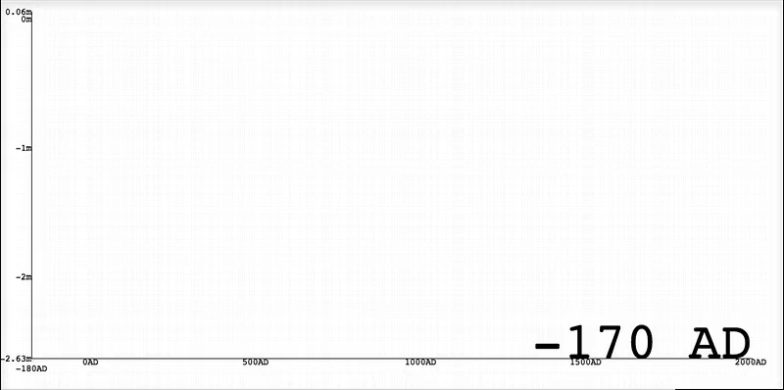
North Carolina Relative Sea Level 0 - 2000 AD
animation based on sea-level data from Kemp et al. (2011) PNAS.
rise >>
subsidence
rise ≈ subsidence
Elevation (m MSL)
rise > subsidence
relative rise ≈ subsidence rate
box sizes represent
elevation range and calendar age distribution of each sea level index point
Time (years)
Animations created by T. Storrs Kegel (Haverford College) and Don Barber (Bryn Mawr College) dbarber@brynmawr.edu

Slide 2
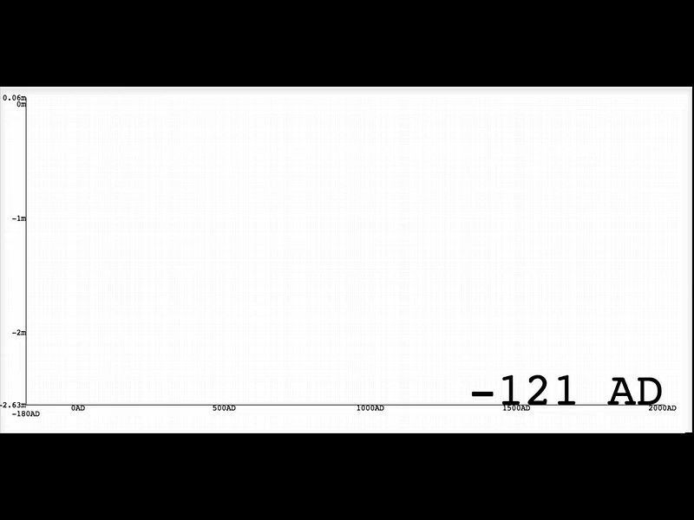
Animations created by T. Storrs Kegel (Haverford College) and Don Barber (Bryn Mawr College) dbarber@brynmawr.edu
NC coast subsides ~1 mm/yr due to Glacial Isostatic Adjustment
Saltmarsh plants grow near paleo-sea level. As land beneath marsh subsides, dead marsh material sinks below sea level and are preserved beneath younger deposits.
Elevation (m MSL)
Time (years)
sea level index points: Kemp et al., 2011; PNAS

Slide 3
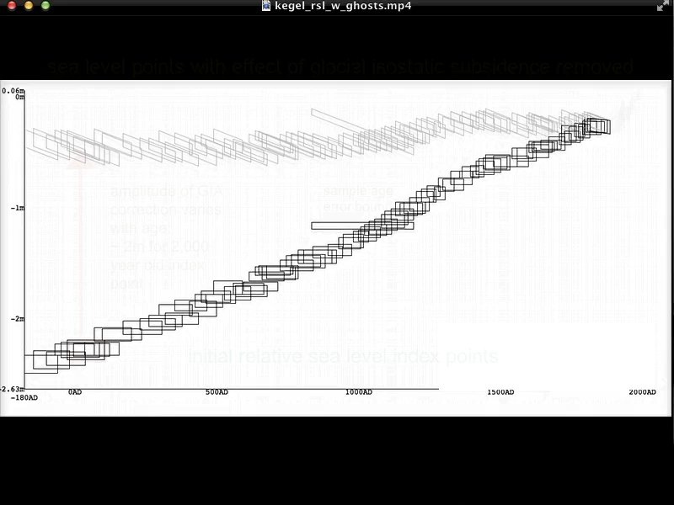
Animations created by T. Storrs Kegel (Haverford College) and Don Barber (Bryn Mawr College) dbarber@brynmawr.edu
data from
Kemp et al.,
(2011) PNAS
Time (years)

