Slide 1
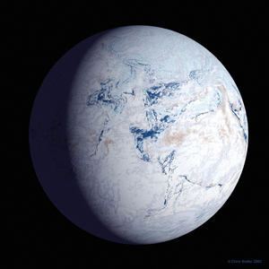
Could Photosynthetic Eukaryotes have Survived in Nearly Enclosed Seas during the Snowball Earth Events?
Adam J. Campbell¹
Edwin D. Waddington¹
Stephen G. Warren^{2,3}
University of Washington
Department of Earth and Space Sciences¹
Department of Atmospheric Science²
Astrobiology Program³
Geological Society of America Meeting, Vancouver, B.C.
October 21st 2014

Slide 2
Outline
Climate of a Snowball Earth with complete ocean cover
Where life could survive?
Inland sea hypothesis
Inland seas could act as refugia for photosynthetic life during a Snowball Earth event

Slide 3
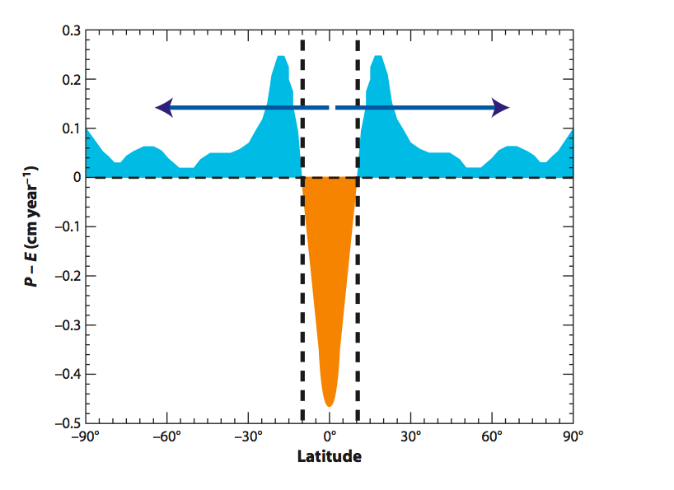
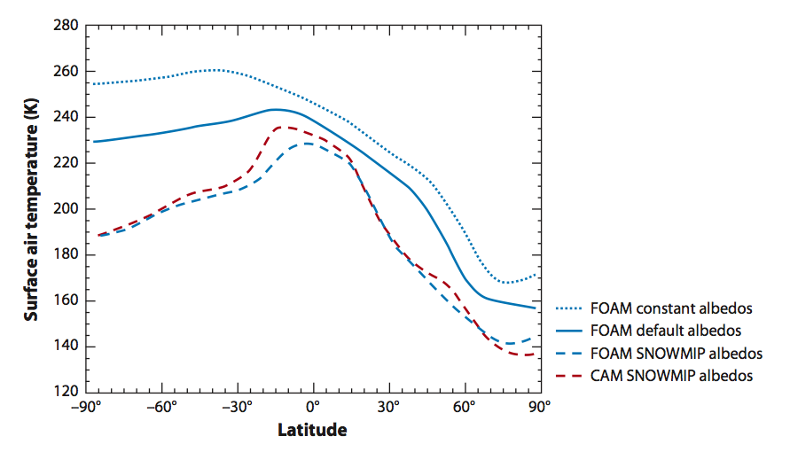
Snowball Earth
Worlds oceans completely covered in ice (hard snowball)
Temperatures range from -20°C at tropics to -70°C at poles (Pierrehumbert et al. 2011)
Thickness of ice covering the oceans ranges from 900m at tropics 3000m at poles
Thickness gradient allowed for flow

Slide 4
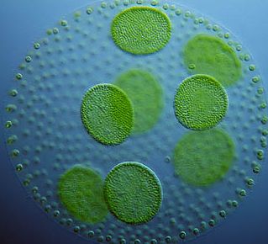
The role of life
Neoproterozoic predates land plants and most animals.
Photosynthetic eukaryotes (Macdonald et al. 2010) were present prior to the Snowball Earth
Requires liquid water at surface

Slide 5
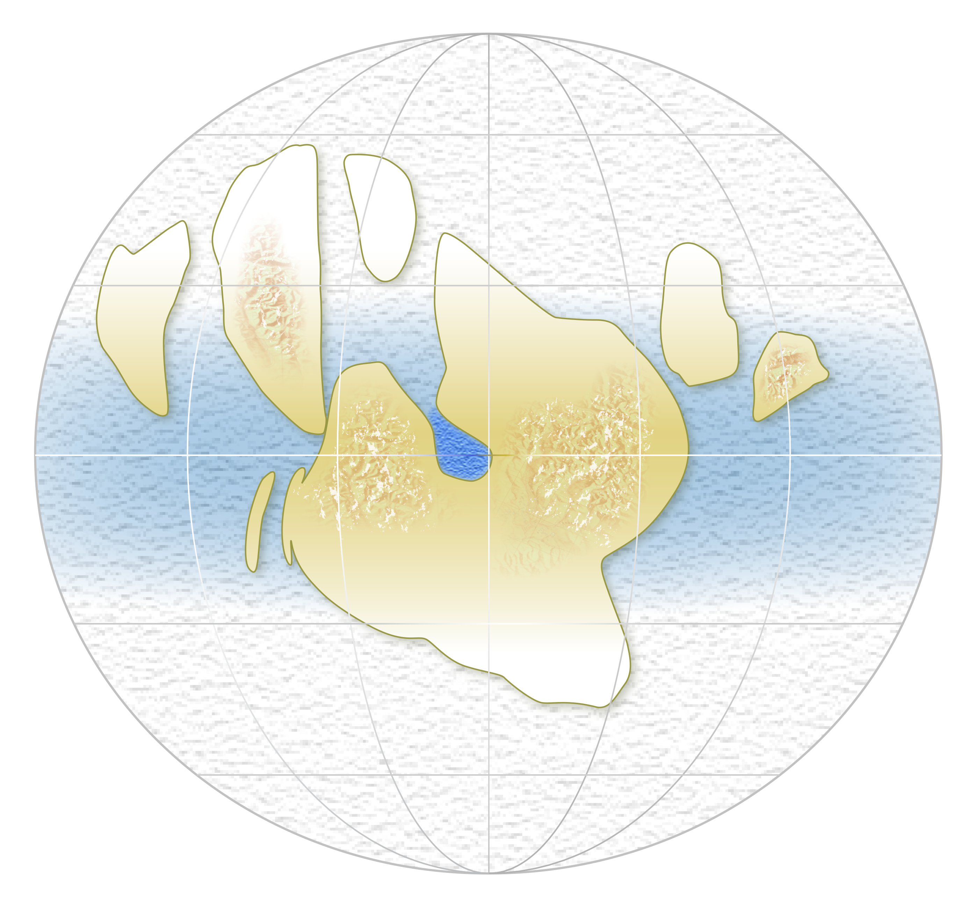
colder
accumulation
sea glacier flow
warmer
sublimation
Inland seas?
colder
accumulation

Slide 6
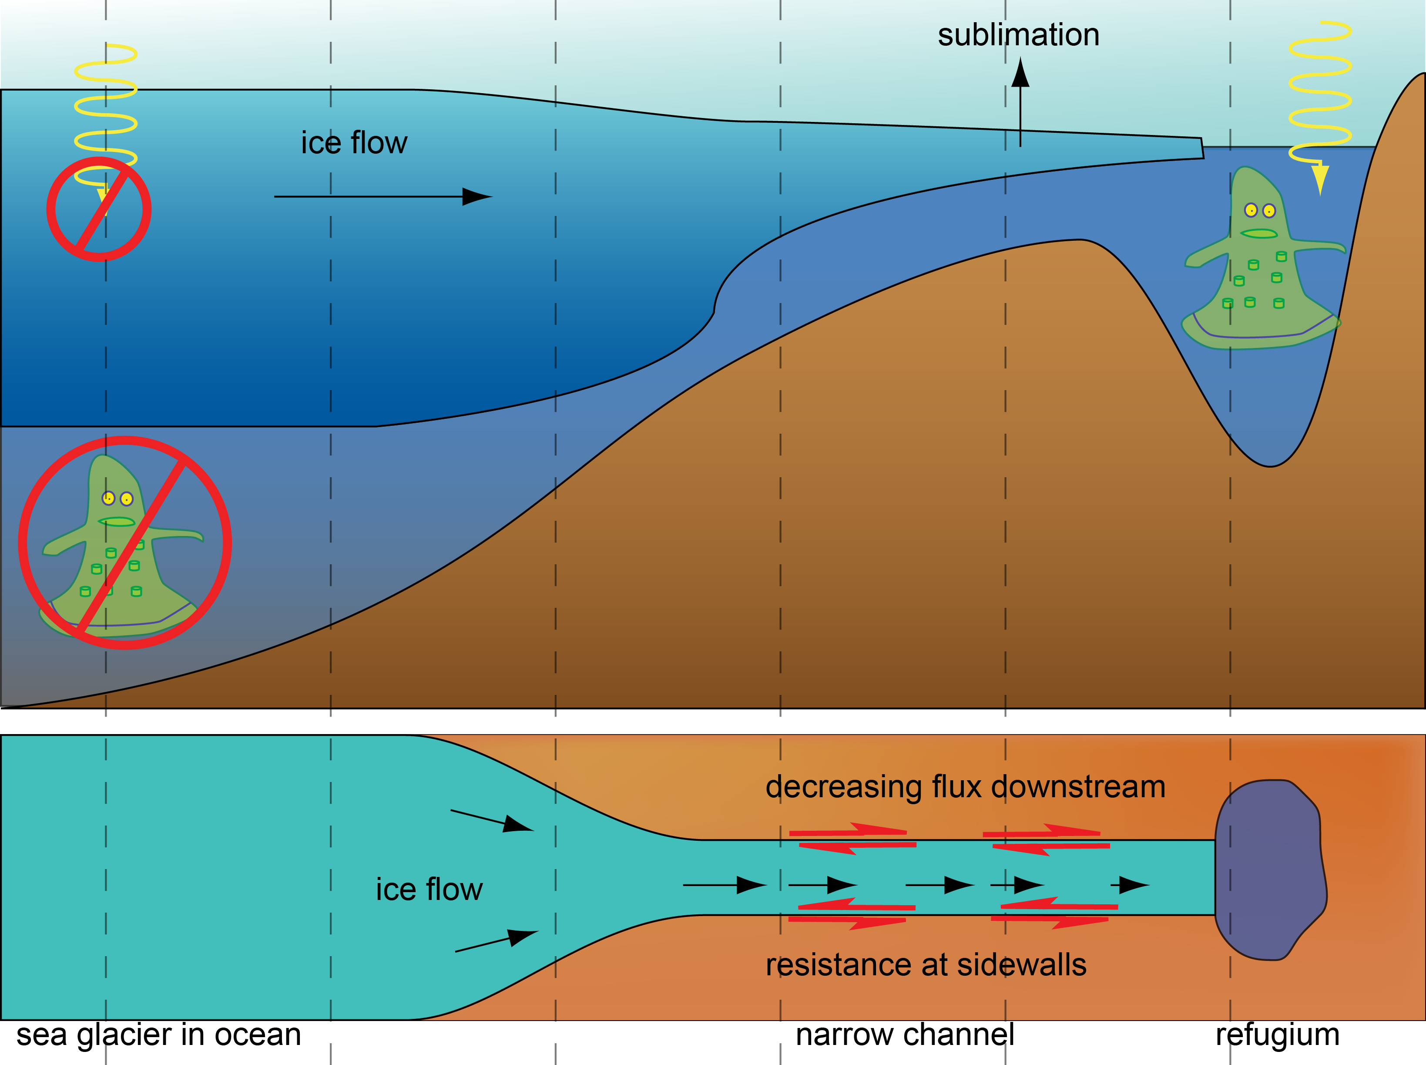

Slide 7
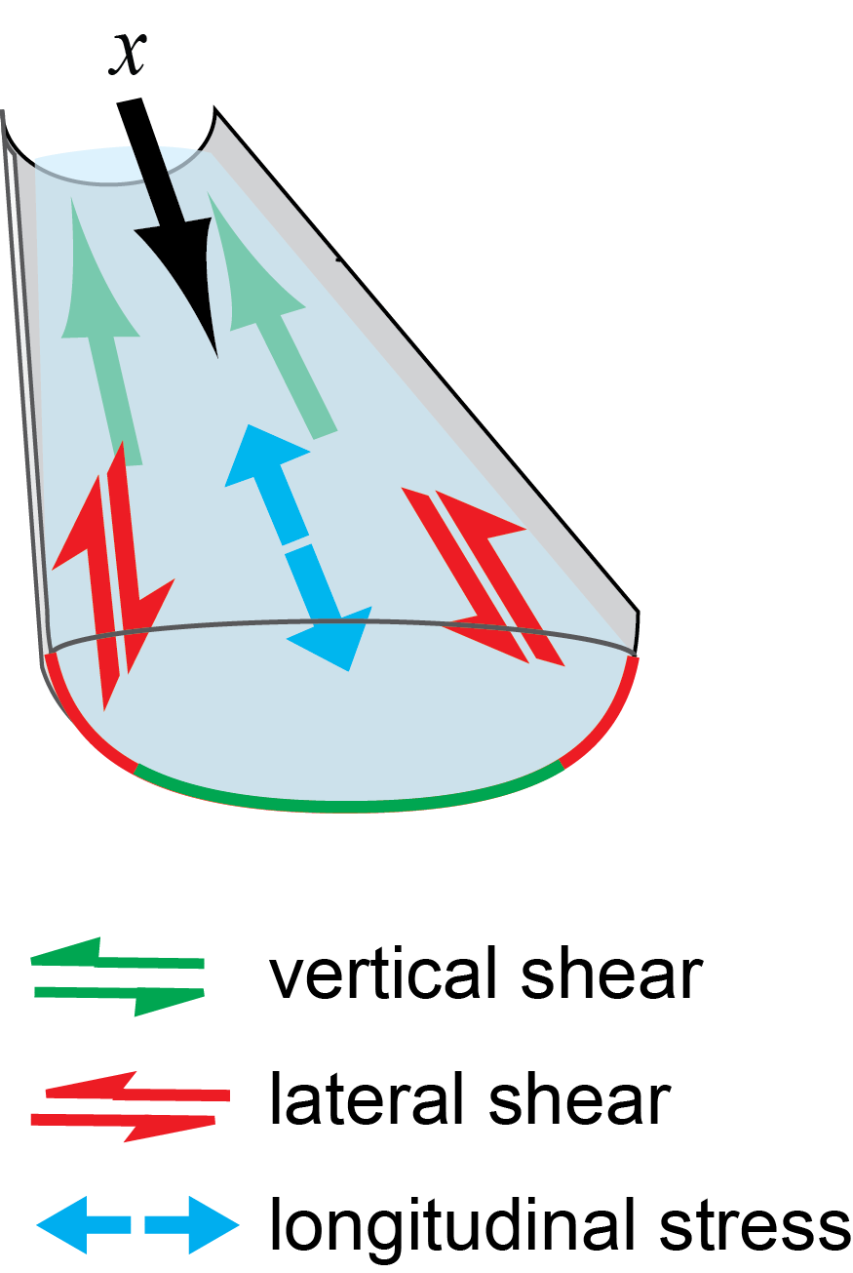
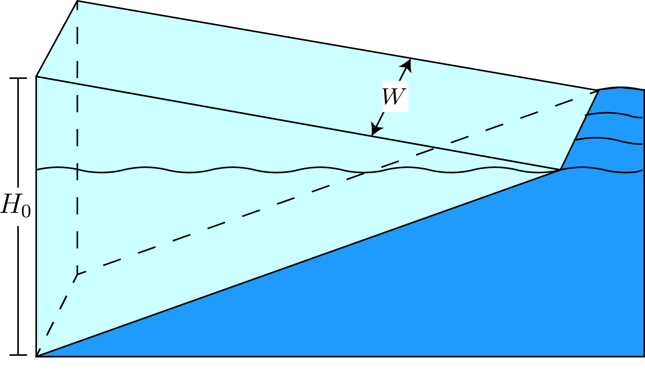
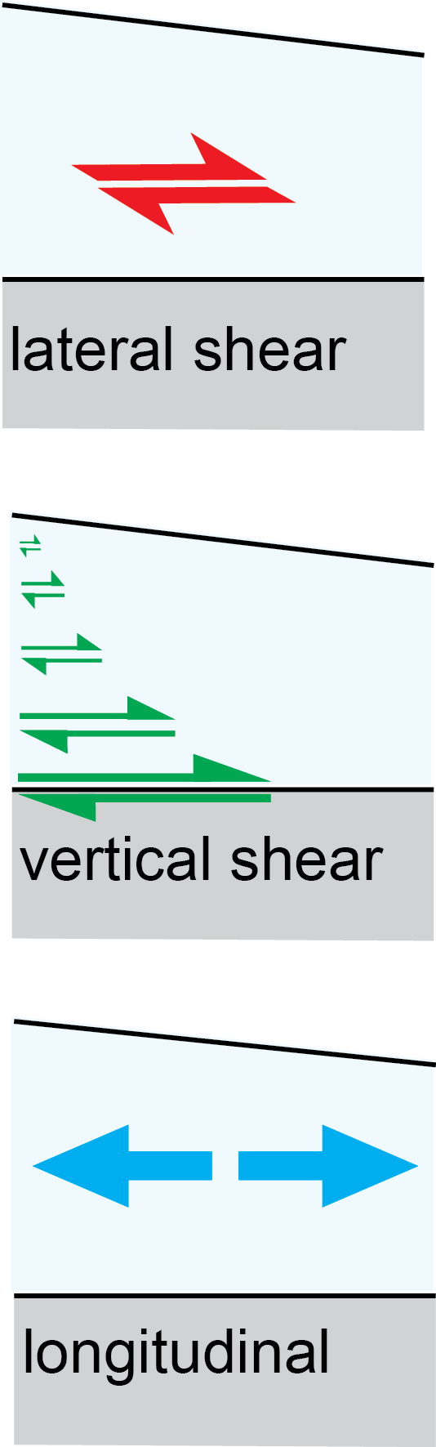
Just how far does a sea glacier go?
L
Model assumptions:
Lateral shear and stretching
Steady state
Uniform surface temperature and sublimation rate
Model calculates:
Penetration distance
Velocity in 2-D
Thickness field

Slide 8
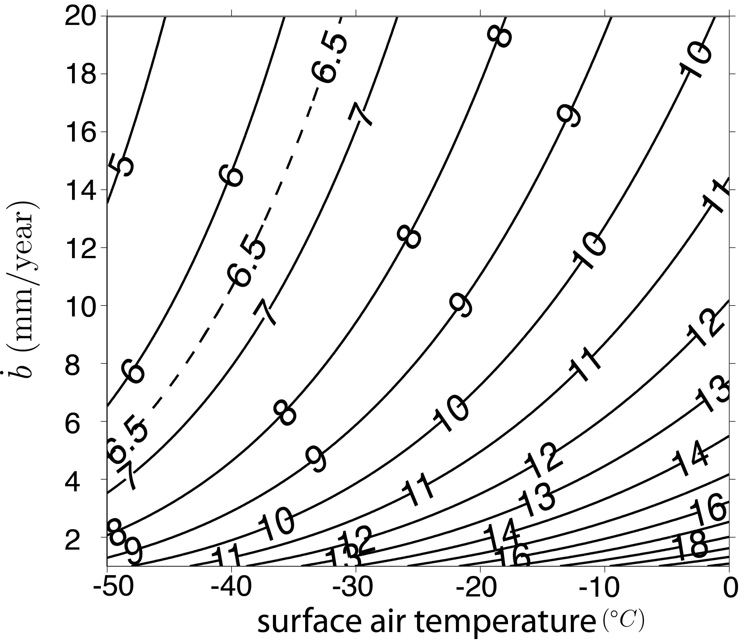

Scaled penetration length (L/W)
H=0
W
L
(Map view)
Upstream ice thickness: 650 m
Red Sea:
W – 200 km
L – 1300 km
sublimation rate

Slide 9
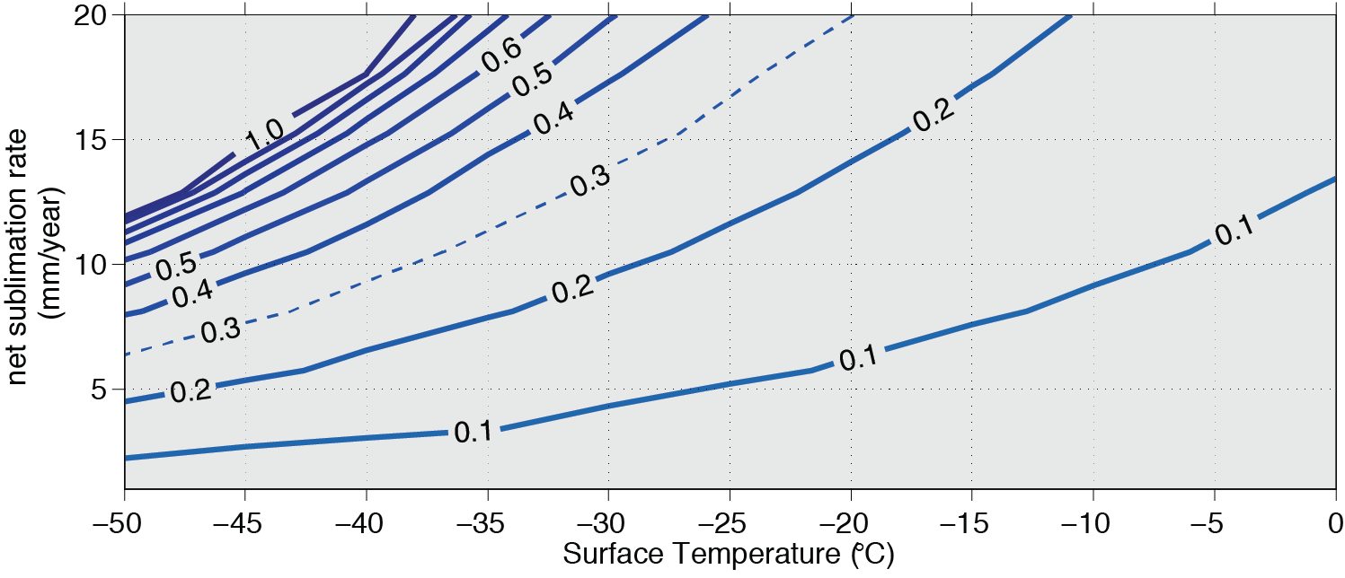
Narrow entrance diminishes penetration

Slide 10
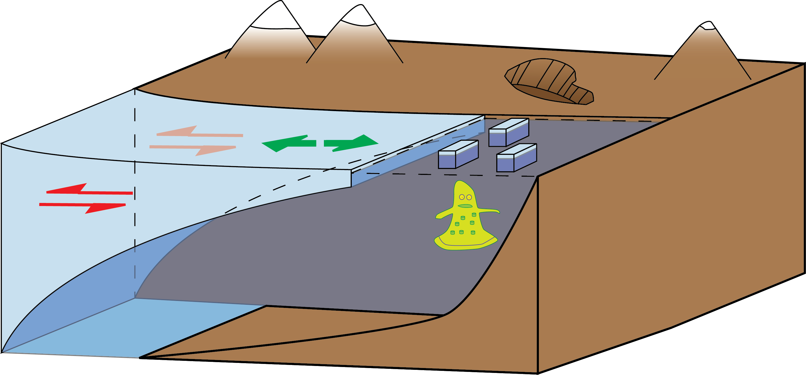
Do inland seas last?
Increasing temperature
Increasing ice softness
Increasing sublimation

Slide 11
Temperature profile of advancing sea glacier

Slide 12
What wins? Softness or Sublimation?

Slide 13
Conclusions
Photosynthetic life may have survived in inland seas during a Snowball Earth Event
Inland seas can keep sea glaciers out
Sea glacier penetration is reduced in channels with narrow entrances
Inland seas aren’t overridden coming out of a Snowball Earth Event.

