Slide 1
“Lignor-Sipps Effect” and the Cambrian Explosion
Mark McMenamin Oct. 2014
Mount Holyoke College GSA Vancouver

Slide 2
Paleontological Bias Factors, 3 examples:
Some organisms are more interesting to study than are others, and hence may have a disproportionate representation in the literature.
Some creatures are much more abundant or more widespread than are others, and hence they have a better chance of being preserved as fossils.
Some organisms are most easily, or perhaps only, preserved at sites of exceptional preservation (Lagerstätten, “monographic swelling”).

Slide 3
Mass Extinctions: abrupt or gradual?
The 1980s saw vigorous debate about whether the end-Cretaceous (66 million years ago) mass extinctions were abrupt or gradual.
Literal reading of the fossil record seemed to indicate that certain groups had been in decline or had died out before the extinction event at the end of the Cretaceous.
Enter the Signor-Lipps Effect.

Slide 4
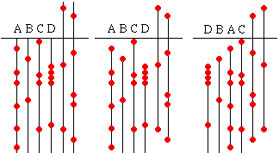
Signor-Lipps Effect (1982): the K-T was abrupt!

Slide 5
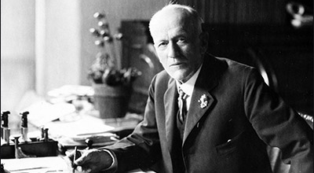
Charles D. Walcott tries to rescue gradual Darwinism
“What is all this
nonsense about an
abrupt Cambrian?”
May 16, 1922. Photo credit: Smithsonian Institution Archives

Slide 6
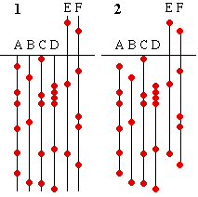
The “Lipps-Signor” Effect

Slide 7
Proterozoic Chiton
Chiton shell (plate or valve); Clemente Formation, Sonora, México; mm scale.

Slide 8
580 million year old eye!
Aesthetes in Sonoran chiton.

Slide 9
K. Derstler (1981)

Slide 10
The 1981 Simulation
Utilized 30 “species”
These were arbitrarily divided into eight “phyla”
“Phyla” species counts were: (9, 1, 2, 5, 4, 2, 3, 4)
A species matrix was sampled (p_{collection}=0.05) to generate diversity curves.
Results showed an apparent gradual rise in “species” diversity.

Slide 11
“Clades” and “Species”

Slide 12
Clade Curve was a close match to Echinoderm Curve

Slide 13
Replicating the 1981 results
Clade first appearances simulation; 12-interval running average

Slide 14
Cambrian Tempo
Derstler’s (1981) model touched on a key question: How abrupt was the Cambrian Explosion?
“[S]ampling effects have probably made the Precambrian-Cambrian diversity rise appear smoother and more gradual than it really was.”
The sudden appearance of Cambrian higher taxa (at the beginning of the Cambrian, 541 million years ago) was real, particularly after one accounts for sampling bias.

Slide 15
3 Cognate Sampling Effects
Classic Signor-Lipps Effect (explains why sudden mass extinctions may appear to be gradual due to sampling bias).
The Lipps-Signor Effect (invokes imperfect sampling to explain why the earliest fossils may occur much later than the actual origination of a group. The effect was used by Darwin and Walcott in an attempt to efface [“gradualize”] the Cambrian Explosion).
Now introducing . . . the Lignor-Sipps Effect!

Slide 16
Lignor-Sipps Effect
In a sudden origination event , sampling effects will make the event appear gradual. This aspect can be seen as a mirror image of Signor-Lipps.
When an evolving lineage undergoes skeletonization, its preservation potential increases dramatically.
If there are delays in the onset of skeletonization, the appearance of particular clades will be delayed, making the event appear even more gradual than was actually the case. This introduces an additional sampling bias not shared in the case of mass extinctions, and thus has no direct counterpart in the Signor-Lipps Effect.

Slide 17
“The Emergence of Animals” (M. McMenamin, Scientific American)

Slide 18
Lignor-Sipps
Simulation
Uses a modified Derstler (1981) simulation to place quantitative constraints on the tempo of the Cambrian Explosion.
This simulation introduces a time lag (two versions: single big pulse or many small pulses) for “phyla”(=clades) that are in the process of developing hard parts and for that reason might show a delayed appearance in the fossil record.

Slide 19
Single Large Pulse in Skeletonization
For first 30 samplings, odd-numbered clades do not register in
this simulation of a delay in the onset of skeletonization.

Slide 20
Gradual Appearance of Clades and/or Skeletons
Clades appear in order, one at a time after each 8 sampling events.

Slide 21
Lignor-Sipps: Double Bias
o, original sampling bias; *, skeletonization delay sampling bias.

Slide 22
Three “Species” Curves
One, original curve; Two, single pulse curve; Three, multiple pulse curve

Slide 23
Conclusions
The Cambrian event looks very sudden due to the match between the Echinoderm Curve and Derstler’s 1981 experiment as replicated here (thus avoiding confirmation bias).
New simulation is consistent with sudden Cambrian origination followed by pulses of skeletonization.
Delay in the onset of skeletonization (as either single or multiple pulse) makes the apparent “species” diversity rise appear even more gradual than in the original apparent species diversity curve.

