Slide 1




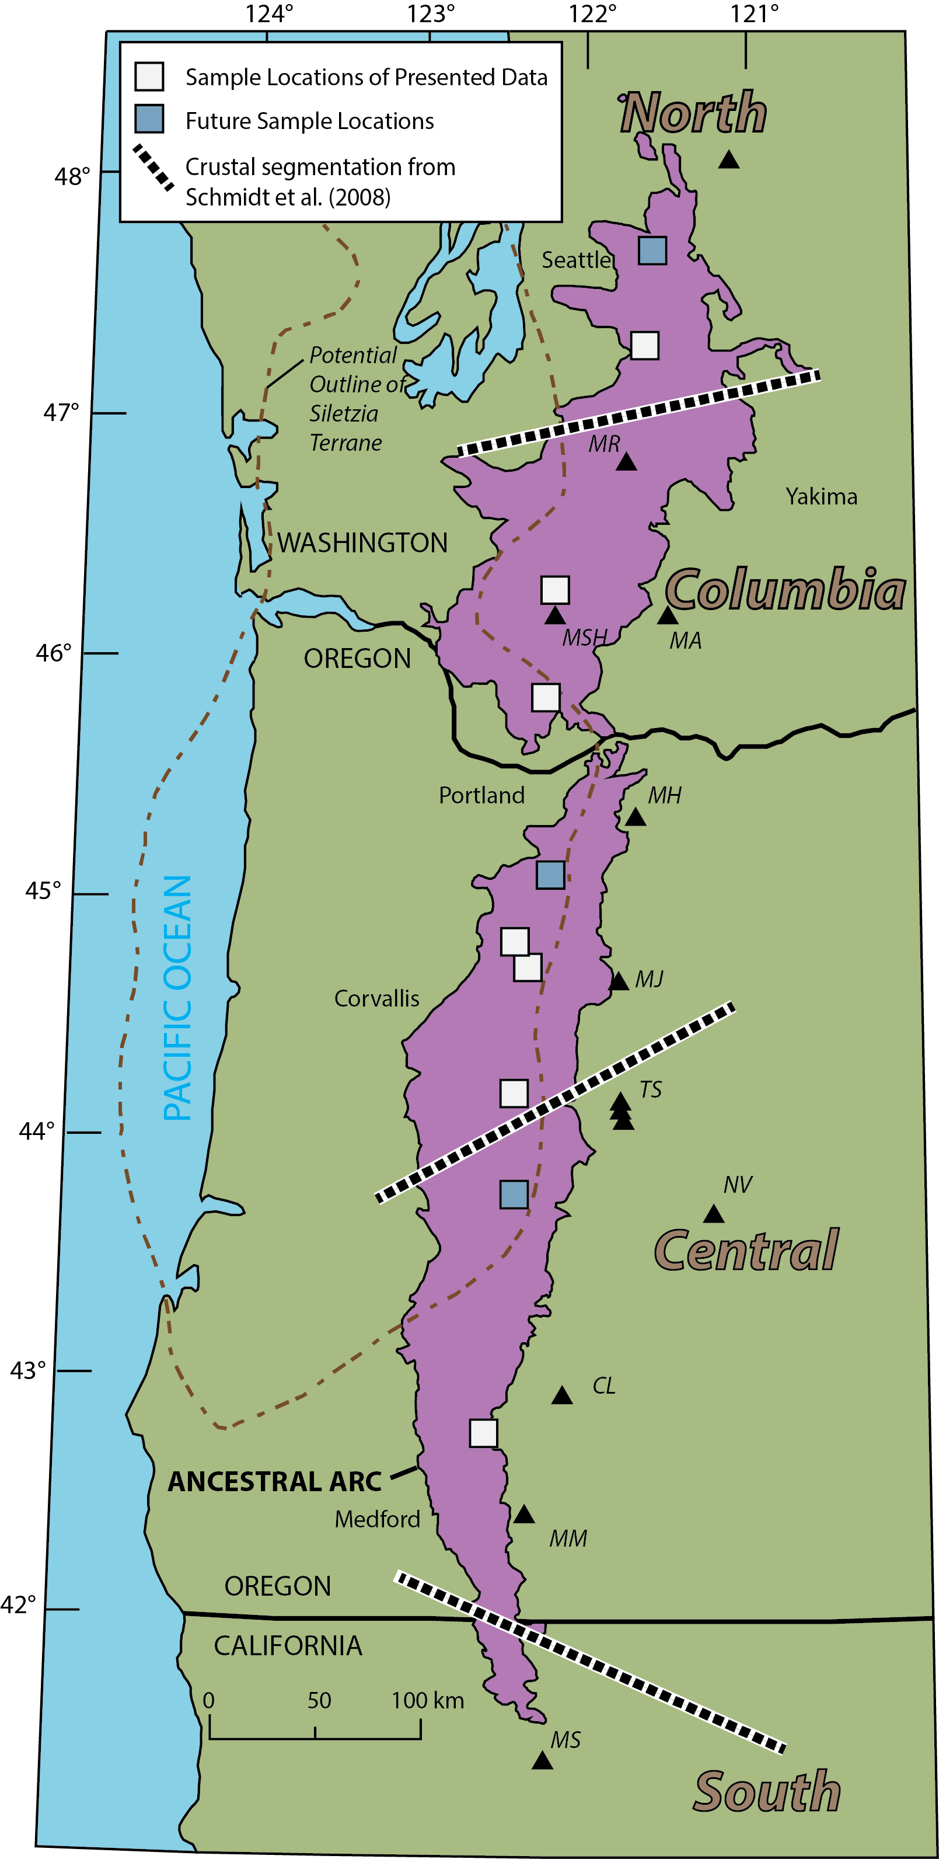
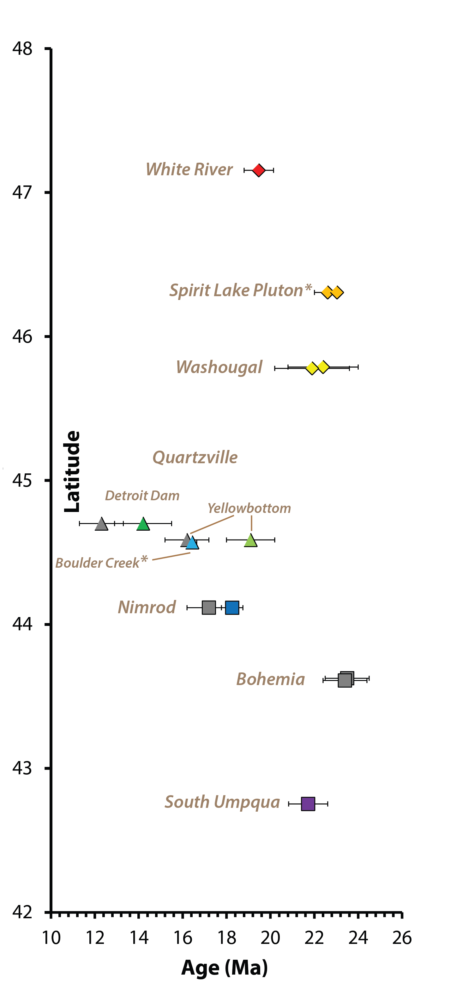
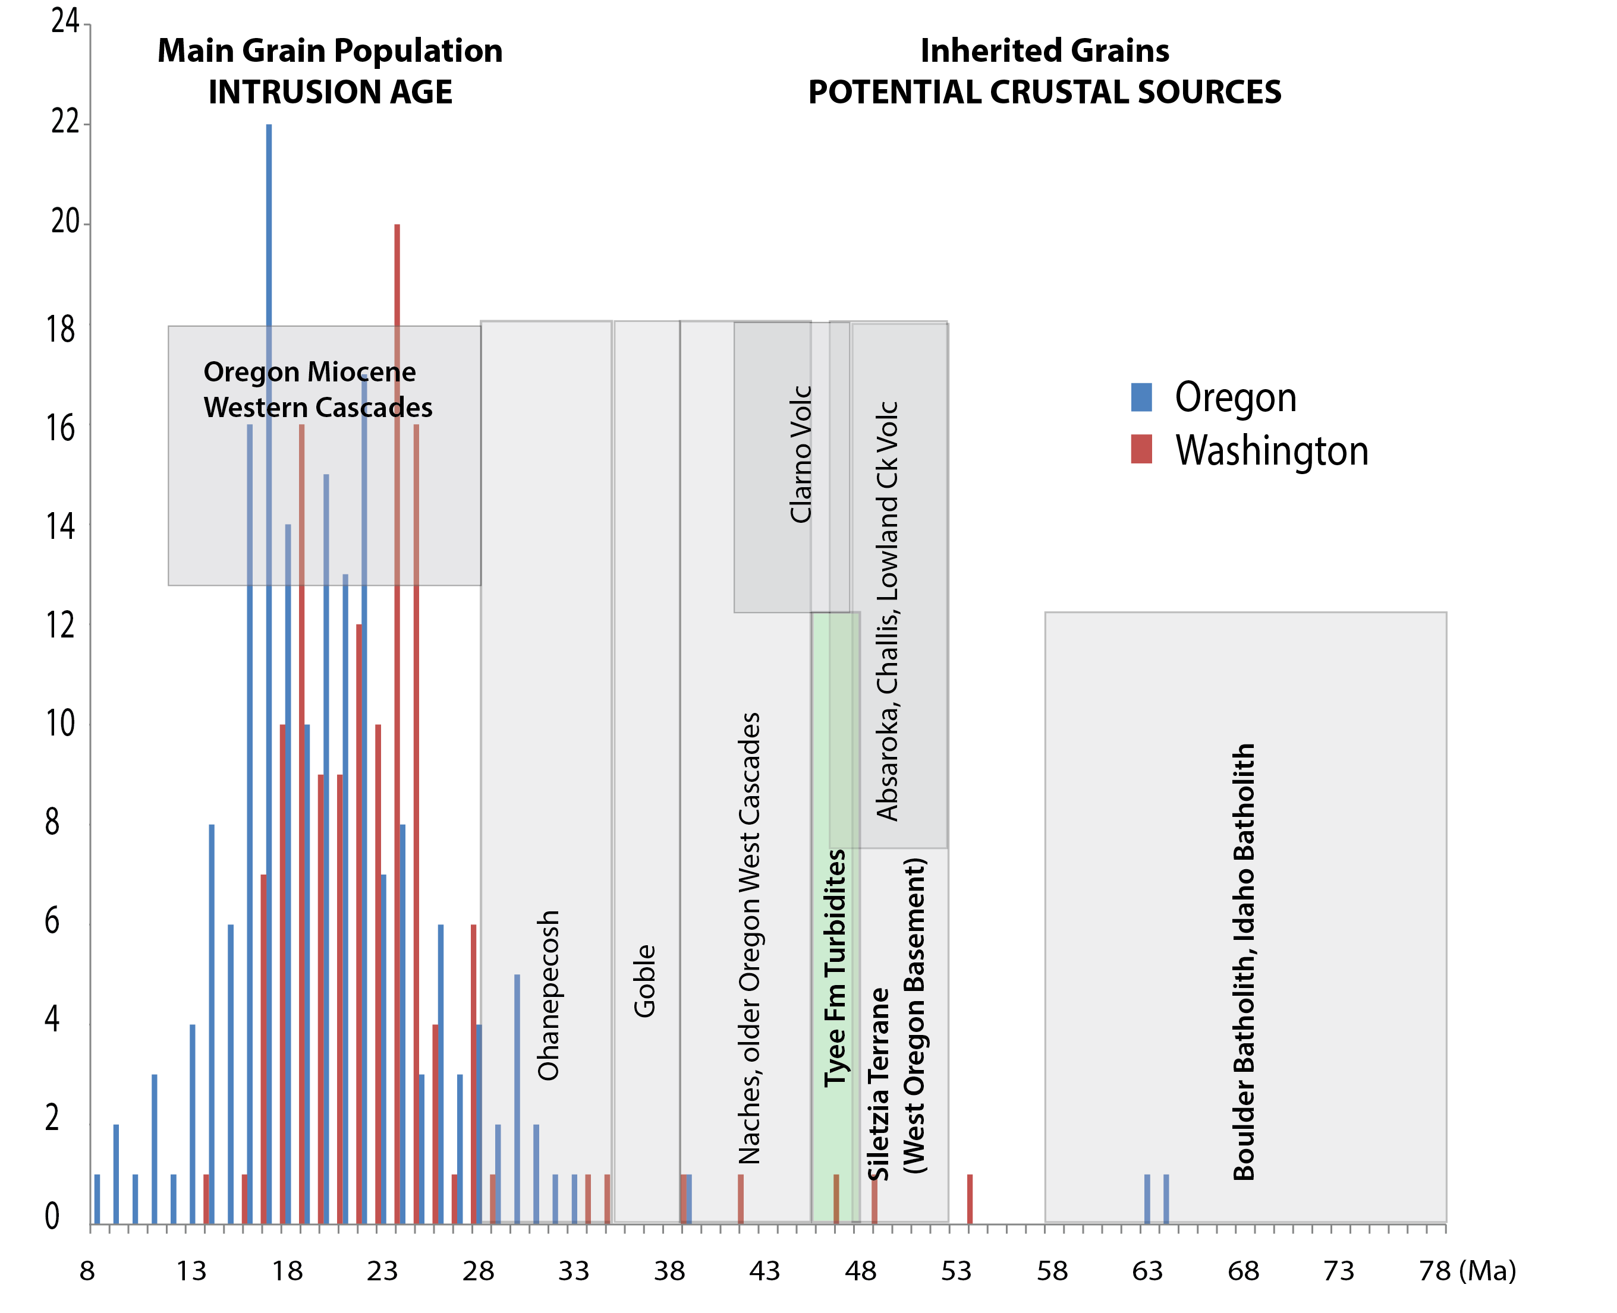
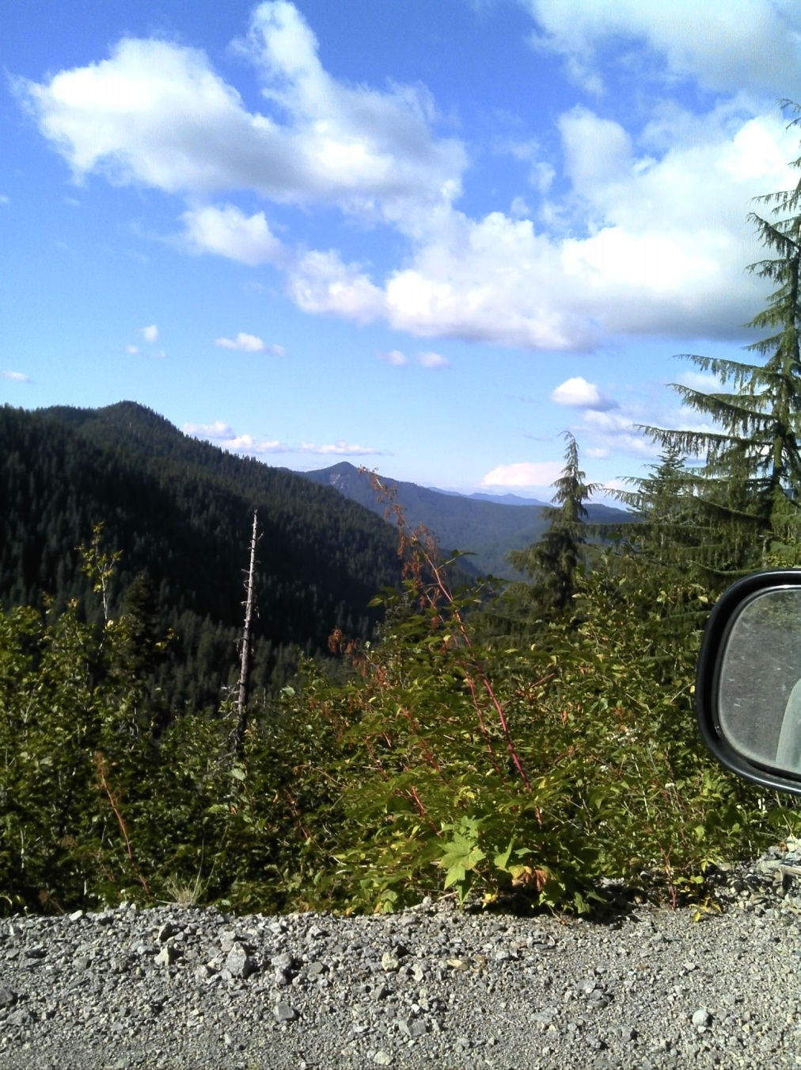
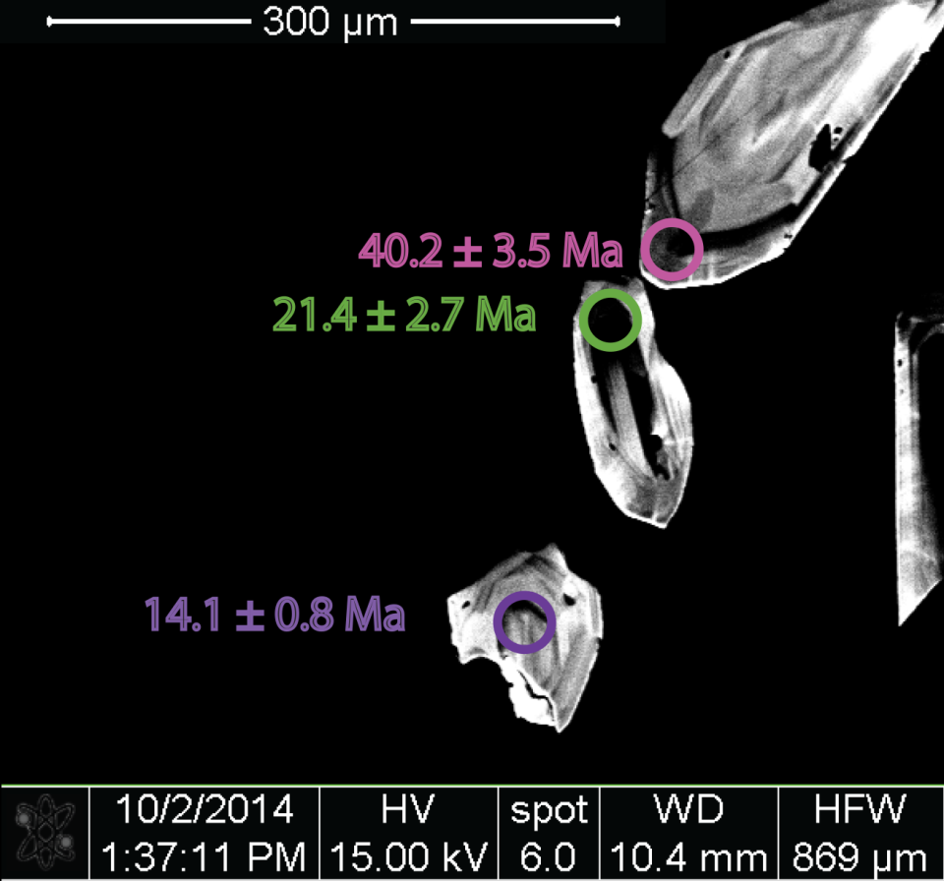
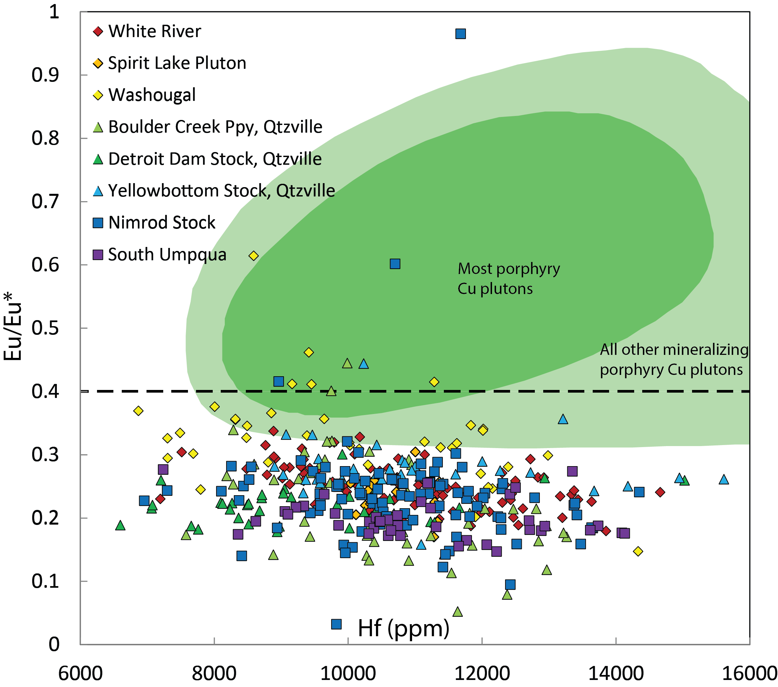
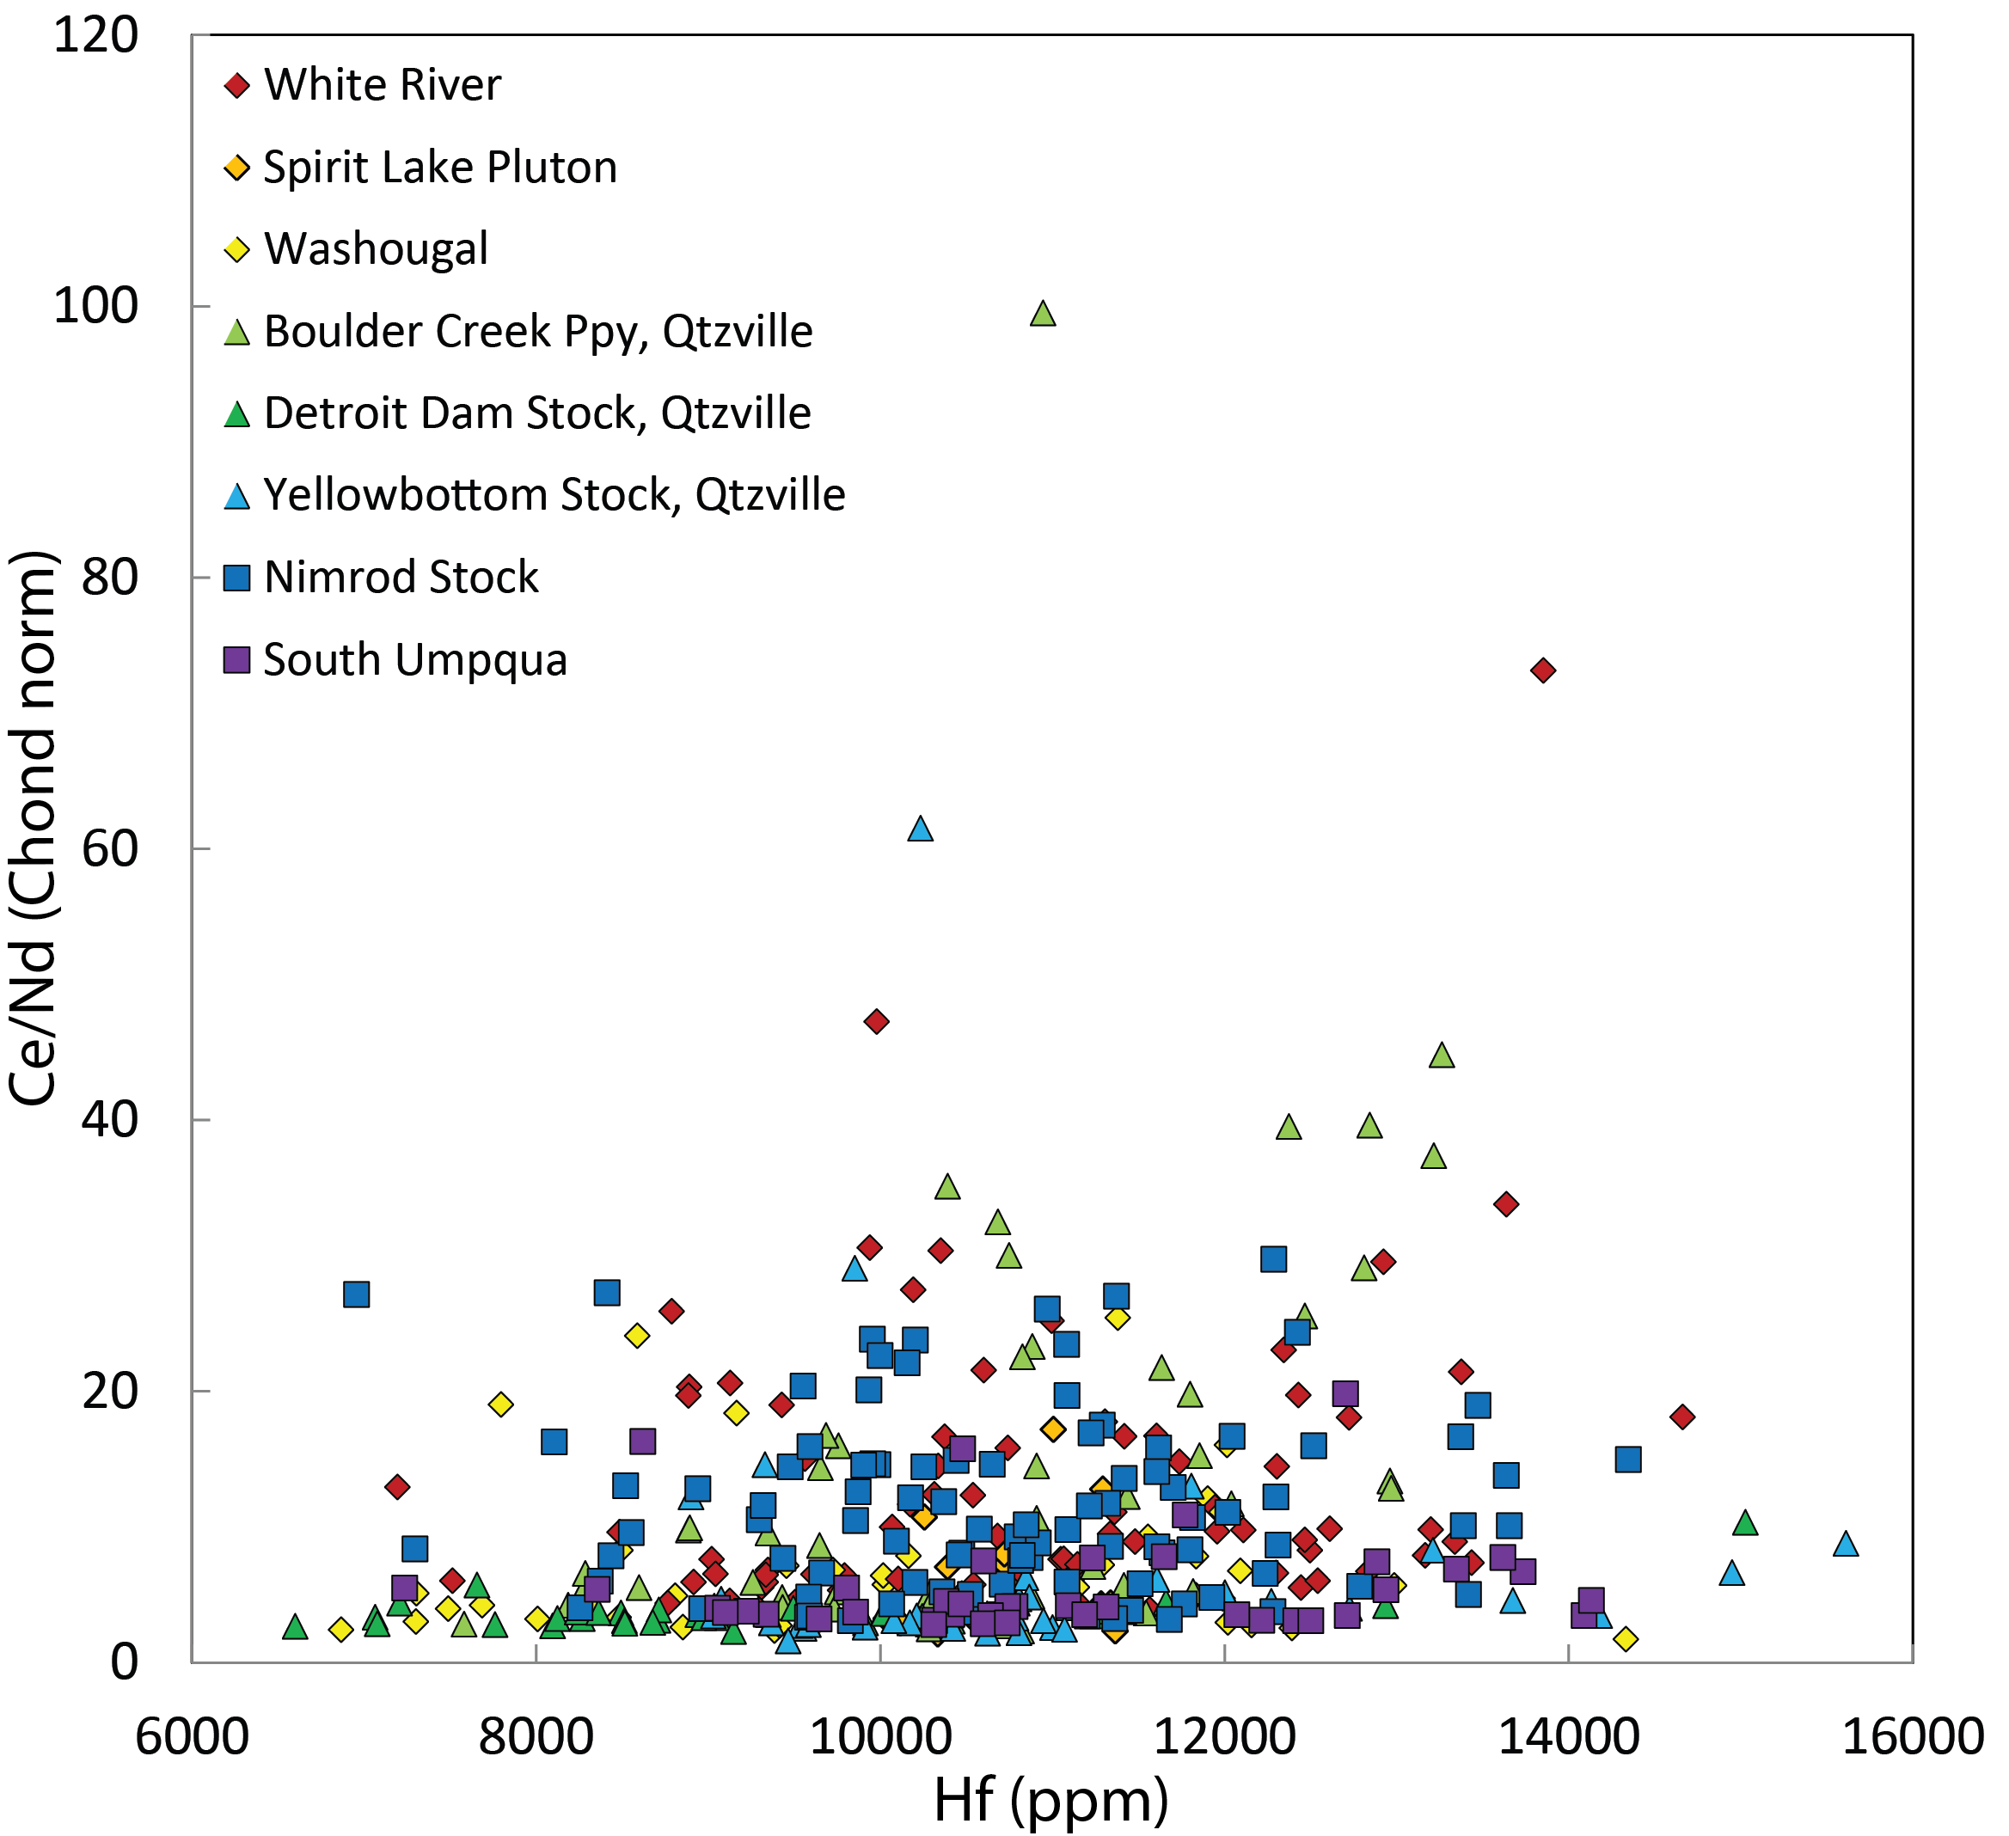
Zircon Geochronology & Geochemistry of Plutonic Rocks of the Western Cascades, Oregon and Washington
Elinor S. Utevsky, John H. Dilles, Adam R.J. Kent
College of Earth, Ocean, and Atmospheric Sciences, Oregon State University, Corvallis, OR United States
Western Cascades consist of volcanic rocks (~45 -25 Ma) and plutons (~25-10 Ma) and are representative of ancestral Cascades magmatism
Host a series of small plutons locally associated with porphyry (Cu-Mo) and epithermal (Au) ore deposits, most notably the Mt. Margaret deposit near Mount St. Helens
Geologic Setting
Plutonic Zircon U-Pb Ages Along Arc
Ages of Zircons from Miocene Plutons
A
Research Question: Is there geochemical evidence to suggest magmatic processes necessary for ore formation? Were the western Cascade magmas sulfur-rich and/or oxidized?
Photo from fieldwork in the North Santiam district, July 2014
FIGURE 4. A) Histogram of individual zircon spot analyses from 11 Miocene intrusions. Plutons contain zircons that are dated at both the ages of intrusion (the main population) and anomalous older ages, suggesting inheritance from one of several underlying crustal sources. Potential contaminants include both basement rocks (i.e., Challis, Clarno, ID Batholith, Siletzia) and detrital sources (Tyee Fm). B) Cathodoluminescence image of 3 zircons from White River have both intrusion ages and an inherited age, likely from early W Cascades volcanics.
B
Zircon trace element concentrations can be used to discern the oxidation state of the melt, which is potentially caused by sulfur degassing (Dilles et al., in press):
Oxidized, sulfur-rich magmas saturate in anhydrite (CaSO₄)
CaSO₄ breaks down during cooling once water-rich fluid phase forms; sulfur is reduced from sulfate (S⁶⁺O₄) to sulfide (S⁴⁺O₂)
This requires complementary oxidation of iron and other metals
2 REE with 2 oxidation states are incorporated in zircons : Eu²⁺ → Eu³⁺ and Ce³⁺ → Ce⁴⁺
Zircons crystallized from oxidized (>NNO) magmas display small negative Eu anomalies (Eu_{N}/Eu_{N}* values of 0.4-1.0) and large positive Ce anomalies (Ce/Nd values >30)
Zircons as Tracers of Oxidation and Sulfur Degassing
FIGURE 2. Zircon U-Pb ages (23.5-12 Ma) correlated with latitude, from spot analyses by LA-ICP-MS at OSU and SHRIMP-RG at Stanford University (denoted by *). SLP samples collected by A. Iveson. Grey samples collected by D. John & analyzed by R. Fleck by SHRIMP-RG.
FIGURE 1. Map of western Cascades region adapted from du Bray & John 2011, showing sample locations and crustal segmentation as described by Schmidt et al. 2008 & 2011. Active Cascade Arc denoted by black triangles.
Preliminary Conclusions
Zircon geochemistry shows little evidence of magmatic processes required for ore formation (i.e., oxidized, sulfur-rich and water-saturated magmas)
Anomalously old zircon grains (~64-30 Ma) suggest inheritance from an underlying source, likely turbiditic sandstones of the Tyee Formation (Dumitru et al., 2013)
Continued data collection necessary: zircon U-Pb ages, REE geochemistry, whole rock major and trace element data, and petrographic analysis
A
B
Acknowledgments & References
FIGURE 3. Hafnium vs. Eu_{N}/Eu_{N}* (A) and Hafnium vs. Ce/Nd (B) in zircon grains from plutons of the Western Cascades (Fig. 1), used as tracers of the oxidation state of a magma. Show limited evidence that these magmas have undergone extensive SO₂ loss and differ significantly from other porphyry Cu mineralizing plutons.
NSF Grant S1419B, GSA Graduate Student Research Grant, and the VIPER group at OSU. Special thanks to Jennifer DiGiulio and Nansen Olson III.
Dilles, J., Kent, A., Wooden, J., Tosdal, R., Koleszar, A., Lee, R., Farmer, L., in press, Zircon compositional evidence for sulfur-degassing from ore-forming arc magmas: Economic Geology.
Du Bray, E., and John, D., 2011, Petrologic, tectonic, and metallogenic evolution of the Ancestral Cascades magmatic arc, Washington, Oregon, and northern California: Geosphere, v. 7 p. 1102-1133.
Dumitru, T., Ernst, W., Wright, J., Wooden, J., Wells, R., Farmer, L., Kent, A., Graham, S., 2013, Eocene extension in Idaho generated massive sediment floods into the Franciscan trench and into the Tyee, Great Valley, and Green River basins: Geology, v. 41, p. 187-190.
Schmidt, M., Grunder, A., Rowe, M., 2008, Segmentation of the Cascade Arc as indicated by Sr and Nd isotopic variation among diverse primitive basalts: Earth and Planetary Science Letters, v. 266, p. 166-181.

